Slide 1
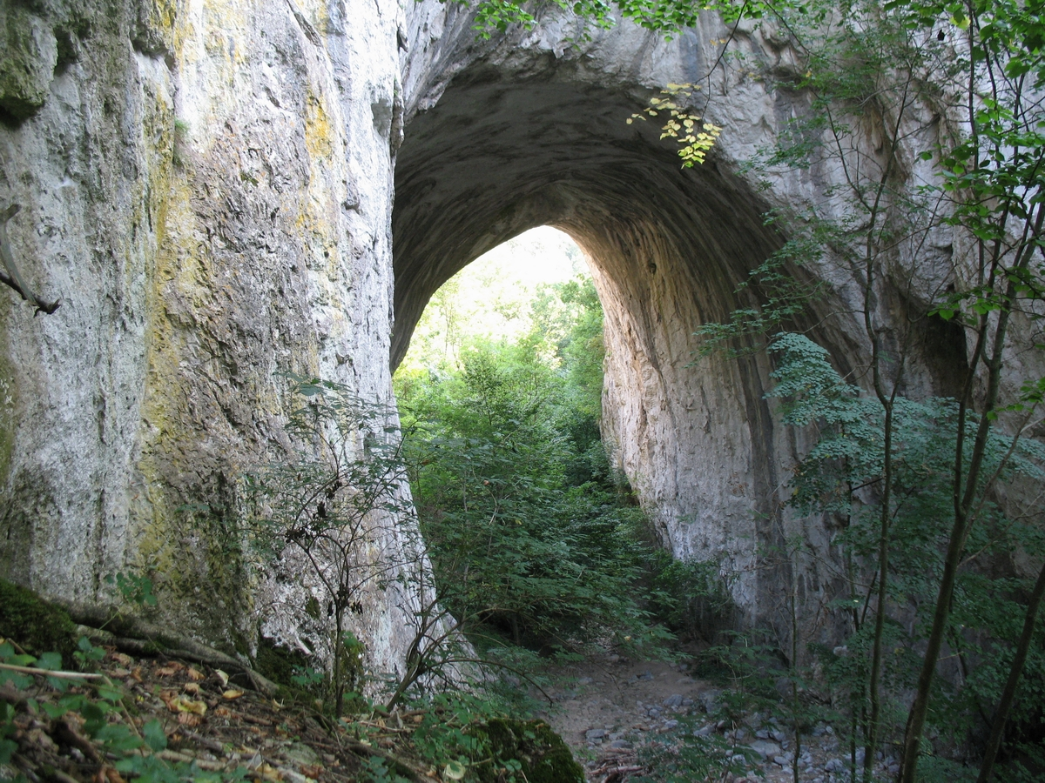
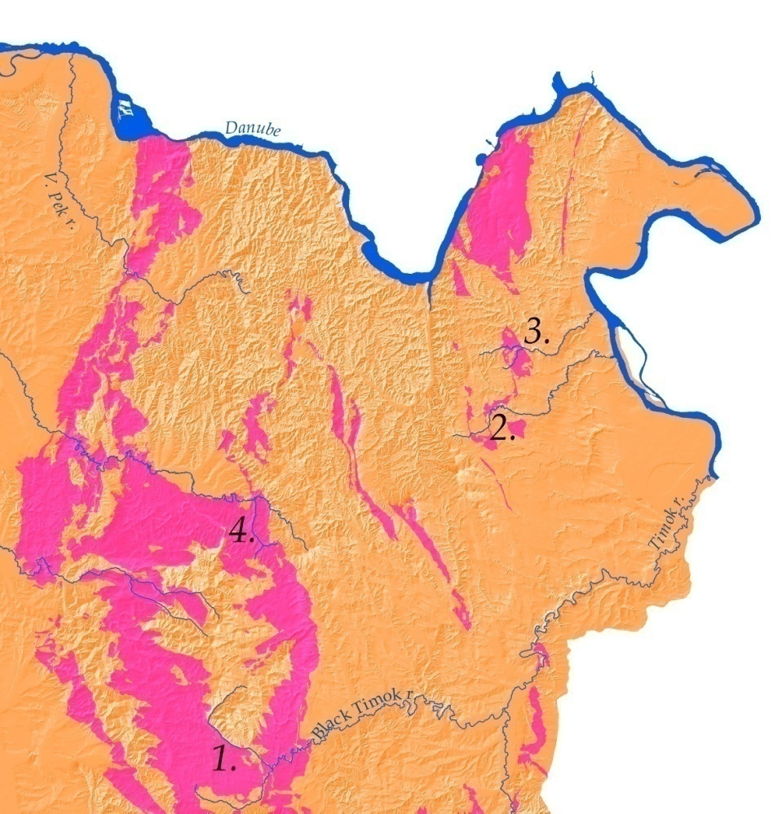
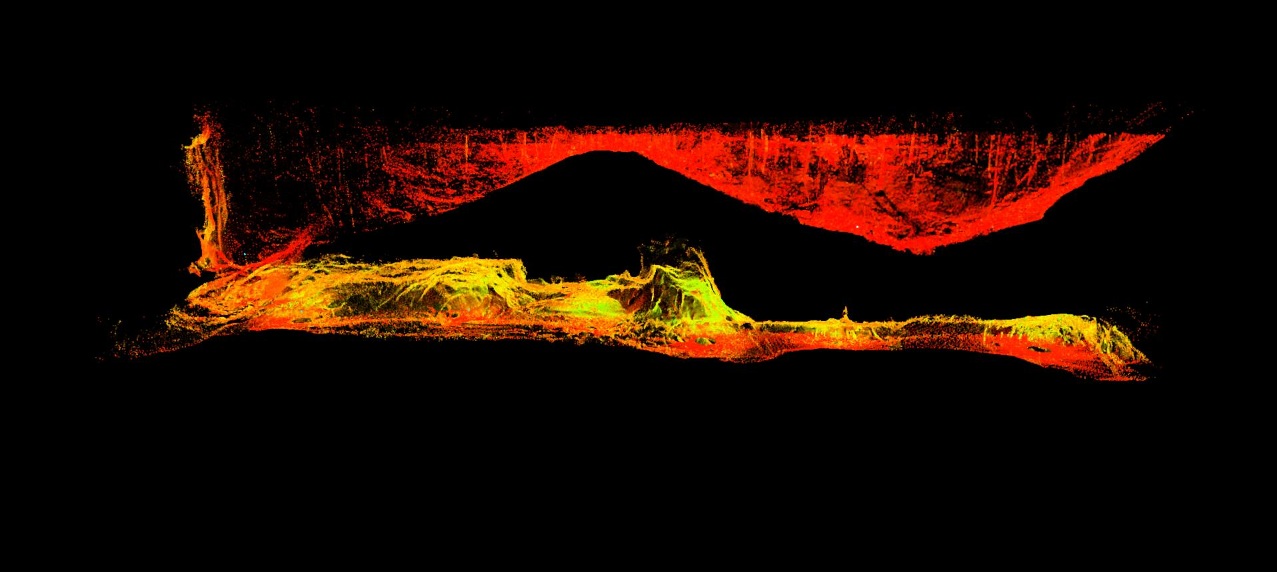
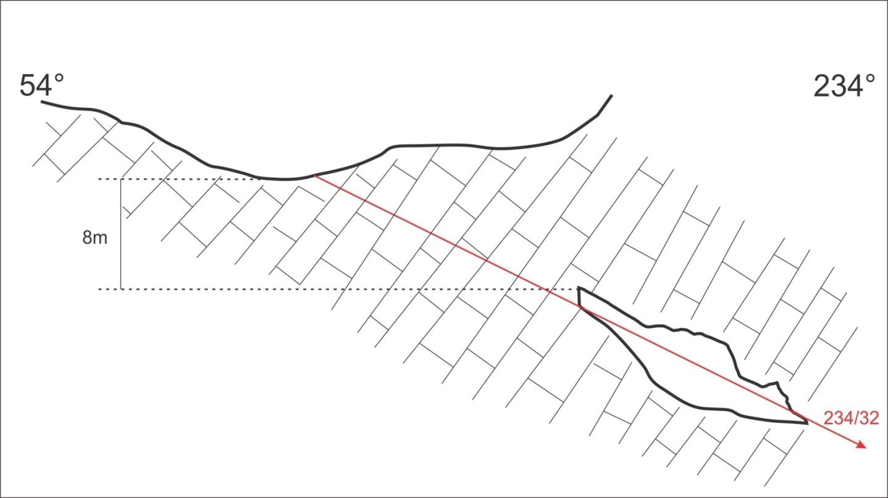
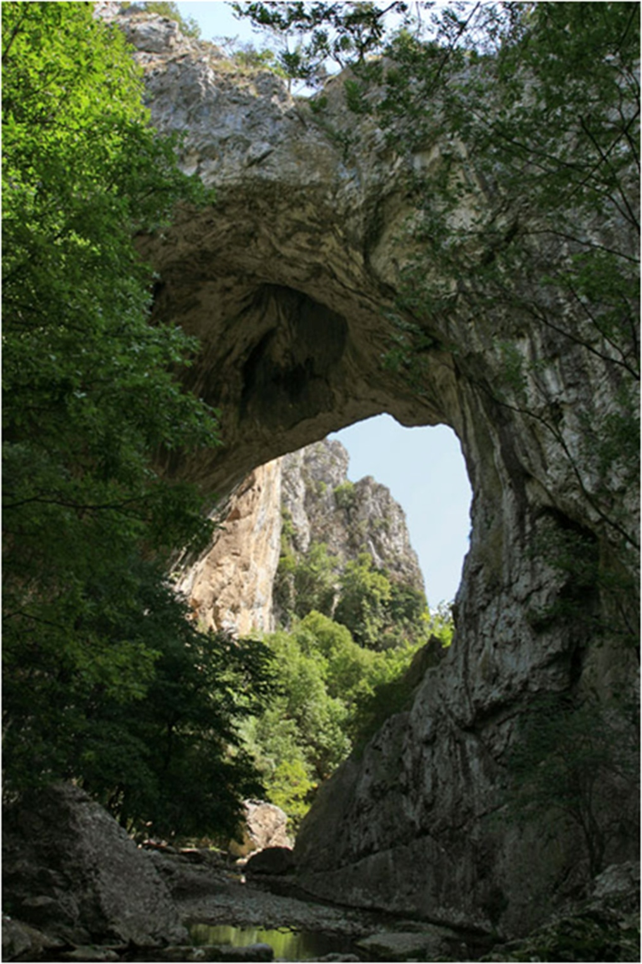
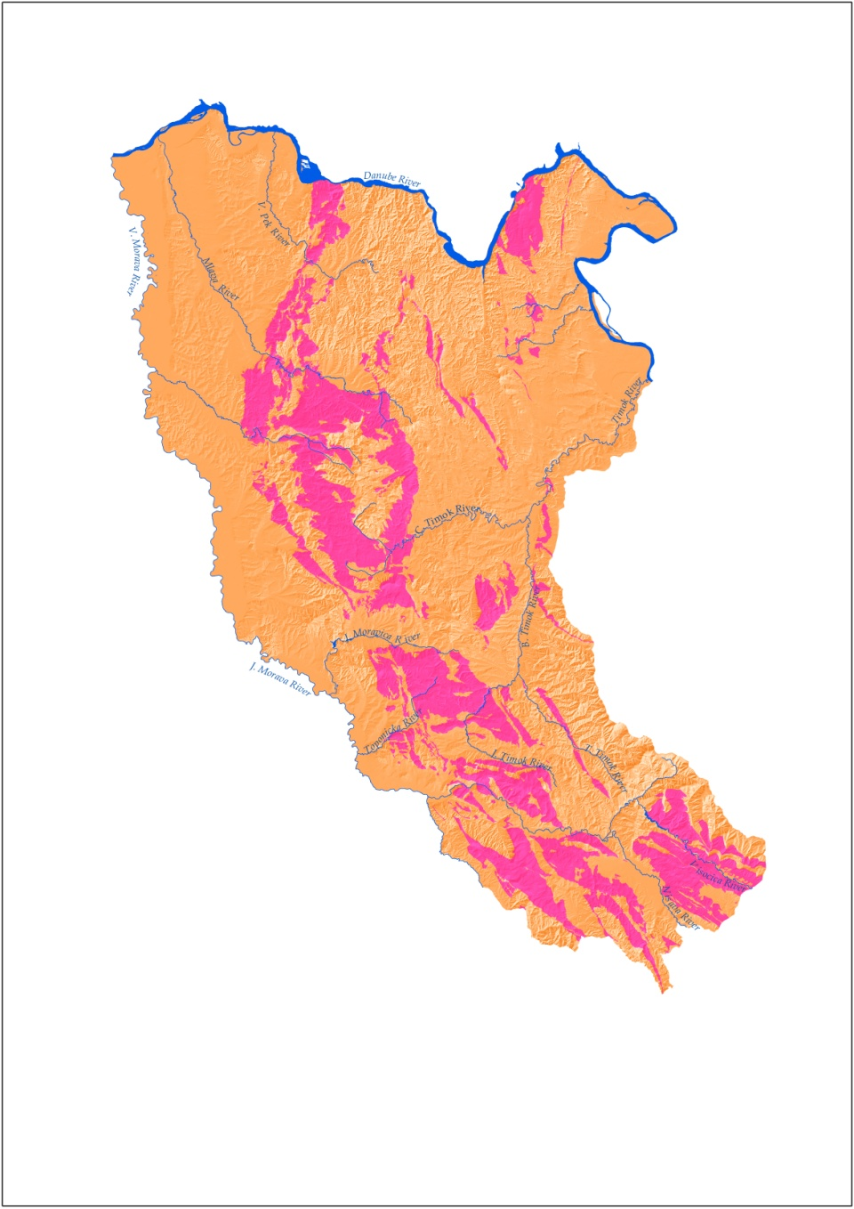
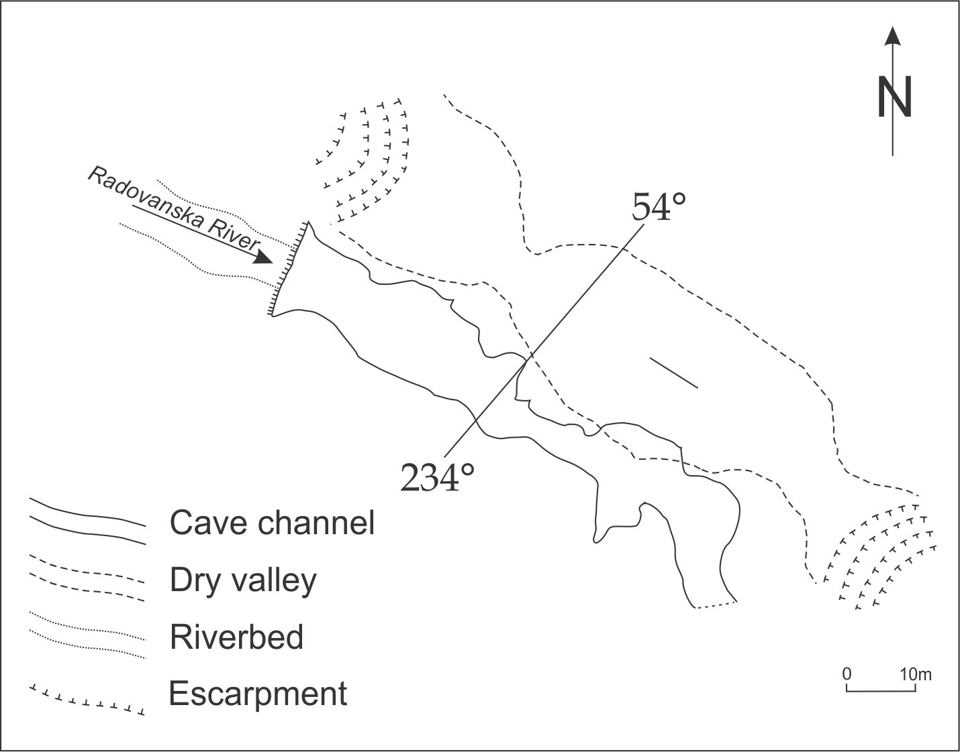
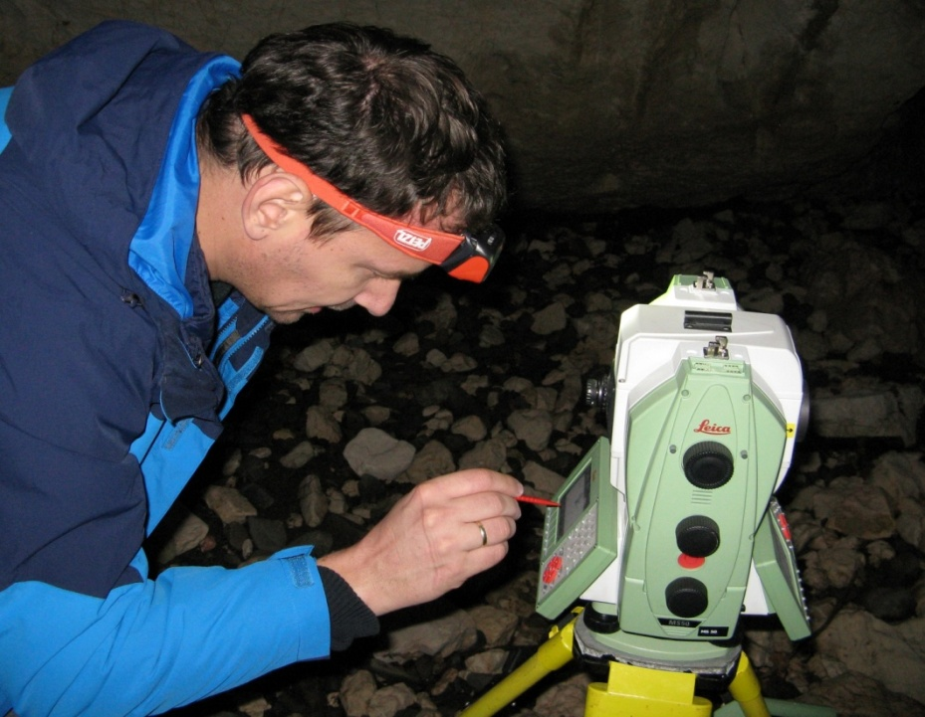
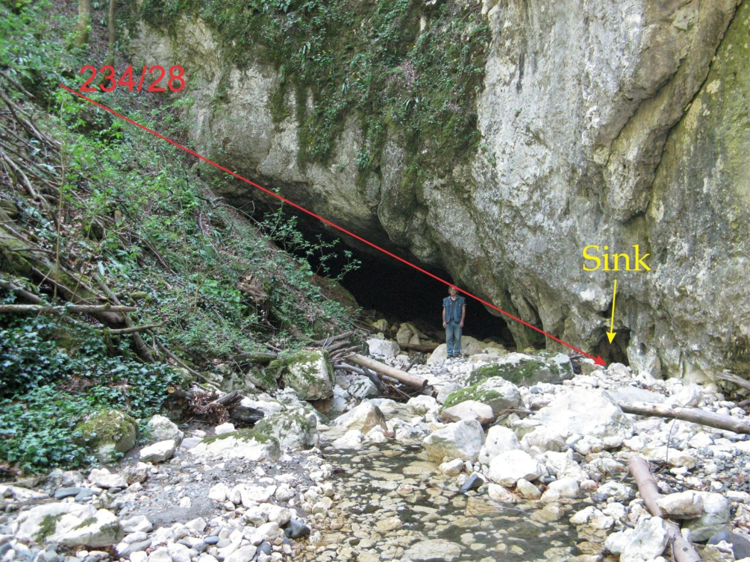
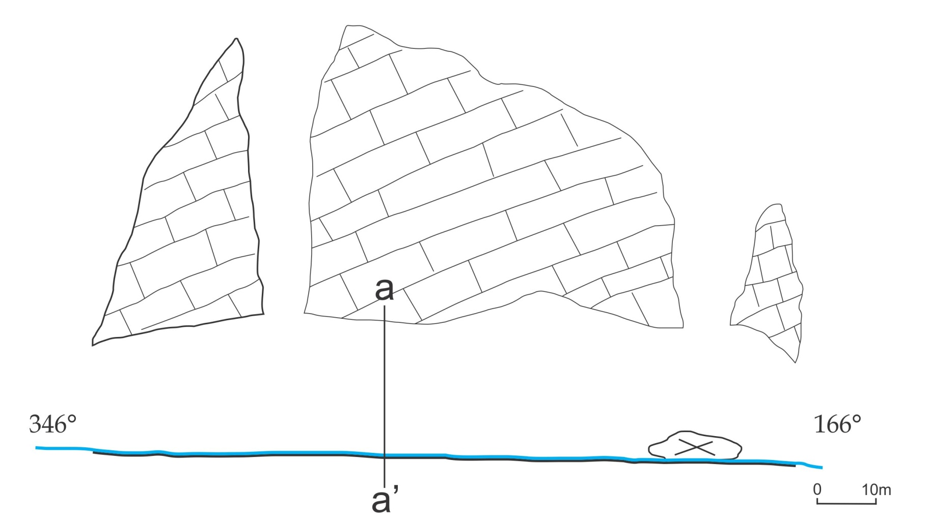
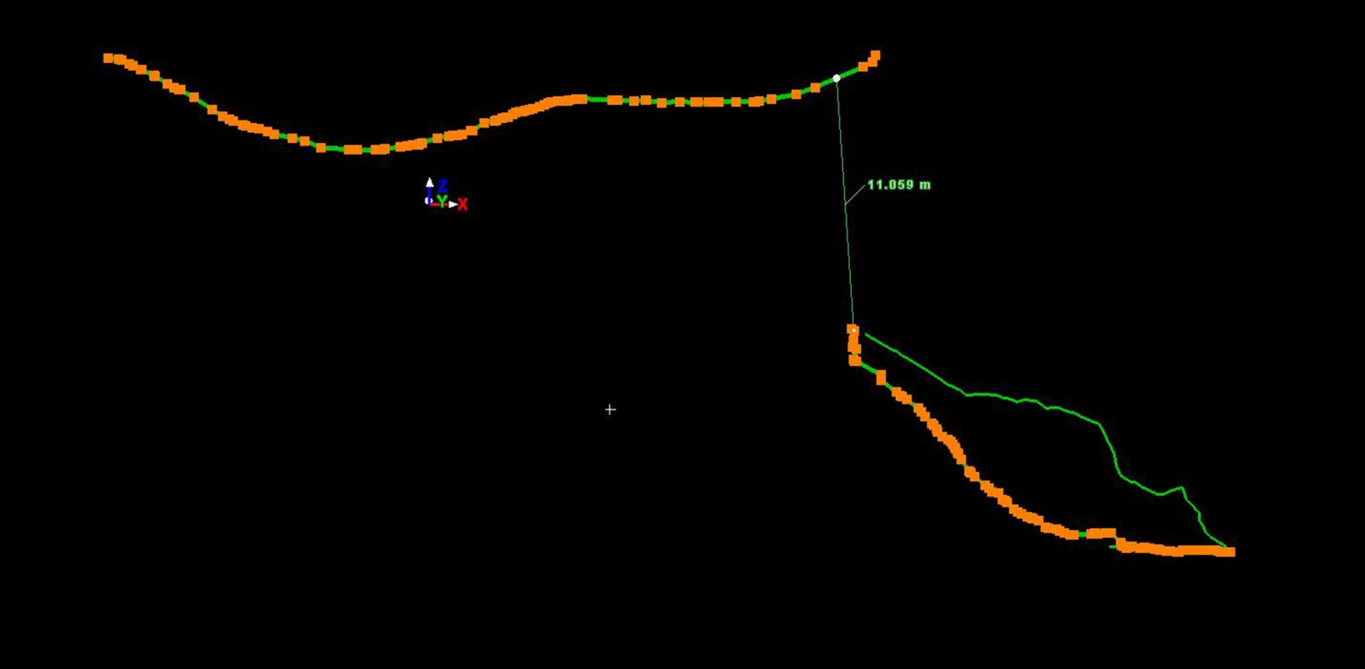
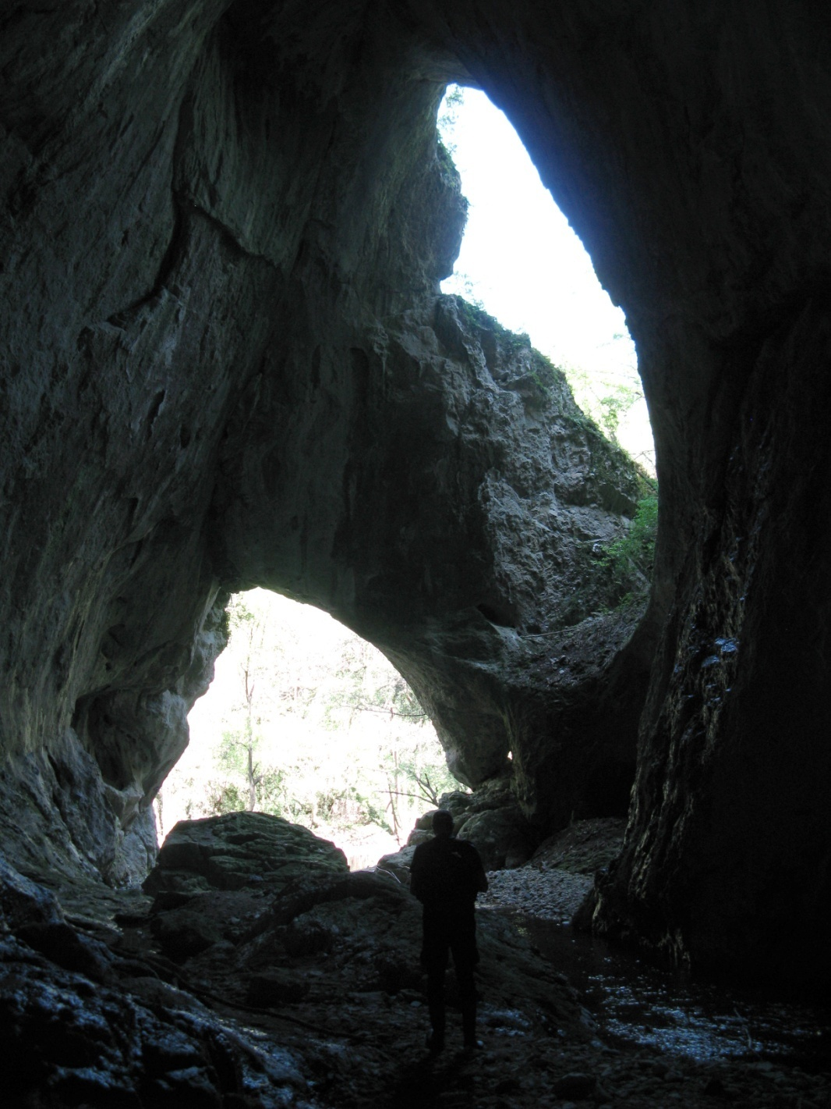
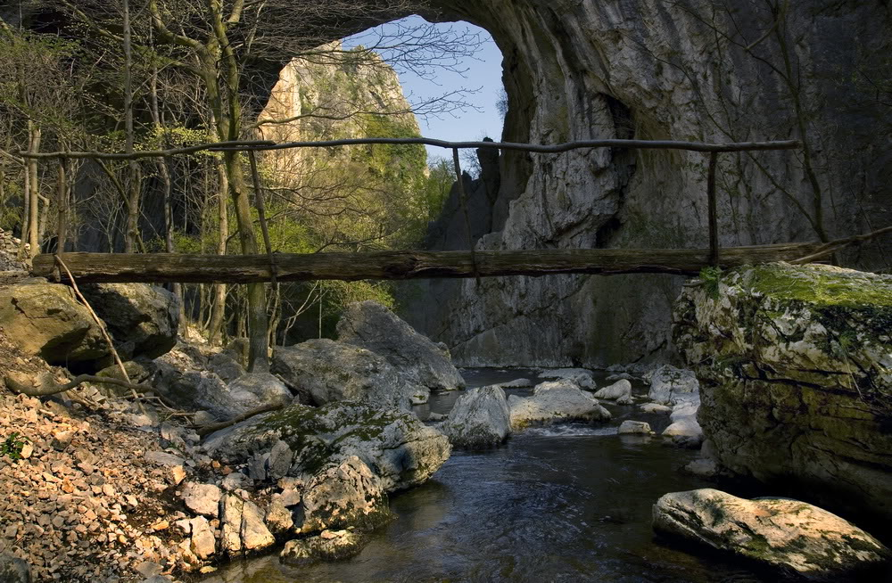
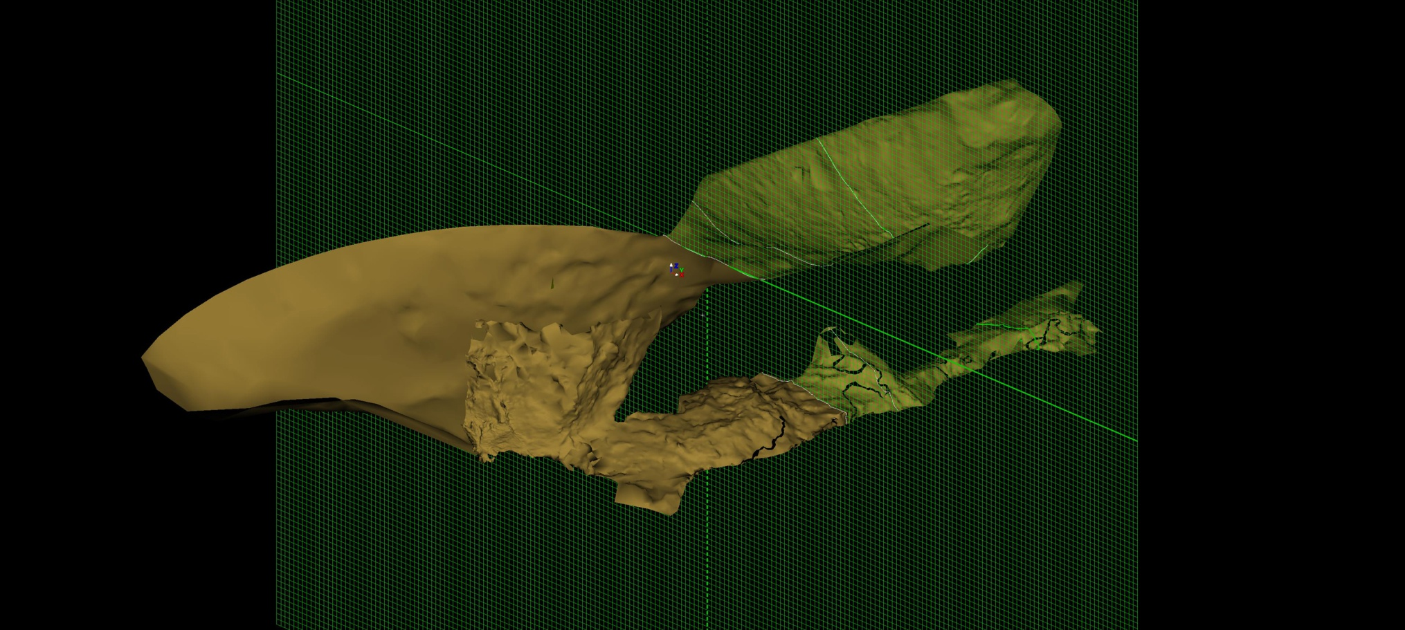
Evolution of collapse valleys in karst – examples from the Carpatho-Balkanides of Serbia –
Aleksandar S. Petrović*, Jelena Ćalić**, Aleksandra Spalević**, Marko Pantić***
* University of Belgrade, Faculty of Geography; ** Geographical Institute “Jovan Cvijić” of the Serbian Academy of Sciences and Arts;
*** Vekom Geo, Belgrade
Introduction
Development of valleys in karst is an issue which has not been sufficiently studied in karst surface morphology. These valleys are long linear forms whose orthogonal projections resemble normal valleys, but most of their characteristics are strongly influenced by karst process. In largest number of relevant references, this subject is either only briefly mentioned or completely lacking. This paper presents the examples of a particular type of valley in karst formed by cave ceiling collapse close to the topographical surface. For these forms, we use the term “collapse valleys”. The relation of these forms to the phenomenon of unroofed caves needs to be studied more in detail in future.
Karst of the Carpatho-Balkanides in eastern Serbia (Fig.1a) is characterized by uneven spatial distribution in several large massifs, but also in a large number of relatively small outcrops (patches and belts), which enable the development of contact karst and fluviokarst. Many morphological elements are of fluvial origin, subsequently modified by karst process.
Methodology
Detailed geomorphological mapping and basic structural-geological mapping were carried out in order to determine the precise settings of collapse valleys’ development. All three caves were primarily surveyed by the classical method of cave surveying – point-to-point polygon line, clinometer and compass, but the cave at the Radovanska River was subsequently additionally surveyed in order to determine the spatial relations between underground and surface forms. For this purpose, we have used the Leica MultiStation MS50, geodetic total station with an ability to scan (automatically determine) up to 1000 points per second (Fig. 3a). Since we were interested only in relative spatial relations, a local coordinate system
was defined, determined by coordinates of the first station and north direction determined by compass. All other standing points have been determined measuring their position in relation to the previous station. For the surface forms, three station positions were sufficient, while for the cave we set up the station on 7 positions.
For the scanning we have used the following parameters:
Above ground: Vertical angle limit: below 90⁰, Horizontal angle: full dome - 360⁰, point spacing 15cm @10m, approximate number of points per station 145 000
Below ground: Vertical angle limit: full dome 270⁰, Horizontal angle: full dome - 360⁰, point spacing 15cm @10m, approximate number of points per station 85 000
Data collected were processed in3DReshaper (Fig. 3b; 4a,b).
Results& Discussion
The Radovanska River on Mt. Kučaj flows along the contact between crystalline schists and thick-bedded Upper Jurassic limestones. The river sinks in the limestones, forming a blind valley. Mapping and scanning of the Radovanska Reka valley showed that the dry valley is positioned parallel to the cave passage, but is offsetto SW (20-30 m horizontally and about 8 m vertically). This offset is due to the existence of a significant tension joint dipping at 234/32 (Fig. 5b), which guided the development of both the cave passage and the dry valley. The valley is of hanging type on both sides and strikes at 300-120, similarly as the major axis of the doline at its bottom, the cave and the joint (Fig. 5a). The entrance to the cave shows a clear cross section of this passage (Fig. 5c).
On the Vratna River, the collapse valley is presently in the last evolutional phase. Particular trait of many such valleys in karst of eastern Serbia is that the remnants of former cave ceilings are present as natural bridges (Ambert & Nicod, 1981; Ćalić-Ljubojević, 2000; Petrović & Carević, 2015). Karstic part of the Vratna valley is characterised by steep, almost vertical valley sides. At the downstream end of the karstic part of the valley, there are two natural bridges (Velika Prerast and Mala Prerast) at the distance of about 100 m (Fig. 7a). The segment of the valley between them is supposedly an unroofed cave whose ceiling collapsed (Fig. 7b).
7a
b.
3a
3b
5a
5b
a.
7b
Fig. 1 – Research area
a – Karst of Carpatho-balkanides of Serbia;
b – location of collapse valleys) (1 – Radovanska River;
2 – Zamna; 3 – Vratna; 4 – Ravna River)
5c
Conclusion
The results of research of valleys in karst, which are presently in one of the phases of collapse valley formation, point to the significant structural-geological influence (Nicod, 1997), which was proven in our study as well. The upward progression of ceiling erosion is supplemented by the opposite development of drawdown dolines at the surface. First collapses lead to the development of daylight holes, which tend to enlarge through time. Further on, the unroofed segments become dominant, and the form may be called a collapse valley.
Case studies
Collapse valleys occur mostly at downstream contacts (where seasonal watercourses leave limestones) or in karst/limestone belts. We present their development through three evolutional phases and show a locus typicus for each of them.
In the first phase, which is visible on the example of the RadovanskaReka River, the river course sinks to the swallets in the riverbed and forms a blind valley. After sinking, the water flows through the tunnel cave, while largest part of the valley remains above the cave. The bottom of the dry valley is dissected by deep dolines, reaching almost to the cave roof, but not connecting with it.
In the second phase, shown on the example of the Zamna River valley, the doline bottoms reach the cave ceilings which develop holes at certain points. These hollows tend to enlarge with time, and the segments of the cave ceiling are reduced.
The final, third phase is characterised by collapse of larger segments of cave ceilings. Only the natural bridges remain,
as the remnants of former caves (e.g. in
the Vratna River valley, Fig. 2). These parts
Of valleys in karst are usually narrow,
steep-sided, resembling classical gorges.
A closer look to the morphogenesis of this
type of valleys is discussed.
The Zamna River flows from Mt. Deli Jovan towards the Danube (Fig. 1b). Along its flow, it crosses several small limestone outcrops. On the contact with one of them, the Zamna sinks underground and forms a 155 m long tunnel cave (Fig. 6a). Two large daylight holes are present close to the entrance/exit of the cave (Fig. 6b). These are the spots where the bottoms of former dolines have cut down to the cave ceiling, causing collapse.
6a
Selected references
Ambert, P., Nicod, J. (1981). Sur quelques karsts de Serbie, au voisinage du Danube. Leurs rapports avec l'évolution du bassin pannonien. Revue Géographique de l'Est, 21/4, pp. 235-249.
Ćalić-Ljubojević, J., (2000). Natural bridges on the Vratna River (Eastern Serbia) as the last remnants of a former cave. Acta Carsologica, 29/2, pp. 241-248.
Nicod, J. (1997). Les canyons karstiques "Nouvelles approches de problèmes géomorphologiques classiques" (spécialement dans les domaines méditerranéens et tropicaux). Quaternaire, 8/2-3, pp. 71-89.
Petrović, S. A., Carević, I. (2015). Geological influence on the formation of Samar natural bridge and collapse valley of Ravna river from the NE Kučaj mountains (Carpatho-Balkanides, Eastern Serbia). Acta Carsologica, 44/1, Postojna, pp.37-46.
4b
6b
2
4a

