Slide 1
Development of High Precision Tsunami Runup Calculation Method
Coupled with Structure Analysis
European Geosciences Union
General Assembly 2017
Vienna | Austria | 23–28 April 2017
Taro Arikawa (1&2), Katsumi Seki (1),
Yu Chida (2), Tomohiro Takagawa (2), and Kenichiro Shimosako (2)
Chuo University
Port and Airport Research Institute

Slide 2
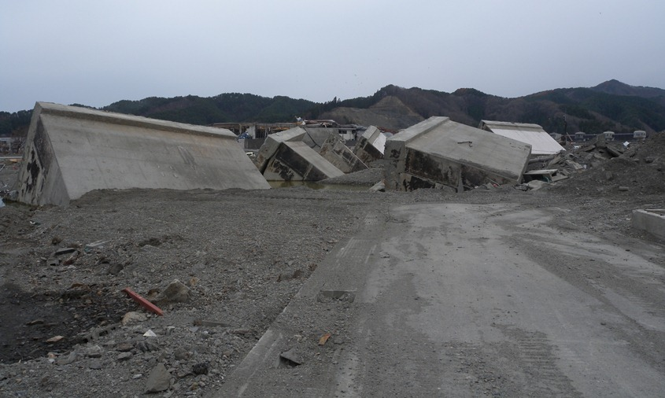
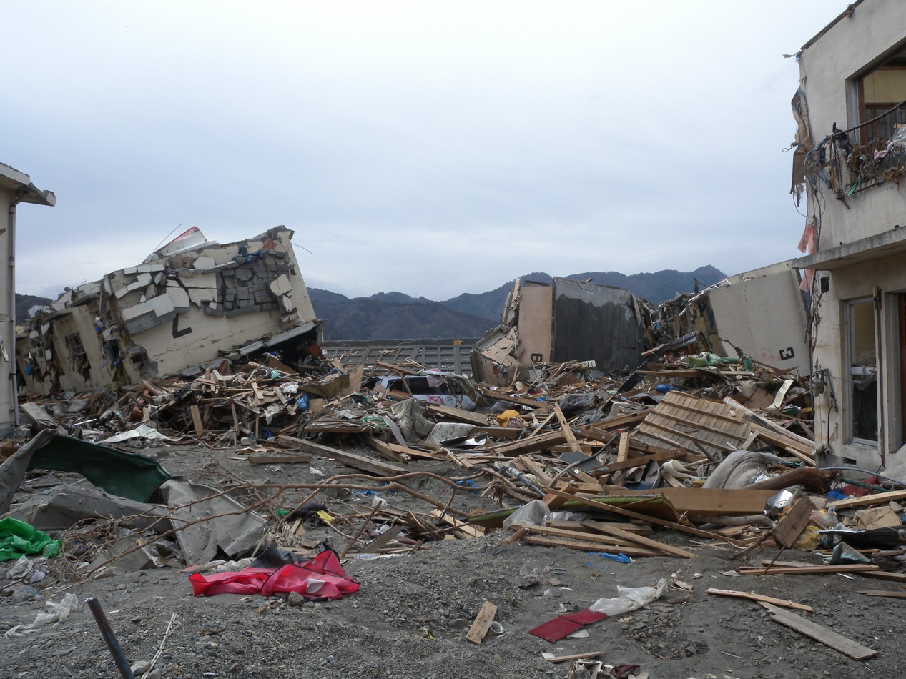
Direction of Research
In order to evaluate the damage due to giant tsunamis, influence of destruction of structures, debris, etc. is required.
The power of the tsunami is greatly different depending on the place and the condition
3 dimensional numerical simulator should be required to analyze overflow, scour, flood into buildings and so on.
The system which connects tsunami propagation simulator and 3-D numerical simulator should be developed.

Slide 3
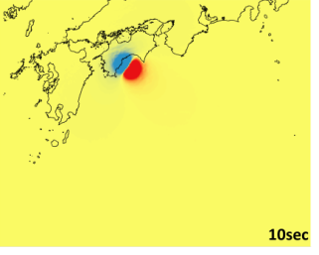
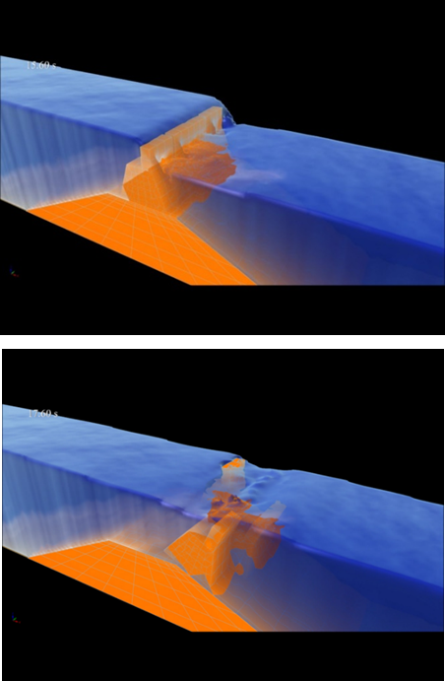
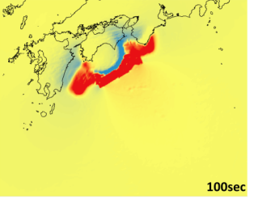
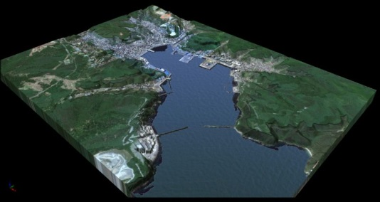
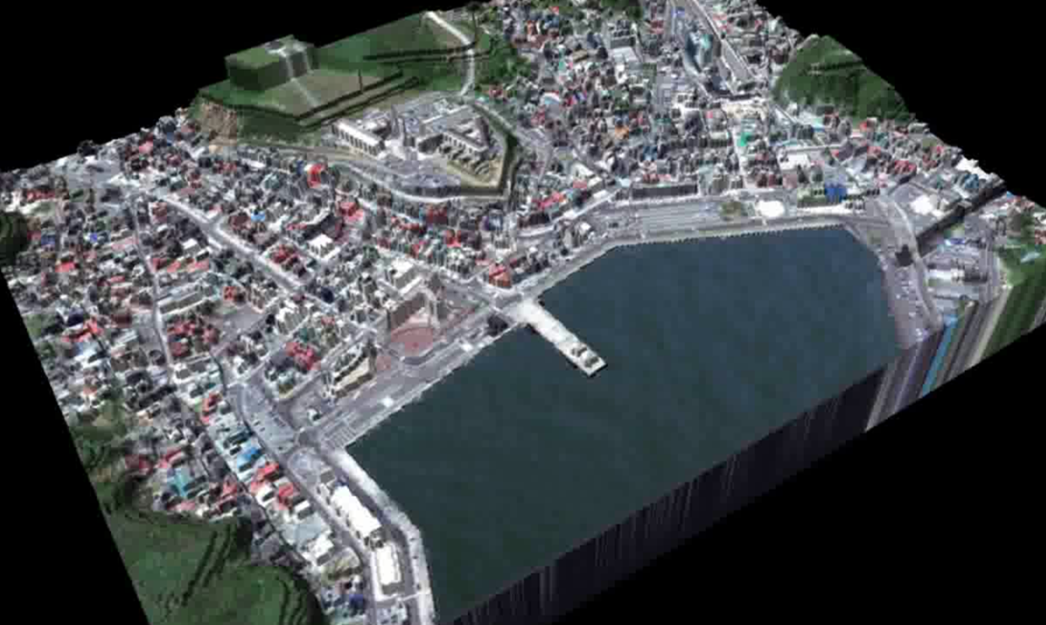
Multiscale and Multiphysics Tsunami Simulator
STR
STOC-IC
Epicenter
STOC-ML
Structure destruction
波源域
Tsunami Propagation
CADMAS
Inundation
STOC-ML
STOC-IC
CADMAS
CADMAS-2F
STR
Nonlinear Long wave equations
Three dimensional NS equations
with continuity surface model
Three dimensional NS equations
with VOF model
Three dimensional two phase NS equations
with VOF model
Structure and geo analysis by FEM or DEM

Slide 4
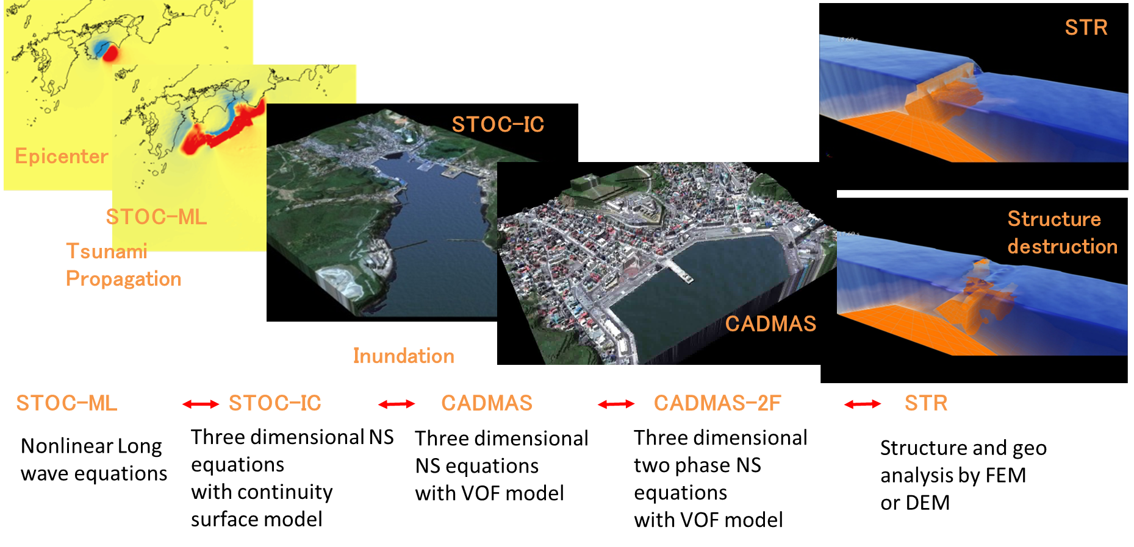
Multiscale analysis
Coupled with wave propagation simulation

Slide 5
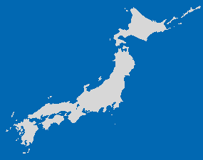


The STOC-CADMAS system
(Arikawa and Tomita, 2016)
3D model Estimates the free water surface with the VOF method
Computation load: heavy
Quasi-3D model (multi-level model)
Assumes hydrostatic pressures at each level
Computation load: light
STOC-ML
CADMAS-SURF/3D
Coupled with DEM/FEM
STOC-IC
Tsunami source
3D model Calculates the free water surface with a vertically integrated continuity equation
Computation load: moderate
STOC system (Tomita et. al., 2005)
CADMAS system (Arikawa et. al., 2005)

Slide 6
STOC(Storm surge and Tsunami simulator in Oceans and Coastal areas)
STOC-ML
3-d Multi-Level constant density RANS model with Eddy Viscosity and hydro-static pressure
(Tomita et. al.,2005)
p=ρg（η- z）
STOC-IC
3-d variable density RANS model with Eddy Viscosity closure and Integrated Continuity eq. for free-surface tracking
Equation of Motions
Equation of Continuity
Equation of Free Water Surface
Integrate in the z direction
γ_{v} : porosity
γ_{x} γ_{y} γ_{z} : transmissivity in each direction of “x”, “y” and “z”

Slide 7
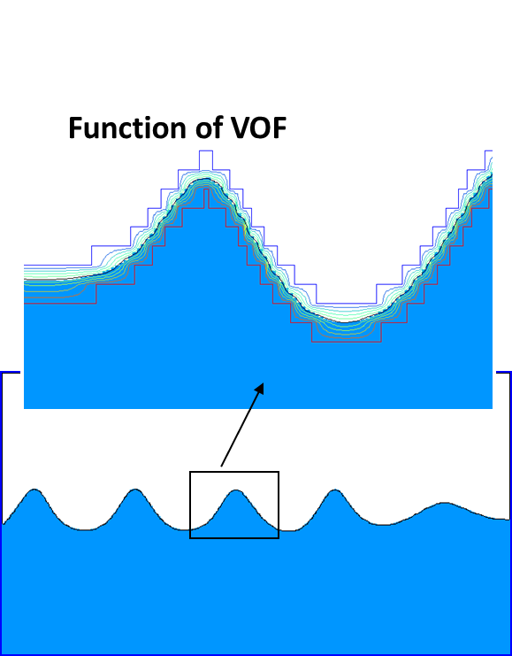
CADMAS-SURF
(SUper Roller Flume for Computer Aided Design of MAritime Structure)
(For 3D version, Arikawa et. al.,2005)
This numerical code is based on the VOF method, and is applicable to not only wave transformation but also interaction of wave, current, structure and foundation. Namely, this numerical flume is replaceable with the laboratory flume, and applicable to the practical works of maritime structure design against wave action.
Equation of Motions
Equation of Continuity
Equation of Free Water Surface (VOF Method)
Volume of Fluid
implies the ratio of fluid volume to cell volume

Slide 8
Connections between simulator calculations
STOC-ML
All connections are made using MPI communications.
Although all three models are capable of segmenting their respective areas of interest, when different calculation methods are used in the same area (for example, STOC-IC calculations are used in an STOC-ML area), the parent area containing the different calculation methods is regulated to prevent segmentation.
Consequently, when a CS3D area is made sufficiently large, the STOC-IC area that contains it ultimately becomes larger as well, as a single area.
STOC-ML
STOC-IC
CADMAS-SURF/3D-MG
STOC-ML
STOC-IC
CADMAS-SURF
/3D-MG
Communication by MPI
Communication by MPI
Must not touch

Slide 9
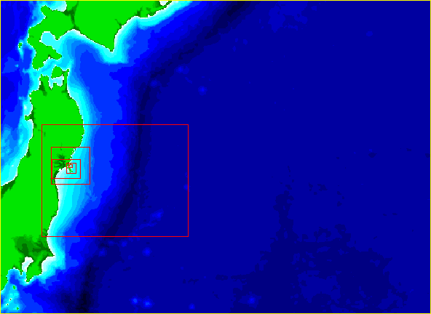
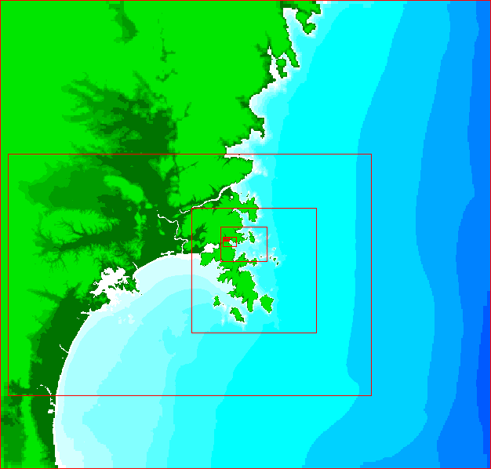
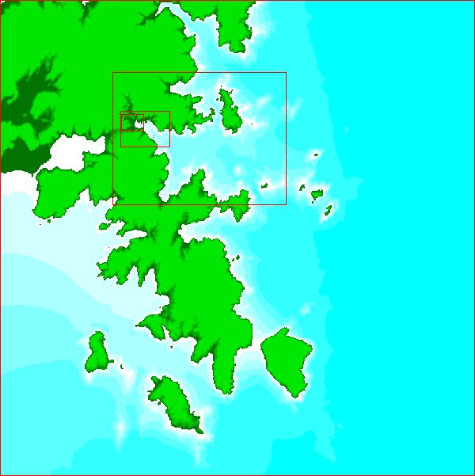
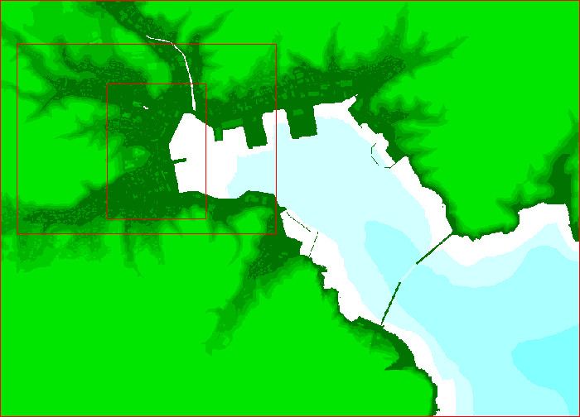
Verification of Accuracy of the system
Domain for STOC-IC
Domain for CADMAS-SURF
Image of calculation at Onagawa

Slide 10
Information of each domain
No. Layer | Grid Size(m) | Ratio of Grid size | Number of grid (X) | Number of grid (Y) | Number of grid (Z) | Number of grid | Code Name | Number of Core
1 | 2,916.0 | － | 500 | 365 | 1 | 182,500 | STOC-ML | 1
2 | 972.0 | 3 | 510 | 390 | 1 | 198,900 | STOC-ML | 1
3 | 324.0 | 3 | 405 | 387 | 1 | 156,735 | STOC-ML | 1
4 | 108.0 | 3 | 900 | 600 | 1 | 540,000 | STOC-ML | 1
5 | 36.0 | 3 | 930 | 930 | 1 | 864,900 | STOC-ML | 1
6 | 12.0 | 3 | 1,020 | 780 | 1 | 795,600 | STOC-ML | 1
7 | 4.0 | 3 | 870 | 627 | 1 | 545,490 | STOC-ML | 1
8 | 4.0 | 1 | 390 | 285 | 13 | 1,444,950 | STOC-IC | 3
9 | 1.0 | 4 | 600 | 800 | 32 | 15,360,000 | CADMAS-SURF/3D | 32
Tsunami Source:
Fujii-Satake ver. 4.0 model with scaling adjustments to match the tsunami waveform obtained with GPS wave sensors off the southern Iwate coast.
Fujii-Satake ver. 8.0
Central Disaster Prevention Council(2011)
Takagawa and Tomita (2012)

Slide 11
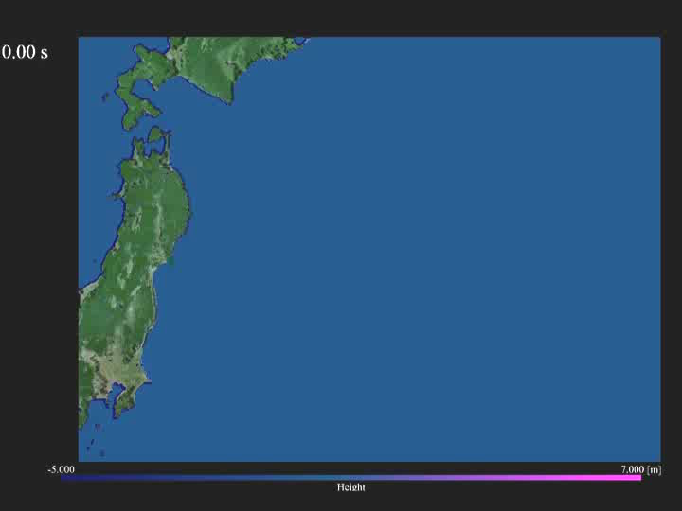
Domain 01, ML
Tsunami Source; Takagawa and Tomita 2012

Slide 12
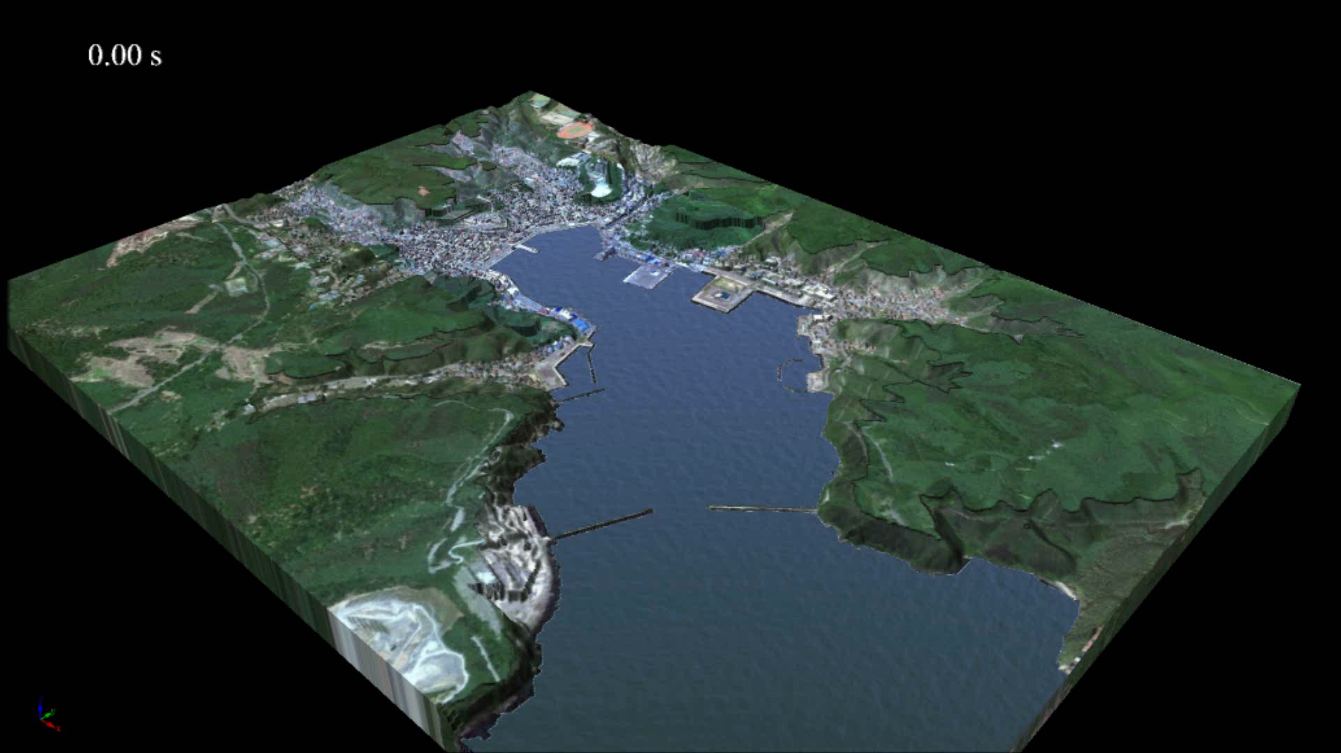
STOC-IC to CADMAS-SURF/3D
Domain 07 to 08
Tsunami Source; Takagawa and Tomita 2012

Slide 13
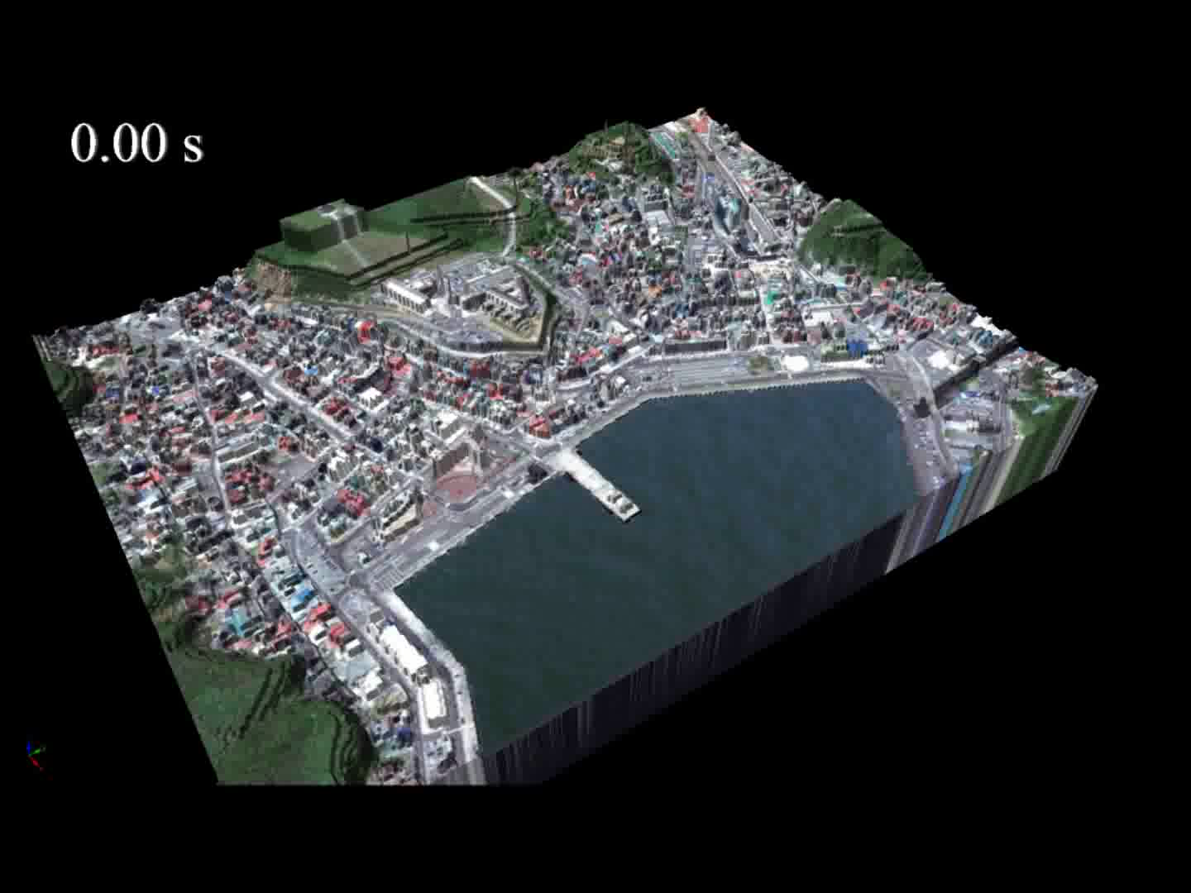
Domain 08, CADMAS-SURF/3D

Slide 14
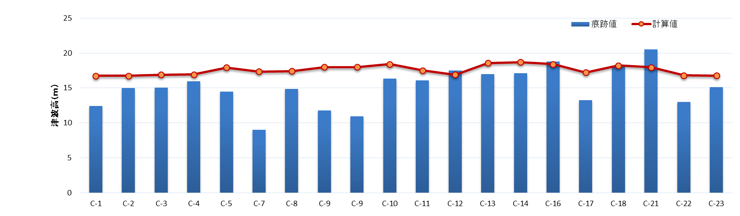
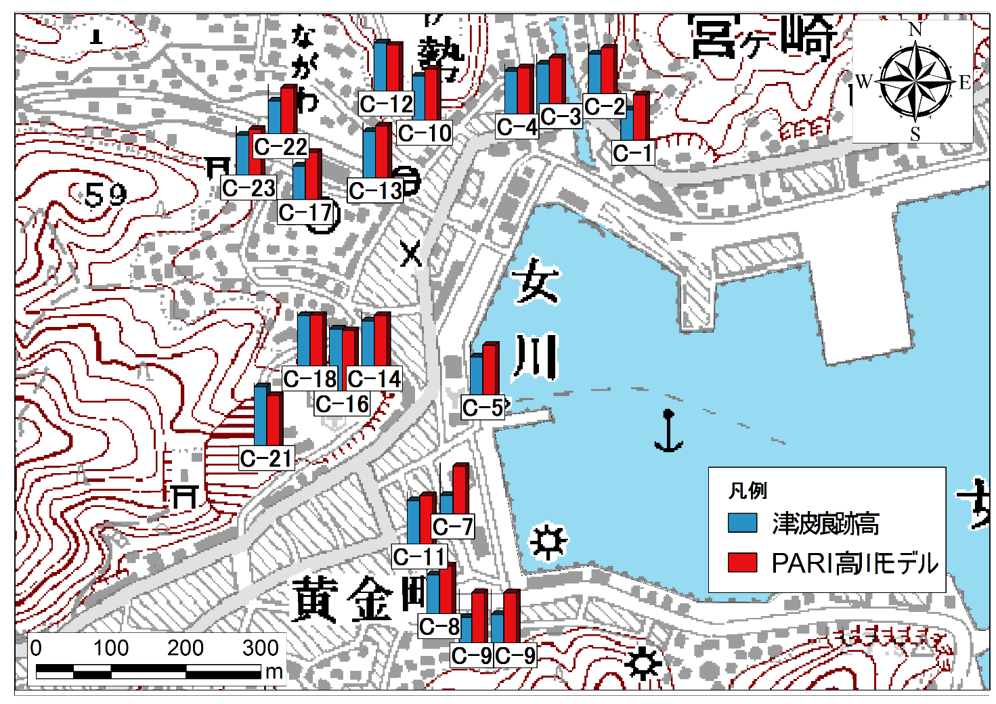
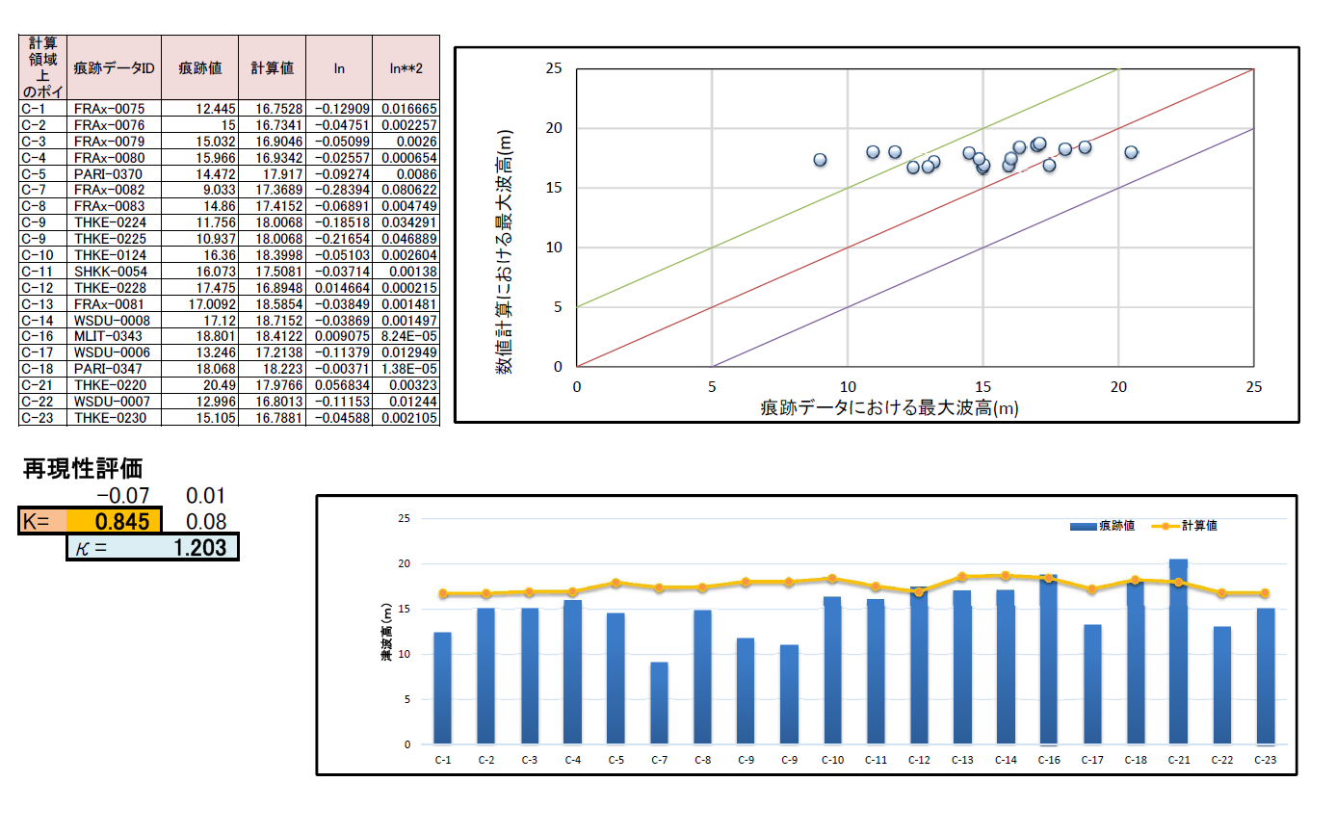
Comparison of Maximum Inundation height
(Tsunami Source: Takagawa andTomita (2012)
measured

Slide 15
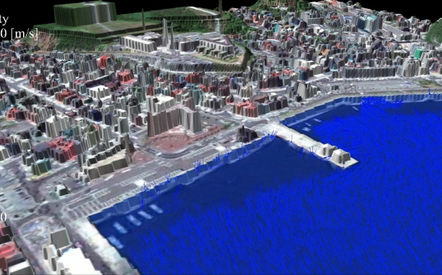
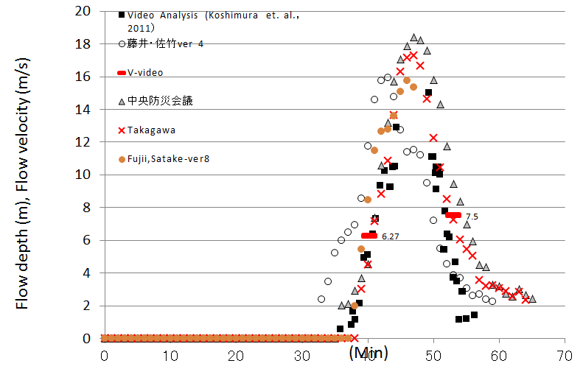
Comparison of Flow depth
Fujii, Satake –ver 4.0
Central Disaster Prevention Council

Slide 16
Multiphysics Simulation
Coupled with Structure Analysis

Slide 17
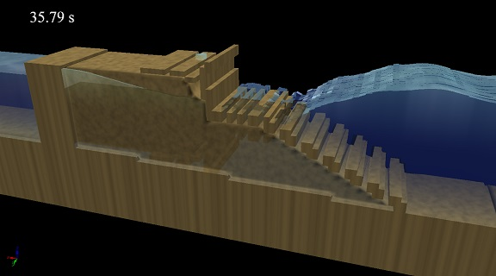
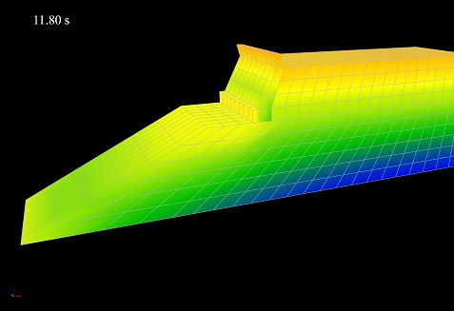
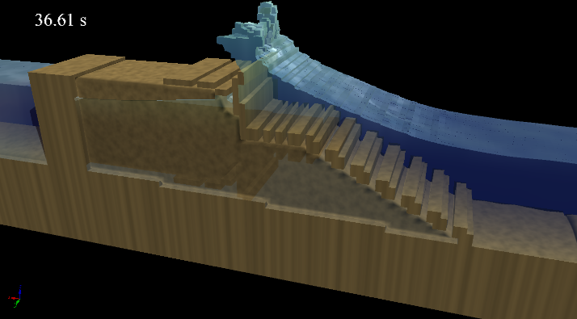
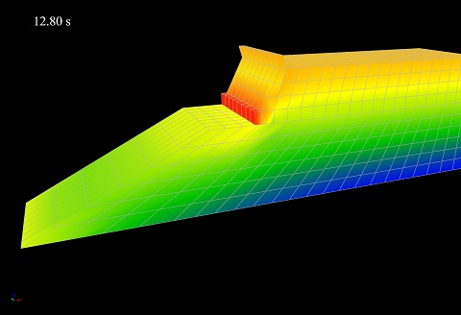
Outline of CADMAS-SURF/3D-STR
(Arikawa et al., 2009)
Main program
call subroutine
call subroutine
CADMAS-SURF/3D
(VOF method)
STR3D
(FEM)
Data on pressure
Data on displacement
Images of CADCADMAS-SURF/3D
calculation step
calculation step

Slide 18
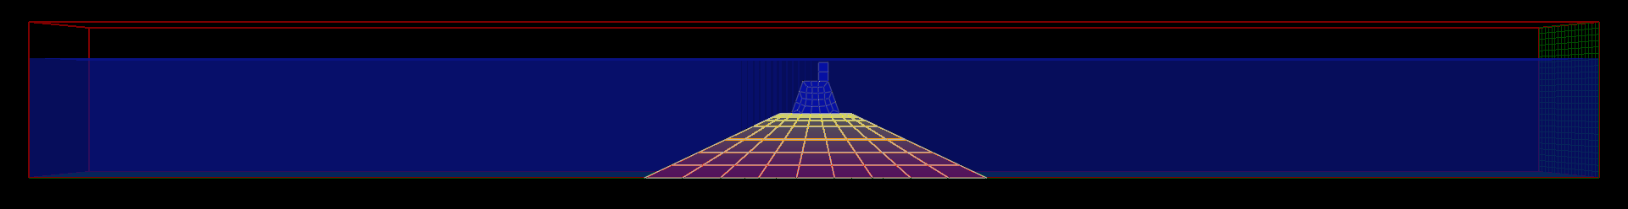
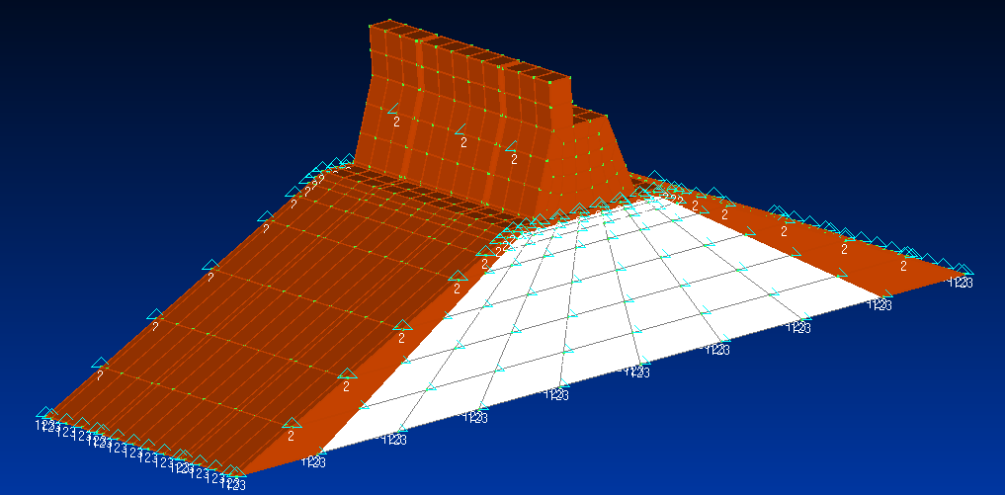
Breakwaters
Numerical Conditions
CADMAS
dx=dy=dz=0.10 m
dummy
STR
Young's modulus ： 2.35e11
Poisson's ratio ： 0.333
Density
test body ： 2135
dummy caisson ： 2349
Coefficient of friction
static ： 0.6
dynamic ： 0.2

Slide 19
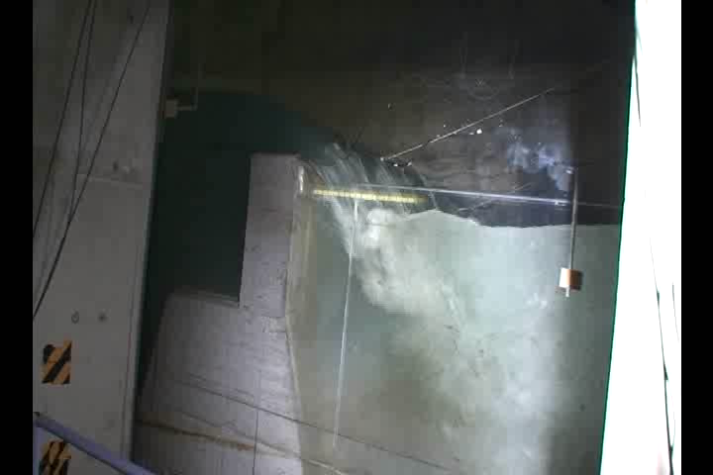
Breakwaters
Physical Experiment
Sea side
Harbor side

Slide 20
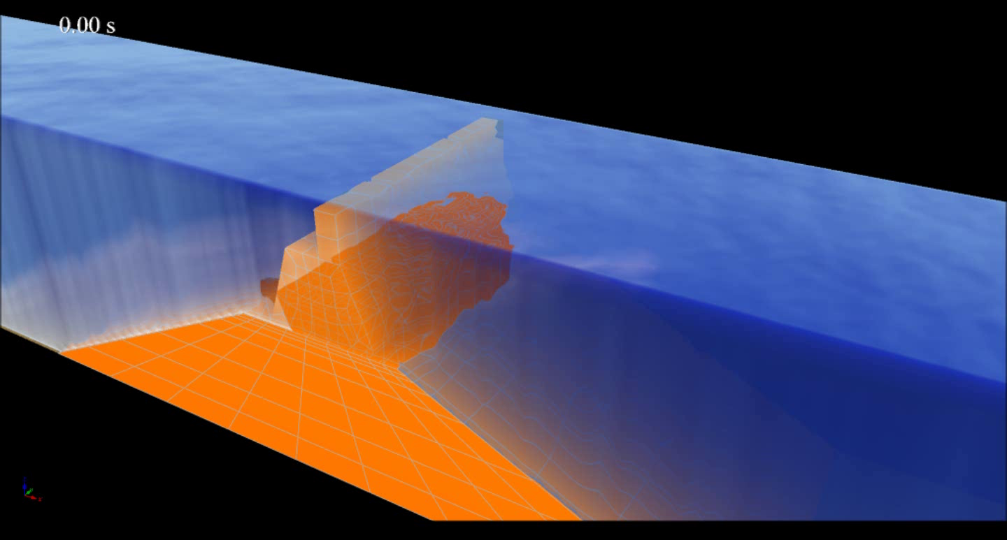
Breakwaters
Animation

Slide 21
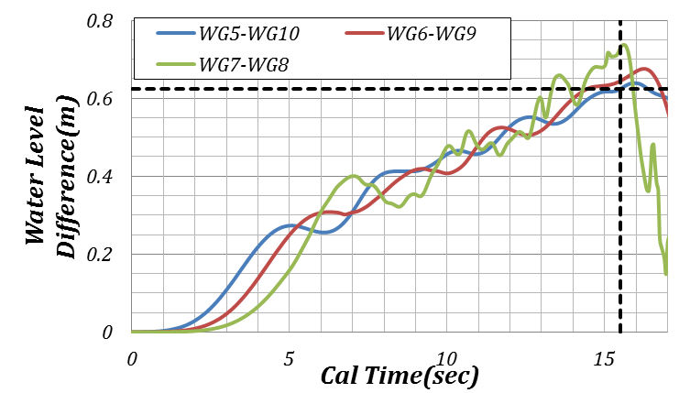
Breakwaters
Water Level Difference
62.4cm
The result of the Water Level Difference of the physical experiment is 60.8cm

Slide 22
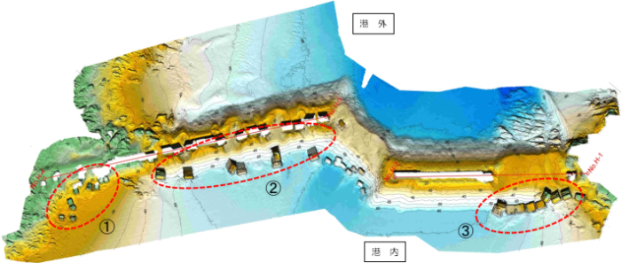
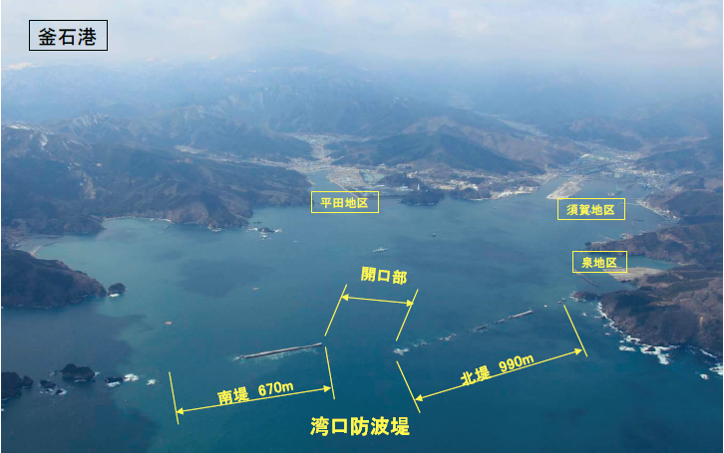
Kamaishi Tsunami Breakwater
Harbor Side
Kamaishi Port
Sea Side
Hirata
Suga
Izumi
Mouth of Port
North part
South part
Tsunami Breakwaters

Slide 23
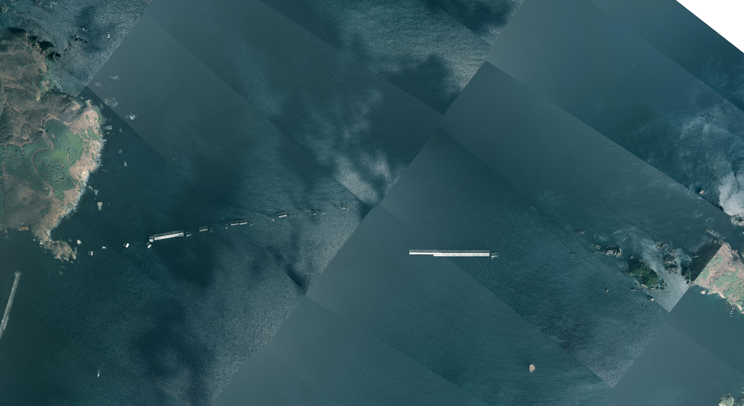
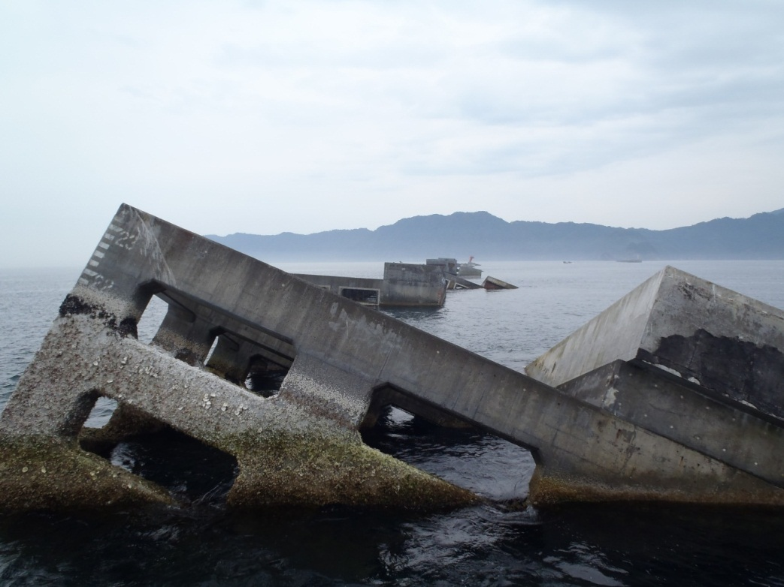
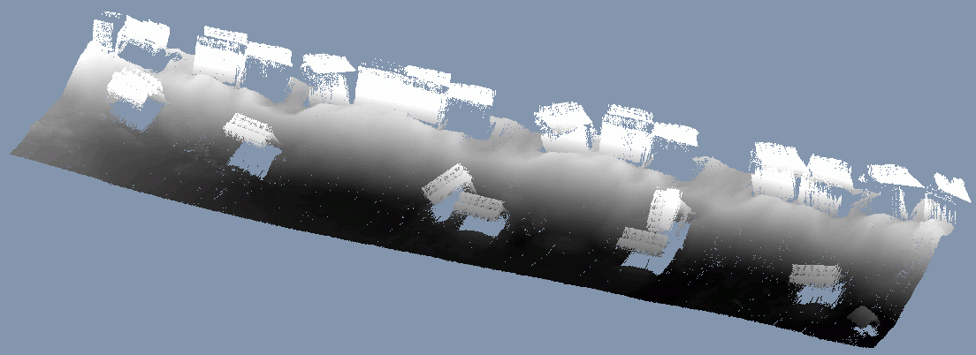
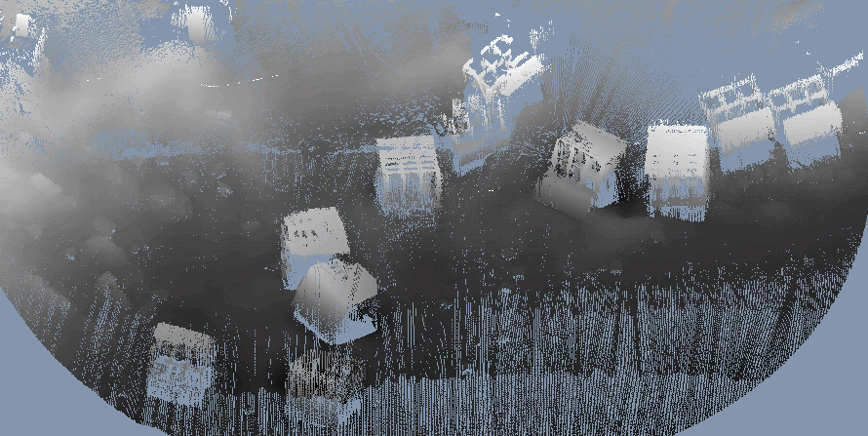
Failure of Breakwater at North Part
TOHOKU REGIONAL BUREAU MINISTRY OF LAND , INFRASTRUCTURE AND TRANSPORT
Outside of Port
深部
Deep Region
浅部
Shallow Region
Inside of Port

Slide 24
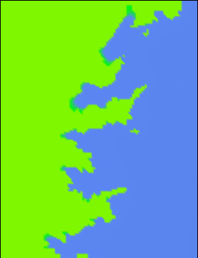
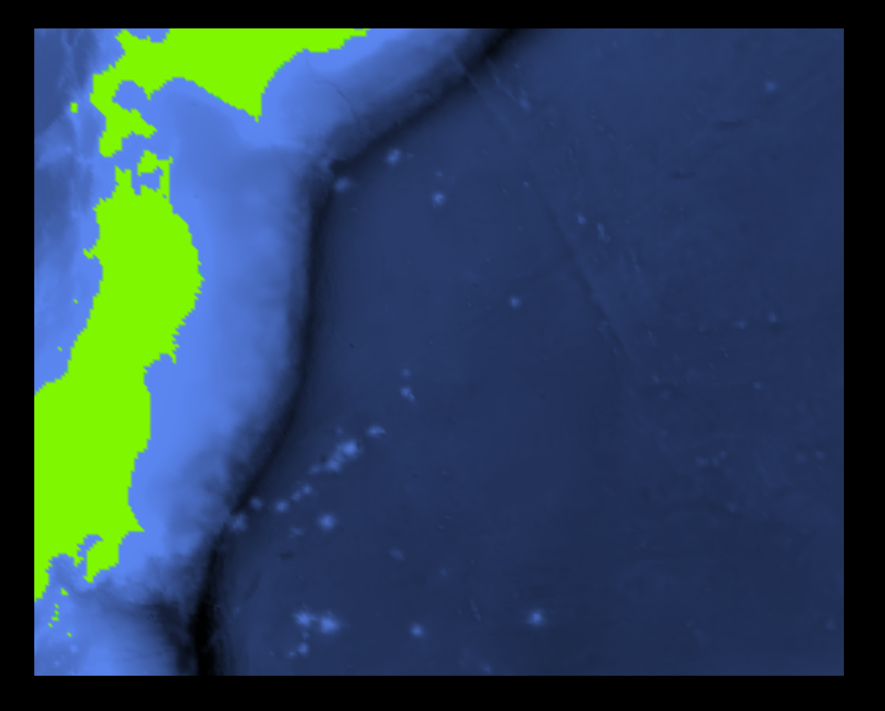
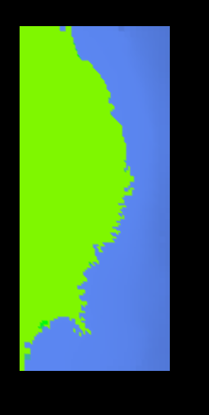
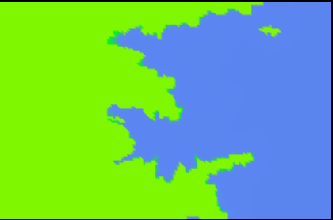
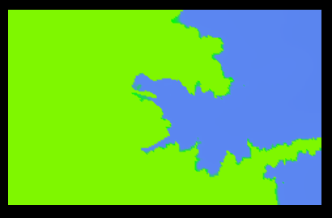
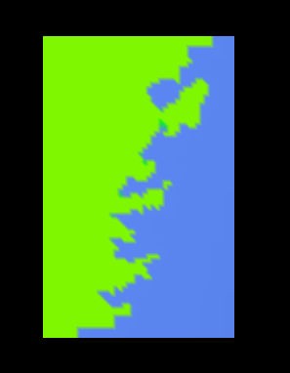
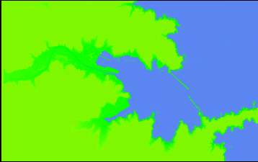
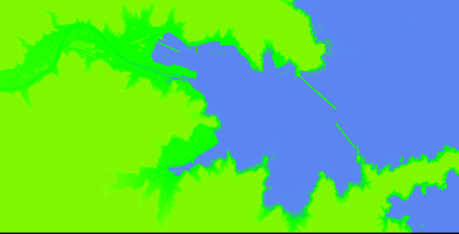
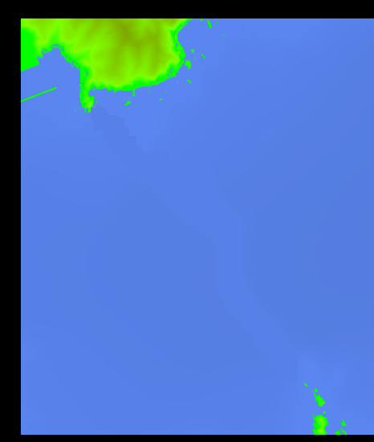
Example of Kamaishi Bay
▼ STOC-ML Domains 4 -6
Calculation Domains
▼ STOC-ML Domain 1 -3
▼ STOC-ML Domain 7
STOC-IC Domain 8
CADMAS Domain 9

Slide 25
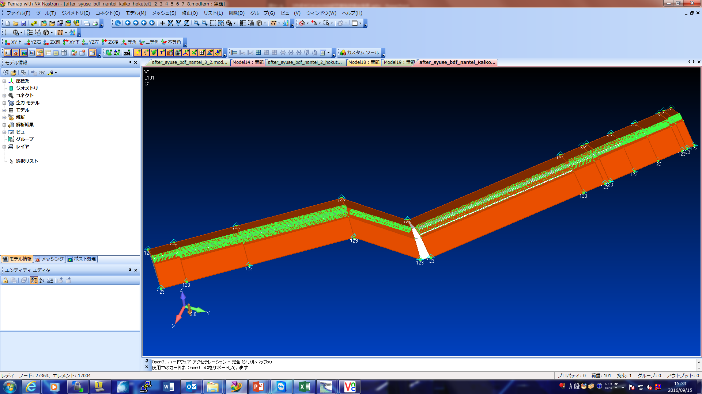
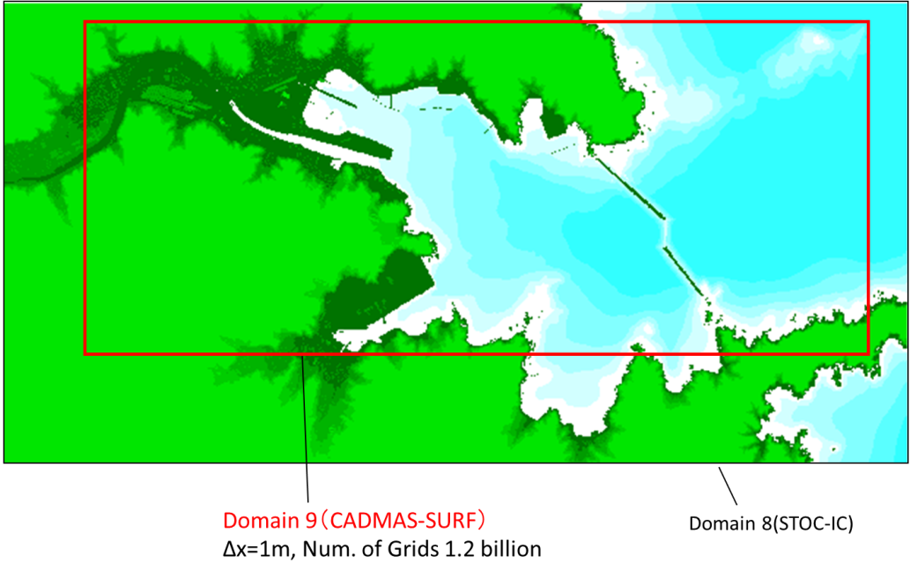
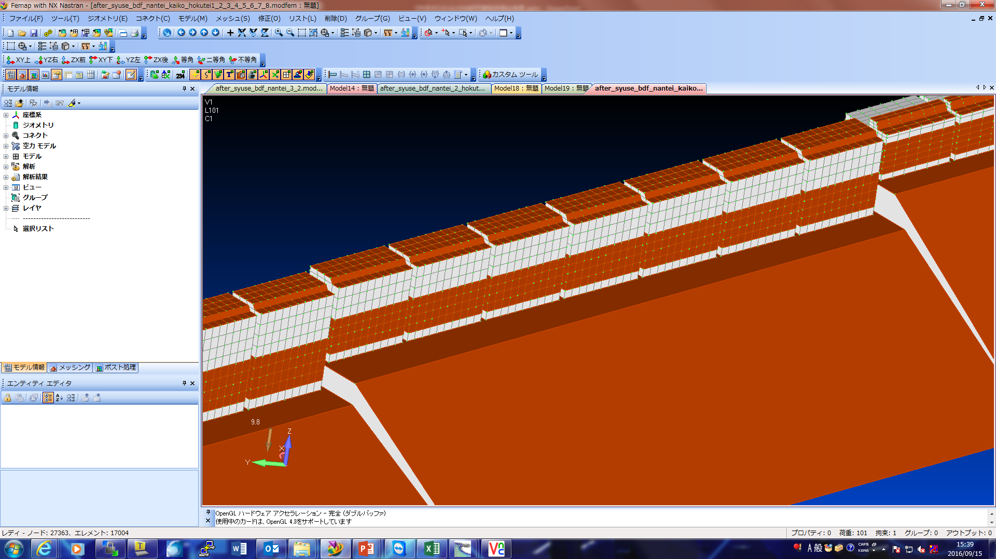
Example of Kamaishi Bay
CADMAS-STR Domain
Model of Breakwater (All)
Magnification
Outer Region is by using STOC-ML
South
mouth
S1-3
D1-3
D4
D2,3
D1
S3-2
S3-1
S2-2
S2-1
S1-2
S1-1

Slide 26
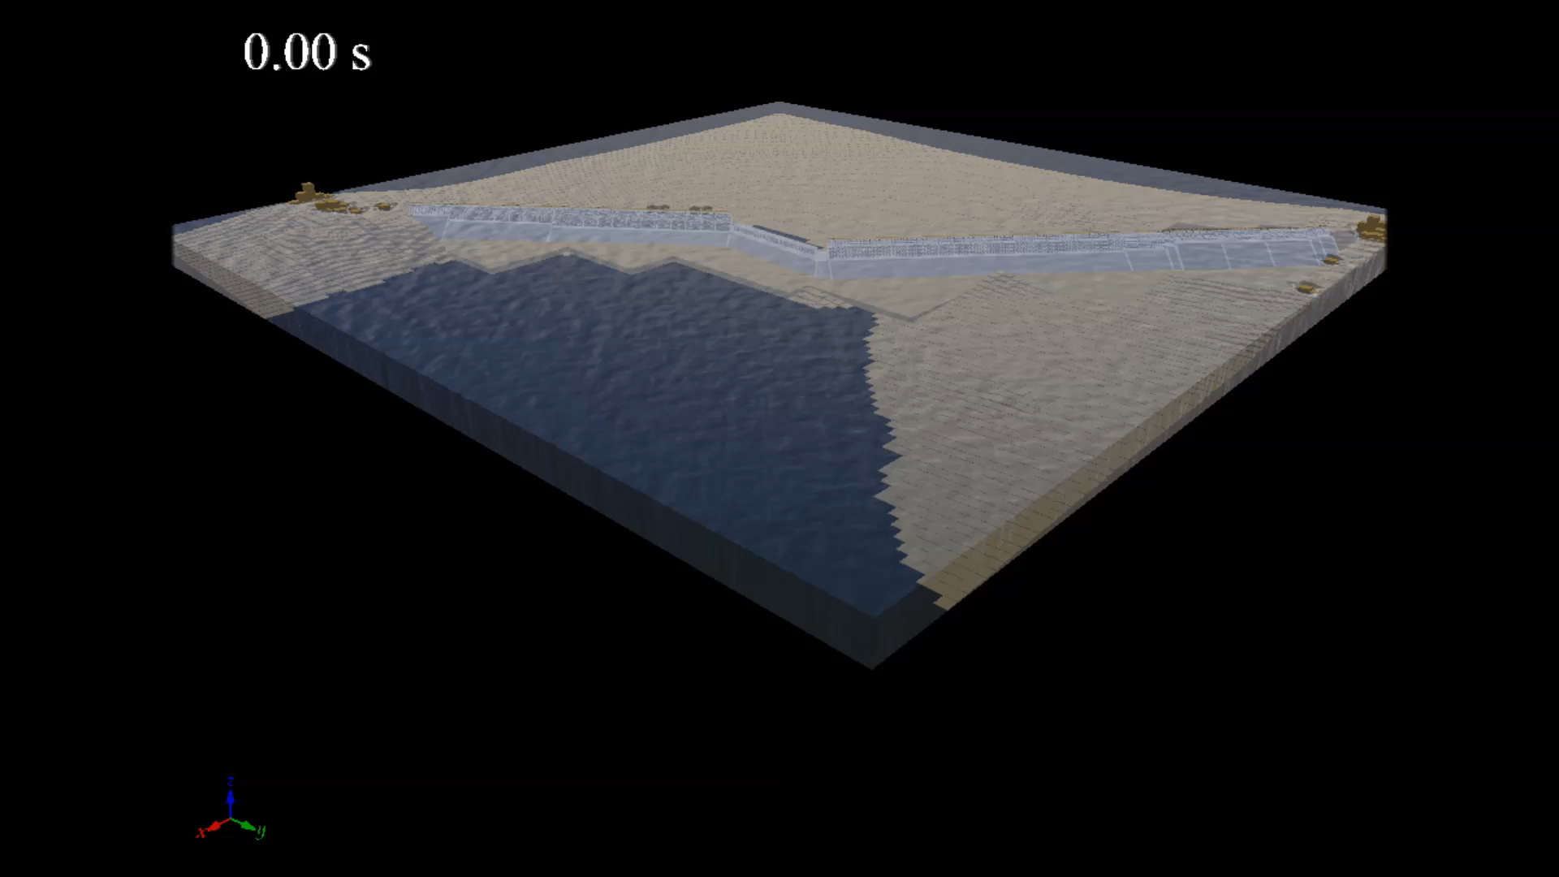
Animation
CADMAS-STR
The average of dt is around 0.005s. If 1 hour calculation would be required, it takes around 10 to 20 days

Slide 27

For evacuation
Coupled with Multiagent simulator

Slide 28



Coupling with Evacuation Simulation
Coupling STOC, CADMAS-SURF and PARI-AGENT
STOC
PARI-AGENT
Arikawa and Tomita (2015)
CADMAS-SURF

Slide 29

For inhabitants
Courtesy of Nakatosa town in Kochi Prefecture
Begin to evacuate 10 minutes after the seismic motion
Begin to evacuate 20 minutes after the seismic motion

Slide 30

Thank you for your attention!!
Let’s study Tsunami together!!
Please come to Japan!!

