Slide 1





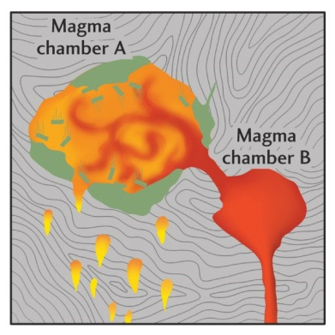
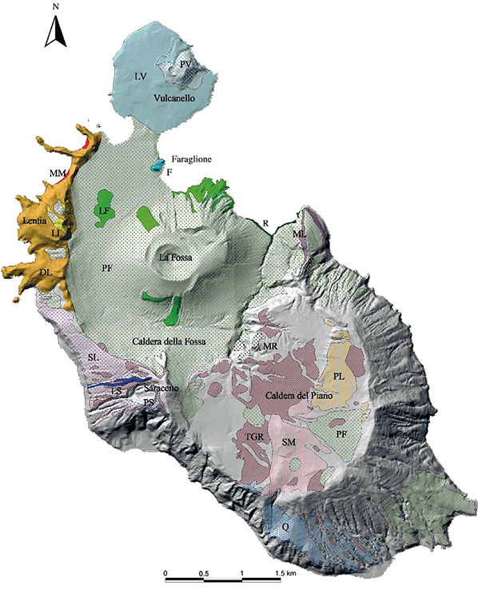
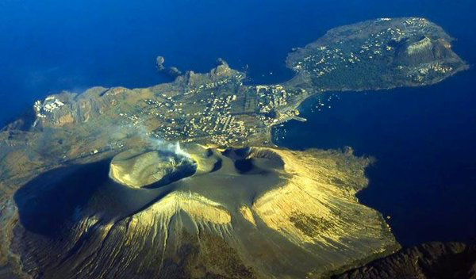
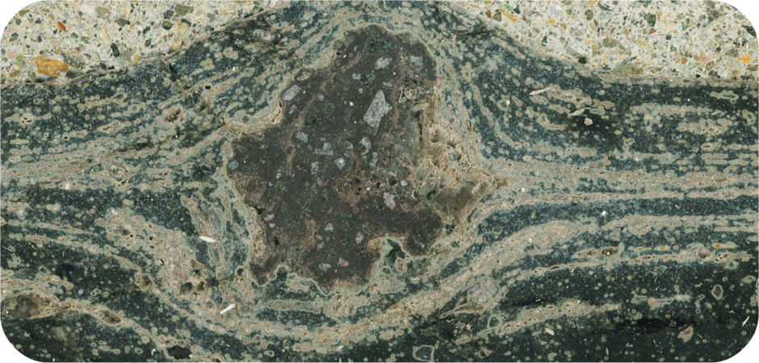
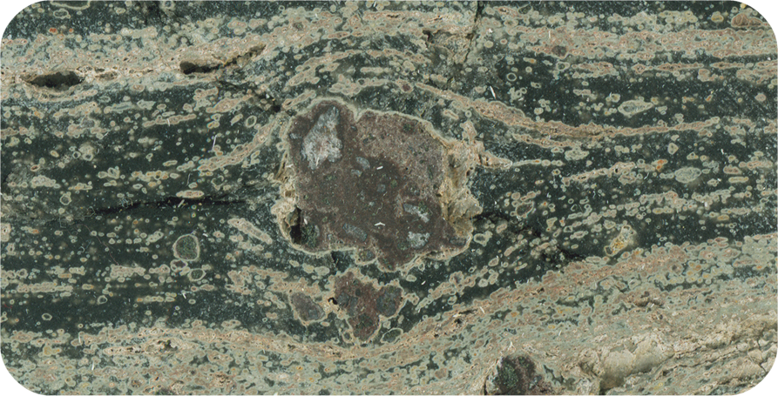
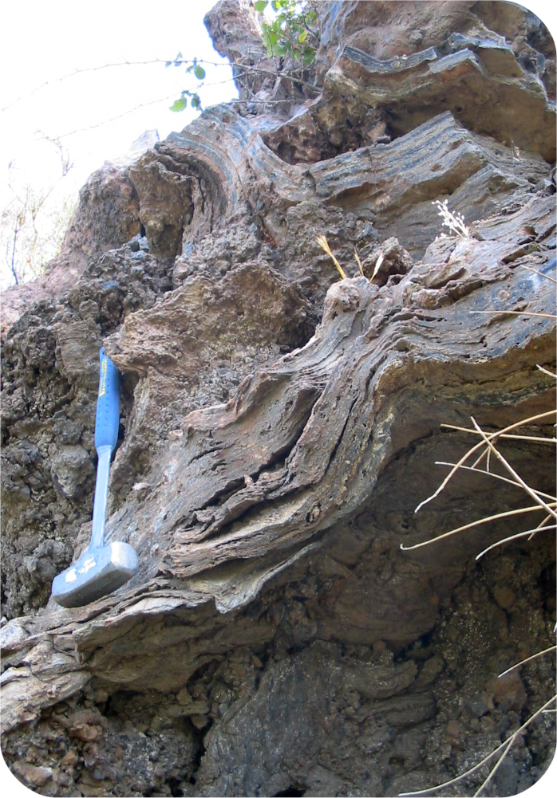
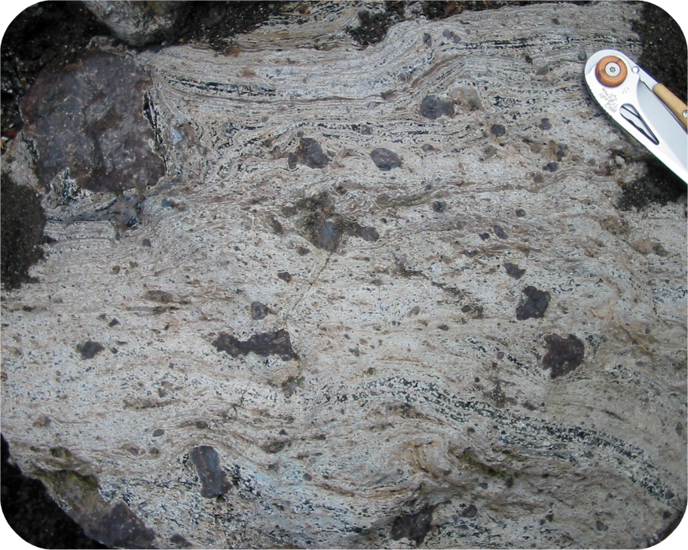
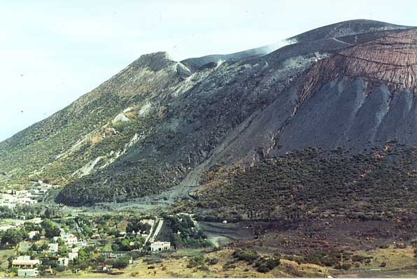
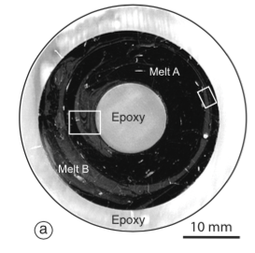
Insights on chaotic dynamics: mixing experiments between natural silicate melts from Vulcano island (Aeolian Islands, Italy)
Stefano Rossi ⁽¹⁾, Daniele Morgavi ⁽¹⁾, Maurizio Petrelli ⁽¹⁾, Francesco Vetere ⁽¹⁾ & Diego Perugini ⁽¹⁾
⁽¹⁾ Petro-Volcanology Research Group (PVRG), Department of Physics and Geology, University of Perugia, Italy
Corresponding author: stefano.rossi1@studenti.unipg.it
PVRG
@
UNIPG
Magma mixing (Fig. 1a) has been recognised as a trigger of high explosive eruptions. Its occurrence has been observed in nature in different volcanic environments in a great variety of structures and textures (Fig. 1b, c, d, e) which are the result of mingling and chemical disequilibrium between two different magmas coming into contact. Moreover, magma mixing has been suggested to be a potential chronometer to estimate the mixing-to-eruption time.
1. Introduction
2. Geological setting
3. Starting materials
4. Chaotic Magma Mixing Apparatus (COMMA)
Fig. 1a
Fig. 2a
Vulcano (Fig. 2a) belongs to the volcanic Aeolian Archipelago which consists of seven islands (Alicudi, Filicudi, Stromboli, Vulcano, Salina, Lipari and Panarea, Fig. 2b) located in the Southern Tyrrhenian Sea. The volcanic products (aged from 1.3 My to the present) belong to different petrologic association, from calc-alkaline to shoshonitic and alkaline (potassic) (e.g. Ventura et al. 1999).
The samples are a shoshonite (the mafic end-member, Fig. 3b) and a rhyolite (the felsic end-member, Fig. 3d) from Vulcano Island. The shoshonite was sampled from Vulcanello (Fig. 3a) and the rhyolite was sampled from “Pietre Cotte”, erupted from Vulcano “La Fossa” cone in 1739 (Fig. 3c).
Magma mixing experiments were performed using Chaotic Magma Mixing Apparatus (COMMA Fig. 4, see Morgavi et al. 2015 for detailed description) installed at Department of Physics and Geology (PVRG_lab, University of Perugia). This new apparatus is designed to carry out experiments at high temperature with high viscosity (up to 10⁶ Pa s) natural silicate melts.
Fig. 3a
Fig. 1b
Fig. 1c
Fig. 3b
5.0 cm
Fig. 1e
5.0 cm
Fig. 3c
Fig. 3d
Fig. 1d
Fig. 2b
Fig. 4
5. Morphological Results
6. Chemical Results
We performed three experiments, two with duration of 10.5 h, and one with a duration of 42 h at P = 1 atm and T=1200°C. The temperature inside the furnace was measured by a wireless S-type Pt-Pt-Rh thermocouple.
The experimental protocol consisted of:
two complete rotations of the outer cylinder in 7 hours
six complete rotations of the inner cylinder in 3.5 hours
it was chosen to ensure the occurrence of chaotic dynamics inside the sample (Ottino et al., 1988). After the experiment, the sample was rapid quenched and cored to obtain a glass cylinder of radius 33 mm and embedded in a epoxy resin. After the hardening of the resin it was sectioned perpendicular to its long axis into slices of ca 0.5 mm thickness (Fig 5a). EMPA analysis were performed at Institüt für Mineralogie of the Leibniz Universität Hannover (Hannover, Germany).
Fig. 6b displays inter-elemental diagrams between some representative elements (K₂O, MgO, CaO, Ti₂O vs. SiO₂). It is possible to observe that for Experiment A and B, data points show the same variability between the two end-members. For Experiment C, results show a clearly shrink in the compositional variability and data points tend to the hybrid composition.
Fig. 6a: Compositional variability triggered by mixing were reported for selected elements (Si, Ca, Mg, K) for experiment A, B and C. End-member and theoretical hybrid composition were also shown. Experiment A and B (time 10.5 h) show similar patterns, while Experiment C (42 h) shows an higher degree of homogenization.
Fig. 5b: BSE images reveal the complexity of the structures generated by the COMMA which, in first approximation, are similar to those observed in mixed natural volcanic rocks.
References
Morgavi D., Petrelli M., Vetere F.P., Gonzàlez-Garcìa D., Perugini D. (2015): High-temperature apparatus for chaotic mixing of natural silicate melts. Review of Scientific Instruments 86, 105108, doi: 10.1063/1.4932610.
Ottino J.M., Leong C.W., Rising H., Swanson P.D. (1988): Morphological structures produced by mixing in chaotic flows. Nature 333, 419-425.
Ventura G., Vilardo G., Milano G., Pino N.A. (1999): Relationship among crustal structure, volcanism and strike-slip tectonics in the Lipari-Volcano Volcanic Complex (Aeolian Island, SouthernTyrrhenian Sea, Italy). Physics of the Earth and Planetary Interiors 116 (1999), 31-52.
Fig. 5a

