Slide 1
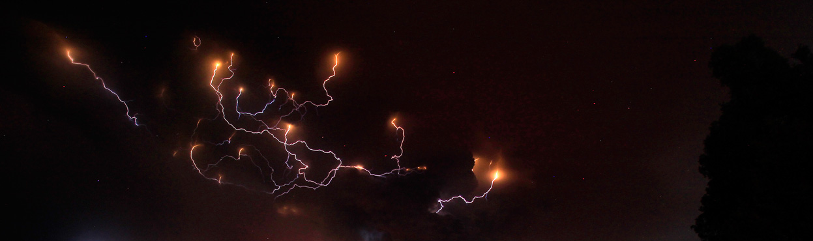
Laboratory simulations of volcanic ash charging and conditions for volcanic lightning on Venus
Navigation pane
Introduction
Experimental design
Results
Conclusions
Further work
Puyehue-Cordon Caulle 2011 (Reuters/Ivan Alvarado)
Madness
Bonus
Martin Airey^{1,2}, Elliot Warriner-Bacon¹, and Karen Aplin¹
¹Department of Physics, University of Oxford, Denys Wilkinson Building, Keble Road, Oxford, OX1 3RH, UK ²Department of Meteorology, University of Reading, Earley Gate, Reading, RG6 6BB, UK

Slide 2
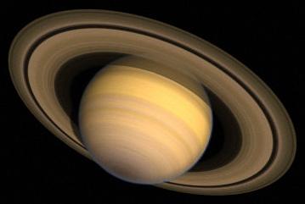
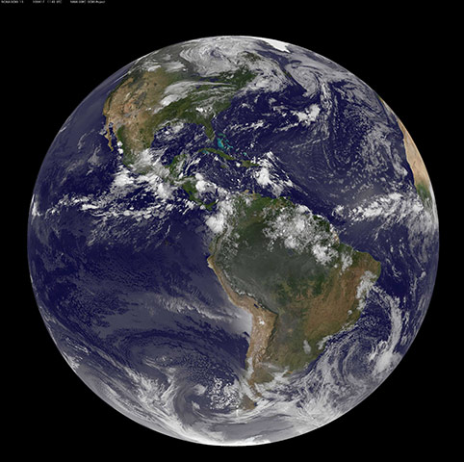
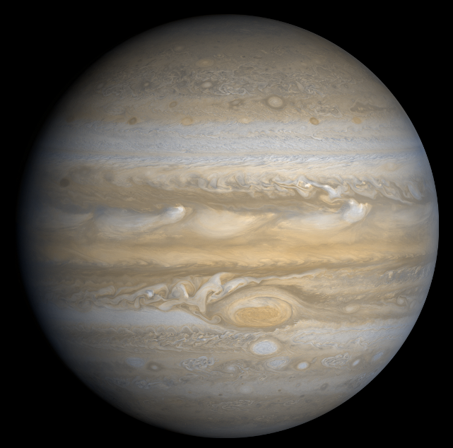
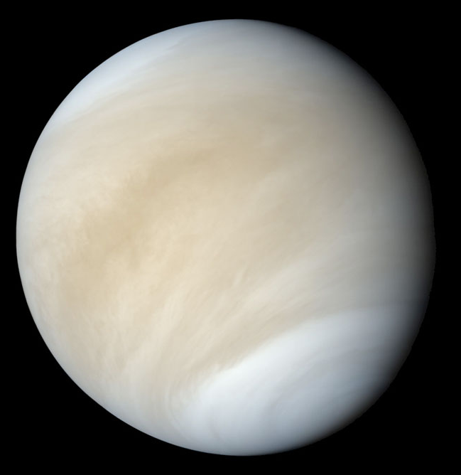
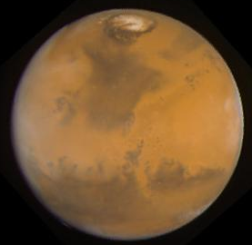
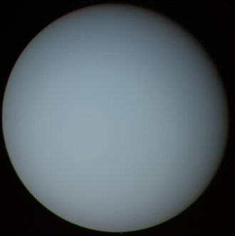
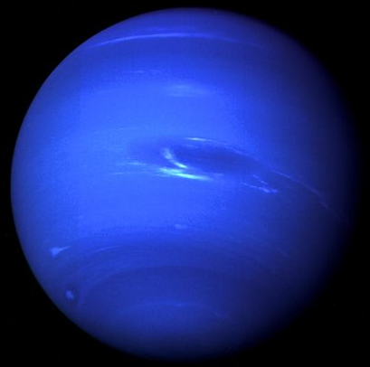
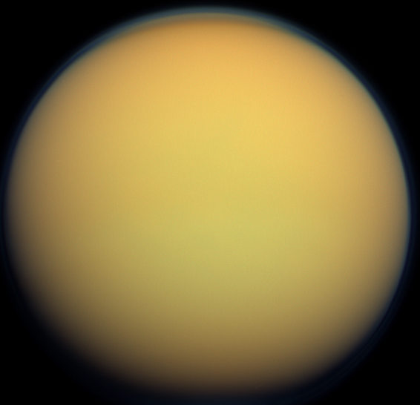
2-minute madness
Planetary lightning in the solar system
Definitely:
Probably:
Possibly:
Volcanic lightning? Yes Venus?
Earth
Jupiter
Saturn
Venus
Mars
… and almost certainly beyond
Uranus
Neptune
Titan
Menu

Slide 3
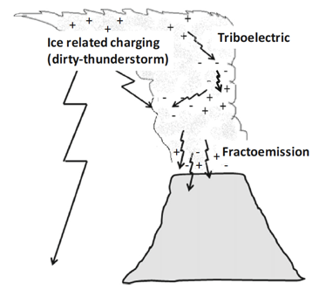
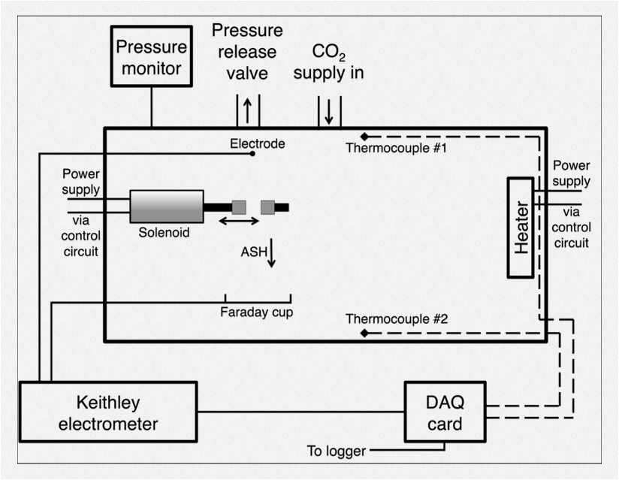
2-minute madness
C
Helling et al. (2016)
Fractoemission and tribocharging charge ash
Fractoemission simulated in experimental chamber
Menu
GPIB cable

Slide 4
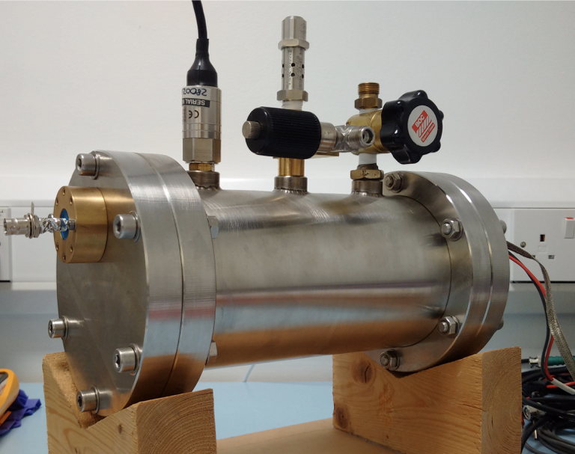
2-minute madness
Menu
PICO spot 3.4 for results and discussion

Slide 5
2-minute madness
Atmospheric composition
  N₂
  CO₂
  air
  zero grade air
Pressure
  0.006 – 39 bar
  ~12 – 80 km alt.
PICO spot 3.4 for results and discussion
Menu

Slide 6
2-minute madness
Atmospheric composition
  N₂
  CO₂
  air
  zero grade air
Pressure
  0.006 – 39 bar
  ~12 – 80 km alt.
PICO spot 3.4 for results and discussion
Menu

Slide 7
Introduction
Planetary lightning in the solar system
Definitely:
Probably:
Possibly:
Volcanic lightning? Yes Venus?
Earth
Jupiter
Saturn
Venus
Mars
… and almost certainly beyond
Uranus
Neptune
Titan
Menu

Slide 8
Introduction
Evidence for lightning on Venus (indirect or inconclusive obs.) e.g.:
  Whistler-mode waves propagating into ionosphere—Venus Express magnetometer (Russell et al., 2007), Pioneer Venus Orbiter electric field antenna and magnetometer (Taylor et al., 1979; Scarf et al., 1980)
  Optical at 777.4 nm—terrestrial telescope (Hansell, 1995)
  Optical detection of lightning storm—Venera 9 (Krasnopolsky, 1980)
  Radio waves—Galileo flyby (Gurnett et al., 2001)
  Formation of nitric oxide only naturally produced by lightning—NASA IRTF HI (Krasnopolsky, 2006)
Evidence against lightning on Venus:
  No optical detection from Venus orbit—Venus Express VMC and Akatsuki LAC
  Lack of detection—Cassini flyby (Gurnett et al., 2001)
  Conductivity too high in the cloud deck for electric fields (Michael et al., 2009)
Could volcanic lightning explain the discrepancies?
Menu

Slide 9
Introduction
Volcanic ash is thought to become charged predominantly by two methods:
  Fractoemission—Magma fragments when erupted explosively, ejecting electrons and ions resulting in different charged particles
  Triboelectrification—Physical contact (friction) between particles results in electron transfer
Charge separation occurs via larger particles (preferentially -ve) to settle faster than smaller particles (preferentially +ve)
Discharges may occur if breakdown voltage is achieved
Menu
Helling et al. (2016)

Slide 10
Experimental design
A 1 litre tank is used to house the ash generation and measurement equipment
Pressure and composition can be controlled by pumping in or out the desired gas from the chamber
‘Pure’ gases achieved by filling/emptying the chamber 5×
A solenoid is used to collide two pieces of pumice at ~2.3 Hz to generate the ash
A copper faraday plate collects the charged ash particles
A high-precision electrometer records the current induced on the plate at a rate of 3 Hz
15-point moving average implemented to remove electrical noise from the solenoid
Menu

Slide 11
Experimental design
Toggle exterior/interior view
Atmospheric composition and pressure control
Rock (pumice) collision fractoemission apparatus
Tap for video
Heating system for future work (not shown)
Current measurement of charged ash
Menu
Data logging
(not shown)

Slide 12
Experimental design
Toggle exterior/interior view
Atmospheric composition and pressure control
Rock (pumice) collision fractoemission apparatus
Tap for video
Heating system for future work
Current measurement of charged ash
Menu
Data logging

Slide 13
Experimental design
Scope of work
Pressure range
  39 – 0.006 bar
  ≈13 – 80 km alt.
  Includes range that may theoretically host plumes on Venus
Atmospheric constituents
  N₂
  CO₂
  air
  zero grade air
Combined scenarios simulate conditions on Venus and the early Earth
Venus atmosphere profile
Menu
Notes:
39 – 10.5 bar ≈ 80 – 20 MV/m breakdown voltage (Earth = ~3 MV/m)

Slide 14

Experimental design
Copper Faraday plate
Solenoid
Colliding rock samples

Slide 15
Results 1
Run to observe fractoemission current in air at 1 bar
Difference between ‘effective zero’ (blue) and fractoemission-affected steady state (red) currents calculated
Current of -0.23 ± 0.03 pA detected
Residual charge allowed to relax before run initiated
Menu

Slide 16
Results 2
Pressure is reduced in steps during fractoemission
Very low pressures result in biggest increases in (negative) current
Lowest pressure results in current of ~-0.53 ± 0.01 pA
Consistent with longer mean free path at lower pressure both enhancing ion mobility and reducing ion clustering
Therefore increased likelihood of ions contacting a silicate particle
Menu

Slide 17
Results 3
Air replaced with CO₂
Pressure kept at 1 bar throughout
‘Effective zero’ allowed to relax after solenoid run at each step
Increasing CO₂ composition results in larger currents
Consistent with low W-value (ion pair production energy) and electron affinity of CO₂ compared with N₂ and O₂
Therefore increased likelihood of ions contacting silicate particles
Maximum current at ~94% CO₂ was ~-5.3 ± 0.15 pA
Allowed to return to steady state after each run
Menu

Slide 18
Results 4
Water vapour pressure varied by replacing air with ‘zero grade air’
Data normalised over four runs due to variation in base current
No clear relationship with water content
Menu

Slide 19
Results 5
Air is gradually replaced with N₂ to determine the effect of O₂ concentration
Fractoemission current increases with decreasing O₂
Consistent with decrease in high electron affinity species (O₂)
Below 1% O₂, trend is reversed (seen in all runs)
Observed drift in ‘effective zero’ over course of run
Menu

Slide 20
Results 6
Pressure increased in a pure CO₂ system
Overall, higher current than in air (~30×) due to the low electron affinity and W-value of CO₂ compared with those for N₂ and O₂
Notwithstanding 1-2 pA fluctuations, increasing pressure results in decrease in current detected
Current decrease estimated at ~0.5 pA/bar
Consistent with shorter mean free path at higher pressure deceasing ion mobility
Menu

Slide 21
Results 7
Highest P runs up to 39 bar (~13 km above Venus’ mean planetary radius)
Ratios plotted are CO₂ at pressure indicated to air at 1 bar
Most currents elevated in high-P CO₂ - up to 5×
Effect of increased current due to increased CO₂ stronger than effect of decreased current due to increased pressure
Highest-P runs show almost negligible, increase compared with Earth suggesting pressure and CO₂ effects balance
Menu

Slide 22
Conclusions
Ash charging due to fractoemission was simulated in an environmental test chamber
Induced currents were measured over a range of pressures (0.006 – 39 bar) and compositions (air, CO₂, N₂)
All ash charging by fractoemission results in deposition of net negatively charged particles
No clear relationship with water vapour pressure
Decreasing O₂ (or increasing N₂) in air results in current increase - consistent with decrease in high electron affinity species (O₂)
Lower pressures favour increased current and higher pressures suppress current - consistent with longer mean free path at lower pressure increasing ion mobility and reducing ion clustering
Higher CO₂/CO₂+air increases current due to low W-value (ion pair production energy) and electron affinity of CO₂ compared with N₂ and O₂
Net effect of high pressure CO₂ ‘Venus plume’ simulation is a current increase up to 36 bar in most cases but seems to decrease >36 bar and current may decrease at pressures >39 bar
Currents in theoretically possible Venus plume (~15 km above mean planetary radius) up to 5× Earth equivalent
Menu

Slide 23
Further work
Modelling to quantify electrical structure of ash plumes on Venus and potential for lightning discharges
Implement additional electrode above ash source to explore above-below charge behaviour
Improve Venus analogue applicability:
  Use heating to better approximate Venus temperature
  Achieve higher-P environment closer to Venus pressure
  Simulate CO₂-SO₂ atmosphere to better simulate Venus atmospheric composition
Menu

Slide 24
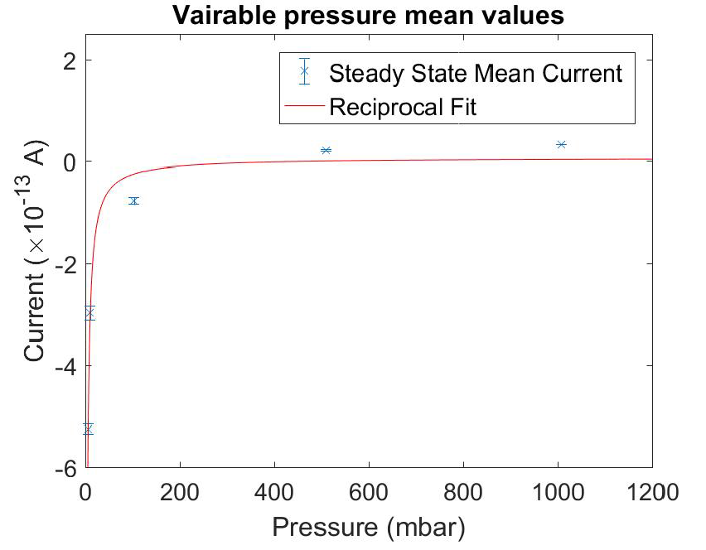
Results 2 bonus
Menu

Slide 25
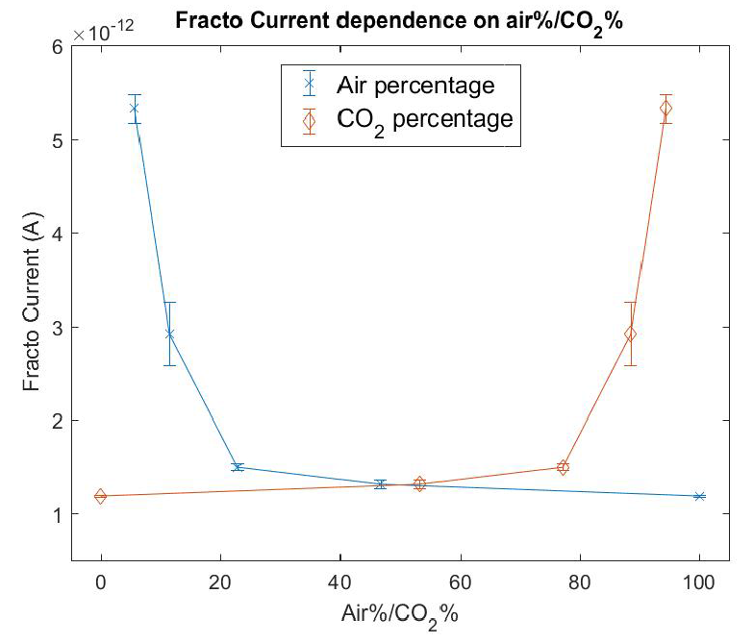
Results 3 bonus
Menu

Slide 26
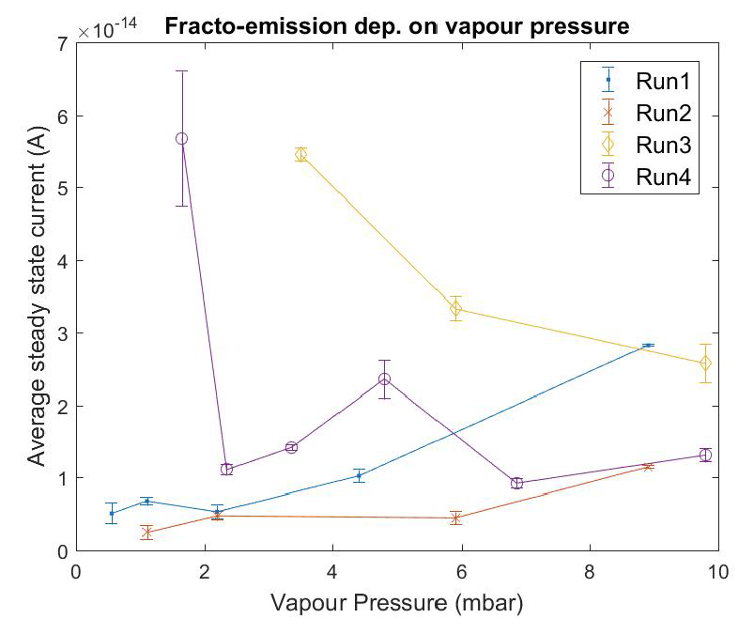
Results 4 bonus
Menu

Slide 27
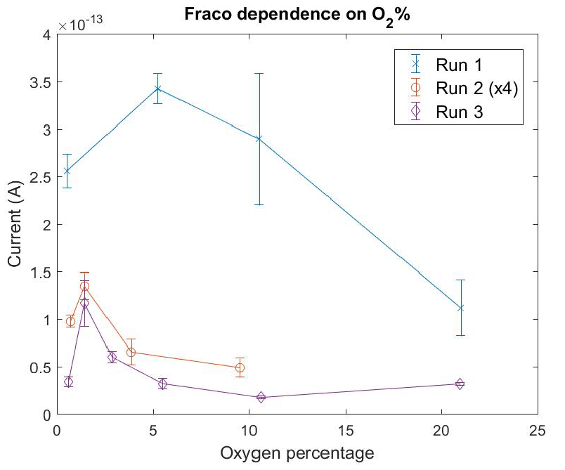
Results 5 bonus
Menu

