Slide 1
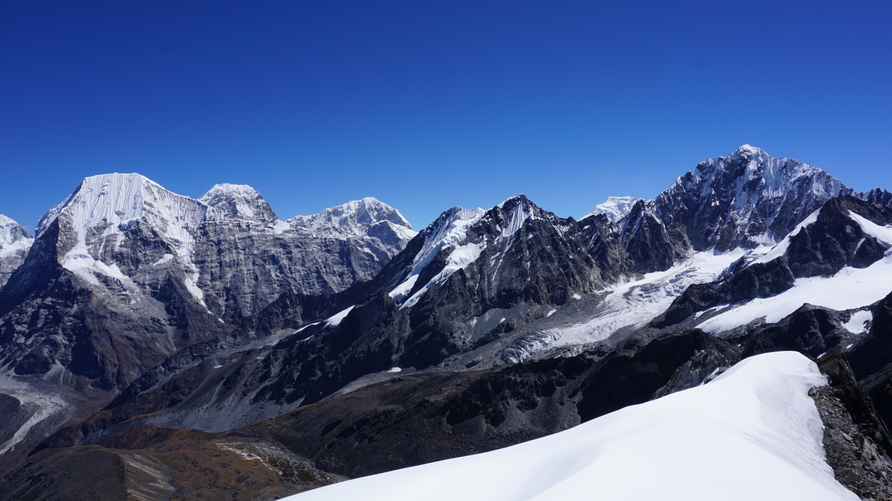
Spatial analysis and statistical modelling of snow cover dynamics in the Central Himalayas, Nepal
Johannes Weidinger¹, Lars Gerlitz², Benjamin Bechtel¹ and Jürgen Böhner¹
¹ Center for Earth System Research and Sustainability, University of Hamburg, Germany
² German Research Centre for Geosciences, Helmholtz Centre Potsdam, Germany
START
Fig. 1: View from Yalun Ri summit (5630 m a.s.l.) in the Rolwaling Himal (Nepal) towards eastern Solu Khumbu region

Slide 2
Structure and content
I. Introduction and study area
This page is the home screen!
START
II. Data base and methodical background
III. Model development and input parameter implementation
HOME
NEXT
IV. Results
V. Model evaluation and discussion
PREV
Navigation:
(Left bar)
…
START
HOME
NEXT
PREV
Brings you back to page 1
Return to this page
Go to the next page
Go to the previous page
Link to further content

Slide 3
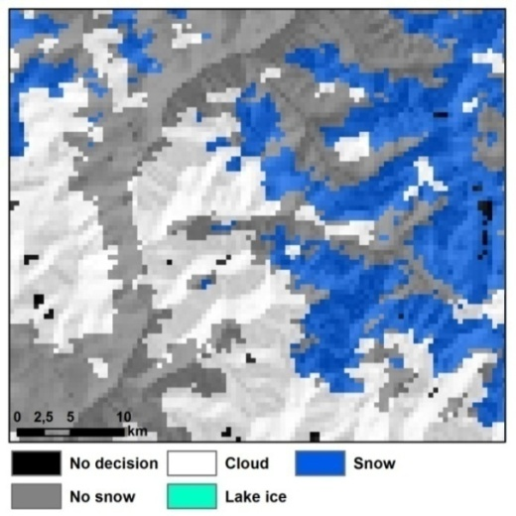
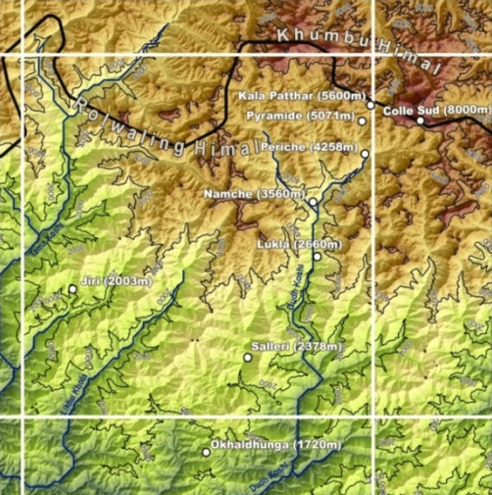
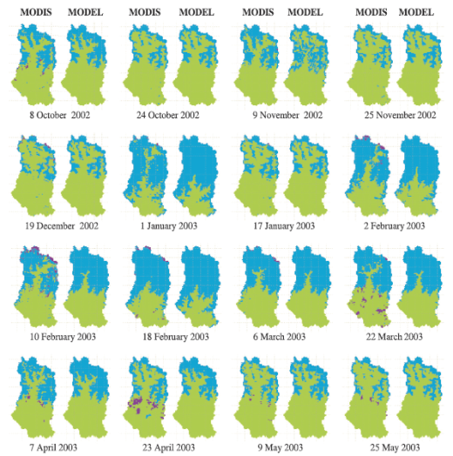
I. Introduction and study area
Scientific necessity – snow cover as important parameter:
- hydrological runoff studies
- snow cover and ecological (plant distribution) modelling
- high resolution “bottom-up” approach in snow cover prediction
Shortcomings of current state of the art techniques and products:
START
HOME
Remote sensing (MODIS)
Reanalysis data (ERA-Interim)
Physical models (top-down)
NEXT
PREV
cloud coverage!
coarse resolution!
temporal resolution!
Cloudy MODIS scene (Weidinger 2016)
ERA-Interim resolution of 0.7° (Gerlitz 2014)
WEB-DHM-S physical model (Shrestha et al. 2012)
I. Introduction

Slide 4
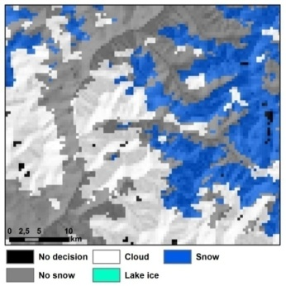
Idea behind the approach:
Development of statistical model on basis of daily MODIS (TERRA) snow cover data:
- statistical modelling of physical processes (solid precipitation, snow melt, sublimation)
- high spatio-temporal resolution (500 x 500 m on a daily basis)
Snow Distribution Model (SDM) and Snow Recession Model (SRM)
Land surface temperatures and TRMM precipitation estimates
Meteorological in situ measurements
Topoclimatic parameters
START
+
+
+
HOME
NEXT
Cloudy MODIS scene
Remote sensing obs.
Point measurements
GIS derived inputs
PREV
I. Introduction

Slide 5
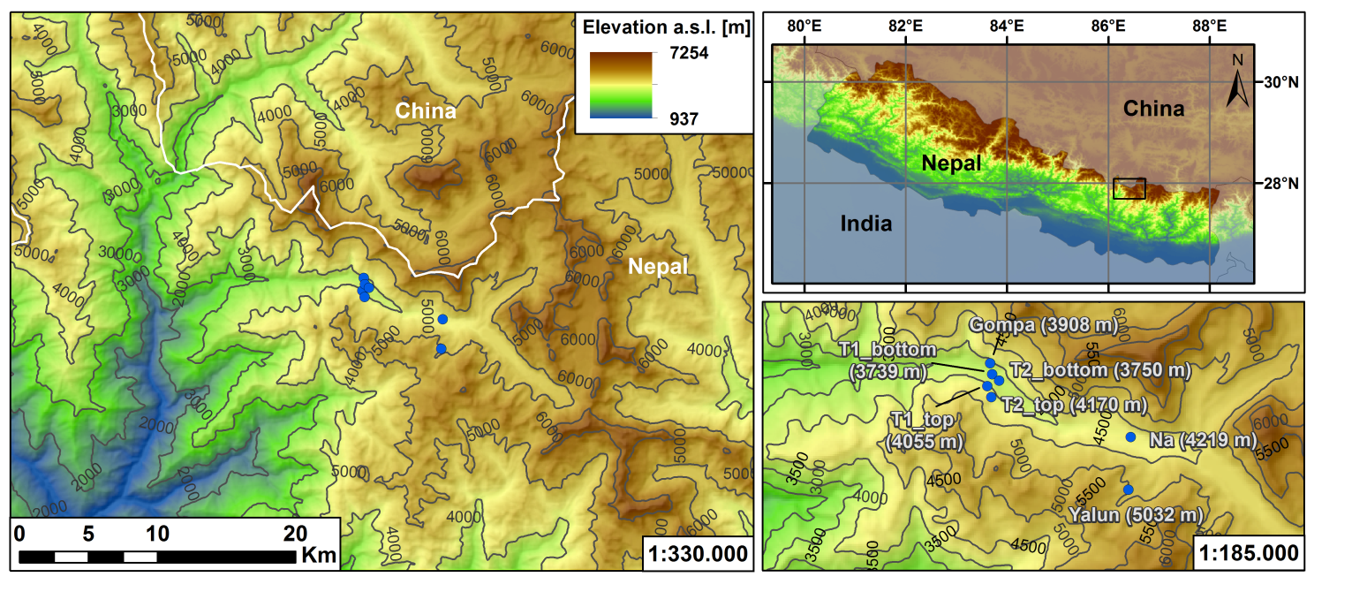
Study area in the Rolwaling Himal
Located in the Gaurishankar Conservation Area (GCA) at the bottom of Mt. Gaurishankar (7134 m a.s.l.)
Between Langtang National Park (East)
and Sagarmatha National Park (Mt. Everest Region West)
START
HOME
NEXT
PREV
7 meteorological weather stations between 3700 and 5100 m a.s.l.:
Gompa
T1 bottom
T2 bottom
Na
Touch to view pictures!
T1 top
T2 top
Yalun
I. Study area

Slide 6
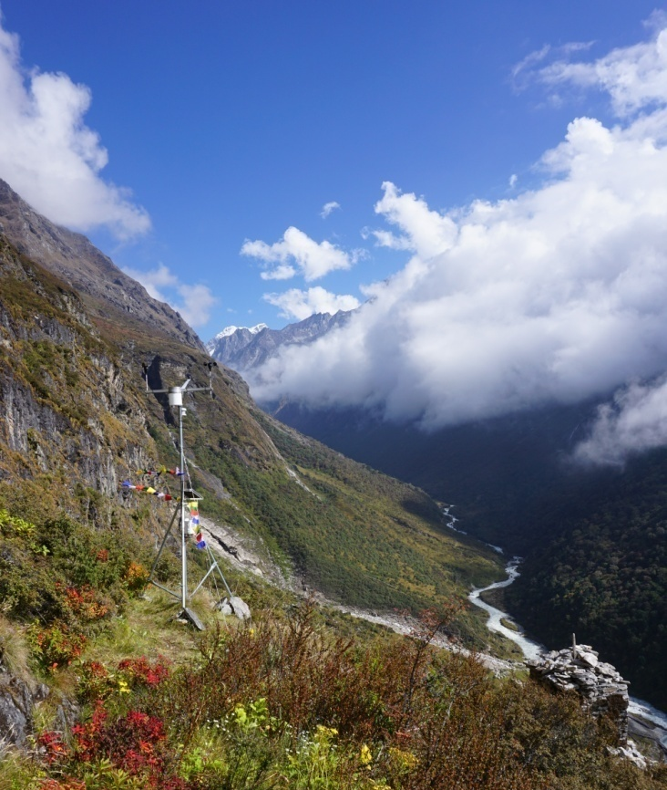
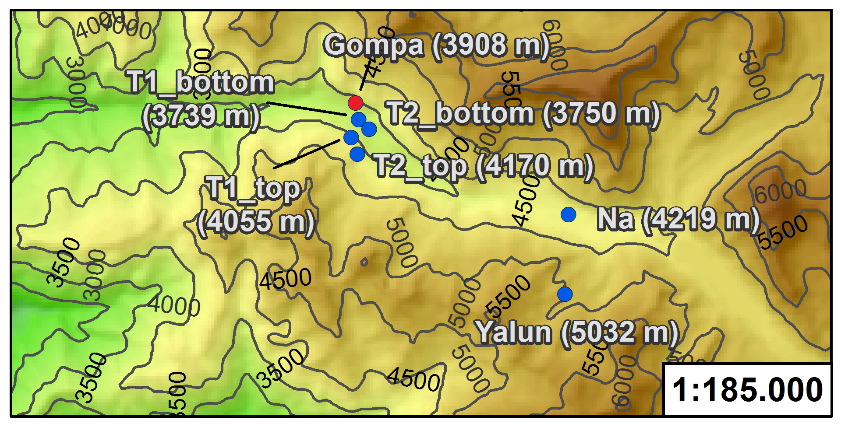
Gompa station at 3908 m a.s.l.
Longitude: 86.375 °E
Latitude: 27.905 °N
Orientation: SSW
Mounted sensors: Air temperature and humidity
Global irradiance
Rain gauge
Wind direction
Wind speed
Show sensors!
START
HOME
NEXT
PREV
I. Study area

Slide 7
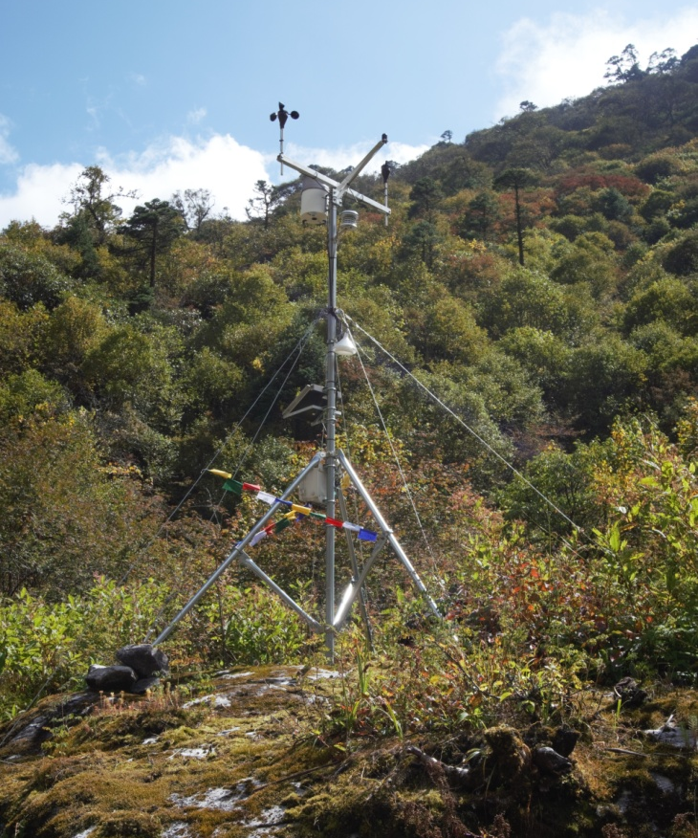
T1 bottom station at 3739 m a.s.l.
Longitude: 86.376 °E
Latitude: 27.901 °N
Orientation: N
Mounted sensors: Air temperature and humidity
Global irradiance
Rain gauge
Wind direction
Wind speed
Show sensors!
START
HOME
NEXT
PREV
I. Study area

Slide 8
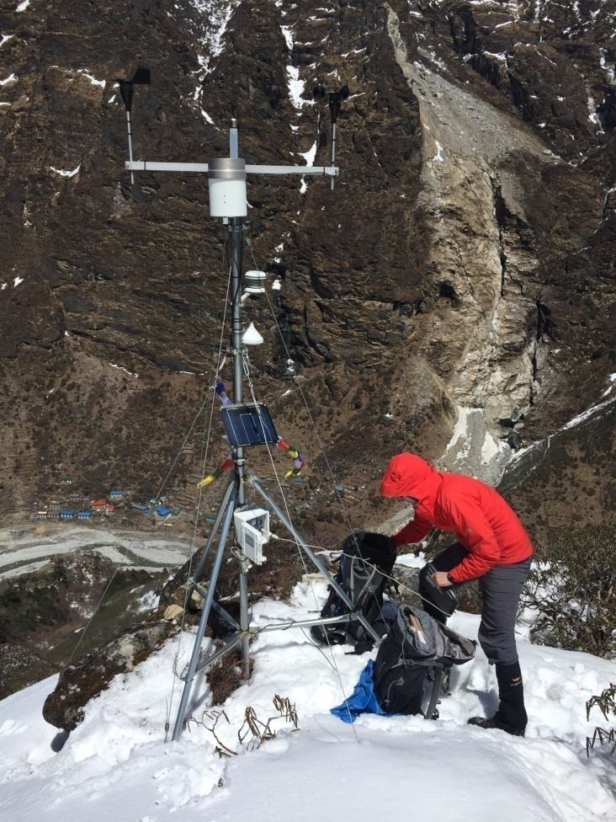
T1 top station at 4055 m a.s.l.
Longitude: 86.374 °E
Latitude: 27.897 °N
Orientation: NE
Mounted sensors: Air temperature and humidity
Global irradiance
Rain gauge
Wind direction
Wind speed
Show sensors!
START
HOME
NEXT
PREV
I. Study area

Slide 9
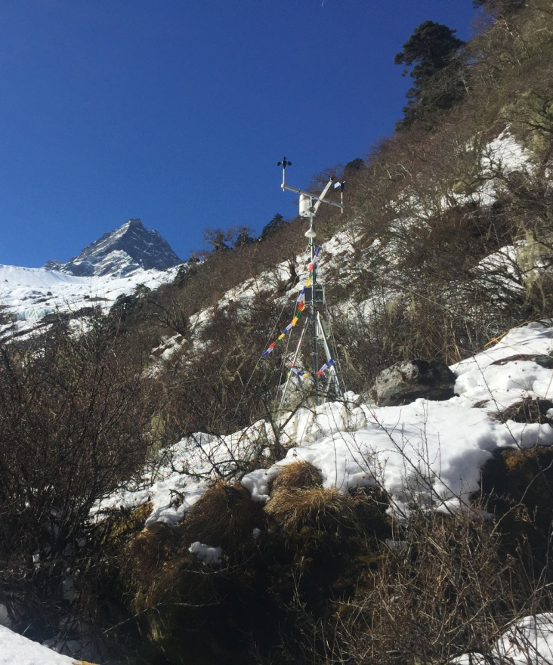
T2 bottom station at 3750 m a.s.l.
Longitude: 86.379 °E
Latitude: 27.899 °N
Orientation: NE
Mounted sensors: Air temperature and humidity
Global irradiance
Rain gauge
Wind direction
Wind speed
Show sensors!
START
HOME
NEXT
PREV
I. Study area

Slide 10
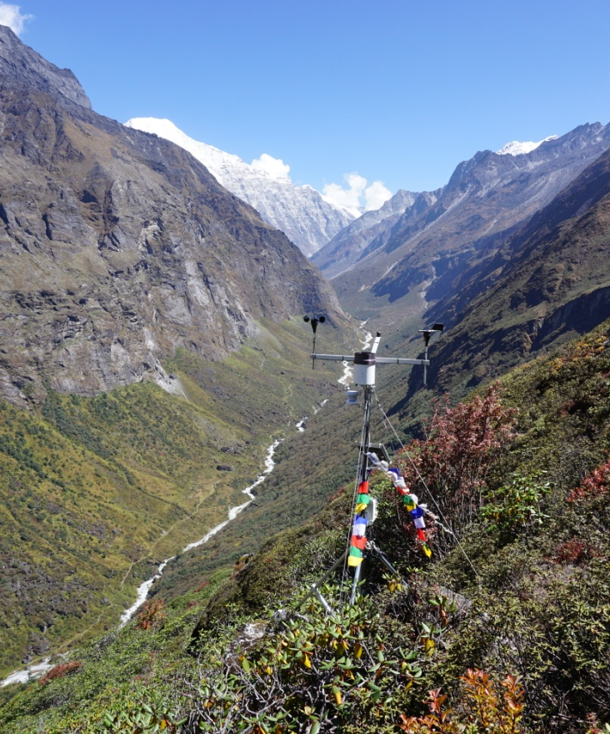
T2 top station at 4170 m a.s.l.
Longitude: 86.375 °E
Latitude: 27.905 °N
Orientation: NE
Mounted sensors: Air temperature and humidity
Global irradiance
Rain gauge
Wind direction
Wind speed
Show sensors!
START
HOME
NEXT
PREV
I. Study area

Slide 11
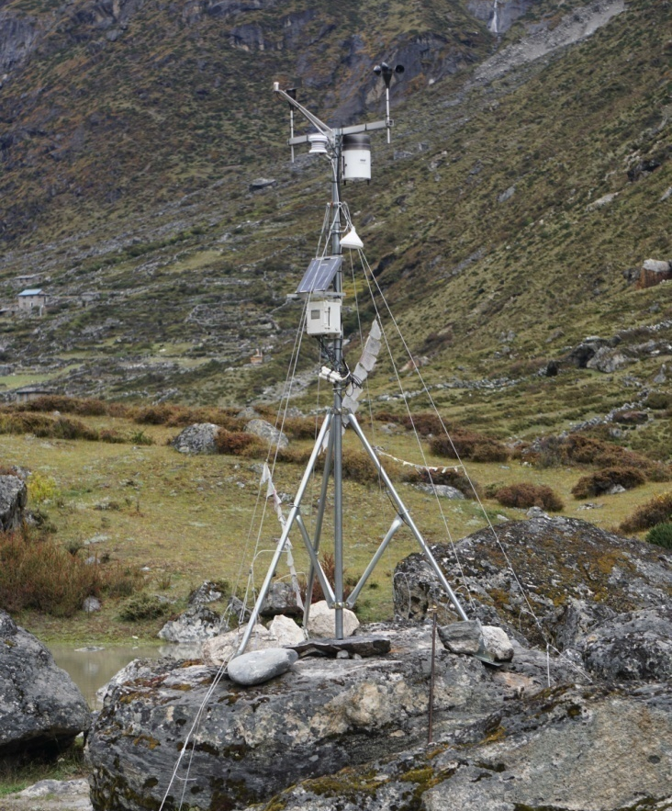
Na station at 4219 m a.s.l.
Longitude: 86.434 °E
Latitude: 27.878 °N
Orientation: SW
Mounted sensors: Air temperature and humidity
Global irradiance
Rain gauge
Wind direction
Wind speed
Show sensors!
START
HOME
NEXT
PREV
I. Study area

Slide 12
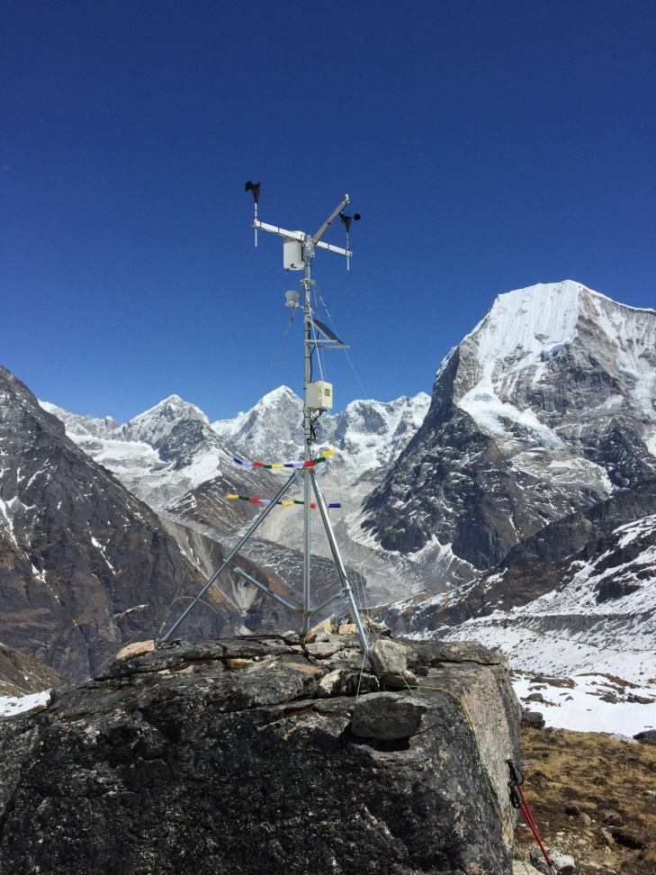
Yalun station at 5032 m a.s.l.
Longitude: 86.434 °E
Latitude: 27.859 °N
Orientation: NE
Mounted sensors: Air temperature and humidity
Global irradiance
Rain gauge
Wind direction
Wind speed
Show sensors!
START
HOME
NEXT
PREV
I. Study area

Slide 13
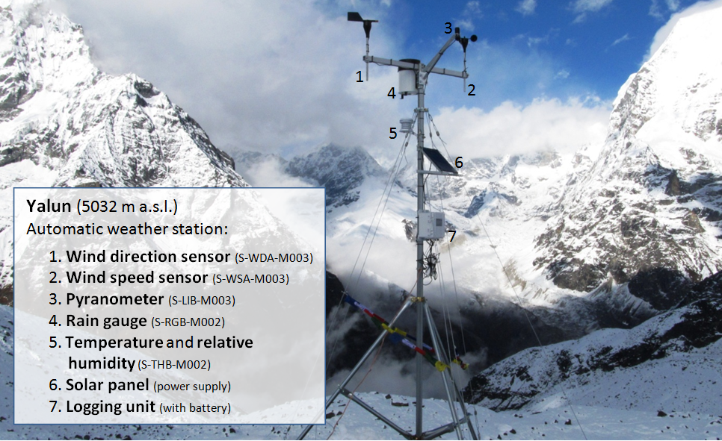
Installed sensors:
START
HOME
NEXT
PREV
Back to station overview!
II. Data base

Slide 14
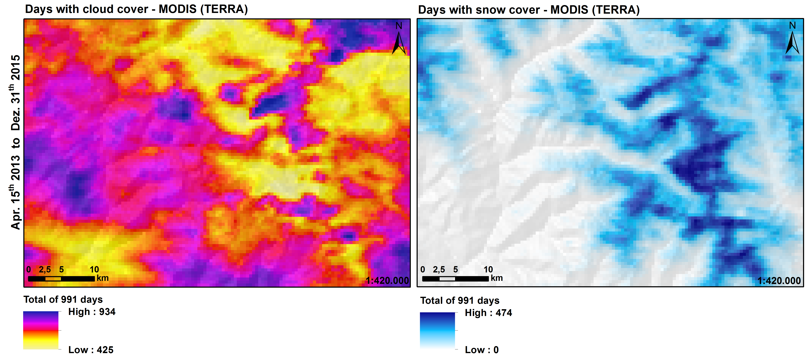
II. Data base and methodical background
Dominated by monsoonal regime and in windward position high precipitation rates
Seasonally maximum between mid-May until mid-September
High cloud
coverage (left
figure)
High elevated
areas along
N-S ridges with
high snow cover
(right figure)
START
HOME
NEXT
PREV
II. Data base

Slide 15
Installed sensors:
START
HOME
NEXT
PREV
II. Data base

Slide 16
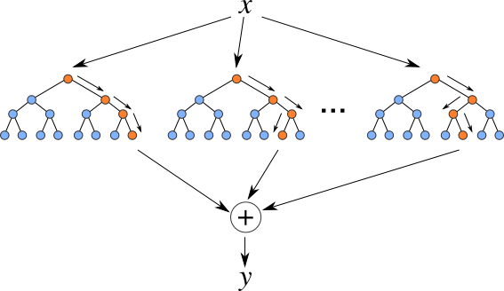
Random forests according to Breimann 2001
Out-of-bag-estimate of error rate (OOB error):
Mean decrease impurity (MDI):
Overall model accuracy (OA):
START
HOME
Formula 1: Out-of-bag-estimate of error rate (OOB error) (Breiman 2001)
NEXT
- Robust to outliers and noise and not overfitting (with a higher tree number)
- Fast and relatively easy to parallelise
- Internal mechanisms of error estimates, strength and variable importance
- One of the “most accurate general-purpose learning techniques available” (Biau 2012: 2)
PREV
Formula 2: Mean decrease impurity (MDI) (Louppe et al. 2013)
Formula 3: Overall model accuracy (OA) (Liaw and Wiener 2002)
II. Data base

Slide 17
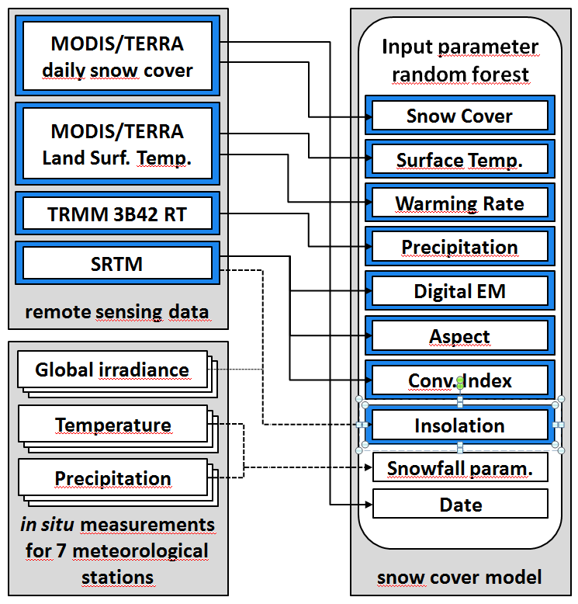
III. Model development and parameter implementation
Remote sensing data on a raster basis adjusted in SAGA GIS and R
Randomised holdout data split for model validation on cell basis (2013 – 2015)
20 % test data
80 % training data
Additionally Jan. - May 2016 data excluded for later evaluation
Cells containing no data in any parameter were excluded
R package ‘randomForest’ by A.Liaw and M.Wiener (2002)
START
HOME
NEXT
PREV
Solar insolation point data regionalized with SAGA GIS and R
III. Model implementation

Slide 18
IV. Results for intern model validation
Statistics calculated using the 20 % test data with the generated models out of 80 % training data
SDM - Snow Distribution Model
Results show high overall accuracy, hit rates and Cohen’s Kappa
SRM - Snow Recession Model
Little lower overall accuracy, hit rates (snow loss) and Cohen’s Kappa
START
HOME
NEXT
PREV
IV. Results

Slide 19
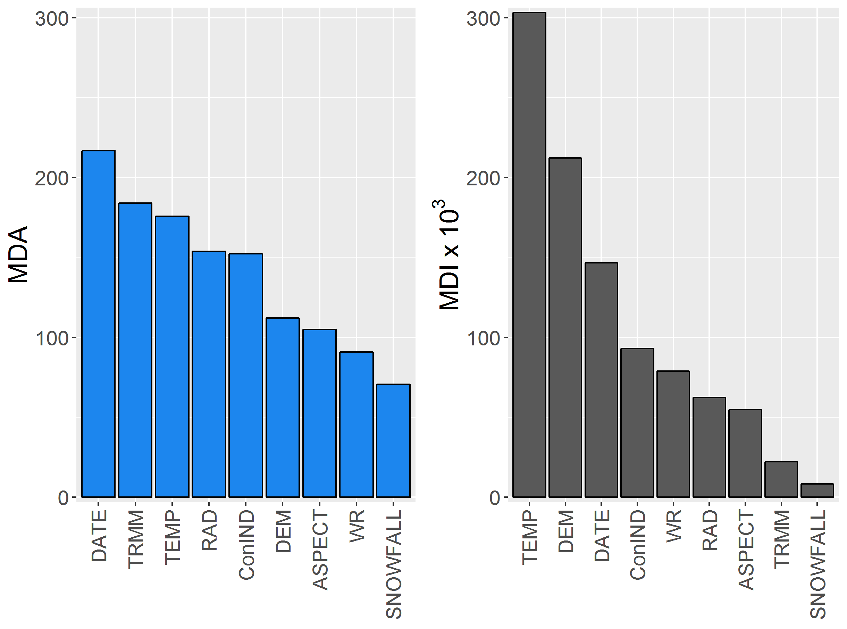
Sensitivity analysis of the SDM
Variable importance - MDAs
Seasonality parameter (DATE),
Precipitation estimates (TRMM),
Land surface Temperatures (TEMP)
and Solar insolation (RAD)
Ability to lower node impurity – MDI
Land surface Temperatures (TEMP),
Digital Elevation Model (DEM) and
the Seasonality parameter (DATE)
START
HOME
NEXT
PREV
IV. Results

Slide 20
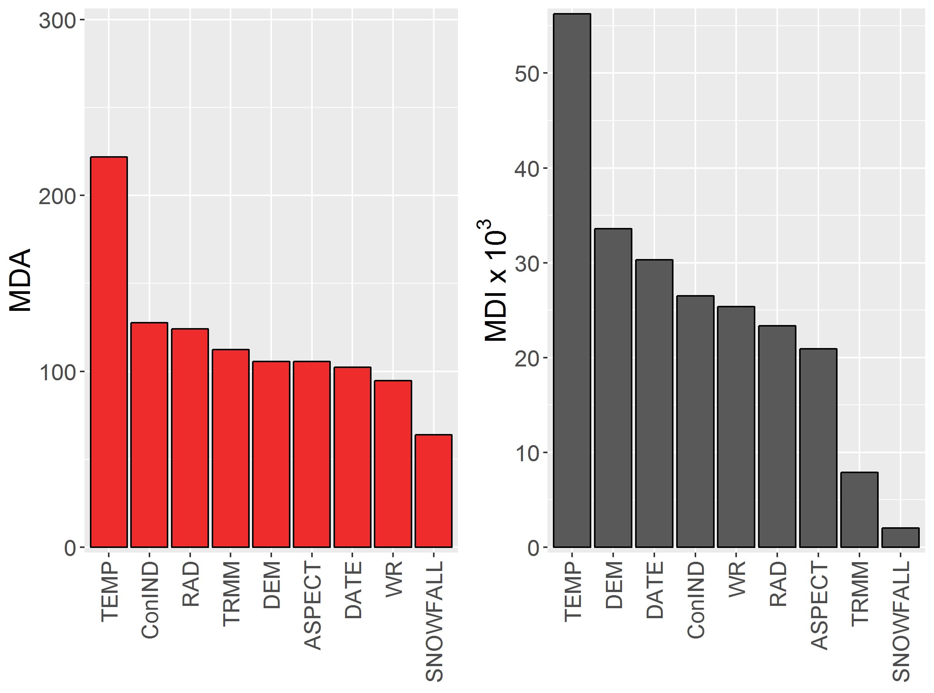
Sensitivity analysis of the SRM
Variable importance - MDAs
Land surface Temperatures (TEMP),
Vertical Exposition (ConIND)
and Solar insolation (RAD)
Ability to lower node impurity – MDI
Land surface Temperatures (TEMP),
Digital Elevation Model (DEM) and
the Seasonality parameter (DATE)
START
HOME
NEXT
PREV
IV. Results

Slide 21
Modelling results for SDM at clear sky conditions
In accordance with the observation, overall acc. of 89,6 % (Feb. 9th 2016) and 88,9 % (Feb. 10th 2016)
Predicted snow patches are more contiguous
Large changes in snow cover distribution are well represented
SDM is able to fill cloud gaps / sensor saturations feasibly
START
HOME
NEXT
PREV
IV. Results

Slide 22
Modelling results for SRM at clear sky conditions
START
HOME
NEXT
PREV
In accordance with observed snow loss, overall acc. of 77,3 %, overestimation of snow stagnation
SDM is able to predict snow recession feasibly in large parts (more effort for shielded areas, e.g. including lee gradient from peripheral to more central areas)
IV. Results

Slide 23
V. Snow Distribution Model validation for consecutive days
2016
START
HOME
NEXT
PREV
Overall Accuracy (for days with more than 100 cells detected by MODIS)
Cohen’s Kappa
Slightly increasing accuracy towards beginning of the monsoon, higher increment for the Kappa
Several periods with unfavourable atmospheric conditions (almost full observation gaps)
IV. Results

Slide 24
Snow Recession Model validation for consecutive days
2016
START
HOME
NEXT
PREV
Overall Accuracy (for subsequent days with more than 50 cells each detected by MODIS)
Cohen’s Kappa
Compared to SDM lower accuracy and kappa in general, increasing trend towards monsoon
Several periods with unfavourable atmospheric conditions (almost full observation gaps)
IV. Results

Slide 25
Discussion and outlook
Bottom-up approach with random forests provided comparable results to physical top-down snow cover distribution models (with even higher spatio-temporal resolution – 8 day MODIS snow cover composites vs. daily snow cover data in the presented approach)
(90.85 % for SDM to 90.0 % WEB-DHM-S by Shrestha et al. 2012)
computational extensive, statistic robust and alienable(!) method to predict snow cover in the Central Himalaya region
Strong dependencies between spatio-temporal climatic variations, topographic parameters and snow cover dynamics
Monsoon period yet not properly resolved (likewise physical approaches e.g. Shrestha et al. 2012)
Huge potential for further enhancements and applications:
Employing MODIS snow cover data version 6 with NDSI, use combination of TERRA and AQUA plattforms (according to Gao et al. 2010), Apply the same modelling approach to adjacent areas, e.g. Khumbu Himal (EV-K2-CNR) for additional verification, Installation of different sensor for fluid and solid deposition
START
HOME
NEXT
PREV
V. Discussion

