Slide 1
Acceleration and loss of relativistic and ultra-relativistic electrons in the outer Van Allen belt during intense storms: a statistical study.
Christos Katsavrias^{1,2}, Ioannis A. Daglis^{1,2},
Wen Li³, Stavros Dimitrakoudis^{4,1}, Marina Georgiou^{1,2},
and Constantinos Papadimitriou^{5,1}
1. University of Athens, Department of Physics, Athens, Greece
2. National Observatory of Athens, IAASARS, Penteli, Greece
3. Center for Space Physics, Boston University, Massachusetts, USA
4. University of Alberta, Department of Physics, Edmonton, Canada
5. SPARC, Athens, Greece
EGU General Assembly, 25 April 2017, Vienna, Austria.

Slide 2
Outline
Motivation – Goal
Data and analysis
Selected Events and Results
Conclusions
EGU General Assembly, 25 April 2017, Vienna, Austria.

Slide 3
Motivation – Goal
Assess the contribution of various mechanisms to the variability of the outer Radiation Belt (e.g. inward diffusion, in-situ acceleration via wave-particle interactions, precipitation into atmosphere, magnetopause shadowing combined with outward diffusion) .
Investigate the impact of ICMEs and HSSs on the dynamics of relativistic electrons.
EGU General Assembly, 25 April 2017, Vienna, Austria.

Slide 4
Data and Methodology
Electron PSD
The electron PSD distribution is calculated from differential fluxes as a function of fixed adiabatic invariants using the method described by Chen et al., 2005, 2007.
Pc5 waves (2 < f < 7 mHz)
Pc5 wave power is calculated from magnetic field measurements using the method described by Balasis et al., 2013.
Lower-band Chorus waves (0.1f_{e} < f < 0.5f_{e})
Chorus wave power is estimated from the POES measurements of precipitating electron fluxes using the method described by Li et al., 2013.
EGU General Assembly, 25 April 2017, Vienna, Austria.

Slide 5
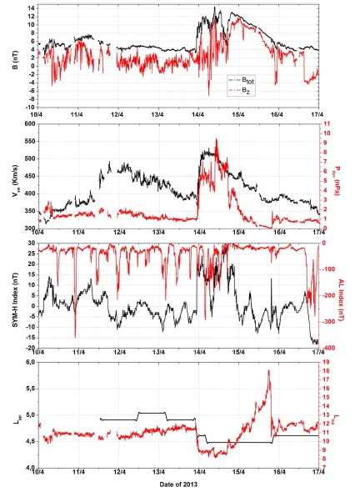
The role of Pc5 waves in electron losses through the magnetopause
Katsavrias et al. GRL2015
Sym-H > 0
L_{mp ~} 8 and L_{pp ~} 4.5
EGU General Assembly, 25 April 2017, Vienna, Austria.

Slide 6
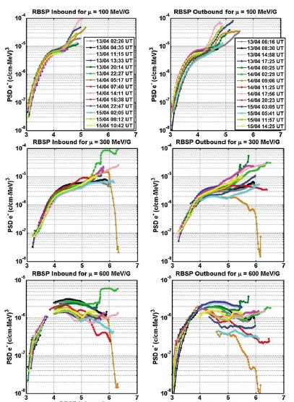
The role of Pc5 waves in electron losses through the magnetopause
Katsavrias et al. GRL2015
Dropout due to MP shadowing
EGU General Assembly, 25 April 2017, Vienna, Austria.

Slide 7
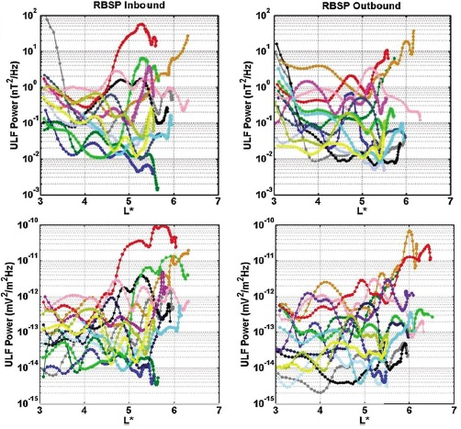
The role of Pc5 waves in electron losses through the magnetopause
Katsavrias et al. GRL2015
Increased Pc5 activity
leeding to outward diffusion
EGU General Assembly, 25 April 2017, Vienna, Austria.

Slide 8
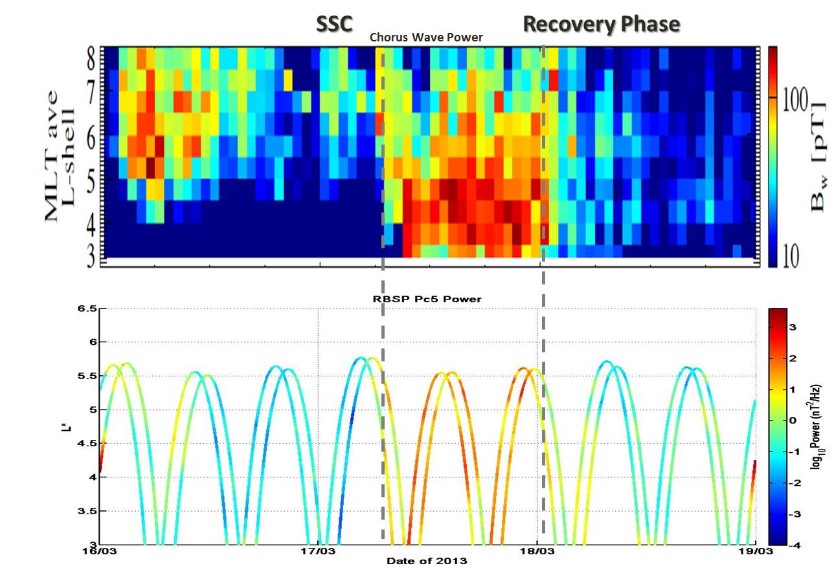
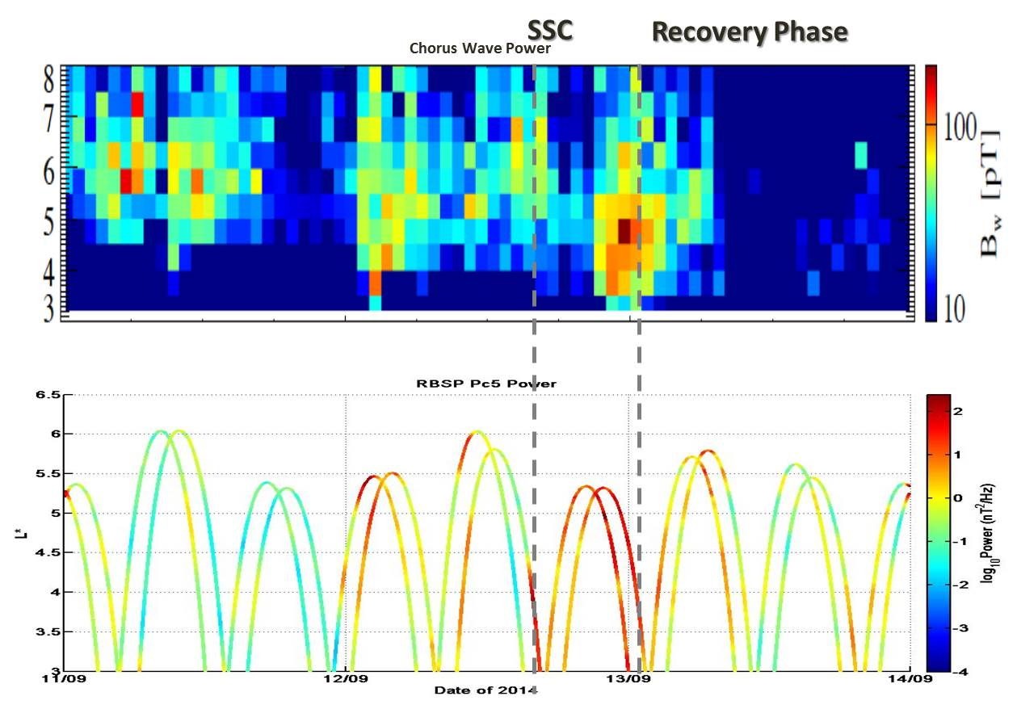
Effects of concurrent Pc5 and Chorus Wave activity
Simultaneous Enhancement of Pc5 and Chorus Activity
Prolonged enhancement of Pc5 without significant Chorus activity
Katsavrias et al. AnnGEO2015
EGU General Assembly, 25 April 2017, Vienna, Austria.

Slide 9
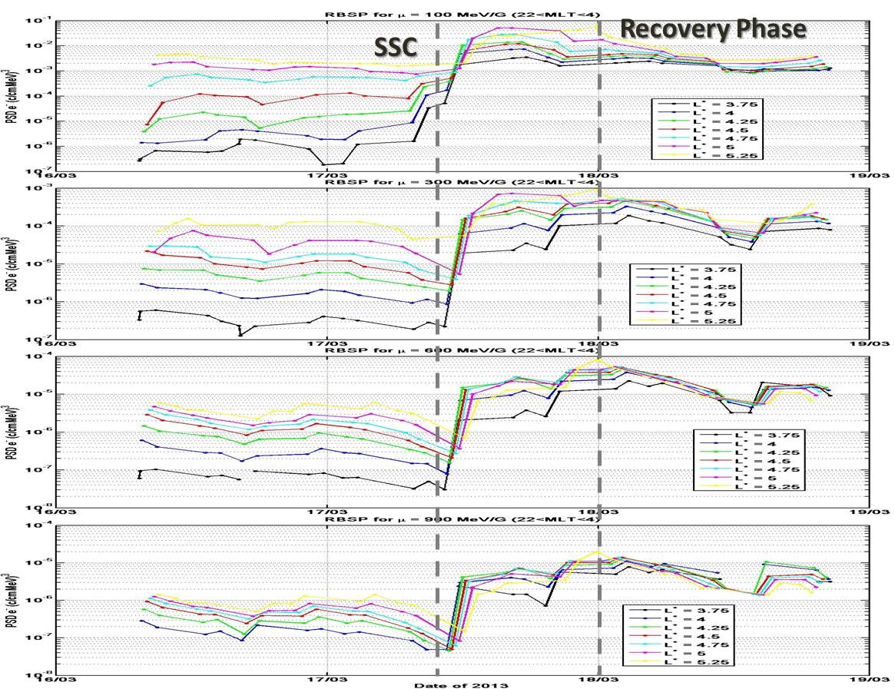
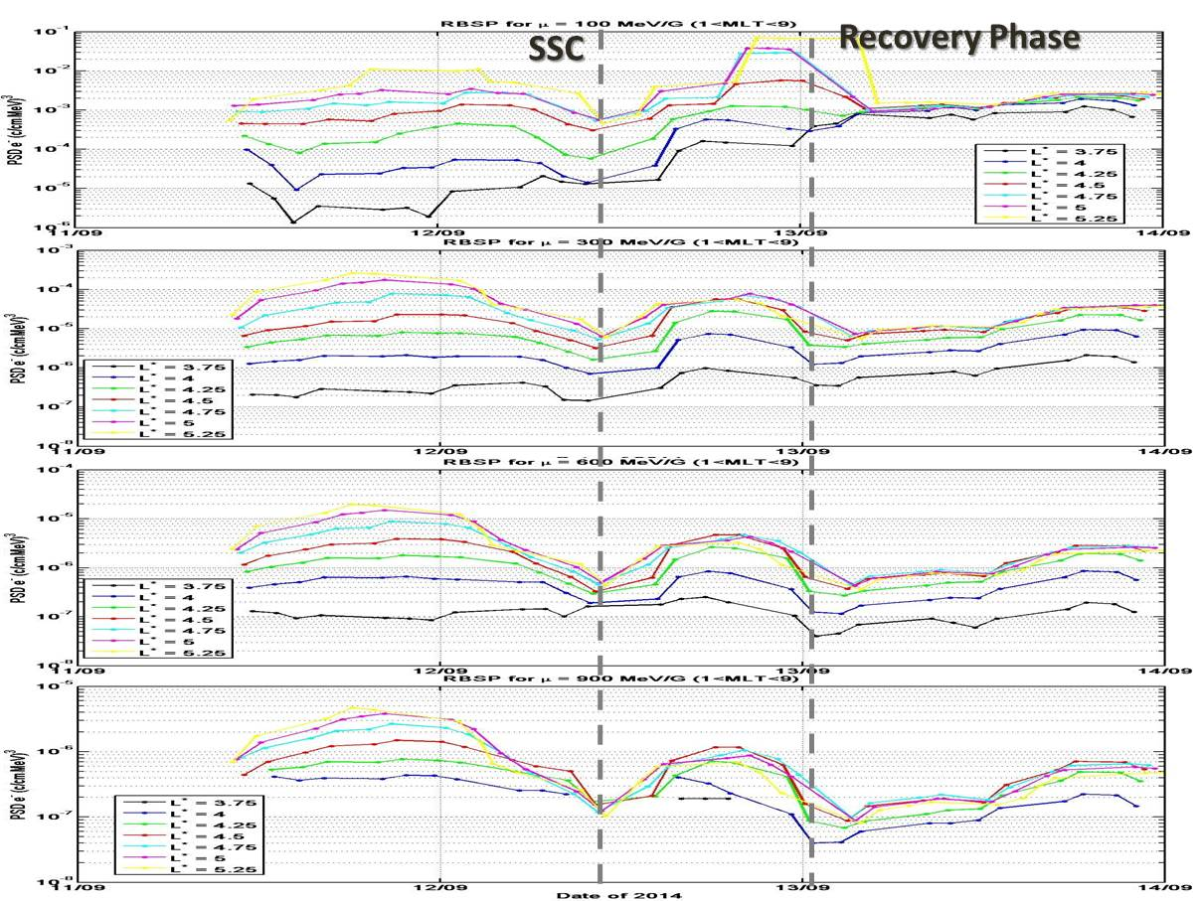
Effects of concurrent Pc5 and Chorus Wave activity
PSD Enhancement
PSD Depletion
Katsavrias et al. AnnGEO2015
EGU General Assembly, 25 April 2017, Vienna, Austria.

Slide 10
Events Statistics
4 HSS
15 Intense Storms
(Sym-H < -100 nT)
11 ICME
8 HSS
61 Storms
26 Moderate Storms
(2013 – 2016)
(-100 nT < Sym-H <-50 nT)
18 ICME
14 HSS
20 Weak Storms
(-50 nT < Sym-H <-30 nT)
6 ICME
EGU General Assembly, 25 April 2017, Vienna, Austria.

Slide 11
Events Statistics
~18% resulted in PSD loss
~73% HSS
~73% Weak Storms
61 Storms
~65% resulted in PSD Increase
~66% ICME
(2013 – 2016)
~17% resulted in
μ- and K-dependent effect
EGU General Assembly, 25 April 2017, Vienna, Austria.

Slide 12
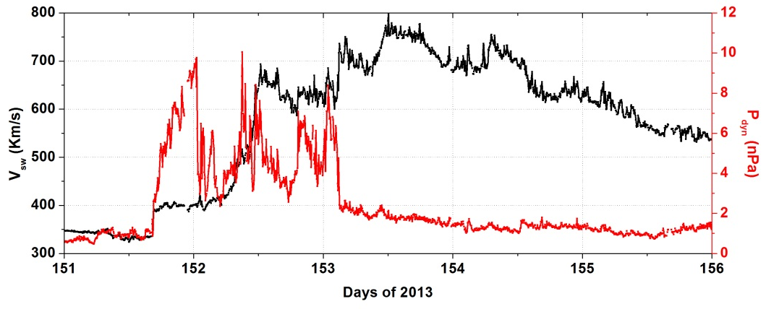
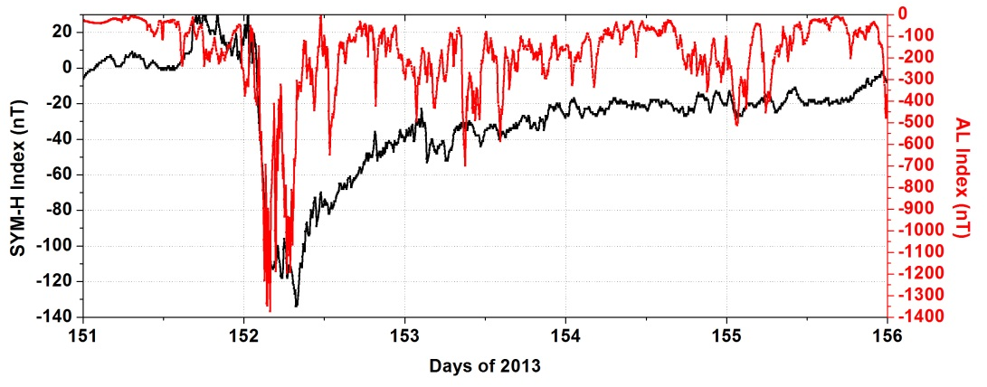
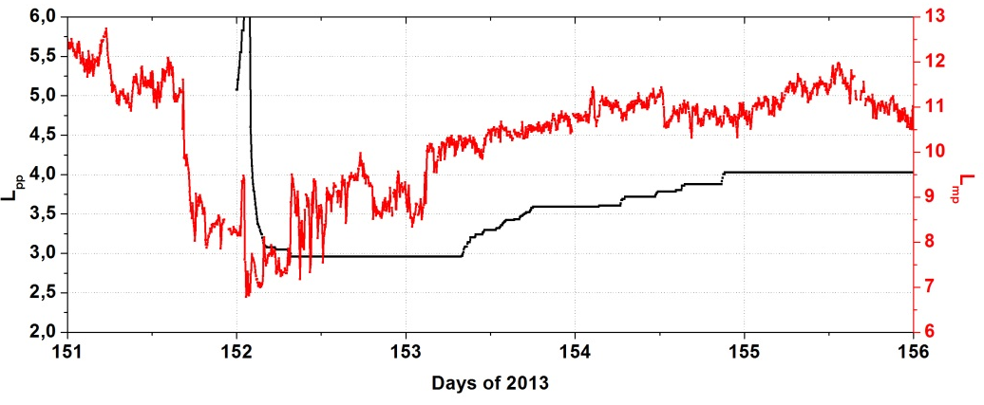
The Interesting Case
of May 30 – June 4, 2013 Event
EGU General Assembly, 25 April 2017, Vienna, Austria.

Slide 13
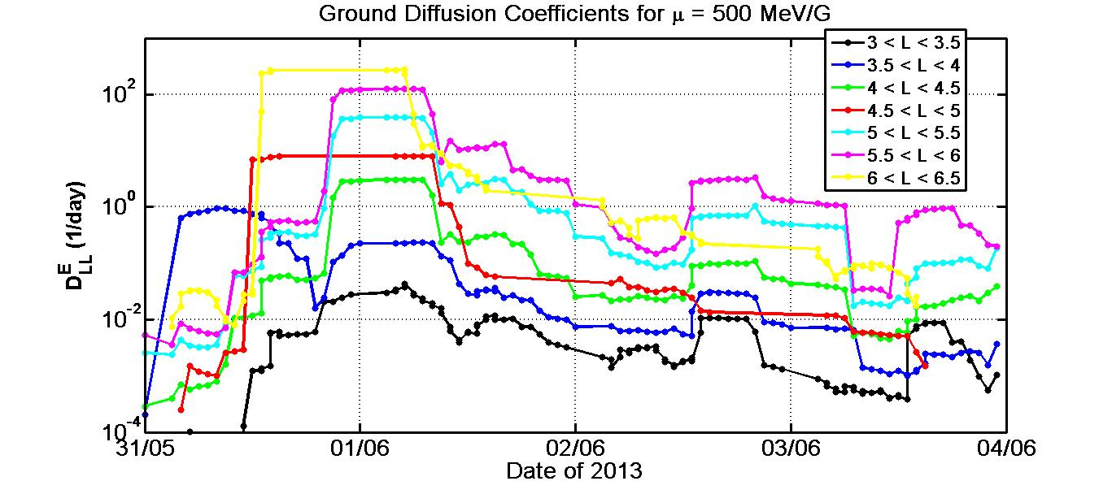
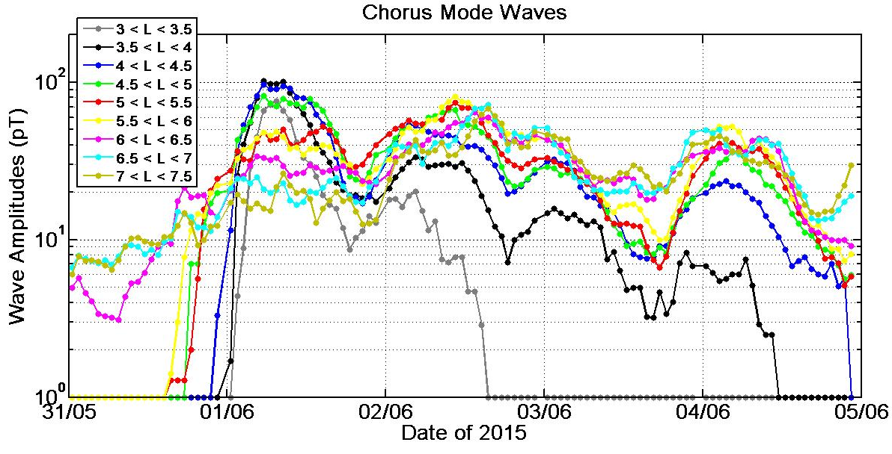
The Interesting Case
of May 30 – June 4, 2013 Event
EGU General Assembly, 25 April 2017, Vienna, Austria.

Slide 14
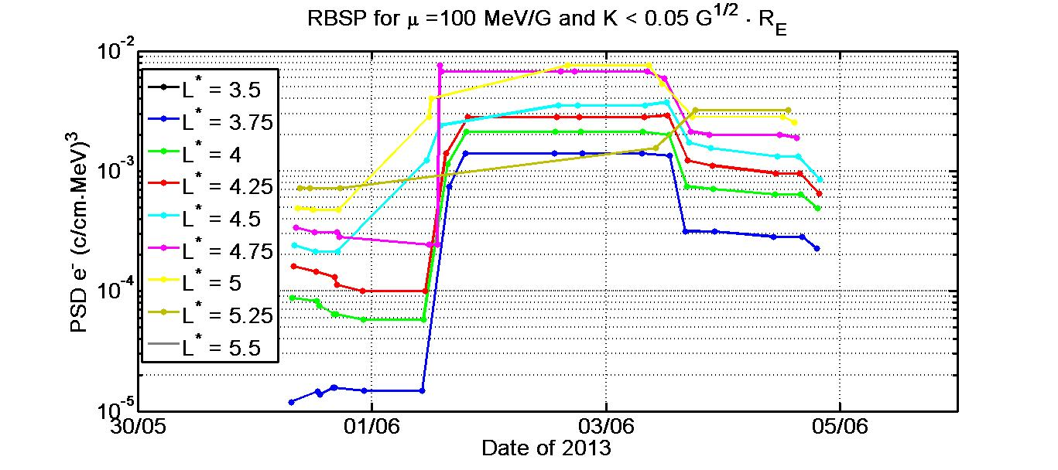
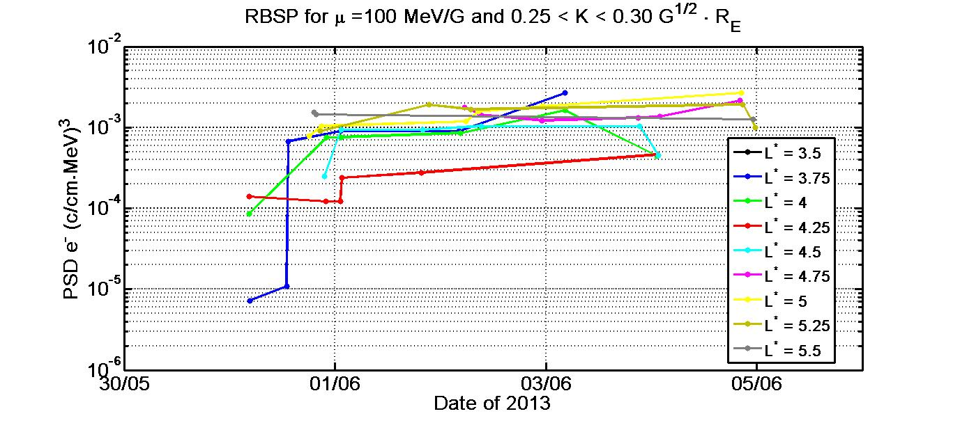
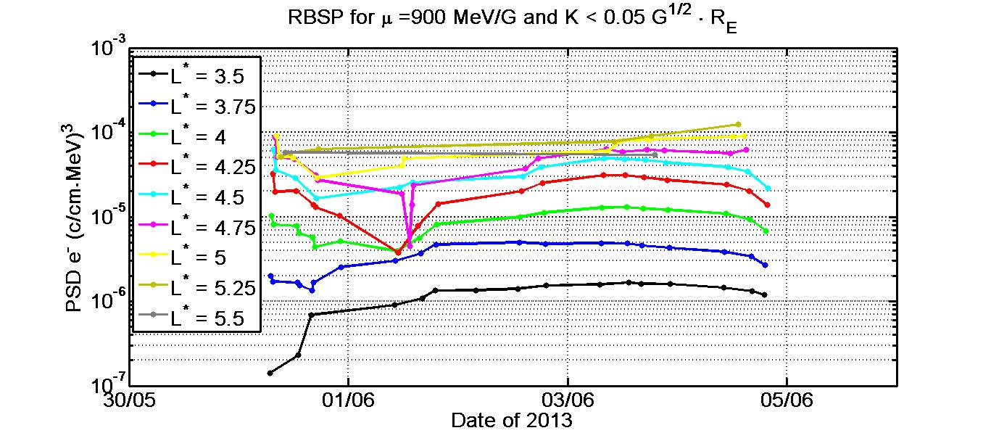
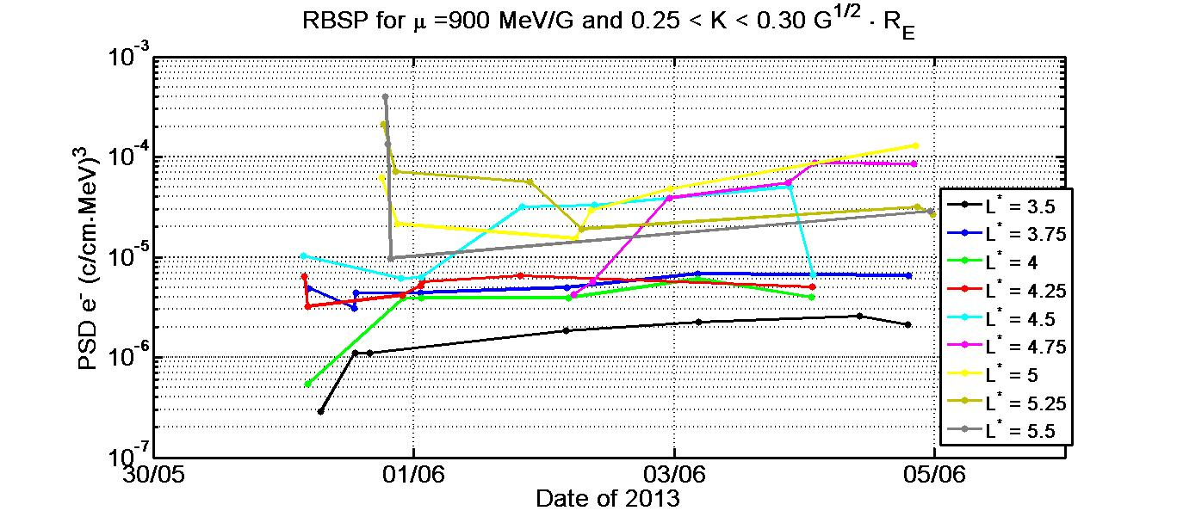
The Interesting Case
of May 30 – June 4, 2013 Event
PSD Enhancement
EGU General Assembly, 25 April 2017, Vienna, Austria.

Slide 15
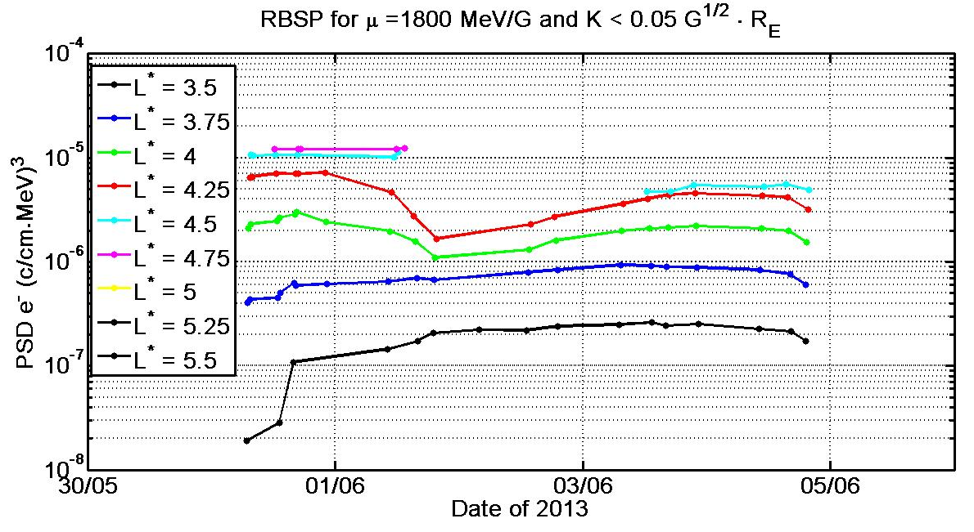
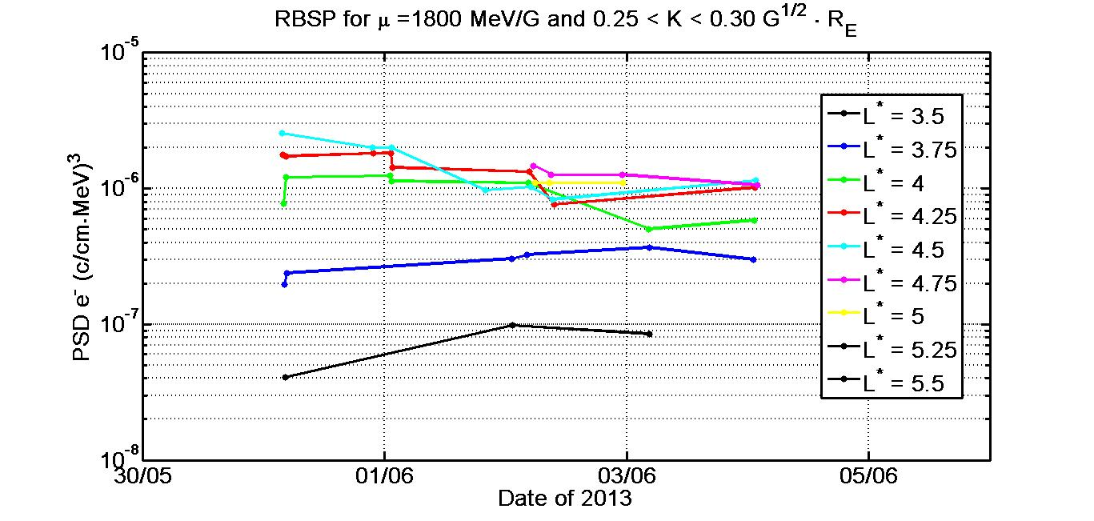
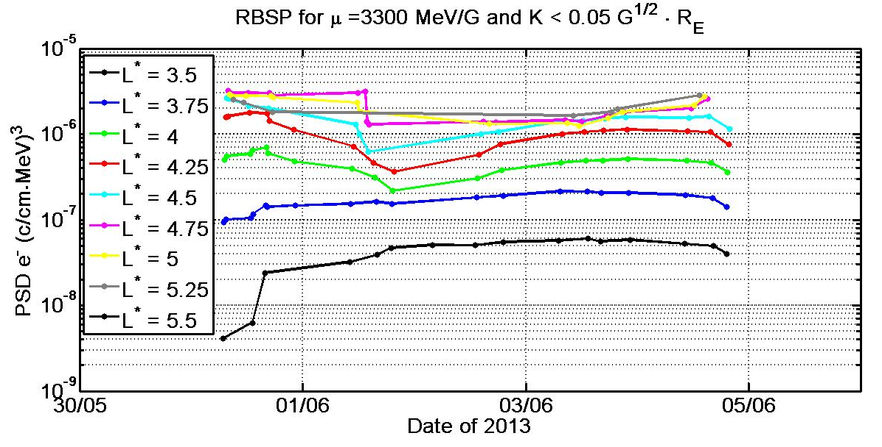
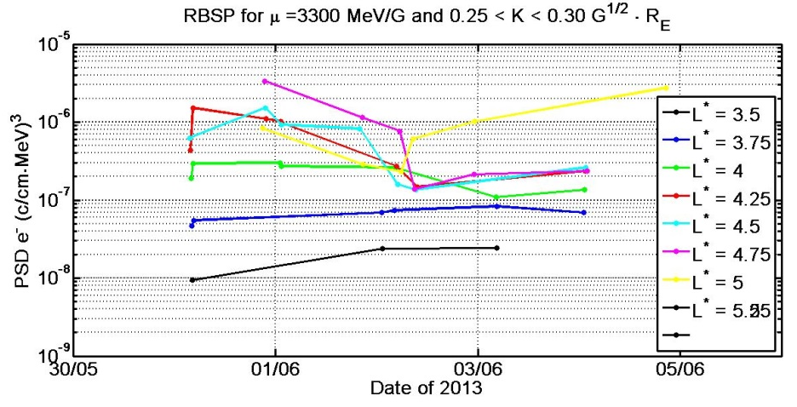
The Interesting Case
of May 30 – June 4, 2013 Event
PSD Depletion
EGU General Assembly, 25 April 2017, Vienna, Austria.

Slide 16
Conclusions
Losses through the magnetopause can occur even for limited compression of the magnetopause due to outward diffusion driven by Pc5 waves. This is a dominant loss mechanism for equatorially mirroring electron.
The comparison of two contradicting events shows that – for similar duration and power – acceleration by chorus waves exceeds outward diffusion driven by Pc5 activity. This occurs for all intense storm events.
EGU General Assembly, 25 April 2017, Vienna, Austria.

Slide 17
Conclusions
From the 61 storm events: 18% resulted in PSD losses (dominated by HSS driven and weak storms), 65% resulted in PSD increase (dominated by ICME driven storms) and 17% had μ- and K-dependent results.
During such events we have increase of the lower μ electron population and decrease of the higher μ electron population with no profound electron precipitation.
EGU General Assembly, 25 April 2017, Vienna, Austria.

Slide 18
Conclusions
In ~85% of events, Poloidal and Toroidal mode waves are well correlated with the AL index and thus the substorm activity.
On the other hand, Compressional mode waves are well correlated with Sym-H index and solar wind pressure.
EGU General Assembly, 25 April 2017, Vienna, Austria.

Slide 19
Thank you for your Attention
EGU General Assembly, 25 April 2017, Vienna, Austria.

