Slide 1
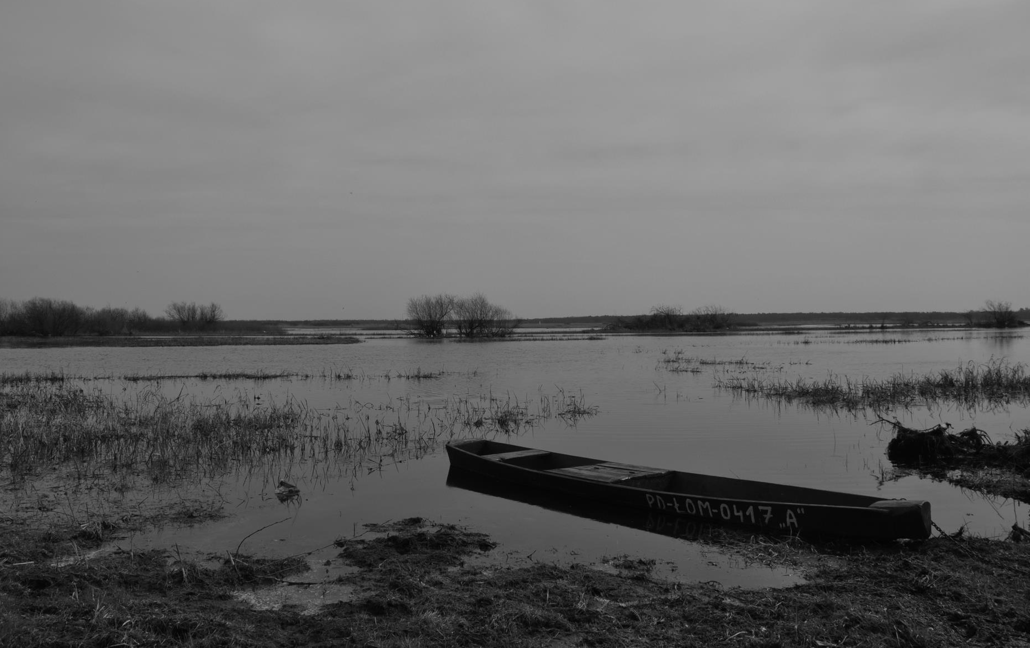
Revisiting the Flood Pulse Concept: How peatland hydrology influences spatial vegetation community distributions in a natural floodplain
Floris Keizer, Paul Schot, Ignacy Kardel, Jarek Chormański, Tomasz Okruszko, Martin Wassen – 26 April 2017
Utrecht University (NL), Warsaw University of Life Sciences (PL)
Photo: Biebrza Floodplain, Gea van der Lee, 2014

Slide 2
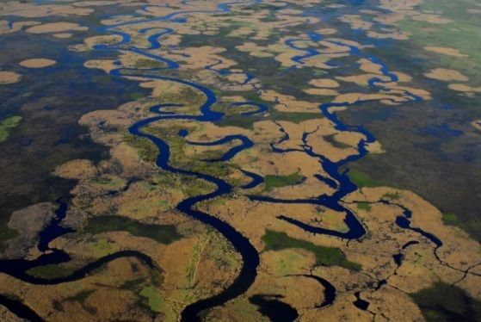
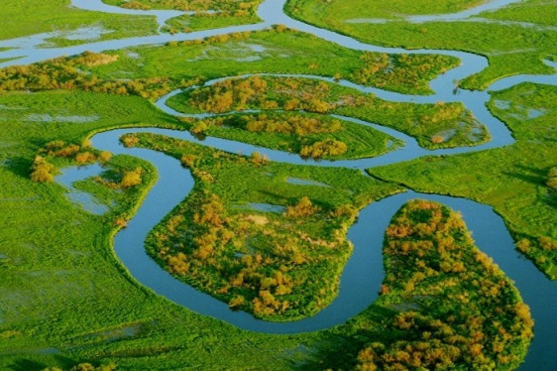
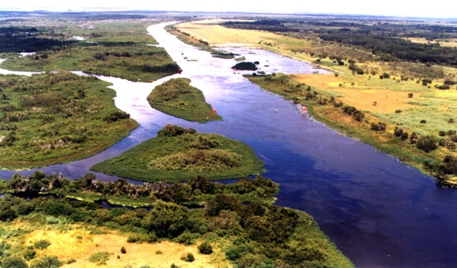
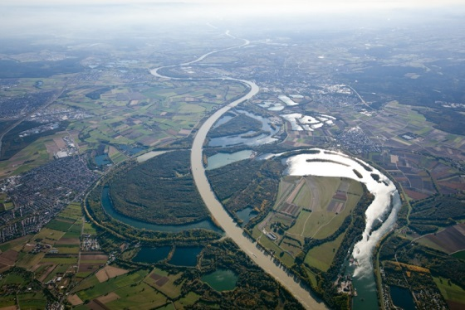
Introduction
Lowland River Floodplains
Dynamics: 90% North-American and European floodplains functionally extinct
(Yearly) inundation
Eco-hydrological relations
Notes:
In this talk, I would like to take you to lowland river floodplains. Because they are located in heavily populated areas, globally most of them can no longer perform their natural function. In US and EU > 90% is virtually extinct. This means that hydrology is altered at a scale that ecohydrological relations at the landscape scale are broken.
In lowland floodplains in the temperate zone, we often find peat deposits (examples from NL, B, D, PL, RUS, US, CAN, Japan, China). These peat deposits have developed over thousands of years under influence of the landscape hydrological setting. Surface water – groundwater interactions are often one part of this setting. As the landscape is heterogeneous, these interactions have a spatial component, which is also reflected in spatial patterns in vegetation communities over these floodplains.

Slide 3
Flood Pulse Concept Predicts…
Introduction
Junk et al., 1989

Slide 4
While…
Introduction
Carici-Agrostietum caninae (C. diandra)
Phragmitetum communis
Chormański et al., 2011; Beumer et al., 2008; Mertes et al., 1997

Slide 5
Study area
Study Area
Natural floodplain NE Poland (± 450 km²)
Yearly flood after snowmelt
Peat deposits
Keizer et al., 2014

Slide 6
Introduction
Hypothesis 1
H1: Interacting hydrological flow processes lead to spatial patterns in inundation water quality.

Slide 7
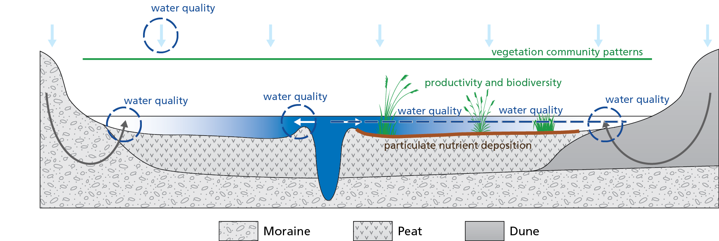
Methodology
Water Quality
1154 water samples (2001-2012)
Water sources: river, rain, groundwater (dune, moraine)
Analysis for EC, pH, Ca²⁺, Mg²⁺, Na⁺, K⁺, Cl⁻, SO₄²⁻, NO₃⁻, NH₄⁺, PO₄³⁻
Notes:
We collected samples of the inundation water during flood stage in the years 2001-2012, totalling 1154 samples covering the entire flooding. Samples were filtered and analysed for water quality parameters.
To relate the inundation water to known water sources, we collected samples of precipitation water, river water upstream of the floodplain stretch and groundwater discharging from the local dunes and the regional moraine plateau. For these samples, the same water quality parameters were analysed if available.

Slide 8
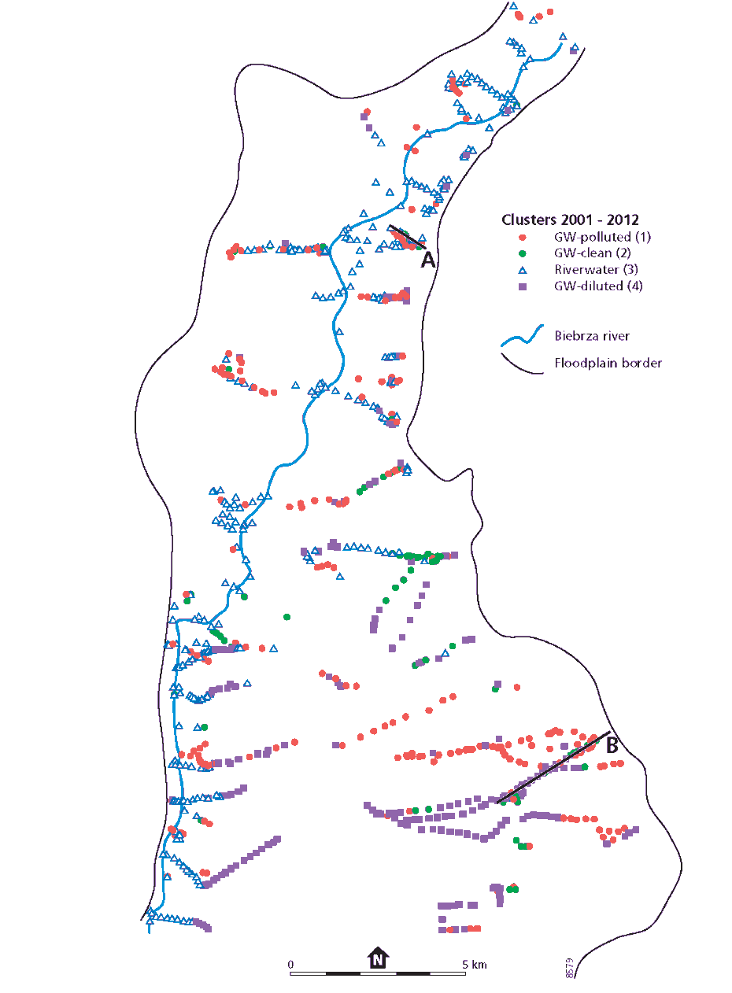
Results
Inundation Water Types
 | 1 | 2 | 3 | 4
n | 290 | 227 | 401 | 236
pH
Ca
Mg
Na
K
Cl
NO₃
NH₄
PO₄
SO₄
Keizer et al., 2014
Notes:
Using the water quality of the flood water AND water sources AND the spatial location on the floodplain, we interpreted the four clusters as belonging to
GW polluted
GW clean
RIVER water
GW dilluted

Slide 9
Introduction
Hypothesis 2
H2: Hot spots of suspended river sediment deposition (high particulate nutrient input) correlate to floodplain productivity and biodiversity.

Slide 10
Methodology
Particulate Nutrient Deposition
Sediment deposition in 3 transects (n=18)
Analysis for nutrients N and P
Loads kg ha⁻¹ year⁻¹ calculated
Notes:
We collected samples of the inundation water during flood stage in the years 2001-2012, totalling 1154 samples covering the entire flooding. Samples were filtered and analysed for water quality parameters.
To relate the inundation water to known water sources, we collected samples of precipitation water, river water upstream of the floodplain stretch and groundwater discharging from the local dunes and the regional moraine plateau. For these samples, the same water quality parameters were analysed if available.

Slide 11
Results
High Nutrient Input
 | Hydrology |  | Sediment |  | Water Quality
 | Elevation | Water Depth | P deposition | N deposition | TDN | PO₄-P
River Distance | 0.80 | -0.67 | -0.75 | -0.65 | -0.73 | -0.20
Elevation |  | -0.87 | -0.62 | -0.56 | -0.82 | -0.01
Water Depth |  |  | 0.70 | 0.71 | 0.75 | -0.00
Notes:
Sediment deposition and TDN decrease towards the edge > spatial pattern in contrast to FPC.
PO4 no clear pattern.

Slide 12
Methodology
Vegetation
Aboveground biomass vascular species
Species richness
Notes:
We collected samples of the inundation water during flood stage in the years 2001-2012, totalling 1154 samples covering the entire flooding. Samples were filtered and analysed for water quality parameters.
To relate the inundation water to known water sources, we collected samples of precipitation water, river water upstream of the floodplain stretch and groundwater discharging from the local dunes and the regional moraine plateau. For these samples, the same water quality parameters were analysed if available.

Slide 13
Results
Vegetation
 | Hydrology |  |  | Sediment Deposition |  | Water Quality
 | River Distance | Elevation | Water Depth | P | N | TDN | PO₄-P
Aboveground Biomass | -0.52 | -0.46 | 0.59 | 0.65 | 0.69 | 0.41 | 0.37
Species Richness | 0.40 | 0.83 | -0.70 | -0.45 | -0.41 | -0.58 | -0.47
Notes:
Biomass decreases with distance from river but most strong correlation with sediment deposition (input N and P). In contrast to FPC: not edge of inundation. No relation with TDN and PO4: not edge of river derived nutrient input.
Unfortunately not relatoin biodiversity……..

Slide 14
Results
Nutrient Input
Particulate
Dissolved
Notes:
Yes relation with particulate nutrients: refinement needed for temperate floodplains where inundation water is not only derived from the river.

Slide 15
Discussion
Lessons
Interacting hydrological flow processes
Spatial pattern in water quality
Zones of inundation, river water and high sedimentation do not coincide
Productivity best predicted by particulate nutrients
Flood Pulse Concept needs refinement for temperate rivers with multiple sources of inundation water

Slide 16
Conclusions
Take home message
Spatial partitioning of multiple sources of inundation water influences hydrological processes, sedimentation rates and composition, and vegetation patterns

Slide 17
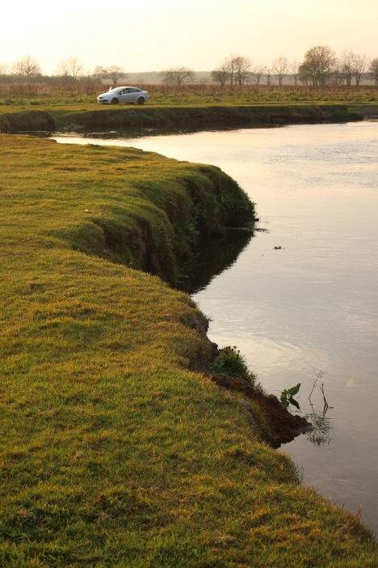
Floris M. Keizer
Environmental Sciences,
Copernicus Institute of Sustainable Development,
Universiteit Utrecht
f.m.keizer@uu.nl
Keizer et al. (2013) A new look at the Flood Pulse Concept: the (ir)relevance of the moving littoral in temporate zone rivers. Ecological Engineering 64: 85-99.
Keizer et al. (2016) Landscape-scale ecohydrological mapping demonstrating how flood inundation water quality types relate to floodplain vegetation communities. Ecohydrology 9(8): 1539-1553.
Keizer et al. (in prep for Landscape Ecology) Floodplain plant productivity is better predicted by particulate nutrients than by dissolved nutrients.

Slide 18
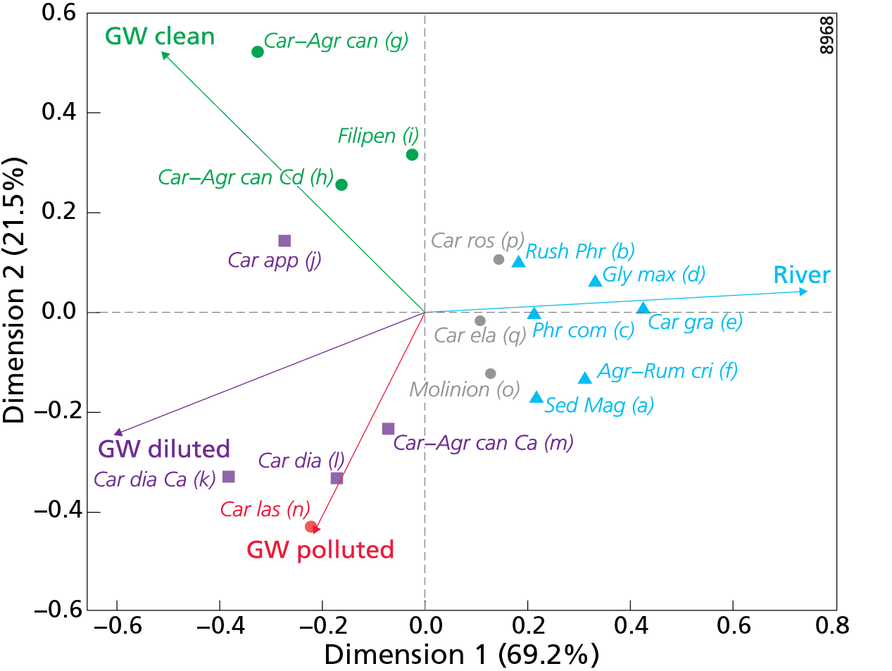
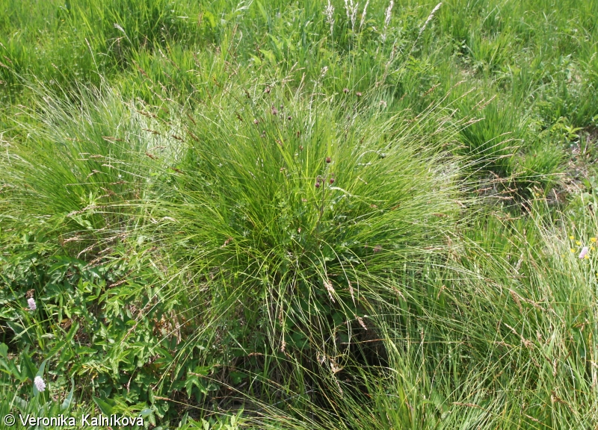
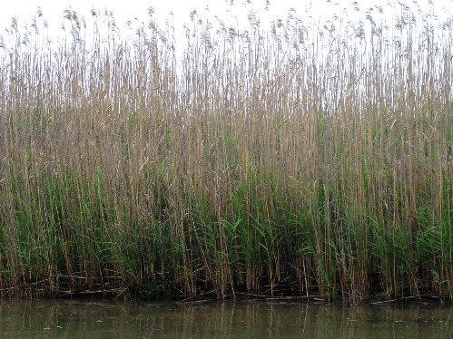
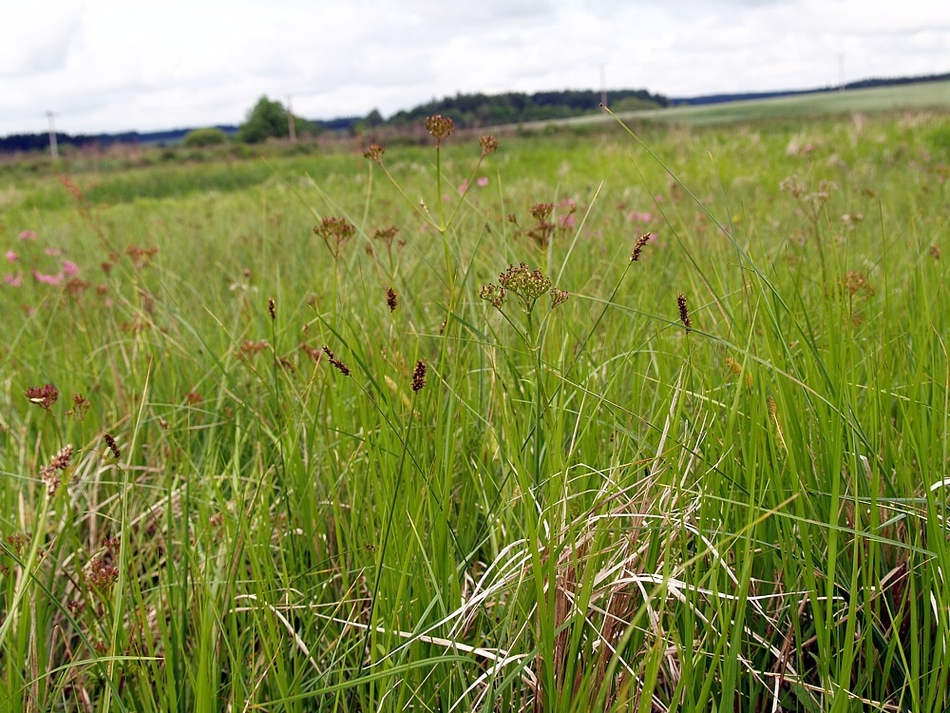
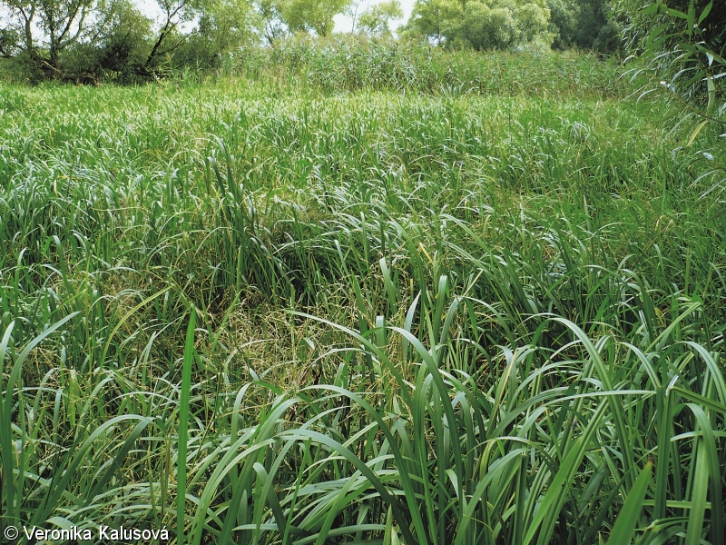
Results
Water Quality Preference
Keizer et al., 2016

