Slide 1

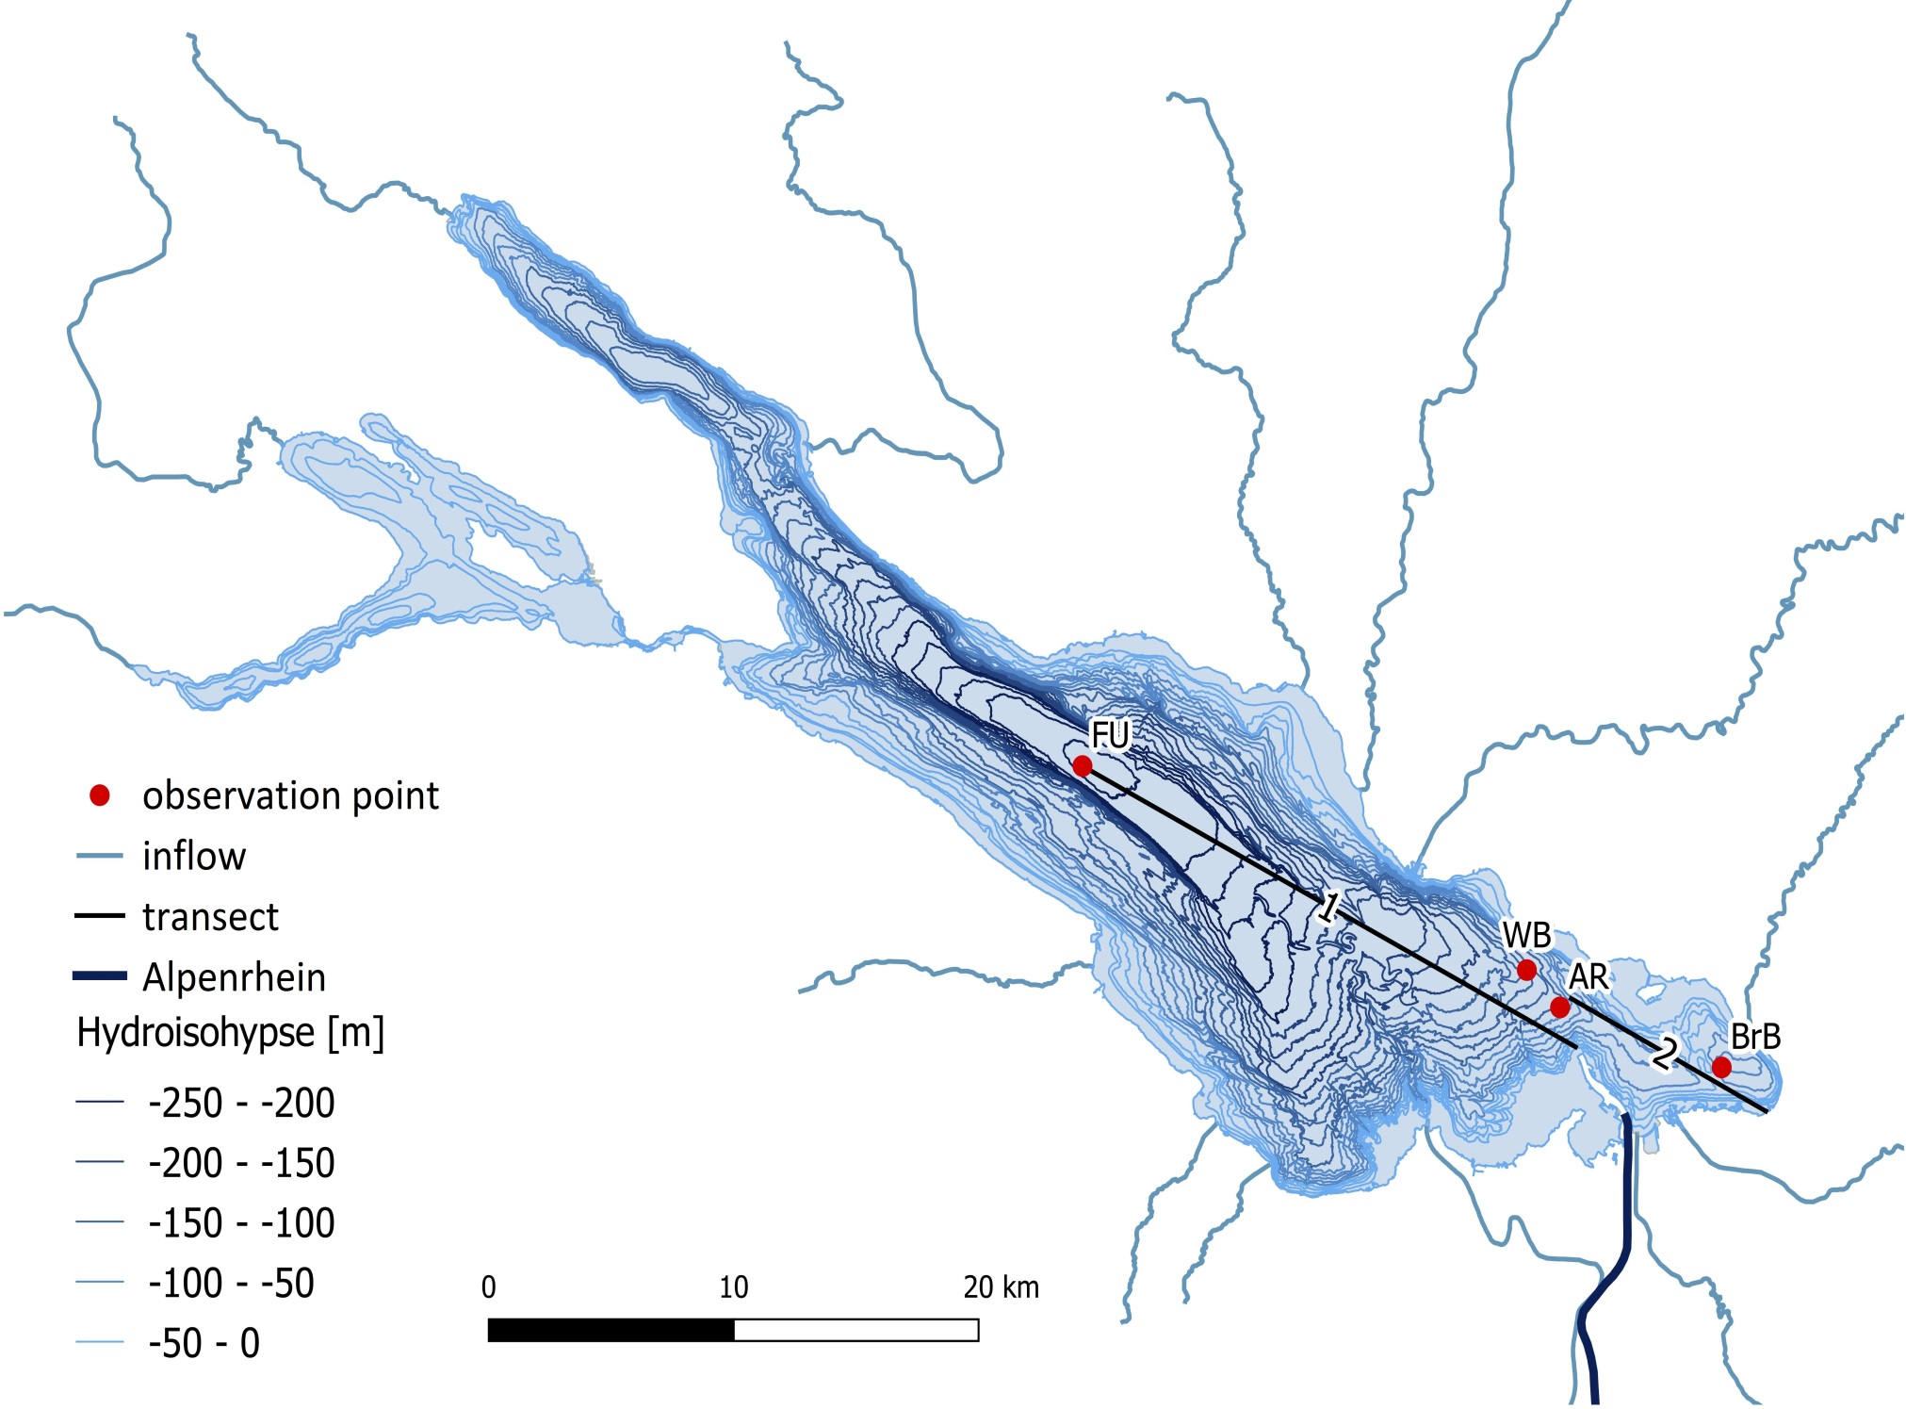
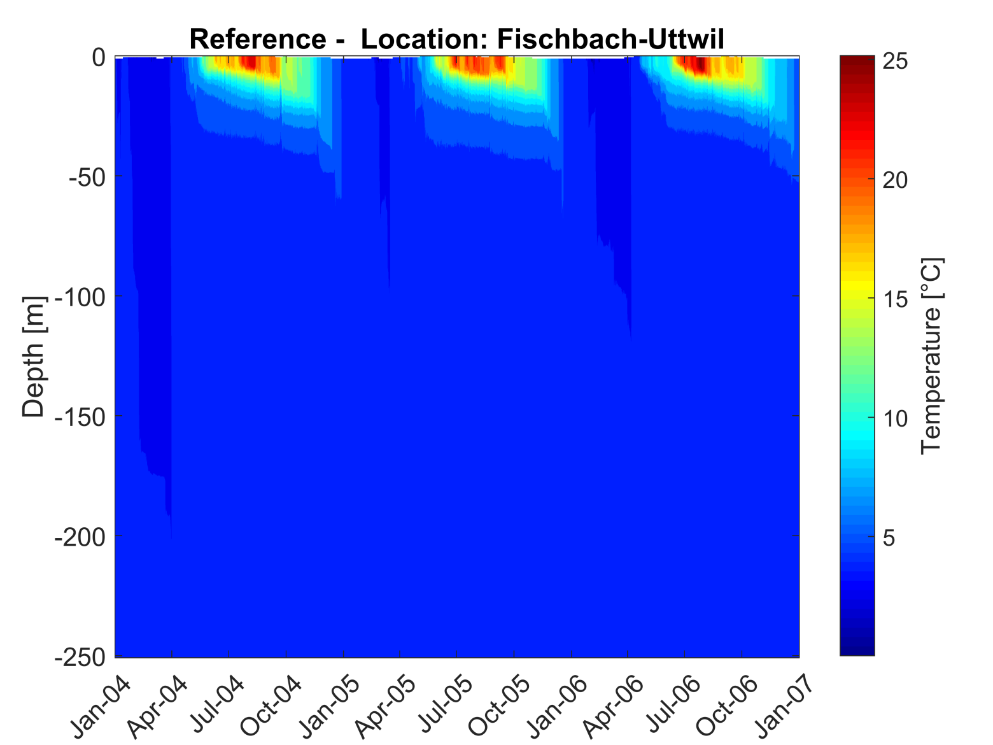
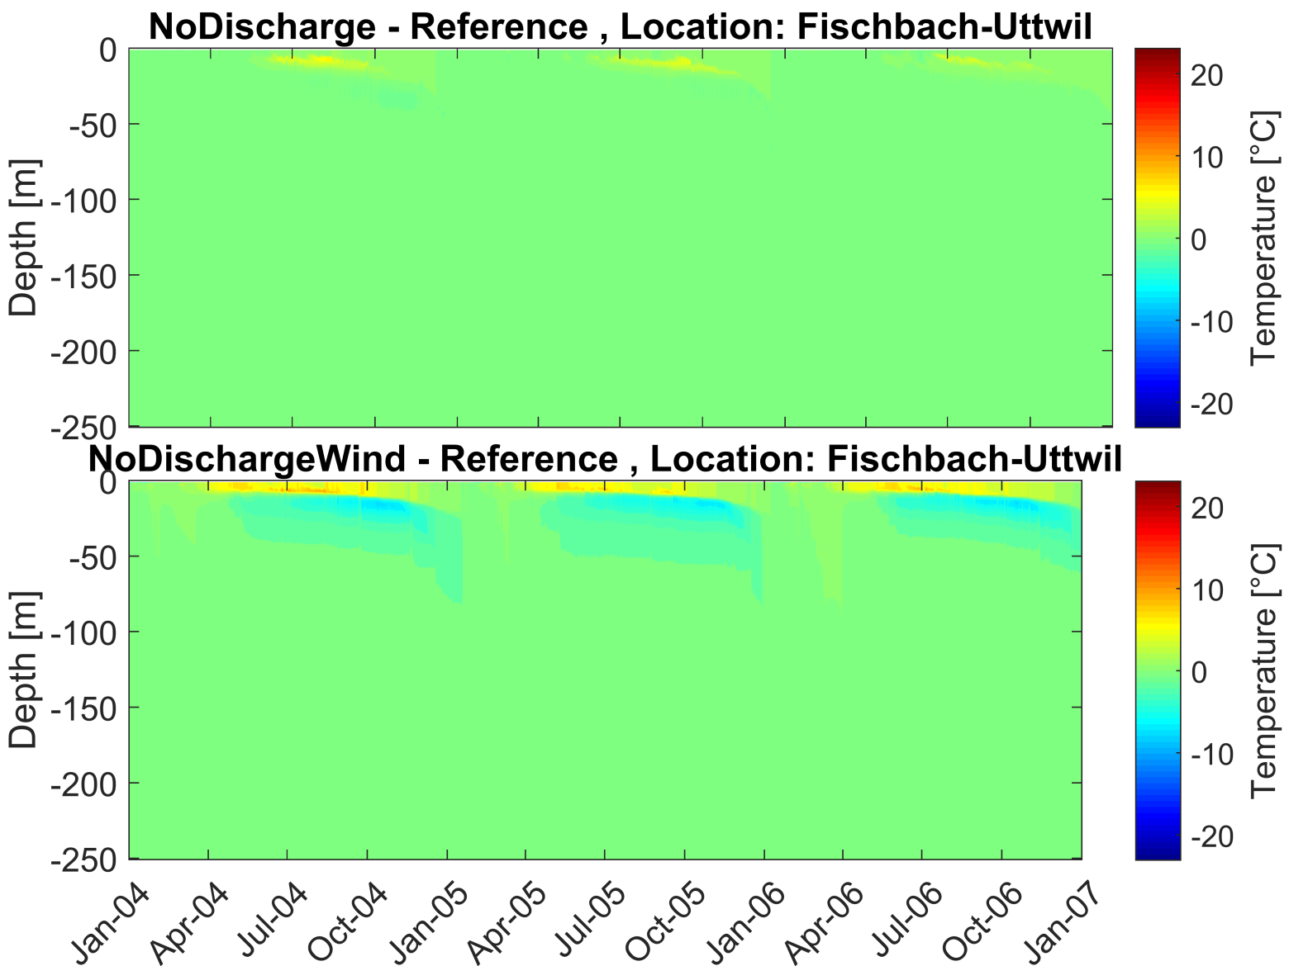
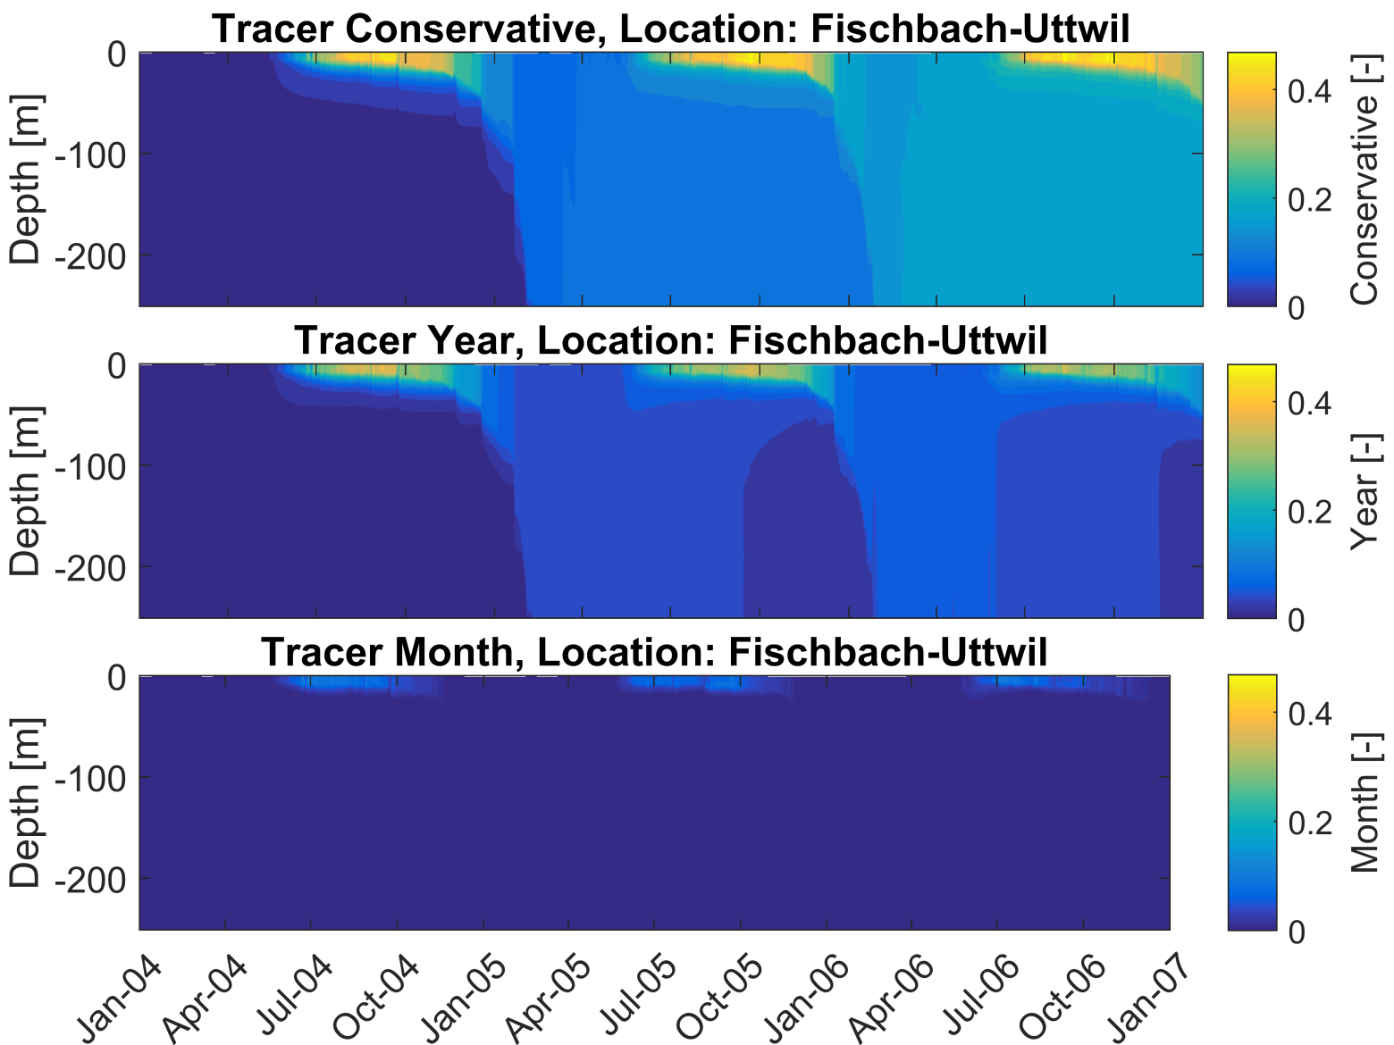
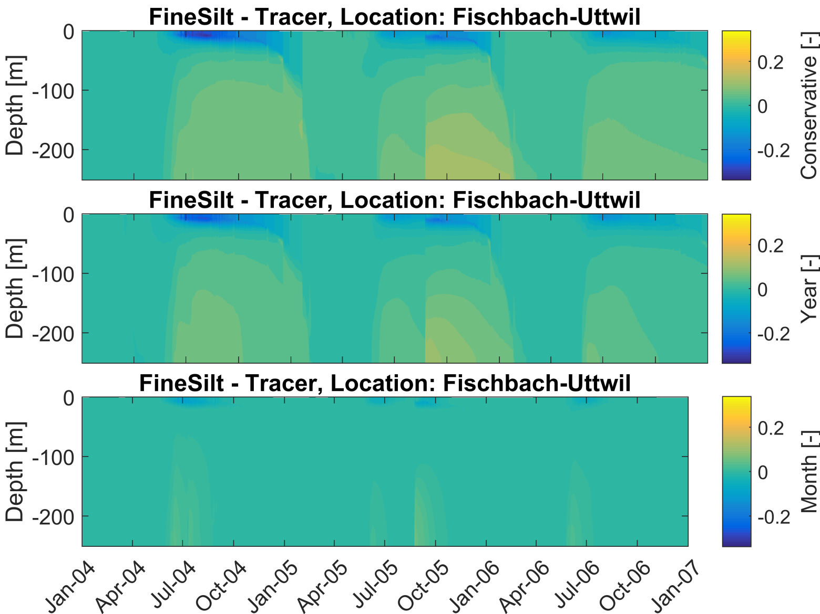
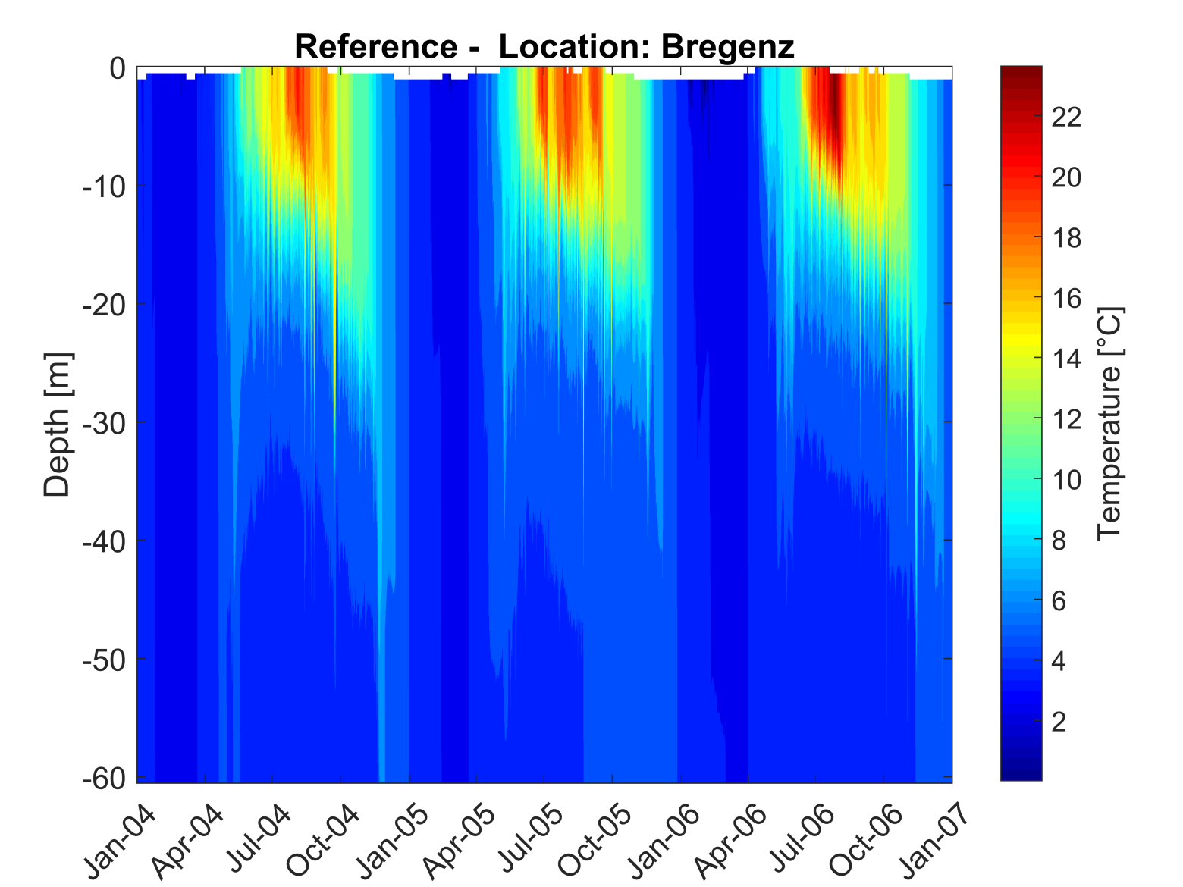
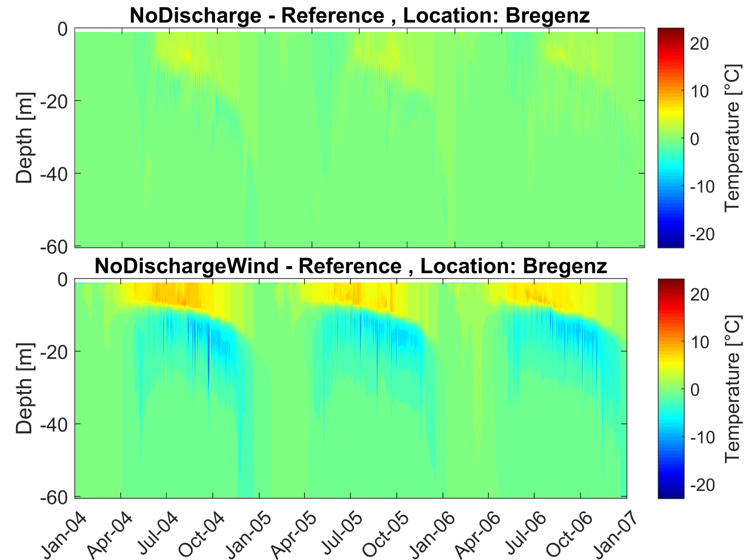
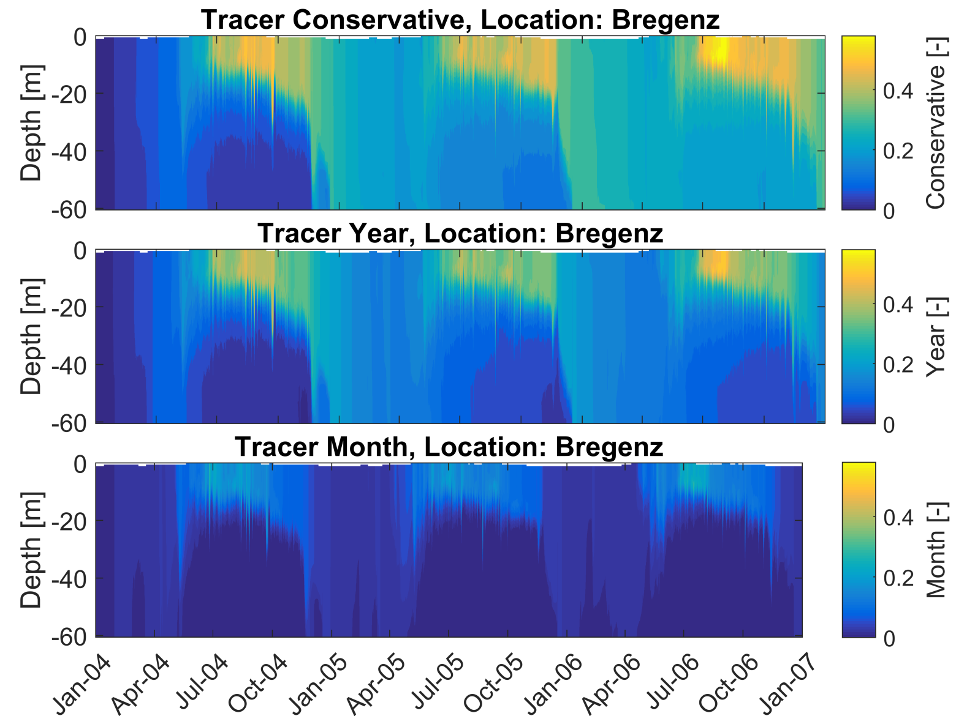
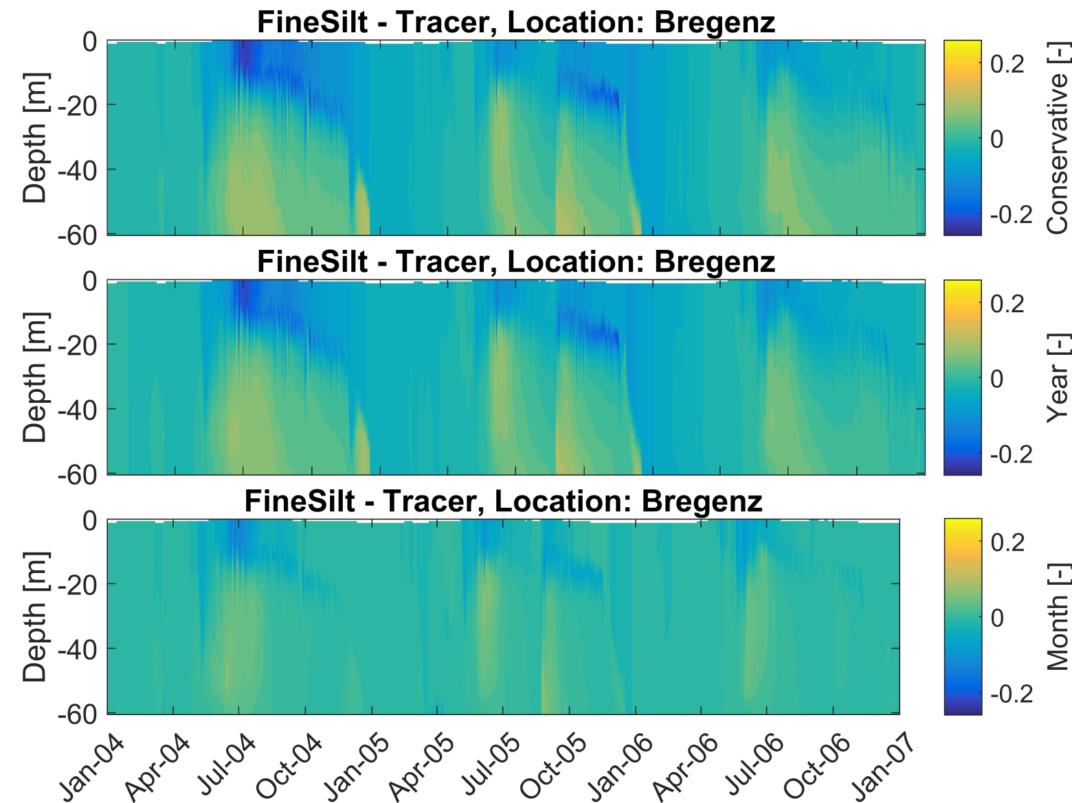





3D hydrodynamic simulation of the influence of internal mixing dynamics on the propagation of river plumes in Lake Constance
Thomas Pflugbeil¹, Franziska Pöschke¹, Anna Noffke¹, Vera Winde¹ and Thomas Wolf¹
¹Institute for Lake Research, State Office for the Environment, Measurement and Nature Conservation of the Federal State of Baden-Wuerttemberg, Germany
Introduction
Lake Constance is one of most important drinking water resources in Germany
Sustainable development and conservation of the lake ecosystem and drinking water quality is of high importance
Project SeeZeichen (ReWaM-project cluster funded by BMBF) is investigating different immission pathways (groundwater, river, superficial inputs) and their impact on the water quality of Lake Constance
Present simulation study investigates the mixing dynamics of Lake Constance and its impacts on river inflows and vice versa and considers
  seasonal (mixing and stratification periods)
  hydrological (flood events, average and low discharge) and
  transport conditions (sediment loads)
Methods
Software: Delft3D-FLOW (Deltares)
Model / Input / Boundary Conditions:
  Spatial resolution: 500 m
  Time resolution: 1 min
  Meteorology: temperature, cloud coverage and humidity, 2D
  (max. 21 weather stations), dx = 1000 m, dt = 1 hour
  Inflows: 14 discharges with water temperature, dt = 1 hour
  Outflow: calculated from sea area and water level differences
  Tracer: without weight, inflow through Alpine Rhine with variable
  decay rate (conservative, yearly, monthly)
  Sediment: inflow through Alpine Rhine, depending on discharge,
  mean grain size 4 µm, 30 µm and 150 µm
Tab. 1 Overview of compared model settings.
Model name | Inflows | Wind | Tracer | Sediment
Reference | + | + | - | -
NoDischarge | - | + | - | -
NoDischargeWind | - | - | - | -
Tracer | + | + | + | -
FineSilt | + | + | + | +
Facts
Lake Constance: |  | Alpine Rhine:
area | 571 km² | length: | 94 km
mean depth: | 90 m | NQ: | 49,5 m³/s
max. depth: | 251 m | MQ: | 238 m³/s
mixis: | monomictic | HQ 10: | 1935 m³/s
trophic level: | oligotrophic | total inflow: | 63 %
Fig. 1 Lake Constance with observation points Fischbach-Uttwil (FU), Wasserburg (WB), Arbon (AR) and Bregenzer Bucht (BrB) as well as transect 1 (AR – FU) and transect 2 (WB – BrB).
Results
Station Fischbach-Uttwil
Temperature
Differences in temperature
Tracer concentration
Differences in tracer concentration
Fig. 2 Time series of the temperature at station FU using the „reference“ simulation.
Fig. 4 Time series of differences in temperature between simulation without discharge and wind compared to „reference“ simulation at station FU.
Fig. 6 Time series of the tracer concentration (normalized) between simulation without sediment at station FU.
Fig. 8 Time series of differences in the tracer concentration between simulation with and without sediment (fine silt) at station FU.
Station Bregenzer Bucht
Fig. 3 Time series of the temperature at station BrB using the „reference“ simulation.
Fig. 5 Time series of differences in temperature between simulation without discharge and wind compared to „reference“ simulation at station BrB.
Fig. 7 Time series of the tracer concentration (normalized) between simulation without sediment at station BrB.
Fig. 9 Time series of differences in the tracer concentration between simulation with and without sediment (fine silt) at station BrB.
Conclusions
Bibliography
Deltares (2014): Delft3D-FLOW User Manual, Version 3.15.34158, May 2014
Haid, V. (2012): Haid, V. (2012): Korngrößenanalysen von Schwebstoffen im Alpenrhein und Bodensee; student report; Institute for Lake Research, Langenargen
Lang and Mirbach (2013): Schwebstoffuntersuchungen Alpenrhein-Bodensee 2012; internal report, Ingenieurgesellschaft Prof. Kobus und Partner GmbH, Stuttgart
Thermal stratification in summer months in 20 m depth (Fig. 2 + 3) Without discharge 5 °C higher temperatures in epilimnion (Fig. 4 + 5) Without discharge and wind no vertical energy exchange → 10 °C higher temperatures in epilmnion, lower temperatures in metalimnion (Fig. 4 + 5) | Conservative tracer accumulates in hypolimnion over time during winter months, in summer months only in epilimnion (Fig. 6 + 7) Tracer with monthly decay rate reaches deepest station (FU) only during stratified periods (Fig. 6) With sediment in Alpine Rhine, the tracer is transported in greater depths, especially during flooding in the summer months (Fig. 8 + 9)
Contact
Homepage: www.seezeichen-bodensee.de
Email: thomas.pflugbeil@lubw.bwl.de
Phone: + 49 (0) 7543 304 156
Project funding number: 02WRM1365

