Slide 1
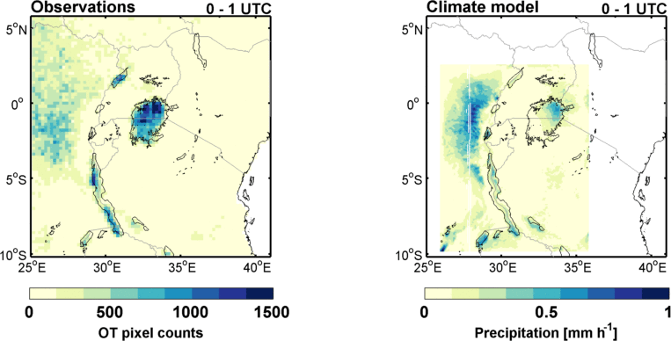
The Lake Victoria Intense storm Early Warning System (VIEWS)
The challenge
The idea
The results
Yesterday’s forecast
Notes:
During daytime we observe the typical afternoon storms over land, but no storms over Lake Victoria. At night, in contrast, we see no storms over land but very high storm intensity over the lake. The principle behind this is quite straightforward: due to the thermal inertia of the water surface, at night the lake is warmer then the surrounding land. As a consequence of this temperature difference, land breezes build up across the lakes borders, causing surface winds to converge over the lake surface. At the same time the air is moistened by sustained evaporation from the lake. When these wet air masses come together, they are lifted up into the atmosphere they generate thunderstorms.

Slide 2
The Lake Victoria Intense storm Early Warning System (VIEWS)
The challenge
The idea
The results
(www.cnn.com)
Yesterday’s forecast
Notes:
this phenomenon would normally not be such a major problem, were it not that every night, most of the 200 000 fishermen go out on the lake to fish.
Accurate statistics are lacking, but the red cross estimates that every year 3000 to 5000 fishermen die on lake Victoria only. Most of these casualties are related to severe weather.
the large number of number of deaths is because fishing in this part of the world is still mostly done in a traditional way, such as in these wooden pirogues. Moreover, fishermen usually can’t swim. But perhaps evenly important is the lack of a proper early warning system which would avoid fishermen sailing off when a severe storm is about to happen. Recently the UK Met Offfice has set up a programme to issue storm warnings based on Numerical Weather Prediction.

Slide 3
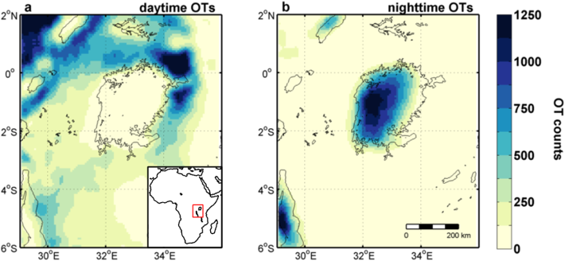
The Lake Victoria Intense storm Early Warning System (VIEWS)
The challenge
The idea
The results
Yesterday’s forecast
Notes:
So we had a paper in Nature communication last fall where projected future changes in extreme thunderstorms over Lake Victoria
While doing the analysis for that paper, we doscovered that there is a positive relationship between afternoon number of OTs on land and the number of OTs the next night on the lake. This means that there is predictability in the system, and we developed a way to forecast extreme nighttime thunderstorms using a simple statistical model.
For our early warning system, we first define a class of extreme events that we want to forecast. In this case we take all nighttime precipitation events above the 99th percentile (so more or less the three strongest events per year). If I observe a number of storms in the afternoon, e.g. 200, the chances of having an extreme event the following night are small, but if we observe 800 storms, then the changes of the following night being ‘extreme’ are large.
Based on this idea we developed a statistical model that uses logistic regression, which allows you to forecast the occurrence of an extreme event assuming a certain threshold probability.

Slide 4
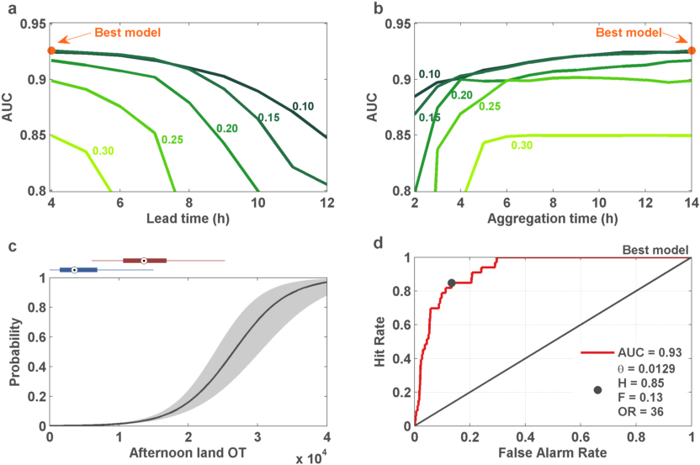
The Lake Victoria Intense storm Early Warning System (VIEWS)
The challenge
The idea
More on
The results
nnnnnnnnnRobustness
nnnnnnnnnFalse alarms
Yesterday’s forecast
(Thiery et al., ERL revised)
nnnnnnnnnClimate change
Notes:
We can then evaluate the skill of our model over the historic period (2005-2013).
Now I would like to ask you to focus on the bottom right panel only
Depending on the choice of the threshold probability (i.e. Being more or less conservative in issuing warnings); your predictions will be more or less skilful; this is visualised in the ROC curve. People familiar with these kind of plots will realise that this model is very skilful, with and area-under-the-curve of 0.93. For a certain warning criterion, we were able to forecast 85% of all extreme events, while only 13% false alarm rate. This means that if you have 4 extreme events per year, our method will forecast at least three of them on average, with a false alarm about every eight days.
A major advantage of this approach is that is it computationally extremely cheap, you can probably do the calculation on your smartphone. The prediction system is also open source, so if you want you can download it tonight and start doing your own predictions for the region.
Although still a prototype, this approach has the potential to become an operational Early Warning System, and thereby help to reduce the loss of lives.
So our next step will be to further improve the statistical model and transform it into an operational tool that is useful for people working on the ground.

Slide 5
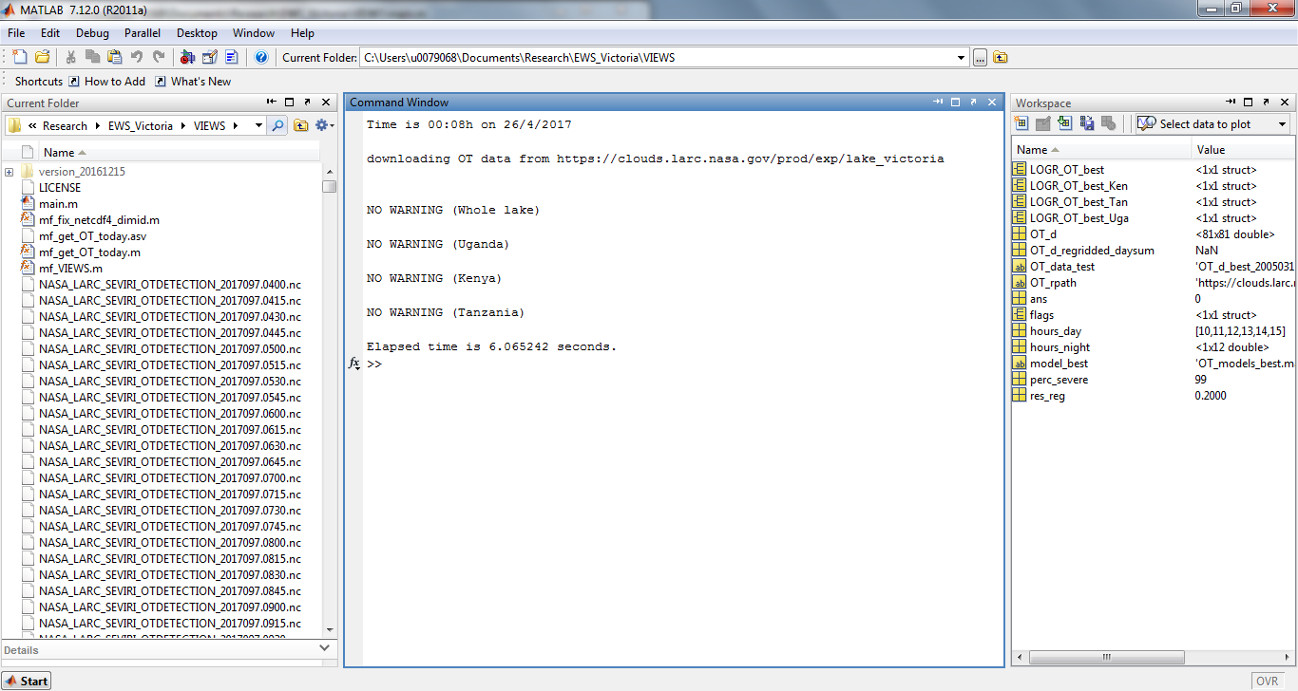
The Lake Victoria Intense storm Early Warning System (VIEWS)
The challenge
The idea
The results
Yesterday’s forecast

Slide 6
The Lake Victoria Intense storm Early Warning System (VIEWS)
The challenge
The idea
(Thiery et al., ERL revised)
More on
The results
nnnnnnnnnRobustness
nnnnnnnnnFalse alarms
Yesterday’s forecast
nnnnnnnnnClimate change

Slide 7
The Lake Victoria Intense storm Early Warning System (VIEWS)
The challenge
The idea
(Thiery et al., ERL revised)
More on
The results
nnnnnnnnnRobustness
nnnnnnnnnFalse alarms
Yesterday’s forecast
nnnnnnnnnClimate change

Slide 8
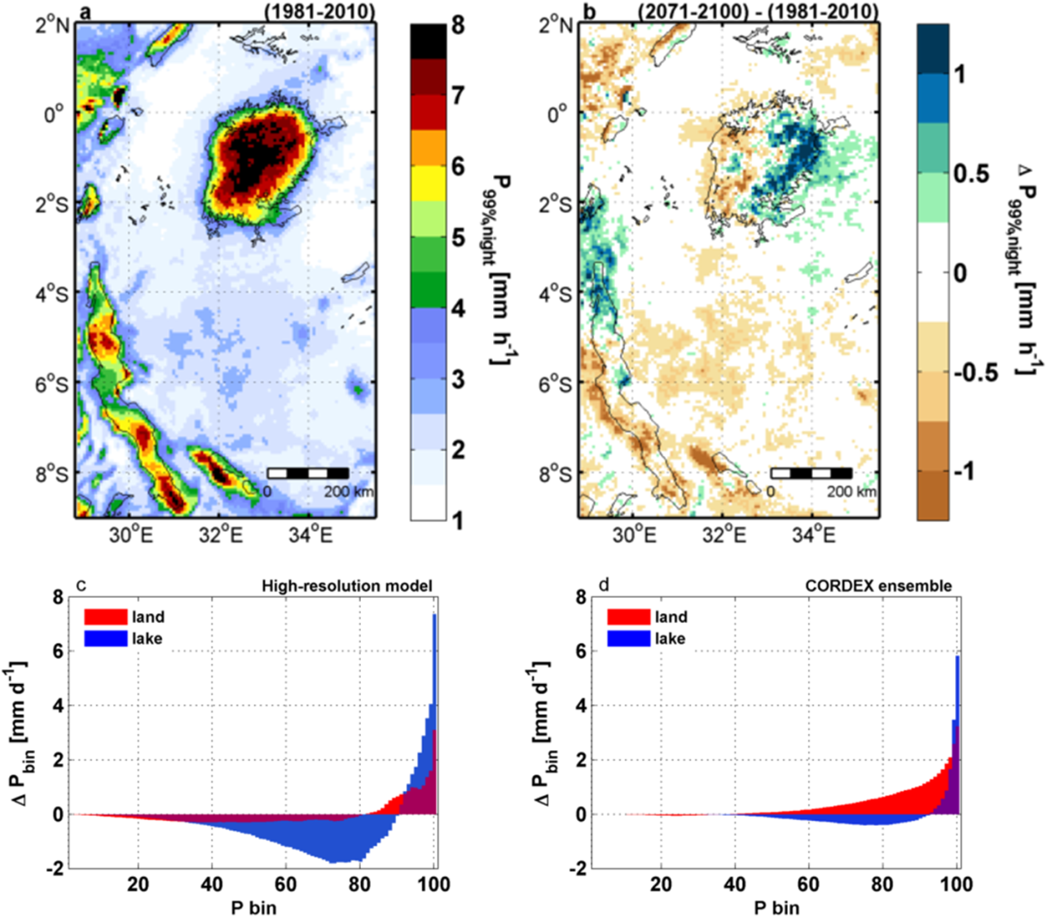
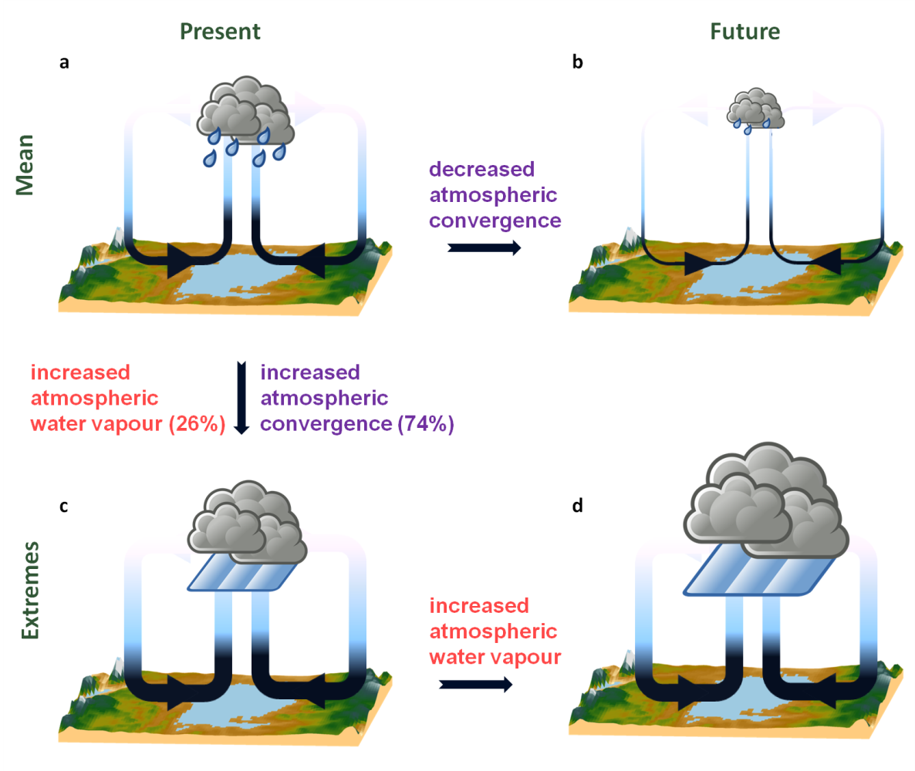
The Lake Victoria Intense storm Early Warning System (VIEWS)
The challenge
The idea
(Thiery et al., Nature Comm. 2016)
More on
The results
nnnnnnnnnRobustness
nnnnnnnnnFalse alarms
Yesterday’s forecast
nnnnnnnnnClimate change

Slide 9
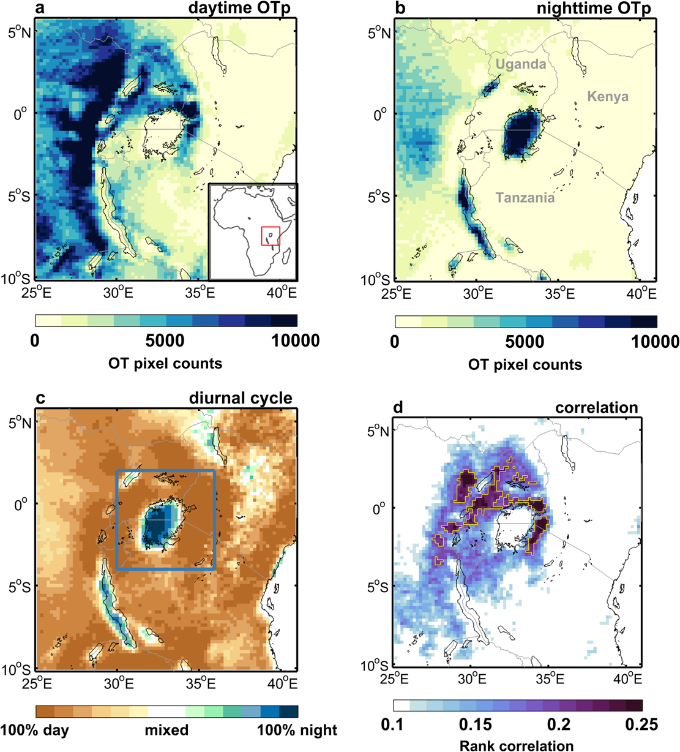
The Lake Victoria Intense storm Early Warning System (VIEWS)
The challenge
The idea
More on
The results
nnnnnnnnnRobustness
nnnnnnnnnFalse alarms
Yesterday’s forecast
nnnnnnnnnClimate change
(Thiery et al., ERL revised)

