Slide 1
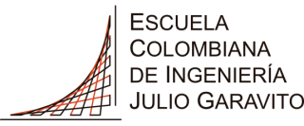
Chaos Analysis of Precipitation Time Series in the upper Magdalena River Basin: Outline for a Downscaling Chaotic Model in Tropical Regions
European Geosciences Union
General Assembly 2017
Vienna. Austria, 23–28 April 2017
Freddy Santiago Duarte Prieto¹, Oscar Eduardo Hernández Murcia², Gerald Augusto Corzo Pérez ^{3,} Germán Ricardo Santos Granados ⁴
1. Escuela Colombiana de Ingeniería Julio Garavito, Bogotá, Colombia (freddy.duarte@escuelaing.edu.co)
2. The University of Iowa, Iowa City, United States (ohernandezmurcia@uiowa.edu)
3. UNESCO-IHE Institute for Water Education, Delft, The Netherlands(g.corzo@unesco-ihe.org)
4. Escuela Colombiana de Ingeniería Julio Garavito, Bogotá, Colombia (german.santos@escuelaing.edu.co)
Escuela Colombiana de Ingeniería Julio Garavito

Slide 2
MOTIVATION
There are a lot of different existent downscaling technique's …
Downscaling
ANN
SDSM
ADC
WRF
LARS-WG
However, the climate systems and the associated dynamic processes are essentially non-linear, and possibly chaotic. Sivakumar, B. and Berndtsson, R. (2010)

Slide 3
BACKGROUND
European Geosciences Union
General Assembly 2017
Vienna. Austria, 23–28 April 2017
The application of the basis of nonlinear dynamics and chaos theory in hydrological studies has been considerable in recent decades, especially in precipitation time series.
1987 | 1989 | 1993 | 1994 | 1995 | 1998 | 2000 | 2001
Hense | Rodríguez-Iturbe et al | Tsonis et al | Jayawardena y Lai | Berntsson et al | Georkakos et al | Waelbroeck et al | Sivakumar et al

Slide 4
STUDY CASE
European Geosciences Union
General Assembly 2017
Vienna. Austria, 23–28 April 2017
The Magdalena River originates in the Northern Andes Mountains in South America, it´s basin covers 24% of Colombia´s national territory. The hydrological regime of the river in its main channel is bimodal with an average flow of 7.200 $m^{3}/s$
Cell GCM: MPI-ESM-MR (Historical + RCP8.5)
N° of cells=1 (1.875°x1.875°)
Period of time: 1850 -2089 (87.659 data)
Mean= 5.7 mm
Standard deviation =6.58 mm
Maximum =52.3 mm
Estaciones Pluviograficas del IDEAM
N° of stations=129
Period of time: 1970 -2011 (11.640 data per sta)
Mean= 4.51 mm
Standard deviation =10.5 mm
Maximum =146.8 mm
Figure 1.- Upper Magdalena River Basin Location , GCM cell and rain gauge station’s in the cell . From Google Earth

Slide 5
METHODOLOGY: NON LINEAR IDENTIFICATION
European Geosciences Union
General Assembly 2017
Vienna. Austria, 23–28 April 2017
Non-linear
Identification
Phase space reconstruction
Type of Motion
Evaluation of the presence of nonlinear dynamics and deterministic chaos in time series.
Power spectrum
Autocorrelation function
False nearest neighbors method
Correlation dimension
Exponents of Lyapunov
Entropy of Kolmogorov
Surrogate data
Exponent of Hurst

Slide 6
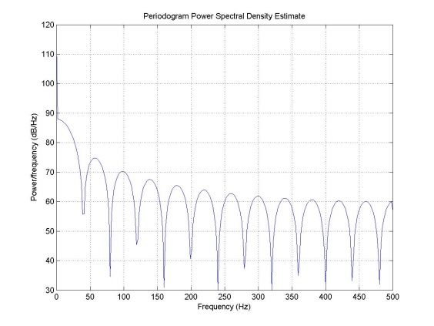
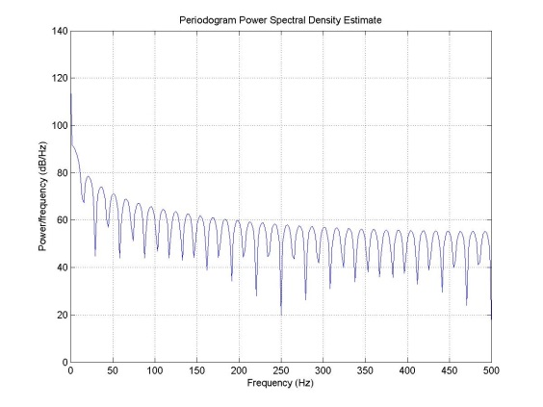
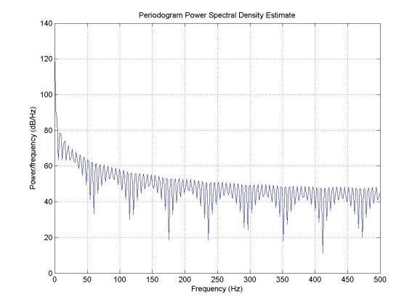
RESULTS: NON-LINEAR IDENTIFICATION
European Geosciences Union
General Assembly 2017
Vienna. Austria, 23–28 April 2017
Figure 5a.- Power Spectrum : rain gauge station Achique, rainfall accumulation of 15 días.
Figure 5b.- Power Spectrum : rain gauge station Achique, rainfall accumulation of 5 días.
Figure 5c.- Power Spectrum : rain gauge station Achique, rainfall accumulation of 1 día.
Decreasing Rainfall accumulation

Slide 7
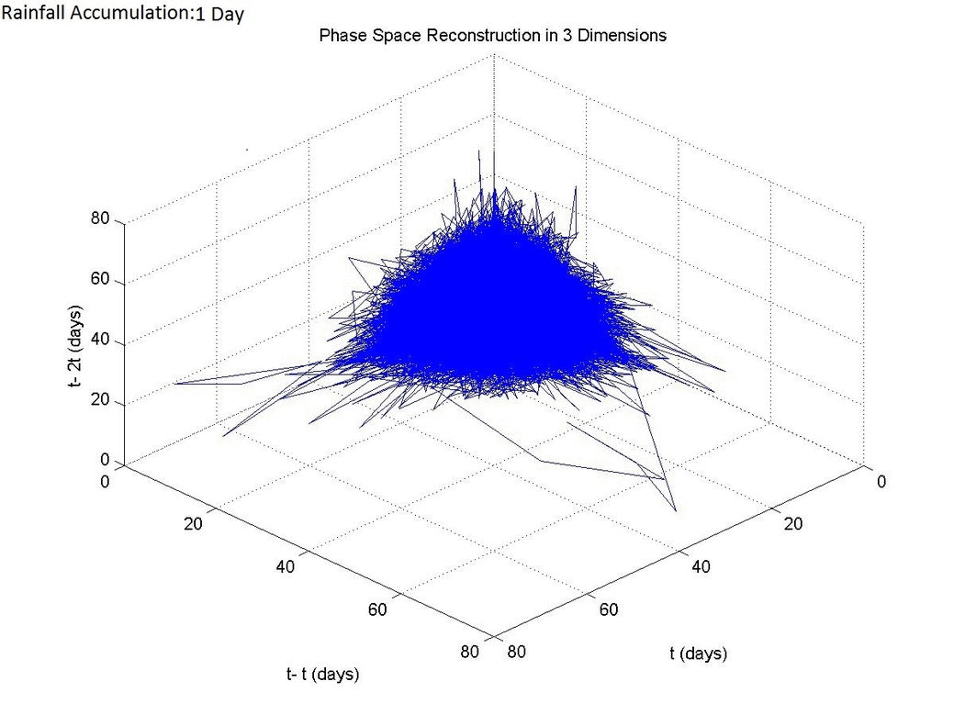
METHODOLOGY:PHASE SPACE RECONSTRUCION
European Geosciences Union
General Assembly 2017
Vienna. Austria, 23–28 April 2017
Non-linear
Identification
Phase space reconstruction
Type of Motion
Method of Time-Delay
(Talkien in 1981)
+Time Delay (τ)
-Autocorrelation function
-Mutual Information
-Space-time separation plot
+Embedding Dimention (m)
-Correlation Dimention
-False Nearest neighbors
-Cao´s method
Figura 8.- Three-dimensional phase space reconstruction for different rainfall accumulation.

Slide 8
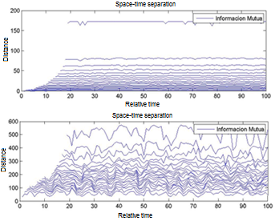
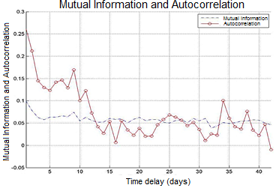
RESULTS: TIME DELAY
European Geosciences Union
General Assembly 2017
Vienna. Austria, 23–28 April 2017
Figure 4.- Time delay comparation for mutual information and autocorrelation method at rain gauge station Campoalegre, rainfall accumulation of 5 días.
Figure 5.- Space-Time Separation Plot comparation for rain gauge station Campoalegre. rainfall accumulation of 5 days (up) and 30 days (down).

Slide 9
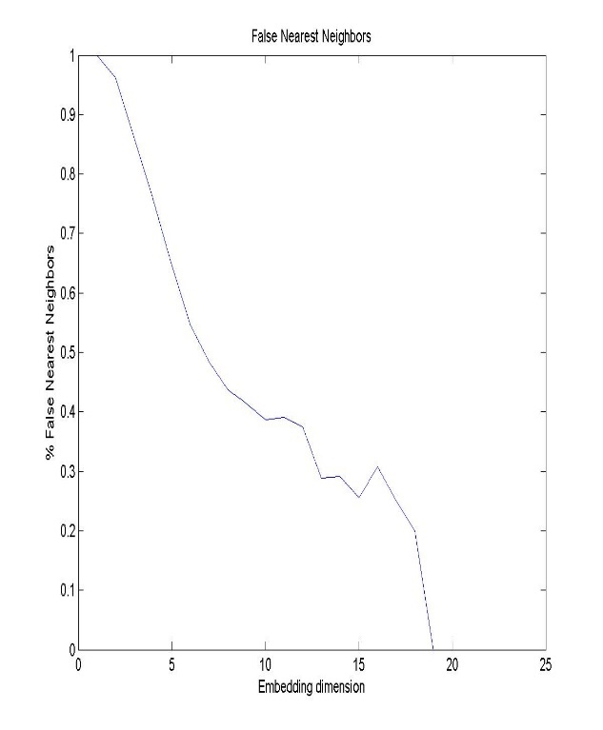
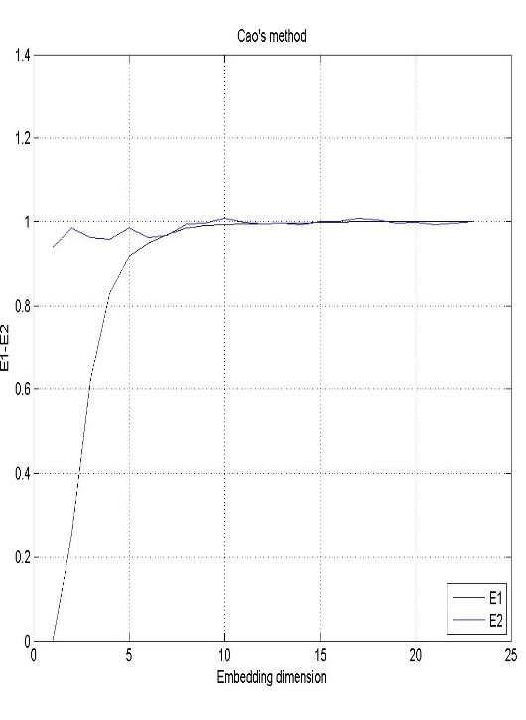
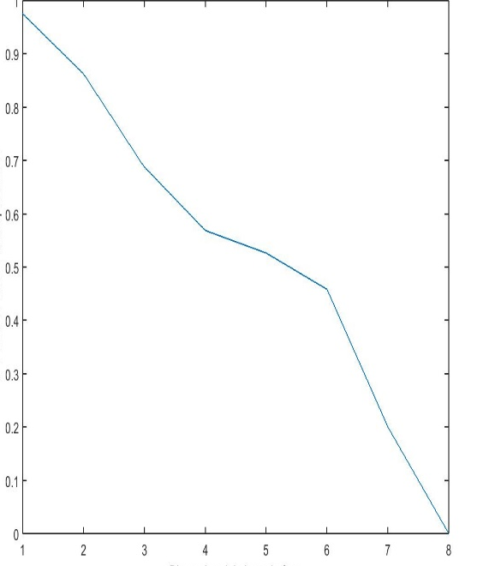
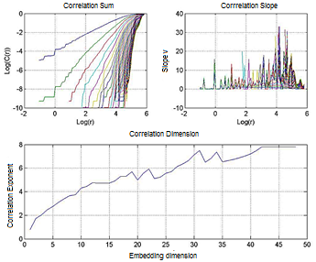
European Geosciences Union
General Assembly 2017
Vienna. Austria, 23–28 April 2017
RESULTS: EMBEDDING DIMENSION
Figure 7.- Correlation Sum (upper left), Correlation Slope (upper right), and Correlation Dimension (down), for rain gauge station Campoalegre, rainfall accumulation of 15 days
Figure 6.- False Nearest Neighbors (up) and Cao´s Method (down) for GCM total precipitation from the Upper River Magdalena Basin

Slide 10
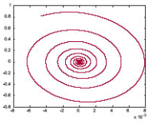
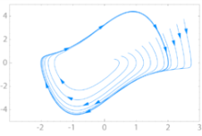
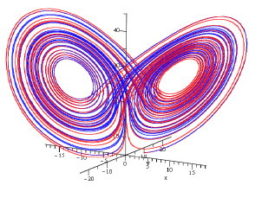
European Geosciences Union
General Assembly 2017
Vienna. Austria, 23–28 April 2017
METHODOLOGY:TYPE OF MOTION
LYAPUNOV SPECTRUM
The type of motion of the dynamic system is determined based on the largest Lyapunov exponent (Max λ) and the sum of the exponents of the spectrum (Σ λ).
Non-linear
Identification
Phase space reconstruction
Type of Motion
Max λ<0
Stable (Fixed Point)
Max λ=0
Stable (Limit Cycle)
Max λ>0 y Σ λ<0
Deterministic Chaos
Max λ>0 y Σ λ>0
Noise

Slide 11
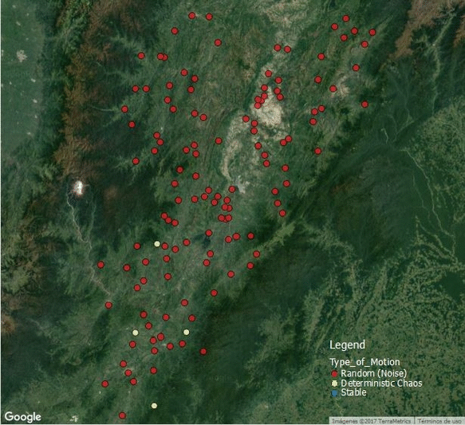
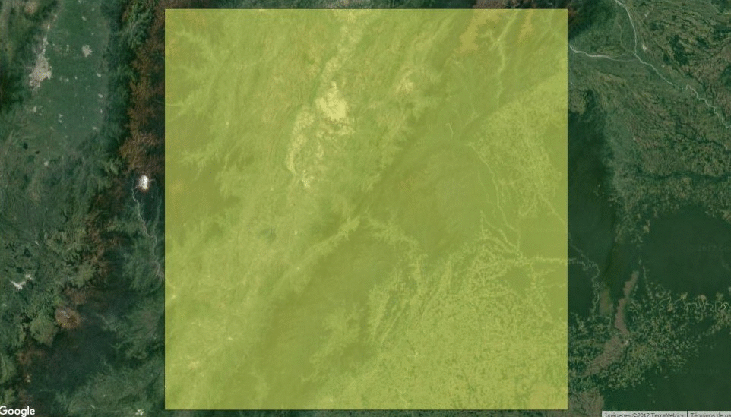
European Geosciences Union
General Assembly 2017
Vienna. Austria, 23–28 April 2017
RESULTS: TYPE OF MOTION
For the analysis of the presence of chaos in the precipitation series of the Upper Magdalena River Basin , were used rainfall accumulation intervals of 1,2,3,5,10,15,30, 45 and 90 days.
Figura 9.- Chaos Analysis Comparation for different rainfall accumulation, in stations( left ) and cell (right).

Slide 12
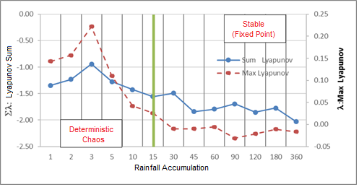
European Geosciences Union
General Assembly 2017
Vienna. Austria, 23–28 April 2017
CONCLUSIONS
It is concluded that deterministic chaos was found for precipitation time series in most of the stations for a 5-day rainfall accumulation for the Upper Magdalena River Basin sector, and deterministic chaos was found in the GCM cells for intervals between 1 and 15 days.
This result is very important since it shows that it is possible to formulate models to improve the transformation of precipitation data between different spatial and temporal scales.
Figura 14.- Sum Lyapunov and Max Lyapunov Comparation for different rainfall acummulation.

Slide 13
European Geosciences Union
General Assembly 2017
Vienna. Austria, 23–28 April 2017
REFERENCES
Angarita, H. (2014) “Metodología para incluir variabilidad climática y escenarios de cambio climático en el modelo WEAP de la macro Cuenca del Rio Magdalena y resultados de las simulaciones”.
Corzo, G. et al (2009) “Downscaling Global Climate Models Using Modular Models and Fuzzy Committees”
Gallego, J. (2010) Aplicación de la teoría de caos para el análisis y pronóstico de series de tiempo financieras en Colombia. Bogotá. Universidad Nacional de Colombia.
Hernández, O. (2009) Analysis and Optimization of Chaotic Models for Storm Surge Prediction. Delft. UNESCO-IHE.
Maraun, D.; Wetterhall, F.; (2009) Precipitation Downscaling Under Climate Change: Recent Developments to Bridge the Gap Between Dynamical Models and the End User.
Siek, M. (2011) Predicting Storm Surges: Chaos, Computational Intelligence, Data Assimilation, Ensembles. Delft. UNESCO-IHE.
Sivakumar, B. and Berndtsson, R. (2010) Advances in Data-Based Approaches for Hydrologic Modeling and Forecasting. World Scientific
Velickov, S. (2004) Nonlinear Dynamics and Chaos with Applications to Hydrodynamics and Hydrological Modelling. Delft. UNESCO-IHE.

Slide 14
Thank You! (Gracias)
Contact Information:
(+57) 312 3073370
freddy.duarte@escuelaing.edu.co
santiagoduarte09@gmail.com
Bogotá D.C., Colombia

