Slide 1





Multi-Frequency Radar/Passive Microwave retrievals of Cold Season Precipitation
from OLYMPEX data
Frederic Tridon¹, Alessandro Battaglia^{1,2}, Joe Turk³, Simone Tanelli³, Stefan Kneifel⁴, Jussi Leinonen³ and Pavlos Kollias⁵
and OLYMPEX team
1. Department of Physics and Astronomy, University of Leicester, UK
2. National Centre for Earth Observation, University of Leicester, Leicester, United Kingdom, Department of Physics and Astronomy, University of Leicester, UK
3. NASA JPL, California Institute of Technology, USA
4. University of Cologne, Institute of Geophysics and Meteorology
5. Stony Brook University, School of Marine and Atmospheric Sciences
Notes:
1

Slide 2
OLYMPEX field campaign
The Olympic Mountains Experiment (OLYMPEX) took place during the 2015-2016 fall-winter season in the vicinity of the mountainous Olympic Peninsula of Washington State. Two goals:
To collect a statistically significant dataset in midlatitude cyclones upstream of, over, and downstream of a mountain range ➔ (GPM) satellite algorithm improvements;
to better understand orographic modification of frontal precipitation processes ➔ how the physics and dynamics of the precipitation mechanisms affect the vertical structure of precipitating clouds.
The venue for OLYMPEX was chosen because it has precipitation from midlatitude baroclinic storm systems arriving frequently from the adjacent Pacific Ocean and abruptly transiting mountainous terrain.
Houze et al., BAMS 2017
http://olympex.atmos.washington.edu/

Slide 3
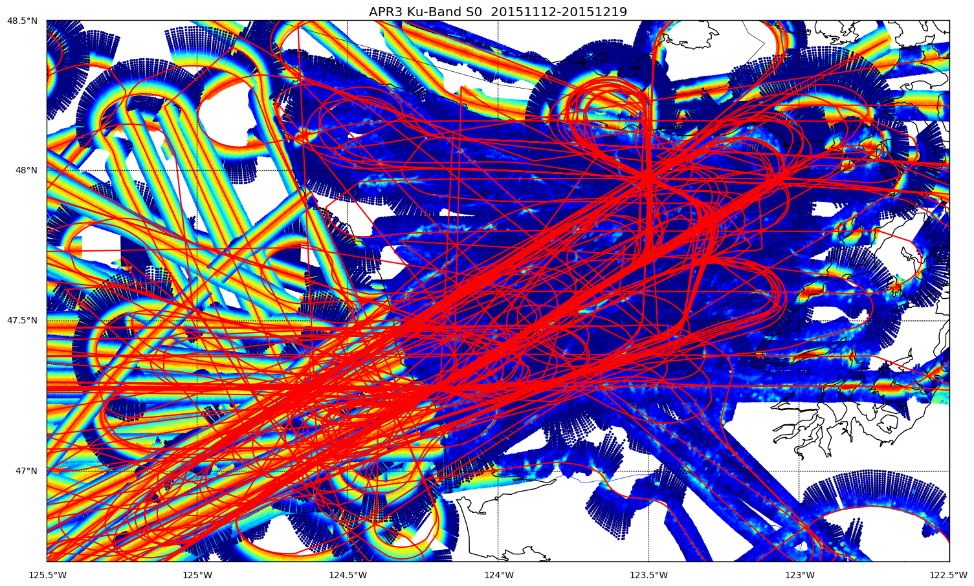
Multi-Platform Analysis of APR3 and MW Radiometric Observations During OLYMPEX
IOP
Nov 12-13: Prefrontal Rain, then cold frontal rain
Nov 18: Shallow small-scale post-frontal convection
Nov 23-24: Weak frontal system passage
Nov 25: Clear-sky flights
Dec 01-02: Weakening storm with broad stratiform
region and orographic enhancement.
Dec 03: Baroclinic system w/orographics
Dec 04: Leftover post-frontal convection
Dec 05: Large frontal system
Dec 08: Atmospheric river type event w/orographics
Dec 10: Good post-frontal convection event
Dec 12: Occluded frontal passage
Dec 13: Post-frontal convection
Dec 18: Weak/mixed frontal passage
Dec 19: Weak post-frontal convection
All DC-8 Flight Tracks During OLYMPEX (APR3 Ku-band σ₀ in color)
NASA aircraft (the DC-8 and ER-2, both with flight durations of 7-8 hours) were used to mimic the satellite measurements by flying above cloud with onboard radars and passive microwave sensors similar to those on the satellite

Slide 4
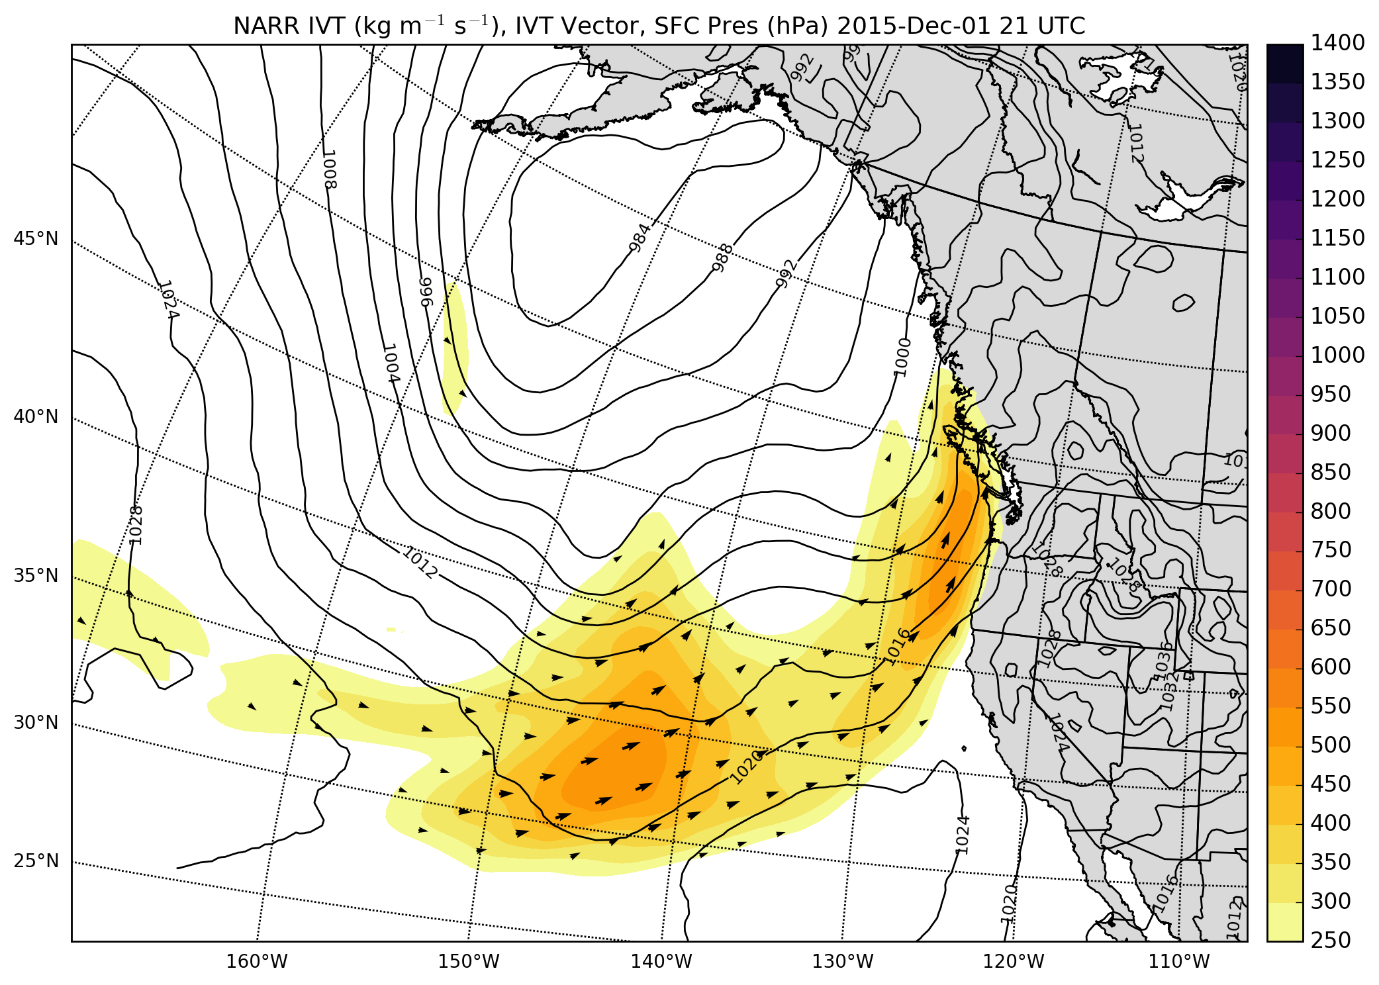
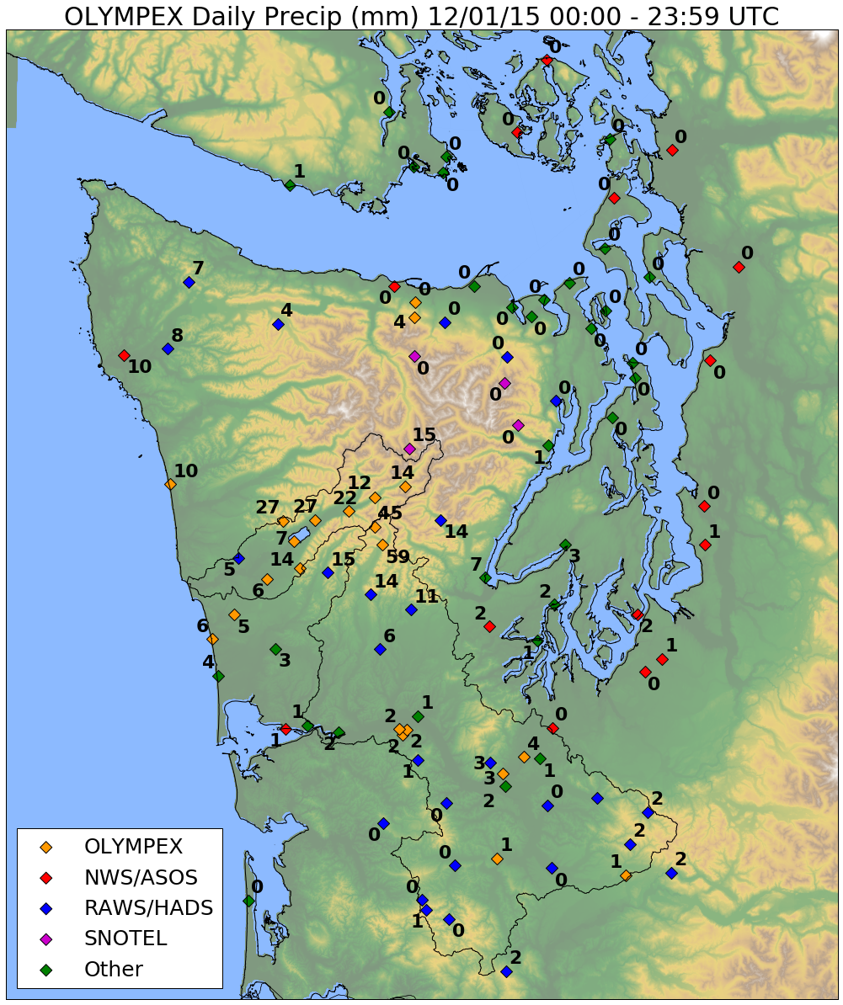
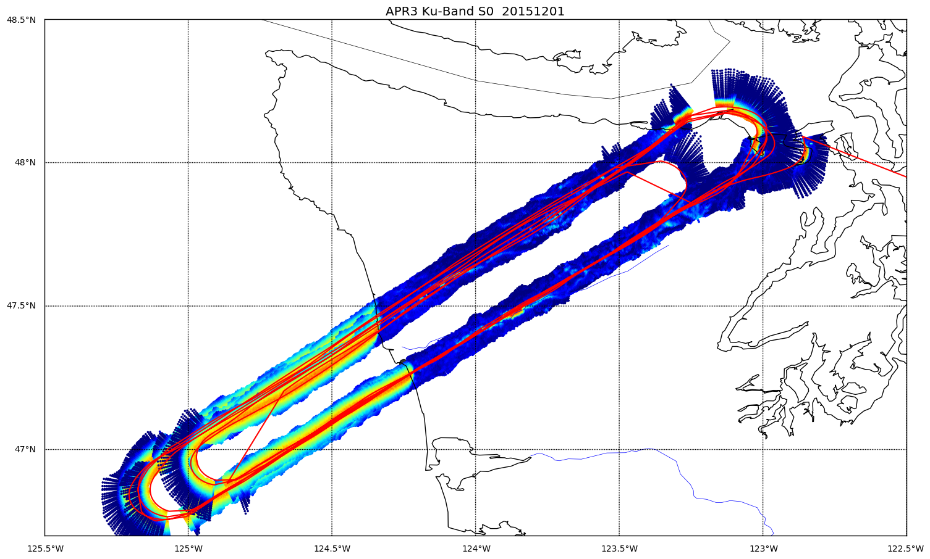
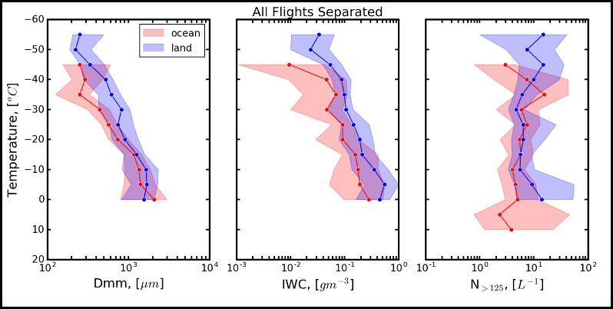
1 December 2015 event
Prefrontal, warm sector, some frontal waves
NARR integrated vapor transport
Credit J.Zagrodnik
Credit: Randy Chase, U. Illinois
Can we capture systematic microphysical parameter and process variability from ocean to summit by multi-frequency suite of instruments?
Notes:
Column properties are important here- again their character and variability as a f(regimes);
What process variability do we see and expecially repeatable or systematic behavior. E.g., ocean to land ice properties and contribution to total rain/snowfall.
Ubiquitous layers of preferential growth of ice types and densities; ice water path contribution to liquid water path

Slide 5
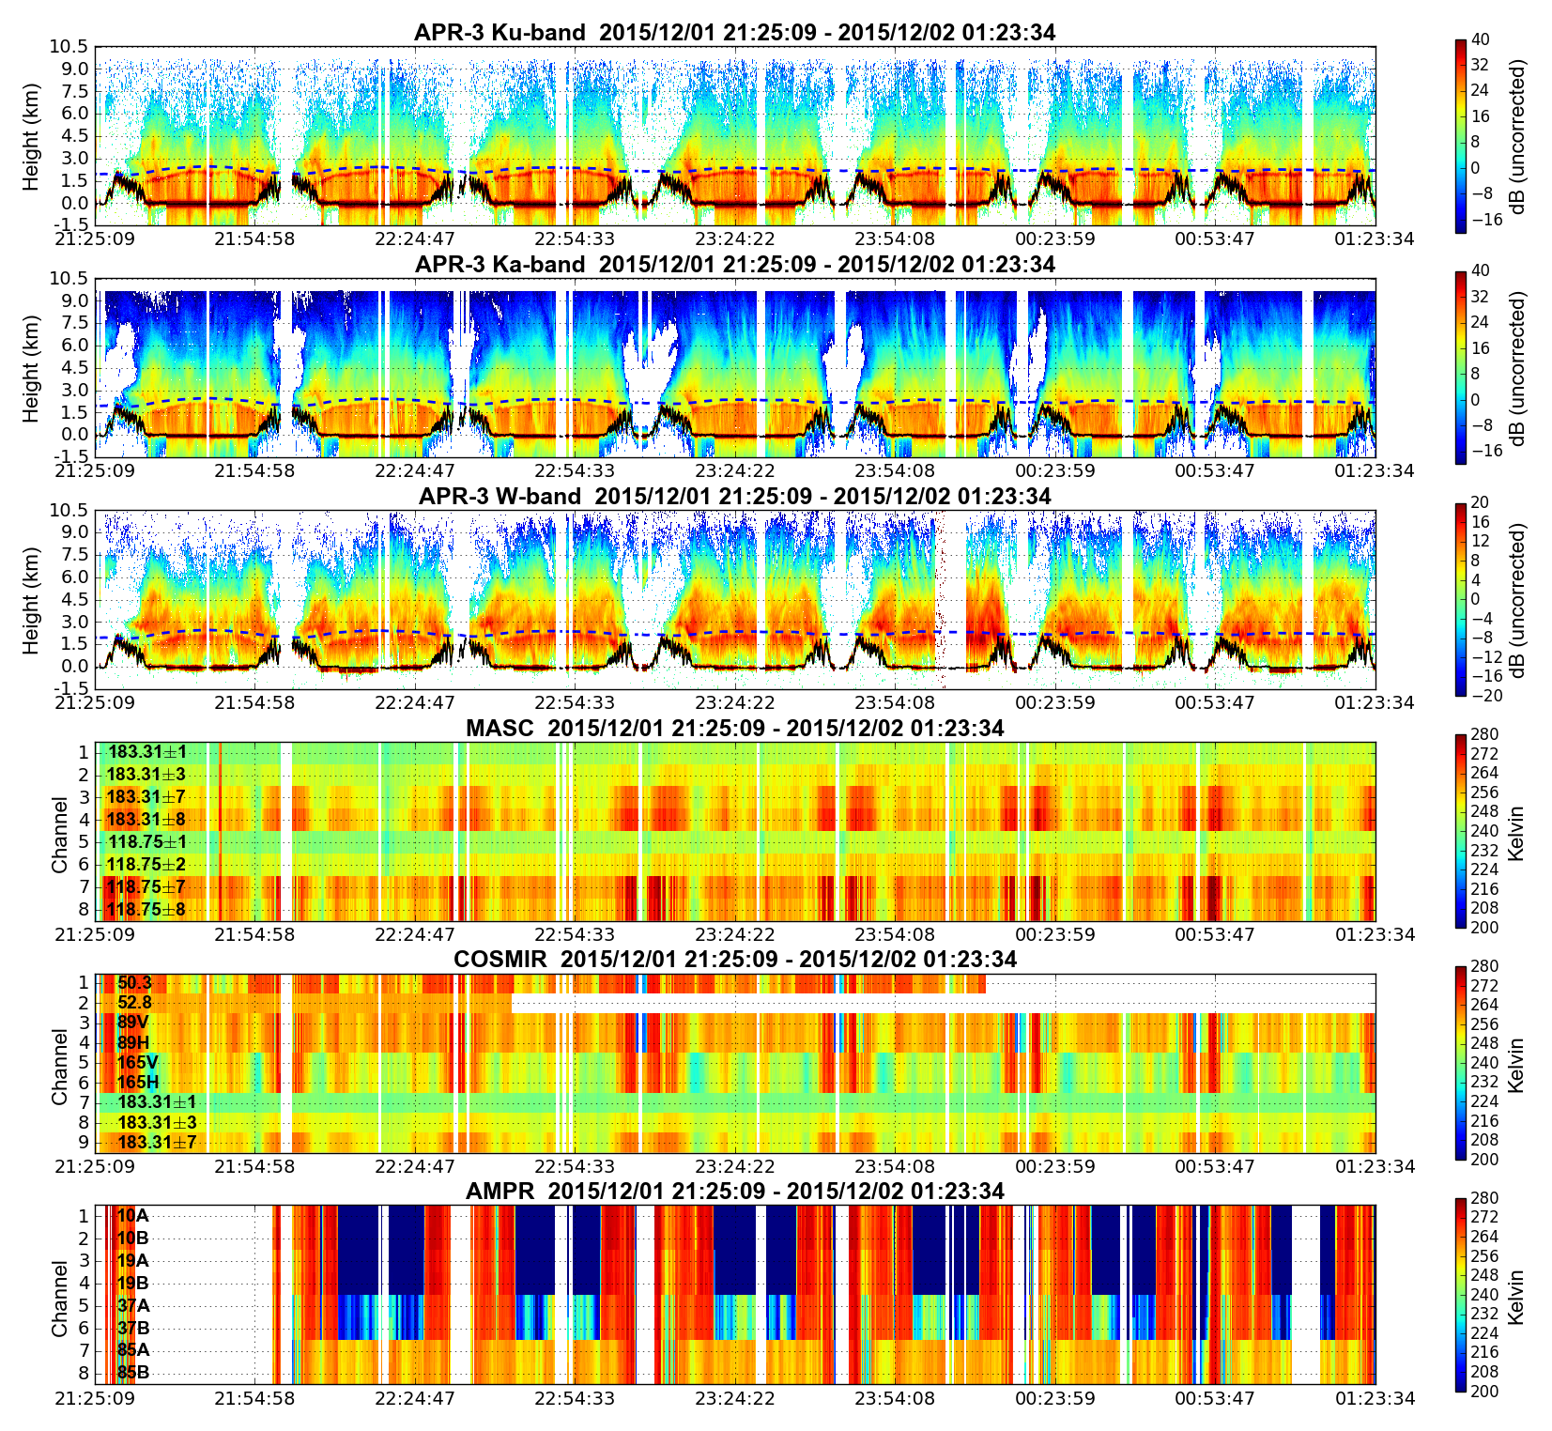
1 December 2015 co-located dataset
Can we derive retrieval consistent with all radar-radiometer observables?
How accurate are these retrievals?

Slide 6
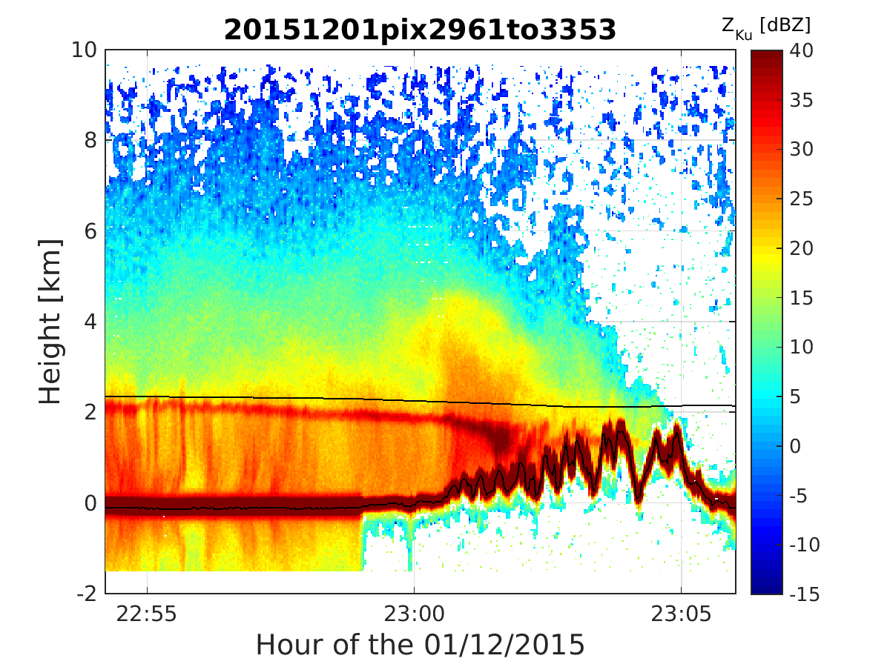
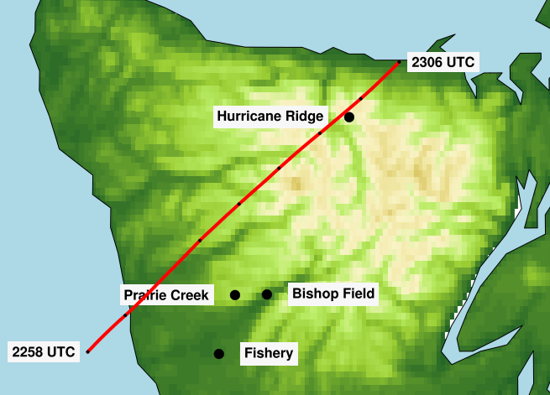
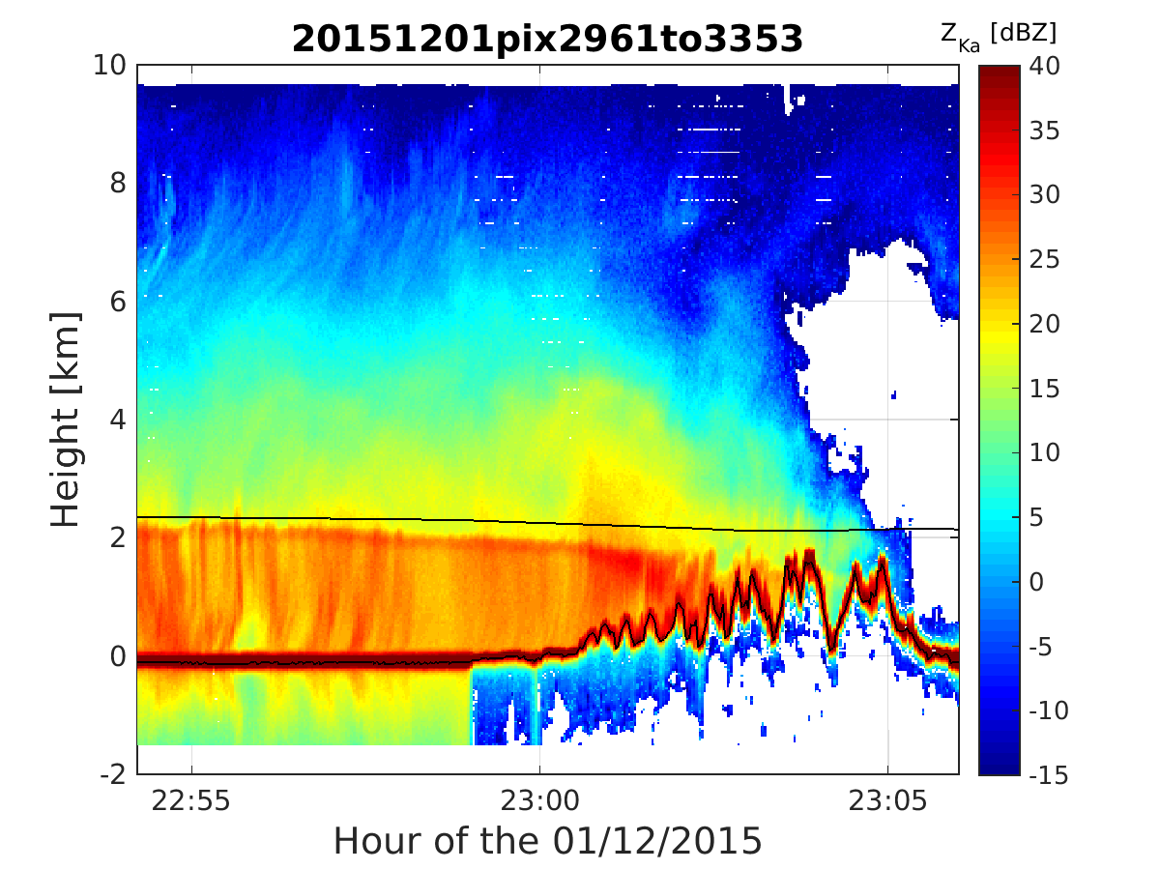
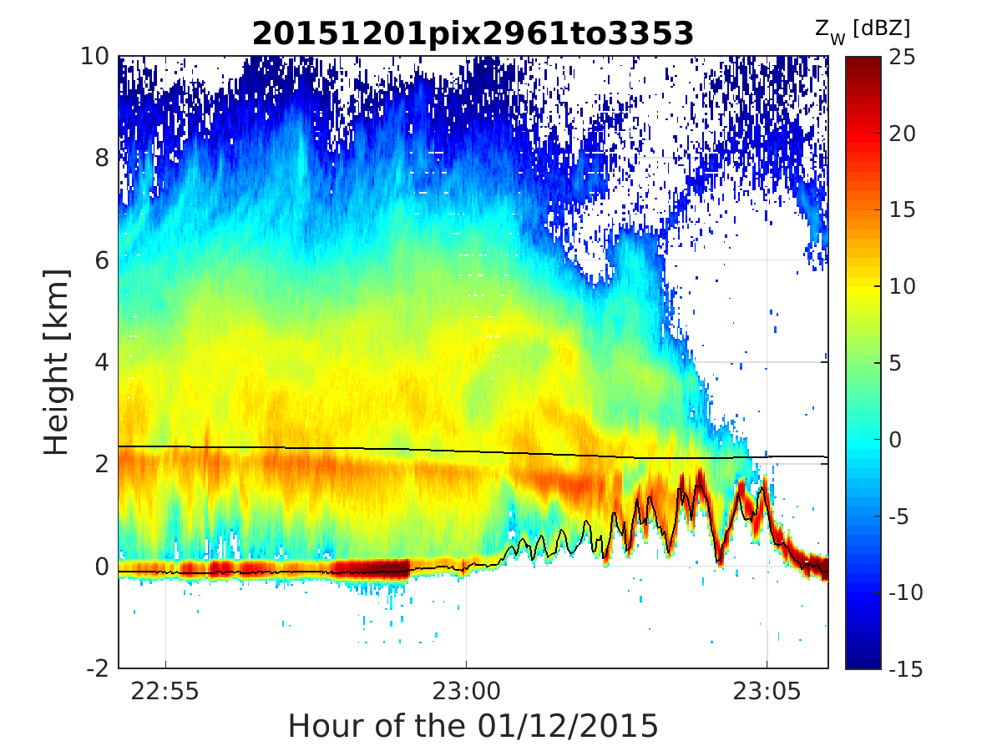
12 December 2015 – 22:54 to 23:06 UTC
ZKu [dBZ]
  Radar echo extends
  further inland
ZKa [dBZ]
ZW [dBZ]
  Intense bright band and enhanced reflectivity along windward slopes
Next: 22:58 profile

Slide 7
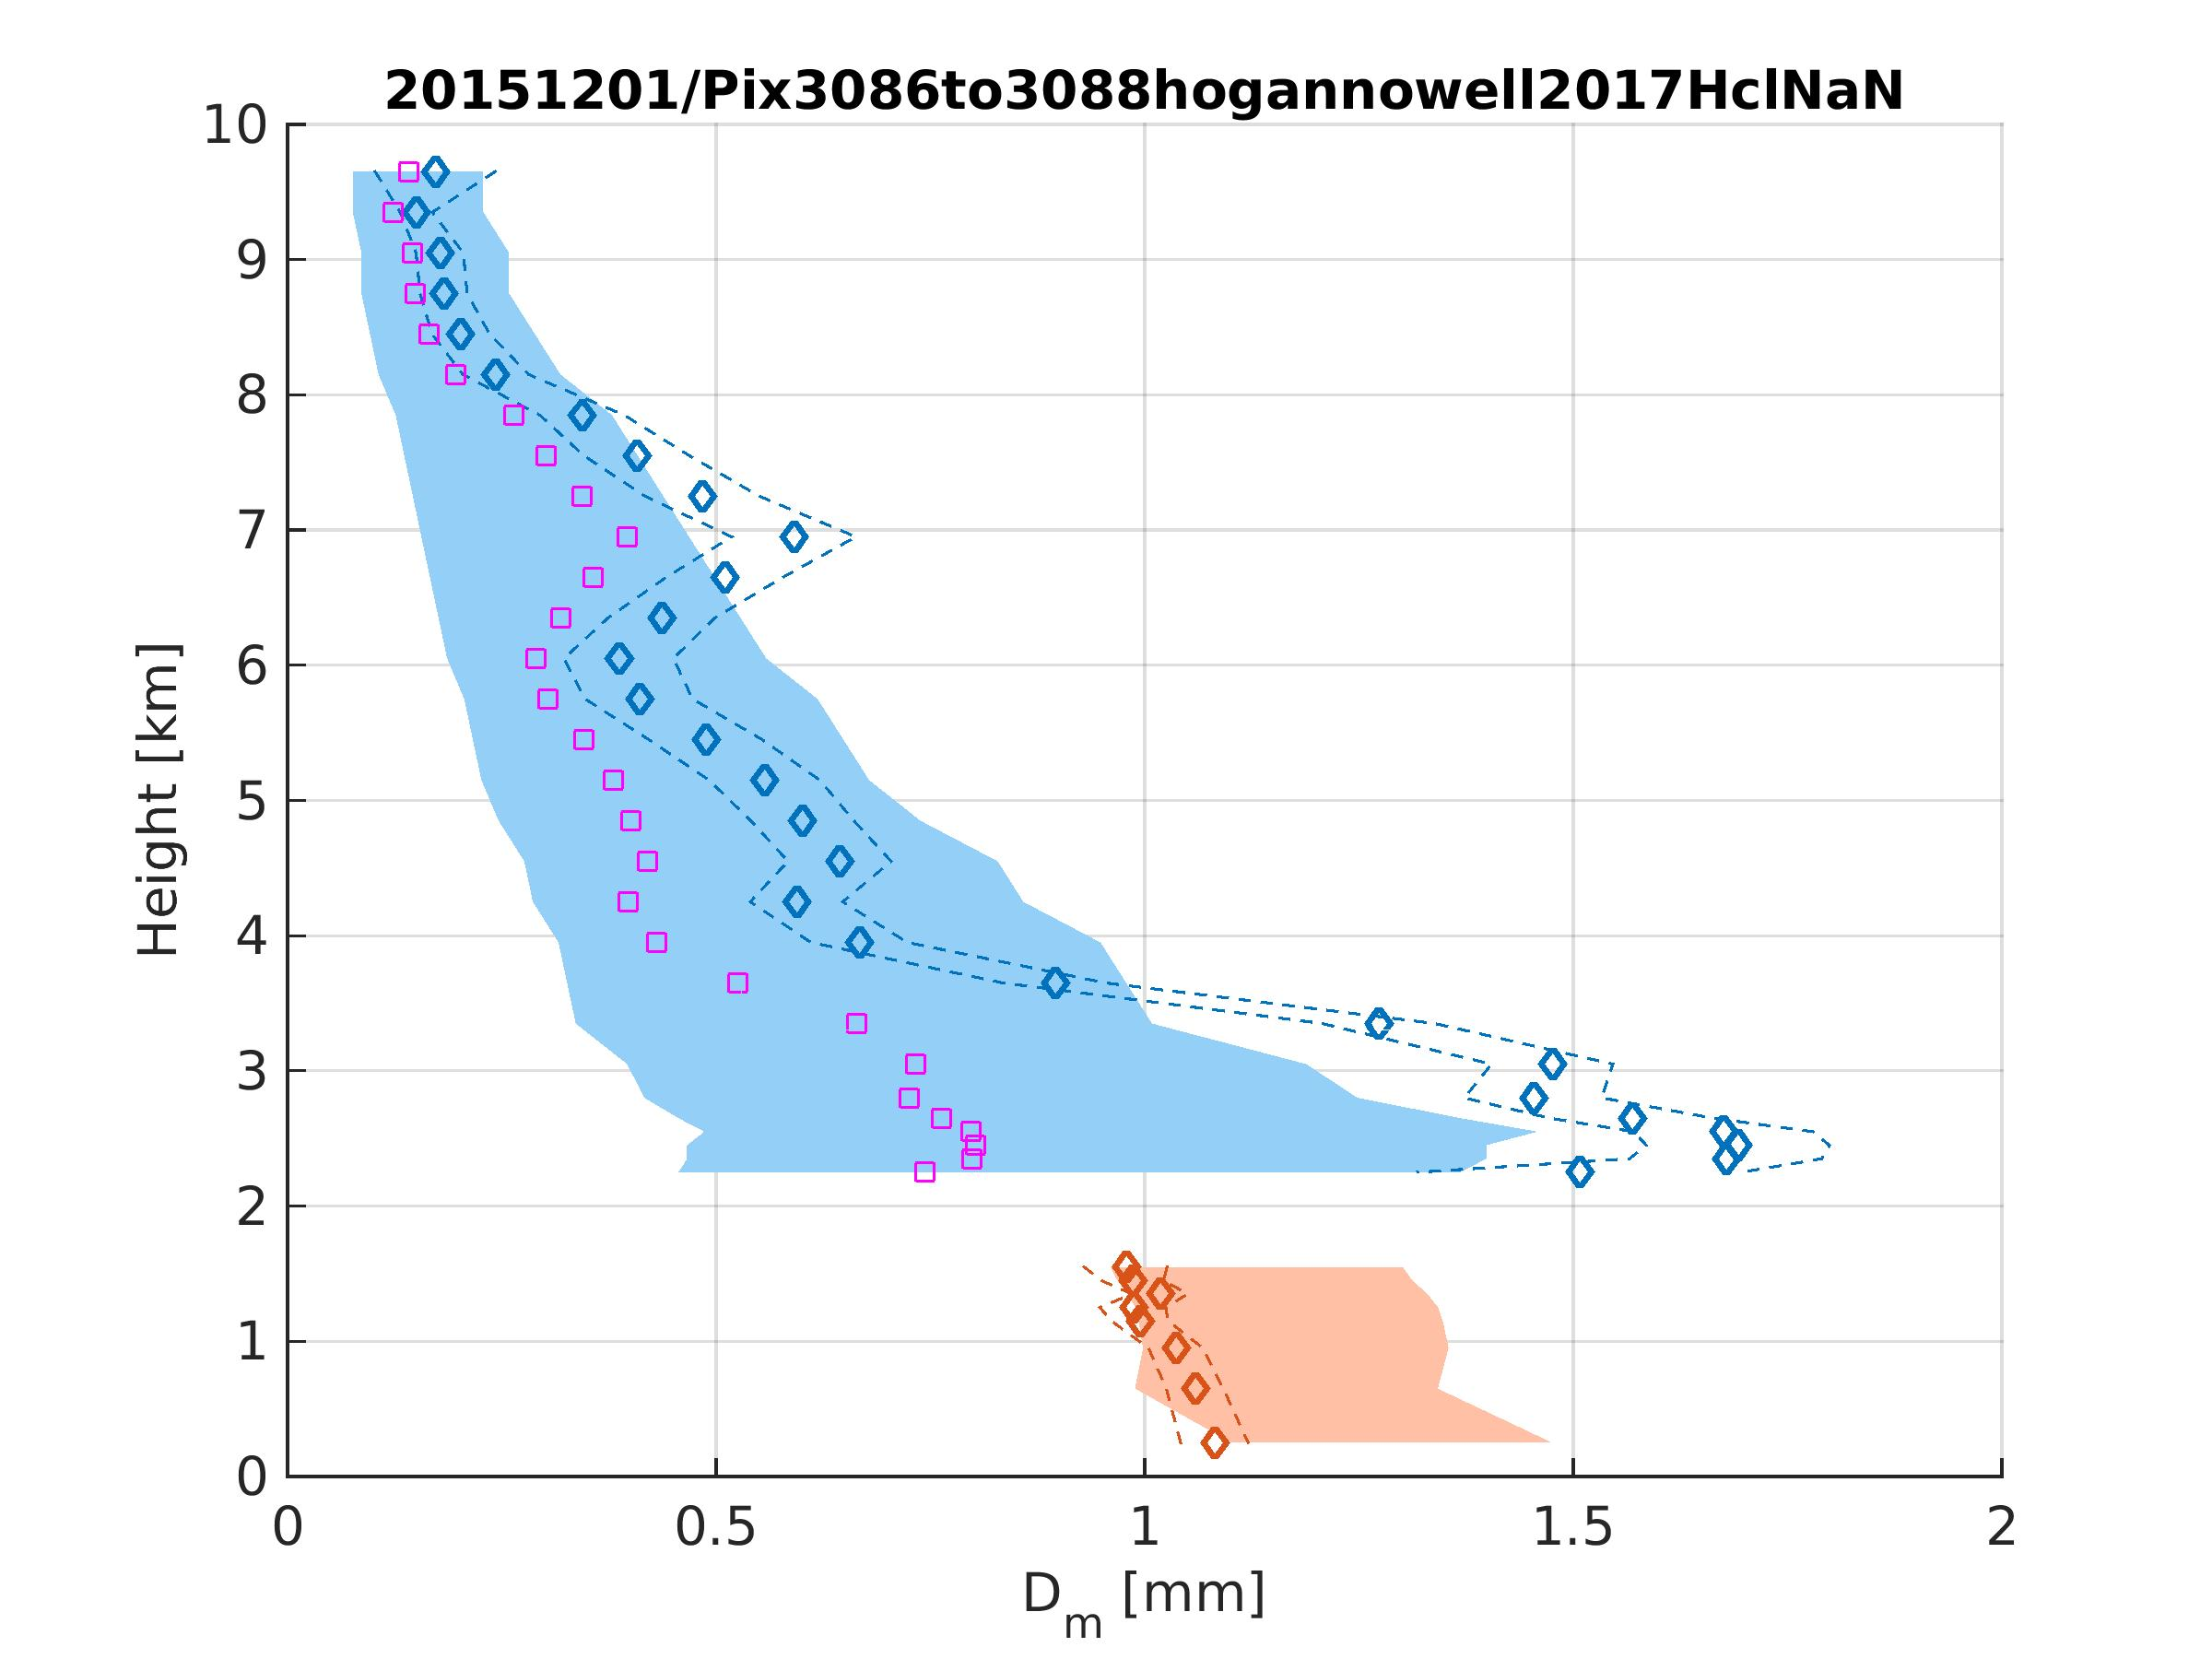
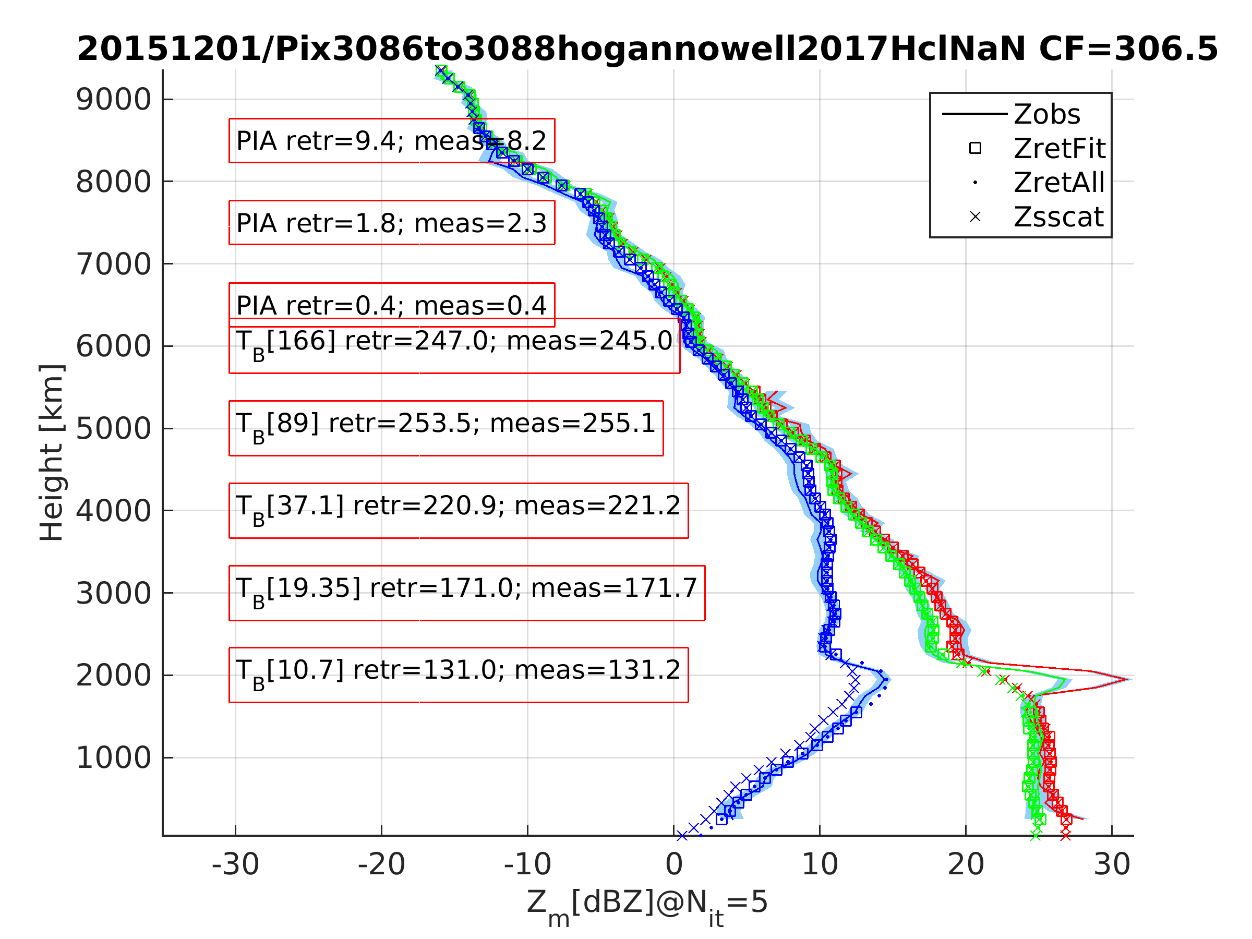
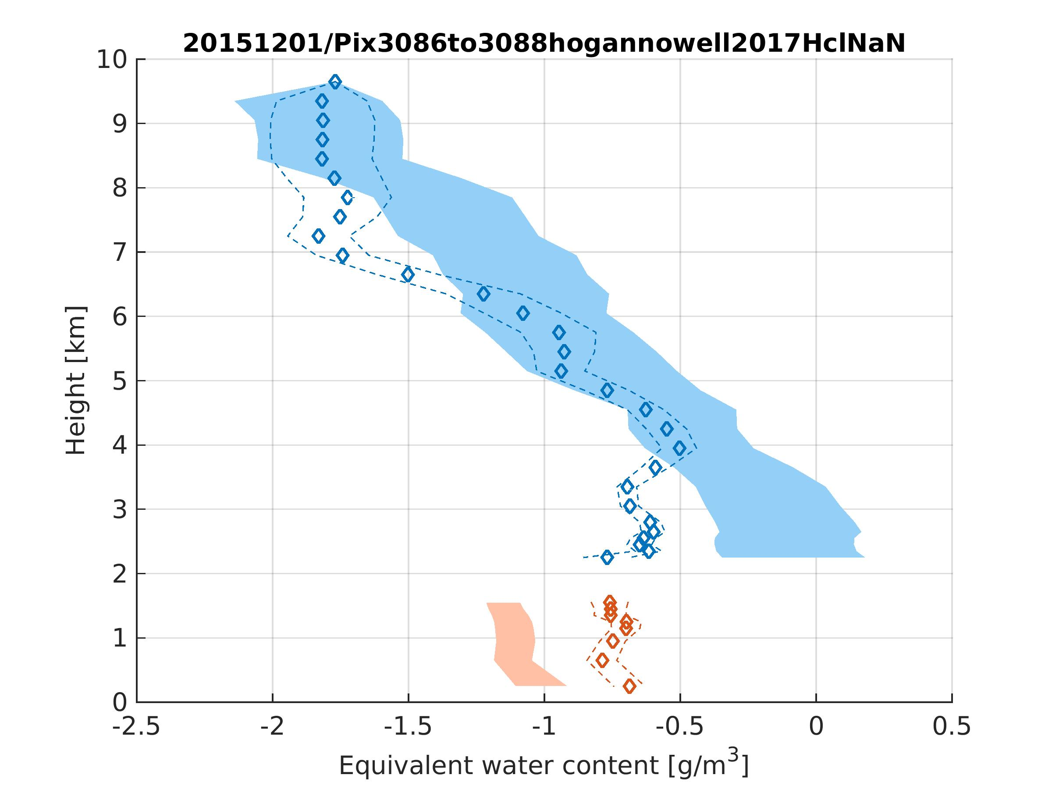
Retrieval technique
Variational method: finds the best profiles optimally matching the measurements
Unknowns: Dm, WC + snow habit
Measurements: 3 Z profiles with PIA, 5 TBs
Exponential PSD
Gamma DSD
D_{m} [mm]
Z [dBZm] Ku Ka W
Example of retrieval with habit from Hogan and Nowell (2017)
WC [g m⁻³]

Slide 8
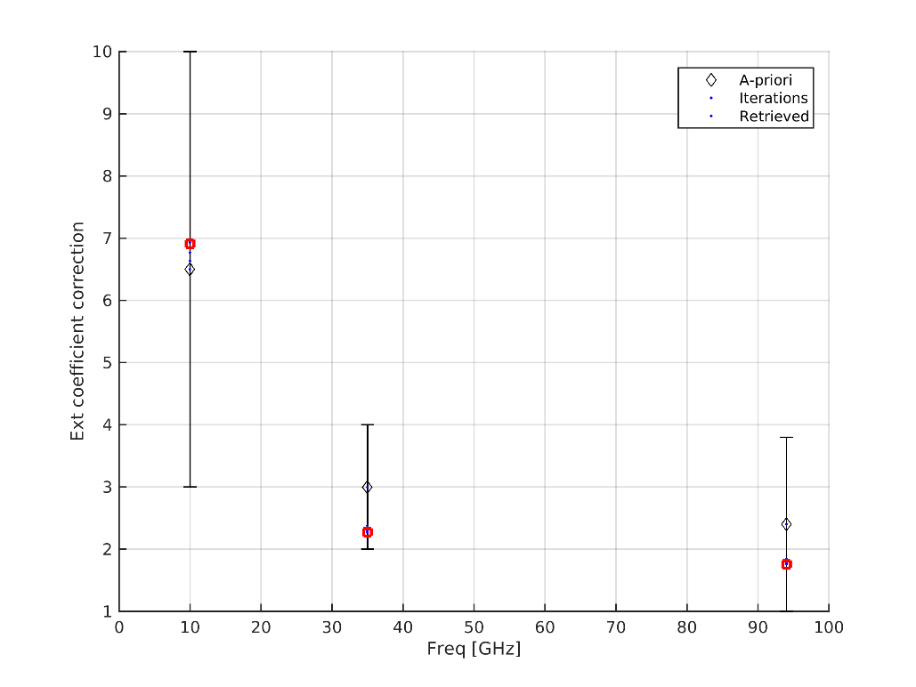
Melting layer
Measurements: 3 Z profiles with PIA, 5 TBs
Z [dBZm] Ku Ka W
Is PIA@Ka really 6 times PIA@Ku?
Hopefully more insight from the next talk by our Japanese colleagues
Melting layer is treated as a black box (Z measurements are not fitted). Extinction is parametrized as a function of the rain rate below.

Slide 9
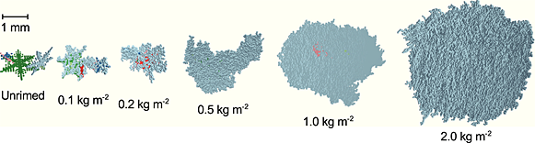
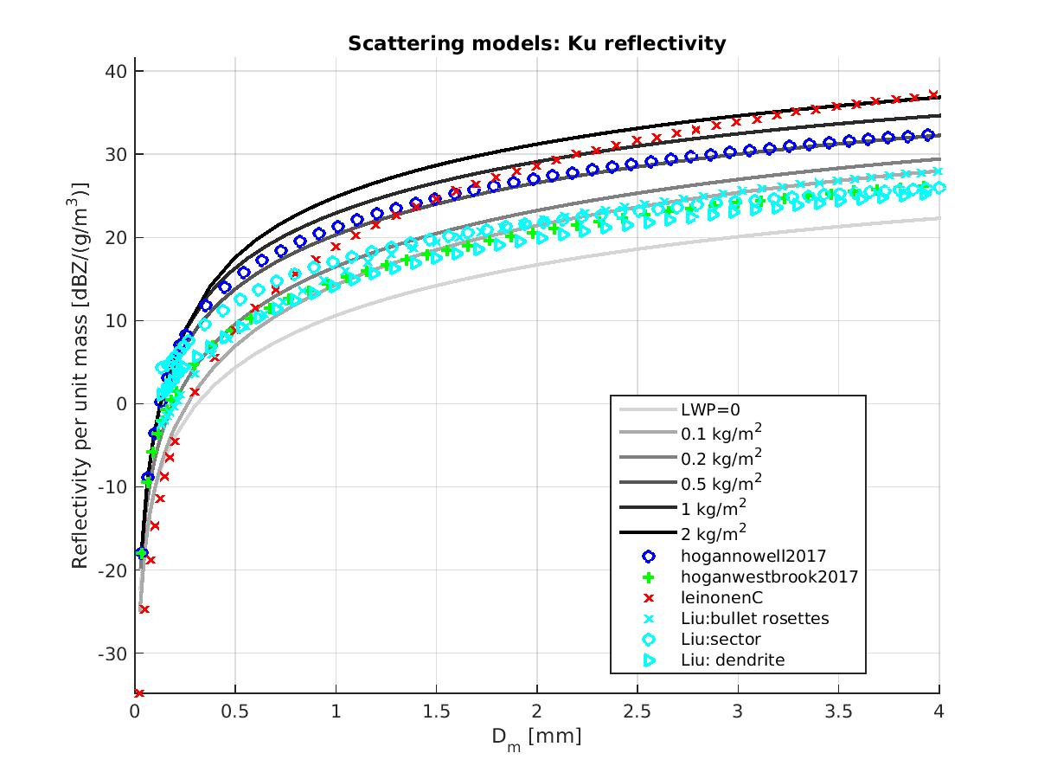
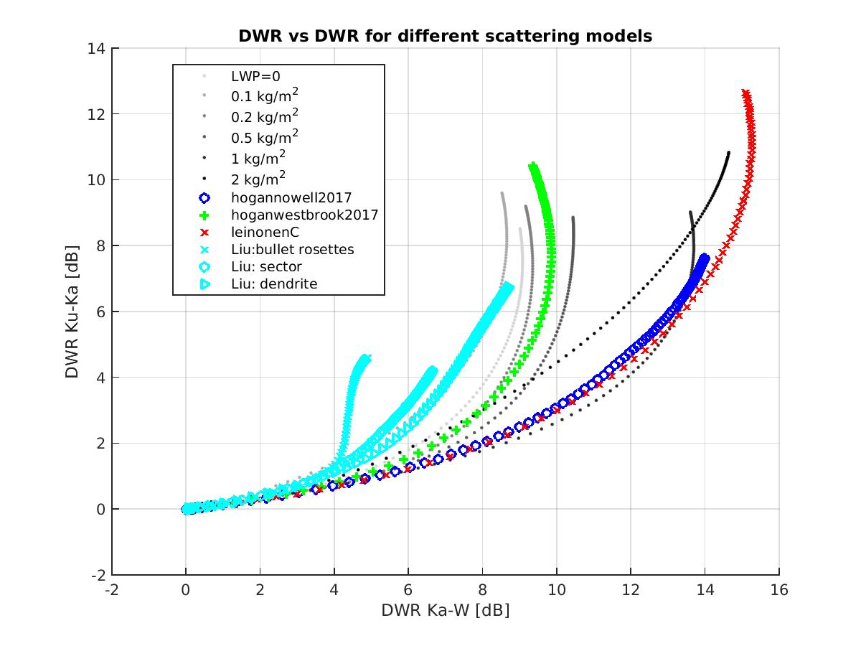
Scattering models
Ice scattering properties are derived according to the most recent scattering models:
Liu DDA (BAMS 2007)
Hogan Self-similar Rayleigh-Gans (JAMC 2017)
Leinonen aggregation and riming particles (Earth and Space Science 2015)
Next slides, examples of retrieval using two contrasting habits: hoganwestbrook2017 vs. leinonenC

Slide 10
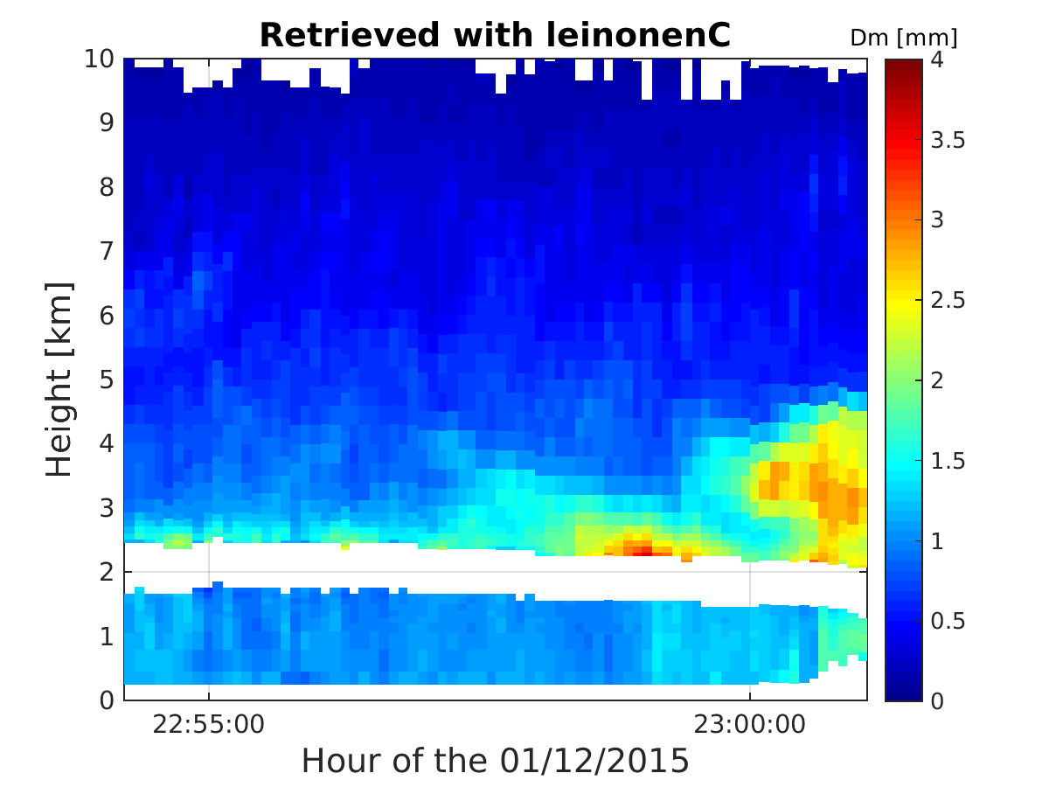
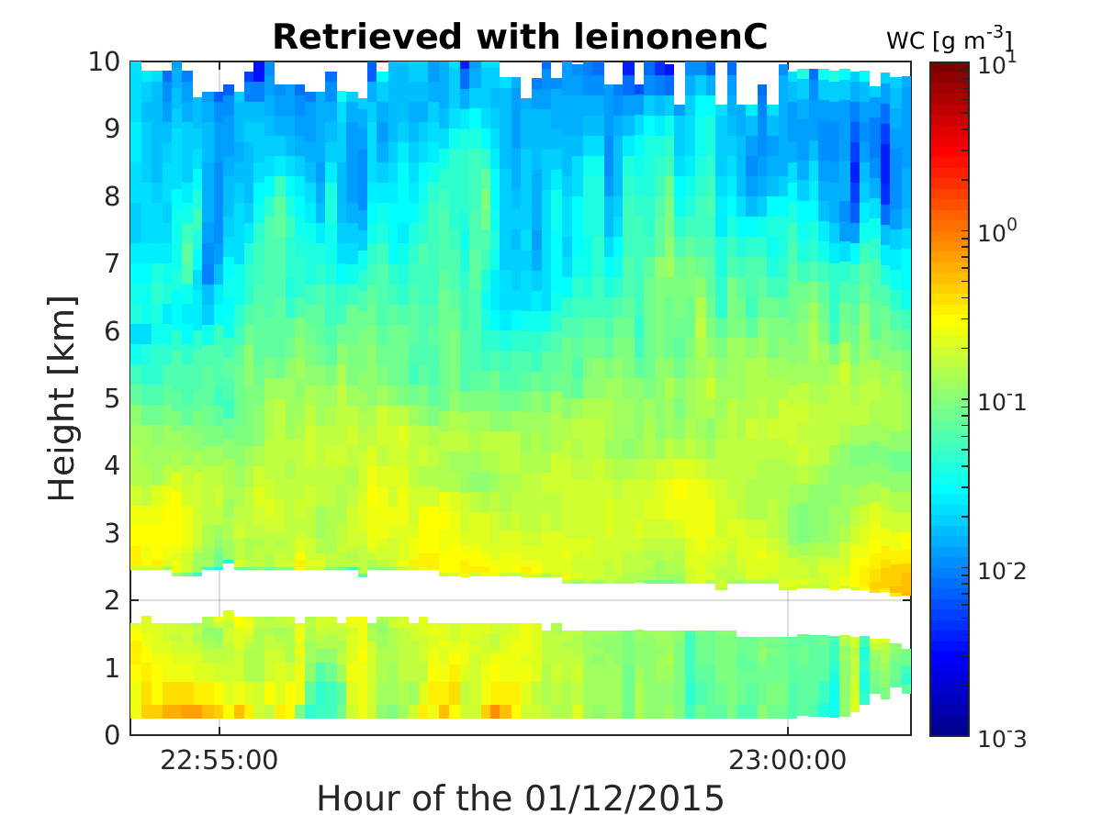
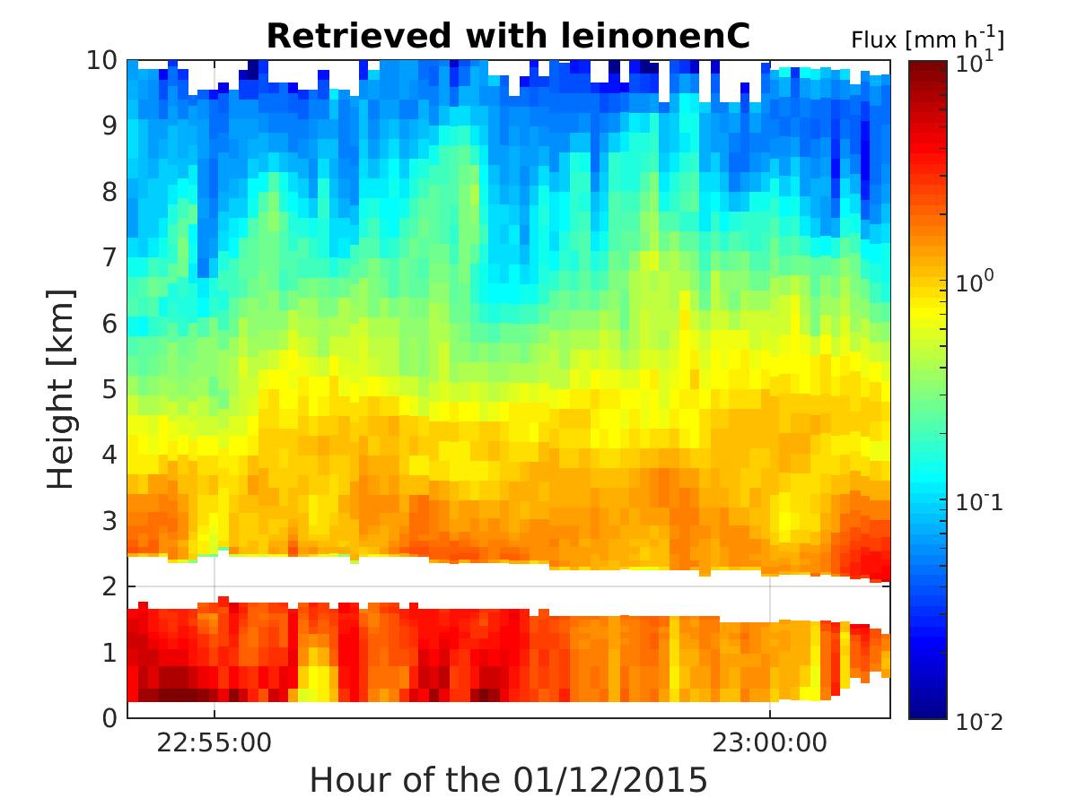
Retrieval with leinonenC habit
Mean volume diameter [mm]
Water content [g m⁻³]
Melting layer
Flux [mm h⁻¹]
Retrieved rain microphysics well constrained in the retrieval
Clearly increase of D_{m} (1 mm over ocean to 1.5 mm over orography)
Retrieved snow microphysics strongly dependent on snow scattering model

Slide 11
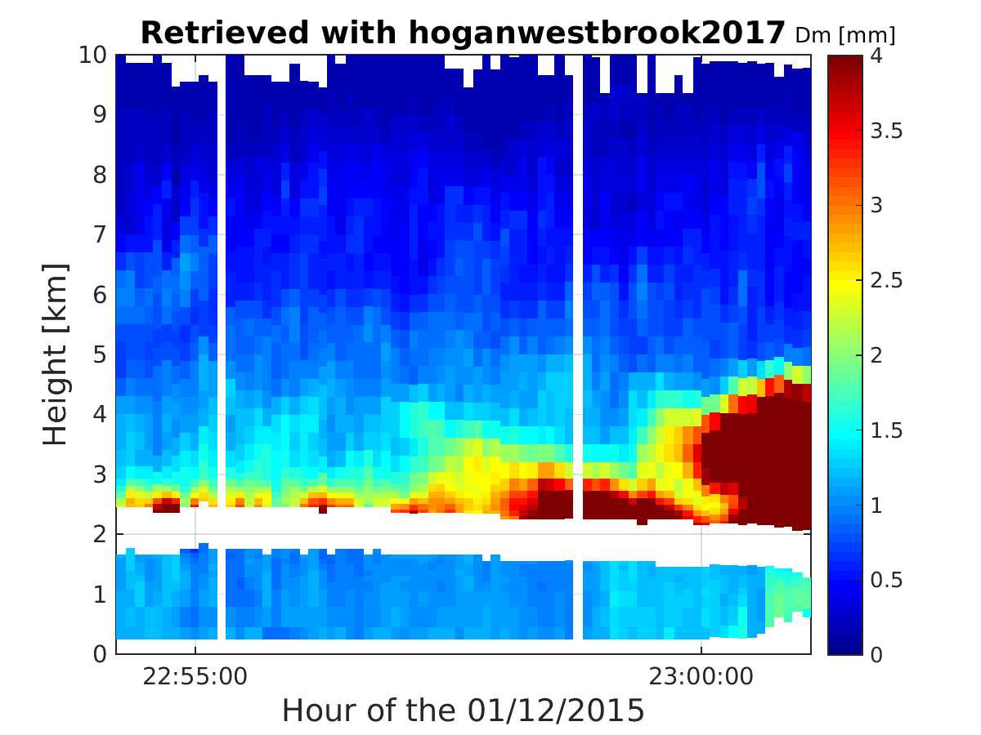
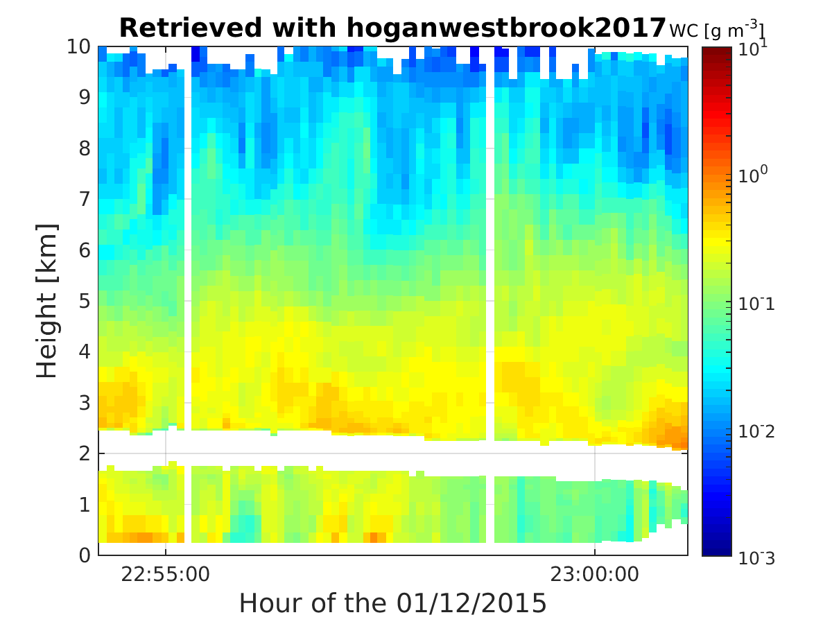
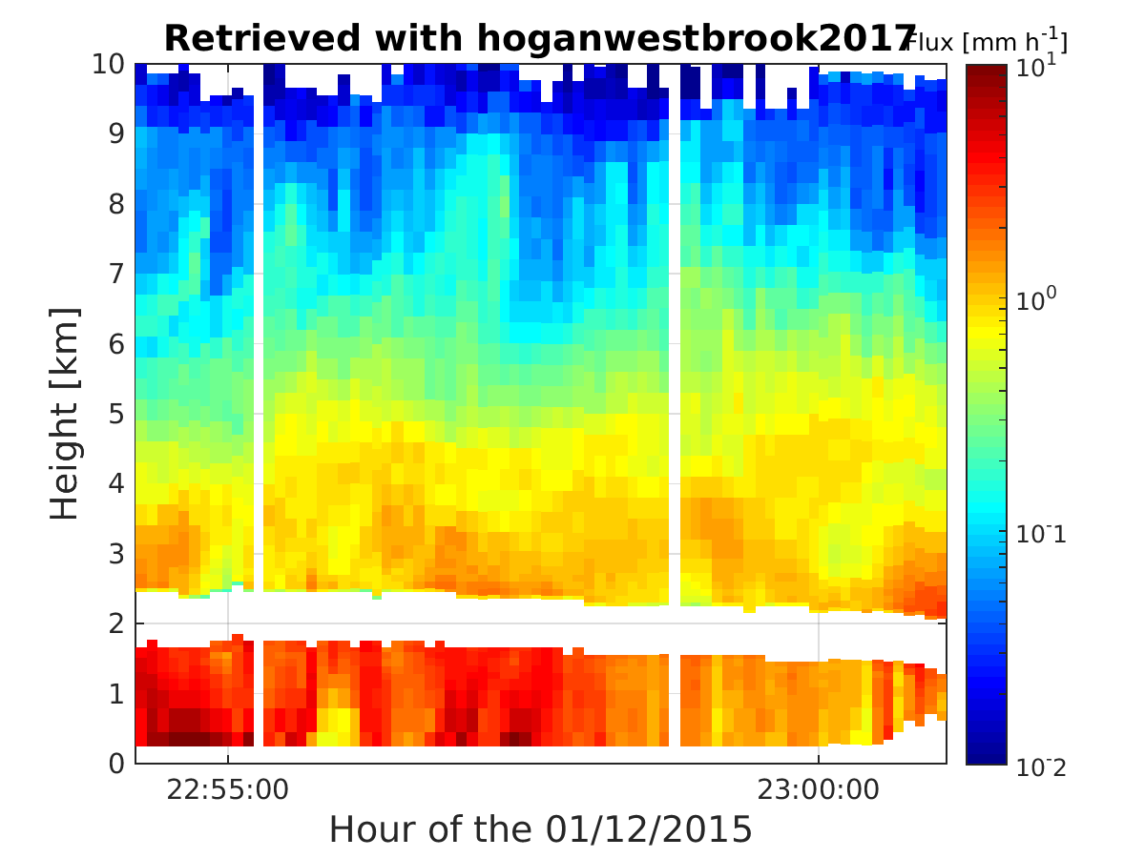
Retrieval with hoganwestbrook2017 habit
Mean volume diameter [mm]
Water content [g m⁻³]
Flux [mm h⁻¹]
Multiple possible solutions
→ filter unrealistic ones using in-situ statistics, matching with PIA and TBs, cost function, continuity in flux, etc.

Slide 12
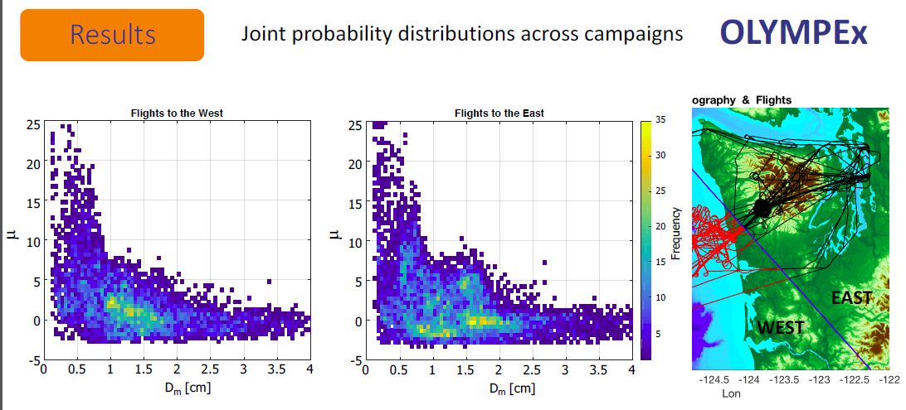
PSD statistics from in-situ measurements
D_{m} [mm]
D_{m} [mm]
From McFarquhar et al., 2017: Aircraft PSD Studies Using UND Citation Data, OLYMPEX Workshop, Seattle, 22 March 2017
→ Snow D_{m} rarely larger than 2.5 mm

Slide 13
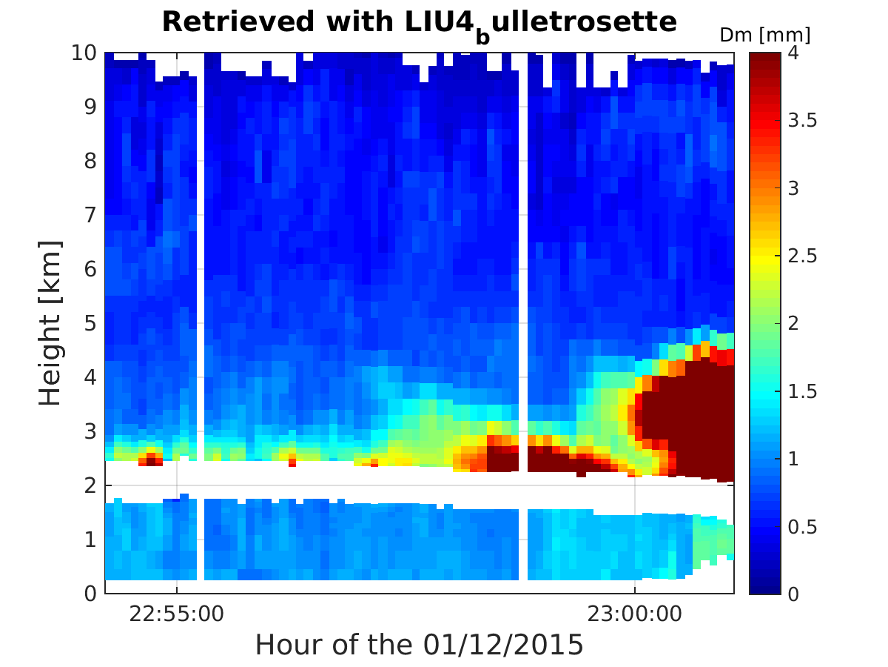
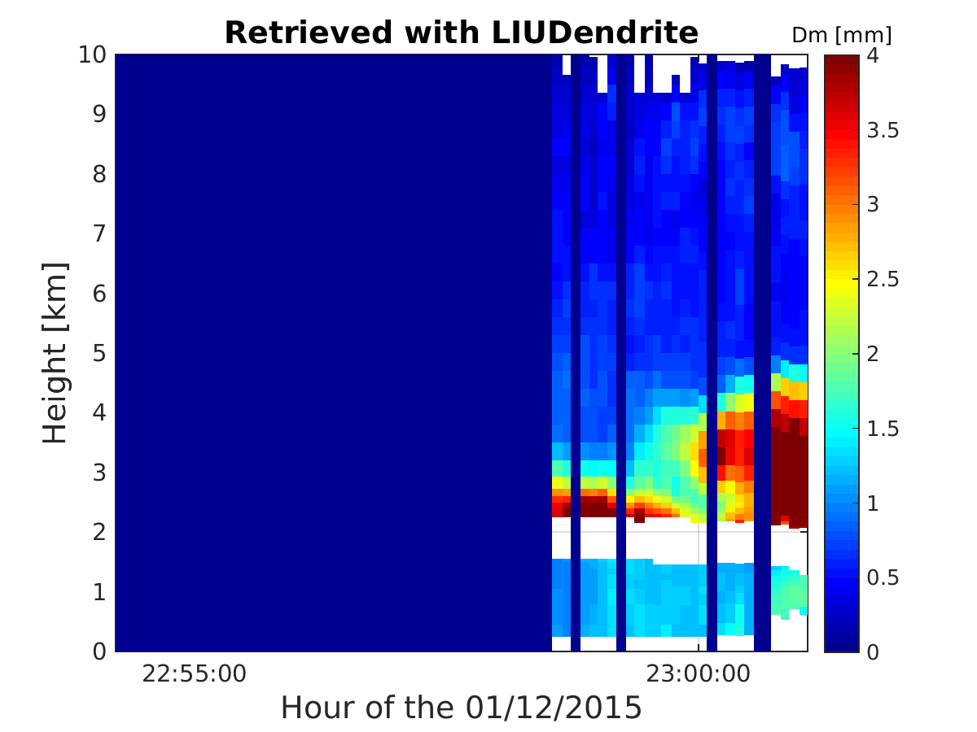
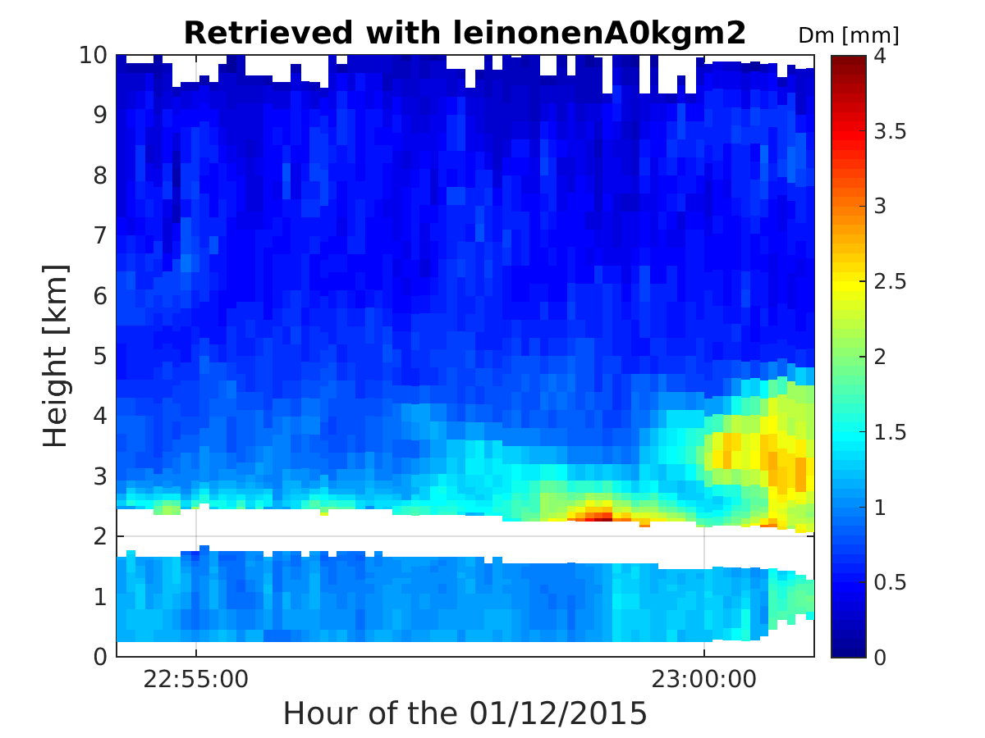
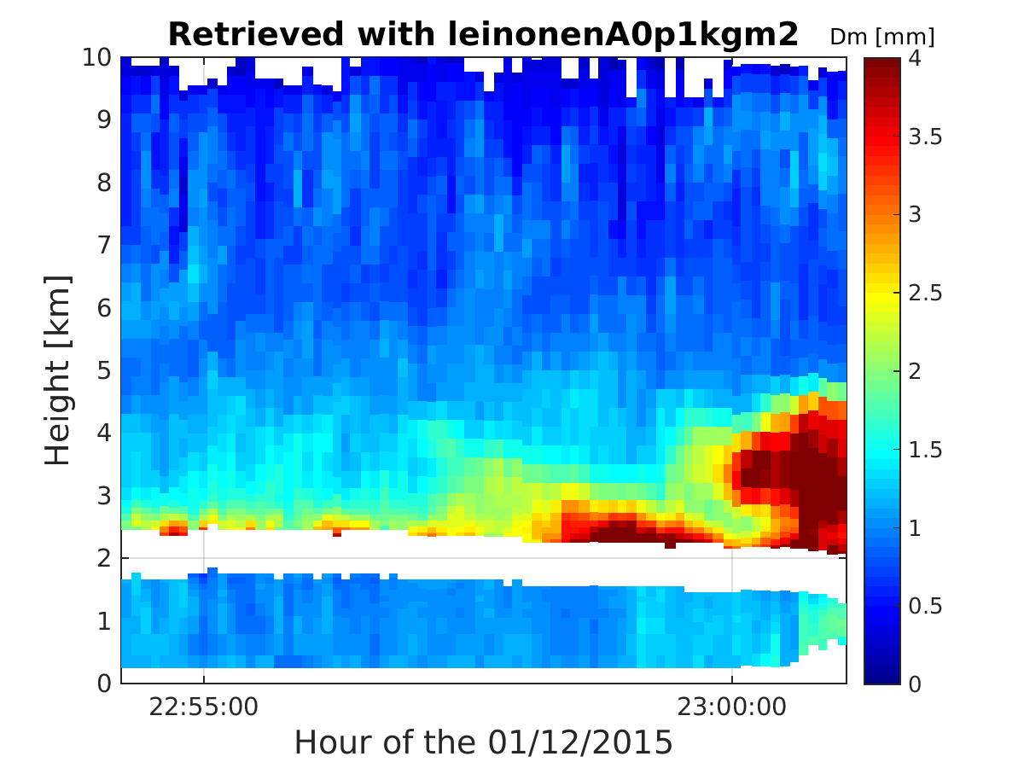
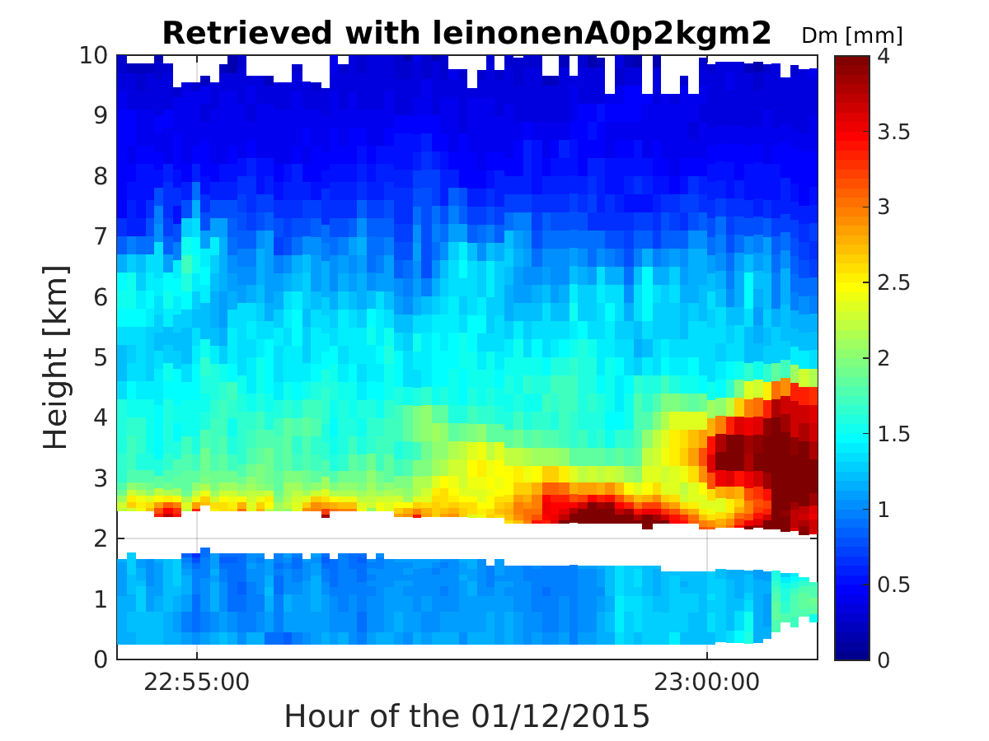
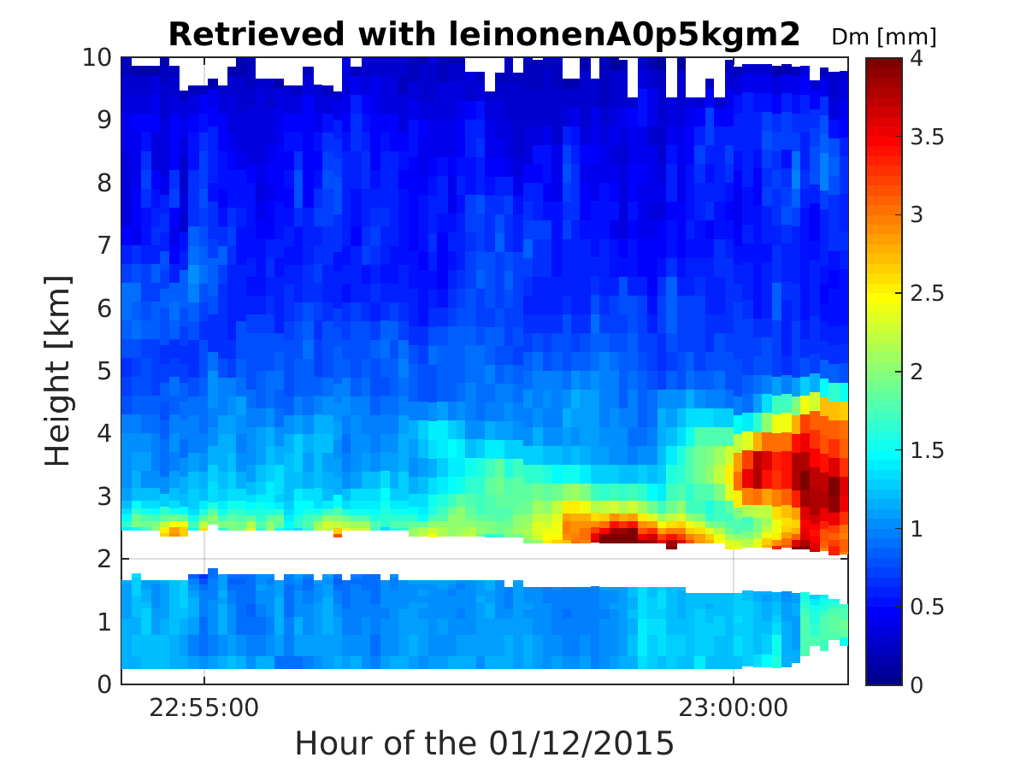
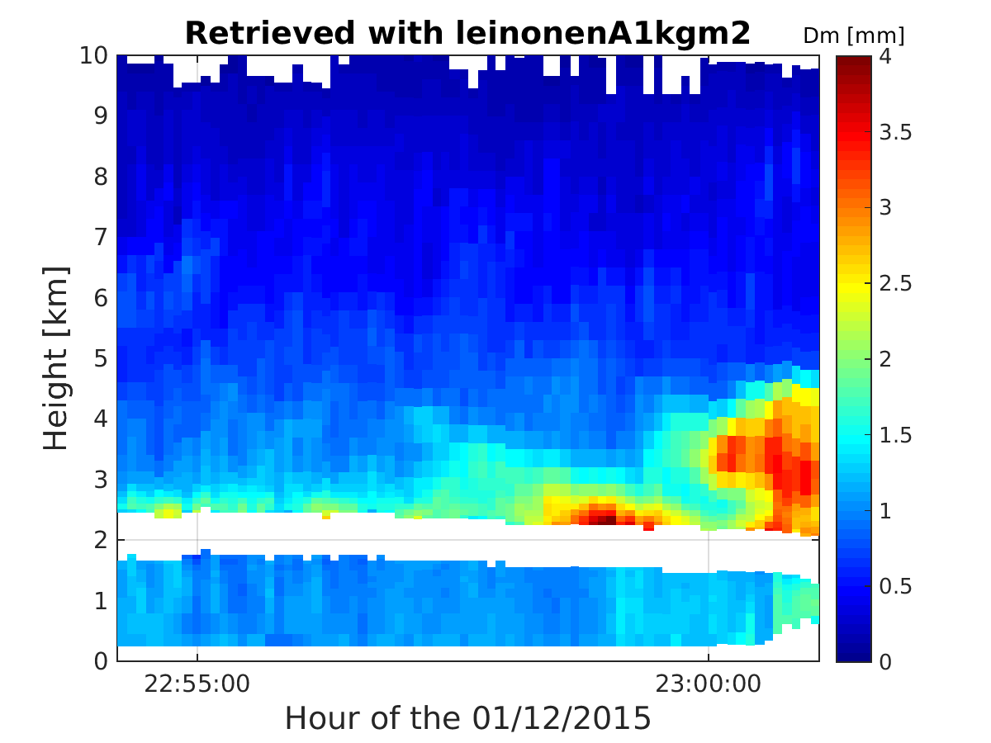
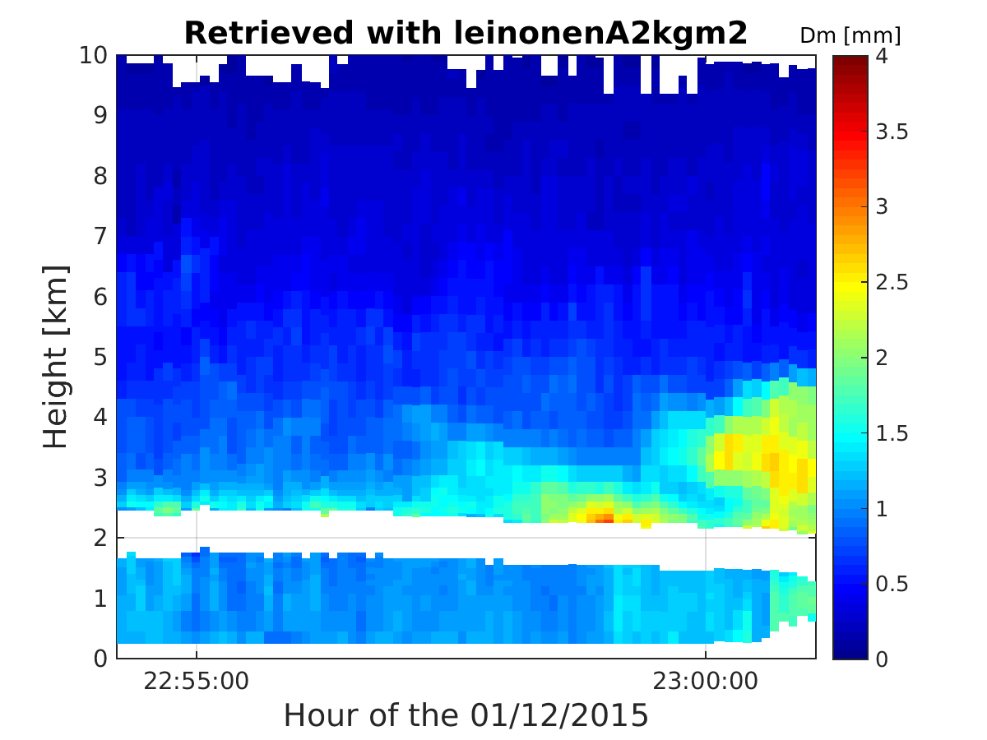
Unrealistic D_{m} compared to in-situ measurements
Similar with leinonenB

Slide 14
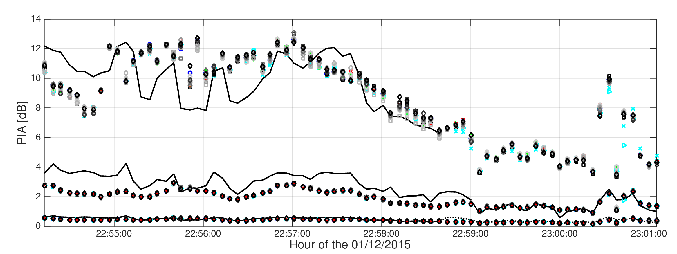
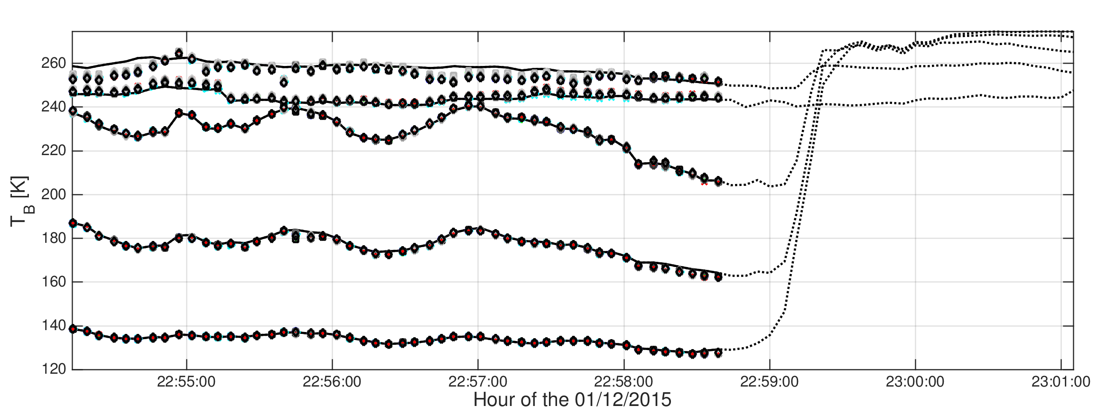
Matching with PIA and TBs
Over ocean
Over land
W
Is PIA@Ka really 6 times PIA@Ku?
Ka
Ku
85GHz
19GHz
10GHz

Slide 15
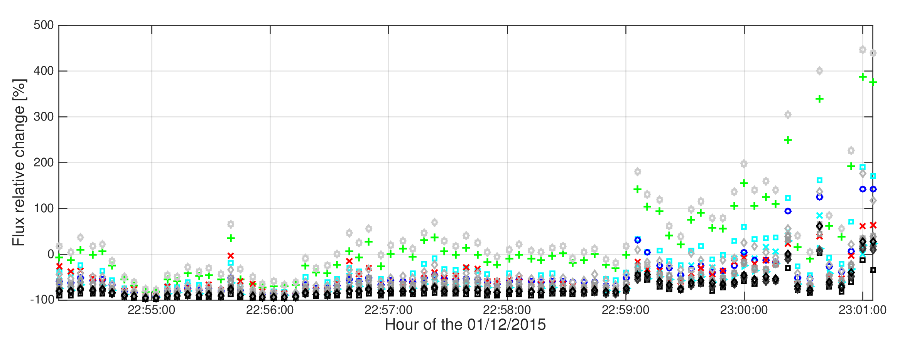
Flux continuity between snow and rain
Flux relative change [%] = (snow rate – rain rate) / rain rate
Factor
2 boundary
In first instance, the flux change could be expected to be close to zero?
but it can change if microphysics processes strongly modify the shape of the PSD (e.g. aggregation in the melting layer, evaporation below cloud base, …)
On going work (parametrization of fall speed still with large uncertainties ➔ MASC observation could help)

Slide 16
Conclusions
Optimal estimation retrieval for multi-wavelength active and passive microwave OLYMPEX airborne observations developed with recently developed scattering properties LUT.
Rain microphysics well constrained by observations ➔ for the example shown there is an increase of Dm moving from the ocean inland (confirmed by disdrometers observations)
Snow microphysics still challenging (difficult to discriminate between different degree of riming ➔ triple frequency signatures are not so clear as previously highlighted in some case studies ➔ in situ constraints crucial to down-select solutions)
Bright band extinction need to be better parametrized as a function of rain rate (important for Ku-Ka PIA relationship critical to derive PIA over land)
Future work: analysis currently restricted to few legs will be extended to the most interesting OLYMPEX case studies (including GPM overpasses) ➔ identification of
process variability (ice properties and contribution to total rain/snowfall) as a function of regimes still challenging based on airborne-only measurements.

