Slide 1



Hail detection algorithm
for the Global Precipitation Measuring
mission core satellite sensors
Kamil Mroz², Alessandro Battaglia^{1,2}, Timothy J. Lang³, Daniel Cecil³, S. Tanelli⁴ and Frederic Tridon¹
1. Department of Physics and Astronomy, University of Leicester, UK
2. National Centre for Earth Observation, University of Leicester, Leicester, United Kingdom, Department of Physics and Astronomy, University of Leicester, UK
3. NASA Marshall Space Flight Center, Redstone Arsenal, Huntsville, USA.
4. NASA JPL, California Institute of Technology, USA
Notes:
1

Slide 2
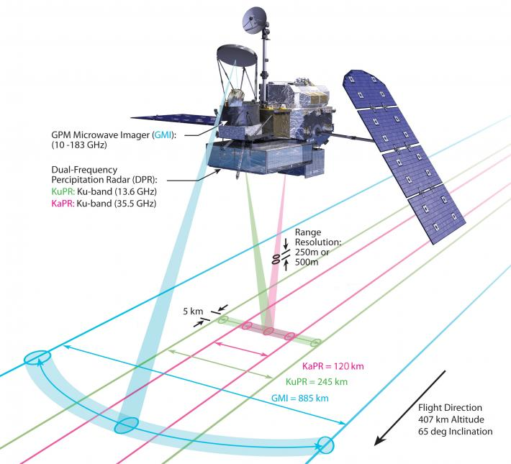
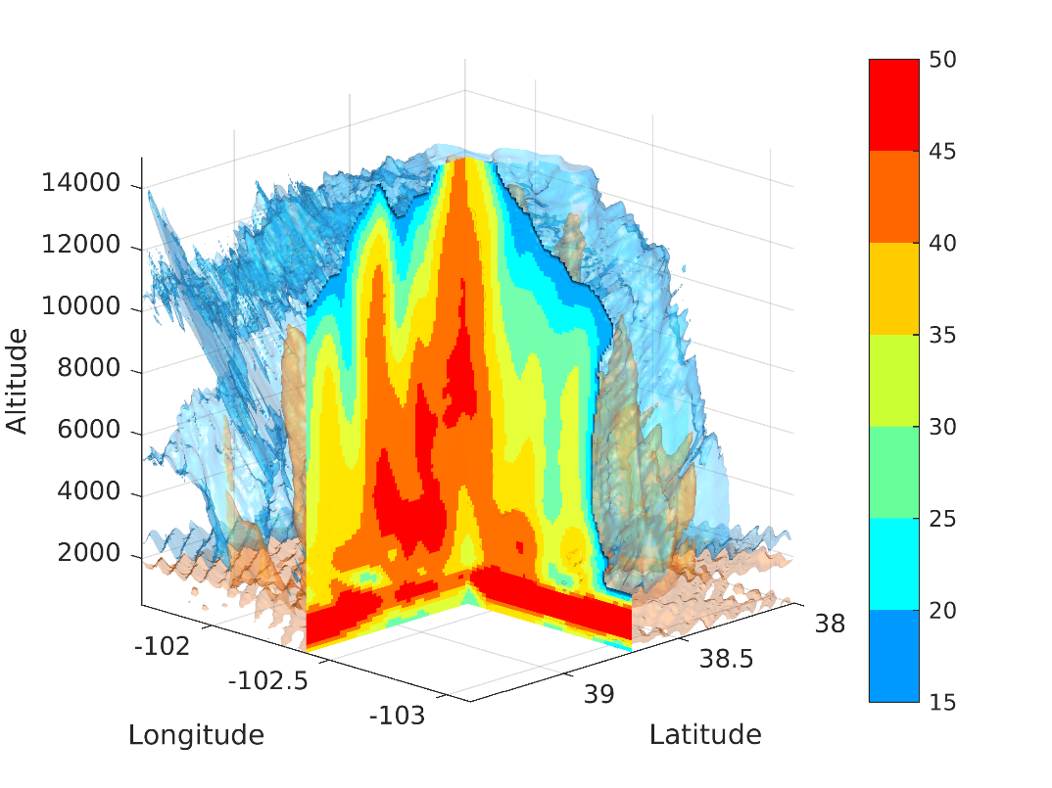
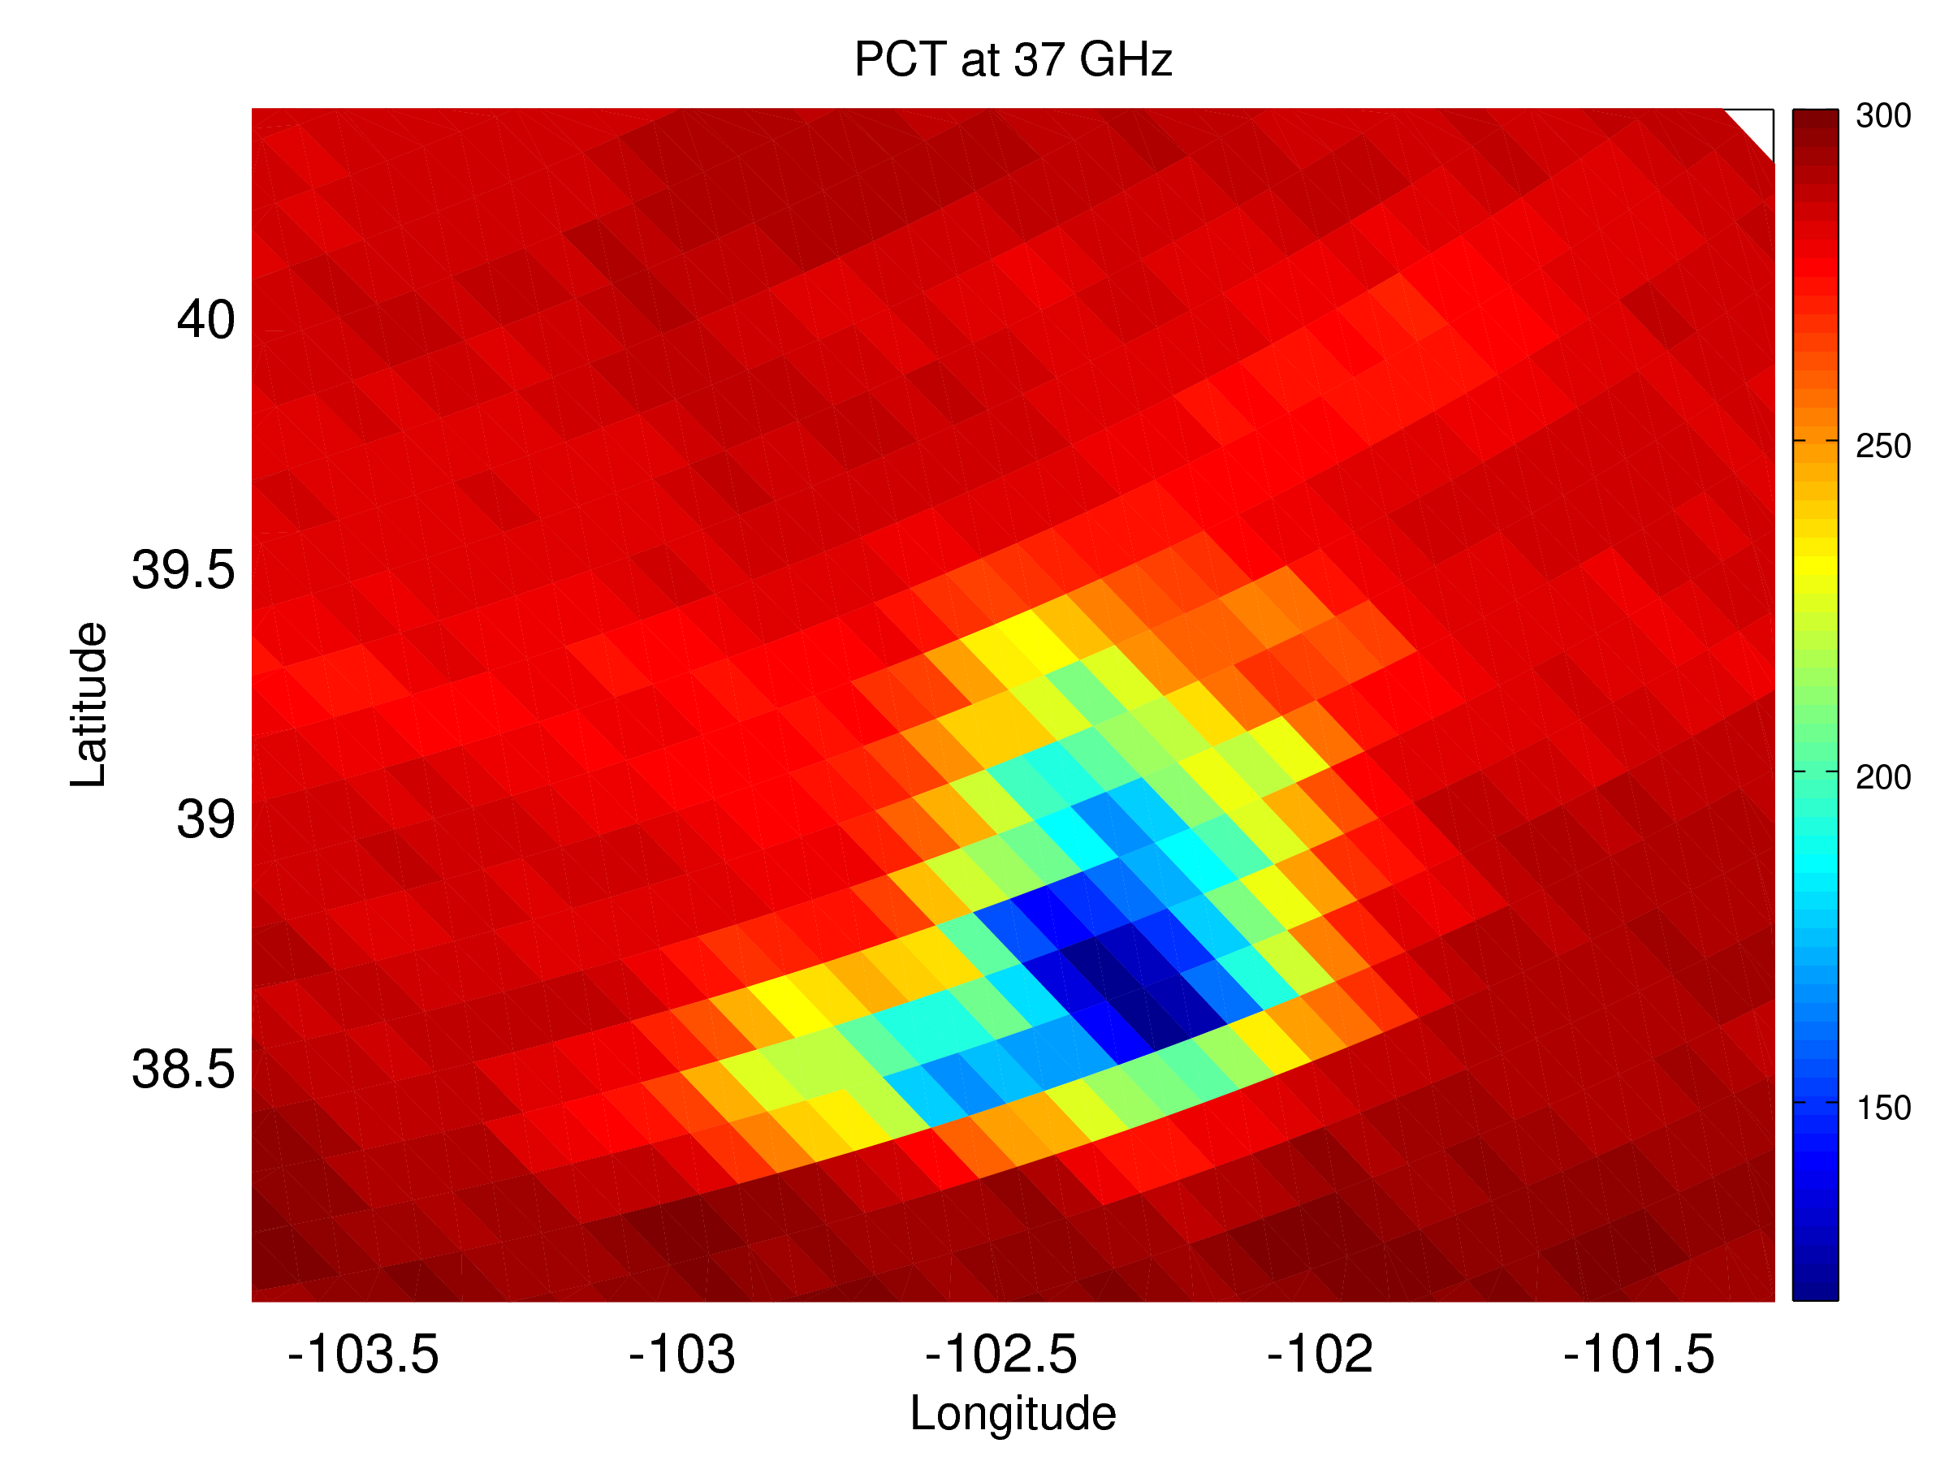
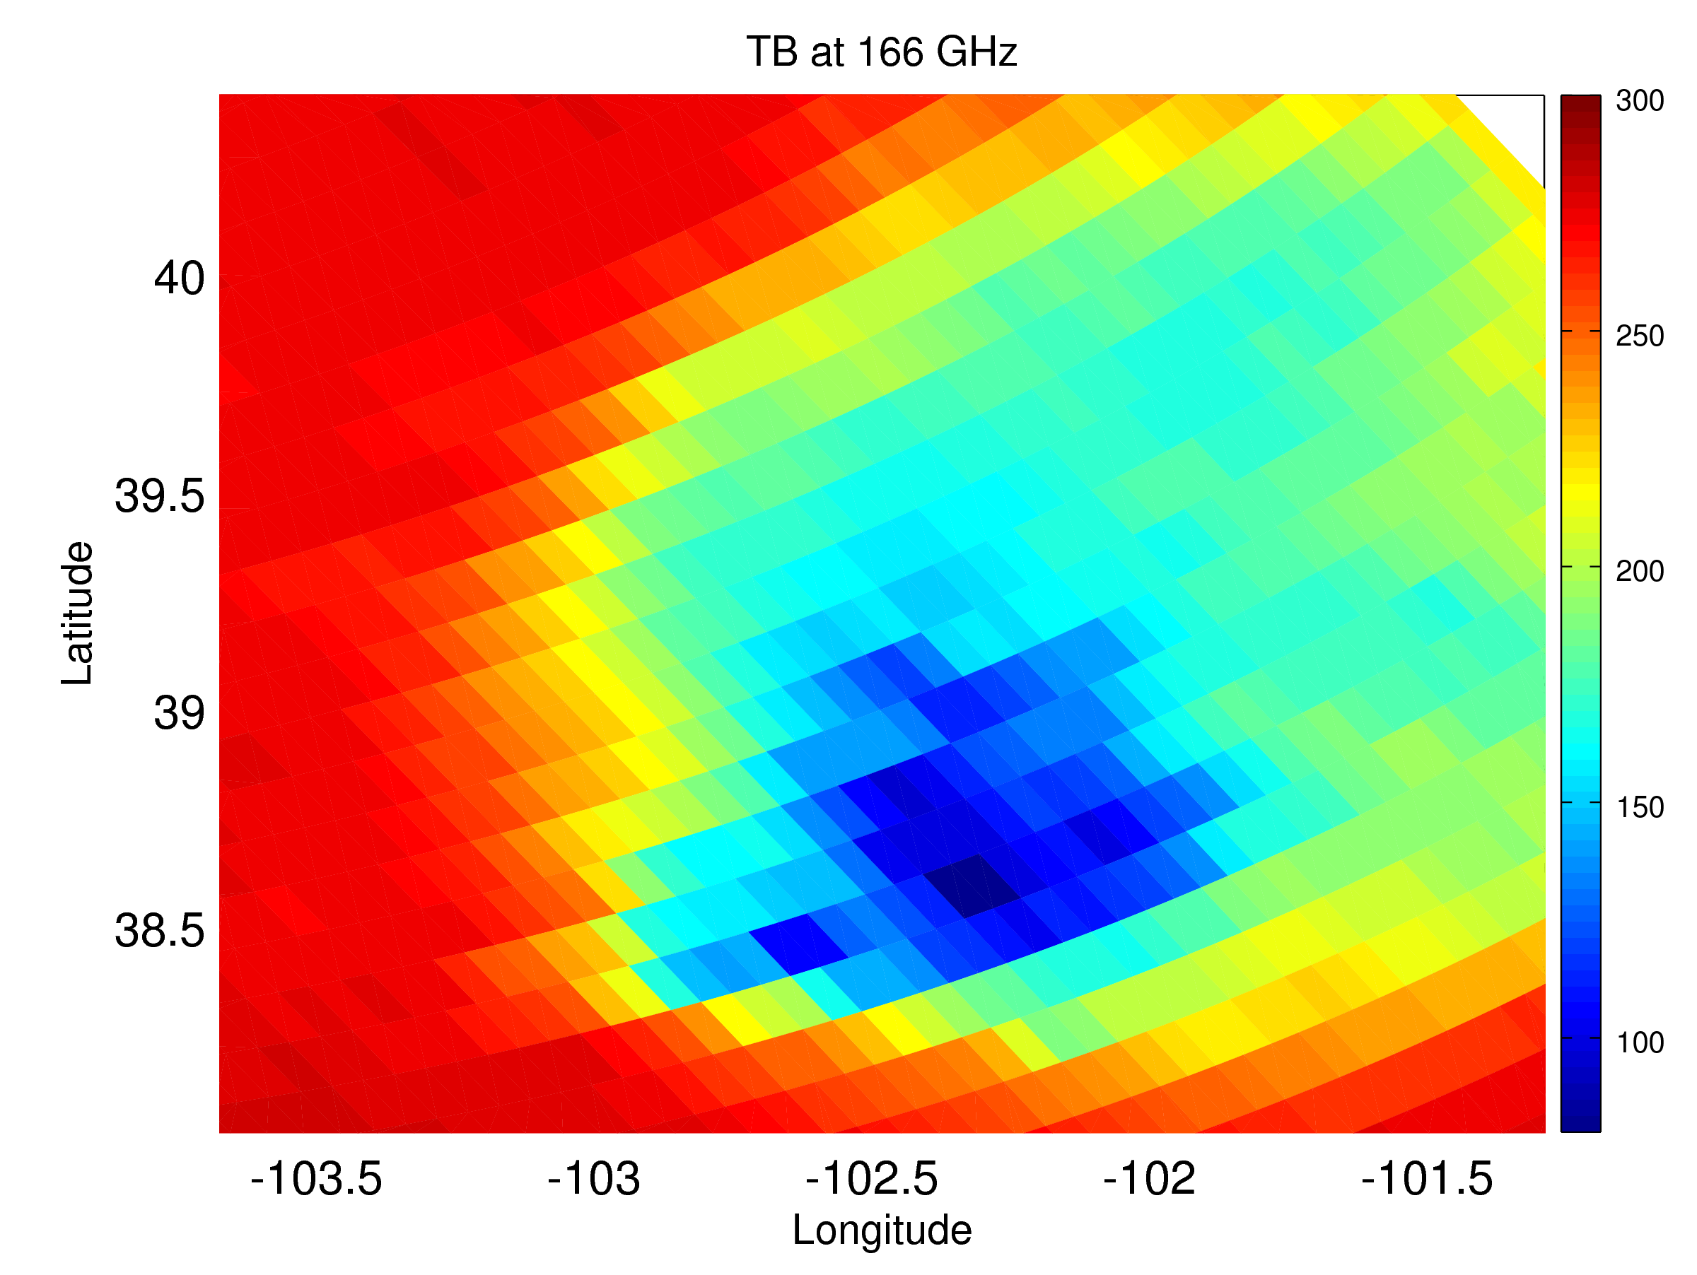
Opportunity: NASA-JAXA Global Precipitation Measuring mission
The GPM radar is the first ever dual frequency (Ku-Ka) precipitation radar in space with a radiometer system operating at 13 different channels ranging from 10 to 188 GHz.
Three-dimensional view of the convective event captured on 2nd April 2014. The 3-D surface corresponds to the measured 15 and 40 dBZ Ku band reflectivity factors in blue and orange, respectively.
Notes:
2
2

Slide 3
Motivation
Extreme weather events in a changing climate: monitoring the intensity and frequency (regional/seasonal) of intense convective storms (and their changes) → the GPM satellite is providing measurements over 90% of the globe.
Modelling of convection
→ time of the occurrence (non sun-synchronous orbit)
→ vertical structure of hail shafts
Notes:
3

Slide 4
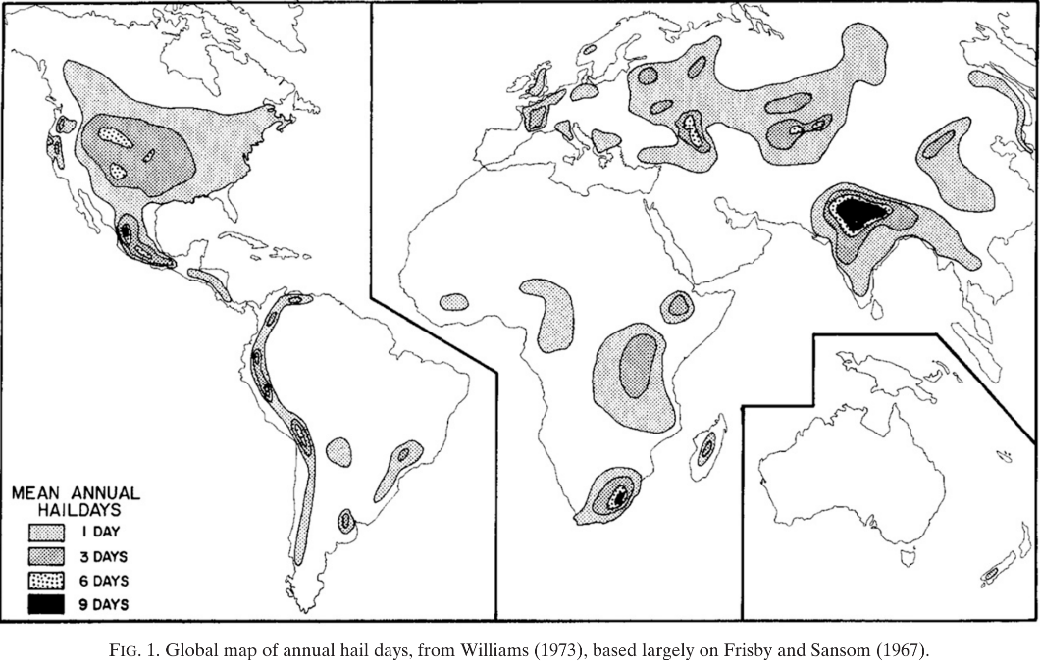
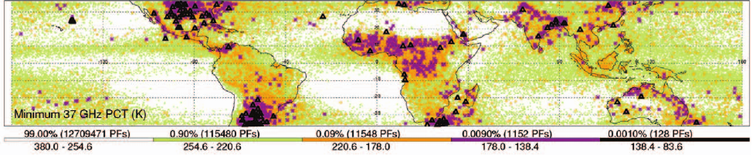
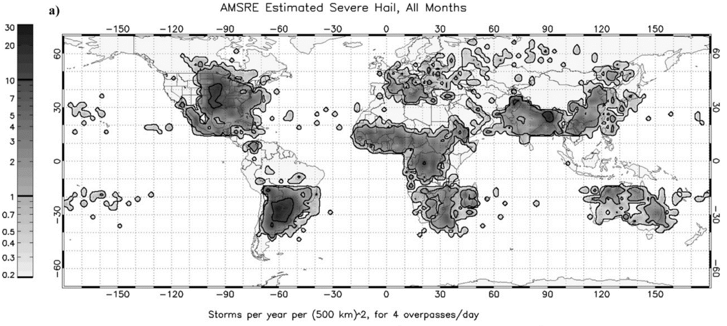
Previous studies
Williams 1973
The data gathered from government meteorological services and private individuals
Ground-based radars: occurrence of hail is strongly related to the storm height and to the maximal reflectivity values.
Zipser et al., 2006 showed a distribution of extreme storms in tropics based on proxies derived from different TRMM observations.
Cecil and Blankenship 2011
Hailstorm frequency of occurrence estimated from AMSR-E 36 GHz PCT

Slide 5
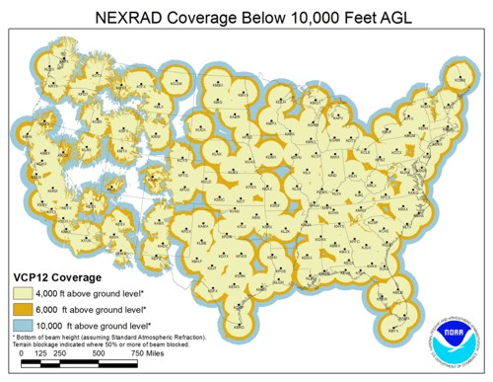
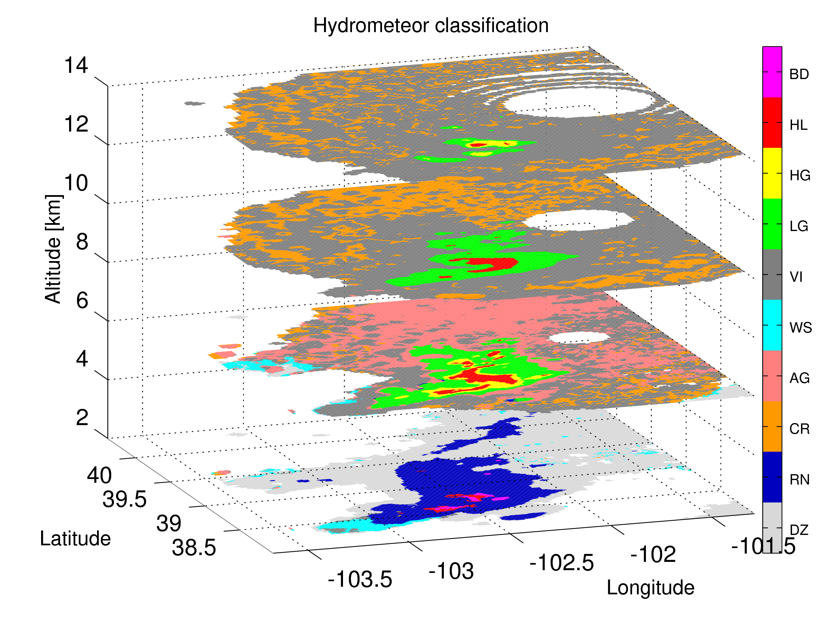
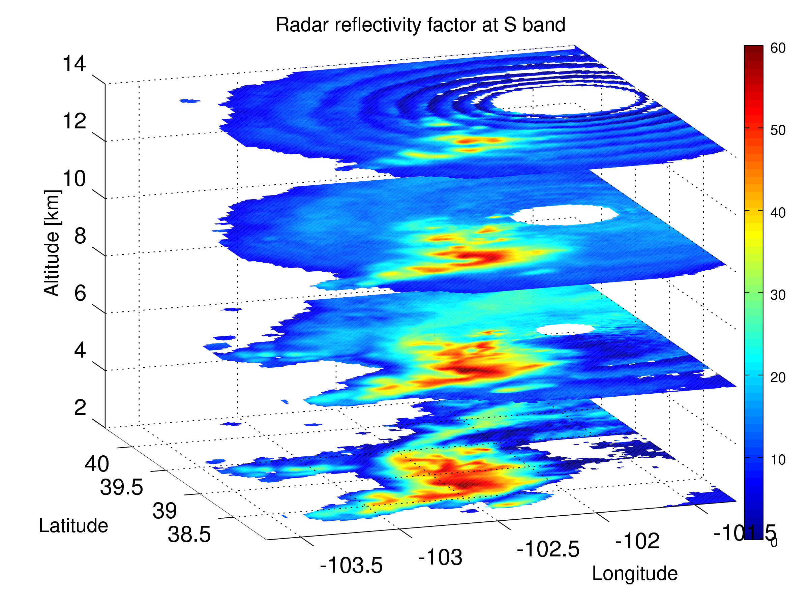
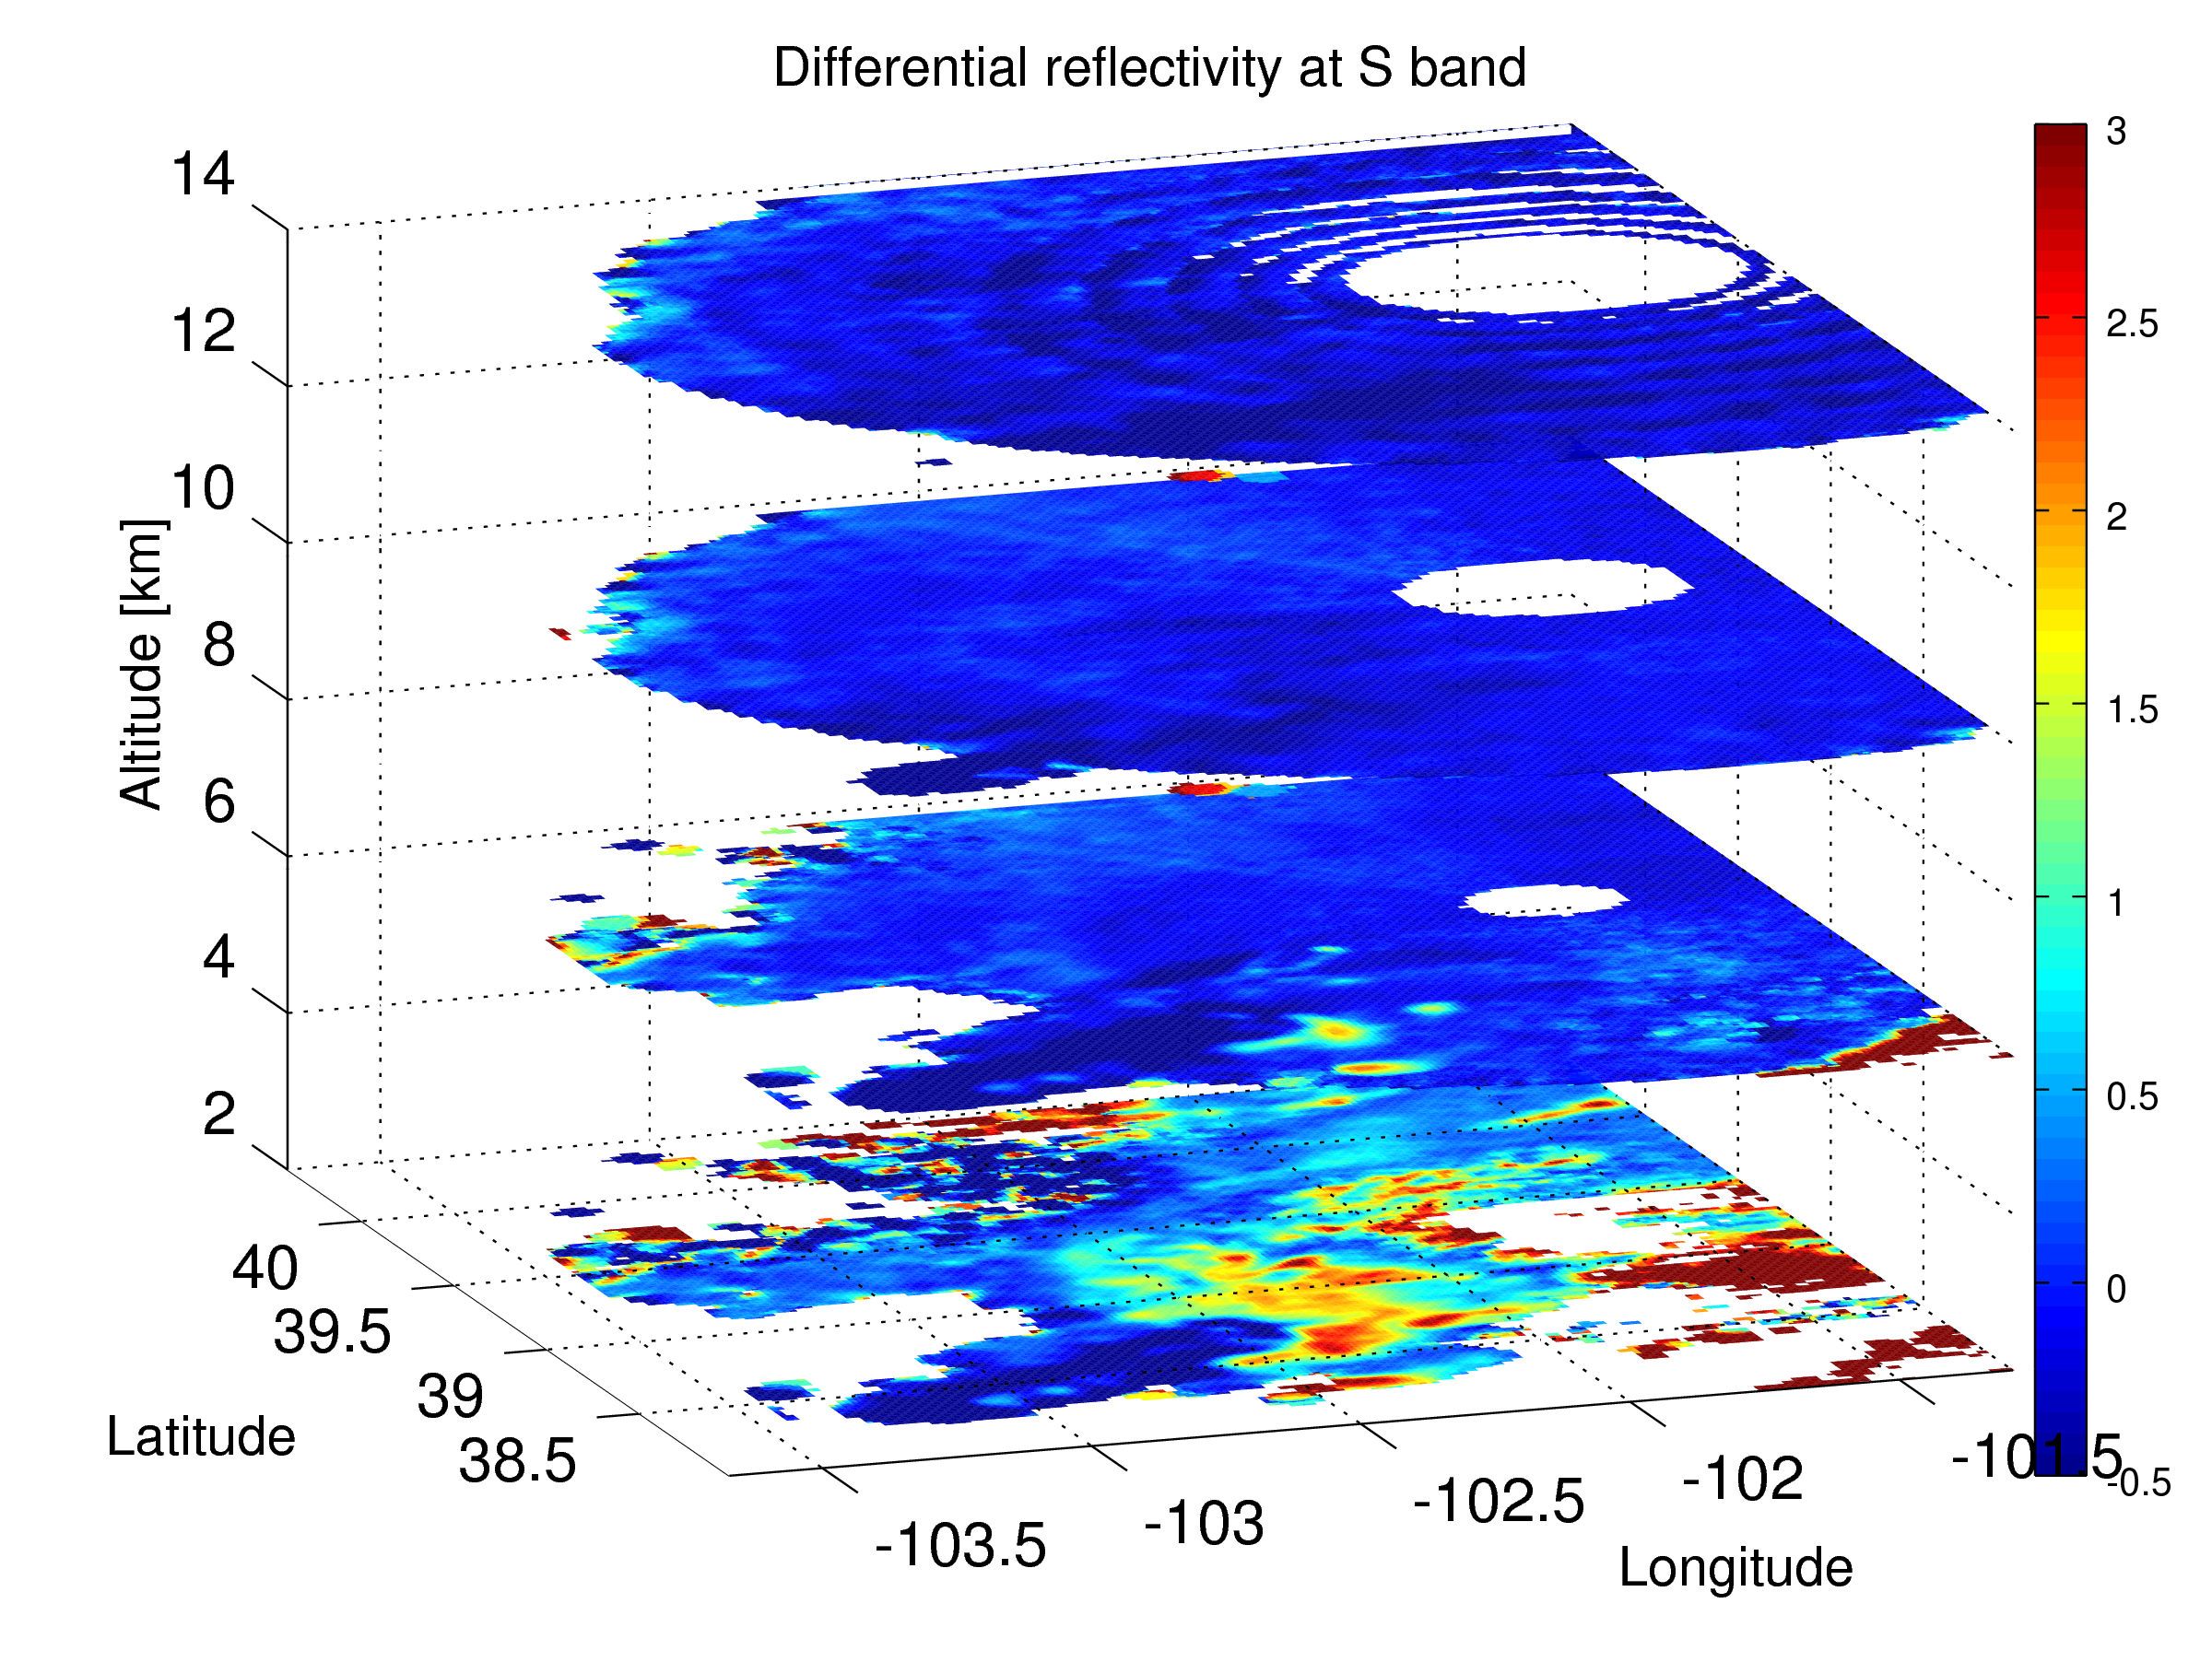
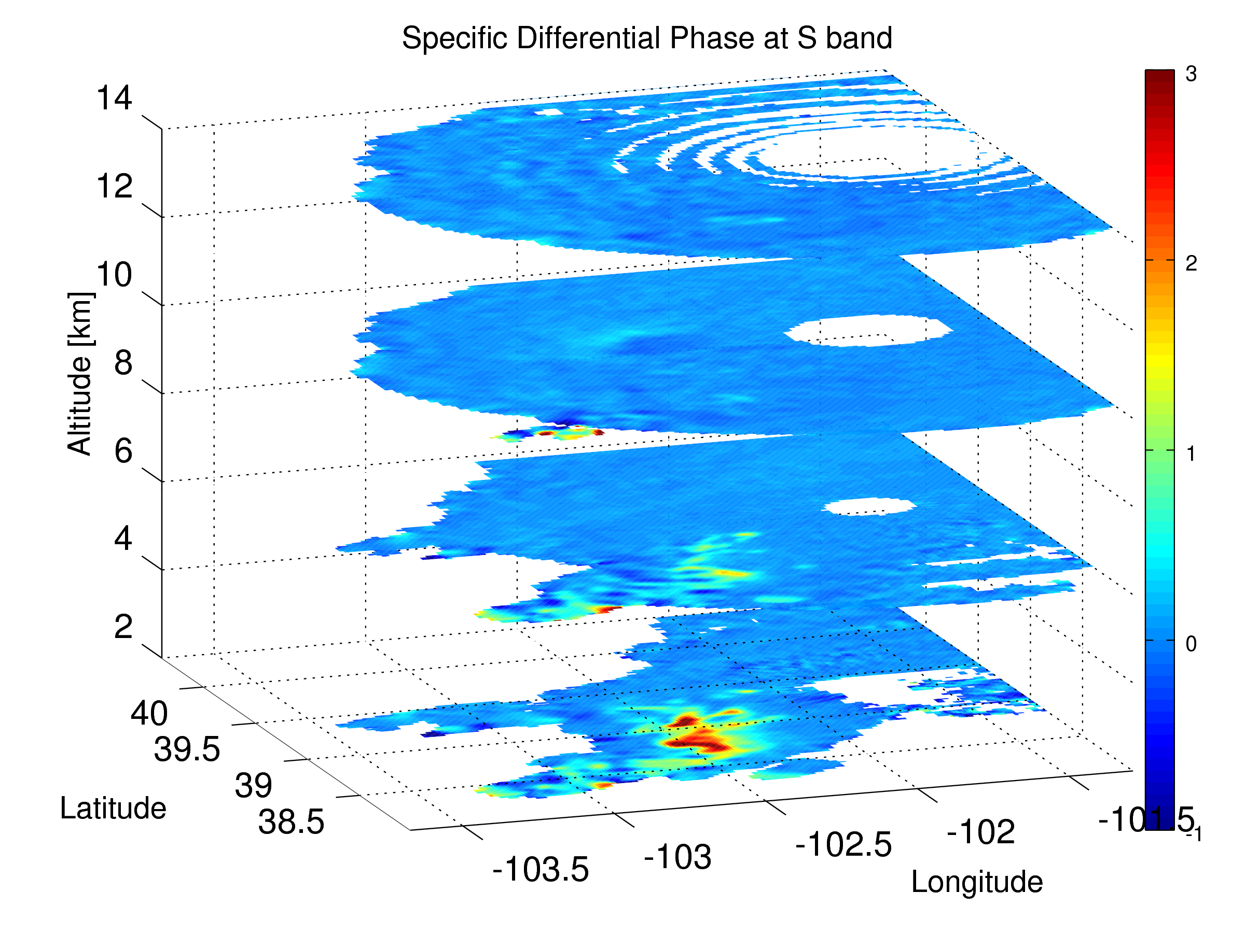
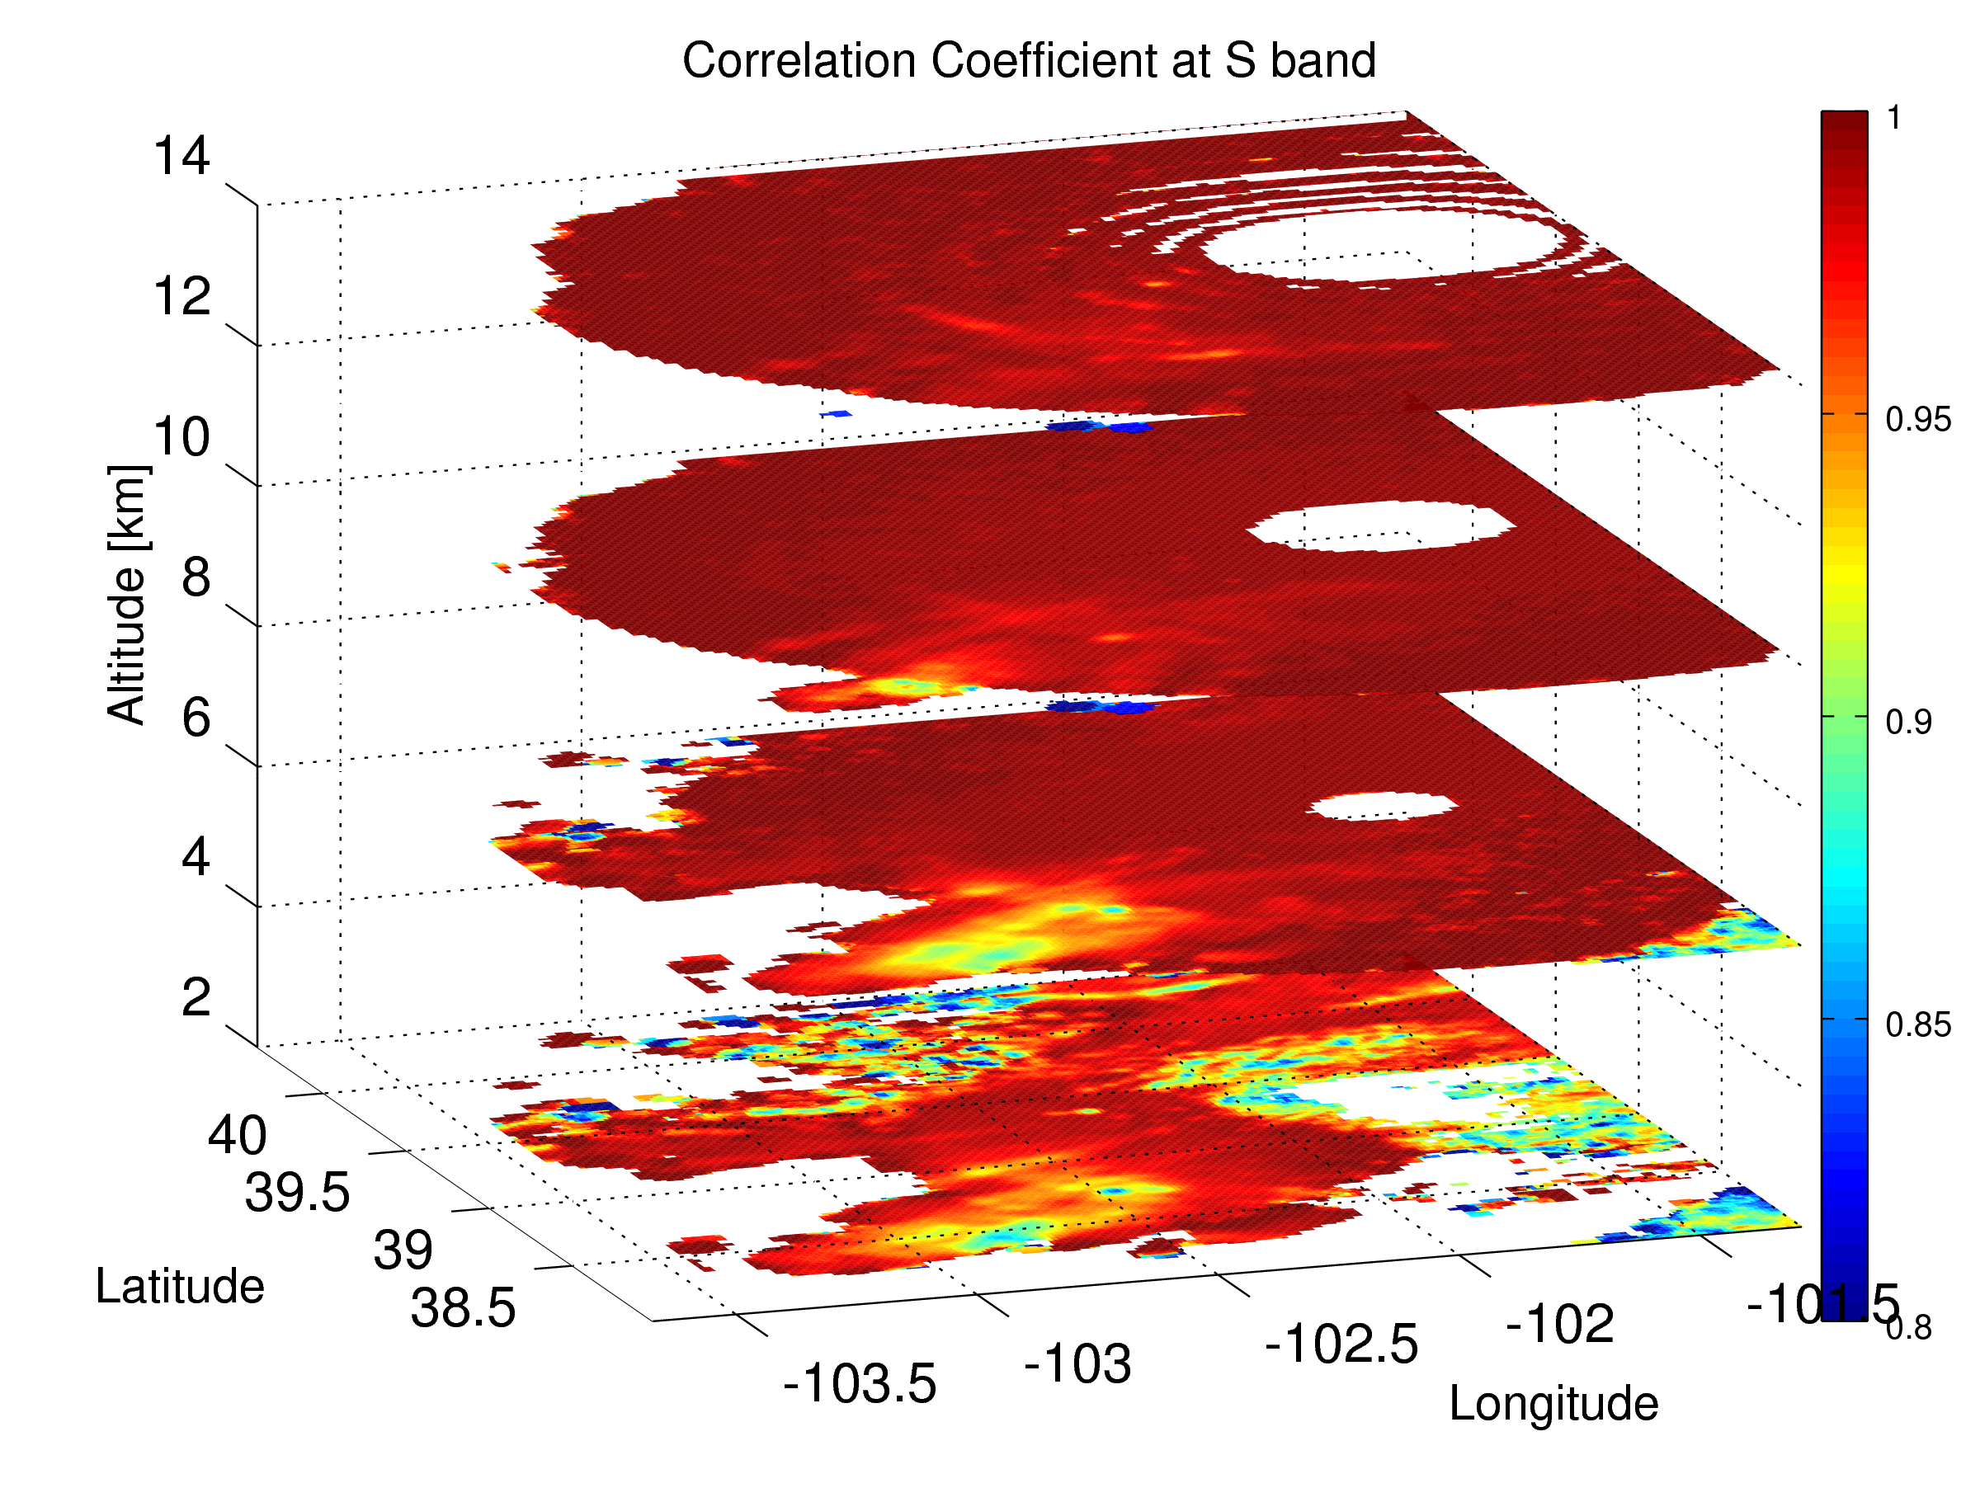
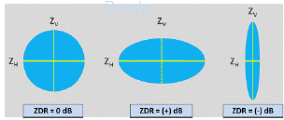
Ground-based validation: NEXRAD data
NEXRAD (Next-Generation Radar) is a network of 160 high-resolution ground-based S-band Doppler polarimetric radars.
Dolan, B., at. al. 2013:
The sum of the 6th power of the diameter of all particles in the volume,
Measures total concentration/size
Insensitive to the concentration but defines the drop shape/particle orientation
More sensitive to the concentration, close to 0 for the ice phase
Measure of how similarly the hor. and ver. polarized pulses are behaving,
Discriminate non vs met echos, ~1 for regular particles (rain, snow)
Notes:
5
5

Slide 6
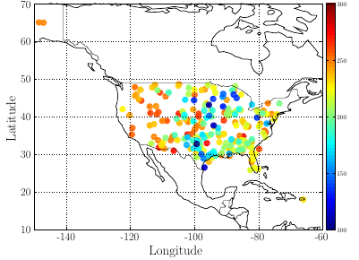
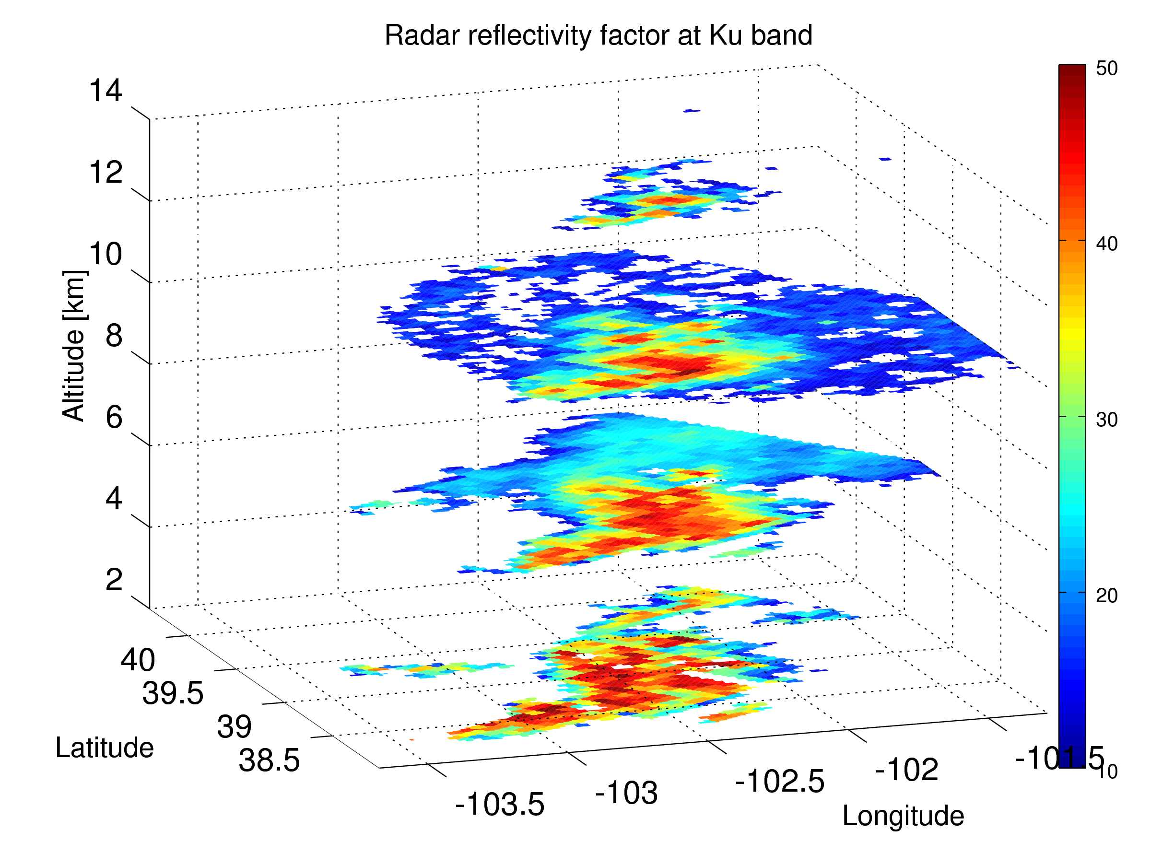
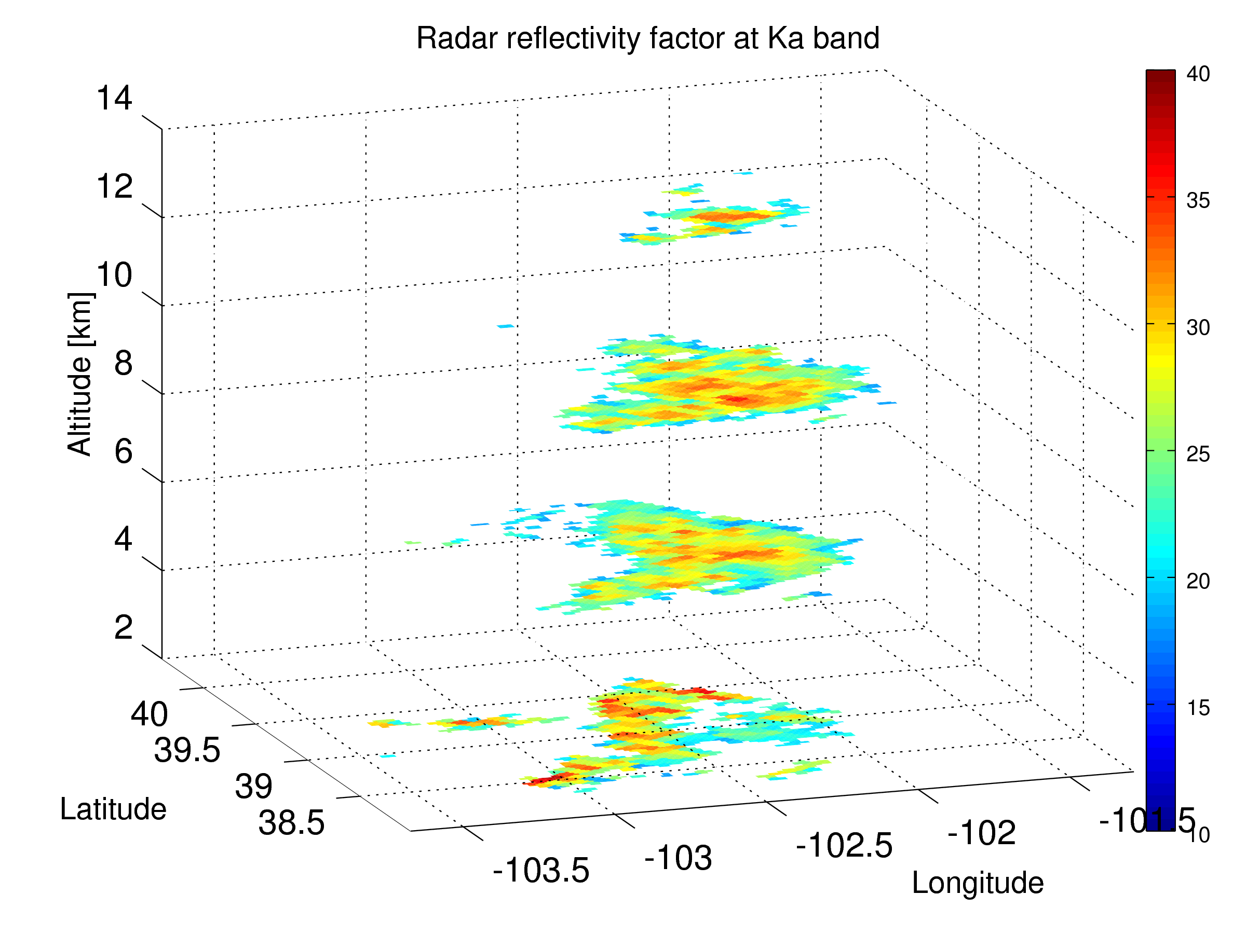
GPM-NEXRAD collocated dataset of extreme events
Position and the minimal BT at 37 GHz
Data from GPM satellite launch to June 2016 used
Only those storms that produce at least 40 dBZ echo at Ku band above the freezing level considered
Ground-based data restricted in range to the nearest 150 km
311 intense storms were selected
DPR
GMI
NEXRAD
Notes:
6
6

Slide 7
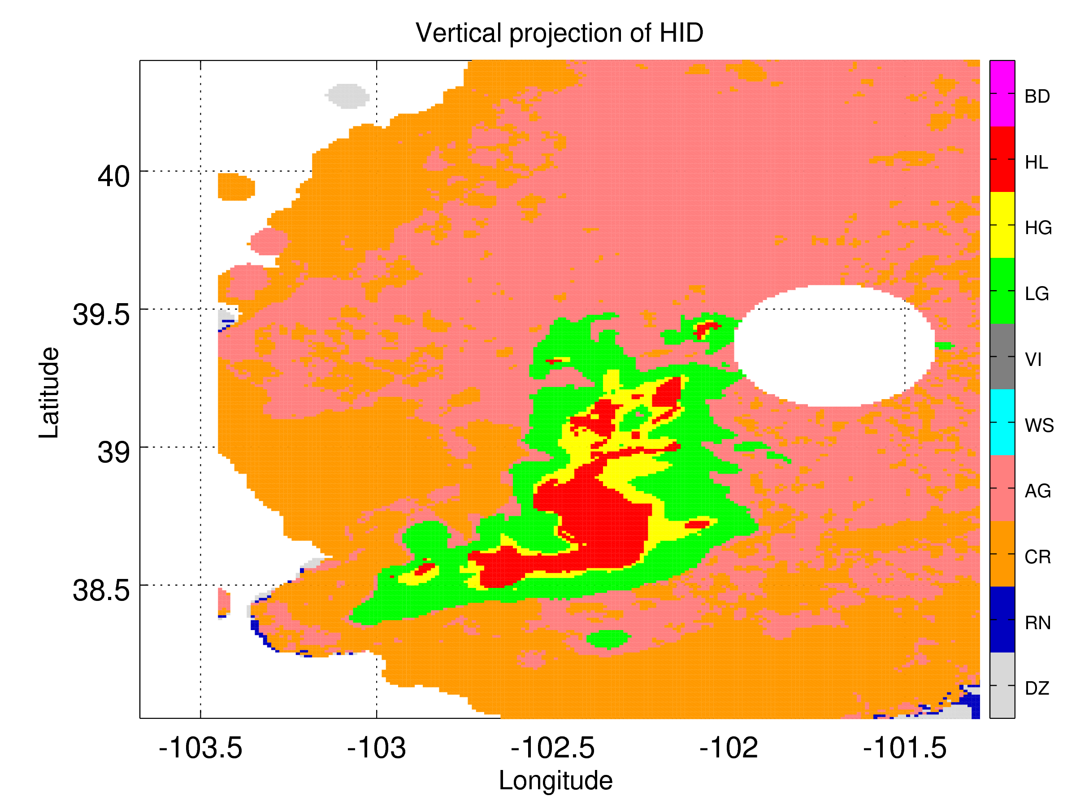
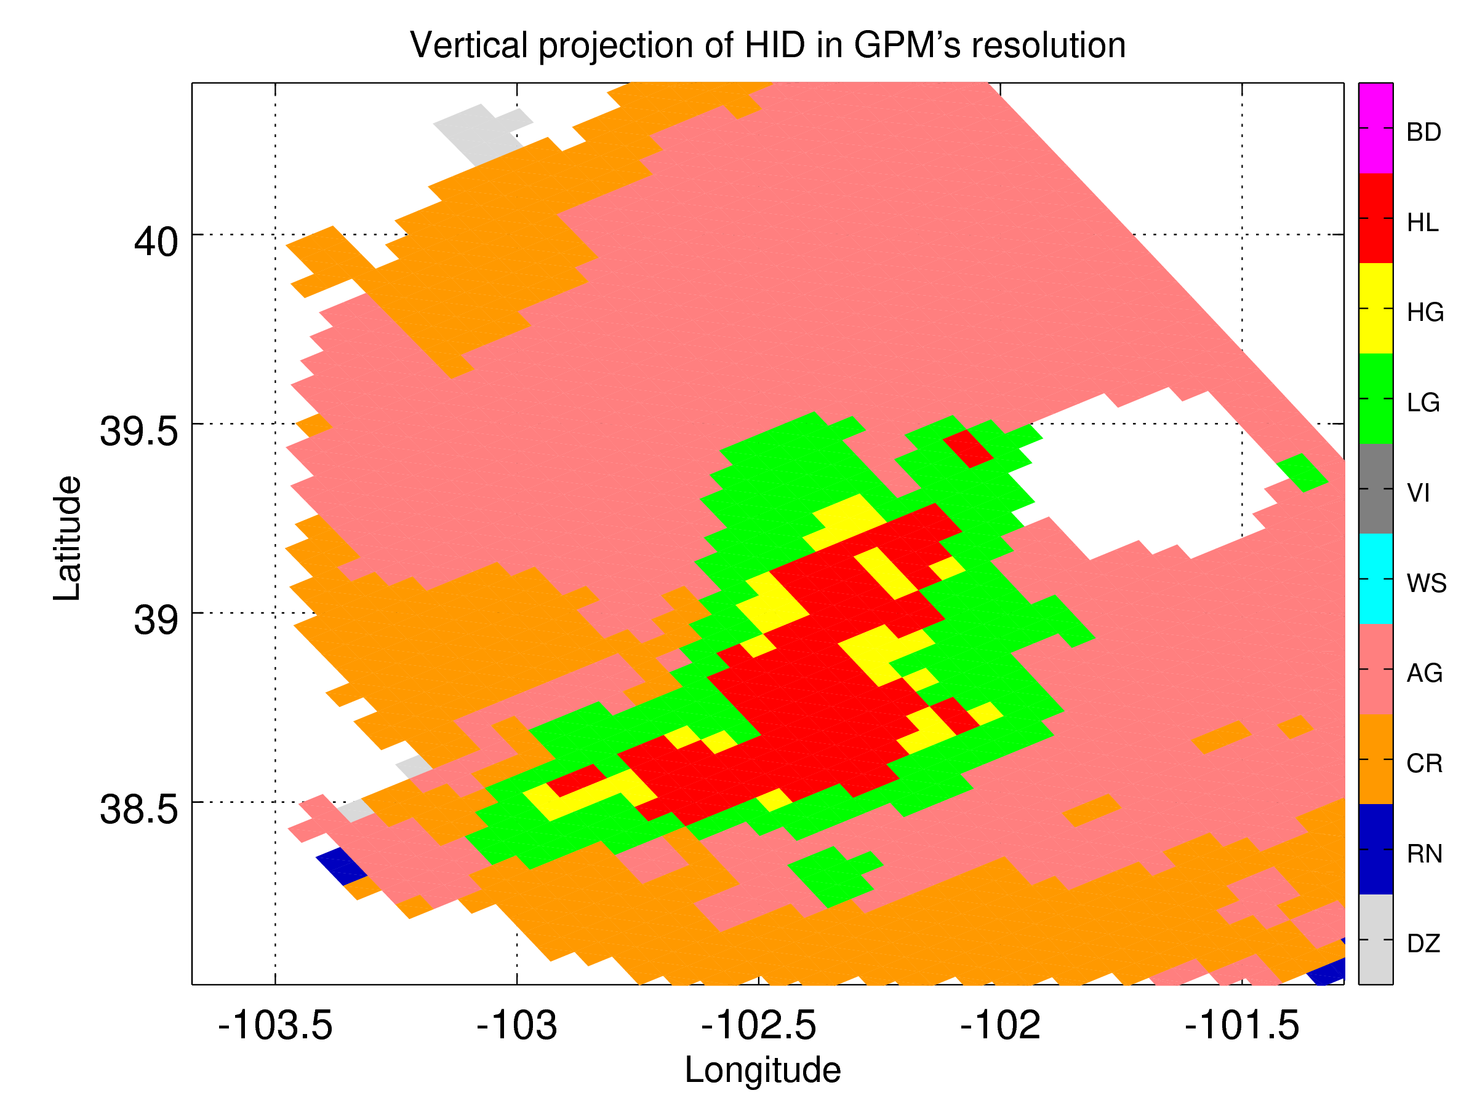
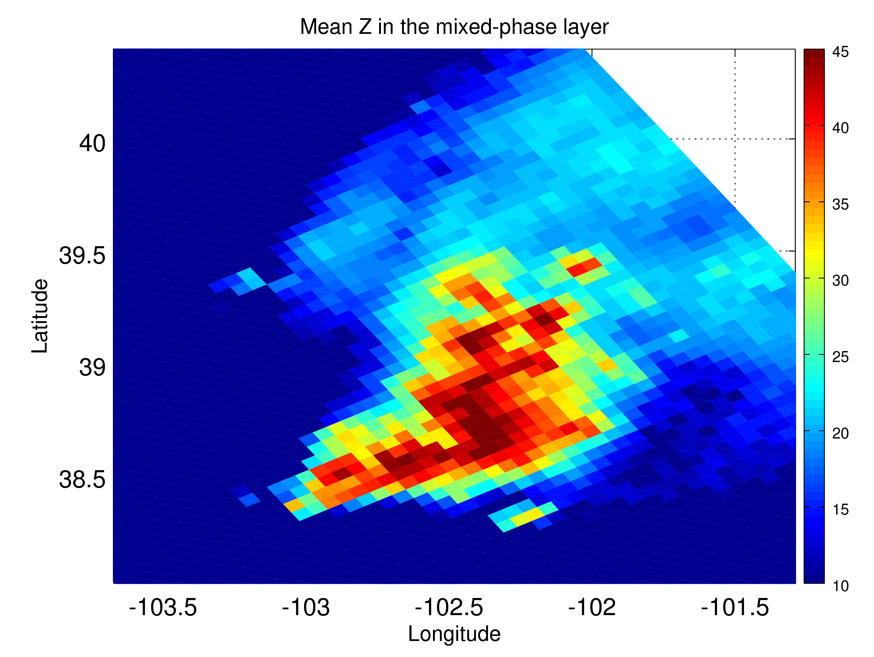
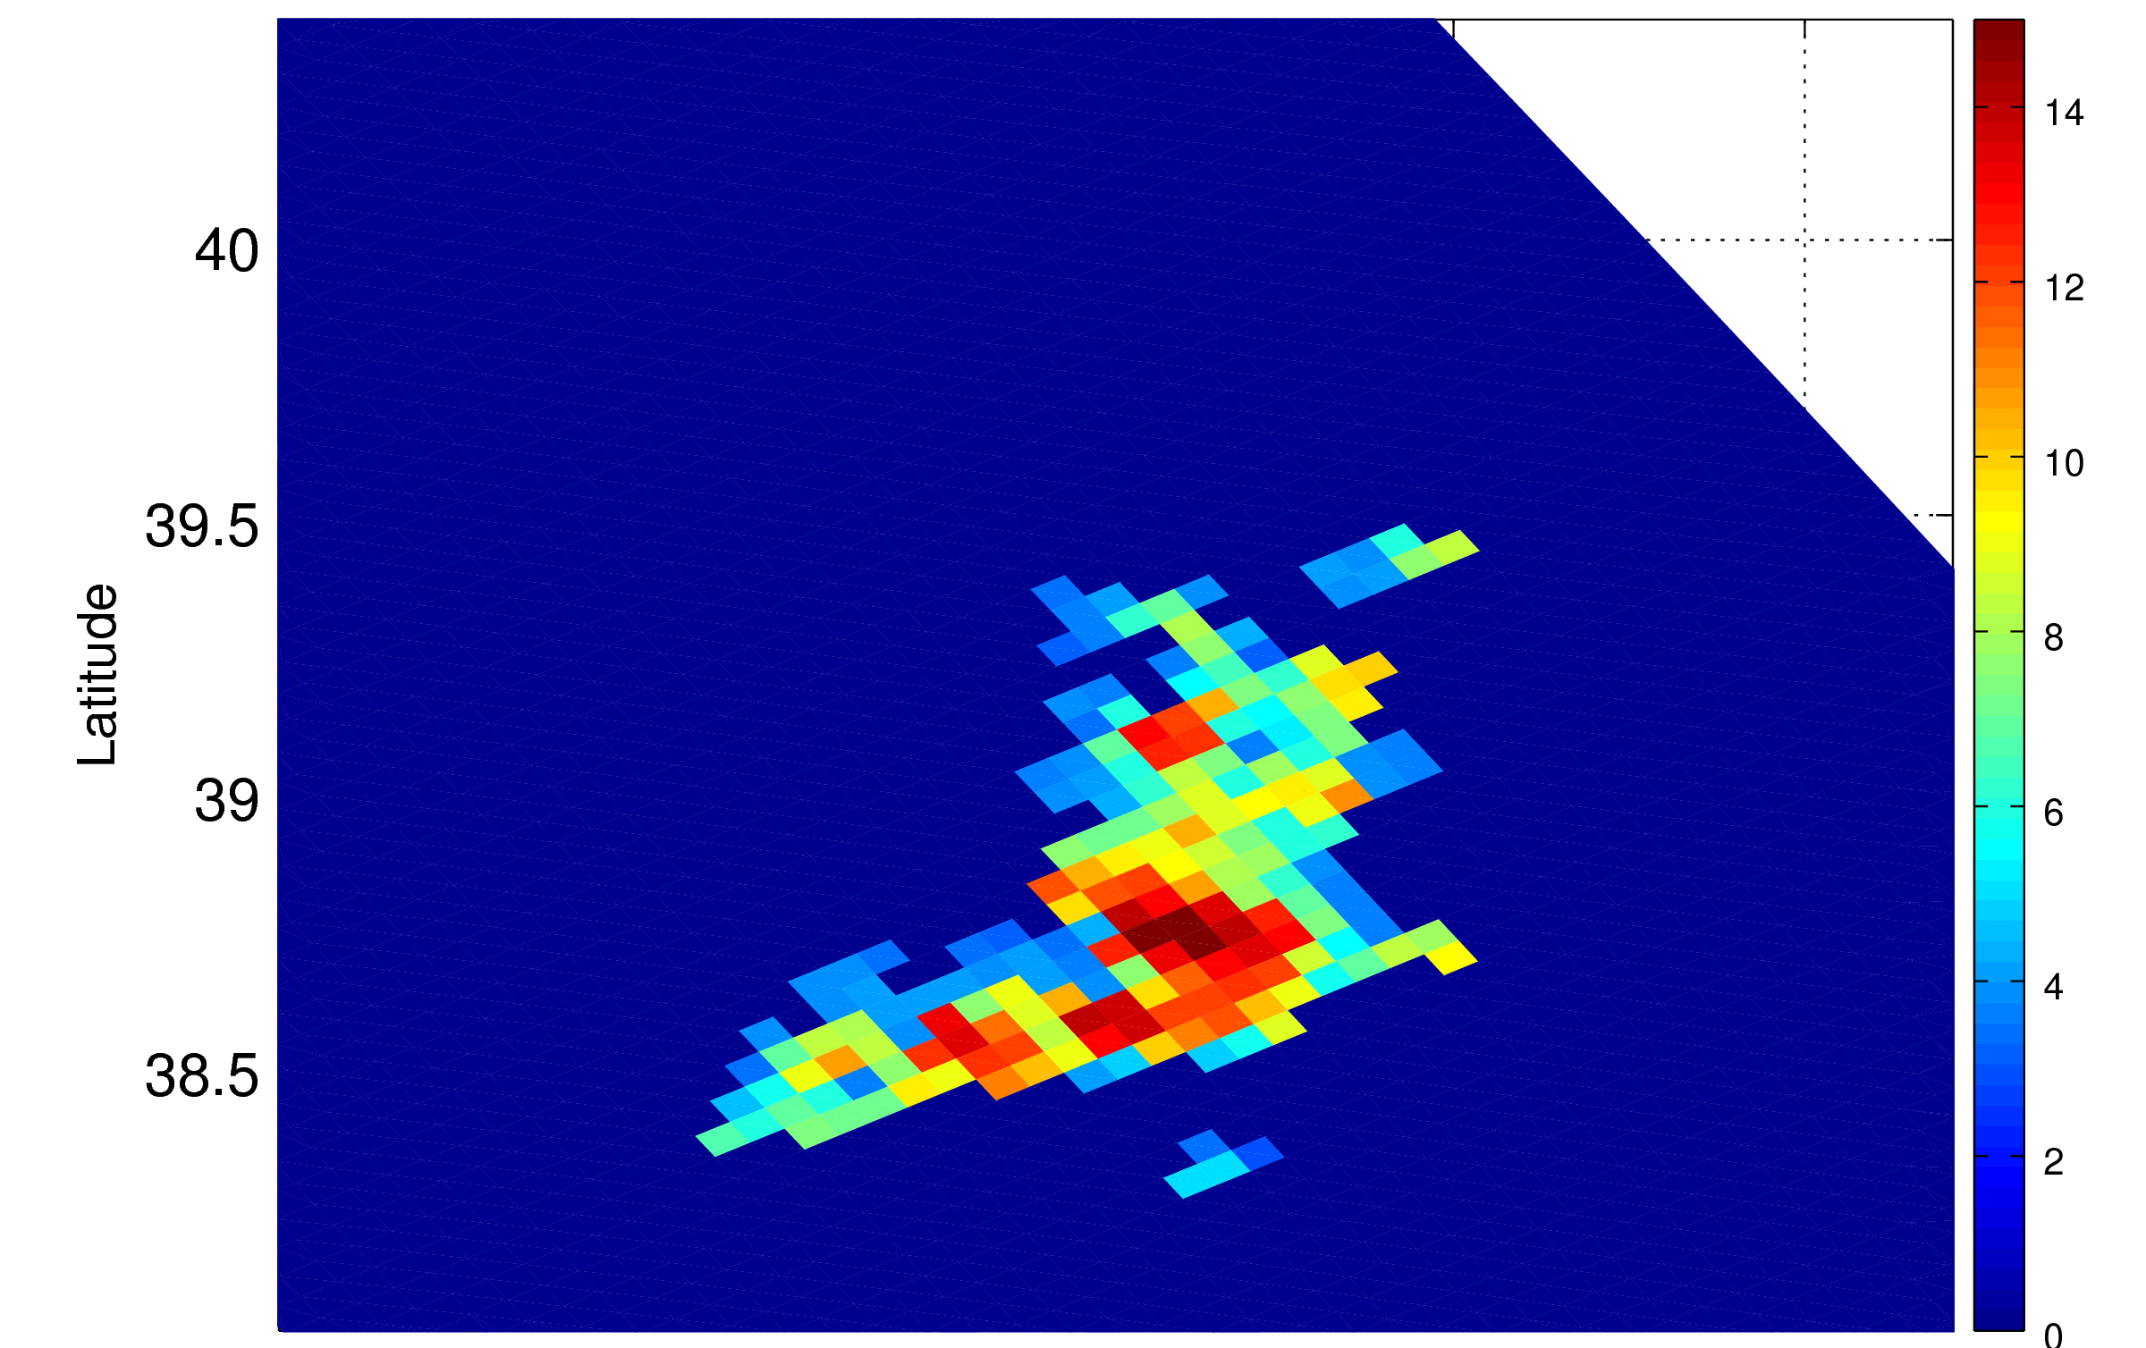
Space vs ground-based observations
Vertical projection with hydrometeor hierarchy
Re-sampling to GPM footprint
We are looking for hail in the
column!
Examples of columnar properties
of the reflectivity profile
Mixed-phase reflectivity [dBZ]
40 dBZ level height [km]
Notes:
7
7

Slide 8
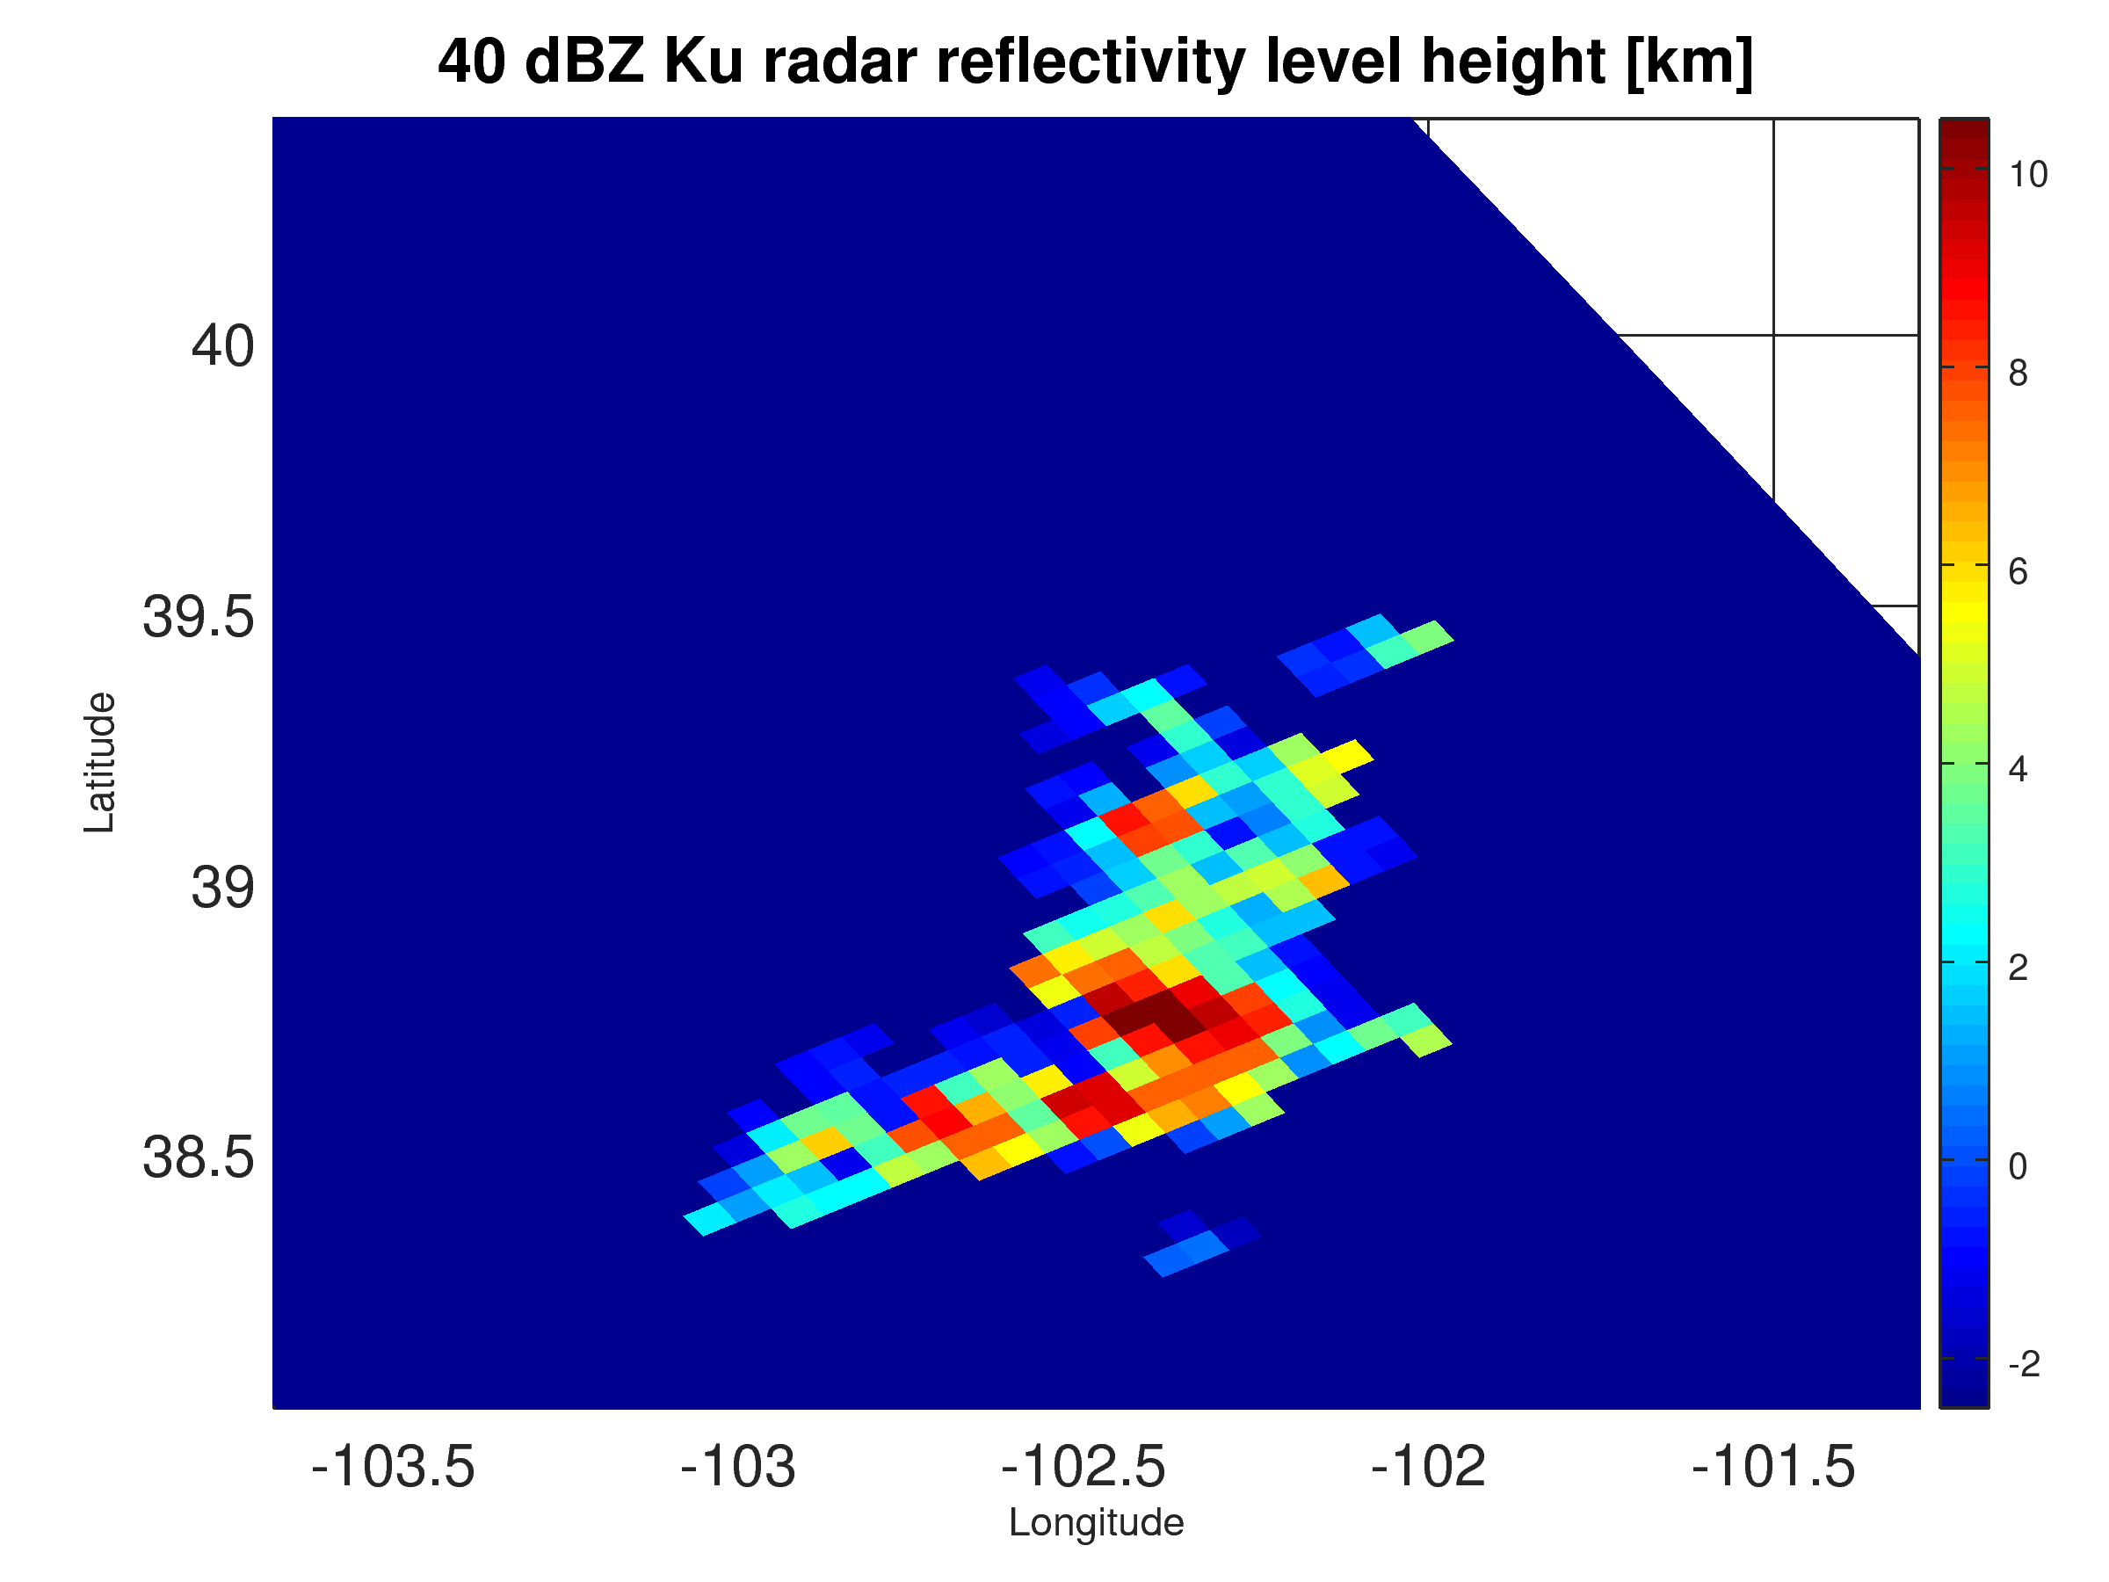
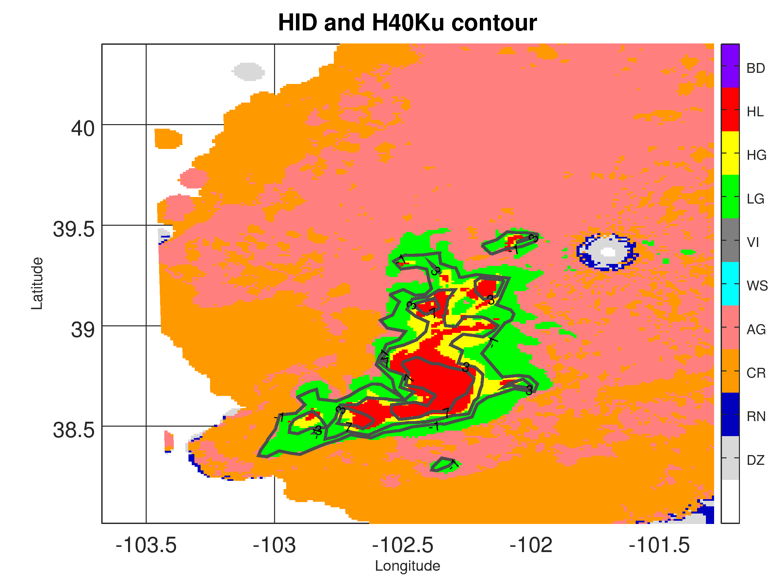
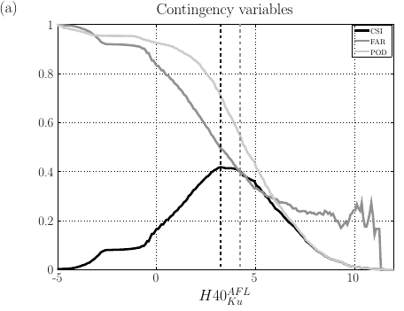
MERGE
The Probability
Distribution
Function
The optimal
threshold for
hail detection
Contingency table
We maximise CSI

Slide 9
Results
RADAR-based proxies
The hail detection algorithm based on three of Ku-based parameters, H40^{ku} , Z_{int}^{ku}, Z_{mix}^{ku}, reached a Critical Success Index of 42%-45%
The simple measure of storm strength, Z_{max}^{ku}, performs very poorly.
When 35 GHz radar measurements are considered, the best performing criteria for hail detection are based on H30^{ka} , Z_{int}^{ka}
RADIOMETER-based proxies
19 and 37 GHz radiometric channels are the best hail indicators among all passive measurements available on board of the GPM satellite.
Higher frequency TBs cannot separate LD graupel vs HD graupel vs hail.
10 GHz channels are strongly dependent on emissivity of the underlying surface

Slide 10
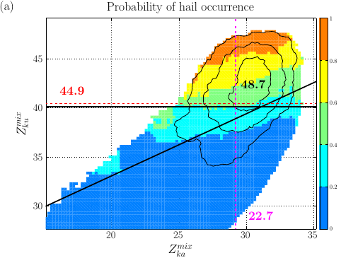
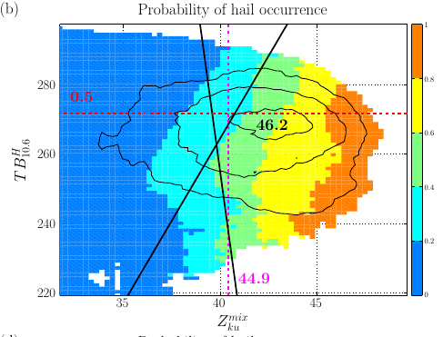
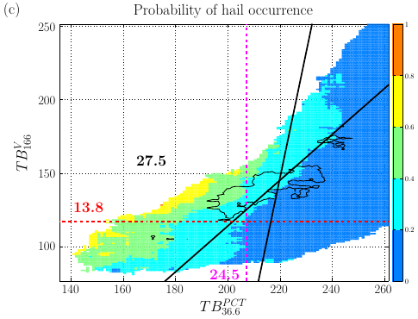
Results: Dual parameter setting
Among all combinations we considered, the biggest improvement in the CSI was not greater than 4 percentage points
Two best performing pairs of parameters are Z_{mix}^{ku} coupled with Z_{mix}^{ka} (CSI:41→ 44%) and Z_{int}^{ku} coupled with Z_{int}^{ka} (CSI:45%→ 49%)
The best performing radar-radiometer proxy is based on Z_{mix}^{ku} and TB @ 19 GHz (CSI:45%→ 46%)
Outside the DPR swath, passive measurements at 36.6 GHz supplemented by 166 GHz channel have the greatest ability to detect hail (CSI of 27.5%)

Slide 11
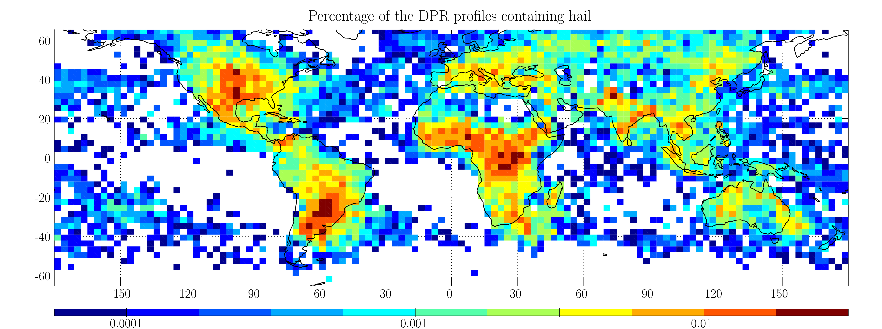
Global distribution of hail events (in the column)
2.5ºx2.5º boxes
2 years of the GPM data
%
Proxy:
Intense storms cluster in equatorial Africa, in the ”tornado alley” in the USA and in Argentina
The region of severe weather in North America extends to the mid latitudes
Other smaller regions affected by hail: the eastern shore of India, the southern slope of the Himalayas, South Africa, Indochina and the coast of the Yellow Sea.
In Europe moderate hail-fall intensity, which decreases even more in northern Asia.
Marine storms are less intense, typically located on the eastern shore of continents e.g. off the coast of Argentina, South Africa, Australia.
Notes:
11
11

Slide 12
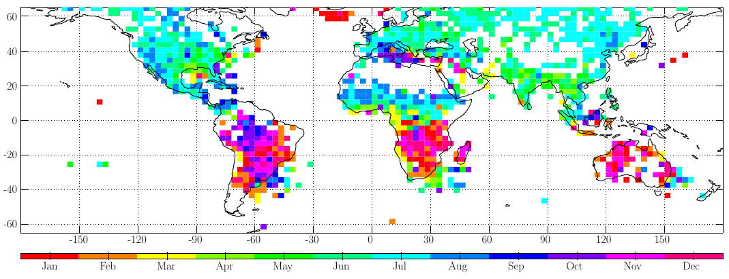
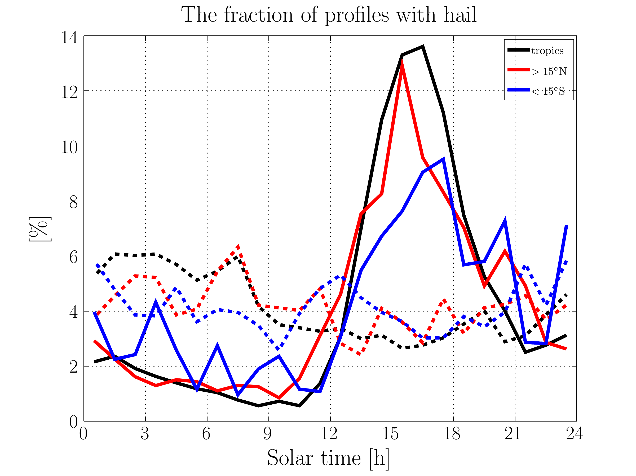
Seasonal distribution of hail events
Seasonality:
Majority of extreme storms happens in the warm season
Spring and summer in the south-central United States
Autumn and winter in Argentina
July-Sept in Europe, October-November for the Mediterranean Sea
Seasonal difference of marine and land storms
Most of the inland storms occur in the afternoon
Notes:
12

Slide 13
Summary
Hail detection algorithm
Designed for the new GPM dataset
Uses polarimetric hydrometeor classification as “truth” not ground reports
Nearly instantaneous matching of GPM observations and the hydrometeor classification
Results
Proxies based on Ku radar reflectivity (H40^{ku} , Z_{int}^{ku}, Z_{mix}^{ku}) have the highest CSI (42-45%)
Algorithms based on Ka measurements perform at least 10% worse than Ku-proxies
The best performing radiometer-based algorithm uses TB19 or PCT37 (CSI=25%)
Not very significant improvement when 2-variable proxies are used
Applications
Hail risk maps
Extreme weather climatology (GPM could fly for more than a decade!)
K. Mroz, A. Battaglia, T. Lang, D. Cecil, S. Tanelli and F. Tridon, Hail detection
Algorithm for the GPM core Satellite, 2017, JAMC in press.
Future work
Investigation of vertical structure of hail shafts ➔ identification of hail mandatory for refining precipitation algorithms
Notes:
13

Slide 14
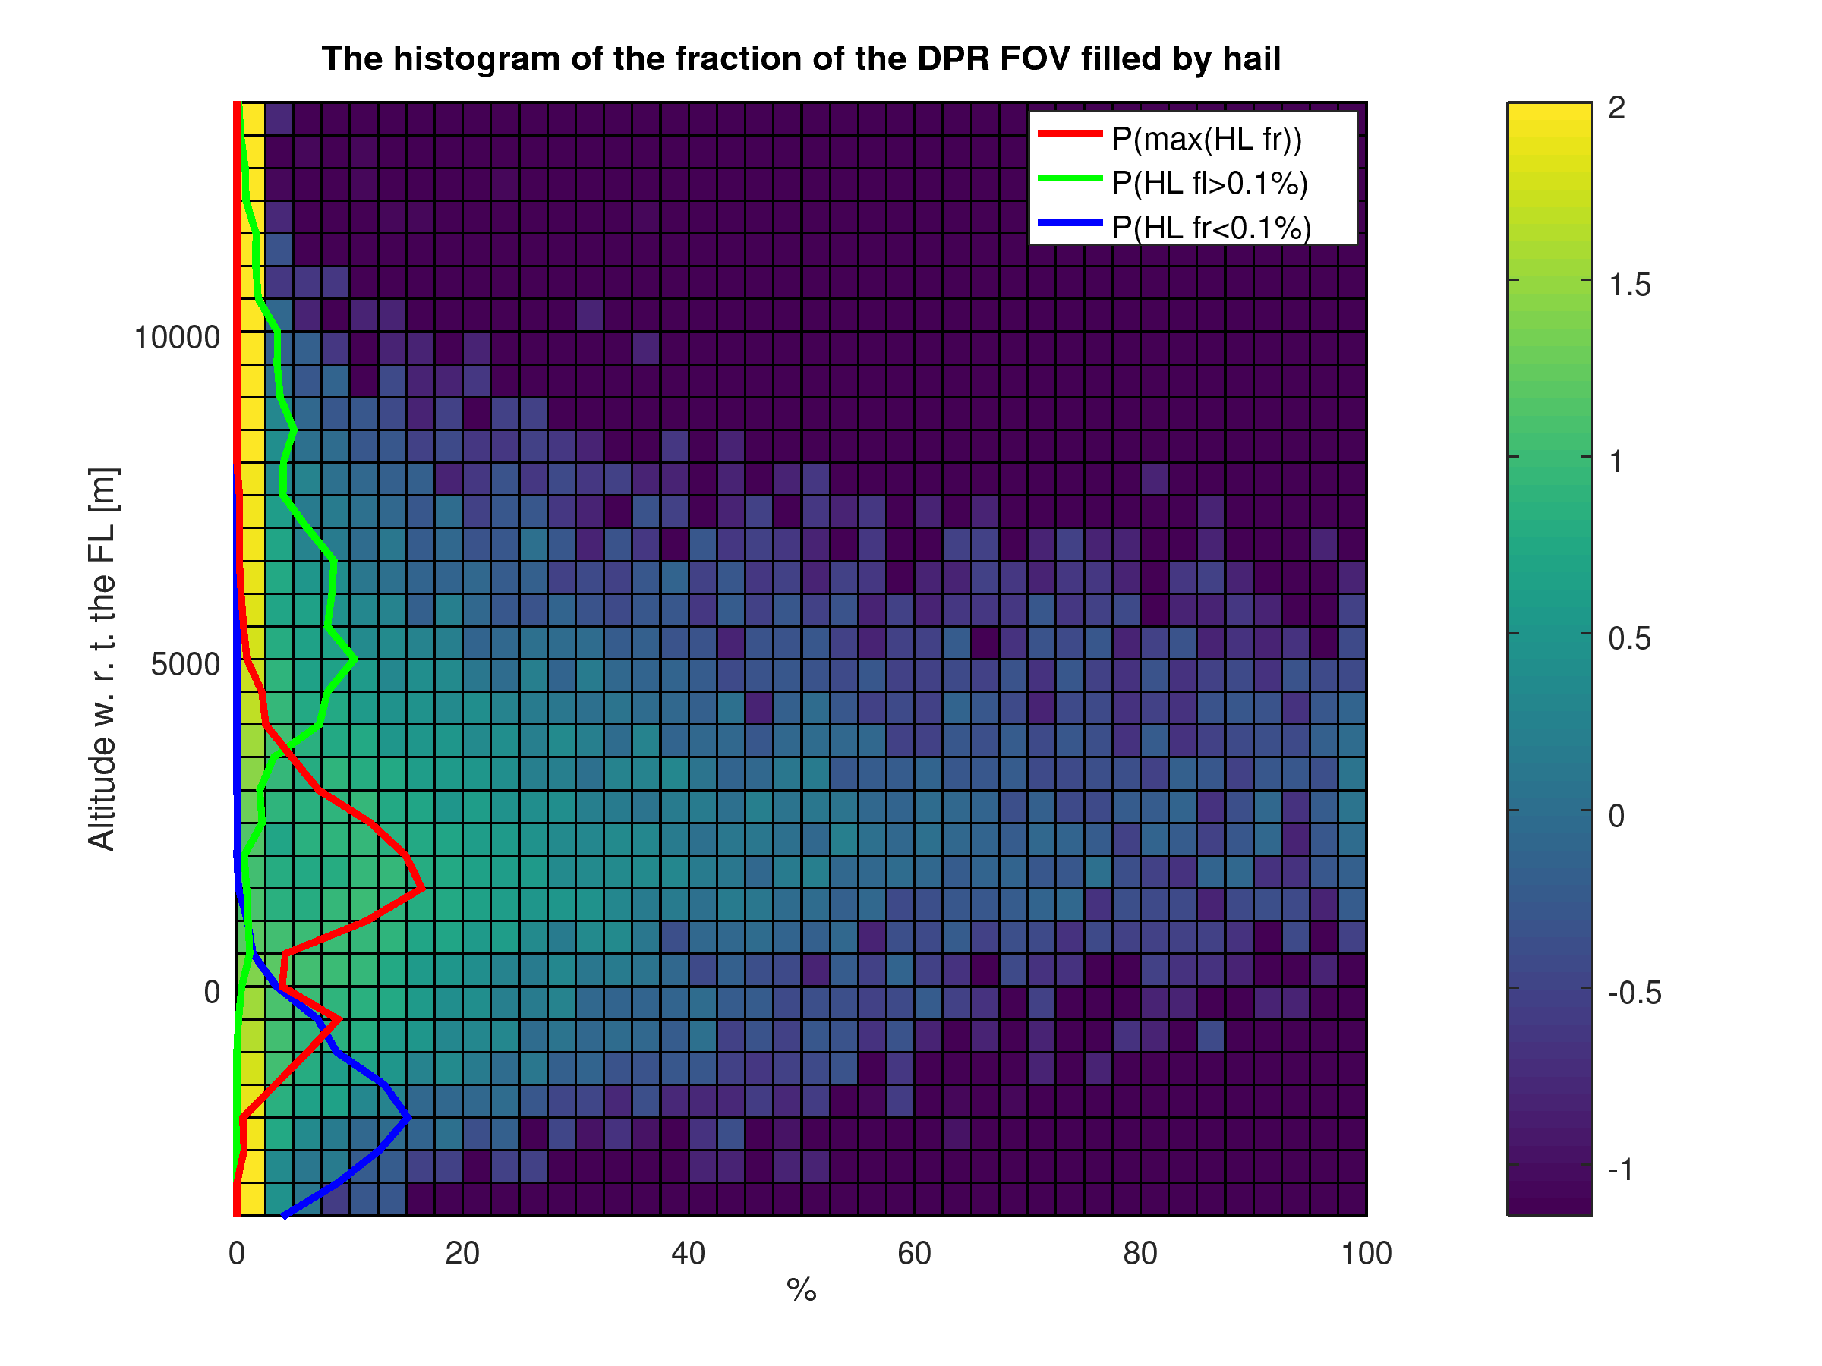
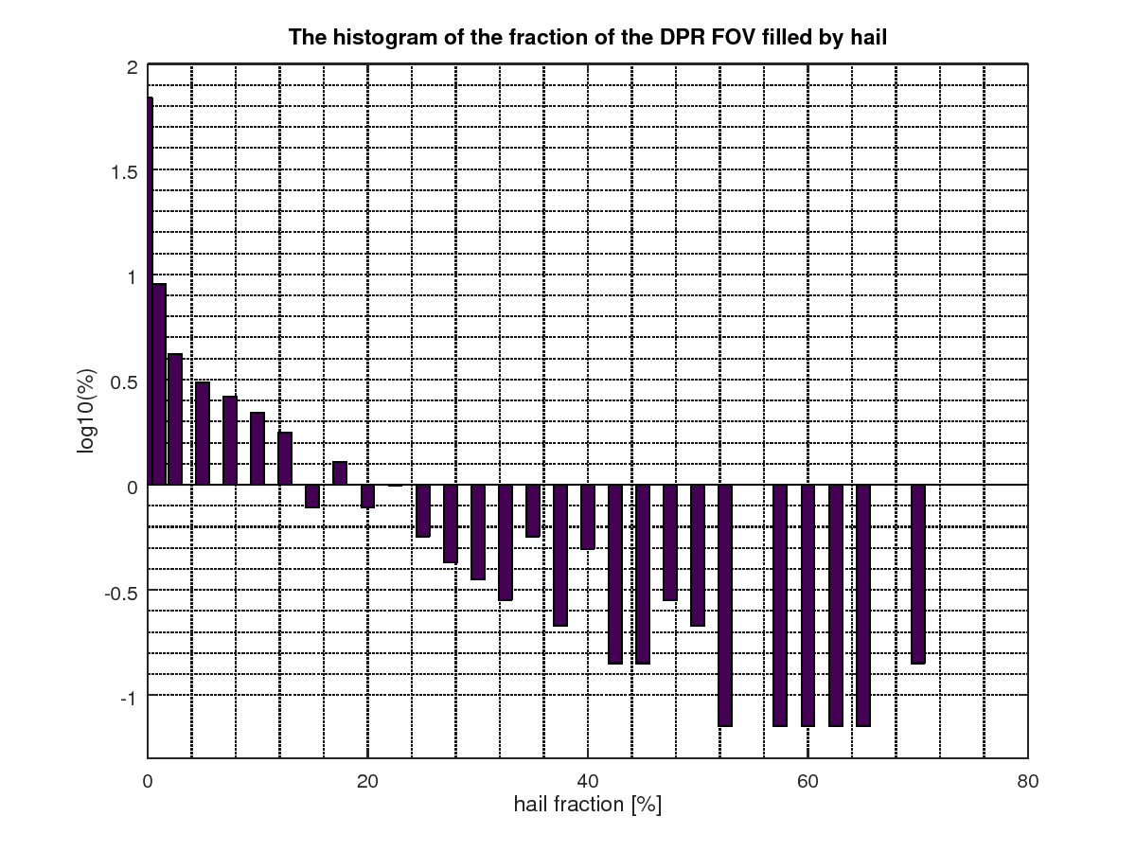
Next step: vertical distribution of hail,
Preliminary results
The histogram of all hail contaminated profiles:
High hail fraction only for altitudes between 0 and 5 km AFL.
The highest level where hail is observed is widely distributed
In most cases hail melts 2 km BFL.
The frequency of hail occurrence at the lowest elevation scan is decreasing exponentially w.r.t. the fraction of the DPR footprint filled by hail
Notes:
14

Slide 15
Hail detection from the ground
Variable | Dry, small | Melting | Large (D>5cm)
Z | >55 dBZ | >60 dBZ | 40-80 dBZ
ZDR | 0-1 dB | >1 dB | -0.5 – 1 dB
CC | 0.95-0.97 | ~ 0.95 | <0.9
KDP | ~0 deg/km | >3 deg/km | N/A
Dolan, B., at. al. 2013:
fuzzy logic
hydrometeor
classification
Notes:
15
15

