Slide 1
Calibration of relative humidity instruments in low pressure, low temperature, CO₂ environment
M. Genzer, J. Polkko, T. Nikkanen, M. Hieta, A.-M. Harri

Slide 2

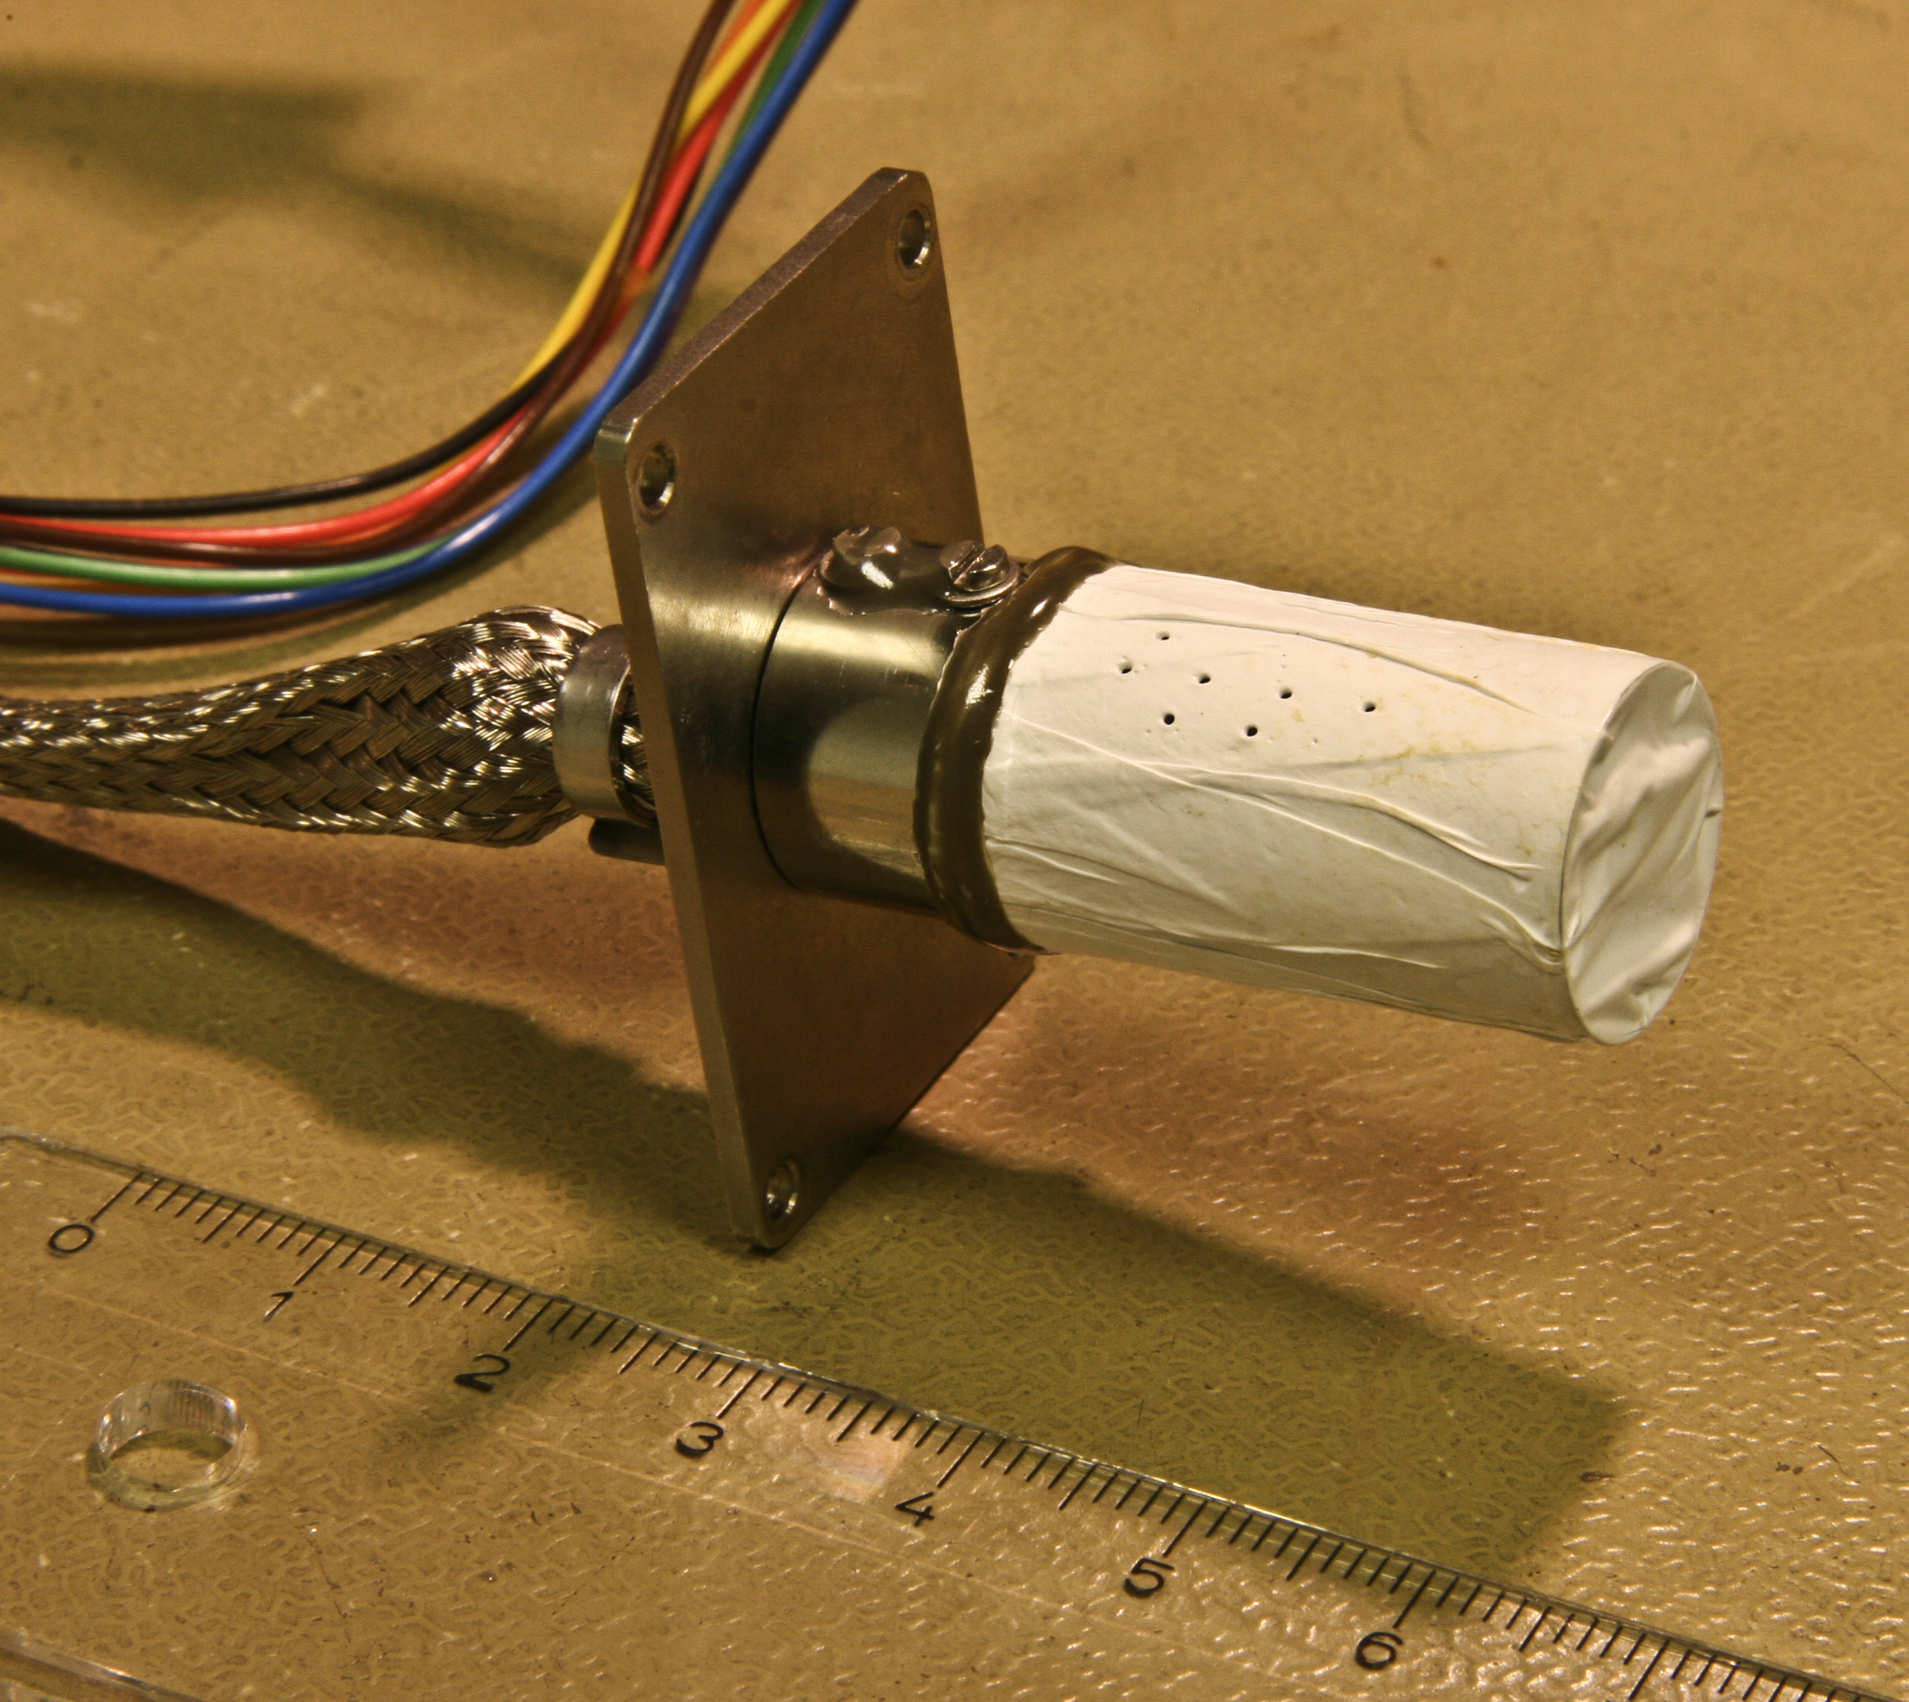
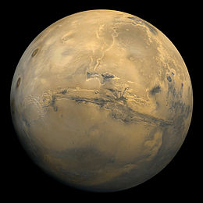
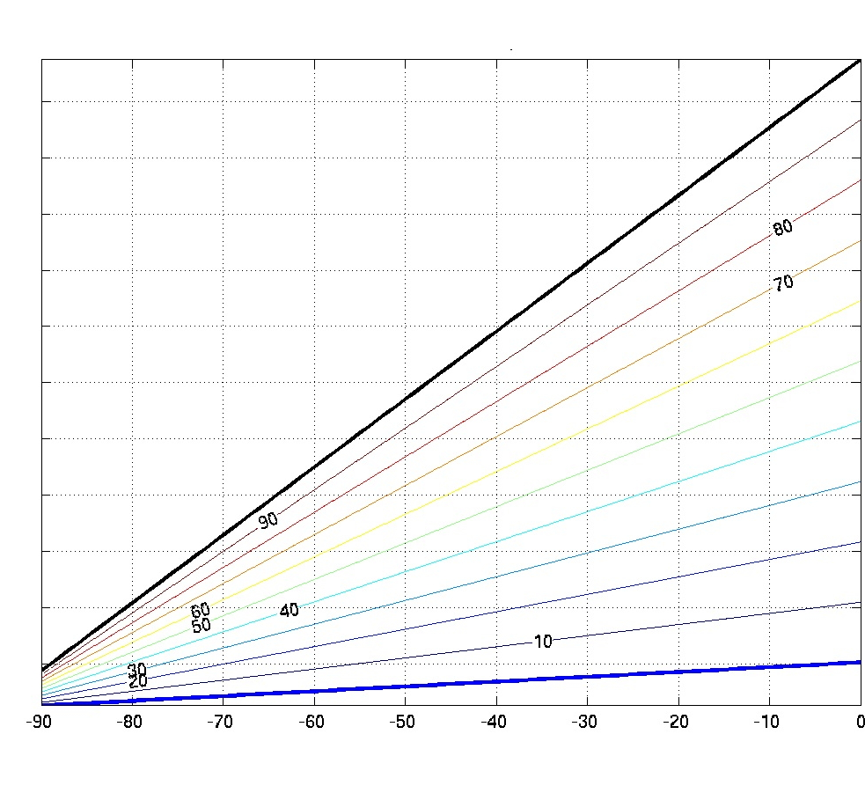
NASA/JPL-Caltech/MSSS
Mars
Humicap® based relative humidity device
Change of Humicap® capacitance as function of temperature and relative humidity. The capacitance affected also by CO₂.
Pressure in order of ~ 6 - 10 hPa
Night temperatures down to -70°C and lower
  Pw < 1 Pa even in saturated conditions
96% CO₂ atmosphere
Saturation points
Capacitance
Temperature / °C
Dry points

Slide 3
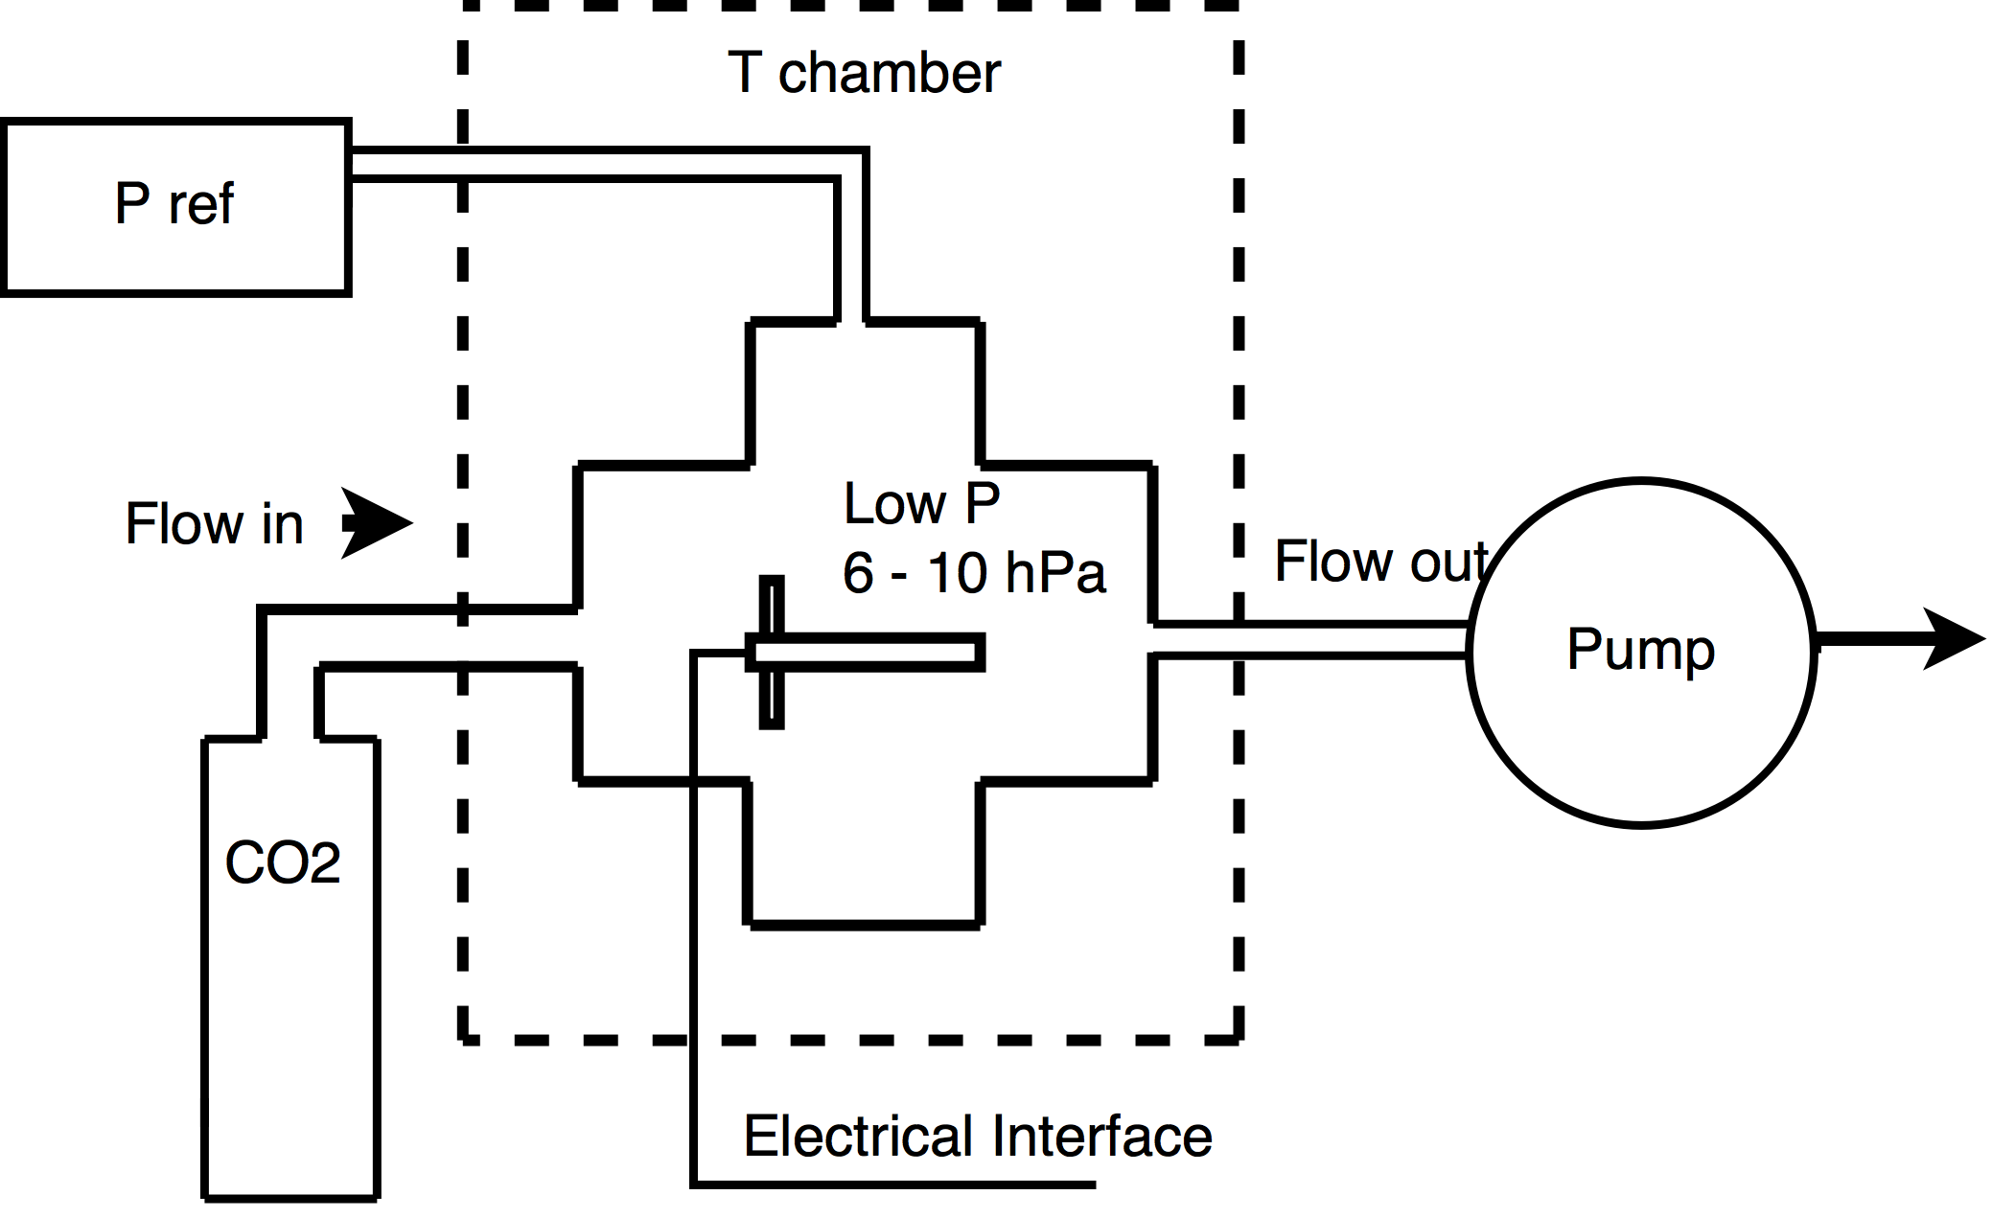
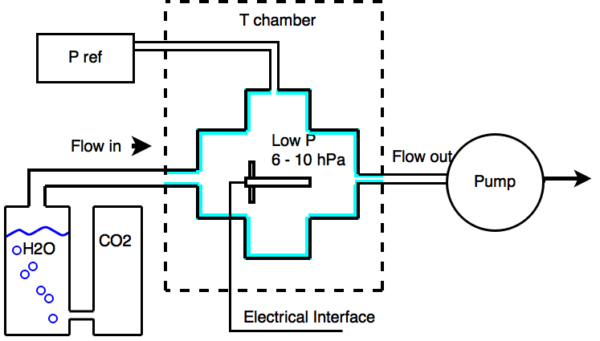
Minimum requirements for calibration conditions
Constant gas flow through the chamber for uniform conditions
-70°C …+25°C
-70°C …+25°C
Dry conditions
EASY
Saturated conditions
HARD

Slide 4
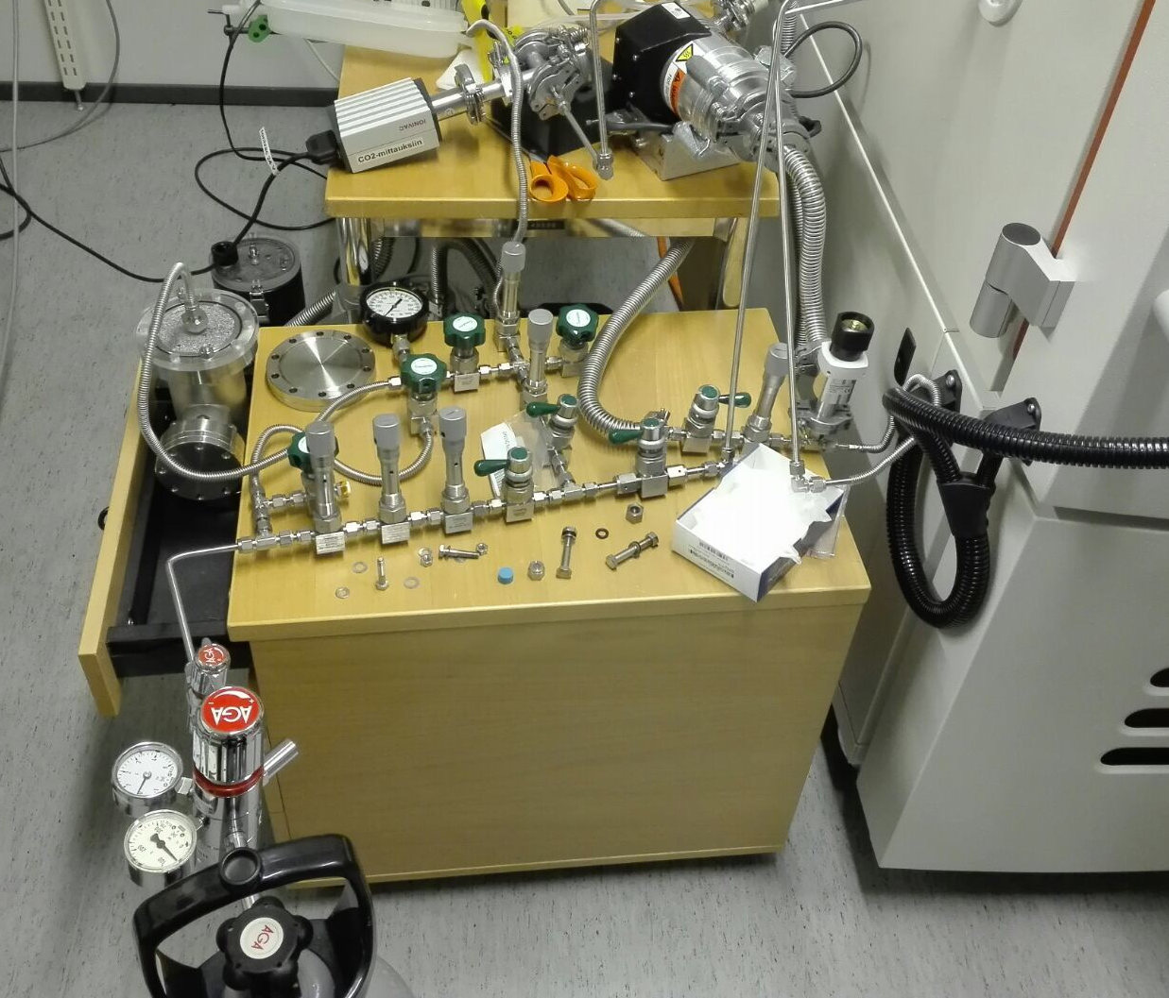
Calibration setup at FMI
The valve and pump system enables different routes for the gas (air or CO₂) to the pressure chamber inside the temperature cabinet. Also the pressure inside the vessel is controlled by opening and closing the valves. Measurements in ambient conditions, vacuum, low-pressure air and low-pressure CO₂ (dry or wet) are all possible with the same setup.

Slide 5
Dry point measurements
For measuring dry points in cold, low-pressure CO₂ environment, dry CO₂ is routed to the pressure chamber with a constant flow that can be adjusted with the valves until the desired reference pressure is achieved.
Measurements are made in several temperature points ranging from room temperature down to -70°C. For comparative measurements in vacuum the CO₂ is switched off and pumping efficiency increased.

Slide 6

CO₂ effect on Humicap®
The CO₂ effect is larger in higher pressures and cold temperatures. Taking into account also the dynamic range of the Humicap®‚ in Martian pressure range the effect is negligible in temperatures > ~ -10°C.

Slide 7
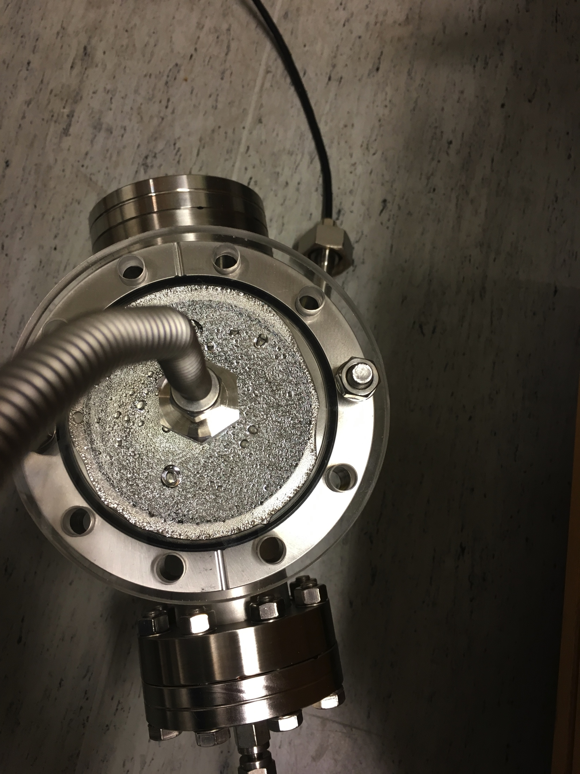
Measurements in CO₂ saturated with water vapor
To achieve saturated conditions, CO₂ is routed via a vessel filled with water. Moist CO₂ is then routed with a constant flow to the pressure chamber. After some time the chamber reaches stable, saturated conditions where the chamber walls are covered with a thin ice layer.

Slide 8

Humicap® capacitance reaction to wet gas
After switching from dry to wet CO₂, the conditions inside the chamber stabilize in approx. 24h, which can be seen from the steady measurements of Humicap® capacitance. Changing the temperature of the chamber to even colder temperature results in Humicap® setting itself to a new level.
…
4 8 12 16 20 24 28 32 36 40 44 48 52 56 60 64 68 72
Switch from dry to wet gas
Temp change -60°C -> -70°C

Slide 9
0 2 4 6 8 10 12 14 16 18 20 22 24 26
Temp switch -70°C -> -60°C
When the temperature is switched back to original -60°C, the Humicap® capacitance also returns to the original level, which means that the conditions inside the chamber are stable.

Slide 10
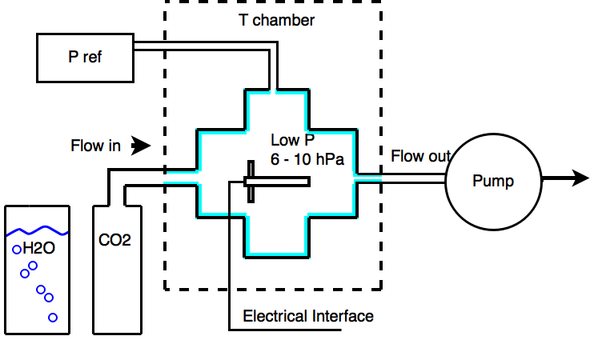
How about switching back to using only dry CO₂?

Slide 11
0 2 4 6 8 10 12 14 16 18 20 22 24 26 28
Switch to dry CO₂
The layer of ice inside the chamber is enough to keep up the saturated conditions even after the gas flow has been switched back to dry CO₂.

Slide 12
Conclusions and future
FMI humidity calibration chamber can achieve stable dry and saturation points in
  CO₂ environment (or air)
  Temperatures down to -70°C
  Martian pressure range and lower (down to vacuum)
    Higher pressures are possible too, but then the lower temperature in CO₂ is constrained
Future development:
  Comparison measurements with other facilities
  Intermediate humidity points between dry and saturation ..?

