Slide 1
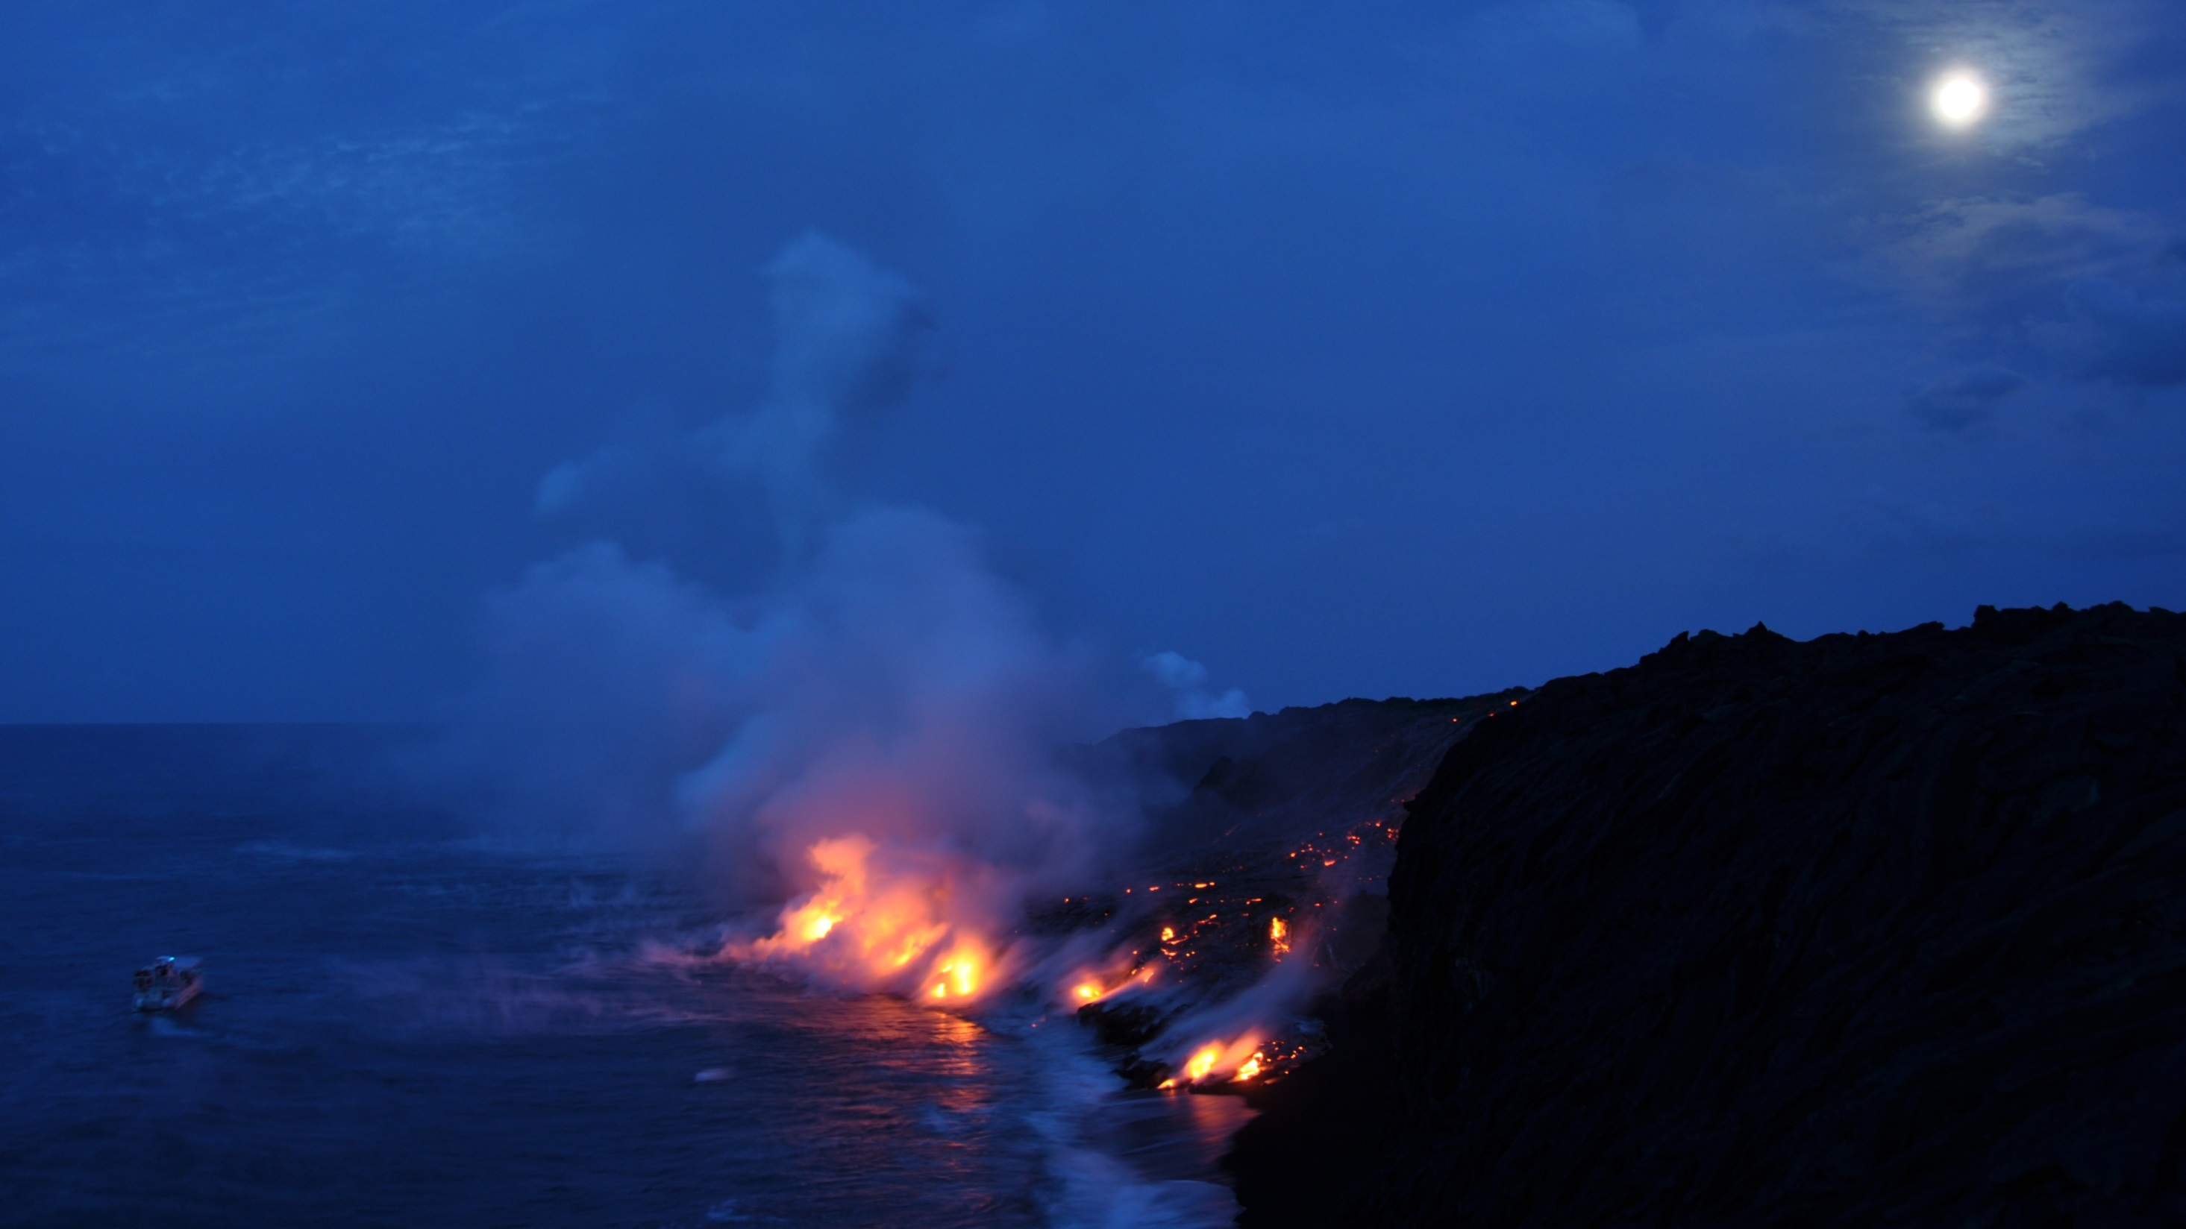

The Hawaiʻi Supersite:
A Success Story for Science and Society
Michael Poland
USGS – Cascades Volcano Observatory
U.S. Department of the Interior
U.S. Geological Survey

Slide 2

Geohazard Supersites and Natural Laboratories
overview
data and users
results
challenges
achievements
Initiative of the Group on Earth Observations (GEO)
Develop deeper understanding of processes that pose natural hazards
Focus on a few regions of high priority, visibility, and applicability
Create comprehensive and open datasets
Hawaiʻi, Iceland, Etna, Vesuvio/Campi Flegrei, Ecuadorian volcanoes, New Zealand volcanoes, Marmara, San Andreas Fault
EGU2017-2246
Vienna, Austria (27 April 2017)

Slide 3
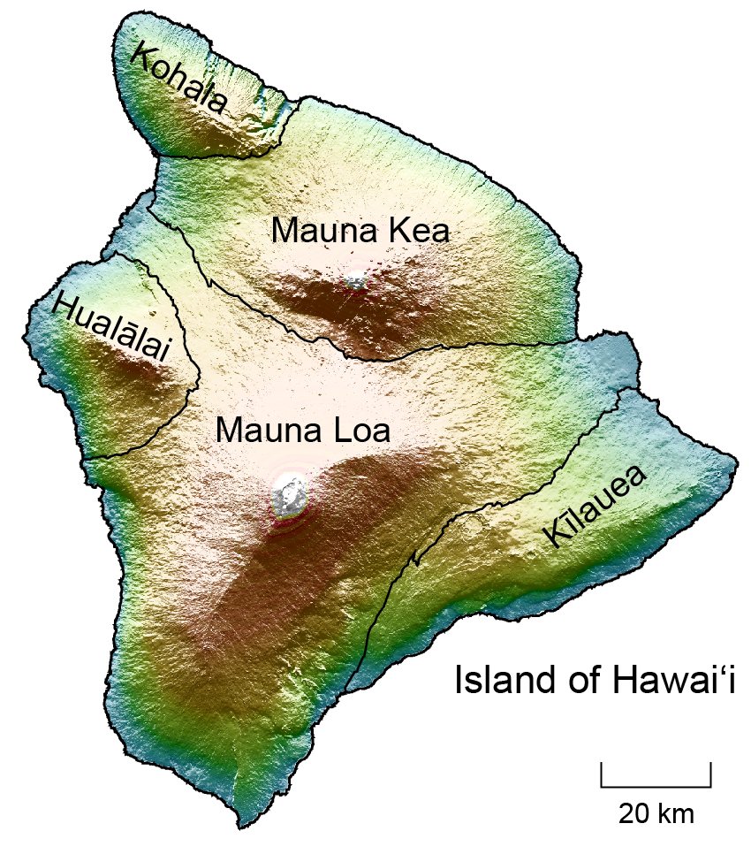
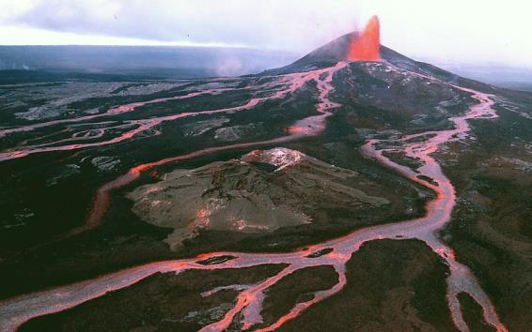
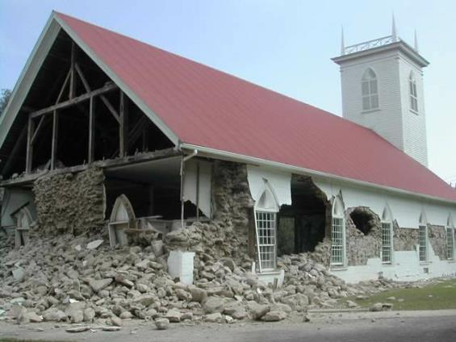
The Hawaiʻi Supersite
overview
data and users
results
challenges
achievements
Volcanoes
Earthquakes
Established in 2008, made permanent in 2012
Key elements:
  Presence of a population exposed to volcanic and seismic hazards
  High likelihood of future seismic and eruptive activity
  History of Kīlauea and Mauna Loa as volcanoes that stimulate basic volcanological research
EGU2017-2246
Vienna, Austria (27 April 2017)

Slide 4
Users and contributors
overview
data and users
results
challenges
achievements
Contributing agencies
ASI (Italy)
CSA (Canada)
DLR (Germany)
ESA (Europe)
GEO (Switzerland)
JAXA (Japan)
NASA (United States)
UNAVCO (United States)
USGS (United States)
Supersite Users
Advanced REm-sen. SYStems
Arizona State University
Central South University
Chinese Academy of Sciences
GFZ Potsdam
INGV
IREA-CNR
NASA JPL
Natural Resources Canada
Stanford University
University of Miami
University of Seoul
University of Wisconsin
UNAVCO
USGS
EGU2017-2246
Vienna, Austria (27 April 2017)

Slide 5
Available data
overview
data and users
results
challenges
achievements
Satellite SAR
ENVISAT (756 scenes)
RADARSAT-1 (500)
ALOS-1 (414)
TerraSAR-X (220)
TanDEM-X (159)ª
COSMO-SkyMed (764)
RADARSAT-2 (470)^{b}
ALOS-2 (150)^{a b}
Ground / airborne
GPS
Seismic
Gravity
Gas emissions
Geologic mapping
UAVSAR
Satellite Optical / IR
Pleiadesª
ASTER
MODIS
Landsat-7/8
ª fulfilled through non-Supersite PI account ^{b} does not include all data acquired
EGU2017-2246
Vienna, Austria (27 April 2017)

Slide 6
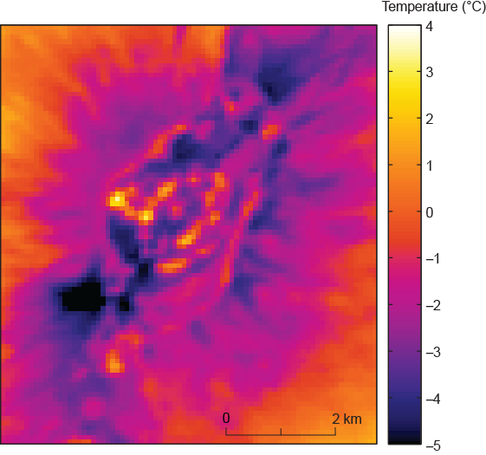
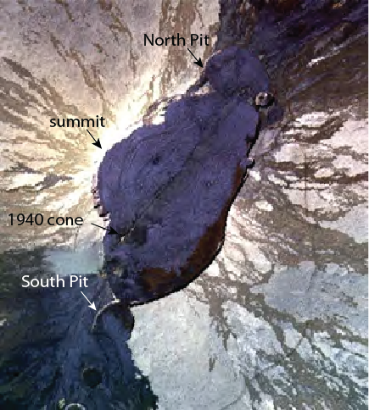
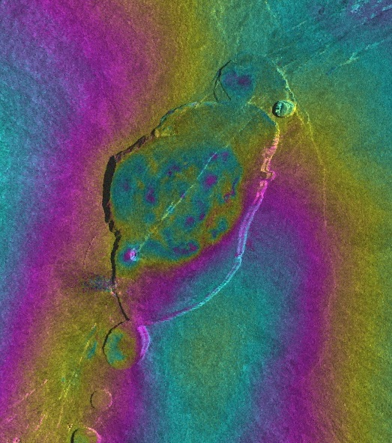
Data synergy: SAR and thermal satellite observations
overview
data and users
results
challenges
achievements
2012-03-29 to 2014-06-19
CSK
Temperature (°C)
range change (cm)
0
1.5
Patrick and Witzke, 2011
EGU2017-2246
Vienna, Austria (27 April 2017)

Slide 7
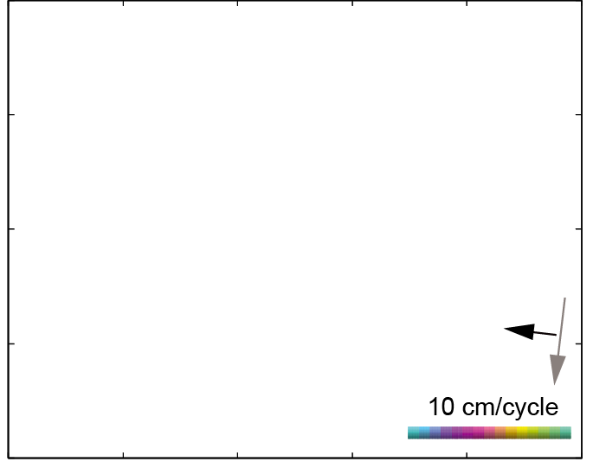
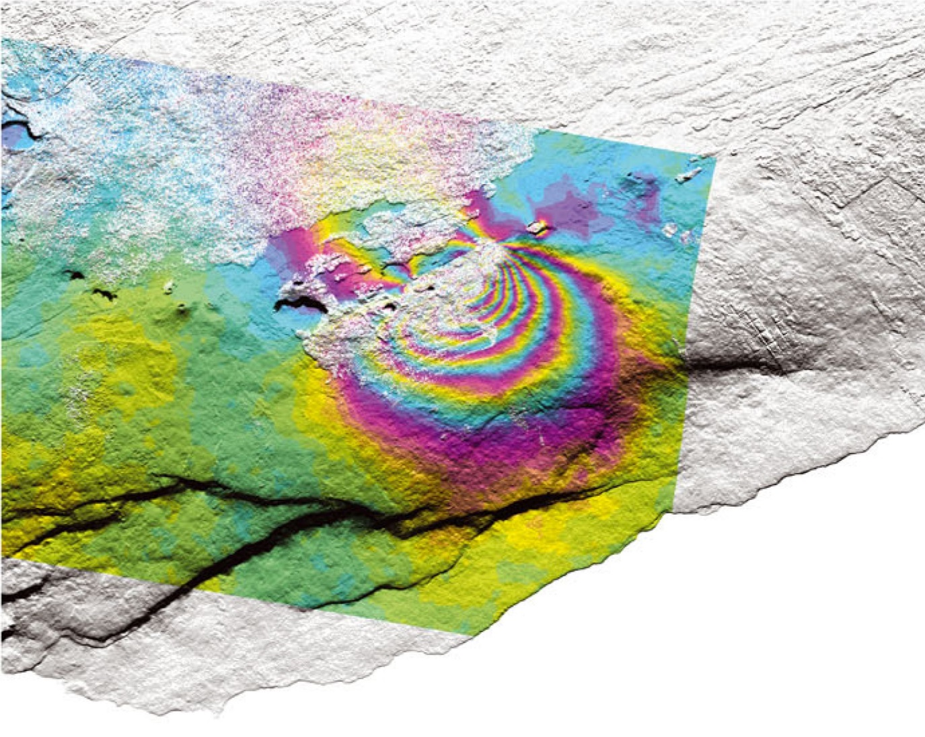
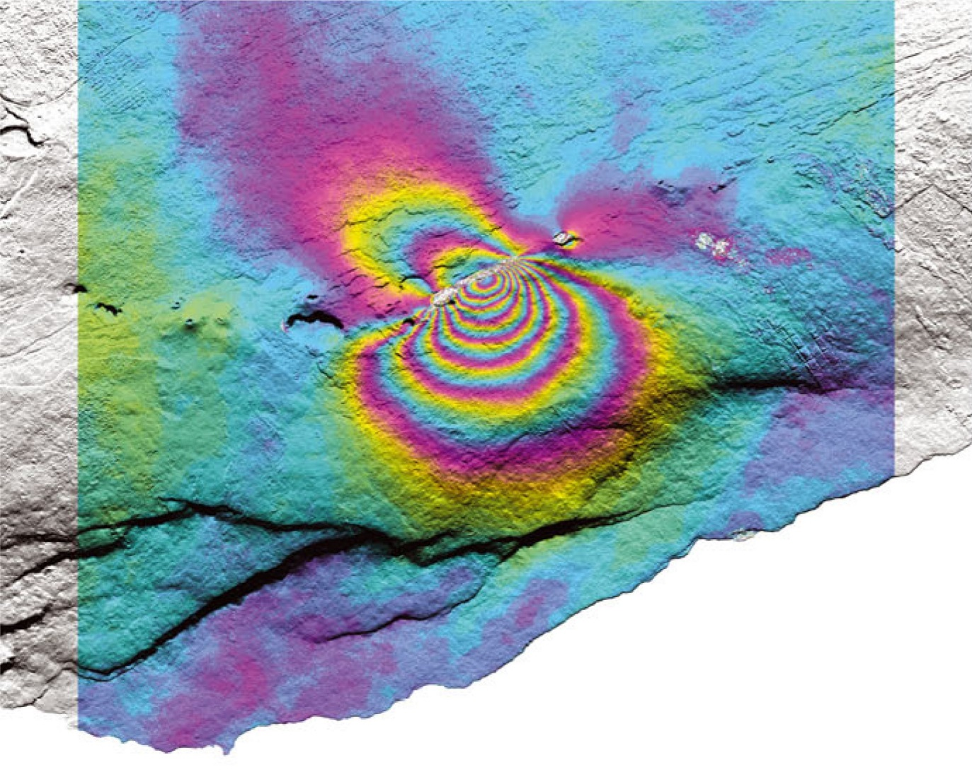
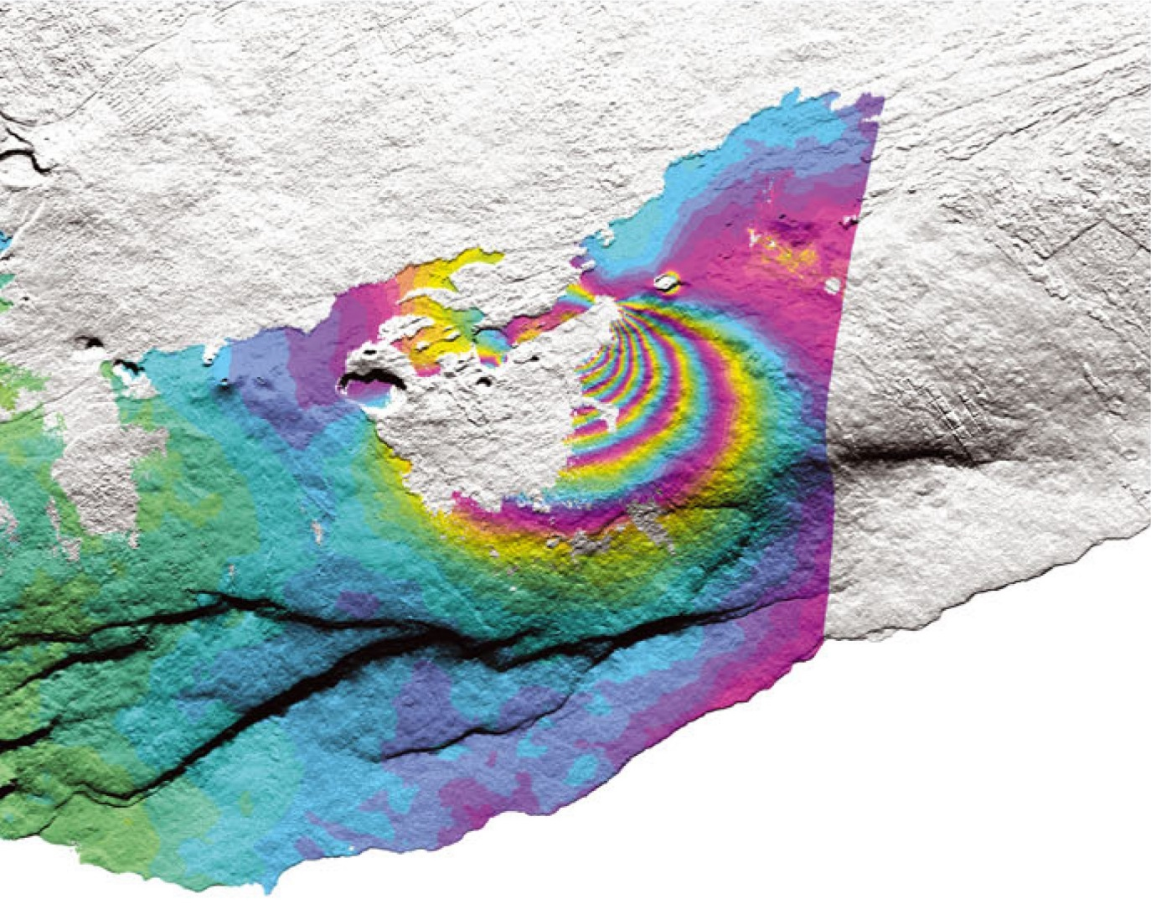
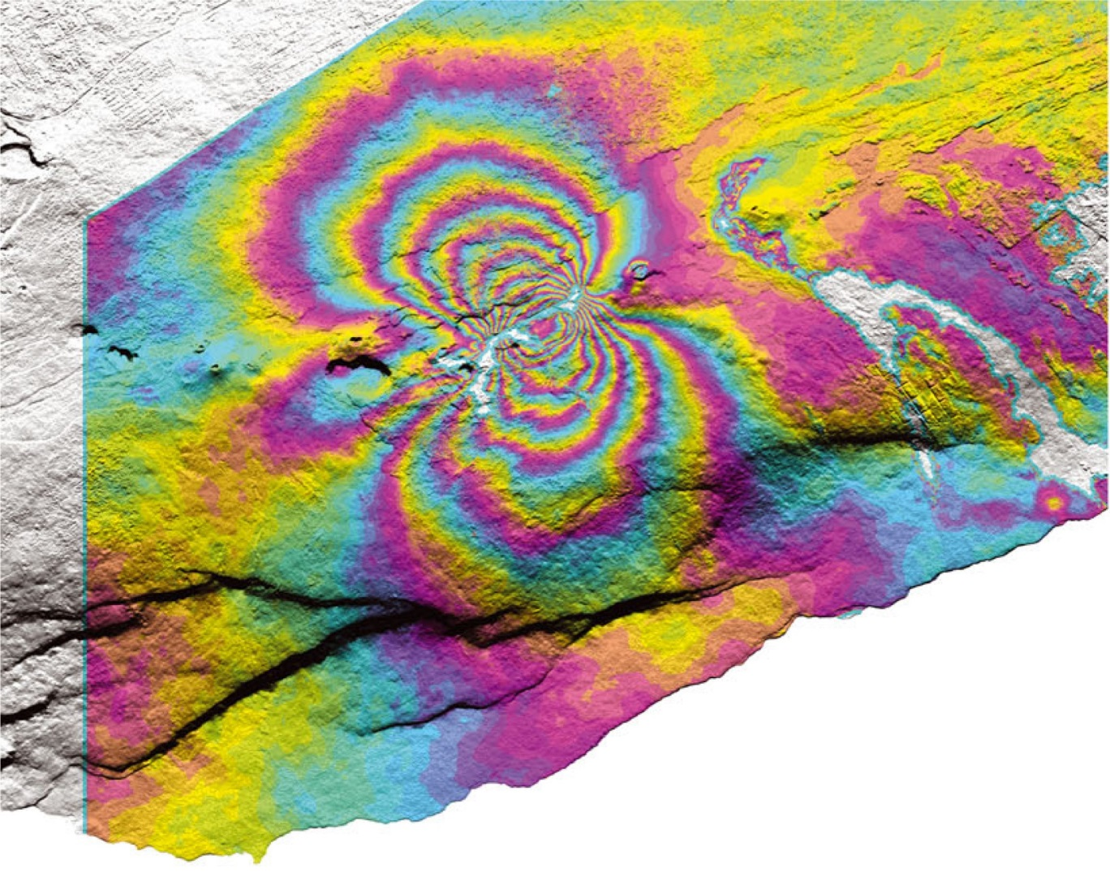


Data synergy: SAR and GPS / tilt
overview
data and users
results
challenges
achievements
May 3
March 11
March 6
UAVSAR
March 10
ALOS-1
TerraSAR-X
COSMO-SkyMed
49°
30°
40°
27°-69°
Lundgren et al., 2013
EGU2017-2246
Vienna, Austria (27 April 2017)

Slide 8
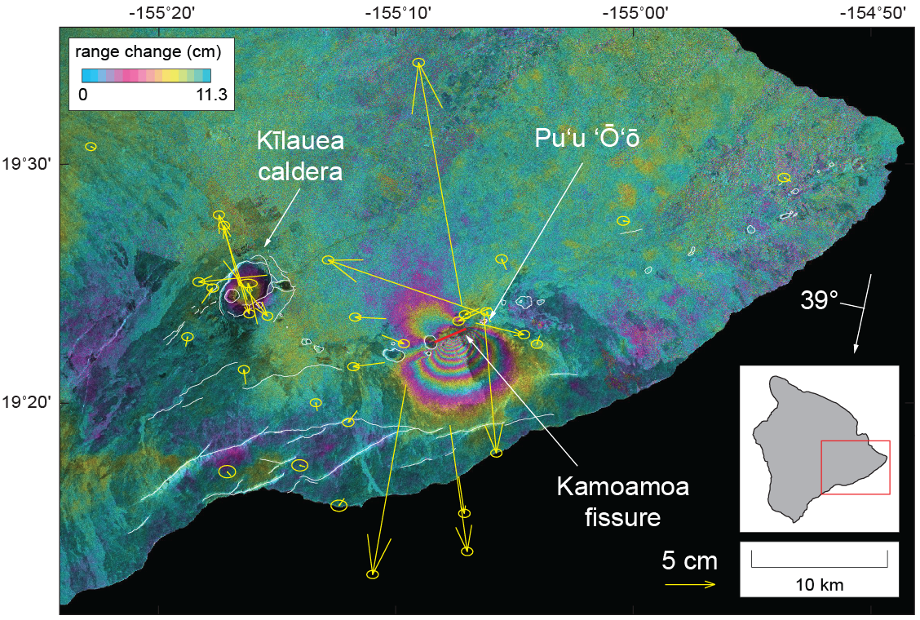
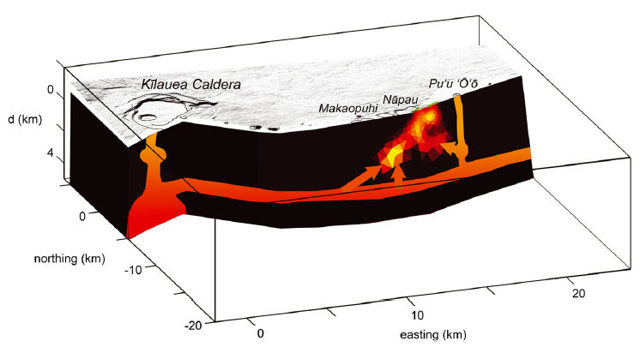
Data synergy: SAR and GPS / tilt
overview
data and users
results
challenges
achievements
ALOS-1
24 January – 11 March 2011
Kīlauea’s March 2011 Kamoamoa fissure eruption
Orr et al., 2015
Lundgren et al., 2013
EGU2017-2246
Vienna, Austria (27 April 2017)

Slide 9
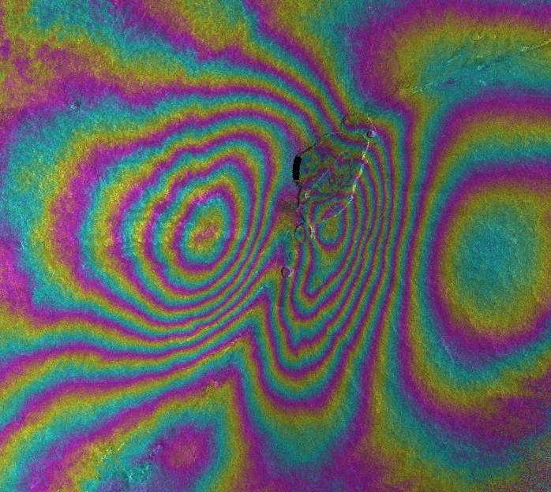
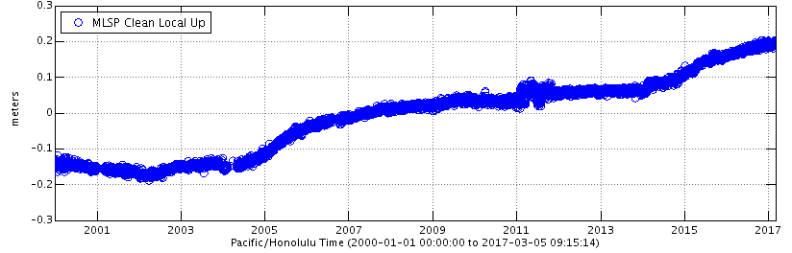
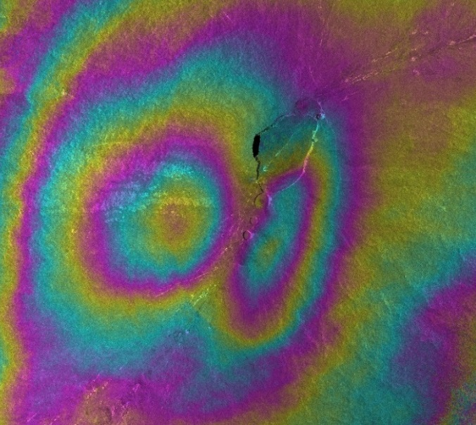
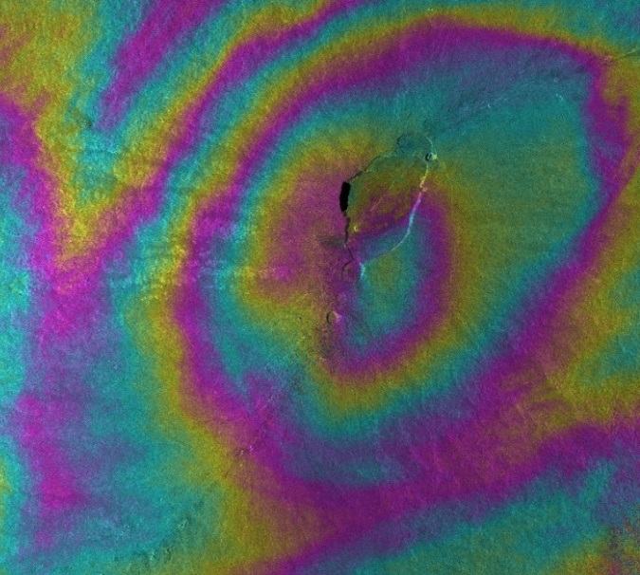
Results: Mauna Loa inflation—2014 to present
overview
data and users
results
challenges
achievements
August 2014 – January 2017
Cosmo-SkyMed interferograms reveal a change in the locus of deformation
range change (cm)
0
1.5
February –
August 2016
August 2016 –
January 2017
EGU2017-2246
Vienna, Austria (27 April 2017)

Slide 10
Results: Kīlauea’s 2015 summit intrusion
overview
data and users
results
challenges
achievements
CSK
range change
RS
A
T2
range change
2015-04-
1
1 to 2015-05-22
2015-04-01 to 2015-06-12
0
1.55 cm
0
2.83 cm
5 km
EGU2017-2246
Vienna, Austria (27 April 2017)

Slide 11
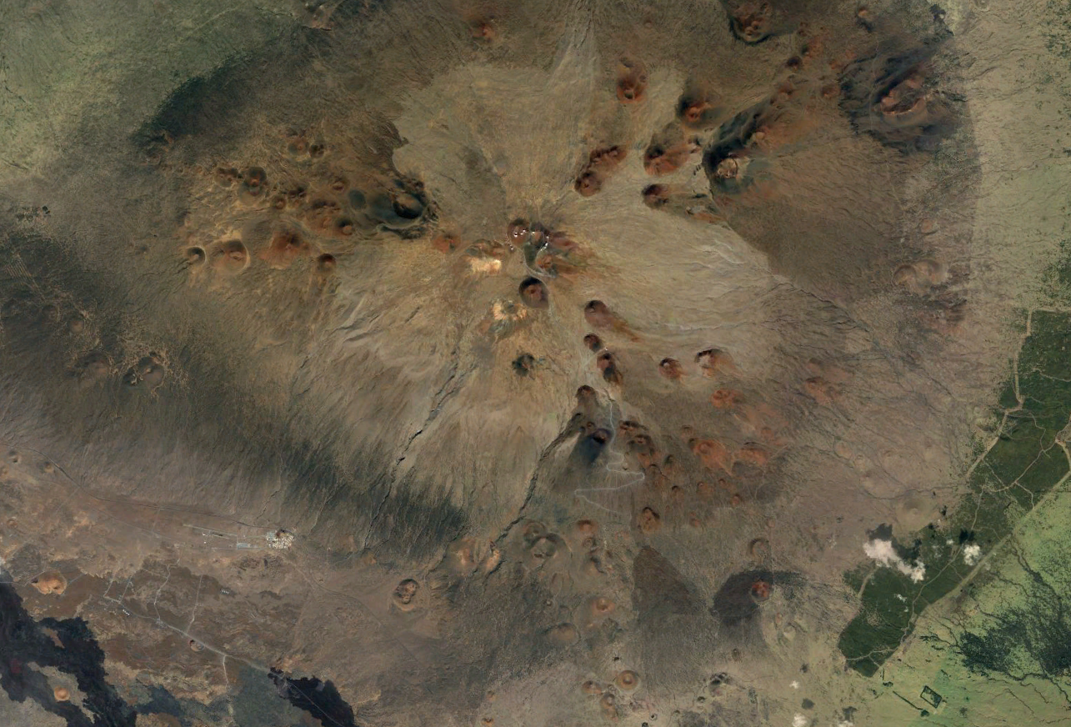
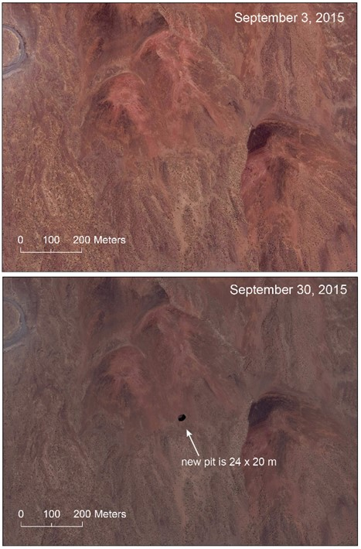
Results: Mauna Kea pit crater
overview
data and users
results
challenges
achievements
5 km
EGU2017-2246
Vienna, Austria (27 April 2017)

Slide 12
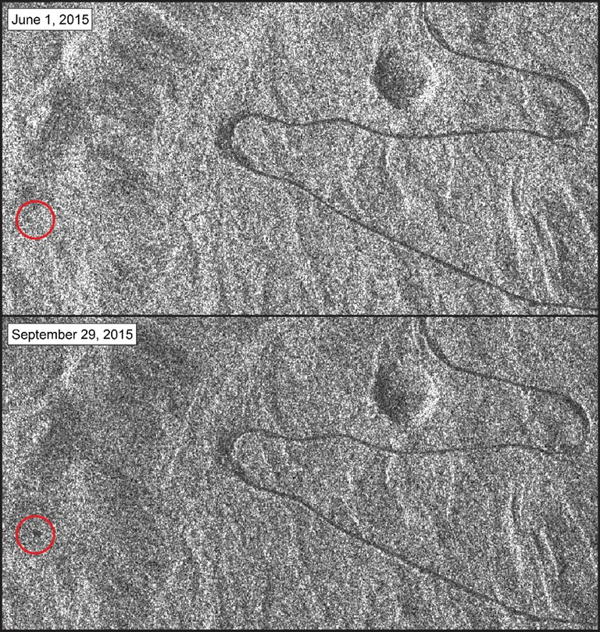
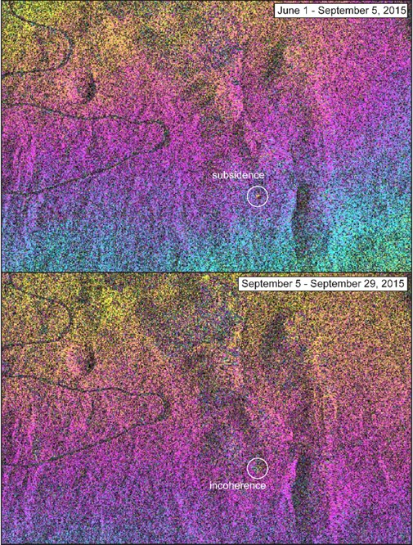
Results: Mauna Kea pit crater
overview
data and users
results
challenges
achievements
RADARSAT-2 data constrain the formation time of the crater to be between 5 and 29 September, 2015.
Interferograms suggest ~1 cm of subsidence in the weeks to months prior to crater formation
EGU2017-2246
Vienna, Austria (27 April 2017)

Slide 13
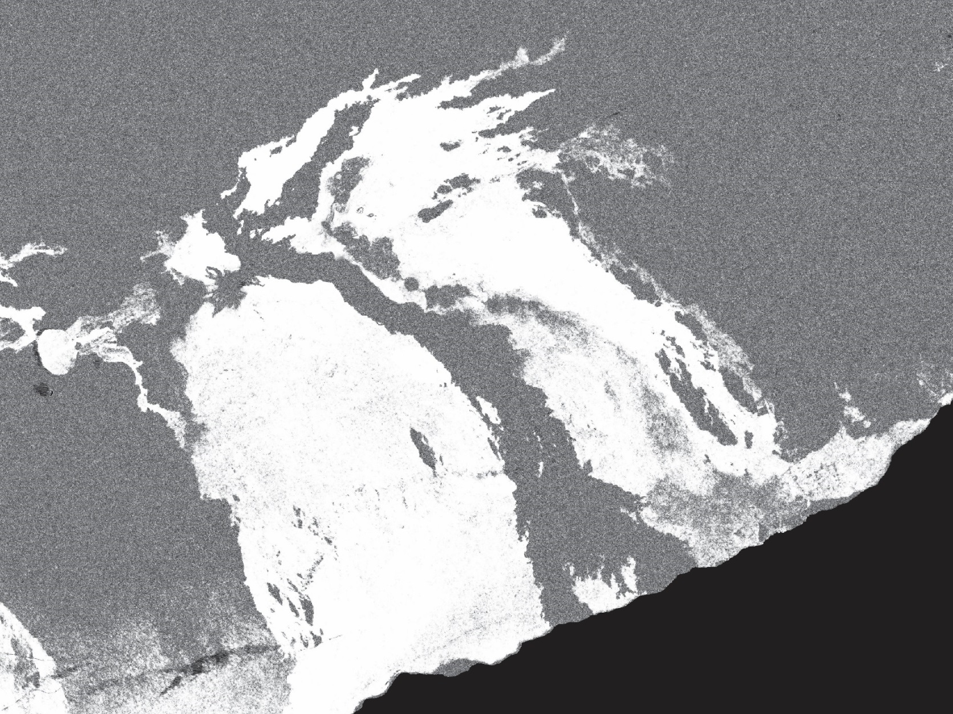

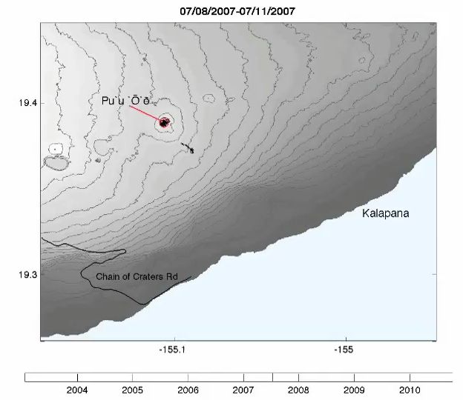
Results: Mapping lava flows with coherence
overview
data and users
results
challenges
achievements
August 12, 2011 – June 13, 2013
TerraSAR-X
Coherence from ENVISAT
Dietterich et al., 2012
EGU2017-2246
Vienna, Austria (27 April 2017)

Slide 14
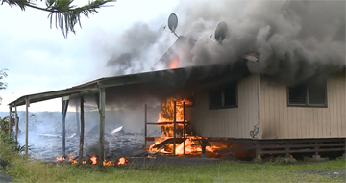
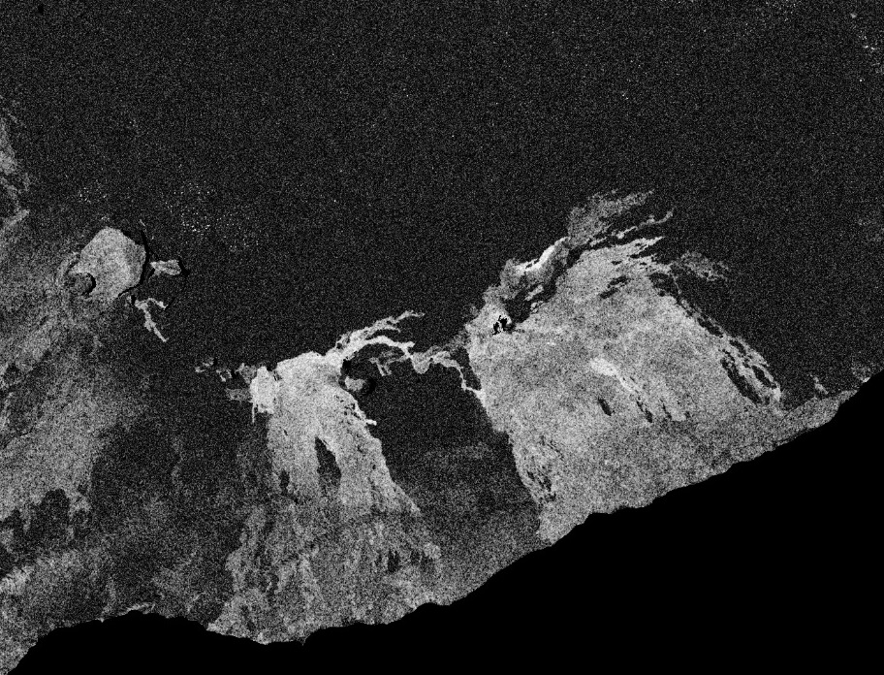
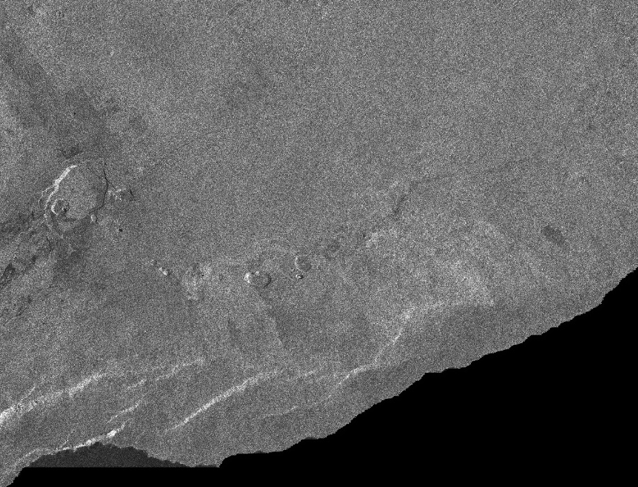
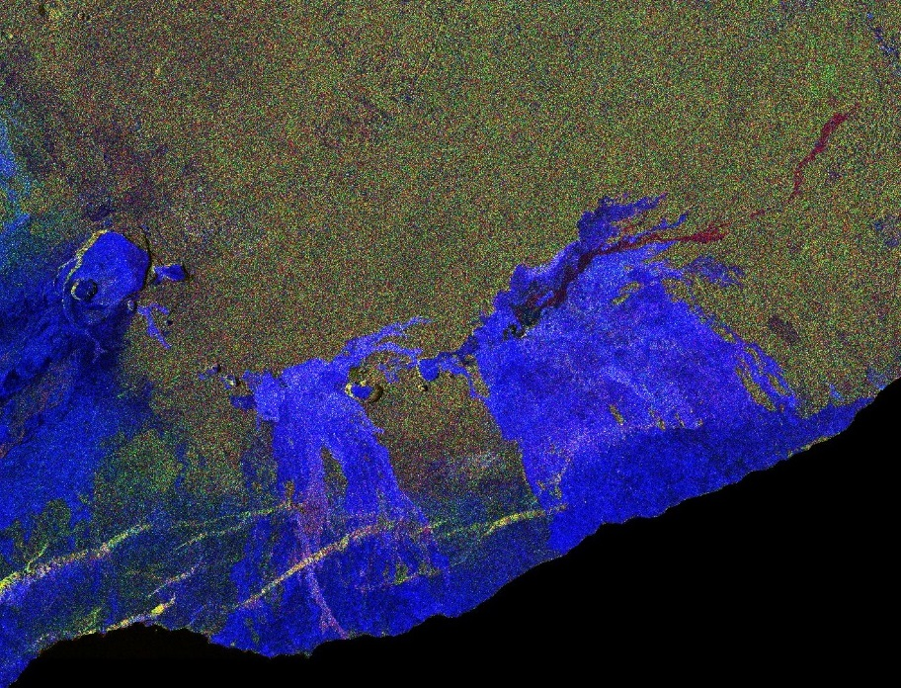
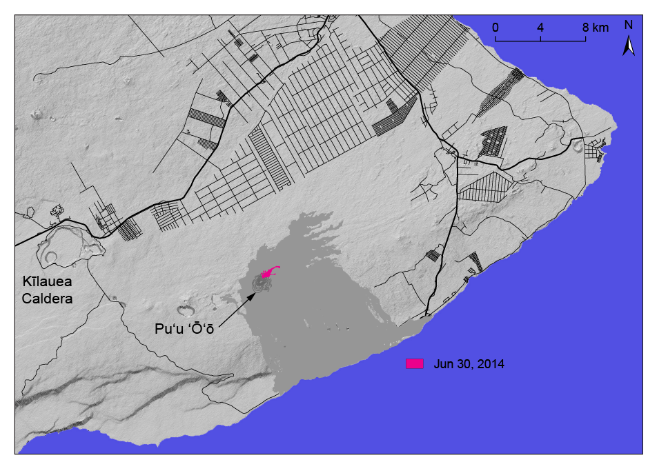
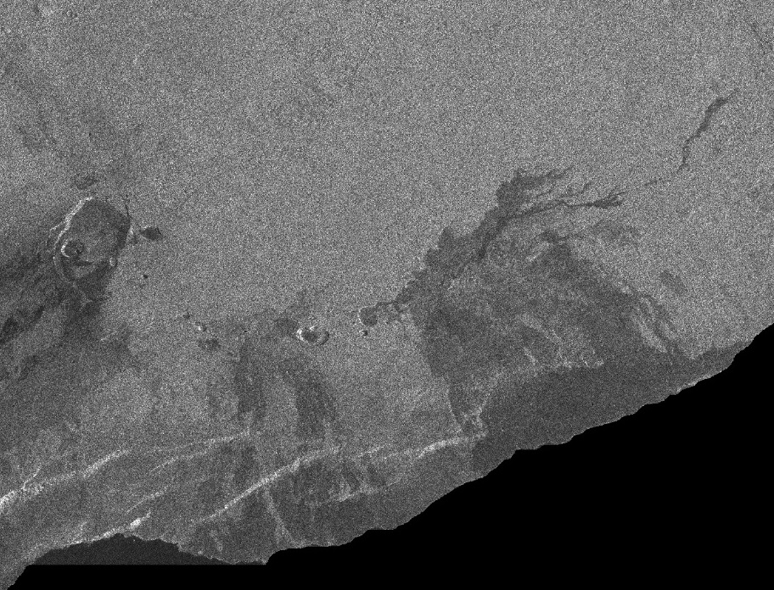






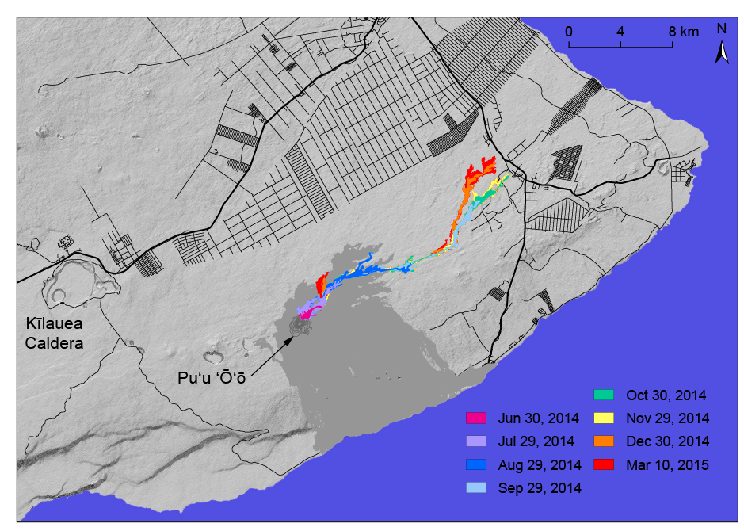


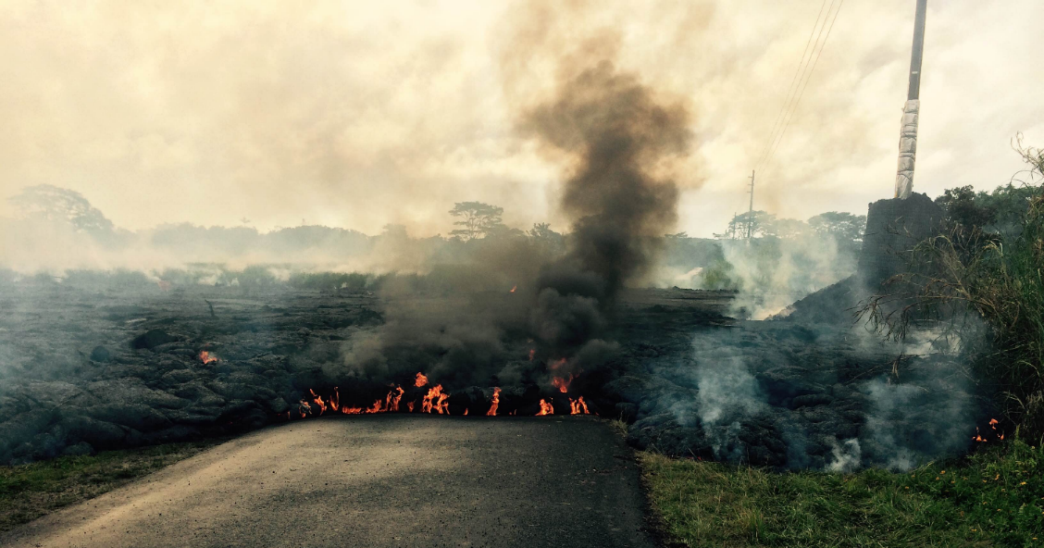
Results: Mapping lava flows with coherence and amplitude
overview
data and users
results
challenges
achievements
14 October 2014 HH amplitude
14 October 2014 HV amplitude
R = 10 July 2014 HV amplitude
G = 14 October 2014 HV amplitude
B = 10 July – 14 October 2014 coherence
10 July – 14 October 2014 coherence
RADARSAT-2
EGU2017-2246
Vienna, Austria (27 April 2017)

Slide 15
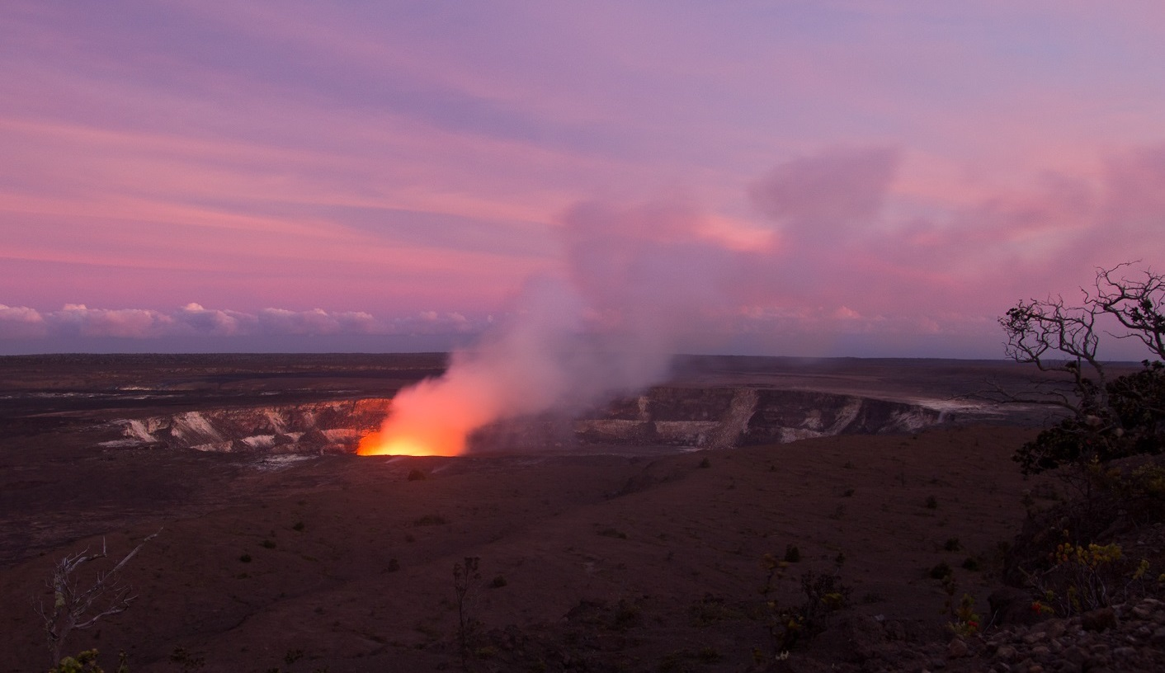
The Hawaiʻi Supersite: Challenges
overview
data and users
results
challenges
achievements
Despite many noteworthy results, opportunities abound:
Improve on-line visibility and posting of results
Encourage coordination between user groups
Create an archive for non-SAR satellite imagery and supporting data (including DEMs)
Identify sources of funding (current efforts are in-kind contributions)
Focus on data fusion between SAR and other remote sensing data (thermal and optical, in particular)
EGU2017-2246
Vienna, Austria (27 April 2017)

Slide 16
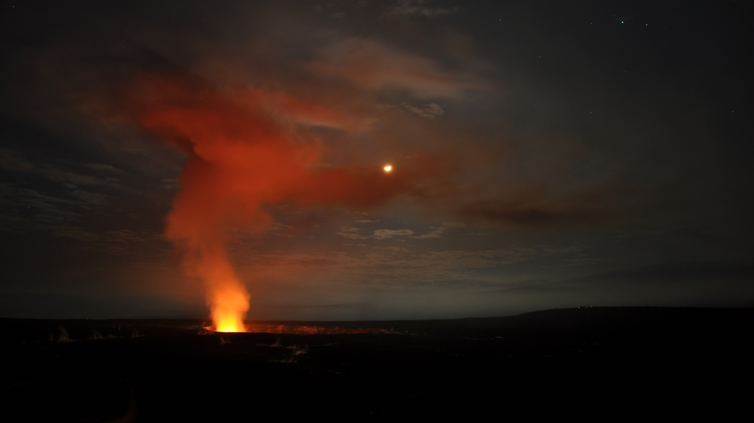
The Hawaiʻi Supersite: Achievements
overview
data and users
results
challenges
achievements
9 years in…What do we have to show for our efforts?
At least 40 peer-reviewed journal articles
Improved models of volcano-tectonic processes, as well as magma supply, storage and transport at Kīlauea and Mauna Loa volcanoes
Development of new InSAR techniques (for example, 3D displacements, coherence mapping, atmospheric adjustments)
Support for software development
Operational exploitation of SAR
EGU2017-2246
Vienna, Austria (27 April 2017)

Slide 17
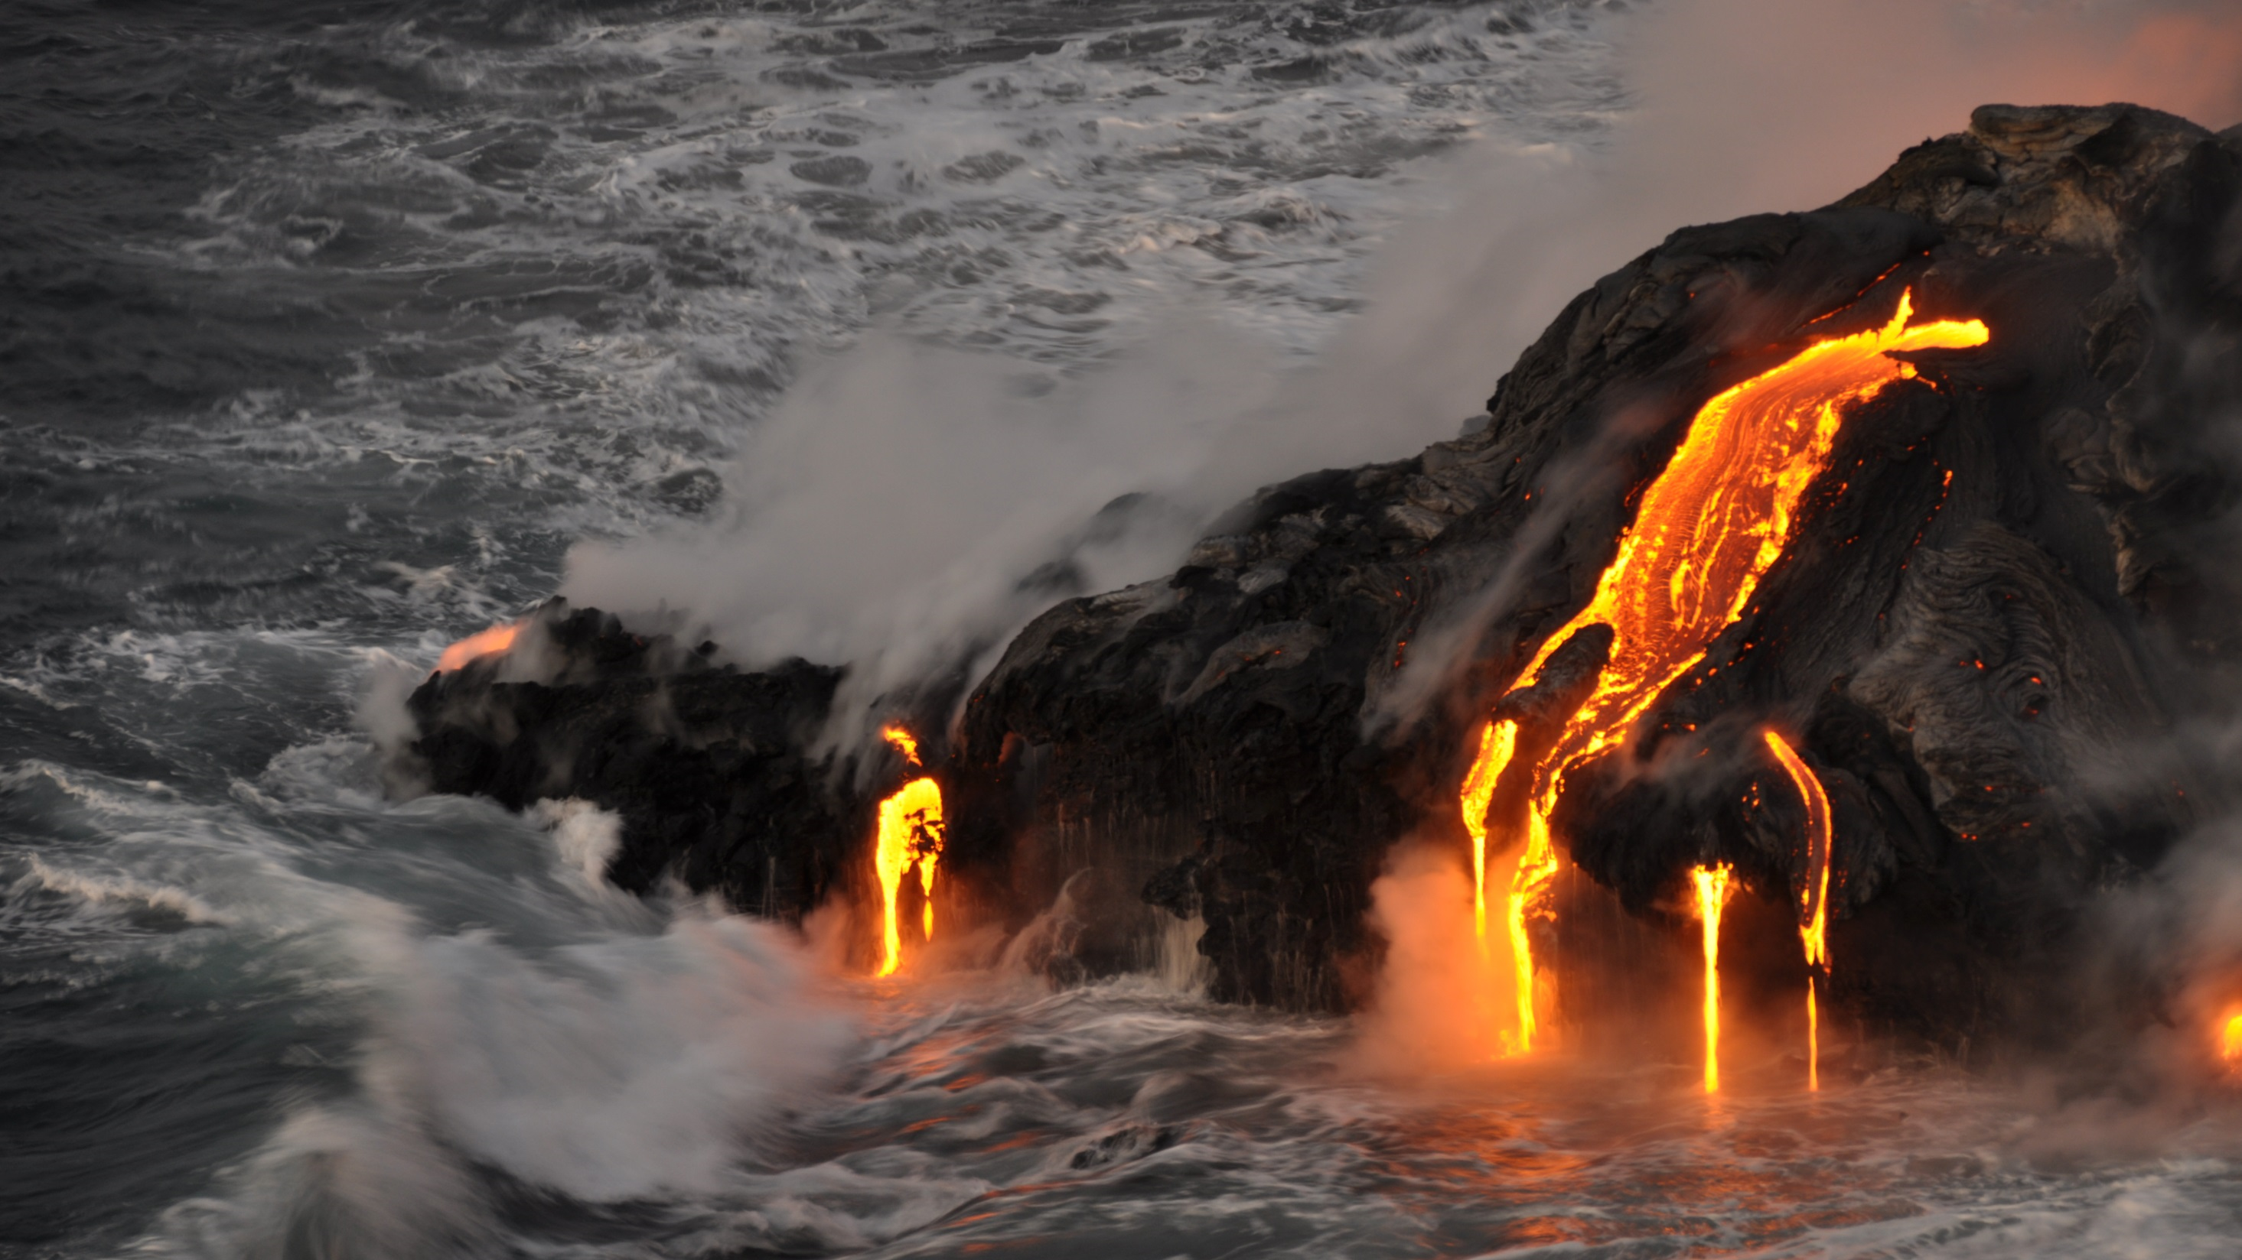
Thank you!
EGU2017-2246
Vienna, Austria (27 April 2017)

