Slide 1
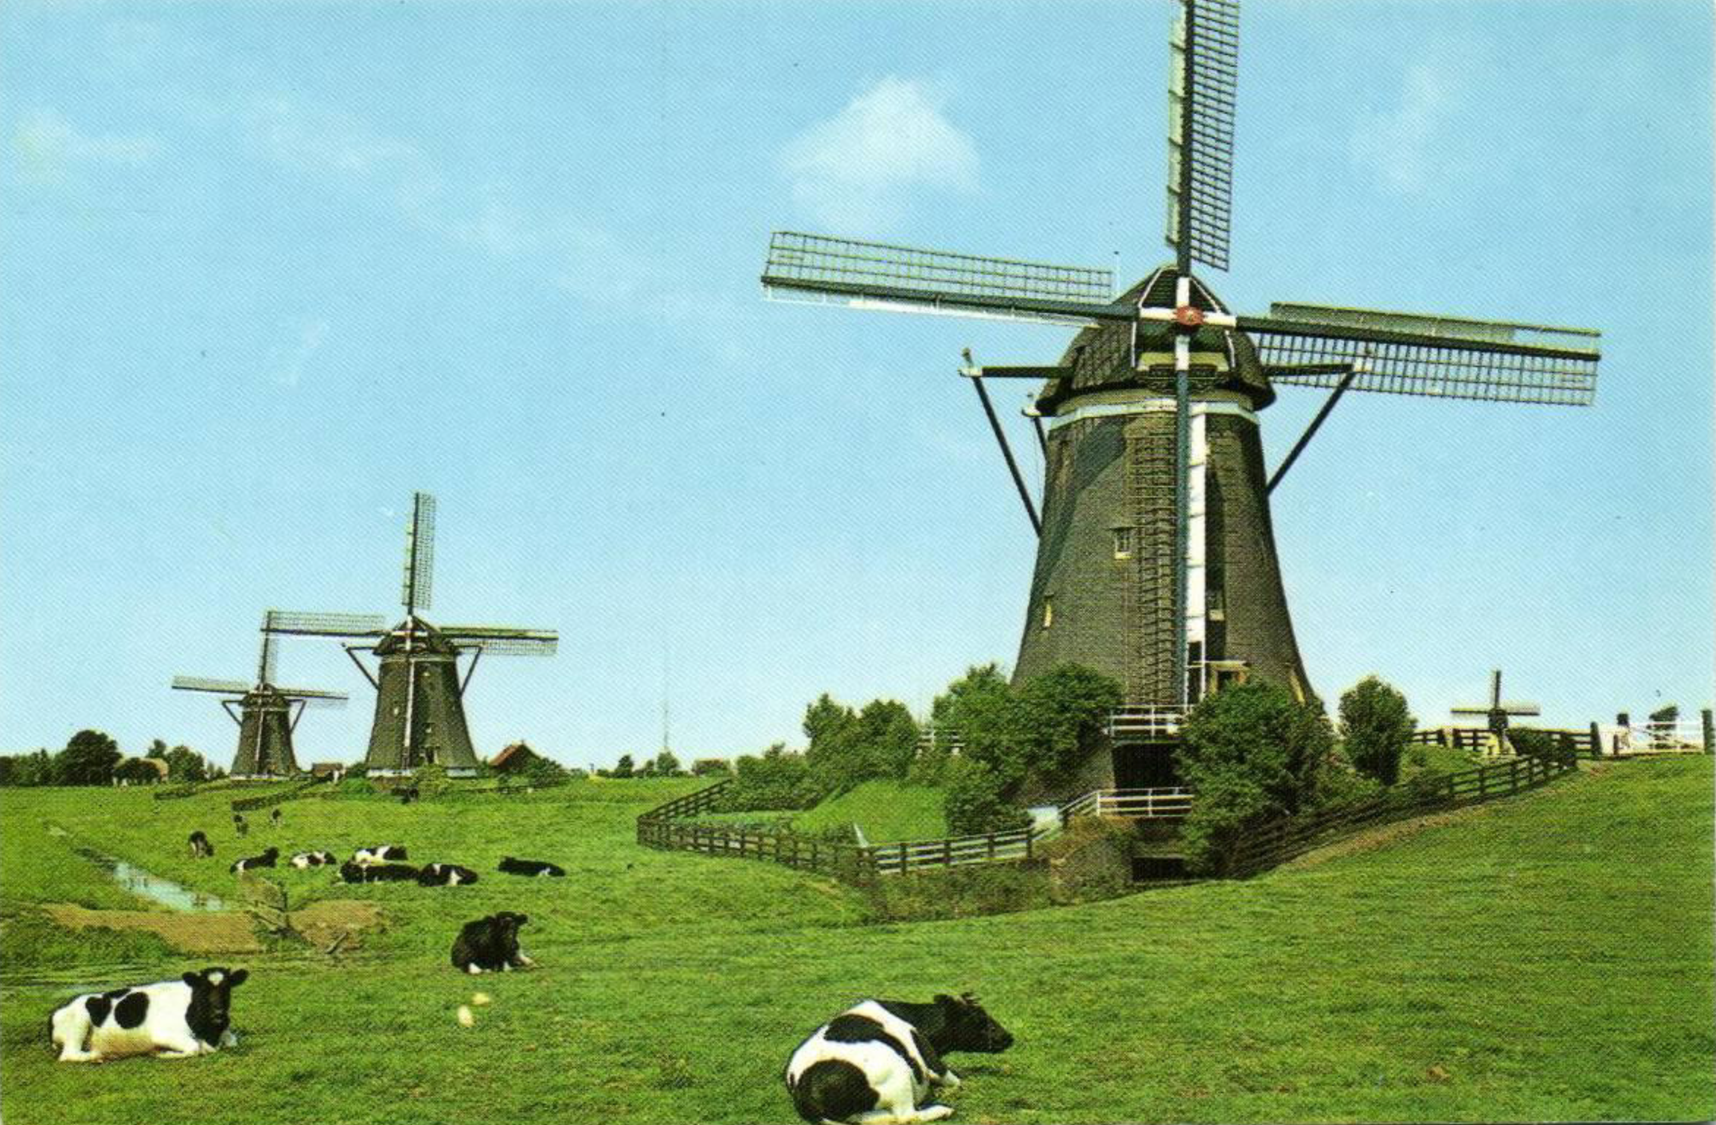



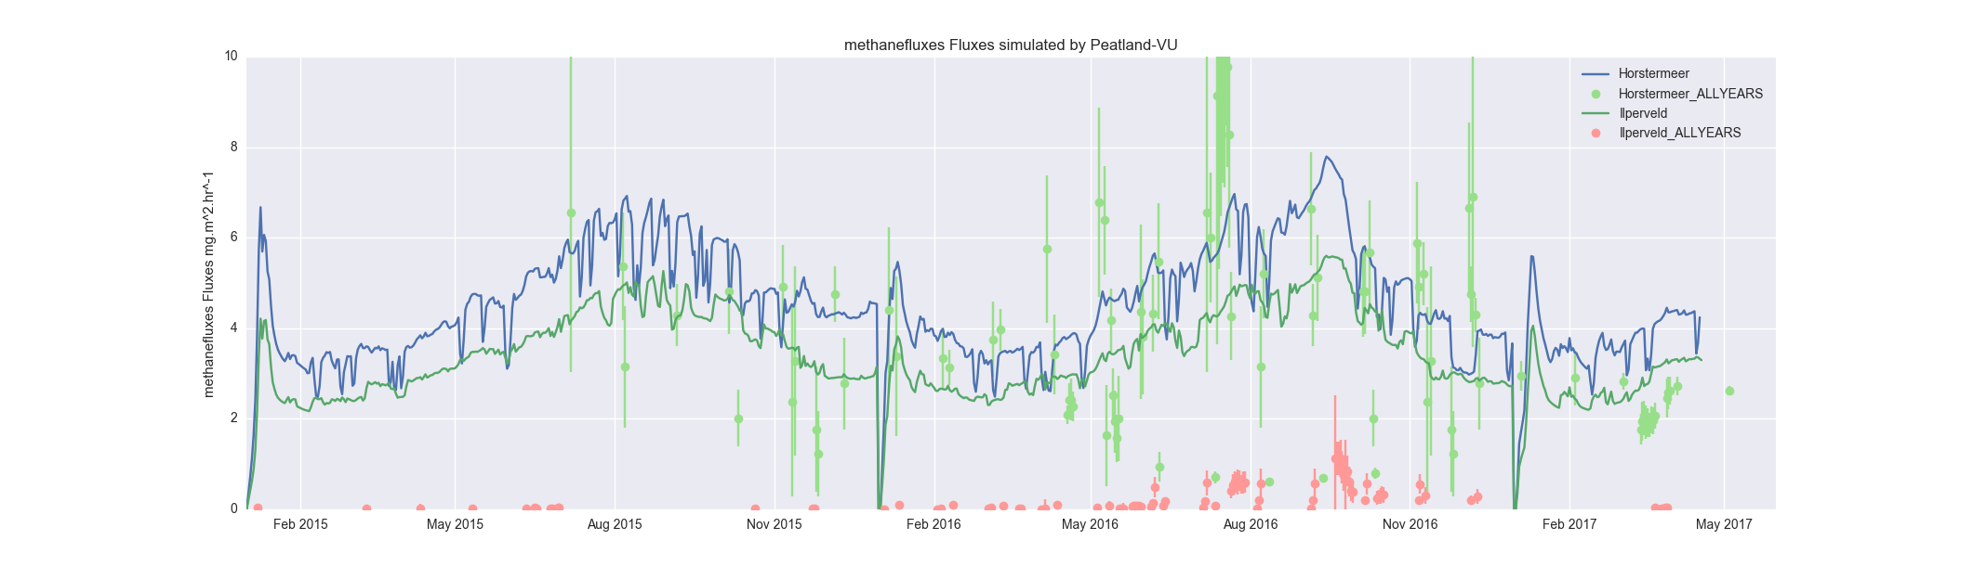
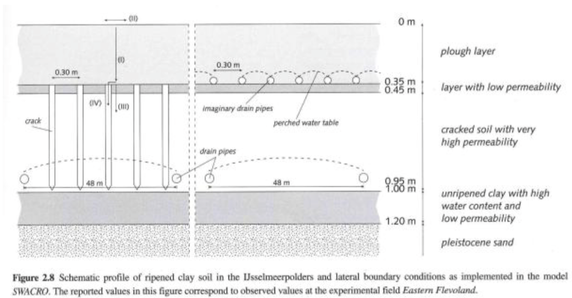
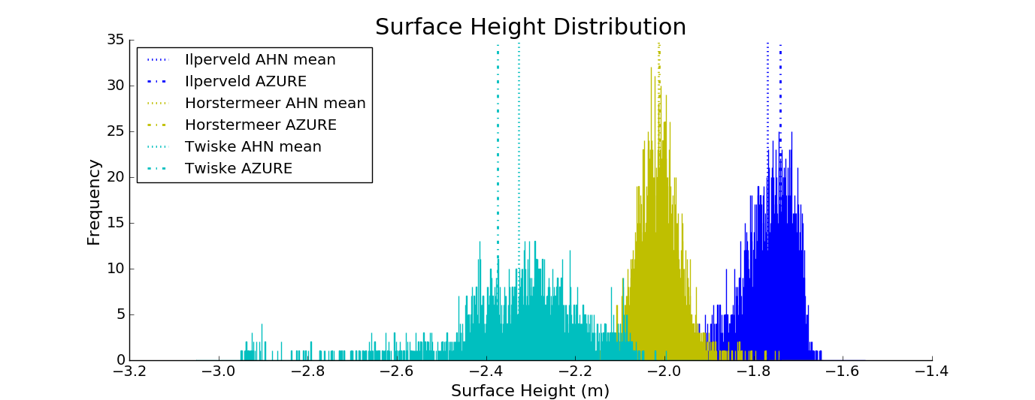
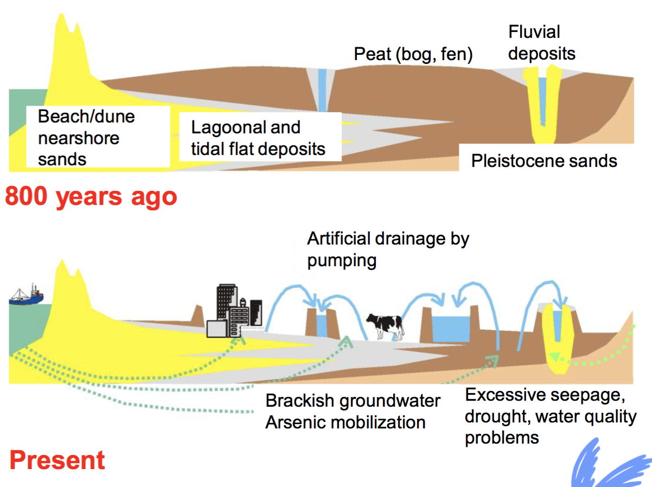

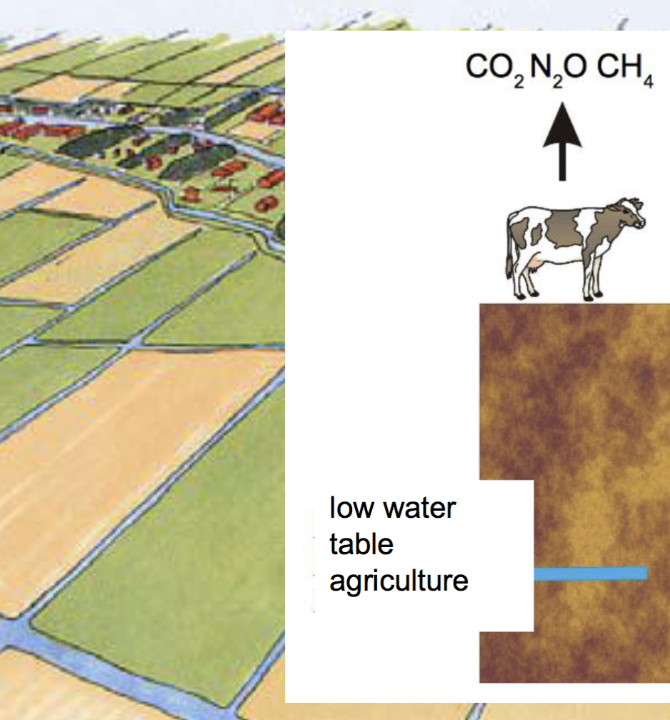
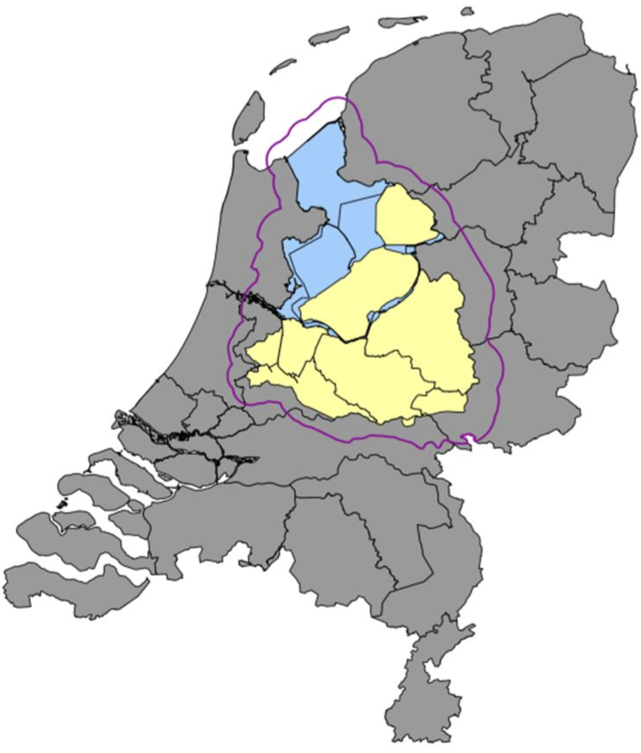
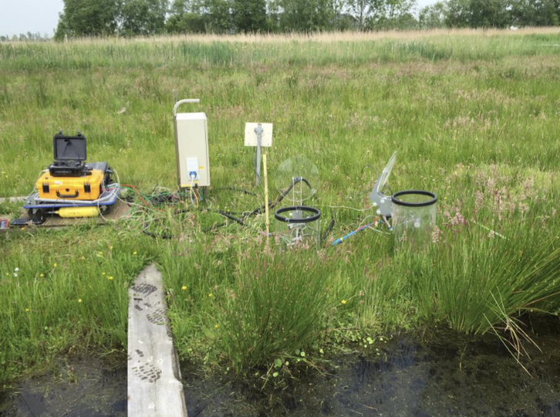
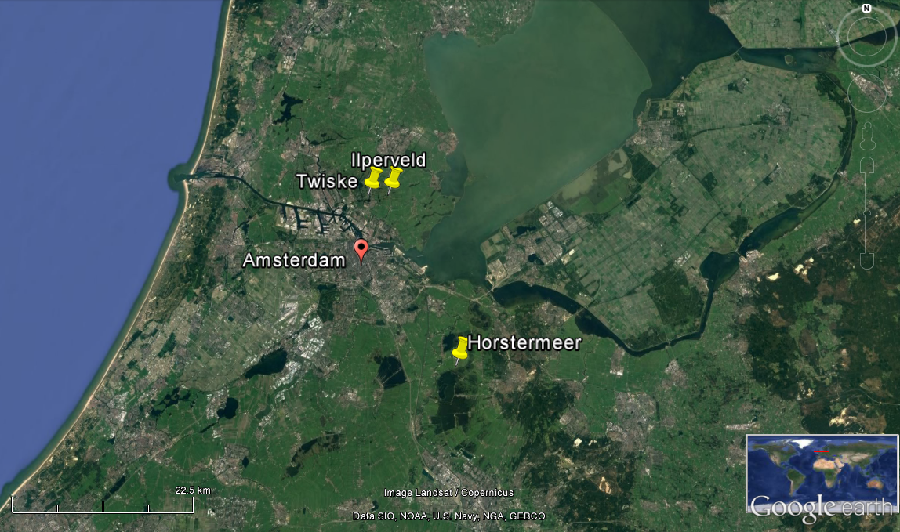
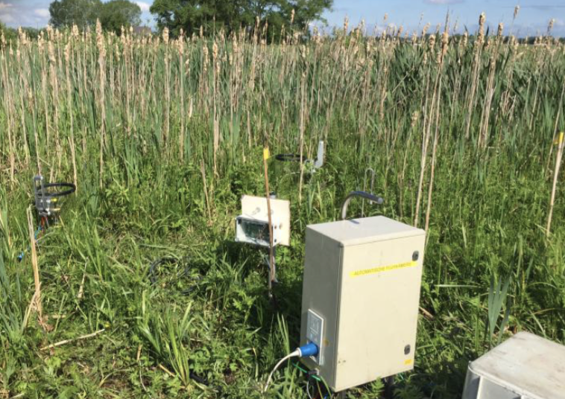
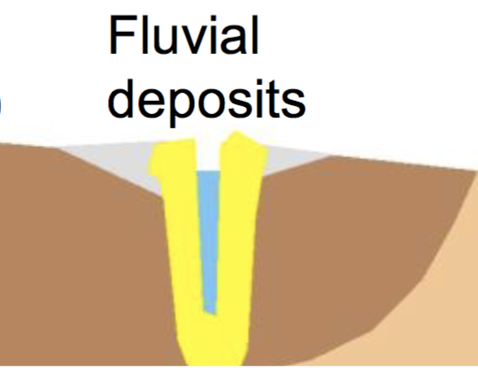
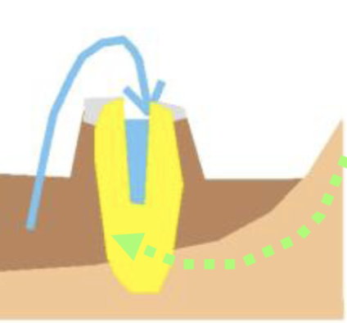
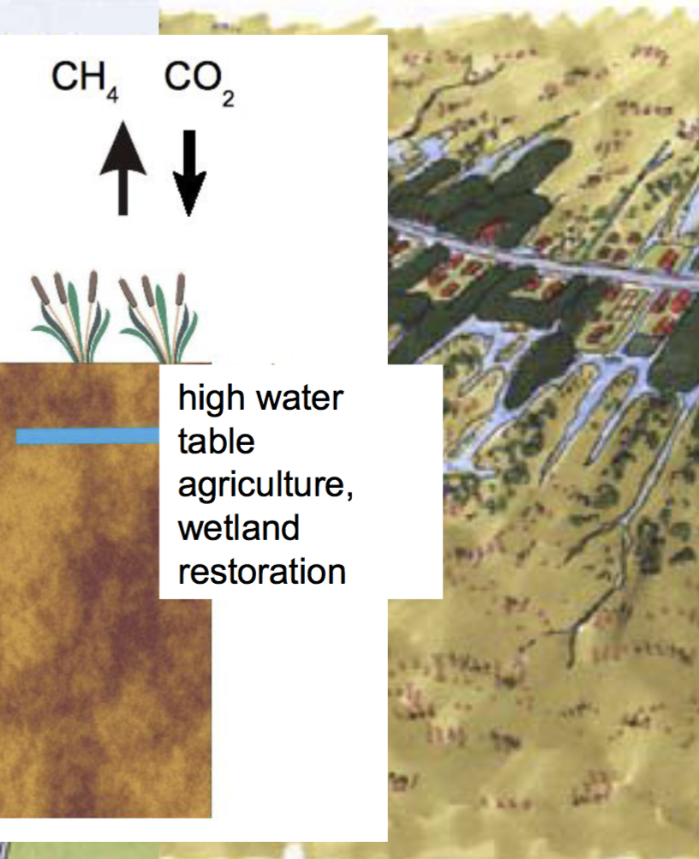
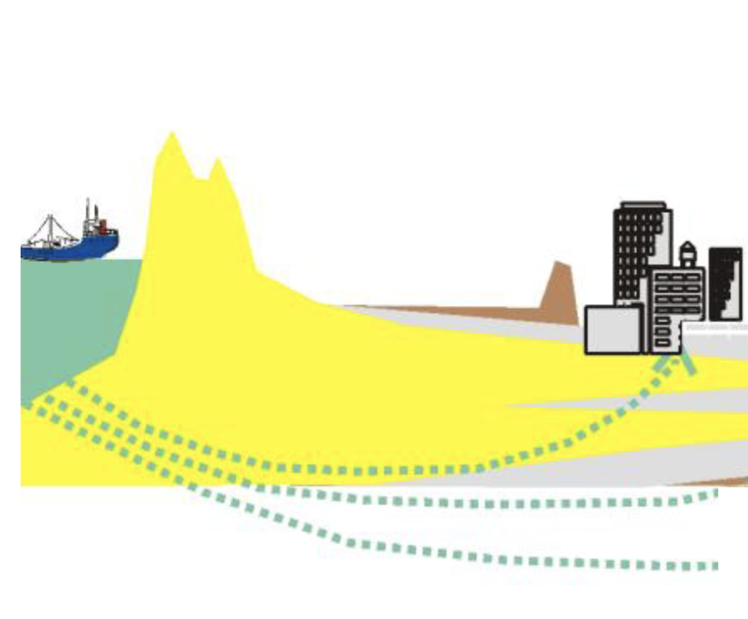

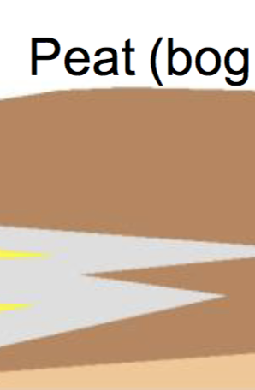
Feeling bogged down about climate change mitigation?
Insight from a Dutch peat-hydrology model
Tanya Lippmann, Ko van Huissteden, and Dimmie Hendriks
Contact: t.j.r.lippmann@vu.nl
Key objective
To investigate the ability of peatland sites to see-saw between a source and sink of methane and carbon dioxide
The problem: Land subsidence & GHG emissions:
Continuous drainage of Dutch peatlands over the last millennium has resulted in land subsidence and enhanced carbon dioxide (CO₂) emissions (Erkens, van der Meulen & Middelkoop, 2016).
Peatland restoration could reverse these effects. However, preliminary field studies show that raising the water table enhances methane (CH₄) emissions (Lamers et al. 2014).
The time period required to achieve stable greenhouse gas (CO₂ & CH₄) emissions is unknown. Therefore, models can provide insight into the suitability of restoration midst the onset of anthropogenic climate change (Tiemeyer et al. 2016).
Including a water balance model improves skill:
Offline coupling of a hydrological and peatland model:
But loses variability:
Surface height variability within one 25m x 25m AZURE grid cell as reported by the AHN 0.5m x 0.5m dataset.
  AZURE: Hydrological model containing unsaturated zone (MetaSWAP) saturated zone/groundwater (iModflow), surface water flow and surface water distribution over the Noord Holland region at 25m resolution (Deltares, 2015).
  Peatland-VU: a peatland process plot-scale model (van Huissteden et al., 2009).
High water table + natural vegetation → Carbon sink
Conclusions
Model is capable of simulating mean emissions but is less skillful at simulating extremes.
Rewetting methods are not communicated to modelers (i.e. Ilperveld site).
Validation sites
References
Deltares. 2014. Grondwatermodel AZURE versie 1.0. Delft, the Netherlands.
Erkens, G., van der Meulen, M. J., & Middelkoop, H. 2016. Double trouble: subsidence and CO 2 respiration due to 1,000 years of Dutch coastal peatlands cultivation. Hydrogeology Journal, 24: 551–568.
Lamers, L. P. M., Vile, M. A., Grootjans, A. P., Acreman, M. C., van Diggelen, R., Evans, M. G., … Smolders, A. J. P. (2014). Ecological restoration of rich fens in Europe and North America: From trial and error to an evidence-based approach. Biological Reviews, 183: 182–203.
Tiemeyer, B., Albiac Borraz, E., Augustin, J., Bechtold, M., Beetz, S., Beyer, C., … Zeitz, J. (2016). High emissions of greenhouse gases from grasslands on peat and other organic soils. Global Change Biology, 22: 4134–4149.
van Huissteden J, Petrescu A. M. R, Hendriks D. M. D., & Rebel K. T. 2009. Sensitivity analysis of a wetland methane emission model based on temperate and Arctic wetland sites. Biogeosciences Discussions 6: 3035–3051.
Top soil removed before rewetting (2013)
Low water table + agriculture → Carbon source
Rewetted in 1993
High water table + paludiculture + natural vegetation → Carbon sink
Restoration possibility
Figure adapted from Ko van Huissteden, 2017

