Slide 1
IMPACT OF FLOODS INDUCED BY EXTREME PRECIPITATION EVENTS ON PUBLIC HEALTHC
EGU2017-3886 | PICOs | HS7.3
Spyridon Mavroulis ⁽¹⁾, Maria Mavrouli ⁽²⁾, Efthymios Lekkas ⁽¹⁾, Athanassios Tsakris ⁽²⁾
(1) Department of Dynamic Tectonic Applied Geology, Faculty of Geology and Geoenvironment, School of Sciences, National and Kapodistrian University of Athens, Greece
(2) Department of Microbiology, Medical School, National and Kapodistrian University of Athens, Greece

Slide 2
IMPACT OF FLOODS INDUCED BY EXTREME PRECIPITATION EVENTS ON PUBLIC HEALTH
Introduction
Aim
Methodology
Conclusions
Results

Slide 3
INTRODUCTION
Hydrometeorological disasters comprise the most reported type of natural disaster, and floods account for the majority of disasters in this category in both developed and developing countries.
Various definitions of floods have been provided from various sources.
The common point of all these definitions is the temporary partial or complete water inundation of normally dry land resulting from various processes and causing damage and losses to human, natural and built environments.

Slide 4
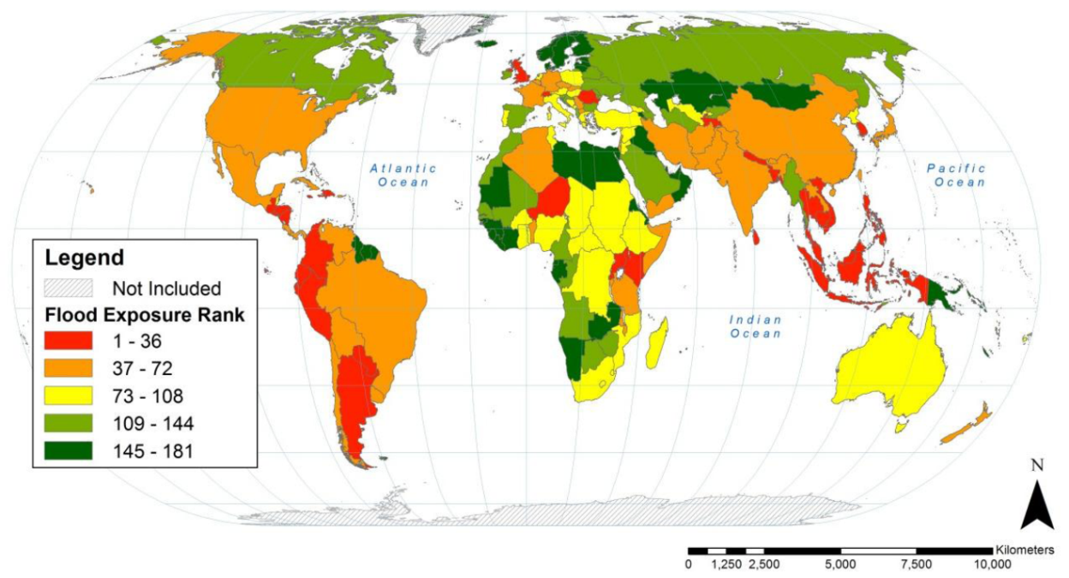
INTRODUCTION
According to their generation mechanism and their basic characteristics, floods are classified into: (a) river or fluvial, (b) coastal, (c) urban, (e) groundwater, (f) rain-on-snow and (g) ice-jam floods.
According to their duration, floods can be divided into: (a) slow-onset floods lasting for long period of one or more weeks or even months, (b) rapid-onset floods lasting for short period of only one or two days and (c) flash floods occurring within minutes or few hours.
Regardless of classifications, flooding can lead to extensive morbidity and mortality and pose multiple risks to public health throughout the world.
Rankings of country-level population flood exposure expressed as quintiles. 148 countries (of 228) had no floods in populated areas during the 1985-2003 period of analysis and are each tied for 181st rank.
Christenson et al. (2014)

Slide 5
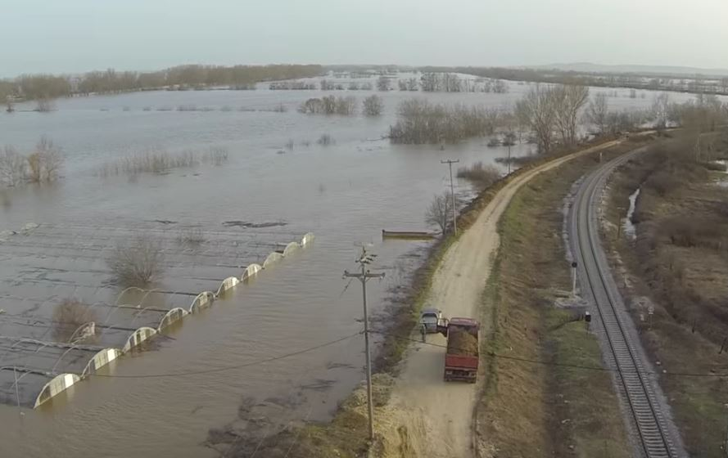
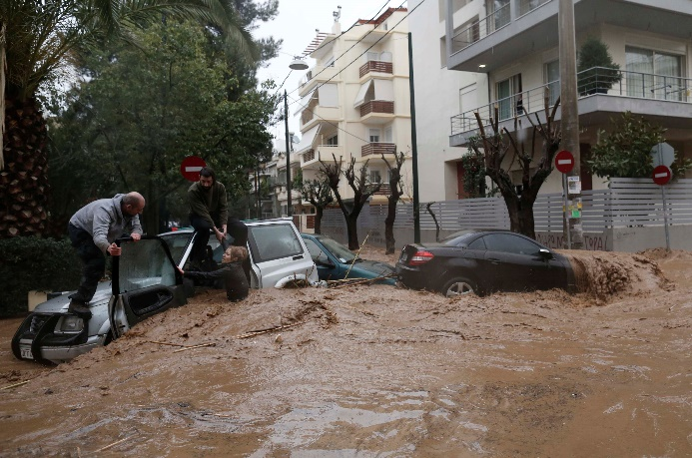
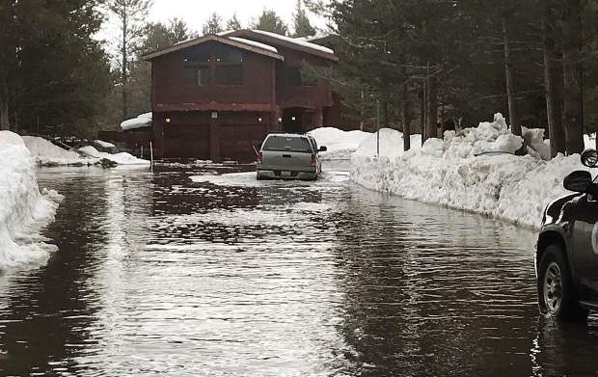
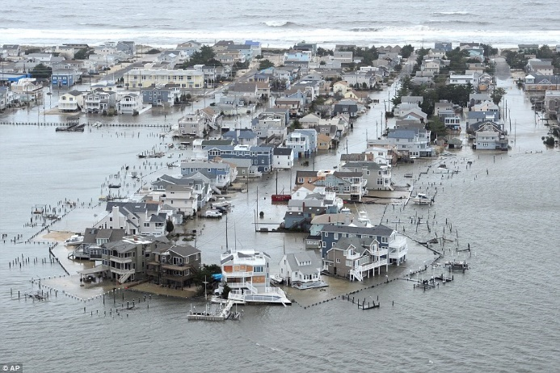
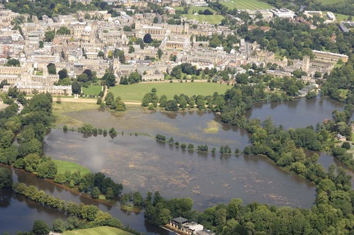
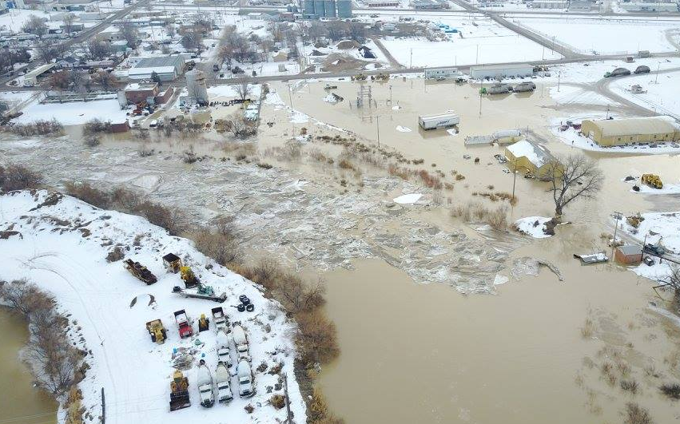
TYPES OF FLOODS
River or fluvial
Urban
Rain on snow
2015 – Evros River (Greece)
2013 – Athens (Greece)
2017 – Lake Tahoe (USA)
Coastal
Groundwater
Ice jam
2012 – Long Beach Island, New Jersey (USA) – Hurricane Sandy
2012 – Christ Church Meadow, Oxford (UK)
2017 – Bighorn River (Western USA)

Slide 6
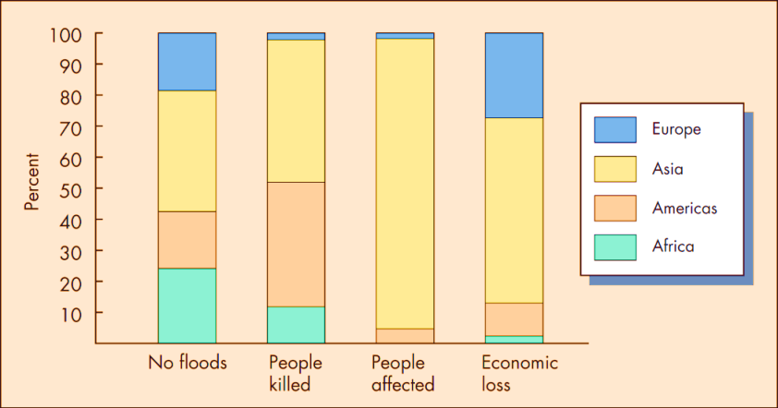
AIM
This study aims to:
review the physical health effects of floods occurred worldwide from 1942 to 2014,
describe the basic epidemiological profile of potential infectious diseases following floods induced by extreme precipitation events,
present the most fatal infectious diseases following floods induced by extreme precipitation events along with the associated key risk factors and the most vulnerable population groups in terms of age and gender
based on available already published scientific data.
Global view of the flood hazard based on data from 1997 to 2006. Asia is greatly affected by flooding.
[Center for Research on Epidemiology of Disasters (CRED) University of Louvain, Brussels, Belgium]
Keller (2012)

Slide 7
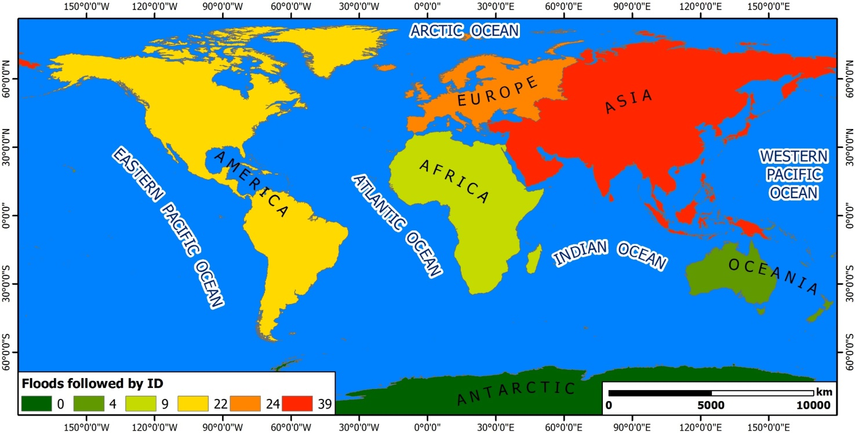
METHODOLOGY
This study involved an extensive and systematic literature review of 124 research publications related to public health impact of 98 floods that occurred globally (Oceania: 4, Africa: 9, America: 22, Europe: 24, Asia: 39) from 1942 to 2014. The inclusion criteria were literature type comprising journal articles and official reports, natural disaster type including floods induced after extreme precipitation events (accumulation of rainwater in poorly-drained environments, riverine and flash floods), population type including humans, and outcome measure characterized by infectious diseases (ID) incidence increase.
Spatial distribution of floods caused by extreme precipitation events and followed by infectious diseases.

Slide 8
RESULTS
TYPES OF INFECTIOUS DISEASES FOLLOWING 98 STUDIED FLOODS INDUCED BY EXTREME PRECIPITATION EVENTS
Types of Infectious diseases | Number of events | Percentage (%)
Rodent-borne | 38 | 38.78
Water-borne | 33 | 33.67
Vector-borne | 25 | 25.51
Respiratory | 19 | 19.39
Fecal-oral | 14 | 14.29
Skin | 9 | 9.18
Blood-borne | 4 | 4.08
Eye | 3 | 3.06
Soil-related | 3 | 3.06
Ear | 2 | 2.04
Fungal | 1 | 1.02
Wound-borne | 1 | 1.02

Slide 9
RESULTS
MOST FATAL INFECTIOUS DISEASES CAUSED BY FLOODS INDUCED BY EXTREME PRECIPITATION EVENTS
Type of infectious diseases | Infectious diseases
Rodent-borne infections | Leptospirosis
Water-borne infections | Diarrhea
Respiratory infections | Respiratory tract infection
MOST VULNERABLE POPULATION GROUPS TO INFECTIOUS DISEASES CAUSED BY FLOODS INDUCED BY EXTREME PRECIPITATION EVENTS
Age group | young children (age ≤ 5 years)
Genre group | Male

Slide 10
RESULTS
RISK FACTORS FOR DISEASE EMERGENCE AND DISEASE INCIDENCE INCREASE
Poor economic status and living in flood prone areas
Destruction of infrastructures, disruption of public utilities, interruption of public health services
Direct physical exposure to sewage-polluted flood water
Lack of adequate potable water and water-supply from contaminated ponds and tube wells along with lack of distribution of water purification tablets
Aggravation of environmental conditions comprising rapid cooling of the environment and heightened humidity
Population displacement resulting in densely populated and overcrowded regions
Unfavorable living conditions in emergency shelters
Improper and inadequate sanitation or no access to clean water and sanitation
Proliferation and abrupt increase of vector and rodent populations after flooding
Contamination of water, damp soil, mud or vegetation caused by rodent urine, dead animals and overflow of latrines

Slide 11
CONCLUSIONS
Various infectious diseases emerge after the flood onset, and outbreaks may result due to the combined effect of several aggravating socio-economic factors and unfavorable environmental conditions.
Because of the increased potential for outbreaks after flooding disasters, enhanced public health services and systems are necessary for the early detection, surveillance and control of emerging diseases and outbreaks.
The integration of different scientific domains and fields are necessary for the early detection of emerging diseases and outbreaks and the targeted intervention for disease control.

