Slide 1
The impact of Labrador Sea temperature and salinity variability on the subpolar AMOC in a decadal prediction system
Matthew Menary, Leon Hermanson, Nick Dunstone
EGU, Vienna, 24/4/17, 4pm, Room D2
Published in GRL in December 2016

Slide 2
Introduction/motivation
The models; their biases
Density drivers; resolution
Mechanisms
This study
Decadal prediction
Assimilation; truth
=> Switching density drivers
Density/AMOC skill; T/S skill
Mixed layer depths
Summary/implications
“Exploring the impact of CMIP5 model biases on the simulation of North Atlantic decadal variability” (2015)
Contents
“The impact of Labrador Sea temperature and salinity variability on the subpolar AMOC in a decadal prediction system” (2016)

Slide 3
Poor skill in density/DSL affects the AMOC
Implications for predictions/projections of AMOC variability – and any dynamical contribution to future trends
May be the case in any prediction system where the underlying climate model and assimilation disagree on the driver of density variability
e.g. Any model that has temperature-dominated near surface density variability in the Labrador Sea (primarily those with warm/salty mean state biases, cf. Introduction)
To improve models, sustained observations of subsurface T/S as well as their fluxes (to pinpoint poorly represented processes) are paramount.
OSNAP
Implications

Slide 4
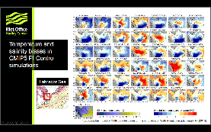
Two hypotheses:
In PI Control simulations, model biases (NA SPG) systematically affect what we interpret controls density changes
What controls density changes then has some systematic effect on the reported mechanism of variability and the timescales involved
Introduction
“Exploring the impact of CMIP5 model biases on the simulation of North Atlantic decadal variability” (2015)

Slide 5
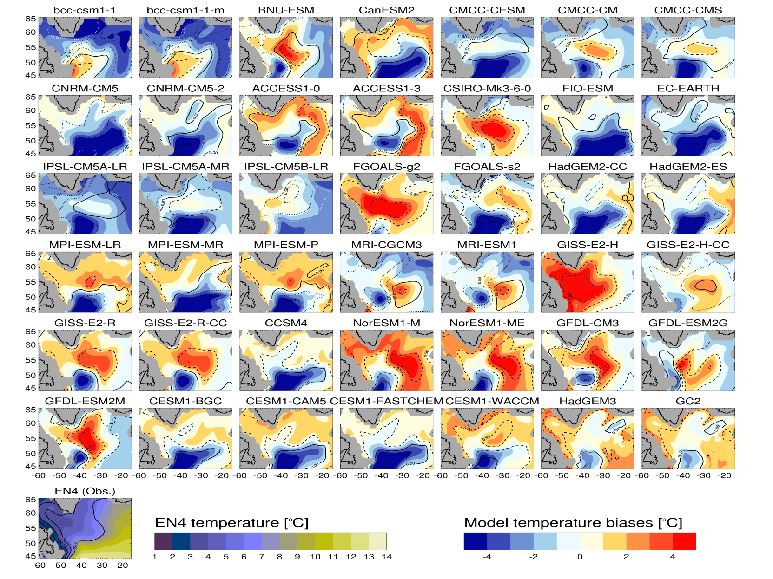
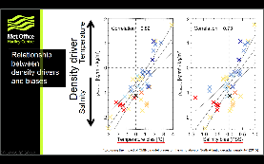
Temperature and salinity biases in CMIP5 PI Control simulations
Labrador Sea
“Exploring the impact of CMIP5 model biases on the simulation of North Atlantic decadal variability” (2015)

Slide 6
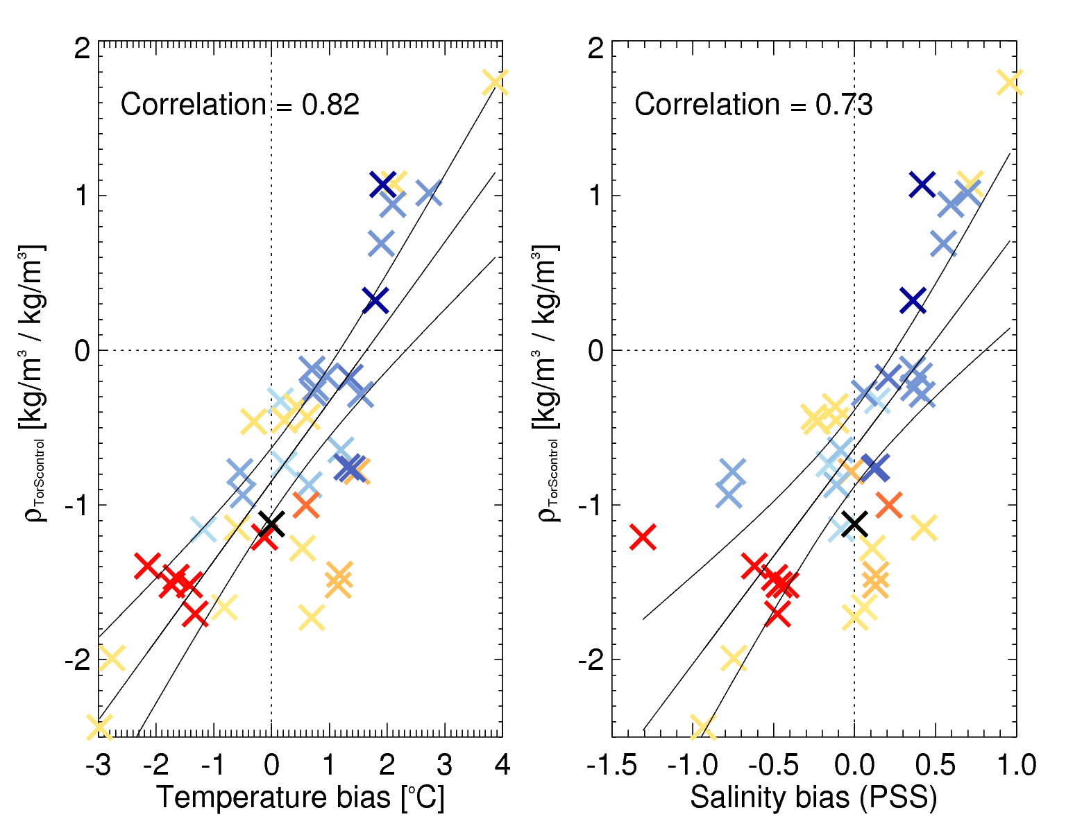
Temperature
Relationship between density-drivers and biases
Density driver
Salinity
“Exploring the impact of CMIP5 model biases on the simulation of North Atlantic decadal variability” (2015)

Slide 7
This study

Slide 8
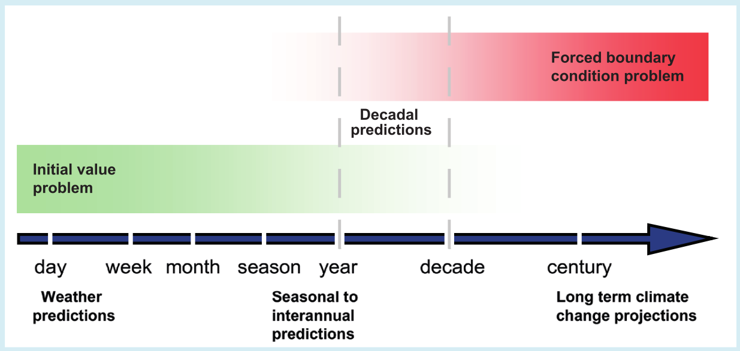
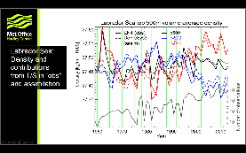
Atmosphere and ocean “decadal” prediction system
NEMO v3.4 ORCA025, GA6.0 N216
Full field assimilation
21 start dates, 10 ensemble members
DePreSys3
IPCC:AR5, from Meehl et al. (2009)

Slide 9
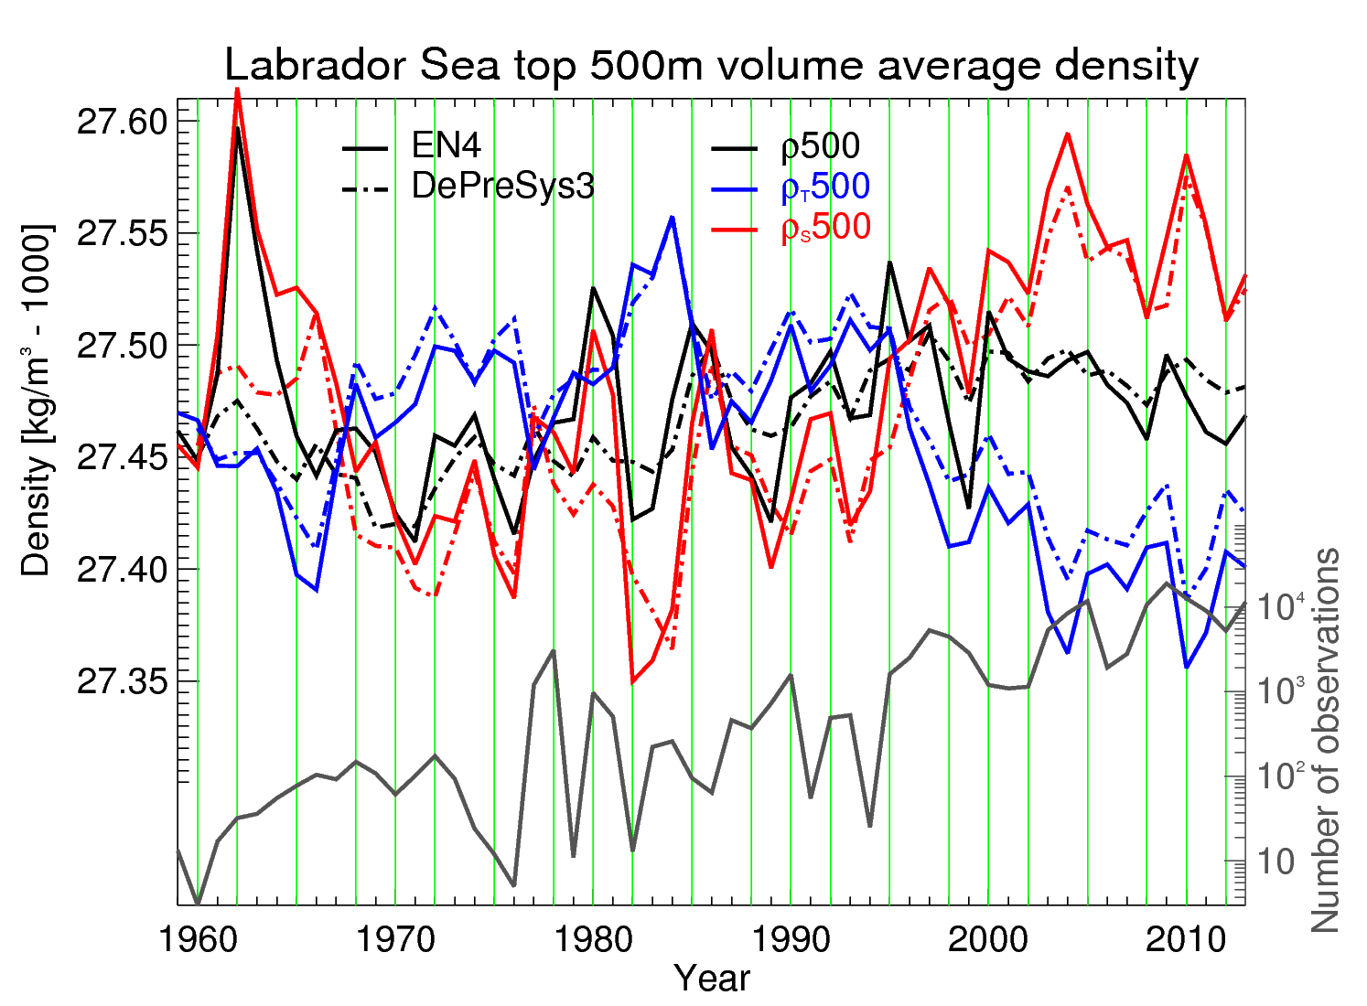
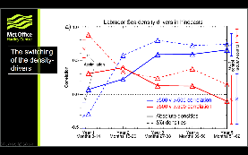
(obs)
(assim)
Labrador Sea: Density and contributions from T/S in “obs” and assimilation

Slide 10
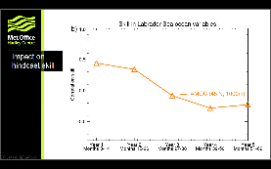
The switching of the density-drivers

Slide 11
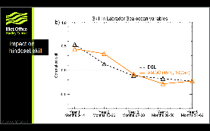
Impact on hindcast skill

Slide 12
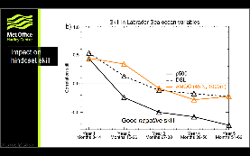
Impact on hindcast skill

Slide 13
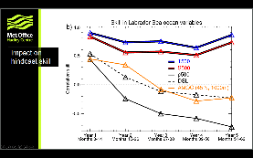
Impact on hindcast skill
Good negative skill

Slide 14
Impact on hindcast skill

Slide 15
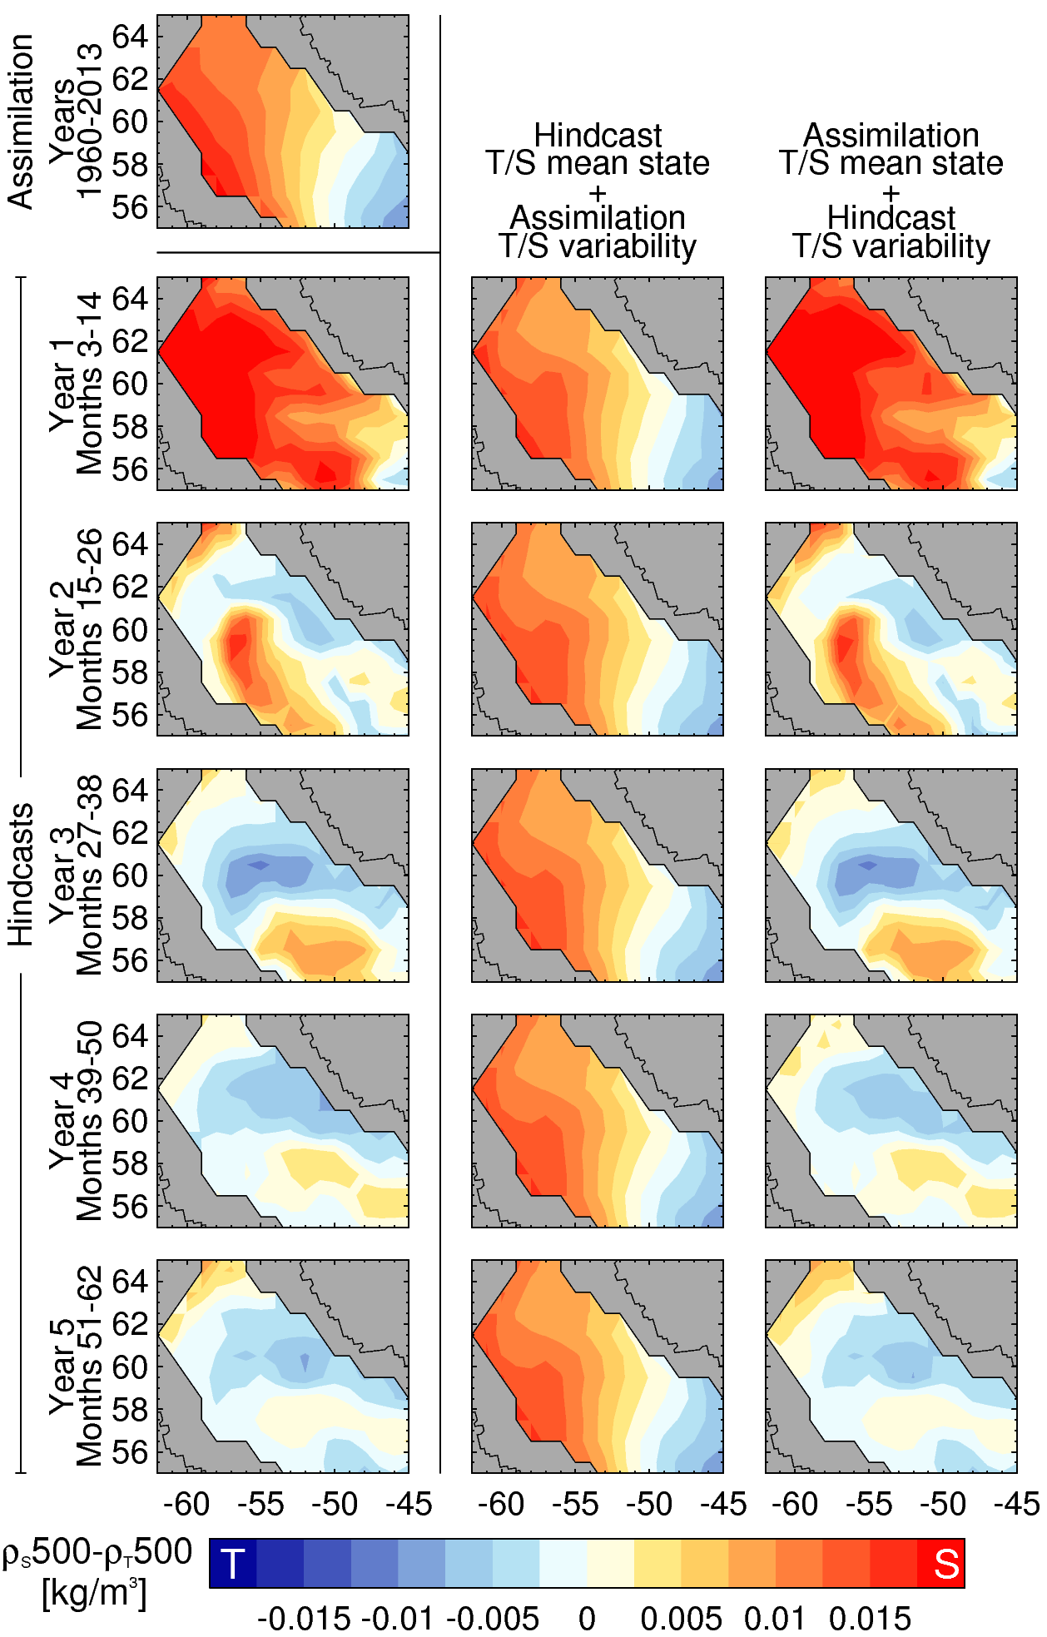
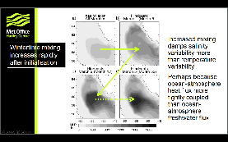
Target
Due to changes in magnitude of T/S variability in the hindcasts, not shifts in T/S mean state
Hindcasts switch from S-driven (red) to T-driven (blue) density variability within 2/3 years

Slide 16
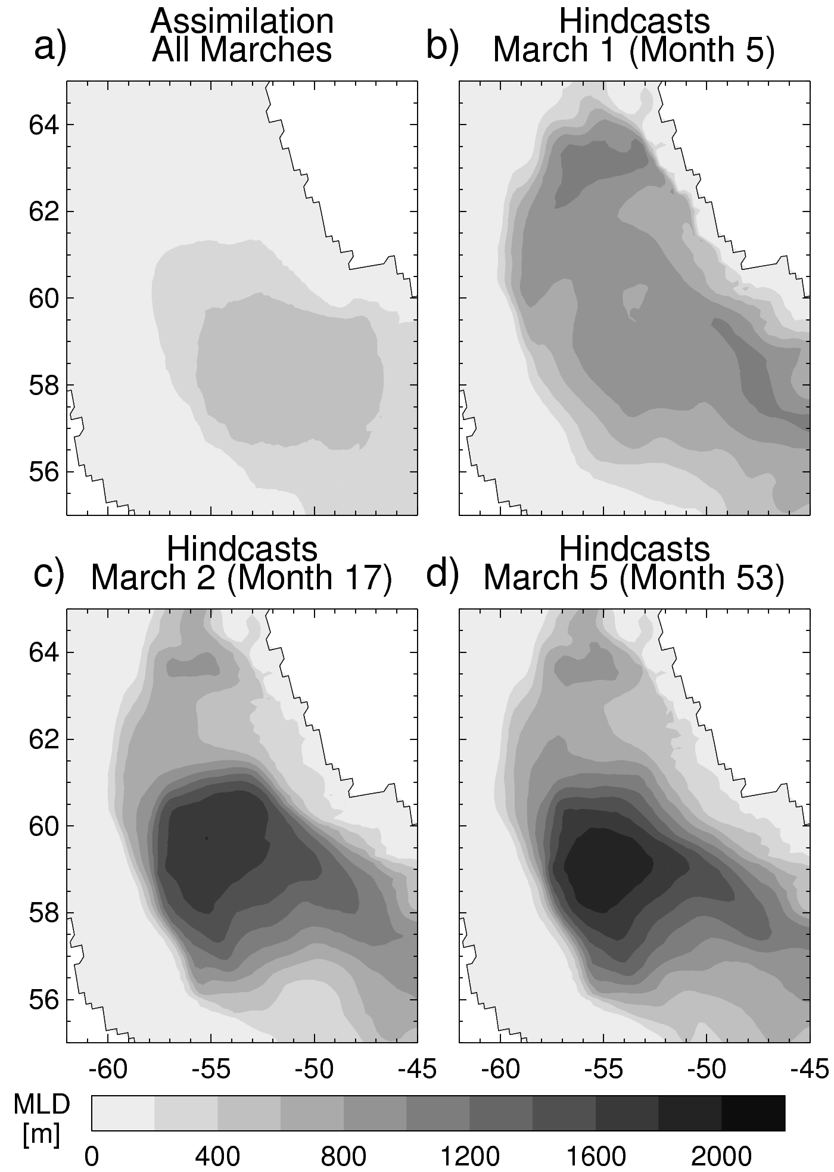
Increased mixing damps salinity variability more than temperature variability
Perhaps because ocean-atmosphere heat flux more tightly coupled than ocean-atmosphere freshwater flux
Wintertime mixing increases rapidly after initialisation

Slide 17
EN4 (obs) and DePreSys3 (assimilation) show similar interannual variability in Lab Sea top 500m T/S/ρ
Both suggest interannual ρ500 variability is due to salinity, though the trend since 1995 is due to temperature
The climate model (HadGEM3-GC2), upon which DePreSys3 is based, has temperature-driven density variability
Freely evolving hindcasts with DePreSys3 switch to temperature-driven density variability within 2-3 years
This is due to changing magnitude of T/S variability (particularly S), not drifts in the mean
There remains high skill in Lab Sea T/S500, but negative skill in ρ500, consistent with the switch in density-driver
This also leads to poor skill in dynamic sea level and the AMOC at 45ºN
Summary

Slide 18
EN4 (obs) and DePreSys3 (assimilation) show similar interannual variability in Lab Sea top 500m T/S/ρ
Both suggest interannual ρ500 variability is due to salinity, though the trend since 1995 is due to temperature
The climate model (HadGEM3-GC2), upon which DePreSys3 is based, has temperature-driven density variability
Freely evolving hindcasts with DePreSys3 switch to temperature-driven density variability within 2-3 years
This is due to changing magnitude of T/S variability (particularly S), not drifts in the mean
There remains high skill in Lab Sea T/S500, but negative skill in ρ500, consistent with the switch in density-driver
This also leads to poor skill in dynamic sea level and the AMOC at 45ºN
Summary

Slide 19
EN4 (obs) and DePreSys3 (assimilation) show similar interannual variability in Lab Sea top 500m T/S/ρ
Both suggest interannual ρ500 variability is due to salinity, though the trend since 1995 is due to temperature
The climate model (HadGEM3-GC2), upon which DePreSys3 is based, has temperature-driven density variability
Freely evolving hindcasts with DePreSys3 switch to temperature-driven density variability within 2-3 years
This is due to changing magnitude of T/S variability (particularly S), not drifts in the mean
There remains high skill in Lab Sea T/S500, but negative skill in ρ500, consistent with the switch in density-driver
This also leads to poor skill in dynamic sea level and the AMOC at 45ºN
Summary

Slide 20
Poor skill in density/DSL affects the AMOC
Implications for predictions/projections of AMOC variability – and any dynamical contribution to future trends
May be the case in any prediction system where the underlying climate model and assimilation disagree on the driver of density variability
e.g. Any model that has temperature-dominated near surface density variability in the Labrador Sea (primarily those with warm/salty mean state biases, cf. Introduction)
To improve models, sustained observations of subsurface T/S as well as their fluxes (to pinpoint poorly represented processes) are paramount.
OSNAP
Implications

Slide 21
Poor skill in density/DSL affects the AMOC
Implications for predictions/projections of AMOC variability – and any dynamical contribution to future trends
May be the case in any prediction system where the underlying climate model and assimilation disagree on the driver of density variability
e.g. Any model that has temperature-dominated near surface density variability in the Labrador Sea (primarily those with warm/salty mean state biases, cf. Introduction)
To improve models, sustained observations of subsurface T/S as well as their fluxes (to pinpoint poorly represented processes) are paramount.
OSNAP
Implications

Slide 22
Poor skill in density/DSL affects the AMOC
Implications for predictions/projections of AMOC variability – and any dynamical contribution to future trends
May be the case in any prediction system where the underlying climate model and assimilation disagree on the driver of density variability
e.g. Any model that has temperature-dominated near surface density variability in the Labrador Sea (primarily those with warm/salty mean state biases, cf. Introduction)
To improve models, sustained observations of subsurface T/S as well as their fluxes (to pinpoint poorly represented processes) are paramount.
OSNAP
Implications

Slide 23
Poor skill in density/DSL affects the AMOC
Implications for predictions/projections of AMOC variability – and any dynamical contribution to future trends
May be the case in any prediction system where the underlying climate model and assimilation disagree on the driver of density variability
e.g. Any model that has temperature-dominated near surface density variability in the Labrador Sea (primarily those with warm/salty mean state biases, cf. Introduction)
To improve models, sustained observations of subsurface T/S as well as their fluxes (to pinpoint poorly represented processes) are paramount.
OSNAP
Implications
The end

Slide 24
Extra slides

Slide 25
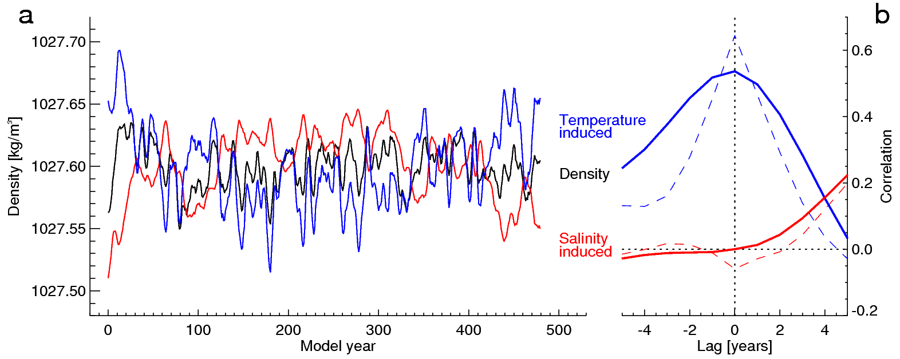

Slide 26
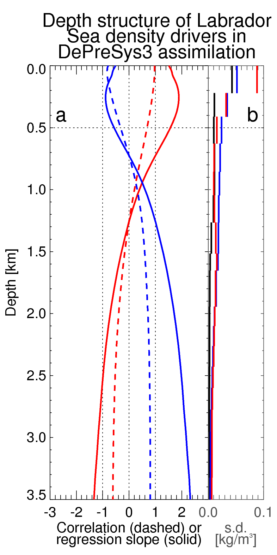
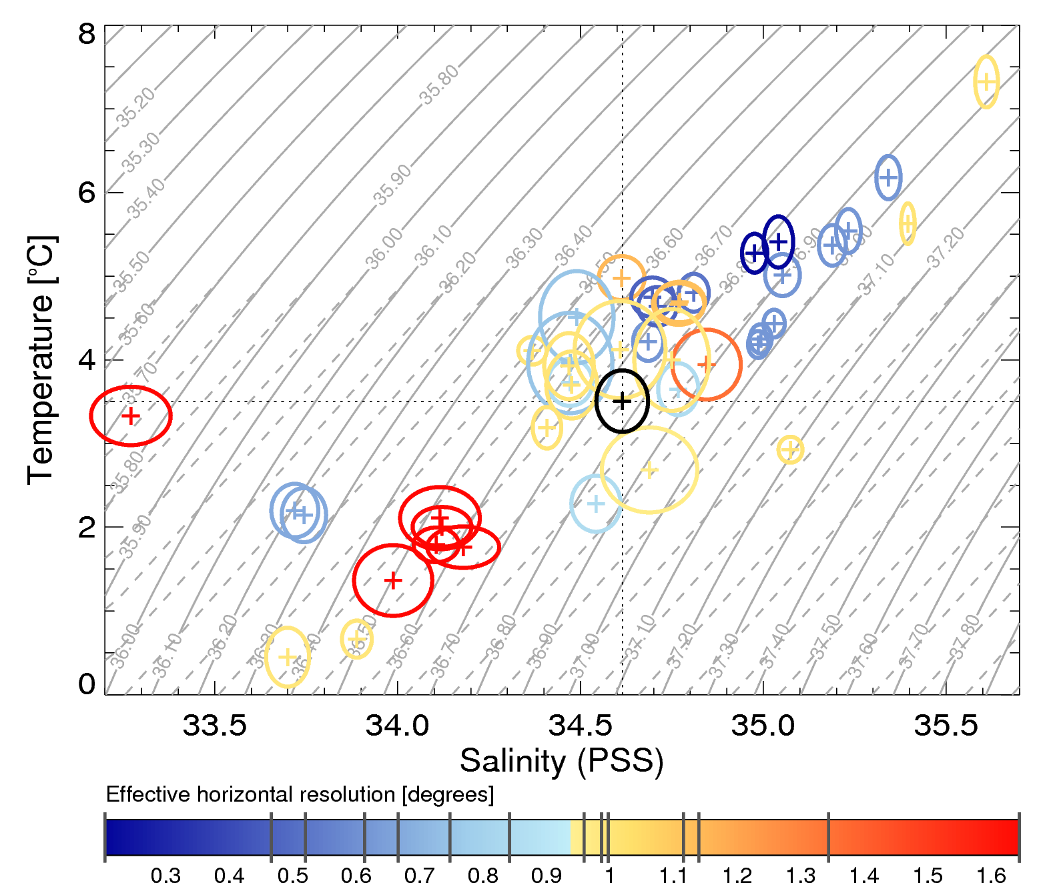

Slide 27
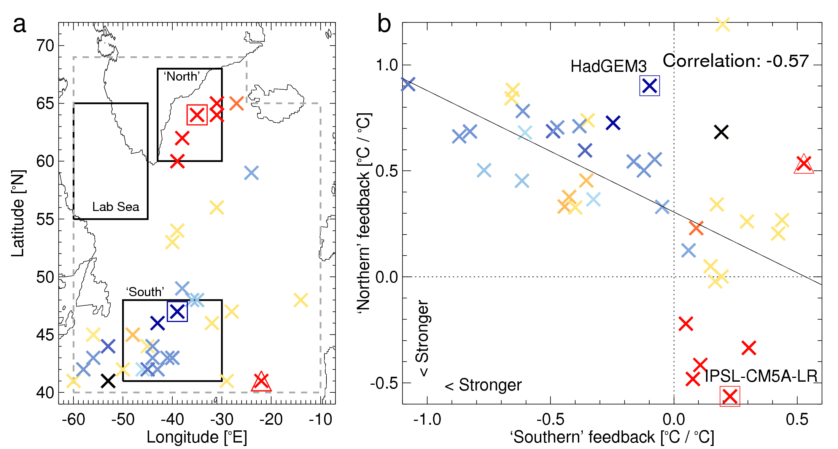
Mechanisms
Links between density-drivers; model mechanisms; ocean model resolution
“Exploring the impact of CMIP5 model biases on the simulation of North Atlantic decadal variability” (2015)

Slide 28
