Slide 1
Dr. Peter Carter
Climate Emergency Institute, Canada
petercarter46@shaw.ca
From up to date climate and ocean evidence with updated UN emissions projections, the time is now for science to recommend an immediate massive effort on CO2.

Slide 2
Will the world of science make
strong emergency recommendations?
Risk of Multiple Interacting Tipping Points Should Encourage
Rapid CO2 Emission Reduction
Yongyang Cai, T. Lenton, T. Lonztec, Nature Climate Change, March 2016
Evidence suggests that several elements of the climate system could be tipped into a different state by global warming, causing irreversible economic damages.
The corresponding optimal policy involves an immediate, massive effort to control CO2 emissions, which are stopped by mid century, leading to climate stabilization at <1.5 °C above pre-industrial levels.

Slide 3
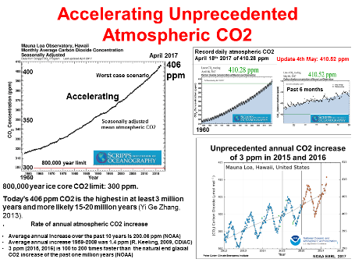
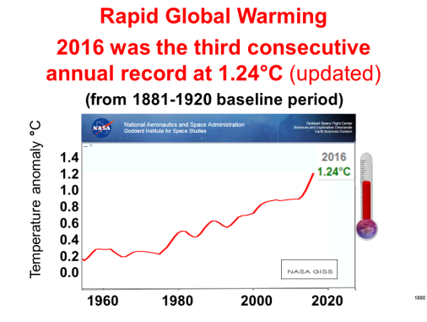
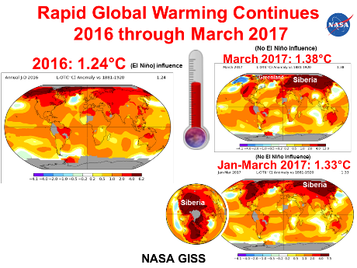
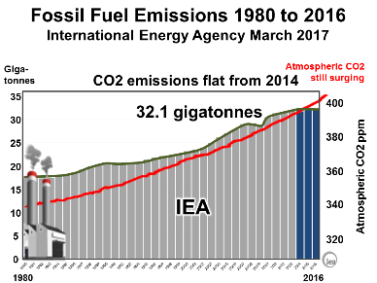
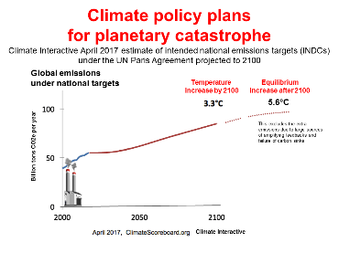
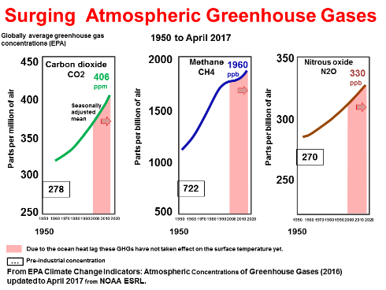
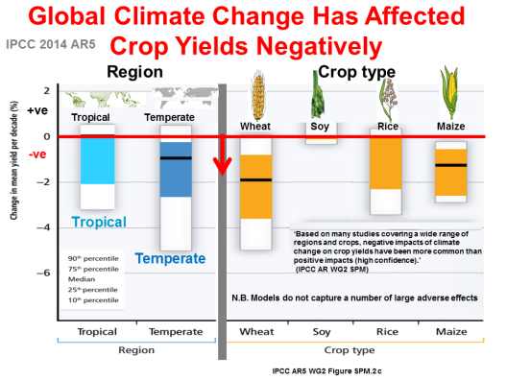
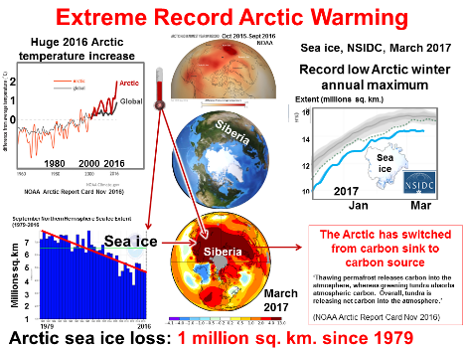
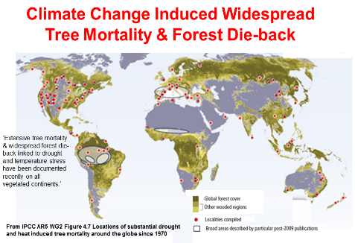
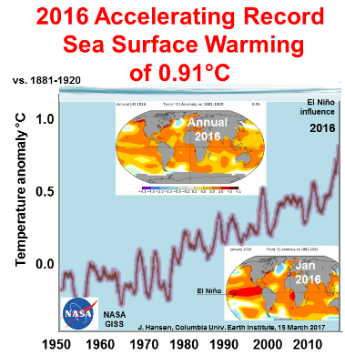
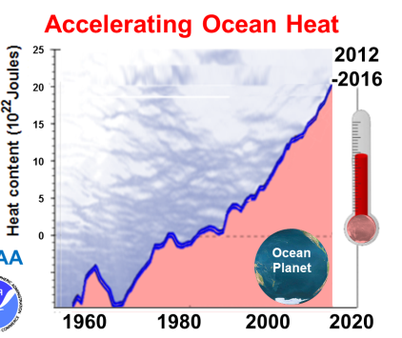
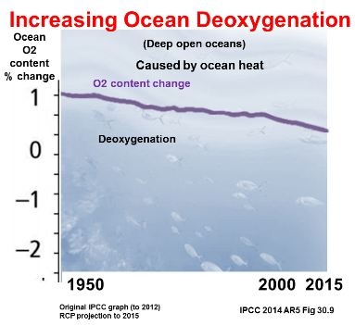
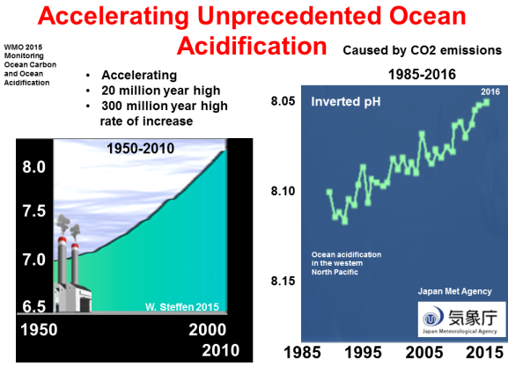
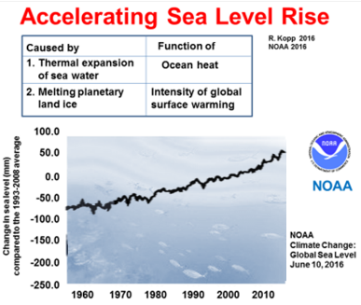
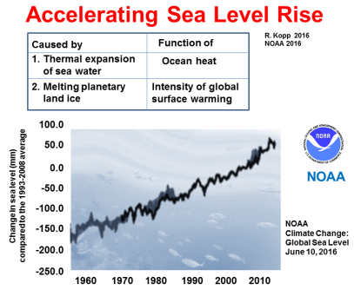
Latest Data & Trends (past 50 years to April 2017) DEFINITE DIRE PLANETARY EMERGENCY
Accelerating multiple atmospheric GHG pollution trending to biosphere collapse
All record-high GHG pollution indicators & direct effects are getting worse, faster
NASA GISS
>2°C
locked-in
due to today’s atmospheric GHG levels
(IPCC 2014 AR5 WG1 12.5.2.)
In 2015 atmospheric CO2 equivalent was 485 ppm
(WMO 2016)
Deeper ocean heat to 2000 m
P. Carter Climate Emergency Institute EGU April 2017

Slide 4
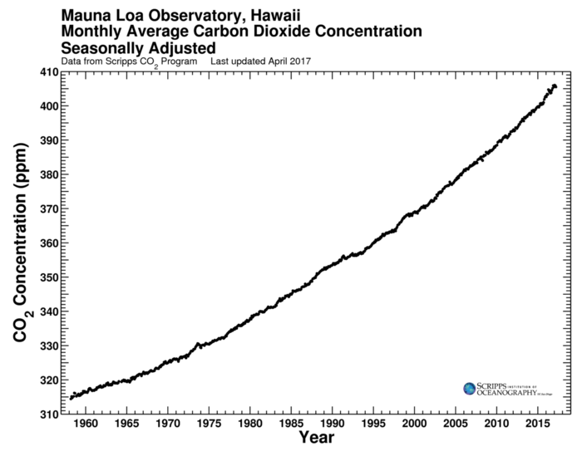
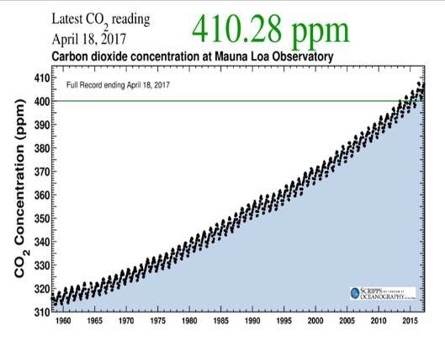
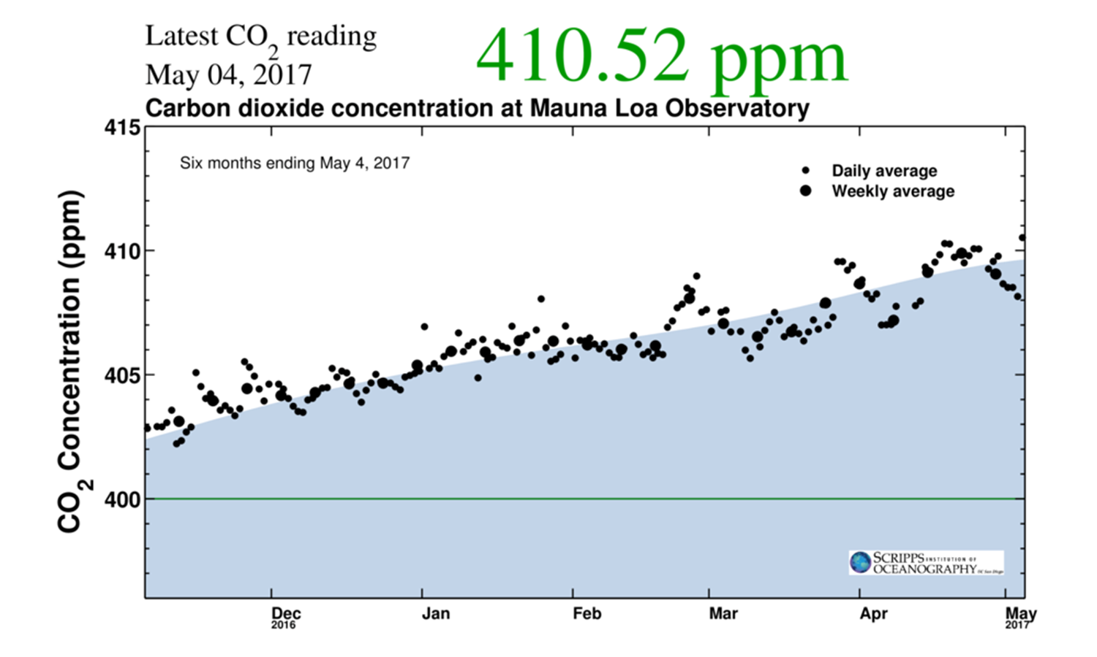
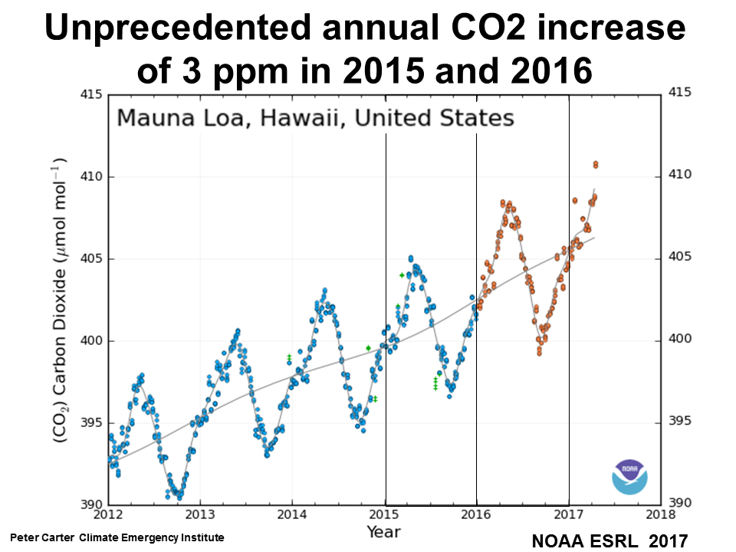
Accelerating unprecedented atmospheric CO2
April 2017
Record daily atmospheric CO2
18 April 2017 of 410.28 ppm
406 ppm
No El Niño effect
Update 4 May: 410.52 ppm
400
350
300
Worst case scenario
Accelerating
Past 6 months
Seasonally adjusted
mean atmospheric CO2
1960
800,000 year limit
300
300
1960
El Nino effect
1960
800,000 year ice core CO2 limit: 300 ppm.
Today’s 406 ppm CO2 is the highest in at least 3 million years and more likely 15-20 million years (Yi Ge Zhang, 2013).
Rate of annual atmospheric CO2 increase
Average annual increase over the past 10 years is 2.06 ppm (NOAA)
Average annual increase 1959-2008 was 1.4 ppm (R. Keeling, 2009, CDIAC)
3 ppm (2015, 2016) is 100 to 200 times faster than the natural end glacial CO2 increase of the past one million years (NOAA)

Slide 5
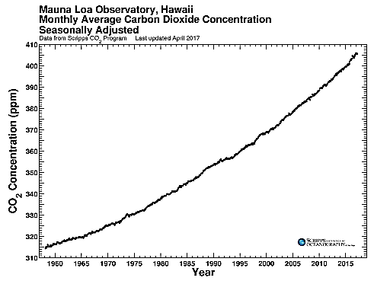
Accelerating unprecedented atmospheric CO2 concentration
Atmospheric CO2 alone confirms global emergency
410
400
Seasonally adjusted
mean CO2
Atmospheric CO2 is at least a 3 million year high,
more likely 15-20 million years
Record atmospheric CO2
The 406 ppm CO2 mean concentration is at least a
3 million year high, most likely
15-20 million years
Future climate forcing potentially without precedent in the last 420 million years
G. L. Foster April 2017
A 40-million-year history of atmospheric CO2
Yi Ge Zhang, 2013, RSTA
Major Climate Transitions of the Last 20 Million Years
A. K. Tripati, 2010
G. L. Foster April 2017
400 ppm
Tripati 2010
15-20 million
years ago
Last 800,000 years
310
1960 1965

Slide 6
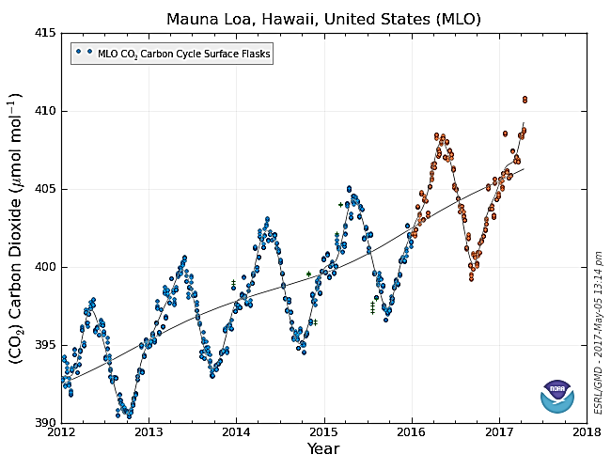
Unprecedented annual CO2 increase
of 3 ppm in 2015 and 2016
No El Niño
effect
Record 3 ppm CO2 increase in one year
2015 & 2016
100 to 200 times the rate of natural
end glacial CO2 increase (NOAA, March 2017)
Possibly the fastest CO2 increase
in Earth history (A. Glikson, 2016)
El Niño effect
Record rate of increase
Average annual increase over the past 10 years is 200.06 ppm (NOAA)
Average annual increase 1959-2008 was
1.4 ppm (R. Keeling, 2009, CDIAC)
NOAA ESRL 2017
Peter Carter Climate Emergency Institute

Slide 7
Daily atmospheric CO2 in April-May 2017 reached above a record 410 ppm

Slide 8
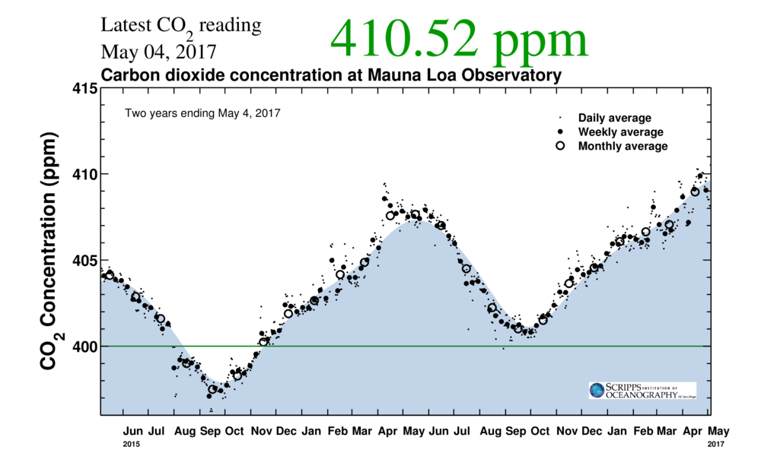
El Niño effect
No El Niño effect

Slide 9
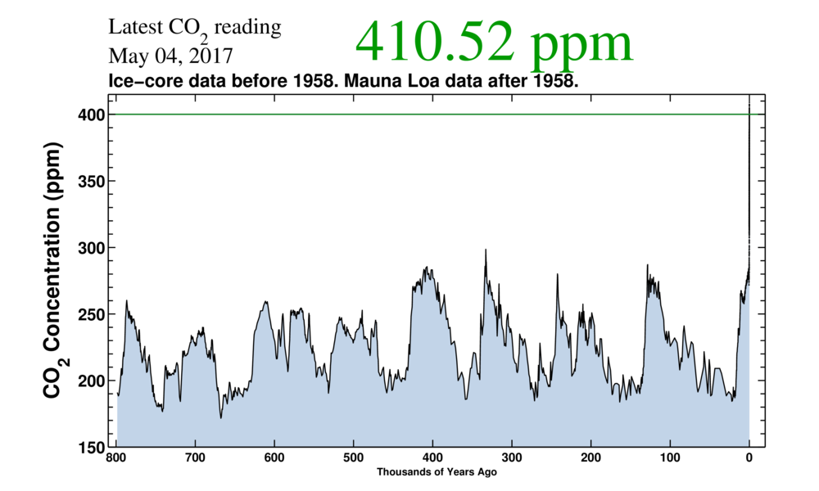
Unprecedented atmospheric CO2
800,000 year ice core data atmospheric CO2 limit is 300 ppm

Slide 10
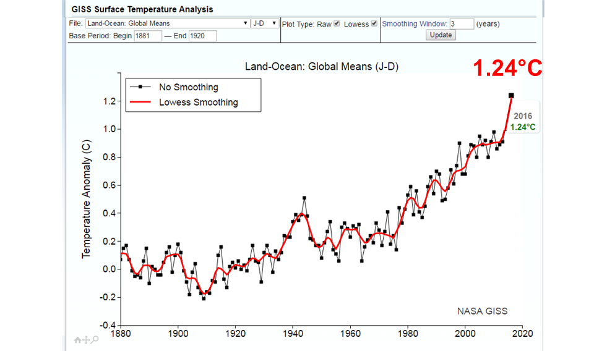
Rapid global warming
2016 was the third consecutive
annual record at 1.24°C (updated)
Base 1881-1920
1.24°C
1881-1920 baseline period)
Most warming has been
since 1960
about 1.0°C
El Nino influence
(El Niño
Influence
2015-2016)

Slide 11
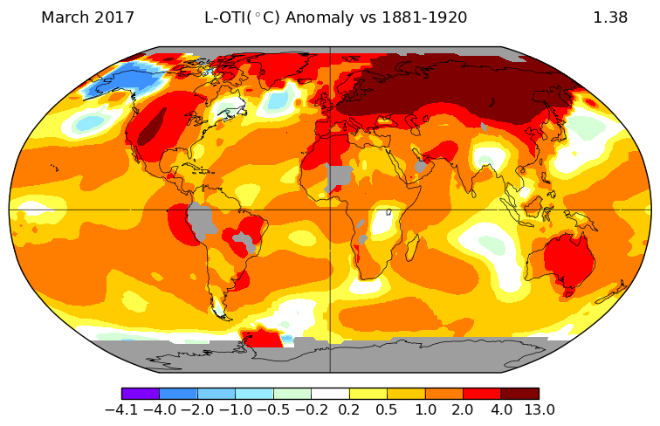
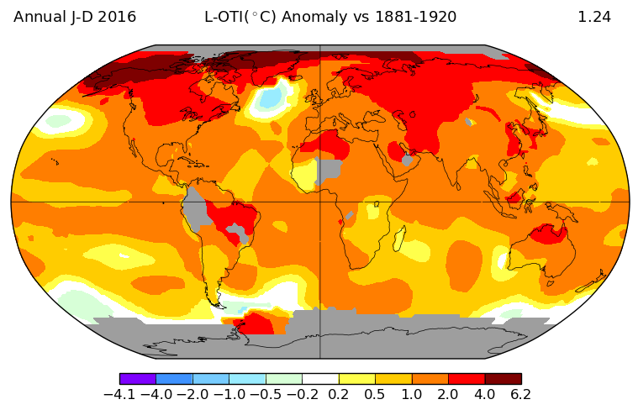
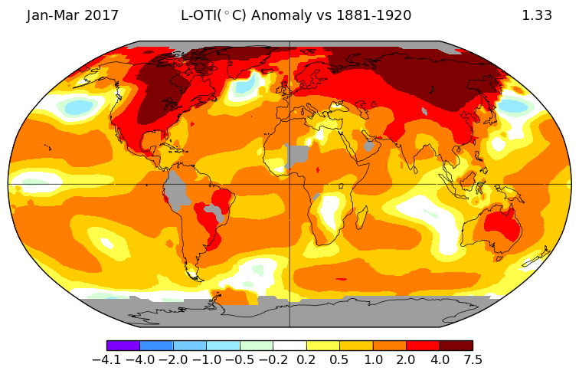
Greenland
Rapid global warming continues
2016 through March 2017
Siberia
(No El Niño influence)
2016: 1.24°C
March 2017: 1.38°C
(El Niño influence)
Greenland
Siberia
Siberia
(No El Niño influence)
Jan-March 2017: 1.33°C
Siberia
Siberia
NASA GISS

Slide 12
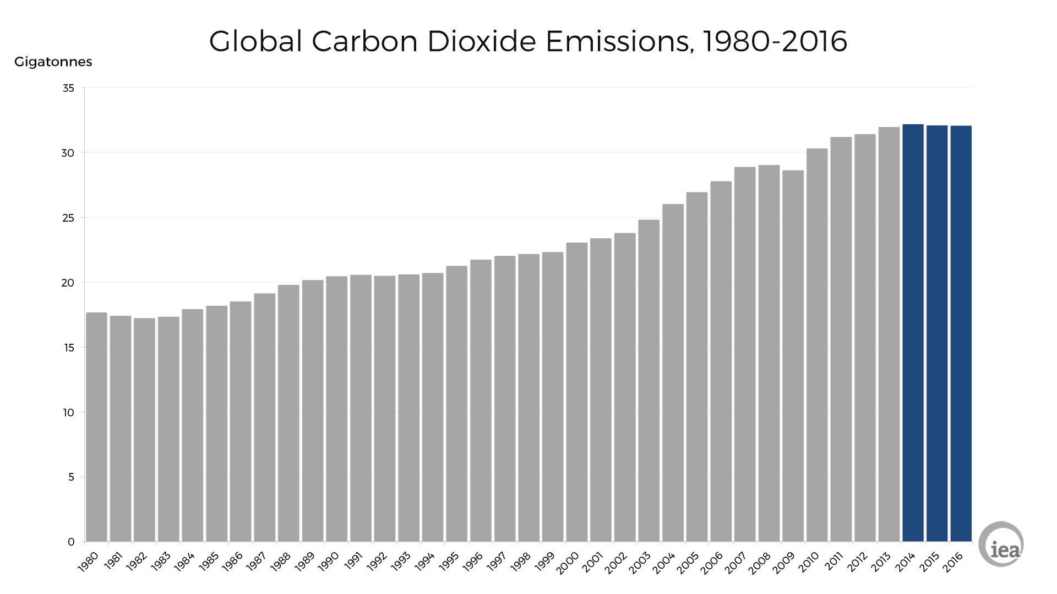
Fossil fuel emissions 1980 to 2016
International Energy Agency March 2017
Giga-
tonnes
Atmospheric CO2
still surging
CO2 emissions flat from 2014
410
400
390
380
370
360
350
340
330
320
35
30
25
20
15
10
5
0
32.1 gigatonnes
400
380
360
340
320
Atmospheric CO2 ppm
IEA
1980 2016

Slide 13
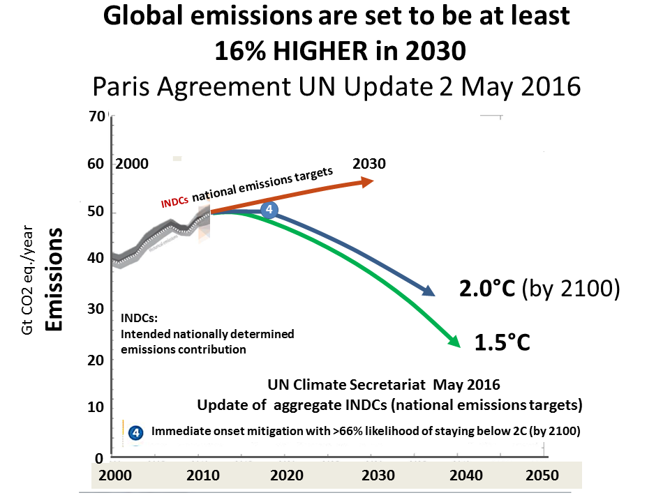
National emissions targets lead to
substantially higher emissions
INDCs: Intended nationally determined contributions
(national emissions targets)
UN Climate Secretariat

Slide 14
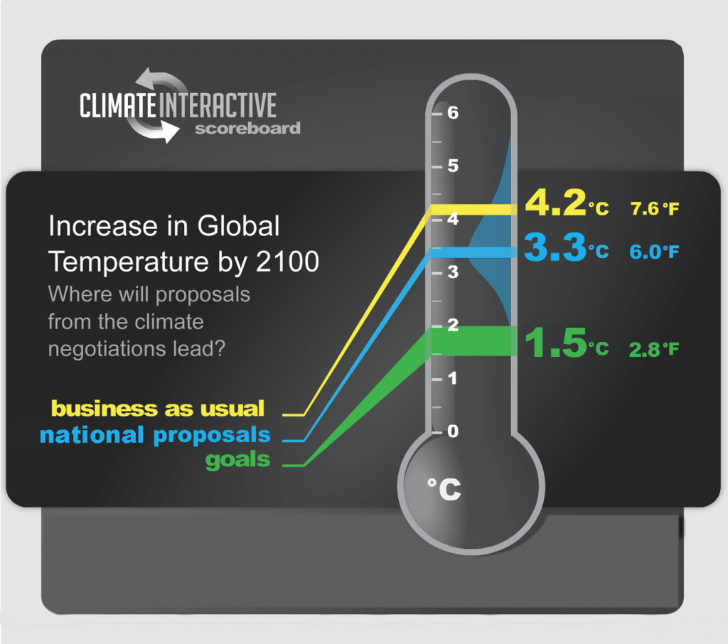
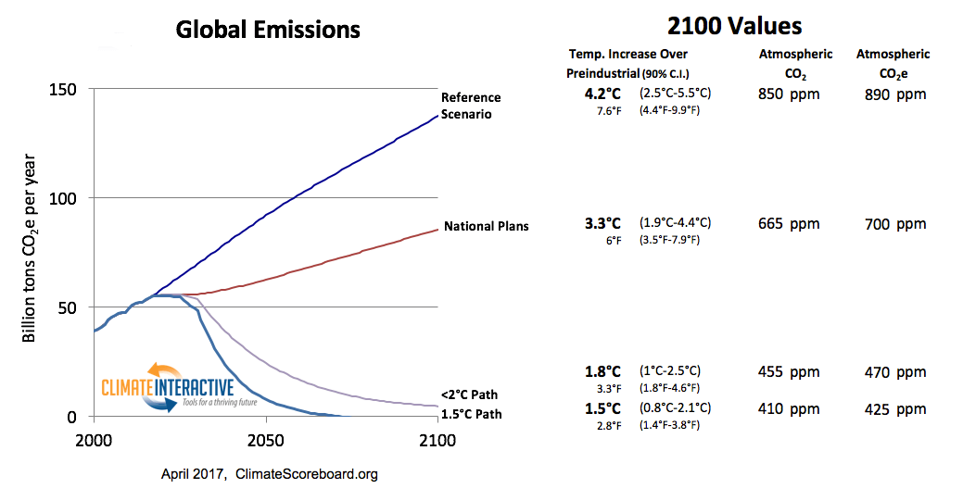
Climate policy plans
for planetary catastrophe
Climate Interactive April 2017 estimate of intended national emissions targets (INDCs) under the UN Paris Agreement projected to 2100
Global emissions
under national targets
Temperature
increase by 2100
Equilibrium
increase after 2100
5.6°C
This excludes the extra emissions due to large sources of amplifying feedbacks and failure of carbon sinks
Billion tons CO2e per year
Climate Interactive

Slide 15
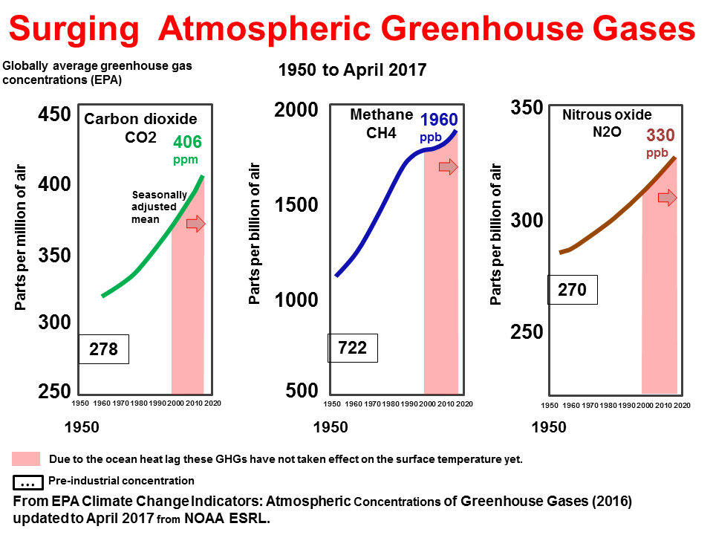

Slide 16
Locked in commitment is 2°C
equilibrium surface warming
The 2014 IPCC assessment estimated the commitment due to atmospheric greenhouse gases at 2.0°C. ‘The commitment from constant greenhouse gas concentrations would correspond to approximately 2ºC warming’ (IPCC AR5 WG1 12.5.2).
This IPCC commitment does not include the extra warming from amplifying feedbacks in any of its projections.
​​​'However, this equilibrium estimate is based on feedbacks estimated for the present day climate. Climate and carbon cycle feedbacks may increase substantially on long time scales and for high cumulative CO2 emissions' (IPCC AR5 WG1 Ch.12 p.1109).

Slide 17
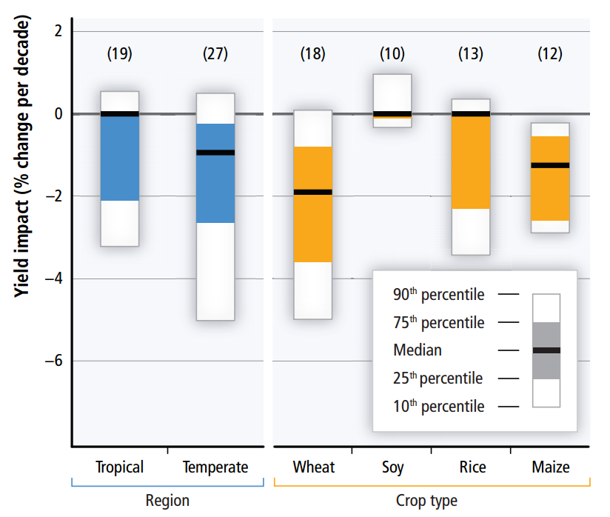
Global climate change has
affected crop yields negatively
Region Crop type
+ve
Tropical Temperate
Wheat Soy Rice Maize
-ve
Tropical
“Based on many studies covering a wide range of regions and crops, negative impacts of climate change on crop yields have been more common than positive impacts (high confidence).” (IPCC AR WG2 SPM)
Temperate
N.B. Models do not capture a number of large adverse effects
IPCC 2014 AR5
IPCC AR5 WG2 Figure SPM.2 c

Slide 18
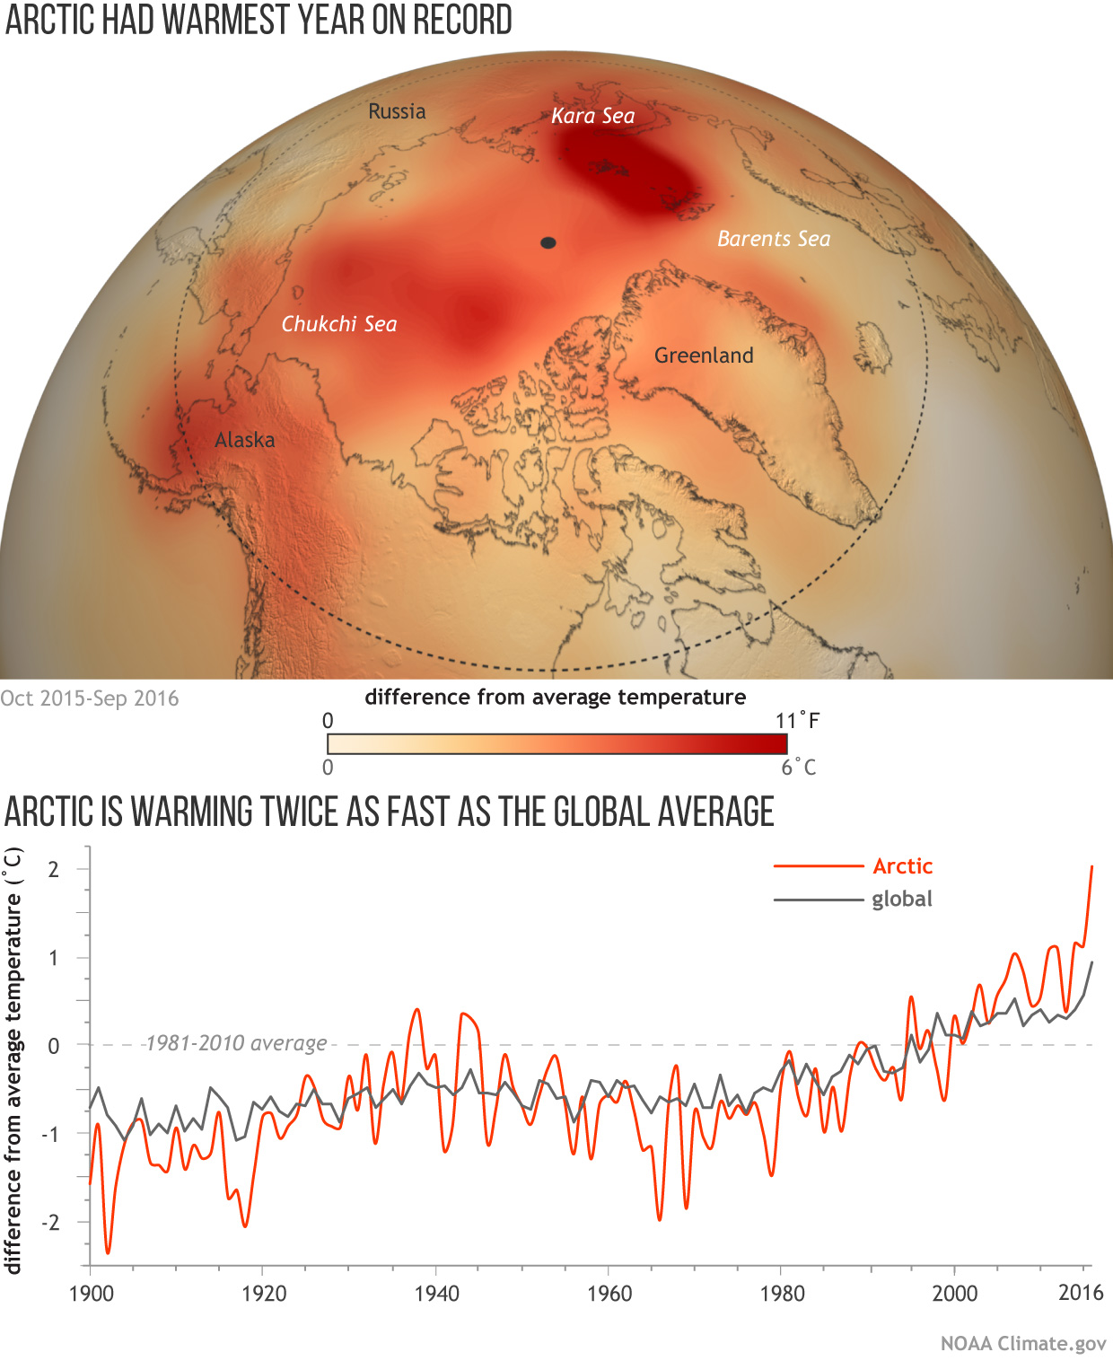
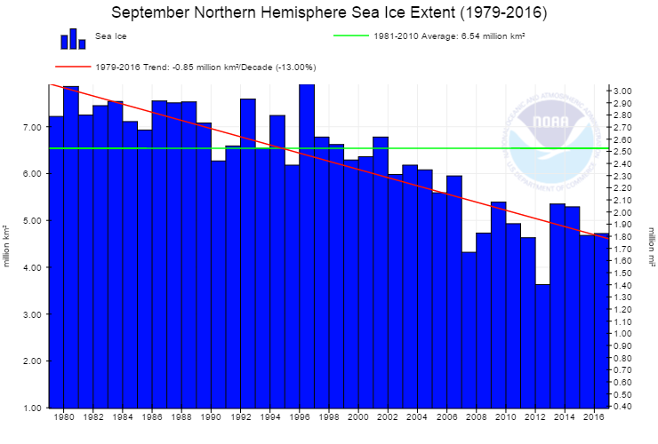
Extreme record Arctic warming
Huge 2016 Arctic
temperature increase
Oct 2015-Sept 2016
NOAA
Sea ice, NSIDC, March 2017
Record low Arctic winter
annual maximum
2
Arctic
1
Global
Extent (millions sq. km.)
0
16
14
12
10
Siberia
1980 2000 2016
Sea ice
NOAA Arctic Report Card Nov 2016)
2017
Jan Mar
September Northern Hemisphere Sea Ice Extent
(1979-2016
Sea ice
The Arctic has switched from carbon sink to carbon source
‘Thawing permafrost releases carbon into the atmosphere, whereas greening tundra absorbs atmospheric carbon. Overall, tundra is releasing net carbon into the atmosphere.’
(NOAA Arctic Report Card Nov 2016)
7
6
5
4
3
2
1
Siberia
Millions sq. km
March 2017
1979 2016
Arctic sea ice loss: 1 million sq. km. since 1979

Slide 19
Climate change induced widespread
tree mortality & forest die-back
‘Extensive tree mortality & widespread forest die-back linked to drought and temperature stress have been documented recently on all vegetated continents.’
From IPCC AR5 WG2 Figure 4.7 Locations of substantial drought and heat induced tree mortality around the globe since 1970
AMAZON
The Amazon carbon sink is saturated, taking up a third less carbon in the past 10 years. (Long-term decline of the Amazon carbon sink. R. Brienen, March 2015)

Slide 20
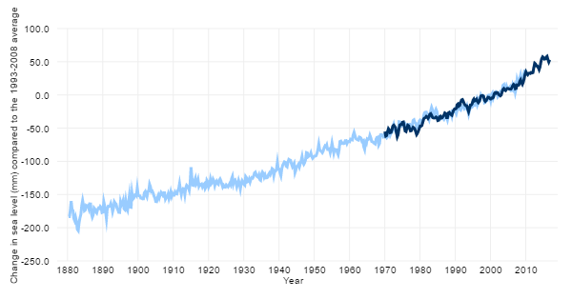
Accelerating* sea level rise
* R. Kopp, 2016
NOAA, 2016
Caused by
1. Thermal expansion
of sea water
2. Melting planetary
land ice
Function of
Ocean heat
Intensity of global surface warming
100.0
50.0
0.0
-50.0
-100.0
-150.0
-200.0
-250.0
NOAA
Climate Change: Global Sea Level,
June 10, 2016 1880- 2016
Change in sea level (mm) compared
to the 1993-2008 average
Change in sea level (mm)
compared to the 1993-2008 average
The light blue line shows seasonal (3-month) sea level estimates from Church and White (2011). The darker line is based on University of Hawaii Fast Delivery sea level data
1880 1890 1900 1910 1920 1930 1940 1950 1960 1970 1980 1990 2000 2010

Slide 21
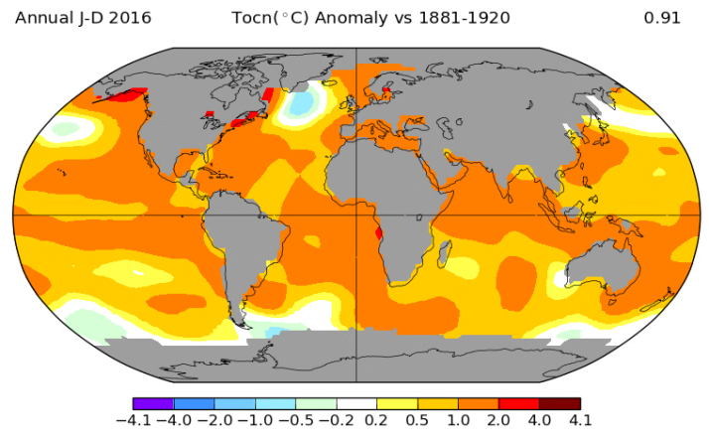
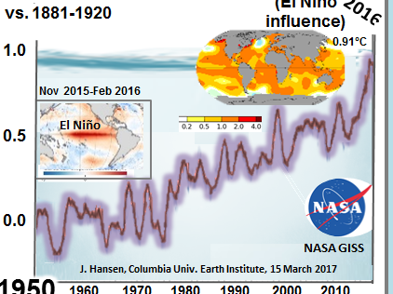
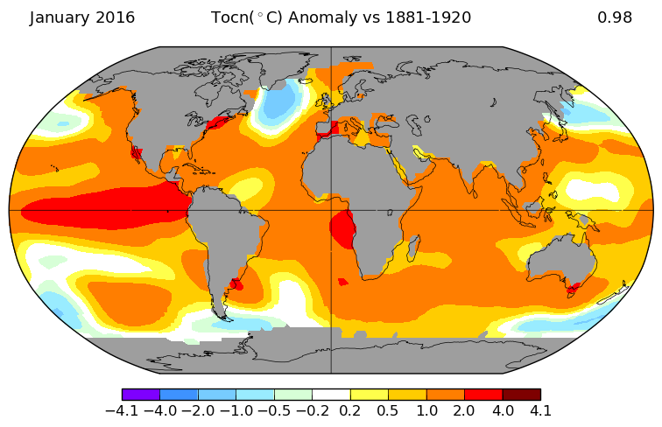
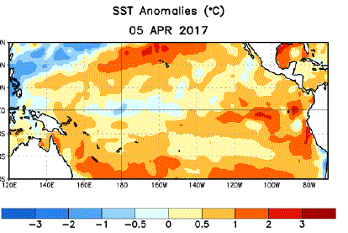
* P. Reid. 2012
2016 accelerating* record
sea surface warming of 0.91°C
vs. 1881-1920
2017 El Niño
El Niño
influence
1.0
0.5
0.0
Annual 2016
2/3 of the Great Barrier Reef devastated
2016
Temperature anomaly °C
Great Barrier Reef
Jan 2016
SST March
2017
Great Barrier Reef
El Niño
NASA GISS
J. Hansen, Columbia Univ. Earth Institute, 15 March 2017
iri.columbia.edu/
1950 1960 1970 1980 1990 2000 2010

Slide 22
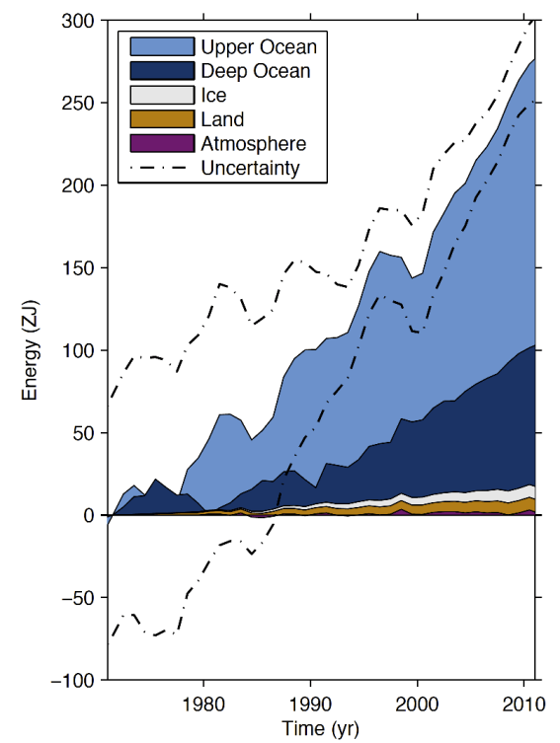
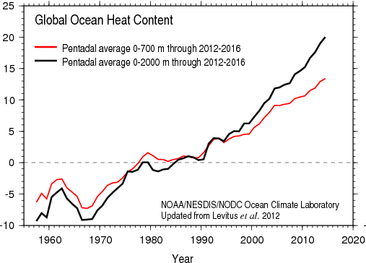
Accelerating* ocean heat
*L. Cheng, 2017
Deeper
From 1990 heat goes deeper faster
Shallower
IPCC AR5 WG1 Box 3.1 Figure 1.

Slide 23
Increasing ocean de-oxygenation
Ocean
O2
content
% change
(Deep open oceans)
Caused by ocean heat
O2 content change
Deoxygenation
1900 1950 2000 2015
Original IPCC graph (to 2012) RCP projection to 2015
IPCC 2014 AR5 Fig 30.9

Slide 24
Accelerating* ocean pH decline
pH decline = acidification increase
*WMO 2013
Sea surface
pH
(hydrogen ion potential)
2015
1900 1950 2000
IPCC AR5 WG1 Figure 6-28 a

Slide 25
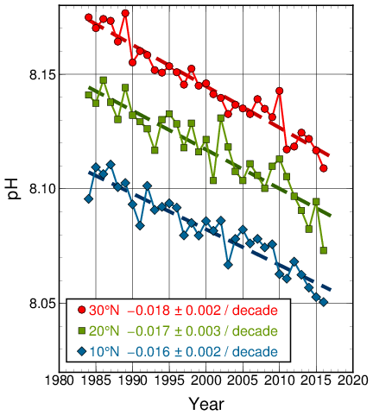
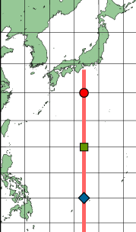
Accelerating unprecedented ocean acidification
Ocean acidification is inverse of pH (hydrogen ion potential) times a unit for unit factor of 10
Ref for acceleration WMO 2015 Monitoring Ocean Carbon and Ocean Acidification
Japan Meteorological Agency

Slide 26
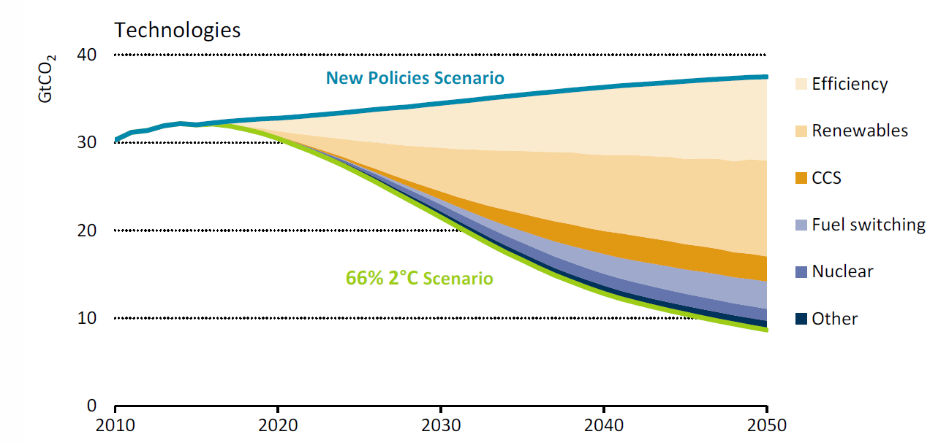
For 2°C Mitigation
Global Emissions Decline Immediately
UN Climate Secretariat
May 2016
IEA IRENA
March 2017
Perspectives for the Energy Transition
Emissions
2050
2050
Figure 2.4 Global CO2 emissions abatement
in the 66% 2°C Scenario
The corresponding optimal policy involves an immediate, massive effort to control CO2 emissions, which are stopped by mid century, leading to climate stabilization at <1.5 °C above pre-industrial levels.
(Yongyang Cai, T. Lenton, T. Lonztec, Nature Climate Change, March 2016)

