Slide 1
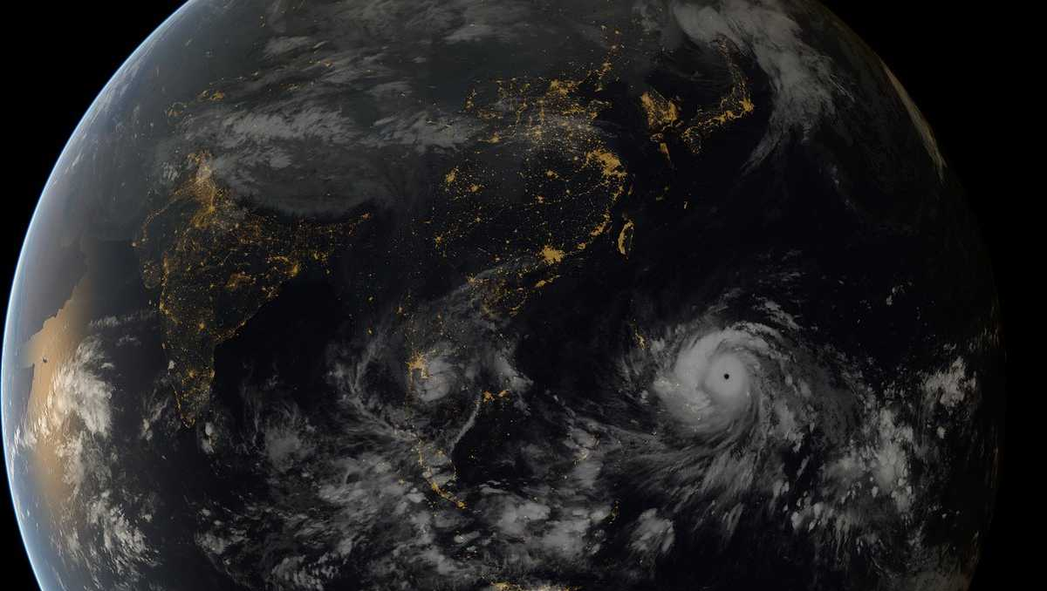

Studying the Impact of Natural Disasters on Human Behavior
A case study from Typhoon Yolanda which occured in Panay, Philippines
Lukas Kampenhuber Andreas Landmann
Bernd Hayo Björn Vollan
Introduction
Preliminary results
Contact
Method
2-minute madness

Slide 2
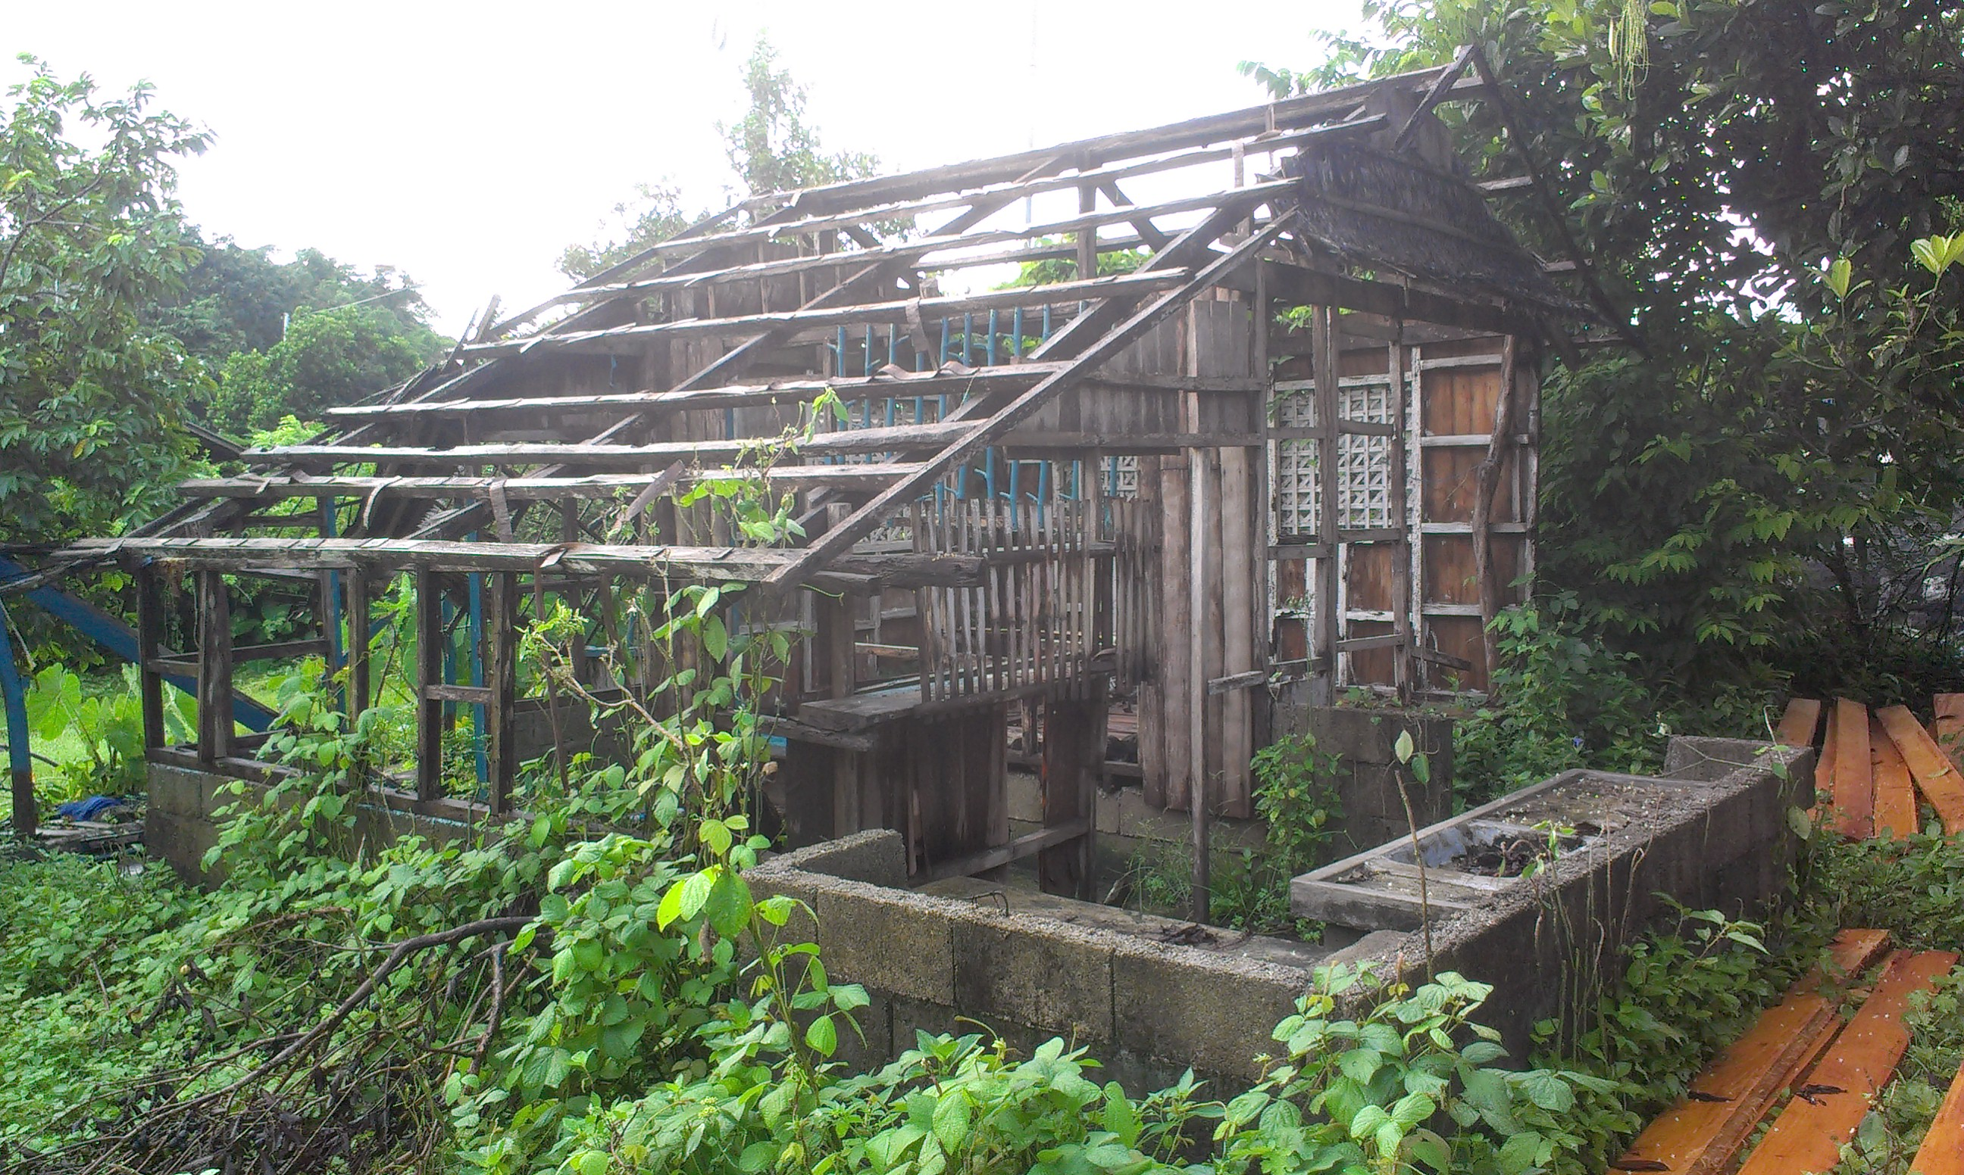
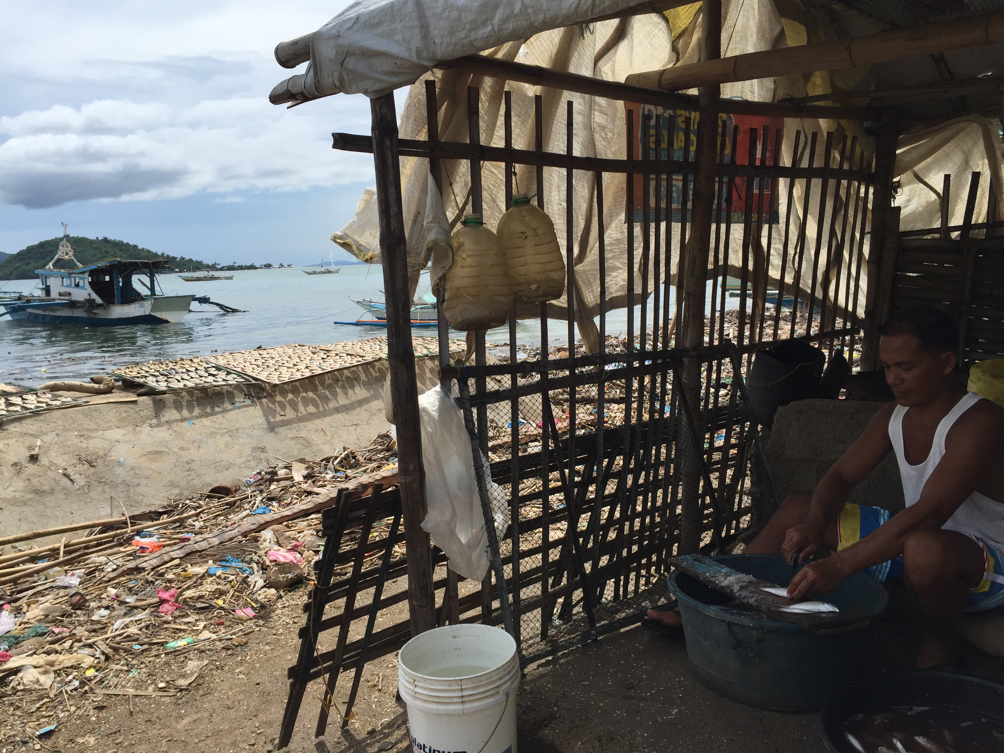
Introduction (1/3)
One of the most devastating typhoons in the Philippines (Yolanda/Haiyan) occurred in 2013, with an approximate death toll of 6340 people. Following up on a study from 2012, we observe solidarity transfers in a lab-in-the-field experiment one year before and three years after typhoon Yolanda occurred. Based on this unique experimental panel-dataset we can define key elements that influence solidarity, such as fairness concerns and effectiveness of disaster relief and potential corruption of governmental and non-governmental agencies.
Furthermore we observe risk and time preferences across affected and non-affected regions and seek to get a better understanding of the effects of natural disasters on human behavior. Understanding the consequences of natural disasters on human behavior might be crucial to develop strategies to conquer the challenges that come with the increasing exposure to environmental risk. Furthermore, our study has important consequences for studies that seek to investigate the stability of economic preferences.
Next Page
Back

Slide 3
Introduction (2/3)
The Philippines is among the countries most vulnerable to climate change, as it is most frequently hit by typhoons or earthquakes causing an estimated $1.6 billion in losses each year. Catastrophic events can dramatically alter existing social and economic relationships. Our main hypothesis is that catastrophic events not only alter social and economic relationships but also the fundamental ways in which people behave. Ever since Charles Darwin it has been argued that adaptation to the environment might favor the persistence of certain traits or behaviors that help the survival of the group.
An emerging body of literature has examined the impact of natural disasters on preferences and behavior. Yet, these studies have produced very different results regarding whether people become more or less cooperative, possibly because of different contexts or methodological problems. One potential methodological problem with most studies is the lack of a baseline experiment to control for initial heterogeneities among different villages. Our study aims to fill this gap and provide evidence on the formation of preferences due to one past catastrophic event.
Previous Page
Next Page
Back

Slide 4
Introduction (3/3)
The aim of this project is to collect data about solidarity and social preferences, and to identify the impact of typhoon Haiyan (locally known as Yolanda) who crossed the Philippines in 2013 on social behavior of coastal inhabitants of Panay island (Western Visayas, Region VI). Building on our baseline experiments with 800 participants in 2012 we aim to implement a follow-up study in the year after the typhoon in order to assess the impact of the damages induced by typhoon Yolanda. More specifically, we explore the causal effects of being hit by Yolanda building on a unique panel data set for a range of outcome variables (especially experimentally measured risk taking and solidarity transfers from the unaffected to the affected people, as well as survey items on social networks and trust). Furthermore, we will analyze the impact of recovery aid and how this affects social network formation and preferences. We will also test whether existing social capital (reflected in voluntary organization membership, collective action, trust and social relationships) prior to the catastrophic event helped people, as individuals as well as communities, deal with.er.
Previous Page
Back

Slide 5
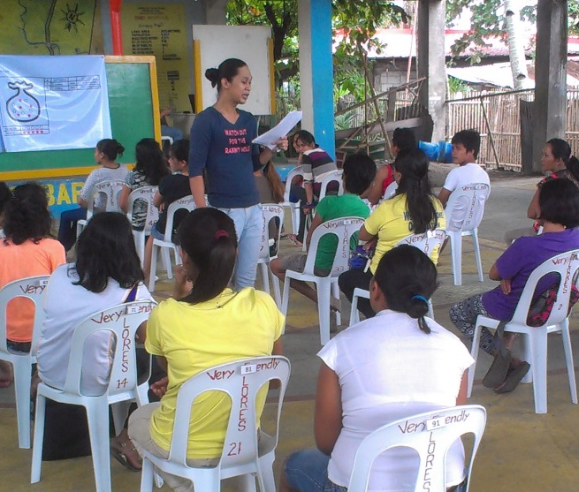
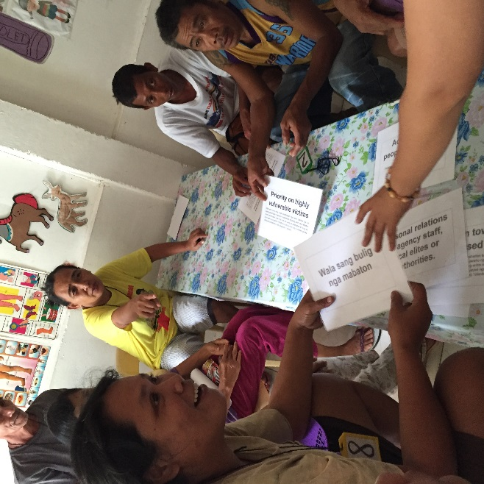
Method (1/4)
Apprehending all the data relevant for our analysis is a challenging task. We use a wide array of different methods to collect individual and village level characteristics. Our main focus lies in established economic lab-in-the-field experiments (some are explained on “Method (4/4)”) and survey based methods where individuals playfully reveal their preferences. We used well known games like risk tasks, solidarity games and spite games to elicit risk preferences and solidarity levels. Another large part of our workshops were focus group discussions. These sessions were conducted by representative groups of each villages (like fishermen, village representatives and random villagers). The invited individuals actively participated in an interactive workshop, where they were asked about certain village characteristics. The last part of our bundle of methods are key informant interviews where we approached relevant key figures in aid distribution and disaster and risk management. With these main data sources we hope to achieve a better understanding about the complex system that influences the behavior of people after an extreme natural disaster.
Next page
Back

Slide 6
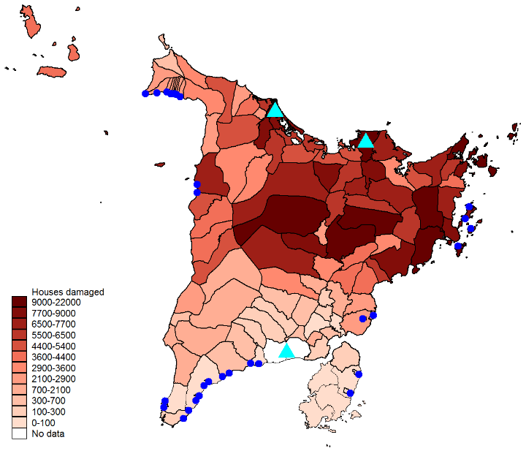
Method (2/4)
We conducted these kind of workshops one year before the typhoon and and three years after. In the map of the island Panay you can see the number of damaged households on the municipality level as a result of the typhoon. The blue dots represent the villages where we conducted our workshops, whereas the turquoise triangles show the three largest cities on Panay: Iloilo, Roxas and Kalibo. The heavily affected north and the slightly affected south of the Island provide us with a quasi experimental setting, where we not only are able to compare the difference in behavior between affected and unaffected people, but also are able to compare the behavior of individuals before and after the typhoon.
Previous page
Next page
Back

Slide 7
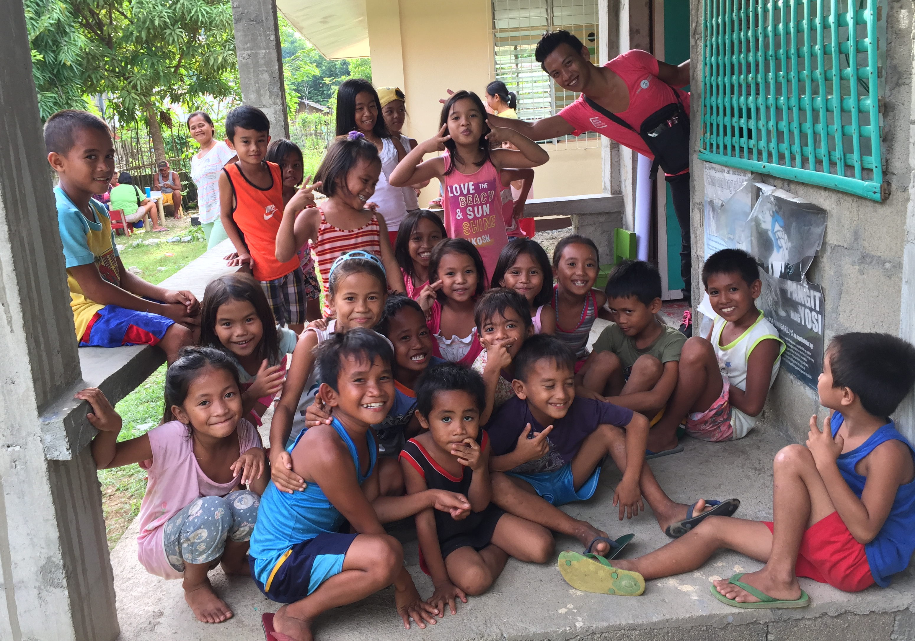
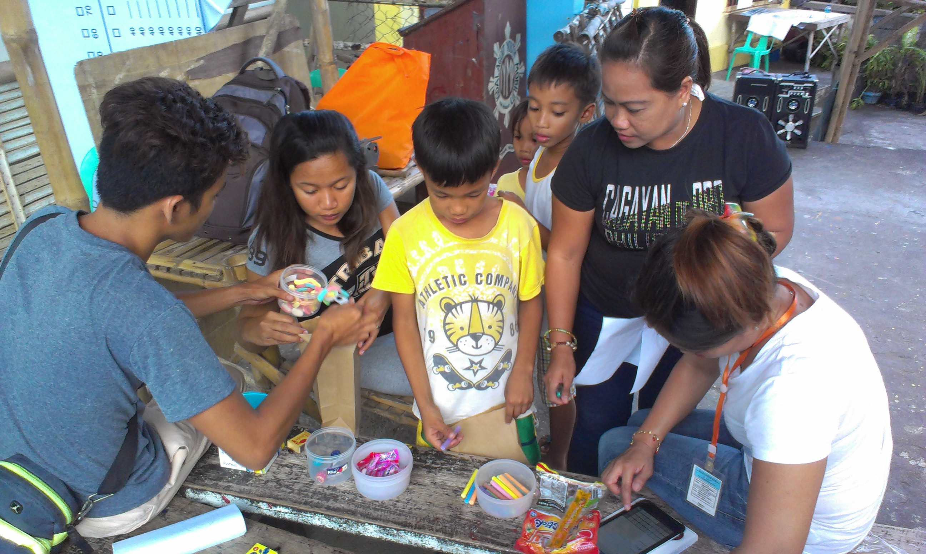
Method (3/4)
Additionally we conducted an explorative study with between six and nine year old children. We contucted this additional study in six villages (three heavily affected and three almost unaffected) with a total number of 103 children. We also used experimental methods to elicit levels of altruism, cooperation and patience. The games we used were dictator games, public good games and a marshmallow test. This study was designed as a cross sectional comparison between affected and unaffected regions, lacking a baseline experiment. Therefore, in total we have observations for 1080 adult and 103 infantile participants.
Previous page
Next page
Back

Slide 8
Method (4/4) – some games briefly explained
Solidarity Game (solidarity) | Dictator Game (altruism) | Prisoner‘s dilemma (cooperation)
Played by three players Each player starts with 200PHP (~4€) One player randomly looses initial endowment The other two „winners“ decide wether and how much to transfer to the „loser“ | Played by two players One player gets an initial endowment, the other starts with nothing The „dictator“ decides wether and how much to transfer to the other player | Played by two players Each player starts with an initial endowmnet Both players decide wether they want to transfer their endowment to the other player. If one does so, the transferred amount is doubled. (binary choice)
$
$ x 2
$
Previous page
Back
$

Slide 9
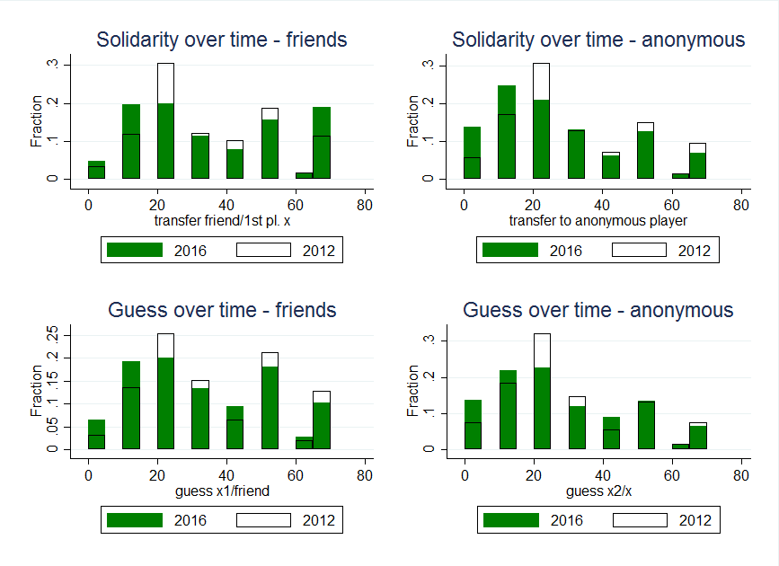
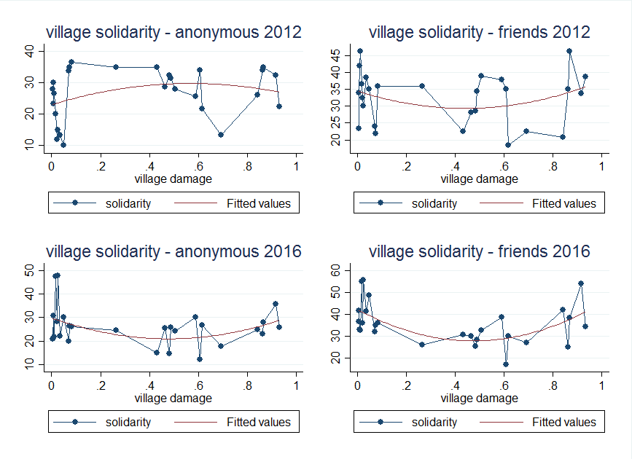
Preliminary Results (1/2)
Altough we are still in the process of analyzing the data, we are still able to share some first insights from the solidarity game and the explorative study with children (see next page).
First examinations of the solidarity game showed decreasing levels of solidarity over time. Additionally we can observe that with additional levels of exposure to the typhoon (measured in destroyed housholds per housholds in a village) the levels of solidarity decrease, but at some point the levels go up again. Comparing this to the initial levels from 2012 we can see that the correlation with exposure increased, and therefore we also observe a high explanation power in fixed effects regressions.
We administer this structure of the effect of exposure to two kind of effects: income effects and group formation. We suspect that decreasing income levels that resulted from exposure lead to lower solidarity levels, but at a certain point people start „bonding together“ and surpass the income effects.
We are still in the process of validating these results.
Next page
Back

Slide 10
Preliminary Results (2/2)
The explorative study with children gave us some first insights into the effects of typhoon Yolanda on behavior.
In the Prisoner’s dilemma (PD), 32.04% of all children decided to transfer their tokens to the other anonymous child. The most cooperative group were children at the age of nine years (42.31%).
Children from affected villages were less likely to cooperate than children from not affected villages (38.00% versus 26.42%, p=0.147). Using Probit regression we could observe that being affected lowers the probability of the child to cooperate significantly (β=-0.28; p=0.018).
The structure of the transfers in the Dictator Game show a similar structure as in the PD. The most “generous” group were children at the age of nine years (mean transfer of 1.77 tokens). A Wilcoxon rank-sum test shows negative and significant differences in the transfers across affected areas on the five percent level (1.92 versus 1.25, p=0.044).
The question remains if these differences occured because of the typhoon, or because of other driving factors.
Previous page
Back

Slide 11
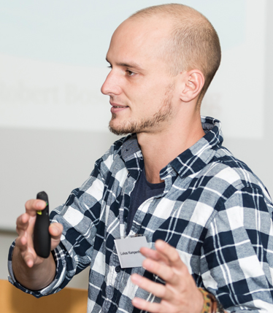

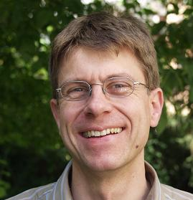
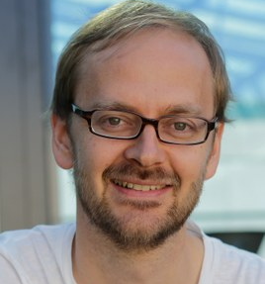
Contact
If you have questions about the project or suggestions we are happy to welcome your thoughts. Please either visit our website at:
https://www.uni-marburg.de/fb02/sustuse/contact
Alternatively you can contact me per e-mail.
 | Lukas Kampenhuber MSc University of Marburg, GER lukas.kampenhuber@wiwi.uni-marburg.de |  | Dr. Andreas Landmann Paris School of Economics, FRA
 | Dr. Bernd Hayo University of Marburg, GER |  | Dr. Björn Vollan University of Marburg, GER
Back

Slide 12
Two minute madness (1/3)
We are interested in the behavioral consequences of severe natural disasters.
In 2013, Typhoon Yolanda made landfall on the Philippines, resulting in millions of damaged households (Our study site: Panay, Vestern Visayas)
Following up on a baseline study from 2012, we elicit solidarity, risk- and time- preferences and personality traits three years after the typhoon
The heavily affected North and slightly affected south provide us with a quasi experimental setting where we can test for long term effects of such an extreme event
We built a unique experimental panel dataset which allows for cross sectional, and before- and after analysis

Slide 13
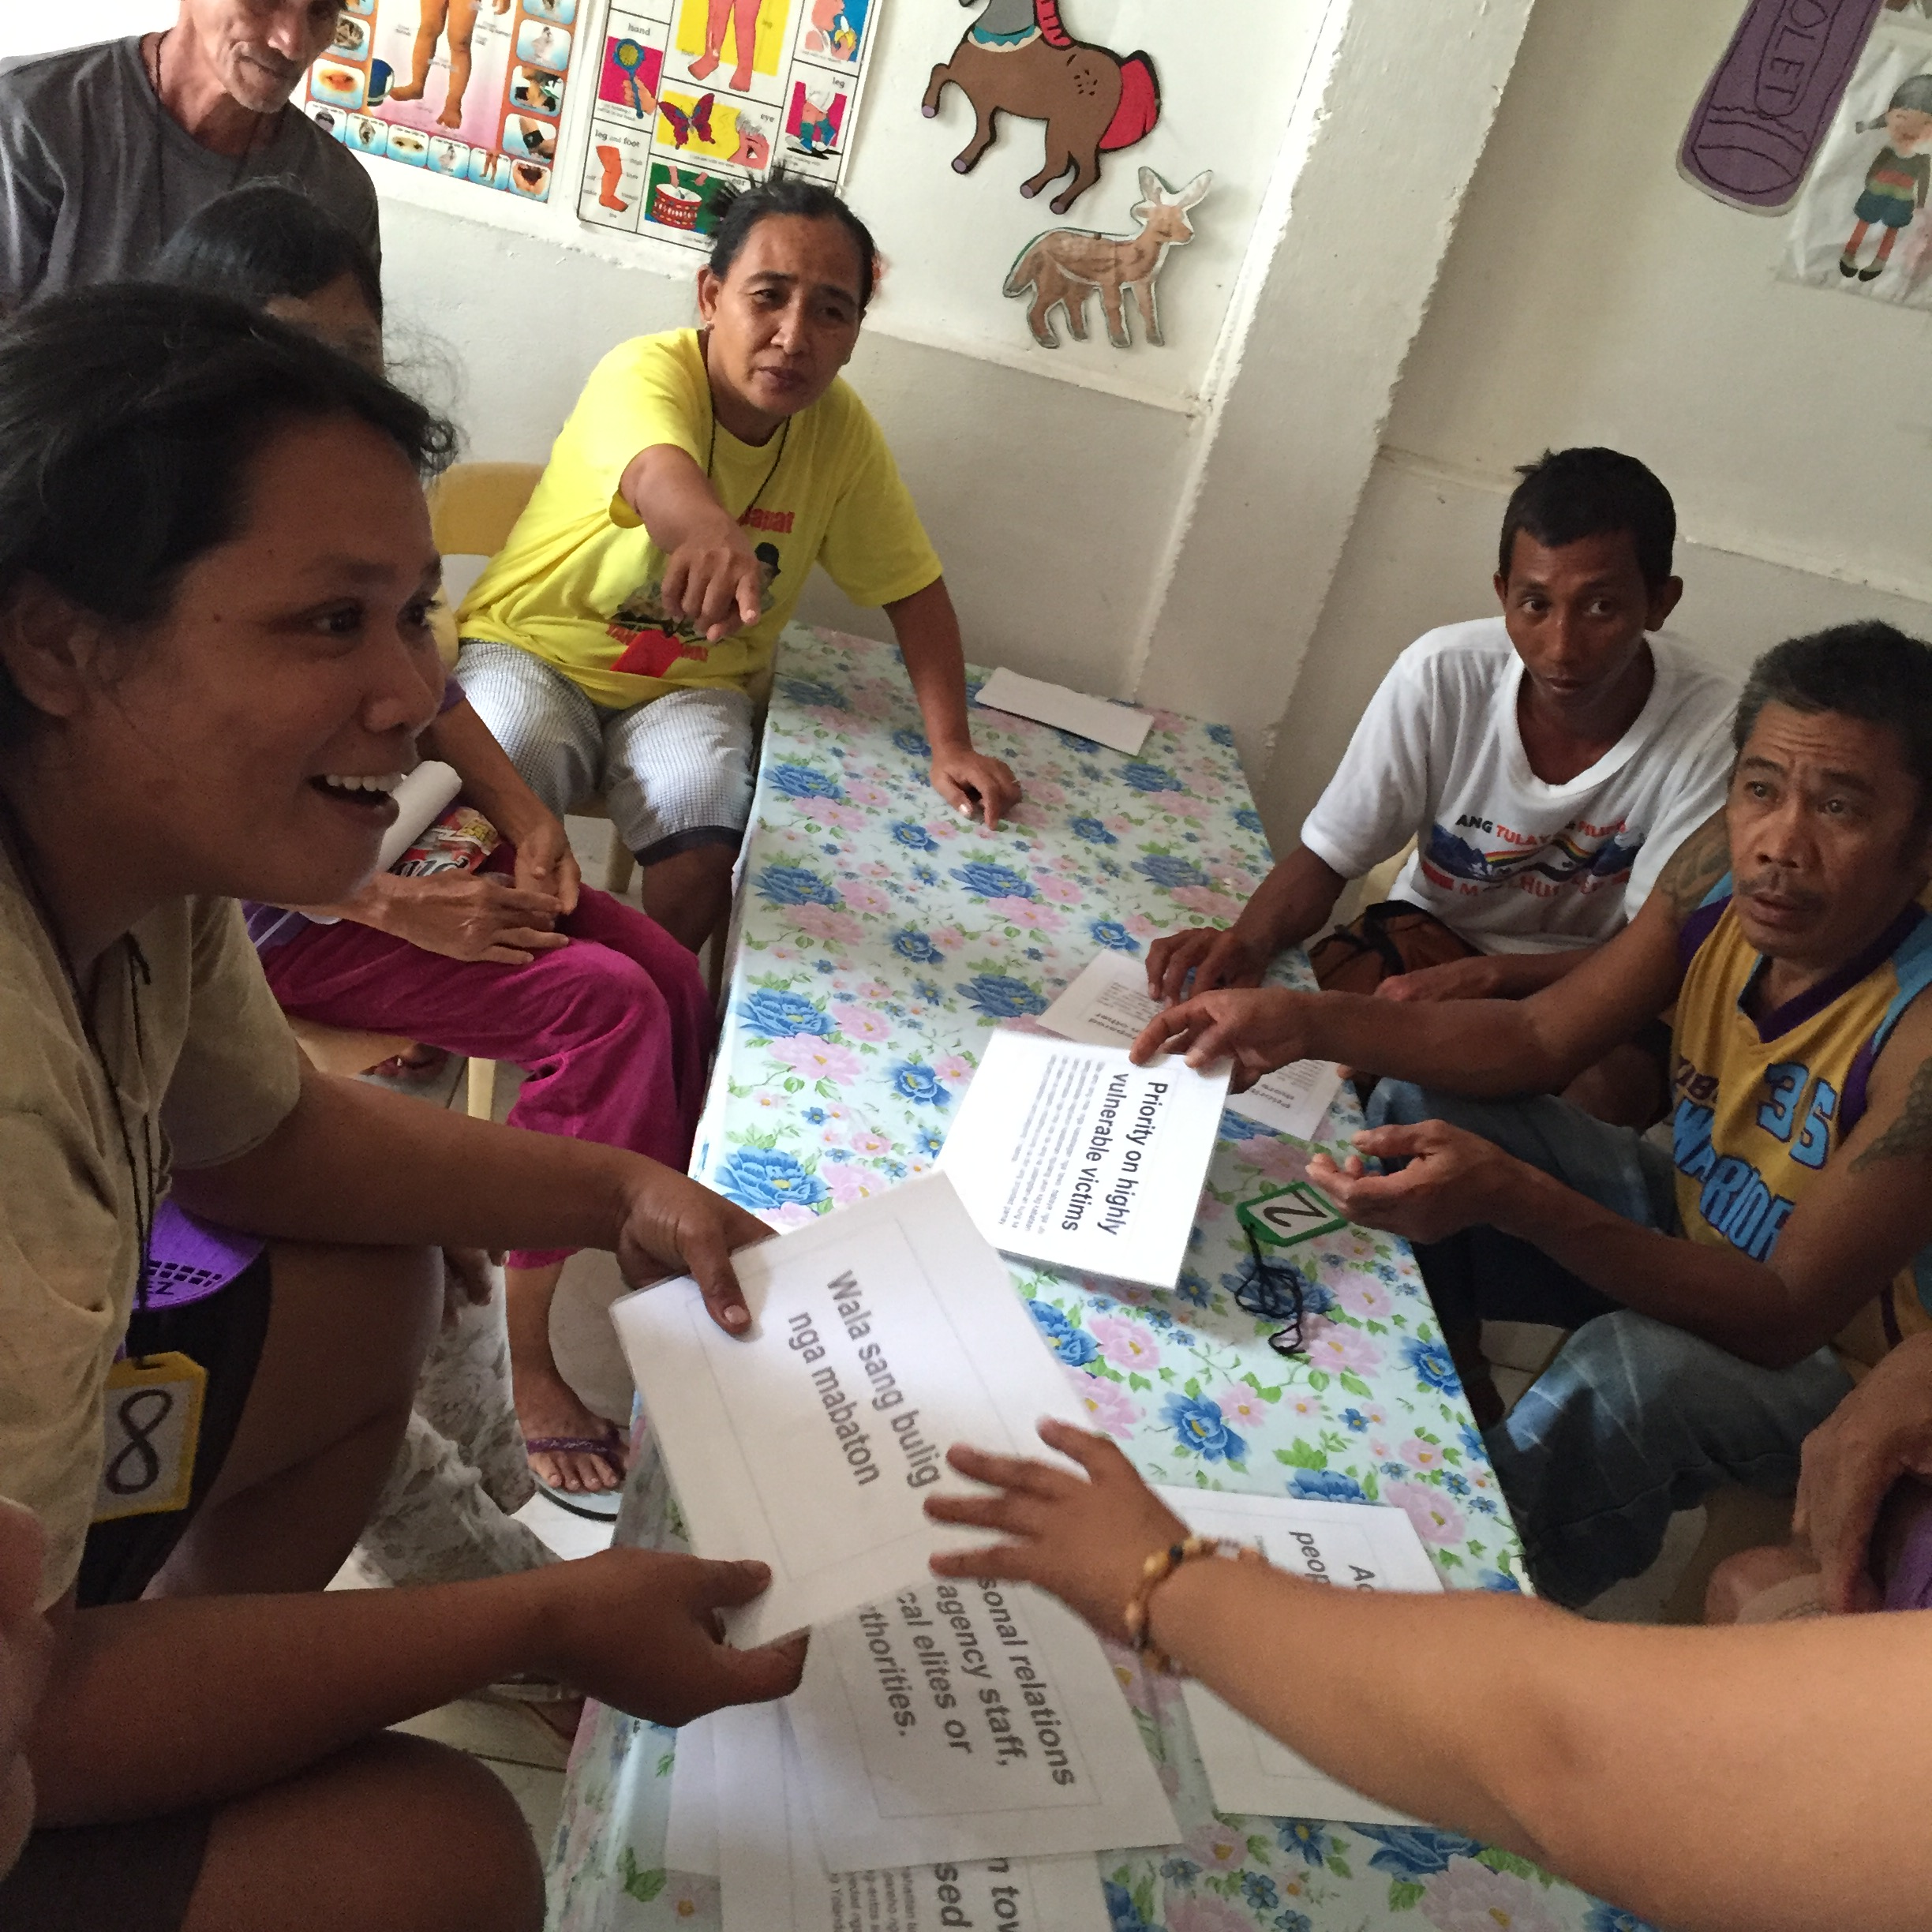

Two minute madness (2/3)
We use a wide array of different methods:
Economic lab-in-the-field experiments where people reveal their preferences
Survey based questionnaires
Key informant interviews
Focus group discussions
Also: explorative study with children

Slide 14
Two minute madness (3/3)
We are still in the process of analyzing our data. However, first examinations showed a “u-shaped” relation between being exposed to a typhoon and solidarity.
Furthermore children showed lower levels of altruism and cooperation in affected villages.

