Slide 1
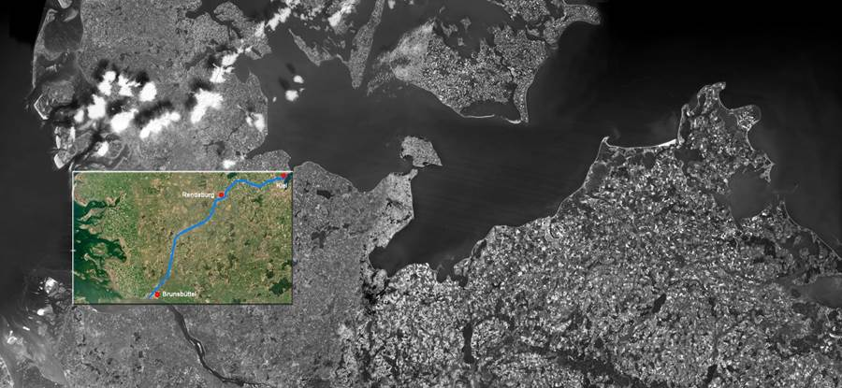
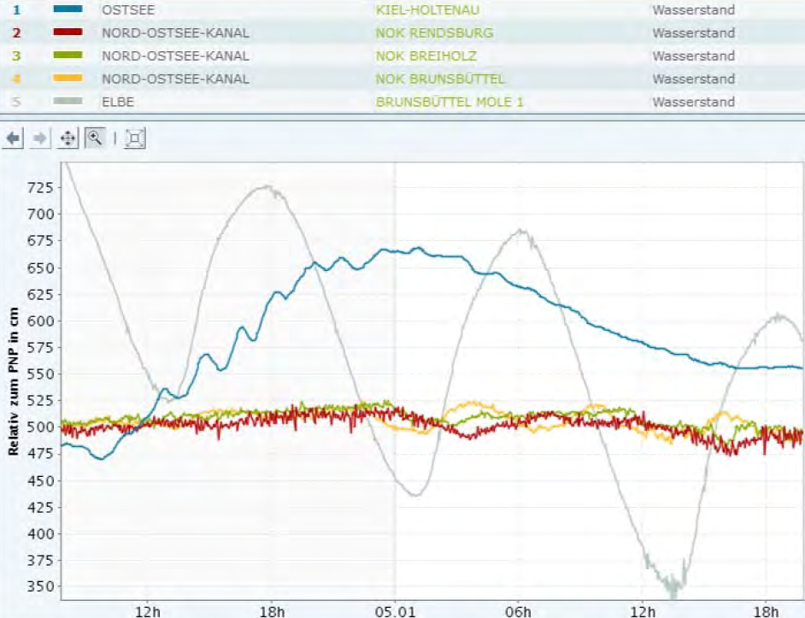
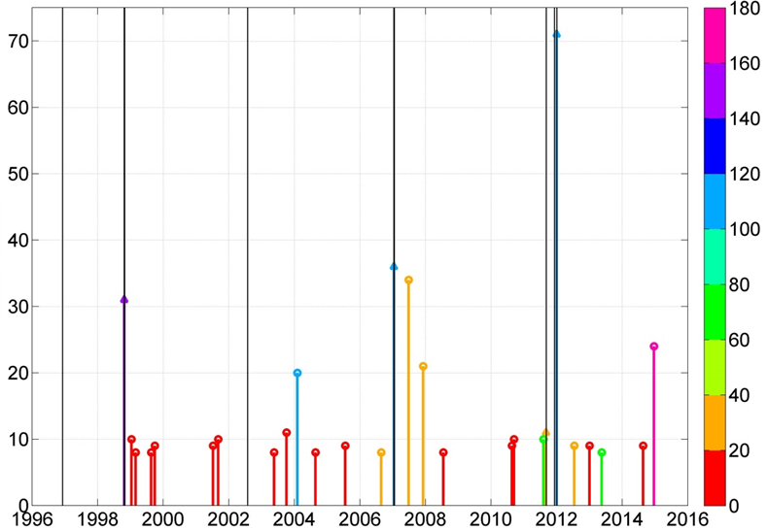
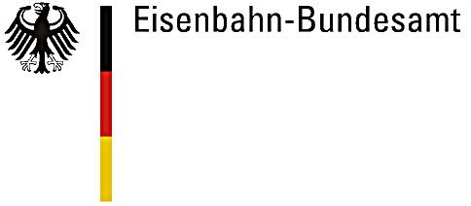
Kiel Canal: Past and future threats for shipping resulting from precipitation, wind surge and sea level rise
Topic 1: Adapting transport and infrastructure to climate change and extreme weather events
A. Ganske¹, N. Schade¹, S. Hüttl-Kabus¹, J. Möller¹, H. Heinrich¹, and B.Tinz² 1: BSH 2: DWD
The Kiel Canal
Influences on canal water levels
most frequented artificial waterway in the world
connects the North Sea and the Baltic Sea (see Fig. 1)
receives its water from a catchment with an area of 1580 km²
Canal’s water levels may only vary between 4.80 m and 5.40 m above gauge height, otherwise shipping is reduced or even ceased. 20 of these problematic water levels were observed between 1979 and 2012.
The responsible waterway authority lowers Kiel Canal’s water levels in advance, if high inflow is expected.
Denmark
Discharge from the canal :
~10 % into the Baltic Sea (sluices at Kiel-Holtenau)
~ 90 % into the Elbe estuary (sluices at Brunsbüttel)
Elbe water levels influenced by tides
→canal discharge only possible during low tide (see Fig. 2), but impossible when water levels are increased by onshore winds
Causes of high canal water levels:
strong precipitation in the catchment jointly with impossible discharge
Baltic Sea
North Sea
Kiel
Above gauge height [cm]
Kiel Canal
Brunsbüttel
Elbe River
Germany
Fig. 2: Water levels between 2017/01/04 and 05, measured at various gauges of Kiel Canal. Grey: Brunsbüttel (Elbe), Blue: Kiel (Baltic Sea), Yellow: Brunsbüttel (Canal), Red+Green: Middle and end of Canal.
By courtesy of Zierul (GDWS).
Fig.1: The Kiel Canal. By courtesy of GDWS, Germany
Determination of high inflow
High water level events
Event Precipitation (R3d) and Antecedent Precipitation Index (API) of Schröter et al. (2015) for the analysis of river flooding:
calculated with time series of precipitation at grid points (REGNIE, Rauthe et al. 2013) within the Canal’s catchment.
1. R3d: relative Maximum of 3-day sum of precipitation
2. API: weighted 30-day sum of precipitation before R3d event
If either R3d or API are larger than their respective 5-year return value R3d^{5y} or API^{5y}, then increased inflow to the Canal is expected.
a
Possible event = 11 day period with API/API^{5y} > 1 at midterm
API/API^{5y}
Within the event: search for phases, in which the Elbe water levels are higher than 5.30 m for over 8 hours (guarantees involvement of both high and low tides )
Max. Duration [h]
100 * API/API^{5y}
b
R3d/R3d^{5y}
Year
Duration of the longest phase and value of the API or R3d
Fig.4: Possible high water level events at Kiel Canal (coloured bars). Lengths of bars: Max. duration of Elbe water levels higher than 5.30 m. Bars with triangle-tops: day of calculated and observed event coincide. Black lines: days with observed problematic water levels.
Fig.3: API/API^{5y} (a) and R3d/R3d^{5y}
(b) within the catchment of the Kiel Canal at 1998/10/25.
Summary
The potential of critical situations in the past was calculated by combining the indices for high inflow and elevated tidal low water of the Elbe River. Occurrences were compared with the recordings of the responsible waterway authority. Most observed events can be explained, but additional dates for problematic canal water levels were determined. These events were possibly prevented by lowering the canal’s water levels in advance of expected high inflow.
Future sea level rise will shorten time periods during which discharge is possible, and therefore the regulation of Kiel Canal’s water levels will become more difficult.
Literature:
Rauthe et al., 2013: Met. Z. 22(3), pp. 235–256.
Schröter et al., 2015: HESS, 19, pp. 309-327.
Contact
Anette.Ganske@BSH.de
Nils.Schade@BSH.de
http://www.bmvi-expertennetzwerk.de

