Slide 1

Large-scale coupled system dynamics modelling and resilience to climate change in Guatemala’s drought-prone areas
Julien Malard, Jan Adamowski, Azhar Inam, Héctor Tuy, Hugo Melgar-Quiñonez

Slide 2






Acknowledgments
This research was conducted by...
...and funded by...
...and would never have been possible without our stakeholder collaborators!

Slide 3
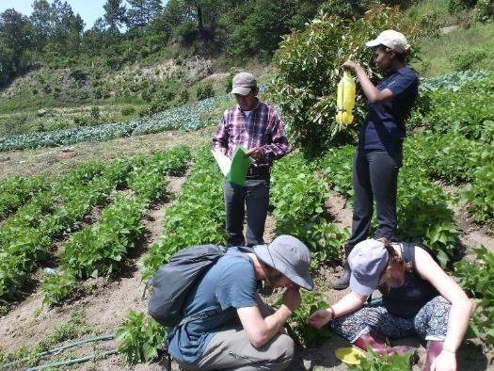
Why Guatemala?
Very high food insecurity
High dependence on small-scale agriculture
Very diverse country

Slide 4
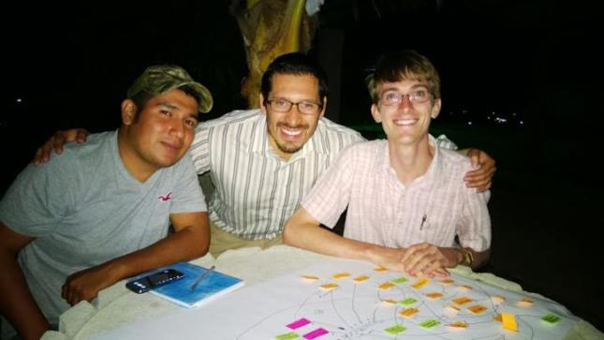
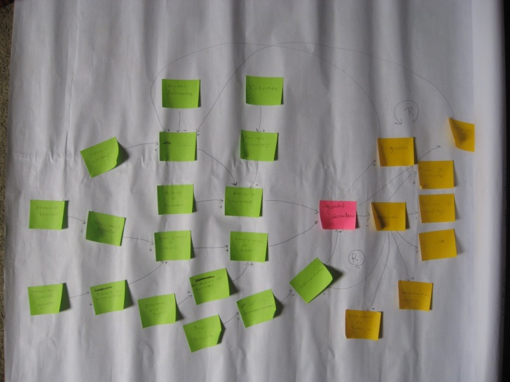
The Model Building Process
Individual interviews
Qualitative group-built model
Group model-building workshops
Quantified System Dynamics Model

Slide 5
Interview example

Slide 6
Quantification example

Slide 7
Proposed methodology
Quantifiable S&F
Diagram
Identify equations
to calibrate
1
2
Identify
relationship form
Hierarchical
Bayesian Inference
3
4
Model coupling
Model runs
& analysis
5
6

Slide 8
Types of equations
Mechanical/logical relationships
Process-based relationships
Empirical relationships
Maize yield = Yield index * Max Potential Yield
ﾤ
Salary = f(Education)
Income = Salary + agricultural sales

Slide 9
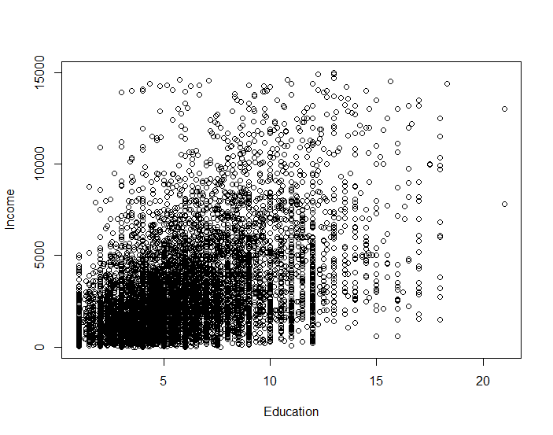
Relationship forms
Income ~ Education

Slide 10
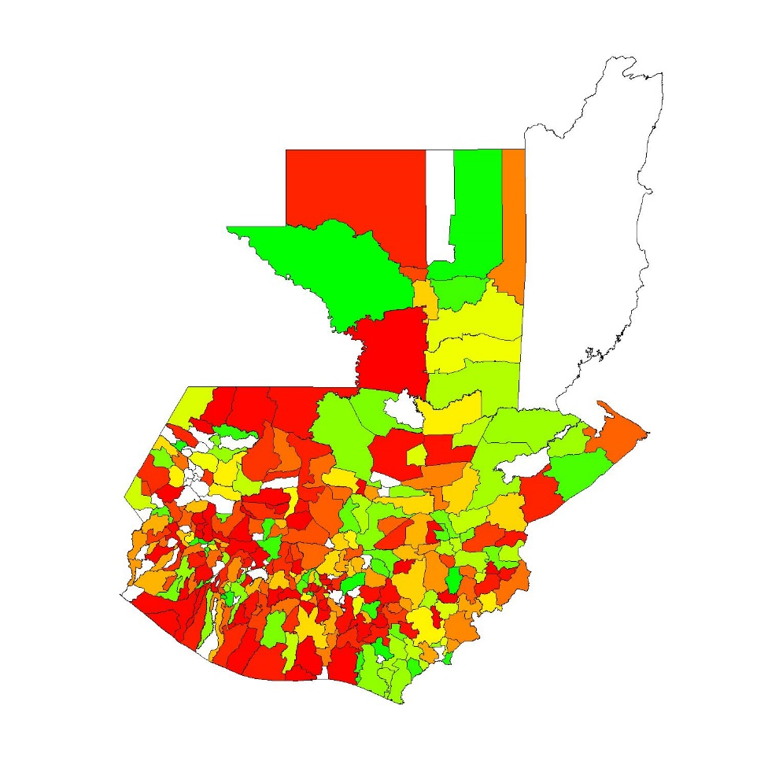
Data availability

Slide 11
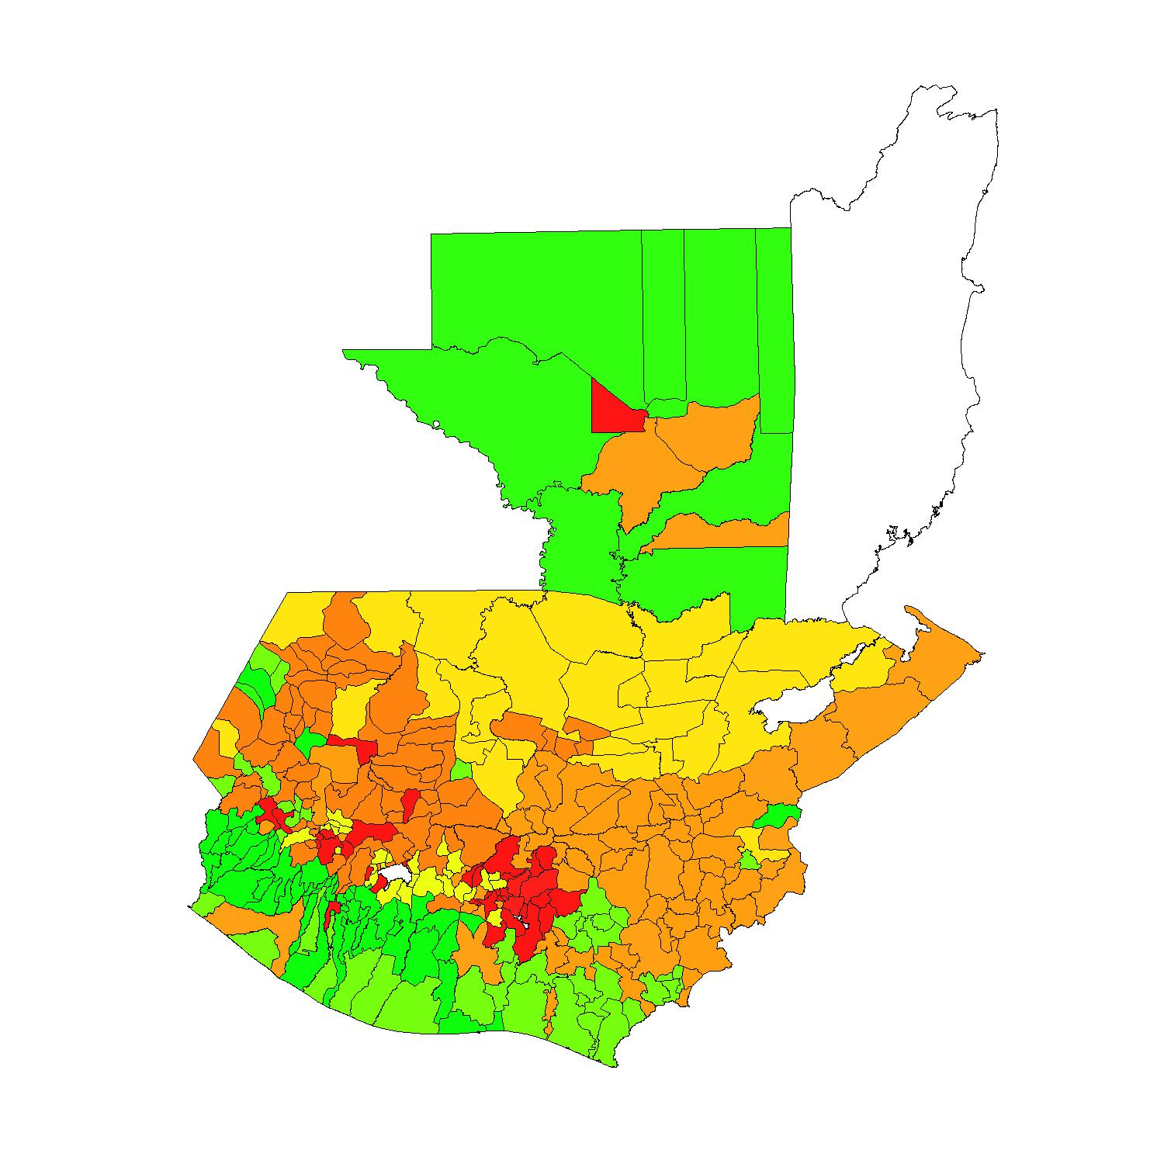
Bayesian Hierarchical Models
10 socioenvironmental territories
Data points
Prior knowledge
Weak a prioris at national level
Territory 1
Territory 2
...
Muni 1
Muni 2
...
IARNA, URL, Guatemala. Perfil del Agro y la Ruralidad de Guatemala 2014

Slide 12
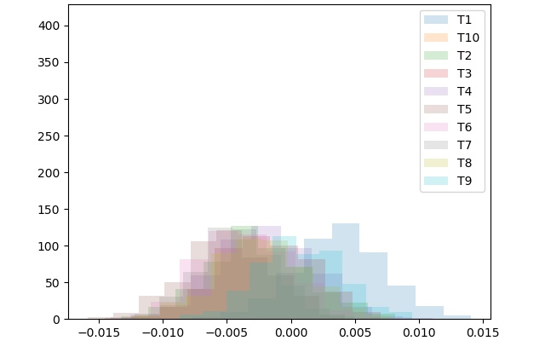
Calibration results
Impact of population density on agricultural commercialisation
Inverse logit equation
Coefficient value

Slide 13
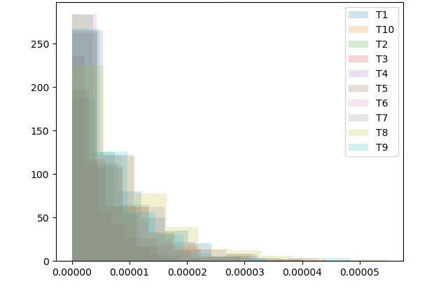
Calibration results
Impact of food quantity on food security
Coefficient value

Slide 14
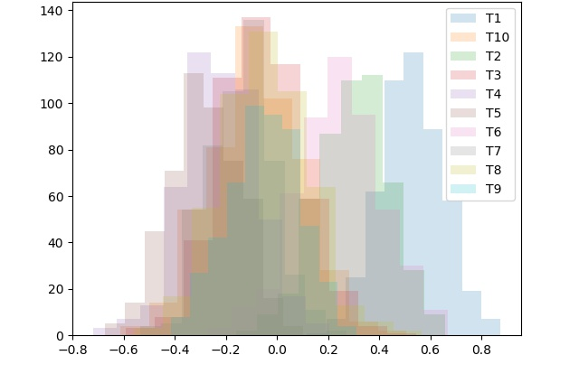
Calibration results
Impact of childhood illnesses on malnutrition
Coefficient value

Slide 15
Model Coupling - Tinamït
DSSAT
SDM

Slide 16
Marksim
تقدیر

Slide 17


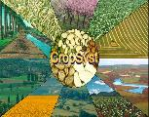



Model Coupling - Tinamït
All Models
Read variables
Start simulation
Exchange values
Generic SDM
Generic PB

Slide 18
Model Use – Climate change
Food security 2020-2060
RCP 8.5
No policies

Slide 19
Model Use – Climate change
Food security 2020-2060
RCP 8.5
Universal education

Slide 20
Model Use – Climate change
Food security 2020-2060
RCP 8.5
Irrigation for all

Slide 21
Resources
Tinamït is available at:
https://github.com/julienmalard/Tinamit
… and documented at:
http://tinamit.rtfd.io
… and community translated at:
https://www.transifex.com/qatikon/tinamit

