Slide 1


Industrial projects enabling student futures in Environmental Physics
Karen Aplin^{1,2} and Alec Bennett^{2,3}
Department of Physics, University of Oxford, UK
Department of Electronic and Electrical Engineering, University of Bath, UK
BIRAL, Portishead, UK

Slide 2
Structure of talk
Introduction and background to project scheme
Organisation of projects
Case studies of successful projects in Environmental Physics
  Freezing rain
  IR sky cam
Perspectives on scheme
  Skills learnt by students
  Benefits to industrial partners
Future plans / improvements

Slide 3
Introduction and background
Initially (from 2012) part of a national programme run by UK Institute of Physics
Motivation:
What key skill are your graduate employees most lacking…?
To improve “employability” - skills identified as useful by employers but not taught in Oxford Physics course
To give third year (Bachelors’ course) students experience of a “real” physics-based problem
Plot from Association of Graduate Recruiters

Slide 4
Organisation of projects (1)
Project ideas are posed by a partner company, and vetted by the scheme leader for clarity, feasibility and scope
Projects are compulsory, but students can choose their preferred project and are given their choice wherever possible
Industrial supervisor, who suggested the problem, commits 1 hour/week. A university-based academic supervisor helps with equipment purchase, preparation of assessed material and any issues with industrial partner
Students work in teams of 4-5
Timeline:
Main project work period (part time)
Allocation
Kick off visit
Presentation
Final report
Sep
Oct
Nov
Dec
Jan
Feb
March
April

Slide 5
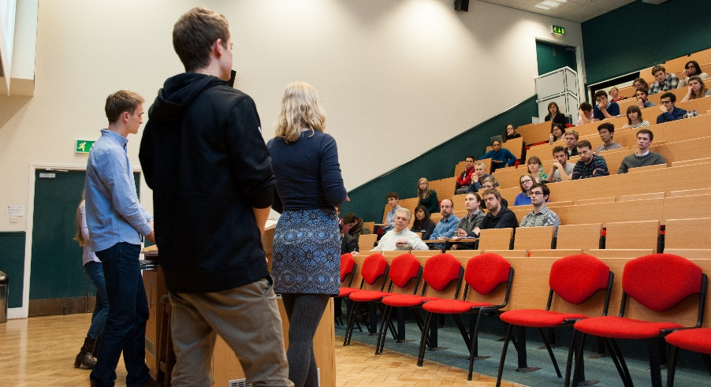
Organisation of projects (2)
Projects are assessed in two ways:
  Group Presentation (20% of marks) –
    all students get the same mark, assessed by a panel at a presentation event
    looking for scientific understanding and progress, and evidence of project management and team work
  Individual Report (80% of marks) - assessed by two examiners
  Total marks are about 15% of the degree, the largest fraction not assessed by a traditional exam
The scheme covers Physics in its broadest sense, extended to engineering and related fields
Environmental Physics projects have been particularly successful within this scheme, despite not having been taught

Slide 6
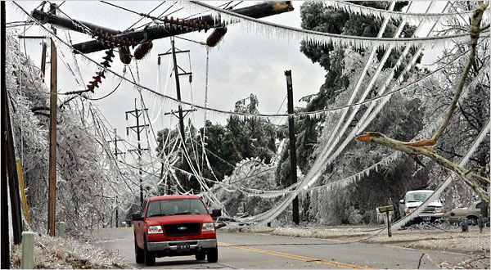
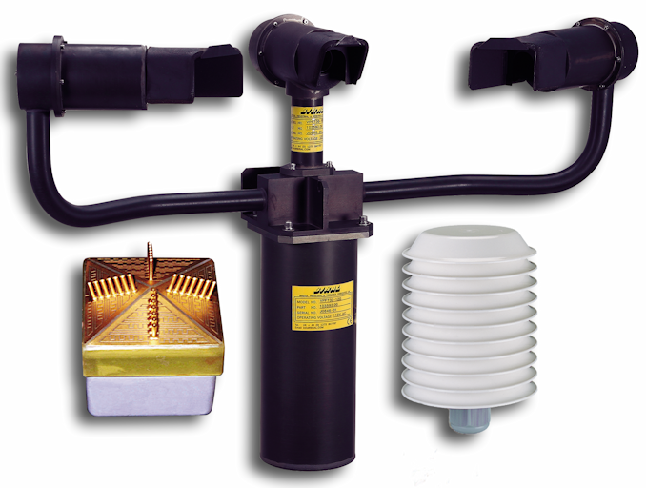
Case study 1: “Super Cool Rain”
Industry Motivation:
Freezing rain is supercooled raindrops, which quickly freeze upon impact and coat all surfaces below 0°C in a thick glaze of ice. Government and industry sectors such as national weather services, aviation and wind farms require sensors capable of detecting these events as early as possible. Biral is interested in making a new, highly sensitive, freezing rain detector and would like to investigate different types of freezing rain detection methods.
Task: Students to research how freezing rain is formed and current detection techniques. Evaluate them and suggest novel detection techniques.
Student findings: Freezing rain global climatology; insight on companies active in the field and critical analysis of current detection methods.
severeweatherwiki.wikispaces.com
Combined visibility, present weather and freezing rain detector (Biral)

Slide 7

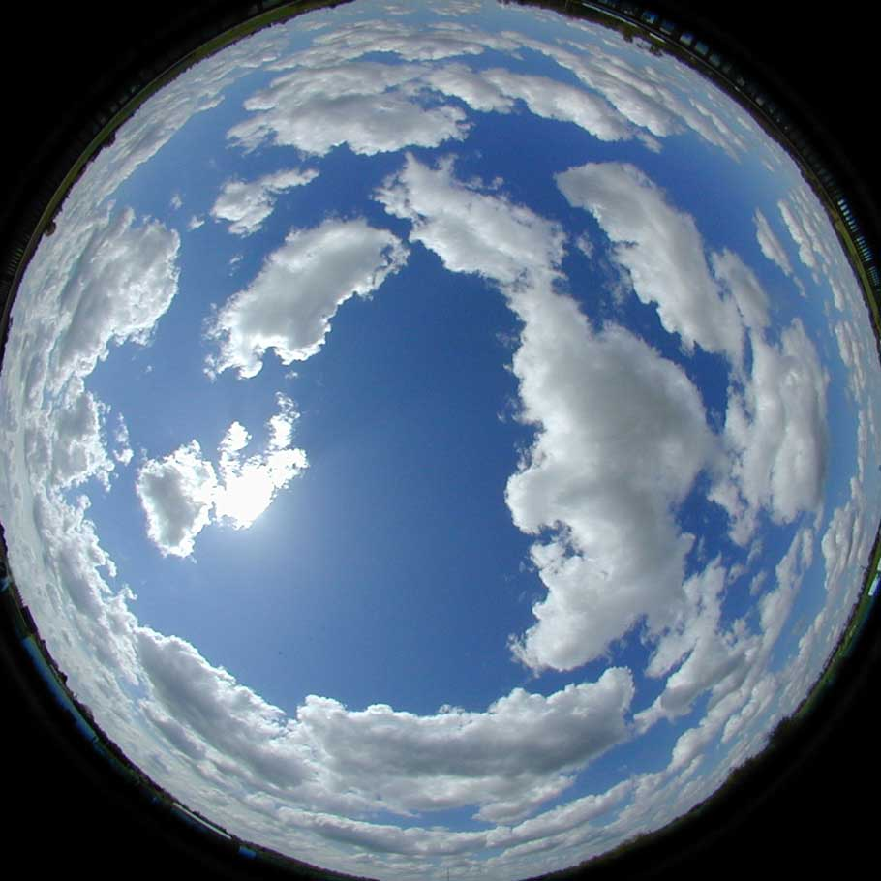
Case study 2: “Nocturnal Cloudspotting”
Industry Motivation:
Measuring the amount of cloud above a site is a fundamental meteorological observation. It is however challenging to detect this using ground-based instrumentation, especially at night. With the reduction in the number of human observers being used globally, manufacturers need to find a robust, inexpensive solution to measure cloud amount during both day and night.
Task: Students to research techniques currently used to automatically determine cloud amount and design a simple prototype sensor based on thermal imaging.
Student findings: Sourced promising components for thermal IR cloud sensing. Used NASA-derived atmospheric profile modelling to determine factors affecting IR propagation in the troposphere. Developed a working prototype, which exceeded Biral's project expectations.
severeweatherwiki.wikispaces.com
Commercial thermal imaging components size compared to coin (source: flir.co.uk)
www.philohome.com/kitephoto/kapp.htm

Slide 8
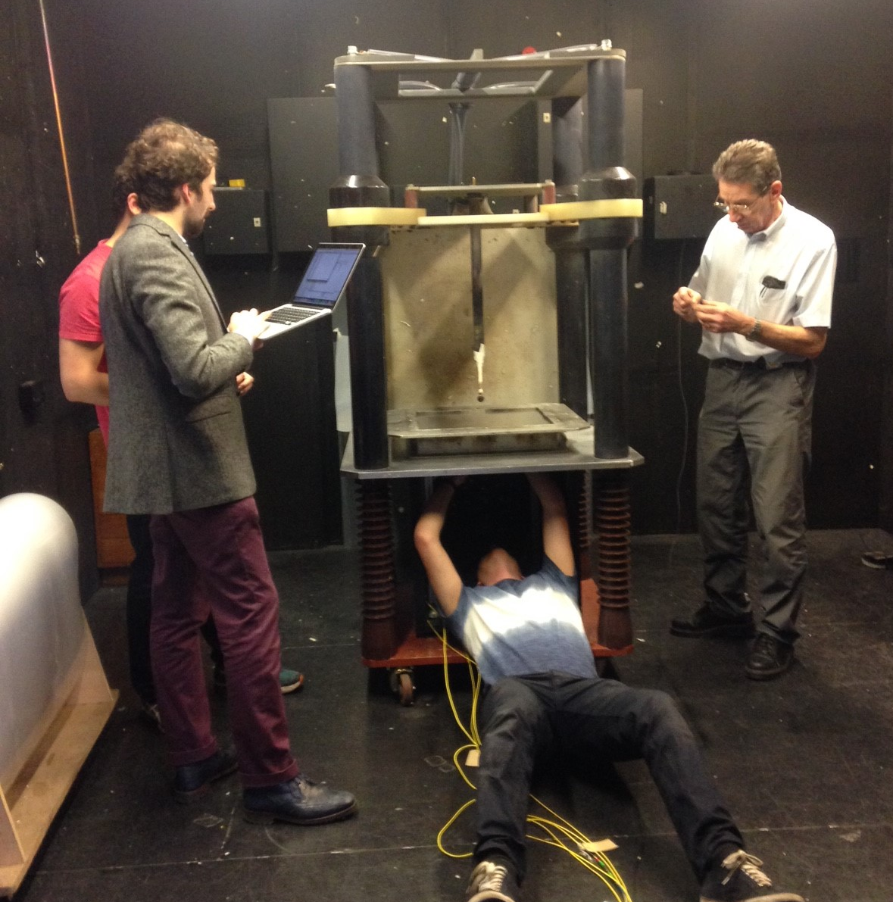
Student feedback on scheme
“On the whole, I would say that the project has been the most enjoyable part of my degree so far.”
“I have really enjoyed taking part in the group project. It has been so nice to do something so different to the rest of my degree. The teamwork aspect I have found particularly good because I have enjoyed … working with an entirely new group of people.“
“A very interesting and engaging project, I enjoyed it, and was satisfying to actually build something”
“Overall I’ve enjoyed doing the project and the application of practical lab skills to something we’ve build ourselves.“
Students working on test rig with staff at Cobham Lightning

Slide 9
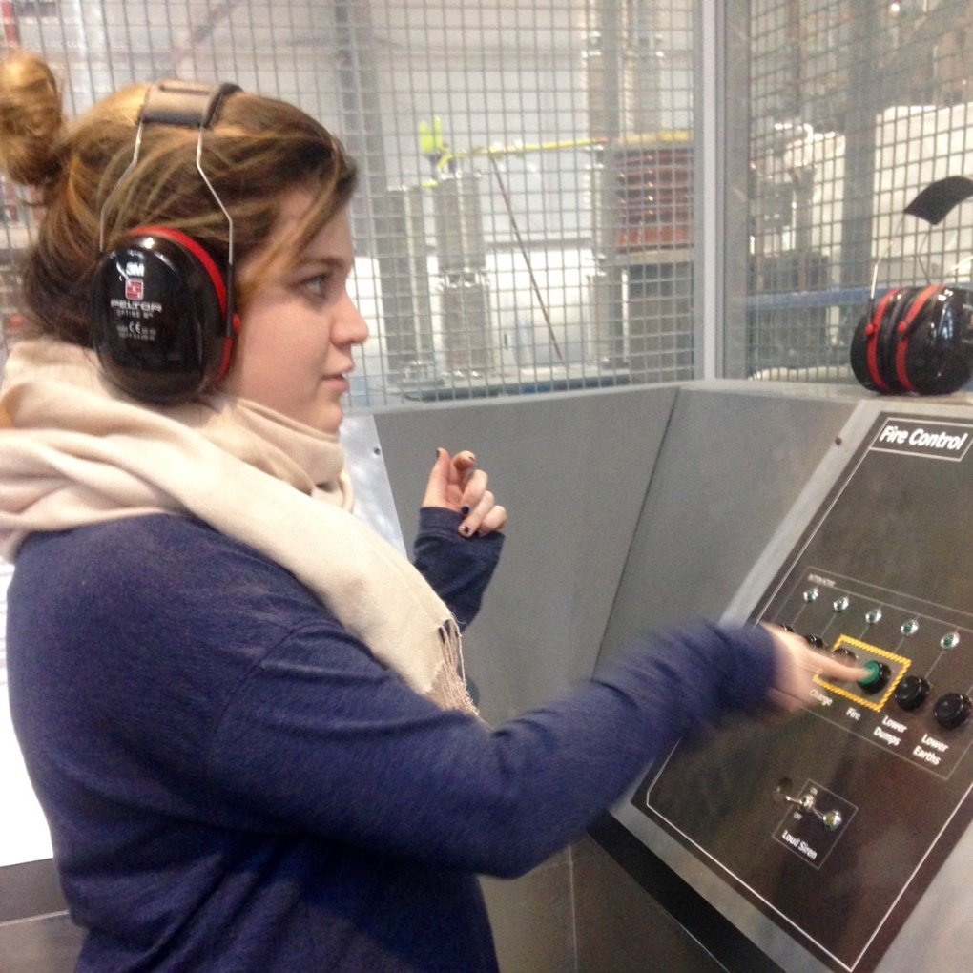
Specific feedback
(on presentations)
  “Was quite useful as a milestone”
  “Having the aim of presenting some of our results meant we were much more focussed on getting results earlier…”
(on what was learnt)
  “How to make progress as a group when even when it feels like no-one really knows what they're doing.”
  “Experiments nearly never show you what you expected to see.”
Negative feedback:
  (from students) Not enough help from local supervisor, some members of group not working hard enough, did not get their first choice of project
  (from companies) Students did not keep in touch with them, one new supervisor didn’t feel adequately supported by the department
  (from internal supervisors) Students can’t plan their own work, not used to / unable to work in a team
Student about to trigger lightning test

Slide 10
Benefits to industrial partner
Students conduct initial literature review, with access to journals not available to the company
Students function outside the company’s culture and innovation procedures, so can provide a different perspective and approach to solving the industrial problem
Students are more likely to receive unbiased opinion from potential customers compared to direct communication by the company’s sales team
The results from the student project are used to assess the risk and possible return of initiating an in-house R&D project
Students have free access to their university’s world-leading experts and equipment relating to the company’s area of interest
Provides a method for making final year students aware of the company, enhancing brand awareness as they enter the workforce
Route to recruit high-performance students

Slide 11
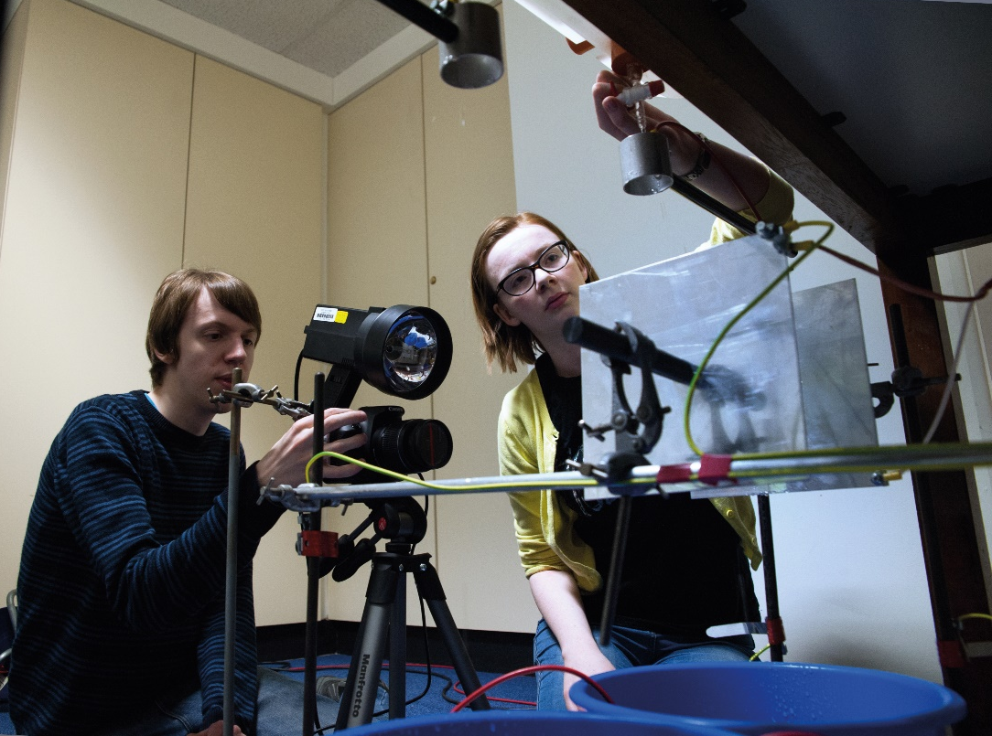
Future plans / improvements
This year we are opening industrial projects to fourth year (Masters’) students in addition to the existing scheme. Environmental projects are again a significant part of the scheme.
Introduction of more open-ended work in lab classes before the third year of the course so that students are better at planning their own project work.
Students photographing charged droplets for another project with BIRAL.
Uses Kelvin water dropper generator, featuring in our poster in this session on laboratory demonstrations for teaching atmospheric electricity
EGU2018-10458 X1.53

