Slide 1
Cosmic-ray geology and hydrology:
a scientist walking in circles
Marek Zreda
University of Arizona, Tucson, USA
EGU 2018, Vienna, 13 April 2018; abstract EGU2018-12052.

Slide 2
What we use in cosmic-ray geology and hydrology
Cosmic-ray particles:
Atoms, protons, neutrons, muons, other
primary
secondary
Neutrons:
high-energy,
fast (evaporation),
epithermal
thermal
Cosmic-ray reactions:
Spallation
High-energy neutrons (generally >10 MeV)
Example: ¹⁶O + n → ¹⁰Be + 4n + 3p
Neutron activation
Low-energy (thermal) neutrons (<1 eV)
Example: ³⁵Cl + n → ³⁶Cl
Other reactions
e.g., muon capture

Slide 3
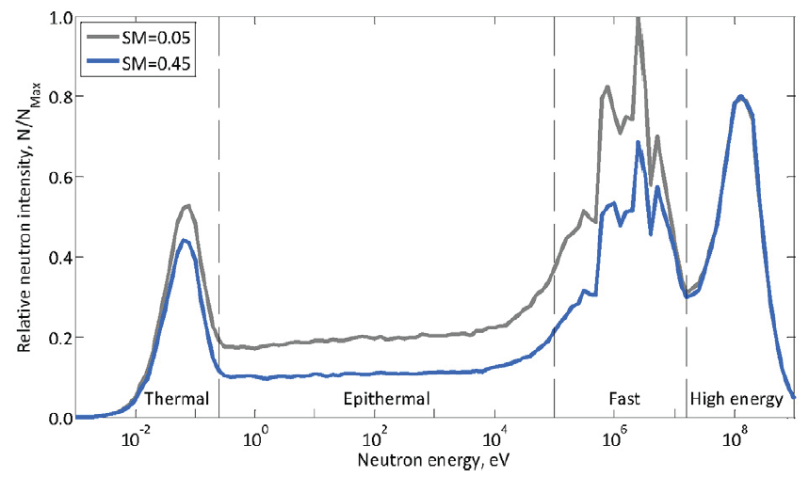
Sensitivity of cosmic-ray neutrons to hydrogen
³⁶Cl
¹⁰Be
Andreasen et al., 2017, Vadose Zone Journal 16 (8).

Slide 4
It ALL starts here… in space: primary cosmic rays
Secondary cosmic rays
Interactions with matter (e.g., H, N, O, Si, K, Ca, Fe, ...)
Cosmogenic isotopes
atmospheric
in-situ
Rock dating:
36Cl
14C
10Be
21Ne
other
GW dating:
36Cl
14C
81Kr
32Si
other
surface ages
erosion rates
displacement rates
burial duration
etc...

Slide 5
It ALL starts here… in space: primary cosmic rays
Secondary cosmic rays
Interactions with matter (e.g., H, N, O, Si, K, Ca, Fe, ...
Cosmogenic isotopes
in-situ
Rock dating:
36Cl
14C
10Be
21Ne
other
As of 1990…
… all isotopic systems calibrated.
The end of the unknown!
surface ages
erosion rates
displacement rates
burial duration
etc...

Slide 6
It ALL starts here… in space: primary cosmic rays
Secondary cosmic rays
Interactions with matter (e.g., H, N, O, Si, K, Ca, Fe, ...
Cosmogenic isotopes
in-situ
water
content
studies
Rock dating:
36Cl
14C
10Be
21Ne
other
surface ages
erosion rates
displacement rates
burial duration
etc...
complications
due to H2O

Slide 7
Early published clues
Swanson and Caffee, 2001, Quaternary Research 56, 366–382.
Samples lattice water fast neutron intensity in air
wt. % neutrons (g air)⁻¹ yr⁻¹
Dry samples 1-2 762
Wet samples 10-12 1166
Incorrect conclusion that high water content means high fast neutron intensity.
But correct assessment that “something is not right” in our understanding.

Slide 8
It ALL starts here… in space: primary cosmic rays
Secondary cosmic rays
Interactions with matter (e.g., H, N, O, Si, K, Ca, Fe, ...
Cosmogenic isotopes
Low-energy neutrons
in-situ
water
content
studies
Rock dating:
36Cl
14C
10Be
21Ne
other
surface ages
erosion rates
displacement rates
burial duration
etc...
complications
due to H2O

Slide 9
It ALL starts here… in space: primary cosmic rays
Secondary cosmic rays
Interactions with matter (e.g., H, N, O, Si, K, Ca, Fe, ...
Cosmogenic isotopes
Low-energy neutrons
in-situ
water
content
studies
Rock dating:
36Cl
14C
10Be
21Ne
other
soil moisture
snow-water equivalent
today
surface ages
erosion rates
displacement rates
burial duration
etc...
complications
due to H2O
epithermal
& thermal
neutrons

Slide 10
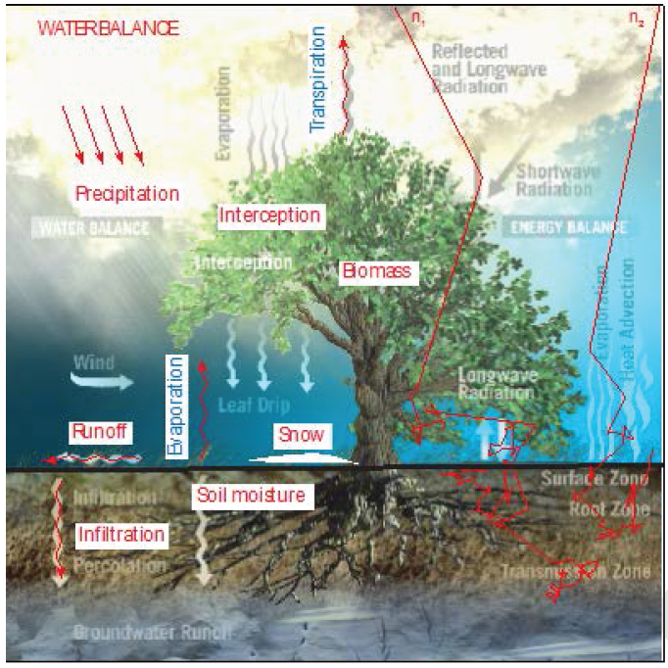
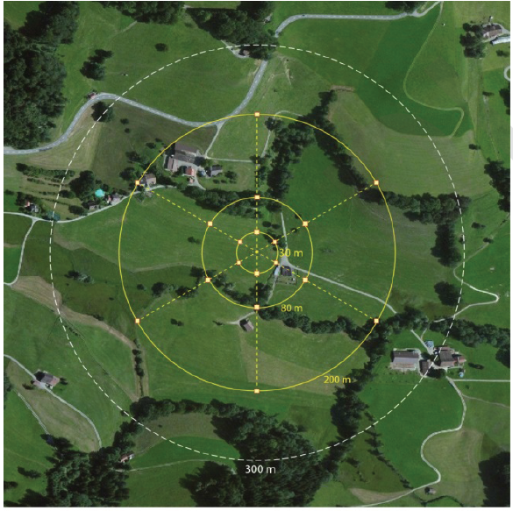
Cosmic-ray hydrology
Zreda, 2016, Journal of the Japanese Society of Soil Physics 132, 25-30.

Slide 11
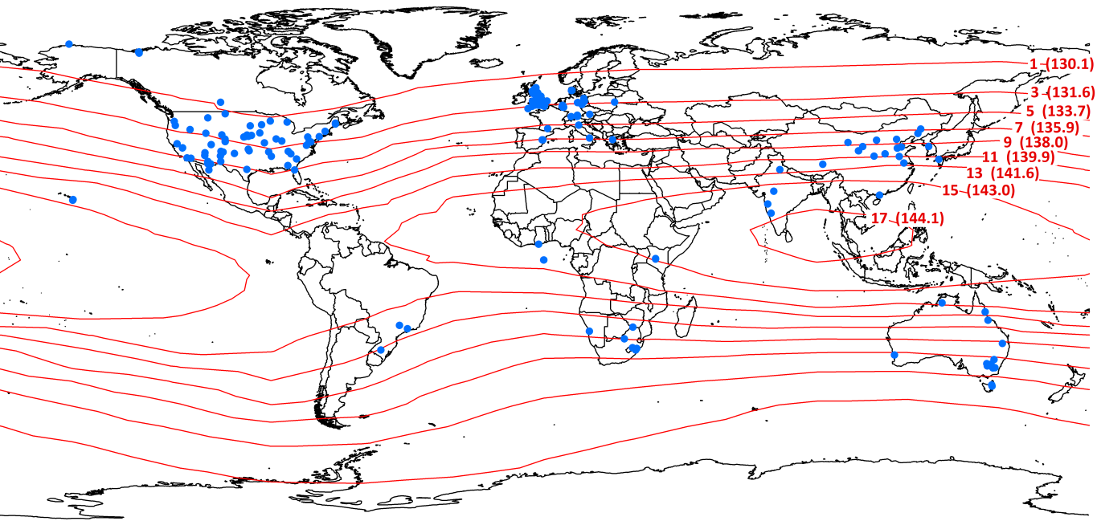
Cosmic-ray sensors - installed as of 2017
Andreasen et al., 2017, Zadose Zone Journal 16 (8).

Slide 12
It ALL starts here… in space: primary cosmic rays
Secondary cosmic rays
Interactions with matter (e.g., H, N, O, Si, K, Ca, Fe, ...
Cosmogenic isotopes
Low-energy neutrons
in-situ
water
content
studies
Rock dating:
36Cl
14C
10Be
21Ne
other
soil moisture
snow-water equivalent
today
surface ages
erosion rates
displacement rates
burial duration
etc...
complications
due to H2O
epithermal
& thermal
neutrons

Slide 13
From hydrology to geology
Feedback from soil water and snow research to cosmogenic geochronology:
For low-E production (e.g., ³⁶Cl):
snow within hectometers of sample site is important because of large footprint
(Koehli et al., 2015, WRR 51, 5772-5790)
For high-E production (e.g., ¹⁰Be):
snow shielding factor more important than previously thought
(Zweck et al., 2013, EPSL 379, 64-71)

Slide 14
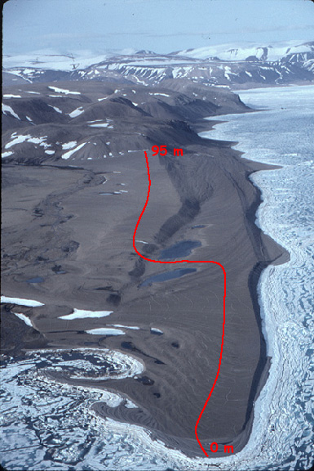
Paleobeach sequence with water bodies
Production and inventory of ¹⁰Be:
unaffected by water bodies,
but affected by snow at sample sites
Production and inventory of ³⁶Cl:
affected by snow at sample sites and around,
by the proximity to water bodies,
and by moisture of the ground

Slide 15
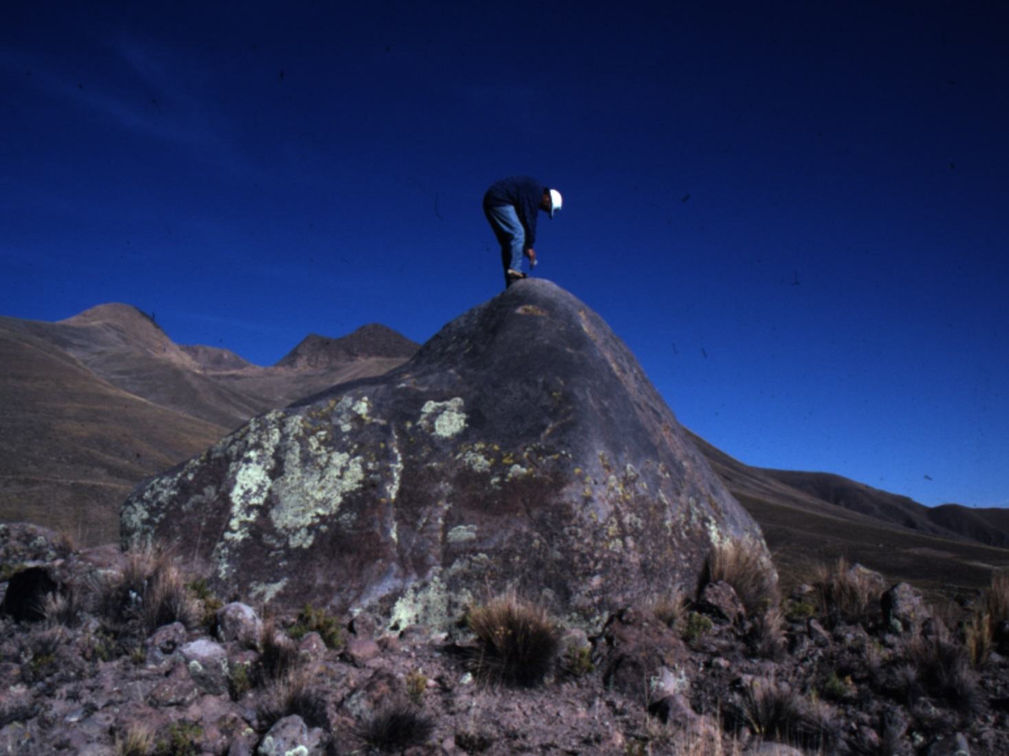
Glacial erratic embedded in moraine matrix
Production and inventory of ¹⁰Be affected by snow on top of boulder
Production and inventory of ³⁶Cl affected by snow on top of boulder, snow around boulder, and soil moisture

Slide 16
It ALL starts here… in space: primary cosmic rays
Secondary cosmic rays
Interactions with matter (e.g., H, N, O, Si, K, Ca, Fe, ...
Cosmogenic isotopes
Low-energy neutrons
in-situ
water
content
studies
Rock dating:
36Cl
14C
10Be
21Ne
other
soil moisture
snow-water equivalent
today
past
surface ages
erosion rates
displacement rates
burial duration
etc...
complications
due to H2O
epithermal
& thermal
neutrons
cosmogenic
Isotopes
???

Slide 17
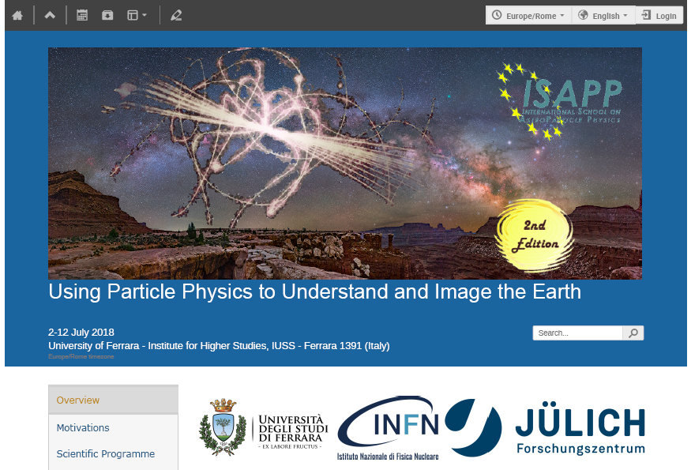
Exploring physics-geology/hydrology connection further
https://indico.cern.ch/event/660892/

