Slide 1
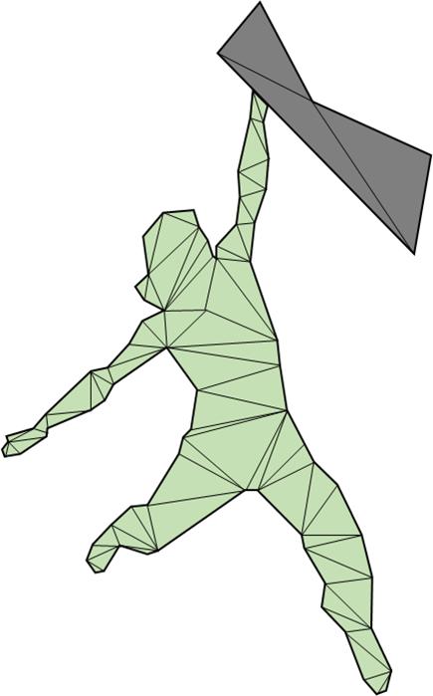
Magnetic Inversion Modelling of Seafloor Massive Sulphides
with a Surface Geometry Mesh
Christopher Galley, Peter Lelièvre, Colin Farquharson, john jamieson
Memorial university of newfoundland
SMS modelling with surface geometry inversion

Slide 2
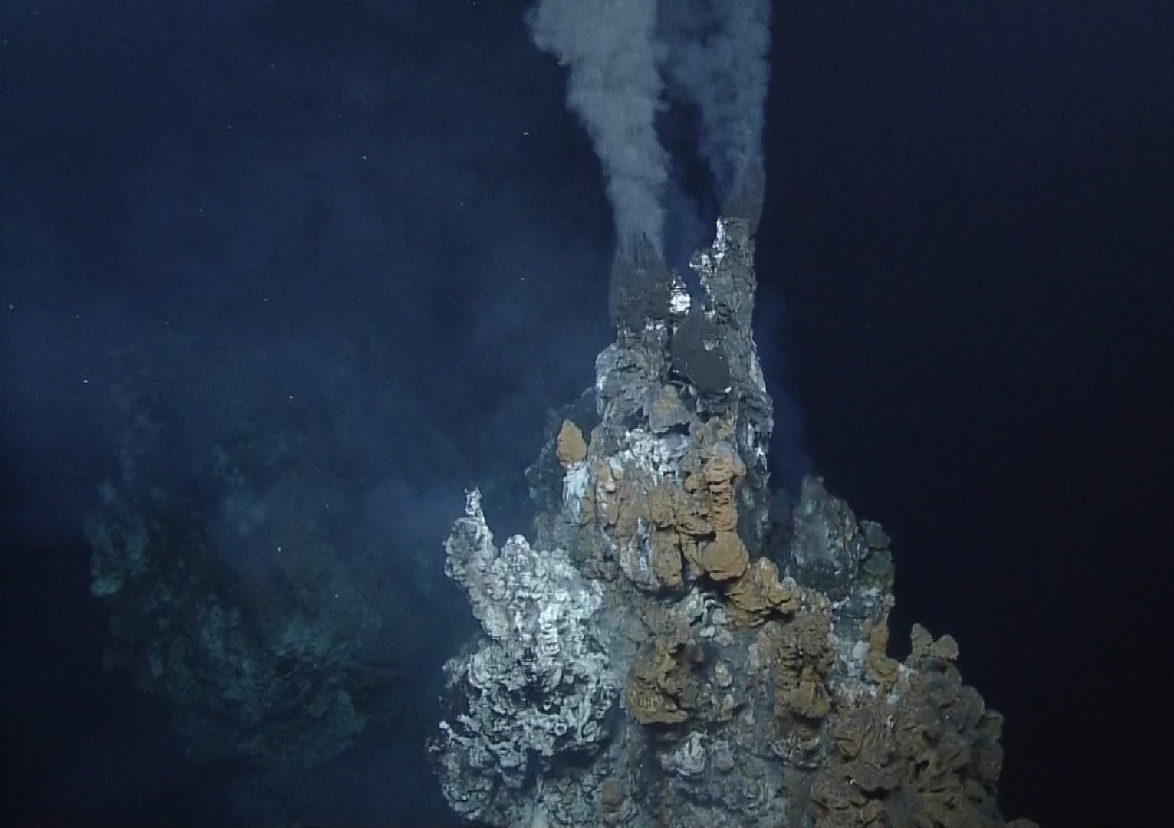
Motivation
Why do we care about seafloor massive sulphide deposit?
Nautilus Minerals
Improving tonnage estimates with surface geometry inversion

Slide 3
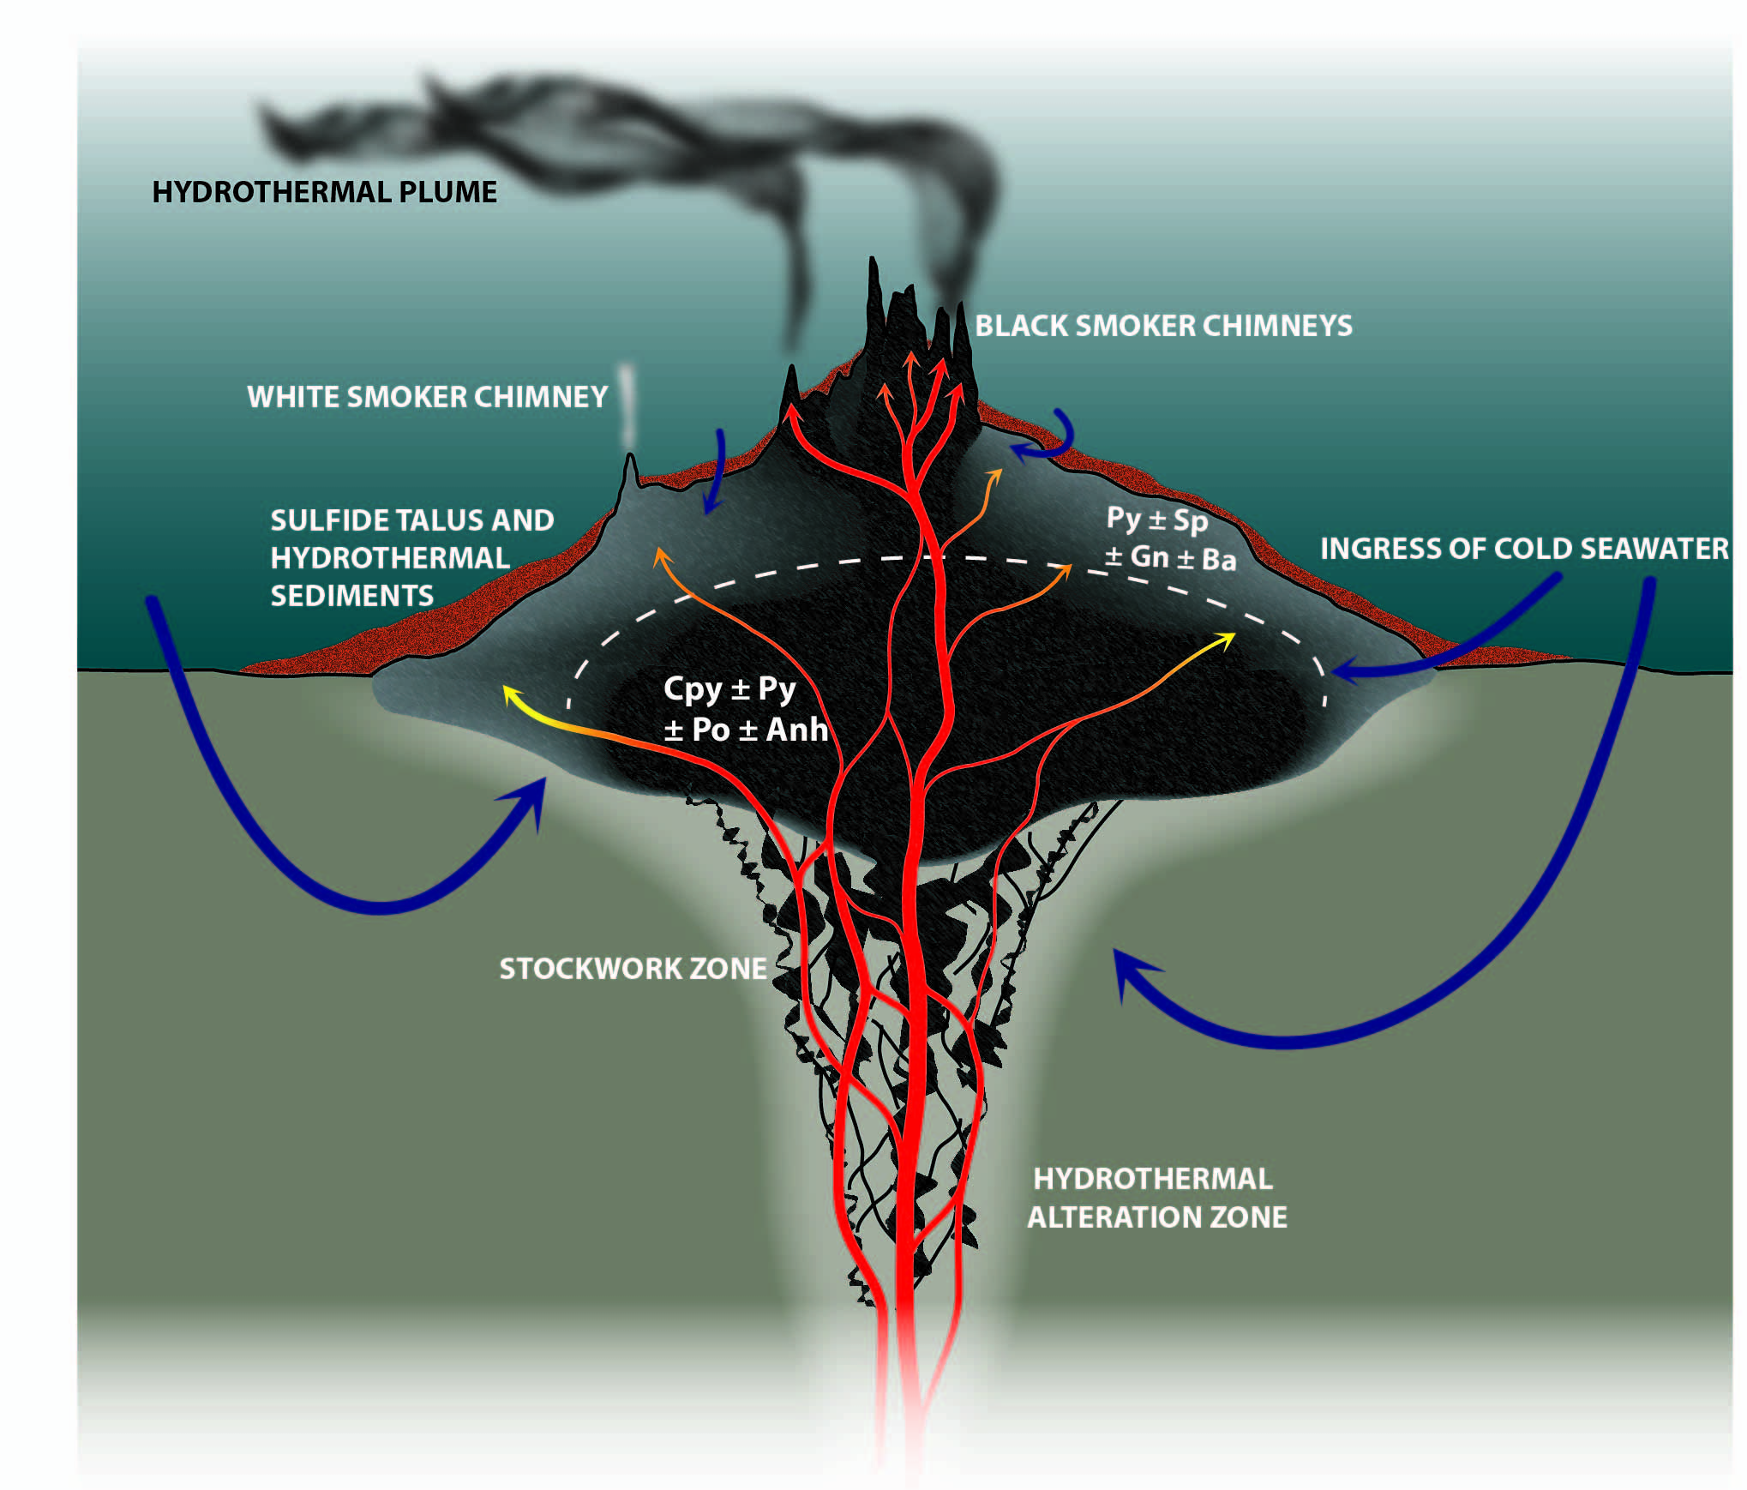
motivation
Grades
Fe 23.6 w.t.%
Zn 11.7 w.t.%
Cu 4.3 w.t.%
Ag 143 ppm
Au 1.2 w.t.%
Herzig & Hannington 1995
Jamieson et. al, 2014
SMS modelling with surface geometry inversion

Slide 4
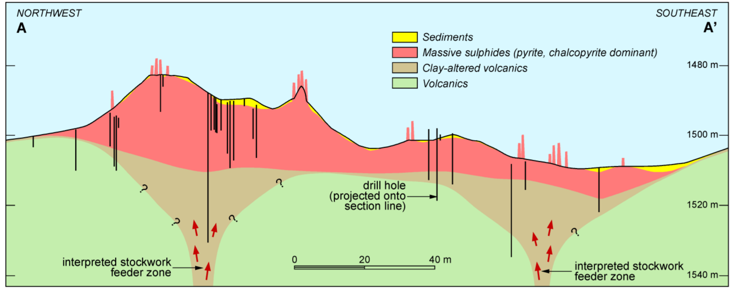
Motivation
Solwara 1, Nautilus Minerals
Improving tonnage estimates with surface geometry inversion

Slide 5
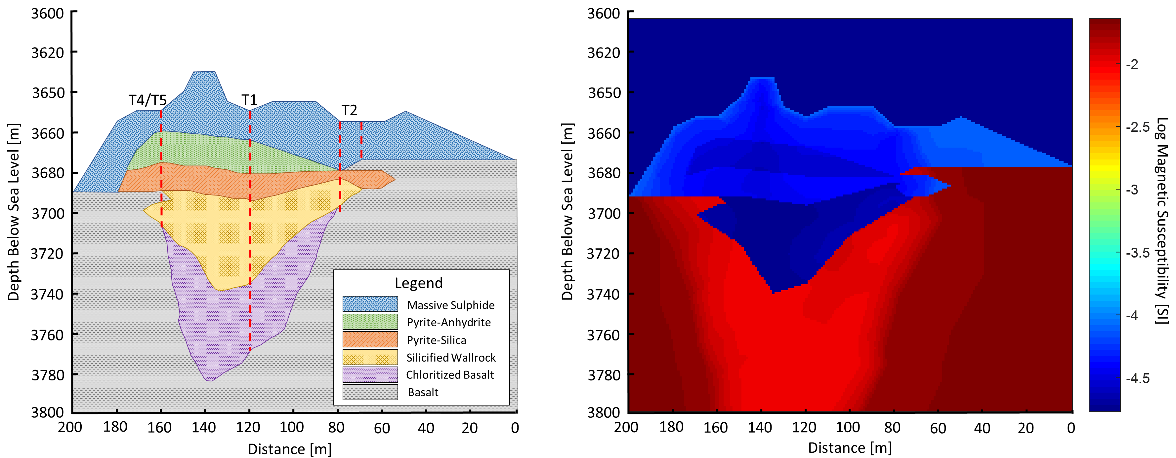
Modelling seafloor massive sulphide deposits
SMS modelling with surface geometry inversion

Slide 6
Modelling seafloor massive sulphide deposits
Water
Massive
Sulphide
Stockwork
Basalt
SMS modelling with surface geometry inversion

Slide 7
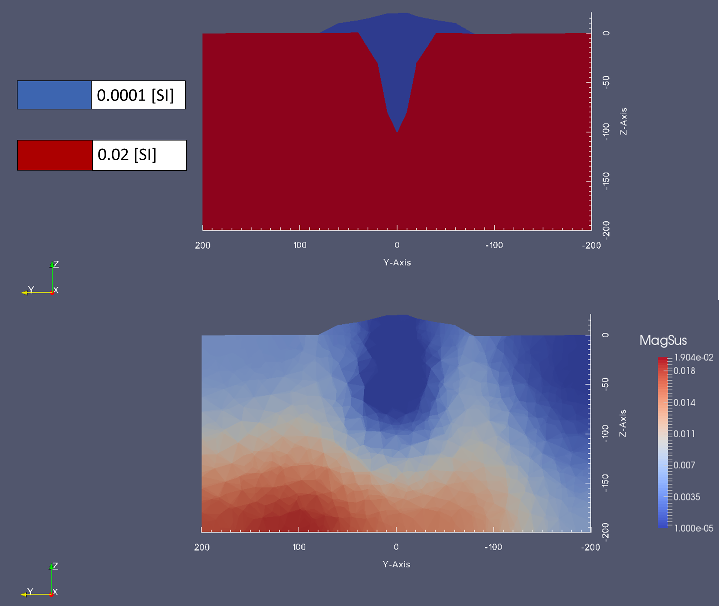
Surface mesh inversion
SMS modelling with surface geometry inversion

Slide 8
Surface mesh inversion
SMS modelling with surface geometry inversion

Slide 9
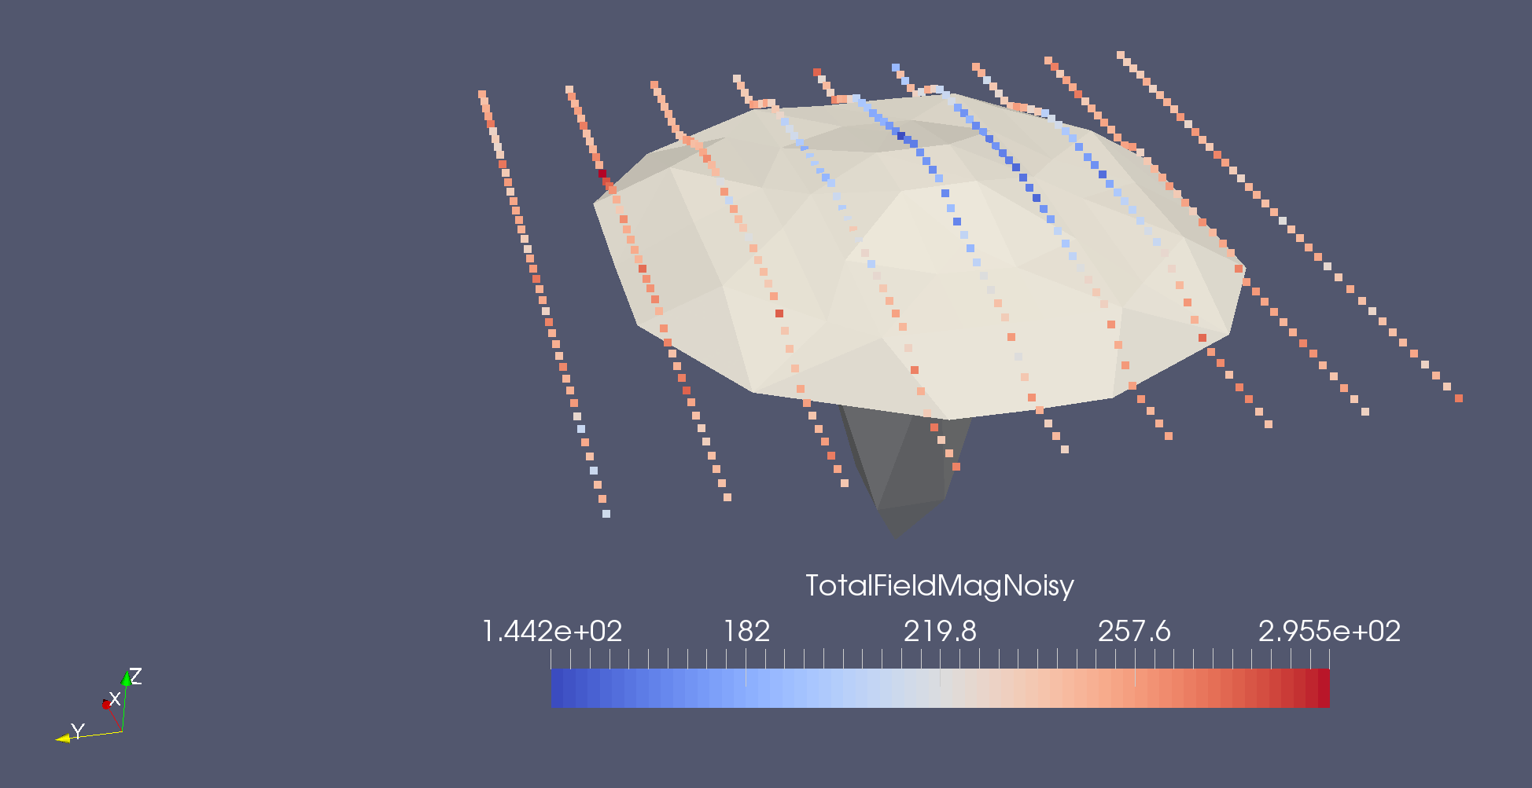
Synthetic Data Generation
Observation Points:
-Constant altitude of 2m
-5% noise
200m
5m
SMS modelling with surface geometry inversion

Slide 10
SMS inversion
Inversion Properties
Massive Sulphide:
0.9393x10⁻⁴ [SI] +/- 5%
Stockwork:
5.383x10⁻³ [SI] +/- 5%
Basalt:
1.889x10⁻² [SI] +/- 5%
True Properties
Massive Sulphide:
1.0x10⁻⁴ [SI]
Stockwork:
5.0x10⁻³ [SI]
Basalt:
2.0x10⁻² [SI]
Massive Sulphide
Stockwork
Basalt
SMS modelling with surface geometry inversion

Slide 11
Sms inversion
Results:
Massive Sulphide:
1.227 Mt+/- (0.1309/0.1139)Mt
Stockwork:
0.1465 Mt +/- (0.0642/0.0505)Mt
True Values:
Massive Sulphide:
1.189 Mt
Stockwork:
0.1940 Mt
Massive Sulphide
Stockwork
Basalt
SMS modelling with surface geometry inversion

Slide 12
Complex target example
Inversion Properties
Massive Sulphide:
0.9393x10⁻⁴ [SI] +/- 5%
Stockwork:
5.383x10⁻³ [SI] +/- 5%
Altered Basalt:
0.960x10⁻² [SI] +/- 5%
Basalt:
1.889x10⁻² [SI] +/- 5%
True Properties
Massive Sulphide:
1.0x10⁻⁴ [SI]
Stockwork:
5.0x10⁻³ [SI]
Altered Basalt:
1.0x10⁻² [SI]
Basalt:
2.0x10⁻² [SI]
SMS modelling with surface geometry inversion

Slide 13
Complex target example
Results:
Massive Sulphide:
1.222 Mt +/- (0.119/0.105) Mt
Stockwork:
0.1932 Mt +/- (0.0489/0.0477) Mt
True Values:
Massive Sulphide:
1.1845 Mt
Stockwork:
0.1933 Mt
Results:
Massive Sulphide:
0.2279 Mt +/- (0.1701/0.1203) Mt
Stockwork:
0.1956 Mt +/- (0.0740/0.0629) Mt
True Values:
Massive Sulphide:
0.3252 Mt
Stockwork:
0.2483Mt
SMS modelling with surface geometry inversion

Slide 14
conclusion
Magnetic inversion with surface meshes provide an effective tool for modelling the sub-surface geometry of SMS deposits.
Some prior information is needed, but much more efficient than extensive drilling.
SMS modelling with surface geometry inversion

Slide 15
Questions?
SMS modelling with surface geometry inversion

