Slide 1
The menace of flood in the Benue Trough Nigeria, West Africa:
2017 Floods and vulnerability analysis
Mercy Ayima Ade (PhD. Research student) Email:1523526@chester.ac.uk
Supervisors: Prof Roy Alexander; Dr Servel Miller; Dr Andrew Miles; Dr Martin Evans

Slide 2
1. Introduction
Floods pose tremendous danger to people’s lives and properties. Globally, they cause about one third of all deaths, injuries and damage associated with natural disasters (Askew, 1999). In Nigeria flooding has forced millions of people from their homes, destroyed businesses, polluted water resources and increased the risk of diseases (NEMA, 2012a, Baiye, 1988; Akinyemi, 1990; Nwaubani, 1991; Edward-Adebiyi, 1997).
In 2012, the country experienced its worst floods in 80 years (NEMA, 2012b; ngrguardiannews.com). Four states within the Benue Trough, Adamawa, Kogi, Benue and Taraba, were the worst affected. About 3,891,314 people were directly affected, 363 people died and 3,871,530 displaced (NEMA, 2012a). The 2012 event brought into focus the impact floods can have not just regionally but also nationally, for example in creating refugee communities (Internally Displaced People) and food insecurity (Ian, 2010).

Slide 3
As such, it would be expected that significant progress and mitigation strategies to prevent future flood related disasters would be high on the government agenda. However, this seems not to be the case as, in 2017, a smaller flood event resulted in even more widespread displacement in same states affected in 2012. According to Leary, et al., (2009), these states have some of the highest levels of vulnerability and thus, when a flood event occurs there is a high probability of its impact being exacerbated leading to disasters.
It is evident that it was not only the magnitude of the flood events that led to such disasters in 2012 and 2017, but also the combination of increased vulnerability, poor response at a national and local level, lack of preparedness, lack of understanding of the risk and overall poor governance. Vulnerability in the context of this research is a degree of damage to a certain objects at risk of flooding (United Nations,1982)(2007). This research examines the 2017 flood event in the Makurdi area of the Benue trough (Figure 1), focusing on its impact, an evaluation of vulnerability and assessment of the response at both a regional and local level.

Slide 4
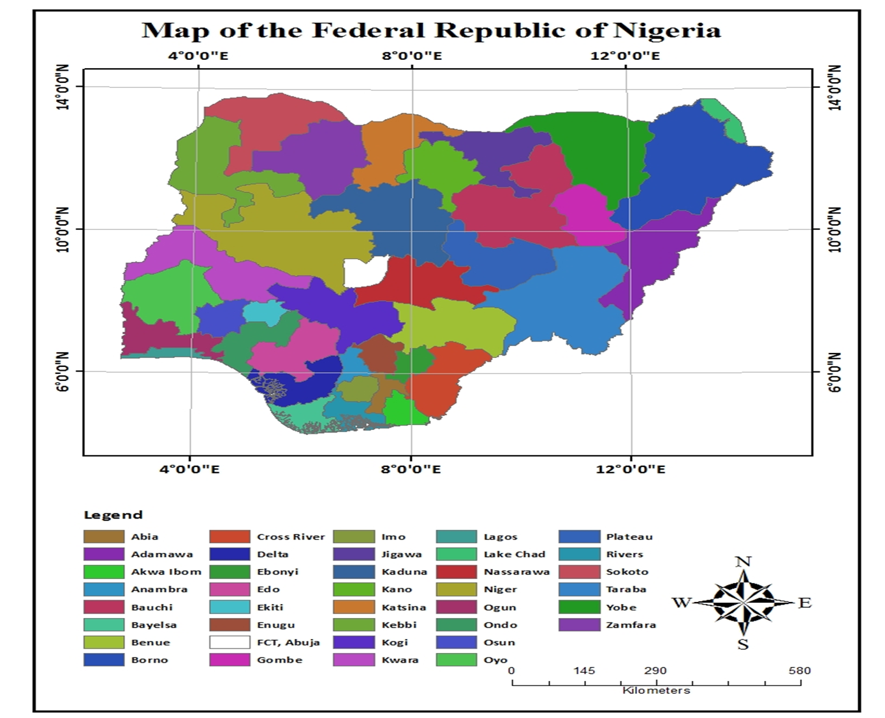

Slide 5
2. Methodology
A range of methods were used to gather data from regional to community scales. Land-use and flood extent data were extracted from Landsat imagery using image classification in ArcGIS. To gain a better understanding of impact, flood depth, financial and property losses, damage to buildings, level of vulnerability and flood response at a local level, questionnaire surveys were undertaken. A stratified random sampling strategy was employed, with individual householders and stakeholders (e.g. Chiefs, Red Cross personnel, emergency managers, hydrologists, farmers) being approached (Figure 2a, 2b), when the opportunity presented itself. GPS and GIS were utilised to map flood damage, floodwater depth and inundation (Figure 3). Visits were made to IDP camps after duly acquiring ethical approval. The data was used to conduct impact analysis, to produce flood depth/damage curves and to examine the spatial distribution of hazard and risk.

Slide 6
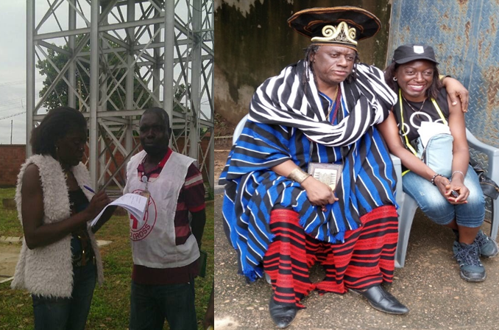

Slide 7
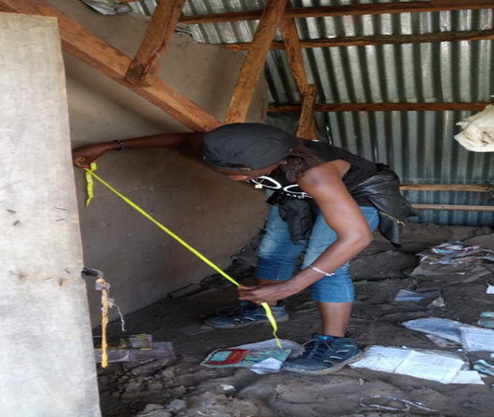
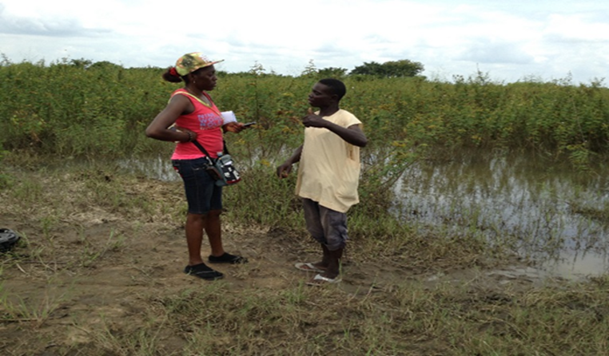

Slide 8
3. Results
The 2017 event had widespread impact throughout Benue state. It was not only associated with riverine flooding, but also, surface water, paleo-channels, canals and blocked drains. Flood inundation occurred up to 8km from the main river Benue bank, with some of the deepest flood water occurring inland around canals and paleo channels (Figure 4). The impact varied from significant damage to buildings (Figure 5), infrastructure (Figure 6) and agriculture, to the loss of property, contamination of local drinking water sources (Figure 7) and extensive displacement of residents with the resultant creation of IDP camps (Figure 8)

Slide 9
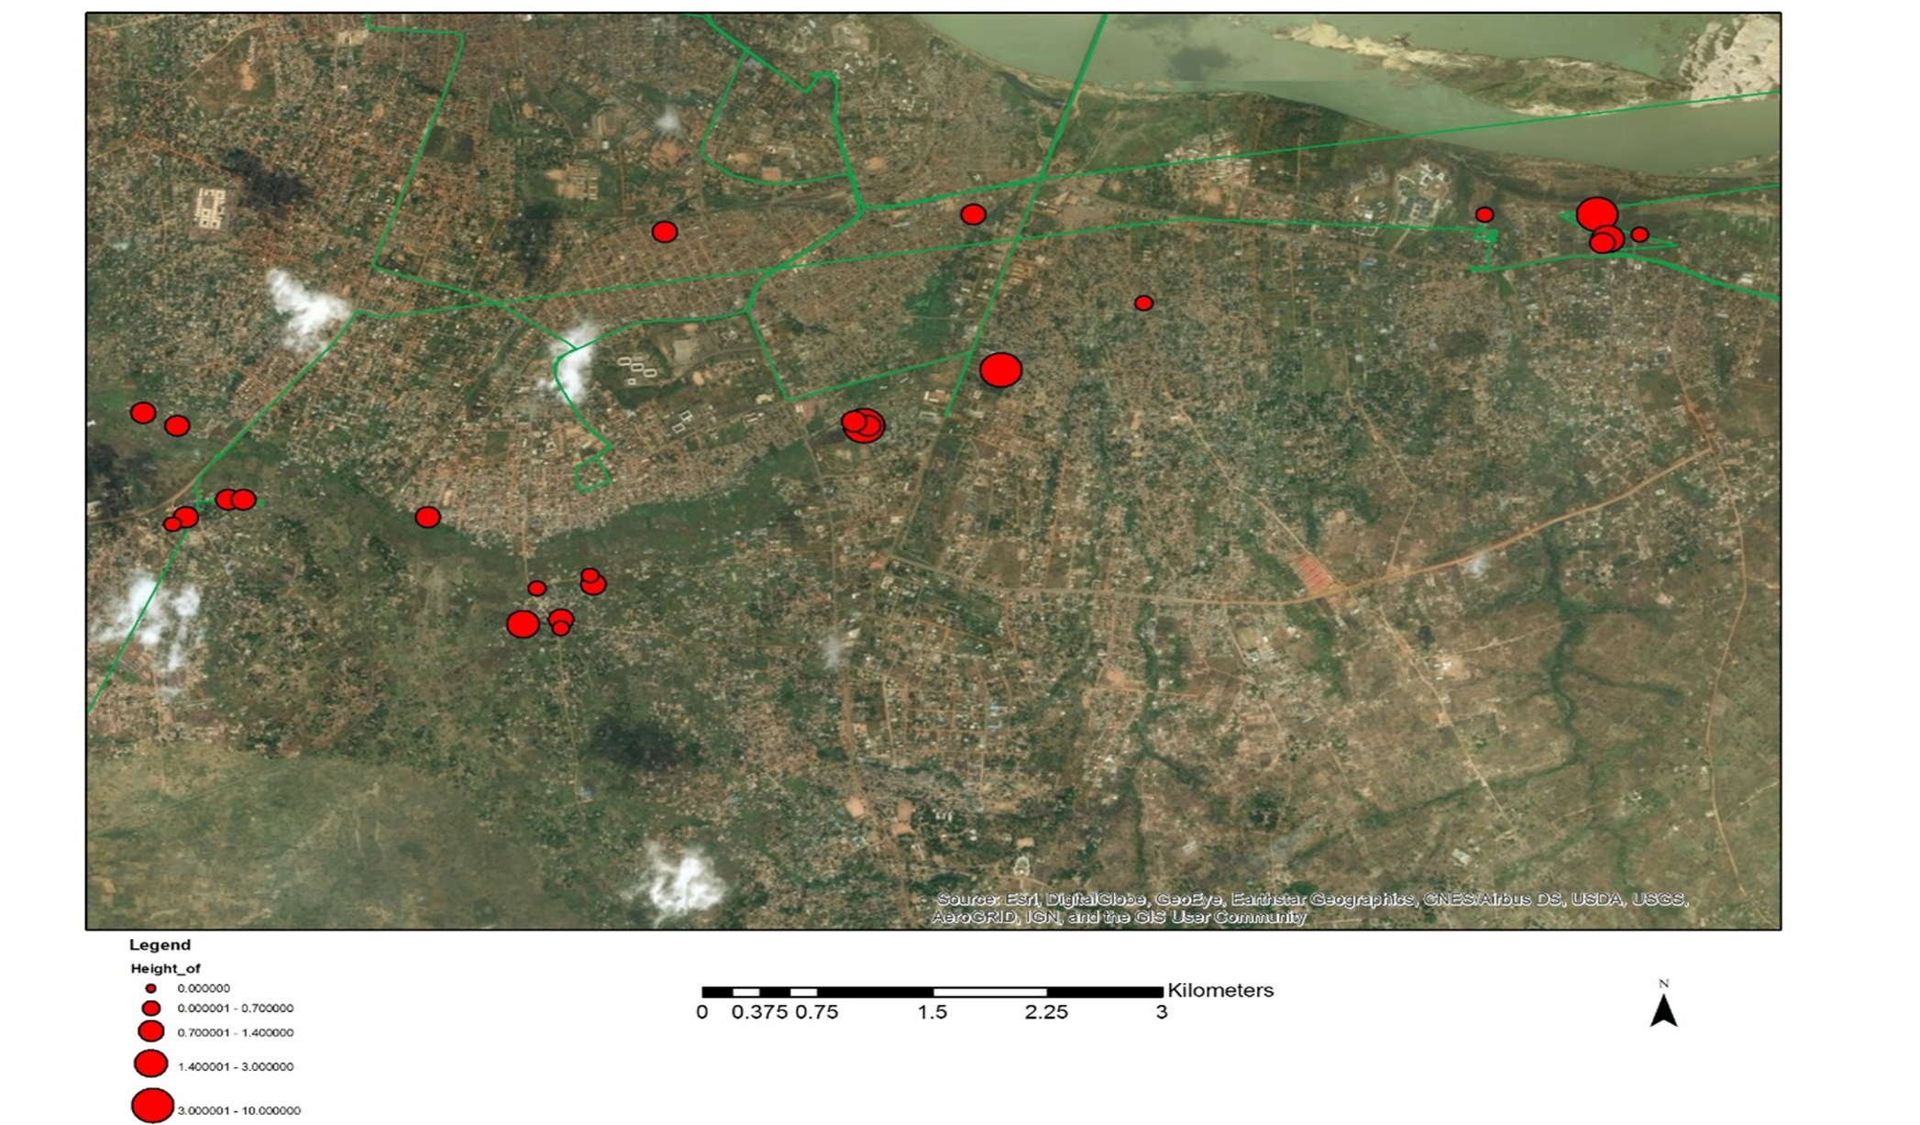

Slide 10
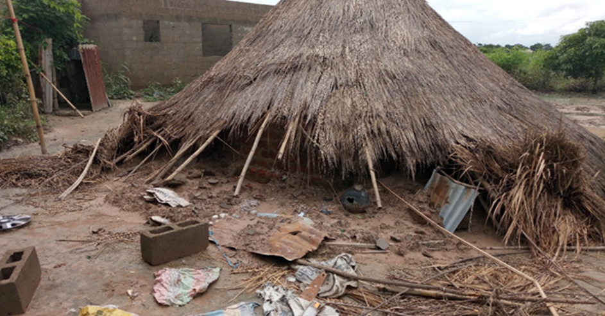

Slide 11
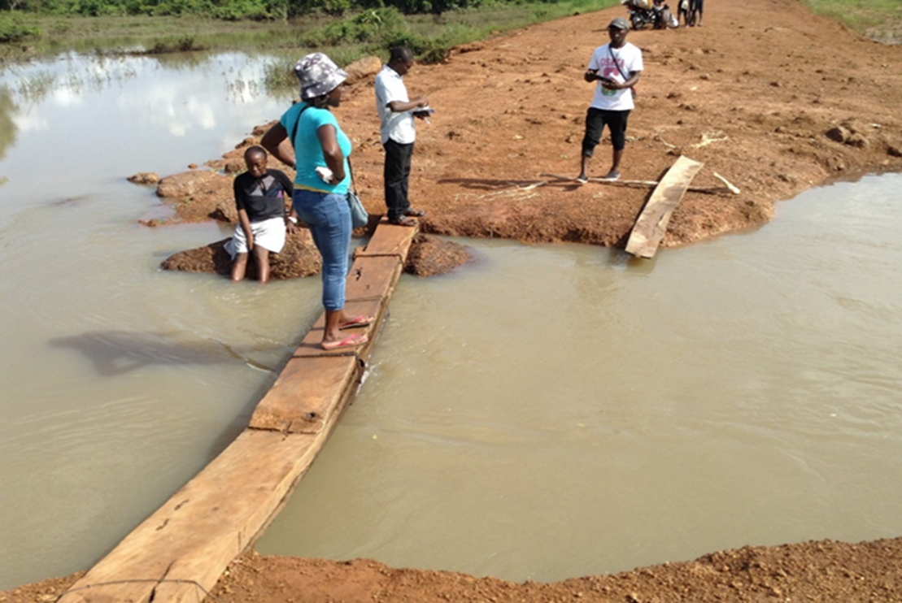
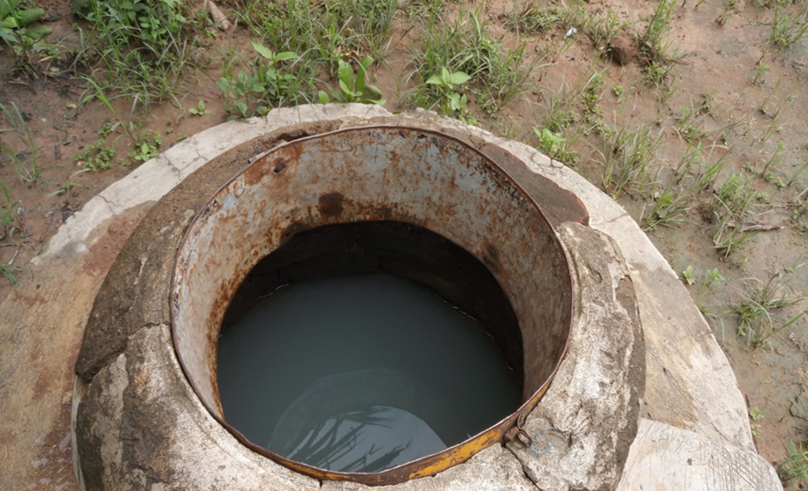

Slide 12
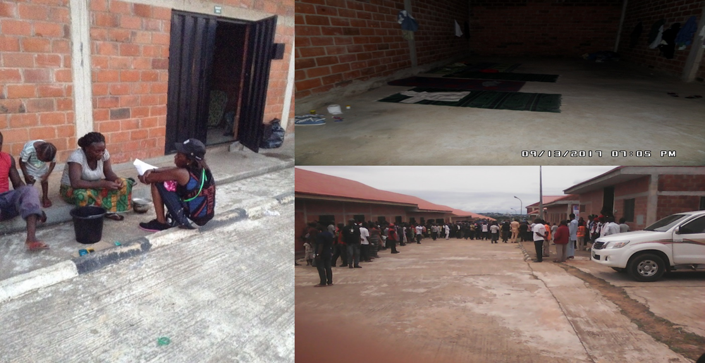

Slide 13
Results Contd.
Analysis of the building and property loss data collected through a combination of questionnaires and geospatial mapping indicates that economic losses were mostly associated with new built flats and duplexes (Figure 9 and 10). This was mainly due to cost of these modern buildings and more affluent occupants. On the other hand, in terms of ‘Total building losses’, huts were most vulnerable as they were not able to withstand the flood waters with supporting structure collapsing (Figure 5). Evaluation of building and content losses and associated flood depth allowed the development of flood depth damage curves (Figure 11 and 12). Flood depth curves showed the relationship between flood water depth and financial losses associated with damaged to both buildings and content These flood depth curves are valuable tools that can be used by decision makers (planners, developers, insurance companies) to gain a better understanding of how flood water impacts on the built environment and how to reduce negative consequences.

Slide 14
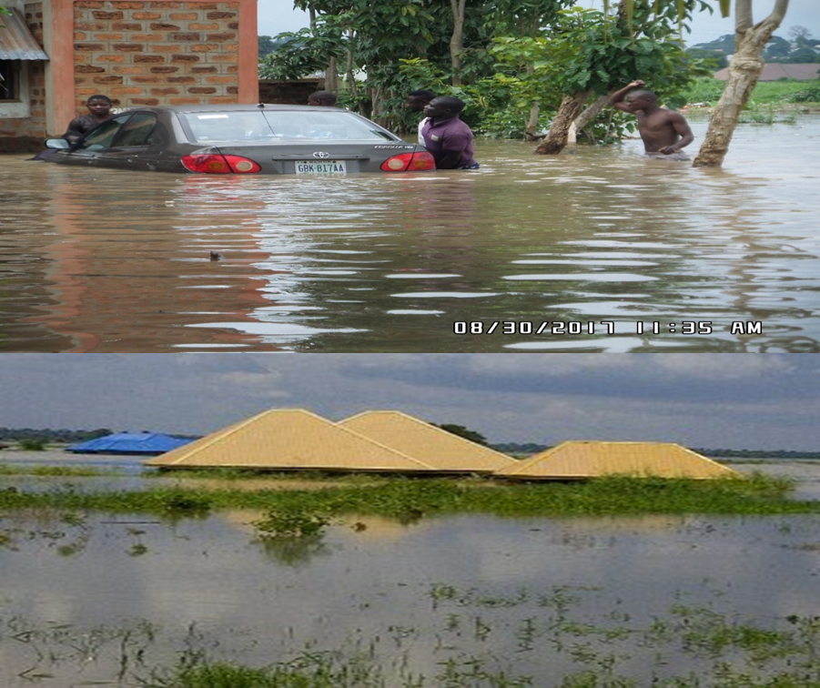
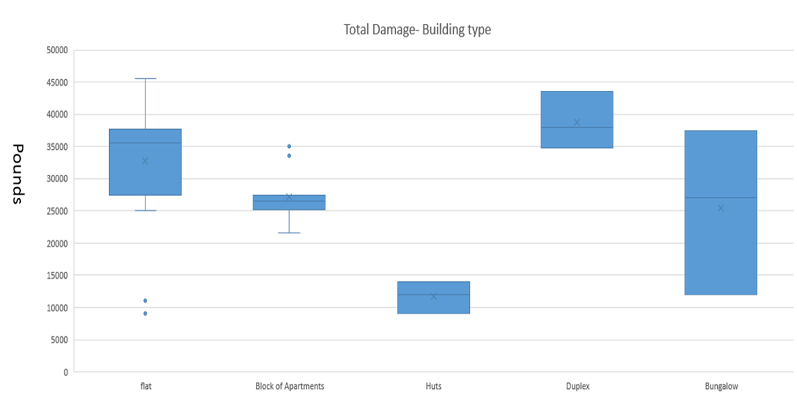

Slide 15
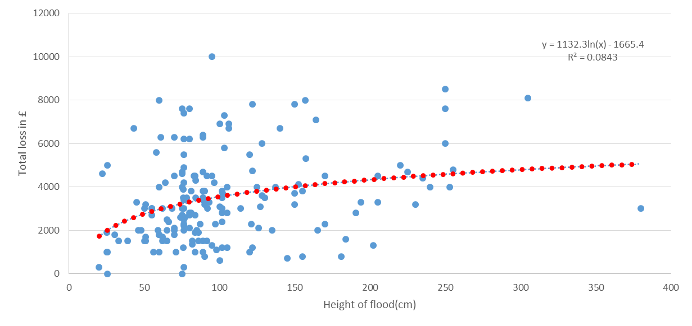
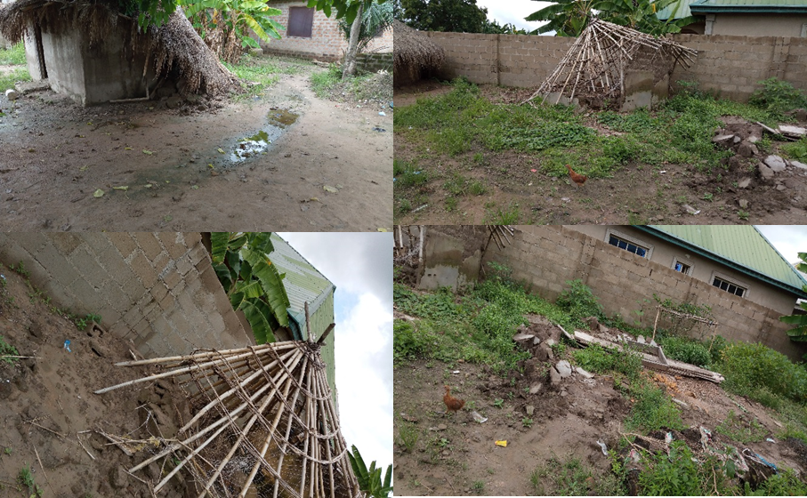

Slide 16
4. Challenges-Flood management
Competing use for land- including development of flood plain for agriculture, housing, infrastructure, how do we manage these competing needs?
Building and cultivation on floodplain or restricted area
Non adherence to building codes and approvals
Better flood zonation and strategies on how best to get residents to vacate floodplains
Blockage of water drainage ways/waste management needs urgent attention and plans to address

Slide 17
Strengthening of environmental laws and town planning guidelines/restrictions.
Increased sensitization of communities from National Emergency Management Agency, National Orientation Agency, and other relevant agencies.
Reducing poverty and social vulnerability
Development of more resistant and resilient infrastructure
Building institutional capacity at a local level to address flooding
Bilateral agreement with countries traversed by the Benue river, include building and management of dams (that contribute to flooding) is urgently needed

Slide 18
Dredging of major rivers
Reduction of siltation associated with land degradation

Slide 19
5. Conclusions
Flooding was from multiple sources including riverine, surface water, minor canals and poor drainage. The study also showed that flooding is a significant problem; response has been slow at best, lacking in most cases and there is reluctance from stakeholders to participate in the recovery and rehabilitation exercises. Pluvial floods are becoming an increasing problem in the Benue Trough and have more long-term implications as very limited response to the disaster was provided. Most of the places from where people were displaced in 2017 were inland areas.
In addition, the quality of human settlements, housing type and construction, infrastructure, and lifelines in the affected communities were of poor quality, leading to high levels of vulnerability (social and physical) which needs urgent attention.

Slide 20
Conclusion Cont.
The poor response to IDPs (lack of adequate food, more shelters, lack of protection of vulnerable groups e.g. girls and mothers, relocation of flood victims) highlight the lack of adequate DRR planning and poor level of governance, which need urgent attention. Thus it is critical to gain a full understanding of the ‘construct’ of risk (exposure, hazard, coping capacity, vulnerability) in order to better inform the development of strategies towards long-term Disaster Risk Reduction (DRR) (Sendai, 2015). The damage observed is enormous and a large number of residents are highly exposed as evidenced in the results.
It is envisaged that some of the findings will be made available to stakeholders to aid in their decision-making processes.

Slide 21
References
Akinyemi, T., 1990. Stemming the Tide of Lagos Floods, in: The Guardian, Friday, July 20, pp: 7.
Askew, A. J. (1999). Water in the International Decade for Natural Disaster Reduction. In Leavesley et al. (Eds.), Destructive Water: Water-Caused Natural Disaster, their Abatement and Control IAHS Publication No.239.
Baiye, E., 1988. Numan in the Throes of Floods, in: The Guardian, Thursday, October 8, pp: 9.
Cyriacus C.M (2015) Geospatial analysis of land suitability for upland rice farming in Gwagwalada Area Council, Nigeria. University of Abuja Press
Edward-Adebiyi, R., 1997. The Story of Ogunpa, in: The Guardian, Saturday, May 17, pp: 5.
Leary N, Conde C,Jyoti K, Nyong A and Pulhin J, (2009). Climate Change and Vulnerability. Earthscan climate, London
National Emergency Management Agency, Annual Report 2012a
Nigeria Post Disaster Needs Assessment (PDNA) 2012b Floods:A report by the Federal Government of Nigeria. With technical support from the European Union, United Nations, World Bank and other Partners. (May 2013)
Nwaubani, C., 1991. Ogunpa River Leaves Bitter Aftertaste in Tragic Course through Abeokuta; in: The Guardian, October 21, pp: 9.

Slide 22
References Cont.
Pattison Ian, (2010) Rural land management impacts on catchment scale flood risk. Durham Theses, E-theses online: http//etheses.dur.ac.uk/531/
Sendai Framework for Disaster Risk Reduction (2015) http://www.unisdr.org/we/coordinate/sendai-framework
United Nations NY (1982) Proceedings of the seminars on flood vulnerability analysis and on the principles of floodplain Management for flood loss prevention. Bangkok
United Nations Framework Convention on Climate Change. (2007). Climate Change: Impacts, Vulnerabilities and Adaptation, In Developing Countries. Bonn.

