Slide 1
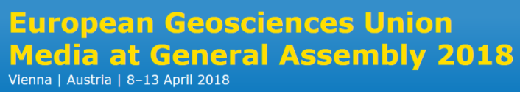


Factors controlling distribution of methylmercury in temperate reservoirs ecosystem in South Korea
Seam Noh^{a,b}, Younghee Kimª, Hyuk Kimª, Seok-min Yuª, Kwang-su Parkª, Kwang-seol Seokª, and Seunghee Han^{b,*}
ªNational Institute of Environmental Research
^{b}Gwangju Institute of Science and Technology

Slide 2
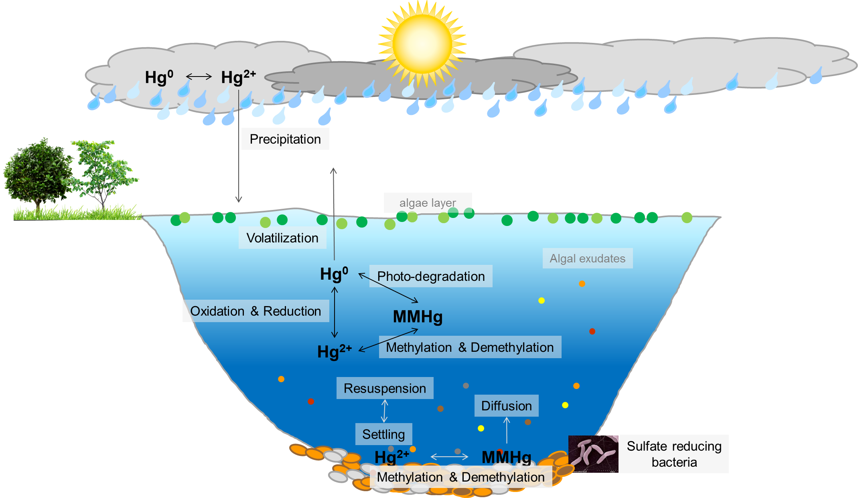
Mercury cycle in lake ecosystem
Research interest
Notes:
This is a simplified diagram of the mercury cycle in a lake ecosystem.
We currently have a limited understanding of the effects of biogeochemical factors on the MMHg distribution in lakes, although individual factors affecting the MMHg distribution have been reported.

Slide 3
Overall objectives
Objectives
To identify the major environmental biogeochemical factors that predict the MMHg distribution in lake ecosystems
To investigate how the composition of dissolved organic matter (DOM) affects the MMHg distribution in lake ecosystems
Notes:
The aim of this study was to identify the major environmental biogeochemical factors that predict the MMHg distribution in lake ecosystems.
Also, we wanted to investigate how the composition of dissolved organic matter affects the MMHg distribution in lake ecosystems.
For this purpose, I conducted two procedures.

Slide 4
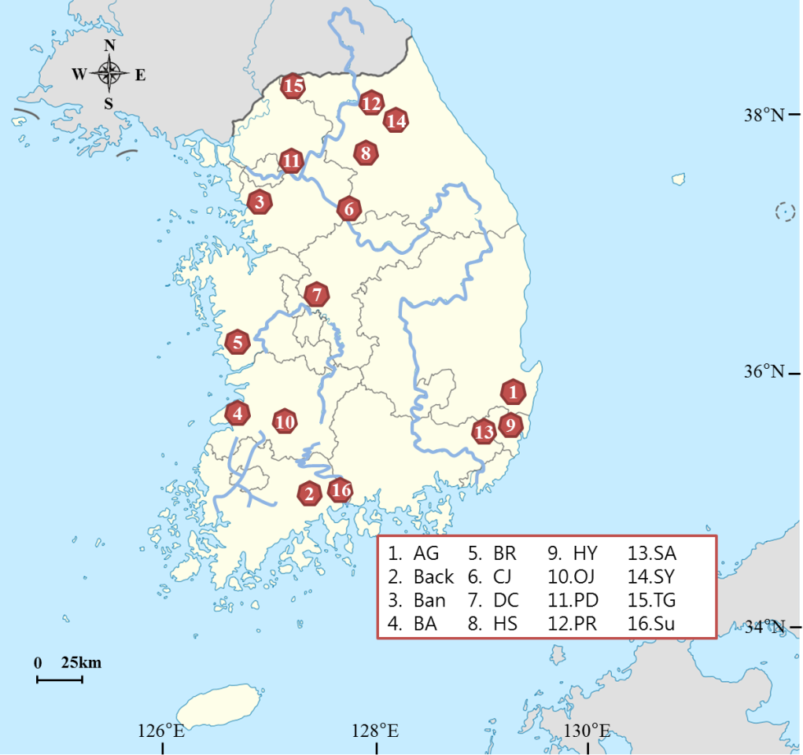
Overall method
Overall method
Duration: 2013-2015
Samples: water (81 ea)
Study area: 16 reservoirs across Korea
Season: Jun. ~ Oct. (summer ~ fall)
Hg and MMHg (unfiltered and filtered water)
Physical: basin area, surface area, depth, water residence time, land use, rainfall
Chemical: pH, cond., SPM, chl-a, DOM, nutrient
Using statistical tools:
Task1 –Pearson’s, PCA, MRA
Task2 –PARAFAC
Notes:
From 2013 to 2015, we collected 0.5-m-deep surface water samples from 16 reservoirs across Korea in the summer and fall.
We measured various geochemical parameters and used different statistical and modeling tools to analyze the data.

Slide 5
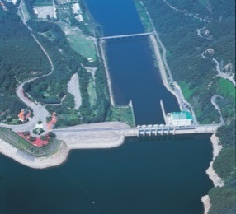
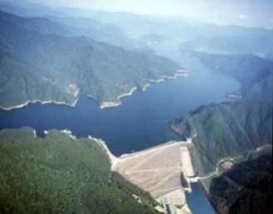
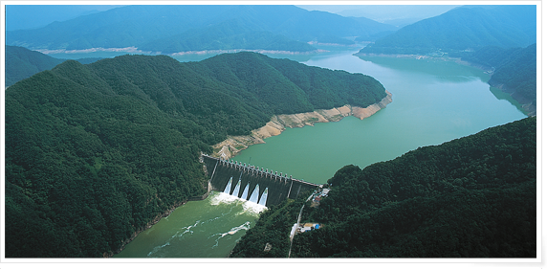
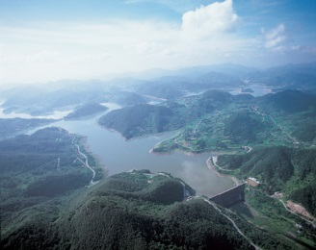
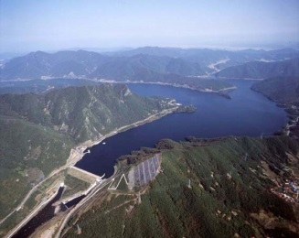
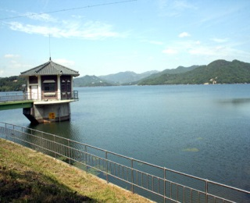
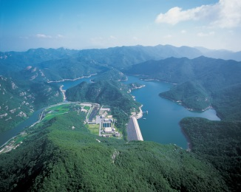
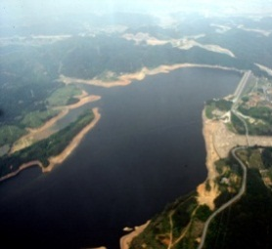
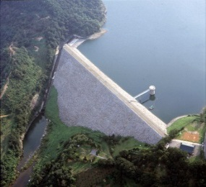
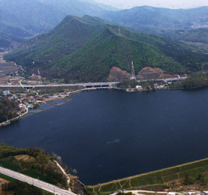
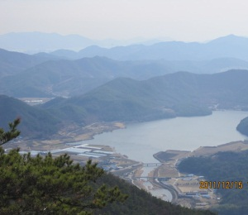
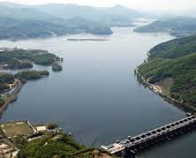
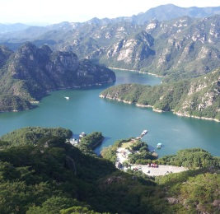
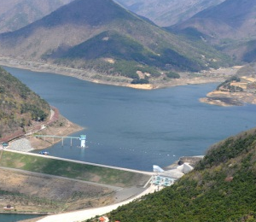
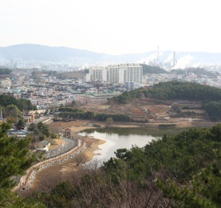
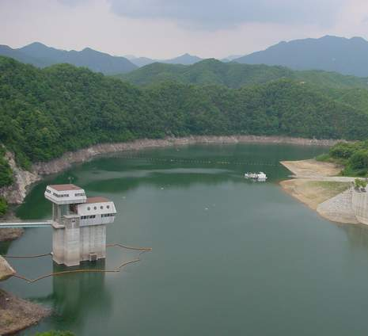
Overall method
Daecheong (1981) | Soyang (1973) | Paro (1944) | Okjeong (1965) | Boryeong (1996) | Togyo (1976) | Buan (1996) | Hoeya (1986)
Forest: 66% Agricul: 15% Urban:17% | Forest: 80% Agricul:4.1% Urban:14% | Forest: 79% Agricul:8.0% Urban:9.9% | Forest: 64% Agricul:13% Urban:23% | Forest: 80% Agricul:11% Urban:6.6% | Forest: 42% Agricul:39% Urban:15% | Forest: 89% Agricul:2.8% Urban:6.8% | Forest: 67% Agricul:19% Urban:8.7%
Sueo (1978) | Banwol (1957) | Baekun (1967) | Paldang (1973) | Chungju (1985) | Angye (1971) | Seonam (1962) | Hoengseong (2000)
Forest: 87% Agricul:8.0% Urban:3.2% | Forest: 18% Agricul: 43% Urban: 39% | Forest: 8.2% Agricul:86% Urban:5.3% | Forest: 25% Agricul:60% Urban:15% | Forest: 10% Agricul:81% Urban:9.0% | Forest: 18% Agricul:57% Urban:25% | Forest: 7.5% Agricul:53% Urban:39% | Forest: 12% Agricul:80% Urban:8.0%
Notes:
The 16 reservoirs are located far from a large river, and industrial areas within generally forested catchments that do not contain wetlands.

Slide 6
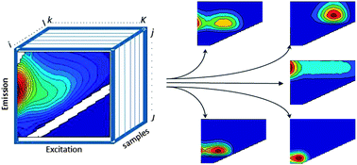
Statistical tools
Hydrologic factors
rainfall
Chemistry factors
Cond.
pH
Basin area
Lake area
Water residence time
SPM
Chl-a
DOC
Sulfate
Depth
Quality of DOM
Microbial
humic-like
Terrestrial
humic-like
Protein-like
MMHg variation
PCA
MRA
PARAFAC
Pearson’s
Principal Component Analysis
Multiple Regression Analysis
PARAllel FACtor analysis
*excitation emission matrix (EEM) spectroscopy
Notes:
The MMHg concentration, morphometrics, water quality information, and composition of DOM were analyzed to see how these physicochemical factors relate to the MMHg distribution in reservoir surface waters.
Multiple tools, including Pearson’s correlation, principal component analysis, multiple regression analysis, and PARAllel FACtor, or PARAFAC, analysis were applied in the statistical modeling.
Specially, PARAFAC is used to interpret natural organic matter fluorescence when measured using excitation emission matrix spectroscopy.
PARAFAC resolves overlapping fluorescence signals into independent spectra representing different chemical components.

Slide 7
Overall result
 | UHg | DHg | UMMHg | DMMHg | UMMHg | DMMHg
 | ng/L |  | pg/L |  | %
AVE | 0.41±0.23 | 0.23±0.10 | 30±32 | 11±6.7 | 9.0±10 | 6.5±7.4
Min | 0.07 | 0.038 | 3.3 | 2.5 | 0.86 | 0.68
Max | 1.2 | 0.55 | 169 | 41 | 49 | 46
 | pH | SPM | Chl-a | DOC | SO4 | NO3
 |  | mg/L | µg/L | mg/L
AVE | 7.8±0.68 | 4.9±8.1 | 8.9±22 | 2.3±0.85 | 14±14 | 4.1±1.7
Min | 5.8 | 0.77 | 0.088 | 1.0 | 2.9 | 1.2
Max | 9.4 | 52 | 124 | 4.8 | 70 | 10
Notes:
The concentration of unfiltered MMHg averaged 30 pg/L (0.15 pM) and ranged from 3.3 to 169 pg/L.

Slide 8
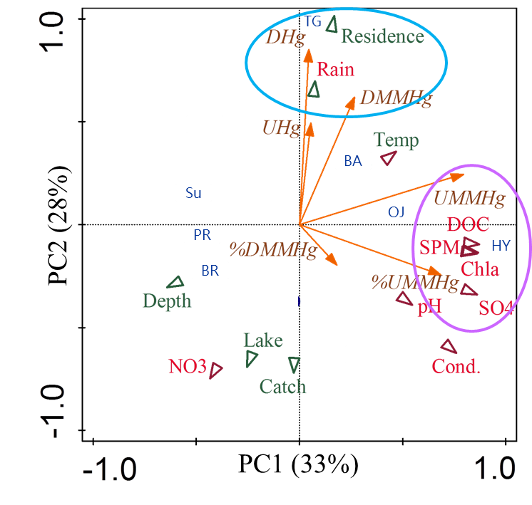
Task 1
UHg: unfiltered THg
DHg: dissolved THg
UMMHg: unfiltered MMHg
DMMHg: disoolved MMHg
%UMMHg: UMMHg/UHg x 100
%DMMHg: DMMHg/DHg x 100
Chl-a: chlorophyll-a
SPM: suspended particulate matter
DOC: dissolved organic carbon
Rain: rainfall
Residence : residence time
Depth: maximum depth
Lake: reservoir area
Catch: catchment area
PC: principal component
Notes:
This is the PCA result.
The highest positive loading on PC1 was found for strong correlations between DOC and suspended particulate matter, chl-a, and sulfate.
This implies that the origin of the DOC is associated with algal biomass rather than watershed runoff.
The UMMHg and %UMMHg were strongly correlated with DOC and SPM, chl-a, and sulfate.
Algal blooms appeared to generate good conditions for microbial Hg methylation.
In China, eutrophic reservoirs have shown increased MMHg concentrations, along with low dissolved oxygen conditions, during the decay of an algal bloom.

Slide 9
Task 1
Rotated principal component matrix
 | Factor
 | F1 (algal biomass) | F2 (hydrologic) | F3 (rainfall)
rainfall | 0.017 | 0.029 | 0.93
residence | -0.12 | -0.26 | 0.83
basin | -0.050 | 0.85 | -0.23
lake | -0.026 | 0.92 | -0.26
depth | -0.41 | 0.69 | -0.52
Temp | 0.46 | -0.64 | -0.25
Cond | 0.94 | -0.074 | -0.13
pH | 0.78 | 0.21 | 0.18
SPM | 0.88 | -0.15 | 0.087
Chla | 0.87 | -0.15 | 0.061
SO₄ | 0.93 | -0.22 | -0.024
NO₃ | -0.25 | 0.29 | -0.83
DOC | 0.87 | -0.37 | 0.13
Loading (%) | 40 | 22 | 22
The rotation was conducted using the Varimax method, with 0.41 Kaiser normalization value.
Notes:
PCA analysis generated three factors with geochemical variables by grouping the correlated parameters.
Factor 1 was consistent with algal biomass.
Factor 2 was consistent with hydrologic factors.
Factor 3 was positively influenced by rainfall and residence time.

Slide 10
Task 1
Regression equation | r²_{adj} | p
UHg
0.75 + 0.16*F2 + 0.13*F3 | 0.24 | 0.045
DHg
0.31 +0.084*F3 | 0.29 | 0.001
UMMHg
0.037 +0.022*F1 + 0.011*F3 | 0.48 | 0.024
DMMHg
0.012 + 0.0040*F3 | 0.23 | 0.004
%UMMHg
5.7 + 2.7*F1 | 0.37 | 0.001
F1: algal biomass, F2: hydrologic, F3: rainfall
Notes:
These three factors were then included as independent variables in a multiple linear regression analysis.
The algal biomass factor explained 37% of the variance in the %UMMHg.

Slide 11
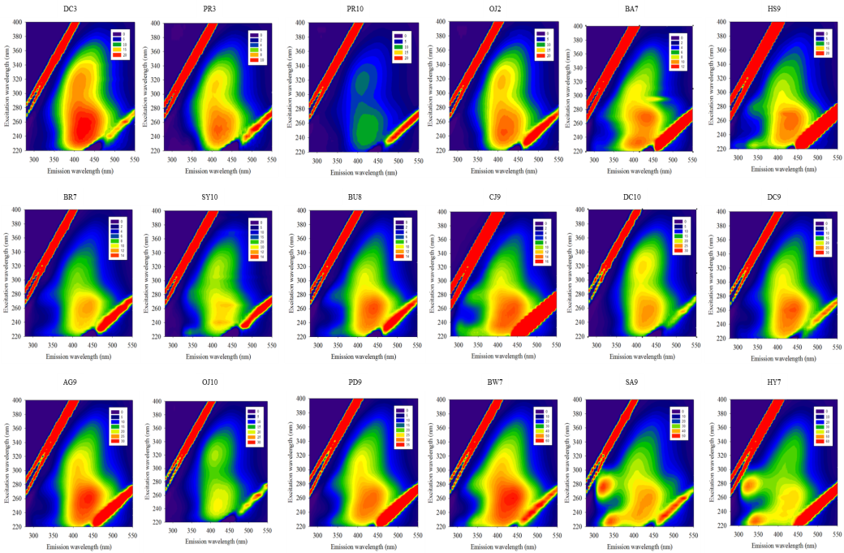
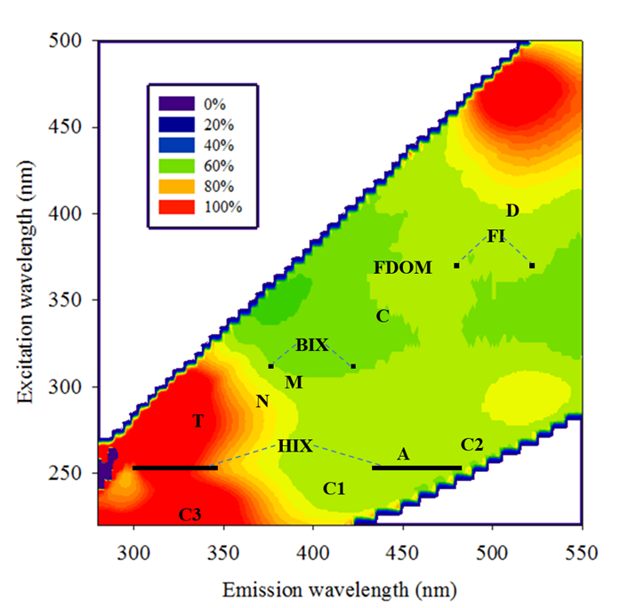
Task 2
A
Composition | Sources and characteristics | Composition | Sources and characteristics
C1 | microbial humic | N | algal derived DOM
C2 | terrestrial humic | T | “protein-like” DOM
C3 | protein-like, autochthonous | FDOM | “quinoid-like” humic DOM
A | “humic-like” DOM | HIX | sorption capacity; C:O and C:N, carboxyl content
C | “humic-like” DOM | BIX | microbially produced DOM
D | soil “fulvic-like” DOM | FI | terrestrial and microbial sources to the DOM pool
B
Notes:
Figure A shows examples of the fluorescence EEM across all the reservoir samples.
Figure B is the relative standard deviation of DOM-normalized fluorescence intensities across all the reservoir samples.
The PARAFAC model identified three components of DOM: microbial humic-like (C1), terrestrial humic-like (C2), and protein-like (C3).
And nine individual fluorescence peaks were identified according to previous studies.
The fluorescence intensities of the reservoir waters showed considerable variation among the sampling sites. Most of the intensity was dominated by peak T and C3.

Slide 12
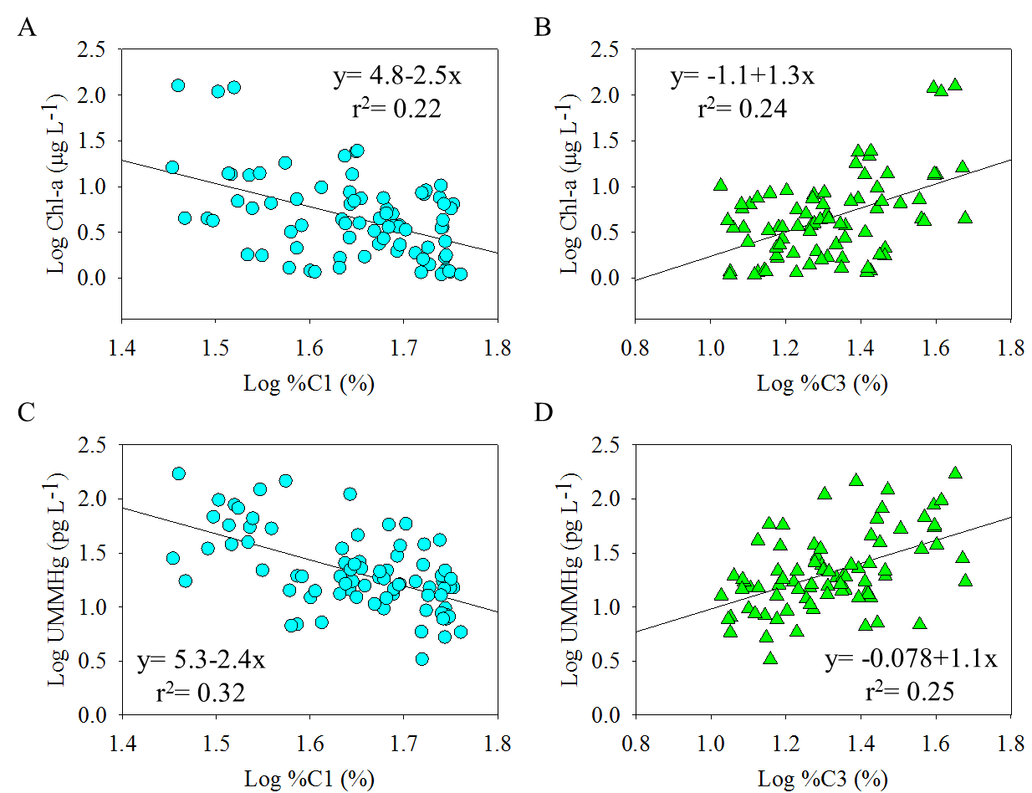
Task 2
Notes:
Based on a linear regression analysis, chl-a and UMMHg showed a negative correlation with humic-like DOM, wile showed positive correlations with protein-like DOM.
These results indicate that UMMHg is influenced by the autochthonous production of DOM.
However, the relatively weak correlation between protein-like DOM and UMMHg may indicate considerable upstream transport of MMHg to the reservoir.

Slide 13
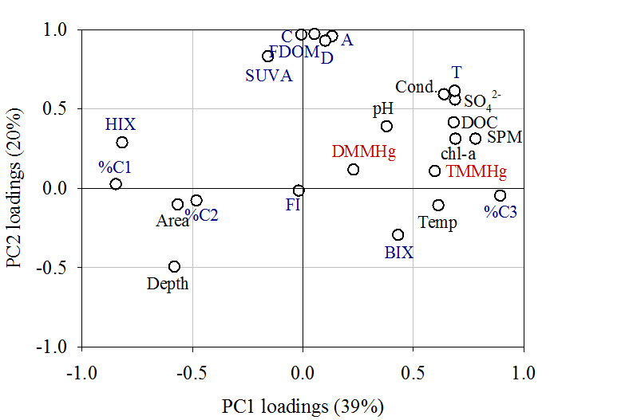
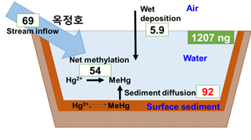
Task 2
A
B
June 2016
DMMHg
UMMHg
FDOM, C, A, D, and SUVA: land-derived humic-like DOM
%C3: autochthonous production of DOM
%C1 and HIX: the highest negative loadings
Notes:
Figure A shows the PCA result for the MMHg and DOM compositions.
The highest positive loading on PC1 was found for strong correlations among UMMHg, chl-a and protein-like DOM.
In contrast, the highest negative loadings were found for humic-like DOM.
These results indicate that UMMHg is influenced by the autochthonous production of DOM.
The MMHg flux calculation process for one of the reservoirs is summarized in Figure B.
Sediment diffusion seems to be the primary source of MMHg in the water, and this input tends to increase in reservoirs enriched with protein-like DOM.
As I mentioned on a previous slide, because of the contribution of upstream transport of MMHg, the relatively weak correlation between protein-like DOM and UMMHg is acceptable.

Slide 14
Summary
Algal biomass and autochthonous DOM subsequent to the algal decomposition was a key factor in increasing MMHg concentration in temperate reservoirs.
The most MMHg in reservoir water was diffused from the surface sediment and this input tends to increase in the reservoirs enriched with autochthonous DOM.
The creation of suboxic conditions and the supply of labile DOM seemed to support enhanced the MMHg production.
Notes:
Let me summarize my talk.

Slide 15
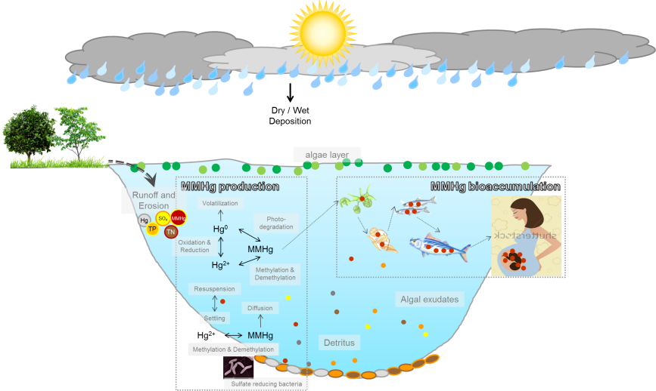
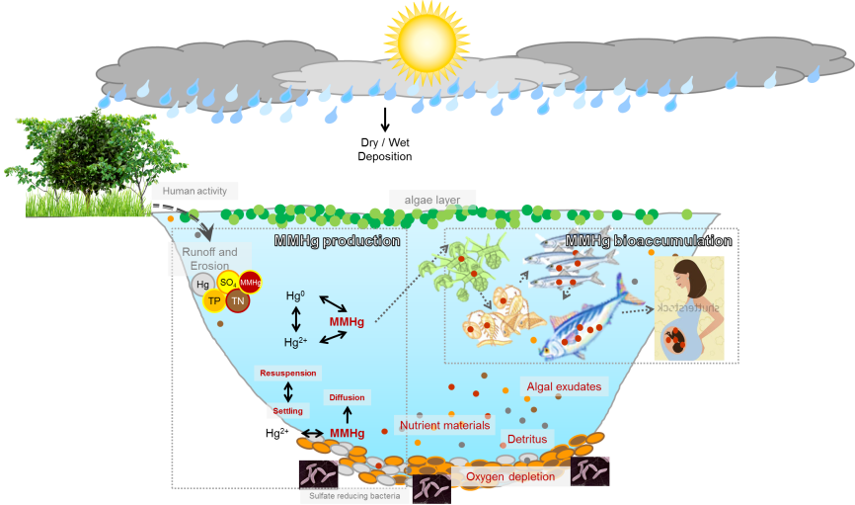
Conclusion
Oligotrophic ecosystem
Eutrophic ecosystem
MMHg production
MMHg production
Notes:
Numerous lakes worldwide have become eutrophic over the past few decades.
This eutrophication has led to changes in ecosystem function and lake water quality.
Nutrient supply to lakes should be managed to prevent lake eutrophication and the consequent increases in the MMHg concentration.

Slide 16
Thank you for your attention

Slide 17

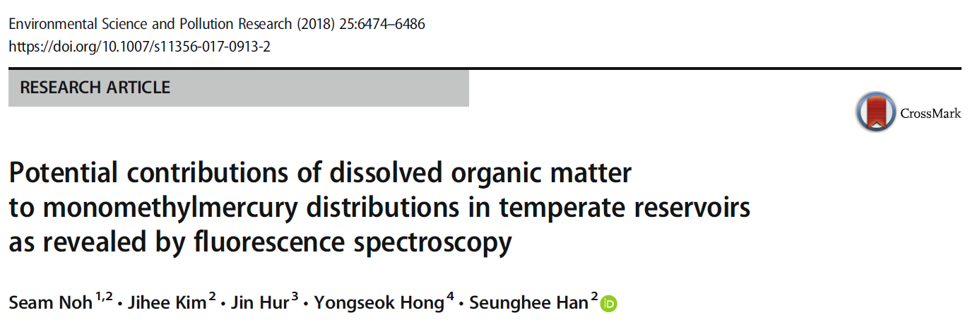
For more details…
Task 1
Task 2

Slide 18
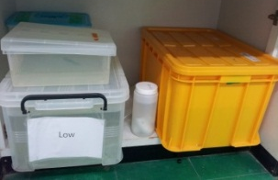
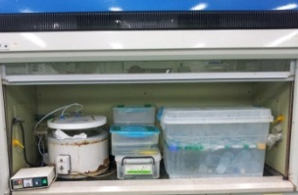
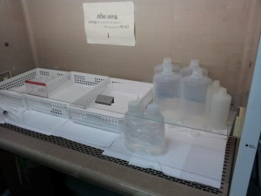
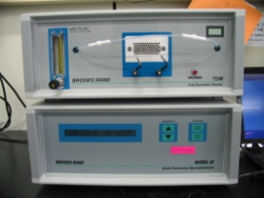
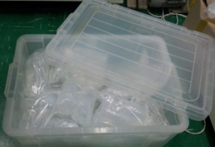
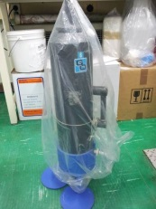

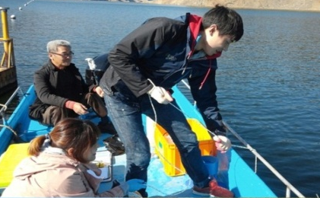
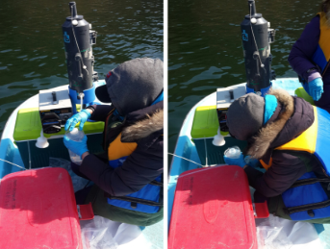
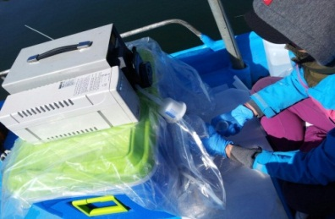
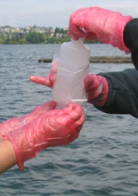
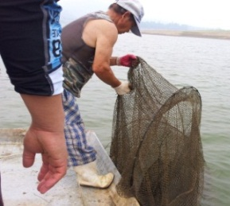
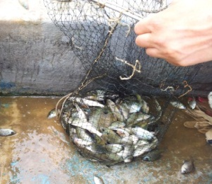
Overall analytical method
Overall method
Sampling preparation
1% Micro-detergent bath
20% HCl bath
(60ºC or room temp)
Preservation w/ 0.4% HCl
Water sampling
surface 0.5 m
Bottle blank check
Keep in double zipper bags
Niskin and filter
cleaning w/ 1% HCl

Slide 19
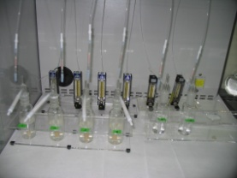
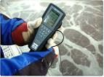
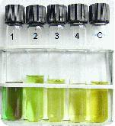
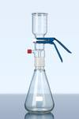
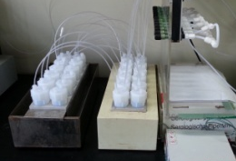
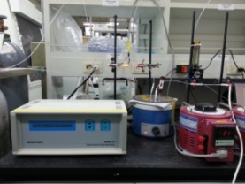
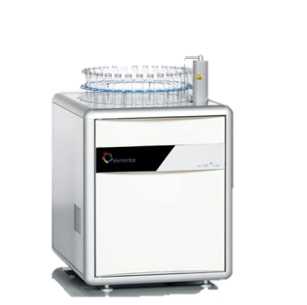
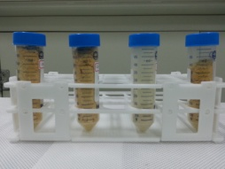
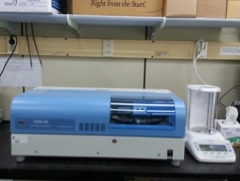

Overall analytical method
Overall method
THg
(water)
BrCl digestion→SnC₂ reduction
Hg⁰ on gold traps
CVAFS
Temp., Cond., pH
MeHg
(water)
Distillation→Ethylation
Ethyl-methyl Hg on Tenax trap
GC-CVAFS
Chlorophyll-a
SPM
THg
(fish)
Lyophilization
DMA
Nutrient
DOC

Slide 20


What is SOM, PCA, and MRA?
Task 1
Clustering
Dimensionality reduction
Principal component 1
Principal component 2
SOM
PCA
In the successful SOM and PCA
Use factors obtained form PCA as independent variables in the multiple regression analysis (MRA)

Slide 21
Physical characteristics
Task 1

Slide 22
Chemical characteristics
Task 1

Slide 23
Hg species distribution
Task 1
Water quality criteria for wildlife (US EPA)
UHg 1.3 ng L⁻¹
DHg 0.6 ng L⁻¹
UMMHg 50 pg L⁻¹

Slide 24
Task 1
Pearson’s correlation
0.1 - 0.3: weak
0.3 - 0.7: moderate
0.7 – 1.0: strong
Correlation coefficient
 | rain | res | basin | lake | depth | temp. | cond. | pH | SPM | Chl-a | SO₄ | NO₃ | DOC
UHg | .47** | .21 | -.24 | -.27* | -.32** | .40** | -.02 | .28* | .20 | .12 | .02 | -.34** | .29*
DHg | .64** | .61** | -.38** | -.27* | -.43** | .21 | -.24 | -.01 | -.01 | -.05 | -.14 | -.18 | .07
UMMHg | .32** | .37** | -.33** | -.35** | -.53** | .38** | .45** | .38** | .77** | .74** | .54** | -.31** | .60**
DMMHg | .50** | .73** | -.20 | -.21 | -.34** | .27 | -.07 | .21 | .04 | .00 | .02 | -.24** | .21
%UMMHg | .13 | .15 | -.23 | -.25* | -.34** | .28* | .52** | .34** | .69** | .71** | .55** | -.34** | .50**
%DMMHg | .08 | .10 | .07 | .00 | -.04 | .16 | .13 | .20 | .03 | .02 | .13 | -.23 | .15
P-values for correlations are indicated by asterisks: * p < 0.05, ** p < 0.01.
r>0.5

Slide 25

Depth profiles
Task 1

