Slide 1
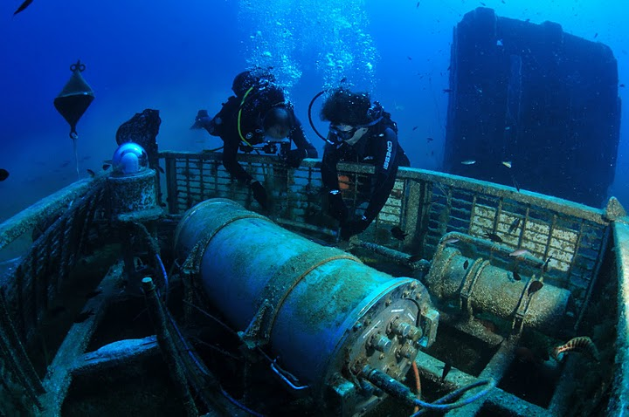
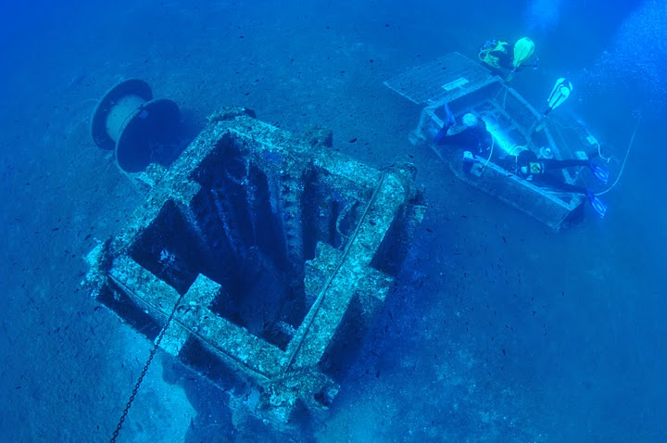
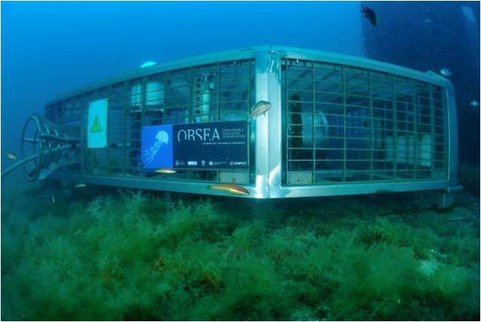
Effortless Integration of Underwater Noise Measurements into EMODnet data portal through Sensor Web Standards
Enoc Martinez, Albert Garcia Benadi, Daniel Mihai Toma,
Antonio Novellino, Patrick Gorringe , and Joaquin del Rio
Notes:
Marine observing systems are composed of a huge diversity of sensors and observation platforms.
The data flow from the sensor to the user requires the use of standards protocols to minimize the effort for new sensor integration on platforms, and to improve discovery and visualization of data from the scientific community. During this webinar, the use of OGC standards applied to marine observing platforms will be shown. Examples of these standards include OGC PUCK, SensorML and the Sensor Observation Service.

Slide 2
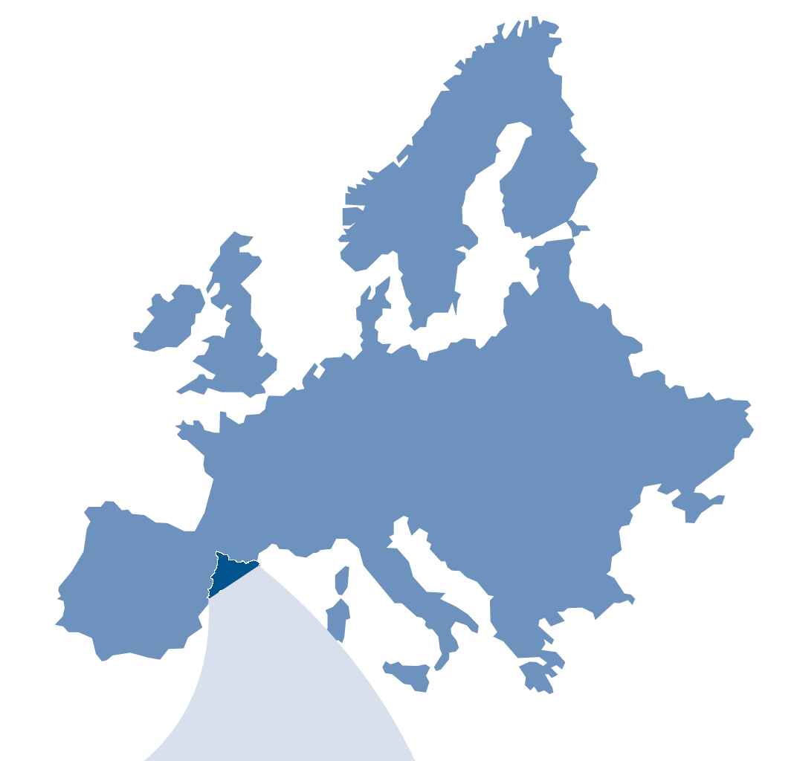
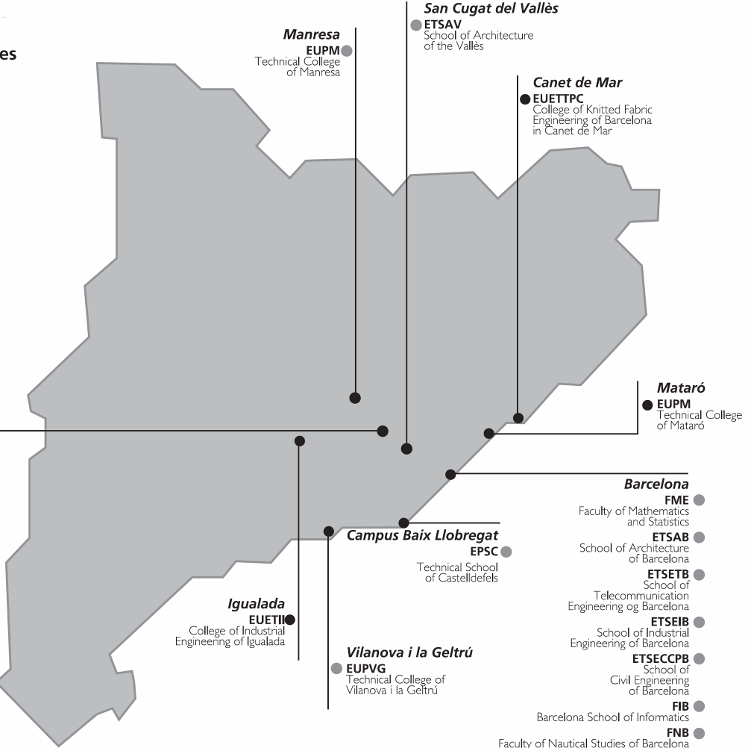
2
The Technical University of Catalonia (UPC)
Localization: Barcelona – Spain
Schools: 23
Departments: 40
Campus: 7
Students: 40000
Lectures & researcher: 2642
Research Institutes: 3
Notes:
Here we can see some examples of transversal thematic areas and its integration in all the working areas of the university.

Slide 3
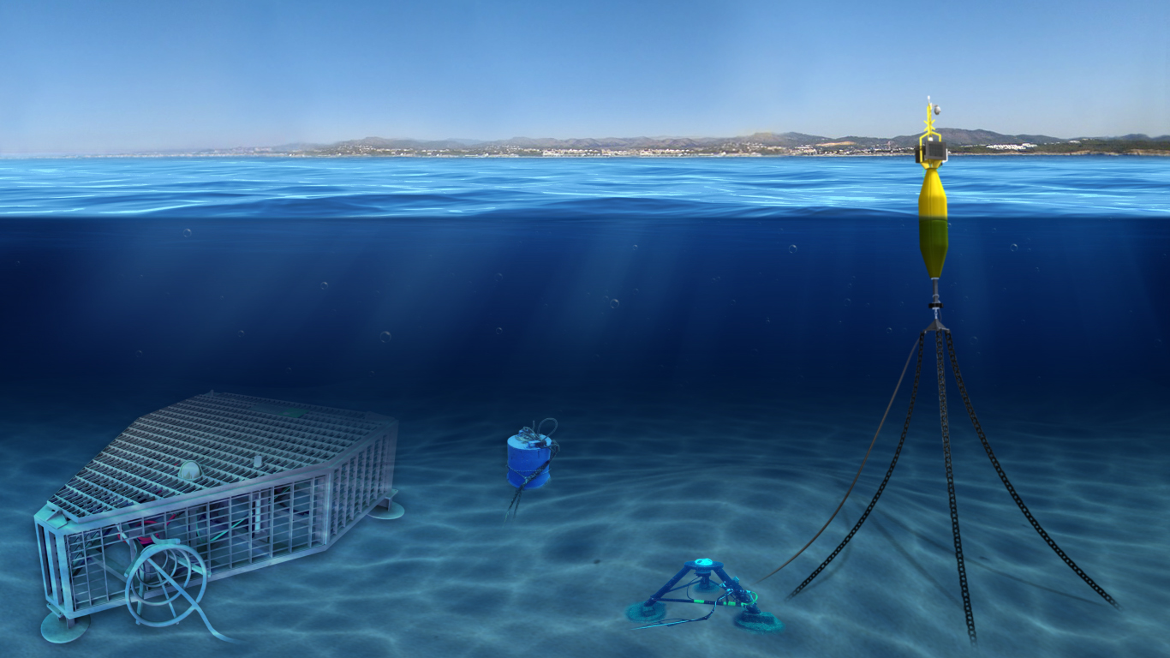
OBSEA: Shallow water cabled Observatory Test Site
www.obsea.es

Slide 4
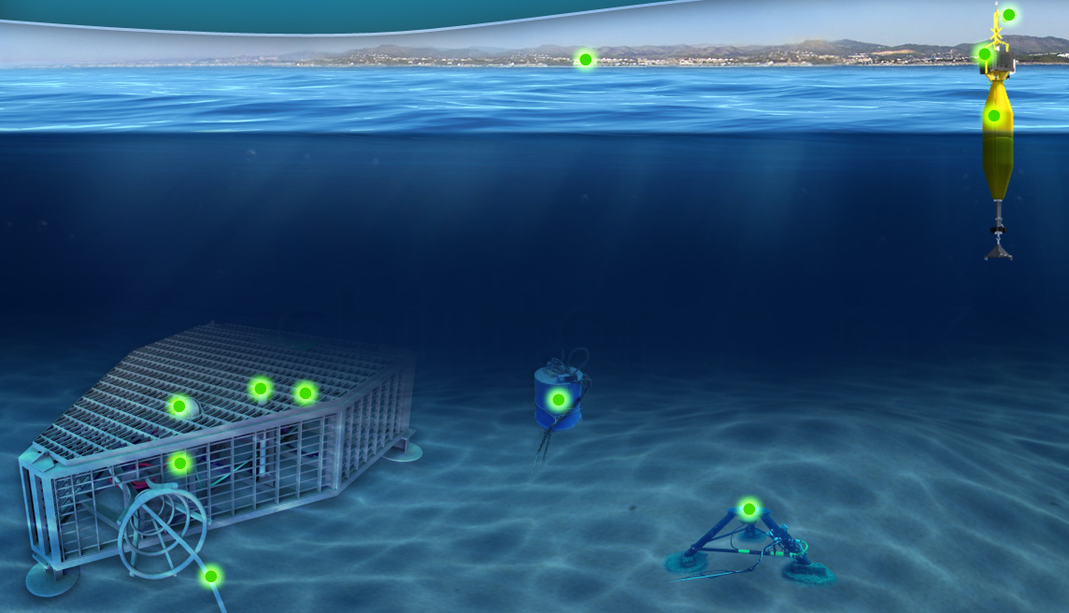
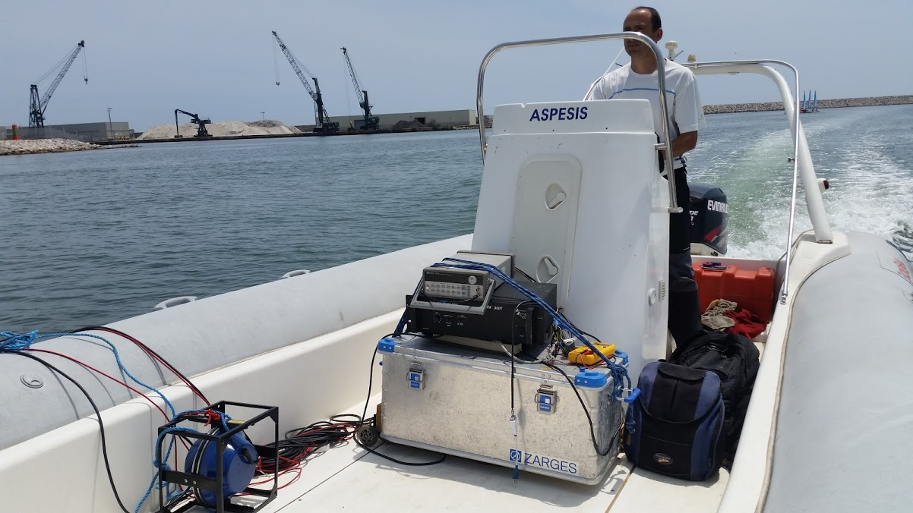
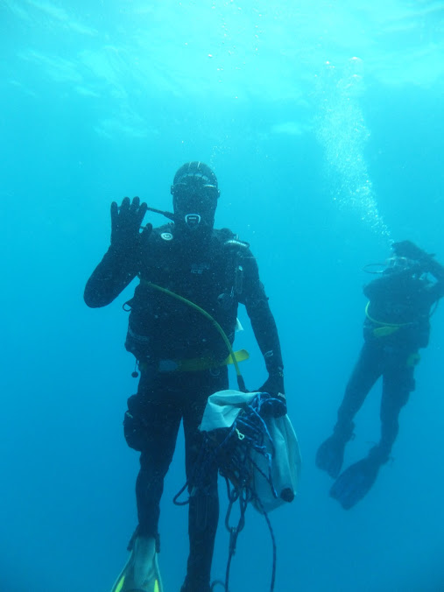
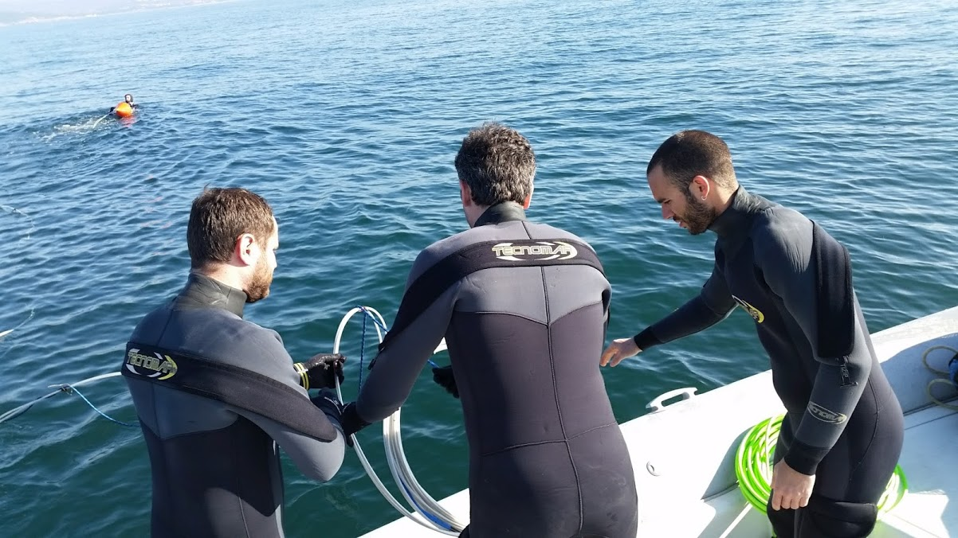
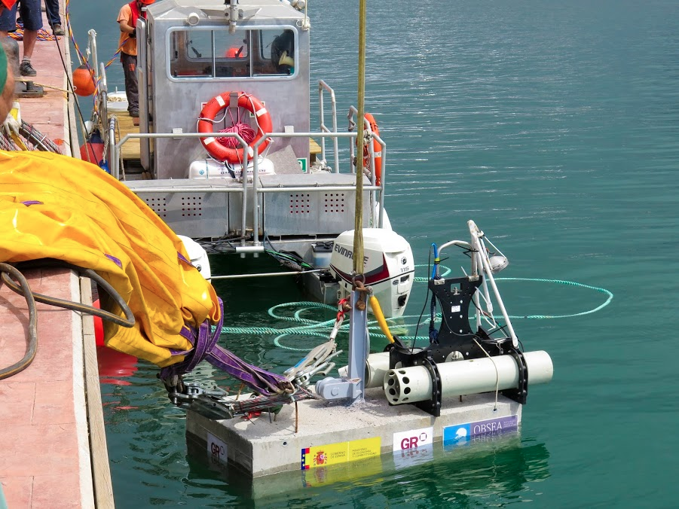
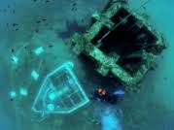
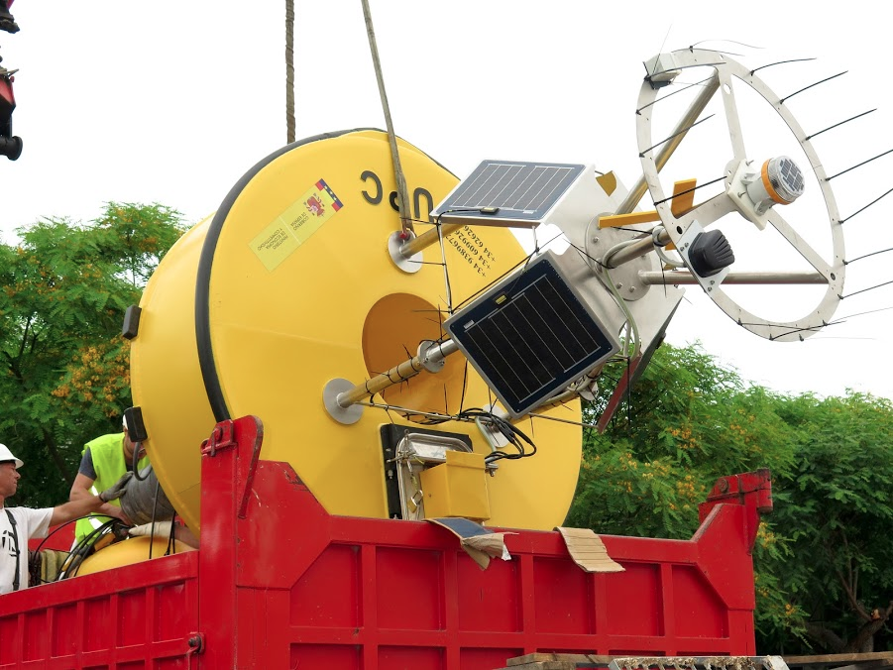
Observatory OBSEA- Organization: UPC
4/4
Photos:

Slide 5
OBSEA underwater cabled observatory schema
20m depth, 4km offshore, 16 wetmate connectors for instrumentation (power, communications, synchronization)
Operations by scuba divers and small boats.
The infrastructure is offered under transnational access (TNA): now H2020 JericoNext
OBSEA participation in EU projects :
ESONET FP6 NEXOS FP7 JERICO FP7 FIXO3 FP7 JERICONEXT H2020 METEOMET2 EMRP EMSODEV H2020 EMSOLINK H2020 MELOA H2020
Notes:
Breve expolicacion del OBSEA

Slide 6
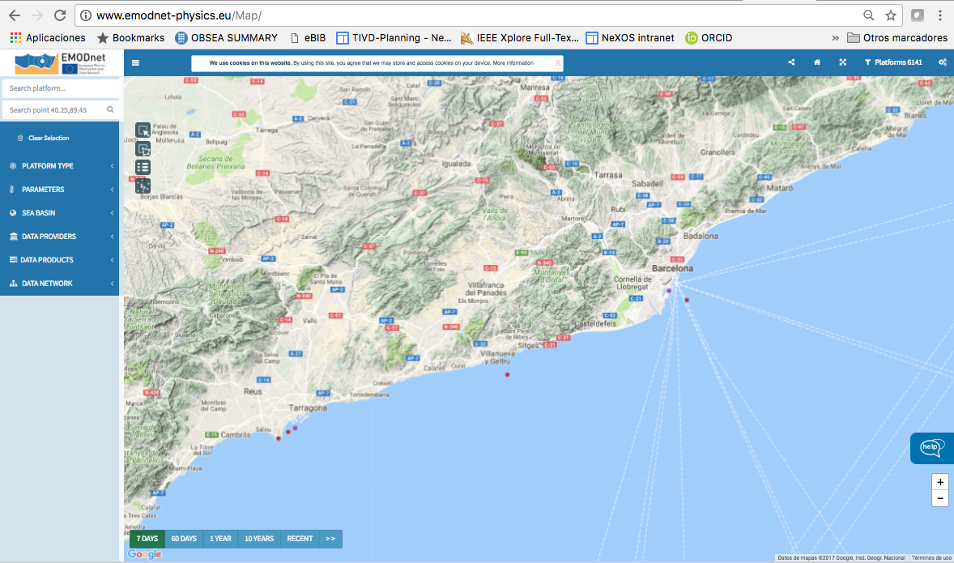
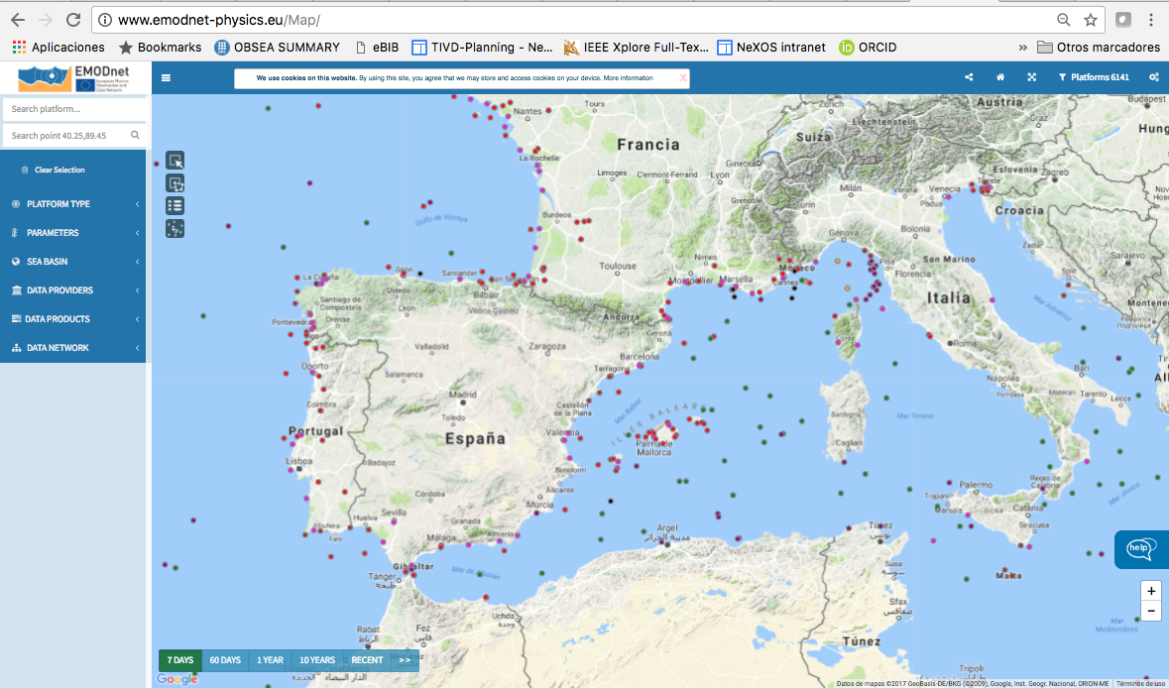

Slide 7
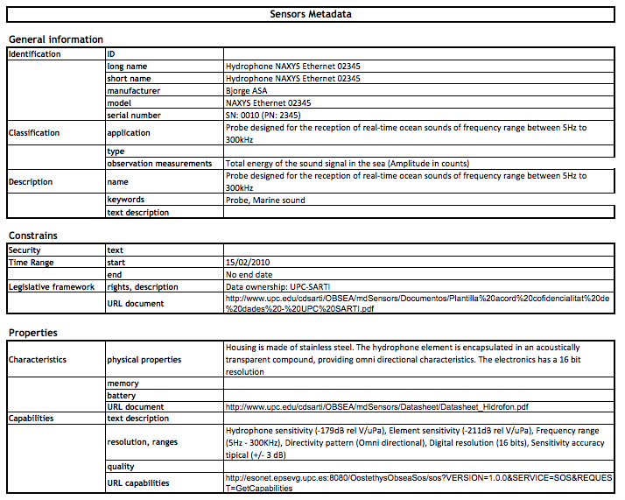

Slide 8
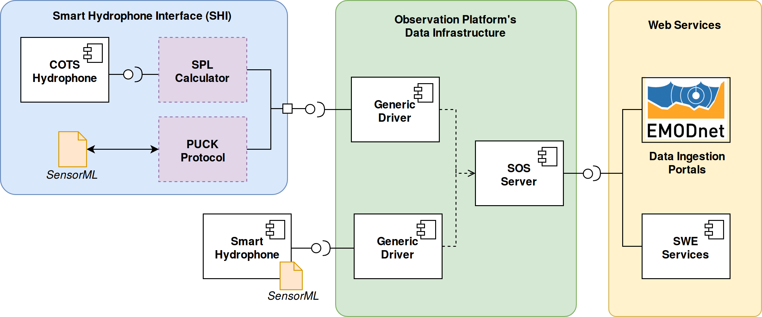

Slide 9
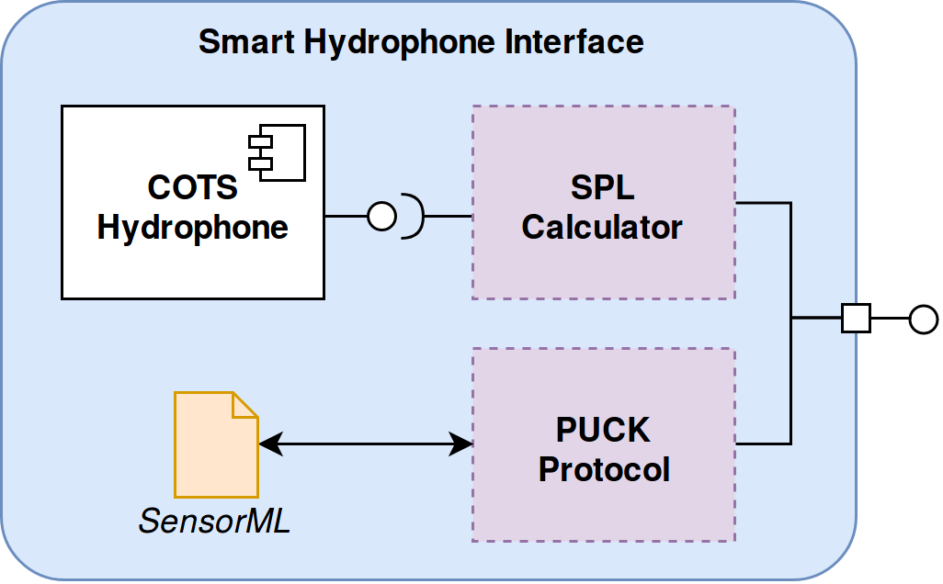

Slide 10
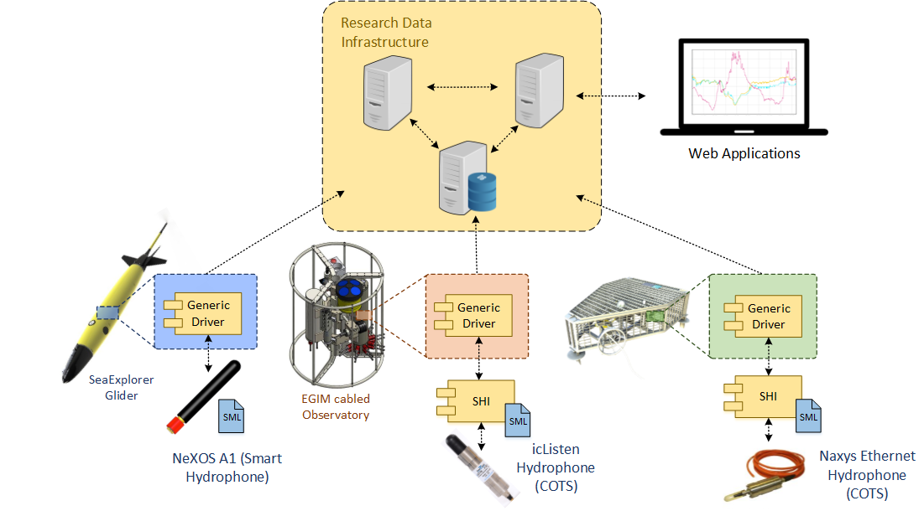
Previous work…

Slide 11
Hydrophone raw data
High Bandwidth link:
Ethernet Cabled
GetObservations
and sensor Metadata
Offshore/underwater
Obsea Servers on shore station
SPL values calculated
InsertResults to SOS Server

Slide 12
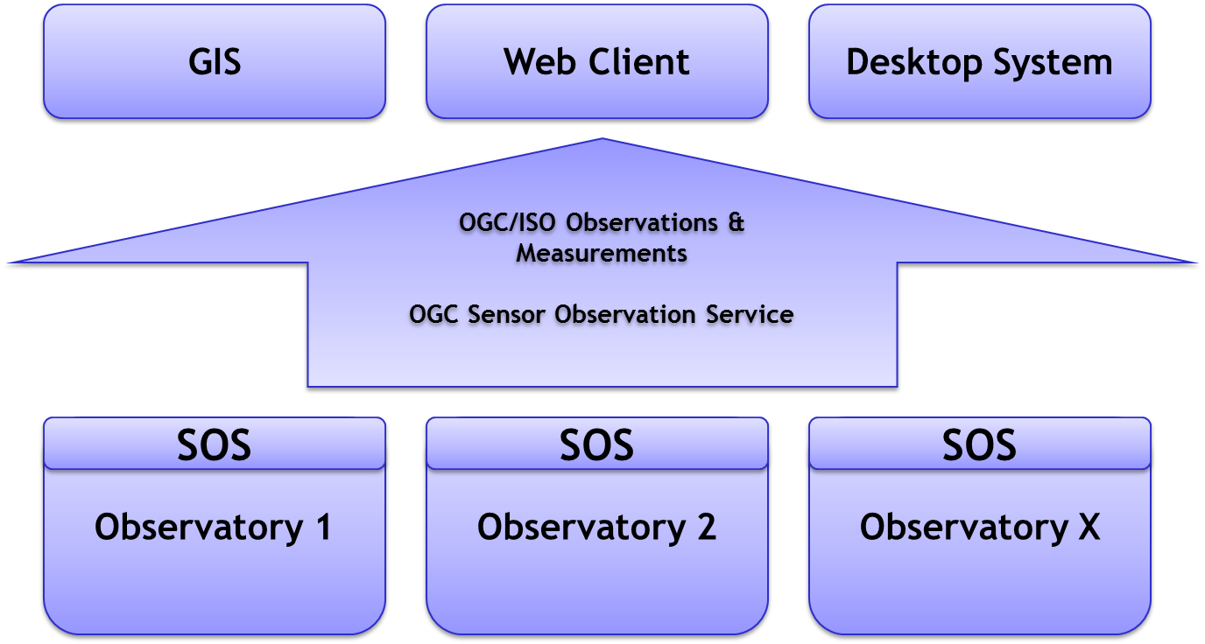
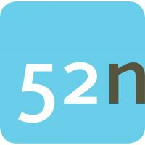
Sensor Web
With standardisation:
Standards need to be implemented only once for each source and consumer → less integration efforts needed

Slide 13
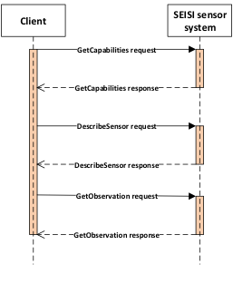
SOS Server at UPC

Slide 14
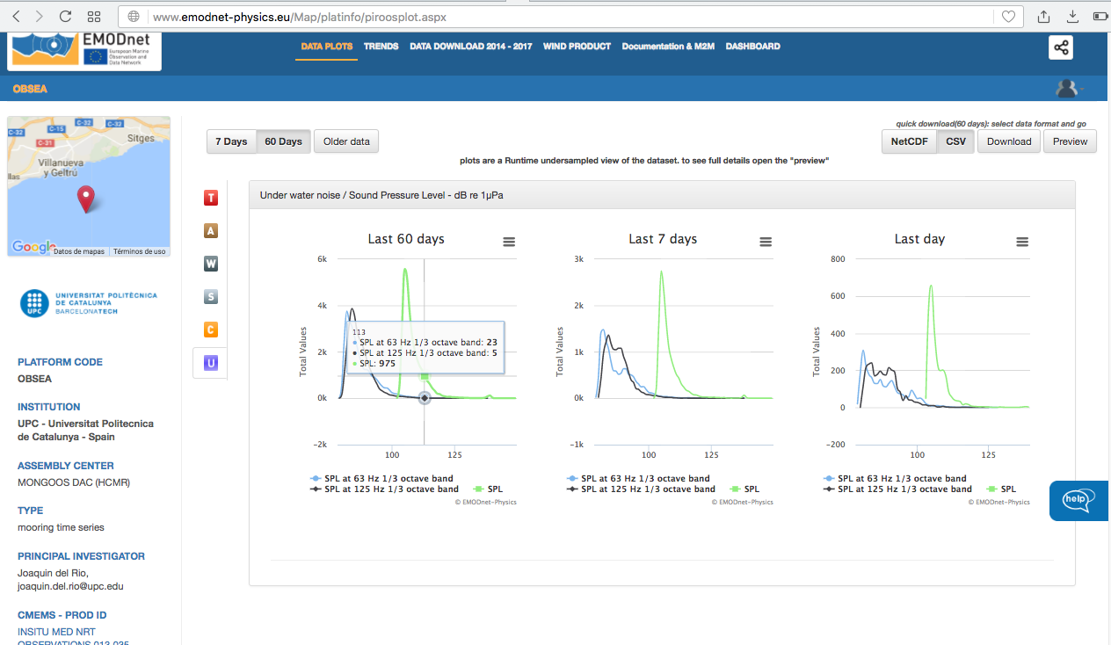

Slide 15
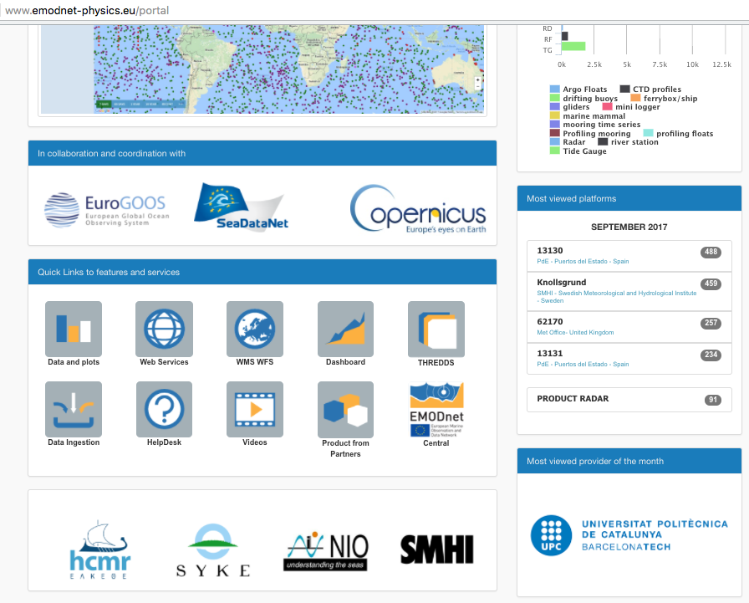
Obsea-UPC: Most viewed provider of the month (september 2017)

Slide 16
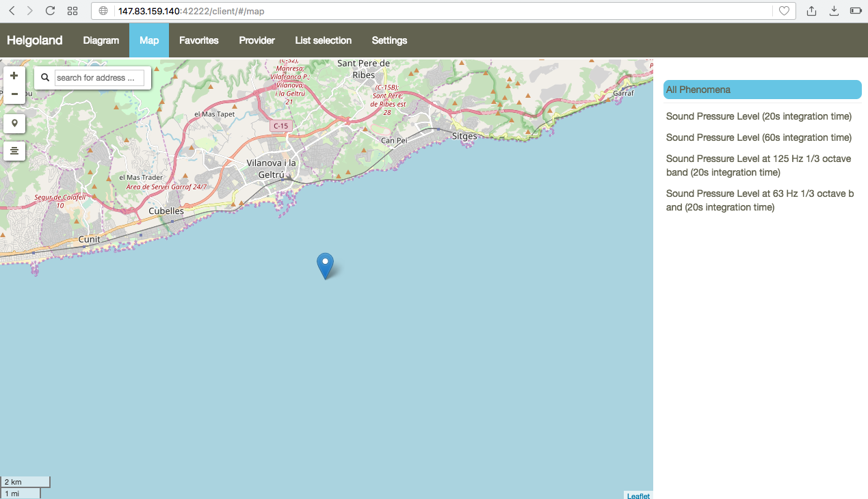
Helgoland SOS Client

Slide 17
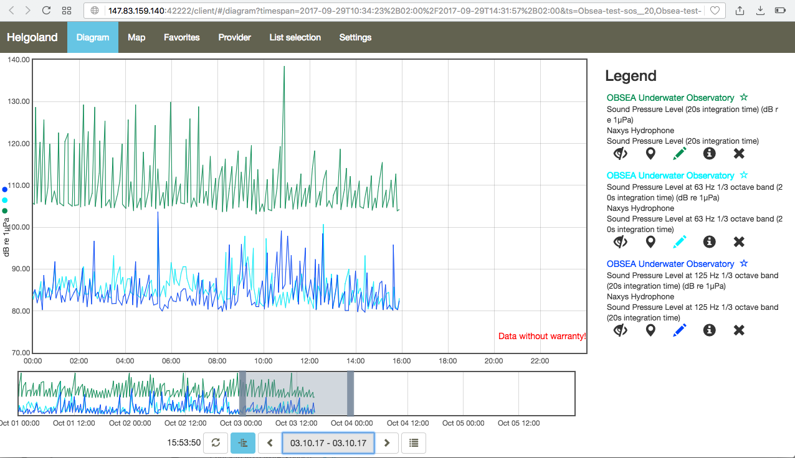
SOS Client: http://147.83.159.140:42222/client
Helgoland SOS Client
Link to data: http://147.83.159.140:42222/client/#/diagram?timespan=2017-09-29T10%3A34%3A23%2B02%3A00%2F2017-09-29T14%3A31%3A57%2B02%3A00&ts=Obsea-test-sos__20%2CObsea-test-sos__21%2CObsea-test-sos__22

Slide 19
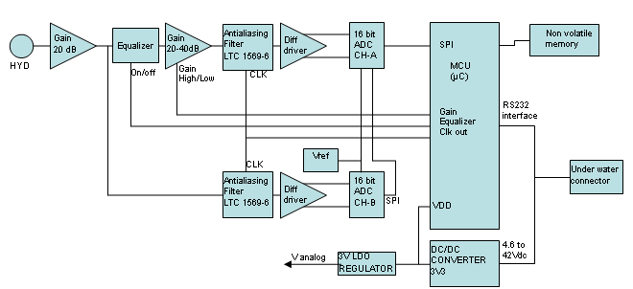
A1 sensor system
Consists of one hydrophone and two A/D converters with different sensitivity to detect acoustic source levels from 50 dB to 180 dB re 1μPa in the frequency range from 1Hz to 50 kHz.

Slide 20
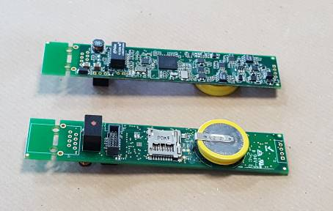
A1 sensor system
Acoustic Specification:
Sensitivity ChA: -138/-158 dB re 1μPa.
Sensitivity ChB: -178 dB re 1μPa.
Frequency range (±1,5dB): from 1Hz to 50kHz
Beam pattern: Omni-directional.
Input equivalent noise: 23dB re 1 uPa/√Hz.
Full BW dynamic range: 130dB.
Dynamic range 1Hz BW: 160dB.

Slide 21
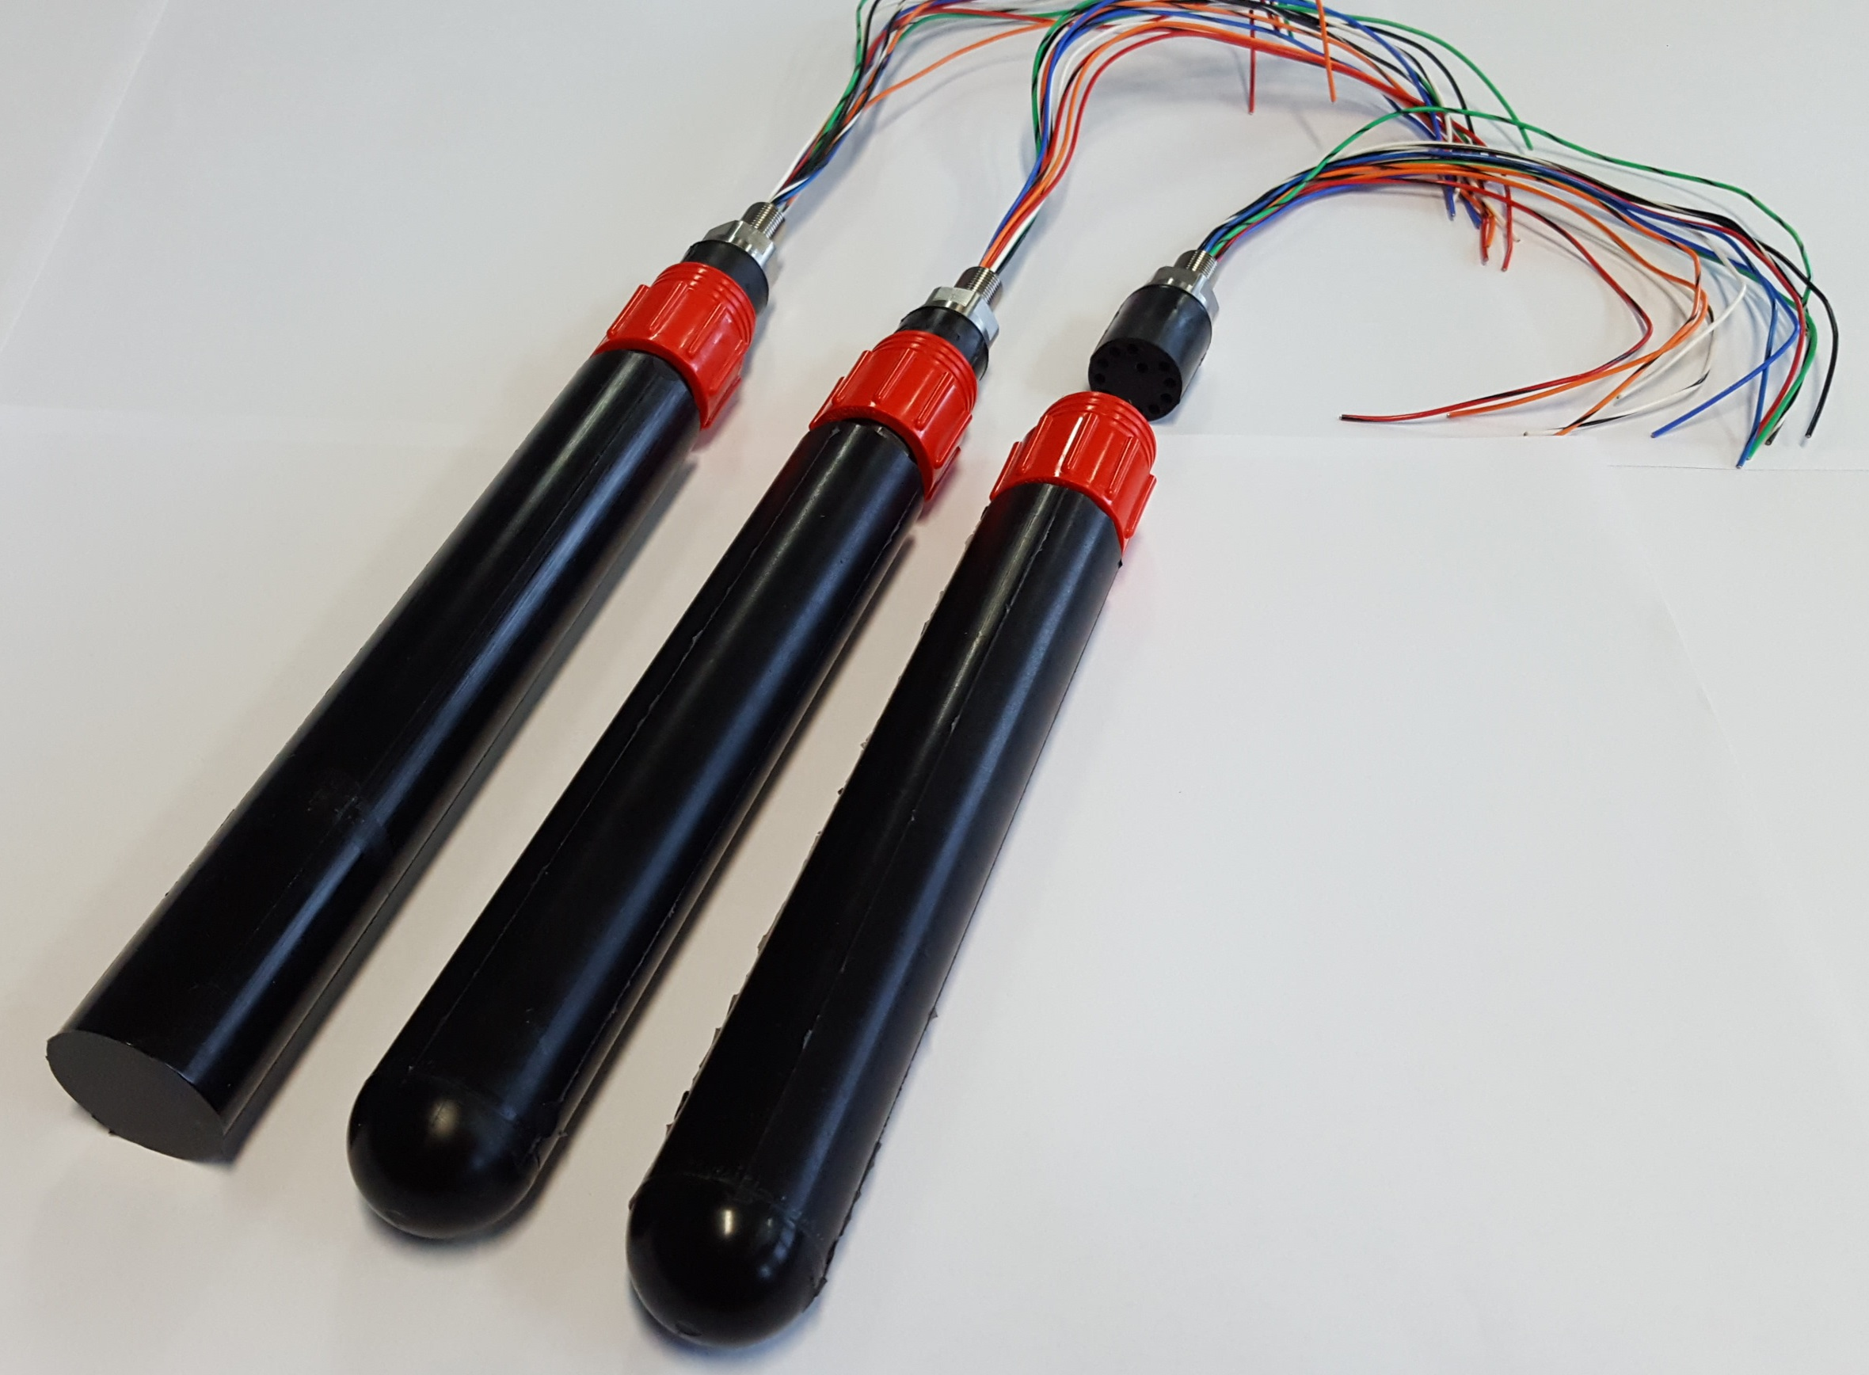
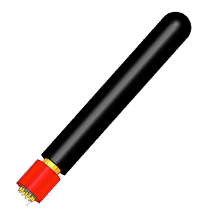
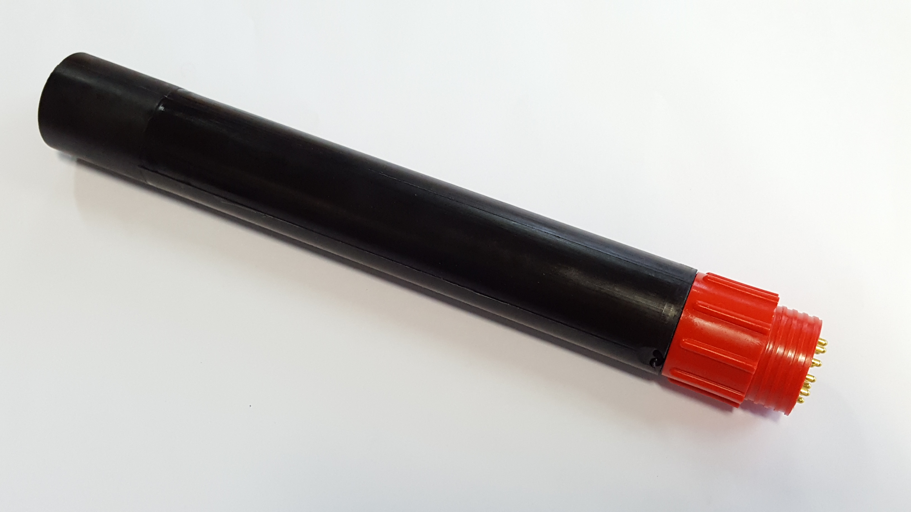
A1 sensor system
Electrical / Mechanical:
Supply voltage 4.6 to 42Vdc.
Max consumption 900mW
Connector SubCon MCBH12M.
Working depth 1500m.
External coat Polyurethane.
Size Φ35 x 250mm.
Embedded function:
Spectral analysis
Noise statistics (incl. EU MSFD)
Mammal detection
Data storage internal memory 128GB

Slide 22
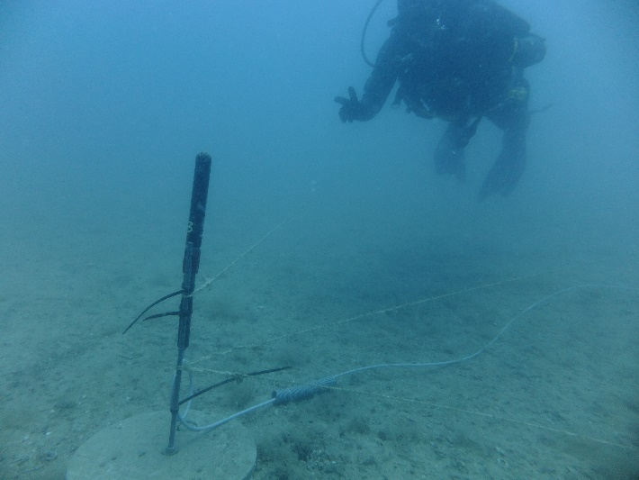
A1 was tested and integrated in many platforms:
NKE Profling float
Obsea observatory
SeaExplorer Gligger
AqcuaAlta Italy
Plocan Canaries
…

Slide 23
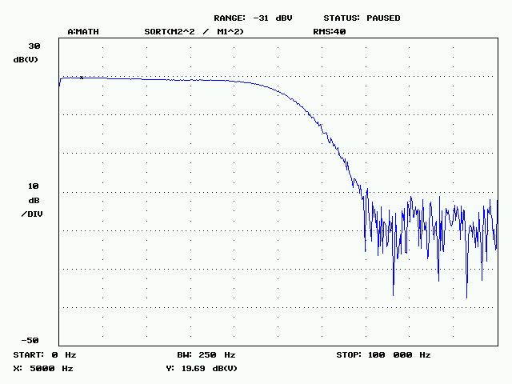
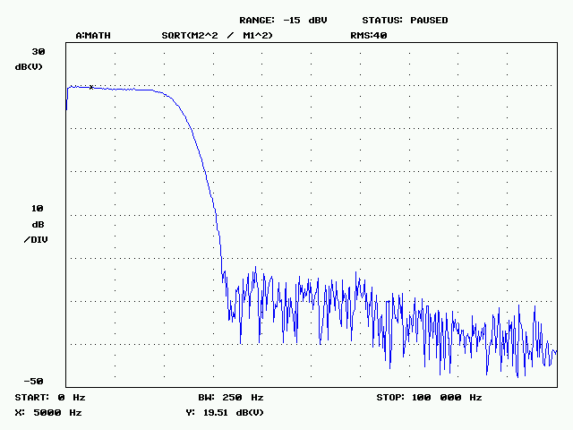
A1 sensor system
transfer function of CHB (20dB gain) with Antialiasing filter F_{cutoff}=50kHz. The marker at 5kHz measures 19.69dB gain
transfer function of CHB (20dB gain) with Antialiasing filter F_{cutoff}= 22.05kHz. The marker at 5kHz measures 19.51dB gain
Notes:
transfer function of CHB (20dB gain) with Antialiasing filter F_{cutoff}=50kHz.The marker at 5kHz measures 19.69dB gain
transfer function of CHB (20dB gain) with Antialiasing filter F_{cutoff}= 22.05kHz. The marker at 5kHz measures 19.51dB gain

Slide 24
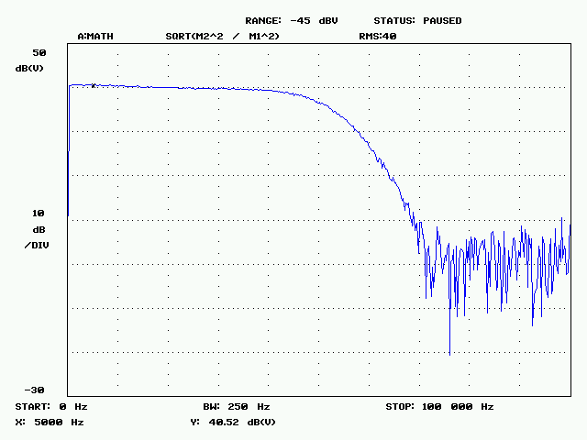
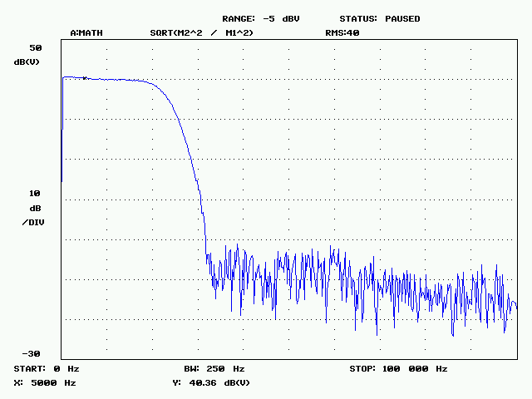
A1 sensor system
transfer function of CHA with selected 40dB gain with Antialiasing filter F_{cutoff}=50kHz.The marker at 5kHz measures 40.52dB gain
transfer function of CHA with selected 40dB gain with Antialiasing filter F_{cutoff}=22.05kHz. The marker at 5kHz measures 40.36dB gain
Notes:
transfer function of CHA with selected 40dB gain with Antialiasing filter F_{cutoff}=50kHz.The marker at 5kHz measures 40.52dB gain
transfer function of CHA with selected 40dB gain with Antialiasing filter F_{cutoff}=22.05kHz. The marker at 5kHz measures 40.36dB gain

Slide 25
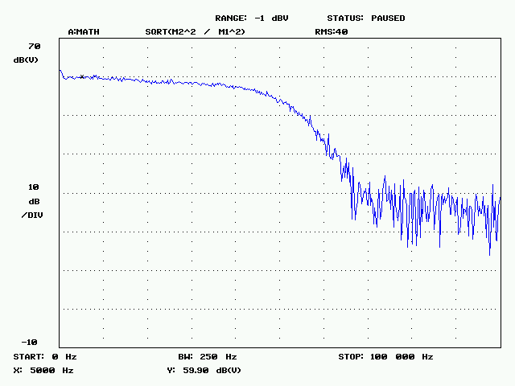
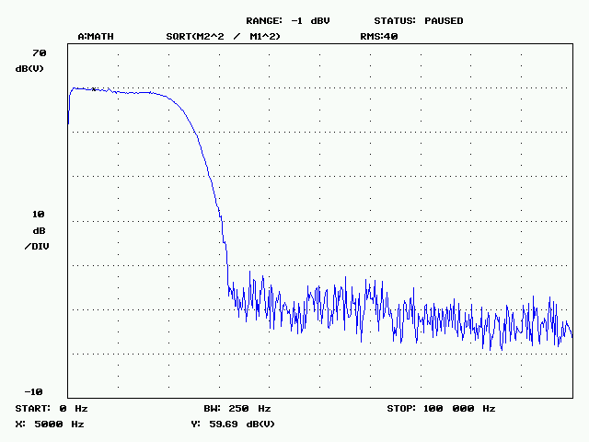
A1 sensor system
transfer function of CHA with selected 60dB gain with Antialiasing filter F_{cutoff}=50kHz. The marker at 5kHz measures 59.90dB gain
transfer function of CHA with selected 60dB gain with Antialiasing filter F_{cutoff}=22.05kHz. The marker at 5kHz measures 59.69dB
Notes:
transfer function of CHA with selected 60dB gain with Antialiasing filter F_{cutoff}=50kHz. The marker at 5kHz measures 59.90dB gain
transfer function of CHA with selected 60dB gain with Antialiasing filter F_{cutoff}=22.05kHz. The marker at 5kHz measures 59.69dB

Slide 26
SPL values
low bandwith link:
RS232/acoustic…
GetObservations
and sensor Metadata
Offshore/underwater
Obsea Servers on shore station
SPL values calculated
InsertResults to SOS Server

Slide 27
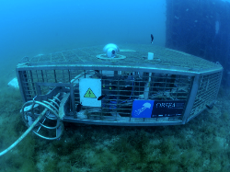
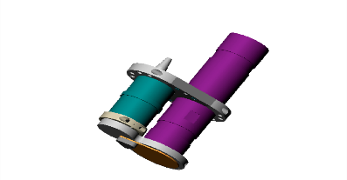
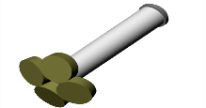
SAS
SOS
SES
Translate data to SWE
services
From the platform, Internet protocols will be used for propagate data to the USERs
SensorWeb Level: SWE standards
Software on host controller uses
the SensorML file to propagate
instrument specifications to the user
SWE Bridge
+
PUCK Tools
Marine Platform
Host controller
(vehicle, buoy, mooring…)
Instrument level:
Instruments communicates
with a controller
Communicate with
Instrument
Get SensorML file
PUCK Payload
SensorML file
Measuring Instruments
A SensorML file with metadata is creted and belongs to the instrument

Slide 28
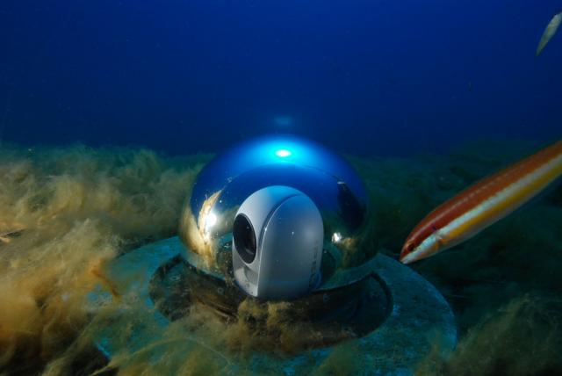
Thanks for your attention.

Slide 29
What else? Next steps to feed Emodnet with more acoustic data…
Impulsive noise…
Validation data: store X seconds of raw acoustic data (wav) every Y hours
Will help to ensure proper funcionality of the hydrophone
Will help to ensure proper data processing: make processing interoperable
…
Identify more real time sound sources/providers that agree to share his data
EuroGOOS Task Team creation to agree on the methodology

Slide 30
References:
http://www.npl.co.uk/upload/pdf/gpg133-underwater-noise-measurement.pdf
http://dosits.org/science/advanced-topics/introduction-to-signal-levels/

Slide 31
Get Observation: post to http://147.83.159.140:42222/obsea-test-sos/service
<?xml version="1.0" encoding="UTF-8"?>
<sos:GetObservation service="SOS" version="2.0.0"
xmlns:sos="http://www.opengis.net/sos/2.0"
xmlns:fes="http://www.opengis.net/fes/2.0"
xmlns:gml="http://www.opengis.net/gml/3.2"
xmlns:swe="http://www.opengis.net/swe/2.0"
xmlns:xlink="http://www.w3.org/1999/xlink"
xmlns:swes="http://www.opengis.net/swes/2.0"
xmlns:xsi="http://www.w3.org/2001/XMLSchema-instance" xsi:schemaLocation="http://www.opengis.net/sos/2.0 http://schemas.opengis.net/sos/2.0/sos.xsd">
<!-- optional, multiple values possible -->
<sos:procedure>5aaf2faf-4dd9-4967-90a3-b731fd174392</sos:procedure>
<!-- optional, multiple values possible -->
<sos:offering>offering_5aaf2faf-4dd9-4967-90a3-b731fd174392</sos:offering>
<!-- ======================================== -->
<!-- Choose one or more ObservedProperties -->
<!-- ======================================== -->
<sos:observedProperty>http://vocab.nerc.ac.uk/collection/P07/current/CFSN0310/#20s</sos:observedProperty>
<!-- SPL @ 63Hz (20 seconds) -->
<!--<sos:observedProperty>http://vocab.nerc.ac.uk/collection/P07/current/CFSN0310/#60s</sos:observedProperty>-->
<!-- SPL @ 125Hz (20 seconds) -->
<!-- <sos:observedProperty>http://vocab.nerc.ac.uk/collection/P07/current/CFSN0310/#63Hz20s</sos:observedProperty> -->
<!-- SPL (60 seconds) -->
<!-- <sos:observedProperty>http://vocab.nerc.ac.uk/collection/P07/current/CFSN0310/#125Hz20s</sos:observedProperty> -->
<sos:temporalFilter>
<fes:During>
<fes:ValueReference>phenomenonTime</fes:ValueReference>
<gml:TimePeriod gml:id="tp_1">
<gml:beginPosition>2017-10-03T10:00:00z</gml:beginPosition>
<gml:endPosition>2017-10-03T10:10:00z</gml:endPosition>
</gml:TimePeriod>
</fes:During>
</sos:temporalFilter>
<sos:featureOfInterest>OBSEA_underwater_observatory</sos:featureOfInterest>
<sos:responseFormat>http://www.opengis.net/om/2.0</sos:responseFormat>
</sos:GetObservation>

Slide 32
<?xml version="1.0" encoding="UTF-8"?>
<sos:GetObservationResponse xmlns:sos="http://www.opengis.net/sos/2.0" xmlns:xsi="http://www.w3.org/2001/XMLSchema-instance" xmlns:om="http://www.opengis.net/om/2.0" xmlns:gml="http://www.opengis.net/gml/3.2" xmlns:xlink="http://www.w3.org/1999/xlink" xsi:schemaLocation="http://www.opengis.net/sos/2.0 http://schemas.opengis.net/sos/2.0/sosGetObservation.xsd http://inspire.ec.europa.eu/schemas/ef/4.0 http://inspire.ec.europa.eu/schemas/ef/4.0/EnvironmentalMonitoringFacilities.xsd http://www.opengis.net/om/2.0 http://schemas.opengis.net/om/2.0/observation.xsd">
<sos:observationData>
<om:OM_Observation gml:id="o_F3E5F8C1F4790232F6D2789B773999765063450C">
<om:type xlink:href="http://www.opengis.net/def/observationType/OGC-OM/2.0/OM_Measurement"/>
<om:phenomenonTime>
<gml:TimeInstant gml:id="phenomenonTime_513293">
<gml:timePosition>2017-10-03T10:00:20.000Z</gml:timePosition>
</gml:TimeInstant>
</om:phenomenonTime>
<om:resultTime xlink:href="#phenomenonTime_513293"/>
<om:procedure xlink:href="5aaf2faf-4dd9-4967-90a3-b731fd174392" xlink:title="Naxys Hydrophone"/>
<om:observedProperty xlink:href="http://vocab.nerc.ac.uk/collection/P07/current/CFSN0310/#20s" xlink:title="Sound Pressure Level (20s integration time)"/>
<om:featureOfInterest xlink:href="OBSEA_underwater_observatory" xlink:title="OBSEA Underwater Observatory"/>
<om:result xmlns:ns="http://www.opengis.net/gml/3.2" uom="dB re 1µPa" xsi:type="ns:MeasureType">105.83</om:result>
</om:OM_Observation>
</sos:observationData>
<sos:observationData>
<om:OM_Observation gml:id="o_E7CCFDED8C363BFFC0A5033ECCDC433EC7602CF7">
<om:type xlink:href="http://www.opengis.net/def/observationType/OGC-OM/2.0/OM_Measurement"/>
<om:phenomenonTime>
<gml:TimeInstant gml:id="phenomenonTime_513297">
<gml:timePosition>2017-10-03T10:00:40.000Z</gml:timePosition>
</gml:TimeInstant>
</om:phenomenonTime>
<om:resultTime xlink:href="#phenomenonTime_513297"/>
<om:procedure xlink:href="5aaf2faf-4dd9-4967-90a3-b731fd174392" xlink:title="Naxys Hydrophone"/>
<om:observedProperty xlink:href="http://vocab.nerc.ac.uk/collection/P07/current/CFSN0310/#20s" xlink:title="Sound Pressure Level (20s integration time)"/>
<om:featureOfInterest xlink:href="OBSEA_underwater_observatory" xlink:title="OBSEA Underwater Observatory"/>
<om:result xmlns:ns="http://www.opengis.net/gml/3.2" uom="dB re 1µPa" xsi:type="ns:MeasureType">106.04</om:result>
</om:OM_Observation>
</sos:observationData>
<sos:observationData>
<om:OM_Observation gml:id="o_DB8279990CC5C33E7AB097E7CA4884CB8DA6ECD3">
<om:type xlink:href="http://www.opengis.net/def/observationType/OGC-OM/2.0/OM_Measurement"/>
<om:phenomenonTime>
<gml:TimeInstant gml:id="phenomenonTime_513301">
<gml:timePosition>2017-10-03T10:01:00.000Z</gml:timePosition>
</gml:TimeInstant>
</om:phenomenonTime>
<om:resultTime xlink:href="#phenomenonTime_513301"/>
<om:procedure xlink:href="5aaf2faf-4dd9-4967-90a3-b731fd174392" xlink:title="Naxys Hydrophone"/>
<om:observedProperty xlink:href="http://vocab.nerc.ac.uk/collection/P07/current/CFSN0310/#20s" xlink:title="Sound Pressure Level (20s integration time)"/>
<om:featureOfInterest xlink:href="OBSEA_underwater_observatory" xlink:title="OBSEA Underwater Observatory"/>
<om:result xmlns:ns="http://www.opengis.net/gml/3.2" uom="dB re 1µPa" xsi:type="ns:MeasureType">106.02</om:result>
</om:OM_Observation>
</sos:observationData>
<sos:observationData>
<om:OM_Observation gml:id="o_BA6F490C7C8F99A6340CB53A7C40FDF92B1C6D13">
<om:type xlink:href="http://www.opengis.net/def/observationType/OGC-OM/2.0/OM_Measurement"/>
<om:phenomenonTime>
<gml:TimeInstant gml:id="phenomenonTime_513305">
<gml:timePosition>2017-10-03T10:01:20.000Z</gml:timePosition>
</gml:TimeInstant>
</om:phenomenonTime>
<om:resultTime xlink:href="#phenomenonTime_513305"/>
<om:procedure xlink:href="5aaf2faf-4dd9-4967-90a3-b731fd174392" xlink:title="Naxys Hydrophone"/>
<om:observedProperty xlink:href="http://vocab.nerc.ac.uk/collection/P07/current/CFSN0310/#20s" xlink:title="Sound Pressure Level (20s integration time)"/>
<om:featureOfInterest xlink:href="OBSEA_underwater_observatory" xlink:title="OBSEA Underwater Observatory"/>
<om:result xmlns:ns="http://www.opengis.net/gml/3.2" uom="dB re 1µPa" xsi:type="ns:MeasureType">106.33</om:result>
</om:OM_Observation>
</sos:observationData>
<sos:observationData>
<om:OM_Observation gml:id="o_D54342B90B37C03FF369ABCE118B9EFCD8AA9031">
<om:type xlink:href="http://www.opengis.net/def/observationType/OGC-OM/2.0/OM_Measurement"/>
<om:phenomenonTime>
<gml:TimeInstant gml:id="phenomenonTime_513309">
<gml:timePosition>2017-10-03T10:01:40.000Z</gml:timePosition>
</gml:TimeInstant>
</om:phenomenonTime>
<om:resultTime xlink:href="#phenomenonTime_513309"/>
<om:procedure xlink:href="5aaf2faf-4dd9-4967-90a3-b731fd174392" xlink:title="Naxys Hydrophone"/>
<om:observedProperty xlink:href="http://vocab.nerc.ac.uk/collection/P07/current/CFSN0310/#20s" xlink:title="Sound Pressure Level (20s integration time)"/>
<om:featureOfInterest xlink:href="OBSEA_underwater_observatory" xlink:title="OBSEA Underwater Observatory"/>
<om:result xmlns:ns="http://www.opengis.net/gml/3.2" uom="dB re 1µPa" xsi:type="ns:MeasureType">106.09</om:result>
</om:OM_Observation>
</sos:observationData>
<sos:observationData>
<om:OM_Observation gml:id="o_ABE0E22C050B19FE4329463EE3428885C800257C">
<om:type xlink:href="http://www.opengis.net/def/observationType/OGC-OM/2.0/OM_Measurement"/>
<om:phenomenonTime>
<gml:TimeInstant gml:id="phenomenonTime_513313">
<gml:timePosition>2017-10-03T10:02:00.000Z</gml:timePosition>
</gml:TimeInstant>
</om:phenomenonTime>
<om:resultTime xlink:href="#phenomenonTime_513313"/>
<om:procedure xlink:href="5aaf2faf-4dd9-4967-90a3-b731fd174392" xlink:title="Naxys Hydrophone"/>
<om:observedProperty xlink:href="http://vocab.nerc.ac.uk/collection/P07/current/CFSN0310/#20s" xlink:title="Sound Pressure Level (20s integration time)"/>
<om:featureOfInterest xlink:href="OBSEA_underwater_observatory" xlink:title="OBSEA Underwater Observatory"/>
<om:result xmlns:ns="http://www.opengis.net/gml/3.2" uom="dB re 1µPa" xsi:type="ns:MeasureType">106.48</om:result>
</om:OM_Observation>
</sos:observationData>
<sos:observationData>
<om:OM_Observation gml:id="o_EF573C044603392FAEF096F9BA4EC25B7DE7B755">
<om:type xlink:href="http://www.opengis.net/def/observationType/OGC-OM/2.0/OM_Measurement"/>
<om:phenomenonTime>
<gml:TimeInstant gml:id="phenomenonTime_513317">
<gml:timePosition>2017-10-03T10:02:20.000Z</gml:timePosition>
</gml:TimeInstant>
</om:phenomenonTime>
<om:resultTime xlink:href="#phenomenonTime_513317"/>
<om:procedure xlink:href="5aaf2faf-4dd9-4967-90a3-b731fd174392" xlink:title="Naxys Hydrophone"/>
<om:observedProperty xlink:href="http://vocab.nerc.ac.uk/collection/P07/current/CFSN0310/#20s" xlink:title="Sound Pressure Level (20s integration time)"/>
<om:featureOfInterest xlink:href="OBSEA_underwater_observatory" xlink:title="OBSEA Underwater Observatory"/>
<om:result xmlns:ns="http://www.opengis.net/gml/3.2" uom="dB re 1µPa" xsi:type="ns:MeasureType">105.98</om:result>
</om:OM_Observation>
</sos:observationData>
<sos:observationData>
<om:OM_Observation gml:id="o_7D8EC43978B3C07D2CA4594B97FF58B86927BB63">
<om:type xlink:href="http://www.opengis.net/def/observationType/OGC-OM/2.0/OM_Measurement"/>
<om:phenomenonTime>
<gml:TimeInstant gml:id="phenomenonTime_513321">
<gml:timePosition>2017-10-03T10:02:40.000Z</gml:timePosition>
</gml:TimeInstant>
</om:phenomenonTime>
<om:resultTime xlink:href="#phenomenonTime_513321"/>
<om:procedure xlink:href="5aaf2faf-4dd9-4967-90a3-b731fd174392" xlink:title="Naxys Hydrophone"/>
<om:observedProperty xlink:href="http://vocab.nerc.ac.uk/collection/P07/current/CFSN0310/#20s" xlink:title="Sound Pressure Level (20s integration time)"/>
<om:featureOfInterest xlink:href="OBSEA_underwater_observatory" xlink:title="OBSEA Underwater Observatory"/>
<om:result xmlns:ns="http://www.opengis.net/gml/3.2" uom="dB re 1µPa" xsi:type="ns:MeasureType">106.09</om:result>
</om:OM_Observation>
</sos:observationData>
<sos:observationData>
<om:OM_Observation gml:id="o_1821C60881A0A2801B5C285E1AE20711CFE60939">
<om:type xlink:href="http://www.opengis.net/def/observationType/OGC-OM/2.0/OM_Measurement"/>
<om:phenomenonTime>
<gml:TimeInstant gml:id="phenomenonTime_513325">
<gml:timePosition>2017-10-03T10:03:00.000Z</gml:timePosition>
</gml:TimeInstant>
</om:phenomenonTime>
<om:resultTime xlink:href="#phenomenonTime_513325"/>
<om:procedure xlink:href="5aaf2faf-4dd9-4967-90a3-b731fd174392" xlink:title="Naxys Hydrophone"/>
<om:observedProperty xlink:href="http://vocab.nerc.ac.uk/collection/P07/current/CFSN0310/#20s" xlink:title="Sound Pressure Level (20s integration time)"/>
<om:featureOfInterest xlink:href="OBSEA_underwater_observatory" xlink:title="OBSEA Underwater Observatory"/>
<om:result xmlns:ns="http://www.opengis.net/gml/3.2" uom="dB re 1µPa" xsi:type="ns:MeasureType">105.77</om:result>
</om:OM_Observation>
</sos:observationData>
<sos:observationData>
<om:OM_Observation gml:id="o_03B114CA5D1B63AC7AE8D4D34E13317151649DD0">
<om:type xlink:href="http://www.opengis.net/def/observationType/OGC-OM/2.0/OM_Measurement"/>
<om:phenomenonTime>
<gml:TimeInstant gml:id="phenomenonTime_513329">
<gml:timePosition>2017-10-03T10:03:20.000Z</gml:timePosition>
</gml:TimeInstant>
</om:phenomenonTime>
<om:resultTime xlink:href="#phenomenonTime_513329"/>
<om:procedure xlink:href="5aaf2faf-4dd9-4967-90a3-b731fd174392" xlink:title="Naxys Hydrophone"/>
<om:observedProperty xlink:href="http://vocab.nerc.ac.uk/collection/P07/current/CFSN0310/#20s" xlink:title="Sound Pressure Level (20s integration time)"/>
<om:featureOfInterest xlink:href="OBSEA_underwater_observatory" xlink:title="OBSEA Underwater Observatory"/>
<om:result xmlns:ns="http://www.opengis.net/gml/3.2" uom="dB re 1µPa" xsi:type="ns:MeasureType">106.31</om:result>
</om:OM_Observation>
</sos:observationData>
<sos:observationData>
<om:OM_Observation gml:id="o_4AE89559E1D8AEED14ED3702583421D90EDA0F14">
<om:type xlink:href="http://www.opengis.net/def/observationType/OGC-OM/2.0/OM_Measurement"/>
<om:phenomenonTime>
<gml:TimeInstant gml:id="phenomenonTime_513333">
<gml:timePosition>2017-10-03T10:03:40.000Z</gml:timePosition>
</gml:TimeInstant>
</om:phenomenonTime>
<om:resultTime xlink:href="#phenomenonTime_513333"/>
<om:procedure xlink:href="5aaf2faf-4dd9-4967-90a3-b731fd174392" xlink:title="Naxys Hydrophone"/>
<om:observedProperty xlink:href="http://vocab.nerc.ac.uk/collection/P07/current/CFSN0310/#20s" xlink:title="Sound Pressure Level (20s integration time)"/>
<om:featureOfInterest xlink:href="OBSEA_underwater_observatory" xlink:title="OBSEA Underwater Observatory"/>
<om:result xmlns:ns="http://www.opengis.net/gml/3.2" uom="dB re 1µPa" xsi:type="ns:MeasureType">105.91</om:result>
</om:OM_Observation>
</sos:observationData>
<sos:observationData>
<om:OM_Observation gml:id="o_7FA4775B632CAF936485B32CD8B3DF98D330DA13">
<om:type xlink:href="http://www.opengis.net/def/observationType/OGC-OM/2.0/OM_Measurement"/>
<om:phenomenonTime>
<gml:TimeInstant gml:id="phenomenonTime_513337">
<gml:timePosition>2017-10-03T10:04:00.000Z</gml:timePosition>
</gml:TimeInstant>
</om:phenomenonTime>
<om:resultTime xlink:href="#phenomenonTime_513337"/>
<om:procedure xlink:href="5aaf2faf-4dd9-4967-90a3-b731fd174392" xlink:title="Naxys Hydrophone"/>
<om:observedProperty xlink:href="http://vocab.nerc.ac.uk/collection/P07/current/CFSN0310/#20s" xlink:title="Sound Pressure Level (20s integration time)"/>
<om:featureOfInterest xlink:href="OBSEA_underwater_observatory" xlink:title="OBSEA Underwater Observatory"/>
<om:result xmlns:ns="http://www.opengis.net/gml/3.2" uom="dB re 1µPa" xsi:type="ns:MeasureType">106.03</om:result>
</om:OM_Observation>
</sos:observationData>
<sos:observationData>
<om:OM_Observation gml:id="o_14EBA12786A74063631A158601F12C4D63B9103C">
<om:type xlink:href="http://www.opengis.net/def/observationType/OGC-OM/2.0/OM_Measurement"/>
<om:phenomenonTime>
<gml:TimeInstant gml:id="phenomenonTime_513341">
<gml:timePosition>2017-10-03T10:04:20.000Z</gml:timePosition>
</gml:TimeInstant>
</om:phenomenonTime>
<om:resultTime xlink:href="#phenomenonTime_513341"/>
<om:procedure xlink:href="5aaf2faf-4dd9-4967-90a3-b731fd174392" xlink:title="Naxys Hydrophone"/>
<om:observedProperty xlink:href="http://vocab.nerc.ac.uk/collection/P07/current/CFSN0310/#20s" xlink:title="Sound Pressure Level (20s integration time)"/>
<om:featureOfInterest xlink:href="OBSEA_underwater_observatory" xlink:title="OBSEA Underwater Observatory"/>
<om:result xmlns:ns="http://www.opengis.net/gml/3.2" uom="dB re 1µPa" xsi:type="ns:MeasureType">108.43</om:result>
</om:OM_Observation>
</sos:observationData>
<sos:observationData>
<om:OM_Observation gml:id="o_9BA546C196F455D22759345E1E361C504CC21CC1">
<om:type xlink:href="http://www.opengis.net/def/observationType/OGC-OM/2.0/OM_Measurement"/>
<om:phenomenonTime>
<gml:TimeInstant gml:id="phenomenonTime_513345">
<gml:timePosition>2017-10-03T10:04:40.000Z</gml:timePosition>
</gml:TimeInstant>
</om:phenomenonTime>
<om:resultTime xlink:href="#phenomenonTime_513345"/>
<om:procedure xlink:href="5aaf2faf-4dd9-4967-90a3-b731fd174392" xlink:title="Naxys Hydrophone"/>
<om:observedProperty xlink:href="http://vocab.nerc.ac.uk/collection/P07/current/CFSN0310/#20s" xlink:title="Sound Pressure Level (20s integration time)"/>
<om:featureOfInterest xlink:href="OBSEA_underwater_observatory" xlink:title="OBSEA Underwater Observatory"/>
<om:result xmlns:ns="http://www.opengis.net/gml/3.2" uom="dB re 1µPa" xsi:type="ns:MeasureType">106.08</om:result>
</om:OM_Observation>
</sos:observationData>
<sos:observationData>
<om:OM_Observation gml:id="o_8EE6EE435F183BB6D7ABC6D01C613130E373D46A">
<om:type xlink:href="http://www.opengis.net/def/observationType/OGC-OM/2.0/OM_Measurement"/>
<om:phenomenonTime>
<gml:TimeInstant gml:id="phenomenonTime_513349">
<gml:timePosition>2017-10-03T10:05:00.000Z</gml:timePosition>
</gml:TimeInstant>
</om:phenomenonTime>
<om:resultTime xlink:href="#phenomenonTime_513349"/>
<om:procedure xlink:href="5aaf2faf-4dd9-4967-90a3-b731fd174392" xlink:title="Naxys Hydrophone"/>
<om:observedProperty xlink:href="http://vocab.nerc.ac.uk/collection/P07/current/CFSN0310/#20s" xlink:title="Sound Pressure Level (20s integration time)"/>
<om:featureOfInterest xlink:href="OBSEA_underwater_observatory" xlink:title="OBSEA Underwater Observatory"/>
<om:result xmlns:ns="http://www.opengis.net/gml/3.2" uom="dB re 1µPa" xsi:type="ns:MeasureType">105.9</om:result>
</om:OM_Observation>
</sos:observationData>
<sos:observationData>
<om:OM_Observation gml:id="o_9D2381674865F21C19F0D3115FA2D2AF1AFC9260">
<om:type xlink:href="http://www.opengis.net/def/observationType/OGC-OM/2.0/OM_Measurement"/>
<om:phenomenonTime>
<gml:TimeInstant gml:id="phenomenonTime_513353">
<gml:timePosition>2017-10-03T10:05:20.000Z</gml:timePosition>
</gml:TimeInstant>
</om:phenomenonTime>
<om:resultTime xlink:href="#phenomenonTime_513353"/>
<om:procedure xlink:href="5aaf2faf-4dd9-4967-90a3-b731fd174392" xlink:title="Naxys Hydrophone"/>
<om:observedProperty xlink:href="http://vocab.nerc.ac.uk/collection/P07/current/CFSN0310/#20s" xlink:title="Sound Pressure Level (20s integration time)"/>
<om:featureOfInterest xlink:href="OBSEA_underwater_observatory" xlink:title="OBSEA Underwater Observatory"/>
<om:result xmlns:ns="http://www.opengis.net/gml/3.2" uom="dB re 1µPa" xsi:type="ns:MeasureType">113.13</om:result>
</om:OM_Observation>
</sos:observationData>
<sos:observationData>
<om:OM_Observation gml:id="o_0E43D4BA9B27F661F1F76975D19B9BE896B16B0D">
<om:type xlink:href="http://www.opengis.net/def/observationType/OGC-OM/2.0/OM_Measurement"/>
<om:phenomenonTime>
<gml:TimeInstant gml:id="phenomenonTime_513357">
<gml:timePosition>2017-10-03T10:05:40.000Z</gml:timePosition>
</gml:TimeInstant>
</om:phenomenonTime>
<om:resultTime xlink:href="#phenomenonTime_513357"/>
<om:procedure xlink:href="5aaf2faf-4dd9-4967-90a3-b731fd174392" xlink:title="Naxys Hydrophone"/>
<om:observedProperty xlink:href="http://vocab.nerc.ac.uk/collection/P07/current/CFSN0310/#20s" xlink:title="Sound Pressure Level (20s integration time)"/>
<om:featureOfInterest xlink:href="OBSEA_underwater_observatory" xlink:title="OBSEA Underwater Observatory"/>
<om:result xmlns:ns="http://www.opengis.net/gml/3.2" uom="dB re 1µPa" xsi:type="ns:MeasureType">105.79</om:result>
</om:OM_Observation>
</sos:observationData>
<sos:observationData>
<om:OM_Observation gml:id="o_7375F423A5B5C5E161D1B02E6C8955AC0C213CC6">
<om:type xlink:href="http://www.opengis.net/def/observationType/OGC-OM/2.0/OM_Measurement"/>
<om:phenomenonTime>
<gml:TimeInstant gml:id="phenomenonTime_513361">
<gml:timePosition>2017-10-03T10:06:00.000Z</gml:timePosition>
</gml:TimeInstant>
</om:phenomenonTime>
<om:resultTime xlink:href="#phenomenonTime_513361"/>
<om:procedure xlink:href="5aaf2faf-4dd9-4967-90a3-b731fd174392" xlink:title="Naxys Hydrophone"/>
<om:observedProperty xlink:href="http://vocab.nerc.ac.uk/collection/P07/current/CFSN0310/#20s" xlink:title="Sound Pressure Level (20s integration time)"/>
<om:featureOfInterest xlink:href="OBSEA_underwater_observatory" xlink:title="OBSEA Underwater Observatory"/>
<om:result xmlns:ns="http://www.opengis.net/gml/3.2" uom="dB re 1µPa" xsi:type="ns:MeasureType">105.43</om:result>
</om:OM_Observation>
</sos:observationData>
<sos:observationData>
<om:OM_Observation gml:id="o_F62B6690821A2490455050A638521A78893BCE53">
<om:type xlink:href="http://www.opengis.net/def/observationType/OGC-OM/2.0/OM_Measurement"/>
<om:phenomenonTime>
<gml:TimeInstant gml:id="phenomenonTime_513365">
<gml:timePosition>2017-10-03T10:06:20.000Z</gml:timePosition>
</gml:TimeInstant>
</om:phenomenonTime>
<om:resultTime xlink:href="#phenomenonTime_513365"/>
<om:procedure xlink:href="5aaf2faf-4dd9-4967-90a3-b731fd174392" xlink:title="Naxys Hydrophone"/>
<om:observedProperty xlink:href="http://vocab.nerc.ac.uk/collection/P07/current/CFSN0310/#20s" xlink:title="Sound Pressure Level (20s integration time)"/>
<om:featureOfInterest xlink:href="OBSEA_underwater_observatory" xlink:title="OBSEA Underwater Observatory"/>
<om:result xmlns:ns="http://www.opengis.net/gml/3.2" uom="dB re 1µPa" xsi:type="ns:MeasureType">105.82</om:result>
</om:OM_Observation>
</sos:observationData>
<sos:observationData>
<om:OM_Observation gml:id="o_B7EBF28EBED323360BB5355F549CEA5254FEA953">
<om:type xlink:href="http://www.opengis.net/def/observationType/OGC-OM/2.0/OM_Measurement"/>
<om:phenomenonTime>
<gml:TimeInstant gml:id="phenomenonTime_513369">
<gml:timePosition>2017-10-03T10:06:40.000Z</gml:timePosition>
</gml:TimeInstant>
</om:phenomenonTime>
<om:resultTime xlink:href="#phenomenonTime_513369"/>
<om:procedure xlink:href="5aaf2faf-4dd9-4967-90a3-b731fd174392" xlink:title="Naxys Hydrophone"/>
<om:observedProperty xlink:href="http://vocab.nerc.ac.uk/collection/P07/current/CFSN0310/#20s" xlink:title="Sound Pressure Level (20s integration time)"/>
<om:featureOfInterest xlink:href="OBSEA_underwater_observatory" xlink:title="OBSEA Underwater Observatory"/>
<om:result xmlns:ns="http://www.opengis.net/gml/3.2" uom="dB re 1µPa" xsi:type="ns:MeasureType">105.13</om:result>
</om:OM_Observation>
</sos:observationData>
<sos:observationData>
<om:OM_Observation gml:id="o_D62843449D3B1F562780F8B0103149A954E16298">
<om:type xlink:href="http://www.opengis.net/def/observationType/OGC-OM/2.0/OM_Measurement"/>
<om:phenomenonTime>
<gml:TimeInstant gml:id="phenomenonTime_513373">
<gml:timePosition>2017-10-03T10:07:00.000Z</gml:timePosition>
</gml:TimeInstant>
</om:phenomenonTime>
<om:resultTime xlink:href="#phenomenonTime_513373"/>
<om:procedure xlink:href="5aaf2faf-4dd9-4967-90a3-b731fd174392" xlink:title="Naxys Hydrophone"/>
<om:observedProperty xlink:href="http://vocab.nerc.ac.uk/collection/P07/current/CFSN0310/#20s" xlink:title="Sound Pressure Level (20s integration time)"/>
<om:featureOfInterest xlink:href="OBSEA_underwater_observatory" xlink:title="OBSEA Underwater Observatory"/>
<om:result xmlns:ns="http://www.opengis.net/gml/3.2" uom="dB re 1µPa" xsi:type="ns:MeasureType">113.96</om:result>
</om:OM_Observation>
</sos:observationData>
<sos:observationData>
<om:OM_Observation gml:id="o_1566CE2552DB7016F637A3620ECD6097F3B59B5A">
<om:type xlink:href="http://www.opengis.net/def/observationType/OGC-OM/2.0/OM_Measurement"/>
<om:phenomenonTime>
<gml:TimeInstant gml:id="phenomenonTime_513377">
<gml:timePosition>2017-10-03T10:07:20.000Z</gml:timePosition>
</gml:TimeInstant>
</om:phenomenonTime>
<om:resultTime xlink:href="#phenomenonTime_513377"/>
<om:procedure xlink:href="5aaf2faf-4dd9-4967-90a3-b731fd174392" xlink:title="Naxys Hydrophone"/>
<om:observedProperty xlink:href="http://vocab.nerc.ac.uk/collection/P07/current/CFSN0310/#20s" xlink:title="Sound Pressure Level (20s integration time)"/>
<om:featureOfInterest xlink:href="OBSEA_underwater_observatory" xlink:title="OBSEA Underwater Observatory"/>
<om:result xmlns:ns="http://www.opengis.net/gml/3.2" uom="dB re 1µPa" xsi:type="ns:MeasureType">105.11</om:result>
</om:OM_Observation>
</sos:observationData>
<sos:observationData>
<om:OM_Observation gml:id="o_4816CC363F5C069FE3708A960545A9D6F3FEF802">
<om:type xlink:href="http://www.opengis.net/def/observationType/OGC-OM/2.0/OM_Measurement"/>
<om:phenomenonTime>
<gml:TimeInstant gml:id="phenomenonTime_513381">
<gml:timePosition>2017-10-03T10:07:40.000Z</gml:timePosition>
</gml:TimeInstant>
</om:phenomenonTime>
<om:resultTime xlink:href="#phenomenonTime_513381"/>
<om:procedure xlink:href="5aaf2faf-4dd9-4967-90a3-b731fd174392" xlink:title="Naxys Hydrophone"/>
<om:observedProperty xlink:href="http://vocab.nerc.ac.uk/collection/P07/current/CFSN0310/#20s" xlink:title="Sound Pressure Level (20s integration time)"/>
<om:featureOfInterest xlink:href="OBSEA_underwater_observatory" xlink:title="OBSEA Underwater Observatory"/>
<om:result xmlns:ns="http://www.opengis.net/gml/3.2" uom="dB re 1µPa" xsi:type="ns:MeasureType">106.23</om:result>
</om:OM_Observation>
</sos:observationData>
<sos:observationData>
<om:OM_Observation gml:id="o_0FCC8F4A1743B03C841DEA48D851EF234557FA4E">
<om:type xlink:href="http://www.opengis.net/def/observationType/OGC-OM/2.0/OM_Measurement"/>
<om:phenomenonTime>
<gml:TimeInstant gml:id="phenomenonTime_513385">
<gml:timePosition>2017-10-03T10:08:00.000Z</gml:timePosition>
</gml:TimeInstant>
</om:phenomenonTime>
<om:resultTime xlink:href="#phenomenonTime_513385"/>
<om:procedure xlink:href="5aaf2faf-4dd9-4967-90a3-b731fd174392" xlink:title="Naxys Hydrophone"/>
<om:observedProperty xlink:href="http://vocab.nerc.ac.uk/collection/P07/current/CFSN0310/#20s" xlink:title="Sound Pressure Level (20s integration time)"/>
<om:featureOfInterest xlink:href="OBSEA_underwater_observatory" xlink:title="OBSEA Underwater Observatory"/>
<om:result xmlns:ns="http://www.opengis.net/gml/3.2" uom="dB re 1µPa" xsi:type="ns:MeasureType">107.93</om:result>
</om:OM_Observation>
</sos:observationData>
<sos:observationData>
<om:OM_Observation gml:id="o_F97C0741BCA6E5C9F9D9DB7F9605292603386E86">
<om:type xlink:href="http://www.opengis.net/def/observationType/OGC-OM/2.0/OM_Measurement"/>
<om:phenomenonTime>
<gml:TimeInstant gml:id="phenomenonTime_513389">
<gml:timePosition>2017-10-03T10:08:20.000Z</gml:timePosition>
</gml:TimeInstant>
</om:phenomenonTime>
<om:resultTime xlink:href="#phenomenonTime_513389"/>
<om:procedure xlink:href="5aaf2faf-4dd9-4967-90a3-b731fd174392" xlink:title="Naxys Hydrophone"/>
<om:observedProperty xlink:href="http://vocab.nerc.ac.uk/collection/P07/current/CFSN0310/#20s" xlink:title="Sound Pressure Level (20s integration time)"/>
<om:featureOfInterest xlink:href="OBSEA_underwater_observatory" xlink:title="OBSEA Underwater Observatory"/>
<om:result xmlns:ns="http://www.opengis.net/gml/3.2" uom="dB re 1µPa" xsi:type="ns:MeasureType">105.46</om:result>
</om:OM_Observation>
</sos:observationData>
<sos:observationData>
<om:OM_Observation gml:id="o_DA6F986B75C52DC077AF68552CCDFEB5F8A99514">
<om:type xlink:href="http://www.opengis.net/def/observationType/OGC-OM/2.0/OM_Measurement"/>
<om:phenomenonTime>
<gml:TimeInstant gml:id="phenomenonTime_513393">
<gml:timePosition>2017-10-03T10:08:40.000Z</gml:timePosition>
</gml:TimeInstant>
</om:phenomenonTime>
<om:resultTime xlink:href="#phenomenonTime_513393"/>
<om:procedure xlink:href="5aaf2faf-4dd9-4967-90a3-b731fd174392" xlink:title="Naxys Hydrophone"/>
<om:observedProperty xlink:href="http://vocab.nerc.ac.uk/collection/P07/current/CFSN0310/#20s" xlink:title="Sound Pressure Level (20s integration time)"/>
<om:featureOfInterest xlink:href="OBSEA_underwater_observatory" xlink:title="OBSEA Underwater Observatory"/>
<om:result xmlns:ns="http://www.opengis.net/gml/3.2" uom="dB re 1µPa" xsi:type="ns:MeasureType">105.67</om:result>
</om:OM_Observation>
</sos:observationData>
<sos:observationData>
<om:OM_Observation gml:id="o_94698361E88F96F7557284AEC4A2D1CB307FE92D">
<om:type xlink:href="http://www.opengis.net/def/observationType/OGC-OM/2.0/OM_Measurement"/>
<om:phenomenonTime>
<gml:TimeInstant gml:id="phenomenonTime_513397">
<gml:timePosition>2017-10-03T10:09:00.000Z</gml:timePosition>
</gml:TimeInstant>
</om:phenomenonTime>
<om:resultTime xlink:href="#phenomenonTime_513397"/>
<om:procedure xlink:href="5aaf2faf-4dd9-4967-90a3-b731fd174392" xlink:title="Naxys Hydrophone"/>
<om:observedProperty xlink:href="http://vocab.nerc.ac.uk/collection/P07/current/CFSN0310/#20s" xlink:title="Sound Pressure Level (20s integration time)"/>
<om:featureOfInterest xlink:href="OBSEA_underwater_observatory" xlink:title="OBSEA Underwater Observatory"/>
<om:result xmlns:ns="http://www.opengis.net/gml/3.2" uom="dB re 1µPa" xsi:type="ns:MeasureType">105.44</om:result>
</om:OM_Observation>
</sos:observationData>
<sos:observationData>
<om:OM_Observation gml:id="o_2D05C585BE26A903E7CDC2E1E92FCE70EB8E58F2">
<om:type xlink:href="http://www.opengis.net/def/observationType/OGC-OM/2.0/OM_Measurement"/>
<om:phenomenonTime>
<gml:TimeInstant gml:id="phenomenonTime_513401">
<gml:timePosition>2017-10-03T10:09:20.000Z</gml:timePosition>
</gml:TimeInstant>
</om:phenomenonTime>
<om:resultTime xlink:href="#phenomenonTime_513401"/>
<om:procedure xlink:href="5aaf2faf-4dd9-4967-90a3-b731fd174392" xlink:title="Naxys Hydrophone"/>
<om:observedProperty xlink:href="http://vocab.nerc.ac.uk/collection/P07/current/CFSN0310/#20s" xlink:title="Sound Pressure Level (20s integration time)"/>
<om:featureOfInterest xlink:href="OBSEA_underwater_observatory" xlink:title="OBSEA Underwater Observatory"/>
<om:result xmlns:ns="http://www.opengis.net/gml/3.2" uom="dB re 1µPa" xsi:type="ns:MeasureType">105.03</om:result>
</om:OM_Observation>
</sos:observationData>
<sos:observationData>
<om:OM_Observation gml:id="o_418FD0DDE7EE8C2EBBFA25E5B3AE17094086A8FB">
<om:type xlink:href="http://www.opengis.net/def/observationType/OGC-OM/2.0/OM_Measurement"/>
<om:phenomenonTime>
<gml:TimeInstant gml:id="phenomenonTime_513405">
<gml:timePosition>2017-10-03T10:09:40.000Z</gml:timePosition>
</gml:TimeInstant>
</om:phenomenonTime>
<om:resultTime xlink:href="#phenomenonTime_513405"/>
<om:procedure xlink:href="5aaf2faf-4dd9-4967-90a3-b731fd174392" xlink:title="Naxys Hydrophone"/>
<om:observedProperty xlink:href="http://vocab.nerc.ac.uk/collection/P07/current/CFSN0310/#20s" xlink:title="Sound Pressure Level (20s integration time)"/>
<om:featureOfInterest xlink:href="OBSEA_underwater_observatory" xlink:title="OBSEA Underwater Observatory"/>
<om:result xmlns:ns="http://www.opengis.net/gml/3.2" uom="dB re 1µPa" xsi:type="ns:MeasureType">104.91</om:result>
</om:OM_Observation>
</sos:observationData>
</sos:GetObservationResponse>

Slide 33
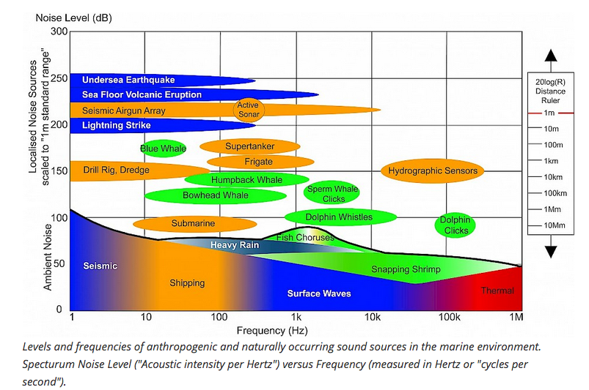
With an hydrophone acquiring up to 96kHz, we are integrating informatin up to 48kHz
Notes:
With an hydrophone acquiring up to 96kHz, we are integrating informatin up to 48kHz.
The SPL

Slide 34
Each provider will provide at least the following:
SPL in dB_{RMS} re 1 µPa with 20 seconds of integration time
SPL₆₃ in dB re 1 µPa at 63 Hz with 20 seconds of time integration
SPL₁₂₅ in dB re 1 µPa at 125 Hz with 20 seconds of time integration
Hydrophone metadata
Sampling frequency
Antialiasing filters applied
Gain
Sensitivity
Offset, in counts if it’s possible
Etc…

Slide 35
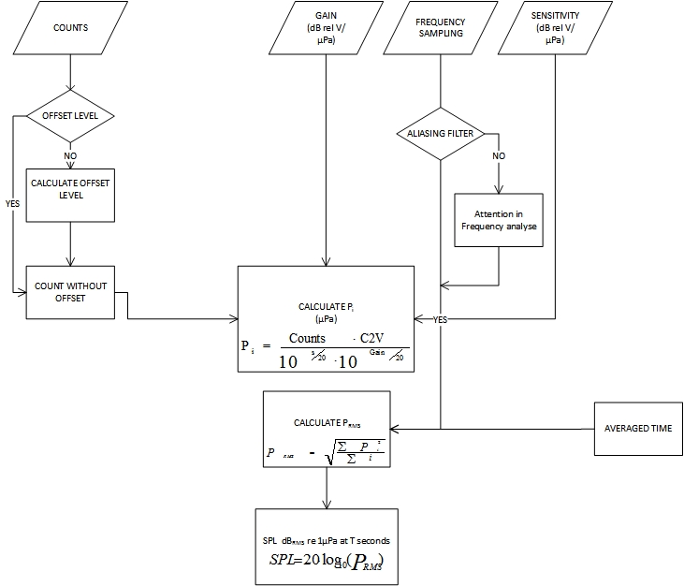

Slide 36
Vocabularies and Metadata:
http://vocab.nerc.ac.uk/collection/P07/current/CFSN0310/#20s
Sound pressure level in water (units dB re 1uPa with integration time 20s). This SPL is calculated with the whole spectrum
http://vocab.nerc.ac.uk/collection/P07/current/CFSN0310/#63Hz20s
Sound pressure level in water (units dB re 1uPa with integration time 20s). This SPL corresponds to the 63Hz 1/3 octave band
http://vocab.nerc.ac.uk/collection/P07/current/CFSN0310/#125Hz20s
Sound pressure level in water (units dB re 1uPa with integration time 20s). This SPL corresponds to the 63Hz 125 octave band
Other metadata:
The sampling rate, gain and offset parameters can be found at the capabilities section. This information can be retrieved with a DescribeSensor operation

Slide 37
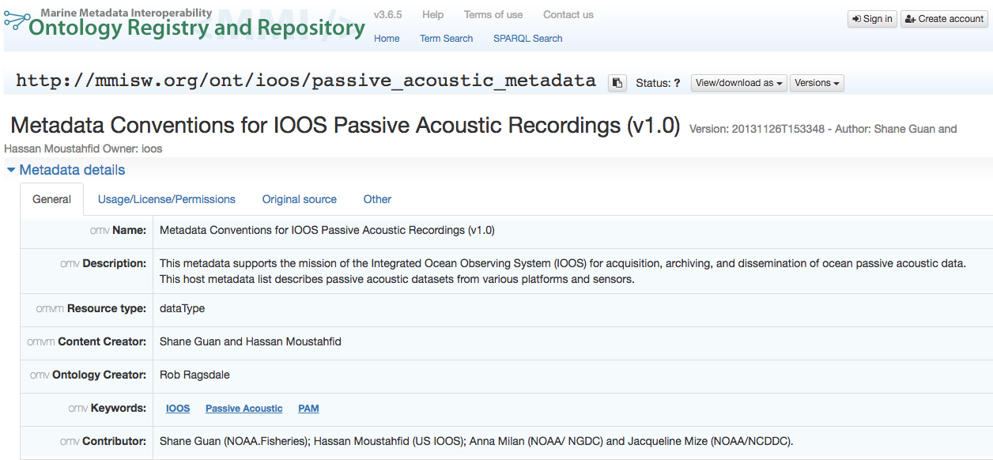
Vocabularies:
http://mmisw.org/ont/ioos/passive_acoustic_metadata
IOOS: It contains some of the parameters that we are using, but they are poorly defined.
If you have any comments or feedback on the vocabularies it would be great.

Slide 38
SOS parameters
SOS URL: http://147.83.159.140:42222/obsea-test-sos
SOS URL: http://147.83.159.140:42222/obsea-test-sos/service
Procedure: "5aaf2faf-4dd9-4967-90a3-b731fd174392"
Offering: "offering_5aaf2faf-4dd9-4967-90a3-b731fd174392"
FeatureOfInterest: http://www.obsea.es
this should be improved with a proper definition of the OBSEA test site
Link to latest data:
http://147.83.159.140:42222/client/#/diagram?timespan=2017-09-08T11:05:44%2B02:00%2F2017-09-08T14:34:55%2B02:00&ts=Obsea-test-sos__22,Obsea-test-sos__21,Obsea-test-sos__20

