Slide 1
COST Action ES1206:
Advanced GNSS tropospheric products for monitoring severe weather events and climate
Jonathan Jones
Met Office, UK
EGU 2018
Notes:
Structure of Action and organisation then Scientific findings

Slide 2
Overview/Problem
Q. How to present 4-year’s worth of work of 150+ people from 60+ institutes in 40 countries in 15mins?
A. I can’t
So, overview of Action and some scientific highlights

Slide 3
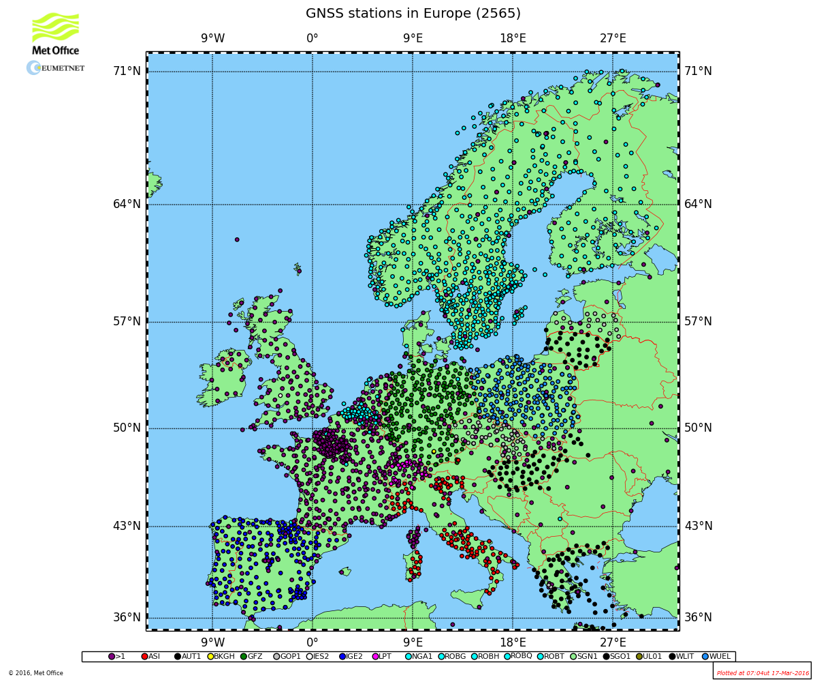
European Operational GNSS-Met.
EIG EUMETNET E-GVAP Project
Focus is GPS-only ZTDs in NRT (<90min delay)
Delivery of ~21M ZTDs per month from ~3300 sites
Operational assimilation underway at a number of European NMSs
T and P used for conversion to Water Vapour (IWV)
Assimilation of ZTDs demonstrated positive impact on NWP

Slide 4
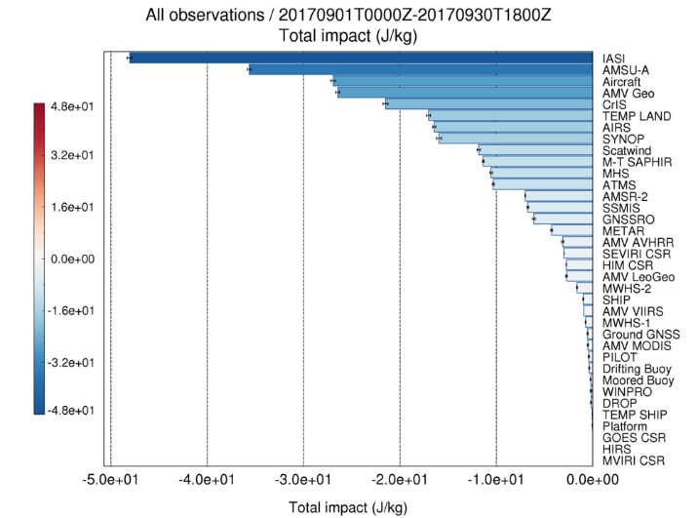
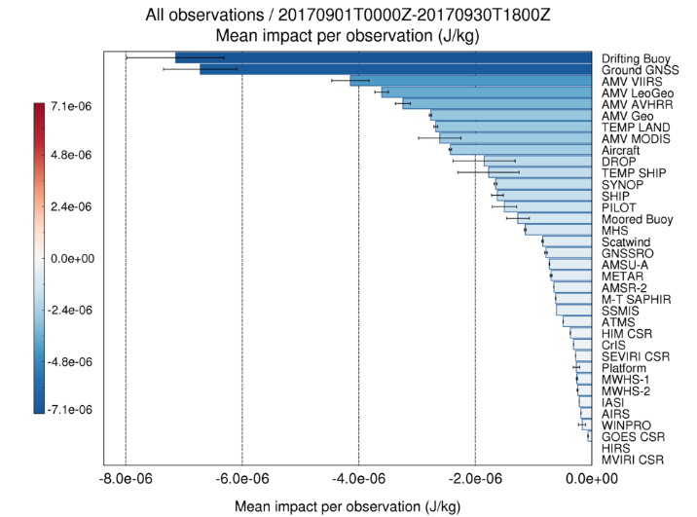
NWP ZTD Impact
Proven positive impact in NWP (Regional, European and Global)
Very high impact on a ‘per-observation’ basis
Current NWP schemes not already saturated with humidity obs.

Slide 5
Emerging Requirements
ZTD gives observation of ‘cone of observation’, averaged over a time period - observations providing horizontal and vertical information are desired
New hi-res NWP models (e.g. UKV 1.5km) require ZTDs with improved timeliness and greater spatial and temporal resolution
Forecasters require IWV images with much improved latency (increase the usefulness of GNSS products)
Climate community now starting to become aware of high-quality reprocessed GNSS tropospheric products

Slide 6
Evolving GNSS Capabilities
Advanced tropospheric products becoming available (slants, EW/NS gradients, 3D tomography, single freq.)
Multi-GNSS - new frequencies, increased number of SVs, improved geometries etc
Real-time raw data streaming (i.e. NTRIP)
Real time PPP processing (e.g. from BNC)
Long-term, homogenised regional and global GNSS-tropospheric products now available (EPN/IGS/others)

Slide 7
ES1206: GNSS4SWEC
‘To enhance existing and develop new, ground-based multi-GNSS tropospheric products, assess their usefulness in severe weather forecasting and climate monitoring, and to improve GNSS accuracy through enhanced atmospheric modelling.’
4yr project (2013-2017)
32 COST Countries
150+ participants from 60+ institutes
8 NCIs in Israel, Canada, USA, Australia and Hong Kong
1 COST NNC (OTC Tunisia)
NB. COST do not fund work
Notes:
COST Actions do not fund actual research
COST Actions do fund meetings, workshops, training schools, STSMs and dissemination

Slide 8
GNSS4SWEC Structure
Chair: J. Jones (UK Met Office)
Vice-chair: G. Guerova (Univ. of Sophia)
WG1 - Advanced GNSS Processing Techniques
Chair: J. Dousa (GOPE) Co-chair: G. Dick (GFZ)
WG2 - GNSS for Severe Weather Monitoring
Chair: S. de Haan (KNMI) Co-chair: E. Pottiaux (ROB)
WG3 - GNSS for Climate Monitoring
Chair: O. Bock (IGN) Co-chair: R. Pacione (e-geos)
WG1
73 participants
25 countries
11 sub-WGs
WG2
38 participants
21 countries
7 sub-WGs
WG3
60 participants
18 countries
5 sub-WGs

Slide 9
Action Networking Activities
Kick-off MC meeting | Brussels, Belgium | 2013
Core Team meeting | Potsdam, Germany | 2013
Working Group and MC Meeting | Valencia, Spain | 2013
Core team Meeting | Prague, Czech republic | 2013
Workshop and MC Meeting | Munich, Germany | 2014
Dissemination Meeting | Washington DC | 2014
Core Team meeting | Vienna, Austria | 2014
Summer School, WG and MC | Varna, Bulgaria | 2014
Core Team meeting | Paris, France | 2015
Workshop and MC | Thessaloniki, Greece | 2015
Working Group and MC Meeting | Wroclaw, Poland | 2015
IGS Workshop | Sydney, Australia | 2016
Workshop and MC Meeting | Reykjavik, Iceland | 2016
WG3 Homogenisation Workshop | Brussels, Belgium | 2016
Core Team Meeting | Vienna, Austria | 2016
Dissemination Meeting | Beijing, China | 2016
Summer School, WG and MC Meeting | Potsdam, Germany | 2016
WG3 Homogenisation Workshop | Warsaw, Poland | 2017
Final Workshop | Noordwijk, Netherlands | 2017
Notes:
How did we achieve the objectives? - 17 meetings and workshops, 2 training schools, 23 STSMs plus Action was presented at 20+ international conferences (engagement with wider geodetic and meteorological communities etc). Remember COST do not fund any actual research, only networking

Slide 10
23 STSMs
Name | From | To | Title
Furqan Ahmed | Luxenbourg | France | Impact of Assimilating GNSS-derived ZTD from Luxembourg and the Greater Region into NWP model AROME
Kalev Rannat | Estonia | Germany | Improved processing and use of GNSS Zenith Total Delay and Integrated Water Vapour data for Climatology
Tomasz Hadas | Poland | Canada | Neutral atmosphere delay model for Precise Point Positioning
Witold Rohm | Poland | UK | Application of GNSS tomography for severe weather studies
Pavel Vaclavovic | Czech Rep. | ROB | Developing of ultra-fast tropospheric products
Tzvetan Simeonov | Bulgaria | Luxembourg | Tropospheric products processing for Bulgarian ground-based GNSS network
Peter Szabo | Hungary | Bulgaria | Tropospheric products from GNSS and ALADIN-Climate regional climate model for East-Southeast Europe
Jan Dousa | Czech Rep. | Turkey | Installing new analysis centre for near real-time GNSS troposphere monitoring in Turkey
Jan Dousa | Czech Rep. | Greece | Installing new analysis centre for near real-time GNSS troposphere monitoring in Greece
Gokhan Gurbuz | Turkey | Hungary | Develop a near real-time GNSS processing system for the Turkish GNSS stations (Istanbul and Ankara).
Karina Wilgan | Poland | Switzerland | Parameterized refractivity models and GNSS path delays in view of GNSS Severe Weather Monitoring
Riccardo Biondi | Italy | Belgium | GNSS atmospheric water vapour detection for extreme events
Andre Sa | Portugal | Poland | Tomography as a tool for atmospheric studies
Katarzyna Stepniak | Poland | France | Impact of processing parameters on the ZTD estimates and adaptation of ZTD screening methods
Michal Kacmarik | Czech Rep. | GFZ | Validation of GNSS Slant Delays
Rita Nogherotto | Italy | La Reunion | Tropical cyclone intensification, water vapour distribution and GNSS measurements
Tomasz Hadas | Poland | Luxenbourg | Optimization of real-time GNSS troposphere delay estimation algorithms
Katarzyna Stepniak | Poland | France | Improved methods for reprocessing of GNSS data for climate monitoring over Poland
Anna Klos | Poland | Luxenbourg | Analysis of ZTD timeseries from reprocessed GPS solutions
Jan Dousa | Czech Rep. | Iceland | Installing new GNSS analysis centre for troposphere monitoring in Iceland
Kamil Kazmierski | Poland | Canada | Real-time troposphere delay gradient estimation with multi-GNSS PPP
Karina Wilgan | Poland | BIRA | Lookup tables of refractivity coefficients for the conversion from zenith path delays to integrated water vapour
Anna Klos | Poland | Lux | Selected Issues of Homogenisation of Synthetic ZTD Data with Noise Characteristic Derived from Reprocessed GPS Solutions
Anna Klos | Poland | ROB | Homogenisation and characterisation of IWV time series from IGS repro1 and its comparison to ERA-Interim
Notes:
Originally planned 12, achieved 23. Great success

Slide 11
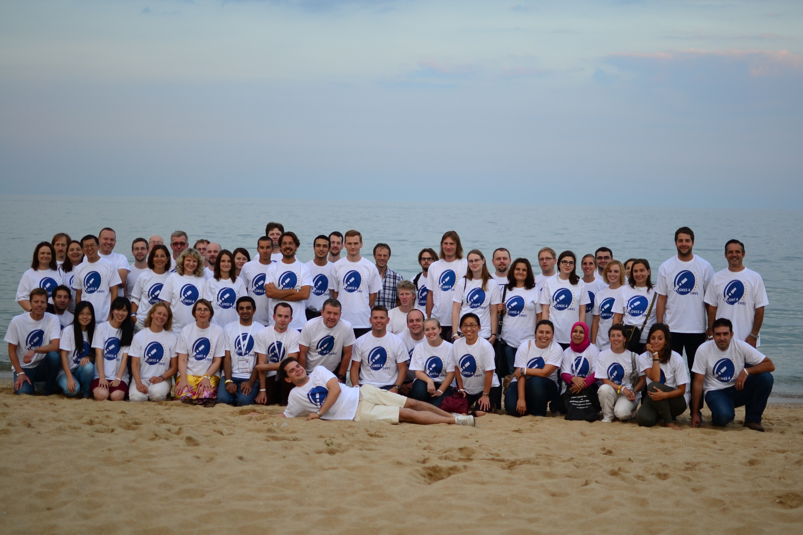
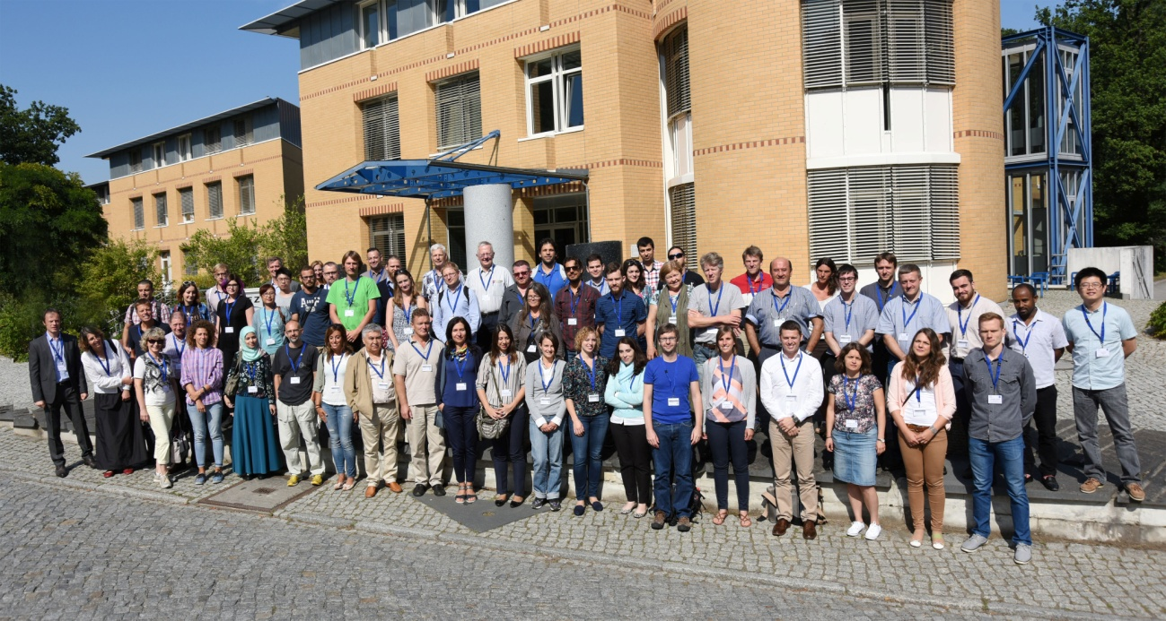
Training Schools
2 Summer Schools to train the next generation of scientists
Talks included basic science, GNSS-meteo, climate and operational meteorology
Sept 2014, Varna, Black Sea Coast
12 Tutors, 33 Students
Aug 2016, GFZ, Potsdam
17 Tutors, 42 Students
Notes:
2 training schools with invited speakers to train the next generation of scientists

Slide 12
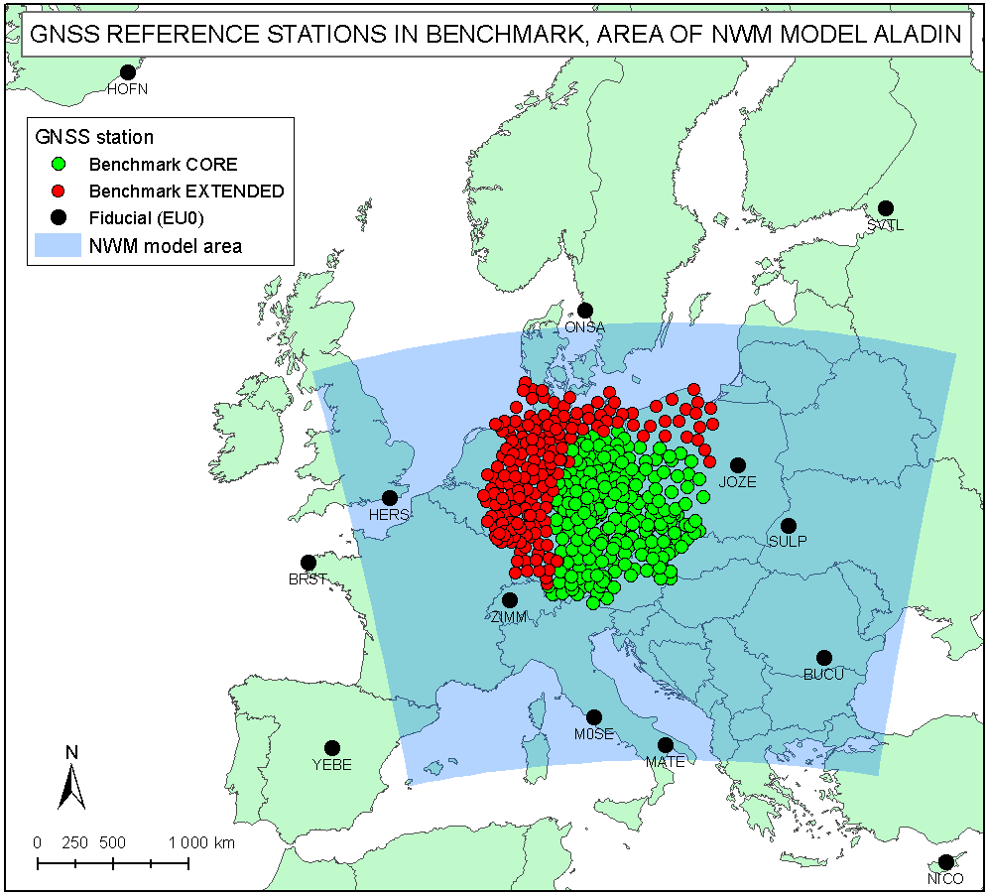
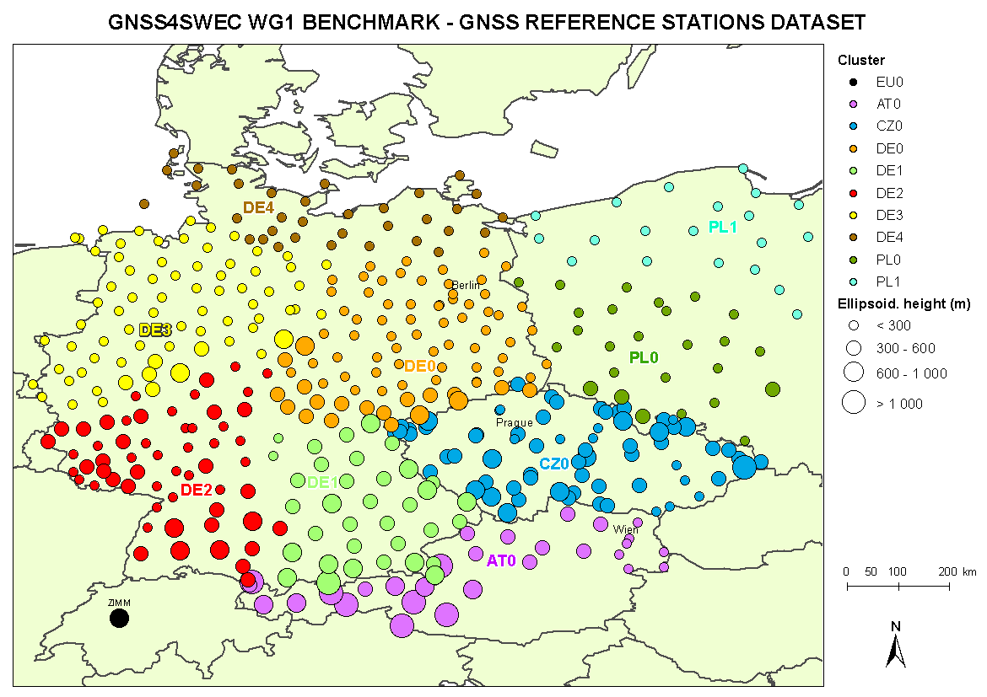
Benchmark Campaign
Goal: Design a common dataset for assessment of advanced GNSS tropospheric products
Benchmark design & data collection
May-June 2013 floods of Danube/ Moldau/Elbe
GNSS: ~500 stations
SYNOP: ~200 stations
NWM: regional (Aladin-CZ), global (ERA-Interim, NCEP GFS)
RAOBS: 2 high-resolution
WVR: Potsdam, Lindenberg
RADAR images: Brdy, Skalka
Reference products
GNSS: Bernese (GOP), EPOS (GFZ)
NWM: G-Nut/Shu (GOP), DNS (GFZ)
Notes:
In terms of the scientific results, too much to list here, just some highlights………..

Slide 13
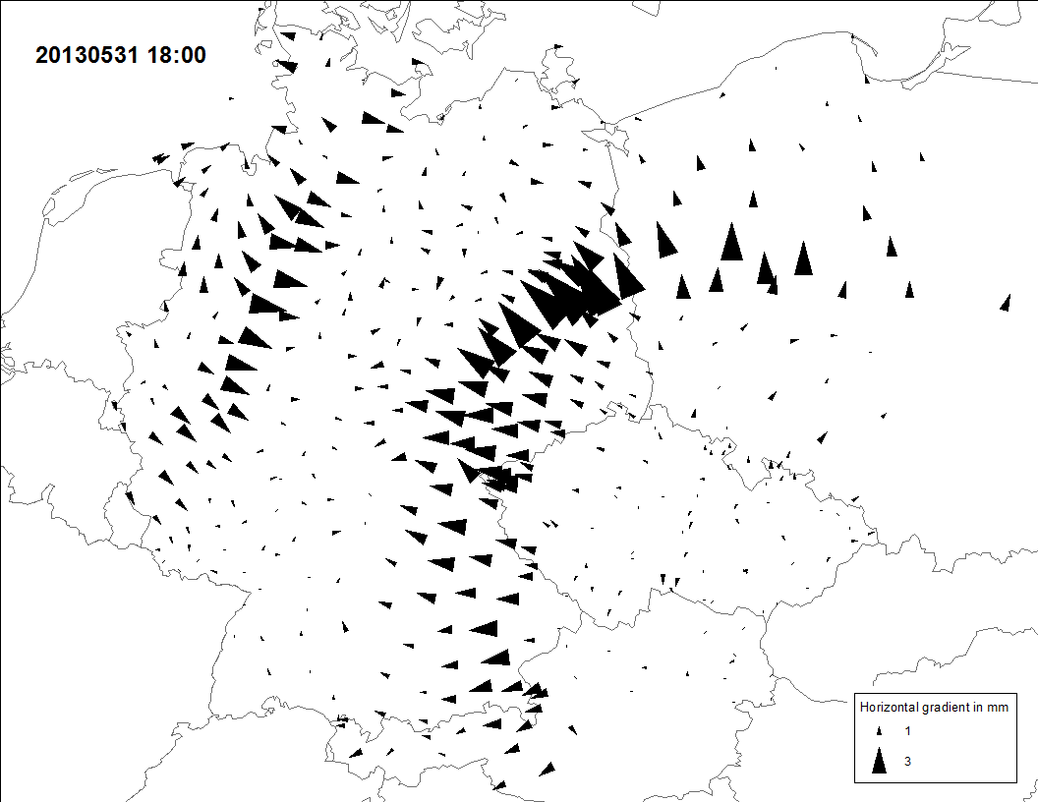
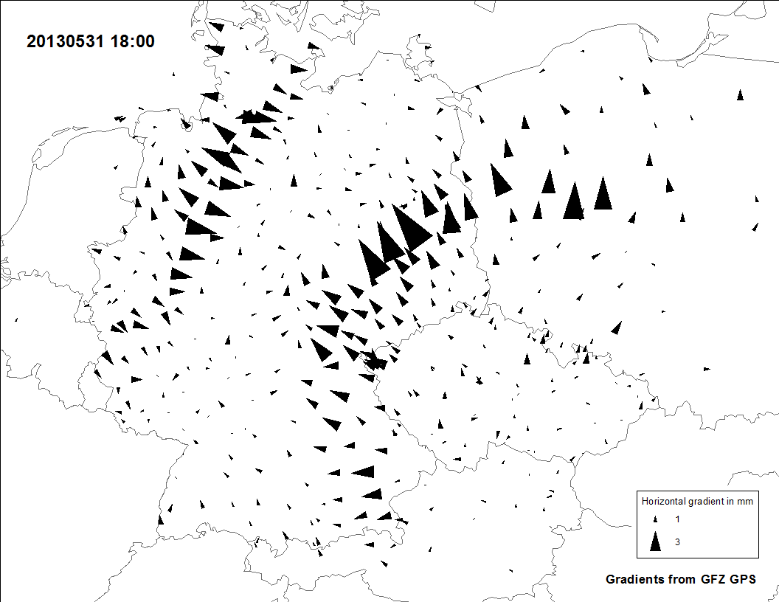
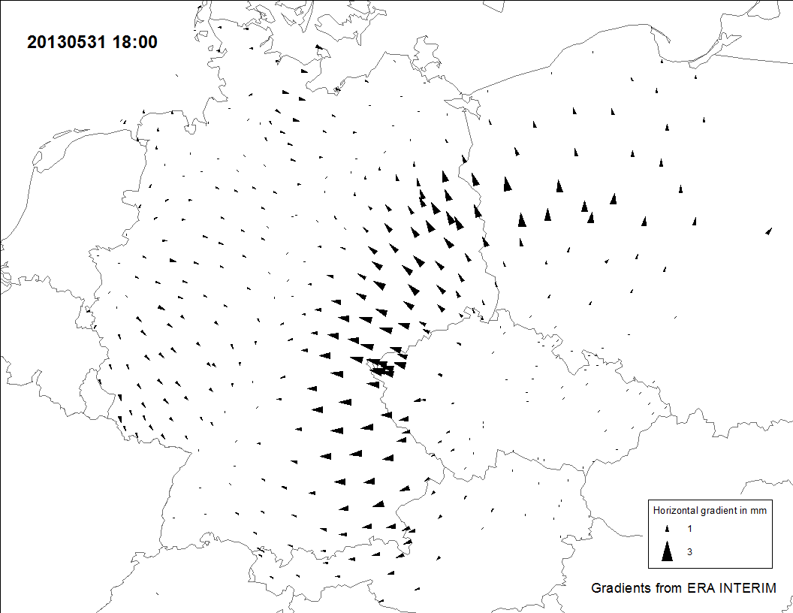
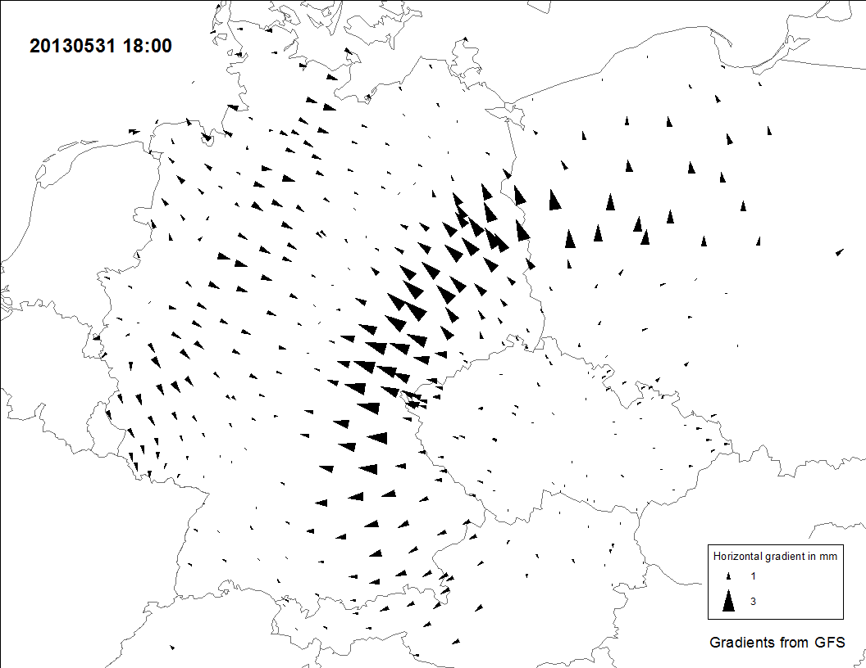
Asymmetry Monitoring
Goal: Develop and assess advanced products for tropospheric asymmetry monitoring
GOP GNSS-gradients
GFZ GNSS-gradients
ERA-Interim gradients
NCEP RT gradients
May 31, 2013 (Benchmark) – estimates of (E-W, N-S) tropospheric gradients from GNSS & NWM
Development of NRT/RT high-resolution gradients and slant delays
Derivation of 1st and 2nd order troposphere gradients from NWM
Inter-comparison of gradients and slant delays from GNSS, NWM and WVR
More info see: Kacmarik et al (2016), atmos-meas-tech.net/9/2989/2016/doi:10.5194/amt-9-2989-2016

Slide 14
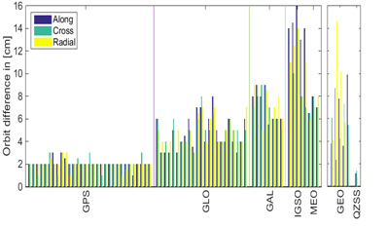
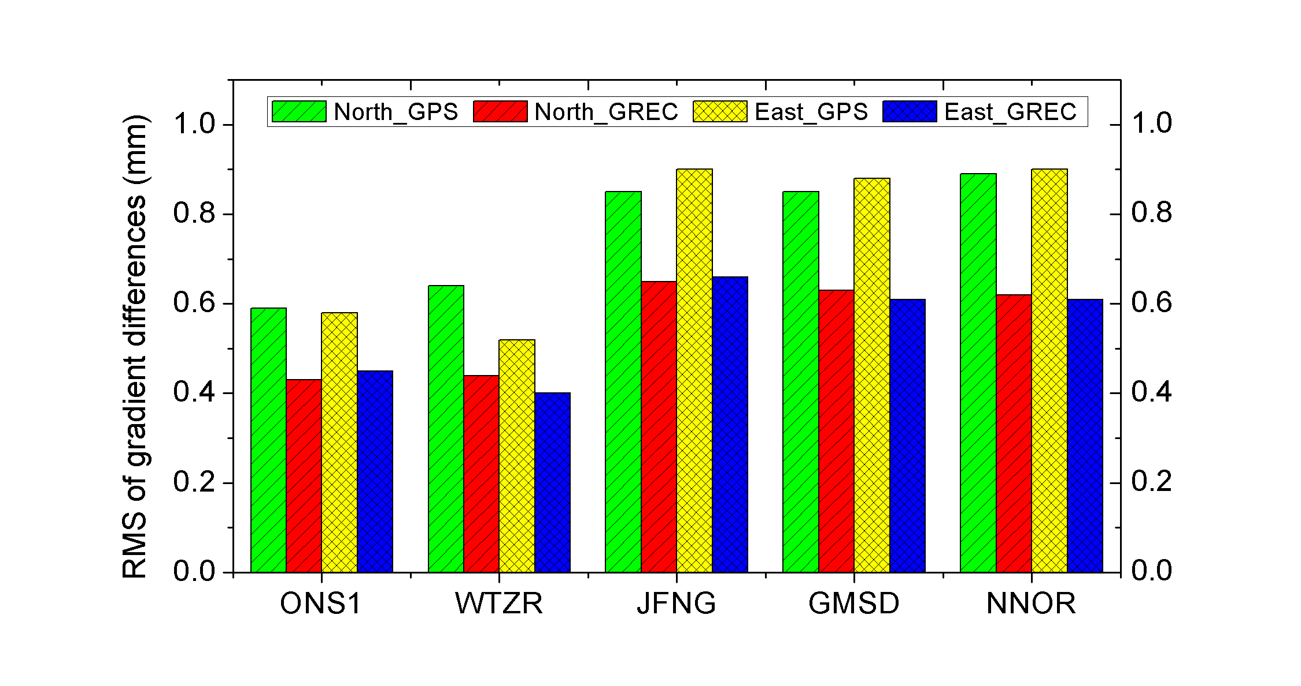
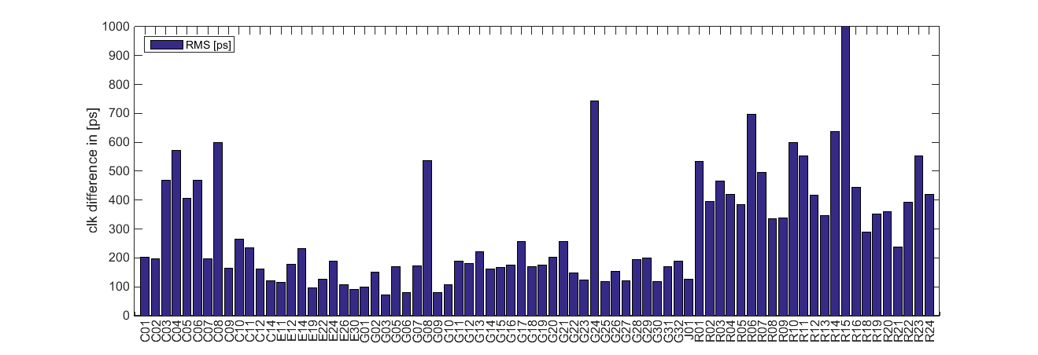
Assessment of Multi-GNSS
Goal: Adapt software for multi-constellation processing and assess its impact on tropospheric products
Several software developed/adapted for multi-GNSS data processing
GLONASS integrated in various NRT & RT-Demo solutions, GLONASS used within Benchmark campaign
Since Nov 2015 GFZ provide ultra-rapid multi-GNSS orbit and clock product every 3 hours
Includes GPS, GLO, GAL, BDS and QZSS
Latency is less than 2 hours
Courtesy of Deng et al (GFZ)

Slide 15
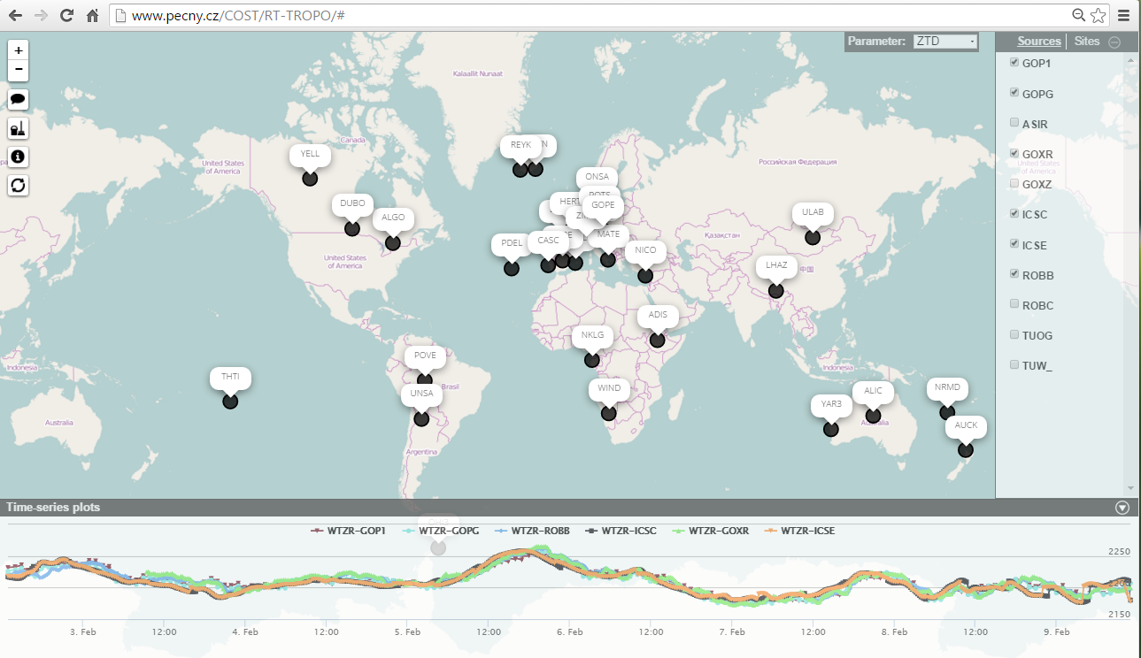
Validation of RT Tropo Estimates
Goal: Develop and assess ultra-fast and real-time tropospheric products for NWP nowcasting
Database of RT products established at GOP
Use IGS RT products for RT PPP
15 European sites
32 Global sites
6 Processing software types
7 ACs (plus WRF Model)
AC | Software | Start | Update | Solutions
GOP | G-Nut/Tefnut | 9.4. 2015 | real-time | GPS, GLO, grad
TUW | TUW software | 15.4. 2015 | real-time | GPS
ROB | G-Nut/Tefnut | 23.4. 2015 | real-time | GPS, GLO, grad
ASI | Gipsy-Oasis | 5.5. 2015 | hourly | GPS, gradients
UL | BNC, PPP-wizard | 15.6. 2015 | real-time | GPS
ICS | G-Nut/Shu | 12.7.2015 | forecast | WRF (EU, CZ)
TUO | RTKLib | 5.11.2015 | real-time | GPS
BKG | BNC | 15.3.2016 | real-time | GPS, GLO
Monitoring at: http://www.pecny.cz/COST/RT-TROPO
F. Ahmed et al. (2016) Comparative analysis of real-time precise point positioning zenith total delay estimates. GPS Solutions, 20 (2). pp. 187-199. ISSN 1521-1886
Notes:
RT solutions noisier (higher RMS) – to be expected, but no inherent bias
Adaptation of NWP schemes to compensate

Slide 16
Improved Network Coverage
Goal: Support transfer of knowledge, data exchange for improving coverage of tropospheric products in Europe
7 new ACs:
Hungary: Satellite Geodetic Observatory
Turkey: Karadeniz Technical University,
Greece: Aristotle University
Turkey: Bulent Ecevit University
Icelandic: Meteorological Office
Poland: MUT
Bulgaria: Sophia University
8 new GNSS networks:
Italy, Hungary, Greece, Lithuania, Latvia, Slovakia, Turkey, Iceland.
+ others expected: Turkey, Austria, Denmark
+ others revitalised: Norway, Sweden, Finland, Poland
All new data made available to E-GVAP (http://egvap.dmi.dk/) for QC and assimilation.
Notes:
Increase in Poland, Greece, Iceland, Latvia, Lithuania, Slovakia and also Italy. But also increase in density in Spain, France and Nordic countries. Not all down to COST Action, but some e.g. STSMs to establish new ACs in Greece and Iceland for example

Slide 17
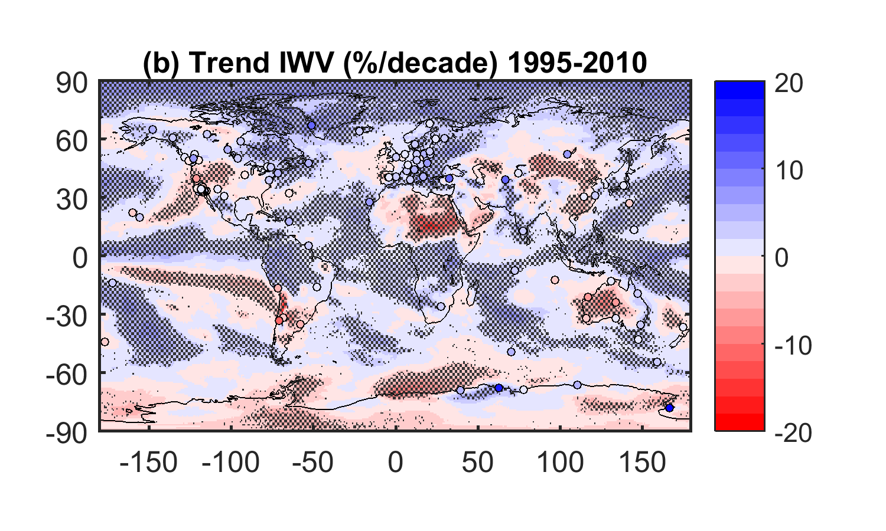
Climate Database at GOP
ERA-Interim vs IGS Repro1 IWV Trend
irkt
ccjm
mcm4
Notes:
Grey areas are statistically significant with 90% confidence level

Slide 18
Impact of Discontinuities on trend estimates
CCJM
(Ogasawara, Japan)
ERA-Interim
IGS repro1
Receiver and antenna changes
Antenna
Trends
+ 0.98 kg/m2/decade
– 1.4 kg/m2/decade
EGU General Assembly, Apr 2016, Vienna, Austria. Geophysical Research Abstracts, 18, pp.EGU2016-6807
Notes:
Big jump in 2001 is due to simultaneous antenna AND receiver change.
Quite a noisy station prior to ~2001 (high residuals – typically <20mm in the vertical)

Slide 19
Ongoing Activities
Final Report submitted - publication mid-2018
Inter-journal Special Issue (ACP/AMT/Ann. Geo) https://www.ann-geophys.net/special_issue400_89.html
Severe Weather database (@UKMO) ongoing
COST/IGS climate database (@GOP) ongoing
Action feeding in to E-GVAP Phase IV (2019-2023)
More of a focus on increased timeliness
Coordination of Global ZTDs
ZTD gradients and STDs are expected to benefit high resolution NWP (data formats already developed)

Slide 20
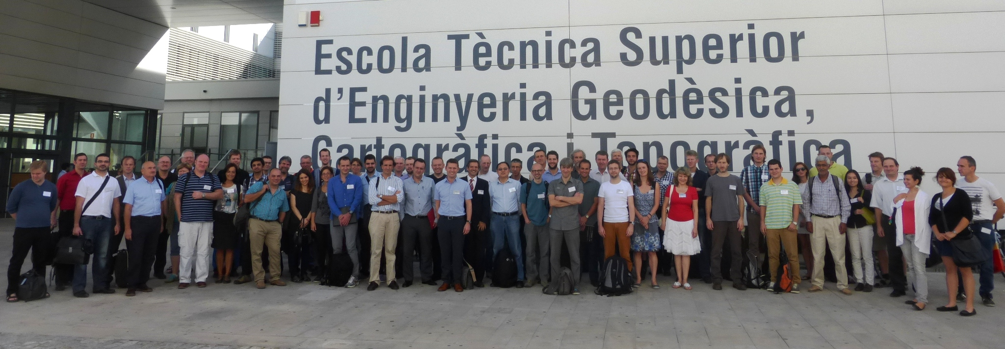
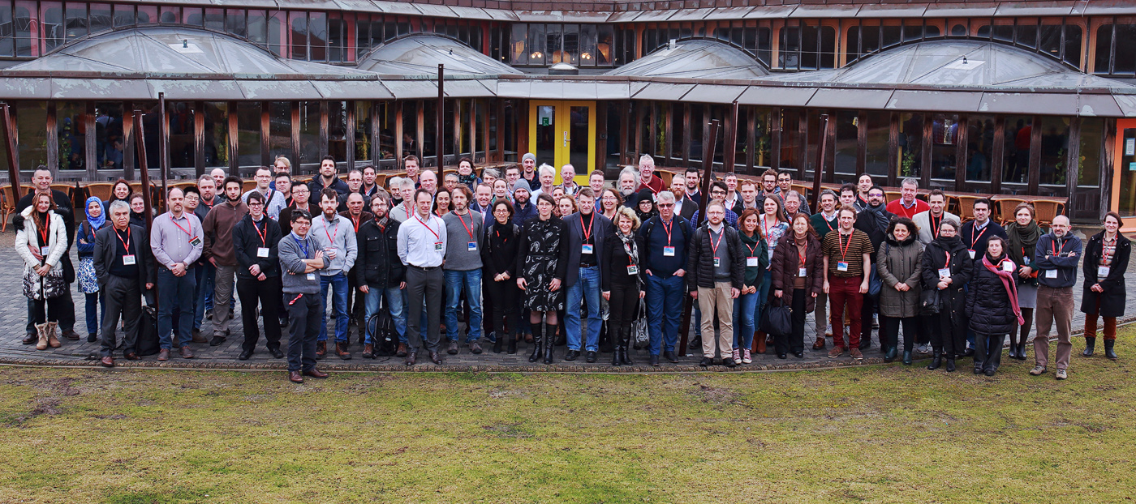
ES1206: Advanced GNSS tropospheric products for monitoring severe weather and climate
Jonathan.jones@metoffice.gov.uk
http://www.cost.eu/COST_Actions/essem/ES1206

Slide 21
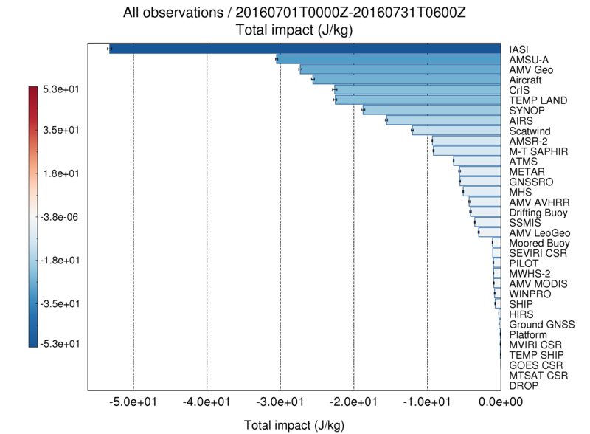
Impact in NWP of additional GNSS
Positive impact of an additional ~300 sites in the Met Office Global UM
GNSS moves up ‘total impact’ scale substantially
More sites = more impact

Slide 22
Action High Level Objectives
Coordinate the development of new, more advanced multi-GNSS tropospheric products and assess the benefit to meteorology
Establish a database of reference tropospheric solutions (GNSS, RS, NWP, WVR, VLBI etc) and determine the value of GNSS to climate research
Establish a severe weather database and determine the value of GNSS to the forecaster community
Increase GNSS coverage (particularly in E and SE Europe) by exchange of data and expertise
Stimulate the exploitation of NWP data as an input to GNSS processing
Standardize conversion of ZTD to IWV

Slide 23
Contents
Executive Summary
Foreword
Glossary
1 Abstract
2 Scientific Background
2.1 Atmospheric Water Vapour
2.2 Global Navigation Satellite Systems (GNSS)
2.2.1 GNSS Basics
2.2.2 Tropospheric Delay
2.2.3 Zenith Delay Estimates
2.2.4 Derivation of IWV from ZTD
2.3 References for Scientific Background
3 General background
3.1 State-of-the-art at start of Action
3.2 Reasons for the Action
3.3 Objectives
3.4 Impacts and Benefits
3.4.1 Societal Benefits
3.4.2 Scientific Benefits
3.4.3 Technological Benefits
3.4.4 Economic Benefits
3.4.5 Target groups and end-users
3.5 Scientific Programme
3.5.1 Scientific focus
3.6 Scientific work plans
3.6.1 Working Group 1: Advanced GNSS processing techniques
3.6.2 Working Group 2: Use of GNSS tropospheric products for high-resolution, rapid-update NWP and severe weather forecasting
3.6.3 Working Group 3: Use of GNSS tropospheric products for climate monitoring
4 Working Group 1
4.1 Campaigns for development of advanced tropospheric products
4.1.1 Benchmark campaign – common data set for new product development and validation
4.1.2 GNSS Real-time PPP demonstration campaign
4.2 Tropospheric asymmetry monitoring and advantage of multi-GNSS
4.2.1 Concept of tropospheric gradients
4.2.2 Global validity and behaviour of tropospheric gradients estimated by GPS
4.2.3 Monitoring of severe weather from wet gradients, residuals and slants
4.2.4 Indicator of tropospheric activity based on the disruption of GNSS signal
4.2.5 Validation of slant tropospheric delays
4.2.6 Information content in post-fit residuals, PPP vs DD approach
4.2.7 Tropospheric parameters from multi-GNSS analysis
4.2.8 Multi-GNSS solutions and products
4.3 PPP and ultra-fast GNSS tropospheric products
4.3.1 Real-Time data and products dissemination
4.3.2 BKG real-time analysis development and contribution
4.3.3 Assessment of IGS RTS orbits and clock corrections and GOP real-time tropospheric products
4.3.4 Real-time product development and evaluation in ROB
4.3.5 GFZ real-time product development and assessment in RT analysis
4.3.6 Contribution to RT demonstration campaign from ULX
4.3.7 New adaptable strategy for RT and NRT troposphere monitoring
4.3.8 Optimum stochastic modeling for GNSS tropospheric delay estimation in real-time
4.4 Exploiting NWM-based products for precise positioning
4.4.1 Tropospheric parameters from numerical weather models
4.4.2 The impact of global and regional climatology on the performance of tropospheric blind models
4.4.3 Refined discrete and empirical troposphere mapping functions VMF3 and GPT3
4.4.4 The impact of NWM forecast length on ZTDs
4.4.5 Dual-layer tropospheric correction model combining data from GNSS and NWM
4.4.6 Tropospheric refractivity and zenith path delays from least-squares collocation of meteorological and GNSS data
4.4.7 Improving Precise Point Positioning with Numerical Weather Models
4.4.8 Using external tropospheric corrections to improve GNSS positioning of hot-air balloon
4.4.9 Real-time PPP augmented with high-resolution NWM model data
4.4.10 Validation and implementation of direct tropospheric delay estimation for precise real-time positioning
4.5 GNSS data reprocessing for climate
4.5.1 EUREF Repro2 contribution of swisstopo
4.5.2 EUREF Repro2 assessment of GOP processing variants
4.5.3 CORDEX.be reprocessing
4.5.4 GRUAN reprocessing
4.5.5 GFZ TIGA reprocessing
4.5.6 ULX TIGA reprocessing
4.6 New analysis centers, networks and solutions
4.6.1 Trop-NET system for collaborative ground-based GNSS Meteorology
4.6.2 Sofia University GNSS analysis center (SUG AC): First processing campaign
4.6.3 TU Wien near real-time GNSS analysis center in Austria (TUW AC): First processing results
4.6.4 New operational solutions from ROB in support to global NWP models and rapid-update numerical nowcasting
4.6.5 New methods to user GNSS vapor estimates for meteorology (NUVEM)
4.6.6 Near real-time GNSS processing at ASI/CGS, Italy
4.6.7 New analysis center (AUTh) and National Observatory of Athens (NOA)
4.6.8 New analysis center in Iceland, Icelandic Meteorological Office (IMO)
4.6.9 New analysis center in Hungary (BUTE)
4.7 References for Working Group 1
5 Working Group 2
5.1 Non-Numerical Nowcasting
5.1.1 Investigation of fog in Bulgaria using GNSS tropospheric products
5.1.2 WRF model evaluation with GNSS-IWV for intense precipitation cases in Bulgaria
5.1.3 Case study of Foehn in Sofia with GNSS tropospheric products
5.1.4 A GNSS-based Nowcasting toolbox for Severe Weather in Belgium
5.2 Numerical Nowcasting and NWP Data Assimilation
5.2.1 HARMONIE-AROME Group
5.2.2 Assimilation of the E-GVAP ZTD data into the WRF model
5.2.3 Improvement of forecast skill of the GLAMEPS Model
5.2.4 Slant Total Delay Assimilation in COSMO-DE: First Results
5.2.5 Data assimilation experiments with GNSS ZTD in AROME 3DVAR
5.3 Tomography
5.3.1 Nowcasting using tomography
5.3.2 Requirements for assimilation of tomography results
5.3.3 Assimilation of relative humidity
5.3.4 Assimilation of temperature and specific humidity
5.3.5 Assimilation of Wet Refractivity
5.3.6 Conclusions
5.4 Standardisation
5.4.1 Introduction
5.4.2 Body
5.4.3 Conclusions
5.4.4 References
5.4.5 Acknowledgments
5.5 Benchmark and Case Study Databases at U.K. Met Office
5.6 ZTD to IWV Conversion
5.6.1 Introduction
5.6.2 Body
5.6.3 Conclusions
5.6.4 References
5.6.5 Acknowledgments
5.7 Exchange Format and User Requirements
5.7.1 Introduction
5.7.2 Body
5.7.3 Conclusions
5.7.4 References
5.7.5 Acknowledgments
5.8 References for Working Group 2
6 Working Group 3
6.1 Introduction
6.2 Available reprocessed ZTD and IWV datasets
6.2.1 Inventory of available reprocessed ZTD datasets
6.2.2 IGS repro1 as first reference GNSS IWV dataset
6.2.3 EPN repro2 GNSS reprocessing campaign
6.2.4 VLBI reprocessing campaign
6.2.5 DORIS reprocessing campaign
6.3 Sensitivity studies on GNSS processing options
6.3.1 An overview of the GNSS data processing strategies
6.3.2 Software Agreement
6.3.3 PPP vs. DD processing modes
6.3.4 Baseline strategy in DD processing
6.3.5 Mapping Functions
6.3.6 Trends in the IWV estimated from ground-based GPS data: sensitivity to the elevation cutoff angle
6.3.7 Improving stochastic tropospheric model for better estimates during extreme weather events
6.3.8 Multi-GNSS data processing
6.3.9 Impact of IGS type mean and EPN individual antenna calibration models
6.3.10 Impact of non-tidal atmospheric loading models
6.3.11 Using estimated horizontal gradients as tool for assessment of GNSS data quality
6.3.12 Conclusions and recommendations on processing options
6.4 Standardisation of ZTD screening and IWV conversion
6.4.1 ZTD screening
6.4.2 ZTD to IWV conversion
6.4.3 The uncertainty of the atmospheric integrated water vapour estimated from GNSS observations
6.5 ZTD/IWV Homogenisation
6.5.1 Introduction
6.5.2 Methodology
6.5.3 Assessment of the homogeneity of ERA-interim
6.5.4 Synthetic dataset generation
6.5.5 Involved homogenization algorithms
6.5.6 Assessment of the performance of the tools on the synthetic datasets
6.5.7 Conclusions and Outlook
6.6 IWV intercomparisons
6.6.1 A literature overview
6.6.2 A comparison of Precipitable Water Vapour Products over the Iberian Peninsula
6.6.3 Comparing precipitable water from remote sensing and space geodetic techniques with numerical weather models
6.6.4 Inter-comparison analysis of tropospheric parameters derived from GPS and RAOB data observed in Sodankylä, Finland
6.7 IWV trends & variability from GNSS data and atmospheric models
6.7.1 Analysis of IWV trends and variability from GNSS and reanalyses
6.7.2 Analysis of IWV trends and variability from GNSS and satellite data
6.7.3 Evaluation of IWV diurnal variation in regional climate models using GPS
6.7.4 Validation of the regional climate model ALARO-SURFEX by EPN Repro2
6.7.5 Evaluation of IWV trends and variability in a global climate model
6.7.6 Anomalies of hydrological cycle components during the 2007 heat wave in Bulgaria
6.8 Database, formats and dissemination
6.8.1 GOP-TropDB – comparison tropospheric database
6.8.2 Tropo SINEX format
6.9 References for Working Group 3
7 National Status Reports
7.1 COST Countries
7.1.1 Austria
7.1.2 Belgium
7.1.3 Bulgaria
7.1.4 Cyprus
7.1.5 Czech Republic
7.1.6 Denmark
7.1.7 Estonia
7.1.8 Finland
7.1.9 France
7.1.10 Germany
7.1.11 Hungary
7.1.12 Iceland
7.1.13 Israel
7.1.14 Italy
7.1.15 Lithuania
7.1.16 Luxembourgh
7.1.17 Poland
7.1.18 Portugal
7.1.19 Slovakia
7.1.20 Spain
7.1.21 Sweden
7.1.22 Switzerland
7.1.23 Turkey
7.1.24 United Kingdom
7.2 COST International Partner Countries
7.2.1 Hong Kong
7.2.2 Australia
7.2.3 Canada
8 STSM Reports
8.1 References Chapters 7 and 8
9 Appendix
A. List of meetings and workshops
B. Members of Management Committee and Working Groups
B1 Members of the Management Committee
B2 Members of the Working Group 1
B3 Members of Working Group 2
B4 Members of Working Group 3
B5 Contributors to GNSS4SWEC Final report - by affiliation
C. List of publications
D. SINEX-TRO V2.00 format description
Final Report Contents

Slide 24
WG1: Advanced GNSS Processing Techniques
Support establishment of new GNSS ACs in Eastern Europe
Develop new multi-GNSS processing algorithms (GLONASS + Galileo ready)
Develop new GNSS tropospheric products (RT slants, gradients etc)
Develop tropospheric models using NWP data to improve real-time GNSS processing
Move new products to operations
1st Workshop (State-of-the-art review)
Kick-off Meeting
2nd Workshop (Ultra-fast/real-time Processing and Multi-GNSS Products)
3rd Workshop (Processing Techniques and New Product Assessment)
YEAR 1
YEAR 2
YEAR 3
YEAR 4
Green = Guidelines/reviews, Blue = Developments, Purple = Databases

Slide 25
WG2: GNSS for Severe
Weather Forecasting
DB of NWP data for positioning
DB of Sev. Weather case studies
Define user requirements
Evaluate quality of new GNSS processing algorithms (incl. GLONASS)
Evaluate new GNSS tropospheric products (gradients, slants etc)
Develop and test methods for init. of NWP models with the new products
Set up databank (obs.+products) for S.W. case studies
Test impact of new GNSS troposheric products for selected severe weather case studies
Develop operational tools for severe weather forecasting
Q.C. of new operational GNSS tropospheric products
Recommendations (Q.C. etc)
2nd Workshop (Strengths and Weakness of NWP models w.r.t. GNSS)
Kick-off Meeting
3rd Workshop (GNSS nowcasting - Tools and Practices)
1st Workshop (State-of-the-art review)
YEAR 1
YEAR 2
YEAR 3
YEAR 4

Slide 26
WG3: GNSS for Climate
Define user requirements
Establish database of reprocessed GNSS tropospheric products
Standardize method for ZTD to IWV conversion
Detect and mitigate discontinuities in the ZTD and IWV time series
Dev., eval., and standardize ZTD to IWV conversion
Develop diagnostic tools for quantifying climate trends and variability
Assess impact of reprocessed GNSS trop. products in NWP reanalysis products and climate models
Issue Guidelines
1st Workshop (State-of-the-art review)
Kick-off Meeting
2nd Workshop (Assessment of reprocessed GNSS tropospheric products)
3rd Workshop (Climate trends and variability of water vapour on regional and global scales)
YEAR 1
YEAR 2
YEAR 3
YEAR 4

Slide 27
Non-COST Funded Dissemination
AGU Fall Meeting | San Francisco, USA | 2013
Galileo Symposium | Prague, Czech republic | 2013
IAG Scientific Assembly | Potsdam, Germany | 2013
GRUAN ICM6 | Beltsville, USA | 2014
IGS Workshop | Pasadena, USA | 2014
EUREF Symposium | Vilnius, Lithuania | 2014
EGU General Assembly | Vienna, Austria | 2014
GRUAN ICM7 | Matera, Italy | 2015
EUREF Symposium | Leipzig, Germany | 2015
EGU General Assembly | Vienna, Austria | 2015
EMS Annual Meeting | Sofia, Bulgaria | 2015
Galileo Symposium | Braunschweig, Germany | 2015
EUREF Symposium | San Sebastian, Spain | 2016
AGU Fall Meeting | San Francisco, USA | 2016
EGU General Assembly | Vienna, Austria | 2016
EMS Annual Meeting | Trieste, Italy | 2016
UNAVCO Science Workshop | Boulder, USA | 2016
ECMWF | Reading | 2017
EUREF Symposium | Wroclaw, Poland | 2017
EGU General Assembly | Vienna, Austria | 2017
Notes:
Presentations - Lots of engagement with wider geodetic and meteorological communities

Slide 28
WG1 Objectives
Coordinate the development of new GNSS tropospheric products (ultra-fast ZTDs, gradients, 3D-tomography, multi-GNSS processing)
Coordinate GNSS data reprocessing and assess quality of homogeneous datasets in support of climate research.
Exploit NWP model products in precise GNSS positioning (mapping functions, tropospheric gradients, for real-time positioning etc).
Support setup of new observing networks and ACs by transferring knowledge and stimulating data exchange.
10 sub-WGs, 70 members from 25 countries

Slide 29
WG2 Objectives
Stimulate communication and transfer of data and knowledge between geodesy and meteorology.
Improve usage of GNSS products in NWP.
Study the impact of new GNSS products (gradients, slant delays, 3D-tomographic data etc) on NWP and non-NWP nowcasting.
Standardize GNSS processing methods and data formats for operational weather forecasting.
Establish a benchmark dataset and case studies for assessment and validation of new products.
5 sub-WGs, 44 members from 21 countries

Slide 30
WG3 Objectives
Assess the potential of GNSS tropospheric products for climate research (absolute accuracy, long-term stability)
Standardize GNSS post-processing methodology (processing, data screening, ZTD-IWV conversion, data homogenization etc)
Strengthen link with climate community
Assess climate trends and variability from GNSS data
Validation of climate model simulations (CMIP, CORDEX, EC-Earth).
5 sub-WGs, 52 members from 17 countries

