Slide 1
Navigation
Click embossed images for more information
Click on the arrows to move on and back
ABSTRACT
LET‘S START
April 12th 2018, Vienna
CTRL+SWAN
“Smart Water Network Monitoring using innovative On-line Sensors ”
European Innovation Partnership on Water Action Group CTRL + SWAN
Cloud Technologies & ReaL time monitoring + Smart WAter Network
A. Di Nardo, R. Bernini, S. Bodini, A. Cammissa, S. Capasso, F. Cascetta, F.Castaldo, M. Cocco, P. Cousin, M. D’Acunto, R. Di Leo, B. Della Ventura, A. Di Mauro¹, M. Di Natale, M. Doveri, B. El Mansouri, R. Germano, N. Giunta, R. Greco, P. Iovino, E. Katsou, R. Koenig, C.S. Laspidou, V. Lisbino, L. Lupi, M. Maietta, E. Martínez Díaz, D. Musmarra, M. Mussons Olivella, O. Paleari, F. Regan, M. J. Rodriguez-Pinzon, J. M. Rodriguez-Varela, L. Sanfilippo, G.F. Santonastaso, D. Savic, A. Scozzari, F. Soldovieri, F. Smorra, F.P. Tuccinardi, V.G. Tzatchkov, L.S. Vamvakeridou-Lyroudia, M. Van Rijn, R. Velotta, S. Venticinque, H. Wouters
1 Communication person of EIP Ctrl+SWAN and Responsible of AG Secretariat (Med.Hydro s.r.l., University of Campania L.Vanvitelli, Aversa, Italia)

Slide 2
Smart Water Network Monitoring using innovative On-line Sensors
Members & Partners
Objectives
Contact
About Ctrl+Swan
Mission
ON-LINE SENSORS TARGETED BY
CTRL+SWAN MEMBERS /PARTNERS
ON-LINE SENSORS INNOVATIVE APPLICATIONS
TARGETED BY CTRL+SWAN MEMBERS
AUTHORS
ON-LINE MONITORING SENSOS WATER QUALITY PARAMETERS
April 12th 2018, Vienna

Slide 3
European Innovation Partnerships (EIP)
European Innovation Partnerships (EIP) were born with the main purpose to initiate and promote collaborative processes for change and innovation in the different sectors across the public and private sector, non-governmental organizations and the general public and to contribute job creation and economic growth. This is mainly done via the establishment of Action Groups.
The European Innovation Partnership on Water (EIP Water in short) is an initiative within the EU 2020 Innovation Union.
The EIP Water implementation started in May 2013 but right now :
The EC does not invite more new AGs
The EC wants to maximize the outcomes and impact of the current AGs thought the work undertaken by the AG Group and by leveraging the projects of the individual AG members
There is no statuary time limit for AGs, AGs can continue working without deadline

Slide 4
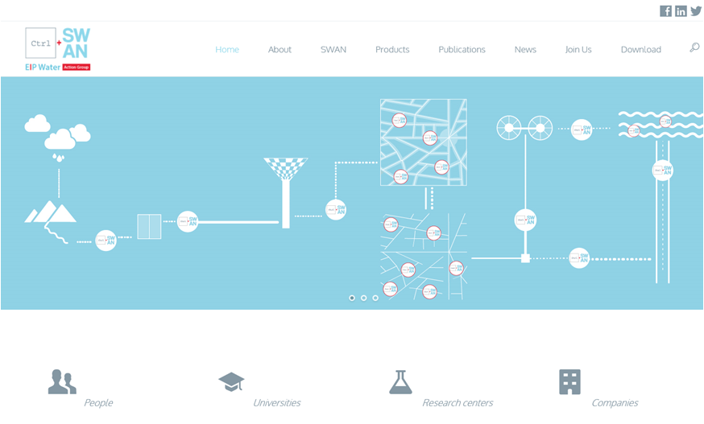
CTRL + SWAN Cloud Technologies and ReaL time Monitoring + Smart WAter Network
CTRL+SWAN was founded in April 2014 (www.swan.technology)
206
15
10
30

Slide 5
CTRL + SWAN Members & Partners
Universities (10)
Second University of Naples – Depertment of Civil Engineering, Design, Building and Environment
Second University of Naples - Department of Industrial and Information Engineering
University of Naples “Federico II” Department of Physics
University IbnTofail of Kenitra
University of Thessaly
University of Exeter
…
Research centers (5)
BioMEMs
National Research Council (CNR) - Institute of Information Science and Technologies, Signal and Images Lab (ISTI)
National Research Council (CNR) - Institute for Electromagnetic Sensing of the Environment (IREA)
National Research Council (CNR) - Institute of Geosciences and Earth Resources (IGG)
The Mexican Institute of Water Technology
EURECAT
…
Companies (18)
Aqua-Consult Ingenieros (A-CING)
Aqualia, gestión integral del agua
EURECAT
EdgeLab S.r.l.
Hach Lange
INFOSOLUTION S.p.A.
MED.HYDRO s.r.l.
Novaetech s.r.l.
Promete S.r.l. – CNR spin-off company
SENSUS ITALIA
SYSTEA - Systems Technology Advance SpA
…

Slide 6
CTRL + SWAN Objectives
# Promote and develop innovative smart sensors to be placed on distribution network for online detection of microbiological and/or physical-chemical parameters
# Design decision support systems to define optimal partitioning of SWAN to improve management and protection of water supply systems
# Implementation of smart platform to collect and manage data from sensors in an early warning system based on cloud technologies. It will be based on multi-sourced and cloud data platforms including quality and quantity monitoring

Slide 7
CTRL + SWAN Mission
Action Group is devoted to the development of innovative sensor technologies to be integrated and implemented in the design of an innovative approach to the water distribution networks management, with the broaden goal to introduce the concept of Smart WAter Network (SWAN) as a key subsystem of the notion of Smart City, as it has been recently recognized in the scientific and technical international community.

Slide 8
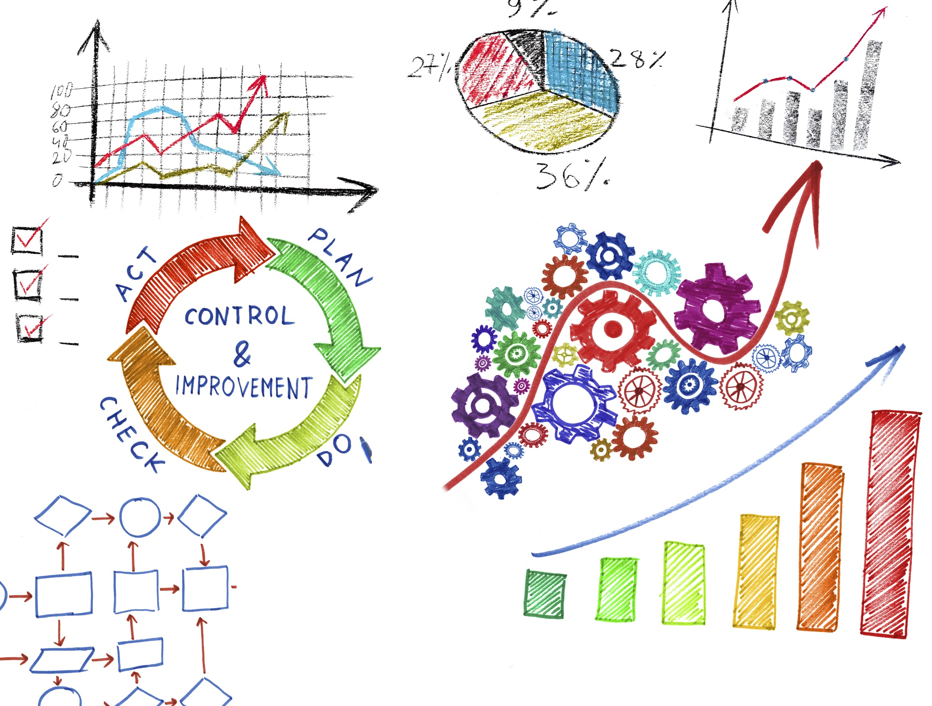
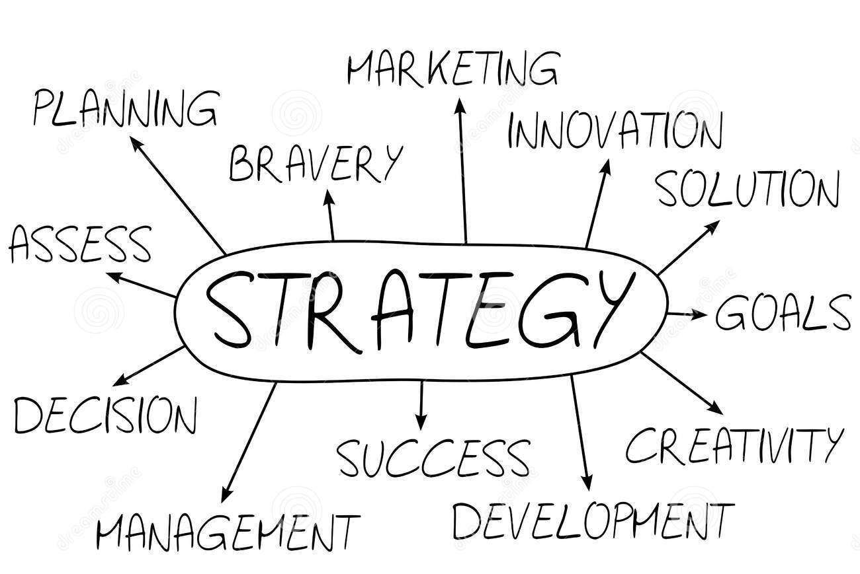
CTRL + SWAN Strategy
# Strengthen current relationships and generate new ones
# Looking for funds to partners through applications to European calls (H2020)
# Design and optimize a really innovative interaction model that can represent a truly best practice
# Design road maps
# Transform R&D results into powerful engineered products/services and solutions

Slide 9
Visit our website
www.swan.technology
Visit EIP Water Marketplace
www.eip-water.eu/CTRL_SWAN
Join us
agctrlswan@gmail.com
Thank you for your attention

Slide 10
Smart Water Network Monitoring using innovative On-line Sensors
Starting from the classification of online water quality monitoring system provided by Lee et al. 2012, it is possible to define three levels of importance for water quality parameters:
based on two main points:
The practicality of the parameters for online monitoring, i.e., if the parameter has large applications or not, if use of reagent is needed or not, the cost for maintenance, etc.;
The parameter indications, e.g., if the parameter represents a contaminant with toxicological relevance, or if the contaminant is related to potential health problems, such as nitrates, etc.
THESE LEVELS WERE APPLIED TO THE SELECTION OF SUITABLE SENSORS BY FOLLOWING THREE MAIN CRITERIA:
the sensors must detect/measure water quality indicators without the use of chemical reagents;
the device must have online and remote capabilities (telemetry);
the device must be the most recent and updated version.
This classification was reviewed, as reported in following Table , from CTRL+SWAN members, with reference to the On-line Measuring Sensors (OMS) available on the market, by adding parameters that requires the use of chemical reagents.
LOW
MEDIUM
HIGH
April 12th 2018, Vienna

Slide 11
Smart Water Network Monitoring using innovative On-line Sensors
Revision of the classification of Lee et al., 2012. Table shows the list of parameters revised by parameters for which online sensor are now on the market (bold characters) or in an R&D/development phase (bold characters with asterisk). Parameters in brackets come from the revision made from Di Nardo et al. 2015 IAHR.
 | Importance of online measurement of a Water Quality parameter
Availability on the market | LOW | MEDIUM | HIGH
No online sensors available | Aldehydes, anionic surfactants, antimony, barium, beryllium, brominated DBP, , chlorate, chlorite, dichloramine, Drug metabolites, formaldehyde, glyphosate, haloacetic acids, heterotrophic plate counts (HPC) bacteria, malathion, marine algal Toxins*, molybdenum, parasites, bacteria* and viruses, pesticides*, phosphate inhibitors, selenium, silver, sulphonammides, taste and odour, trihalomethanes, vanadium, viable bacteria | heavy metals*, (cadmium*), (mercury) | (E. coli*), (total coliform*)
Can be indirectly estimated using available online sensors | Assimilable organic carbon (AOC), ozone, radioactivity, stability, total suspended solids, uranium, trihalomethane formation potential | Lead* | -
Online sensors available | Algal pigments, (arsenic), (boron), (chemical oxygen demand), chloramine, chlorine, (cobalt), (corrosion inhibitors), dioxide, (dissolved organic carbon), flow, fluorescence, (hydrogen sulphide), level sensors, (manganese), multi-angle light scattering, (magnesium), multi-spectrum absorption, (nitrogen organic), , pressure, (potassium), (silicon), (silicate), (sodium), streaming current, total chlorine, total dissolved solids, (toxicity), ultraviolet 254 nm absorption (SAC 254), UV visible spectra, volatile organic carbon, total trihalomethanes | (Alkalinity), (aluminium), bacterial count, (calcium), (chromium 6+), chromium speciation*, (copper), fluoride, (hardness), (iron), , (nickel), (nitrite), particle count, , (sulphate) temperature, total residual chlorine, (zinc) | Ammonia, (chloride), colour, conductivity, dissolved oxygen, free residual chlorine, COD, (nitrate), (orthophosphate), (phosphorus), oxidation reduction potential, pH, turbidity, (total cyanide), (total organic carbon)
April 12th 2018, Vienna

Slide 12
Smart Water Network Monitoring using innovative On-line Sensors
The effort of each AG member was first to update previous Table and, then, to provide a contribution on the possibility of on-line monitoring of some very important biological parameters or chemical parameters.
Based on their Knowledge expertise, each AG members provided some innovative current and potential Online Monitoring Sensors (OMS), based on different methods/techniques
A synthetic description of the parameters targeted by AG members are reported in the following.
For AG members or partners are reported the list of OMSs including: i) on-line measurement techniques already available on the market; ii) methods and techniques under pre-market development; iii) methods and techniques at research level.
April 12th 2018, Vienna

Slide 13
Smart Water Network Monitoring using innovative On-line Sensors
NOVAETECH SRL AND DEPARTMENT OF PHYSICS OF THE UNIVERSITY OF NAPLES
ON-LINE MEASURED PARAMETERS | METHODS/TECHNIQUES | RESEARCH | DEVELOPMENT | ON MARKET
Pesticide | Quartz-Crystal Microbalance with antibodies |  | X
Bacteria | Quartz-Crystal Microbalance with antibodies | X
April 12th 2018, Vienna

Slide 14
Smart Water Network Monitoring using innovative On-line Sensors
HACH LANGE
ON-LINE MEASURED PARAMETERS | METHODS/TECHNIQUES | RESEARCH | DEVELOPMENT | ON MARKET
Alkalinity, ammonia, chlorine dioxide, chloride, chloramine, corrosion inhibitors, dissolved oxygen, hardness, hydrocarbons, fluoride, nitrate, nitrite, orthophosphates, ozone, phosphate, sodium, silicate, sulphide, total suspended solids, total organic carbon, total/free residual chlorine, total cyanide, turbidity, ultraviolet 254 nm absorption | Amperometric, digital, optical probes, ion-selective electrode (ISE) technology, photometric analyzers, UV absorption, electro chemical sensors, radical advanced oxidation, light scattering analytics |  |  | X
April 12th 2018, Vienna

Slide 15
Smart Water Network Monitoring using innovative On-line Sensors
SYSTEA SpA
ON-LINE MEASURED PARAMETERS | METHODS/TECHNIQUES | RESEARCH | DEVELOPMENT | ON MARKET
Alkalinity, aluminium dissolved and total, ammonia, arsenic diss. and total, BOD; calcium, chloride, chlorine (total and free), chromium 6+ and total, COD, color, copper diss. and total, ethylene gycol, fluoride, hardness, hydrazine, iron diss. and total, manganese diss. and total, monochlorammine, nickel diss. and total, nitrate, nitrite, orthophosphate, silicates, sucrose, sulphate, sulphide, volatile phenols, silver total, total cyanides, TOC, total nitrogen, total phosphorus, total suspended solids (TSS), ultraviolet 254 nm absorption (SAC), zinc diss.and total | Wet-chemistry automated spectro-photometric methods fluorimetry, Ion-Selective Electrode (ISE), InfraRed light scattering, UV-absorption |  |  | X
Acute toxicity | Bacteria luminescence optical detection |  |  | X
Lead, admium, mercury | Wet chemistry automated fluorimetry |  | X
Anionic surfactans, sulphonamides, marine algal toxins (saxitoxin, domoic acid, okadaic acid) | Wet-chemistry automated spectrophotometric method |  | X
E.coli and total coliforms | MPN automated quantification by fluorescence & color absorption |  | X
April 12th 2018, Vienna

Slide 16
Smart Water Network Monitoring using innovative On-line Sensors
CNR - IBF - ISTI
ON-LINE MEASURED PARAMETERS | METHODS/TECHNIQUES | RESEARCH | DEVELOPMENT | ON MARKET
Heavy metals | Nanofiber materials, based on electrochemical techniques. | X
April 12th 2018, Vienna

Slide 17
Smart Water Network Monitoring using innovative On-line Sensors
IREA-CNR
ON-LINE MEASURED PARAMETERS | METHODS/TECHNIQUES | RESEARCH | DEVELOPMENT | ON MARKET
Hydrocarbons, nitrates, organic compounds, phosphates | Optofluidic jet waveguide | X
Ammonia, chlorides, nitrates | Microwave resonator | X
April 12th 2018, Vienna

Slide 18
Smart Water Network Monitoring using innovative On-line Sensors
EDGELAD
ON-LINE MEASURED PARAMETERS | METHODS/TECHNIQUES | RESEARCH | DEVELOPMENT | ON MARKET
Ammonium, E. coli, heavy metals, nitrites and nitrates, phosphate, total coliform | Electrochemical | X
April 12th 2018, Vienna

Slide 19
Smart Water Network Monitoring using innovative On-line Sensors
PROMETE
ON-LINE MEASURED PARAMETERS | METHODS/TECHNIQUES | RESEARCH | DEVELOPMENT | ON MARKET
Cadmium, Lead | Bio-based electrodes | X
April 12th 2018, Vienna

Slide 20
Smart Water Network Monitoring using innovative On-line Sensors
DCU –DUBLIN UNIVERSITY
ON-LINE MEASURED PARAMETERS | METHODS/TECHNIQUES | RESEARCH | DEVELOPMENT | ON MARKET
e-coli | Enzyme based biosensor |  | X
Water Quality monitor (Optical clarity) | Optical sensor |  | X
Marine algal toxin | Antibody-based fluorescence biosensor | X
Phosphate | Microfluidics – blue method | X
Chromium speciation | Microfluidics – on chip heating and separation. | X
April 12th 2018, Vienna

Slide 21
Smart Water Network Monitoring using innovative On-line Sensors
PROTEUS PROJECT
ON-LINE MEASURED PARAMETERS | METHODS/TECHNIQUES | RESEARCH | DEVELOPMENT | ON MARKET
PH, Conductivity, Pressure, temp, Chlorine, chloride | MEMS + Carbon Nano tubes | X | X
April 12th 2018, Vienna

Slide 22
Smart Water Network Monitoring using innovative On-line Sensors
S::CAN validated by CETAQUA
ON-LINE MEASURED PARAMETERS | METHODS/TECHNIQUES | RESEARCH | DEVELOPMENT | ON MARKET
Colour (+ in pipe), conductivity, nitrate, total organic carbon, temperature (+ in pipe), total/free residual chlorine, turbidity (+ in pipe), ultraviolet 254 nm absorption (+ in pipe), UV-visible spectra and contamination alarm | Amperometry (membrane), electro-chemical sensor, optical probes, UV-vis spectrometry |  |  | X
April 12th 2018, Vienna

Slide 23
Smart Water Network Monitoring using innovative On-line Sensors
MICROLAN validated by CETAQUA
ON-LINE MEASURED PARAMETERS | METHODS/TECHNIQUES | RESEARCH | DEVELOPMENT | ON MARKET
Microbiological total activity (viable bacteria) | Enzyme activity (alkaline phosphatase) by fluorescence |  |  | X
April 12th 2018, Vienna

Slide 24
Smart Water Network Monitoring using innovative On-line Sensors
METTLER TOLEDO validated by CETAQUA
ON-LINE MEASURED PARAMETERS | METHODS/TECHNIQUES | RESEARCH | DEVELOPMENT | ON MARKET
Microbial count, particle count | Light scattering + intrinsic fluorescence detection |  |  | X
April 12th 2018, Vienna

Slide 25
Smart Water Network Monitoring using innovative On-line Sensors
GRUNDFOS validated by CETAQUA
ON-LINE MEASURED PARAMETERS | METHODS/TECHNIQUES | RESEARCH | DEVELOPMENT | ON MARKET
Bacterial count, particle count | 3D microscopy |  |  | X
April 12th 2018, Vienna

Slide 26
Smart Water Network Monitoring using innovative On-line Sensors
AG members describe some online monitoring sensors applications:
April 12th 2018, Vienna

Slide 27
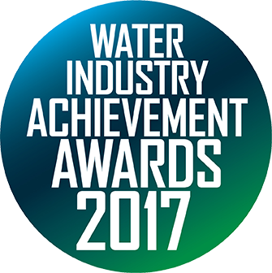
Smart Water Network Monitoring using innovative On-line Sensors
Brightwork B.V., The Netherlands, NL
Short description technologies
Sand-Cycle : Radio frequency ID (RFID) based smart monitoring and control technology for moving bed bioreactors. This technology introduces and marks the first full-scale application of RFID technology in water and wastewater industry. It actively facilitates day-to-day tracking and access to real-time status of the system operation via wireless sensing and big data analytics. Sand-cycle acts as remote control for expert judgment to detect malfunctions and troubleshoot the failures associated with the reactor operation. Also, cost-effective in terms of savings made on manual maintenance and energy requirements.
Brief applications description
Used in long-term and full-scale monitoring of moving bed bio-filters (MBFs) in water and wastewater industry. Technological advancements are being made to incorporate into other granulated and fluidized systems with moving bed reactor configuration like traditional sand filters, anaerobic digestors etc. This technology can be further extended within several water and wastewater applications.
http://brightwork.nl/over-ons/
https://sand-cycle.com/
April 12th 2018, Vienna

Slide 28
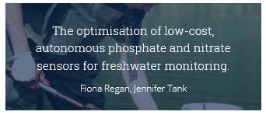
Smart Water Network Monitoring using innovative On-line Sensors
School of Chemical Sciences, DCU Water Institute, Dublin City University, Ireland
Short description technologies
DCU has demonstrated the potential of a low-cost LED based optical sensor for monitoring optical clarity and color in freshwater and marine deployments. Centrifugal microfluidics has shown real promise in phosphate sensor design as well as speciation of Cr (VI) and Cr (III). The key to successful delivery of a suitable sensor is integration of expertise.
Latest developments are in the area of environmental DNA (eDNA) using DCU generic centrifugal microfluidic platforms with adequate valving and channels to allow for mixing, and biosensor (probe) interaction as well as integration of on-chip lysing.
Brief applications description
Current microfluidic phosphate sensors have been fully tested in the field and these are being further developed for on-line integration for phosphate monitoring as well as fully long-term autonomous monitoring.
DCU has demonstrated successfully the testing of an enzyme based e-coli sensor providing a sample-to-answer result in 75 minutes compared with the current standard approach taking two days. The results obtained from a bathing water sampling campaign and freshwater analysis of a river catchment demonstrate the potential of the technology for potential on-line or near-realtime monitoring of e-coli for decision support systems.
http://dcuwater.ie/research/research-and-innovation/
April 12th 2018, Vienna

Slide 29
Smart Water Network Monitoring using innovative On-line Sensors
Easy Global Market
Short description technologies
Investigation about the smart integration of chemical sensors based on carbon nanotubes, MEMS based physical sensors together with a cognitive engine providing on-the-fly reconfigurability. The results present some of the innovative outcomes especially developed for drinking, rain and waste water networks through the PROTEUS project, funded under European Union’s H2020 Programme for research.
Brief applications description
Aiming at improving water quality with less health, safety and security concerns, environmental pollutions, reducing implementation and maintenance costs, are also included current progress in energy harvesting (Water flow force energy harvester suitable for water networks) and sensing technology with the design and associated flowchart of a multifunctional sensor chip. The sensor node will gather 9 main water parameters: Temperature, pH, Conductivity, Dissolved Oxygen, Pressure, Flow rate, Chlorine, Chloride and Nitrate, which are key indicators for water management.
http://www.proteus-sensor.eu/
April 12th 2018, Vienna

Slide 30
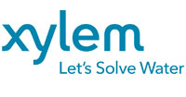
Authors

Slide 31
Abstract
The recent development and dissemination of Information and Communications Technology (ICT) has a key role to drive cities to be smarter. The economic growth needs of cities that become smarter, sustainable, more efficient and liveable. Smart water represents a key core of the smart cities and the application of smart solutions will allow the cities to use ICT and big data to improve infrastructure and services (i.e. network efficiency, protection from contamination, etc.). In the water sector, the integration and implementation of novel technologies for water systems monitoring (drinking, distribution, sea, river water, etc.) as smart meters and sensors together with cloud computing systems introduce an innovative management that transform the traditional water networks into modern Smart WAter Networks (SWAN). The introduction of innovative on-line sensors in the water system can contribute to monitor and control many water quantitative (e.g. flow, pressure, etc.) and quality (e.g. residual chlorine, PH, organic matter, etc.) parameters providing smart water management solutions contributing to prompt Smart Water Network as subsystem of the Smart City, recently recognized by the scientific and technical international community. In fact, the use of innovative on-line sensors allows to overcome the traditional management of water networks and to handle important issues such as reduction of water losses, analysis of big data, improvement of water quality, etc. The Ctrl+SWAN (Cloud Technologies & ReaL time monitoring+Smart WAter Network) Action Group (AG) was created within the European Innovation Partnership on Water, in order to promote innovation in the water sector by advancing existing solutions. The vision of the AG consists of treating water network not as a traditional system with devices trivially added, but as a SWAN featuring new applications to promote optimal management and protection. The paper presents an update of a previous work on the state of the art on the best On-line Measuring Sensors (OMS) already available on the market and innovative technologies in the Research and Development (R&D) phases. Ctrl+SWAN membership bring up to date the list of parameters measured with innovative on-line sensors, the new sensor technologies and their innovative applications.

