Slide 1

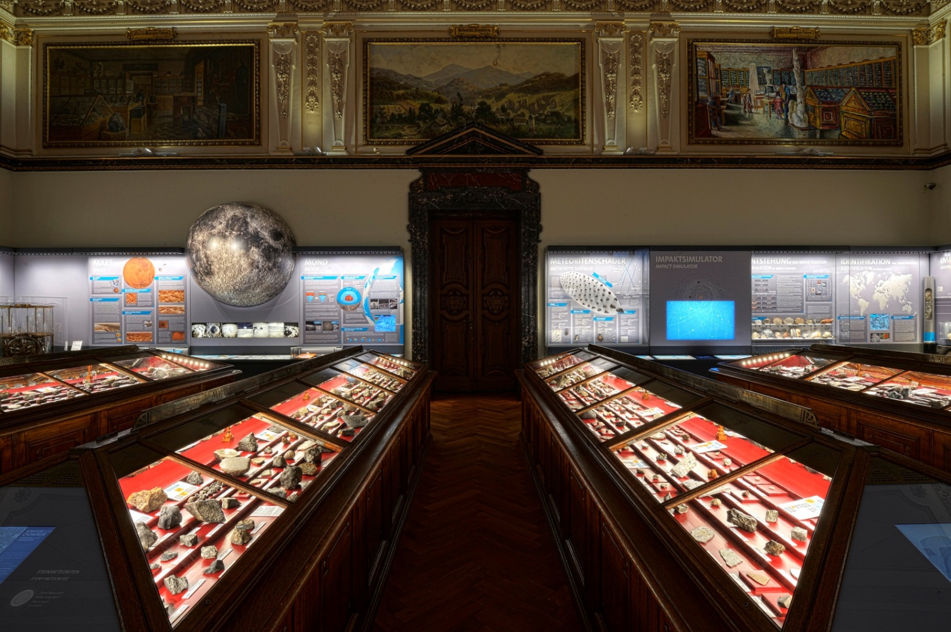























The physical and data infrastructure for
Europe’s Natural Science Collections
EGU2018-16356
Wouter Addink
wouter.addink@naturalis.nl
DiSSCo Coordination team member

Slide 2


Natural Science collections - bio- & geo-diversity
Leading scientific facility
Discovering, describing and interpreting life on Earth
Tackling societal challenges
Sustainable future

Slide 3
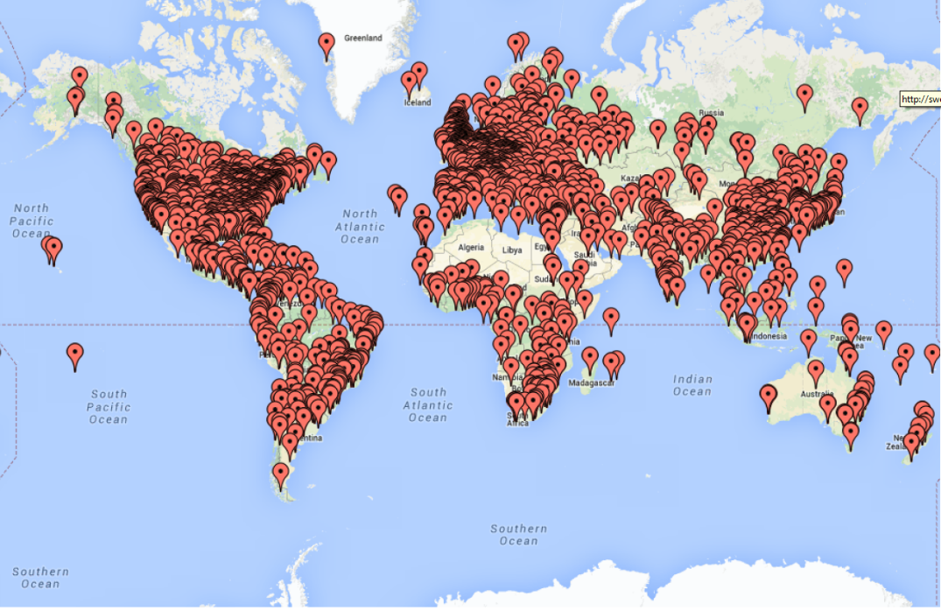
Europe: the global leader
55% of the world‘s assets with rich historical and global distribution
European Collection facilities:
> 1.5 billion specimens
> 80% of world’s species
> 5,000 scientists employed
> 16,000 scientific visitors pa
> 10 million public visitors pa
> 25 million web visitors pa
16,000 researchers travel every year to physically access scientific collections
800k objects are packed and shipped (at an annual public cost of more than €70M)

Slide 4






DiSSCo: A new European infrastructure
114 National Facilities
21 Countries
Largest ever formal agreement between natural science collection facilities
Centralised governance model already in place
Supporting network of working groups
DiSSCo builds on top of a mature community of institutions
Strategic collaboration already underpinned by sound governance and decision-making structures

Slide 5
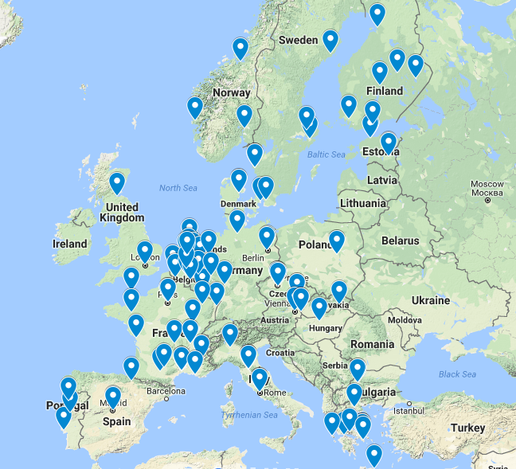

One European collection
A new business model
Synchronising 114 facilities:
Act under the premise:
One European Collection of scientific assets
Understanding scientific needs for developments of collections at European level rather than institutional
Creating Economies of scope and scale (pooling resources, expertise & experience)
Deploy monitoring mechanisms to measure impact of collections at institutional and national level
Enabling national institutions to invest in specialisation strategies (e.g. in alignment with national priorities)
Synchronisation
of
National facilities
Institutional collections will not only benefit from maximising the scientific impact of their assets, but also they will be able to inform strategic collections development decisions based on global needs. DiSSCo mandates a new business model in the operation of its distributed facilities

Slide 6







Policies
Taxonomic skills
Access
Data skills
Data
Analytical skills
Data
Skills
Labels
Imaging
Traits
Molecular data
Chemical data

Slide 7
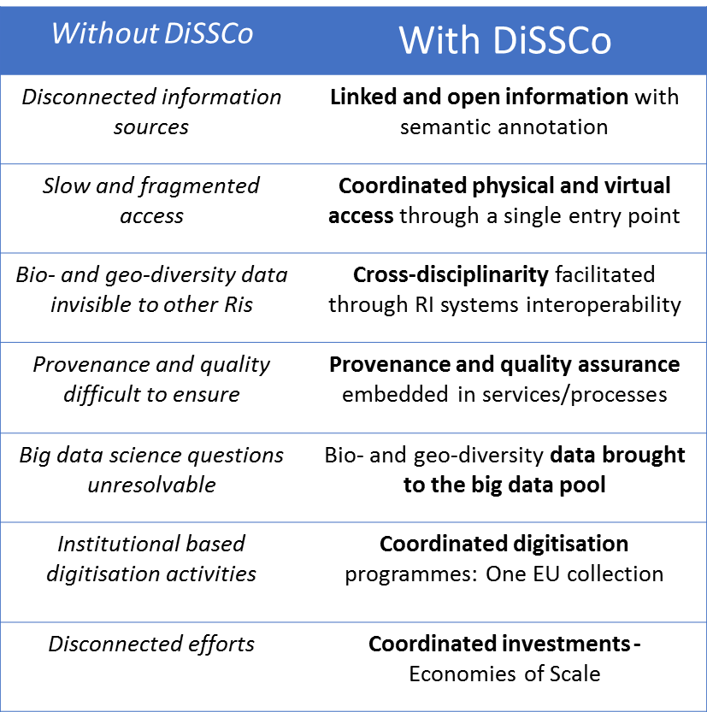

Added value of DiSSCo
Linked Information
Economies of scale
01
02
Unified Access
07
Operational efficiency
03
06
Cross-disciplinarity
05
04
Interpretation & analysis services
Ensured
Provenance,
& Quality
DiSSCo provides clear added value to existing network activities
DiSSCo required to deliver coordinated services, access and development

Slide 8

DiSSCo science services
single
entry
point
1
e-Science services
A one-stop shop for services providing unified discovery, access, interpretation and analysis of complex linked data
2
Physical and remote access services
A universal harmonised physical access service and digitisation on demand service
3
Support & Training services
Integrated user support desk and implementation of multi-modal training programmes to enhance data skills
DiSSCo provides three distinct classes of service to the scientific community

Slide 9
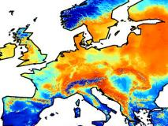


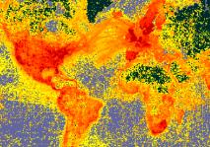

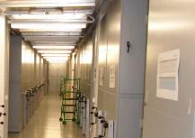
DiSSCo services to other infrastructures
ENVRI plus, 2017
RIs providing data on external factors
Modelling / Prevention / Early detection
Integrative RIs
Species/
organisms
observatories
System
observatories
Experiments
DATA MEASUREMENTS MODELLING
Species distribution & genomics
Biodiversity standards / Reference data
Taxonomic backbone
Institutional collections
Need and Urgency of DiSSCo identified by:
Env Science WG (2010)
OECD SciColl (2013)
ESFRI roadmap (2016)
Alien Invasive species use case
DiSSCo delivers services on bio- and geo- diversity reference data to other RIs (especially in the Environmental domain).
DiSSCo occupies a foundational layer in the Research Infratsructure landscape

Slide 10


DiSSCo Design: Accelerating scientific research
Proven research
requirements
Accelerate, scale up,
coordinate strategy
Open science
Broad user base
Enable big data & open science
Expanded scientific constituency
Focus on societal challenges
Enable multi-disciplinary science
Design Study
Information highly dispersed
Require integrated data and services
Coordinated strategy
Accelerate generation and linking of information into research data objects
Ensure provenance and quality
Provide reliable, unified, certified services and harmonised policies
Provide services to other Research Infrastructures
Response
Outputs
Need
UN Sustainable Development Goals
Impact
DiSSCo is a response to the need for high quality, aggregated data and services to tackle societal challenges
DiSSCo will broaden user base, by lowering the entry barrier to big data science

Slide 11

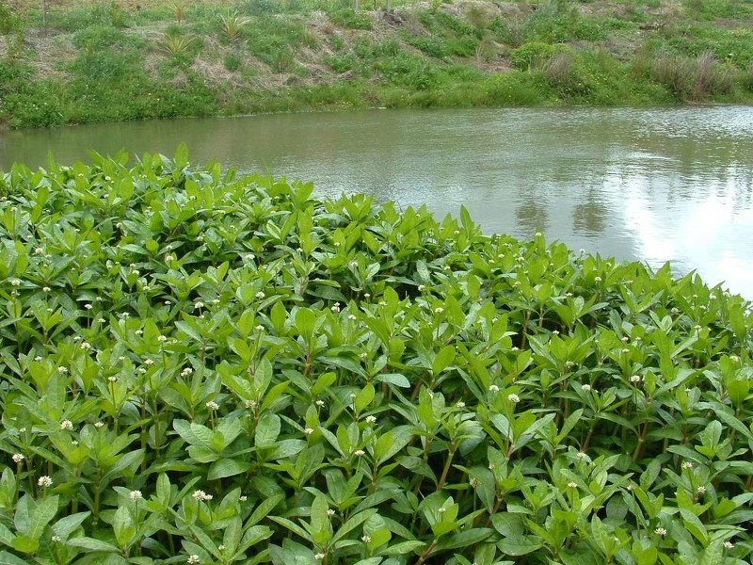



Case study – Invasive Alien Species
EXAMPLE: Alligator Weed
(Alternanthera philoxeroides)
Negative impact on native species, ecosystem services and infrastructure
UN Sustainable Development Goals (Target 15.8)
Economic costs of IAS for EU
€20 Billion / year
Kettunen et al. 2009
Urgent challenge
Institutional collections
Facilities &
information
Climate data
Ecological monitoring data
Genomic information
Species distribution & genomics
Linked
Data
Other Research Infrastructures
Modelling / Prevention / Early detection
Analysis /
Interpretation
Services
Linking dispersed information is imperative for providing solutions at the scale, urgency and quality required
DiSSCo provides the links required to tackle key scientific and societal challenges

Slide 12
Decision making: DiSSCo Stakeholder Forum
Specification of core cloud services | Service Level Agreements
e-Infrastructures
Standardisation bodies
New community data Standards
Recommendations - specifications
| Knowledge exchange
Technical communities
Research Infrastructures
User requirements | Systems interoperability
Data, workflow and systems integrity
FAIR principles
EOSC
EUDAT/EGI participate in Stakeholder forum and Technical Advisory Board
Pilots: Herbadrop with EUDAT, and AAI implementation with EGI

Slide 13

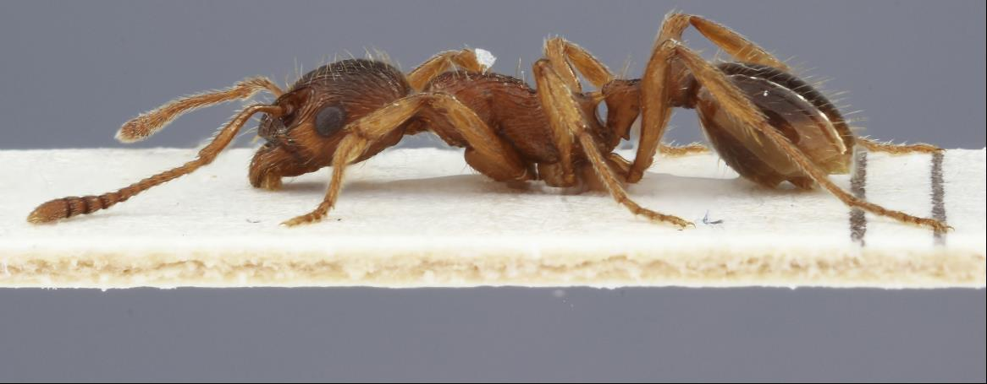
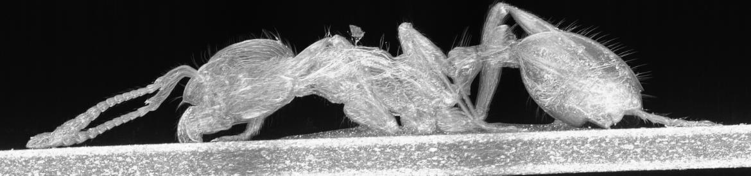
Future-proofing data & digitisation
Quality assurance and fit for purpose by applying common standards and procedures
Stable to future technologies through robust metadata schemes
Advanced digitisation techniques will be driven by research requirements
DiSSCo EC-funded project (ICEDIG.eu)
(scored: 14.5/15)
Established technology
2D image
1 picture with sub-micron resolution
= 20 MB / specimen
Emerging Technology
3D model
raw data and reconstructed images
= 200 GB / specimen
Value of current data will persist – new information will be added
DiSSCo will drive technological innovation to support future research
Societal challenges require urgent mobilisation of information

Slide 14


Financial Resourcing: Sources of support
European Level
Additional financing through European Investment Bank and other financial instruments
National Level
Industrial scale digitisation funded through national digitisation programmes and supported by national data infrastructure
Institutional Level
Curation, collection management and expertise for data enrichment, on-demand digitisation
DiSSCo requires resources at European, national and institutional levels
National and institutional commitments are already in place for the preparatory phase (14 countries)

Slide 15
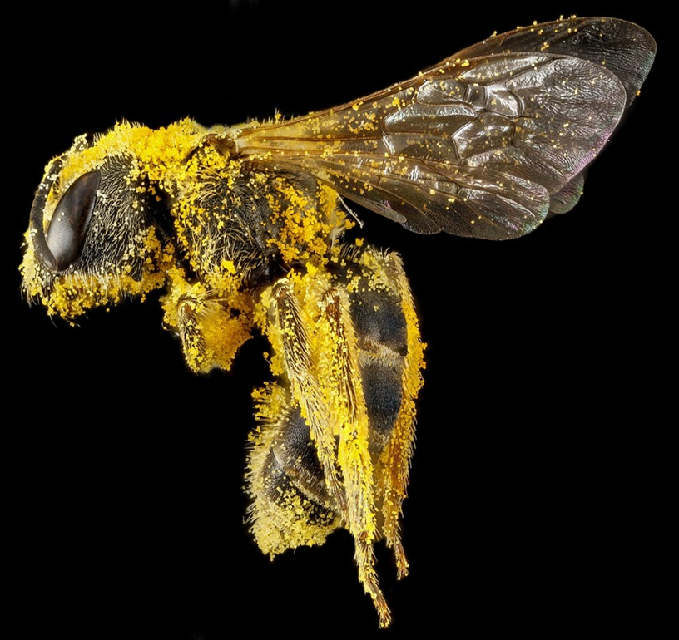
A mature and urgently needed initiative
Europe has the opportunity for scientific leadership at a global level
Direct response to identified needs in the European and international RI landscape
Lowers the barrier for big, open science practices across tens of thousands of users
A super-mature community with 114 self-sustainable facilities (nodes) across 21 countries
Agreed transfer of authority to a central Hub – governance agreed for all phases
A key missing Research Infrastructure for national and global sustainable development goals

