Slide 1
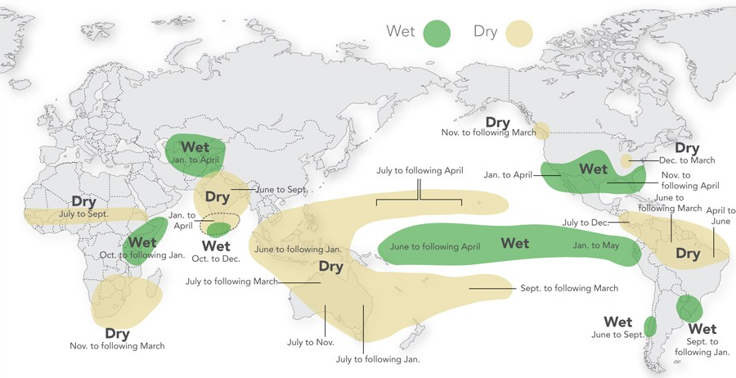
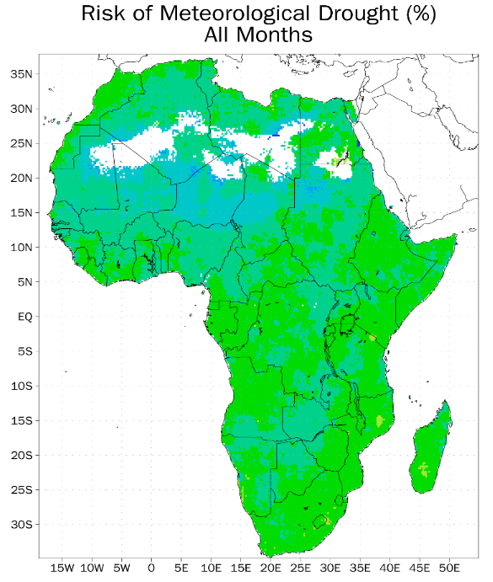
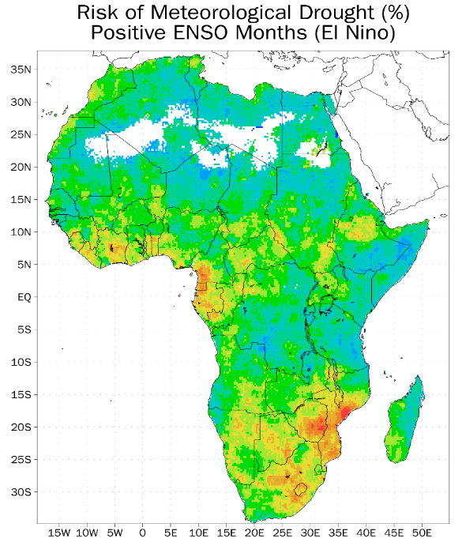
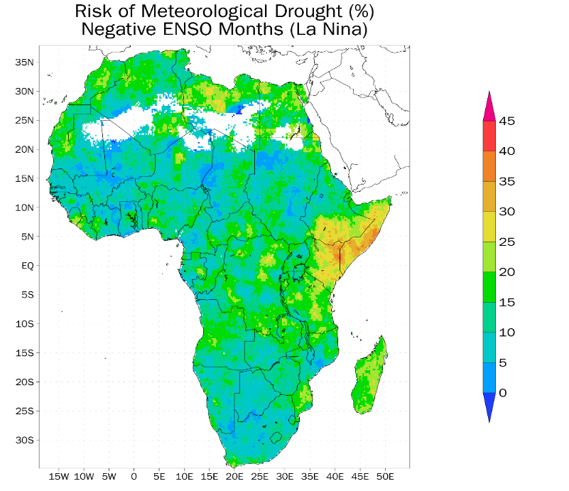
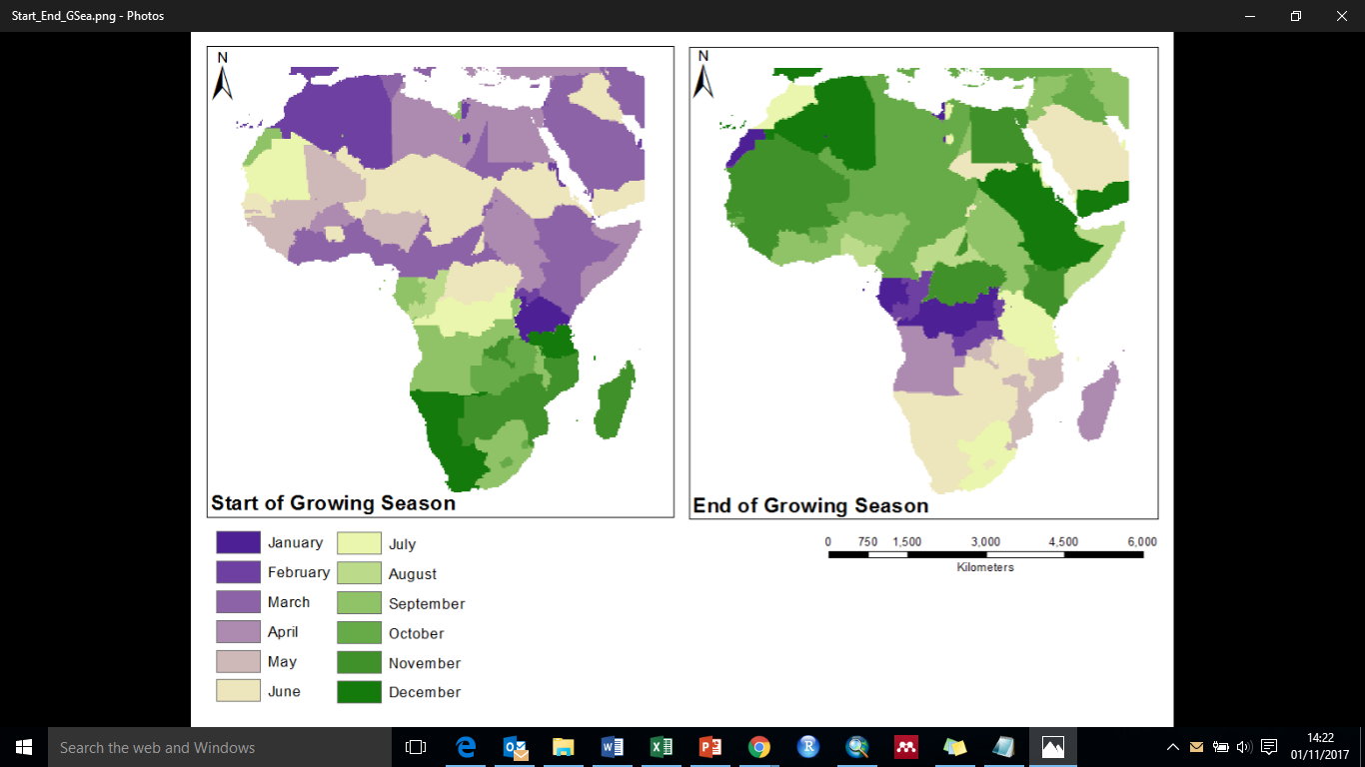
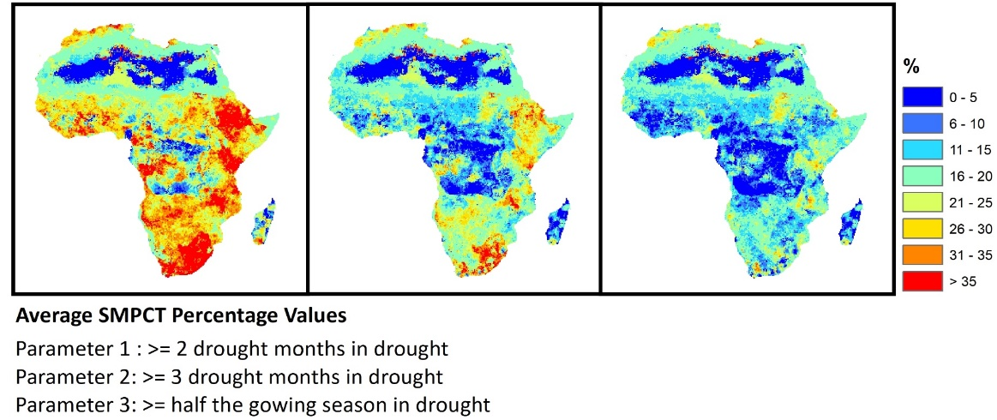
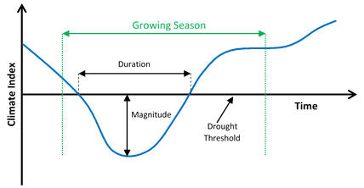
Hydrological Propagation of ENSO Impacts on Drought Risk Across Sub-Saharan Africa
Josie Baulch, Justin Sheffield, Jadu Dash
Department of Geography & Environment, University of Southampton, Southampton, United Kingdom
J.Baulch@soton.ac.uk
1. DROUGHT IN SUB-SAHARAN AFRICA
4. RESULTS
5. DISCUSSION
Importance
Sub-Saharan Africa (SSA) has a high dependency on agriculture, that in turn, is highly dependent on climate variability. In particular, drought events in SSA can have significant impacts on the social-economic well-being of populations whose livelihoods depend heavily on agriculture. Studies have shown that years with reduced precipitation have led to severe economic stress and increased imports due to reductions in food production. There is potential that this can lead to socio-political conflict in regions that are already stressed due to water insecurity.
The potential for declines in overall rainfall and increases in climate variability in the future is likely to pose a serious threat to food security by reducing crop productivity and increasing inter-annual variations in yields. Understanding how climate variability propagates into rain-fed agriculture and crop yield variations is important for improving climate forecasts and developing effective mitigation and management techniques.
El Niño Southern Oscillation and Drought
Large-scale climate oscillations such as the El Niño Southern Oscillation (ENSO) can cause changes in atmospheric circulations, such as the Hadley and Walker circulations, or upper atmosphere jet streams, impacting regional temperature and precipitation patterns across the globe.
Recent studies have found that, in addition to regional factors that influence the development of drought, ENSO has a major influence on drought across much of sub-Saharan Africa.
The relative drought risk maps (figure 1) show an obvious change in risk in El Niño and La Niña years. For meteorological drought, as the literature suggests, El Niño years show a higher risk in southern Africa and the western Sahel area, whereas in La Niña years, risk is higher in the Horn of Africa. These variations propagate into agricultural drought risk variations, but are less defined, with El Niño years showing a generally higher risk than La Niña years.
Drought duration spatial variations also change with different ENSO scenarios, but the variations are not as strong as the relative risk variations. The duration of meteorological droughts increases significantly in specific areas in both El Niño and La Niña years with a regional increase most obvious in southern Africa in El Niño years. The expected variations are more prominent for agricultural drought with an increase in drought duration obvious in the horn of Africa in La Niña years. There is little regional difference in the drought magnitude variations. Some increase in agricultural drought magnitude can be seen in southern Africa in El Niño years, but the main difference is the increase in magnitude variation, particularly in La Niña years.
Figure 1: The percentage of years experiencing meteorological and agricultural drought within the growing season between 1950 – 2016 using SPI3 and SMPCT data for A) all years, B) El Niño years, C) La Niña years, and D) neutral years.
Preliminary results for this study, that considered all drought months in the year, showed the spatial patterns show in the above figure. The relative drought risk showed spatial variations in El Niño and La Niña years that are consistent with the literature, but are significantly different from the results of the study that considers only drought months in the growing season. Most obviously, the latter results show much more variation in the relative drought risk, with certain regions experiencing drought years over 55% of the study period in El Niño years, whereas the preliminary results show a maximum of 45%.
2. STUDY OBJECTIVES & DATA
The aim of this study is to understand the mechanisms that drive the onset and propagation of drought across SSA, specifically concentrating on the effects of positive and negative ENSO events. We focus on meteorological and agricultural drought metrics, on a pixel-by-pixel basis, considering only the growing season months, when drought impacts are highest.
6. CONCLUSIONS & FURTHER WORK
Climatic and hydrological data:
African Flood and Drought Monitor (Sheffield et al., 2014)
Meteorological drought: Standardised Precipitation Index (SPI3)
Agricultural drought: Soil Moisture Percentile (SMPCT)
Drought events from the past 66 years have been assessed, and spatial and temporal variations determined, allowing the associated risk of drought to the ENSO climate oscillation to be deciphered, and the propagation of these trends through the hydrological cycle to be analysed. By only analysing climatic and hydrological indices in the growing season, drought years can be defined in a way that considers the agricultural impacts of extreme events, leading towards potential for improved seasonal forecasts that will be more useful for farmers in sub-Saharan Africa.
Running a sensitivity analysis allowed for the chosen ENSO and drought year parameters to be carefully considered. Defining a drought year as a growing season with 2 or more drought months displayed the greatest variation of results, and using the lower ENSO values of +/- 0.5 allowed for a greater number of El Niño and La Niña years to be included in the study. The variation in results from this analysis shows that drought characteristics are highly sensitive to parameter changes, highlighting the importance of understanding the data and choosing the best fit for the analysis.
ENSO data:
Multivariate ENSO Index (MEI)
NOAA
Growing season data:
Crop Calendar Data – Maize (long season) [Filled]
Centre for Sustainability and the Global Environment, Nelson Institute, University of Wisconsin-Madison
Figure 2: The average duration of meteorological and agricultural droughts within the growing season between 1950 – 2016 using SPI3 and SMPCT data for A) all years, B) El Niño years, C) La Niña years, and D) neutral years.
3. METHODOLOGY
Next steps
Run a regional change over time analysis on the drought duration data to determine any temporal variations or extreme events (see map).
Repeat analysis for other hydrological variables (SPI1, SPI12, Streamflow Percentile) to further understand propagation patterns
Include a time lag into the analysis to allow for the time difference between meteorological drought and hydrological drought.
Calculate the statistical significance of the results (t-tests) and consider the practical significance.
Use a range of crop calendar datasets to determine the growing season of the most prominent crop for each pixel.
Investigate the impacts of considering ENSO values from other times of year (not just in the growing season).
Determine the growing season for each 0.25x0.25° pixel.
Define positive and negative ENSO years by the average monthly MEI value across the growing season.
For each growing season, calculate the number of drought months; if this is greater than the drought year threshold, also calculate the duration and mean magnitude of the drought.
By amending the number of drought months used to define a drought year, a sensitivity analysis was run to determine the most appropriate parameters. This analysis was also run to define the thresholds for El Niño and La Niña events.
Amissah‐Arthur, A., Jagtap, S., & Rosenzweig, C. (2002). Spatio‐temporal effects of El Niño events on rainfall and maize yield in Kenya. International Journal of Climatology, 22(15), 1849-1860.
Giannini, A., Biasutti, M., Held, I. M., & Sobel, A. H. (2008). A global perspective on African climate. Climatic Change, 90(4), 359–383. https://doi.org/10.1007/s10584-008-9396-y
Kotir, J. H. (2011). Climate change and variability in Sub-Saharan Africa: a review of current and future trends and impacts on agriculture and food security. Environ Dev Sustain, 13, 587–605. https://doi.org/10.1007/s10668-010-9278-0
Rippke, U., Ramirez-Villegas, J., Jarvis, A., Vermeulen, S. J., Parker, L., Mer, F., ... & Howden, M. (2016). Timescales of transformational climate change adaptation in sub-Saharan African agriculture. Nature Climate Change.
Sheffield, J., and Wood, E., (2011), Drought: past problems and future scenarios. Earthscan: London, UK
Sheffield, J., Wood, E. F., Chaney, N., Guan, K., Sadri, S., Yuan, X., ... & Ogallo, L. (2014). A drought monitoring and forecasting system for sub-Sahara African water resources and food security. Bulletin of the American Meteorological Society, 95(6), 861-882
Figure 3: The mean magnitude of meteorological and agricultural droughts within the growing season between 1950 – 2016 using SPI3 and SMPCT data for A) all years, B) El Niño years, C) La Niña years, and D) neutral years.

