Slide 1
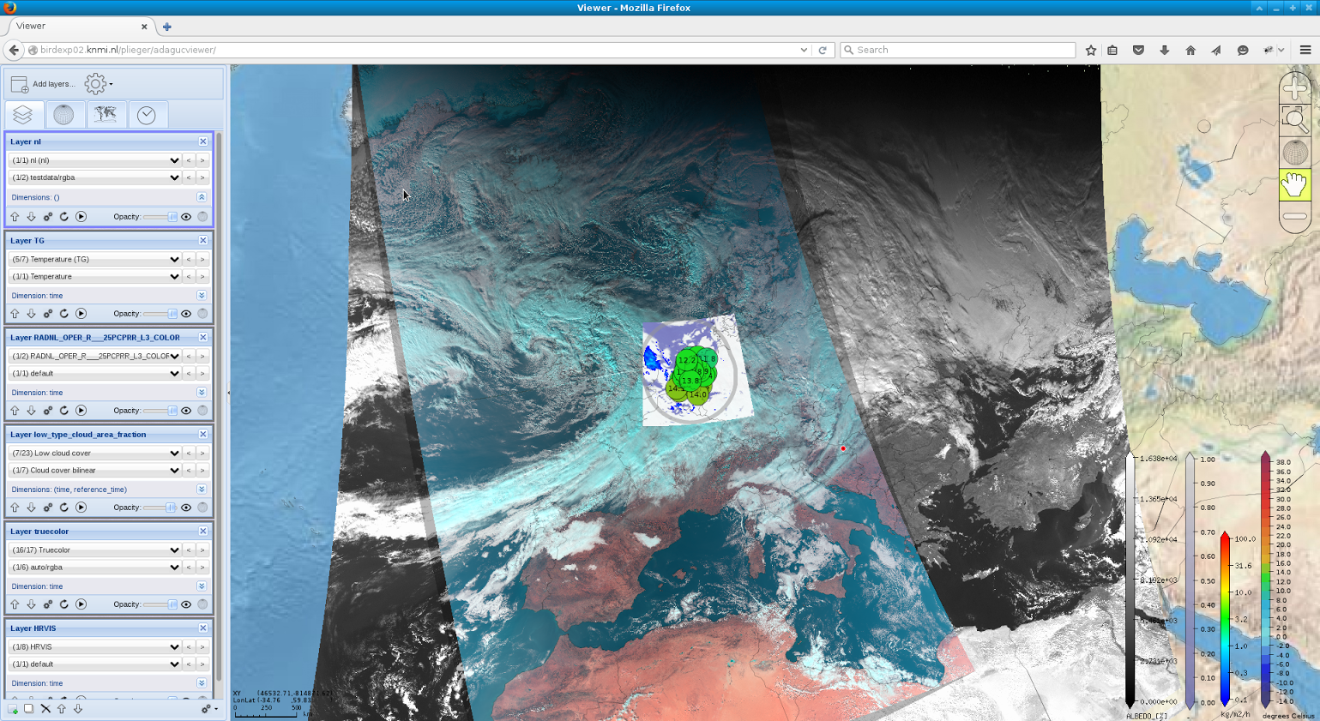
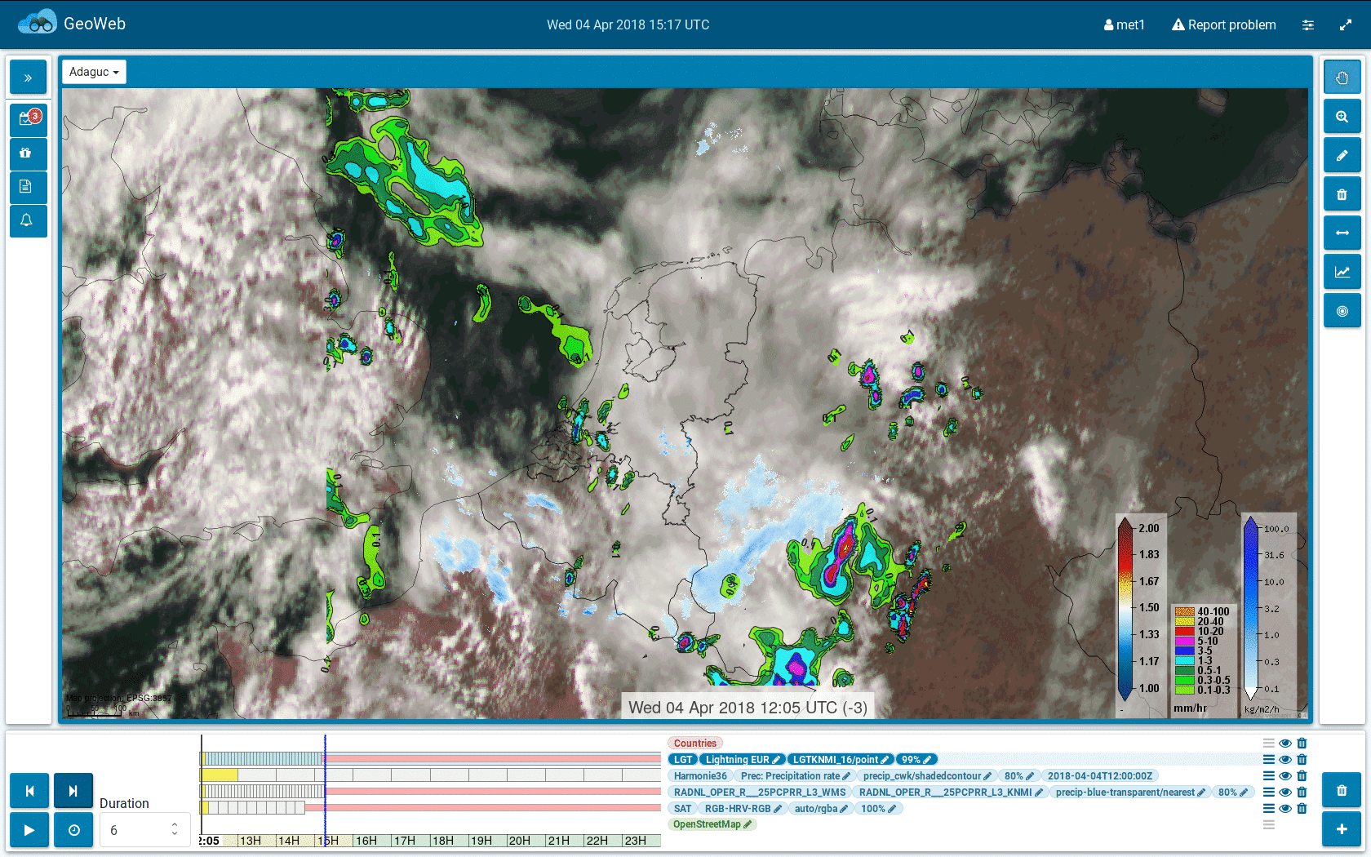
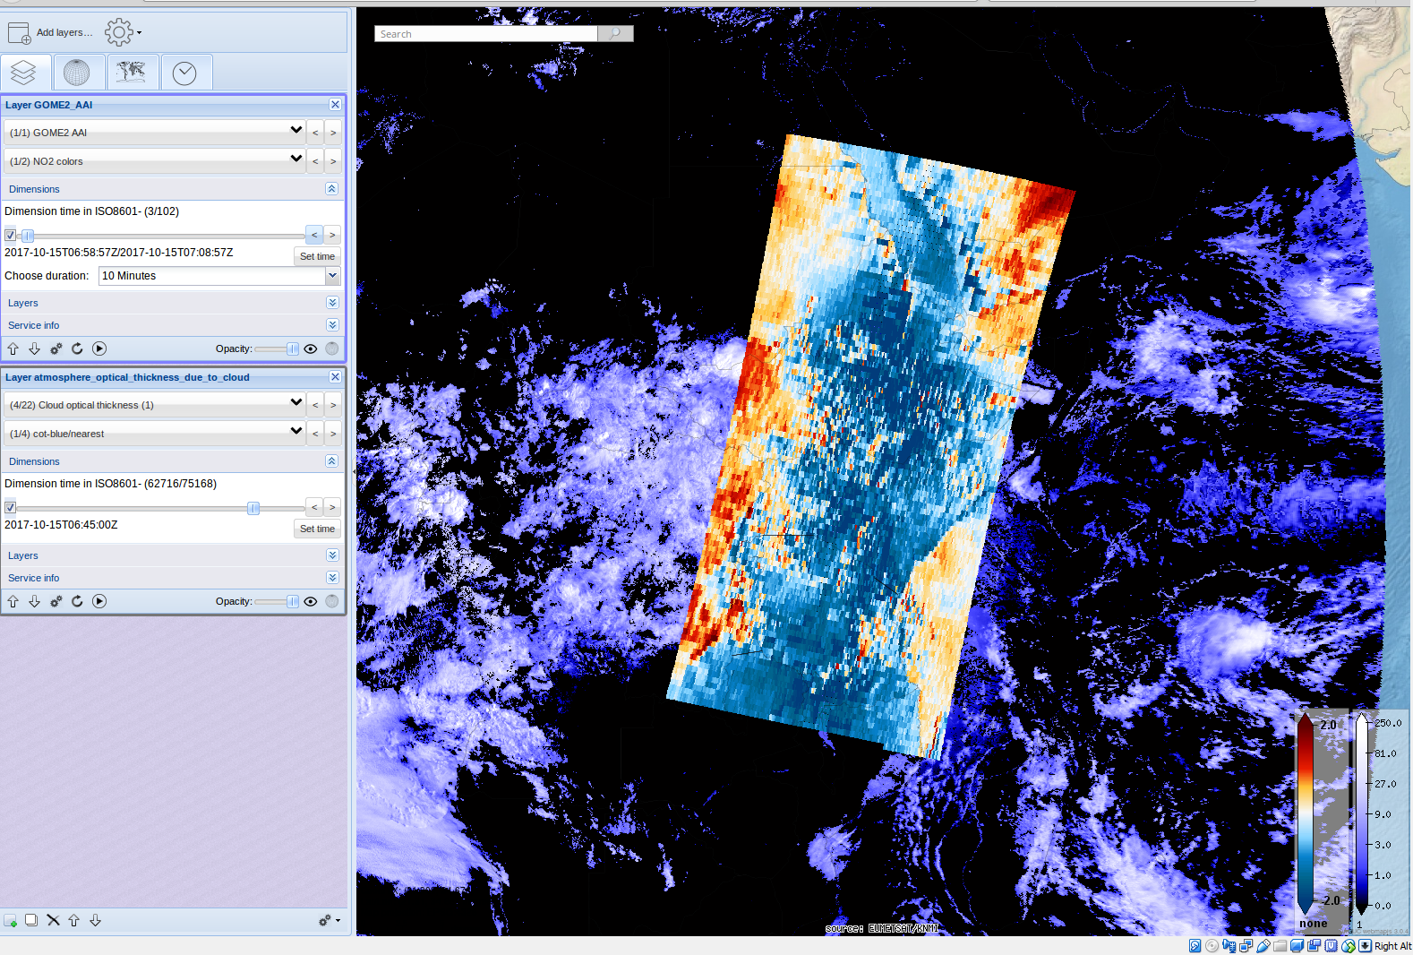
KNMI open source visualization
and Meteorological Working Station
Vienna 2018
GeoWeb meteorological working station
ADAGUC open source visualization
Realtime OGC Web Map Services
Used in production and research
Currently in development
Open source software
Web based
Seeking collaboration !

Slide 2
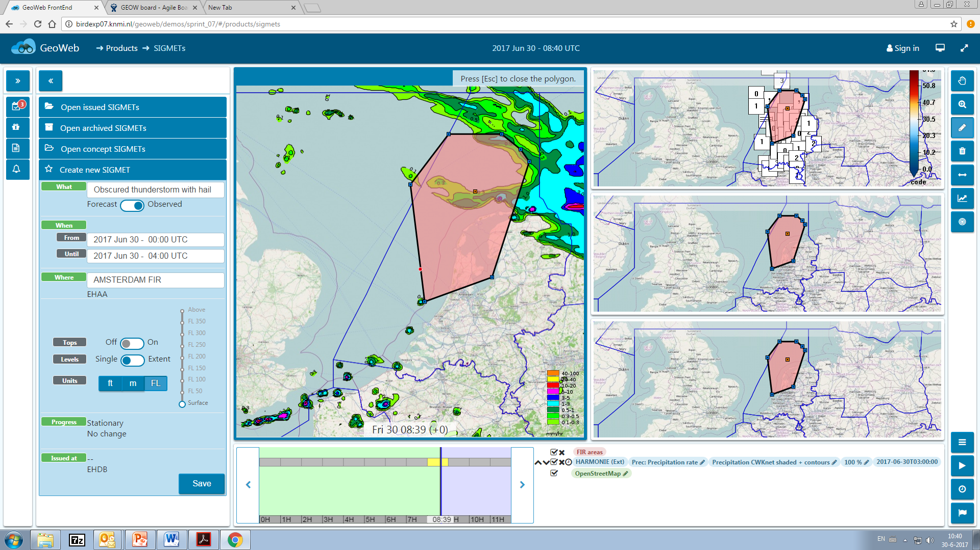
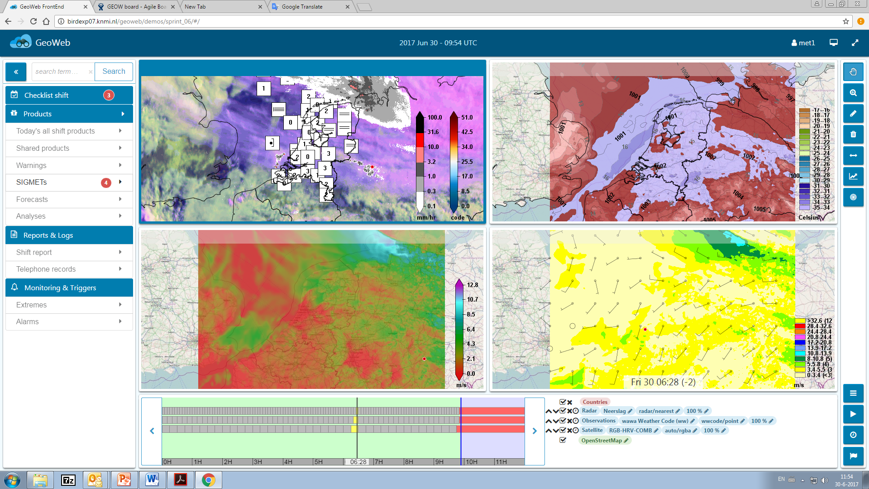
KNMI GeoWeb project
GeoWeb
Meteorological weather forecasting
Satellites
Weather Models
Automated weather observations
Lightning
Radar
Research and exploration
Add your own datasets via Web Map Services
Production of TAF and SIGMET
TAF: Terminal Aerodrome Forecast
SIGMET: Significant Meteorological Message
Draw area on the map to indicate area of interest
Supports output in IWXXM
Currently in development
Seeking collaboration !
Uses open standards and open source software
Uses ADAGUC server for image generation
Web application is built in ReactJS

Slide 3
Model data, satellite data, animation loops, forecasts
GeoWeb

Slide 4
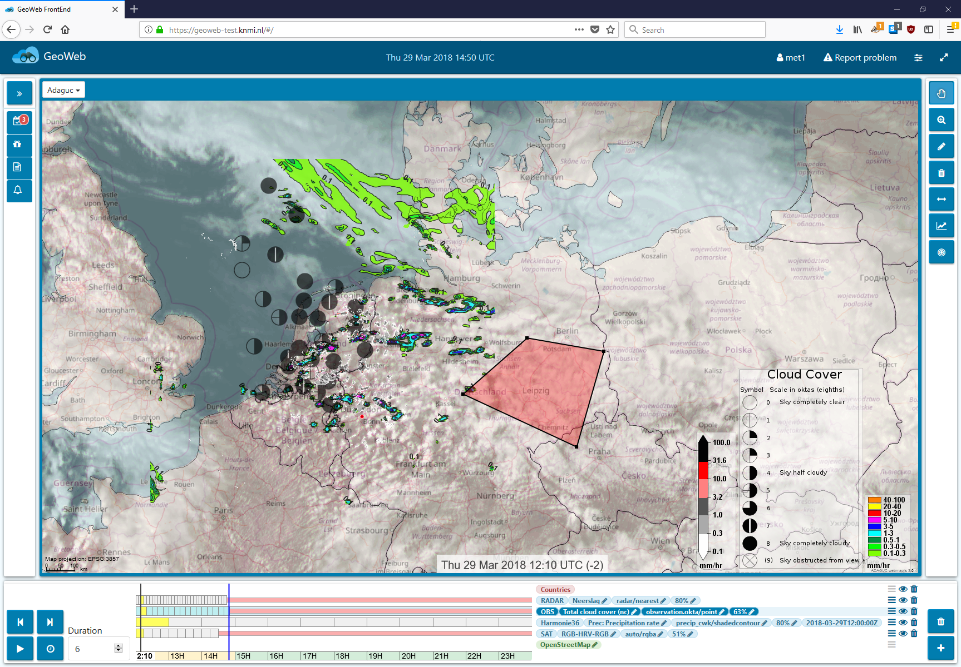
Realtime observations
GeoWeb

Slide 5
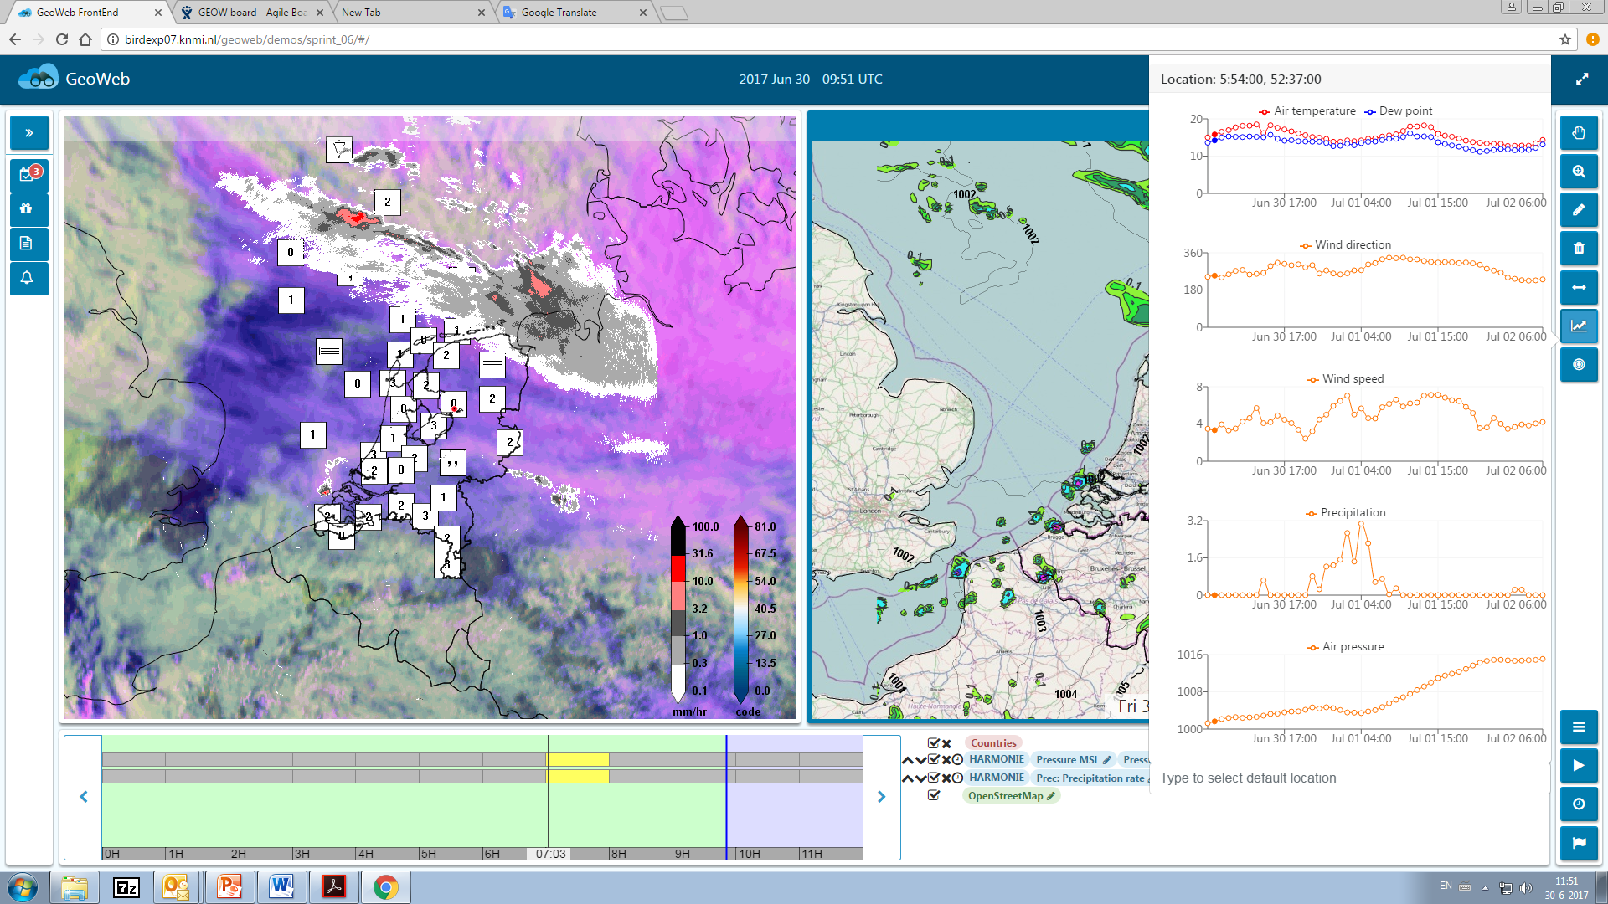
Interactive timeseries – click any location to get timeseries
GeoWeb

Slide 6
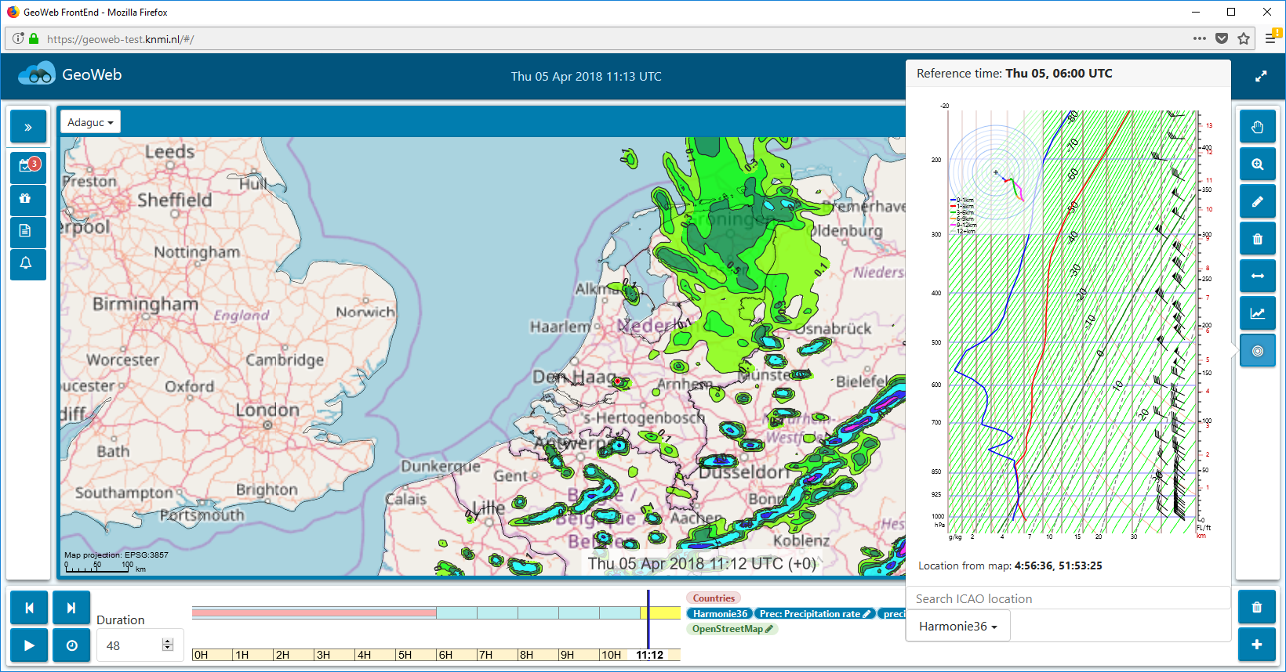
Interactive progtemp – click for vertical profile
GeoWeb

Slide 7
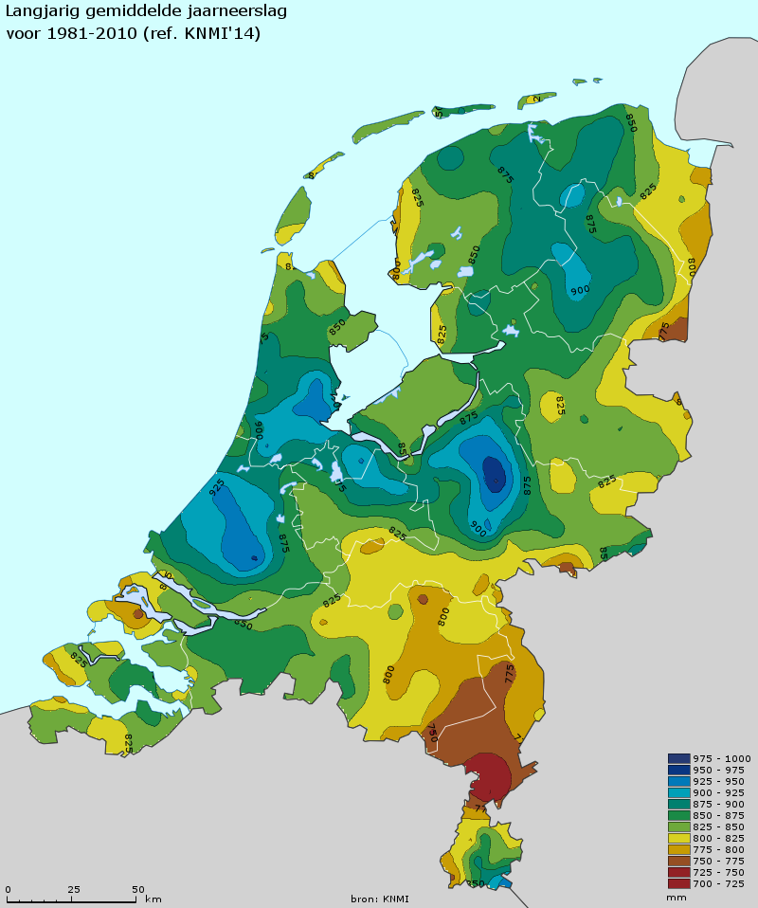
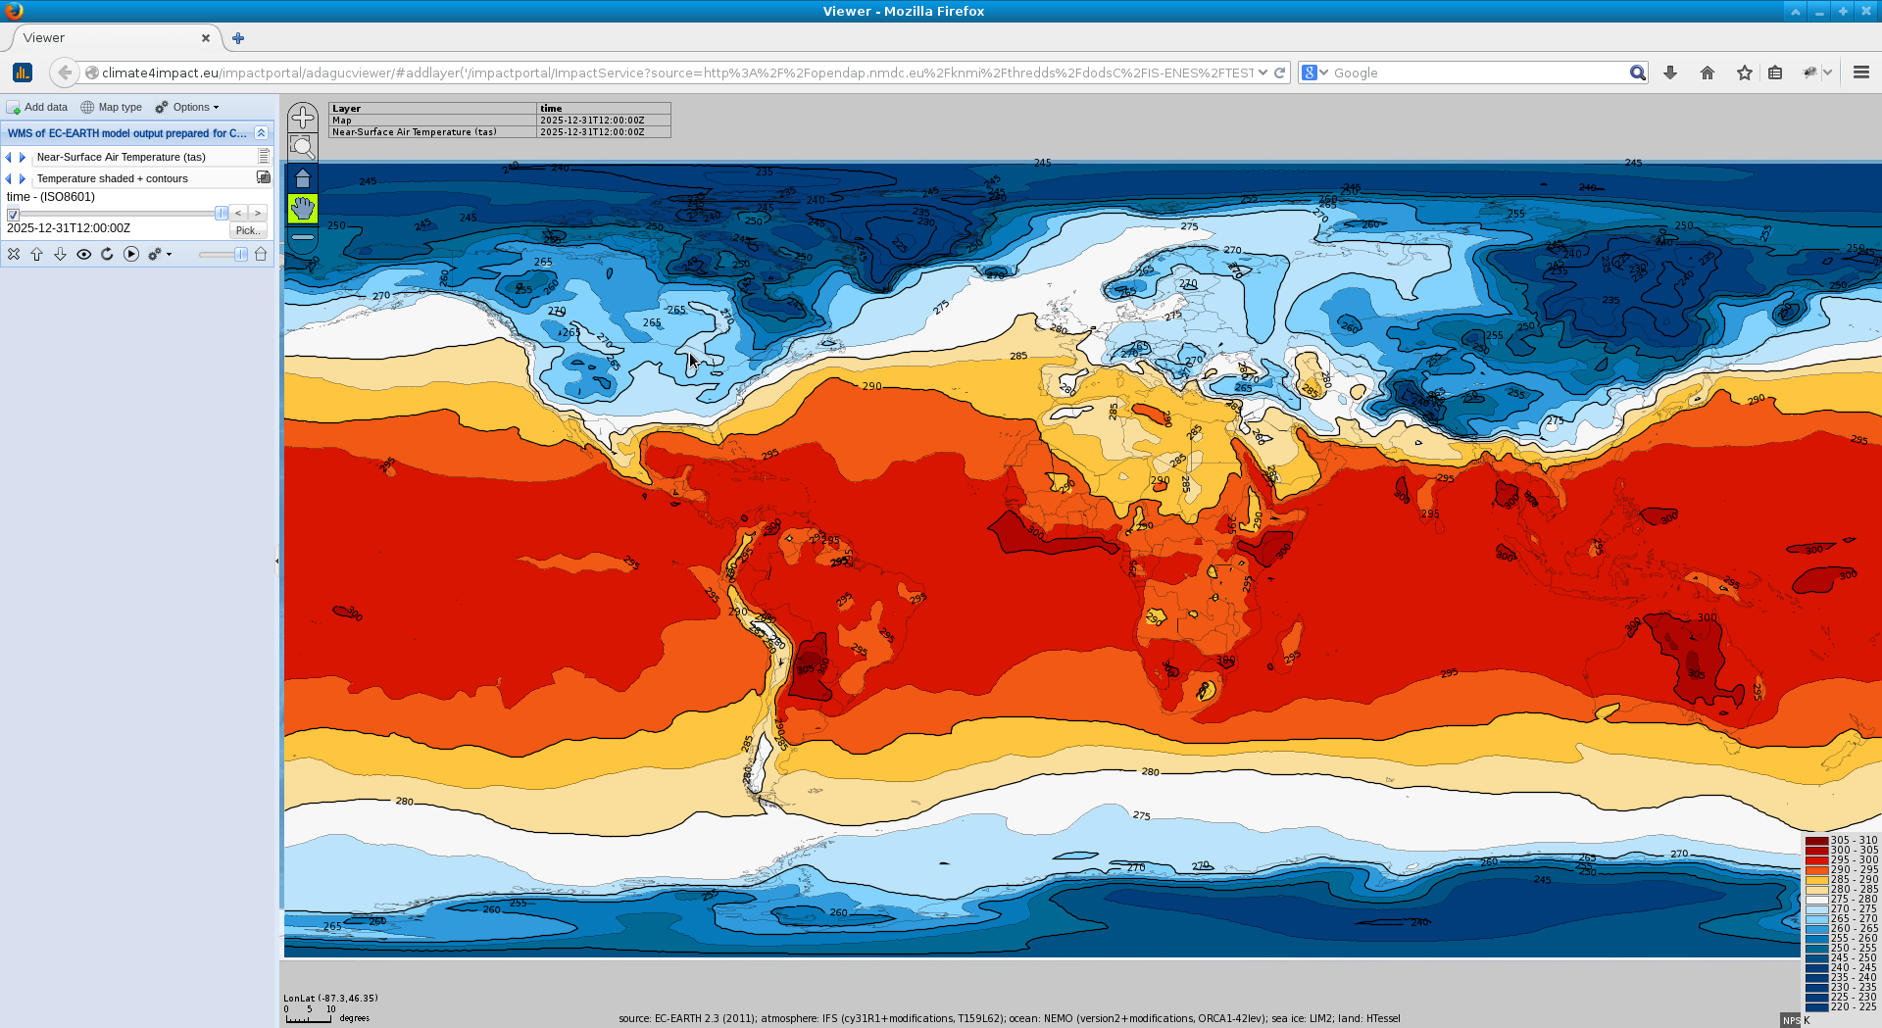
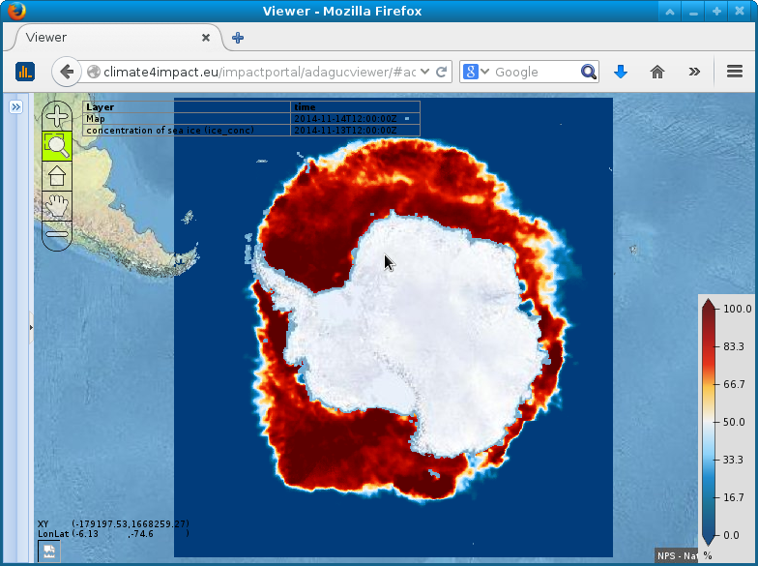
ADAGUC – Visualization and data service
ADAGUC
ADAGUC – Atmospheric Data Access for the Geospatial User Community
Serves OPeNDAP, WMS,WCS
Reads NetCDF with Climate and Forecast Conventions
Reads HDF5, PNG, GeoJSON, WMS and OPeNDAP
Supports multiple dimensions
TIME / ELEVATION / ensemble / threshold / member / etc ...
Realtime and live update of new data and aggregations
Concatenate huge amounts of NetCDF files to a single dataset
Precipitation radar is publicly available as WMS, data since 2009, new data each 5 minutes, ~900.000 timesteps accessible
Automatic visualization and exploration of new data. Can be opendap services, NetCDF files, THREDDS catalogs, etc ...
Server is written in C++, high performance, realtime reprojections
Docker container is available
Allows to quickstart with ADAGUC
Used in production environment
Supports tiling of high res imagery for interactive viewing
Adaguc workshop on June 6,7 and 8. Interested?: mail to adaguc@knmi.nl
https://github.com/KNMI/adaguc-server

Slide 8
Adaguc viewer for combining datasets in space and time
ADAGUC
Observations
Every 10 minutes
Precipitation Active radar
Harmonie
Weather model
Suomi NPP
Polar Satellite
Meteosat
Geostationary satellite

Slide 9
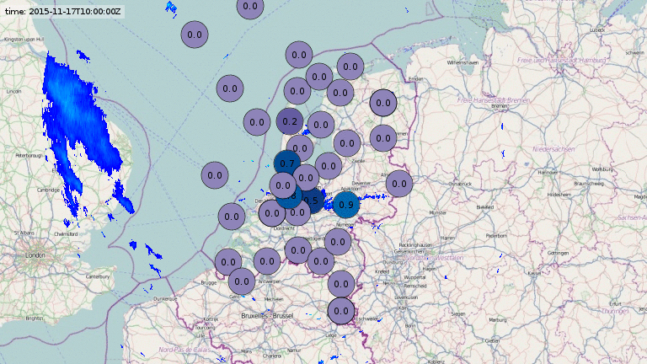
ADAGUC
Combine different sources
Share data and research results
Experiment with data without interfering operational systems
Serve a ADAGUC Web Map Service from your laptop / workstation
Precipitation radar
Every 5 minutes
Observations
Every 10 minutes

Slide 10
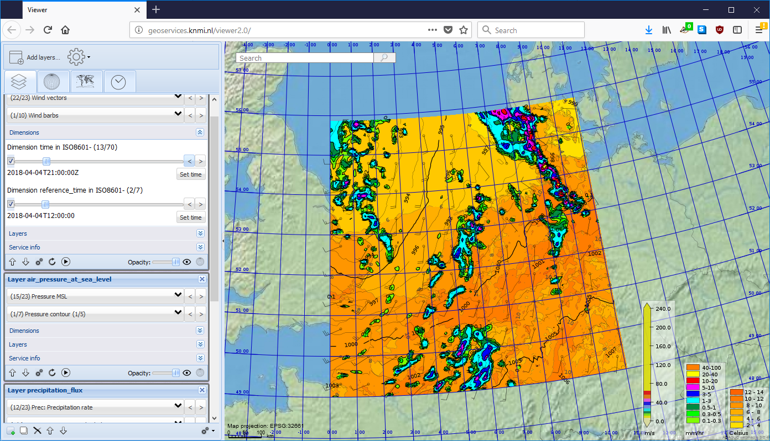
Adaguc viewer with Harmonie weather model
ADAGUC

Slide 11
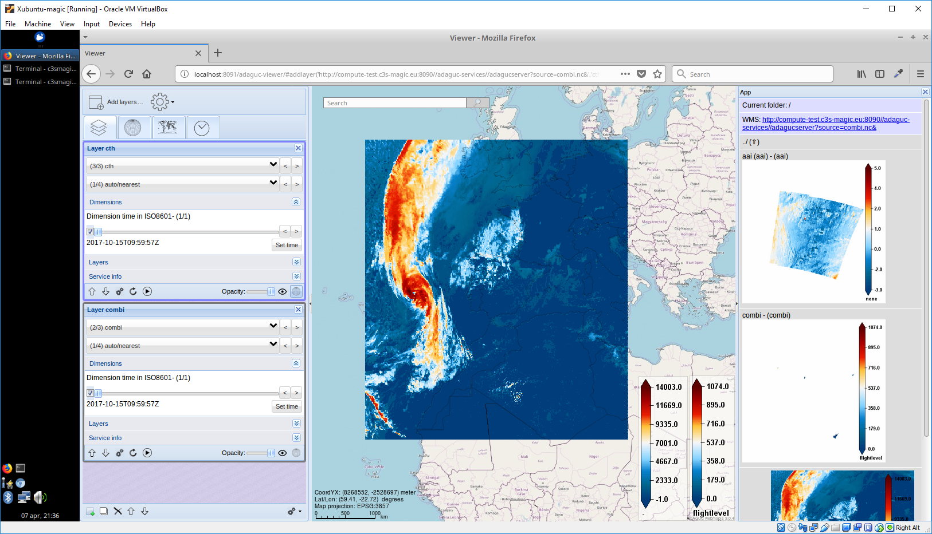
Adaguc viewer with autowms application (Right pane)
ADAGUC

Slide 12
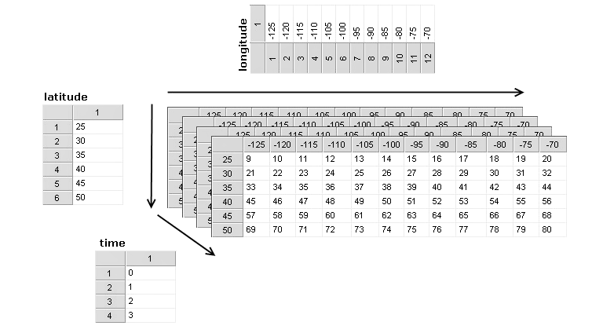
NetCDF-CF
Formats
NetCDF4 with Climate and Forecast conventions
Standard names and units
Identify and compare
Dimensions, variables and attributes

Slide 13
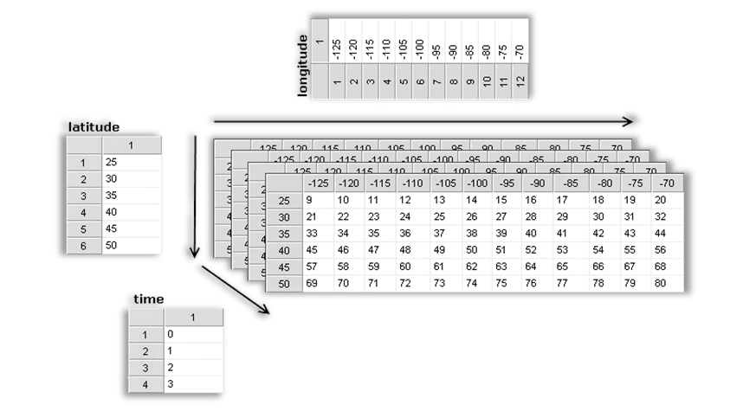
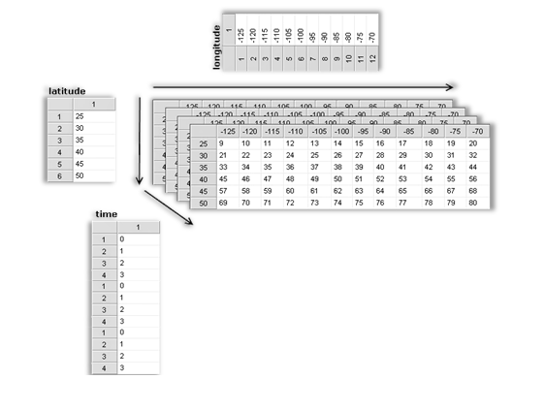
Aggregations: Represent multiple files as a single big one
Formats
Concatenates over time dimension
Adaguc uses sqlite or postgresdb to index dimensions over several NetCDF files
Precipitation radar demonstrates this effectively by concatenating 900.000 files into a singe WMS layer
Data can be added to a live service to enable realtime update of data

Slide 14
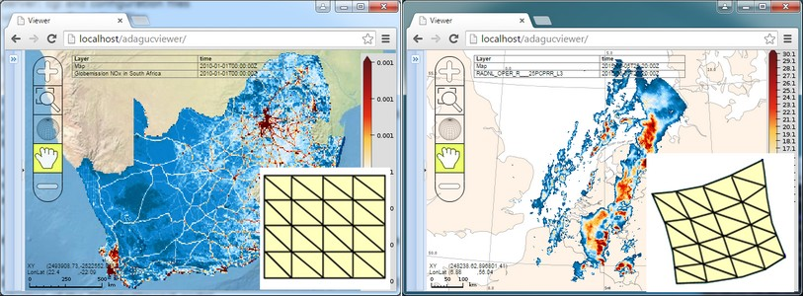
Support for structured grids
Formats
Regular grids and georefernced grids with a geographical projection
Supports both CF projection parameters and Proj4 projection strings
Weather models / climate models / geostationary satellite data / radar data

Slide 15
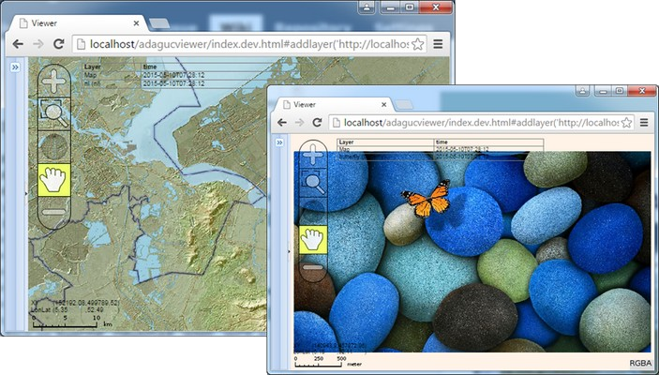
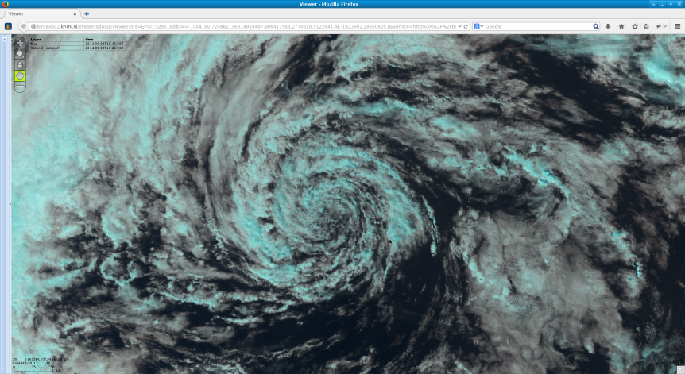
Support for georeferenced imagery stored in NetCDF or PNG
Formats
NetCDF with true color support
True color data (RGBA)
4 channels, red, green, blue and alpha – 8 bits per channel → uses NETCDF_UINT (RGBA)
Used for background maps, meteorological maps, composites of satellite imagery

Slide 16
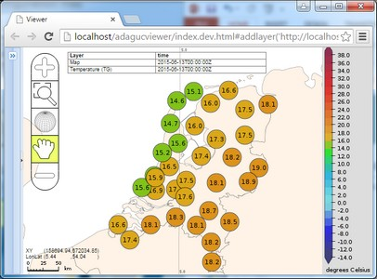
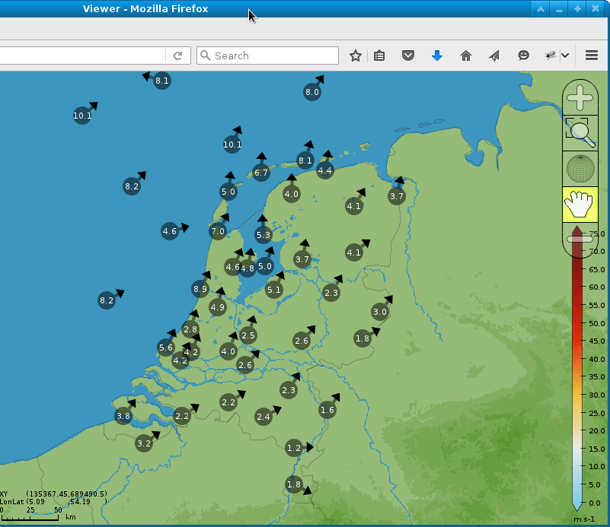
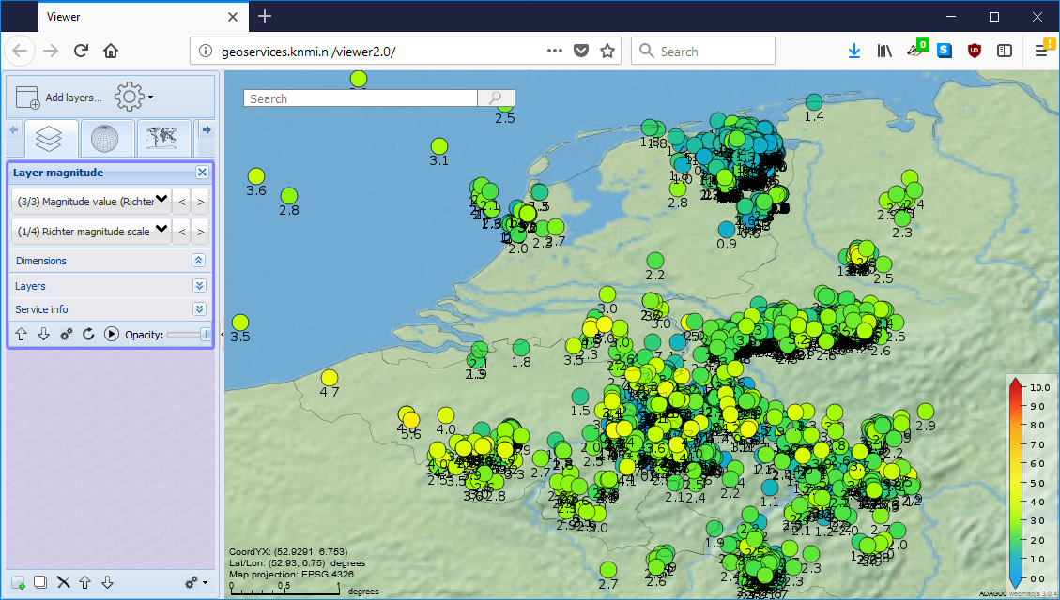
Support for point data measurements / observations
Formats
Uses NetCDF-CF Featuretype timeseries or point
Measurements from automated weather stations, timeseries
Seismological measurements

Slide 17
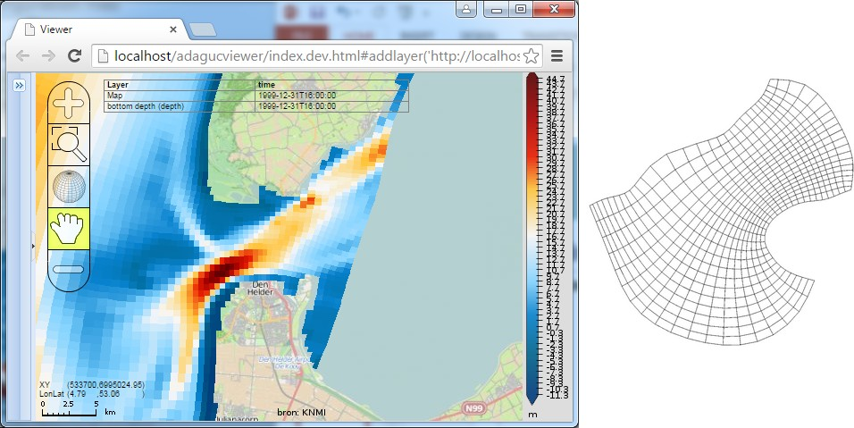
Support for curvilinear data
Formats
Fluid mechanics / hydrological models
Resolution increases where flow is higher
Quads are linked with irregular shape and size
Grids cannot be described using a geographical transformation → Curvilinear data

Slide 18
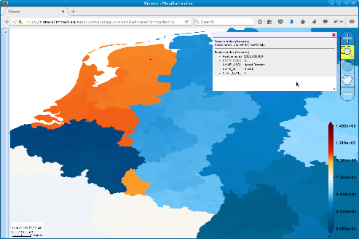
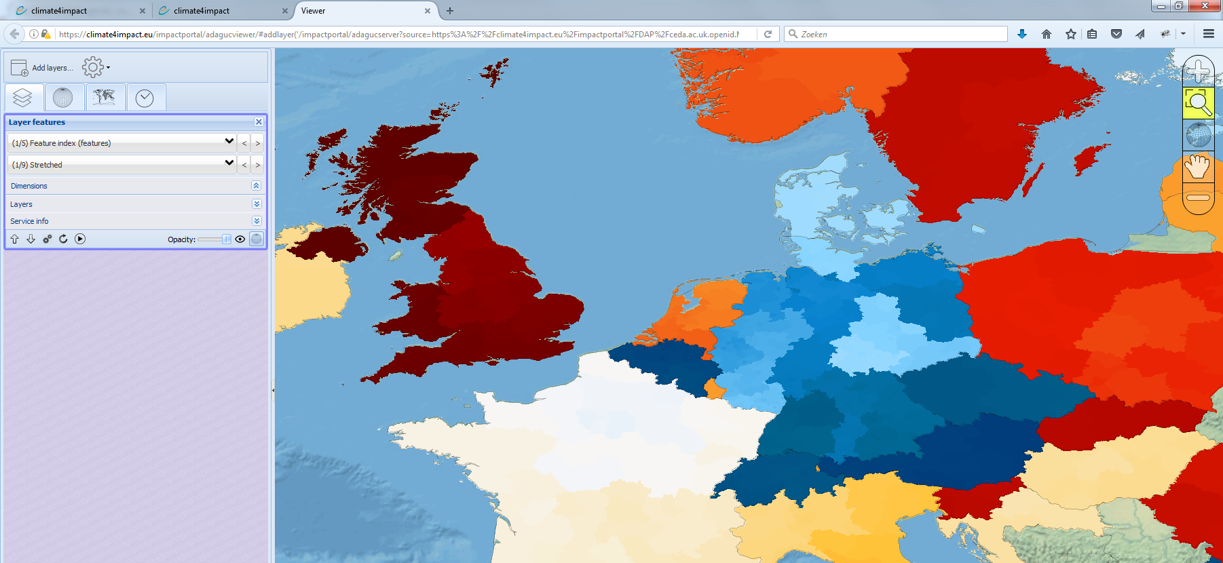
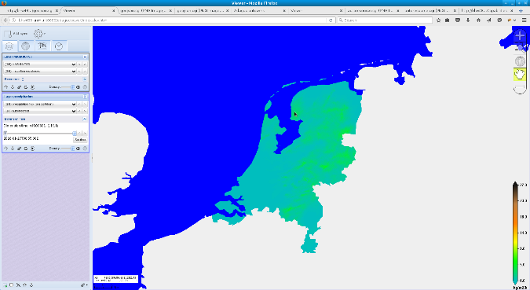
Support for vector data defined in GeoJSON
Formats
ADAGUC-Server supports GeoJSON via WMS and WCS
GeoJSON can be rasterized to gridded NetCDF using the Web Coverage Service
Allows for various operations like statistics per polygon, area extraction, etc..

Slide 19
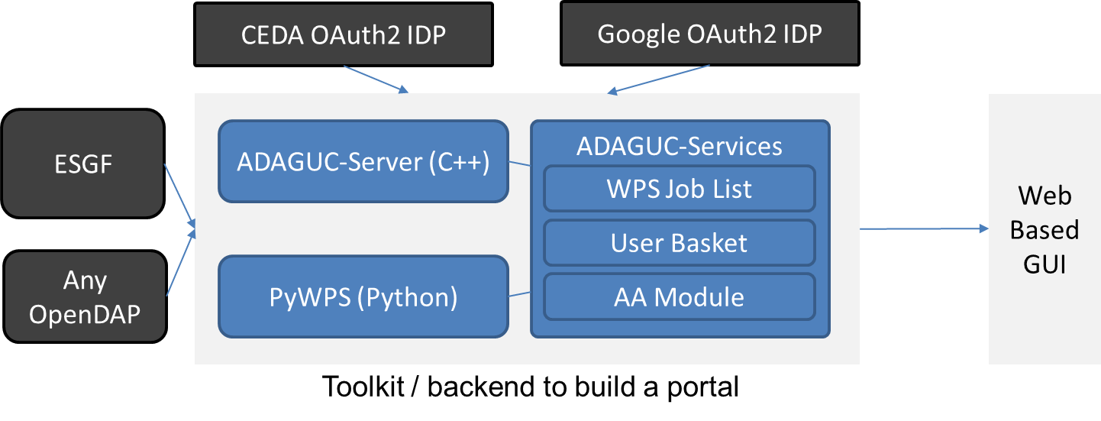
Analysis with adaguc-services, adaguc-server and PyWPS
Analysis
ADAGUC-Services is a Java Spring application controlling ADAGUC-Server and PyWPS
Adaguc-Server is utilized for visualization and geographical processing (WMS / WCS)
PyWPS is utilized for generic web processing (WPS), climate indicator calculation, combining data
This framework is in development and used in CLIPC / C3S-Magic / IS-ENES Climate4Impact
Adaguc services supports x509 client certificate authentication and OAuth2 authentication (ESGF)
Processed results are stored in a personal basket with private OpenDAP support
Processed results can be re-used in new calculations and can be visualized using ADAGUC-Server

Slide 20
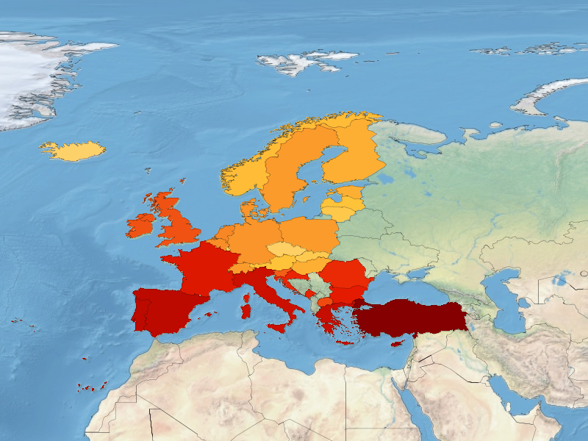
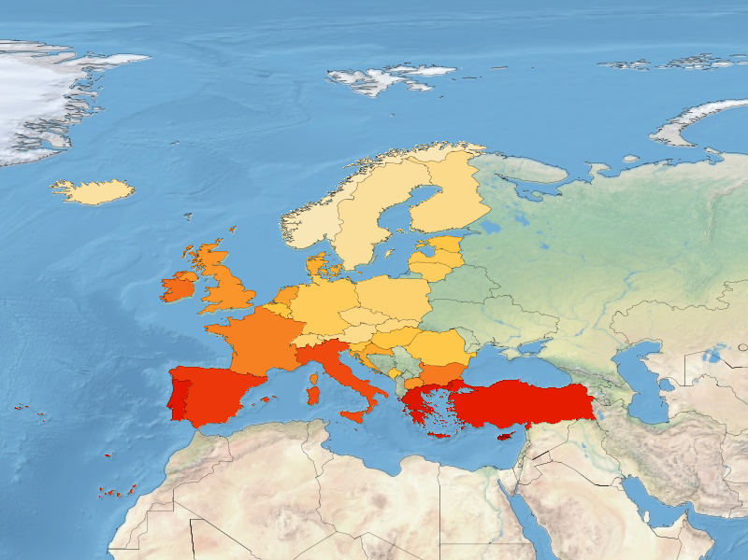
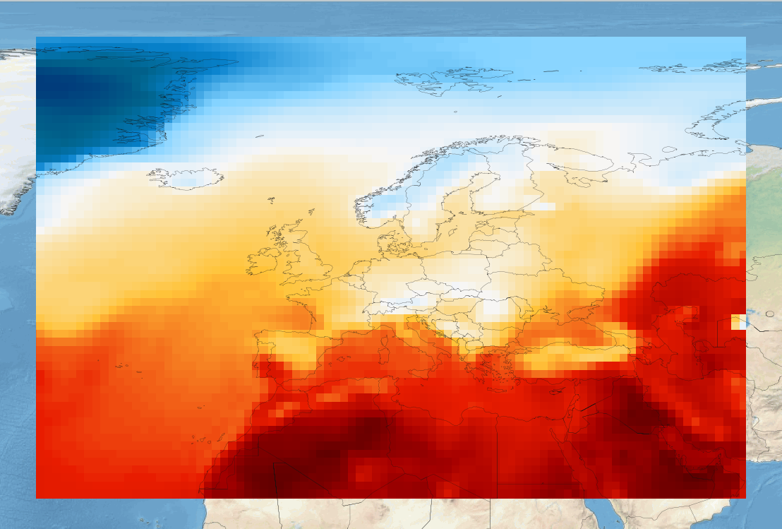
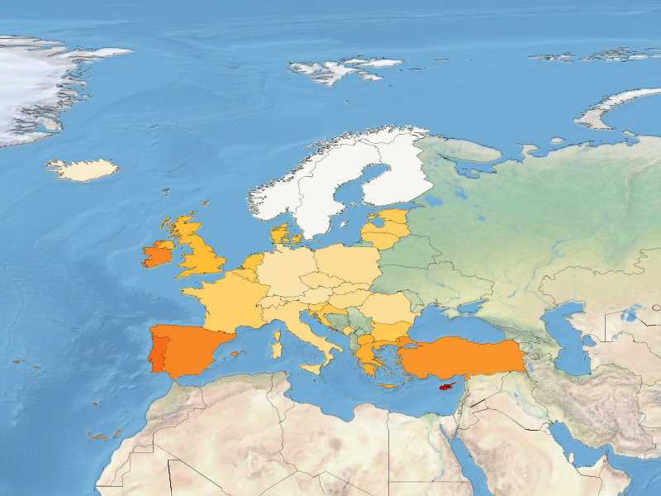
Analysis: extract statistics per country
Analysis
Maximum per region
Calculates statistics per region from grids
Uses Adaguc-services framework
Mean, min, max, etc ...
Uses GeoJSON for region definition (E.g. NUTS regions)
Outputs NetCDF and CSV
Average per region
Minimum per region

Slide 21
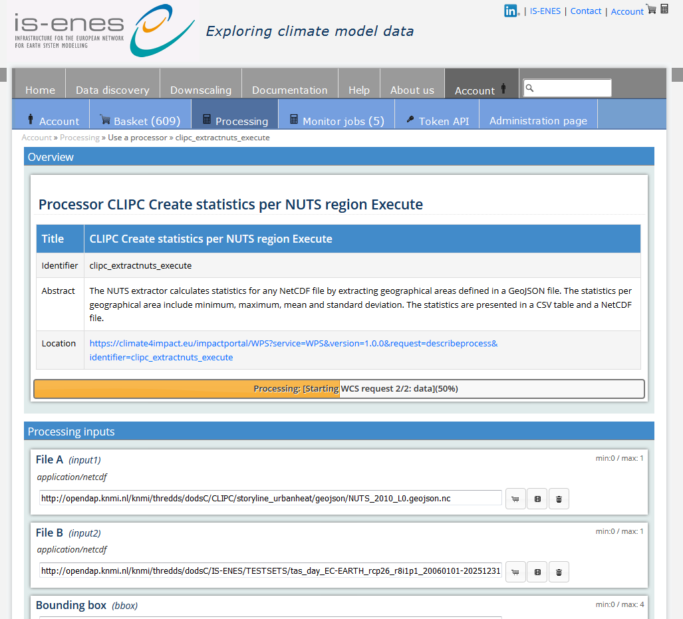
Web processing interface
Analysis
Climate4Impact portal
Simple automatically generated UI
Links to preview (ADAGUC)
Links to private basket
title
identifier
abstract
value
basket
preview
delete

Slide 22
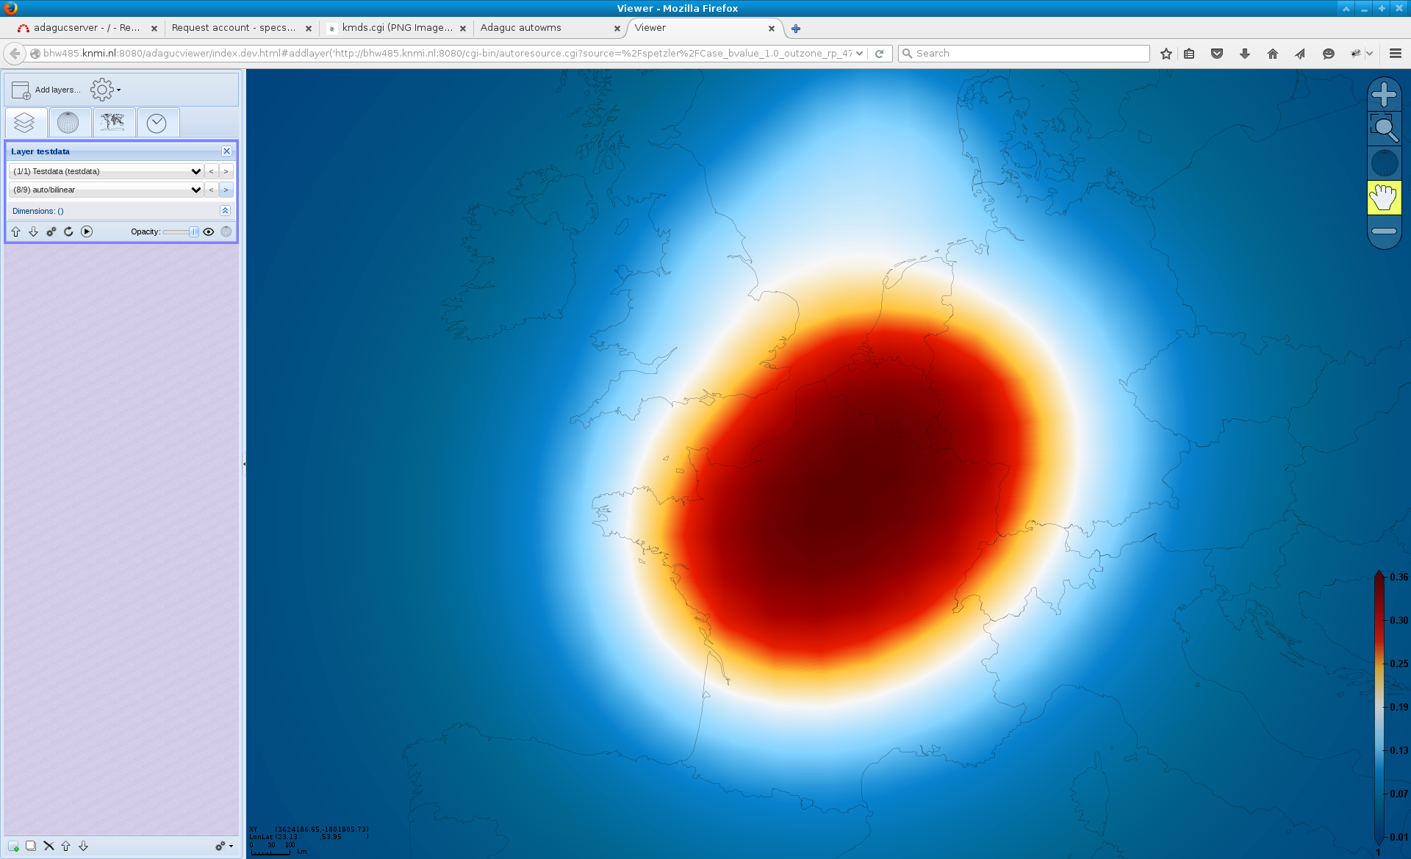
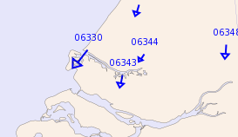
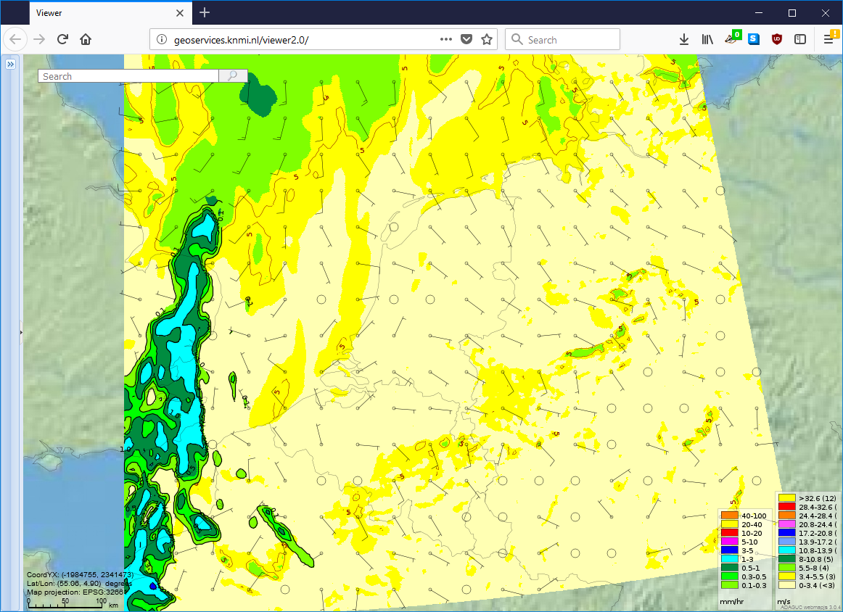
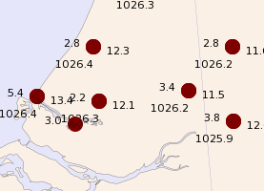
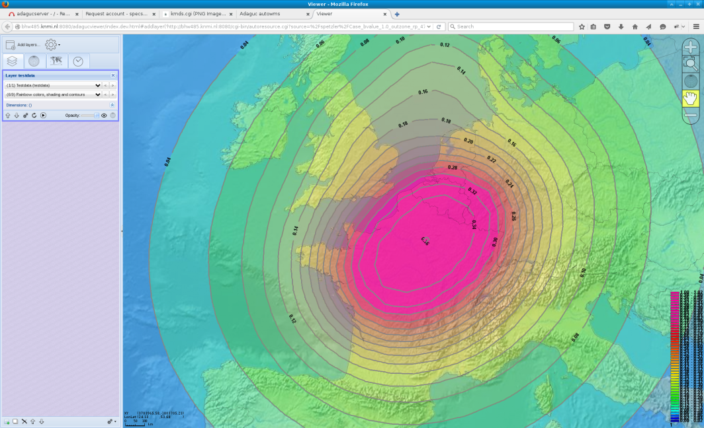
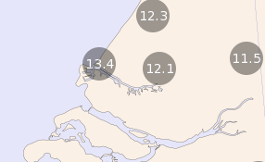
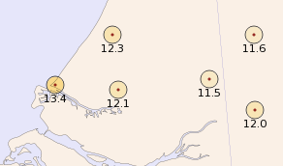
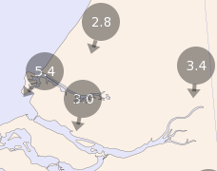
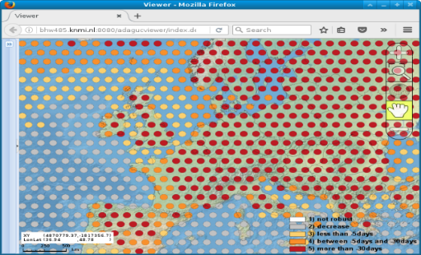
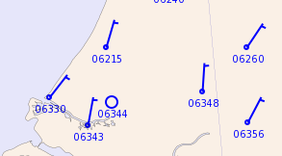
Styling
Styling
Bilinear
Shading + Contours

Slide 23
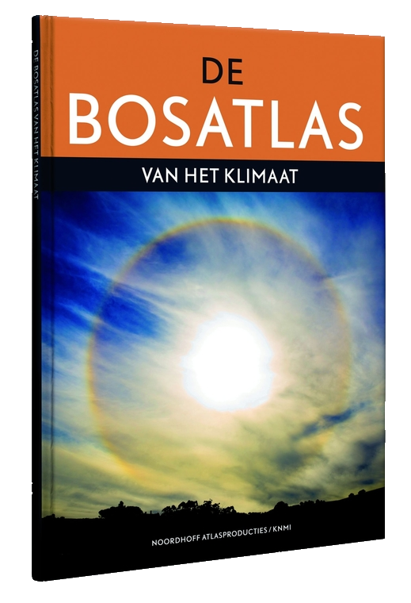
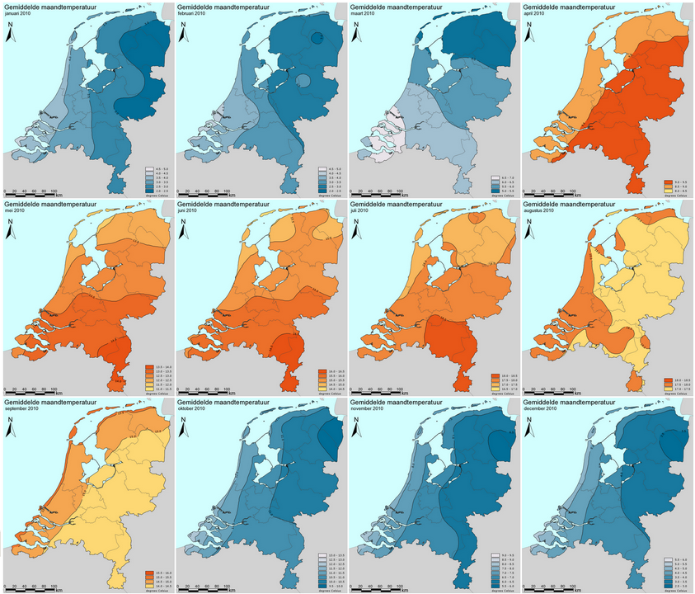
Styling – The Dutch climate atlas, long term temperature maps
Styling

Slide 24
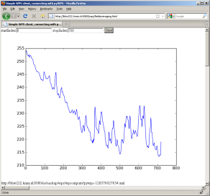
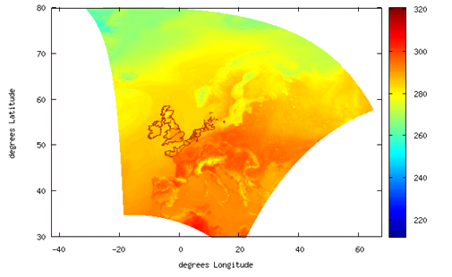
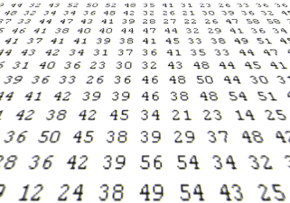
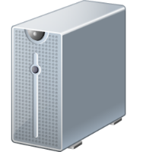
Overview: HTTP → OpenDAP → WCS →WMS → WPS
Standards
Work done by client or researcher
OGC WPS
Processing
OGC WMS
Graphics
OGC WCS
OpenDAP
Geo-referenced
HTTP / FTP
Array based
Data files
01001010010
01010010010
10010100100
10010011000
Work done by server
(de Boer & Plieger, 2016)

Slide 25
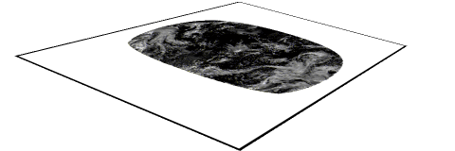
ADAGUC Web Map Services → Interactively view huge datasets
Standards
+
ADAGUC
Server
ADAGUC
Viewer
NetCDF Data
(big, 5.5Gb)
PNG images
(small, 180Kb)
Combined
geographically

Slide 26
Web Coverage Service → WCS
Standards
Download what you see
Convert to ASCII, Geotiff, NetCDF
Reproject and subset
Use WCS directly in your scripts
R
Python (PyWPS)
Matlab
Supports time, elevation, …
WCS client in viewer
Rasterizes GeoJSON
Rasterizes polar satellite data

Slide 27
Applications: C3S-Magic
Applications
Metrics and Access to Global Indices for Climate Projections (MAGIC)
This portal provides the functions as requested in the C3S tender “Global Climate Projections: Data Access, product generation and impact of front-line developments” (GCP). It provides solutions that allow to assess GCM projections using well-established metrics, and manipulation tools to allow tailoring the outputs to the users’ needs.
This portal uses the ADAGUC visualization and analysis framework

Slide 28
The EUNADICS-AV portal
Applications
Demonstrating dissemination of pan-European forecast, observation and alert products for environmental hazards
Eunadics uses ADAGUC WMS for visualization and ADAGUC WCS for rasterizing to combine satellite imagery and observations in space and time
Oral presentation:
EGU2018-15582, Mon, 09 Apr, 14:45–15:00, Room L8
+
=
Seviri CTH
Gome AAI
New ash at height product

Slide 29
Applications: Geoweb
Applications

Slide 30
Applications: https://climate4impact.eu/ portal
Applications

