Slide 1
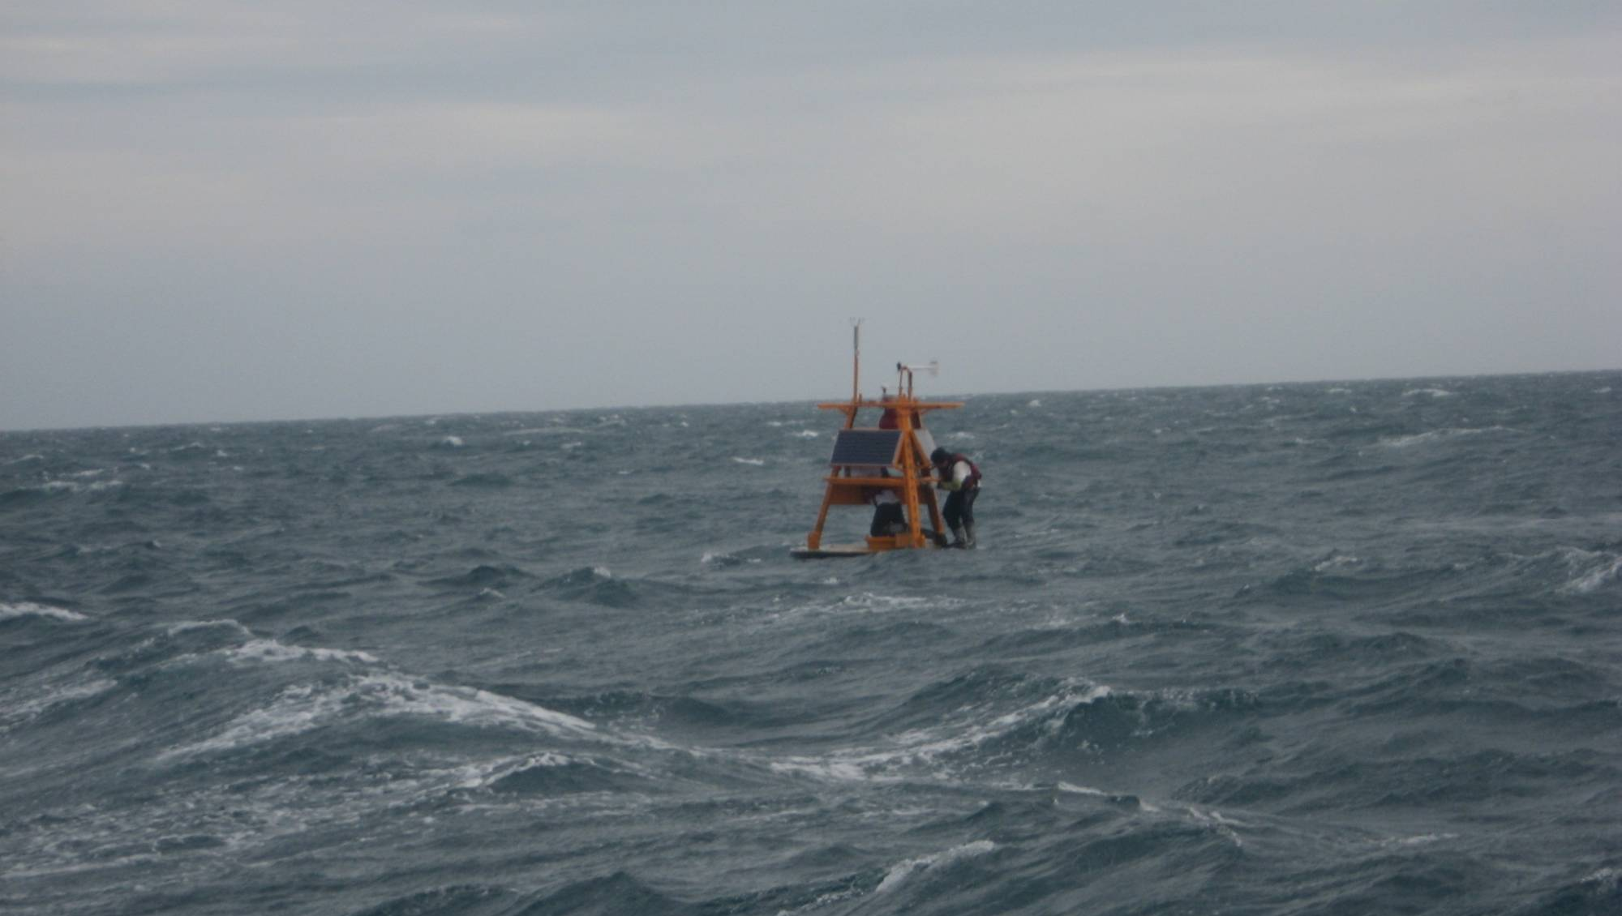
Marine Disaster Prevention Information Service Platform
Yang-Ming Fan, En-Chi Wu, and Chia Chuen Kao
Coastal Ocean Monitoring Center
National Cheng Kung University
Tainan, Taiwan (R.O.C.)
ymfan@mail.ncku.edu.tw

Slide 2
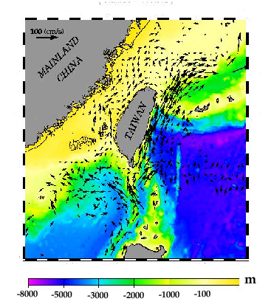
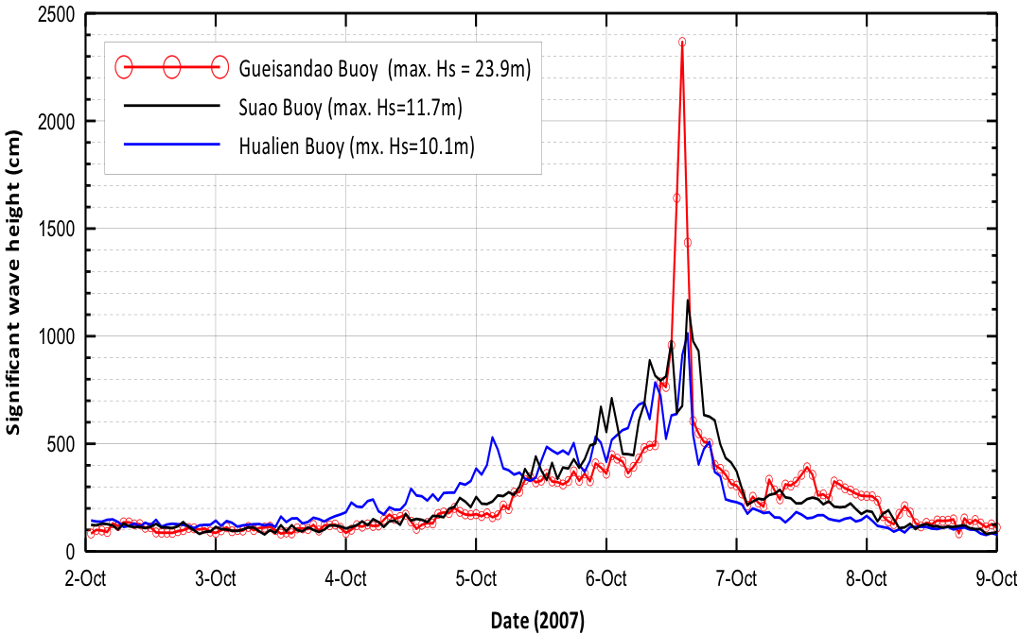
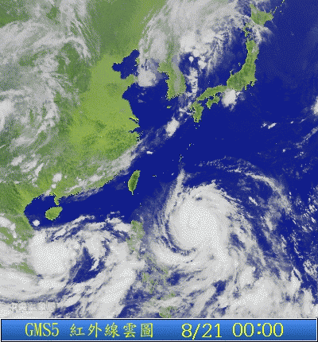
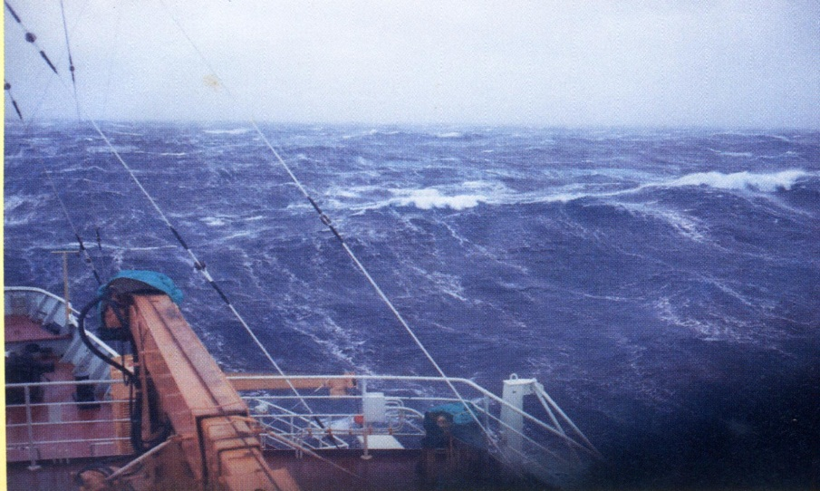
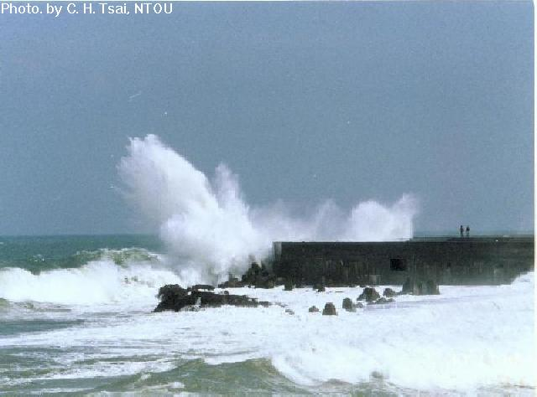
Marine enviroment in Taiwan
extreme wave
swell
storm surge
wave runup
overtopping
Typhoon season
Winter monsoon season

Slide 3
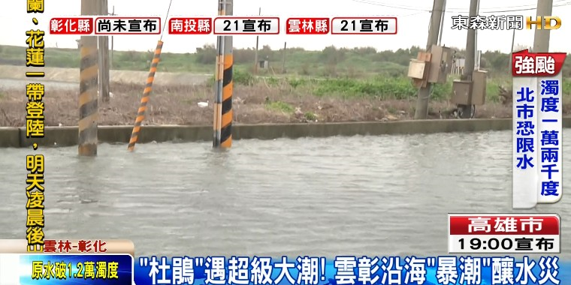
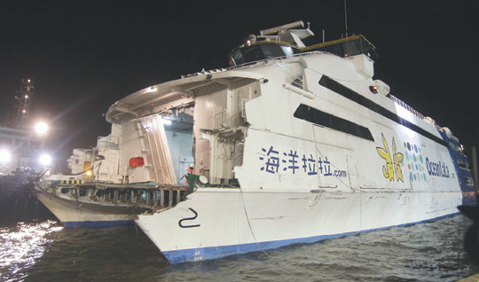
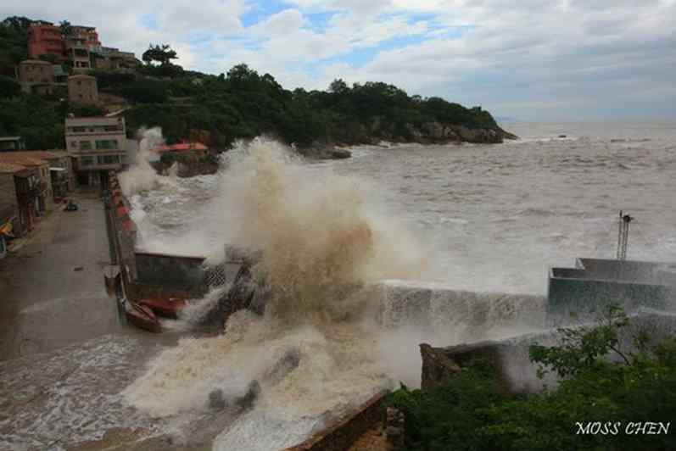
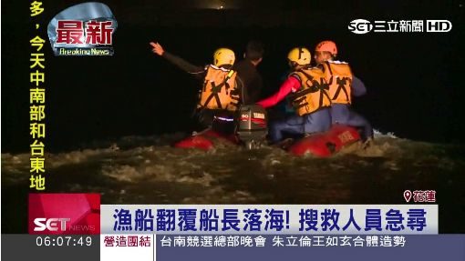
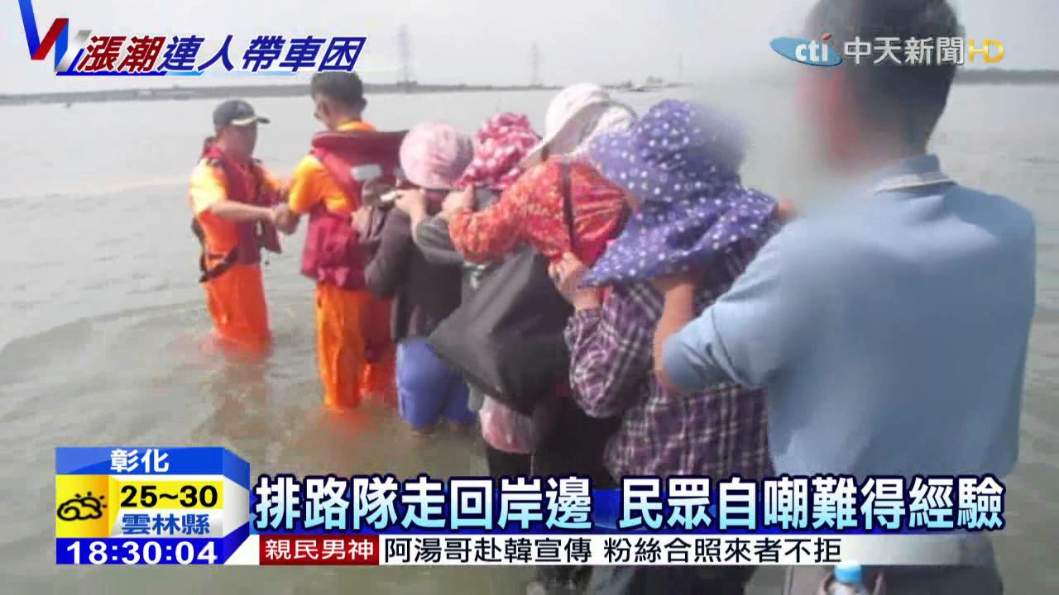
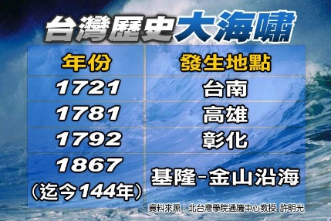
Common oceanographic disasters in Taiwan
storm surge flooding
maritime disasters
objects missing at sea
seawall damage
oil spill
trapped by high tide
tsunami
Photo: REUTERS/Tyrone Siu
freak wave

Slide 4
Strategies
Northwest Pacific marine meteorology database
Applied technologies for marine meteorology disaster prevention
Marine Disaster Prevention Information Service Platform

Slide 5
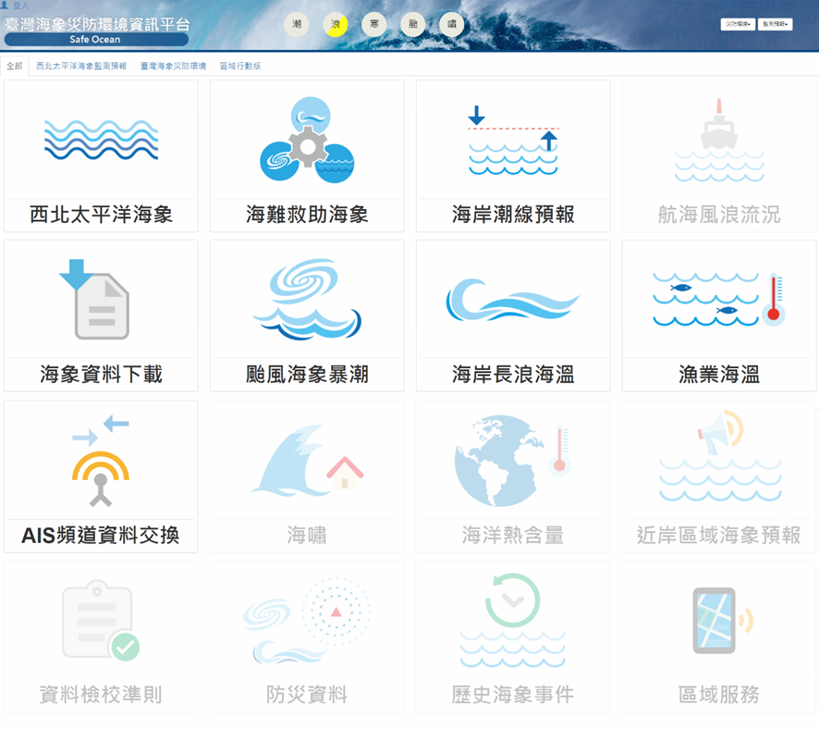
10 products will be completed progressively before 2020.
oil spill
objects missing at sea
trapped by high tide
ship safety
typhoon wave
storm surge
swell disaster index
unusual cold-water
tsunami
ocean heat content
Northwest Pacific marine meteorology display
Marine meteorology data for maritime disasters
Tide mark forecasting
Ship safety service
Download –
marine meteorology
Typhoon wave &
storm surage
Swell warning service
Unusual cold-water
AIS
Tsunami
Ocean heat content
Regional marine forecasting
Real-time Quality Control Manuals
Prevention information
History marine disaster event
Regional service

Slide 6
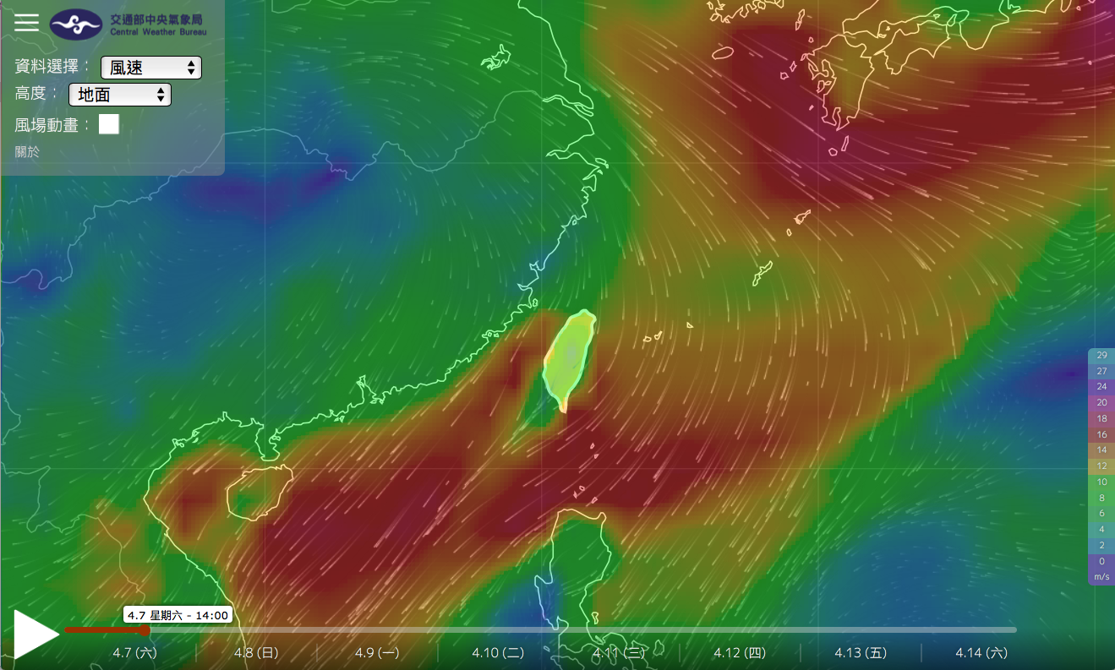
Northwest Pacific marine meteorology display

Slide 7
Marine meteorology data for maritime disasters
- Oil spill

Slide 8
Tide mark forecast

Slide 9
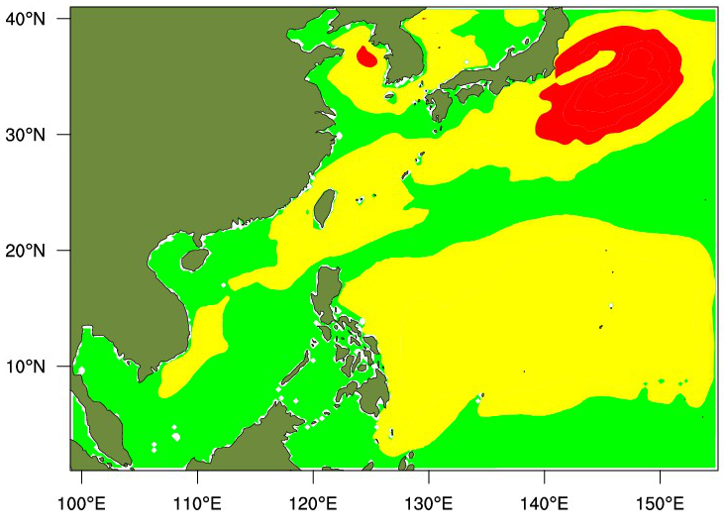
Ship safety service
AM08:00, 1st March 2018
Time: O Real time O Select
01/03/2018 08:00 am ~
01/03/2018 08:00 am
Ship|s Tonnage: 2700 Tonne
01
Inquire
+
–
Safety index
Safe Normal Dangerous

Slide 10
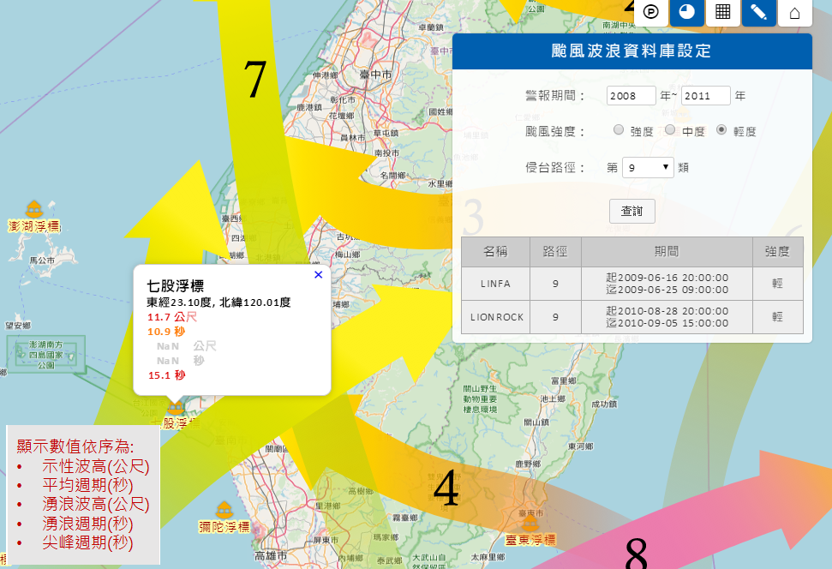
Typhoon wave

Slide 11
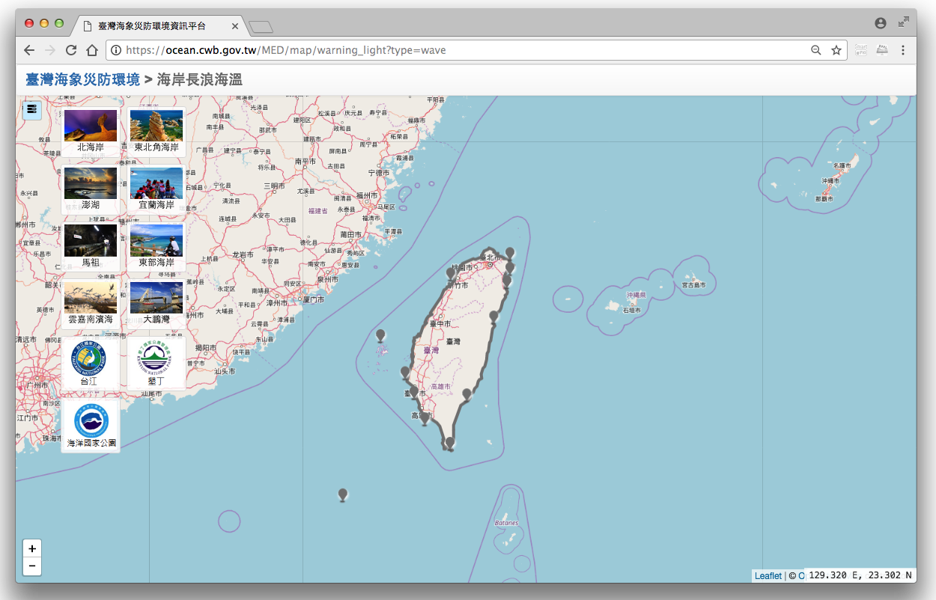
Swell warning service
Notes:
Swell warning service arranged with particular regional councils around Taiwan coastlines. This is to cover such hazards as erosion, waterfront safety and infrastructure inundation. The warning criteria will be set by COMC and are different for each area; most have a threshold of around 3.5m in height, with some more sensitive thresholds set according to other meteorological conditions such as atmospheric pressure and wind strength. Although swell is strictly the determining factor, in practice it is combined waves (including all landward swells and the contribution of wind waves) that are used as the forecast parameter.

Slide 12
Tsunami
Time: 27/02/2010
Real time HIstory
Tidal statio: 後壁湖
淡水
麟山鼻
八里樁
Inquire
龍洞
竹圍
梗枋
新竹
蘇澳
王功
花蓮
箔子寮
澎湖
東石
成功
東港
蘭嶼
小琉球
後壁湖

Slide 13
Regional marine forecasting

