Slide 1
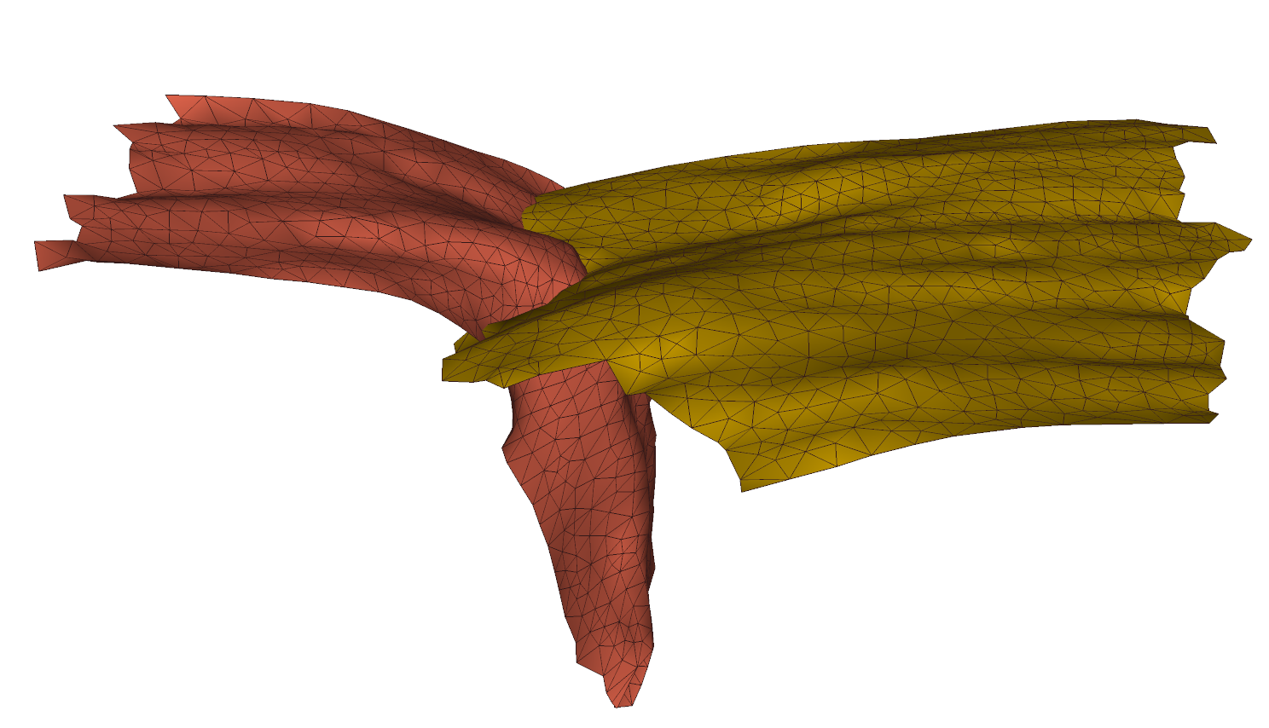
Rollback and decapitation of a south-facing subduction beneath the Tadjik Basin and the Hindu Kush
Reuben Creighton¹
Gordon Lister¹
Wim Spakman^{2,3}
(1) Research School of Earth Sciences, Australian National University, Canberra 2601 Australia
(2) Department of Earth Sciences, Utrecht University, Budapestlaan 4, Utrecht 3584 CD, The Netherlands
(3) Center for Earth Evolution and Dynamics (CEED), University of Oslo, Sem Saelands vei 24, NO-0316 Oslo, Norway

Slide 2
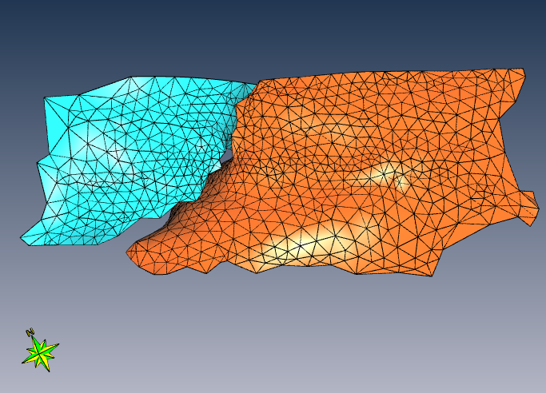

Slide 3
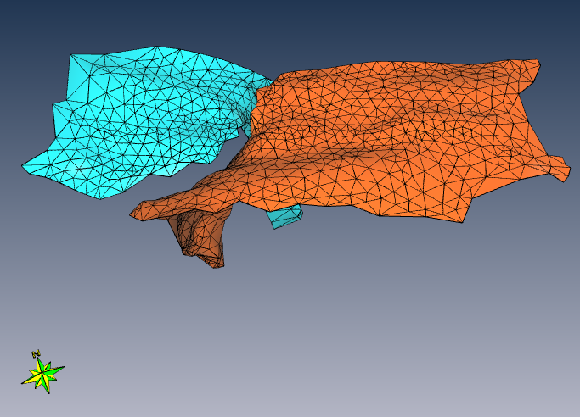

Slide 4
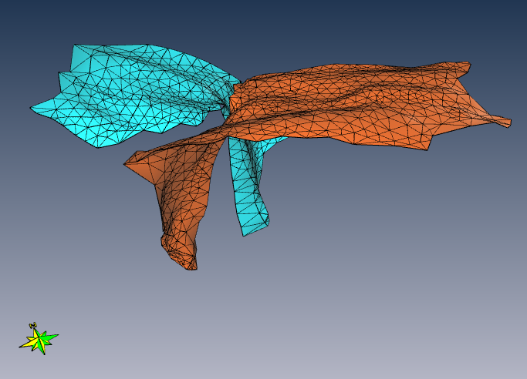

Slide 5
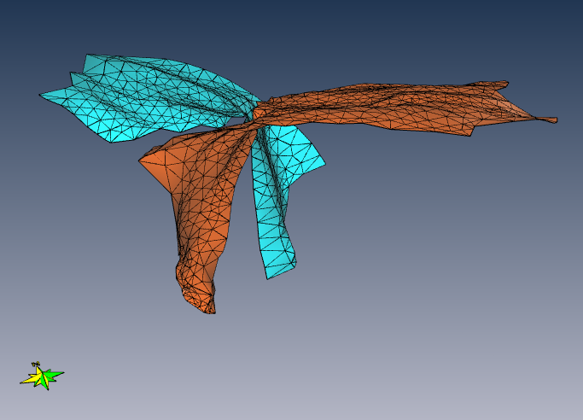

Slide 6
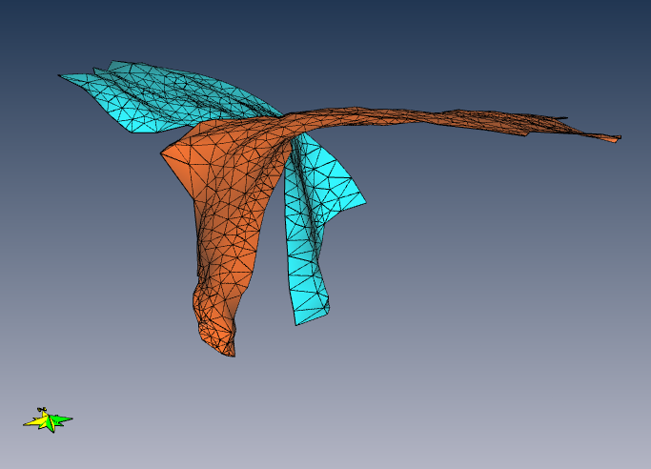
?

Slide 7
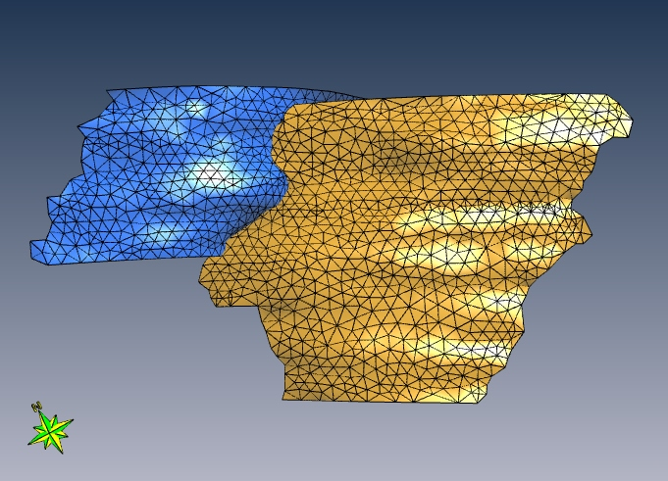

Slide 8
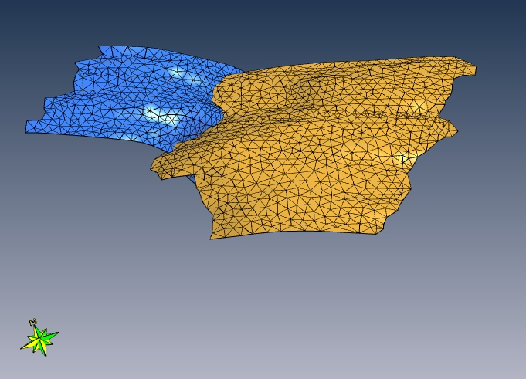

Slide 9
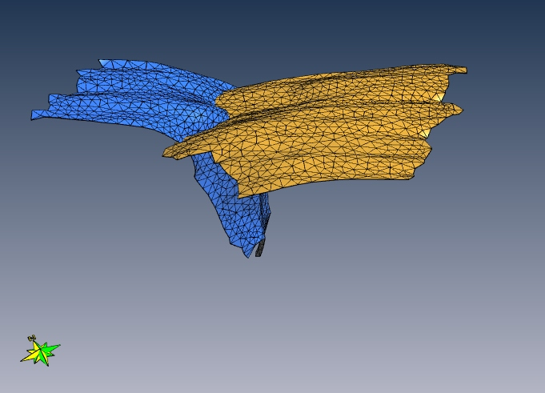

Slide 10
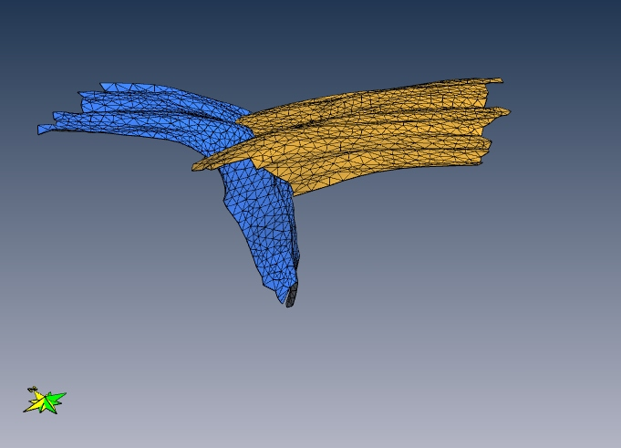

Slide 11
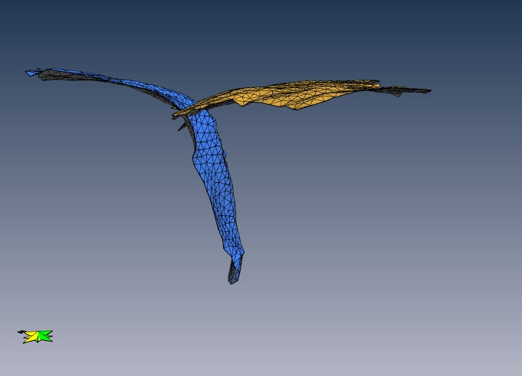

Slide 12
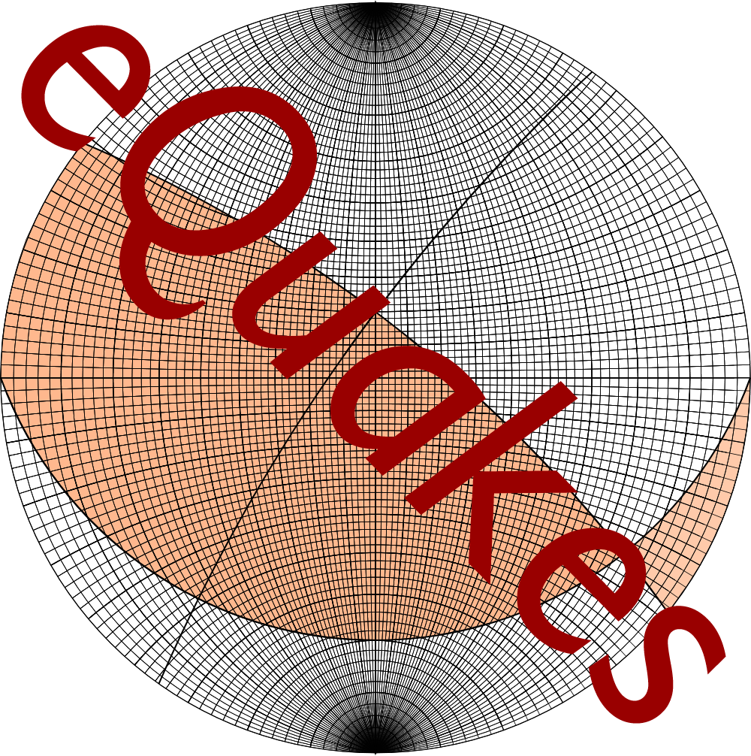
What and Why?
Data Sources
3D Slab Surface Model
Seismic Tomography Model (UU-P07)
EHB Hypocentre Catalogue
Global CMT Project
Notes:
Building 3d model simplify

Slide 13
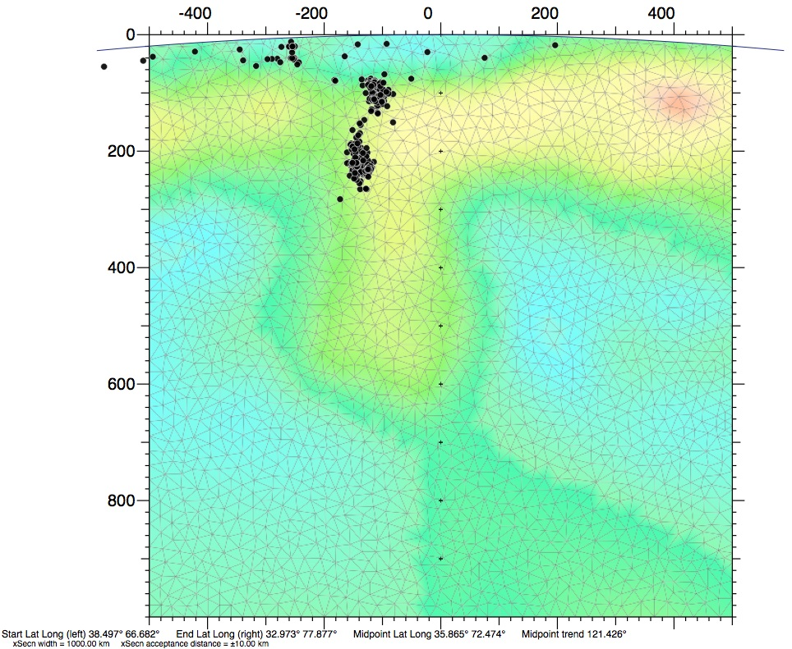
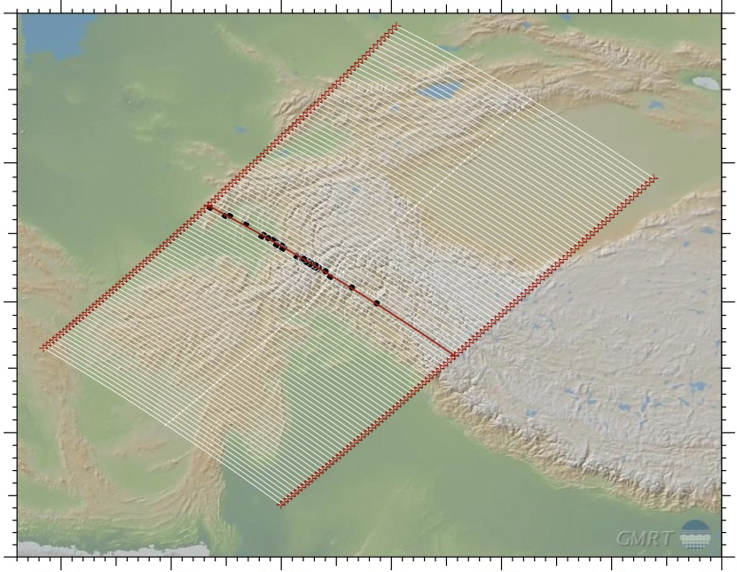
Interpretations
A
A′
A
A′
‘Deep India meets deep Asia’
(S.-K. Kufner et al. 2016)
Two converging subduction zones
(Chatelain et al. 1980; Burtman and Molnar 1993; Fan et al. 1994; Liao et al. 2017)
A single contorted slab
(Billington et al. 1977; Vinnik et al. 1977; Searle, Hacker and Bilham 2001)
Tomography Model: UU-P07
Notes:
Multiple interpretations have been made of the deep earthquakes under the Hindu Kush.
Central to the problem is the ambiguity of hypocentre localisation on the problem of morphology.
Tomography can help with this, but there is significant problem of resolution difference.

Slide 14
Interpretations
South Dipping Model
North Dipping Model
NW
SE
NW
SE
Notes:
Localisation of seismicity is the most significant difference between models.
Very difficult to test this hypothesis on tomographic and seismic data alone.

Slide 15
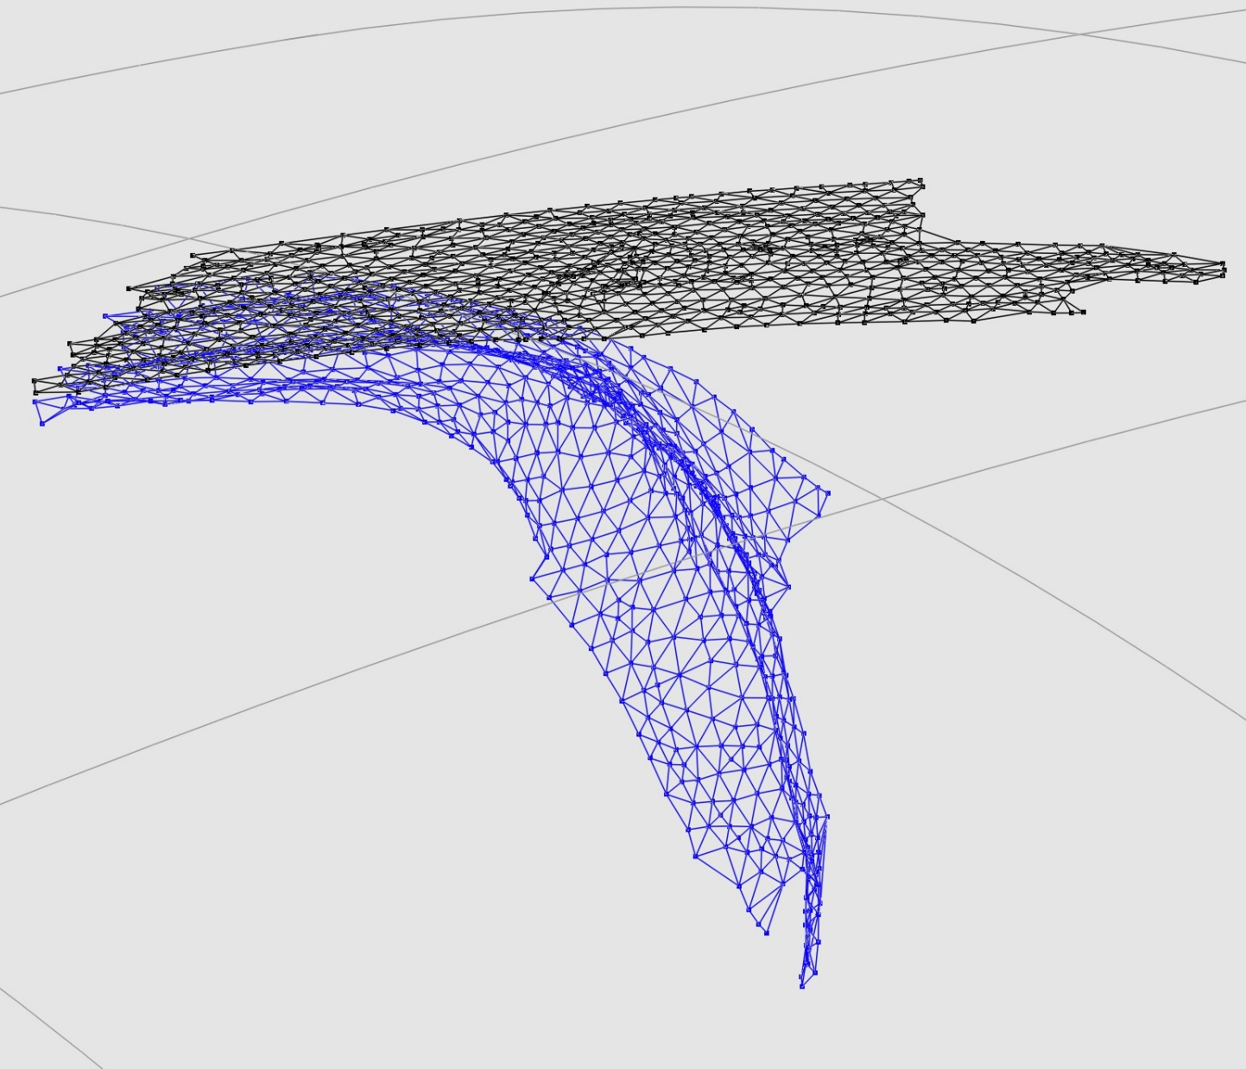
Slab Floating
15
Notes:
This figure shows a comparison between the south dipping Asian slab model, and a floated version of the same slab.
Floating is not attempting to model the subduction process. It is an assessment tool for the minimum slab surface models.
We can bring the mesh models to a flat configuration at the surface of a sphere, then we can make a minimum estimate of the surface area of crust prior to subduction.
We can also interpret the strain in the mesh produced by the flat configuration, and make inferences about the accuracy of the slab model.

Slide 16
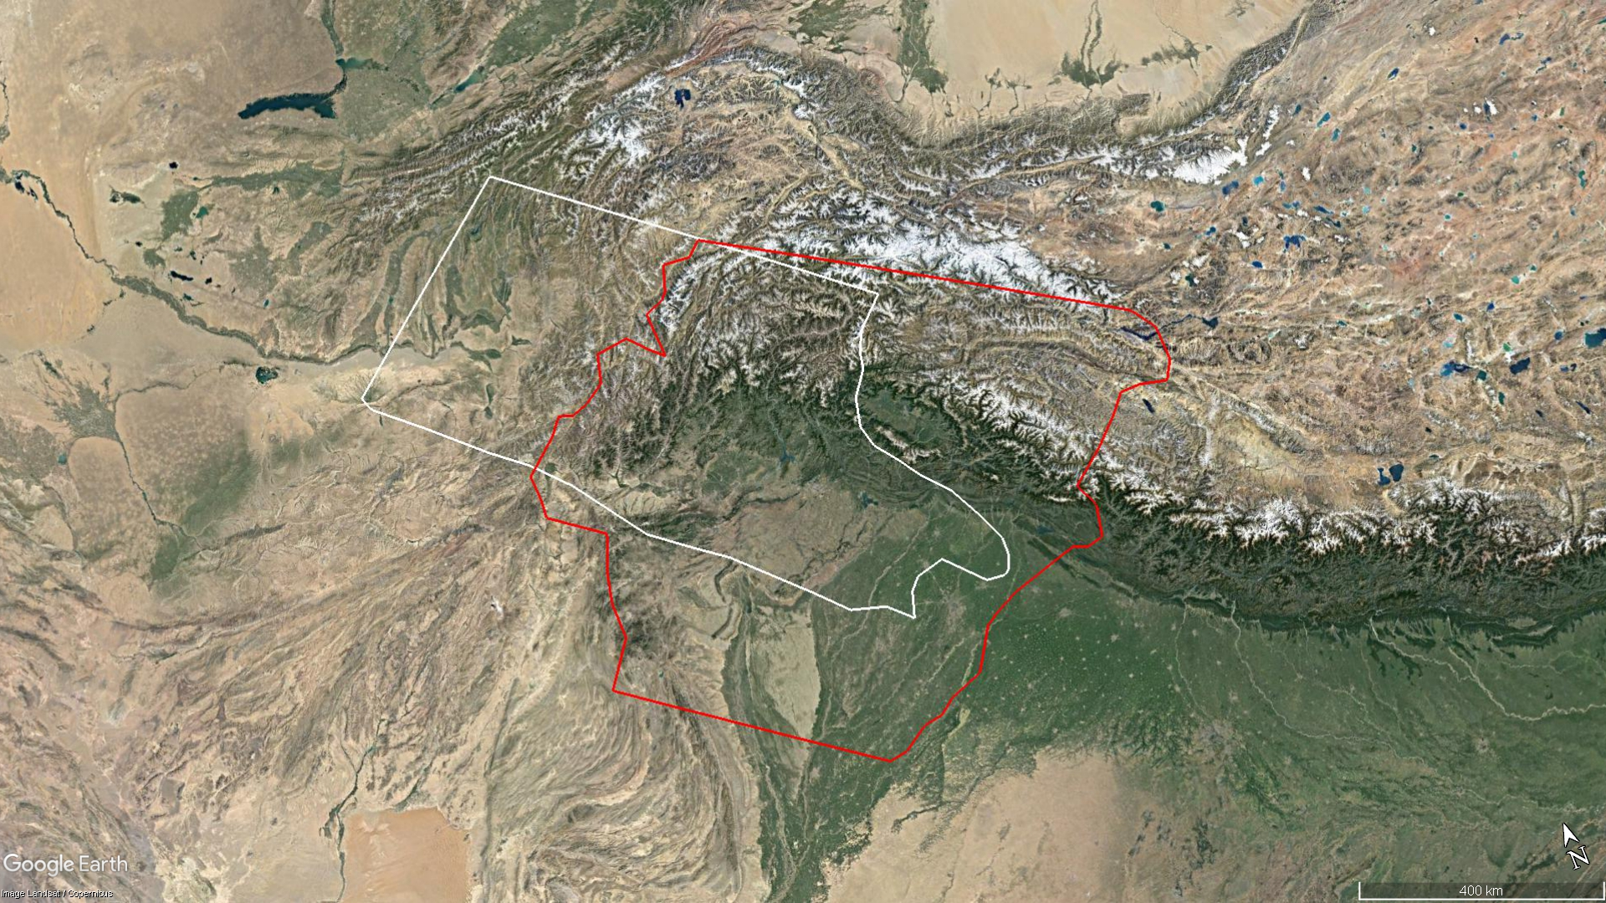
Floated Slabs at Surface:
Notes:
Features consistent with rolling back Asian slab:
Shakhdara extensional gneiss dome in pink.
Tajik Basin fold and thrust belt in blue.

Slide 17
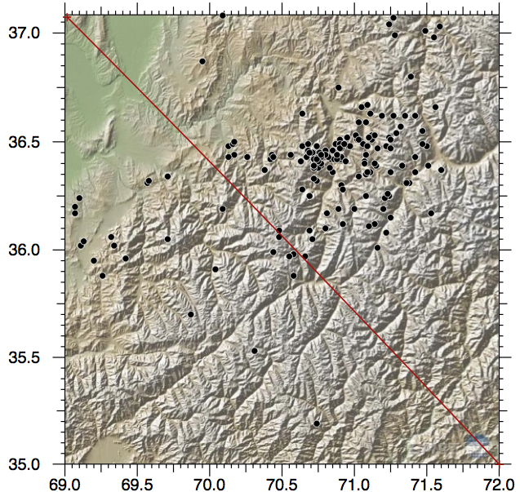
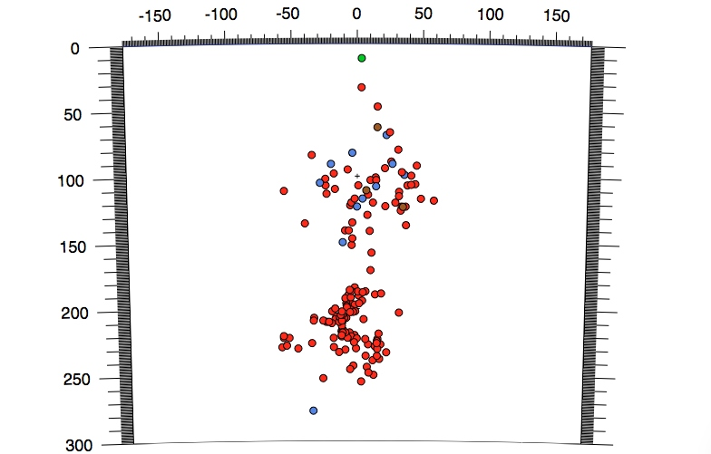
Hindu Kush Seismicity
B
CMT Hypocentres
B
B′
B′
Notes:
Evidence for slab break-off
Boudin interpretation
Essential advantages and disadvantages of comparing tomographic data set with CMT and hypocentre data.
Data sets are non-equivalent and have very different resolutions.
This makes comparison of specific features difficult.
But also means that if observations made are in agreement, they are supported by two sources of information.
(Remembering that CMT’s are averaged, instantaneous point solutions to seismic events.)

Slide 18
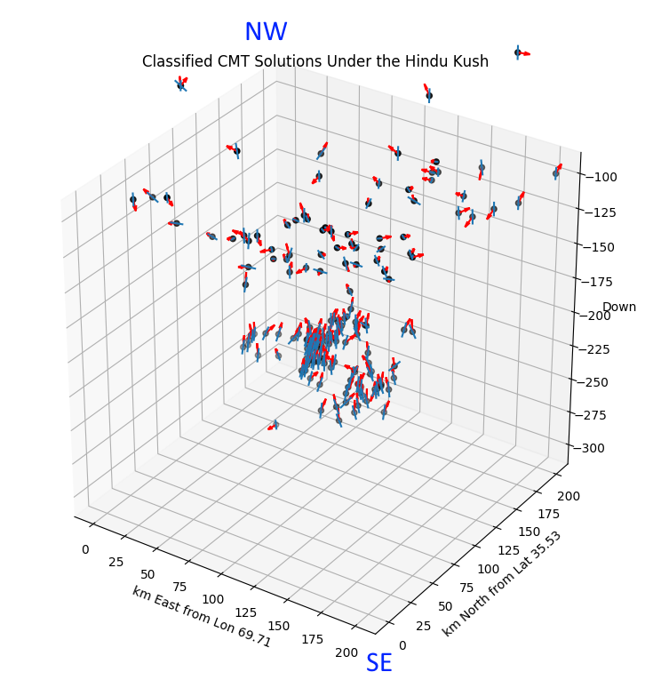
CMT Solutions in an arbitrary 3D Box.
View is NW to SE (B’ to B in previous figure)
Units are kilometres for a uniform scale
Note the difference in clustering and orientation between groups.

Slide 19
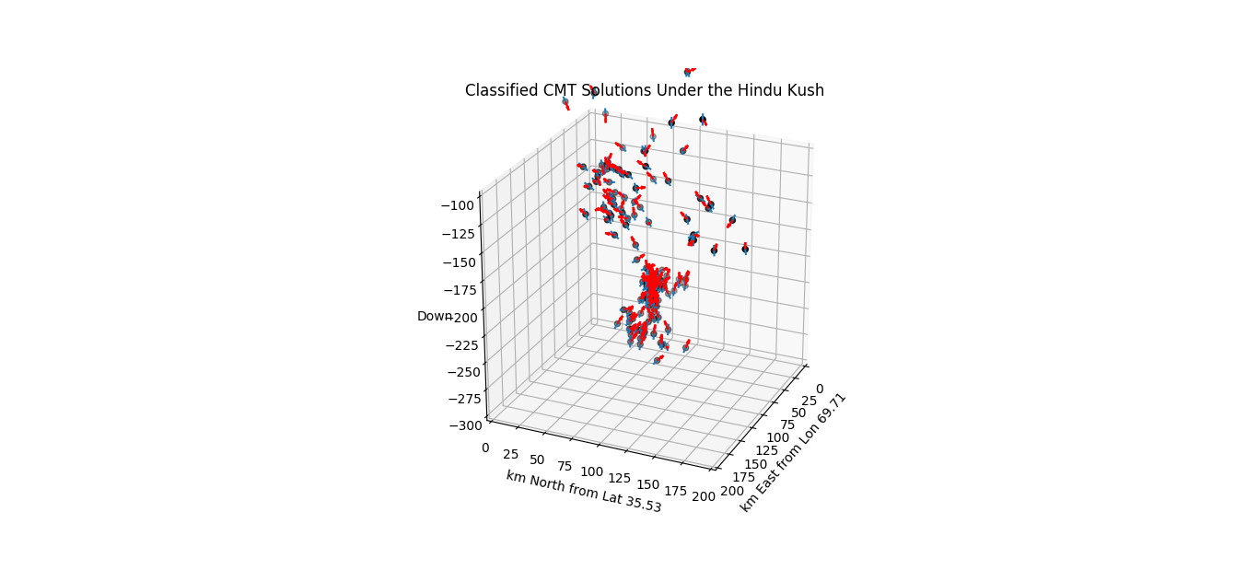
N

Slide 20
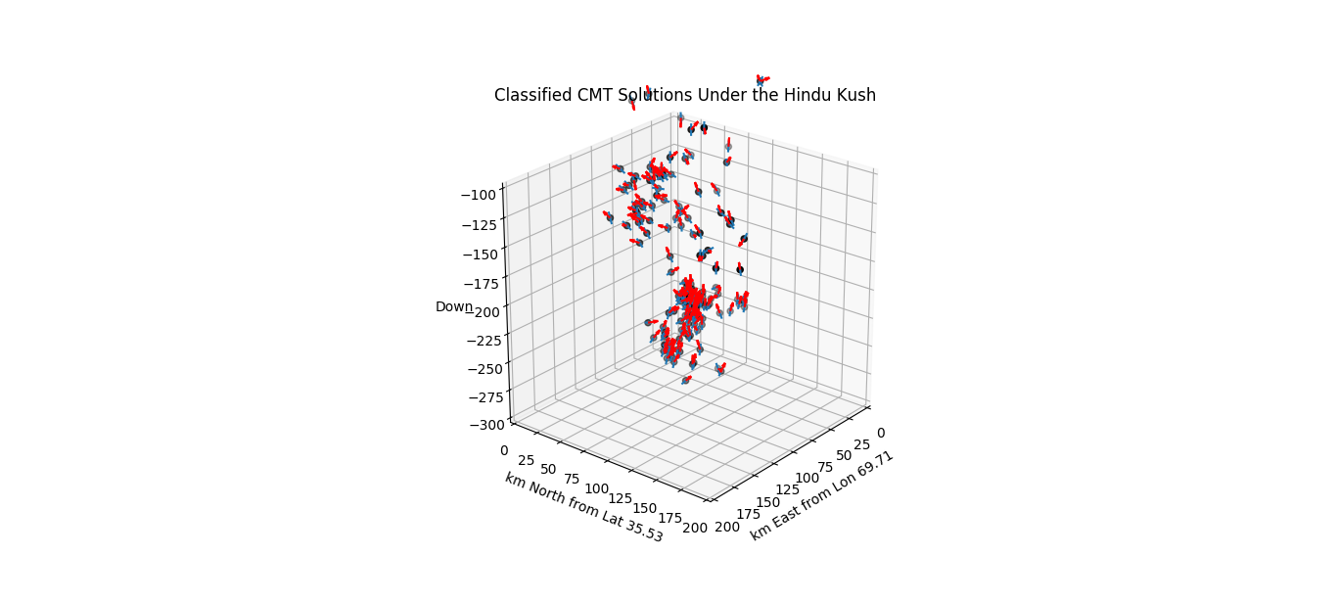
N

Slide 21
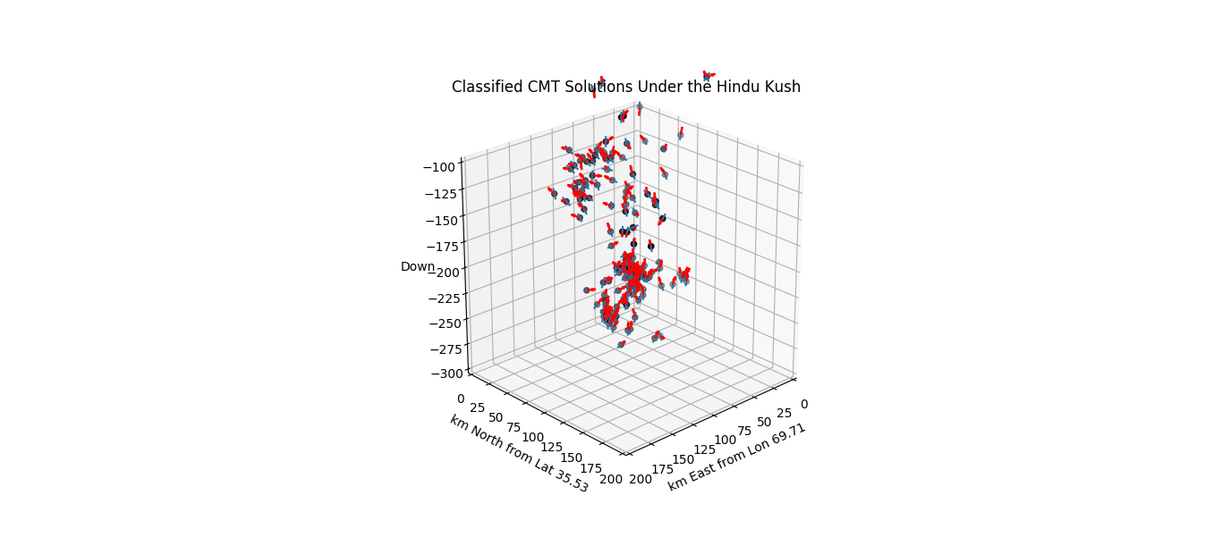
N

Slide 22
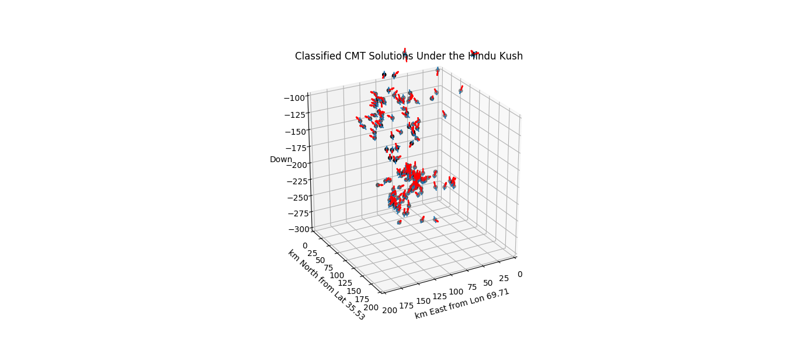
N

Slide 23
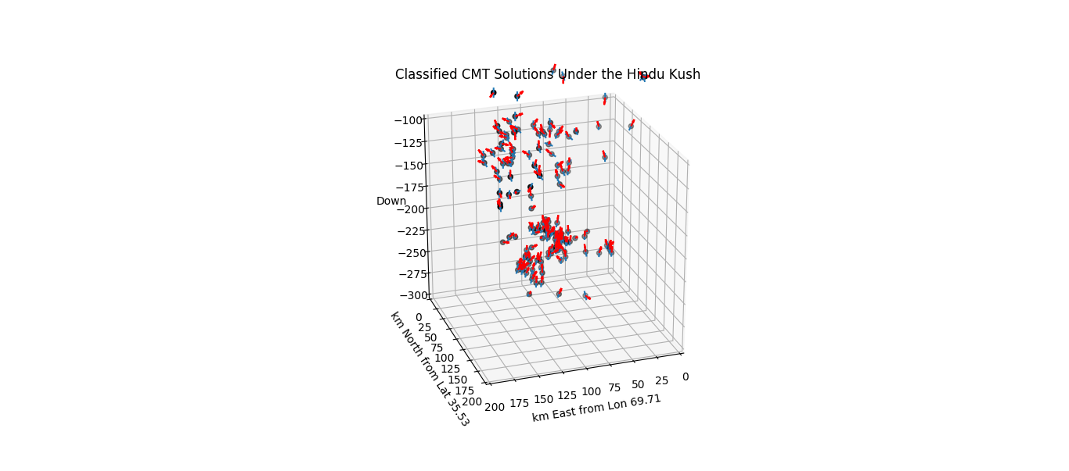
N

Slide 24
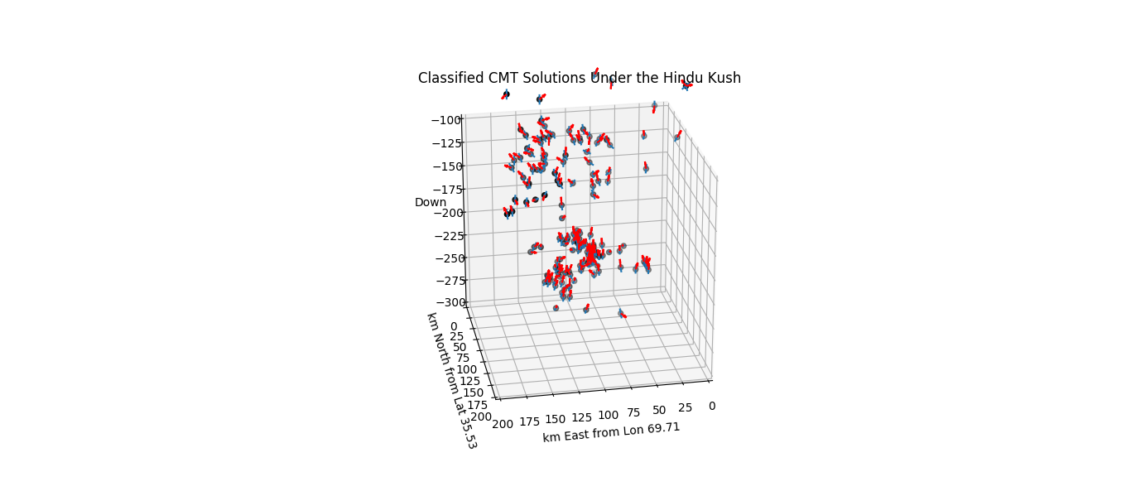
N

Slide 25
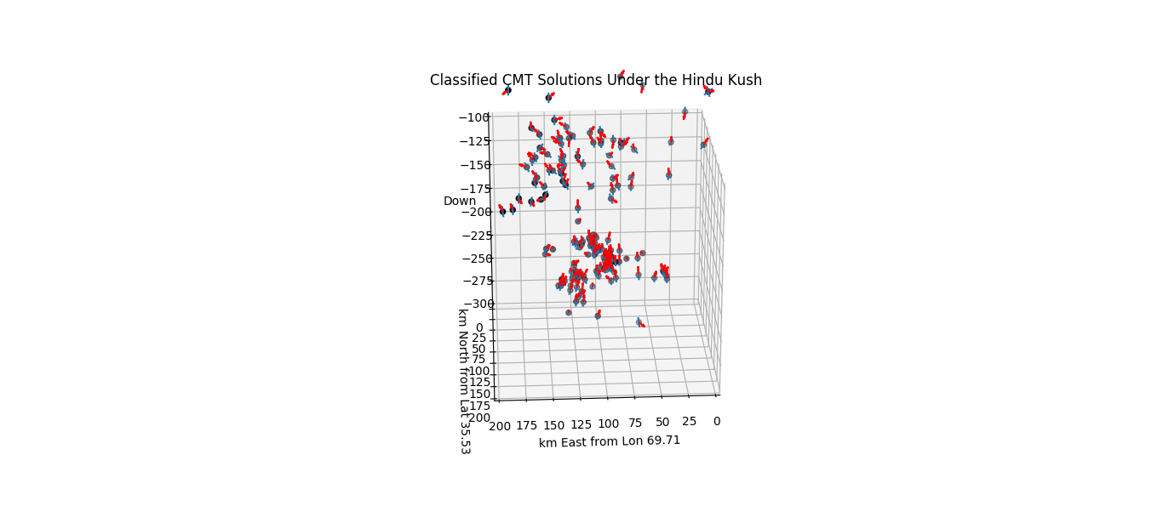
N

Slide 26
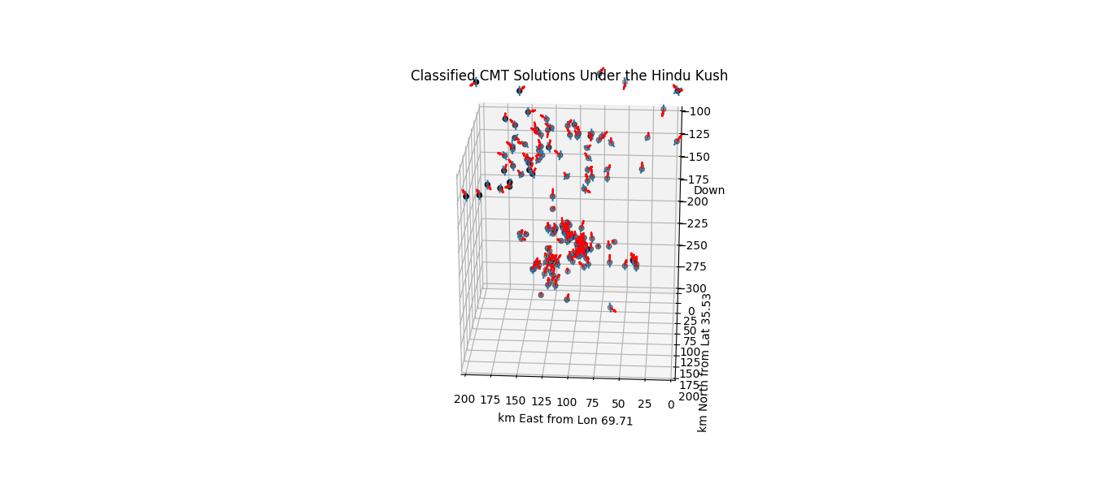
N

Slide 27
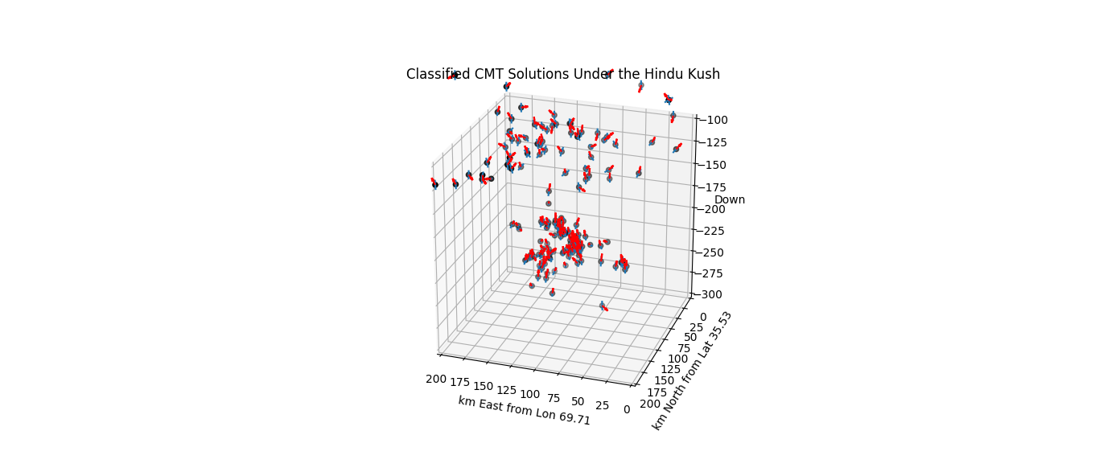
N

Slide 28
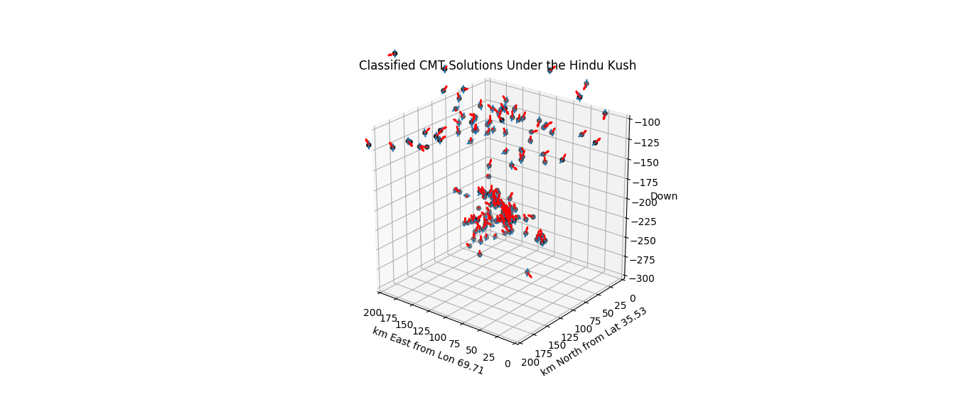
N

Slide 29
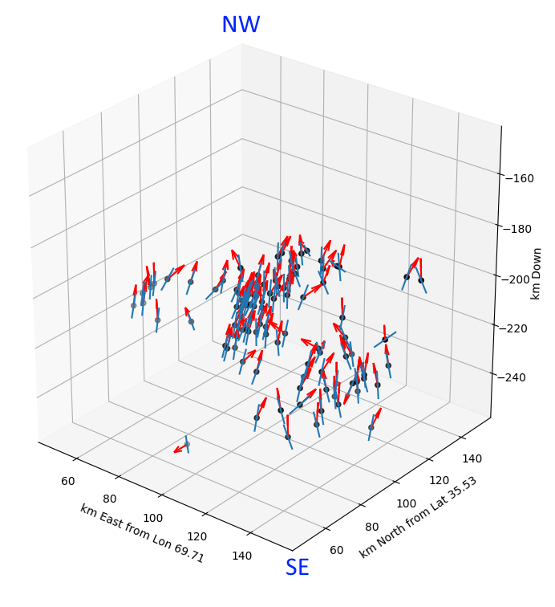
Blue = Fault Plane
Red = Slip Line
Note highly coordinated clustering towards focal points.

Slide 30
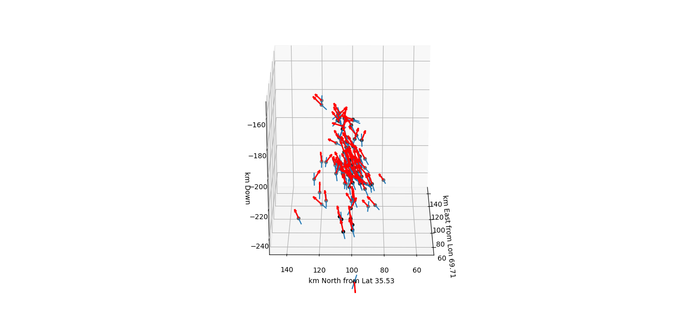
N

Slide 31
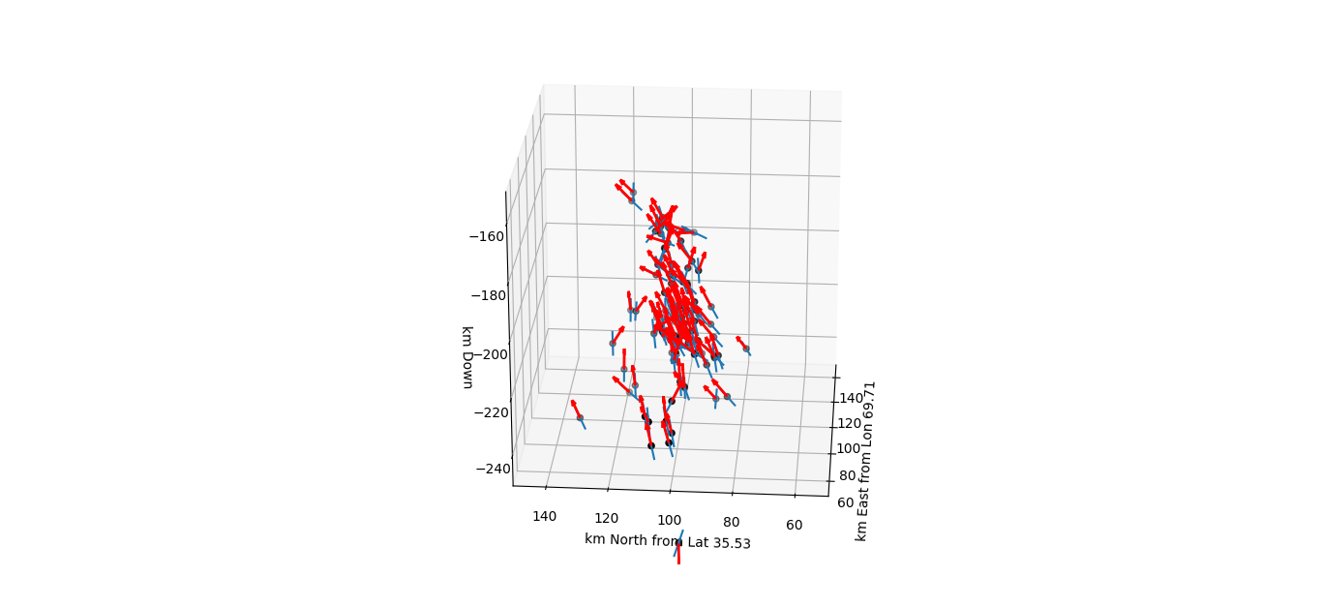
N

Slide 32
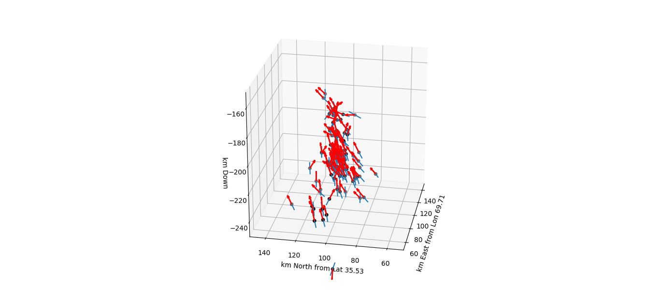
N

Slide 33
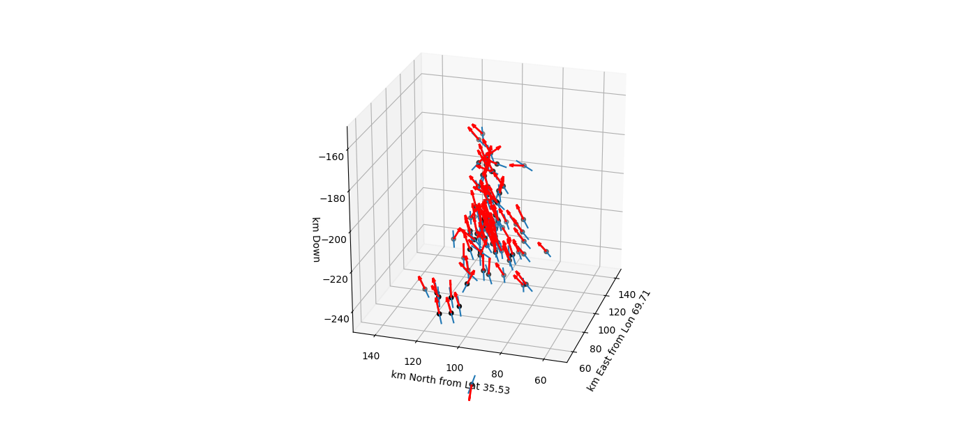
N

Slide 34
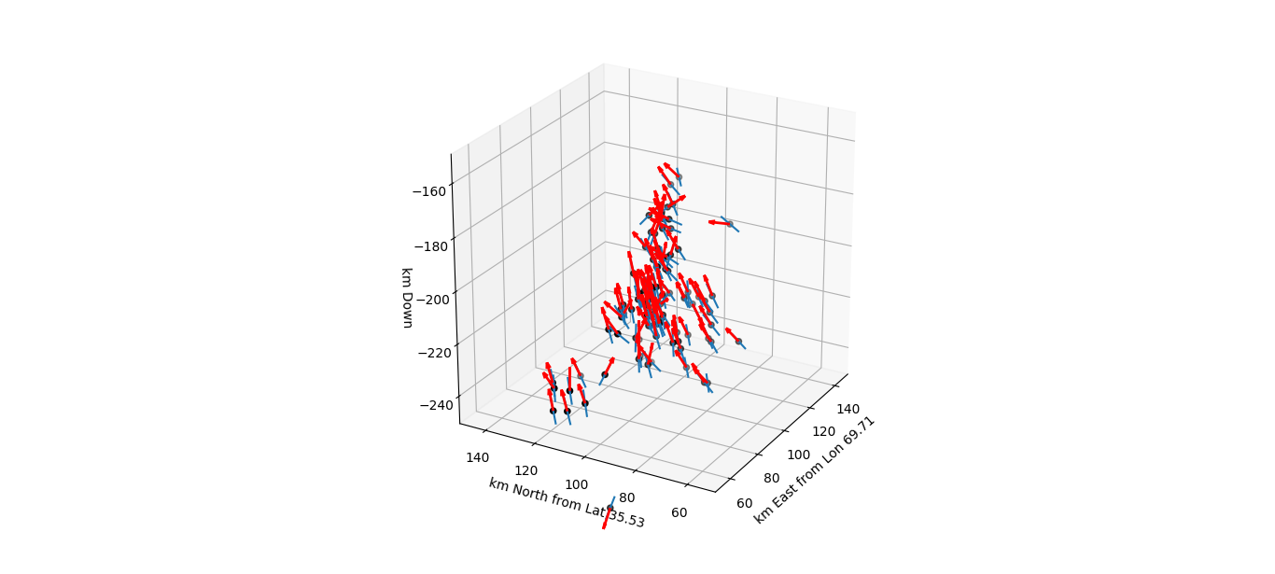
N

Slide 35
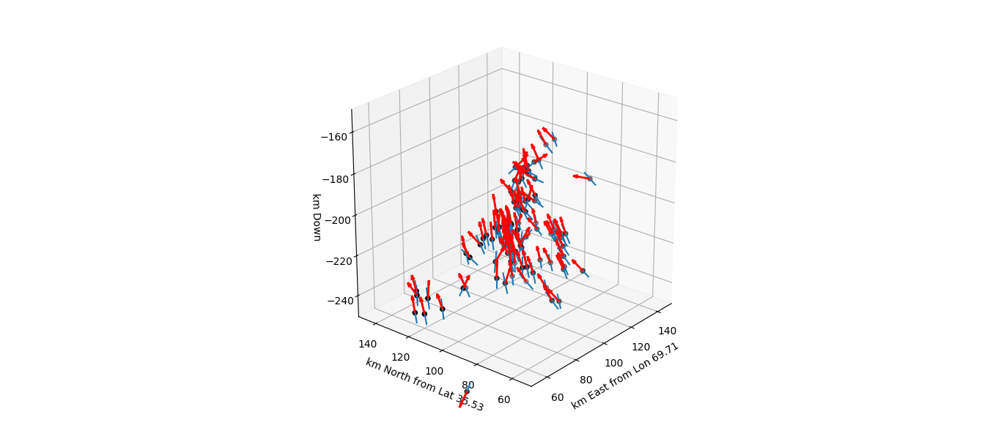
N

Slide 36
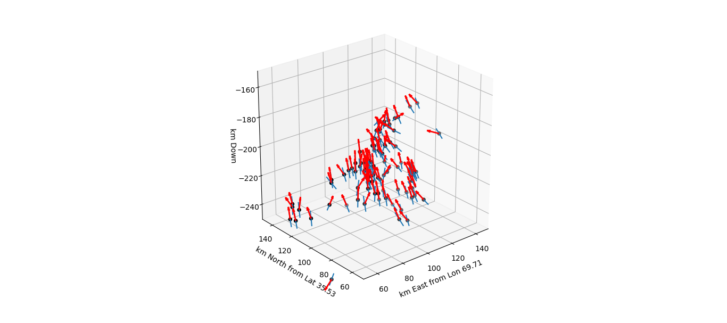
N

Slide 37
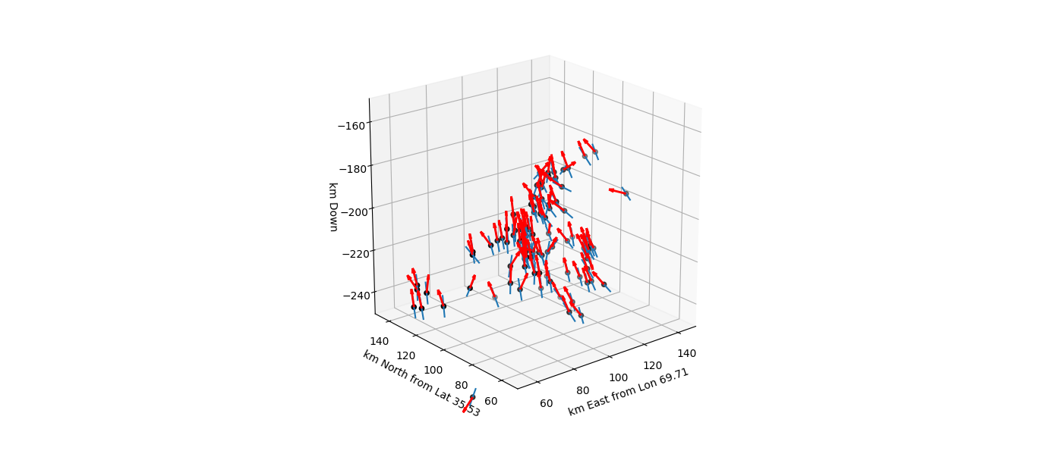
N

Slide 38
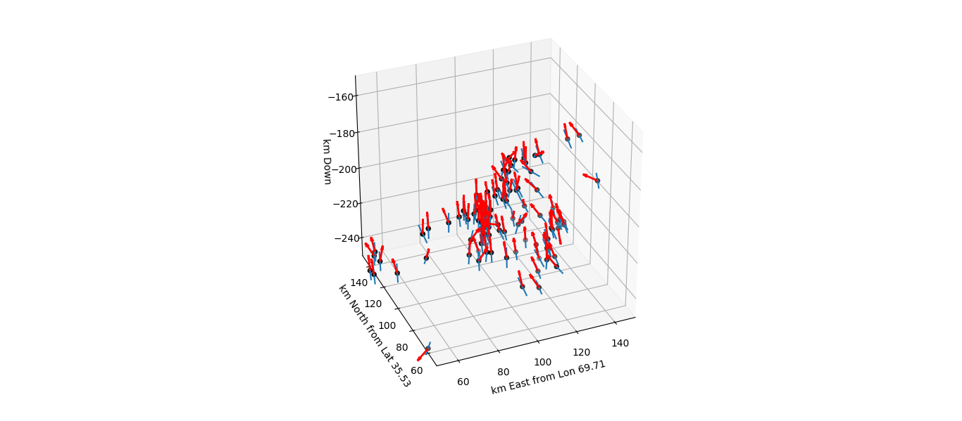
N

Slide 39
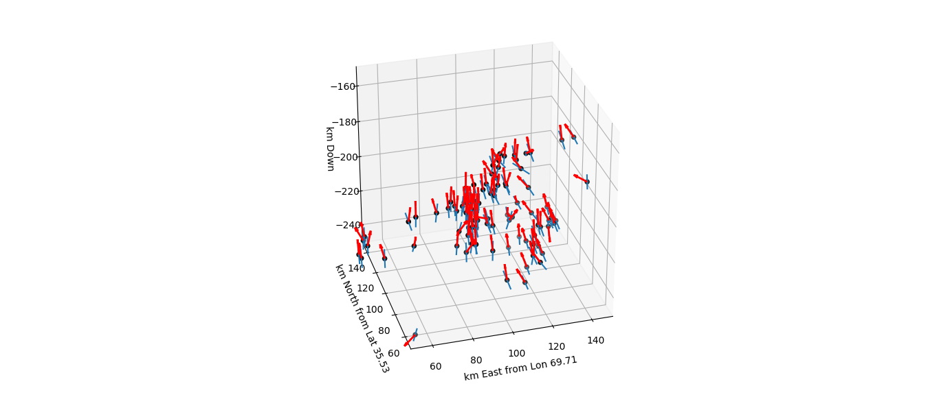
N

Slide 40
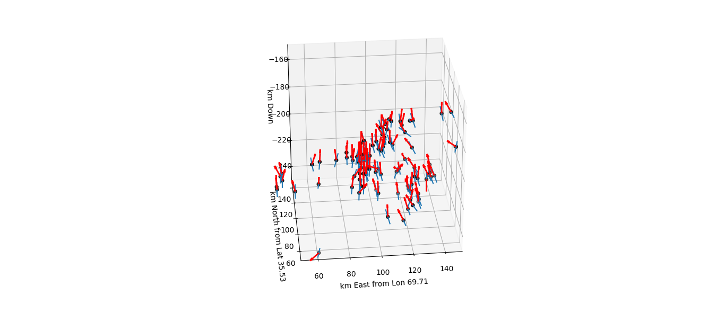
N

Slide 41
N

Slide 42
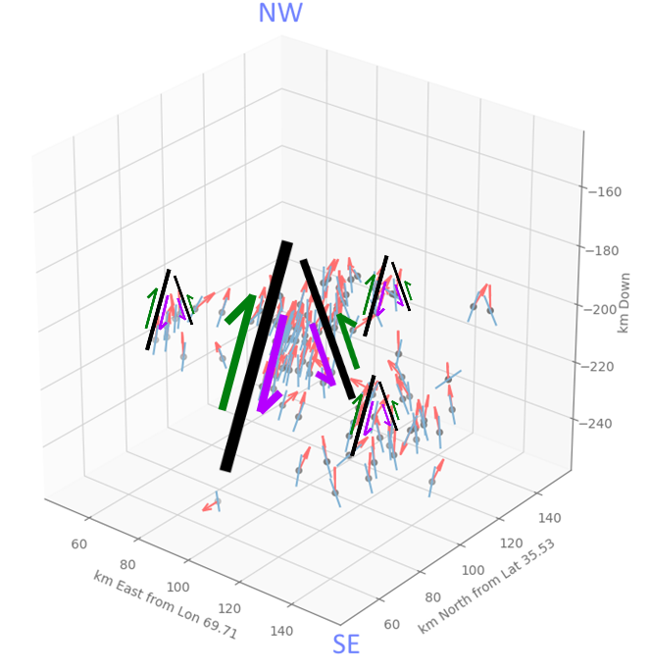

Slide 43
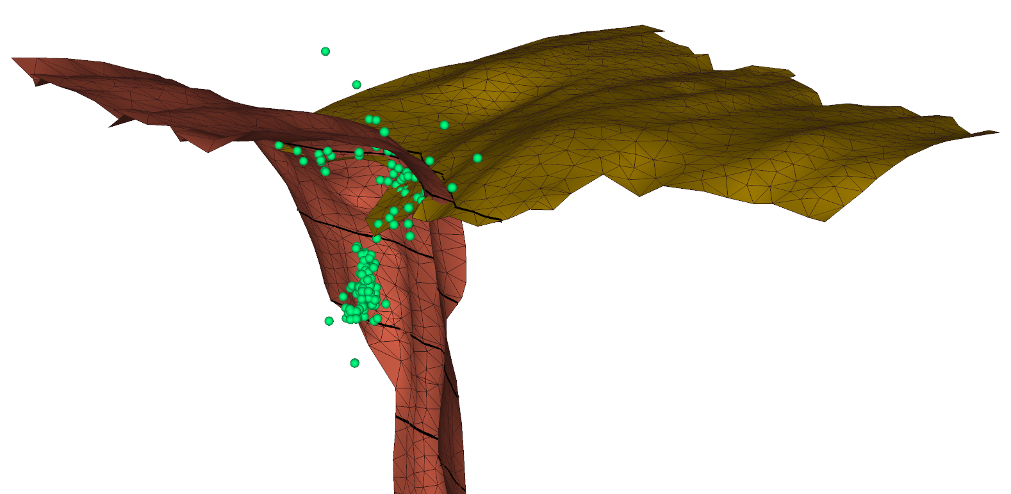
Decapitation Model:
Green dots represent CMT hypocentre locations
Perspective is ~West to East into the slide.
Upper group predominantly shallow dipping
200 km
100 km
Lower group predominantly steeply dipping
Highly clustered orientations
300 km
400 km
Notes:
Decapitation quakes occur at a consistent depth band, along the modelled intersection of plate surfaces.

Slide 44
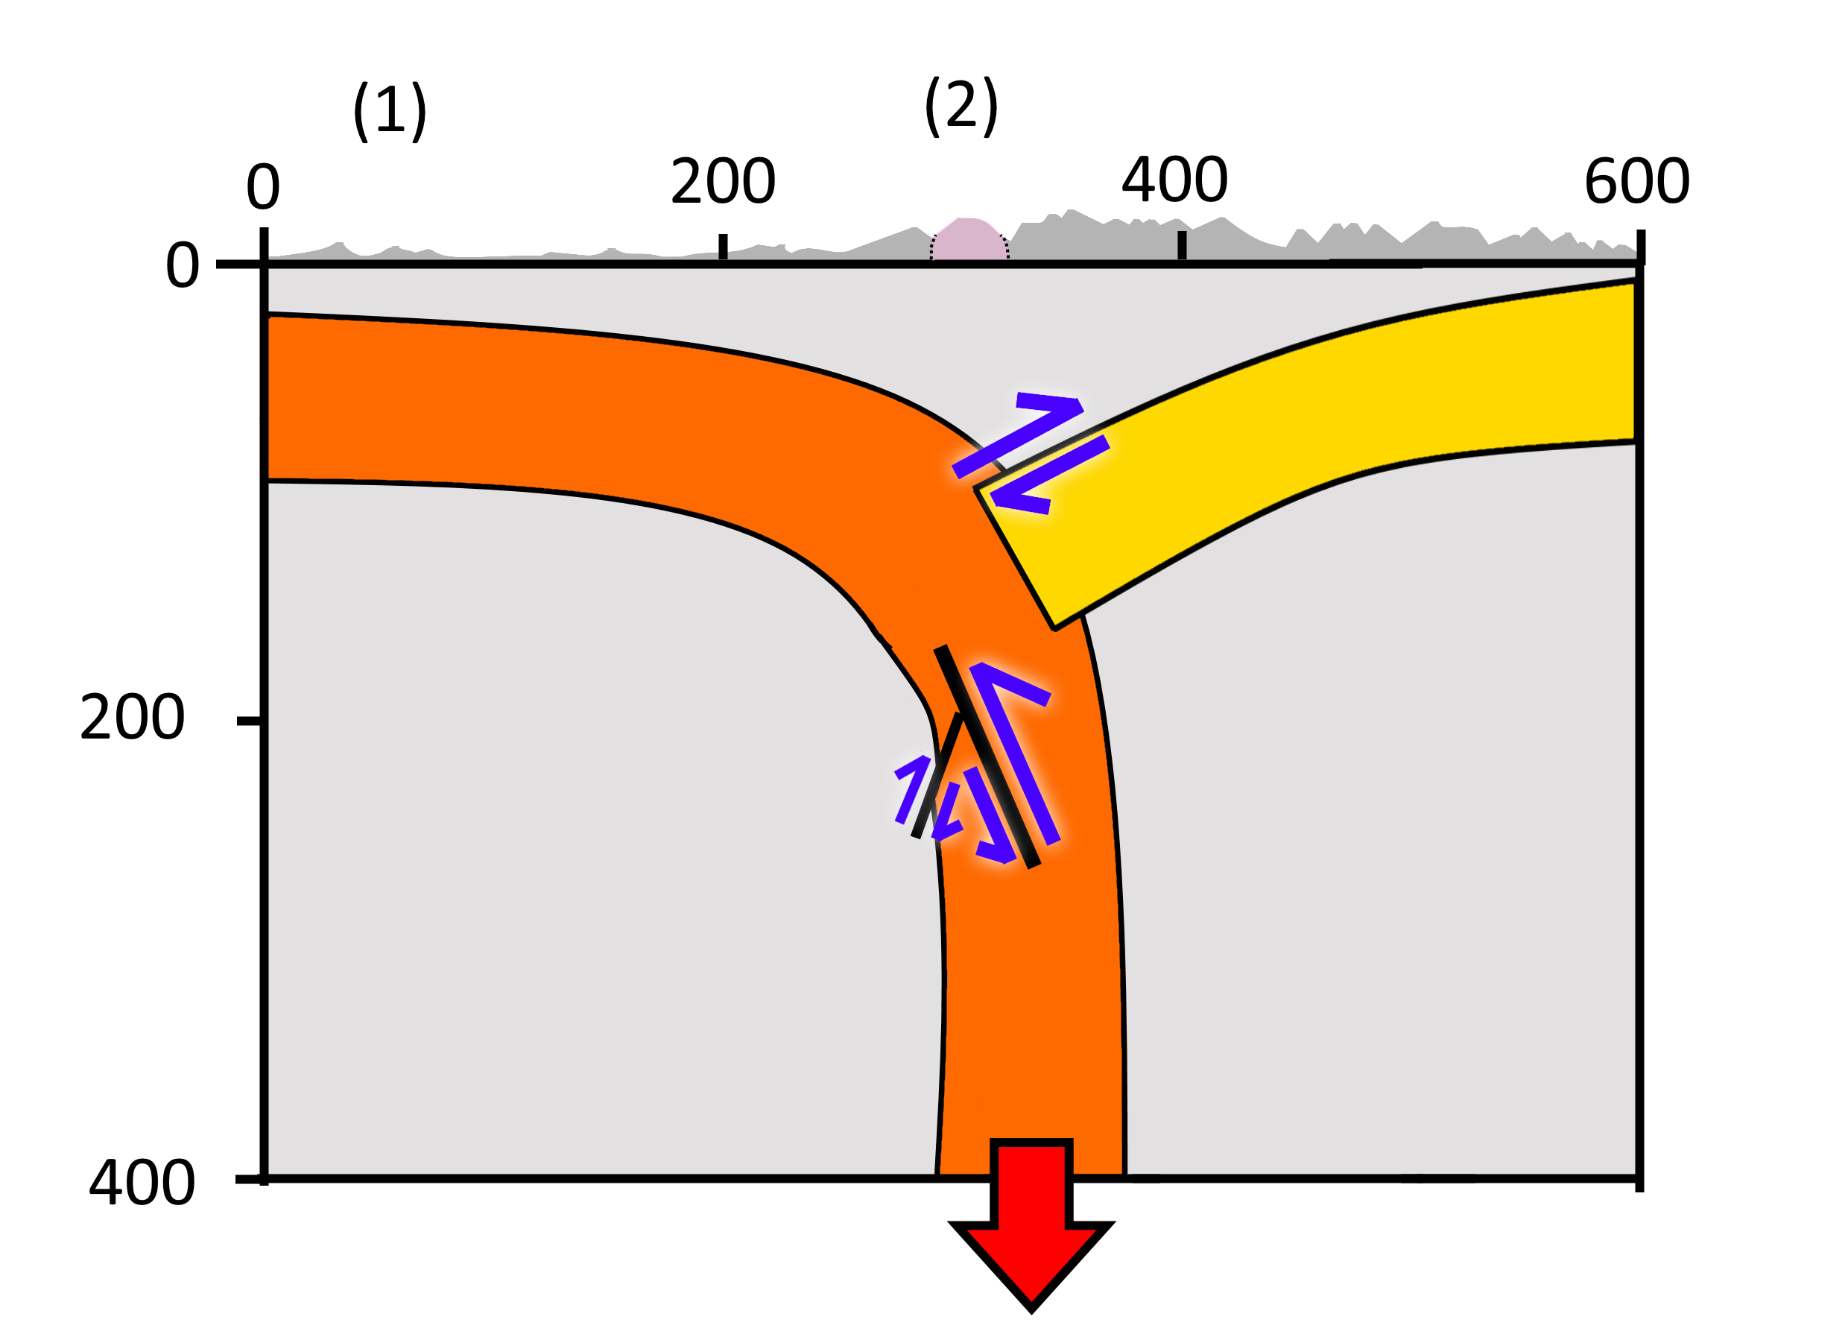
NW
SE

