Slide 1
Self-Sensing Fiber Reinforced Cement Mortars for the Monitoring of Critical and Transport Infrastructures
Oğuzhan Öztürk (1), Ülkü Sultan Keskin (1), and Mustafa Şahmaran (2)
(1) Selcuk University, Civil Engineering Department, Turkey, (2) Hacettepe University, Civil Engineering Department, Turkey

Slide 2
CONTENT
1. INTRODUCTION
2. FABRICATING OF SELF SENSING CONCRETE
3.LABORATORY EXPERIMENTS
4.RESULTS AND DISCUSSION
5. CONCLUSION

Slide 3
Introduction
The fastest evaluation of the extent of deformation taking place in this sort of structures is of critical importance in the view of public safety. Therefore, in order to evaluate the current situation and health of public structures several techniques were developed.
In the case of such techniques, condition of a structure is monitored by inserting strain gauges, fiber optic sensors, acoustic sensors, piezoelectric ceramic sensors into critically vulnerable places in the structure. Biggest problem standing in front of the sensor-based structural/materials health monitoring techniques is the inexistence of reliable, easily implantable, cheap and durable sensors that can be inserted into large scale structural systems

Slide 4
Introduction
In general, structural materials that do not consist of any sensor but used for sensor purpose is called self-sensing materials

Slide 5
Introduction
Thanks to self-sensing capability of concrete therefore, structural/materials health monitoring can easily be made without being in need of any integrated systems.
The main purpose of this study is to monitor structural/materials health condition of reinforced cement mortars through the development of new generation cementitious composites which can self-sense the deformations, stresses and possible damages in a safe and sensitive way.

Slide 6
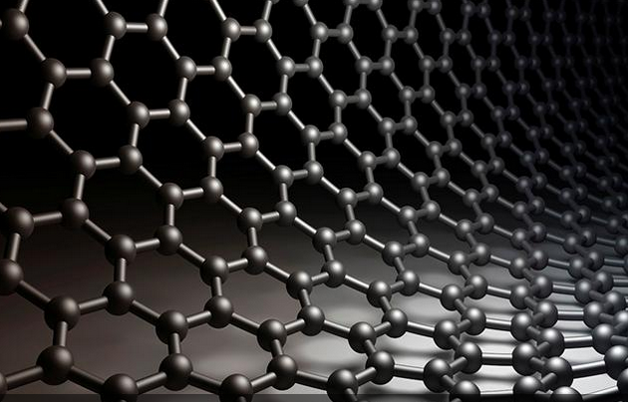
Introduction
In the scope of this study, it is aimed not only to develop multifunctional cementitious composites that have self-sensing ability but to considerably improve composite mechanical properties (strength and ductility) through proposed techniques.
To provide piezo-resistive characteristic, carbon based particles, fibers, filaments etc. are widely used during fabricating of cementitious composites

Slide 7
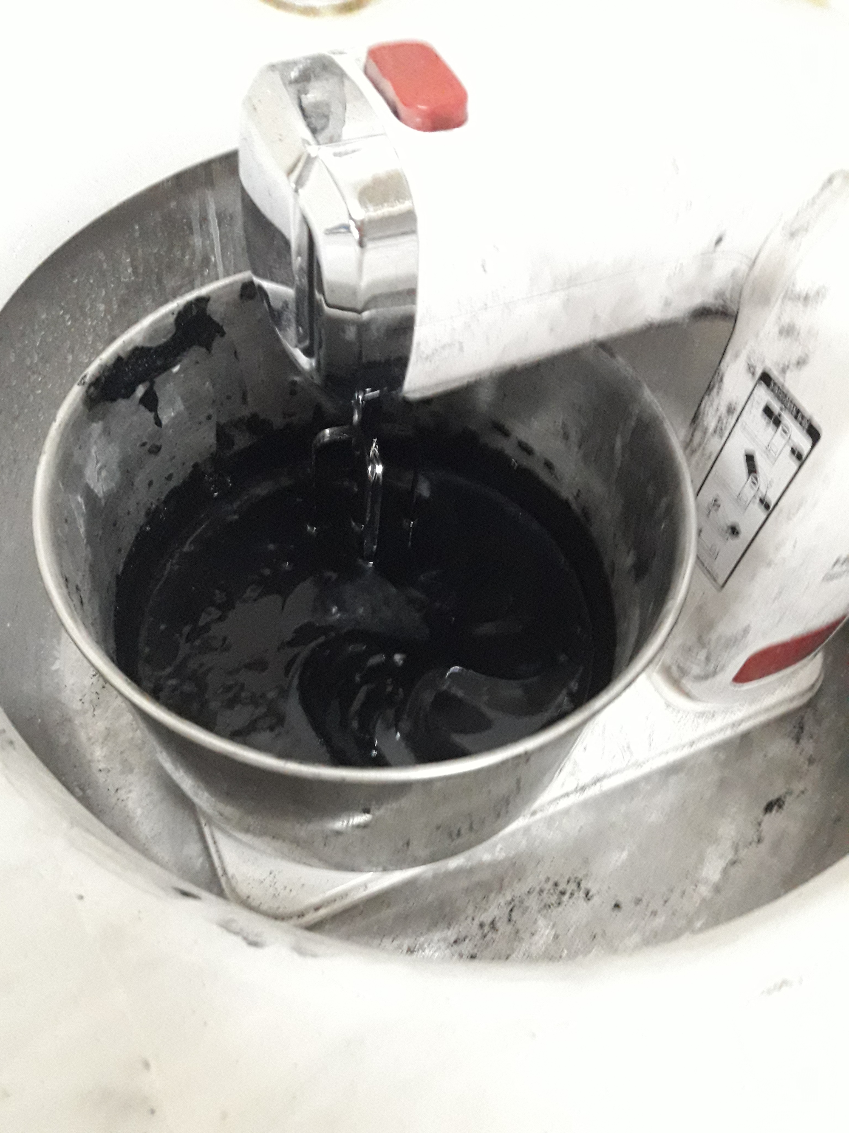
Experımental methods
Uniform distribution of carbon nano tubes (CNTs) was provided for self-sensing attribute of reinforced cement mortars.
Properties at room temperature | Carbon nano tubes
Special gravity (g/cm³) | 1,8
Elastic Modulus (TPa) | 1
Strength (GPa) | 10-60
Electrical conductivity (Siemens/cm) | 10²-10³
Thermal conductivity (Watt/metre.Kelvin)* | 6000
Thermal expansion coefficient | Neglible

Slide 8
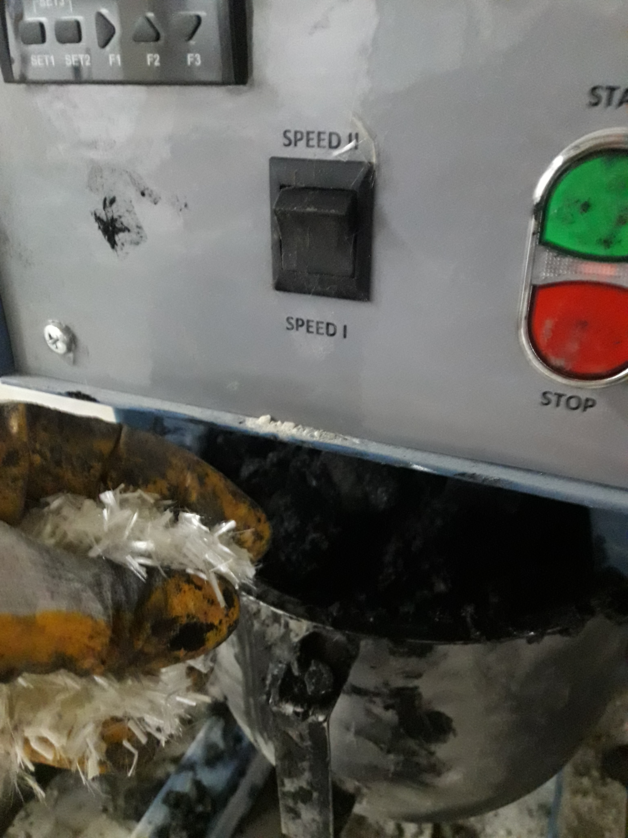
Dispersion process
Undispersed Carbon nano tubes
Special dispersion*
Homogeneously dispersed CNT solution
* Ali Al Dahawi, Oğuzhan Öztürk, Farhad Emami, Gürkan Yıldırım, Mustafa Şahmaran, (2016) Effect of mixing method on the Electrical properties of cementitious composites incorporating different Carbon-based materials, Construction and Building Materials,104;160-168.

Slide 9
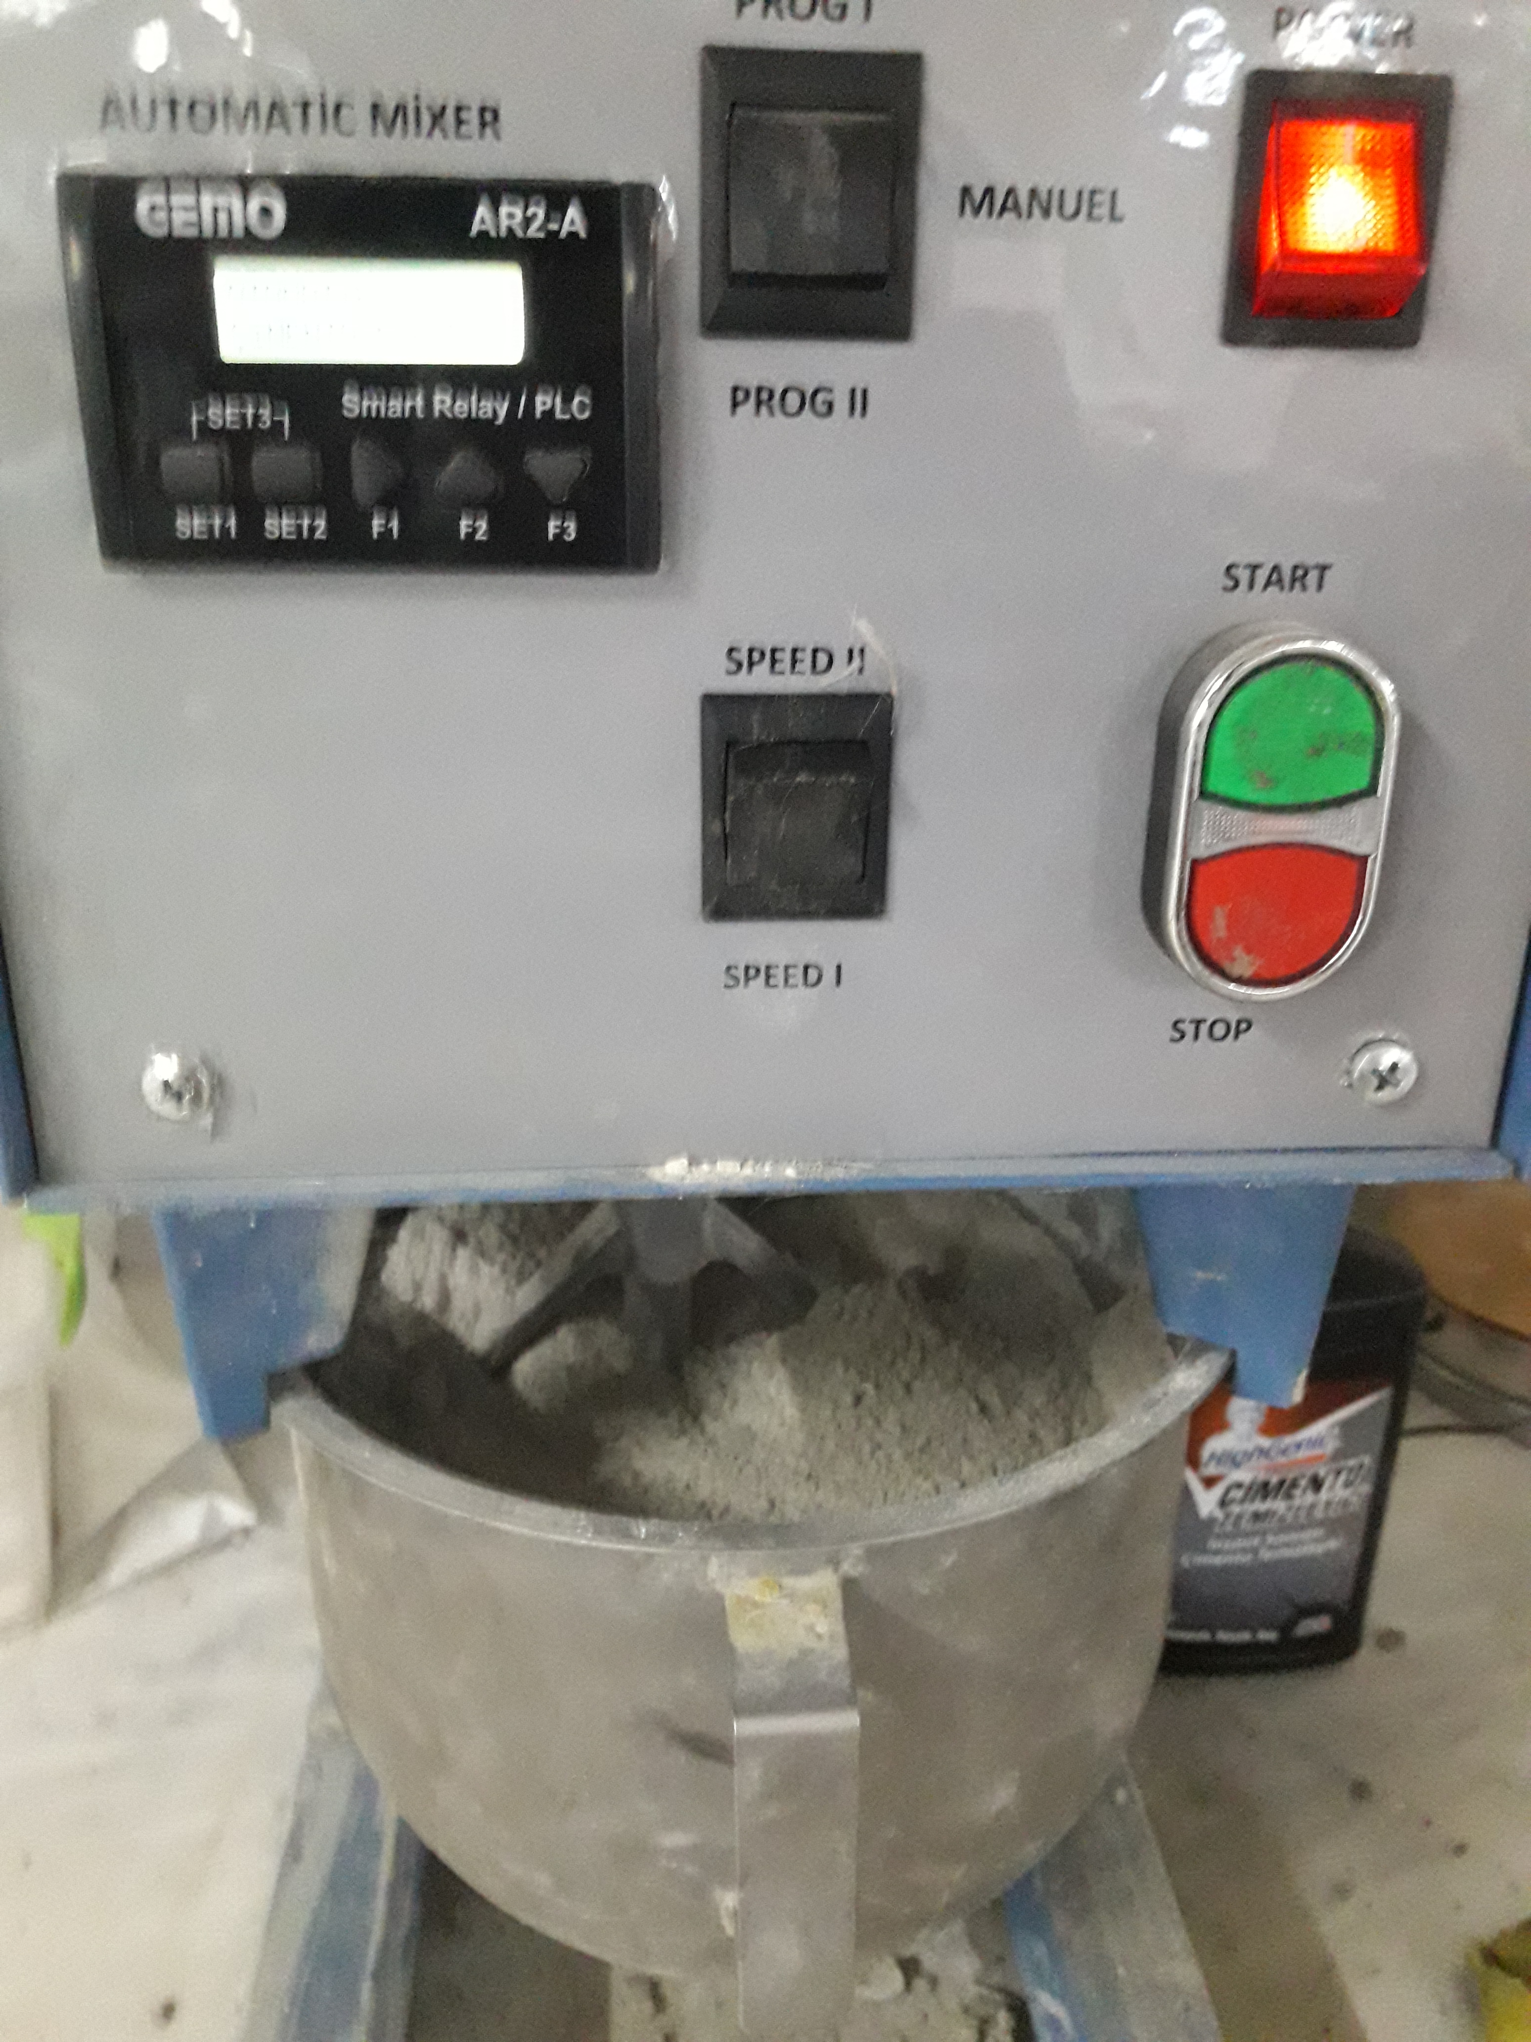
Dispersion process and specimens
Percolation threshold%0.55 CNT by weight of total cementitious materials*
Ali Al-Dahawi, Mohammad Haroon Sarwary,Oğuzhan Öztürk, Gürkan Yıldırım, Arife Akın, Mustafa Şahmaran and Mohamed Lachemi (2016),
Electrical percolation threshold of cementitious composites possessing selfsensing functionality incorporating different carbon-based materials, Smart Mater. Struct. 105005.

Slide 10
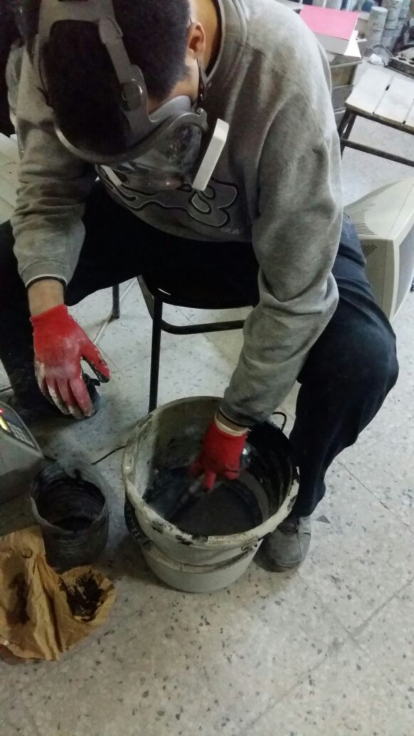
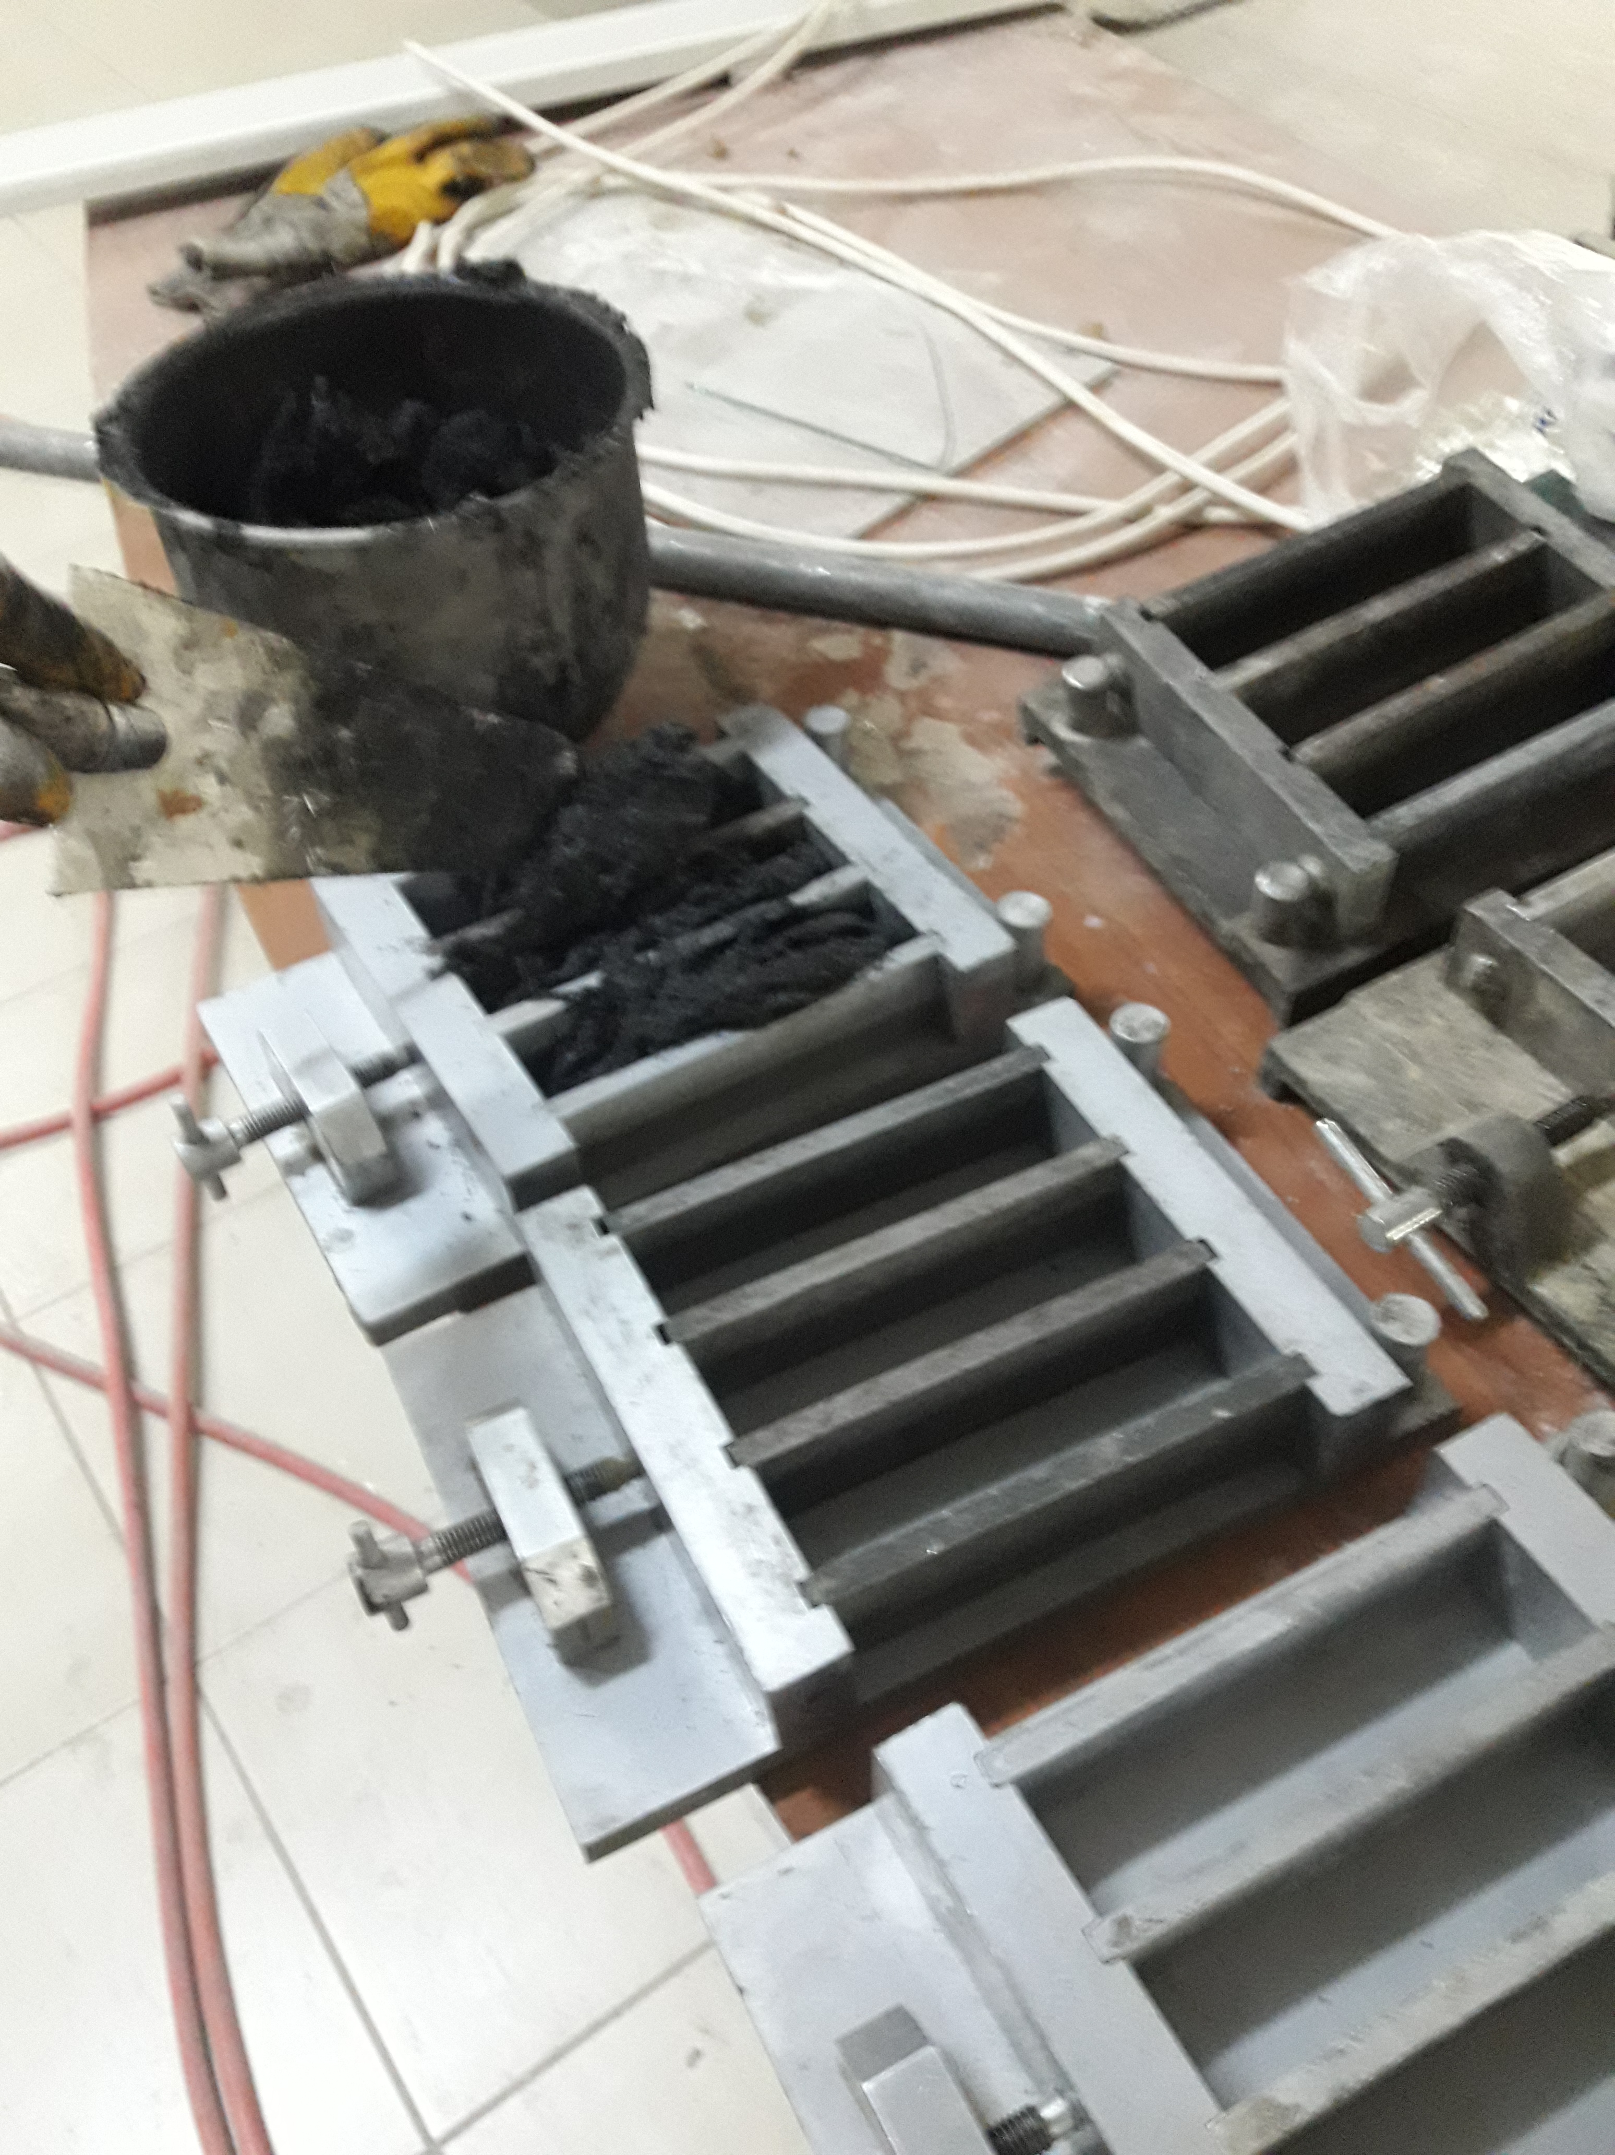
Testing
3-point flexural tension tests were conducted by using concrete resistivity meter at the 0.3 mm/min deformation speed and resistivity of specimen was obtained by 2 probe concrete resistivity meter

Slide 11
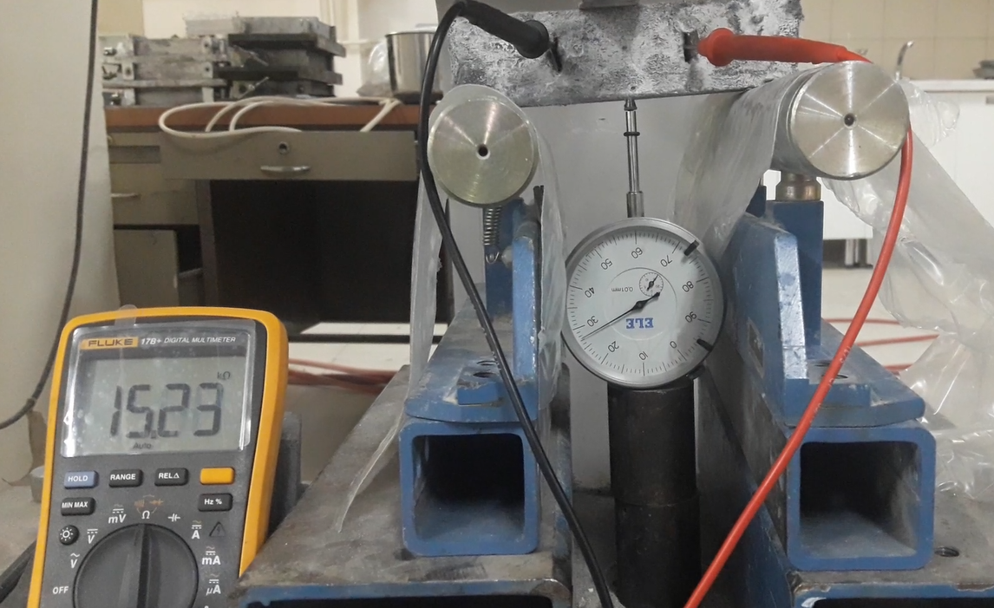
Simultenous Deformation Assessment
*Ali Al-Dahawi, Gürkan Yıldırım, Oğuzhan Öztürk, Mustafa Şahmaran, (2017). Assessment of self-sensing capability of Engineered Cementitious Composites within the elastic and plastic ranges of cyclic flexural loading, Construction and Building Materials, 145;1-10.

Slide 12
Results-flexural loading*
*Gürkan Yıldırım, Mohammad Haroon Sarwary, Ali-Ali Dahawi, Oğuzhan Öztürk, Özgür Anıl, Mustafa Şahmaran, (2018) Piezo-resistive behaviour of CF and CNT reinforced concrete beams subjected to static flexural loading: Shear failure investigation, Construction and Building Materials; 168: 266-279

Slide 13
Results-Compressive loading

Slide 14
Results
*Improved mechanical performance
*Self-sensing attribute attained
for critical infrastructures

Slide 15
Conclusion
All mixtures produced with carbon nano tubes materials, with the exception of the control mixtures, exhibited piezoresistive behavior under flexural loading, which is crucial for sensing capability. It is believed that incorporating the sensing attribute into cementitious composites will enhance beneﬁts for sustainable civil infrastructures.

