Slide 1




Gas chromatography based on Micro Electro Mechanical Systems (MEMS) for in situ space exploration of planetary environments: first development
L. Bouchra ¹, C. Szopa ¹, A. Buch ², P. Cardinael ³, V. Pelon-Agasse ³, D. Coscia ¹, J.-P. Pineau ¹, V. Guerini ¹, T. Bourouina ⁴
LATMOS, Versailles-Saint-Quentin University, Guyancourt, France.
LGPM, Ecole Centrale, Paris, France.
SMS Laboratory, Rouen Normandie University, France.
ESIEE Paris, Noisy-le-Grand, France.
2 min Madness
Introduction
Trap
Adsorbent
Principle
Column
Prototype
Conclusion
Detector
leila.bouchra@latmos.ipsl.fr Pico4.14 - EGU2018 10 April 2016

Slide 2
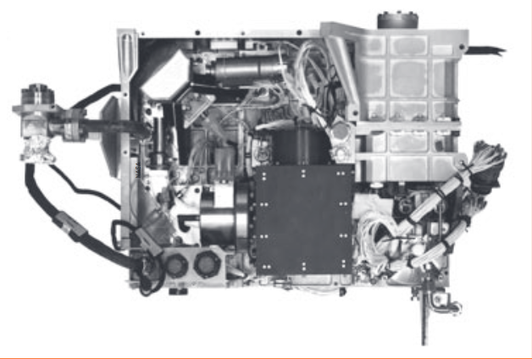
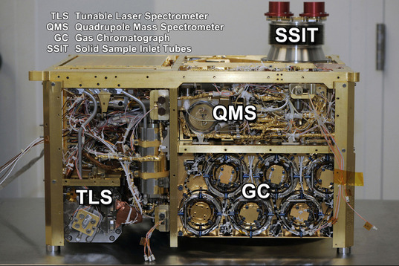
Gas chromatography based on Micro Electro Mechanical Systems (MEMS) for in situ space exploration of planetary environments: first development
The gas chromatograph (GC) is an instrument used in space for many years (Viking, 1975). It allows in-situ chemical analysis that is important for exobiological research (search for organic molecules, chirality, ...).
However, spatial constraints are becoming stronger (size, weight, energy, ...). In order to be able to respect these constraints, it becomes necessary to use miniaturization.
To develop our GC prototype, we use a miniature technology called MEMS (MicroElectroMechanical Systems).
For this, we must characterize the different parts of the GC: injection, separation and detection.
Introduction
GC-MS Viking 1 (1975)
Tray dimensions: 28 × 38 cm.
Copyright 1974 Springer Science and Business Media.
GC-MS Curiosity (2011)
Tray dimensions: ~20 x 30 cm.
Copyright NASA/JPL.
leila.bouchra@latmos.ipsl.fr Pico4.14 - EGU2018 10 April 2016

Slide 3
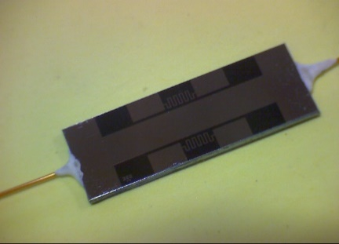
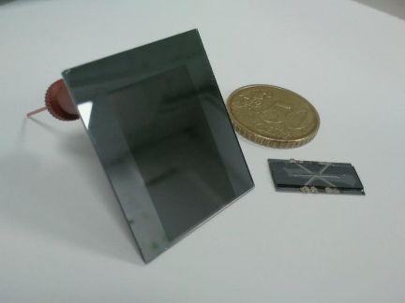
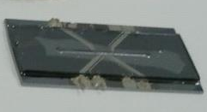
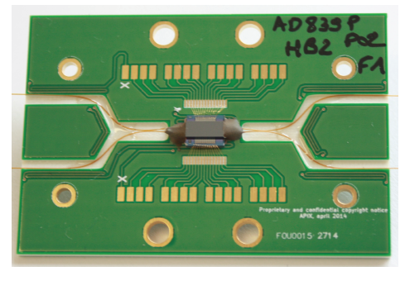
Gas chromatography based on Micro Electro Mechanical Systems (MEMS) for in situ space exploration of planetary environments: first development
Introduction
The first step is to characterize the injection phase of the GC. Characterize the adsorbents used for the trap, the evaluation of low temperature entrapment and thermodesorption of the molecules.
The second step is to characterize the separation of the chromatographic columns.
The third step is to characterize the detection phase. Characterize the limit of detection and the linearity range of the detectors.
The final step is to assemble the different parts and test the operation and performance of the GC prototype.
The results obtained show correct performance from an analytical point of view.
~ 4 cm
2-3 cm
4 cm
~ 3 cm
Trap
Point injection
Column
Separation
Detector
Sensitivity
leila.bouchra@latmos.ipsl.fr Pico4.14 - EGU2018 10 April 2016

Slide 4
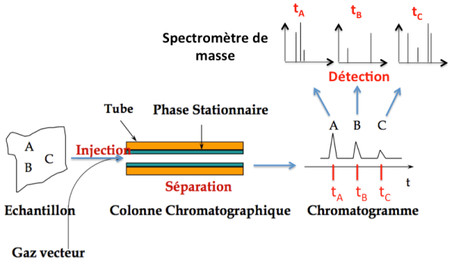
Gas chromatography based on Micro Electro Mechanical Systems (MEMS) for in situ space exploration of planetary environments: first development
Principle
A mixture of molecules in the gaseous state (sample) is sent in the chromatographic column using a carrier gas (mobile phase).
This column inside is covered with a resin (stationary phase) and based on the attraction with this phase, molecules pass through the column at different speeds.
At the end of the column, the molecules are detected and we obtain a chromatogram.
This chromatogram represents exit time, called retention time, of different molecules.
And coupled with a mass spectrometer, we can assign a time to a molecule.
Mass Spectrometer
Tube
Stationnary Phase
Sample
Chromatographic Column
Chromatogram
Carrier Gas
leila.bouchra@latmos.ipsl.fr Pico4.14 - EGU2018 10 April 2016

Slide 5

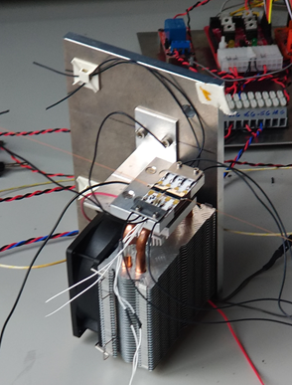
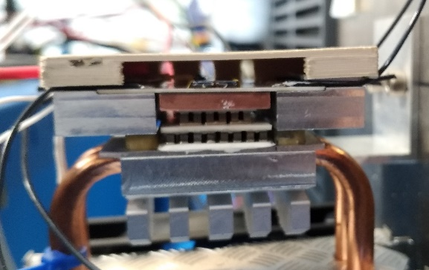
Gas chromatography based on Micro Electro Mechanical Systems (MEMS) for in situ space exploration of planetary environments: first development
Trap
The first step of the GC is to trap molecules so that they enter the column at the same time.
The thermodesorption injector (TI) is like a tube filled with a powder, called adsorbent, allowing the capture of molecules.
The molecules are injected into the TI when it is in low temperature (0 °C to -10 °C) via a Peltier module.
Then the TI is heated to 180 °C in a few seconds, by integrated resistance in the TI, (1 to 5 seconds) to free molecules in the column.
Adsorbents
Metal plate to keep
the whole
Cover to protect TI
Trap
Fan to regulate
the temperature
Ceramic plate
Peltier module
TI mechanical support
leila.bouchra@latmos.ipsl.fr Pico4.14 - EGU2018 10 April 2016

Slide 6
Gas chromatography based on Micro Electro Mechanical Systems (MEMS) for in situ space exploration of planetary environments: first development
Trap
The different test was performed using a gaseous mixture of hydrocarbons to 100 ppm, said Crystal, composed of:
1.CO2; 2.N-Butane; 3.N-Pentane; 4.Hexane; 5.Benzene; 6.Toluene.
A
B
A – The Crystal mixture was injected into the TI at 0 °C and maintained at temperature for 30mins to check trapping.
The trapping of 30mins time was chosen based on the time of preparation of the samples on the Curiosity mission.
We see that there is no hole in the trap during the cooling phase.
leila.bouchra@latmos.ipsl.fr Pico4.14 - EGU2018 10 April 2016

Slide 7
Gas chromatography based on Micro Electro Mechanical Systems (MEMS) for in situ space exploration of planetary environments: first development
Trap
The different test was performed using a gaseous mixture of hydrocarbons to 100 ppm, said Crystal, composed of:
1.CO2; 2.N-Butane; 3.N-Pentane; 4.Hexane; 5.Benzène; 6.Toluène.
A
B
B – The trap has been heated at 180 °C for 10s in order to inject the Crystal mixture in the column. The presence of peaks on the chromatogram indicates the release of the mix after heating the TI.
Which confirms the good functioning of the desorption of the trap.
leila.bouchra@latmos.ipsl.fr Pico4.14 - EGU2018 10 April 2016

Slide 8
Gas chromatography based on Micro Electro Mechanical Systems (MEMS) for in situ space exploration of planetary environments: first development
Trap
The different test was performed using a gaseous mixture of hydrocarbons to 100 ppm, said Crystal, composed of:
1.CO2; 2.N-Butane; 3.N-Pentane; 4.Hexane; 5.Benzène; 6.Toluène.
C
C – The Crystal mixture was injected into the trap at 0 °C and maintained at temperature for 40 seconds then was heated at 180 °C for 10 s.
There is the presence of 5 peaks on the chromatogram, the mixture compounds were detected.
The trapping and desorption of the TI phase has been validated.
However, during the test, a fall significant intensity of the peaks was observed. The presence of a leak in the seals of capillaries of the TI level has been detected, resulting in the loss of material during time of trapping and the absence of pentane peak in the chromatogram B.
Treatment of the leakage is currently underway.
leila.bouchra@latmos.ipsl.fr Pico4.14 - EGU2018 10 April 2016

Slide 9
Gas chromatography based on Micro Electro Mechanical Systems (MEMS) for in situ space exploration of planetary environments: first development
Adsorbent
The TI being filled with an adsorbent, a study was conducted on these.
There are 2 types of adsorbents: sieves carbons (carbon-based) and porous polymers (at base of polymer). Each adsorbent have different characteristics (table below) and a study of the thermal properties of each of them was conducted.
Name | Density (g/mL) | Granulometry (mesh) | Temperature max. (°C)
Carbopack C | 0,64 | 80-100 | 400
Carbopack B | 0,38 | 60-80 | 400
Tenax TA | 0,25 | 60-80 | 350
Tenax TA | 0,29 | 80-100 | 350
Tenax GR | 0,4 |  | 350
Carbosieve SIII | 0,72 |  | 400
Molecular sieve 5A | 0,34 | 80-120
Porapak Q | 0,66 | 50-80 | 250
Tenax TA and GR are used for respectively organic and light inorganic molecules.
Carbopack B and C are used for heavy molecules (C3 - C20). Carbopack B has a relative adsorption force stronger than the Carbopack C.
Carbosieve SIII is used for small molecules (C2 - C5).
Molecular sieve 5A is used for small molecules (C4 - C6).
Porapak Q is effective for hydrocarbons.
Sieve carbon
Porous polymer
Sigma-Aldrich
leila.bouchra@latmos.ipsl.fr Pico4.14 - EGU2018 10 April 2016

Slide 10
Gas chromatography based on Micro Electro Mechanical Systems (MEMS) for in situ space exploration of planetary environments: first development
Adsorbent
Evolved gas analysis (EGA) is a method used to study the gas evolved from a heated sample that undergoes decomposition or desorption.
In our case, the adsorbents were heated using a pyrolyseur (ramp temperature of 280 °C to 800 °C).
Adsorbents EGA
There are 3 different behavior:
Tenax TA and GR have a decomposition from 460 °C.
Popapak Q breaks from 280 °C.
The sieve carbon decomposes not.
The no decomposition of the carbon sieve comes from the fact that those adsorbents are prepared at high temperatures.
Porous polymers decompose at different temperatures depending on their composition.
Granulometry difference
Isotherme 280°C
Graphite
460
leila.bouchra@latmos.ipsl.fr Pico4.14 - EGU2018 10 April 2016
leila.bouchra@latmos.ipsl.fr Pico4.14 - EGU2018 10 April 2016

Slide 11
Gas chromatography based on Micro Electro Mechanical Systems (MEMS) for in situ space exploration of planetary environments: first development
Adsorbant
A GC analysis was conducted on each of the 3 behaviors to view the products of decomposition, the selected adsorbents are: 1.Tenax TA (arbitrary choice).
A
B
C
A – The desorption phase of Tenax TA highlights the adsorption of several chemical entities in majority of spirits long carbon chain.
B – The constant phase shows only the presence of peaks of column, peak of p-tertpentylphenol and peaks of chemical complex species in the final analysis, which confirms the cleaning of adsorbent in large quantities.
C – The degradation phase contains almost all chemical families from the alkene to alcohol without highlighting a majority.
leila.bouchra@latmos.ipsl.fr Pico4.14 - EGU2018 10 April 2016

Slide 12
Gas chromatography based on Micro Electro Mechanical Systems (MEMS) for in situ space exploration of planetary environments: first development
Adsorbant
A GC analysis was conducted on each of the 3 behaviors to view the products of decomposition, the selected adsorbents are: 2.Porapak Q (arbitrary choice).
A
B
C
A – The desorption phase shows an absorption of chemical species of aromatic type and ketone.
B – The constant phase shows the presence of several chemical species. We can deduce that either adsorbent cleaning was not effective either degradation has already begun.
C – The degradation phase contains almost all chemical families from the alkene to alcohol without highlighting a majority
leila.bouchra@latmos.ipsl.fr Pico4.14 - EGU2018 10 April 2016

Slide 13
Gas chromatography based on Micro Electro Mechanical Systems (MEMS) for in situ space exploration of planetary environments: first development
Adsorbant
A GC analysis was conducted on each of the 3 behaviors to view the products of decomposition, the selected adsorbents are: 3.Carbosieve SIII (arbitrary choice).
A
B
In the desorption phase (A) and the degradation phase (B) of Carbosieve SIII, few molecules are released.
There are above all presence of peaks of column due to the degradation of the stationary phase during the process.
The adsorbent is 'stable' even at high temperature.
leila.bouchra@latmos.ipsl.fr Pico4.14 - EGU2018 10 April 2016

Slide 14
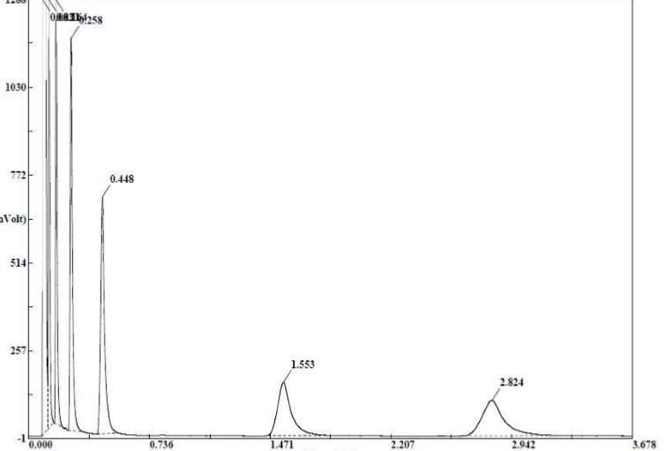
Gas chromatography based on Micro Electro Mechanical Systems (MEMS) for in situ space exploration of planetary environments: first development
The second step of the GC is to separate the molecules so that they can be detected with the retention time.
MEMS chromatographic columns are engraved on plates of silica. The inside is then covered with the stationary phase.
Because of this new technology, the engraving of the columns is not perfect and the filing of the stationary phase is a method under development (lab SMS).
So there is unfortunately little results on this part of the GC.
However, some tests could be conducted on columns which the filing of the stationary phase could be done on a half.
Column
4 cm
Example of a chromatogram obtained with a MEMS (5m, deposit PDMS) column.
Injection of the mixture of C10, C11, C13, C14, C15
leila.bouchra@latmos.ipsl.fr Pico4.14 - EGU2018 10 April 2016

Slide 15
Gas chromatography based on Micro Electro Mechanical Systems (MEMS) for in situ space exploration of planetary environments: first development
Column
Waiting for the MEMS columns, a study on commercial chromatographic columns (5m) of same characteristics was made.
Use of two-column ZB - 1MS and ZB - WAX with 3 different temperature programs:
Rampe10 : 32°C (1min) – 10°C/min – 150°C (10mins)
Rampe5 : 32°C (1min) – 5°C/min – 150°C (10mins)
Isotherme : 60°C
compound
Rampe10
Rampe5
Isotherme
tr (mins)
tr (mins)
tr (mins)
Alkanes
pentane
0,38
0,38
0,35
hexane
0,54
0,53
0,41
heptane
0,94
0,93
0,54
octane
1,85
1,9
0,84
nonane
3,2
3,75
1,51
decane
4,74
6,25
3
undecane
6,3
9,03
6,3
dodecane
7,8
11,86
13,62
hexadecane
13,11
22,12
ZB-1MS
eicosane
leila.bouchra@latmos.ipsl.fr Pico4.14 - EGU2018 10 April 2016

Slide 16
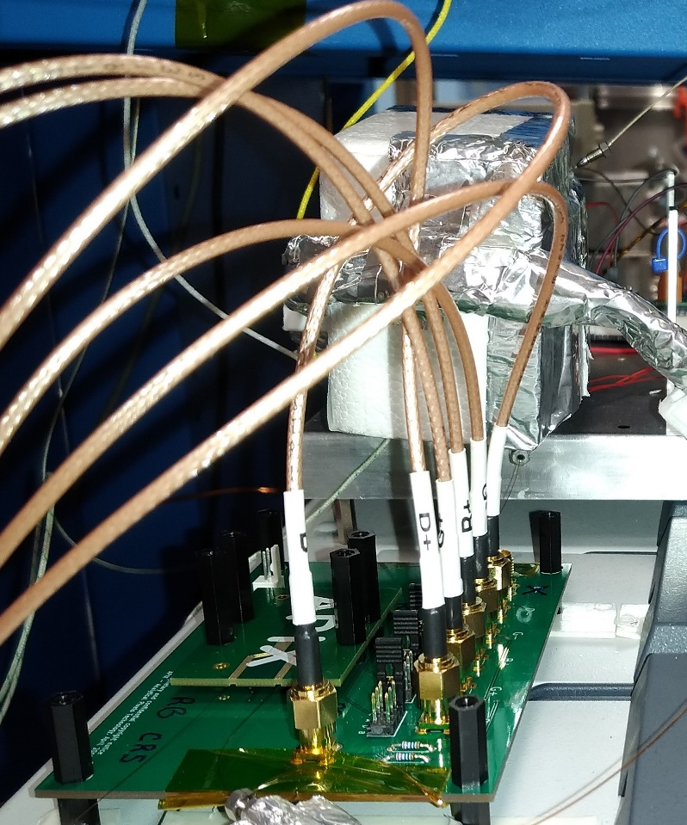
Gas chromatography based on Micro Electro Mechanical Systems (MEMS) for in situ space exploration of planetary environments: first development
Detector
The third step of the GC is to detect molecules.
The study was conducted on 2 sensors:
TCD (Thermal Conductivity Detector) and NEMS (NanoElectroMechanical Systems).
The TCD is a detector used in space (SAM, MOMA). However the current manufacturer no longer produces these TCDs. So it is necessary to do the tests on the new TCD (produced by the ESIEE).
The NEMS (produced by APIX) is a new type of detector in production, which is why the study has also been made on them.
The TCD is supposed to be more sensitive to the light molecules and the NEMS for strong molecules, they are complementary and have been studied at the same time.
TCD and its shell for thermal insulation
NEMS
leila.bouchra@latmos.ipsl.fr Pico4.14 - EGU2018 10 April 2016

Slide 17
Gas chromatography based on Micro Electro Mechanical Systems (MEMS) for in situ space exploration of planetary environments: first development
Detector
The different test was performed using a gaseous mixture of hydrocarbons to 100 ppm, said Crystal, composed of:
1.CO2; 2.N-Butane; 3.N-Pentane; 4.Hexane; 5.Benzène; 6.Toluène.
Time (s)
A
toluène
hexane
benzène
pentane
A - Injection of a volume of 50µL of Crystal corresponding to 2,1e-10 mol.
There is the presence of the 5 peaks of the mixture, toluene is less defined.
B - Injection of a volume of 5µL of Crystal corresponding to 2,1e-11 mol .
We see the disappearance of toluene and the limit of detection for other molecules.
The disappearance of toluene and the presence of the light molecules shows a better sensitivity to molecules of low molecular weight.
butane
B
butane
pentane
hexane
benzène
Time (s)
leila.bouchra@latmos.ipsl.fr Pico4.14 - EGU2018 10 April 2016
leila.bouchra@latmos.ipsl.fr Pico4.14 - EGU2018 10 April 2016

Slide 18
Gas chromatography based on Micro Electro Mechanical Systems (MEMS) for in situ space exploration of planetary environments: first development
Detector
The different test was performed using a gaseous mixture of hydrocarbons to 100 ppm, said Crystal, composed of:
1.CO2; 2.N-Butane; 3.N-Pentane; 4.Hexane; 5.Benzène; 6.Toluène.
Time (s)
A
toluène
A – Injection of a volume of 50µL of Crystal corresponding to 2,1e-10 mol.
The detection of the NEMS begins with pentane observed weakly.
B – Injection of a volume of 5µL of Crystal corresponding to 2,1e-11 mol .
We see the disappearance of pentane and hexane and the limit of detection of other molecules.
The no detection of the first light molecules and the disappearance of the pentane and hexane shows a better sensitivity to molecules of high molecular weight. We can suppose that the sensitivity can be even better with stronger molecules than toluene.
pentane
benzène
hexane
Time (s)
B
toluène
benzène
leila.bouchra@latmos.ipsl.fr Pico4.14 - EGU2018 10 April 2016

Slide 19
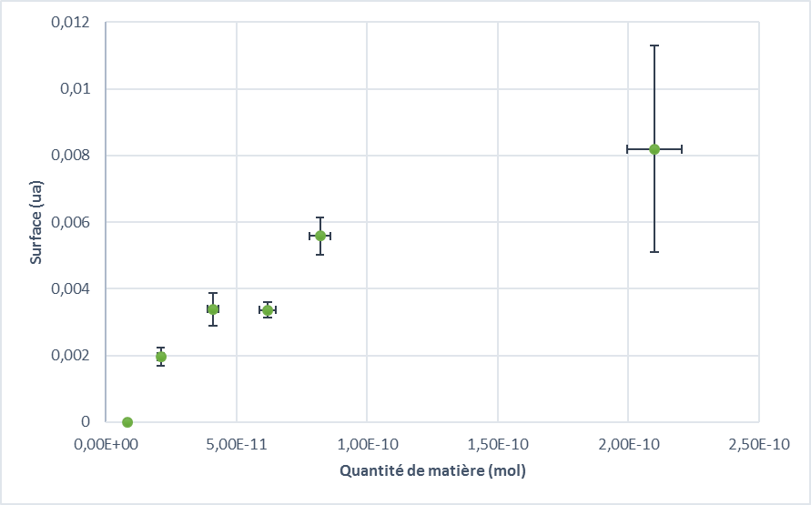
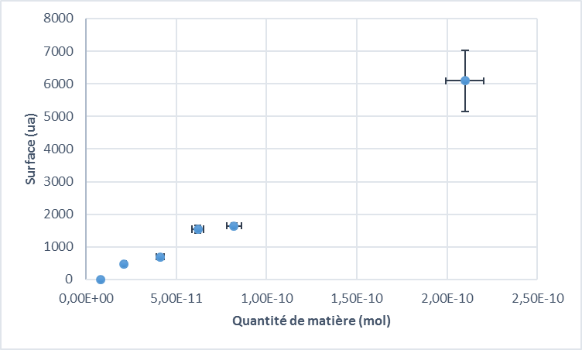
Gas chromatography based on Micro Electro Mechanical Systems (MEMS) for in situ space exploration of planetary environments: first development
Detector
TCD
NEMS
A
B
Area (ua)
Area (ua)
Matter quantity (mol)
Matter quantity (mol)
A - Range of linearity of the TCD (use of butane). B - Range of linearity of the NEMS (using toluene).
There for the two detectors a linearity on 2 orders of magnitude. Highest amount of material need information in order to confirm the results and to reach the level of saturation.
The lack of information between 1e-10mol and 2e-10mol is due to a limit of manipulation in the laboratory.
leila.bouchra@latmos.ipsl.fr Pico4.14 - EGU2018 10 April 2016

Slide 20
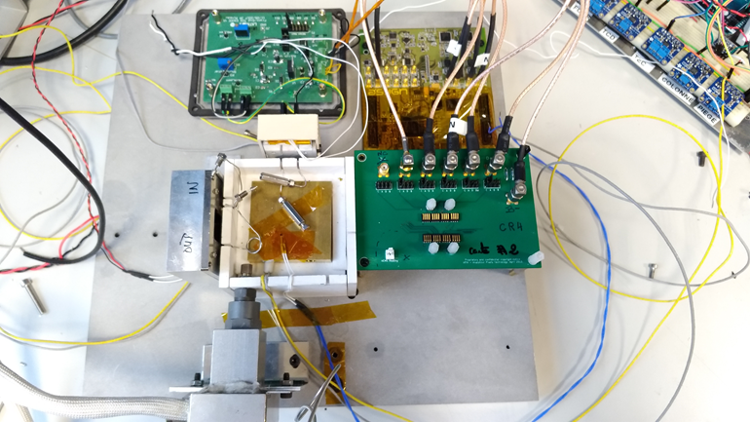
Gas chromatography based on Micro Electro Mechanical Systems (MEMS) for in situ space exploration of planetary environments: first development
Prototype
The final step is to assemble the 3 compounds and test the GC prototype.
On the picture, there is the presence of 2 detectors, the trap, the electric circuit. The column is under finalization.
The different component are attach to a central oven allowing the thermal stabilization of the whole.
The metal plate on which is based the prototype is about the size of the A4 sheet.
The goal is then to thermally isolate the GC prototype from the outside.
During the tests, the Crystal mixture has been send in GC using an automatic valve in order to have a repeatability in handling.
Electric circuit
TCD
Central oven
Trap
NEMS
leila.bouchra@latmos.ipsl.fr Pico4.14 - EGU2018 10 April 2016

Slide 21
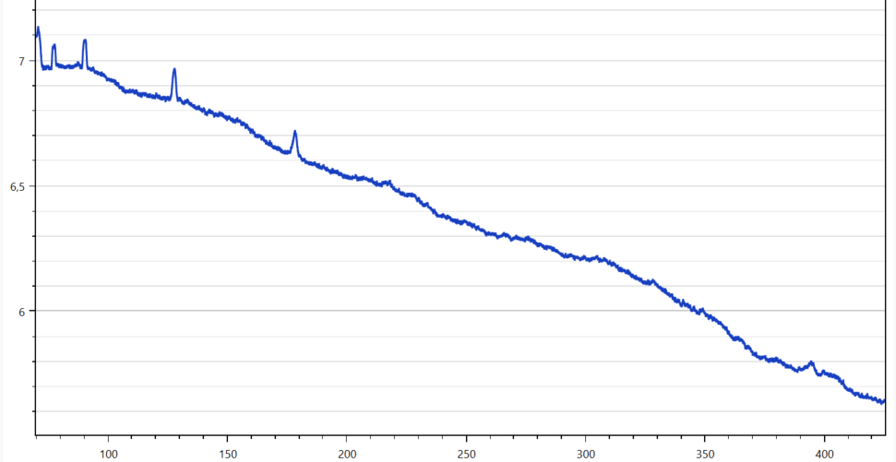
Gas chromatography based on Micro Electro Mechanical Systems (MEMS) for in situ space exploration of planetary environments: first development
Prototype
TCD – GC prototype chromatogram
pentane
toluene
butane
hexane
benzene
benzene
Tension (V)
hexane
pentane
toluene
Time (s)
There are detection of all the molecules of the Crystal to the TCD mixture and the detection of pentane to toluene for the NEMS. We keep the same result than the one from the individual test, which confirm the good functioning of the different miniaturize part of the GC individually and together.
There is also a better detection for the TCD tested individually and better detection to the NEMS on the prototype.
leila.bouchra@latmos.ipsl.fr Pico4.14 - EGU2018 10 April 2016
leila.bouchra@latmos.ipsl.fr Pico4.4 - EGU2018 10 April 2016

Slide 22
Gas chromatography based on Micro Electro Mechanical Systems (MEMS) for in situ space exploration of planetary environments: first development
Conclusion
The study of trapping at 0 °C and the thermodesorption at 180 °C of the TI shows a good functioning of the component despite a leak at the level of the joints of the capillaries (processing).
The study of the thermal properties of the adsorbents used in traps showed a decomposition of the adsorbents at high temperature which can led to contamination of our sample. In the light of the results, the adsorbent selected to fill traps is Tenax TA (60/80 mesh).
The study of the columns could be done way further by a delay in supply and the filing of the stationary phases. However, the results obtained on partially treated columns showed a good separation of hydrocarbons.
The study of the detectors is done thoroughly and found limit of detection at ~10e-11 mol. The detection limit of the NEMS can be lower for molecules of higher molecular weight than toluene (test in progress). The TCD is more sensitive to the light molecules while the NEMS is more sensitive to the strong molecules. These two detectors are compatible and can be used simultaneously.
A first prototype of GC miniature could be completed and the results are satisfactory in a chemical analyze point of view.
leila.bouchra@latmos.ipsl.fr Pico4.14 - EGU2018 10 April 2016

Slide 23
Gas chromatography based on Micro Electro Mechanical Systems (MEMS) for in situ space exploration of planetary environments: first development
2 min Madness
B
C
A
A
B
Trap
Column
Detector
C
tA
tB
tC
2-3 cm
~ 4 cm
4 cm
~ 3 cm
Trap
Point injection
Column
Separation
Detector
Sensitivity
leila.bouchra@latmos.ipsl.fr Pico4.14 - EGU2018 10 April 2016

Slide 24
Gas chromatography based on Micro Electro Mechanical Systems (MEMS) for in situ space exploration of planetary environments: first development
Time (s)
2 min Madness
A
benzène
B
toluène
hexane
pentane
hexane
benzène
toluène
pentane
butane
butane
Time (s)
C
toluène
Time (s)
A – Reference chromatogram (detector FID laboratory)
B – TCD chromatogram
C – NEMS chromatogram
There the same time of retention for the 3 detectors and a different sensitivity for the TCD and the NEMS.
pentane
benzène
hexane
leila.bouchra@latmos.ipsl.fr Pico4.14 - EGU2018 10 April 2016

