Slide 1
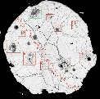
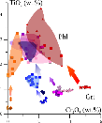
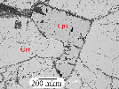
Mono-and polymineralic inclusions within garnet megacrysts from the Grib kimberlite, Arkhangelsk province, Russia : evidence for kimberlite melt evolution
Geological setting
Host
garnet
1 type
2 type
3 type
Phl,
Amph
Nataliya Lebedeva ⁽¹⁾, Anna Nosova ⁽¹⁾, Alexey Kargin ⁽¹⁾, Lyudmila Sazonova ^{(1, 2)}, Ekaterina Peresetskaya ⁽²⁾
(1) Institute of Geology of Ore Deposits, Petrography, Mineralogy and Geochemistry, Moscow, Russia,
(2) Lomonosov Moscow State University, Moscow, Russia.
Cpx
Ilm
Serp
Conclusions

Slide 2
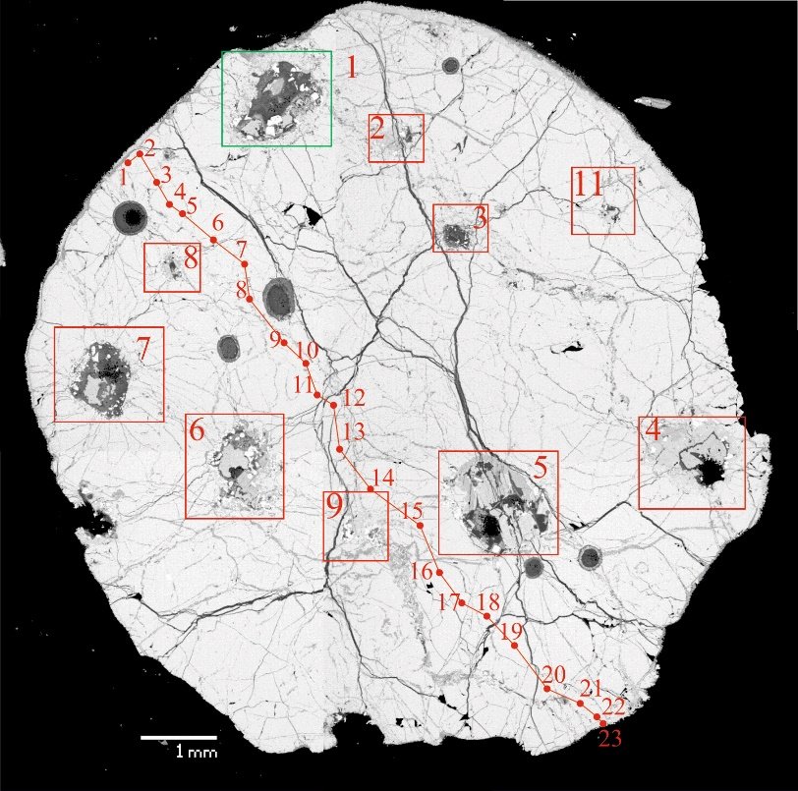
Problems and solution methods
2-MINUTE
Geological setting
1. Experiments (Dalton and Presnall, 1998; Dasgupta et al., 2009; Foley et al., 2009 etc)
Host
garnet
2. Petrological modelling based on kimberlite composition (Price et al., 2000, Kopylova et al., 2007)
3. Melt inclusion whitin Ol, Cr-Spl, Grt, Mnt (Kamenetsky et al., 2013; Abersteiner et al., 2017)
4. Polymineralic inclusion within Cpx and Grt megacryst and
minerals from xenolith (Achtenbergh et al., 2004, Bussweiler et al., 2016)
1 type
2 type
Polymineralic inclusions within garnet (megacrysts, peridotite, eclogite) from the Grib kimberlite (Group I)
Archangelsk Diamond Provinces, Russia
3 type
Phl,
Amph
Cpx
Ilm
Serp
17Gr1-8/1
d

Slide 3
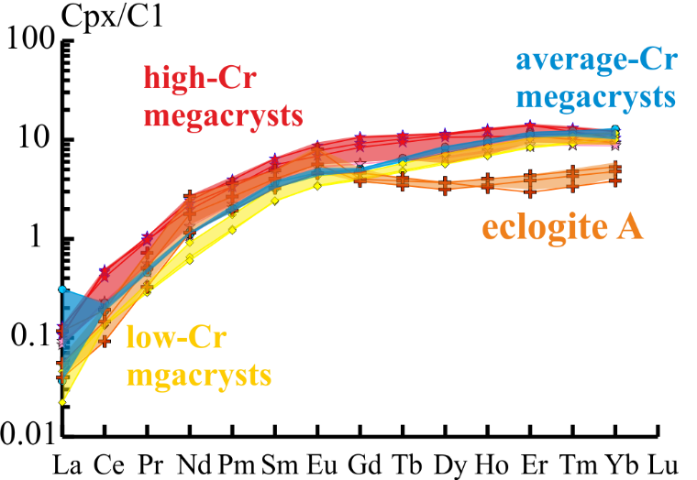
Problems, Samples
2-MINUTE
Garnet
Geological setting
Host
garnet
1 type
 | (La/Yb)_{CI} | (Eu/Gd)_{CI}
High-Cr | 0.009-0.01 | 0.81-0.93
Average-Cr | 0.003-0.02 | 0.91-0.94
Low-Сr | 0.002-0.006 | 0.86-0.94
Eclogite | 0.01-0.02 | 0.99-2.00
2 type
3 type
Phl,
Amph
(Grutter et al., 2004)
Griffin et al., 1999
Cpx
Ilm
Serp
Griffin et al., 1999
d

Slide 4
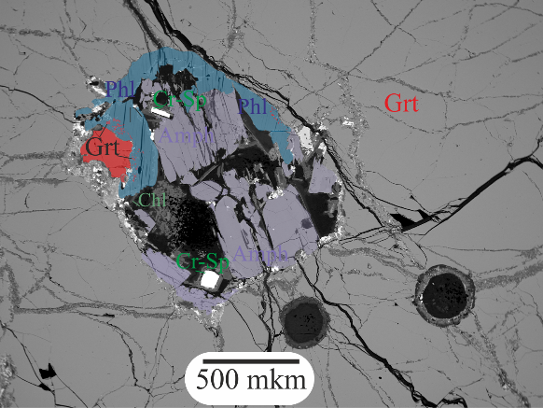
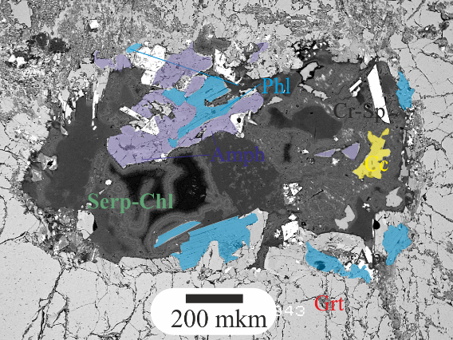
Type of polymineralic inclusions
2-MINUTE
Geological setting
Host
garnet
1 type of
inclusion
The angular inclusions consist of relict mineral assemblages represented by Cpx grains, Ilm and Serp groundmass.
1 type
2 type
2 type of
inclusion
The inclusions consist of relicts Prv, Ilm, Cr-Spl with Carb, Cpx, Phl.
Depending on the substitute matrix, we identified two subgroups: The 2a type inclusions have carbonate-silicate matrix and the 2b type ones have sulphate matrix.
3 type
Phl,
Amph
2a
2b
Cpx
Ilm
3 type of
inclusion
The elliptic and angular inclusions consist of Amp, Phl, Cr-Sp, Carb and Serp-Chl groundmass.
Serp

Slide 5
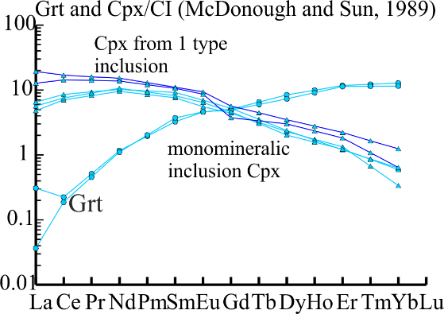
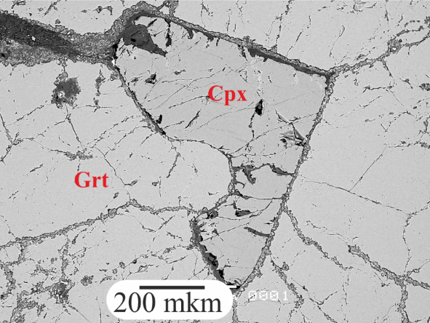
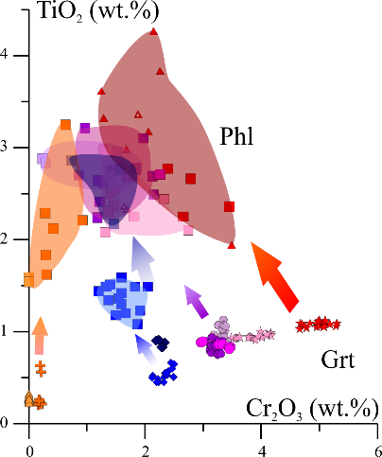
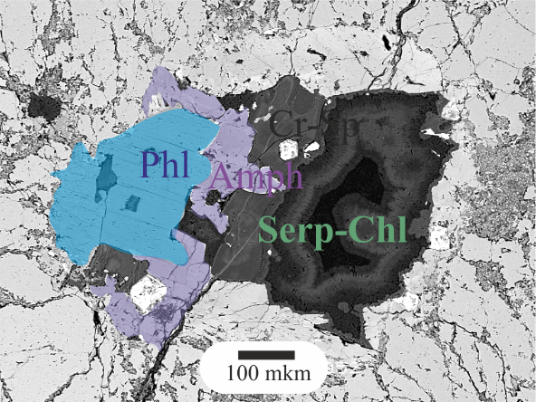
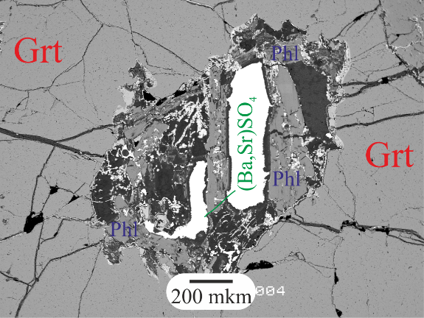
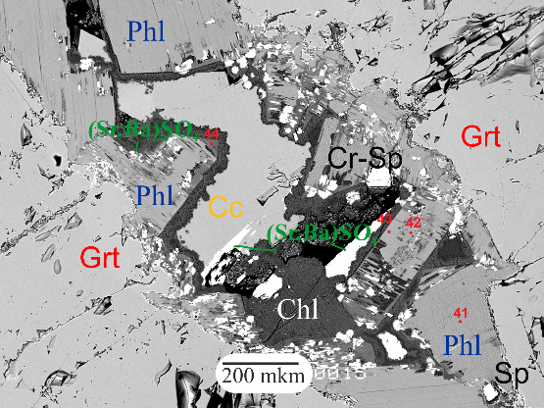
Kimberlite evolution
2-MINUTE
Geological setting
1 stage:
Mantle metasomatism
1 type of inclusion
Relicts Prv, Ilm,Cr-Sp from 2 type of inclusion
Host
garnet
1 type
For Cpx: T=1082-1188^{о}С P: 5GPa (Nimis 2000)
2 type
2 stage:
High-Ti host kimberlite melt
Groundmass 2a type of inclusion
3 type
Phl,
Amph
Cpx
3 stage: post-emplacement alteration
Groundmass 2b type of inclusion
Pargasite are stable at depths corresponding to P <3 GPa
Ilm
Serp
Notes:
Monomineralic inclusion of clinopyroxene can be idiogenous host garnet.

Slide 6
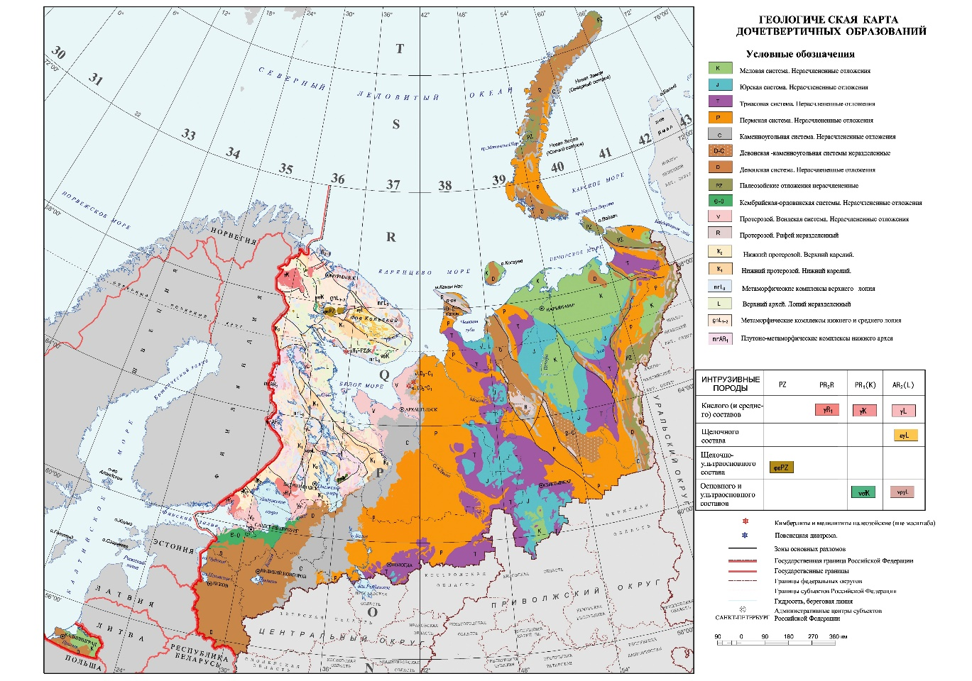
Geological settings
Geological setting
Host
garnet
1 type
2 type
3 type
Phl,
Amph
Cpx
The Grib kimberlite pipe (376±3 Ma, Larionova et al., 2016) is located in the central part of Arkhangelsk diamond province in the Paleoproterozoic collisional suture zone underlain by the AR lithosphere roots.
Ilm
Serp

Slide 7
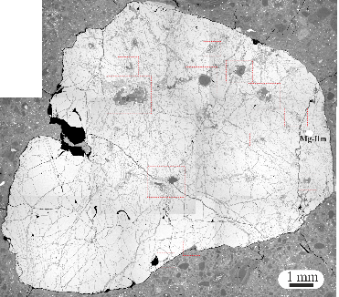
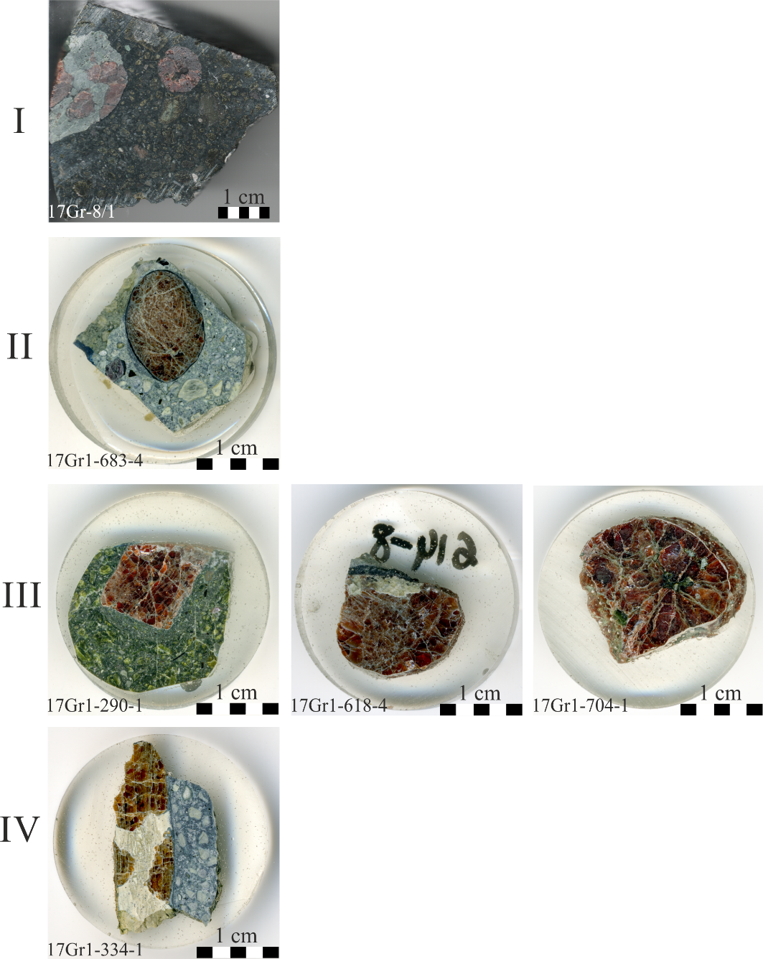
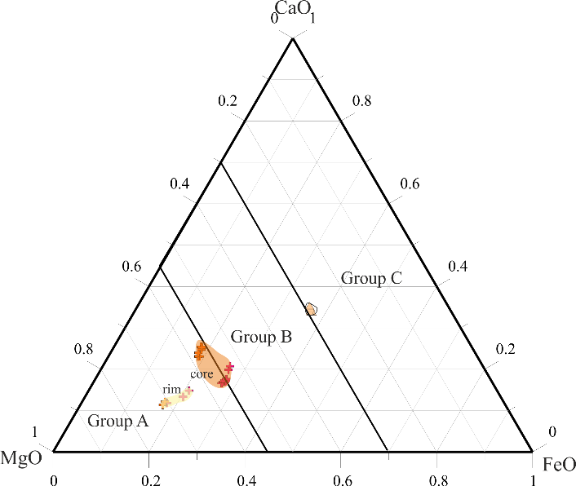
Host garnet composition
High-Cr megacryst
Geological setting
Host
garnet
Average-Cr megacryst
1 type
2 type
low-Cr megacryst
3 type
Phl,
Amph
Eclogitic A
Eclogite
Cpx
Ilm
Peridotite
We investigate 15 samples of garnet with inclusions, which have “megacrysts image”
All megacrysts, peridotite and eclogite A have 68-77 % Py, eclogite C have content about 29 % Py component.
Serp

Slide 8
Host garnet composition
Geological setting
From low-Cr to high-Cr megacryst are observed increase LREE concentration.
The absence of signs of sinusoidal REE distribution for average and high-Cr megacrysts indicates that the grt were in equilibrium with the LREE-enriched kimberlite melt. Low-Cr megacrust show flatt patterns of distributions near Gd, it can be relict link with parent peridotite.
Eclogitic Grt were not in equilibrium with the kimberlite melt
Host
garnet
1 type
 | (La/Yb)_{CI} | (Eu/Gd)_{CI}
High-Cr | 0.009-0.01 | 0.81-0.93
Average-Cr | 0.003-0.02 | 0.91-0.94
Low-Сr | 0.002-0.006 | 0.86-0.94
Eclogite | 0.01-0.02 | 0.99-2.00
2 type
3 type
Phl,
Amph
High Ti, Zr, Y contents in all megacrysts suggest that they were formed as a result of high-temperature melt-associated mantle metasomatism
Griffin et al., 1999
Cpx
Ilm
Serp

Slide 9
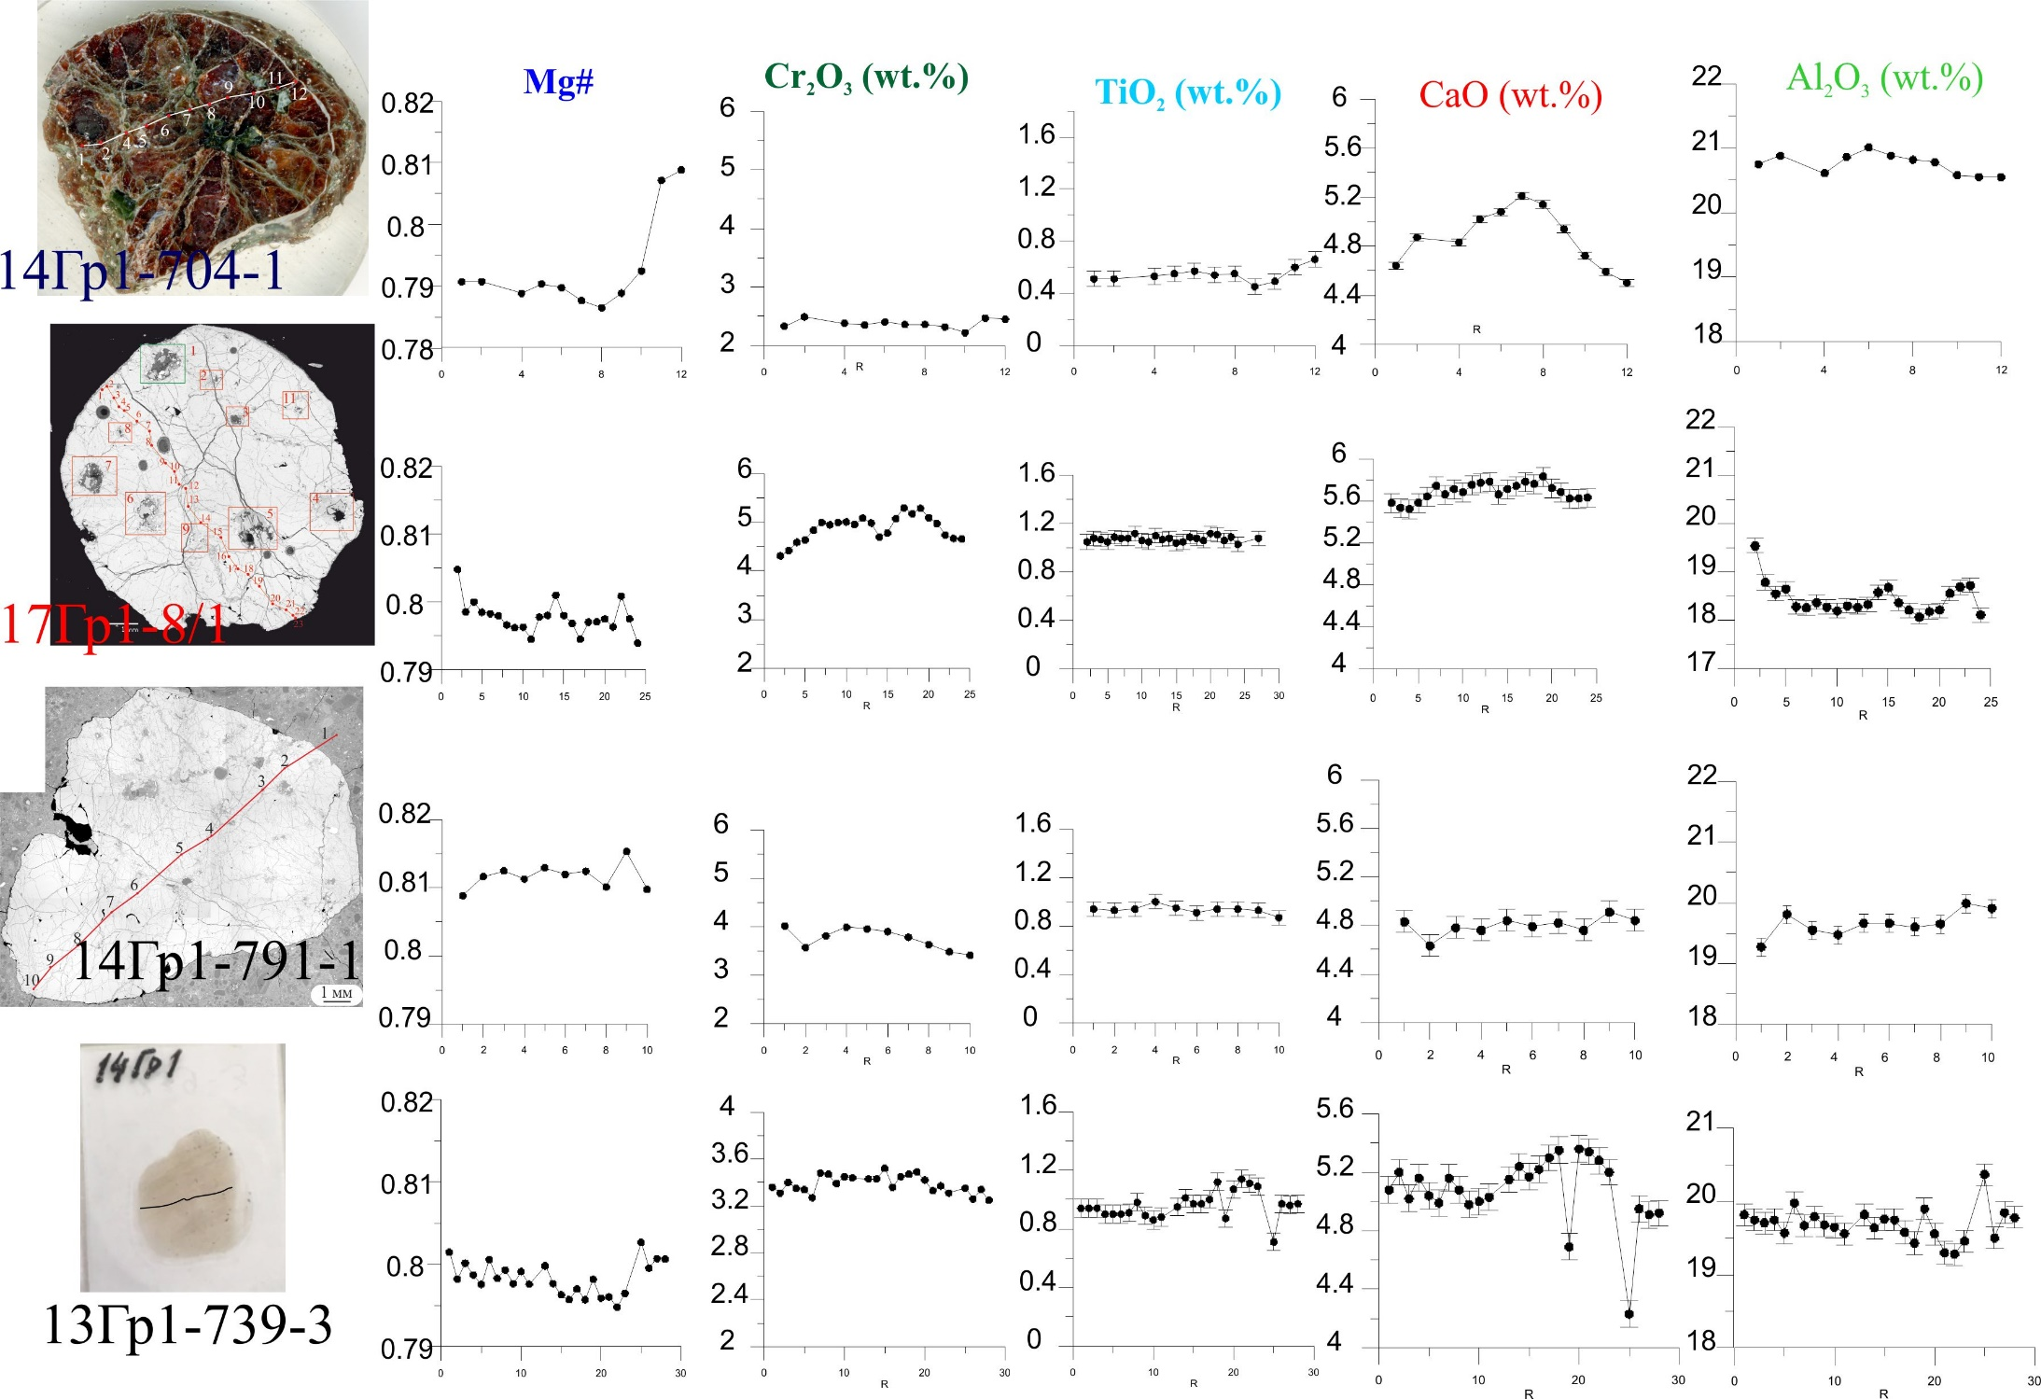
Some host garnet
Geological setting
Host
garnet
g
1 type
2 type
3 type
Phl,
Amph
Cpx
Ilm
Serp

Slide 10
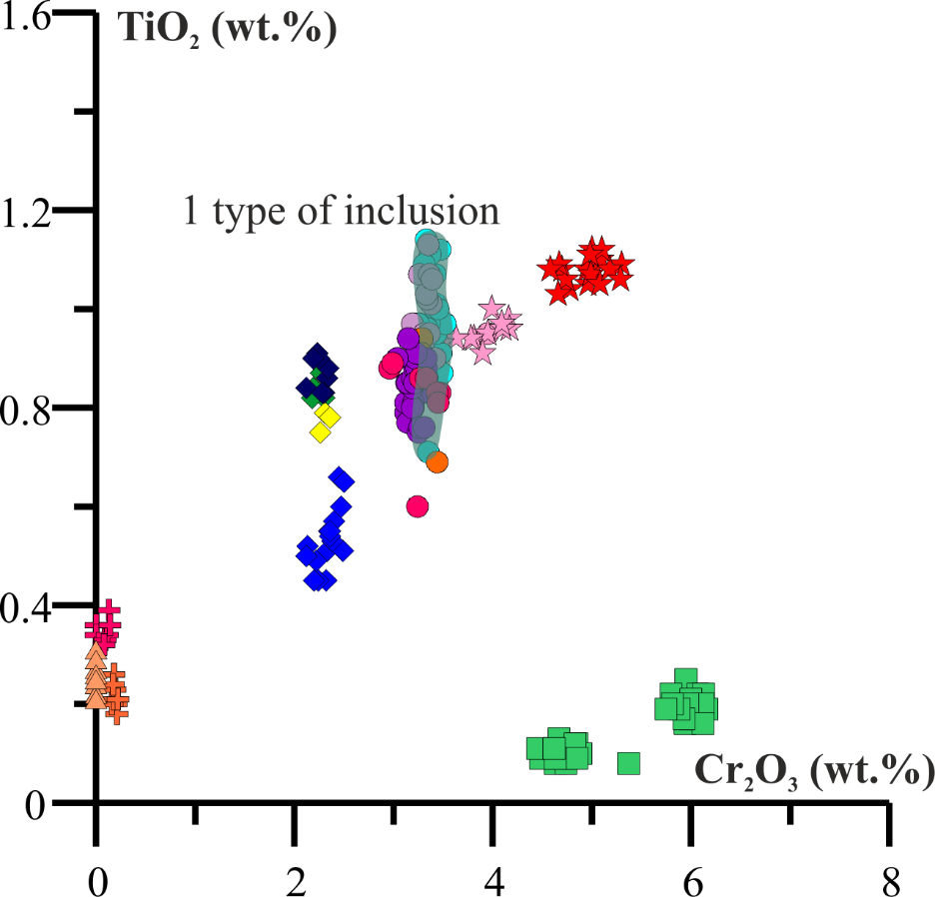
1 type of inclusion
Geological setting
Host
garnet
1 type
2 type
Composition Cpx from polymineralic inclusions overlap with monominerlic inclusion.
3 type
Phl,
Amph
Cpx
The angular inclusions consist of relict mineral assemblages represented by Cpx grains, Ilm or Cr-Spl and Serp groundmass.
Ilm
Serp

Slide 11
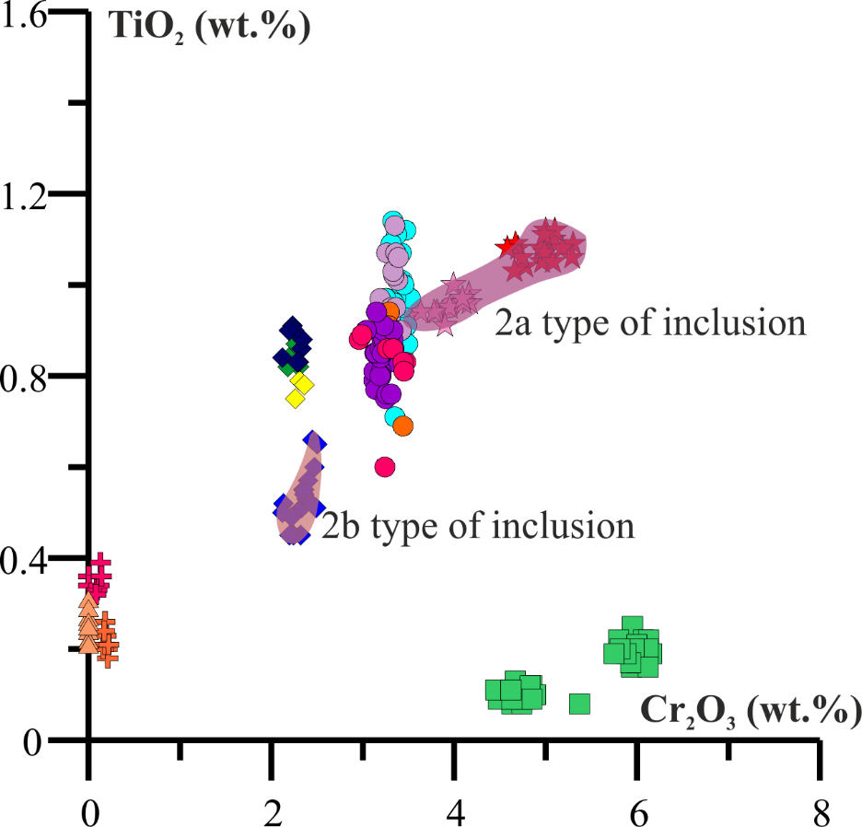
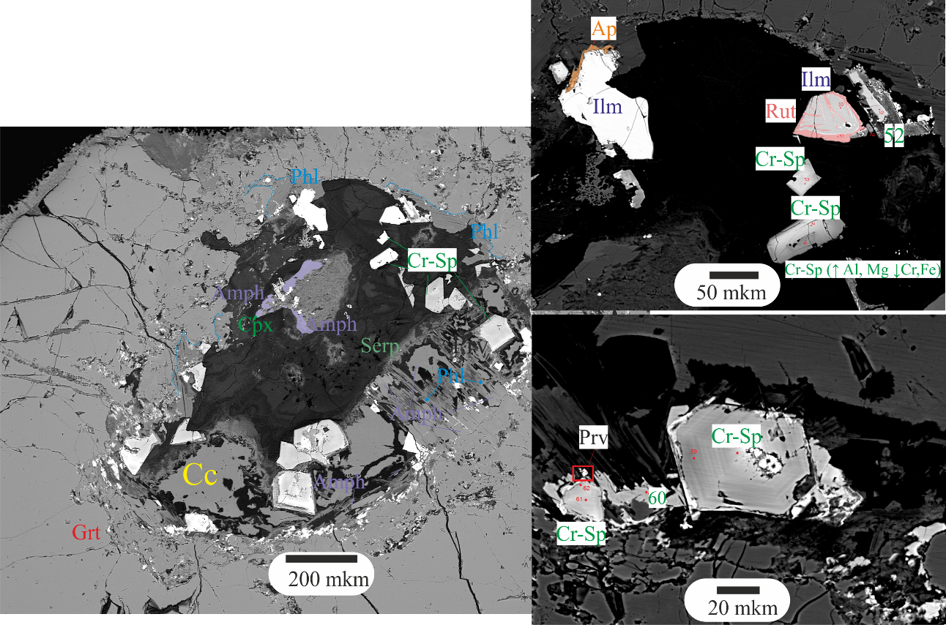
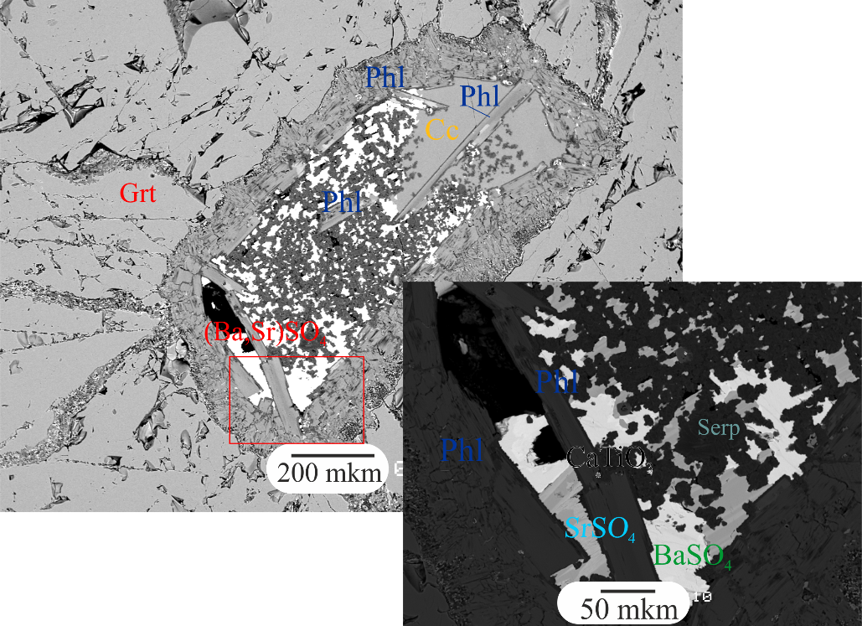
2 type of inclusion
Geological setting
The inclusions consist of relicts Prv, Ilm, Cr-Spl with Carb, Cpx.
The 2a type inclusions have carbonate-silicate matrix and the 2b type ones have sulphate matrix.
Host
garnet
1 type
2 type
2a have
carbonate-silicate matrix
2b have sulphate
composition of matrix
3 type
Phl,
Amph
Cpx
Ilm
Serp

Slide 12
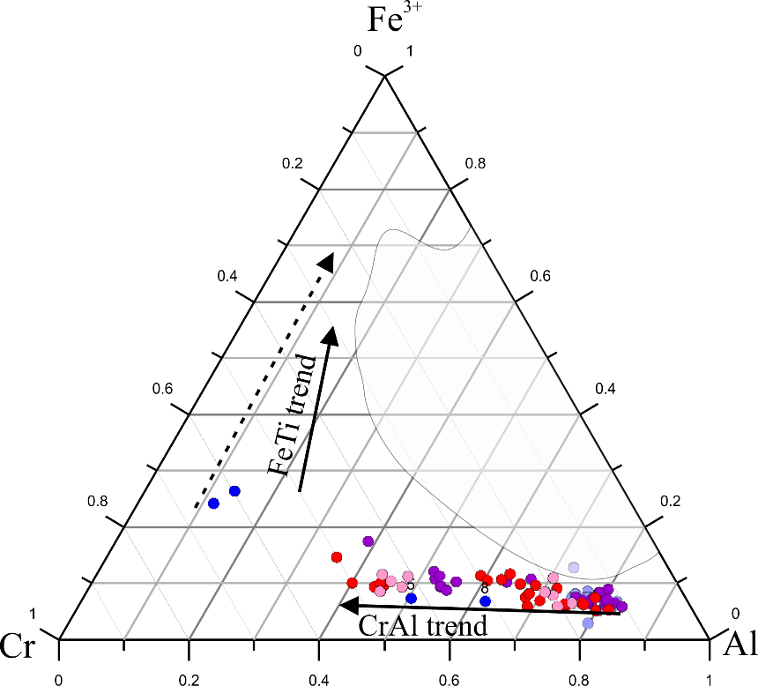
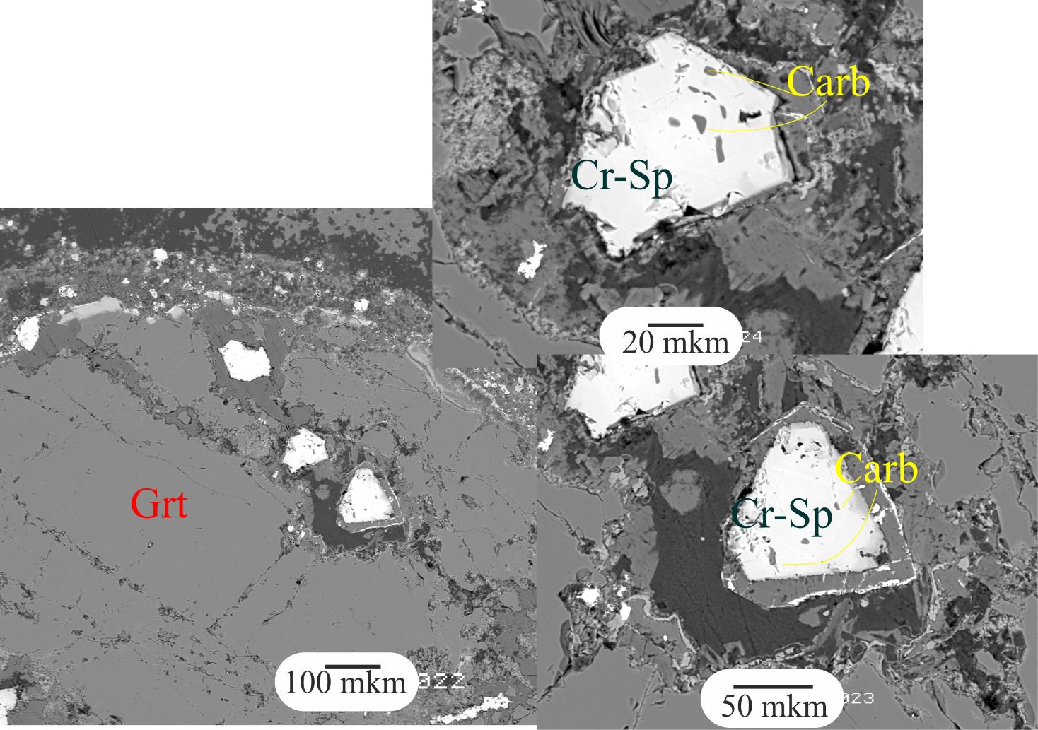
2a type of inclusion
Geological setting
Relicts Cr-Spinel within polymineralic inclusion have small carbonate inclusion.
Host
garnet
1 type
2 type
3 type
Phl,
Amph
Cpx
Ilm
Composition these Cr-Sp differ from zonal Cr-Sp. It same as kimberlite trend according to Mitchell.
Serp
Notes:
polymineralic inclusion within Cr-diopside is surrounded by a halo of micro-inclusions of phlogopite and calcite within We interpret this halo as a reaction rim between incoming melt and the original host phase.

Slide 13
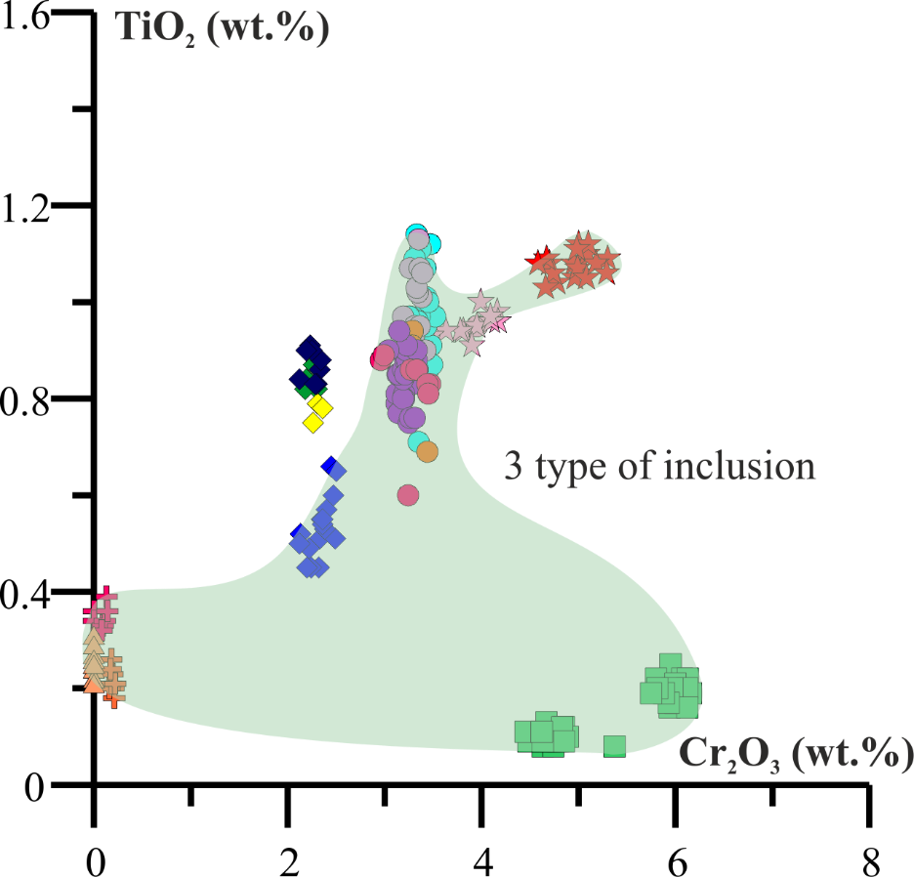
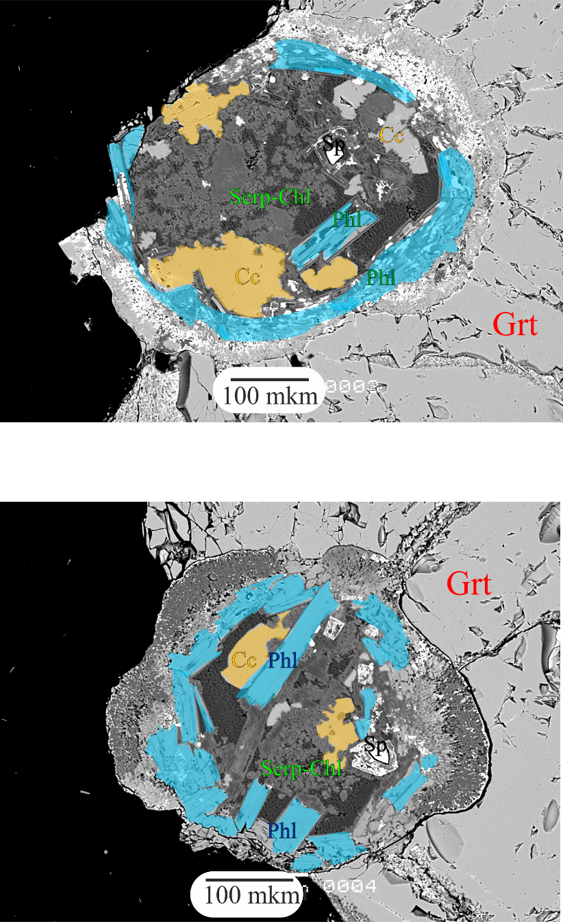
3 type of inclusion
Geological setting
Host
garnet
1 type
2 type
3 type
The elliptic and angular inclusions consist of Amp, Phl, Cr-Sp, Carb and Serp-Chl groundmass.
Phl,
Amph
Cpx
Ilm
Serp

Slide 14
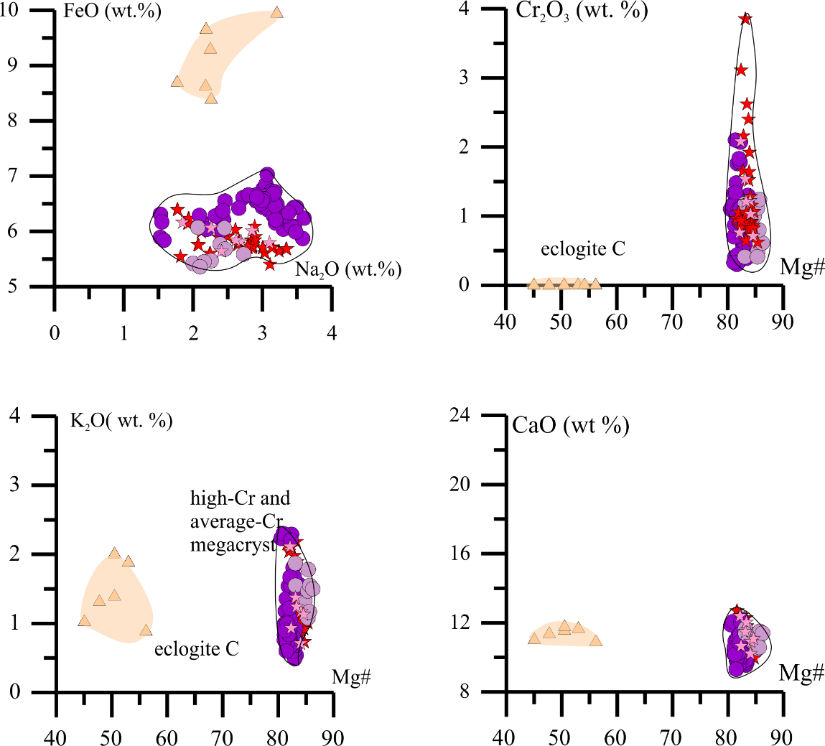
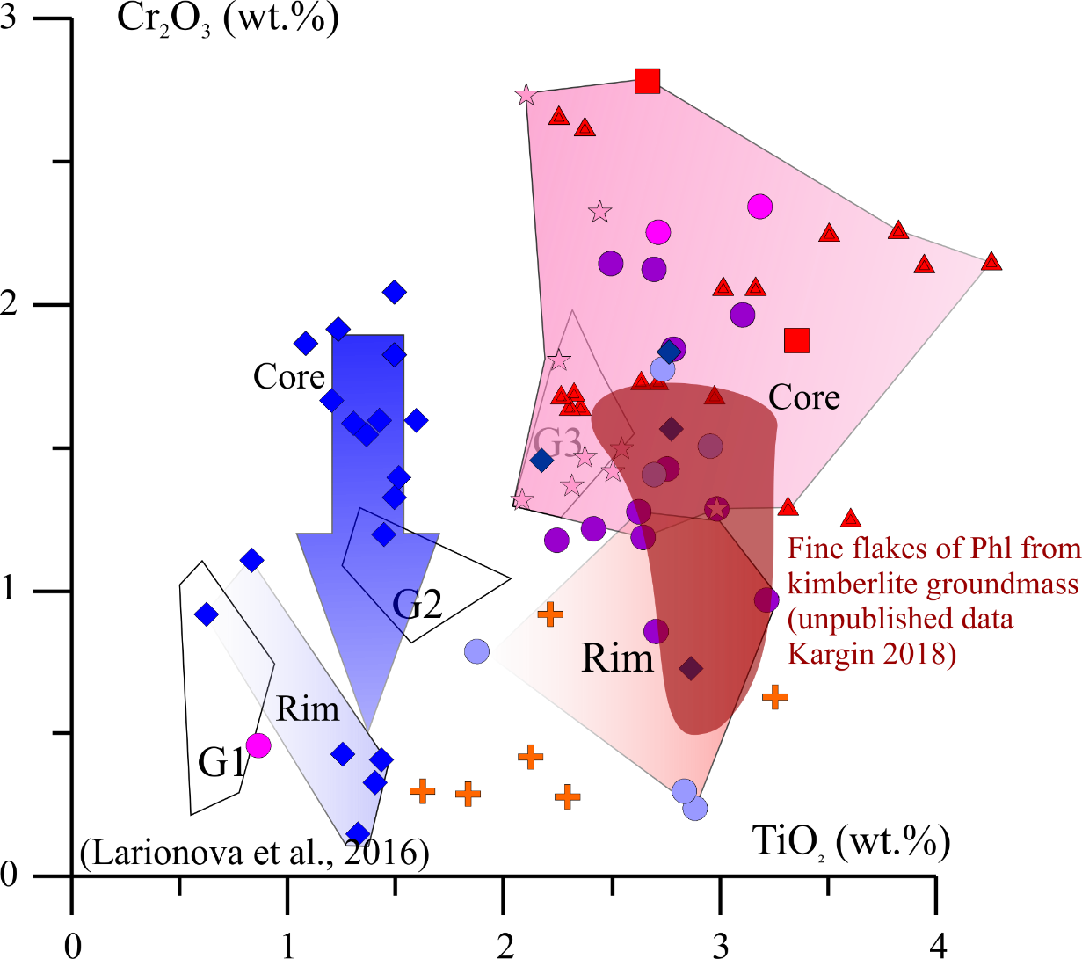
Phl and Amph composition
Geological setting
Host
garnet
1 type
2 type
3 type
Phl,
Amph
Cpx
All amphiboles are pargasite.
Pargasite are stable at depths corresponding to P <3 GPa
Ilm
Fine flakes high-Ti and Cr Phl from kimberlite groundmass crystallized from kimberlite melt.
Phlogopite composition depends on garnet composition
Serp

Slide 15
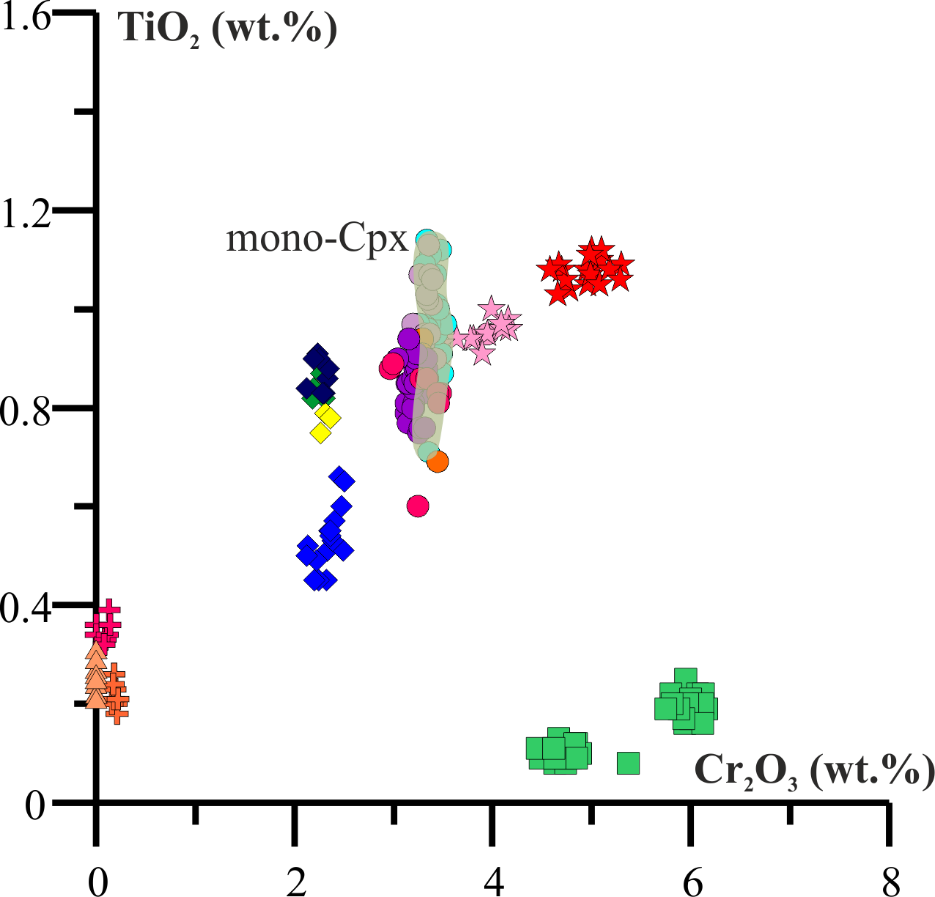
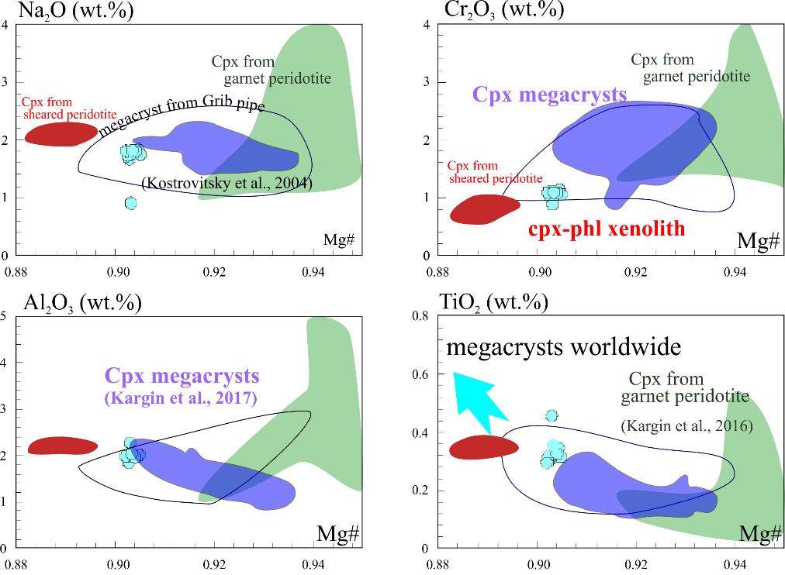
Monomineralic inclusion. Clinopyroxene
P: 4.3-4.4 GPa
T: 730-841 ^{о}С
(Kargin et al., 2016)
Geological setting
Host
garnet
P: 7 GPa
T: 1200 ^{о}С
(Kargin et al., 2016)
1 type
2 type
P: 3.6-4.7 GPa
T: 765-992 ^{о}С
(Kargin et al., 2017)
3 type
Phl,
Amph
Cpx
 | (La/Yb)_{CI} | (La/Gd)_{CI}
mono | 9.53-14.14 | 1.08-1.24
poly | 15.50-19.88 | 2.52-3.40
Ilm
Serp
For Cpx T: 1082-1188^{о}С P: 5GPa (Nimis 2000)

Slide 16
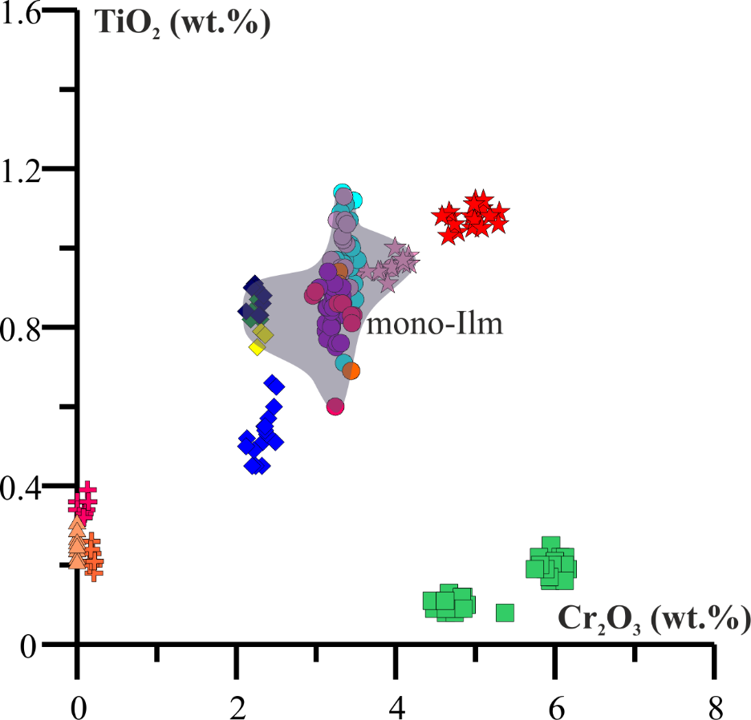
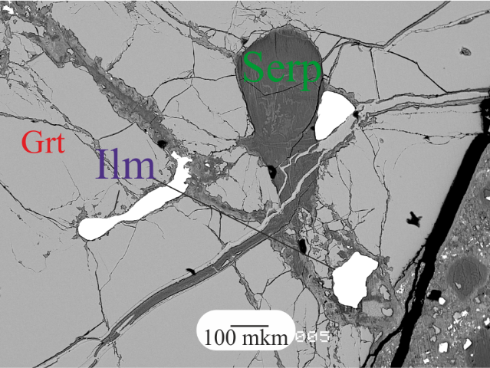
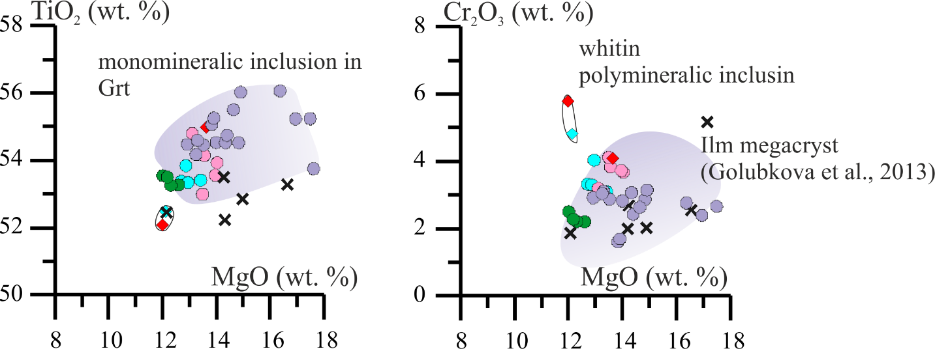
Monomineralic inclusion. Ilmenite
Geological setting
Host
garnet
1 type
2 type
3 type
Phl,
Amph
Ilmenite have different form and close by composition.
Cpx
Ilm
Serp

Slide 17
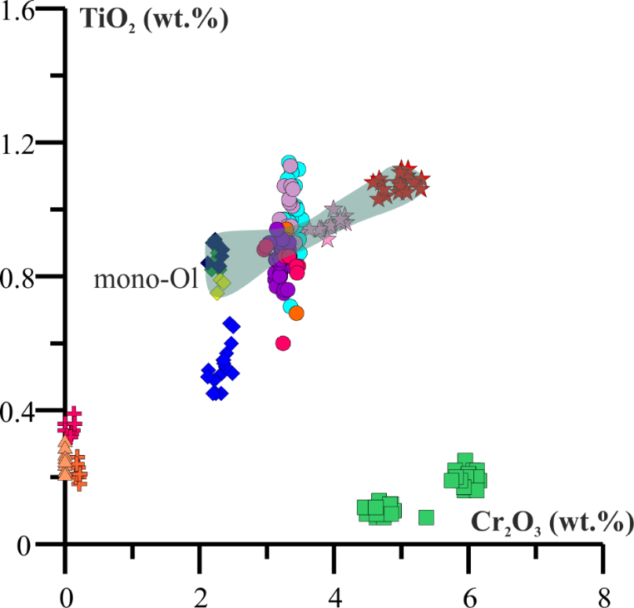
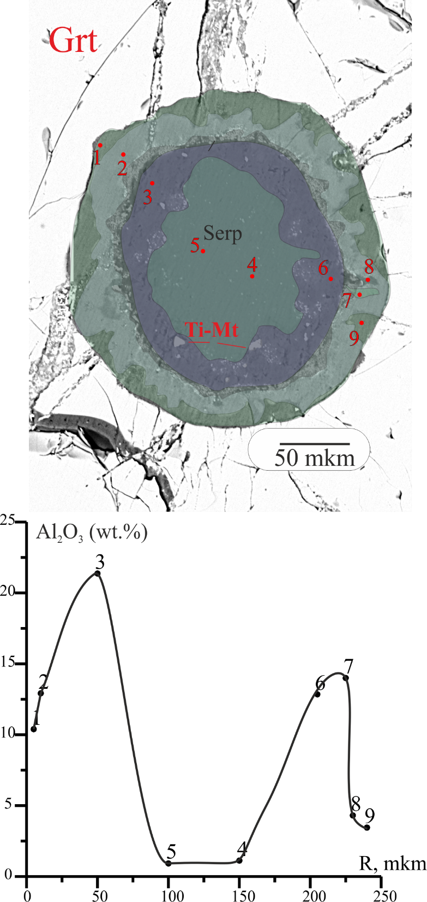
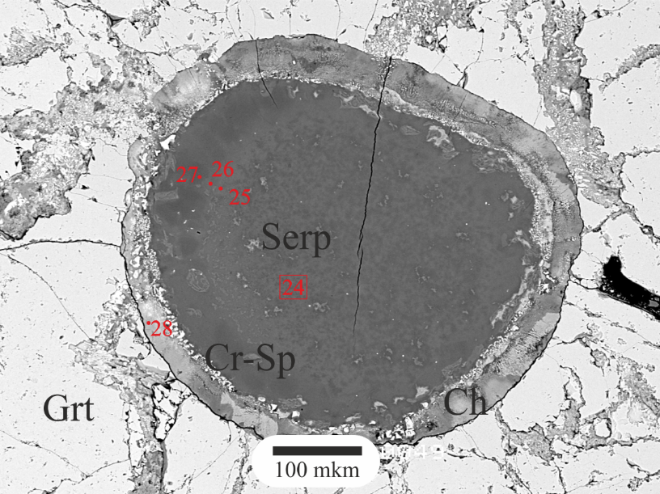
Monomineralic inclusion. Serpentine
Geological setting
Host
garnet
1 type
2 type
3 type
Phl,
Amph
Cpx
Ilm
Serp
Inclusion altered Ol within low-Cr garnet
Zoned Serp-Chl inclusion within high-Cr garnet

Slide 18
Kimberlite evolution
Geological setting
Host
garnet
1 stage: Garnet megacryst were formed by mantle metasomatism. Probably perovskite, Ilmenite and clinopyroxene were formed at that moment and then the garnets were captured by host melt. Depth of capture could be corresponded to P = 5 GPa and T around 1082-1188 ºC (for Cpx, Nimis 2000).
2 stage: High-Ti host kimberlite melt carried megacrysts and fragments of peridotite and eclogite. The garnet cracked and veinlets have been formed. High-Ti Phl had been formed at that veinlets and within the early inclusions. Probably the garnet were partialy melted under influence of the kimberlite melt.
3 stage: Post-emplacement alteration are effected due to low-Ti ,Cr and high-Ba, Sr post-kimberlite fluid. Amphibole, serpentine, chlorite, barite and celestine formed within inclusions.
1 type
2 type
3 type
Phl,
Amph
Cpx
Ilm
Serp

Slide 19
Thank you for your attention!
Geological setting
Host
garnet
1 type
2 type
3 type
Phl,
Amph
Cpx
Ilm
Serp

