Slide 1




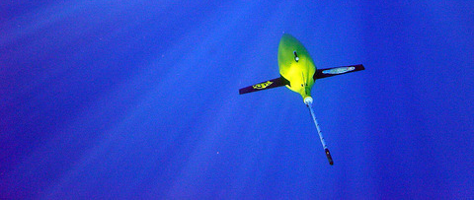
Passive Acoustic Monitoring from gliders
Pierre Cauchy, K. J. Heywood, B. Y. Queste, N. D. Merchant, D. Risch, P. Testor
Gliders for PAM
Wind speed measurements
Marine life monitoring
Anthropogenic noise
EGU General Assembly 2018

Slide 2

Gliders for Passive Acoustic Monitoring
24/7/365 monitoring
Surface to bottom
Spatial coverage
Silent platform
(99% of the time)
Battery position adjustment
Altimeter
Pump

Slide 3
Wind speed measurements
Air sea interactions
Can measure during hurricanes!
Calibration of satellite measurements
Improvement of climate models
Cauchy et al. Wind speed measured from underwater gliders using passive acoustics
Under review: Journal of Atmospheric and Oceanic Technology

Slide 4
Marine life
Fish night chorus
Population monitoring
Long term – large scale
Marine protected areas
Hidden individuals
Non invasive
Potential indicator for ecosystem health
Di Iorio et al. ‘Posidonia meadows calling’: a ubiquitous fish sound with monitoring potential. Remote Sensing in Ecology and Conservation (2018).
Fish choruses

Slide 5
Marine life
Sperm whale and dolphin echolocation clicks
Whales
Population monitoring
Habitat modelling
Mapping
Density estimation
Animal characterization
Sperm whale size estimation
Long-finned pilot whales

Slide 6
Marine life
Sperm whale and dolphin echolocation clicks
Whales
Population monitoring
Habitat modelling
Mapping
Density estimation
Animal characterization
Sperm whale size estimation
From Growcott et al. (2011):
Total length = 1.258 x IPI + 5.736
Inter Pulse Interval (IPI) = 5 ms.
Sperm whale size = 12 m.
IPI = 5 ms

Slide 7
Anthropogenic sounds
Seismic survey
Impact of activities
Noise pollution
Regulations
Marine protected areas
Ship detection

