Slide 1





How much water is used for irrigation?
A new approach exploiting satellite soil moisture observations
European General Assembly, Vienna 10th April, 2018
Luca Brocca (1), Angelica Tarpanelli (1), Paolo Filippucci (1), Wouter Dorigo (2), Felix Zaussinger (2), Alexander Gruber (2,3), Diego Fernandez Prieto (4)
National Research Council, Research Institute for Geo-Hydrological Protection, Perugia, Italy (luca.brocca@irpi.cnr.it)
CLIMERS – Research Group Climate and Environmental Remote Sensing, Department of Geodesy and Geoinfomation, Vienna University of Technology, Vienna, Austria
Department of Earth and Environmental Sciences, KU Leuven, Heverlee, B-3001, Belgium
European Space Agency, ESA-ESRIN, Frascati, Italy
http://hydrology.irpi.cnr.it/people/luca-brocca
http://hydrology.irpi.cnr.it

Slide 2
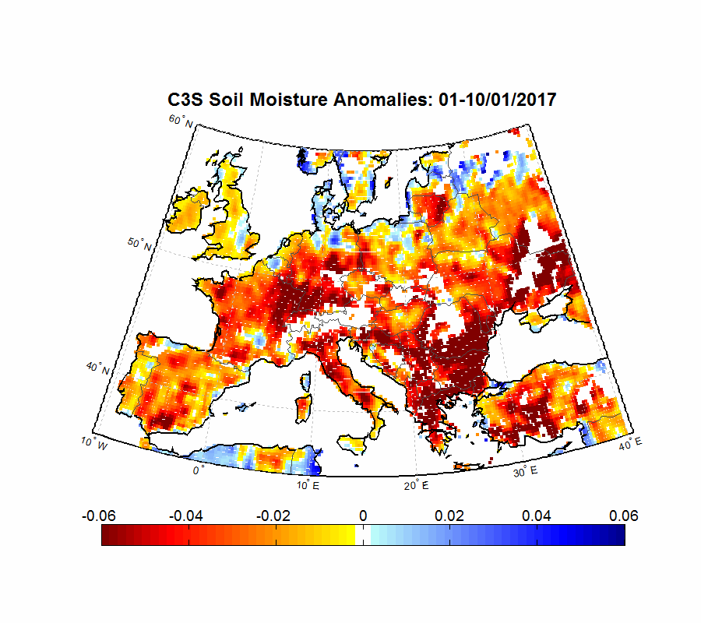

The irrigation problem
Water scarcity is a current issue in many parts of the world, and particularly in Europe in the recent and current period.
Climate changing is expected to exacerbate the problem.
Soil moisture anomalies in Europe in 2017
Copernicus Climate Service (C3S)
CNR Press Release by
Luca Brocca and Wouter Dorigo (1st July 2017)
Irrigated agriculture accounts for about 70 percent of water withdrawn worldwide being the greatest human intervention in the hydrological cycle.
We currently do not have information about the water used for irrigation, except for statistical inventories available for specific and small regions and/or at multiannual temporal scale
→ Accurate information on
irrigation water are desperately needed

Slide 3
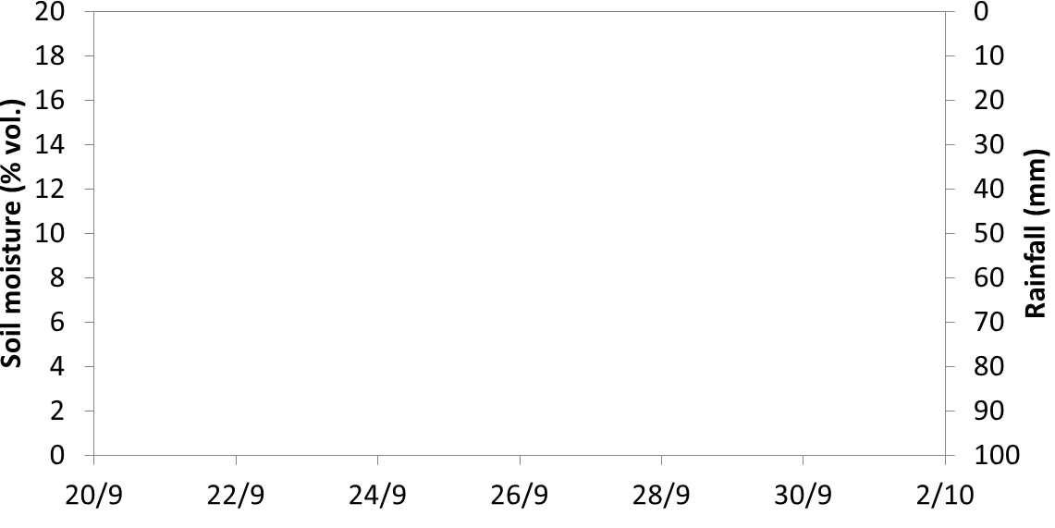


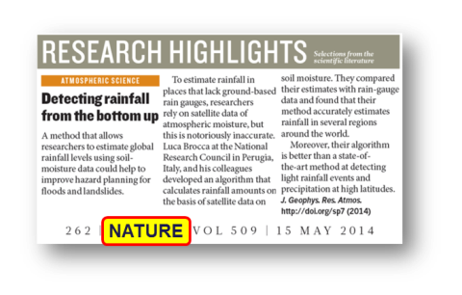
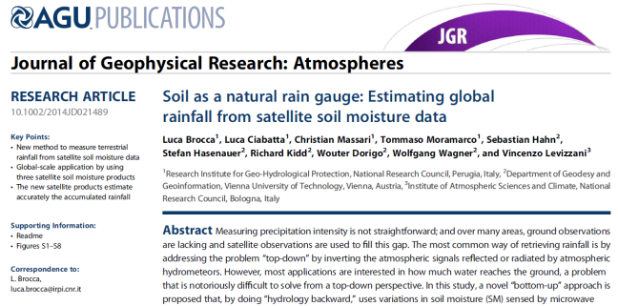
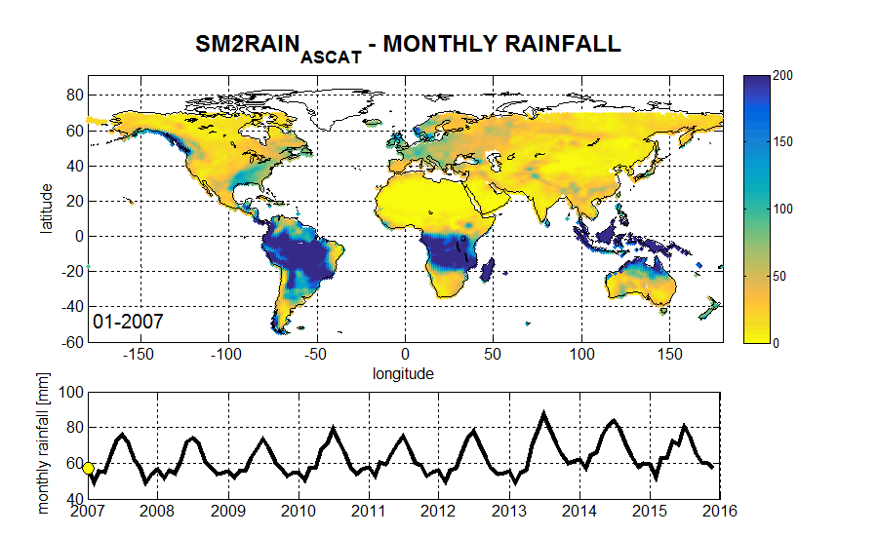
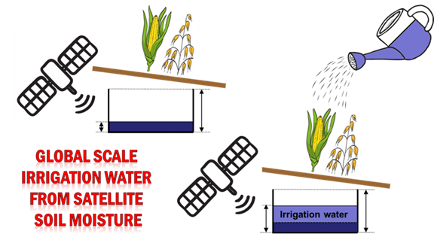
The IDEA: using soil moisture for irrigation
From soil moisture to irrigation
Modelling (climate/hydrology)
Satellite observations
SM2RAIN: From soil moisture to rainfall
Irrigation
SM2RAIN is a new “bottom-up” approach (Brocca et al., 2014 JGR) for estimating the ACCUMULATED RAINFALL from satellite (and in situ) soil moisture observations
ORAL TOMORROW
Rainfall estimation from soil moisture observations, SM2RAIN: recent advances and future directions
Brocca, L. et al; Wed, 11 Apr, 15:30–15:45, Room B
https://www.linkedin.com/pulse/do-you-know-sm2rain-read-here-its-short-story-luca-brocca
http://hydrology.irpi.cnr.it/research/sm2rain
Detection of irrigated areas
Quantification of irrigation water

Slide 4
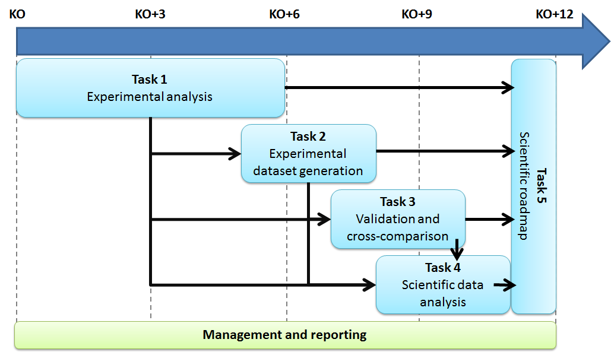
WACMOS-IRRIGATION project
Understanding of the potential of satellite soil moisture data to obtain irrigation information on a global scale

Slide 5
WACMOS-IRRIGATION project
DETECTING IRRIGATION THROUGH COARSE RESOLUTION SATELLITE SOIL MOISTURE PRODUCTS ON A GLOBAL SCALE
QUANTIFYING IRRIGATION THROUGH IN SITU SOIL MOISTURE DATA
QUANTIFYING IRRIGATION THROUGH COARSE RESOLUTION SATELLITE SOIL MOISTURE PRODUCTS
QUANTIFYING IRRIGATION THROUGH HIGH RESOLUTION SATELLITE SOIL MOISTURE PRODUCTS
not shown!
4 slides
4 slides
1 slides

Slide 6
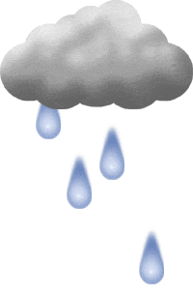

THE adapted “sm2rain” METHOD
relative soil moisture
irrigation
surface runoff
precipitation
drainage
p(t):
precipitaition
Z*ds(t)/dt=p(t)+i(t)-r(t)-e(t)-g(t)
i(t):
irrigation
e(t):
evapotranspiration
soil water capacity
= soil depth X porosity
evapotranspiration
r(t):
surface runoff
Inverting the water balance equation for i(t), assuming:
g(t)=as(t)^{b}
r(t)=0
e(t)=ET_{pot}(t)s(t)
SOIL LAYER
i(t)=Z* ds(t)/dt+a s(t)^{b}+ET_{pot}(t) s(t)-p(t)
g(t):
drainage =
deep percolation + subsurface runoff
1 equation
3 parameters (Z*,a, b) + knowledge of s(t), p(t) and ET_{pot}(t)

Slide 7
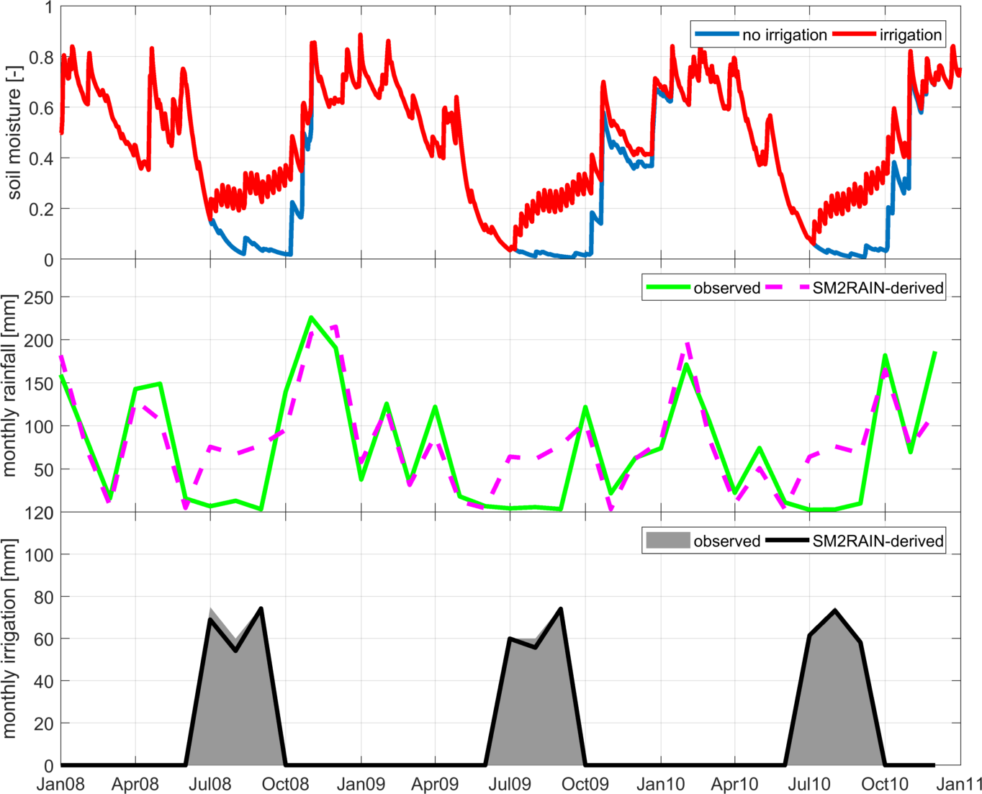
SYNTETHIC DATA
The method theoretically works
We apply 600 mm per year from June to September
We have soil moisture data affected by irrigation, i.e., synthetic satellite soil moisture (red line)
We apply SM2RAIN to satellite soil moisture to obtain SM2RAIN-derived rainfall+irrigation (magenta)
We subtract observed rainfall (green) from SM2RAIN-derived rainfall+irrigation to obtain irrigation

Slide 8
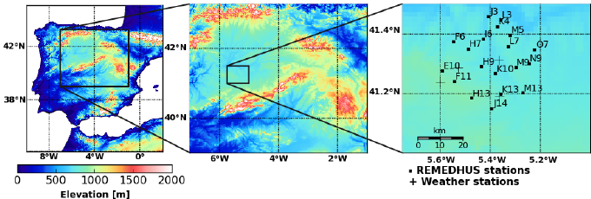
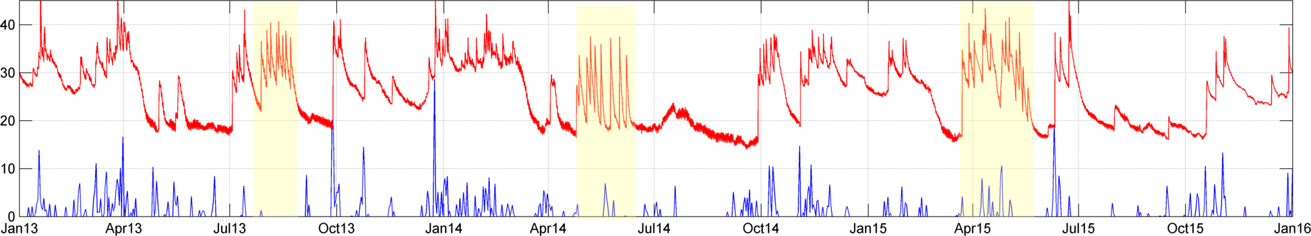
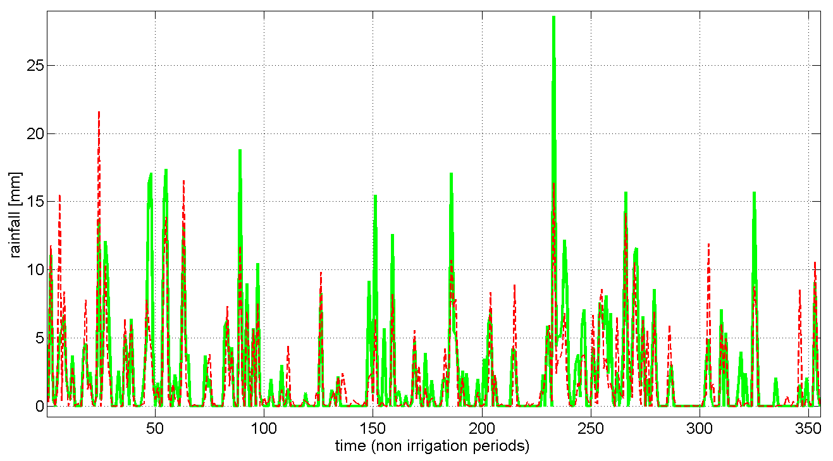
IN SITU SOIL MOISTURE DATA
Spain
CANIZAL station
SOIL MOISTURE
PRECIPITATION
R=0.78
Application of SM2RAIN in non irrigated periods
Green=observed
Red=SM2RAIN-derived

Slide 9
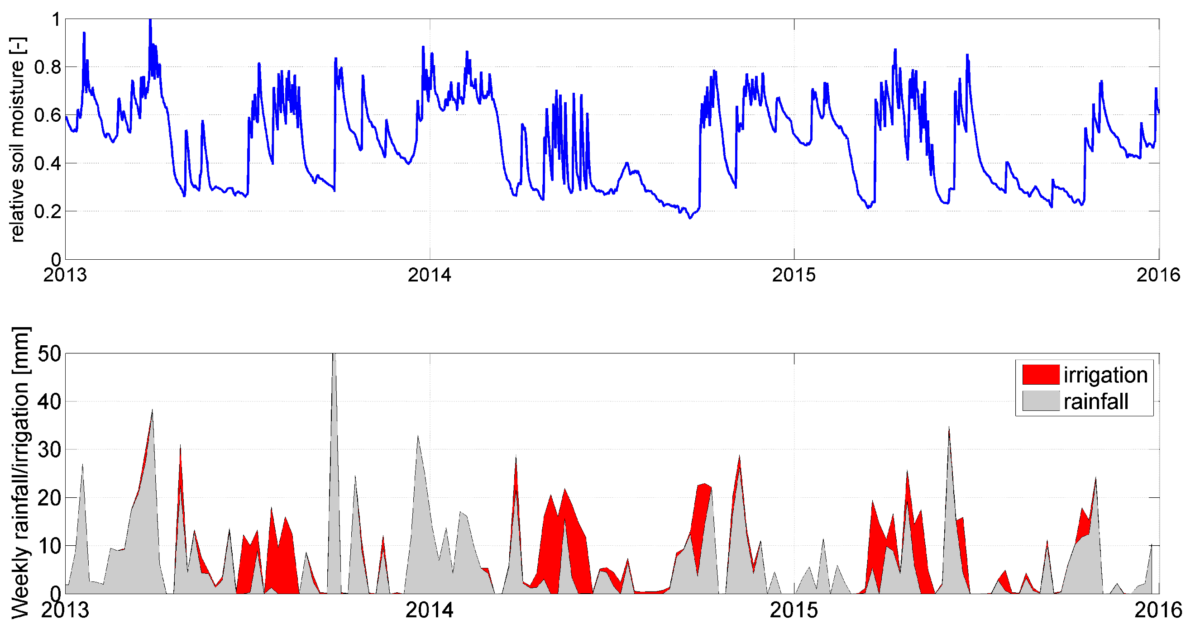
IN SITU SOIL MOISTURE DATA
Spain
SOIL MOISTURE
To be compared with actual observations ☹

Slide 10
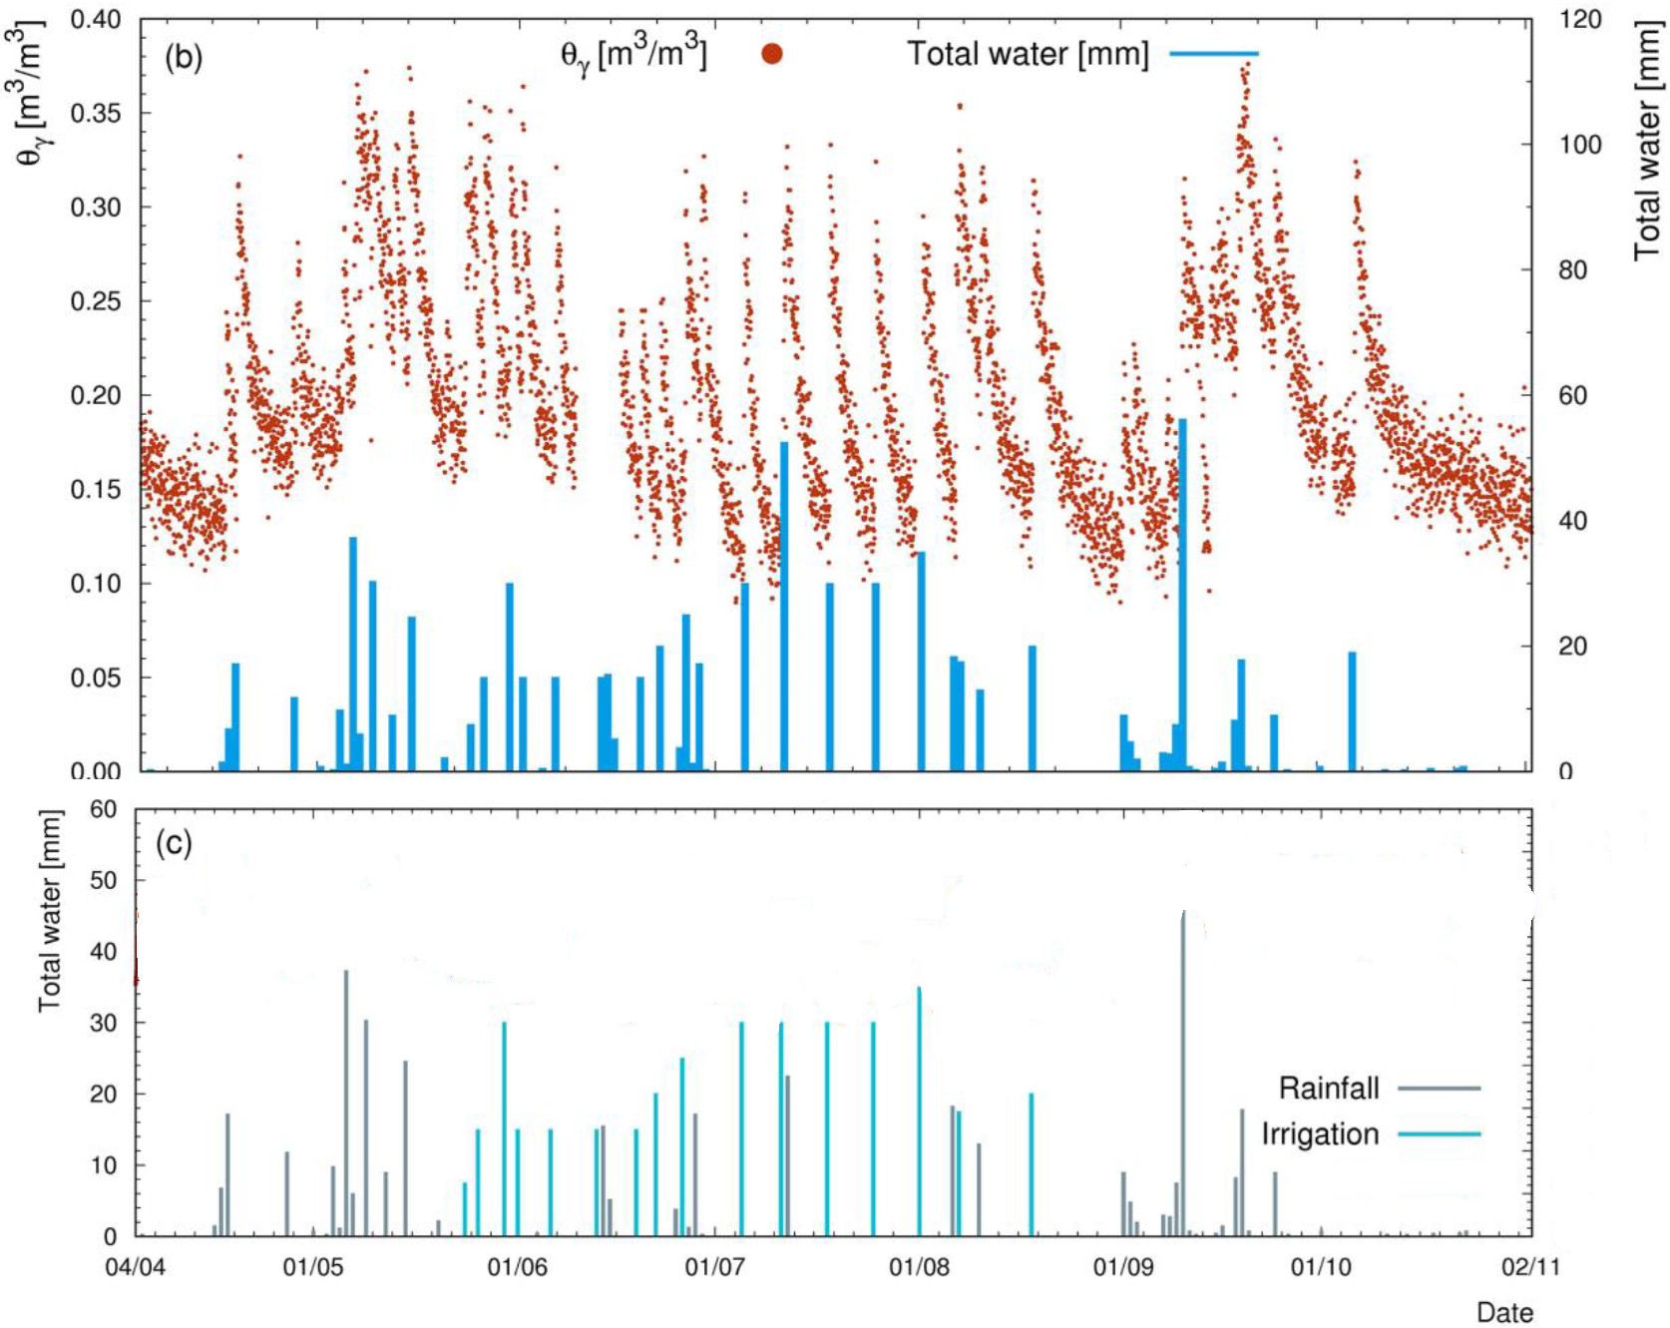
…finally the first irrigation + soil moisture observations last week!!!
IN SITU SOIL MOISTURE DATA
Italy
GOAL: study the soil water content measuring the attenuation effects on gamma rays emitted by terrestrial radionuclides during a tomato crop season.
Soil moisture, precipitation and irrigation are measured!!!
Courtesy by F. Mantovani, V. Strati, and M. Baldoncini (UNIFE)

Slide 11
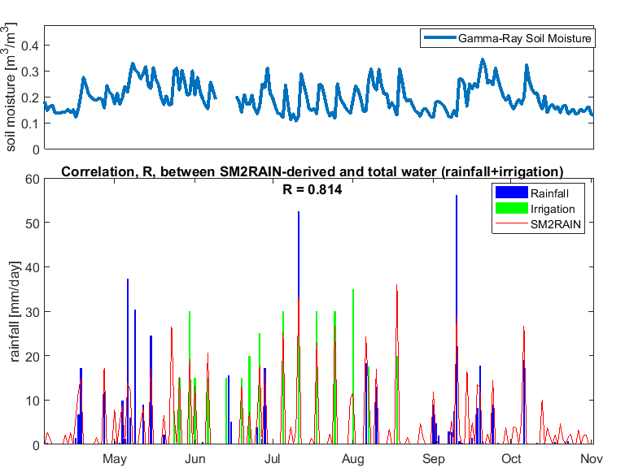
IN SITU SOIL MOISTURE DATA
The method works if forced with in situ soil moisture observations (good quality)
Italy
We apply the adapted SM2RAIN algorithm to gamma-ray soil moisture observations. Parameter values are calibrated against precipitation observations only.
The validation with irrigation data (in green) shows good performance of the proposed approach (agreement between red line and green bar) !!!

Slide 12
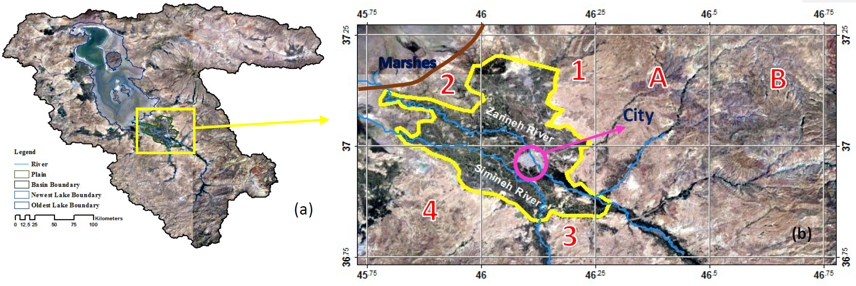

COARSE RESOLUTION SATELLITE SOIL MOISTURE
URMIA LAKE (Iran)
STUDY AREA
Southern part of Urmia Lake → Miandoab plain in West Azarbayjan province of Iran.
DATASETS | AGENCY PRODUCER | SPATIAL EXTENSION | PERIOD | SPATIAL/TEMPORAL SAMPLING
GLEAM | ESA | Global | 2011-2015 | 0.25-degree/1-day
AMSR2 | JAXA | Global | 2012-continuing | 0.25-degree/~1-day
MSWEP | European Commission, Joint Research Centre (JRC) | Global | 1979-2015 | 0.25/3 hours
In-situ Precipitation | Meteorological Organization | - | 1980-continuing | 1-day
In-situ irrigation | WRM organization | - | 2012-2015 | 1-day

Slide 13
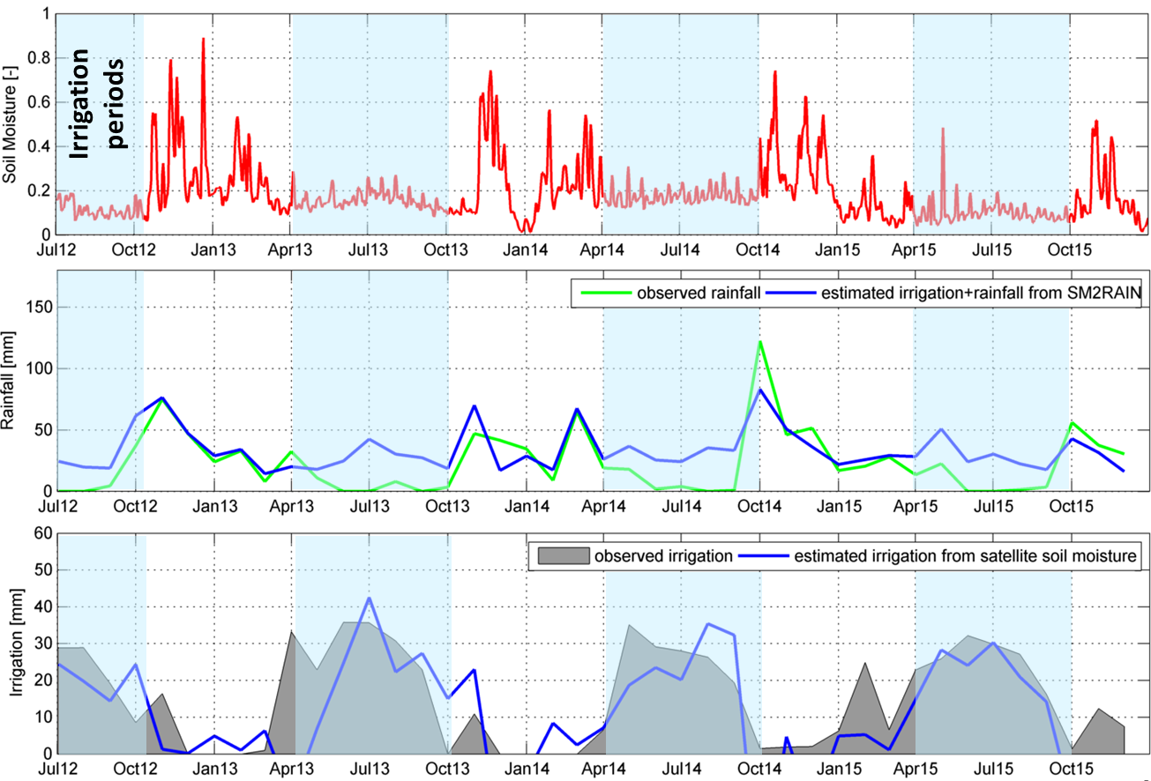
COARSE RESOLUTION SATELLITE SOIL MOISTURE
ORAL (THIS MORNING !)
Estimation of Irrigation Water Using Satellite Soil Moisture Data in a Semi-Arid Area
Hashemi et al; Tue, 10 Apr, 09:45–10:00, Room 2.15
For a very large irrigated area, AMSR2-JAXA soil moisture product is able to detect irrigation, the proposed approach provides reliable irrigation estimates

Slide 14
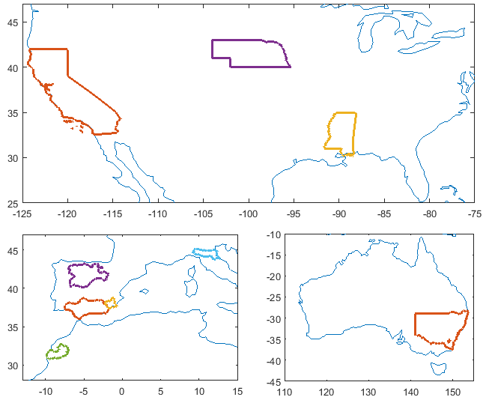
COARSE RESOLUTION SATELLITE SOIL MOISTURE
PILOT SITES
USA: California, Nebraska, Mississippi
AUSTRALIA: Yanco
SPAIN: Andalusia, Castilla Y Leon, Murcia
ITALY: Romagna
MOROCCO: Marrakech
MISSISSIPPI
NEBRASKA
CALIFORNIA
a)
ROMAGNA
CASTILLA Y LEON
YANCO
ANDALUSIA
MURCIA
b)
MARRAKECH
c)

Slide 15
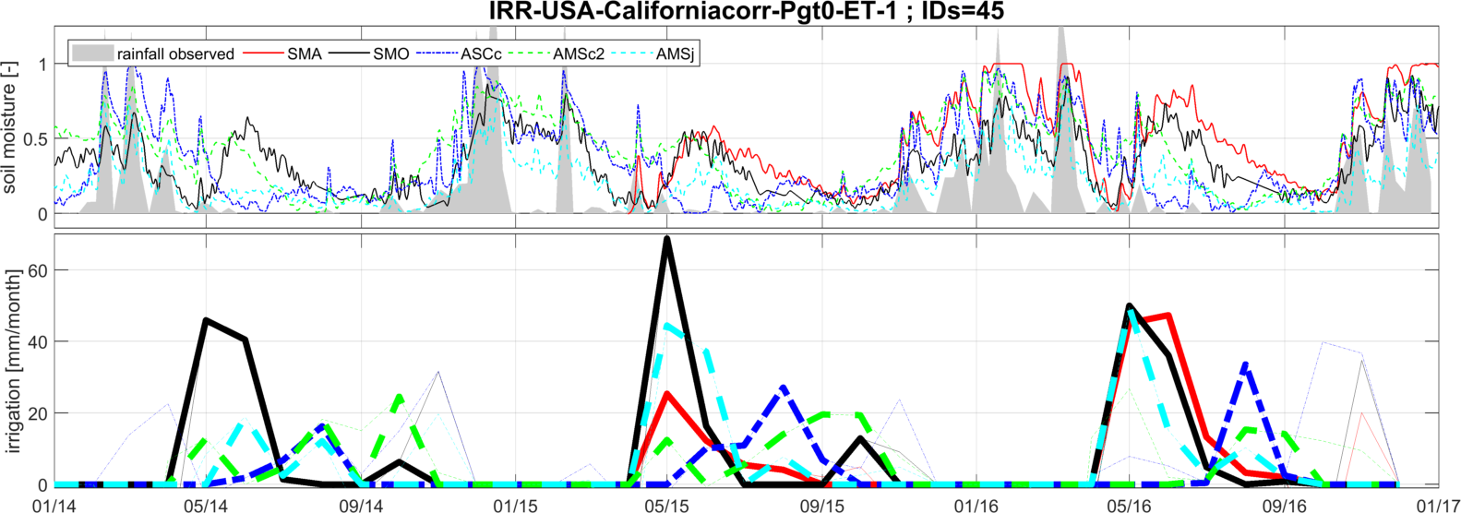
COARSE RESOLUTION SATELLITE SOIL MOISTURE
CALIFORNIA
SMOS
AMSR2-JAXA
ASCAT
SMAP
AMSR2-LPRM
Results for the different pilot sites are encouraging, but the unavailability of a benchmark (i.e., observed irrigation) does not allow to test properly the method…
GROUND OBSERVATIONS OF IRRIGATION ARE NEEDED!

Slide 16
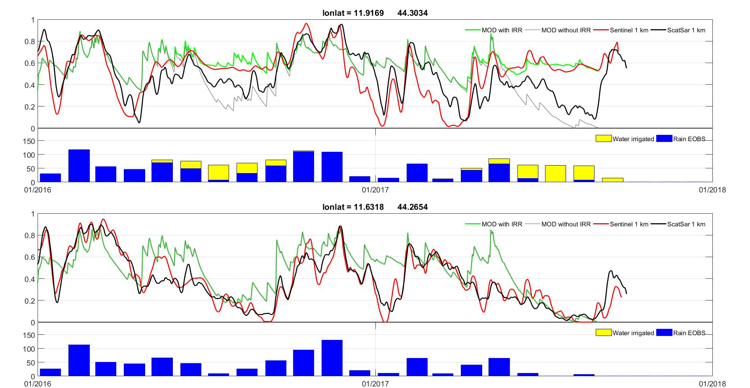
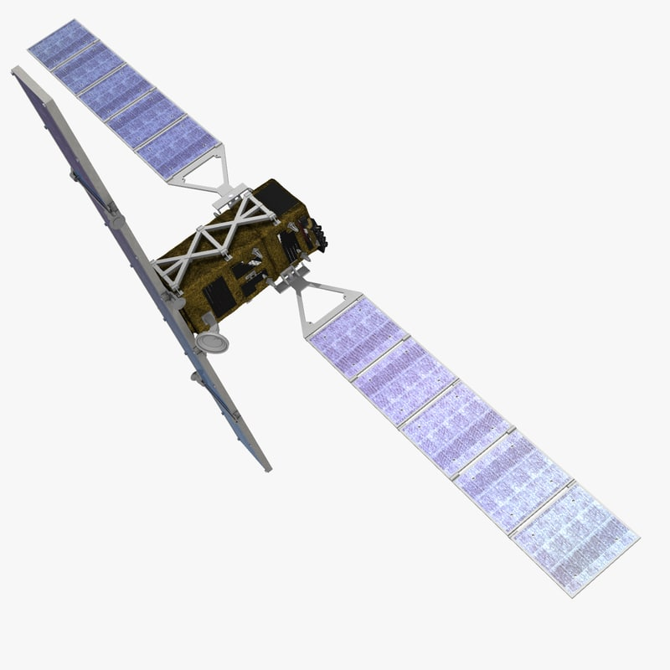
HIGH RESOLUTION SATELLITE SOIL MOISTURE
IRRIGATED PIXEL
Courtesy by B. Bauer-Marschallinger (TUWien)
Sentinel-1
Simulated SM with IRRIGATION
ASCAT
Simulated SM without IRRIGATION
ROMAGNA (ITALY)
NON-IRRIGATED PIXEL
Sentinel-1 sees irrigation over small areas !!!
Different high-resolution satellite soil moisture products (e.g., SMOS 1km, SMAP and AMSR2 9km) are used in Italy and Spain, where we have in situ data. Only with Sentinel-1 satisfactory results are obtained, so far!

Slide 17

TAKE HOME MESSAGES
We can use in situ soil moisture observations for quantifying irrigation through the adapted SM2RAIN
Coarse resolution satellite soil moisture products have shown some potential
High resolution satellite soil moisture products are more appropriate for irrigation quantification
QUESTIONS?
http://hydrology.irpi.cnr.it/people/luca-brocca
http://hydrology.irpi.cnr.it

