Slide 1
The role of asthenospheric flow during rift propagation and breakup
Luke Mondy¹, Patrice Rey¹, Guillaume Duclaux² , Louis Moresi³
1. EarthByte Group, Basin GENESIS Hub, The University of Sydney, NSW, Australia.
2. Université Côte d’Azur, CNRS, OCA, IRD, Géoazur, 06560 Valbonne, France.,
3. School of Earth Sciences, Melbourne University, Victoria 3010, Australia.

Slide 2
Initial motivations
Interested in 3D problems
Things we can’t represent in 2D models
Got access to two(!) big supercomputers
Had a Underworld working nicely
http://www.underworldcode.org/

Slide 3
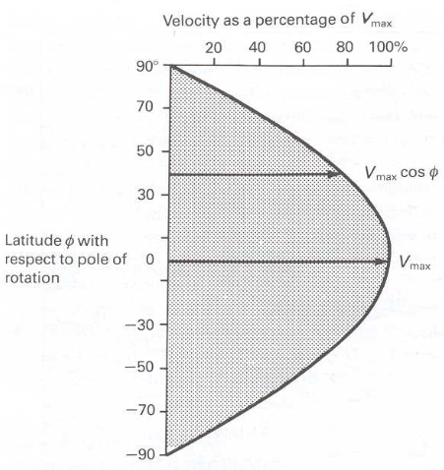
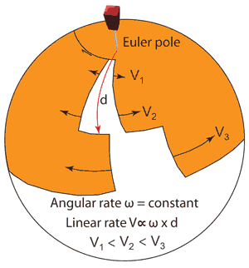
Rifting close to an Euler pole
Lundin et al., 2014
Kearey et al., 2009

Slide 4
Rifting close to an Euler pole
Lundin et al., 2014
Kearey et al., 2009

Slide 5
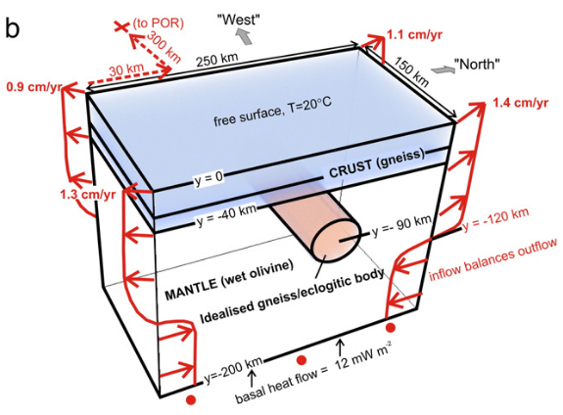
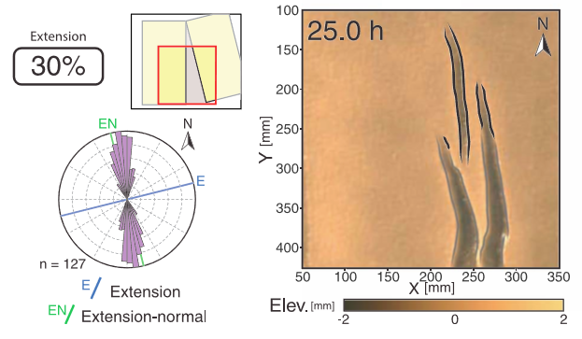
Rifting close to an Euler pole
.
Martin, 1984
Ellis et al., 2011
Lundin et al., 2014
Kearey et al., 2009
Molnar et al., 2017

Slide 6
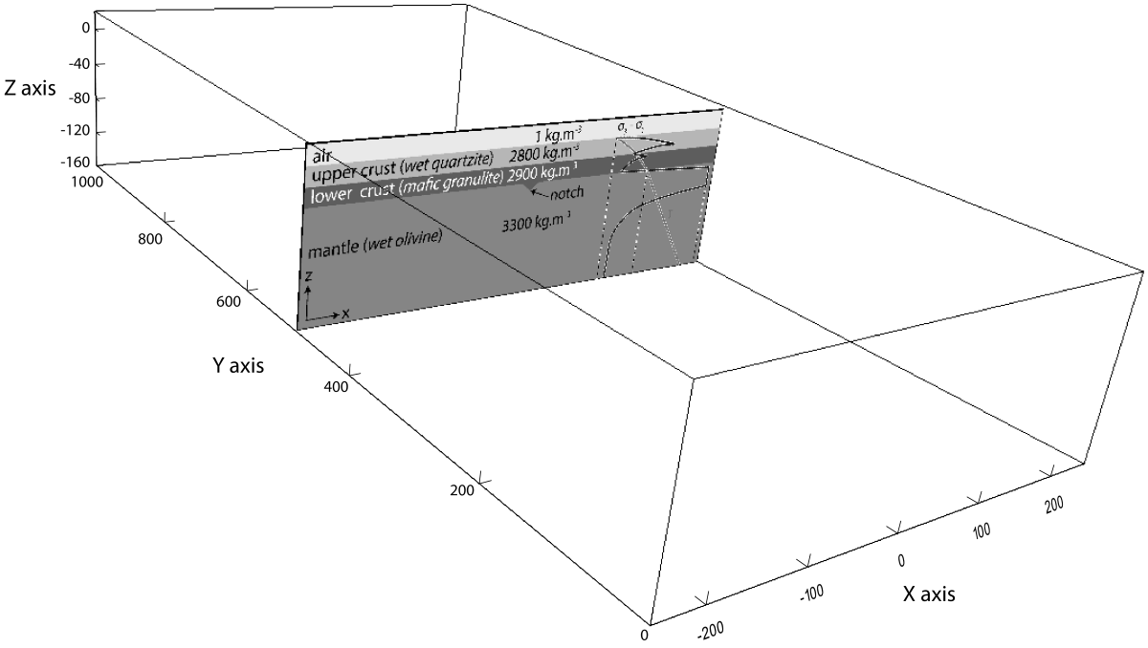
Numerical experiments: Domain and rheology
Domain: 500 km x 1000 km x 180 km
Resolution: 256 x 512 x 96 (~1.88 km elements)
Total particles: ~2.5 billion
Rheology
Gerya, T. (2009). Introduction to numerical geodynamic modelling. Cambridge University Press.

Slide 7
Numerical experiments: boundary conditions
Two experiments
0
Y axis (km)
500
1000

Slide 8
Numerical experiments: boundary conditions
“Slow end”
Euler pole
0
Two experiments
Y axis (km)
500
0
1000
Y axis (km)
“Fast end”
500
1000

Slide 9
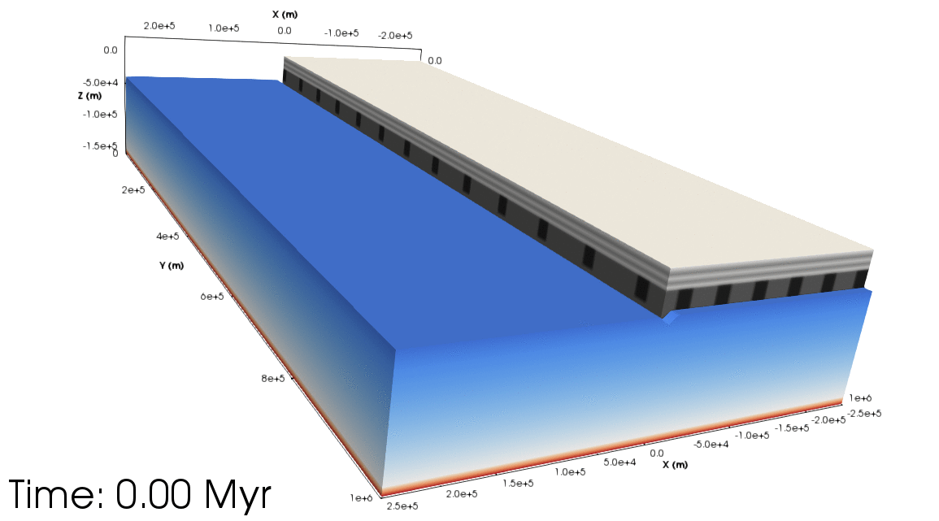
Exploring the results: Overview
Orthogonal experiment
Upper crust
Lower crust
Lithospheric mantle
Asthenosphere

Slide 10
Exploring the results: Overview
Orthogonal experiment
Rotational experiment
Slow end
Fast end

Slide 11
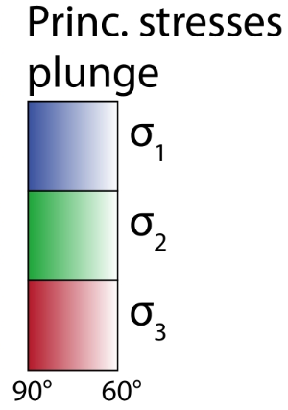
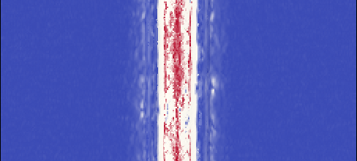
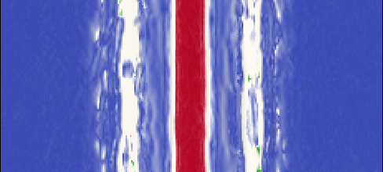
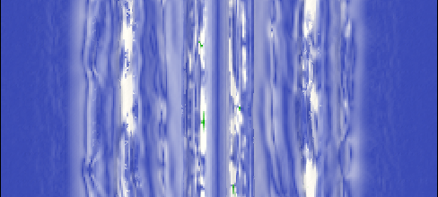
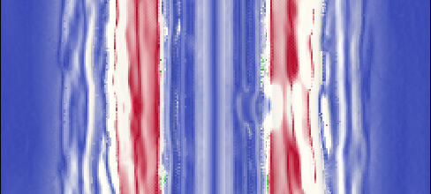
Exploring the results: tectonic regimes
- Extensional
Orthogonal experiment
- Strike-slip
- Compressional
Time: 0.5 Myr
Ext.: 2.75%
Time: 1.5 Myr
Ext.: 8%
Time: 3.6 Myr
Ext.: 20%
Time: 6.0 Myr
Ext.: 33%
400
600
-200
0
200
-200
0
200
-200
0
200
-200
0
200

Slide 12
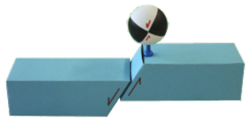
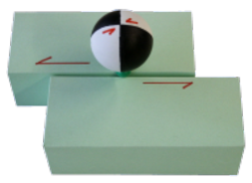
Exploring the results: tectonic regimes
- Extensional
Orthogonal experiment
- Strike-slip
- Compressional
Time: 0.5 Myr
Ext.: 2.75%
Time: 1.5 Myr
Ext.: 8%
Time: 3.6 Myr
Ext.: 20%
Time: 6.0 Myr
Ext.: 33%
400
600
-200
0
200
-200
0
200
-200
0
200
-200
0
200

Slide 13
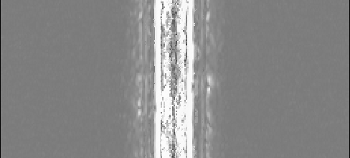
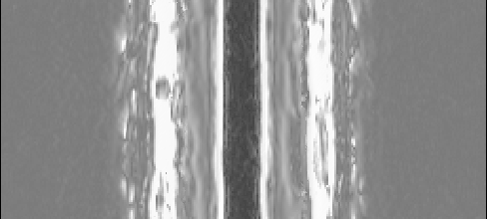
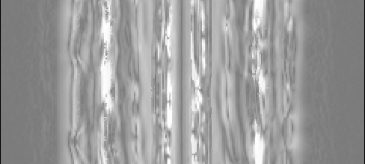
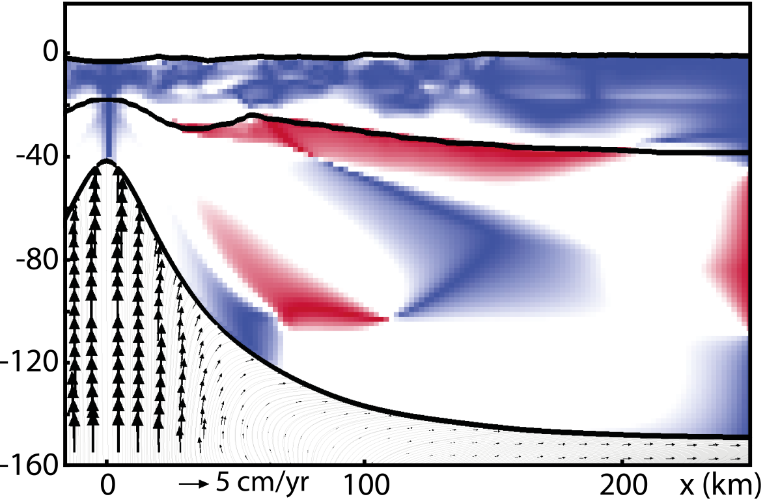
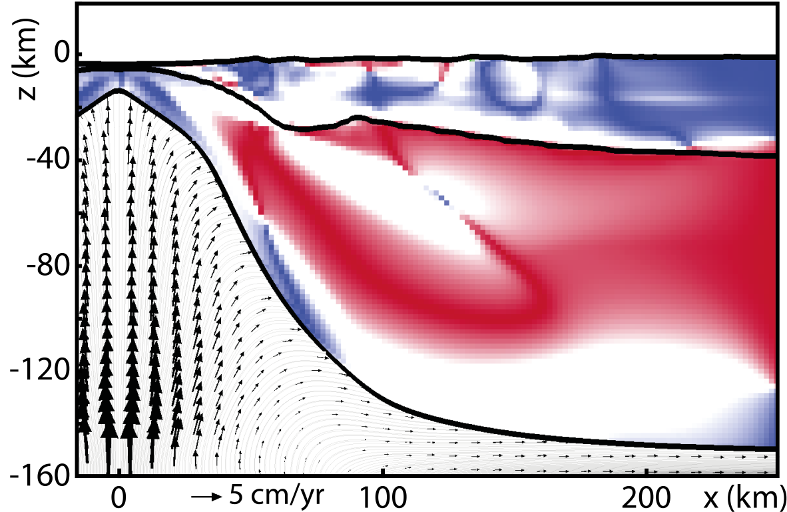
Exploring the results: tectonic regimes
- Extensional
Orthogonal experiment
- Strike-slip
- Compressional
Time: 0.5 Myr
Ext.: 2.75%
Time: 1.5 Myr
Ext.: 8%
Time: 3.6 Myr
Ext.: 20%
Time: 6.0 Myr
Ext.: 33%
400
600
-200
0
200
-200
0
200
-200
0
200
-200
0
200

Slide 14
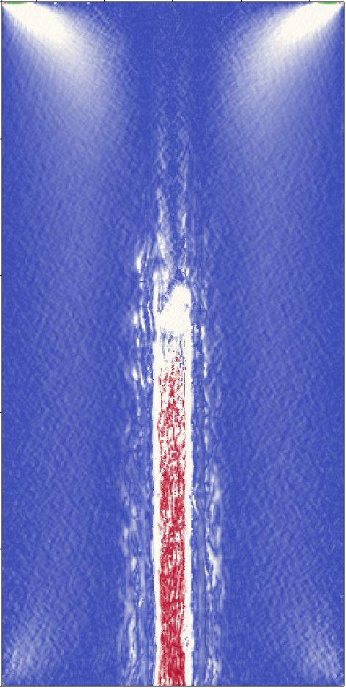
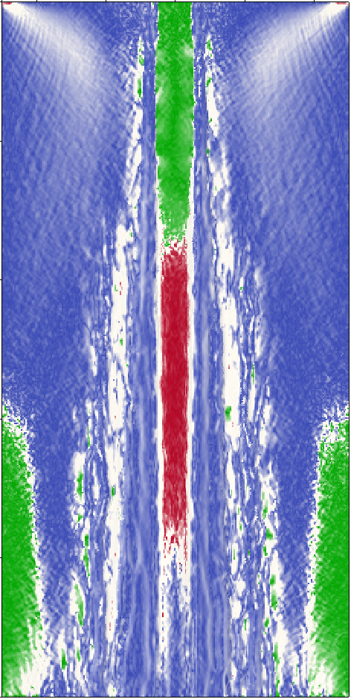
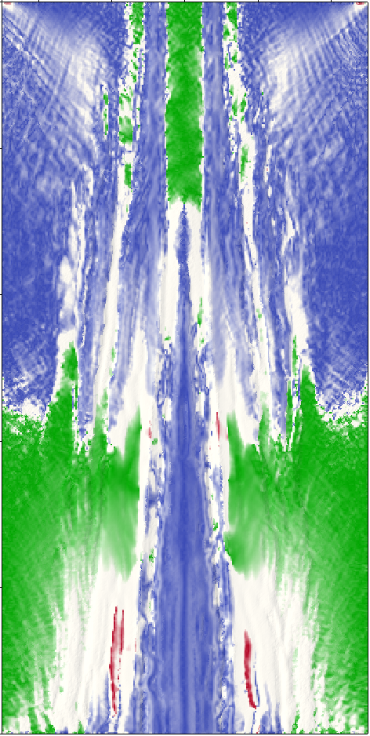
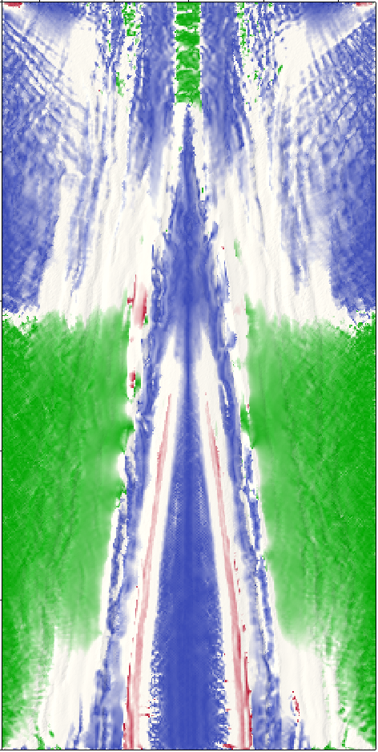
Exploring the results: tectonic regimes
- Extensional
Rotational experiment
- Strike-slip
- Compressional
Time: 0.5 Myr
Ext.: 0.5%, 2.75%, 5%
Time: 1.5 Myr
Ext.: 1.5%, 8%, 15%
Time: 3.6 Myr
Ext.: 3.6%, 20%, 36%
Time: 6.0 Myr
Ext.: 6%, 33%, 60%
0
Slow end
200
400
600
800
1000
Fast end
-200
0
200
-200
0
200
-200
0
200
-200
0
200

Slide 15
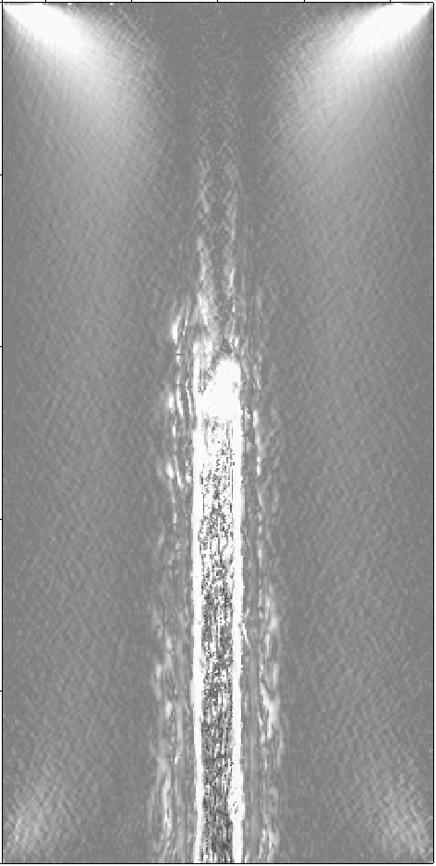
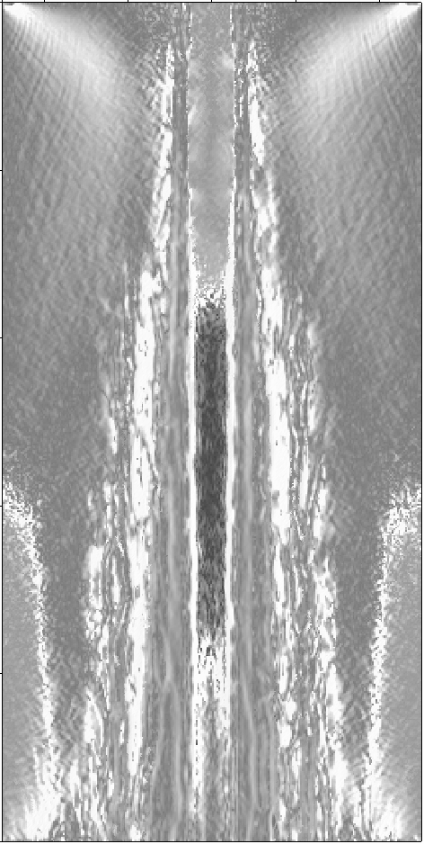
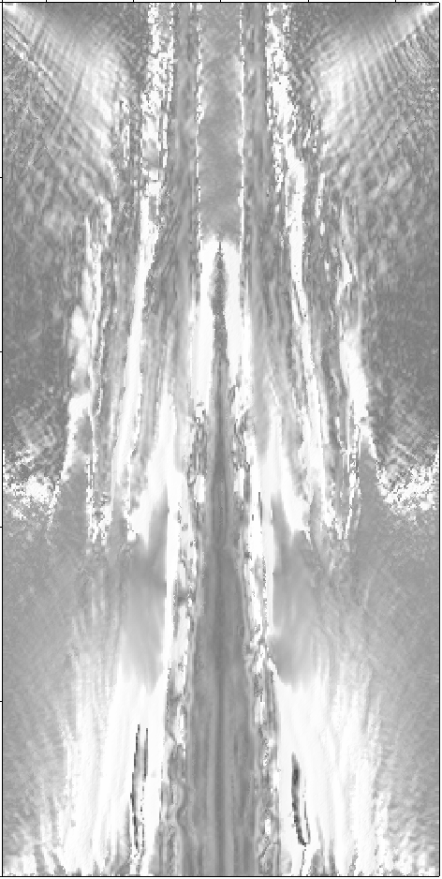
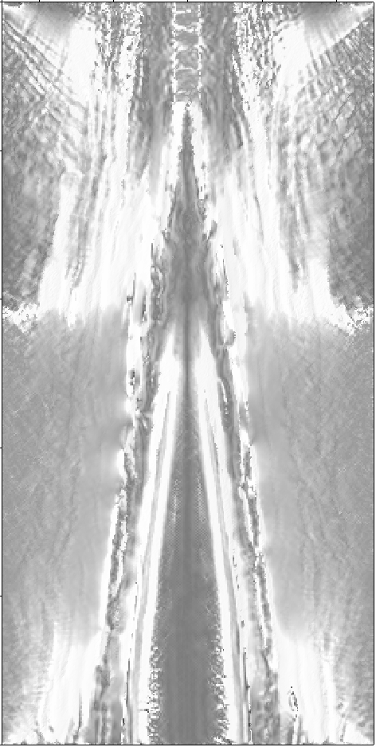
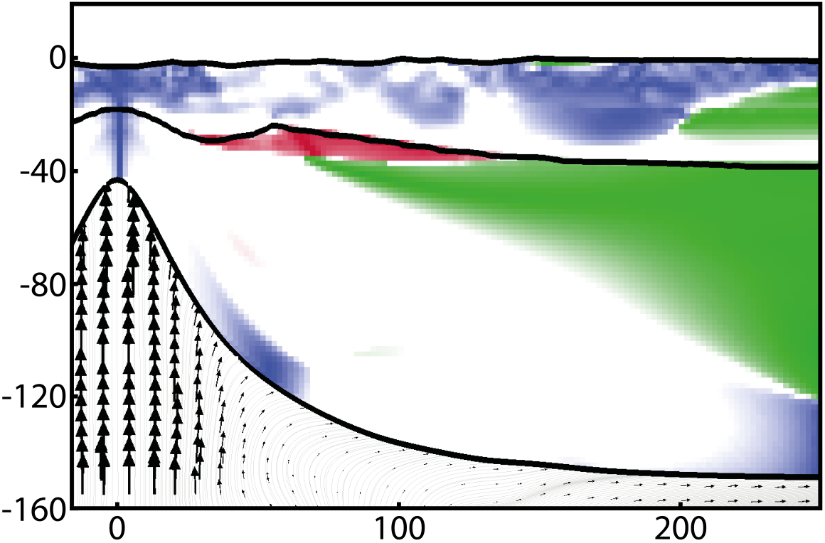
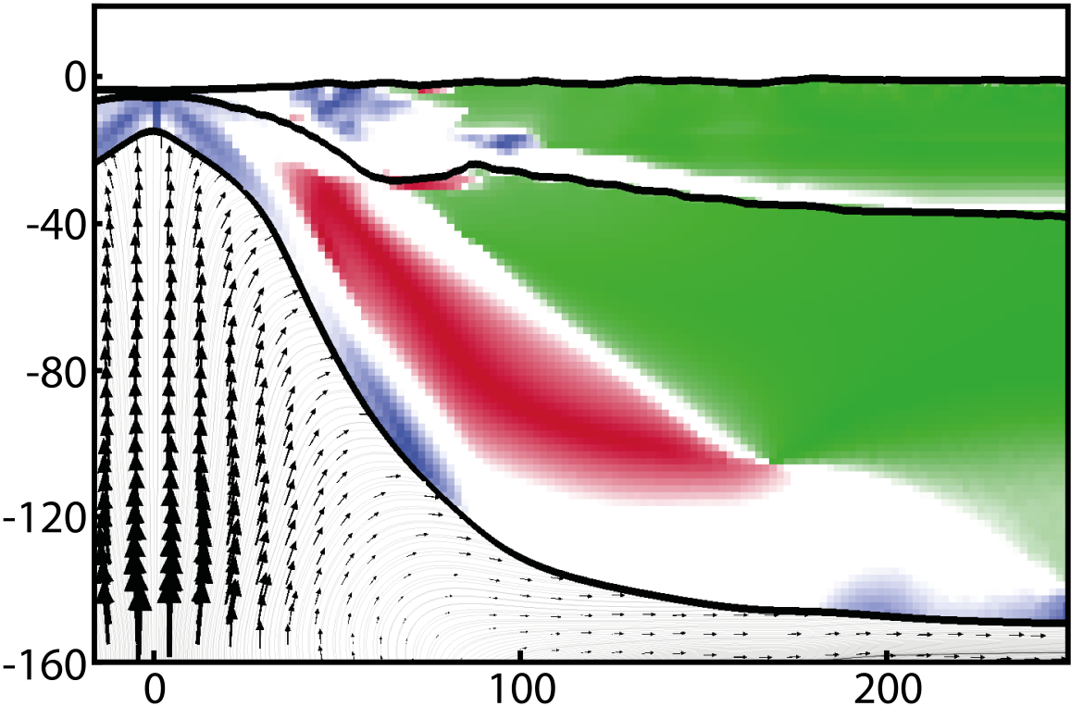
Exploring the results: tectonic regimes
- Extensional
Rotational experiment
- Strike-slip
- Compressional
Time: 0.5 Myr
Ext.: 0.5%, 2.75%, 5%
Time: 1.5 Myr
Ext.: 1.5%, 8%, 15%
Time: 3.6 Myr
Ext.: 3.6%, 20%, 36%
Time: 6.0 Myr
Ext.: 6%, 33%, 60%
0
Slow end
200
400
600
800
1000
Fast end
-200
0
200
-200
0
200
-200
0
200
-200
0
200

Slide 16
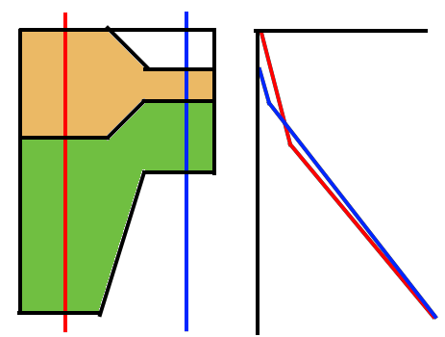
Interpretation
A
Rift push:
Density differences inducing buoyancy forces
Imposing horizontal stresses on the margins
B
Pressure
Crust
A -> B
Mantle
Depth
A <- B
Astheno
Davis, M., & Kusznir, N. (2002). Are buoyancy forces important during the formation of rifted margins?. Geophysical Journal International, 149(2), 524-533.
Huismans, R. S., Podladchikov, Y. Y., & Cloetingh, S. (2001). Transition from passive to active rifting: relative importance of asthenospheric doming and passive extension of the lithosphere. Journal of Geophysical Research: Solid Earth, 106(B6), 11271-11291.

Slide 17
Interpretation
Orthogonal experiment
A
B
Pressure
Crust
A -> B
Mantle
Depth
A <- B
Astheno

Slide 18
Interpretation
Orthogonal experiment
A
B
Pressure
Crust
A -> B
B
A
Mantle
Depth
A <- B
Astheno
When F_{B->A} > F_{tectonic BCs}, switch to compression occurs

Slide 19
Interpretation
Slow end
Rotational experiment
A
B
Pressure
Crust
A -> B
Mantle
Depth
A <- B
Fast end
Astheno
X axis (km)

Slide 20
Interpretation
Slow end
Rotational experiment
A
B
Pressure
Crust
A -> B
Mantle
Depth
A <- B
Fast end
Astheno
0
-40
Slow end
Fast end
-80
-120
-160
X axis (km)
0
500
1000
Y axis (km)

Slide 21
Interpretation
Slow end
Rotational experiment
A
B
Pressure
Crust
A -> B
Mantle
Depth
A <- B
Fast end
B
A
Astheno
A
B
0
-40
Slow end
Fast end
-80
-120
-160
X axis (km)
0
500
1000
Y axis (km)

Slide 22
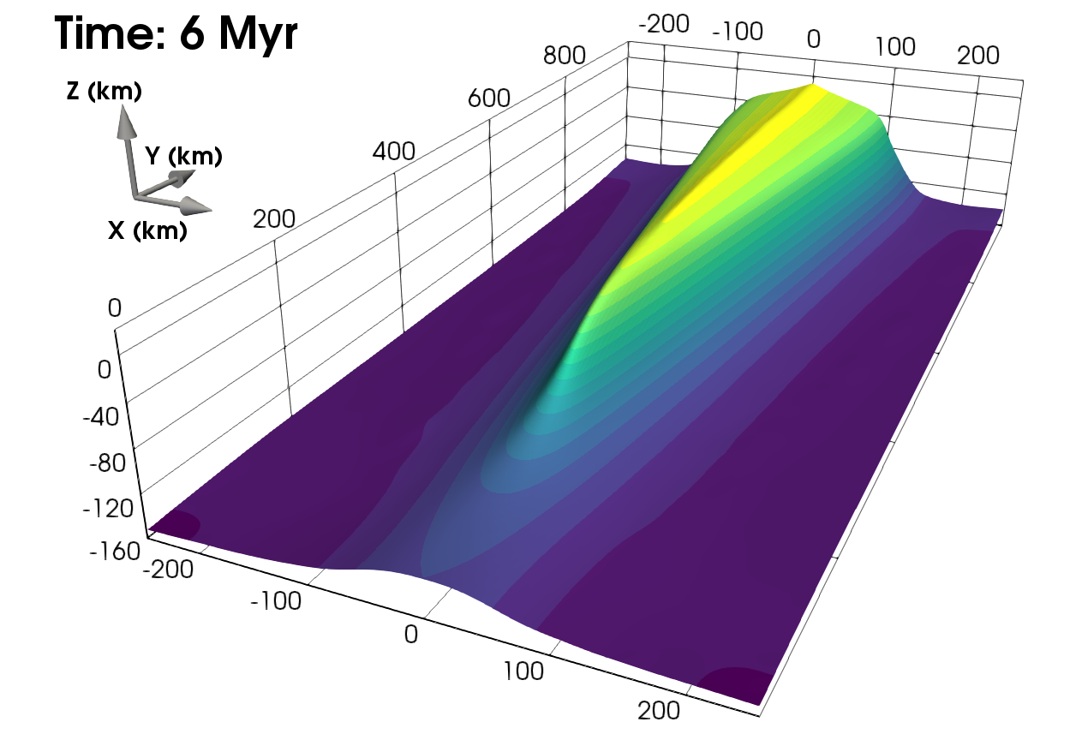
Interpretation
Slow end
Lithosphere-asthenosphere boundary
Fast end
Rotational experiment
A
B
Pressure
Crust
A -> B
Mantle
Depth
A <- B
Slow end
Fast end
B
A
Astheno
A
B
0
-40
Slow end
Fast end
-80
-120
-160
X axis (km)
0
500
1000
Y axis (km)

Slide 23
Interpretation
Slow end
Lithosphere-asthenosphere boundary
Fast end
A
B
B
A
Rotational experiment
A
A
A
B
Pressure
A
Crust
A -> B
Mantle
Depth
A <- B
Slow end
Fast end
B
A
Astheno
A
B
0
-40
Slow end
Fast end
-80
-120
-160
X axis (km)
0
500
1000
Y axis (km)

Slide 24
Gravitational Potential Energy

Slide 25
Gravitational Potential Energy
Radial pattern forces both σ₁ and σ₃ horizontal

Slide 26
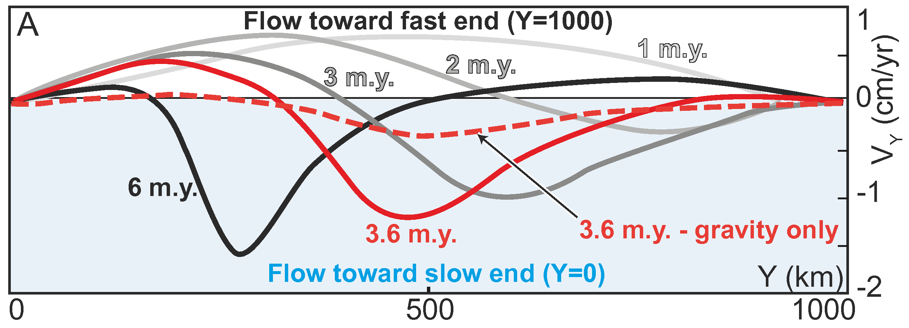
Asthenospheric flow
0
500
Y axis (km)
1000
Koopmann, H., Brune, S., Franke, D., & Breuer, S. (2014). Linking rift propagation barriers to excess magmatism at volcanic rifted margins. Geology, 42(12), 1071-1074. Van Wijk, J. W., & Blackman, D. K. (2005). Dynamics of continental rift propagation: the end-member modes. Earth and Planetary Science Letters, 229(3-4), 247-258.

Slide 27
Asthenospheric flow
0
500
Y axis (km)
1000
Koopmann, H., Brune, S., Franke, D., & Breuer, S. (2014). Linking rift propagation barriers to excess magmatism at volcanic rifted margins. Geology, 42(12), 1071-1074. Van Wijk, J. W., & Blackman, D. K. (2005). Dynamics of continental rift propagation: the end-member modes. Earth and Planetary Science Letters, 229(3-4), 247-258.

Slide 28
Natural world
Does this mean anything?
Experiments were testable:
Do we see strike-slip earthquake focal mechanisms in rifts close to Euler poles?

Slide 29
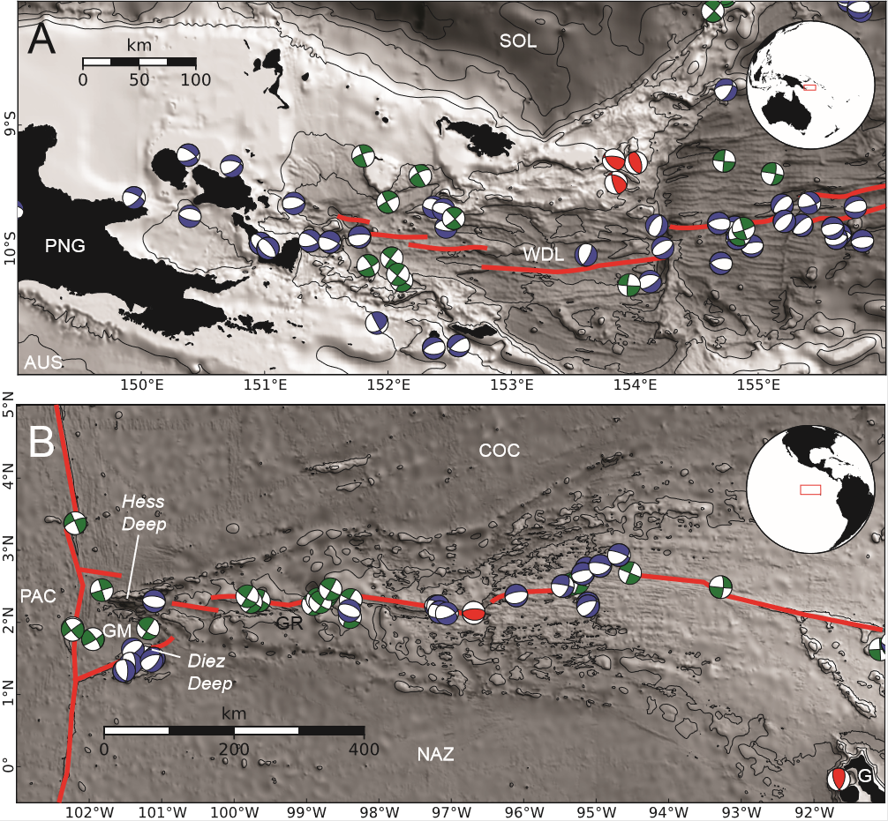
Natural world
Does this mean anything?
Experiments were testable:
Do we see strike-slip earthquake focal mechanisms in rifts close to Euler poles?
1st order: yes!

Slide 30
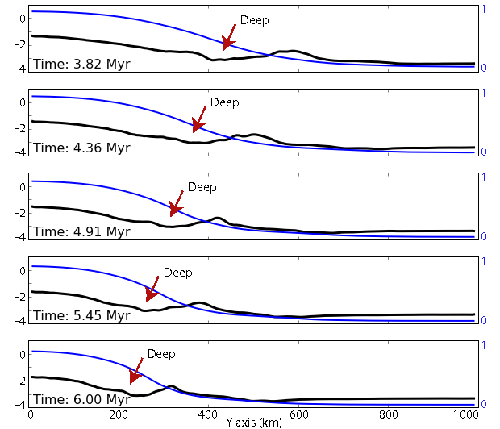
Natural world
Does this mean anything?
Experiments were testable:
Reproduced the Hess Deep
Elevation (km)
1 / Beta factor
Floyd, J. S., Tolstoy, M., Mutter, J. C., & Scholz, C. H. (2002). Seismotectonics of mid-ocean ridge propagation in Hess Deep. Science, 298(5599), 1765-1768.

Slide 31
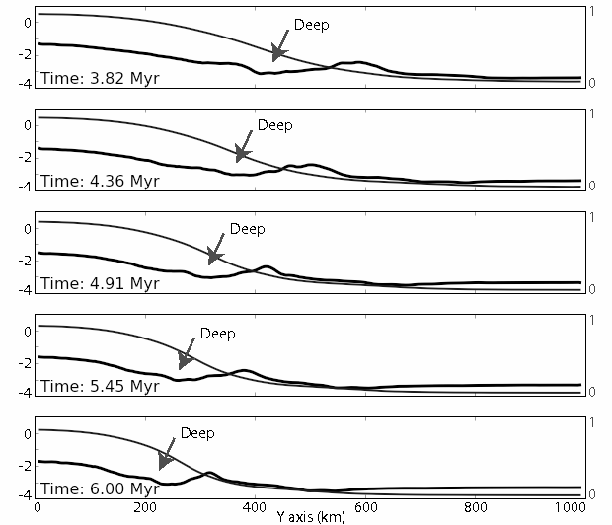
Natural world
Does this mean anything?
Experiments were testable:
Reproduced the Hess Deep, and its strike-slip zone
Time: 3.6 Myr
Ext.: 3.6%, 20%, 36%
Elevation (km)
Floyd, J. S., Tolstoy, M., Mutter, J. C., & Scholz, C. H. (2002). Seismotectonics of mid-ocean ridge propagation in Hess Deep. Science, 298(5599), 1765-1768.
-200
0
200

Slide 32
Conclusions
Experiments show that all rifting is active
Spatial and temporal stress regime variations: passive margin invesion, strike-slip deformation ubiquitous during rift propagation.

Slide 33
Conclusions
Experiments show that all rifting is active
Spatial and temporal stress regime variations: passive margin invesion, strike-slip deformation ubiquitous during rift propagation.
Reproduce the experiments:
https://github.com/OlympusMonds/lmondy-et-al-3D-Rifting-Experiments

Slide 34
Stress regimes
σ₂
vertical
σ₃
σ₁
If a principal stress is within the cone, it is ‘Andersonian’.
Zhong et.al, World Stress Map (2012)

Slide 35
Exploring the results: strain patterns
Orthogonal experiment: phases through time

Slide 36
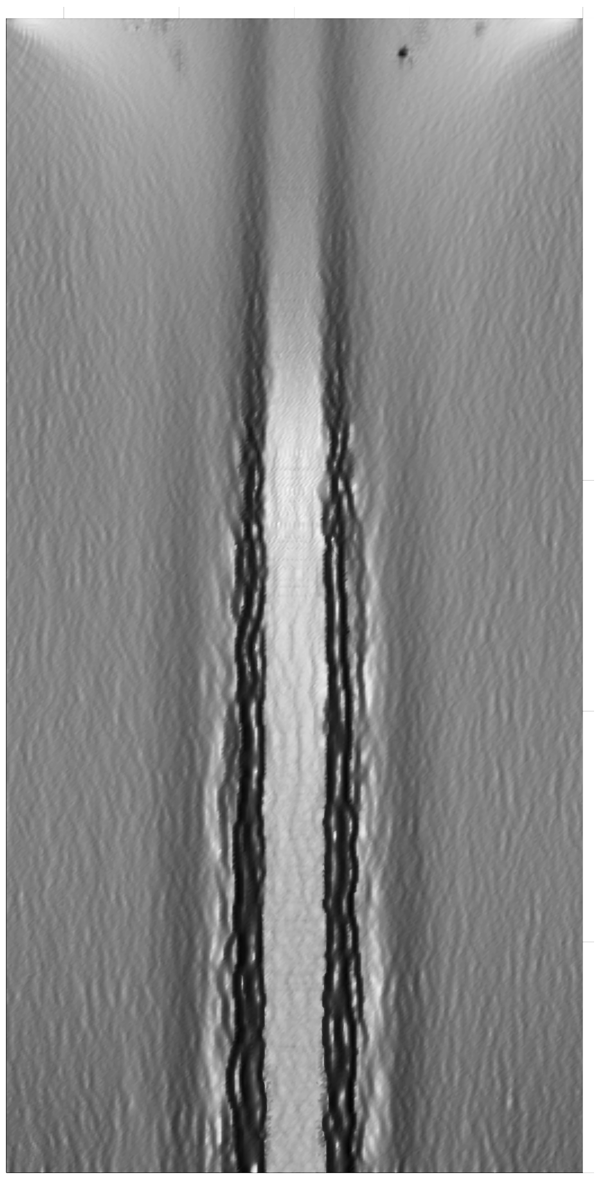
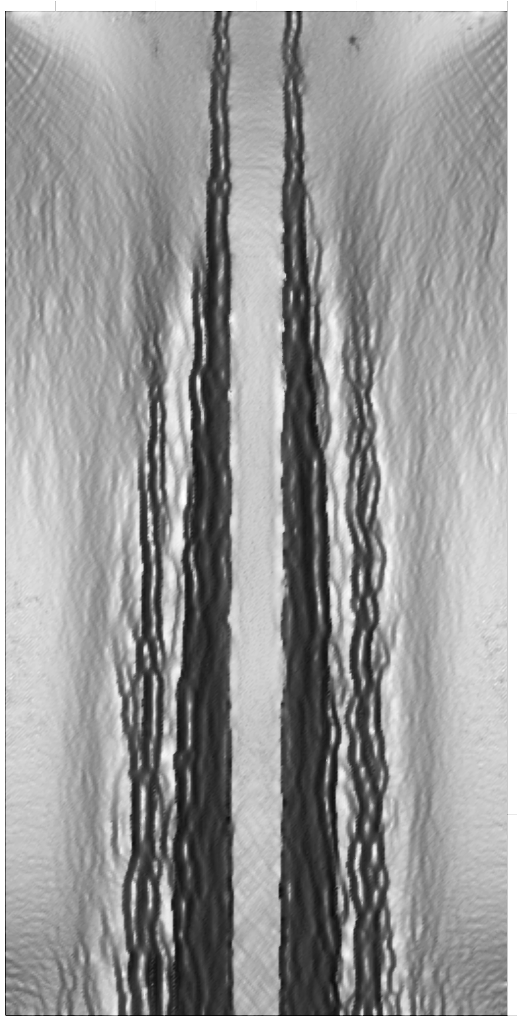
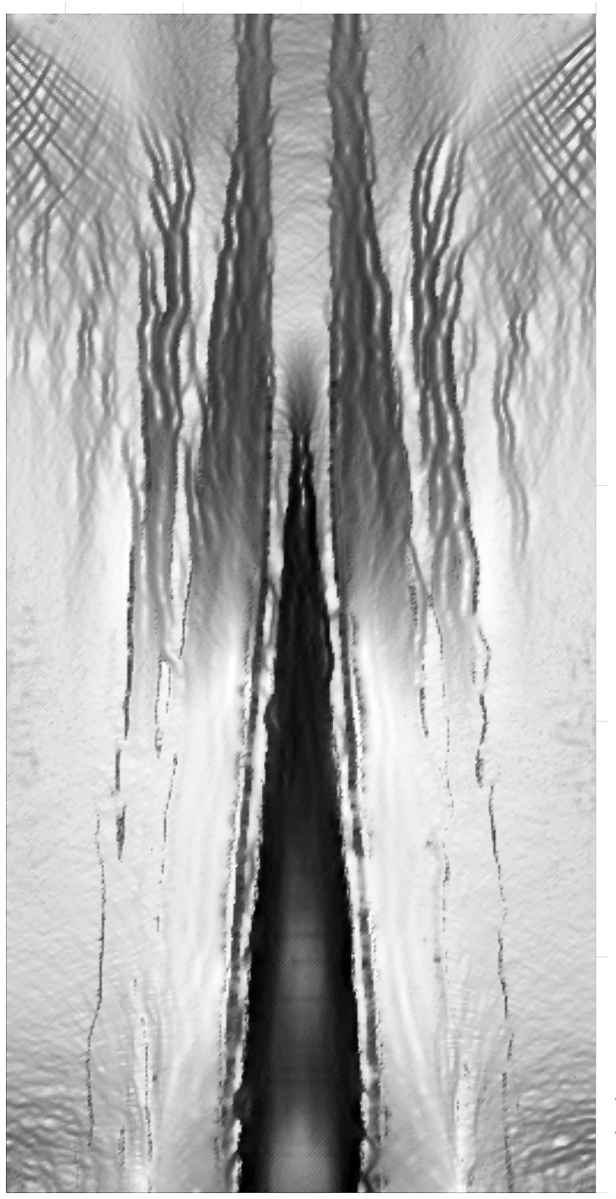
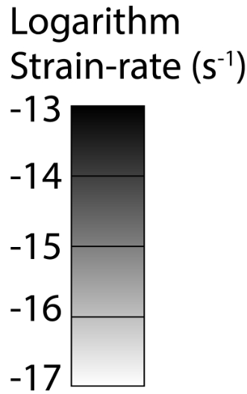
Exploring the results: strain patterns
Orthogonal experiment: phases through time
Rotational experiment: phases through time and space
Time: 0.0 Myr
Ext.: 0%, 0%, 0%
Time: 0.5 Myr
Ext.: 0.5%, 2.75%, 5%
Time: 1.5 Myr
Ext.: 1.5%, 8.25%, 15%
Time: 3.6 Myr
Ext.: 3.6%, 19.8%, 36%
Slow end
0
200
400
600
800
Fast end
1000
-200
0
200
-200
0
200
-200
0
200
-200
0
200

Slide 37
Exploring the results: strain patterns
Orthogonal experiment: phases through time
Rotational experiment: phases through time and space
Time: 0.0 Myr
Ext.: 0%, 0%, 0%
Time: 0.5 Myr
Ext.: 0.5%, 2.75%, 5%
Time: 1.5 Myr
Ext.: 1.5%, 8.25%, 15%
Time: 3.6 Myr
Ext.: 3.6%, 19.8%, 36%
Slow end
0
200
400
600
800
Fast end
1000
-200
0
200
-200
0
200
-200
0
200
-200
0
200

