Slide 1


Spatio-temporal cluster analyses of landslides causing damage in Switzerland
Marj Tonini ⁽¹⁾ and Mariaelena Cama ⁽²⁾
(1) University of Lausanne, Institute of Earth Surface Dynamics, Faculty of Geosciences and the Environment, Lausanne, Switzerland (marj.tonini@unil.ch), (2) Institute of Geography, Department of Geociences, University of Tübingen, Germany (mariaelenacama@gmail.com)
Motivation
Study area & dataset
Click buttons to navigate
Results
Method
Ripley’s K-function
Global cluster behavior
Code
3D-Kernel density
Space-time kernel densities
Video
Scan Statistics
Local spatio-temporal clusters

Slide 2
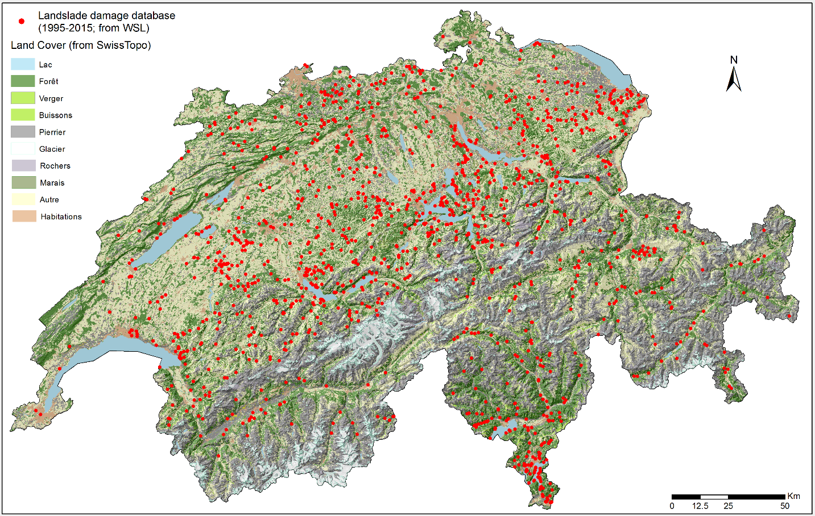
Motivations
Cluster analysis represents a key tool in the investigation of spatio-temporal patterns of landslides, allowing to discover hotspot and recurrence which can help to detect predisposing factors.
The present research analyses the spatio-temporal pattern distribution of landslides causing damage in Switzerland in the last twenty years (1995-2015), with the aim of detecting if neighboring events are also closer in time, generating clusters.
Total # of events = 1454
Data source: National multitemporal damage database, implemented and provided by the Swiss Federal Institute for Forest, Snow and Landscape Research (WSL). Based on the analysis of historical information. (https://www.wsl.ch/en/natural-hazards.html)

Slide 3
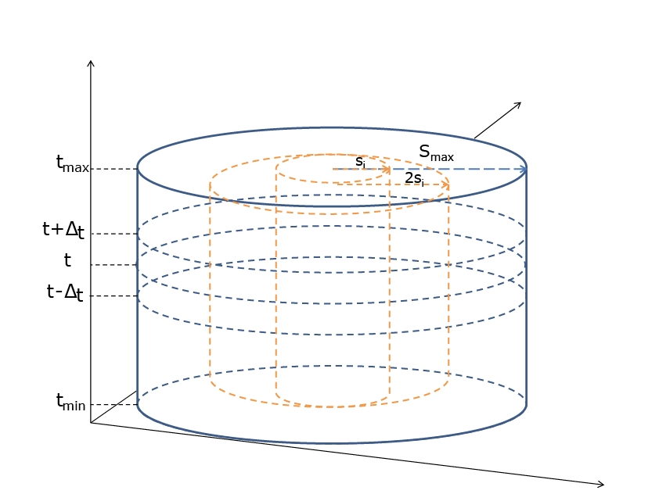
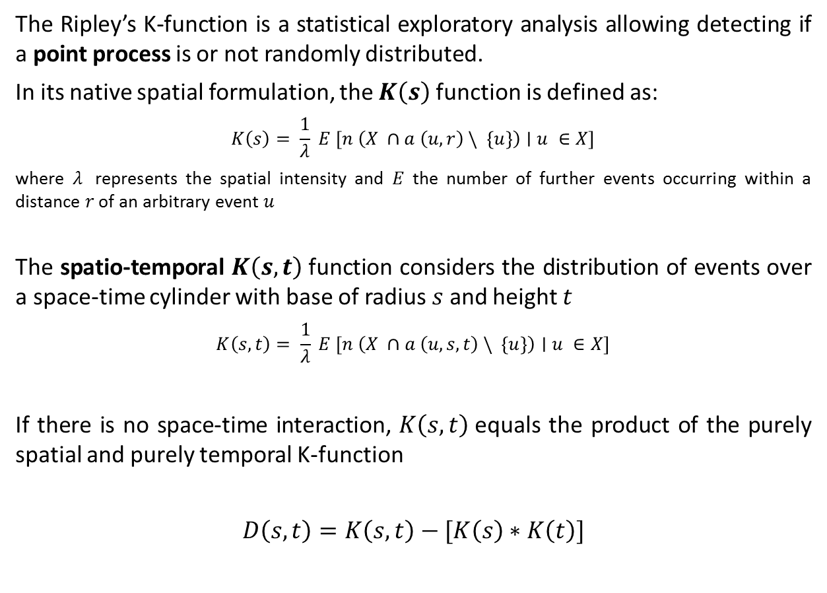
Ripley’s K function
The Ripley’s K-function is a statistical exploratory analysis allowing detecting if a point process is or not randomly distributed.
In its native spatial formulation, the $K\left(s\right)$function is defined as:
$$K\left(s\right)= \frac{1}{λ} E [n \left(X ∩a \left(u,r\right) \backslash \left\{u\right\}\right)∣u ∈X]$$
where $λ$ represents the spatial intensity and $E$ the number of further events occurring within a distance $r$ of an arbitrary event $u$
The spatio-temporal $K\left(s,t\right)$function considers the distribution of events over a space-time cylinder with base of radius $s$ and height $t$
$$K\left(s,t\right)= \frac{1}{λ} E [n \left(X ∩a \left(u,s,t\right) \backslash \left\{u\right\}\right)∣u ∈X]$$
If there is no space-time interaction, $K\left(s,t\right)$equals the product of the purely spatial and purely temporal K-function
$$D\left(s,t\right)=K\left(s,t\right)−[K\left(s\right)∗K\left(t\right)]$$

Slide 4
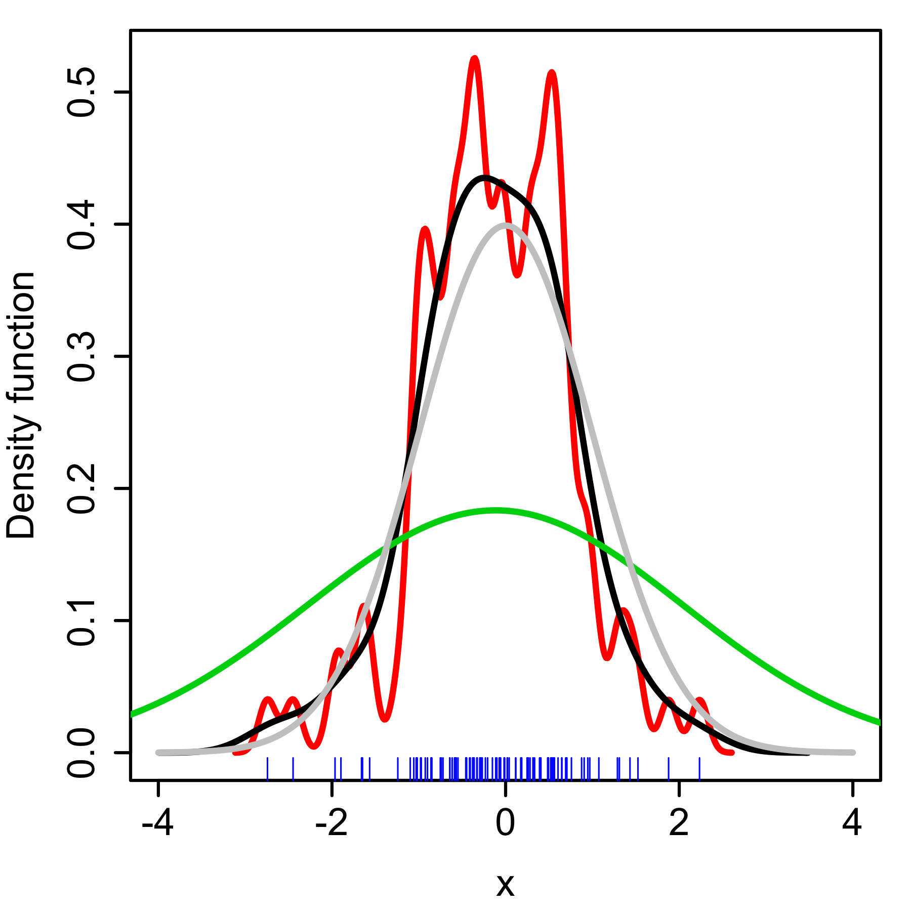
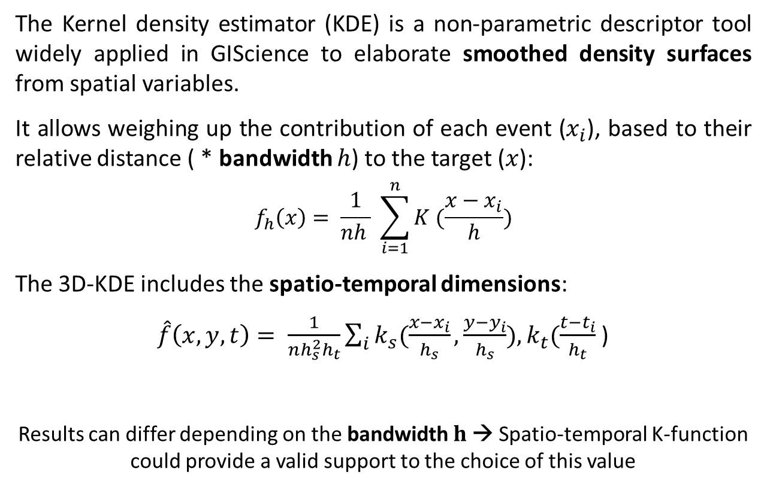
Kernel density estimator
The Kernel density estimator (KDE) is a non-parametric descriptor tool widely applied in GIScience to elaborate smoothed density surfaces from spatial variables.
It allows weighing up the contribution of each event ($x_{i}$), based to their relative distance ( * bandwidth $h$) to the target ($x$):
$$f_{h}\left(x\right)= \frac{1}{nh } \sum_{i=1}^{n}{K (\frac{x−x_{i}}{h}})$$
The 3D-KDE includes the spatio-temporal dimensions:
$\hat{f}\left(x,y,t\right)= \frac{1}{nh_{s}^{2}h_{t}}\sum_{i}{k_{s}(\frac{x−x_{i}}{h_{s}}}, \frac{y−y_{i}}{h_{s}}),k_{t}(\frac{t−t_{i}}{h_{t}}$)
Results can differ depending on the bandwidth $h$→ Spatio-temporal K-function could provide a valid support to the choice of this value
KDE with different bandwidths of a random sample of 100 points from a standard normal distribution.
Grey: true density (standard normal). Red: h=0.05. Black: h=0.337. Green: h=2.
Source: https://en.wikipedia.org/w/index.php?curid=28979200

Slide 5
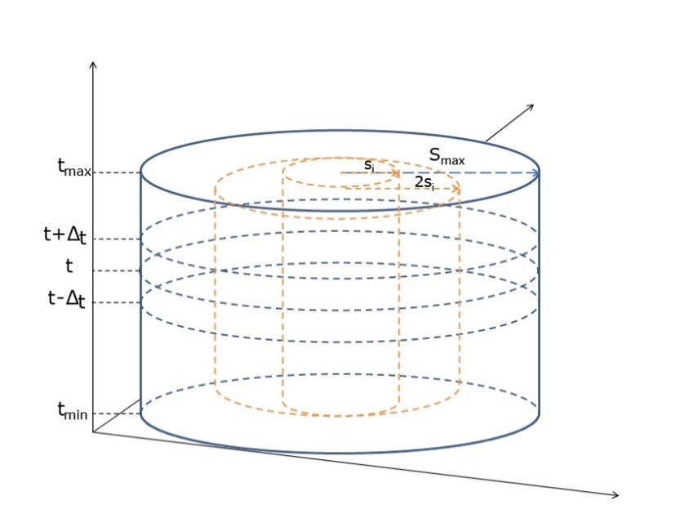
Scan Statistics
Spatio-temporal scan statistics permutation model (SaTScanTM) allows detecting clusters location and estimating their statistical significance.
Cylindrical windows scan the area across the space and in time.
For each cylinder are computed:
The number of observed and expected occurrences
The Likelihood Function (LF)
The cylinder with the maximum LF is the Most Likely Cluster.
Statistical inference (p-value):
Generates random replicas of the dataset under the null hypothesis that observations are distributed randomly (Monte Carlo sampling).
Compares the most likely clusters in the real and random datasets.

Slide 6
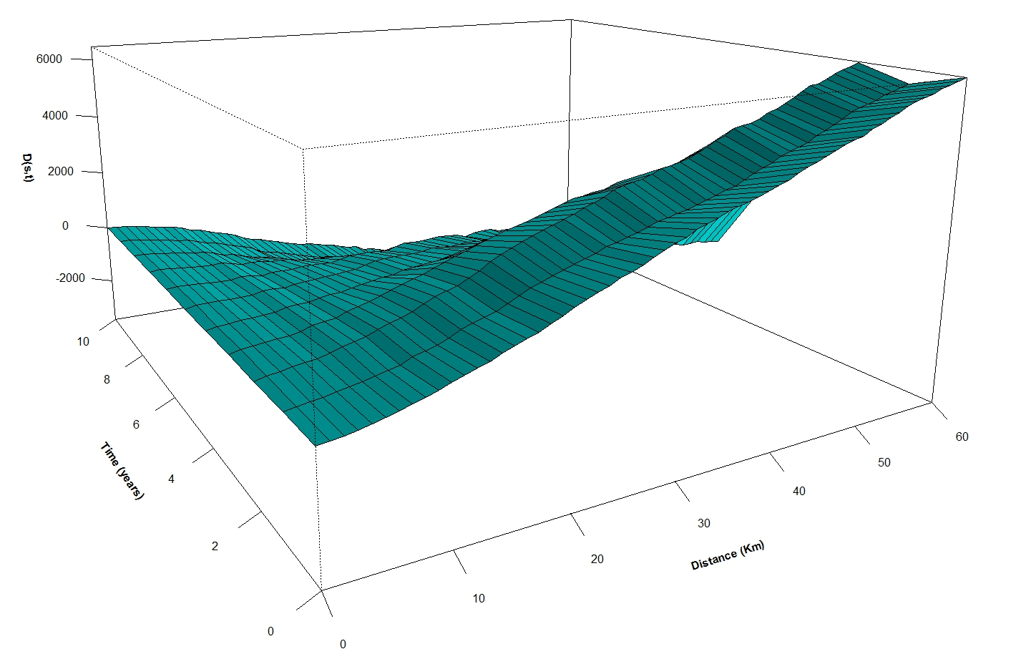
Global cluster behavior
The perspective 3D-plot of D(s,t) provides a first diagnostic of space-time clustering, allowing inferring about the space-time interaction.
Positive values indicate an interaction between these two variables at a well detectable spatio-temporal scale.
Higher/increasing values indicate in our case a peak of clustering at 2 years and about 15 Km distance.
These values were retained to define the Kernel bandwidth.

Slide 7
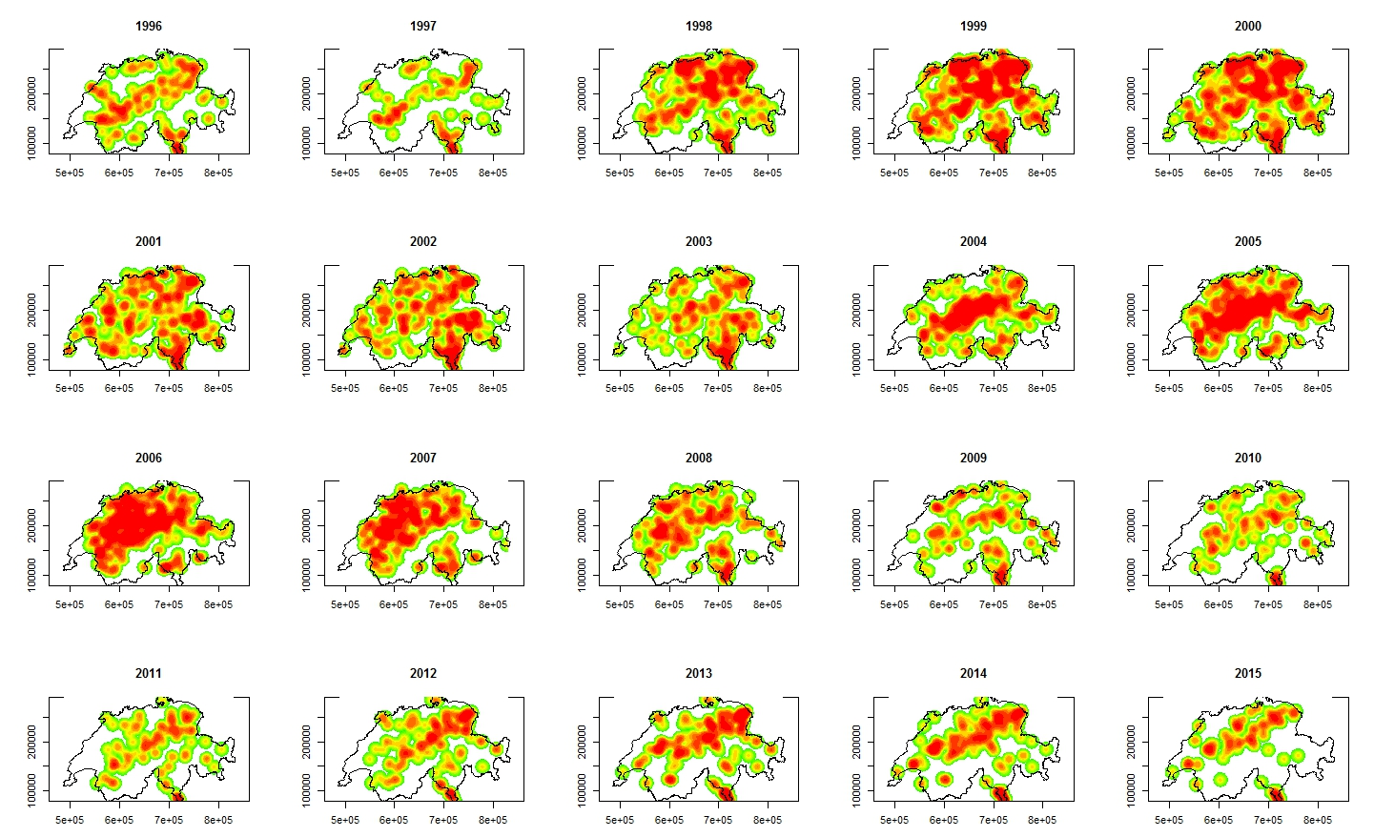
Yearly space-time Kernel density maps

Slide 8
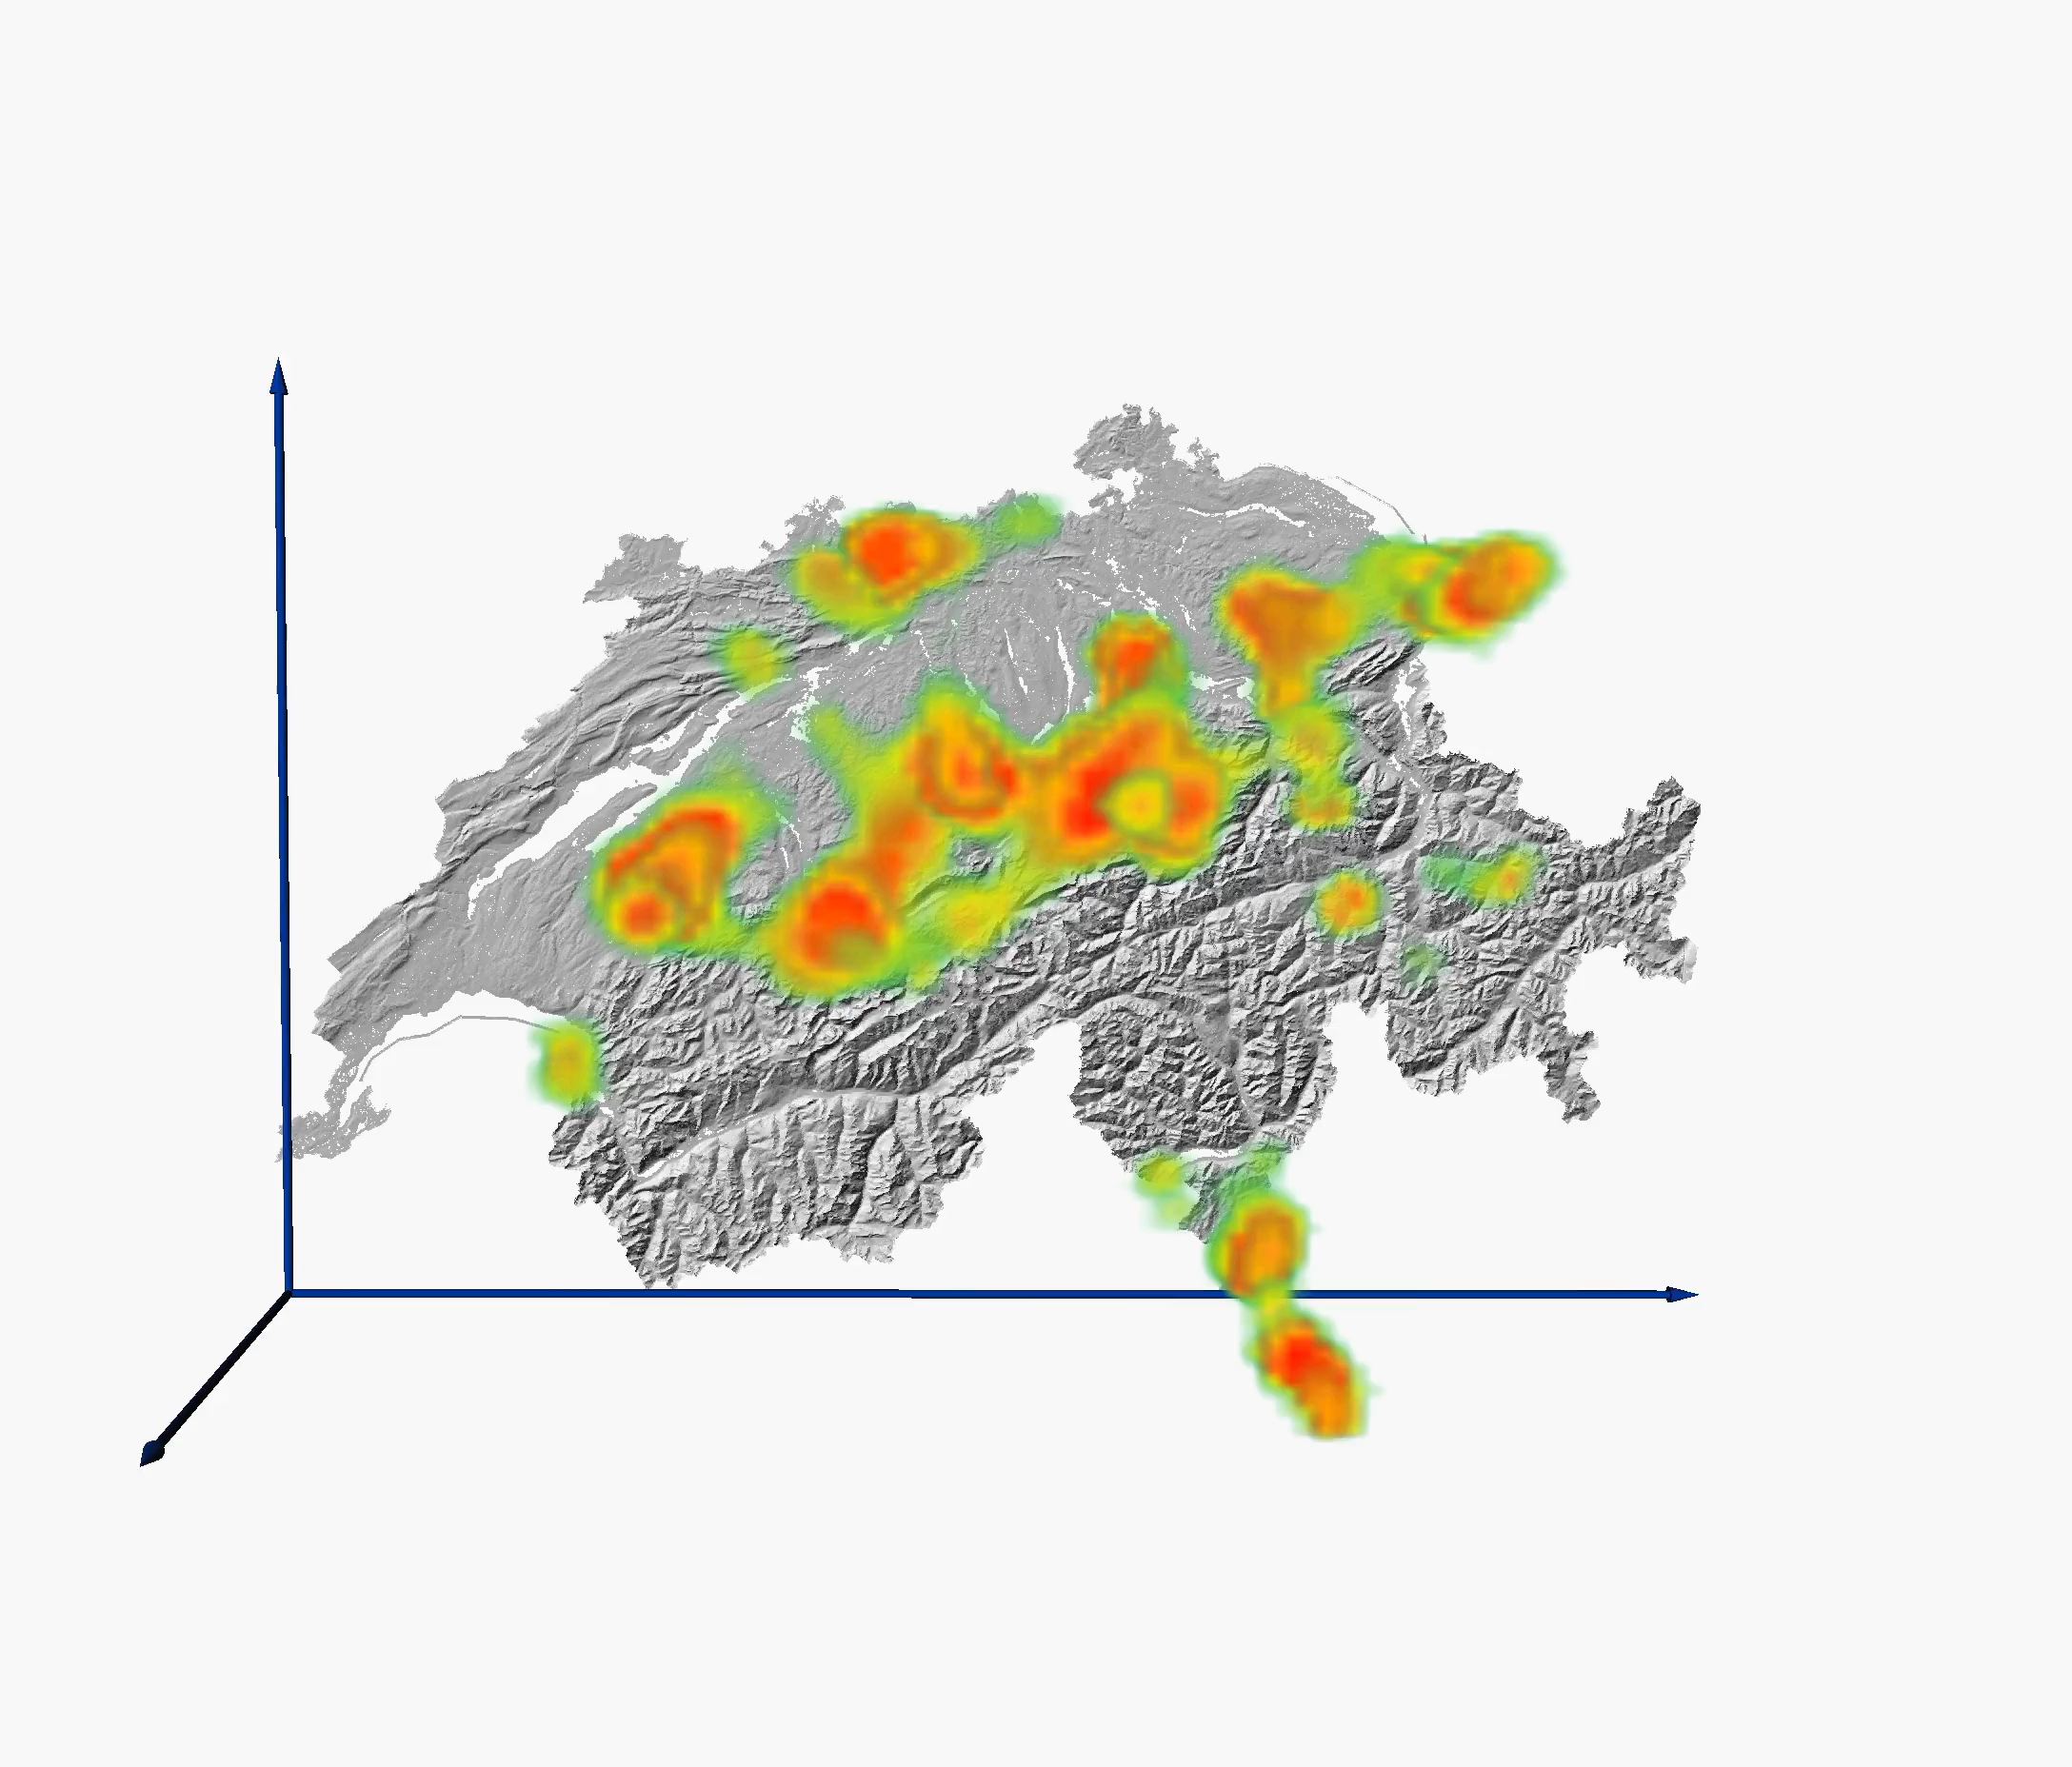
Space-time Kernel density 3D-map

Slide 9
Local spatio-temporal clusters
Results of scan-stactistics application show that the number of significant clusters decreases with the maximum radius, while they increase in extension. Even if more detailed analyses are required for the determination of cause-effect relationships among landslides and other variables, some relations with the local climatic and meteorological conditions can already be argued. For example, the rainfall event of August 2005, which triggered hundreds of landslides, is clearly highlighted by the cluster number 3c. At the smaller scale (cluster 4b), it is possible to define a longer period (circa 2 years) for the cluster duration. This could indicate a possible path dependency effects among fore-events and the main event of August 2005.

Slide 10

Code
# Load library
library(splancs)
# Import Landslides 1995-2015
LS <- readShapeSpatial("Landslides")
# Import limits of Switzerland
Swiss <- readShapeSpatial("Swiss")
b1 <- Swiss@polygons
b2 <- b1[[1]]
b3 <- b2@Polygons
b4 <- b3[[1]]
polyg <- b4@coords/1000
# Extract Time and PTS object
Time_LS <- data.frame(X=LS$x, Y=LS$y, Year=LS$Year)
pts_LS <- cbind(Time_LS$X/1000, Time_LS$Y/1000)
# Computes the space-time K-functions
ST_LS <- stkhat(pts=pts_LS, times=Time_LS$Year, poly=polyg, c(1995,2015), seq(0,60,1), seq(0,10,1))
# Compute space-time Kernel density
LSsp<-as.points(LS$x,LS$y)
LStime<-LS$Year
stK3d_LS<-kernel3d(LSsp, LStime, seq(490000, 830000, 1000), seq(79000, 290000, 1000), seq(1995,2015,1), 15000, 2)
http://www.maths.lancs.ac.uk/~rowlings/Splancs/

Slide 11


References
Tonini, M.; Pereira, M. G.; Parente, J.; Vega Orozco C.; Evolution of forest fires in Portugal: from spatio-temporal point events to smoothed density maps; Nat Hazards (2017); 85:1489–1510
Tonini, M.; Pedrazzini A.; Penna I.; Jaboyedoff M.; Spatial pattern of landslides in Swiss Rhone Valley; Springer; Nat Hazards (2013); 73: 97–110
Pereira, M. G.; Caramelo, L.; Vega Orozco, C.; Costa, R.; Tonini, M.; Space-time clustering analysis performance of an aggregated dataset: The case of wildfires in Portugal; Environmental Modelling & Software (2015); 72:239-249
Cama, M.; Lombardo, L.; Conoscenti, C.; Rotigliano, E.; Improving transferability strategies for debris flow susceptibility assessment: Application to the Saponara and Itala catchments (Messina, Italy); Geomorphology (2017); 288: 52–65
Contact: marj.tonini@unil.ch

