Slide 1
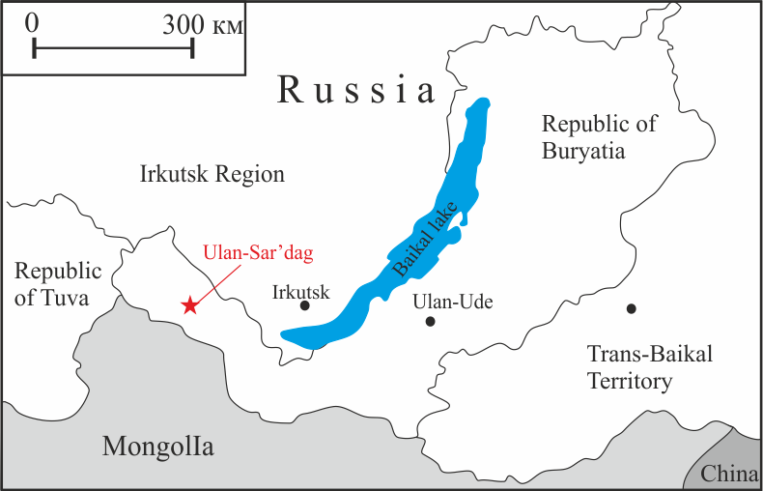
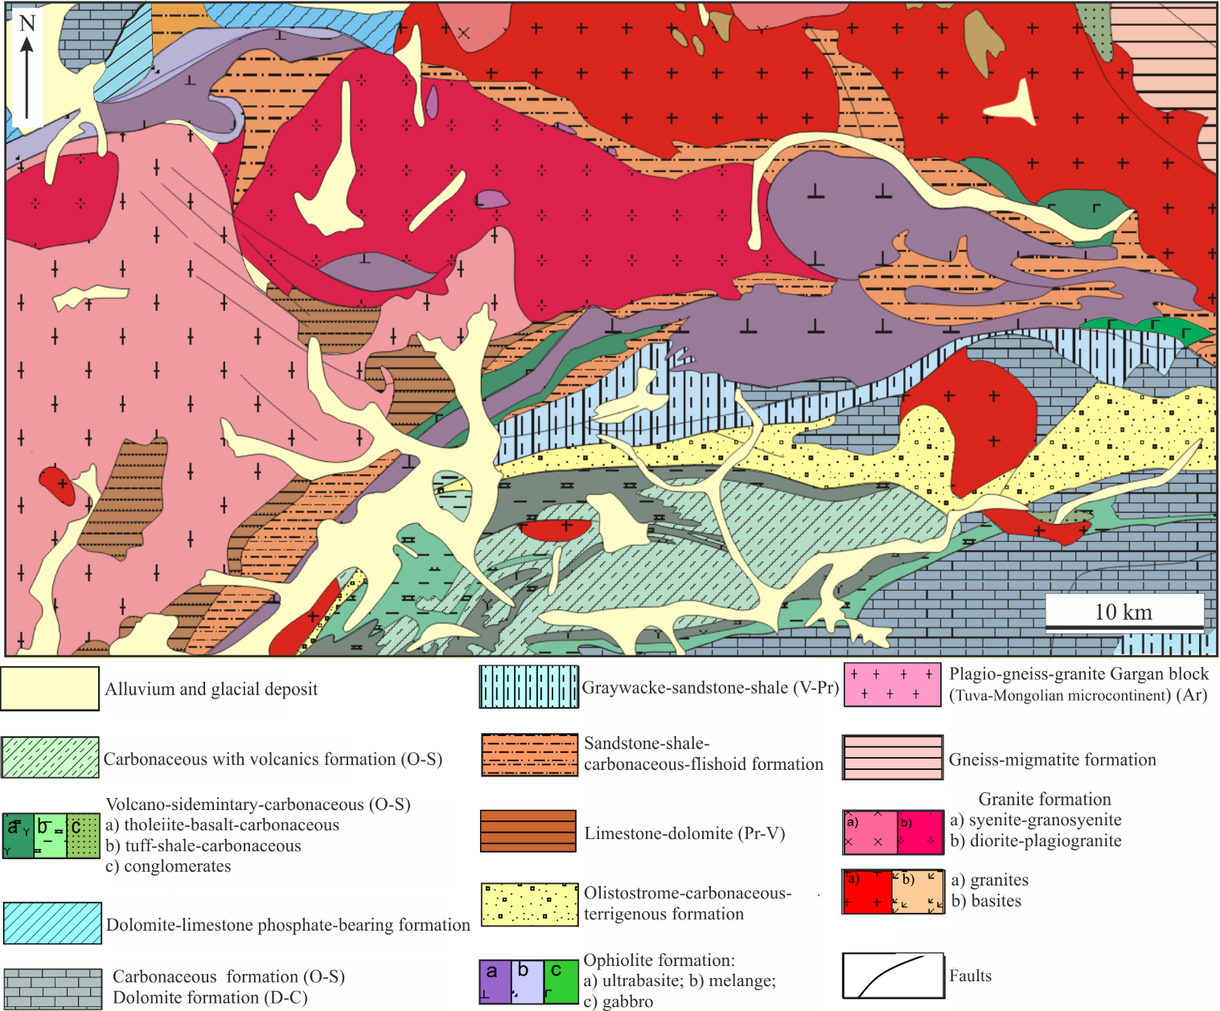
Geochemical and mineralogical indicators (Cr-spinelides, Platinum Group Minerals) of the geodynamic settings of formation of mafic-ultramafic Ulan-Saridag massif (Eastern Sayan) Olga Kiseleva¹, Evgeniya Airiyants¹, Dmitriy Belyanin^{1,2}, Sergey Zhmodik^{1,2} 1 – Sobolev Institute of Geology and Mineralogy SB RAS, Novosibirsk, Russian Federation 2-Novosibirsk State University, Novosibirsk, Russian Federation
Ulan-Saridag massive
Northern branch
Southern branch
The geographical position of the Ulan-Saridag massif
The Ulan-Saridag mafic-ultramafic massive is tectonic sheet. It is part of ophiolite complexes of Eastern Sayan and fold–thrus region of Central-Asian Fold Belt. The massive is part of the Dunzhugur Island Arc of Paleosian Ocean in Riphean-Vend Age. The ophiolite complex consists of the Northern and southern branches, which may have been formed in different geodynamic conditions. The massive of Ulan-Saradag is located between these structural branches. We received some interesting new data about volcanic rocks, chemical composition of chrom-spinelides and platinum mineralization for this massive.
Geological schematic map of the south-eastern part of the Eastern Sayan

Slide 2
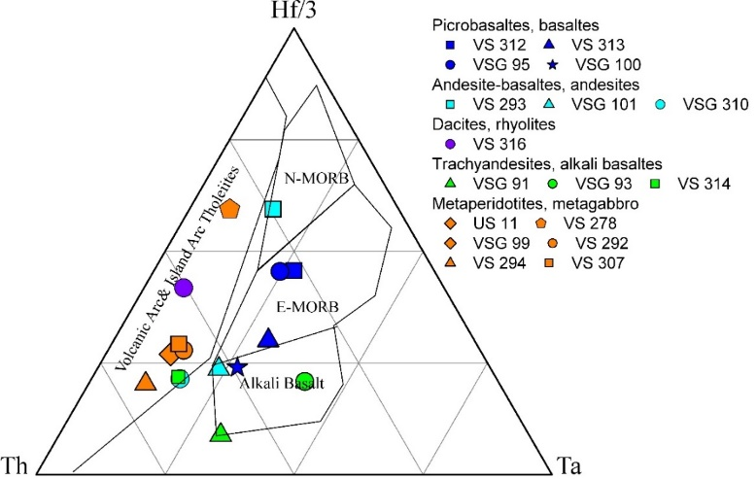
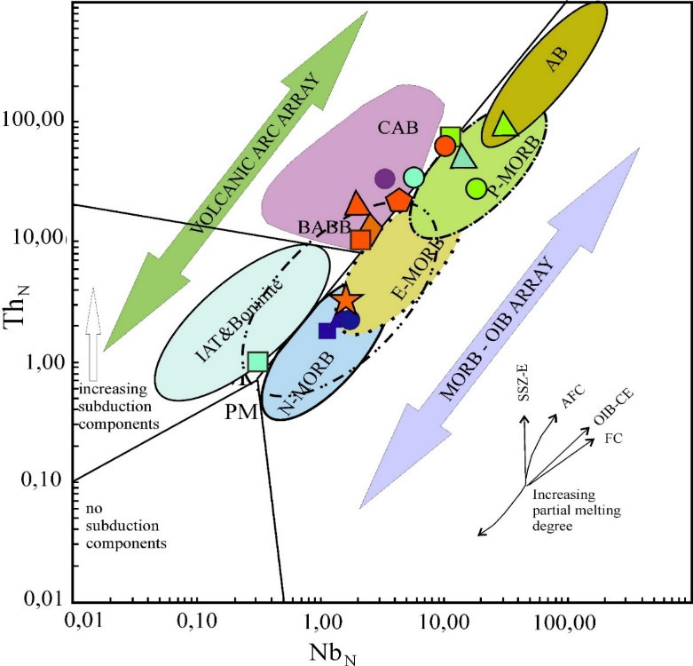
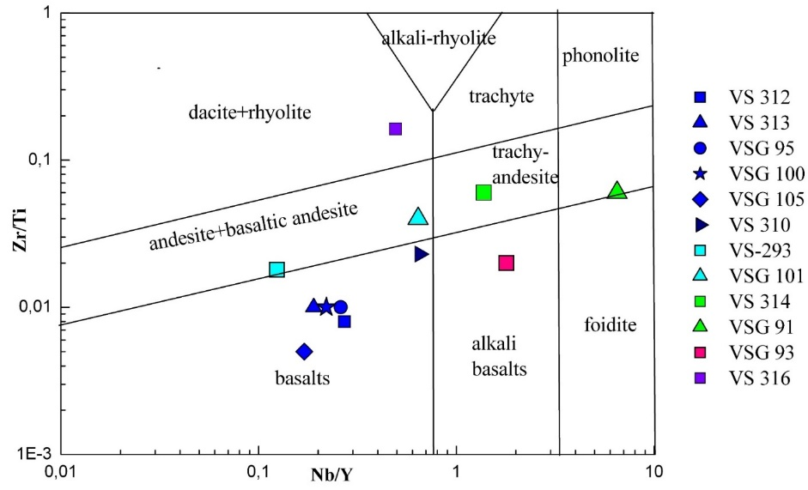
The distribution of rare-earth elements, HFSE (high field strength elements) and LILE (lithophilic elements) in volcanic rocks are typical of MORB, boninites, island-arc volcanics and OIB basalts.
Features of volcanic rocks
MORB-normalized diagrams distribution of HFSE in vulcanites and peridotites of Ulan-Saridag massif
Peridotites, gabbro
Gabbro, metagabbro
Discrimination diagramm of Th-Hf/3-Ta
E-MORB
Boninite
CAB (calc-alkiline basalt)
Picrobasalt
Andesibasalt
Andesites
OIB (alkiline oceanic within-plate basalts)
Trachyandesite
11
13
12
14
7
10
8
9
Boninite
Boninite
15
16
17
1
4
3
5
6
2
Andesites, dacites
Andesites, dacites
Discrimination diagrams of Nb/Y and Zr/Ti for volcanic rocks and apogabbros of the Ulan-Saridag massive
Discrimination diagramm of Th_{N}-Nb_{N}
11
12
13
14
20
8
7
10
17
15
16
9
Picrobasaltes, basalts
Picrobasaltes, basalts
Basalt, trahyandesites
Basalt, trahyandesites
Basalt, trahyandesites

Slide 3
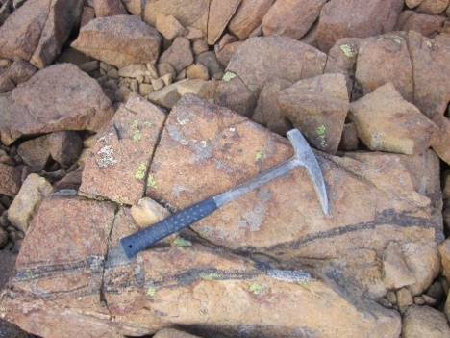
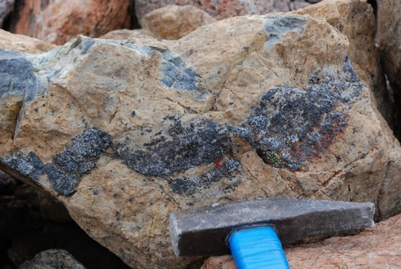
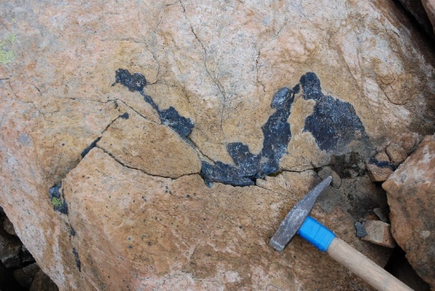
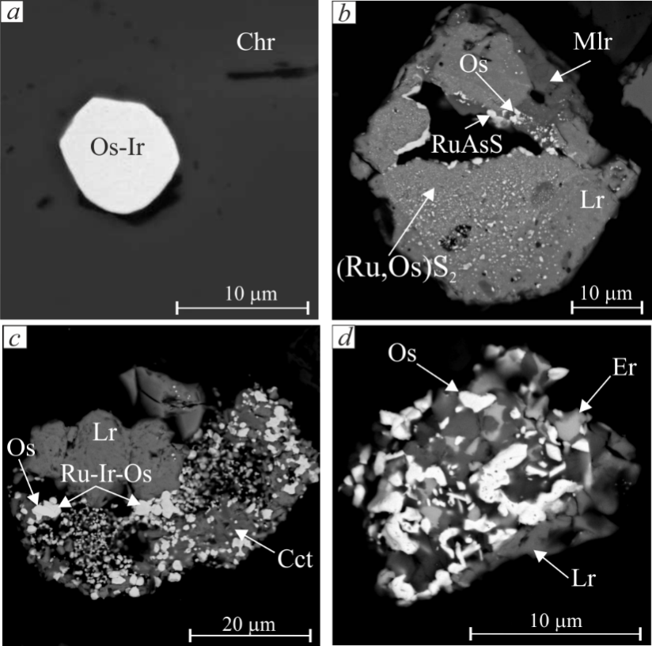
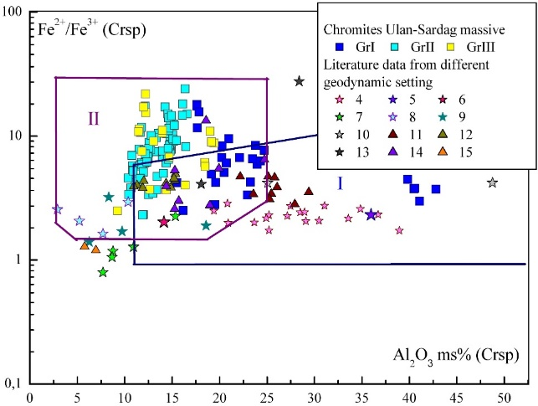
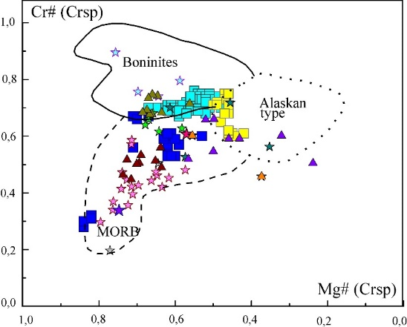
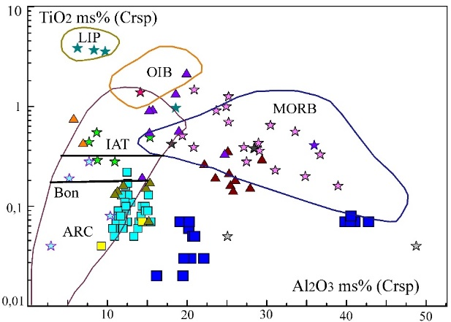
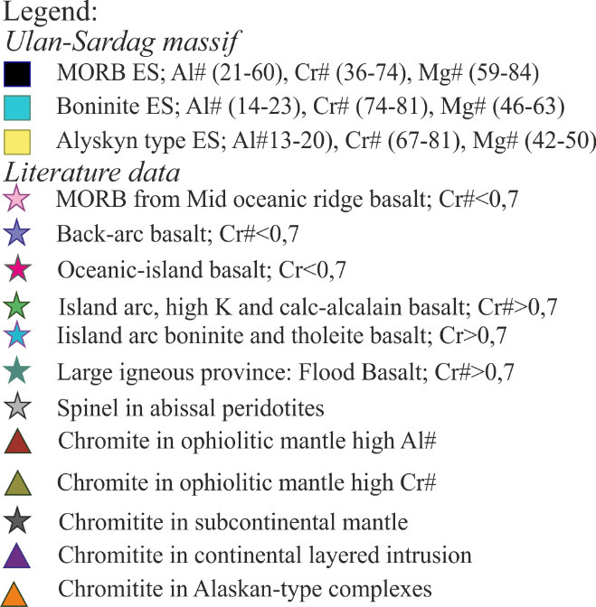
Features of MPG mineralization in chromitites
Features of chromitites
a
б
в
Chromite in ultrabasic rocks of the massif. a) thin-banded, b) massive veins, c) schlieren.
Discriminatory diagrams showing the Al₂O₃ - Fe²⁺/ Fe³⁺ , TiO₂ - Al₂O₃ ratios and Cr#-Mg# in the chromites of their chromites according to literature data and data Ulan-Sardag massif.
Minerals of the platinum group in chromites (BSE): a) grain of iridosmin in chrom- spinelide; b) concretion of millerite and zonal grain of laurite (in the center of the phase with erlikmanite minal and inclusions of osmium; c) concretion of laurite and laurit-erlymanite with multiple inclusiones (Os-Ir-Ru); d) interpenetrating concretion of laurite and erlikmanite with nanosized inclusions Os.
Chemical parameters of chrom-spinelides and parental melt composition in equilibrium with podiform chromitites are located in three fields: MORB, suprasubduction zones, boninites, ural-alaskyn type.
Distribution and PGE mineralization are typical for podiform chromitites of world ophiolite complexes. Platinum group mineralization consist of Os-Ir solid solution, two generation of sulfides PGE (magmatic Lr-Er and gidrothermal newly-formed Lr). Native osmium, ruthenium, RhNiAs are in close assotiation with chlorite, serpentine, sulfides of nikel sulfide. Metamorphism from green shale to amphibolite facies leads to a change in magmatic platinum group minerals, dissolution, remobilization PGE. The rise in temperature leads to the enlargement and agglomeration of nanoparticles of EPG from nano- to micro-level.

Slide 4
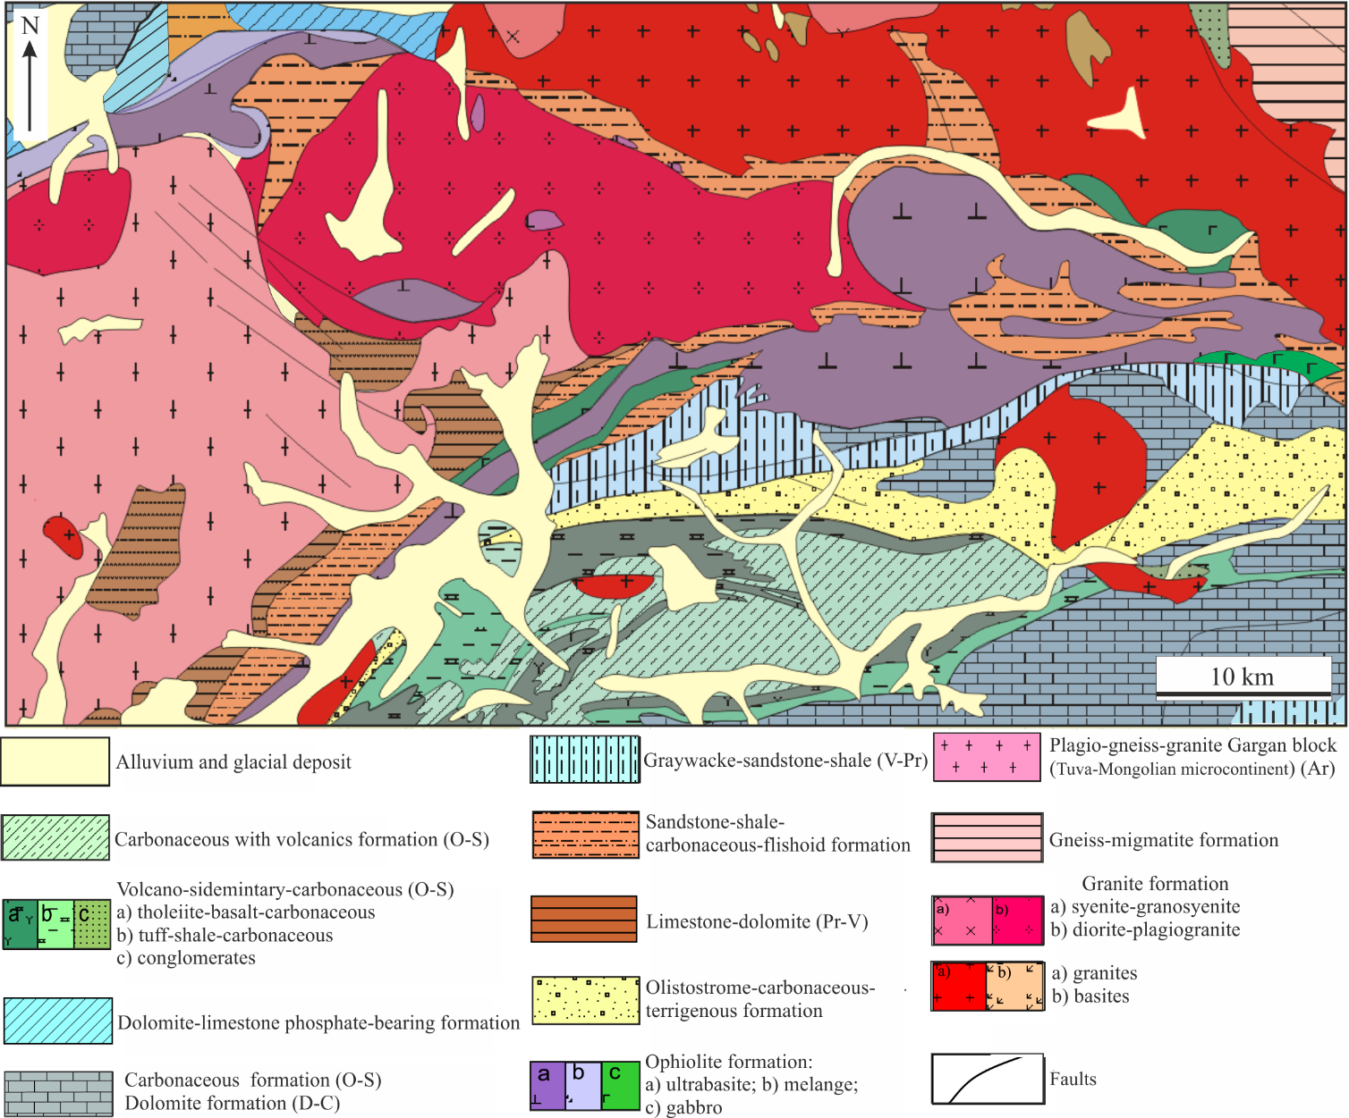
Geochemical and mineralogical indicators (Cr-spinelides, Platinum Group Minerals) of the geodynamic settings of formation of mafic-ultramafic Ulan-Saridag massif (Eastern Sayan) Olga Kiseleva¹, Evgeniya Airiyants¹, Dmitriy Belyanin^{1,2}, Sergey Zhmodik^{1,2} 1 – Sobolev Institute of Geology and Mineralogy SB RAS, Novosibirsk, Russian Federation 2-Novosibirsk State University, Novosibirsk, Russian Federation
The geographical position of the Ulan-Saridag massif
Geological schematic map of the south-eastern part of the Eastern Sayan
Ulan-Saridag massive
Northern branch
Southern branch
The mafic-ultramafic massif of Ulan-Saridag is a part of the Central Asian orogenic belt (the Dunzhugur island arc, which is part of the largest ancient ocean basin (Riphean age) (Paleoasian Ocean).Ophiolites of Eastern sayan divide on two branches - Northern and Southern branches.

Slide 5
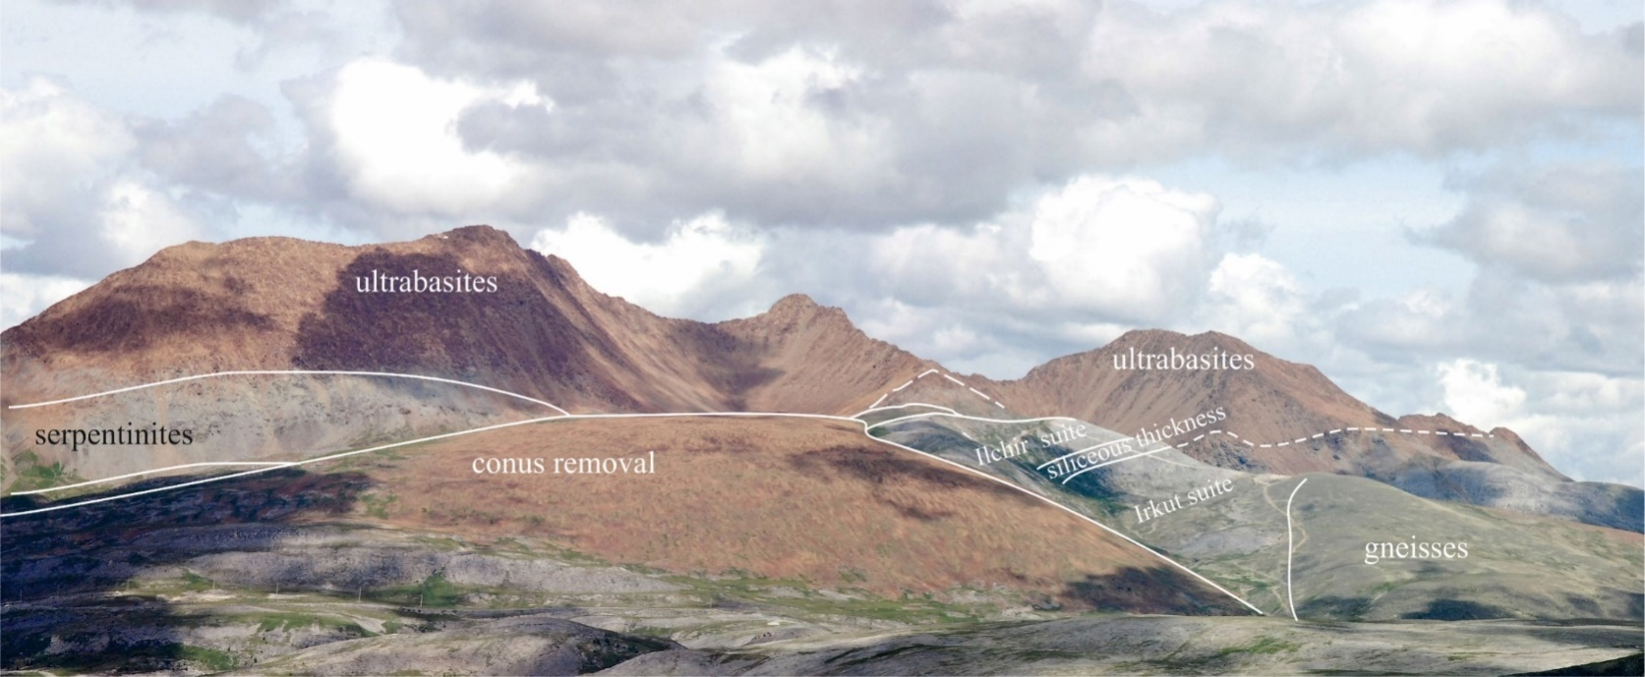
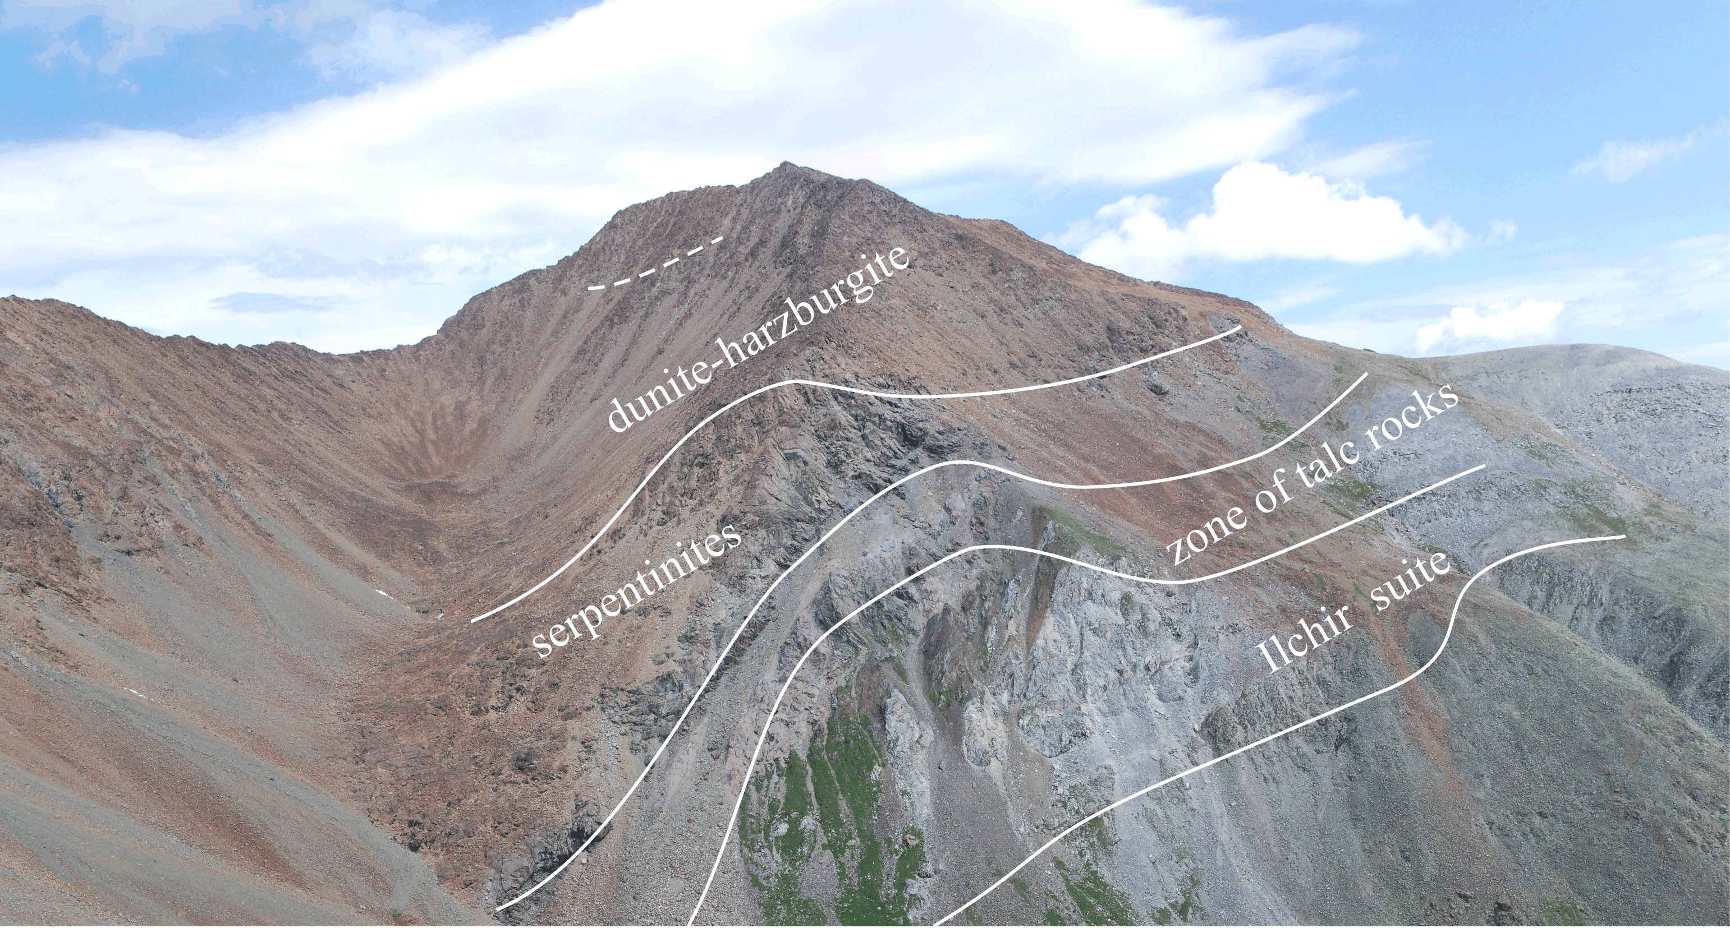
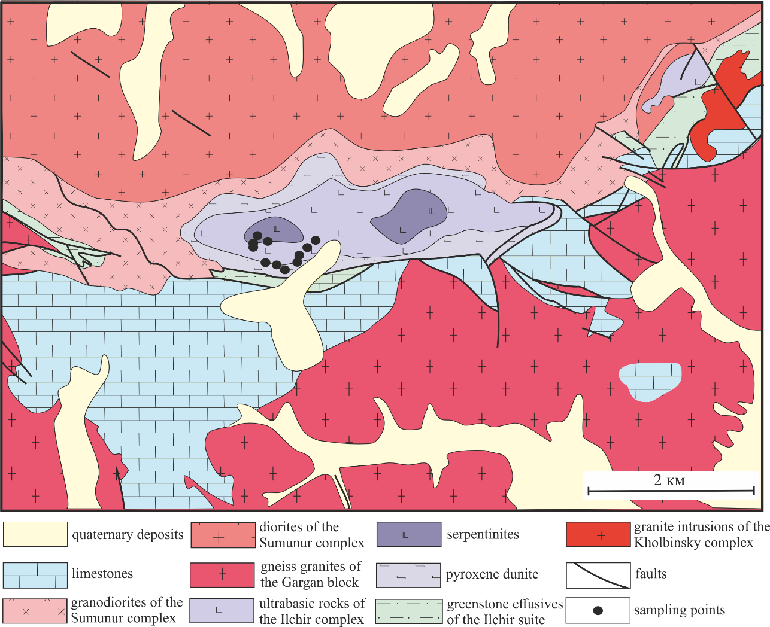
Scheme of the geological structure of the Ulan-Saridag mafic-ultramafic massif.
Photos Ulan-Saridag mafic-ultramafic massif.
Mafic-ultrmafic massive Ulan-Sariadag consist of mantle section (serpentinites, dunites, peridotites - garzburgites, pyroxenites, gabbro). Volcanic-sedimentory formation are presented Ilchir suit. The rocks of ophiolitic complexes are deformed in condition of greensheet to amfibolites facies.
A trench 200 meters long opens the volcanites of the Ilchir suit and their contact with the ultrabasites. Those was volcanogenic thickness with interbedding volcanites and sulfidized black shale.
Rocks of the normal and subalkaline series represent in volcanic association: picrobasalts, basalts, andesibasalt, boninites, andesites, trachyandesites, trachytes,
dacites.

Slide 6
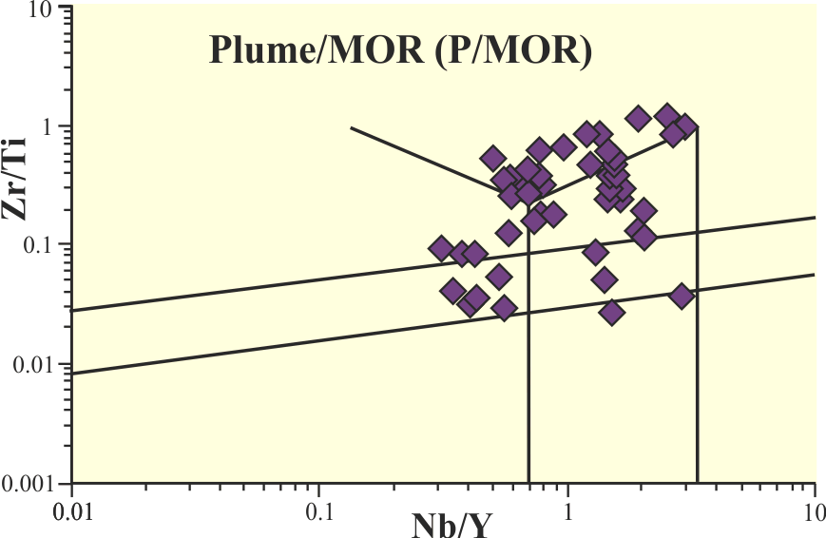
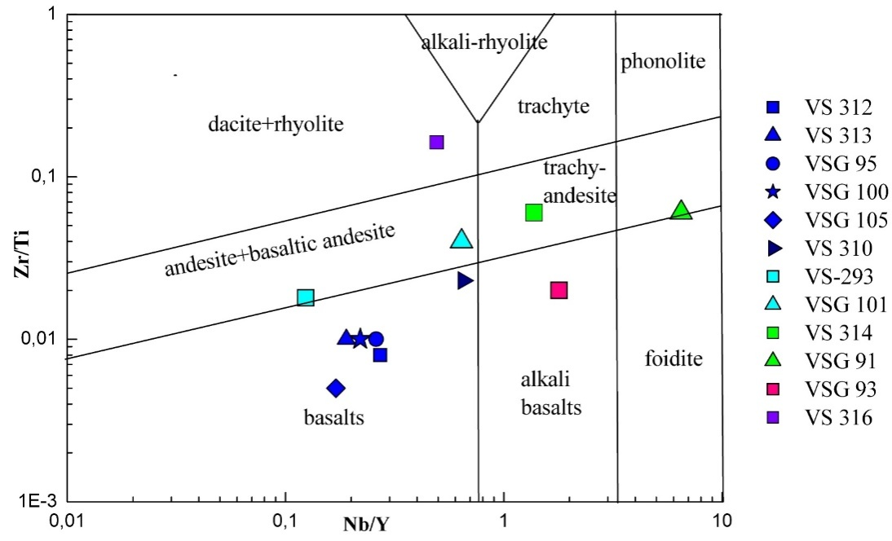
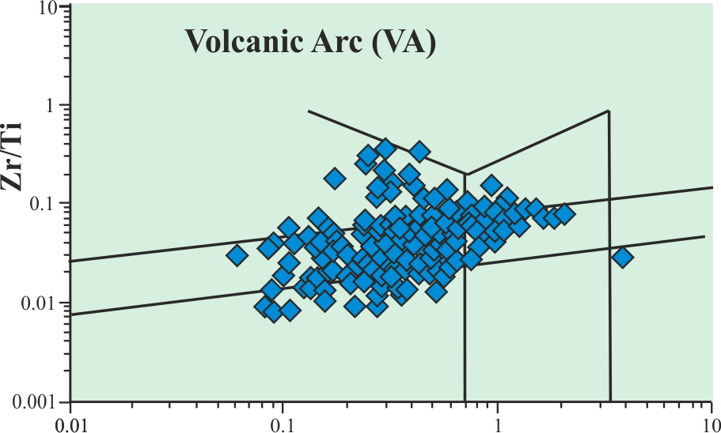
Geochemistry of vulcanites and peridotites
The classification of volcanic and metavolcanic rocks are based on TAS diagrams (SiO₂-Na₂O+K₂O) and ratious of immobile HFSE (high field elements (Nb/Y-Zr/Ti). They are presented picrobasaltes, basalts, basaltic-andesites, trachyandesites, alkaki basalte, tephriphonolite. All rocks in varying degrees are metamorphosed from greenschist shale to amfibolites facies (serpentine, talc, carbonate, magnezite, chlorite, tremolite, magnetite).
Discrimination diagrams of Nb / Y and Zr / Ti for volcanic rocks and apogabbros of ophiolite complexes (a, b) (literature data) and the Ulan-Saridag massive(c).
SiO₂ (mаs.%)
SiO₂ (mas.%)
TAS diagrams for volcanic rocks of massif Ulan-Saridag
11
12
13
14
20
8
7
10
17
15
16
9
Literature data: Harald Furnes, Yildirim Dilek (2017) Geochemical characterization and petrogenesis of intermediate to silicic rocks in ophiolites: A global synthesis. Earth-Science Reviews, 166, 1–37.

Slide 7
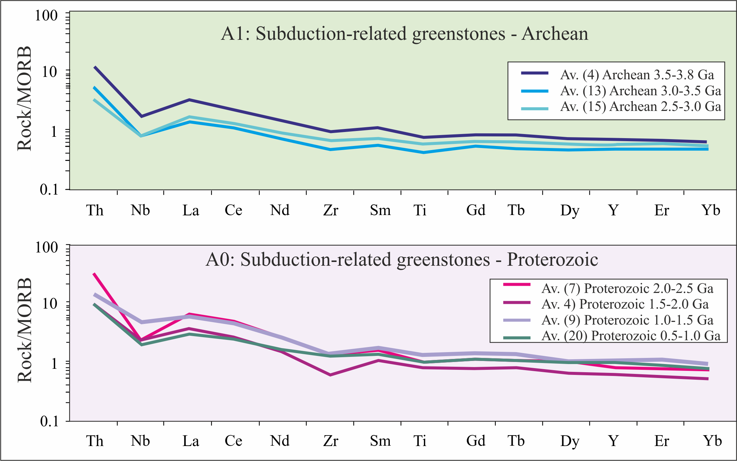
Geochemical features of peridotites and gabbro
MORB-normalized diagrams distribution of HFSE in peridotite of Ulan-Saridag massive
MORB-normalized diagrams distribution of HFSE in peridotite (literature data)// MORB values from Pearce and Parkinson (1993).
Literature data: Furnes, Dilek, de Wit (2015) Precambrian greenstone sequences represent different ophiolite types. Gondwana Research, 27, 649–685.
Two groups are distinguished on the basis of geochemical features:
Group-I – rocks have negative anomalies for Ta, Nb, Zr, Hf, Ti and positive anomalies for LREE (La, Sm) and LILE – Sr
Group-II – rocks have positive anomaly for Zr, La/Yb =13- 17.

Slide 8
Geochemical features of vulcanites
There are two series:
I - basalt - andesibasalt - andesite.
II - subalkaline basalt - trachybasalt - trachyandesite – trachyte.
This indicates the spatial independence of basalt and alkaline-basalt magma sources, which were the progenitors of the melts that formed the rocks of these series.
Andezi-basalt (boninite)
Sub-Group I (sample №7) – andezi-basalte have U shape pattern in spider diagrams (primitive mantle normalized) and U shape chondrite normalized profiles REE typical for high-Ca boninites and are similar in composition in boninites of Bonin Island. Sample №7 have low abundance REE. It has enrichment for LILE, Sr (relatively N-MORB) and positive anomalies Zr, Hf, negative anomalies for Ta, Nb and low negative anomalies for Ti, Sr (we have also negative anomalies for these elements). Distribution of REE in boninites is the same as N-MORB, although Ulann-Saridag sample have a few depletion LREE, minimum Eu, enrichment of HREE relatively N-MORB. This is considered as proof of the strong depletion of their mantle source due to one or more episodes of extraction of basalt melts (Duncan, Green, 1980, 1987).
Spider diagram and graph of PEE distribution in boninite of the Ulan-Saridag massif
Spider diagrams of boninites of world ophiolitic complexes. Pearse J.A. at.al. (1992) Boninite and harzburgite form leg 125 (Bonin-Mariana forearc): a case study of magma genesis during the initial stages of subduction. Procced. Ocean Drill. Pros. Sci. Results, 125, 623-658.
Enrichment with large ionic lithophile elements Rb, Ba, Cs, Sr, U is observed in comparison with N-MORB, which reflects the contribution of the fluid extracted from the subducted slab (Pearce, 1982). Boninites are the type of vulcanites that can unambiguously indicate their origin in the supra-subduction conditions of the ensimatic island arc.

Slide 9
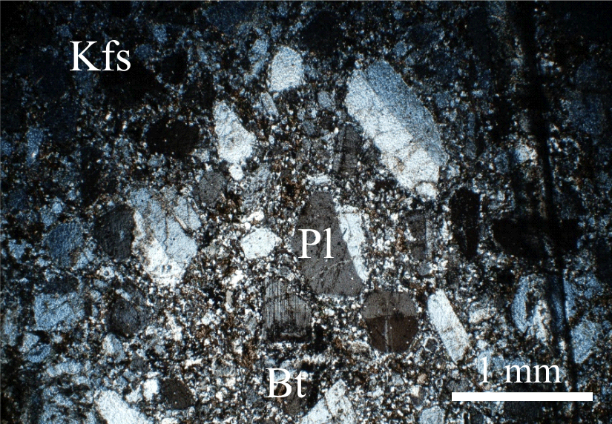
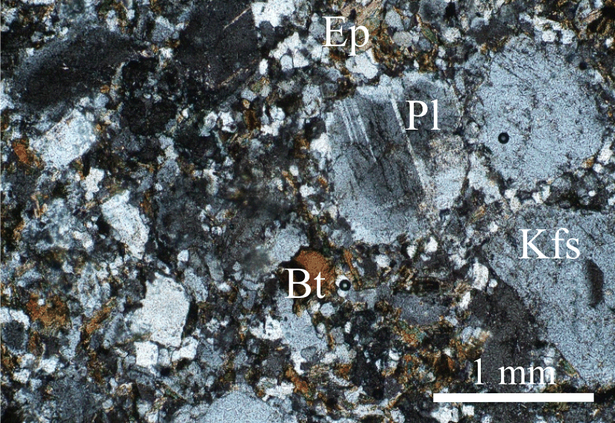
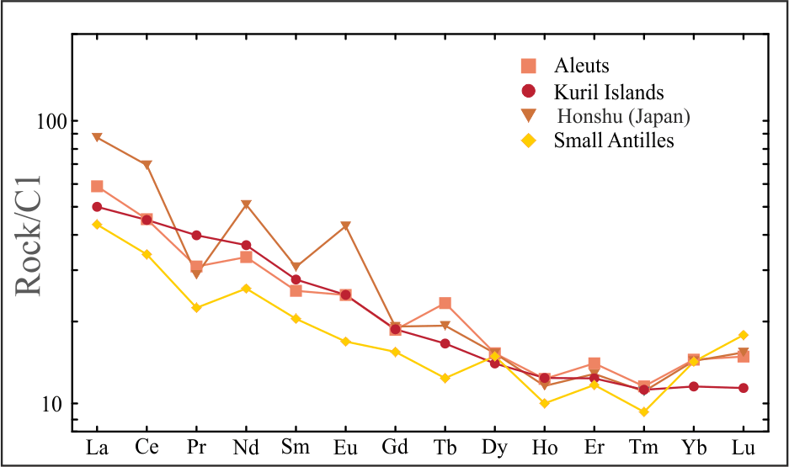
Andesites, dacites
Sub-Group II (samples № 8-10) – normal alkalinity series – andesites, dacites. They have pattern typical for Island Arc Vulcanites (VA). They have negative anomalies Ta, Nb, Nd, Ti and Sr and positive anomalies for Zr, Hf (andesites, dacites have same Sr negative anomaly from Archean island-back-arc complexes). distribution characteristic of the formations formed in the island arc (De Wit, Ashwal (1997), Furnes et.al. (2012), Cousens (2000)). The distribution of rare elements in the andesites of the Ulan-Saridag massif is similar to the distribution characteristic of the formations formed in the island arc. Low ratio La/Yb may indicate into oceanic ridge setting.
Microphoto of the andezite showing the occurrence of plagioclase (Pl), K-feldspar (Kfs) and biotite (Bt).
Spider diagram and graph of PEE distribution in andesites of the Ulan-Saridag massive
Microphoto of the andeszie showing the occurrence of plagioclase (Pl), K-feldspar (Kfs), biotite (Bt) and epidote (Ep).
Spider diagrams and graphs of the distribution of REE andesites of modern island arcs. www.geokem.com

Slide 10
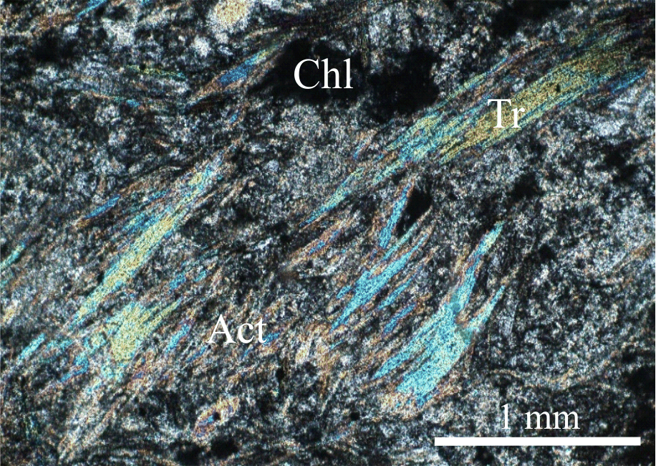
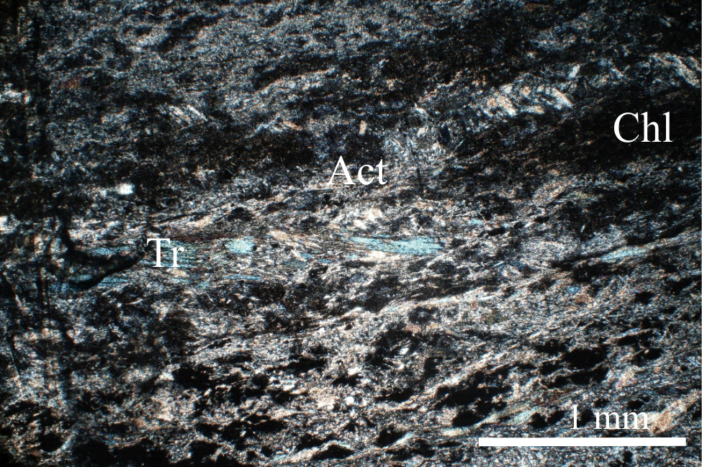
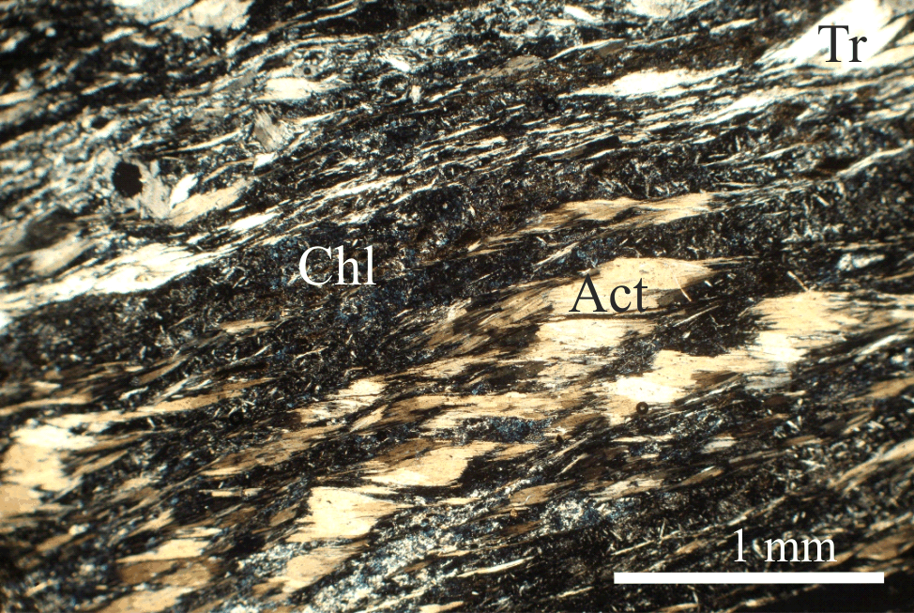
Picrobasaltes, Basaltes
Sub-Croup III (samples № 11-14)– picrobasaltes, basalts. The trace element abundance (in spider diagrams and REE -rare earth elements pattern) are typically of those for E-MORB. They have positive anomalies for (Ta, Nb), Nd, Ti, Sr; negative anomaly for Th relatively N-MORB. Picrobasaltes and basalts posses flat REE patterns apparently indicately of an undepleted mantle source and a correspondingly flat primitive mantle normalized pattern exepting LILE elements. Perhaps picrobasaltes, basalts derived from undepleted and enriched mantle wedg (mantle source).
Spider diagram distribution in picrobasaltes, basalts of the Ulan-Saridag massif
Microphoto of the basalt's showing the occurrence of actinolite (Act), tremolite (Tr) and chlorite (Chl).
Graph of PEE distribution in picrobasaltes, basalts of the Ulan-Saridag massif

Slide 11
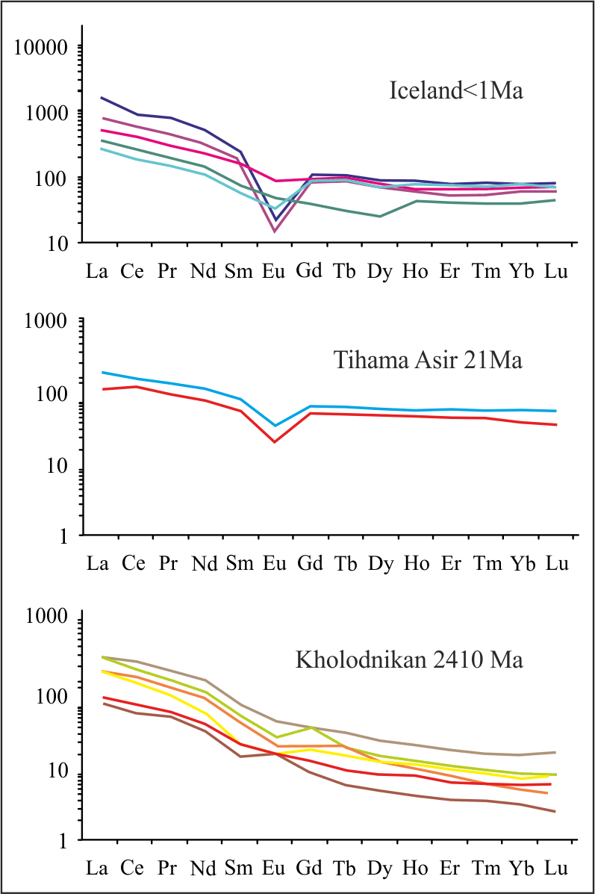
Alkaline basalt, trahyandesites
Subgroup IV (samples №15-17) have enrichment LILE, LREE and HFSE elements and have pattern typical for OIB basalts and oceanic intraplate basalts. They have positive anomalies for Ta, Nb, Zr and from negative to positive anomaly for Ti and negative anomaly for Sr. They have strongly enriched in terms of the trace-elements systematics.
Spider diagram and graph of PEE distribution in alkaline basalt, trahyandesites of the Ulan-Saridag massif
REE patterns of the P/MOR types are all LREE-enriched with the majority of them having (La/Lu)N = 1-10, a few samples from the oldest complex show exceptionally high (La/Lu)N (such our sample of volcanites). High La/Yb = 13 (№ 17) – 43 (№15). The P/MOR types display patterns characterized by relative enrichment in the most incompatible elements (Th, Nb, La) pronounced negative anomalies Ti, Sr.
Graphs of PEE distribution graph of PEE distribution
(literature data).
Literature data: Furnes, Dilek, de Wit (2017). Geochemical characterization and petrogenesis of intermediate to silicic rocks in ophiolites: A global synthesis. Earth-Science Reviews 166, 1–37

Slide 12
ISP-MS analyses of peridotites, gabbro and volcanic rocks (ppm)
 | 1 | 2 | 3 | 4 | 5 | 6 | 7 | 8 | 9 | 10 | 11 | 12 | 13 | 14 | 15 | 16 | 17
Cs | 0,10 | 0,10 | 0,19 | 0,66 | 0,19 | 3,30 | 0,11 | 2,52 | 2,34 | 1,20 | 0,56 | 0,39 | 5,97 | 0,39 | 1,48 | 4,12 | 1,38
Rb | 0,95 | 1,15 | 8,47 | 14,52 | 30,30 | 96,84 | 8,22 | 35,73 | 51,68 | 31,17 | 16,48 | 12,22 | 63,88 | 14,54 | 70,31 | 59,64 | 43,54
Ba | 116,71 | 90,68 | 215,14 | 66,43 | 883,08 | 1003,04 | 35,82 | 251,27 | 398,22 | 447,24 | 128,29 | 111,69 | 392,99 | 150,87 | 505,77 | 394,98 | 579,05
U | 0,51 | 0,39 | 0,78 | 0,15 | 1,94 | 3,19 | 0,15 | 2,78 | 1,37 | 1,23 | 0,09 | 0,15 | 1,61 | 0,12 | 3,32 | 1,55 | 3,07
Th | 1,73 | 1,46 | 2,57 | 0,39 | 2,50 | 8,56 | 0,09 | 6,66 | 4,58 | 4,33 | 0,24 | 0,30 | 0,33 | 0,24 | 12,23 | 3,62 | 9,21
Ta | 0,36 | 0,33 | 0,42 | 0,36 | 0,60 | 2,18 | 0,06 | 2,99 | 1,28 | 0,66 | 0,24 | 0,30 | 0,27 | 0,27 | 6,37 | 3,97 | 2,50
Nb | 6,96 | 6,17 | 5,76 | 4,52 | 12,45 | 30,36 | 0,90 | 41,48 | 16,61 | 9,72 | 3,25 | 4,31 | 4,33 | 3,37 | 93,67 | 56,92 | 32,41
La | 24,97 | 21,09 | 14,11 | 5,67 | 22,60 | 43,26 | 1,28 | 38,84 | 28,85 | 31,56 | 3,13 | 4,91 | 3,49 | 4,55 | 66,28 | 43,69 | 31,81
Ce | 47,59 | 40,24 | 27,90 | 13,32 | 44,28 | 90,01 | 2,36 | 76,93 | 55,82 | 59,18 | 7,72 | 12,10 | 7,66 | 11,30 | 115,73 | 90,91 | 68,95
Sr | 541,16 | 625,73 | 408,01 | 294,64 | 546,39 | 416,38 | 249,47 | 227,19 | 138,63 | 488,12 | 157,98 | 250,75 | 132,42 | 207,60 | 138,15 | 366,20 | 432,58
Pr | 5,49 | 4,73 | 3,46 | 2,15 | 5,23 | 10,23 | 0,38 | 9,51 | 6,75 | 6,46 | 1,15 | 1,78 | 1,15 | 1,70 | 12,08 | 11,51 | 8,56
Nd | 21,19 | 18,52 | 14,92 | 10,12 | 19,03 | 38,45 | 1,64 | 38,00 | 23,39 | 22,57 | 5,28 | 9,55 | 5,81 | 8,34 | 40,24 | 48,21 | 30,18
Zr | 102,76 | 90,18 | 83,48 | 68,29 | 683,19 | 541,58 | 25,99 | 366,56 | 189,12 | 504,67 | 43,20 | 69,26 | 51,06 | 56,45 | 261,53 | 273,55 | 451,80
Hf | 2,30 | 2,21 | 2,30 | 1,89 | 13,60 | 12,49 | 0,66 | 8,94 | 4,81 | 10,66 | 1,20 | 1,83 | 1,38 | 1,50 | 5,54 | 6,07 | 9,81
Sm | 3,76 | 3,48 | 3,25 | 3,19 | 3,91 | 7,00 | 0,51 | 8,80 | 5,09 | 4,36 | 1,76 | 2,96 | 1,84 | 2,40 | 5,92 | 10,59 | 5,93
Eu | 1,23 | 1,15 | 1,15 | 1,08 | 1,73 | 2,13 | 0,14 | 2,10 | 1,20 | 1,49 | 0,67 | 1,15 | 0,82 | 0,86 | 1,41 | 3,29 | 1,86
Gd | 3,49 | 3,20 | 2,69 | 3,38 | 4,16 | 6,11 | 0,79 | 9,87 | 5,21 | 3,94 | 2,08 | 3,77 | 2,30 | 2,67 | 4,42 | 9,17 | 5,60
Ti | 6040,07 | 5174,47 | 4877,55 | 7440,01 | 4358,59 | 8060,23 | 1452,14 | 7560,27 | 8191,10 | 3082,24 | 5377,89 | 7607,80 | 5122,79 | 6096,61 | 4382,77 | 17324,12 | 7415,14
Tb | 0,51 | 0,43 | 0,40 | 0,58 | 0,62 | 0,97 | 0,13 | 1,64 | 0,78 | 0,56 | 0,35 | 0,65 | 0,42 | 0,46 | 0,54 | 1,26 | 0,78
Dy | 2,73 | 2,61 | 2,39 | 3,39 | 3,38 | 5,56 | 0,91 | 10,13 | 4,37 | 3,04 | 2,14 | 3,83 | 2,66 | 2,85 | 2,58 | 6,59 | 4,16
Ho | 0,56 | 0,51 | 0,46 | 0,70 | 0,74 | 1,10 | 0,23 | 2,15 | 0,93 | 0,65 | 0,45 | 0,84 | 0,59 | 0,56 | 0,48 | 1,21 | 0,88
Y | 15,45 | 13,23 | 11,43 | 17,86 | 22,01 | 29,59 | 7,20 | 64,60 | 25,48 | 19,69 | 11,96 | 22,25 | 16,72 | 15,13 | 14,38 | 31,83 | 23,54
Er | 1,58 | 1,45 | 1,18 | 1,96 | 2,41 | 3,06 | 0,77 | 6,37 | 2,66 | 2,00 | 1,25 | 2,34 | 1,80 | 1,64 | 1,37 | 3,07 | 2,39
Tm | 0,21 | 0,22 | 0,16 | 0,30 | 0,40 | 0,47 | 0,13 | 1,05 | 0,40 | 0,33 | 0,18 | 0,35 | 0,30 | 0,24 | 0,22 | 0,43 | 0,38
Yb | 1,46 | 1,37 | 1,00 | 1,88 | 2,61 | 3,25 | 0,91 | 7,19 | 2,40 | 2,30 | 1,08 | 2,40 | 1,85 | 1,54 | 1,52 | 2,63 | 2,35
Lu | 0,21 | 0,21 | 0,14 | 0,27 | 0,40 | 0,51 | 0,15 | 1,07 | 0,37 | 0,38 | 0,15 | 0,36 | 0,27 | 0,22 | 0,23 | 0,39 | 0,38
Ba/Th | 67,61 | 61,95 | 83,84 | 171,12 | 352,60 | 117,15 | 399,67 | 37,75 | 86,85 | 103,19 | 538,31 | 373,05 | 1198,41 | 630,63 | 41,36 | 109,22 | 62,87
La/Yb | 17,12 | 15,35 | 14,11 | 3,02 | 8,67 | 13,30 | 1,41 | 5,40 | 12,02 | 13,72 | 2,91 | 2,05 | 1,89 | 2,94 | 43,47 | 16,61 | 13,53
Zr/Ti | 0,02 | 0,02 | 0,02 | 0,01 | 0,16 | 0,07 | 0,02 | 0,05 | 0,02 | 0,16 | 0,01 | 0,01 | 0,01 | 0,01 | 0,06 | 0,02 | 0,06
Zr/Nb | 14,76 | 14,63 | 14,48 | 15,13 | 54,87 | 17,84 | 29,00 | 8,84 | 11,38 | 51,92 | 13,28 | 16,06 | 11,80 | 16,73 | 2,79 | 4,81 | 13,94
La/Nb | 3,59 | 3,42 | 2,45 | 1,26 | 1,82 | 1,42 | 1,43 | 0,94 | 1,74 | 3,25 | 0,96 | 1,14 | 0,81 | 1,35 | 0,71 | 0,77 | 0,98
Th/Nb | 0,25 | 0,24 | 0,45 | 0,09 | 0,20 | 0,28 | 0,10 | 0,16 | 0,28 | 0,45 | 0,07 | 0,07 | 0,08 | 0,07 | 0,13 | 0,06 | 0,28
Nb/Y | 0,01 | 0,02 | 0,03 | 0,06 | 0,03 | 0,05 | 0,12 | 0,64 | 0,65 | 0,49 | 0,27 | 0,19 | 0,26 | 0,22 | 6,51 | 1,79 | 1,38
Zr/Y | 0,15 | 0,15 | 0,21 | 0,34 | 0,28 | 0,34 | 3,61 | 5,67 | 7,42 | 25,62 | 3,61 | 3,11 | 3,05 | 3,73 | 18,19 | 8,59 | 19,19
∆Nb | 1,50 | 1,50 | 1,53 | 1,44 | 1,22 | 1,35 | -0,24 | 0,10 | -0,12 | -1,27 | 0,10 | 0,08 | 0,22 | -0,01 | 0,14 | 0,20 | -0,58

Slide 13
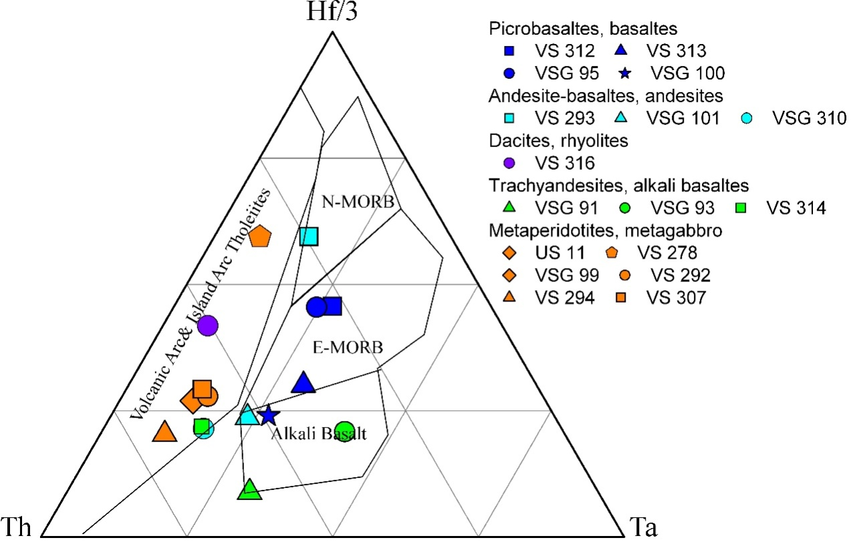
The results of geochemical data on vulcanites and peridotites are presented in the Th-Hf /3-Ta and Nb_{N}-Th_{N} diagrams, which reflect the origin of the substance.
11
12
13
14
7
10
8
9
15
16
17
1
5
4
6
3
2
Discriminattion diagram of Th-Hf/3-Ta
Discrimination diagram of Th_{N}-Nb_{N}
Andezi-basalt (boninite). On diagram Ta-Hf/3-Th andezi-basalt falls on the boundary of fields N-MORB and volcanic arc and island arc tholeites field. On diagram (Nb) _{N} – (Th) _{N} sample falls into field of IAT&Boninites and lie on line of Volcanic Arc Array.
On the diagramm of Ta-Hf/3-Th peridotites, gabbroids, andesites and dacites lie in field of Volcanic Arc and Island Arc Tholeites and on boundary with field of alkali basalts.
Andesites, dacites together with peridotites and gabbro on the diagram (Nb) _{N} – (Th) _{N} correspond to the trend of Volcanic Arc Array and lie into field of BABB (back arc basin basalts), CAB (calc alkiline basalt). Backarc basin basalts (BABB) characterized by input of subduction or crustal components. On the diagramm of Ta-Hf/3-Th peridotites, gabbroids, andesites and dacites lie in field of Volcanic Arc and Island Arc Tholeites and on boundary with field of alkali basalts.
Picrobasalts and basalt on the diagram of Ta-Hf/3-Th lie on field of E-MORB and alkali basalts. On the diagram of Ta-Hf/3-Th alkali basalts and trahiandesites lie in field of alkali basalts and Volcanic Arc. On the diagram (Nb)_{N} – (Th) _{N} picrobasaltes, basalts, alkali basalts and trahyandesites lie on trend of MORB on OIB array from MORB to OIB.

Slide 14
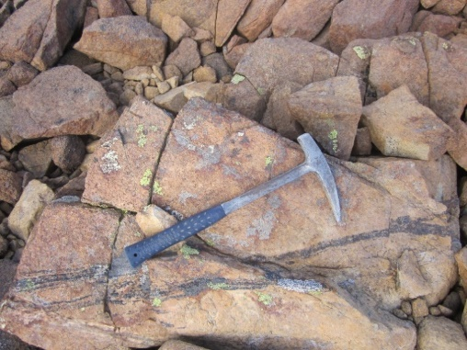
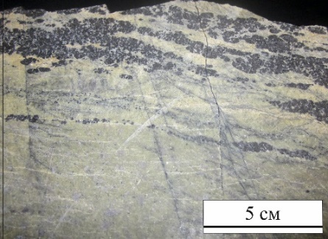
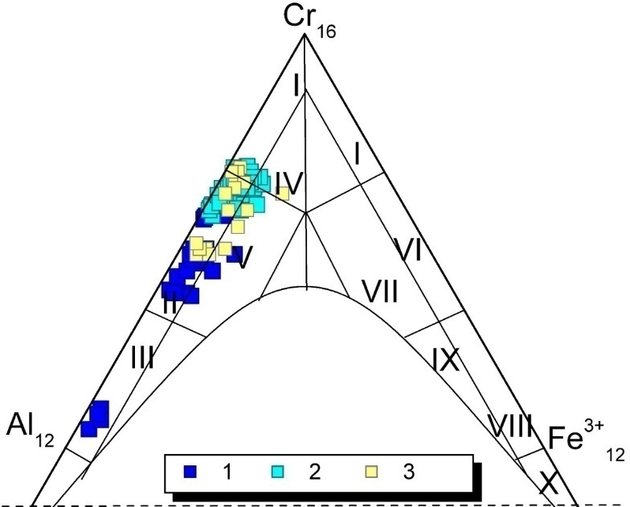
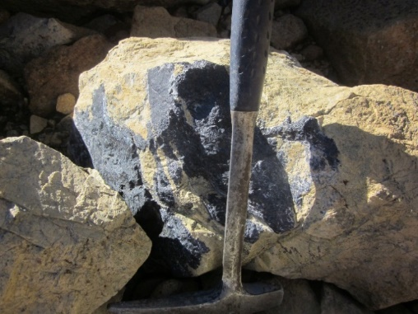
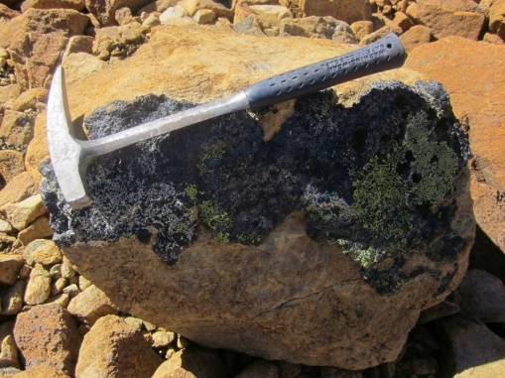
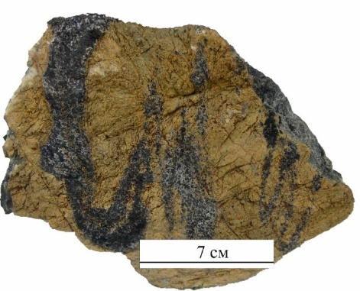
Structural and textural features and stages of deformation are: 1) lenticular (from one to three centimeters in thikness); 2) irregular ore bodies (lenses some centimeters thick, pods, schlieren); some lenses, pods, schlieren pods is grouped forming vein type. 3) schlieren type during the tectonic processes is transformed to structure of tectonic flow, deformation structure up to forming the structure of “snowball” type – massive chromitites;
Features of chromitites
Chromitites are located within the mantle section (dunites, garzburgites, serpentenites). Massive chromitites consist of aggregate euhedral to subhedral crystal shape of chromite grains, only separated one from the other by a thin film of chlorite and serpentine or olivine and minor serpentine.
Ore Chr-spineles consist of chrompicotite, alumochromite, chromite, ferrochromite and Chr-magnetite and magnetite. Chr-spineles have composition (мас.%): Al₂O3 10÷22 и 36÷39, Cr₂O₃ 46÷53 и 28÷35; MgO 12÷15 и 19÷20 мас.
Studied chromitites show chemical characteristics typical of podiform chromite deposits
Shlieren, lensoidal pods
Shlieren, lensoidal pods
Diagram compositions of Chr-spineles of the
Ulag-Saridag massif
Vein type, deformed pods
Vein type
Table of Chr-spinel parameters
 | Al# | Cr# | Mg#
I group | 24-60 | 36 - 74 | 45 - 74
II group | 14 - 23 | 74 - 81 | 32 - 48
III group | 13 - 27 | 68 - 81 | 28 - 35
Structure of “snowball”
Deformed structure

Slide 15
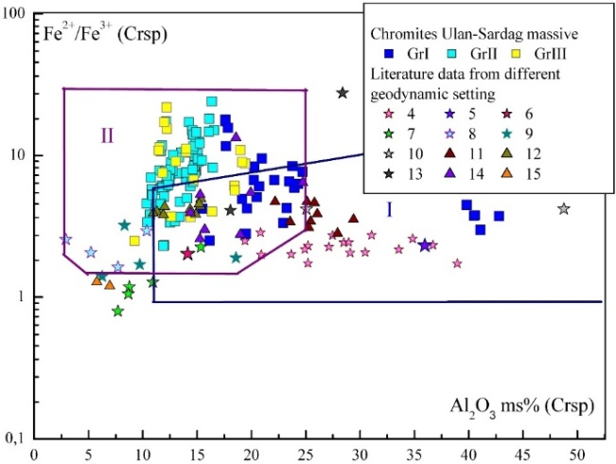
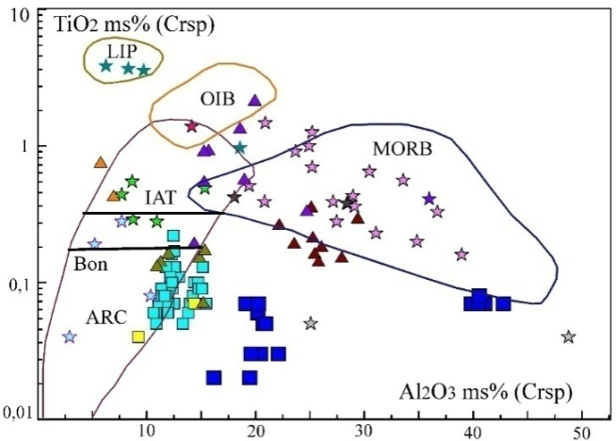
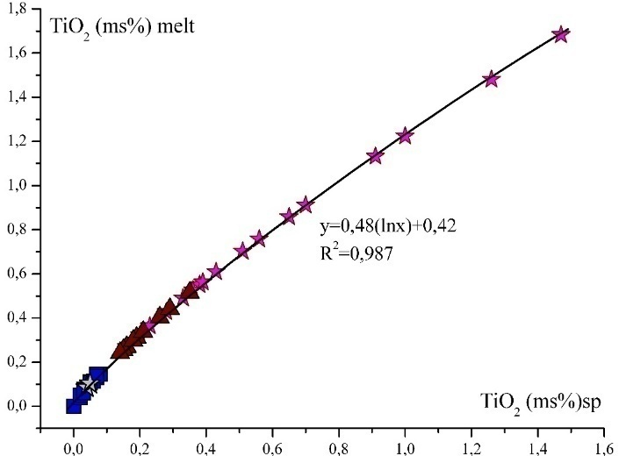
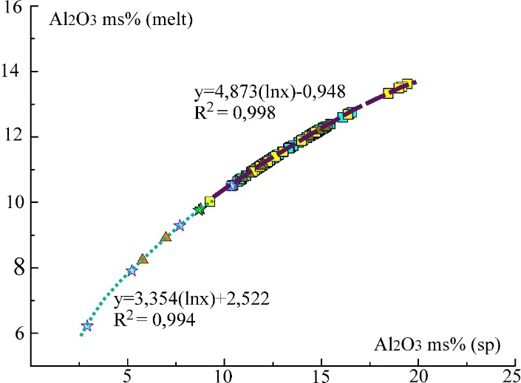
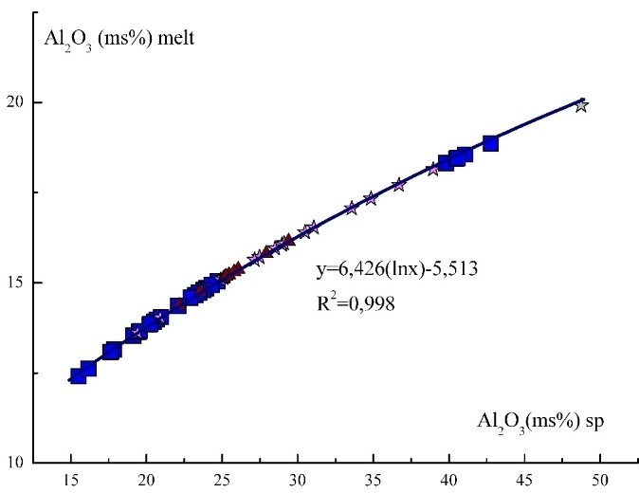
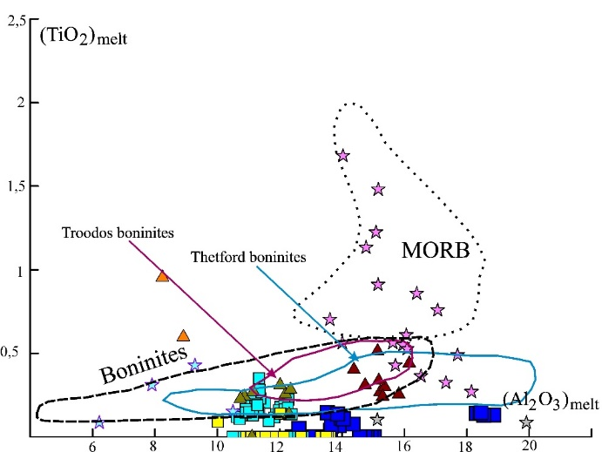
Ore chr-spinels from the podiform chromite on the discriminatory diagrams are divided into three groups and localized in the fields MORB-type (I group), supra-subduction zone (boninites) peridotites (I, II groups), Alaskan type (III group) (a-c). Graphic plots of calculated Al₂O₃ composition of melts in equilibrium with Ulan-Saridag chromitites, compared with spinel melt relationship for MORB (a) and Arc lavas and chromitites Alyaskan type (b).
a
b
c
d
e
f
g
The chr-spinels composition of podiform chromitites, in terms of their FeO, MgO, Al₂O₃, TiO₂ contents, is considered to function of the parental melt composition. We estimated the Al₂O₃, TiO₂ contents and FeO/MgO of the parental melt composition in equilibrium with the podiform chromite (table above). The chr-spineles of group I correspond to trend (Al₂O₃)_{sp} – (Al₂O₃)_{melt} for MORB setting (d). The chr-spineles of group II and III correspond to trend Island arc boninites (8) and chromite from Uralo-Alaskan Complex (15) (e). The calculated abundance TiO₂ in melt is very low and do not reach (arrive) the field of MORB type. Despite the low TiO₂ content, the trend of (TiO₂)_{sp} – (TiO₂)_{melt} corresponds to this trend for MORB spinel’s. It is remarkable that the ratios of (TiO₂)_{sp}/(TiO₂)_{melt} are similar to this ratio in chr-spinels from abyssal peridotites (f). Based on calculated of abundance TiO₂ and Al₂O₃ in melt chr-spineles of massive Ulan-Saridag lie in Boninitic field (g).

Slide 16
PGE distribution and mineralization
Graphs of the distribution of PGE in chromitites of massif Ulan-Saridag
Graphs of the distribution of PGE in massif chromitites (literatura data)
Total PGE concentration in 9 chromitites samples ranges from 242 to 992 ppb and is about 2,5 to 5,5 times higher than in serpentinized peridotites. The all chromitites have enrichment Pd (78-903 ppb). It is unusual for chromitites. There is no obvious correlation between PGE abundance and chromite composition. All samples has positive correlation among the pairs Os-Ir (R₂=0.79), Ir-Ru (R₂=0.71), Os-Ru (R₂=0.64). Palladium has no correlation with another elements.
Chondrite-normalised PGE patterns of Ulan-Saryadag chromitites display average (Os+Ir+Ru)/(Rh+Pt+Pd) ratios typical of Cr-rich chromitites formed in the mantle section of supra-subduction zone ophiolites In most cases, PGE patterns are characterized by a consistent positive anomaly in Ru, and a negative anomaly in Pt.
Rocks/C1
Literature data:
I - Ahmed Hassan Ahmed, Hesham M. Harbi, Abdelmonem M. Habtoor (2012). Compositional variations and tectonic settings of podiform chromitites and associated ultramafic rocks of the Neoproterozoic ophiolite at Wadi Al Hwanet, northwestern Saudi Arabia. Journal of Asian Earth Sciences 56,118–134.
II - Prichard H. M., Lord R. A., Neary C. R. (1996). A model to explain the occurrence of platinum – and palladium – rich ophiolite complexes. Journal of the Geological Society, 153, 323-328. (Chromitittes from Oman ophiolite, northen Semail)
III – Tsoupas G. , Economou-Eliopoulos M. (2008). High PGE contents and extremaly abundant PGE-minerals hosted in chromitites from Veria ophiolite complex, northern Greece. Ore Geology Reviews 33, 3-19.
IV – Gurskaya L.I., Smelova L.V., Kolbancev L.R., Lyahnickiy U.S., Shahova S.N. (2004) Platinum mineralization in chromite-bearing ultrabasic-basic massives of chromitites from Ray-Iz massive Polyar-Ural. Publishing office St-Pet. mapfactories FSBI. 306 p (in Russian).
V – Agafonov L.V., Lhamsuran G, Kuguget K.S., Oydup Ch.K. (2005). Platinum-bearing of ultramafic-mafic complexes of Mongolia and Tuva. Ulaan-Batar, 224.
For all publications: 1 - the chromitites are enriched in Os-Ir-Ru, 2 - chromitites enriched in Pt-Pd

Slide 17
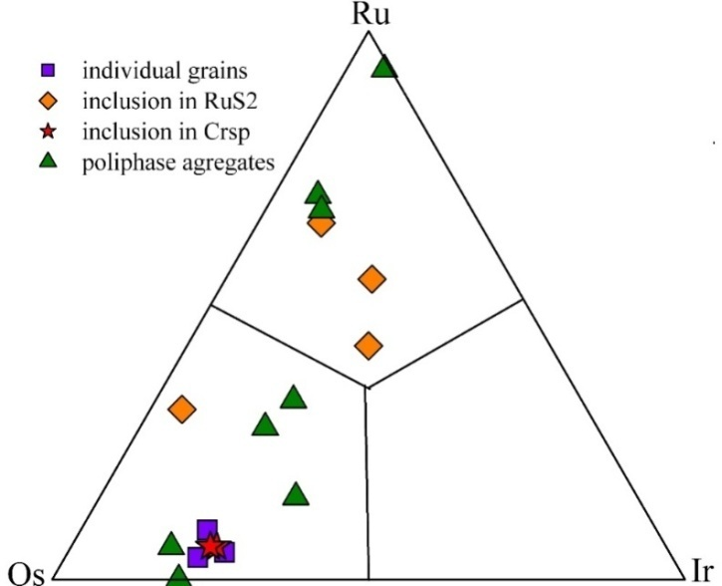
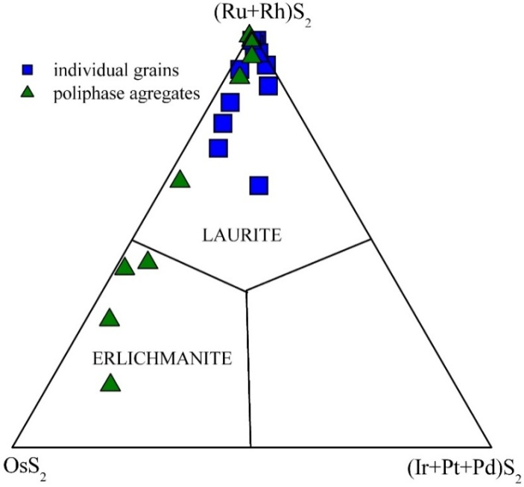
PGE mineralization are represented by Os-Ir-(Ru) solid solutions, native Os, Ru, laurite-erlichmanite (Ru,Os)S₂, laurite (RuS₂), irarsite (IrAsS), zakarinit (RhNiAs).
Diagram of composition Os-Ir-Ru alloys
Sulfides of PGE are the predominant phases in chromites of Ulan-Saryadag massives. They occure as idiomorphic inclusions in chrom-spinelides. Solid solutions of Os-Ir-(Ru) were found as idiomorphic inclusions in spinel, and in xenomorphic grains in intergrowths with laurite. Solid-solution laurite-erlichmanite and Os-Ir correspond to early high-temperature magmatic stage.
The phases (Os, Ir, Ru) of varying composition are common as numerous micro - and nano-size inclusions in laurite-erlichmanite. Native Os (Os> 80 wt.%) and Ru (Ru=93 wt.%) occur in polyphase aggregates, together with chalcocite, laurite, laurite-erlichmanite, heazlewoodite , zakarinite, Os-Ir-Ru solid solutions.
Laurite and laurite-erlichmanite RuS₂-(Ru,Os)S₂ are represented most widely. There are two groups: 1) laurite-erlichmanite (Ru,Os)S₂; 2) laurite RuS₂ – phase of variable composition (Ru,Os)S₂ occurring in multi-component aggregates of heterogeneous composition and containing a large number of rounded and rectangular micro-inclusions of native Os, (Os-Ir), and Ru. Laurite has homogeneous microstructure and composition consistent with the stoichiometric composition. It forms individual grains in chlorite and serpentine. It is known that (Os-Ir) and solid solutions of laurit-erlichmanite are forming before or nearly simultaneously with the segregation of chrome - spinel in the upper mantle at T=1200oC and P= 5-10 kbar.
Sulfo-arsenides and arsenides of Ru, Ir, Rh, Ni are formed from the residual fluid phase at post-magmatic stage, together with heazlewoodite. It is possible that in chromitites from USM there are two generations of sulphides:
The first generation – magmatic solid solutions of laurite-erlichmanite.
The second stage– the newly formed laurite, with primary laurite-erlichmanite or intergrowths with chalcosine, and millerite confined to zones of chloritization.
The predominance of Os, Ru sulphides over the solid solutions of Os-Ir-Ru indicates a higher sulfur fugacity in the mantle source of USM
Diagram of composition PGE sulfides

Slide 18
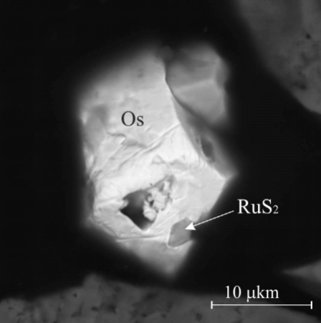
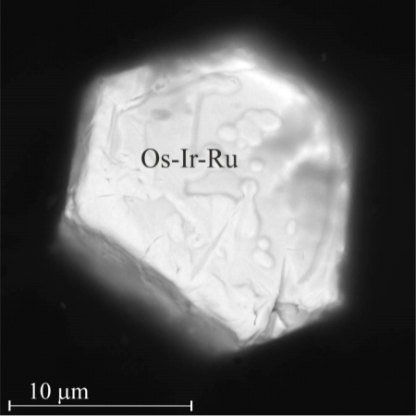
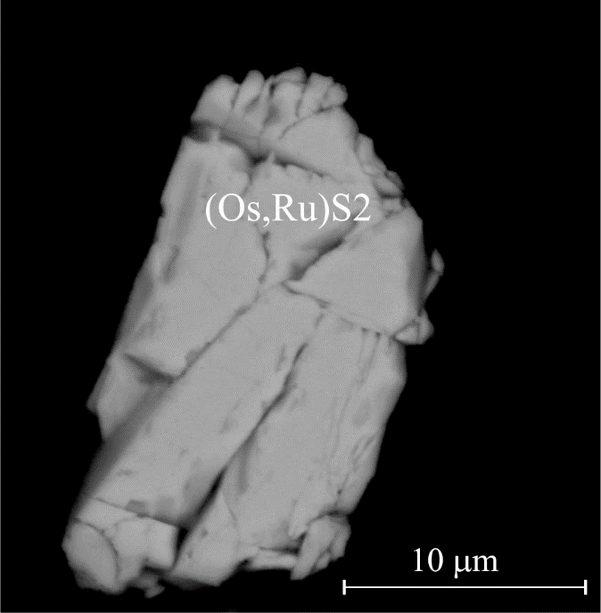
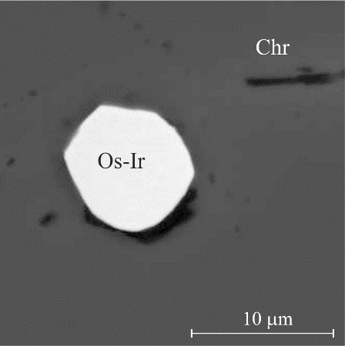
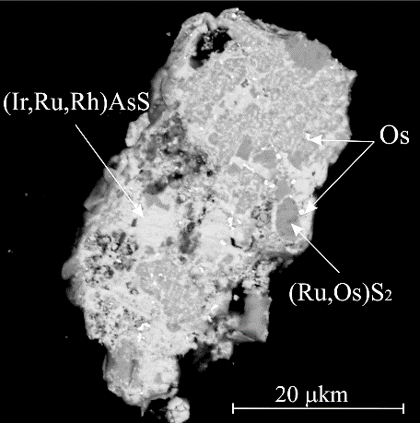
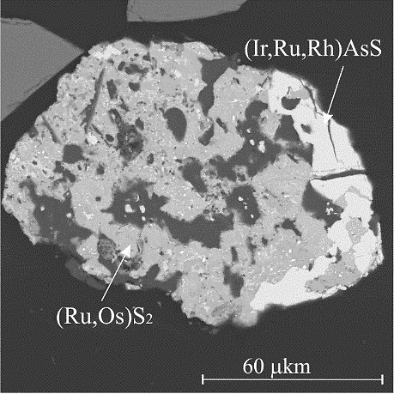
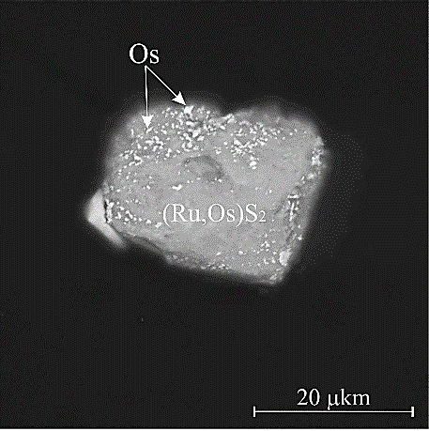
I - MAGMATIC STAGE
II - POSTMAGMATIC STAGE
substitution of laurite-erlichmanite by irarsite
Desulfurization processes
III - METAMORPHIC STAGE
Remobilization, enlargement of nanorparticle to microlevel, recrystallization (under increasing temperature)
Processes of integration and aglomeration

Slide 19
CONCLUSION
1. The geochemical features of the volcanic and ultramafic rocks are consistent with Supra-Subduction Zone
2. Enrichment of incompatible (LILE, LREE). All rocks are enriched by the incompatible, non-conservative elements such us Ba, Th, Cs, Rb. This is characteristic for subduction related ophiolites. Enrichment of non-conservative (Cs, Ba,Th, U, La, Ce, Sr, Nd) in the mantle wedge above subduction zones occurs when fluids and silicic melts are released from subducted, altered oceanic crust and assotiated sediments move into and react with upper mantle peridotites. Negative anomalies for Nb is typical for subducted related ophiolites. This is due to the fact that during slab dehydration dehydration Nb, Zr, Hf, Ti are conservative and are retained in the downgoing slab.
3. Boninites are the type of vulcanites that can unambiguously indicate their origin in the suprasubduction conditions of the ensimatic island arcs.
Positive anomaly Zr can be related with If the thermal conditions in the subduction zone are such that the slab melts, then Nb, Zr, Hf become non-conservative and are described above the baseline.
4. Difference in geochemical features indicates that there are several sources for Ilchir volcanites. Source for OIB basalts consist of restitic oceanic crust, wich recycling in mantle. The new data on volcanics of the Ulan-Sairdag massive (picrobasalts, subalkaline trachybasalts, trachyandesites, alkali basalts) indicate spreading conditions and of local plume magmatism, according to the slab-window mechanism in the subducted plate (Thorkelson and Taylor 1989, Haeussleretal, 1995). ).A slab window model can also explain the multiple geochemical composition of volcanites of massive Ulan-Sardag.
5. Chr-spinels rarely alteratied and can be used a reliable petrogenetic indicator. The primary chemistry of chr-spinels provides important information about the composition of the parental melt, magmatic processes (partial melting). Chr-spinelsformed by participation of magmas of different composition and then changed in suprusubduction setting. Chr-spinels are localized into three fields: MORB, High-Al chromites from MORB-like tholeiitic magmas (in a back-arc setting), during melt/mantle interaction with a subsequent change to a subduction setting. High-Cr spinelides are thought to form from boninitic magmas in an island arc environment (subduction setting)
Chr-spinels are localized in the fields MORB-type (the first group), Supra-subduction zone (Boninites) peridotites (the second and part of the first group), Alaskan type (the third group). The chromites falling into the field of the Uralo-Alaskan type could be formed during the partial melting of the fluid metasomatized mantle, with the interaction of andesitoid melts with the rocks of the overlying mantle wedge (Volchenko et al., 2007; Burns, 1985, Garuti etal., 2012).
The paleoreconstruction of the formation of the Sayano-Baikal-Muya accretionary-collisional belt

Slide 20
7. Chondrite-normalised PGE patterns of Ulan-Saridag chromitites display average (Os+Ir+Ru)/(Rh+Pt+Pd) ratios typical of Cr-rich chromitites formed in the mantle section of supra subduction zone ophiolites. The processes leading to extreme fractionation of PGE can be connected fluid-saturated supra-subduction.
It is known that (Os-Ir) and solid solutions of laurit-erlichmanite are forming before or nearly simultaneously with the segregation of chrome - spinel in the upper mantle at T=1200°C and P= 5-10 kbar.
We suppose there are two generation of sulphides in chromitites from Ulan-Saridag massive
1- PGM generation – magmatic solid solutions of laurite-erlichmanite.
2 - generation the newly formed laurite, with primary laurite-erlichmanite or intergrowths with chalcosine, and millerite is found in zones of chloritization. It has assotiation with serpentine, chlorite, irarsite, and BSE sulfides (Ni).
The predominance of Os, Ru sulphides over the solid solutions of Os-Ir-Ru indicates a higher sulfur fugacity in the mantle source of Ulan-Saridg massive, than other ultrabasic massive of Dungugur ophiolites.
Sulfo-arsenides and arsenides of Ru, Ir, Rh, Ni are formed from the residual fluid phase at post-magmatic stage, together with heazlewoodite. Metamorphogenic stage: in the process of serpentinization and chloritization at a temperature of about 300°C, Al₂O₃ and MgO were removed from chrom-spinelides by the formation of high-iron and high-chromium Chr-spinelides.
Infiltration of the fluid along the permeable (проницаемые) zones into laurit-erlikmanite led to dessulfurization of sulfides, deviation from stoichiometry, the appearance of microdefects in the crystal lattice, the appearance of nanopores on the grain surface.
According to the experimental data, the congruent dissotiation (разложение) of RuS₂ → Ru0 occurs at T = 300°C, fS₂ = (-20), P = 0.5 kbar. The appearance of nano- and microparticles Os0, Ru0, (Os, Ir), in laurit-erlicmanite is the result of elemental rearrangement due to to variations of T and fS₂. In the course of progressive metamorphism (epidote-amphibolite, amphibolite facies) and / or thermal event (introduction of granitic intrusion), the changed P-T conditions affected on the stability of nanoparticles.
At increasing the temperature to 590-650°C (amphibolite facies), the nanoparticles in the sulfide matrix become unstable, which leads to their coalescence, agglomeration and coarsening (to micron sizes).
Thank you for attention

