Slide 1

Time-resolved accumulation of essential and strategic elements in different bioenergy plants
Melvice Ngalle EPEDE
EGU 2018
PICO presentation: Session SSS8.1 - Advances in bioremediation and biomining research
Thursday, 12 Apr 2018, 10:40.

Slide 2
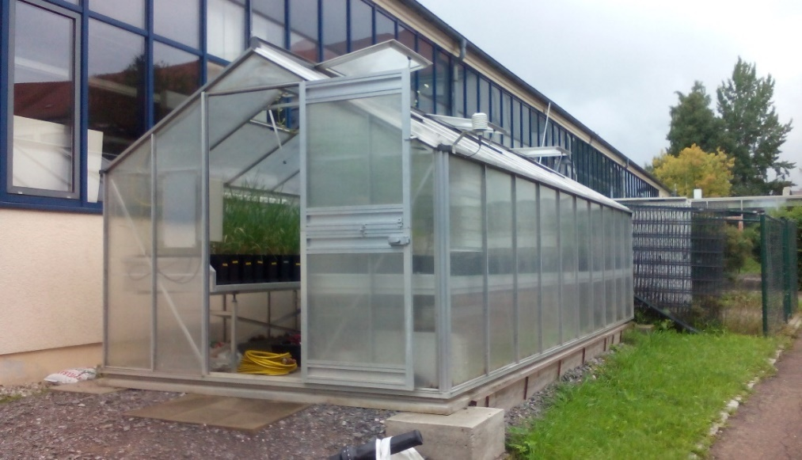
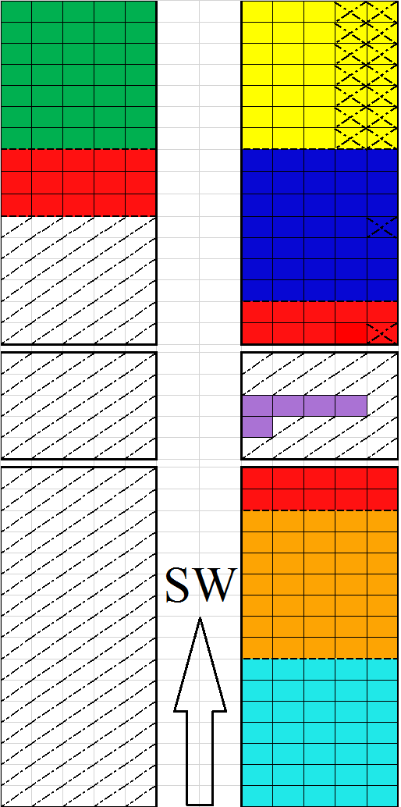
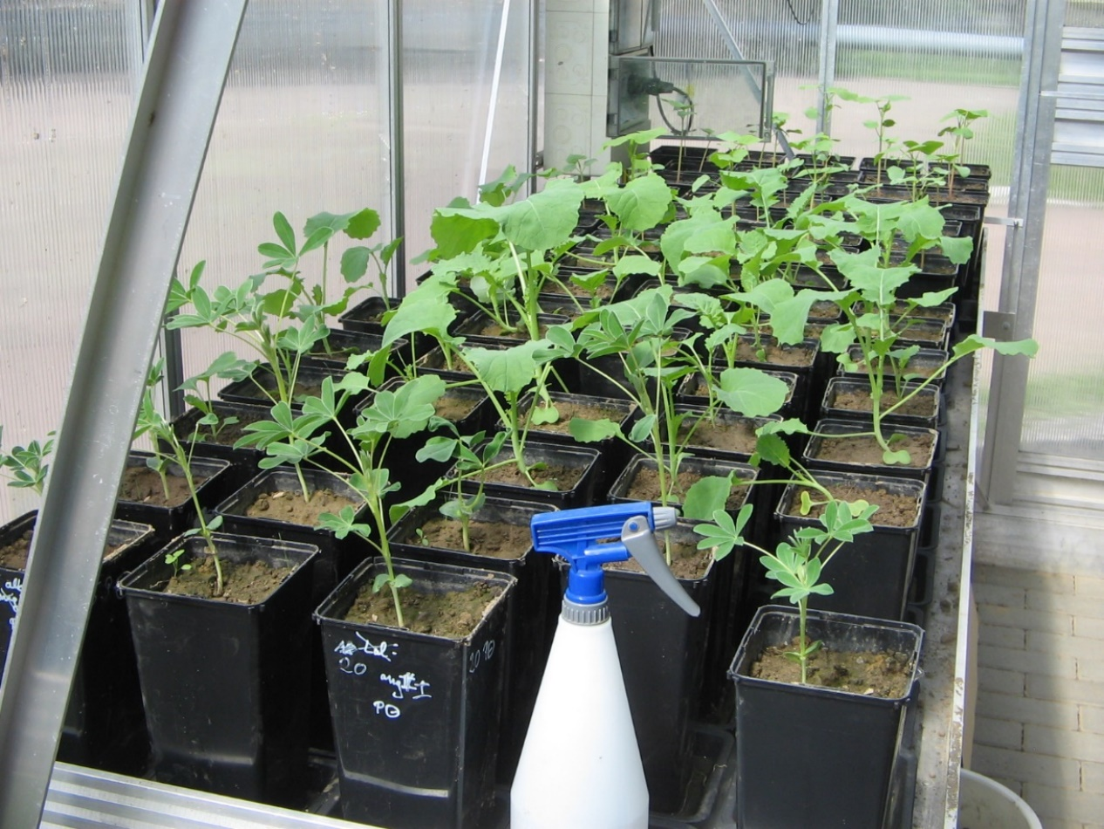
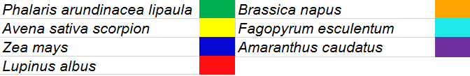
Greenhouse Set-up

Slide 3
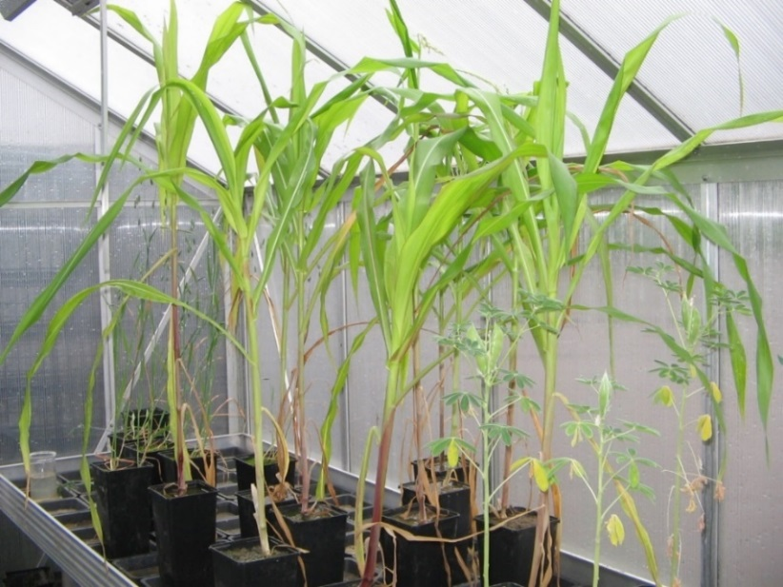
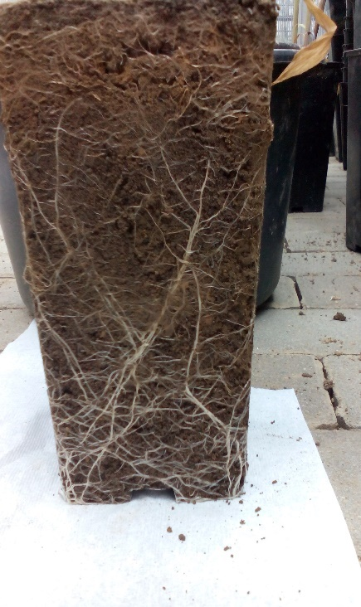
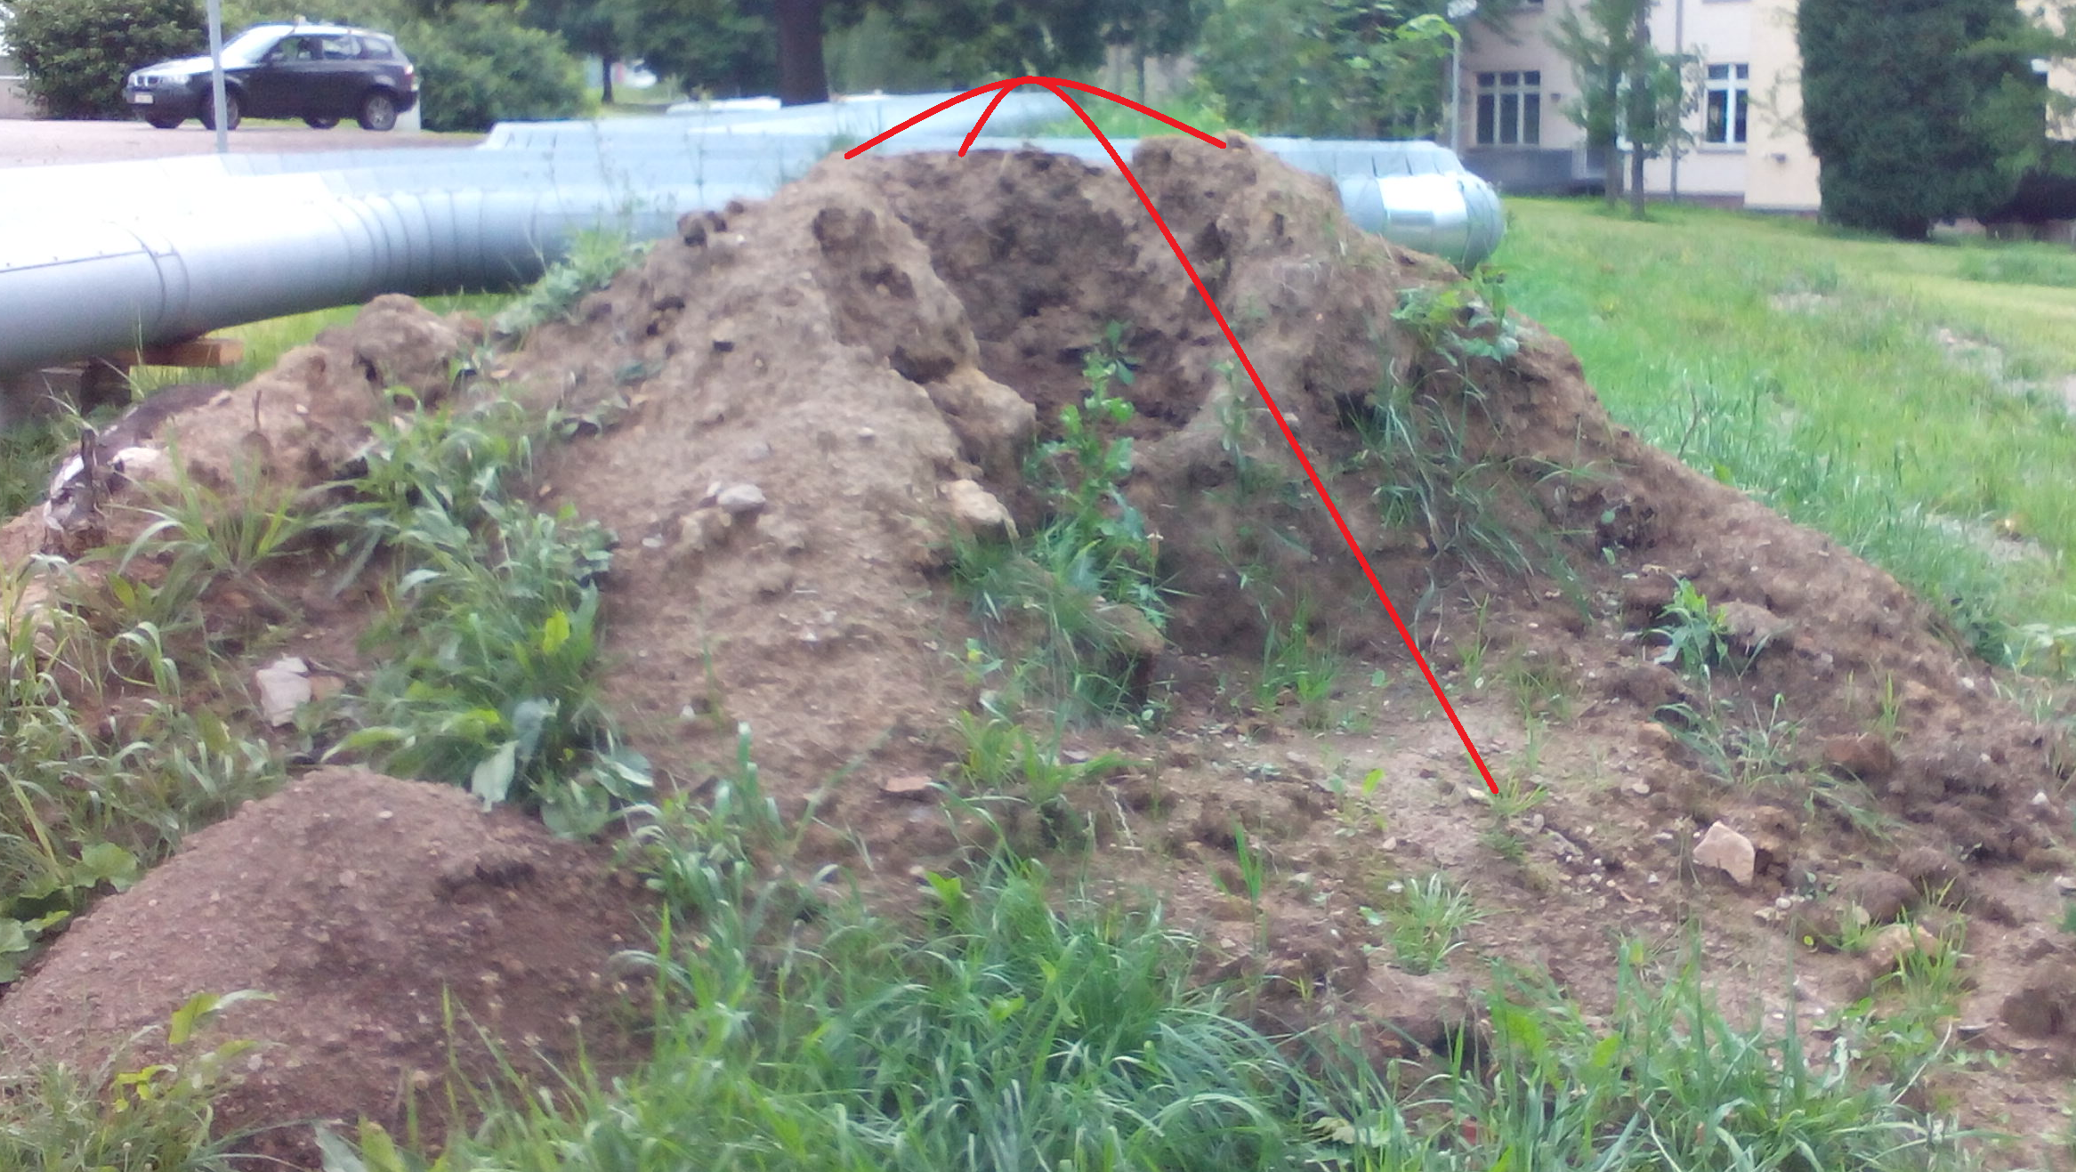
Heap from contruction site in campus
Milling
Weighing
Decomposition
Microwave digestion
Dilution
ICP-MS
Soil charaterisation
 | Ge [mg/kg] | Si [g/kg] | La [mg/kg] | Ca [g/kg] | Fe [mg/kg]
Gesamtkonz. | 1,82±0,21 | 111,4±17,0 | 23,07±1,57 | 7,35±0,68 | 23572±2027
Fraktion I | 0,049±0,001 | 0,116±0,004 | 0,056±0,001 | 4,21±0,15 | 0,77±1,50
Fraktion II | 0,053±0,002 | 0,132±0,007 | 0,335±0,022 | 0,48±0,06 | 15,77±0,21

Slide 4
Concentrations of Si, Ca, Ge and La in shoot and root biomass
Avena sativa
There seems to be association between Ca and Si
Also between Ge and La in all the species

Slide 5
Concentrations of Si, Ca, Ge and La in shoot and root biomass
Phalaris arudinacea

Slide 6
Concentrations of Si, Ca, Ge and La in shoot and root biomass
Zea mays

Slide 7
Concentrations of Si, Ca, Ge and La in shoot and root biomass
Harvest day | difference | lower | upper | P value
2-1 | -4845.2 | -9165.5 | -524.9 | 0.02
3-1 | -6940.6 | -11260.9 | -2620.4 | 0.00005
4-1 | -8583.2 | -13531.8 | -3634.7 | 0.000008
5-1 | -4977.0 | -9979.2 | 25.1 | 0.05
6-1 | -5759.4 | -10708.0 | -810.9 | 0.01
7-1 | -7381.3 | -12144.5 | -2618.2 | 0.0001

Slide 8
Concentrations of Si, Ca, Ge and La in shoot and root biomass
No statistically significant difference between the different harvest dates
Day 3-1 (P value = 0.06 (>.05))

Slide 9
Concentrations of Si, Ca, Ge and La in shoot and root biomass
Harvest day | difference | lower | upper | P value
3-1 | -0.16 | -0.29 | -0.03 | 0.005
4-1 | -0.18 | -0.33 | -0.02 | 0.01
7-1 | -0.18 | -0.33 | -0.04 | 0.004

Slide 10
Concentrations of Si, Ca, Ge and La in shoot and root biomass
Harvest day | difference | lower | upper | P value
3-1 | -1.22 | -2.22 | -0.23 | 0.005
4-1 | -1.25 | -2.39 | -0.11 | 0.02
7-1 | -1.19 | -2.29 | -0.10 | 0.02

Slide 11
The results of this study clearly shows a time dependency of elemental accumulation.
However, there is a statistically significant difference between essential nutrients and other strategic elements;
Among different plant species (df = 6, F Test = 7.098, P value < 0.001)
Between the different plant tissues ( df = 1, F Test = 33.366, P value < 0.001)
Among the different elements (df = 6, F Test =2.126, P value < 0.001)

