Slide 1
EGU 2018-7927
CL.18
11/4/2018
Evolution of the Viennese Urban Heat Island caused by expected Reduction of Vegetation Fraction in favour of Built-up Land until 2030/2050
Project: URBANIA - Influence of the development of outlying districts and urban growth on the urban heat island of the city of Vienna in the context of climate change
ACRP 8th call: KR14AC7K11944
1 Viennese Growth
2 Models
3 Urban Szenarios
4 Conclusion and outlook
Project team:
Institute of Meteorology, University of Natural Resources and Life Sciences (BOKU):
BOKU-Rad: Philipp Weihs, Heidelinde Trimmel, Sandro Oswald
BOKU-Klim: Herbert Formayer, Imran Nadeem
BOKU-Biomet: Erich Mursch-Radlgruber, Christian Gützer
Environmental Agency of Vienna (MA22): Jürgen Preiss, Christian Härtel
CNRS-Météo-France: Valéry Masson, Robert Schoetter, Aude Lemonsu, Stéphanie Faroux

Slide 2
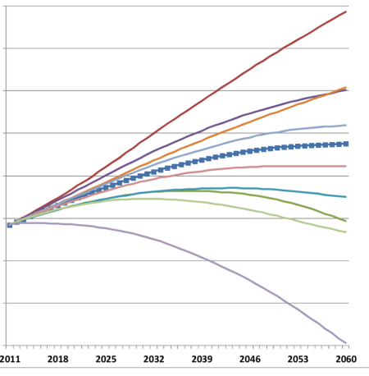
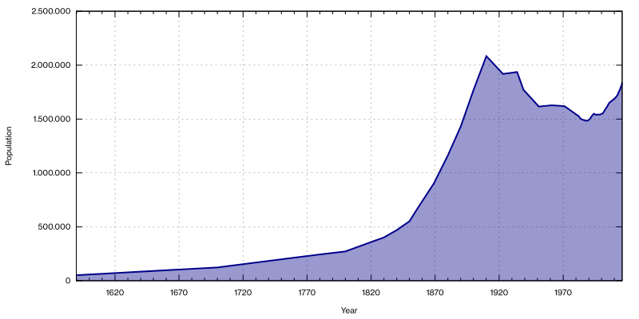
EGU 2018-7927
CL.18
11/4/2018
Motivation
Vienna‘s population is growing ...
- > will reach 1900 level again 2028
-> but 1971:22.9m²/person, 2014:44.7m²/person (trend stabalizing)
-> amount of population growth uncertain (parameters: fertility, life expectancy, migration (national and international))
1 Viennese Growth
2 Models
3 Urban Szenarios
Breakdown of Austrian-Hungarian Empire
4 Conclusion and outlook
Von Lodp - Eigenes Werk, Statistischen Mitteilungen der Stadt Wien (Heft 4/2000)Statistik Austria. Statistisches Jahrbuch 2009. http://www.statistik.at/web_de/static/bevoelkerung_zu_jahresbeginn_seit_1981_nach_bundeslaendern_031770.xlsx http://www.statistik.at/web_de/static/bevoelkerung_zu_quartalsbeginn_seit_2002_nach_bundesland_023582.xlsx
http://www.statistik.at/web_de/statistiken/menschen_und_gesellschaft/bevoelkerung/bevoelkerungsstand_und_veraenderung/bevoelkerung_zu_jahres-_quartalsanfang/023582.html , CC BY-SA 3.0, https://commons.wikimedia.org/w/index.php?curid=29606863

Slide 3
EGU 2018-7927
CL.18
11/4/2018
Motivation
1 Viennese Growth
2 Models
3 Urban Szenarios
4 Conclusion and outlook
1844 - Description of urban heat island by A.Stifter
-> increased demand and supply of residential and other urban areas
-> increased urban heat island
Problem? Lets have EGU in summer to discuss...

Slide 4
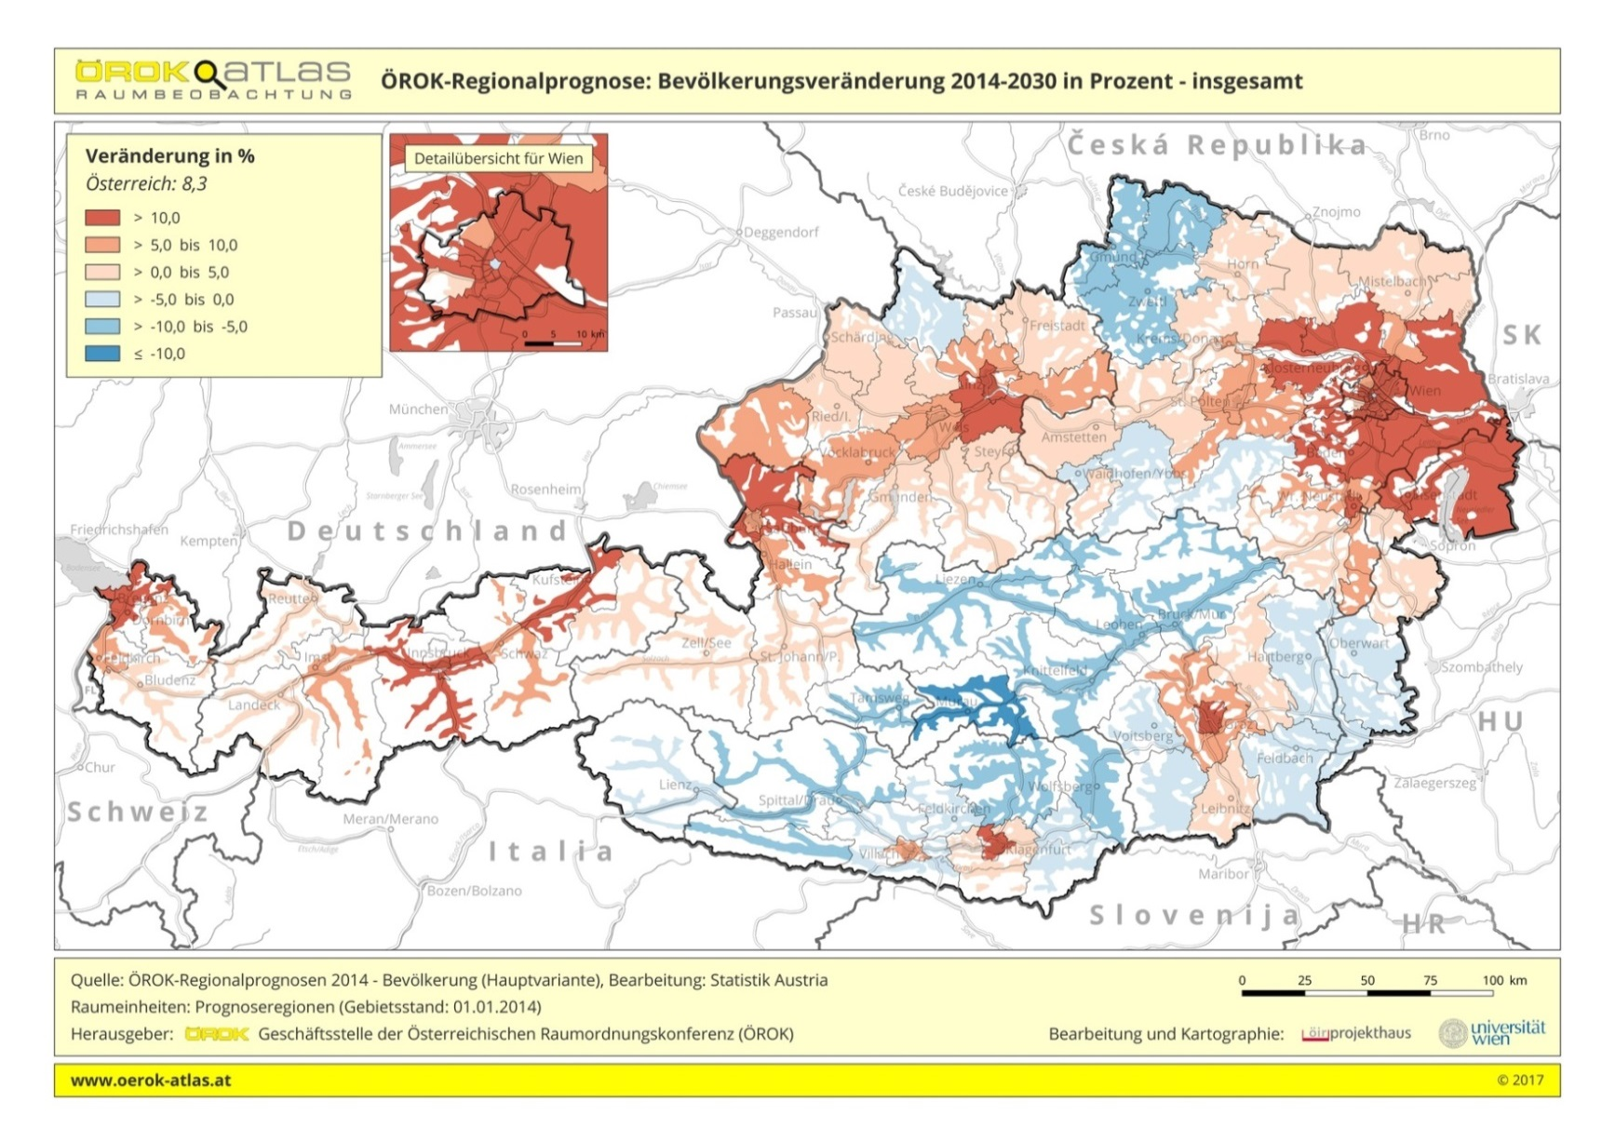
EGU 2018-7927
CL.18
11/4/2018
How much + where?
Population is growing in widespread around city borders
Greater Vienna: 2030: max +15.15% per district
2060: max +29.30% per district
-> main growth in „stadtregion+“ (see: PGO 2010)
1 Viennese Growth
within city borders: 2030: max +27.2 % per district
2060: max +55.2 % per district
2 Models
3 Urban Szenarios
4 Conclusion and outlook

Slide 5
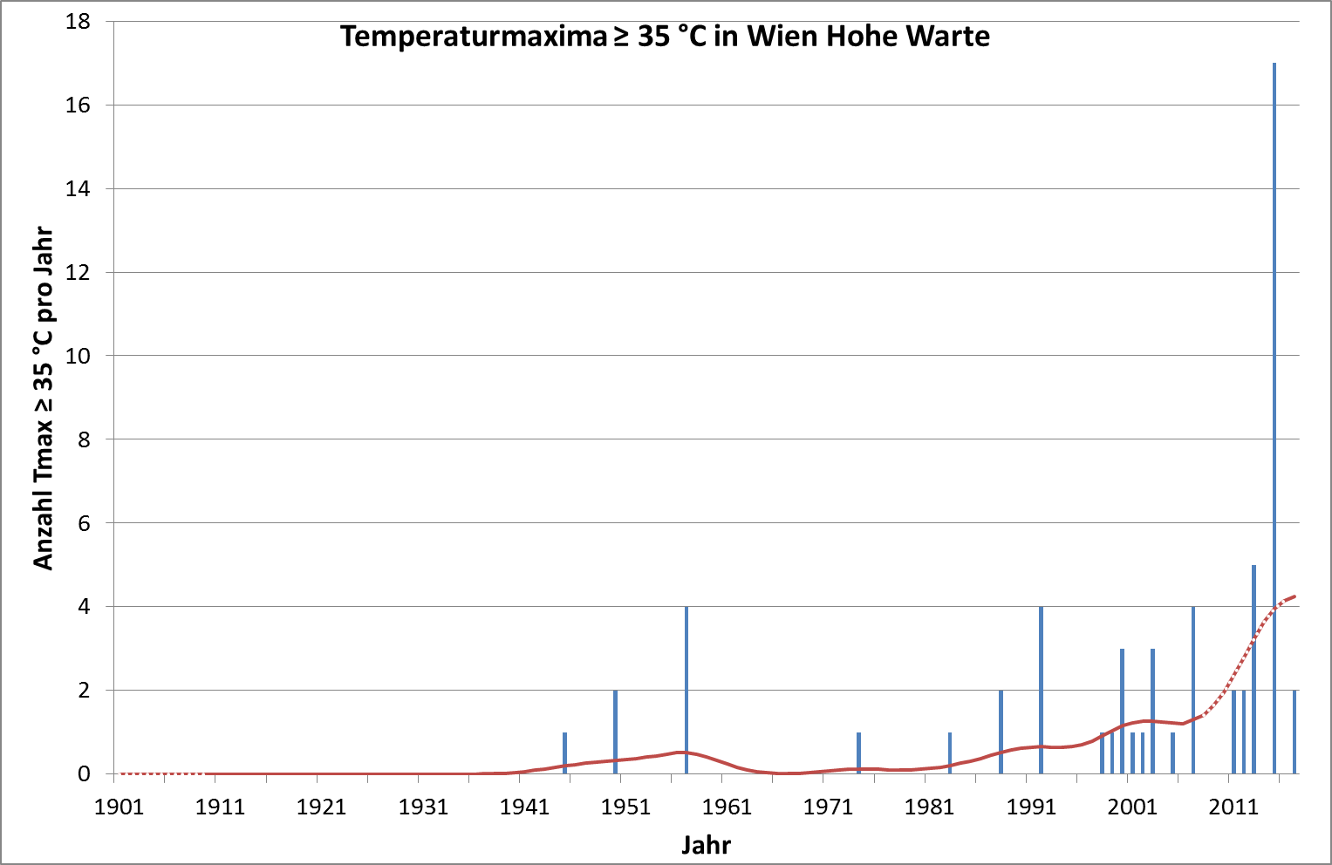
EGU 2018-7927
CL.18
11/4/2018
Selection of reference period
1 Viennese Growth
2015
2 Models
-> Tmax >= 35°C since observation started (Wien Hohe Warte)
3 Urban Szenarios
4 Conclusion and outlook
Number of days Tmax >=35°C per year
Year

Slide 6
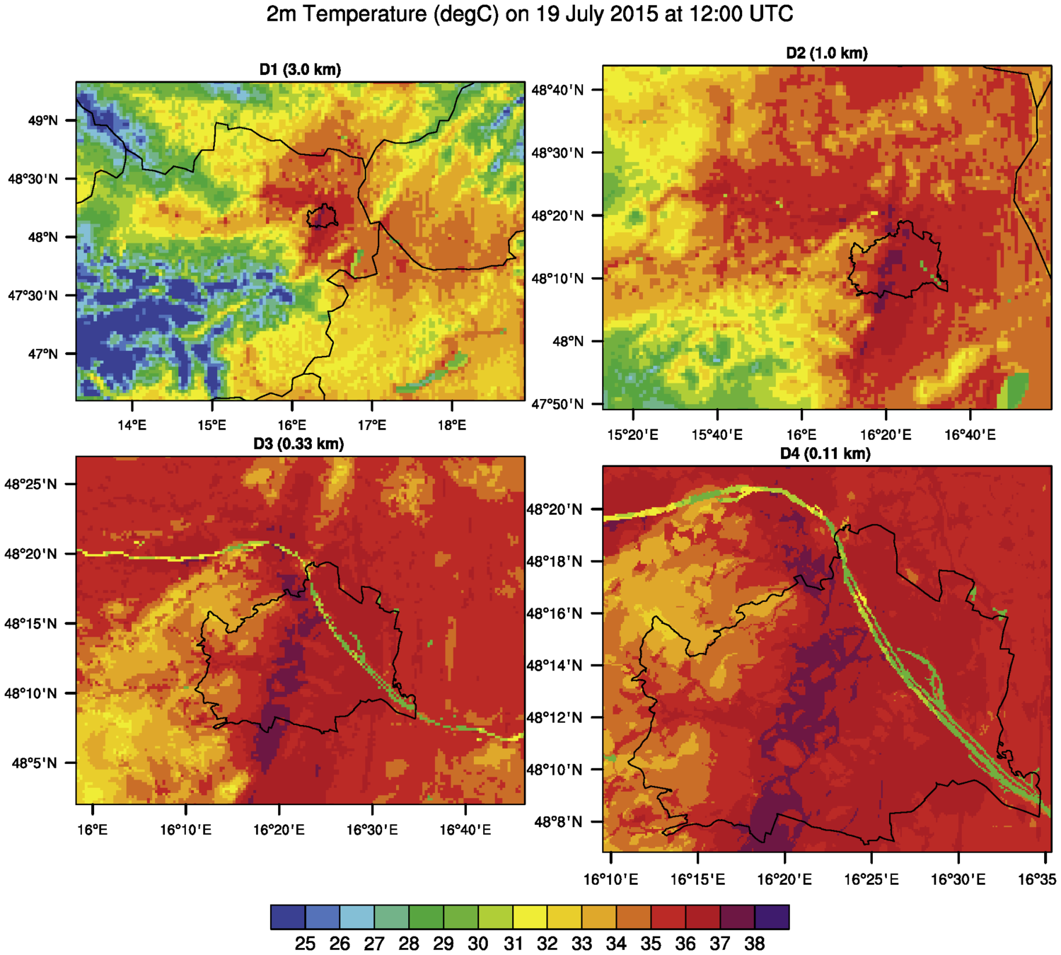
EGU 2018-7927
CL.18
11/4/2018
Lateral boundary conditions:
9km ECMWF analysis data (6h)
Static: Topography- SRTM1Arc:30m)
Landcover-USGS Classes (1 urban class)
WRF v3.9.1
1 Viennese Growth
NEST1
NEST2
2 Models
3 Urban Szenarios
4 Conclusion and outlook
NEST3
NEST4

Slide 7
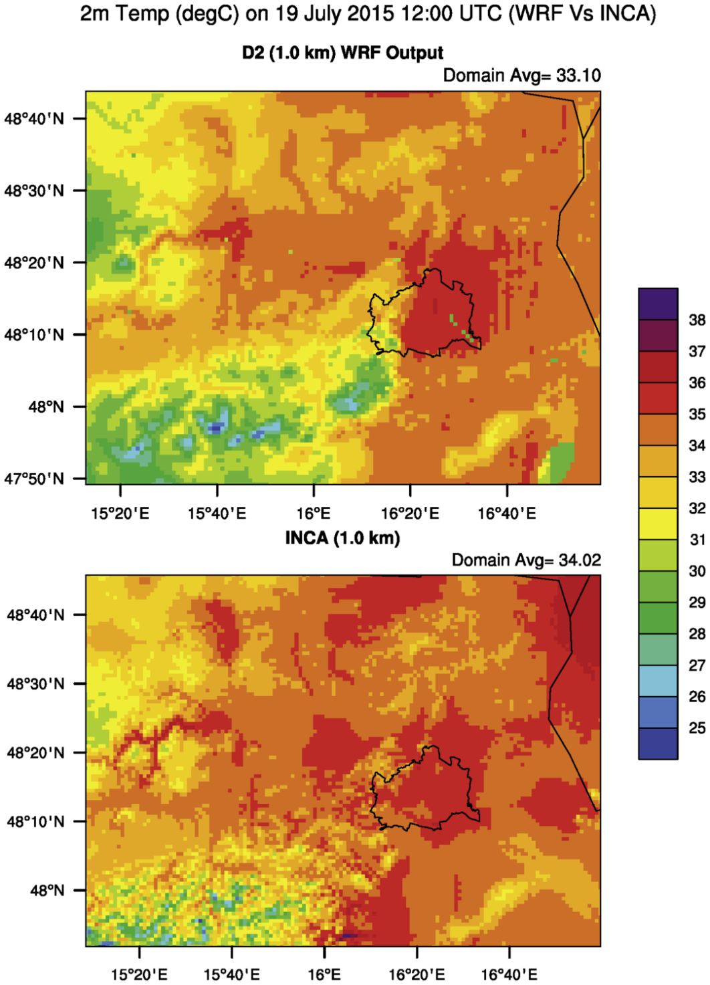
EGU 2018-7927
CL.18
11/4/2018
Comparison with observation data
1 Viennese Growth
-Spatial distribution fits
good to gridded
interpolated observations
data set (INCA¹)
- Spatial patterns are represented
even better (rivers and lakes, urban area )
-Absolute values fit good <1°C on average
- WRF slightly underestimates air temperature
2 Models
3 Urban Szenarios
4 Conclusion and outlook
¹ Haiden et al. 2011

Slide 8
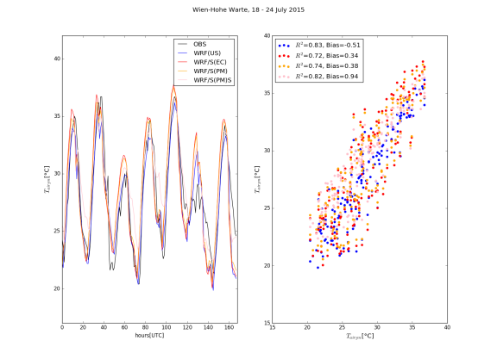
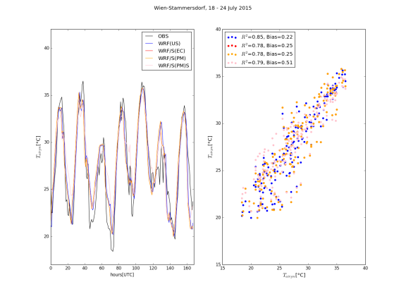
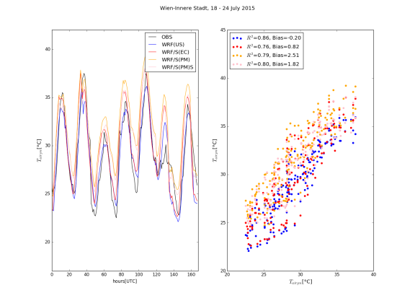
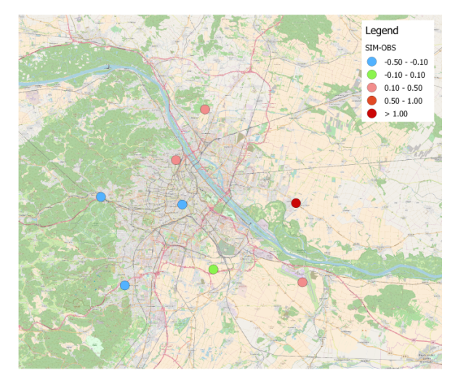
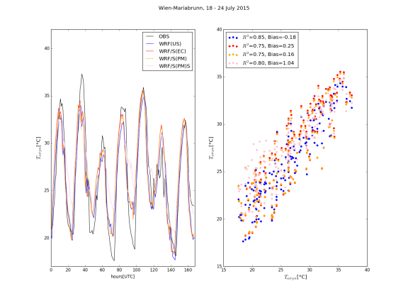
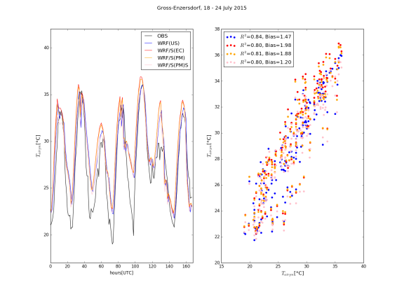
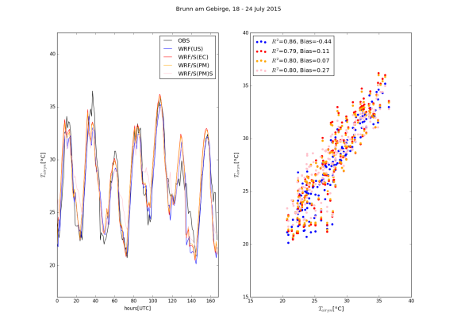
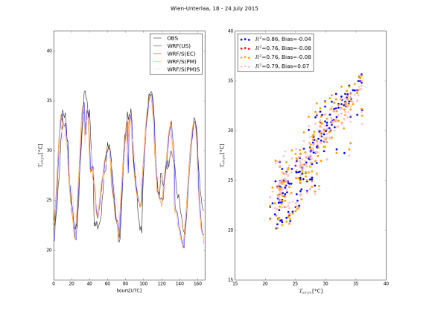
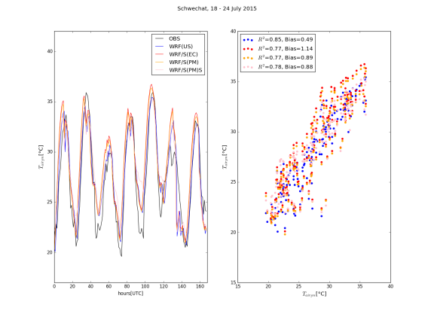
EGU 2018-7927
CL.18
11/4/2018
Comparison WRF, WRF/SURFEX offline and ground stations
1 Viennese Growth
2 Models
3 Urban Szenarios
4 Conclusion and outlook

Slide 9
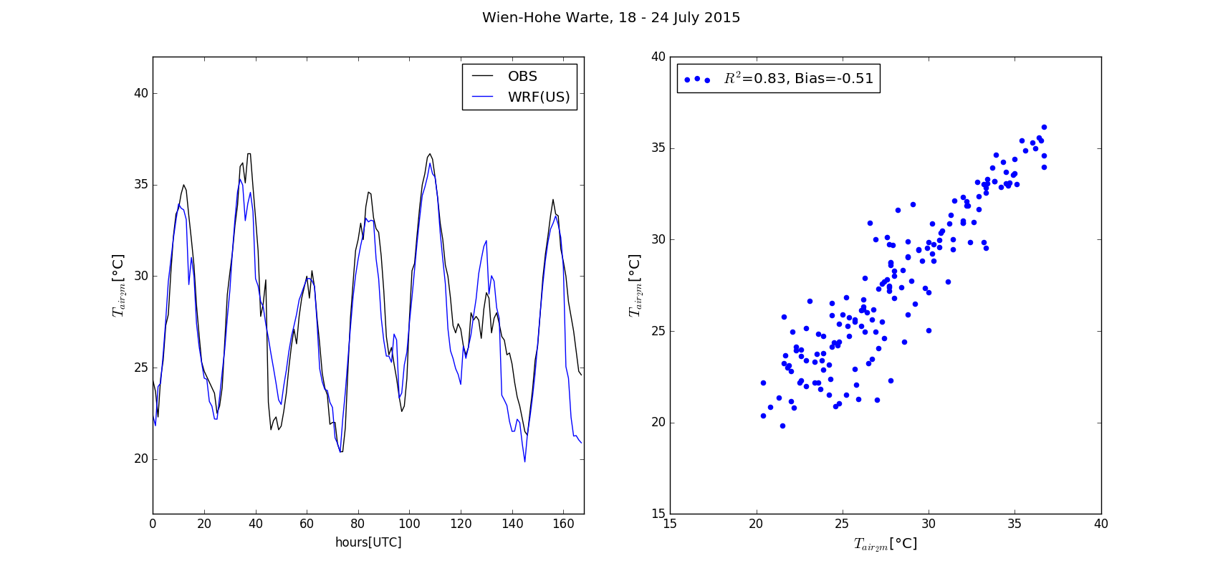
EGU 2018-7927
CL.18
11/4/2018
Comparison WRF, WRF/SURFEX offline and ground stations
1 Viennese Growth
Bias
Model runs:
- WRFv3.9.1 using USGS classes (US)
2 Models
3 Urban Szenarios
4 Conclusion and outlook

Slide 10
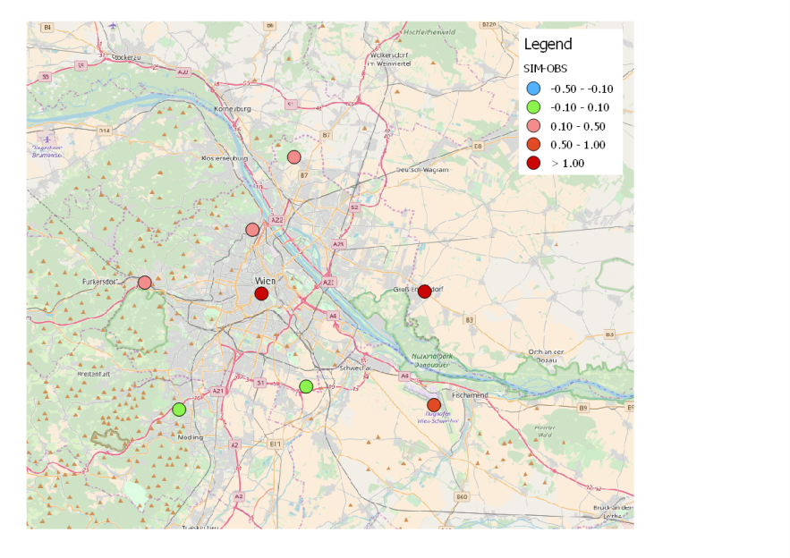
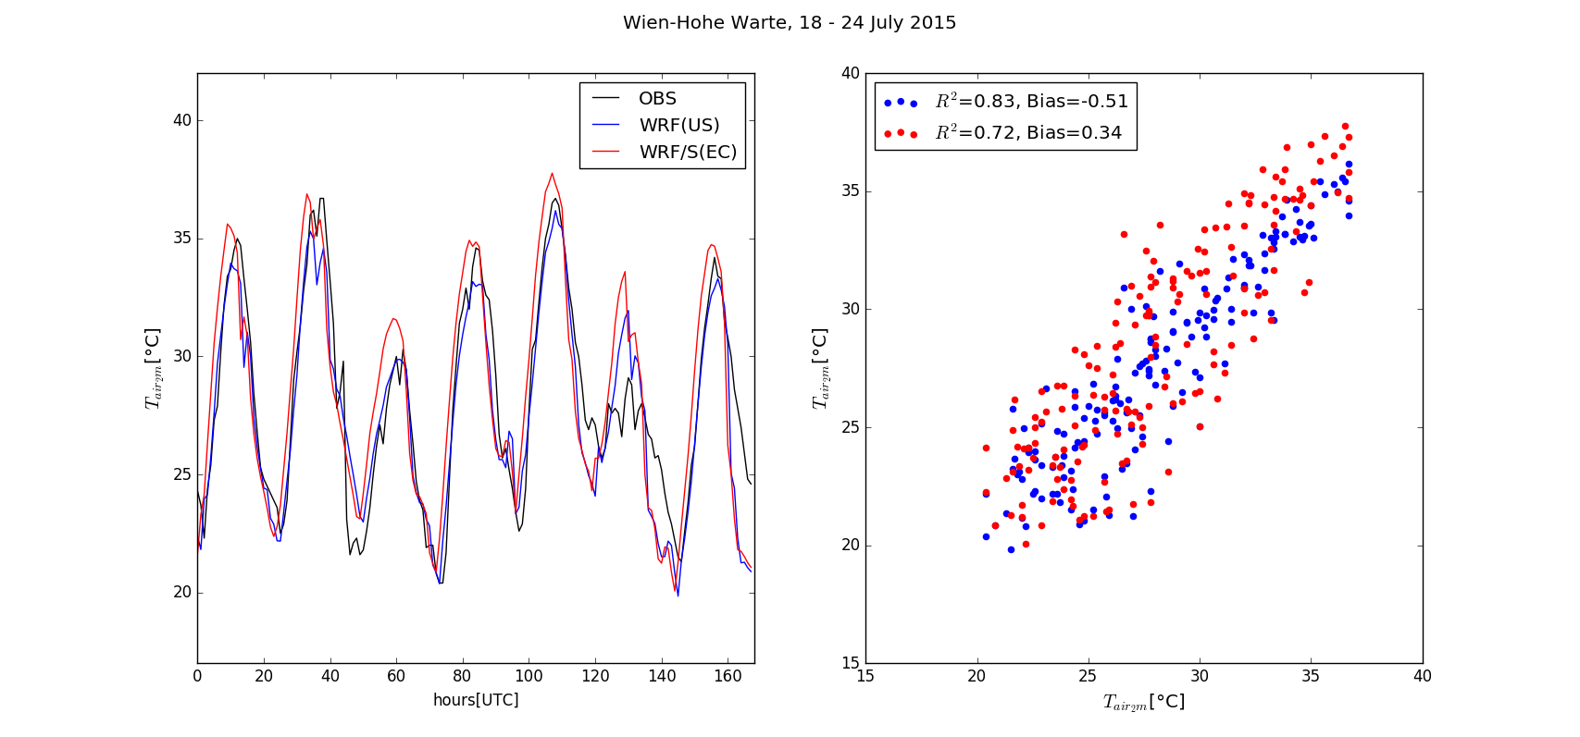
Comparison WRF, WRF/SURFEX offline and ground stations
1 Viennese Growth
Bias
Model runs:
- WRFv3.9.1 using USGS classes (US)
SURFEXv8 offline runs forced by WRF:
WRF/S using ECOCLIMAP (EC)
2 Models
3 Urban Szenarios
4 Conclusion and outlook

Slide 11
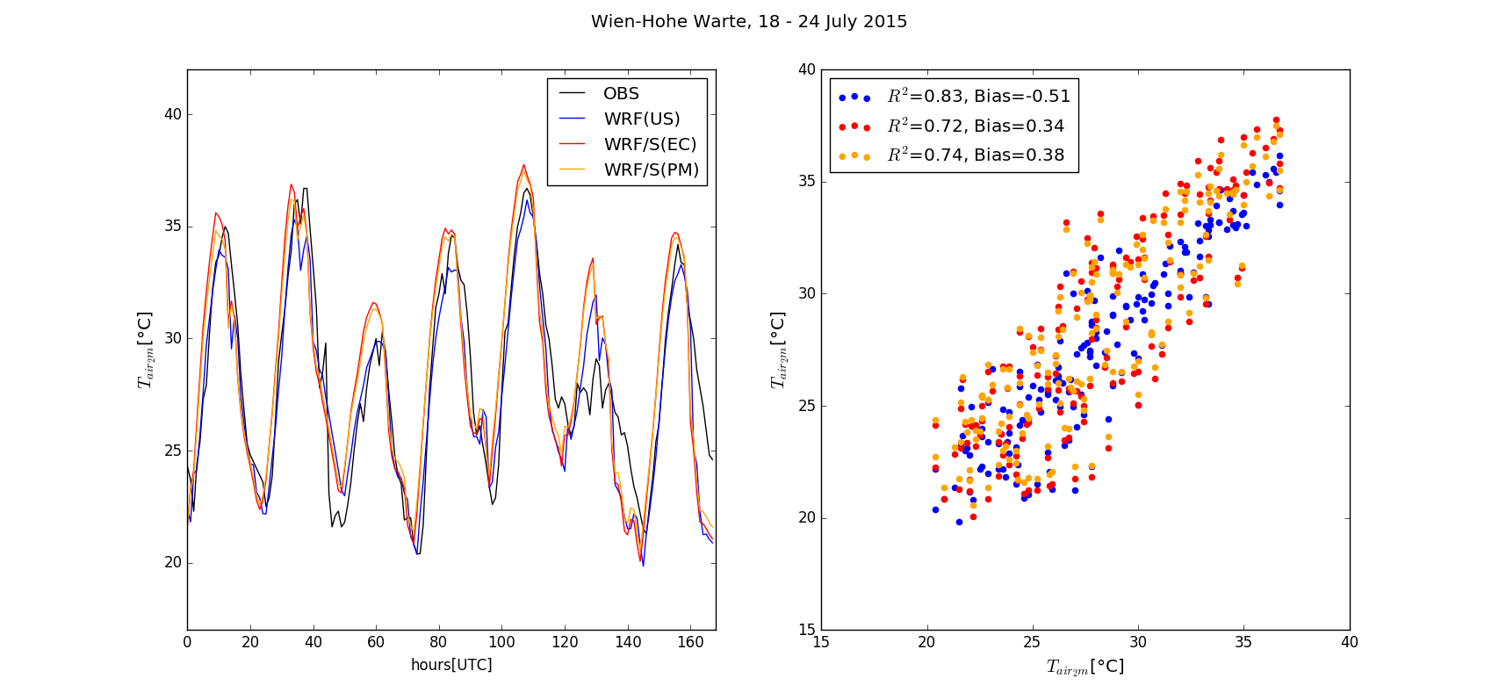
EGU 2018-7927
CL.18
11/4/2018
Comparison WRF, WRF/SURFEX offline and ground stations
1 Viennese Growth
Bias
Model runs:
- WRFv3.9.1 using USGS classes (US)
SURFEXv8 offline runs forced by WRF:
WRF/S using ECOCLIMAP (EC)
- WRF/S high resolution maps (PM)
2 Models
3 Urban Szenarios
using: highres. building height, surface fractions, UrbanAtlas,CORINE,...
4 Conclusion and outlook

Slide 12
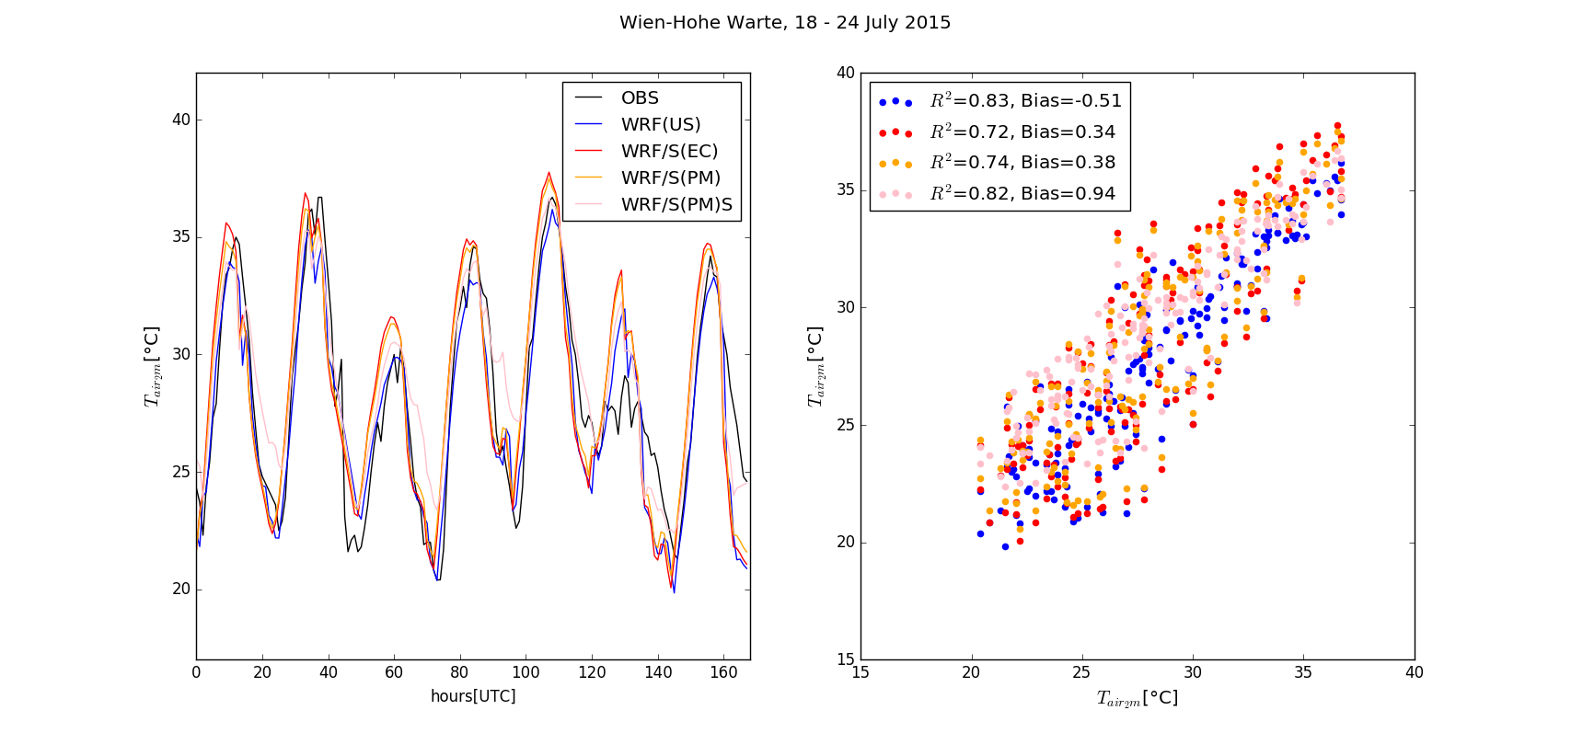
EGU 2018-7927
CL.18
11/4/2018
Comparison WRF, WRF/SURFEX offline and ground stations
1 Viennese Growth
Bias
Model runs:
- WRFv3.9.1 using USGS classes (US)
SURFEXv8 offline runs forced by WRF:
WRF/S using ECOCLIMAP (EC)
- WRF/S high resolution maps (PM)
- WRF/S (PM)S forced by first sigma level (~40m)
2 Models
3 Urban Szenarios
4 Conclusion and outlook

Slide 13
EGU 2018-7927
CL.18
11/4/2018
Comparison WRF, WRF/SURFEX offline and ground stations
-> WRF tends to underestimate maxima
-> WRF/SURFEX tends to overestimate maxima
-> both overestimate minima
-> clouds are not predicted well
1 Viennese Growth
2 Models
3 Urban Szenarios
4 Conclusion and outlook

Slide 14
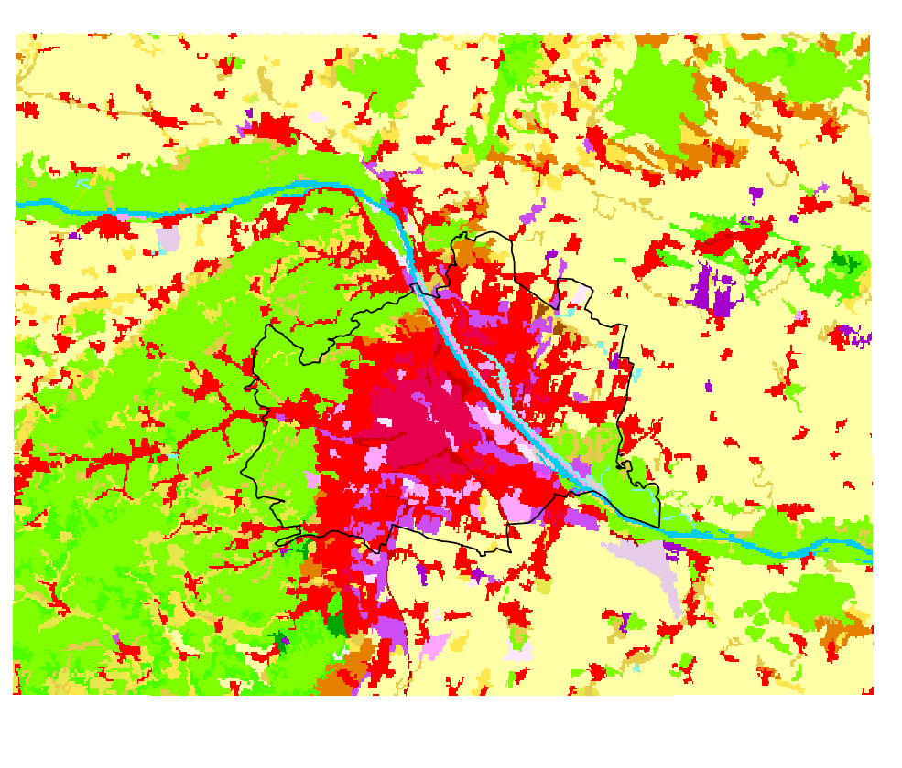
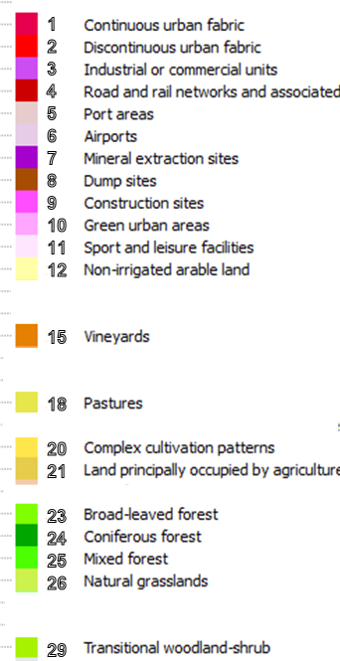
people within Vienna city borders:
2001: 1.550.123
observed land use change
EGU 2018-7927
CL.18
11/4/2018
CORINE 2000
1 Viennese Growth
2 Models
3 Urban Szenarios
4 Conclusion and outlook

Slide 15
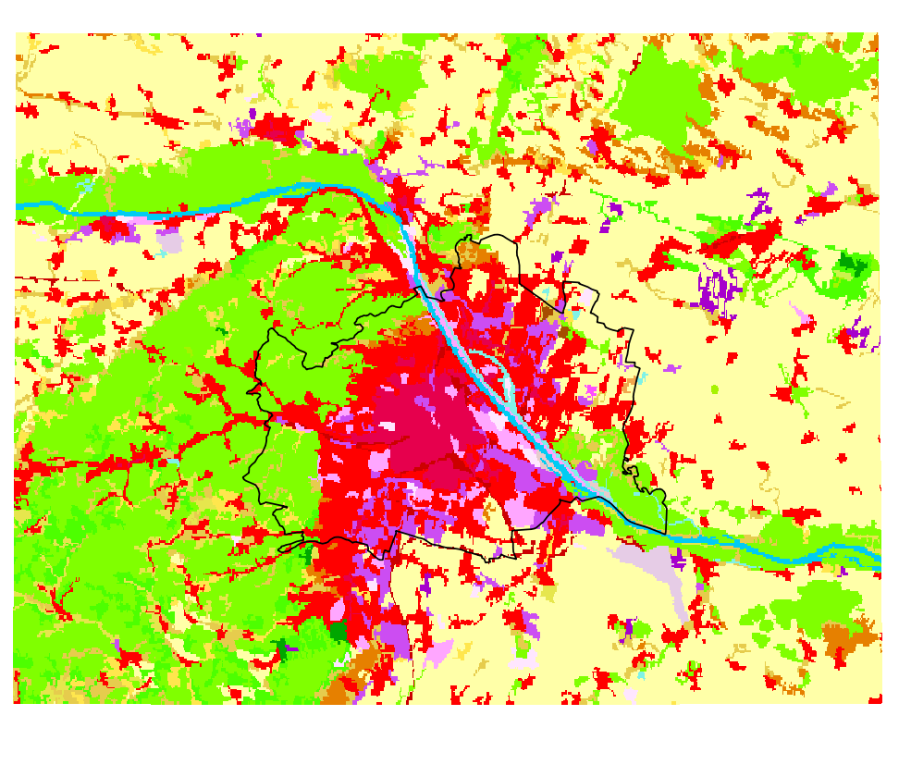
people within Vienna city borders:
2014: 1.766.746 (13J: +216.623) +14% ref. to 2001
2030: 2.077.300 (16J: +310.554) +18% ref to 2014
2050: 2.286.094 (36J: +519.348) +30% ref to 2014
Change of „Mobilitätsreserve?“
observed land use change
EGU 2018-7927
CL.18
11/4/2018
CORINE 2012
1 Viennese Growth
2 Models
3 Urban Szenarios
4 Conclusion and outlook

Slide 16
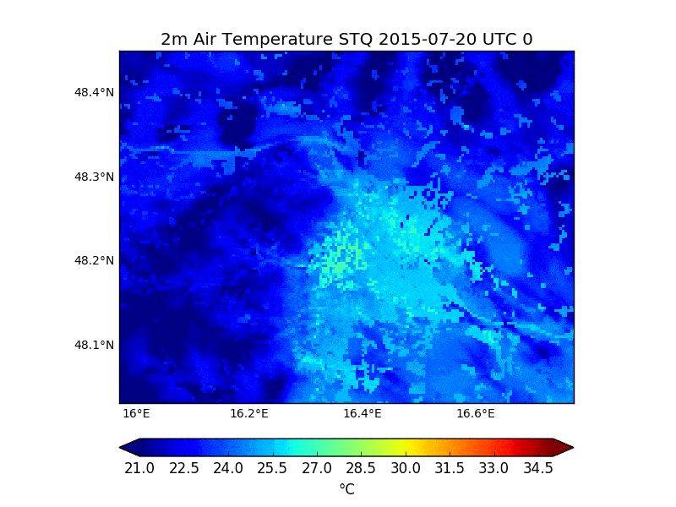
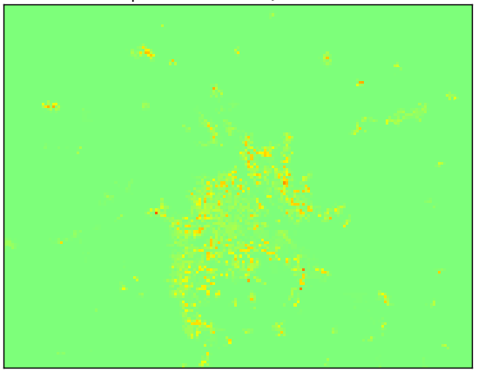
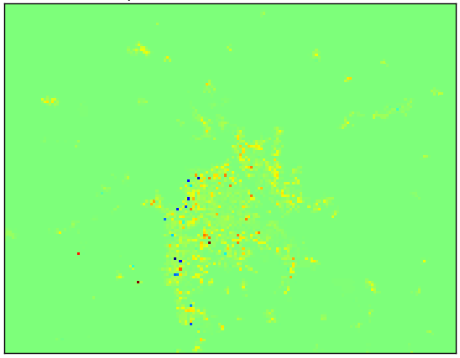
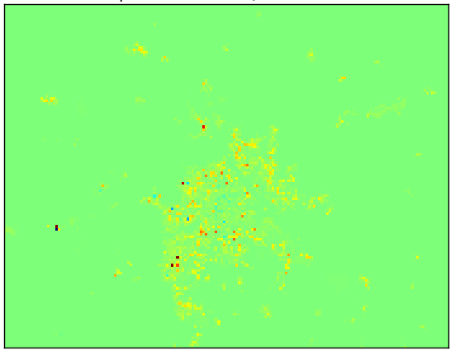
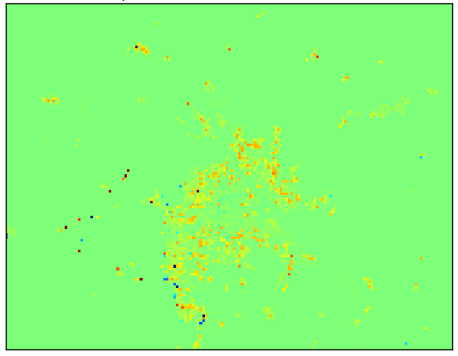
EGU 2018-7927
CL.18
11/4/2018
Diurnal circle of air temperature on day Tmax>30°C („heißer Tag“)
„DENSER“
2050+ Scenario 1) increased built area >85% +10%
WRF/S (PM)
@ 2UTC+ @ 13UTC:
T_{max_urban}- T_{min_rural} = 8°C
1 Viennese Growth
STQ
S1
2 Models
3 Urban Szenarios
4 Conclusion and outlook
S1-STQ
Max: +0.3 °C
0UTC
6UTC
12UTC
18UTC

Slide 17
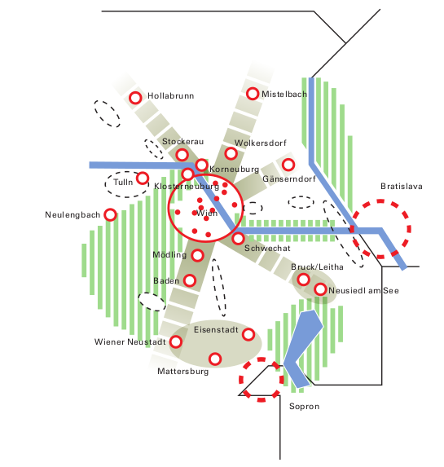
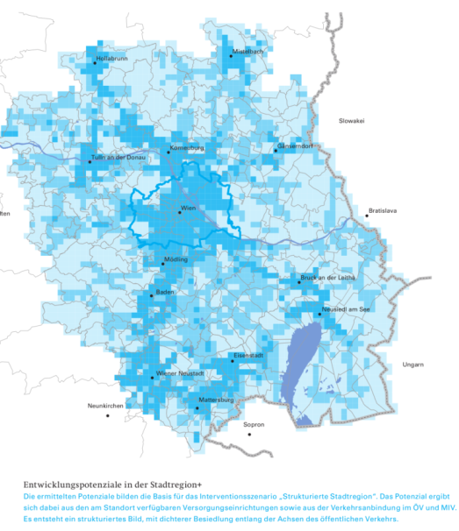
EGU 2018-7927
CL.18
11/4/2018
„LARGER“
New urban areas:
Lower buildings -> more space demand
1 Viennese Growth
 |  | 2012 „STQ“ | 2050+ Scenario 2 „scattered“ extrapolated current growth | 2130+ Scenario 3 „structured“ development following traffic axes
Simulation input Nest3 | „Built-up land“ fraction [km²] | 9 02 (100%) | 1 113 (123%) | 1 449 (161%)
 | „Nature“ fraction [km²] | 3 284 (100%) | 3 073 (94%) | 2 736 (83%)
Real Stadtregion+ | actual urban area [km²] | 1 080 (100%)
2 Models
3 Urban Szenarios
4 Conclusion and outlook

Slide 18
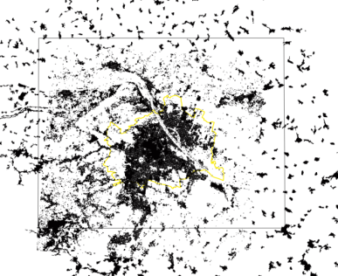
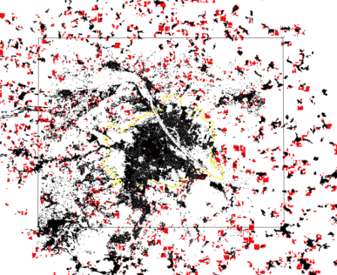
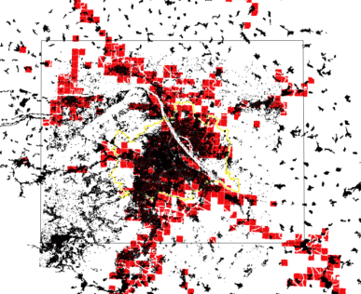
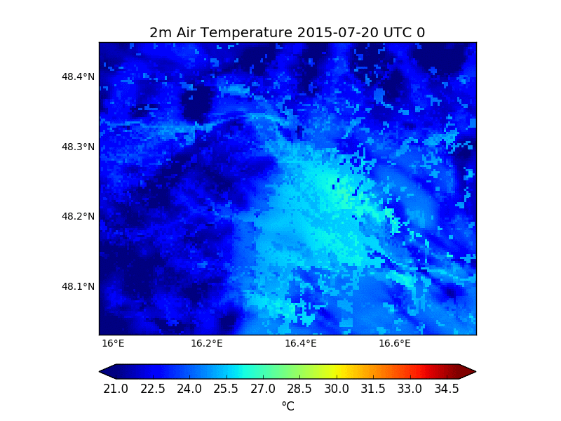
EGU 2018-7927
CL.18
11/4/2018
Diurnal circle of air temperature on day Tmax>30°C („heißer Tag“)
STQ
WRF/S (PM-XUNIF)
new urban area set uniform
as first test:
BLT=0.5
GARDEN=0-2
BH=10
WALL_O=0.5
1 Viennese Growth
2 Models
3 Urban Szenarios
4 Conclusion and outlook
S2
S3

Slide 19
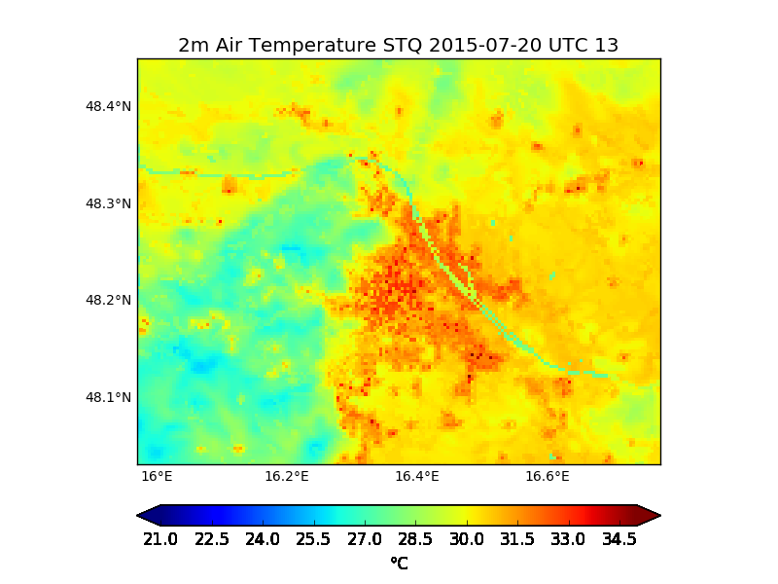
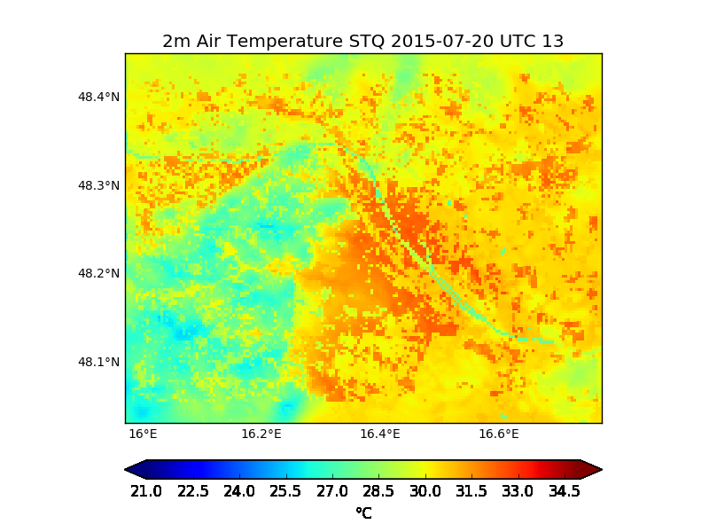
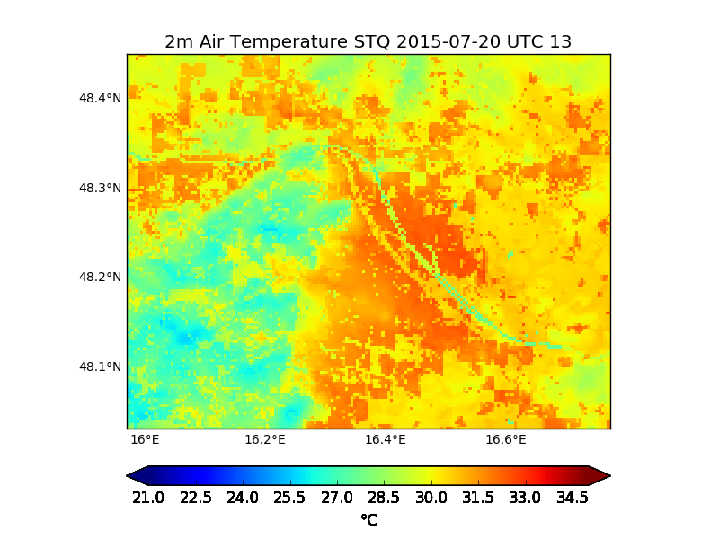
STQ
Regions:10x10points-> 11km²
North
13UTC Tair | C | W | N | E | S
STQ | 29.0 | 24.6 | 23.8 | 25.1 | 26.6
S4 | 29.3 | 25.2 | 24.3 | 25.4 | 27.0
Diff | +0.3 | +0.6 | +0.6 | +0.3 | +0.4
1 Viennese Growth
West
East
2 Models
Center
3 Urban Szenarios
South
4 Conclusion and outlook
S3
S4

Slide 20
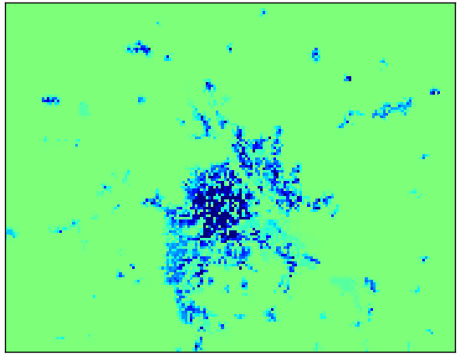
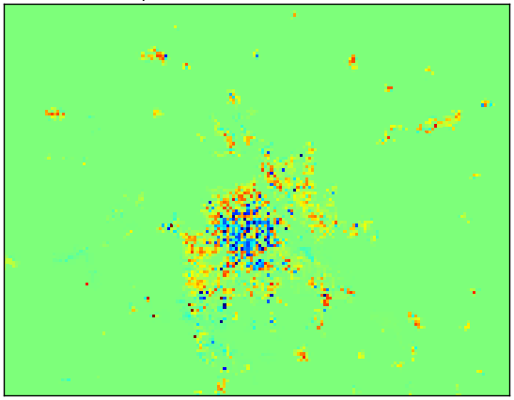
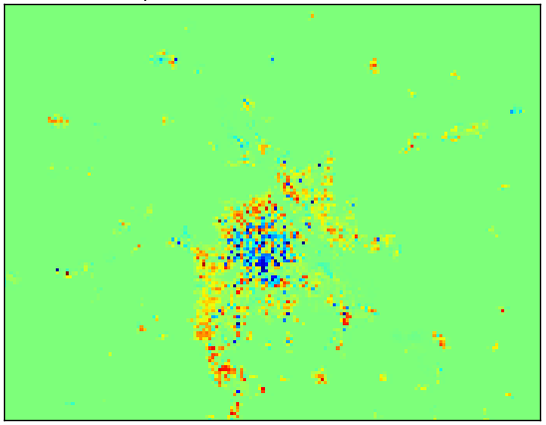
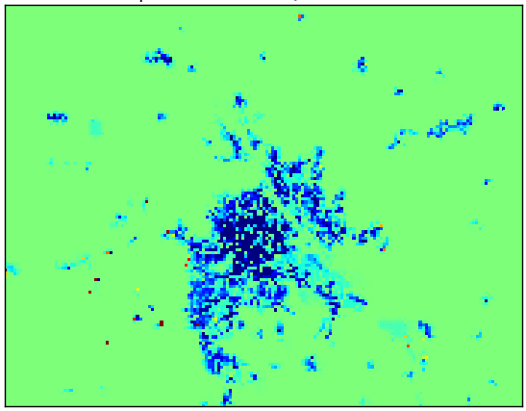
EGU 2018-7927
CL.18
11/4/2018
„TOWARDS SOLUTIONS“
 | 2012 | 2130+ Scenario 4)
Heat capacity wall [J/m³K] Commercial High and low density residential | 0.975 *10⁶ 1.520 *10⁶ | 0.975 *10⁶ 1.496 *10⁶
Heat capacity roof [J/m³K] (all categories) | 1 554 000 | 1.496 *10⁶
Thermal conductivity wall [W/mK] (all categories) | 1.7 | 0.1
Thermal conductivity roof [W/mK](all categories) | 1.4 | 0.1
Values of this table calculated using spatial data sets of Vienna and absolute values from: Amtmann M and Altmann-Mavaddat N (2014) Eine Typologie österreichischer Wohngebäude, Austrian Energy Agency, TABULA/EPISCOPE; Berger T et al. (2012) Auswirkungen des Klimawandels auf den thermischen Komfort in Bürogebäuden, Berichte aus der Energie- und Umweltforschung
1 Viennese Growth
0 UTC
2 Models
3 Urban Szenarios
6 UTC
4 Conclusion and outlook
S2-STQ: increased isolation
WRF/S (PM)
12 UTC
S4-STQ:
increased built area + insolation
Min: -0.5 °C
Max:+0.3 °C
18 UTC

Slide 21
EGU 2018-7927
CL.18
11/4/2018
First conclusions - possible relativ changes of air temperature (derived only from surface energy balance changes):
Densification of built up area
-> maximum +0.3 °C within actual urban areas.
-> Largest increases in the evenings.
Urban sprawl -> maximum +2°C in the new urban area
-> spatial average: 0.6°C.
-> also the actual urban structure will be affected.
Countermeasures as ambitioned insolation
-> -0.5°C within the actual urban area during night
-> even under increased building density
-> also at noon in the inner districts air temperature
could be reduced even when the built area is increased
1 Viennese Growth
2 Models
3 Urban Szenarios
4 Conclusion and outlook

Slide 22
EGU 2018-7927
CL.18
11/4/2018
Next steps:
Effects of urban densification and expansion on temperature including roughness modified wind field, change of urban boundary layer using WRF:
WRF-TEB coupling ongoing!
Szenarios will be run with:
3 land use categories (simplified from LCZ categorization according to WUDAPT Methodology – Steward and Oke 2012, presented EGU2017)
PBL-Scheme: Yonsei University Scheme
1 Viennese Growth
2 Models
3 Urban Szenarios
4 Conclusion and outlook

Slide 23
EGU 2018-7927
CL.18
11/4/2018
Lots more to do:
In depth spatio-temporal analysis of observed heat waves
Analyze effect on thermal comfort within urban canopy
-> see poster: EGU2018-9582 Oswald et al. 2018
today, 11 Apr, 17:30–19:00
Search for key factors and more effective urban szenarios (together with city authorities):
Change of spatial distibution of new building areas
Change of building morphology
Building properties (roof albedo, new materials, latent heat, ...)
Climate change 2030/2050 for RCP4.5 and RCP8.5
Role of anthropogenic heat (spatio-temporal patterns)
website launch July 2018: http://urbania.boku.ac.at
1 Viennese Growth
2 Models
3 Urban Szenarios
4 Conclusion and outlook

Slide 24
Thank you for your attention!

