Slide 1
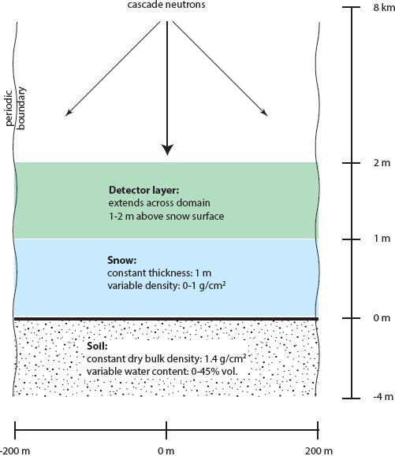
Can snow and soil moisture be measured simultaneously using cosmogenic neutrons?
Mie Andreasen Geological survey of Denmark and Greenland, Denmark (ma@geus.dk)
Marek Zreda University of Arizona, Hydrology and Water Resources, USA (marek@hwr.arizona.edu)
[1] Abstract
Snow at the hectometer scale can be measured using cosmogenic neutrons, but the neutron intensity measured in air above the snow surface depends on two variables: the amount of snow and water content of the underlying soil. Both variables can be measured using neutrons of different energies because they respond differently to combinations of snow and soil water. We used neutron transport modeling to examine the response of the intensity of thermal and fast (epithermal) neutrons to snow and soil moisture, with spatially uniform snow ranging from 0 cm to 100 cm of water equivalent, and spatially uniform soil moisture ranging from 0% to 45% by volume. The results show that snow can be measured up to 10 cm of snow water equivalent; above that value the changes in the neutron intensity are too small to be useful. A unique solution for both snow and soil moisture is possible for snow water equivalent less than 5 cm. These results are preliminary. They should be refined using additional modeling and then tested using controlled field experiments in which both soil moisture and snow are known independently.
[3] Model details
MCNPx used
Cosmic-ray neutron spectrum of Zweck et al. (2013, EPSL 379, 64-71)
Dry atmosphere
Uniform soil chemistry (quartz)
Uniform soil moisture
Values (vol. %): 0, 5, 15, 25, 35 and 45
Uniform snow placed on top of soil
Constant thickness of snow (why?)
Values (mm of snow water equivalent): 0, 1, 2, 5, 10, 20, 50, 100, 200, 500 and 1000
66 combinations of soil moisture and snow (scenarios)
Two million particles used per scenario
Periodic side boundaries (neutrons that leave the domain reappear on the other side)
[2] Conceptual model
[7] Summary of results and future
Snow can be measured up to 50 mm of snow water equivalent where the neutron responses to snow and to soil water are distinctly different.
Beyond 50 mm of SWE the neutron intensities respond to variable soil moisture and snow water equivalent in such ways that make unique solution difficult.
Future work should include:
Better neutron transport modeling that includes variable soil chemistry, non uniform soil moisture and snow water equivalent.
Field measurements to compare with model results.
[4] Model output observations: fast neutrons
Fast neutron intensity decreases monotonically with increasing SM and SWE.
The response is non-unique: the same value is obtained for different combinations of SWE and SM.
Potentially usable decrease of neutron intensity occurs between SWE of 0 mm and 100 mm; above 100 mm of SWE the fast neutron response is insignificant.
Neutron intensity response to SWE is strongest for low soil water content and for low snow water equivalent.
[5] Model output observations thermal neutrons
Intensity of thermal neutrons first increases with increasing SM or SWE and then decreases; the same neutron intensity is obtained for different combinations of SWE and SM. Thermal neutron increase is due to the air-snow boundary below which thermalization is most efficient.
SM is measurable for SWE lower than 50 mm.
Neutron intensity shows non-unique response to SWE at low SM, decreasing progressively with increasing SM.
[6] Model output observations: thermal/fast ratio
The ratio of thermal to fast neutron intensity contains additional information that can be used to compute both SWE and SM.
SWE smaller than 50 mm is measurable nearly uniquely under all SM values.
Other combinations of SM and SWE cannot be resolved using the ratio alone.
But combined with fast and thermal neutron responses, they can be used to separate the effects of soil moisture and snow water equivalent over nearly the entire range of their values shown in the graphs.

