Slide 1


The observed winter circulation at Insight’s landing site and its impact on understanding the year-round circulation and aeolian activity in Elysium Planitia and Gale Crater
Claire E. Newman, Aeolis Research, Pasadena, CA
working with
Daniel Viudez-Moreiras, Mariah Baker, Kevin Lewis, Javier Gomez-Elvira, Sara Navarro, Josefina Torres, Aymeric Spiga, Don Banfield, Nick Teanby, Francois Forget, Jorge Pla-Garcia, Stephen R. Lewis, Maria Banks, Sébastien Rodriguez, Antoine Lucas, and the rest of the InSight team

Slide 2
Why Insight’s met sensors - especially wind! - are so great
OR:
Claire E. Newman, Aeolis Research, Pasadena, CA
working with
Daniel Viudez-Moreiras, Mariah Baker, Kevin Lewis, Javier Gomez-Elvira, Sara Navarro, Josefina Torres, Aymeric Spiga, Don Banfield, Nick Teanby, Francois Forget, Jorge Pla-Garcia, Stephen R. Lewis, Maria Banks, Sébastien Rodriguez, Antoine Lucas, and the rest of the InSight team

Slide 3
Why are wind sensors so important?
Wind is crucial to the dust cycle and storms, water cycle, surface-atmosphere exchange, aeolian processes, EDL, surface operations, ...
But Mars atmospheric models *greatly* diverge in predicted wind speeds
In situ wind data can be used to test and improve models, which can then be used confidently to extrapolate to other locations, seasons, and epochs
Prior missions provided generally poor wind data
Viking was good, but calibrated high frequency wind data not yet publicly available
Pathfinder wind speeds could not be calibrated; MER rovers had no wind sensors
Phoenix Lander was shortlived and took infrequent, low rate wind data with a ‘telltale’
In Gale Crater, MSL’s wind sensor was damaged on landing and broke fully after 2 Myrs ☹

Slide 4
Why are wind sensors so important?
Wind is crucial to the dust cycle and storms, water cycle, surface-atmosphere exchange, aeolian processes, EDL, surface operations, ...
But Mars atmospheric models *greatly* diverge in predicted wind speeds
In situ wind data can be used to test and improve models, which can then be used confidently to extrapolate to other locations, seasons, and epochs
Prior missions provided generally poor wind data
Viking was good, but calibrated high frequency wind data not yet publicly available
Pathfinder wind speeds could not be calibrated; MER rovers had no wind sensors
Phoenix Lander was shortlived and took infrequent, low rate wind data with a ‘telltale’
In Gale Crater, MSL’s wind sensor was damaged on landing and broke fully after 2 Myrs ☹ [see next talk]

Slide 5
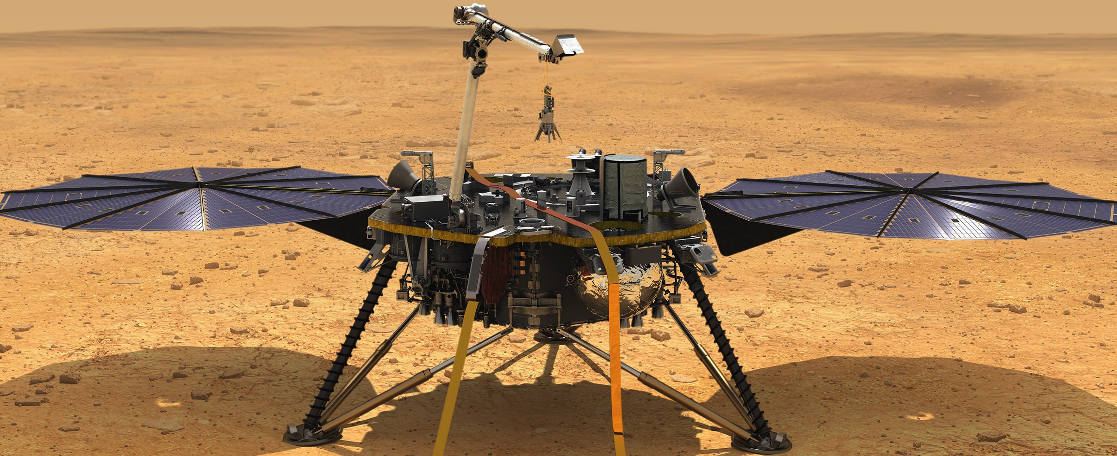
More about InSight’s meteorological sensors
InSight has the APSS suite of meteorological sensors:
TWINS (~1.1m air temperature, wind speed, wind direction) - 2 sensor booms
PS - surface pressure at up to 20Hz frequency
Plus InSight has the HP³-RAD IR Radiometer - surface brightness temperature
HP³-RAD Field of View 2 provides brightness temperature of surface with no significant shadowing
‘TWINS’ air temperature and wind sensor booms
Two of each helps to remove the thermal and dynamical impact of the lander
RAD sensor FOV 1 and 2
Solar panel
Solar panel
Lander

Slide 6
InSight can help us learn more about Gale Crater, too
InSight is within 10° of Gale Crater, the landing site of MSL => wind data in Elysium Planitia help to provide regional context for winds in Gale Crater
This helps us interpret the MSL wind data we do have and other related MSL observations (e.g. aeolian changes)
InSight
*
Latitude (°N)
Gale Crater
Longitude (°E)
Fortunately, both InSight wind sensors are working very well as of now!

Slide 7
Interpreting InSight’s meteorological data using numerical atmospheric models
Many different atmospheric models are being used to help understand InSight observations, from Large Eddy Simulations (e.g. ~10m resolution over 10km) to Global Climate Models (~° resolution over the full planet)
I’m going to show results from MarsWRF: a multi-scale model that covers from global all the way down to ‘meso’ (~km) scales

Slide 8
Modeling InSight’s circulation with the MarsWRF multiscale model
(Topography map shown for each domain)
Domain 1 (global atmosphere)
Domain 2
Domain 3
60
30
0
--30
-60
InSight
60
30
0
--30
-60
*
Latitude (°N)
Gale Crater
30 60 90 120 150 180 210 240 270 300 330
Longitude (°E)
~13km resolution domain ‘nested’ inside domain 2; includes InSight and Gale Crater (MSL)
Domain 4
2° resolution global atmosphere domain; captures global scale flows (Hadley cell, thermal tides, etc.)
0.67° resolution domain ‘nested’ inside global domain
InSight
*
~4km resolution domain ‘nested’ inside domain 3; resolves small scale weather at InSight, but feels effects of regional and global flows too

Slide 9
Comparing InSight observations (in color) with MarsWRF model results (in black) during local (northern) winter
So far we’ve observed over 120 sols, including a period with a regional dust storm
I’ll focus on the clear period before the storm
The dusty period will be described in the next talk

Slide 10
Comparing daily cycle of pressure predicted by MarsWRF with (1min-avgd) InSight data for a ‘clear’ period in local winter (Ls~312°)
Match to surface pressure cycle is good
MarsWRF captures absolute values
Also captures diurnal range quite well, and most of the tidal signatures (shape)
Local true solar time (hours)

Slide 11
Comparing daily cycle of winds predicted by MarsWRF with (1min-avgd) InSight data for a ‘clear’ period in local winter (Ls~312°)
360
270
180
90
0
15
10
5
0
Wind speed
Wind speed (m/s)
Wind direction (°)
Direction wind blows from
0 3 6 9 12 15 18 21 24
0 3 6 9 12 15 18 21 24
Local true solar time (hours)
Local true solar time (hours)
Some agreement in wind speed
MarsWRF predicts evening/overnight wind speeds very well (~2-5am peak likely due to lander parts affecting wind from a narrow range of directions)
Also captures timing of diurnal variations quite well
But daytime speeds are too low
Close match to wind direction
MarsWRF predicts wind directions very well
Although from ~6pm to 4am the predicted direction is ~340° (NNW) rather than the ~310° (NW) observed

Slide 12
Comparing daily cycle of winds predicted by MarsWRF with (1min-avgd) InSight data for a ‘clear’ period in local winter (Ls~312°)
360
270
180
90
0
15
10
5
0
Wind speed
Wind speed (m/s)
Wind direction (°)
Direction wind blows from
0 3 6 9 12 15 18 21 24
0 3 6 9 12 15 18 21 24
Local true solar time (hours)
Local true solar time (hours)
Hadley circulation near-surface return flow from ~N to S in this season
This flow is funneled between the dichotomy boundary and Elysium Mons to come more from the W
Flow is reinforced by daytime upslope flow on dichotomy boundary
Flow is opposed by nighttime downslope flow on dichotomy boundary
*
InSight
Topography

Slide 13
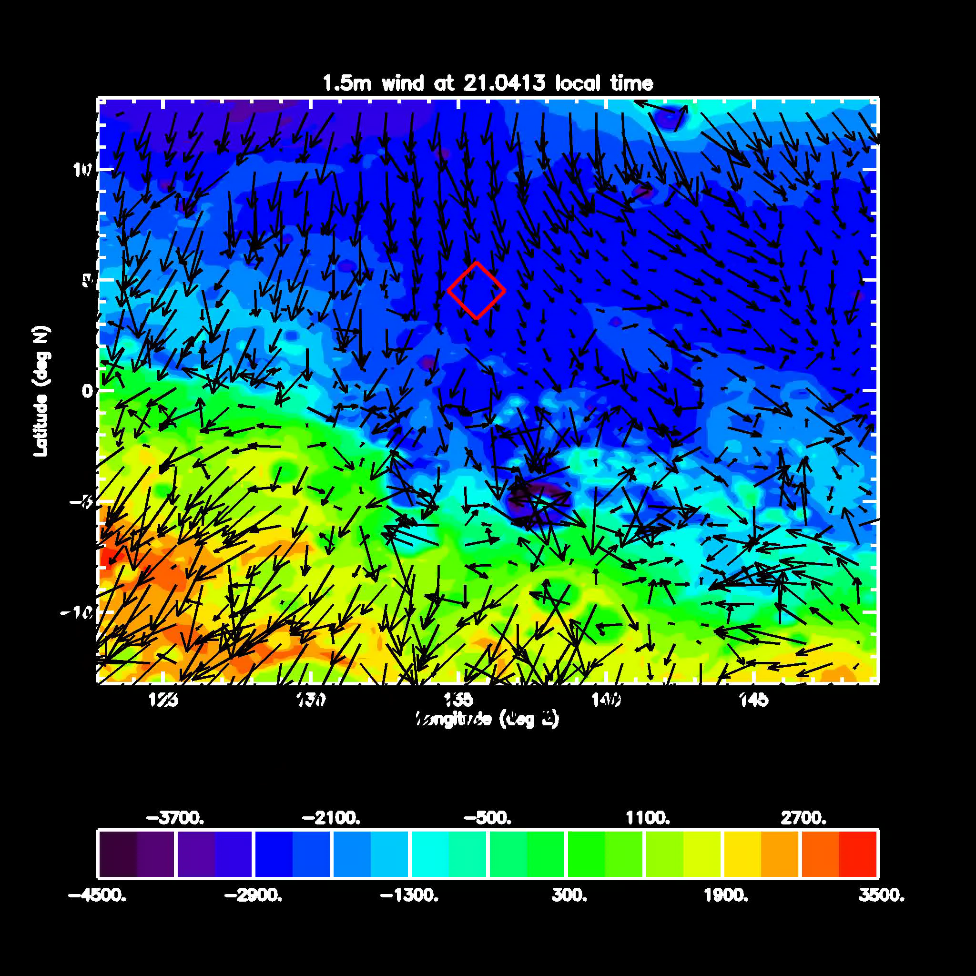
MarsWRF winds for a ‘clear’ period in local winter (Ls~312°)
ELYSIUM MONS
Direction of Hadley cell return flow
Hadley circulation near-surface return flow from ~N to S in this season
This flow is funneled between the dichotomy boundary and Elysium Mons to come more from the W
Flow is reinforced by daytime upslope flow on dichotomy boundary
Flow opposed by nighttime downslope flow on dichotomy boundary
DICHOTOMY BOUNDARY

Slide 14
What happens to the predicted daily cycle of wind speed if we change the physical processes or surface properties in MarsWRF?
Default model
Higher order closure PBL scheme
A different Planetary Boundary Layer (PBL) scheme produces slower nighttime winds and faster daytime winds, in better agreement with observations
Different roughness map (most z₀ smaller)
With both changes

Slide 15
What happens to the predicted daily cycle of wind speed if we change the physical processes or surface properties in MarsWRF?
Default model
Higher order closure PBL scheme
A different roughness map increases most wind speeds by ~50%, also in better agreement with observations
Different roughness map (most z₀ smaller)
With both changes

Slide 16
What happens to the predicted daily cycle of wind speed if we change the physical processes or surface properties in MarsWRF?
Default model
Higher order closure PBL scheme
Different roughness map (most z₀ smaller)
With both changes
But changing both the PBL scheme and roughness map produces the best overall agreement with observations

Slide 17
=> we are already using InSight data in many ways:
To improve not only our understanding of the circulation on Mars, but also what processes, boundary conditions, and assumptions are responsible for it

Slide 18
MarsWRF wind predictions for other seasons (not yet observed by InSight APSS)
[showing results for ony the default model set-up: MRF PBL scheme, MOLA-derived roughness map]

Slide 19
MarsWRF predictions for other seasons (not yet observed by InSight)
Wind speed
Wind direction
6.5m/s
Ls~330° (late northern winter)
In local winter:
The strongest wind is predicted to come from ~225° (SW) at 9am or ~360° (N) late afternoon / at night
Peak wind speeds (for the default model) are ~6.5m/s
In local summer:
The Hadley circulation reverses (now from ~S to N at low levels)
The strongest wind occurs at ~9am and comes from ~150° (~SSE)
Peak winds speeds (for the default model) are double those in winter
14m/s
Ls~150° (late northern summer)

Slide 20
Modeling the changes during a large regional dust event that occurred during InSight’s first 60 sols using MarsWRF

Slide 21
Comparing predicted surface pressure with (1min-avgd) InSight data
Before the regional storm
During the regional storm
Local true solar time (hours)
Local true solar time (hours)
MarsWRF captures very well the increase in diurnal surface pressure amplitude observed during the regional storm
MarsWRF also captures the smaller increase observed in the semi-diurnal tidal amplitude

Slide 22
Comparing predicted wind speed with (1min-avgd) InSight data
Before the regional storm
During the regional storm
MarsWRF predicts a slight reduction in daytime wind speeds, although smaller than that observed by InSight
MarsWRF predicts little change in the general pattern, and yet more variability from hour to hour and sol to sol, both as observed by InSight

Slide 23
Comparing predicted wind direction with (1min-avgd) InSight data
Before the regional storm
During the regional storm
MarsWRF correctly predicts the wind turning through 360° in most sols, as observed by InSight
Now we can dig into the model ouput to explore what causes this result: may be enhanced thermal tides now controlling the wind direction more, rather than the dichotomy slope

Slide 24
MarsWRF wind speed predictions over one year at InSight
Maximum daily wind speed
Mean daily wind speed
Minimum daily wind speed
Areocentric solar longitude, Ls (°)
Period observed by InSight to date predicted to have relatively low winds

Slide 25
MarsWRF wind speed predictions over one year at InSight
Maximum daily wind speed
Mean daily wind speed
Minimum daily wind speed
Areocentric solar longitude, Ls (°)
Period observed by InSight to date predicted to have relatively low winds
Peak wind speeds predicted in mid local (northern) summer, toward the end of 2019

Slide 26
MarsWRF wind speed predictions over one year at InSight
Maximum daily wind speed
Mean daily wind speed
Minimum daily wind speed
Areocentric solar longitude, Ls (°)
NB: this seasonal trend is opposite to that predicted by another model [Spiga et al., 2018]
Models diverge greatly in how they predict wind speed will vary diurnally and seasonally
And even internally, model results (e.g. peak wind speeds) vary with model setup

Slide 27
How does this help us better understand the circulation in Gale Crater?

Slide 28
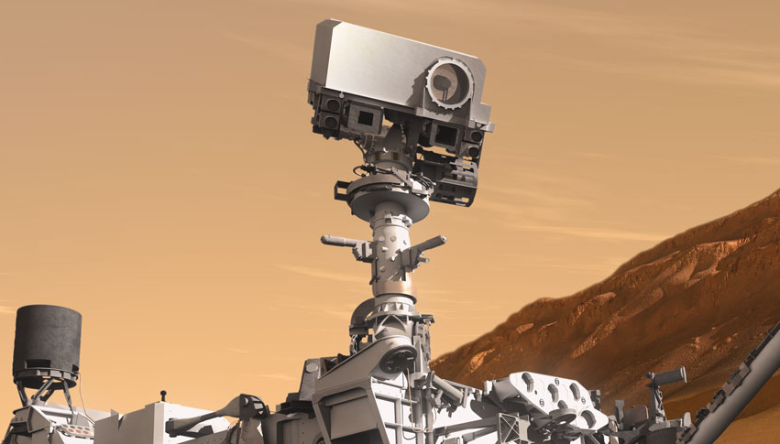
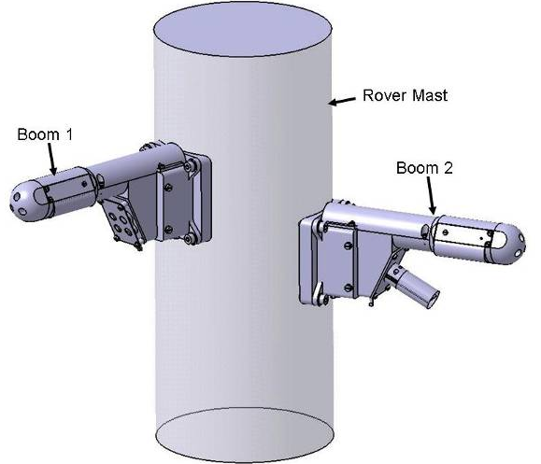
MSL’s wind measurements in Gale Crater suffered from electronic noise at night and a broken wind sensor
When wind came from the hemisphere in front of the MSL rover, we could measure wind direction and speed well
MSL’s REMS wind sensors
Wind from ‘rear’ of rover
Wind from ‘front’ of rover
Working wind sensor
But when wind came from the ‘rear’ it was messed up by the mast before reaching the wind sensor => Only got direction to within 90° and NO info on speed
Broken on landing

Slide 29
MSL’s wind measurements in Gale Crater suffered from electronic noise at night and a broken wind sensor
MSL’s REMS wind sensors
=> Very few periods of very good wind data exist for Gale Crater, and even then the overnight period is still lost due to noise
Broken on landing
Broken after 2 Mars yrs

Slide 30
MSL wind data are especially sparse at the current time of year (mid to late northern winter)
Fortunately, this is when regional winds flow from ~InSight to Gale Crater over much of the sol (see earlier slides)
Frequent winter wind direction
=> InSight winds provide direct regional context for testing modeled regional winds at Gale Crater, and for understanding the more complex circulation inside the crater (due to the major topography)
InSight
*
Latitude (°N)
Gale Crater
Longitude (°E)

Slide 31
Using InSight wind data, we also hope to better understand aeolian processes on Mars
Our approach:
Use the observed wind field to date to improve the model’s representation of wind
Run the model over a full year to predict present day aeolian feature characteristics

Slide 32
Using InSight wind data, we also hope to better understand aeolian processes on Mars
Active aeolian features tell us about the present day, long-term (multi-year for dunes) wind field
Inactive aeolian features tell us about the long-term wind field in past epochs (e.g. orbital obliquities, etc.)

Slide 33
MarsWRF wind stress predictions over one year at InSight
Maximum daily wind stress
Mean daily wind stress
Minimum daily wind stress
Areocentric solar longitude, Ls (°)
Period observed by InSight to date predicted to have relatively low wind stresses
=> Expect greatest aeolian activity at this time of year
=> Net annual sand transport to the ~NNW (as strongest winds are from the ~SSE here)

Slide 34
Predicted dune orientation and migration in InSight region assuming an unlimited sand supply
InSight location
Net annual sand flux direction
Using ‘Gross Bedform-Normal Transport’ theory to predict dune orientation (Rubin and Hunter, 1987)
Latitude (°N)
PREDICTIONS:
Expected dune migration toward ~NNW
Most dunes oriented from ~SW to NE
For threshold wind stress = 0.007Pa
Longitude (°E)

Slide 35
Predicted dune orientation and migration in InSight region assuming a limited sand supply
InSight location
Net annual sand flux direction (note this is identical to before)
Now using ‘Fingering Mode’ theory to predict dune orientation (Courrech du Pont et al. 2014; Gao et al., 2015)
Latitude (°N)
PREDICTIONS:
Expected dune migration toward ~NNW
Most dunes oriented from ~SSE to NNW
For threshold wind stress = 0.007Pa
Longitude (°E)

Slide 36
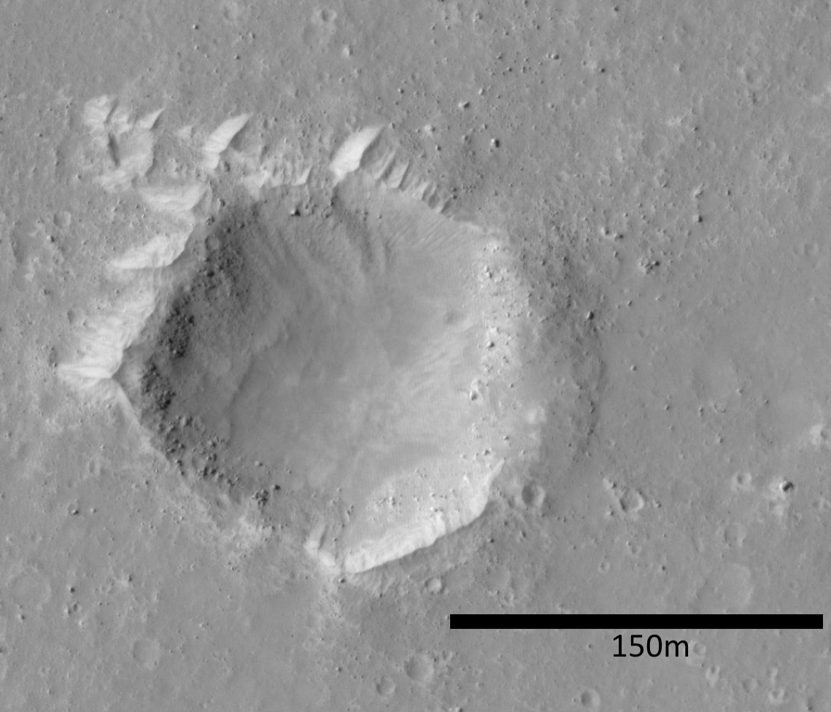
Comparing predicted and observed aeolian characteristics
Many craters in Elysium Planitia have bedforms outside them, often to the NW
But does this imply net sand transport from the NW (suggesting winds are strongest at the current time of year, unlike our predictions) or something else?
And did any of these bedforms form in a past epoch? We can also model winds for different obliquity, timing of perihelion, etc.
We may need to wait almost an Earth year, until InSight is in local summer, to find out how winds really change with season
Hopefully with repeat imaging of this region - from HiRISE and InSight - we will also see aeolian changes that we can correlate with winds

Slide 37
Conclusions
InSight wind data are incredibly valuable for understanding far more than just the local meteorology
They provide insight into the regional winds that influence Gale Crater
Also, comparisons with model predictions let us see where the physics, boundary conditions, and assumptions used in models are wrong
Comparison of observed winds with aeolian features in Elysium Planitia may not be possible if no features are currently active
Even if so, can still use observed winds to improve models, which can then be run for past epochs to generate wind and aeolian predictions

