Slide 1
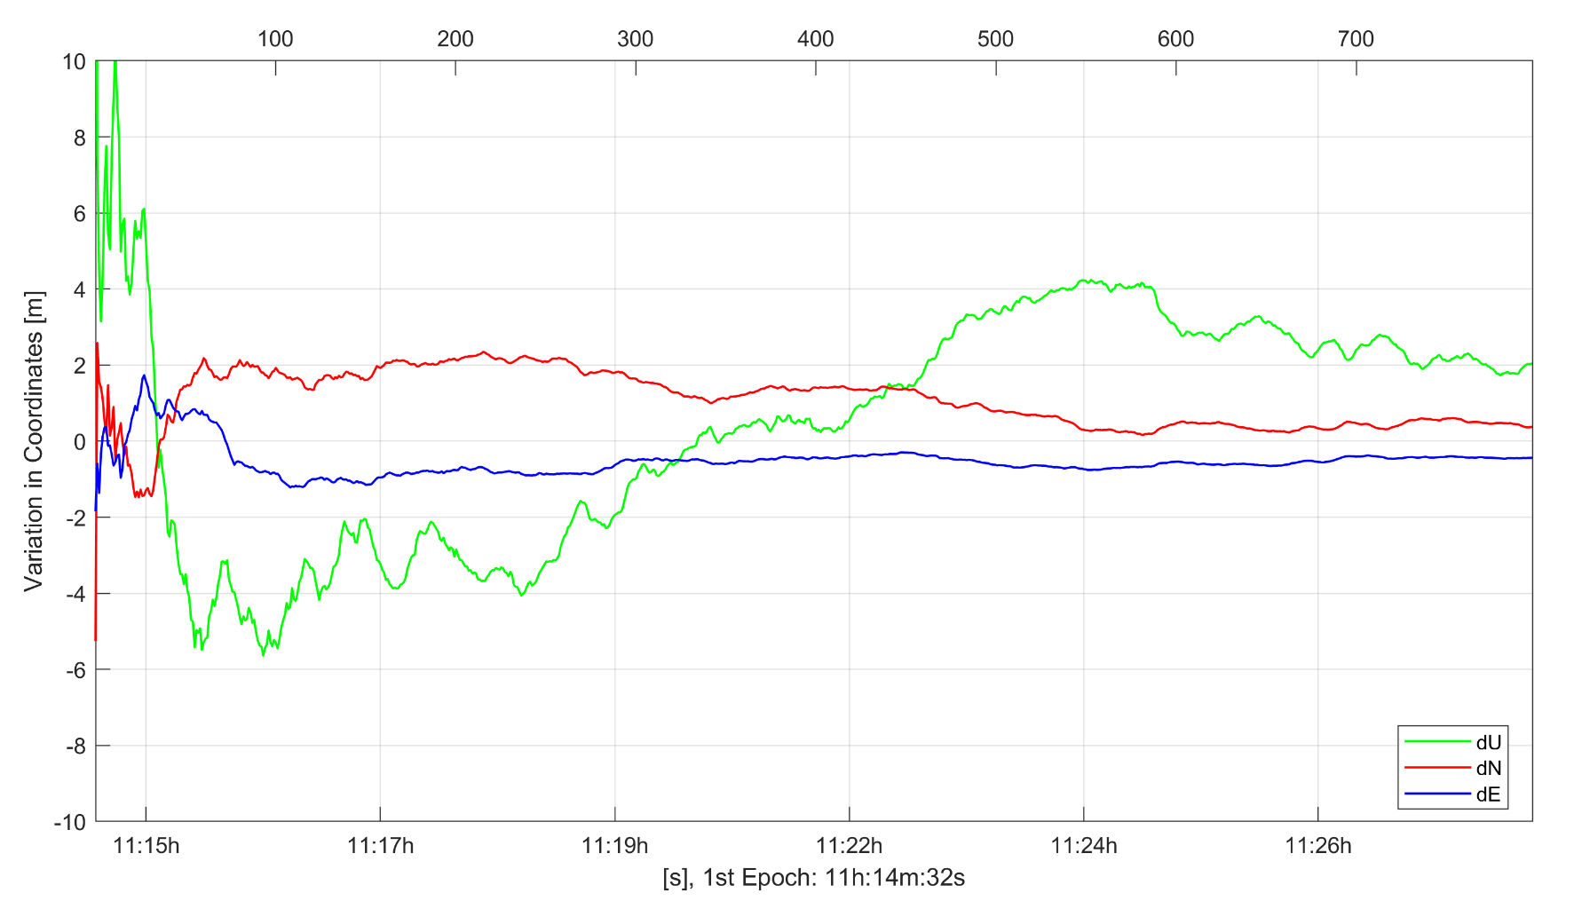
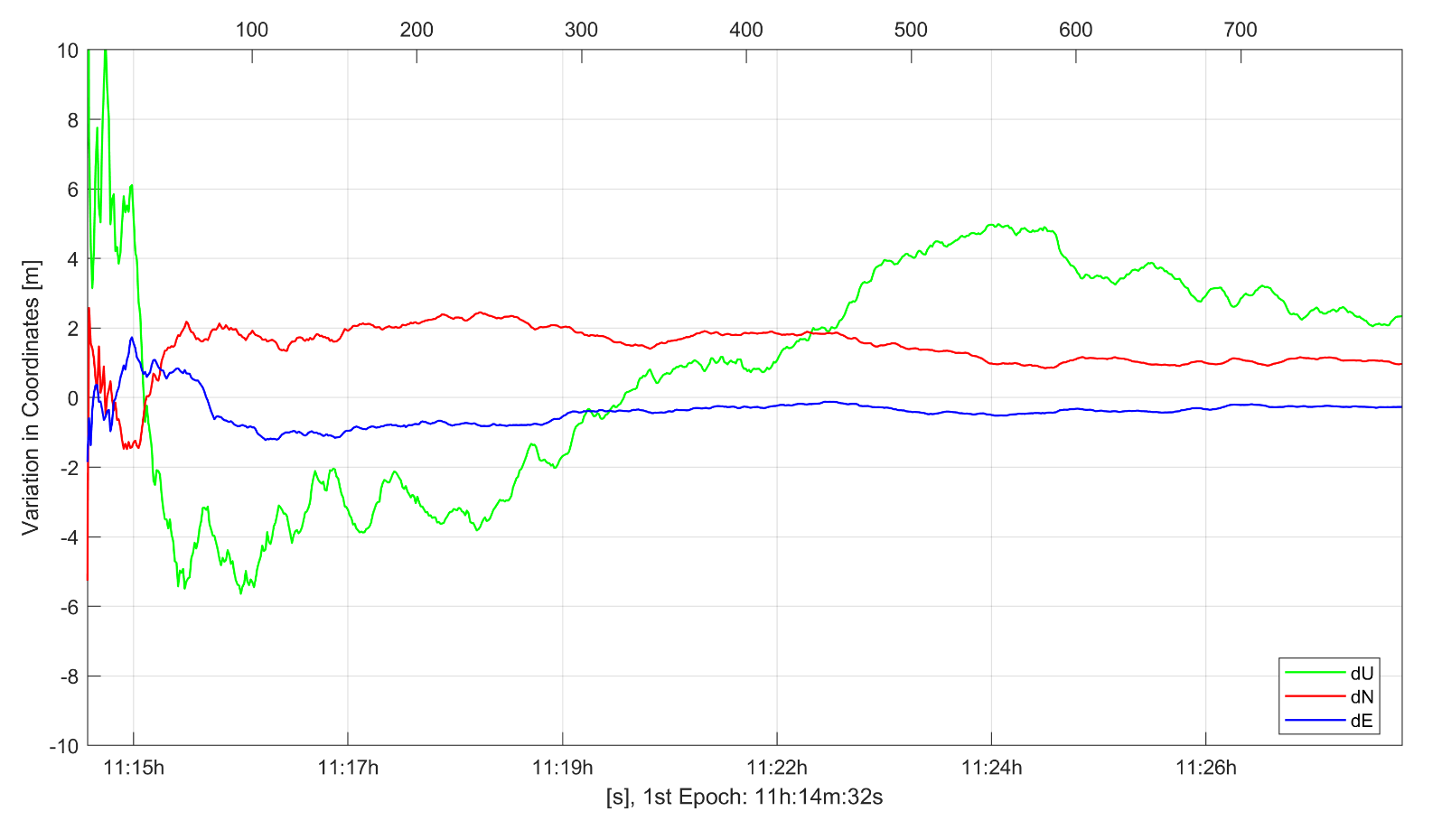
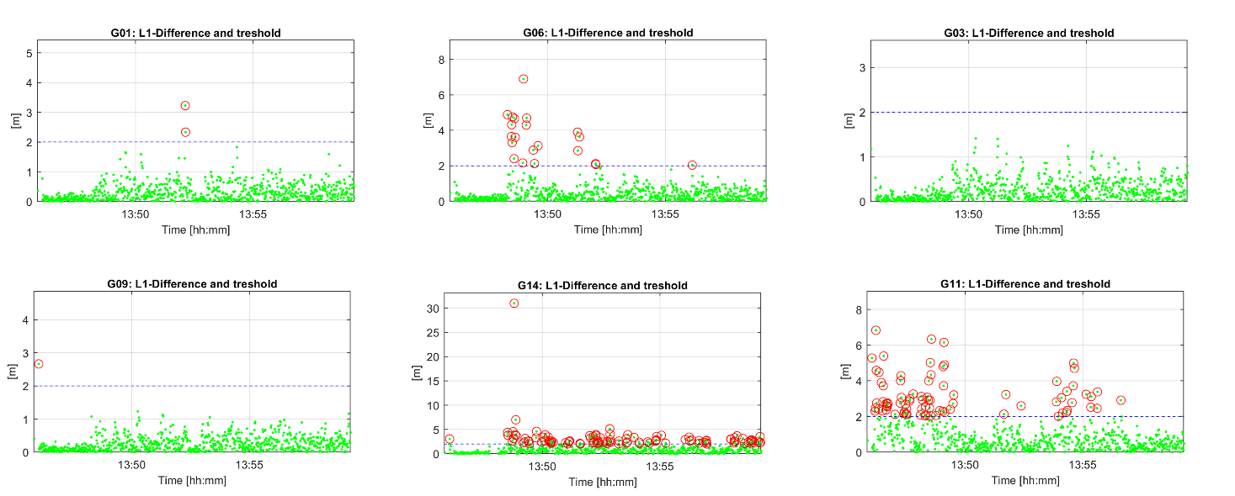
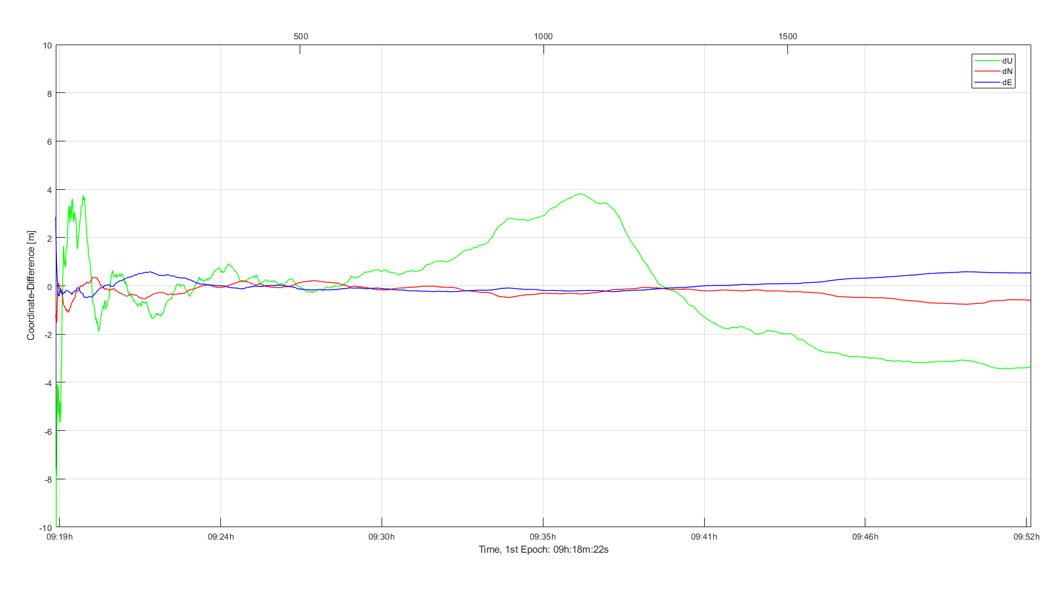
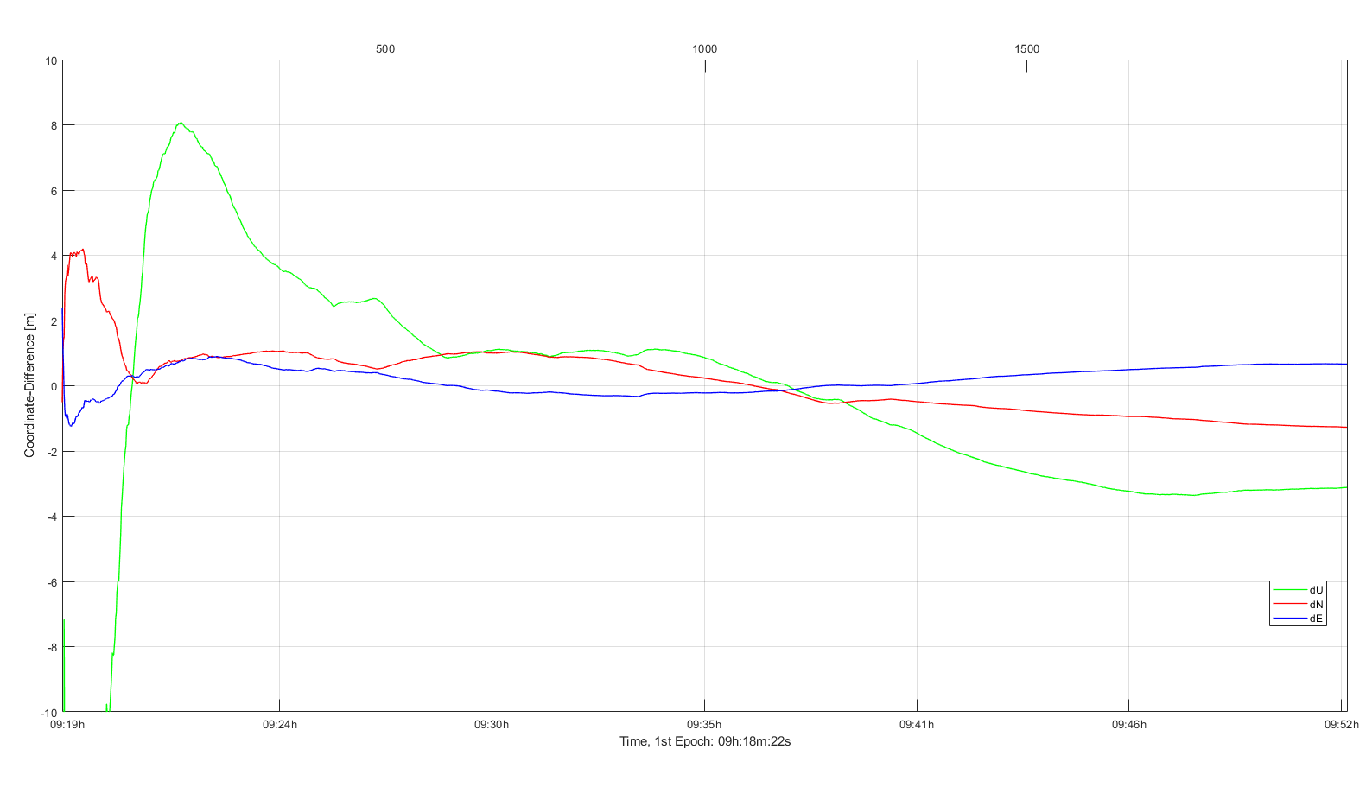
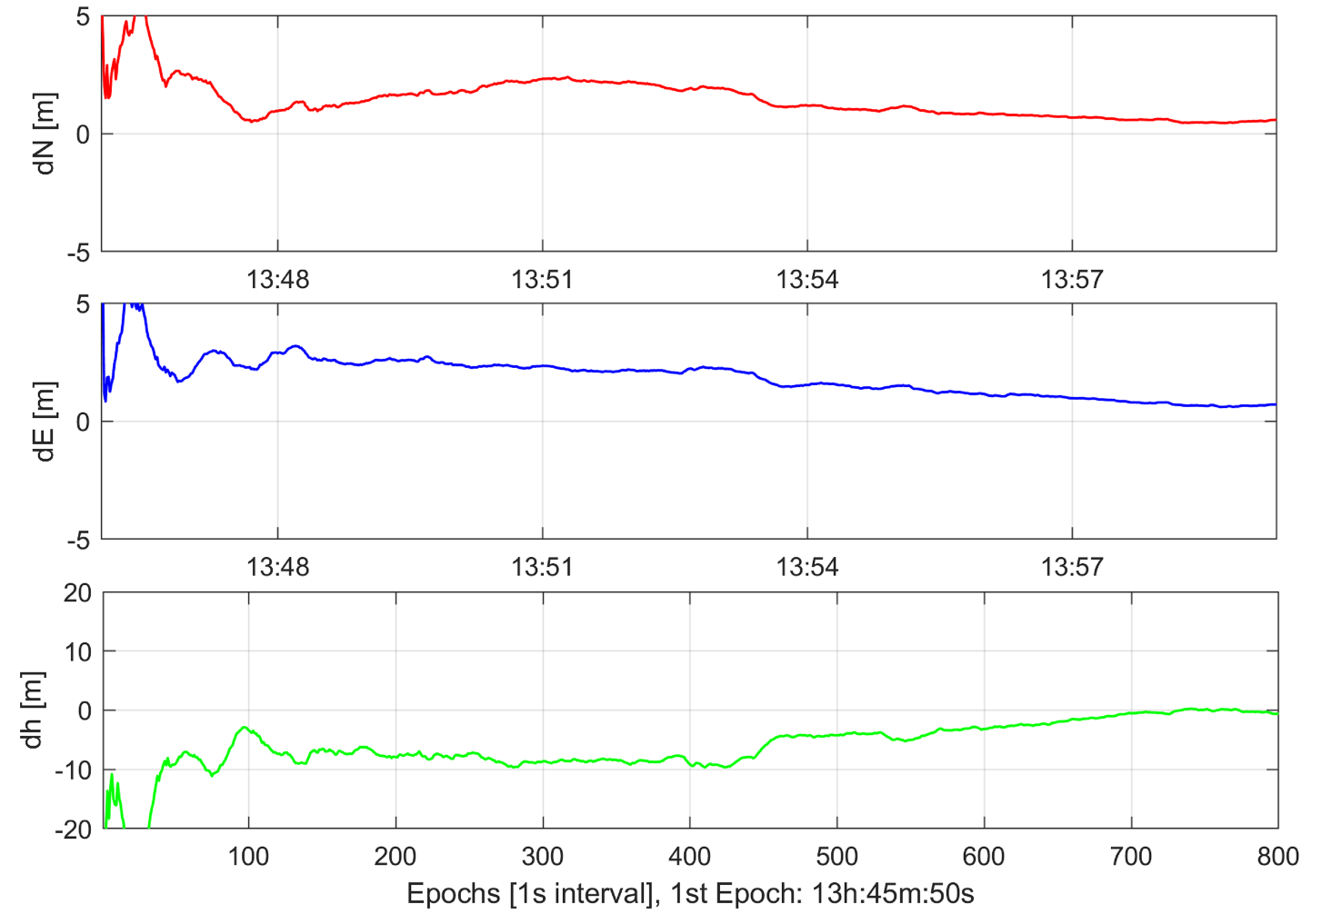
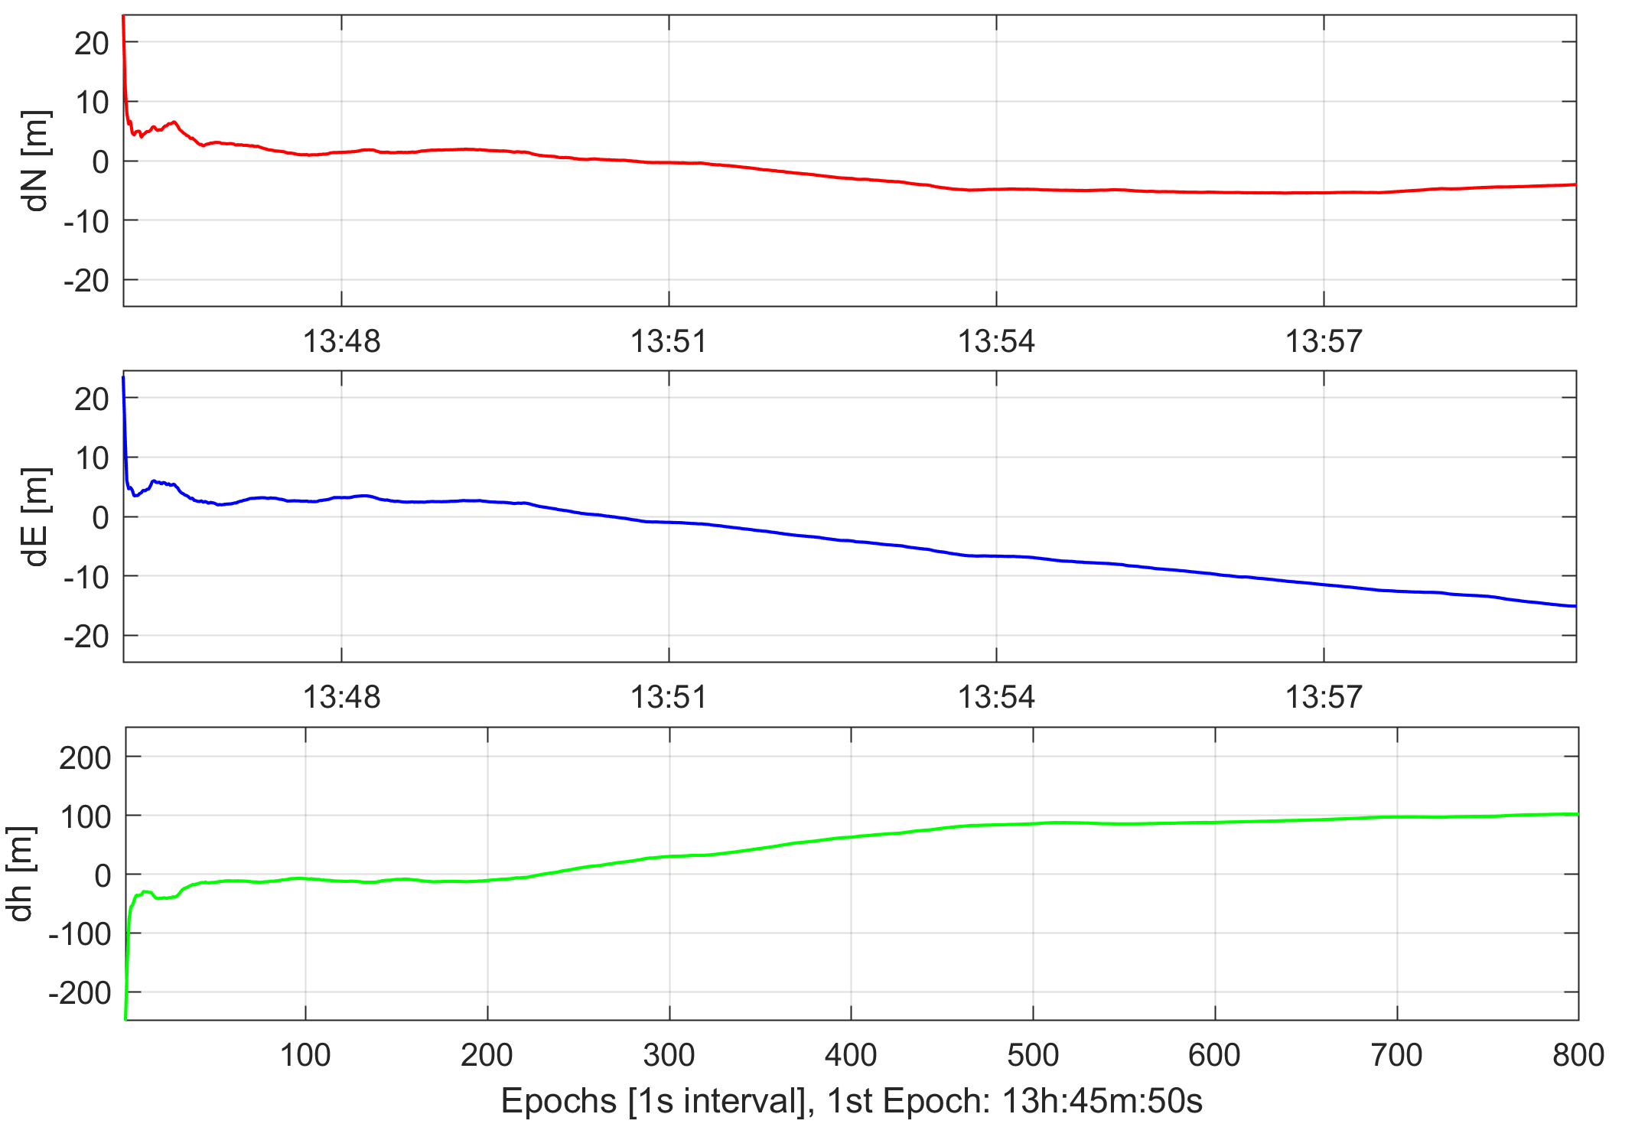
PPP with smartphone GNSS data
M. Aichinger-Rosenberger (1), M.F. Glaner (1), M. Lytvyn (2), R. Weber (1)
(1) Department of Geodesy & Geoinformation, TU Vienna, Advanced Geodesy / E120-4, Vienna, Austria
(2) TeleConsult Austria GmbH, Graz, Austria
E-mail: matthias.aichinger-rosenberger@tuwien.ac.at
Abstract
Precise Point Positioning (PPP) is one the most promising processing techniques for Global Navigation Satellite Systems (GNSS) data nowadays. With double-frequency observations of a single receiver in static mode, coordinate accuracies at the centimetre/millimetre level can be achieved. However, PPP is not restricted to expensive geodetic multi-frequency receivers, also single-frequency observations from low-cost receivers can provide promising results. Precise orbit and clock information might be retrieved for post-processing or even in real-time from ground based service providers like IGS or geostationary satellites through Signal-in-Space (SIS). In 2020/21 a new SIS-service, the Galileo Commercial Service (Galileo HAS), will become available.
Within project GAL-CS the research group Higher Geodesy at TU Vienna explores the limitations in PPP positioning with smartphones. The project is conducted in cooperation with the TeleConsult Austria (TCA) company located in Graz. We make use of the fact that since 2016 the retrieval of raw smartphone GNSS observation data is supported by a number of Android devices, which has multiple benefits.
Here we present current results gained by processing data obtained from a Huawei P10 smartphone.
Recording and processing of smartphone data
The datasets shown in the following were recorded with a Huawei P10 smartphone on 03/10/2018 and 04/10/2018 at the rooftop of the university building in Vienna. The logging in RINEX format was carried out using both the Geo++ RINEX Logger and the self-developed logging app from TCA. The datasets cover time periods from 15 – 30 minutes.
The PPP processing of the observations was carried out with the raPPPid software, which is the PPP module of the Vienna VLBI and Satellite Software (VieVS PPP) and continually developed from our research group. The data are processed using static Kalman filtering with appropriate weighting adjusted to the approximated quality of the measurements. Zenith wet delay (ZWD) and receiver clock error are estimated within the procedure. Zenith hydrostatic delay (ZHD) is modeled using the formula of Saastamoinen (1972).
Ionospheric corrections are derived using the standard Klobuchar algorithm for the shown results. This will be refined in future processing by using regional STEC maps derived from reference station data. Precise orbit and clocks products were obtained via the (real-time) correction streams of Centre national d'études spatiales (CNES). In a future state such corrections will be retrieved from the Galileo HAS. All results shown in the following were determined in the WGS-84 system.
In a first analysis, the impact of the phase measurements to a code-only solution is investigated. The code-only solution (left part of Figure 1) shows promising results, especially for the N- and E-component. The deviation from the true position reaches sub-5m within a minute approximately and sub- 1m after ~ 10 minutes.
However the results get worse by a factor of 10 when additionally using phase observations (right part). This indicates poor quality of phase data and the presence of (large) cycle slips in the observations.
A reasonable explanation for a large number of cycle slips is a process called duty cycling. Thereby the device measures only for a fraction of every second and turns to standby for the remaining time. This can cause the loss of the ambiguity parameter.
Cycle slip detection
Fig. 3: Comparison of coordinate deviation to true position (N , E, H) from raPPPid processing, 04.10.2018
(left: Solution using only GPS, right: Solution using GPS + Galileo)
Dual-frequency smartphone
Fig. 2: Cycle slip detection for different GPS satellites, 04.10.2018
(values above threshold marked in red)
Fig. 4: : Comparison of coordinate deviation to true position (N , E, H) from raPPPid processing, 04.10.2018
(left: Solution using only code measurements, right: Solution using only code + phase measurements)
As mentioned before, phase data of the Huawei P10 suffers from cycle slips in quite big way. This is easily visible in Figure 2, where results of a cycle slip detection method implemented in raPPPid are shown. It uses the recorded phase and Doppler measurement of the last epoch to predict the new phase measurement and compares it with the observation. By using a pre-defined threshold for the difference between observation and prediction the algorithm decides to keep/dismiss the observation.
In the shown case, a threshold of 2m was chosen and all observations above it were removed in advance of processing. Figure 3 shows the fact that some satellites suffer from a large number of cycle slips (G06,G11,G14) while others provide relatively stable phase measurements (G01,G03,G09).
In addition to the P10 we also show results from the Xiaomi Mi 8, a dual-frequency device. This gives the advantage of using the ionosphere-free linear combination (IFLC) and should provide more accurate results. However since the smartphone tracks L1/L5 signals, not enough satellites (delivering L5 signals) were available to use IFLC.
Despite this drawback, for both code and code+phase L1 processing better results than for the P10 are obtained. Especially the phase observations show a more stable performance. Even though they again worsen the code solution, the amount of degradation is much lower than for the Huawei device, see Figure 4.
Results
Impact of Galileo observations
Code only vs Code+Phase
Conclusions
This part analyses the impact of Galileo observations on the solution. Therefore these were added in the processing routine. However, since the smartphone was not able to track more than three satellites maximum, the observations don’t have that much impact on the performance. Thus the results closely match those derived from GPS data only. This fact is confirmed by Figure 3.
Code processing alone yields 1m-accuracy after few minutes in N- and E-component, sub 5m-accuracy in height
Phase observations are of low quality and worsen the results by factor 10
Cycle slip detection is a crucial task when using smartphone data
Xiaomi Mi 8 shows better results, especially when also processing phase observations
More Galileo satellites and usage of more accurate regional ionosphere models will improve results
References
J. Zumberge, et al. (1997). ‘Precise point positioning for the efficient and robust analysis of GPS data from large networks. Journal of Geophysical Research, Vol. 102:5005–5017.
GSA White paper (2017). ‘Using raw GNSS measurements on Android devices’
Fig. 1: Comparison of coordinate deviation to true position (N , E, H) from raPPPid processing, 04.10.2018
(left: Solution using only code measurements, right: Solution using only code + phase measurements)
Aknowledgements
Data for processing are mainly available through: http://www.igs.org/, https://cnes.fr/
Geo++ RINEX Logger: https://play.google.com/store/apps/details?id=de.geopp.rinexlogger&hl=de_AT
The authors acknowledge the IGS and CNES for providing their data.
G1.3 – High-precision GNSS: methods, open problems and Geoscience applications EGU2019-14940 Board number X3.103 EGU General Assembly 2019 | Vienna, Austria | 7–12 April 2019

