Slide 1
EGU General Assembly, VIENNA, 12th April, 2019
Geoethics in environment
Water-protection perspective in the GOAL Project framework
Handl Sebastian¹, Calheiros Cristina², Mayr Ernest¹, Schneider-Voß Susanne¹, Fiebig Markus¹, Langergraber Günter¹
¹Universität für Bodenkultur Wien, Austria. ²Centro Interdisciplinar de Investigação Marinha e Ambiental, Portugal.
sebastian.handl@boku.ac.at

Slide 2
The GOAL Project
EGU General Assembly, VIENNA, 12th April, 2019
Cofunded by the ERASMUS+ Programme
Six partners from universities in Portugal, Austria, Israel, Italy, Lithuenia and Spain
Project leader Clara Vasconcelos (Portugal Team)

Slide 3
The GOAL Project
EGU General Assembly, VIENNA, 12th April, 2019
Aims:
discuss geoethics as an indispersible field in geosciences with a strong connection with education for Sustainable Development (SDGs)
raise awareness towards the defence of life and the richness of Earth
engage students in the idea that geosciences develop and promote cultural, educational and scientifical values that could be considered a social capital of human communities
promote an ethical approach in our interaction with Earth
foster responsible behaviours and scientific/professional practices among the target group to serve society while addressing environmental matters

Slide 4
The GOAL Project
EGU General Assembly, VIENNA, 12th April, 2019
Main target group:
Higher Educational students
Professors
Researchers
Group of interest for the project activities:
Geoheritage site guides
Secondary teachers

Slide 5
The GOAL Project
EGU General Assembly, VIENNA, 12th April, 2019
Expected results:
Geoethics syllabus to be used in a higher education curricular unit or to be used as modules in diverse higher education curricular units
Educational resources that have the goal of fostering awareness-raising on ethical and social implications of geoscience knowledge
Online platform www.goal-erasmus.eu as a way to share and disseminate all the outputs and deliverables developed during the project

Slide 6
The GOAL Project
EGU General Assembly, VIENNA, 12th April, 2019
Educational resources related to :
Georisks management and the mitigation of geohazards
Geoparks and georesources
Geoethics in environment and water protection
Promotion of geoethical values and responsibility

Slide 7
Geoethics in environment – water protection
EGU General Assembly, VIENNA, 12th April, 2019
2 Educational resources (ER) for Higher Education
concrete environmental and water protection problems of human life
ER1 : competing interests in water supply
ER2 : water reservoirs and energy production from hydropower

Slide 8
Geoethics in environment – water protection
EGU General Assembly, VIENNA, 12th April, 2019
What can be considered a modern ethical guidance?

Slide 9
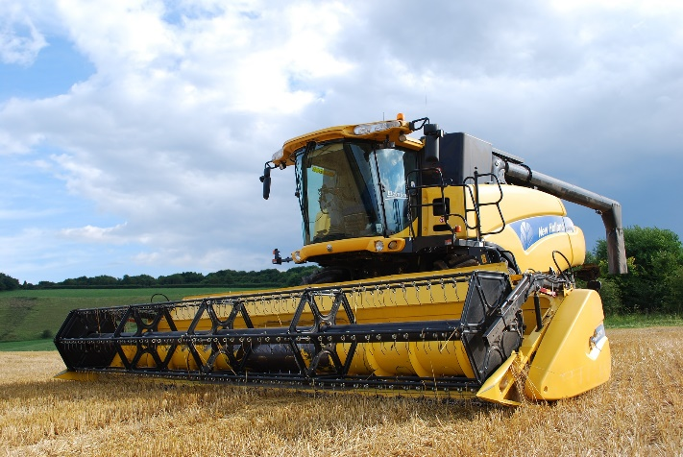
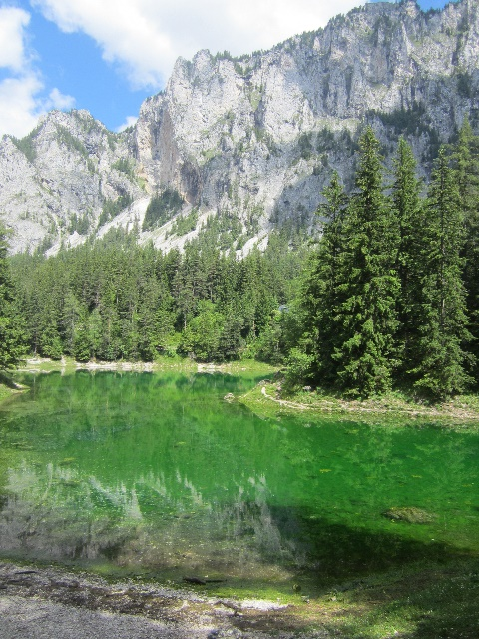
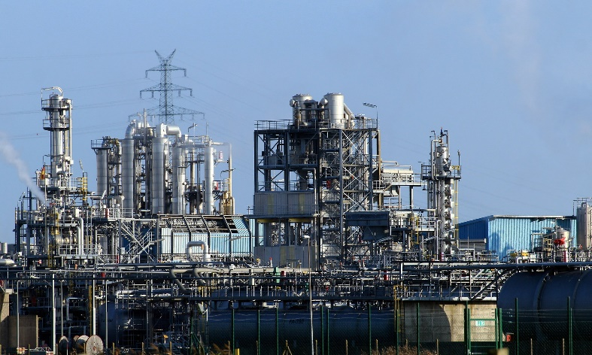
ER1 : competing interests in water supply
EGU General Assembly, VIENNA, 12th April, 2019
underpinning general principles:
strong utilization pressure on land and waterbodies
water cycle connects natural areas with areas of strong anthropogenic influence

Slide 10
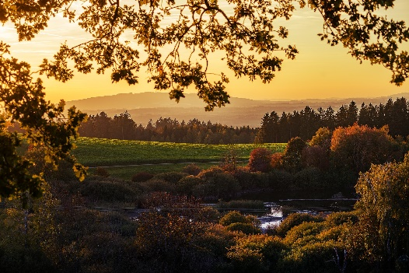
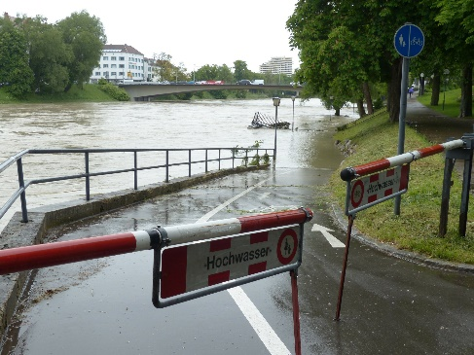
ER1 : competing interests in water supply
EGU General Assembly, VIENNA, 12th April, 2019
Industry
Water supply
Agriculture
Tourism / Natural parks
Flood protection

Slide 11
ER1 : competing interests in water supply
EGU General Assembly, VIENNA, 12th April, 2019
Industry
Water supply
Agriculture
medical products
emerging contaminants
water use
fertilisers
pesticides
water use
Tourism / Natural parks
Flood protection
land use
water management
land use ecology / water management

Slide 12
ER1 : competing interests in water supply
EGU General Assembly, VIENNA, 12th April, 2019
Industry
Water supply
Agriculture
medical products
emerging contaminants
water use
fertilisers
pesticides
water use
Tourism / Natural parks
Flood protection
land use
water management
land use ecology / water management

Slide 13
ER1 : competing interests in water supply
EGU General Assembly, VIENNA, 12th April, 2019
Industry
Water supply
Agriculture
medical products
emerging contaminants
water use
fertilisers
pesticides
water use
Tourism / Natural parks
Flood protection
land use
water management
land use ecology / water management

Slide 14
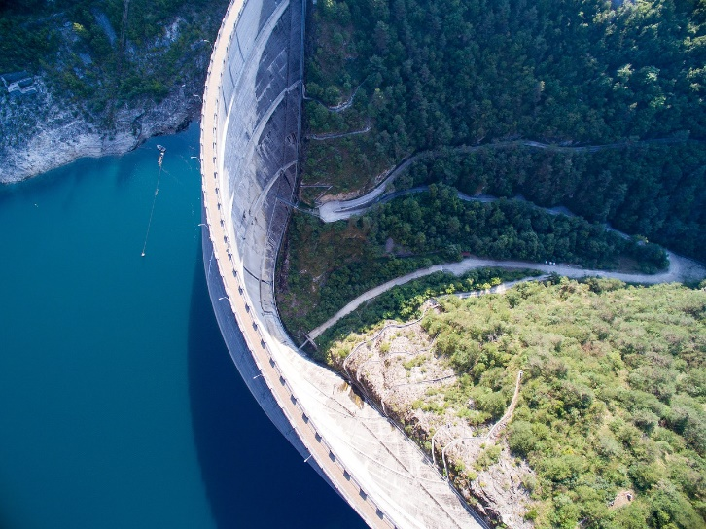
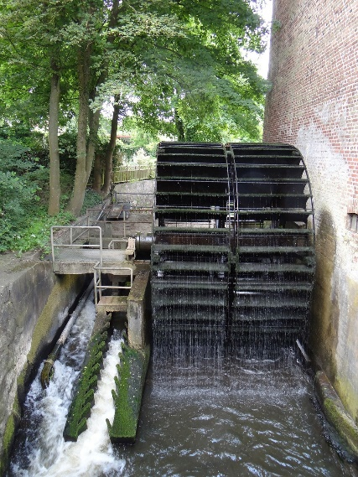
ER2 : water reservoirs and energy production from hydropower
EGU General Assembly, VIENNA, 12th April, 2019
artificial reservoirs
energy production from hydro-power

Slide 15
ER2 : water reservoirs and energy production from hydropower
EGU General Assembly, VIENNA, 12th April, 2019
artificial reservoirs
energy production from hydro-power
agriculture by irrigation
constant drinking water supply
hydropower
sustainable energy production

Slide 16
ER2 : water reservoirs and energy production from hydropower
EGU General Assembly, VIENNA, 12th April, 2019
artificial reservoirs
energy production from hydro-power
agriculture by irrigation
constant drinking water supply
hydropower
sustainable energy production

Slide 17
ER2 : water reservoirs and energy production from hydropower
EGU General Assembly, VIENNA, 12th April, 2019
artificial reservoirs
energy production from hydro-power
agriculture by irrigation
constant drinking water supply
hydropower
sustainable energy production
but what about?

Slide 18
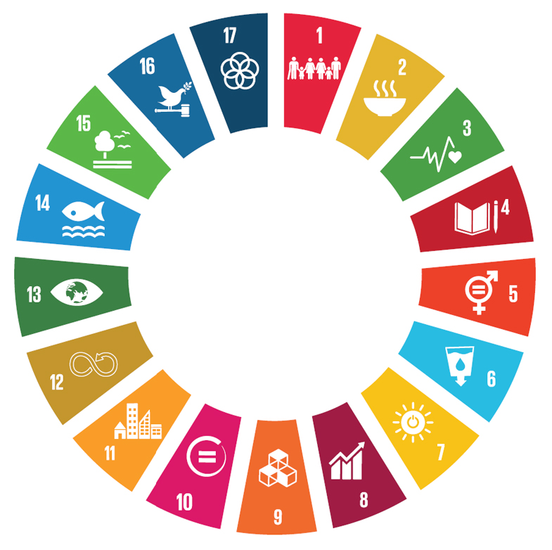
Geoethics in environment – water protection
EGU General Assembly, VIENNA, 12th April, 2019
Professionals that graduated from higher education facilities should be aware that,
SDGs are to be considered collectively.
There is no general rule.
Every case must be considered individually.

Slide 19
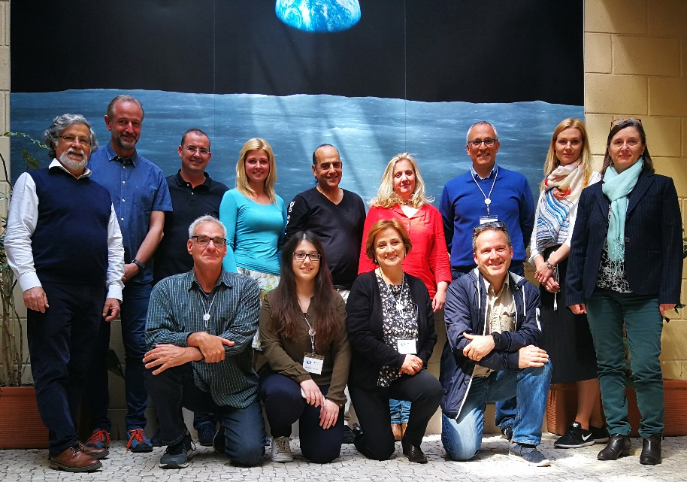
Geoethics in environment
EGU General Assembly, VIENNA, 12th April, 2019
www.goal-erasmus.eu
Water-protection perspective in the GOAL Project framework
Handl Sebastian¹, Calheiros Cristina², Mayr Ernest¹, Schneider-Voß Susanne¹, Fiebig Markus¹, Langergraber Günter¹
¹Universität für Bodenkultur Wien, Austria. ²Centro Interdisciplinar de Investigação Marinha e Ambiental, Portugal.
sebastian.handl@boku.ac.at

