Slide 1



Assessing 20th century tidal range changes in the North Sea and the North Atlantic
German Reserach Foundation

Slide 2
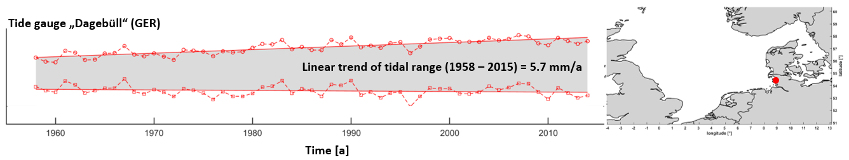
Reason for our investigation
The local tidal regime in the German Bight is changing since the middle of the 20th century:
  Tidal high waters show strong positive trends
  Tidal low waters show no significant or even negative trends
        As one result, the tidal range is increasing

Slide 3
Questions to ask and problems to solve
Q1: Are significant changes in tidal range appearing only regional in the German Bight or are they a basin-wide phenomenon?
    Outside of the German Bight, the data availability of tide gauges is partly very limited and varies greatly in time and space.

Slide 4
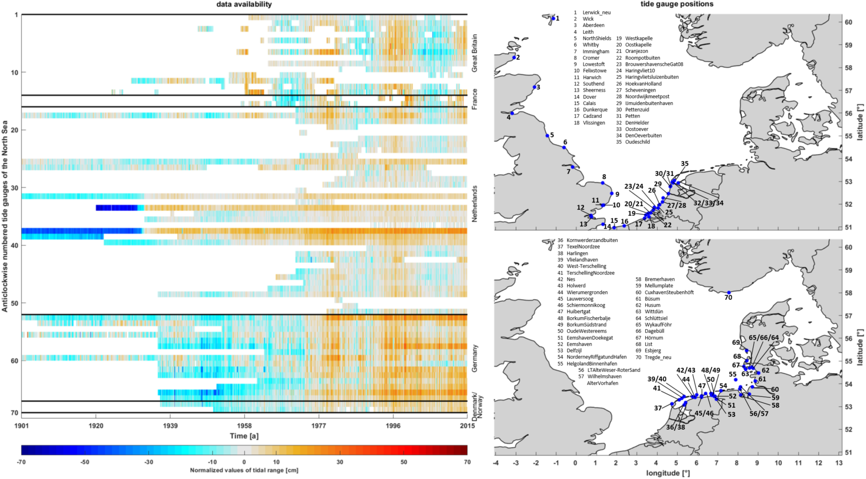
Entire data basis
Data availability and spatial tide gauge positions

Slide 5
Entire data basis
Data availability and spatial tide gauge positions

Slide 6
Entire data basis
1958
2015
Data availability and spatial tide gauge positions

Slide 7
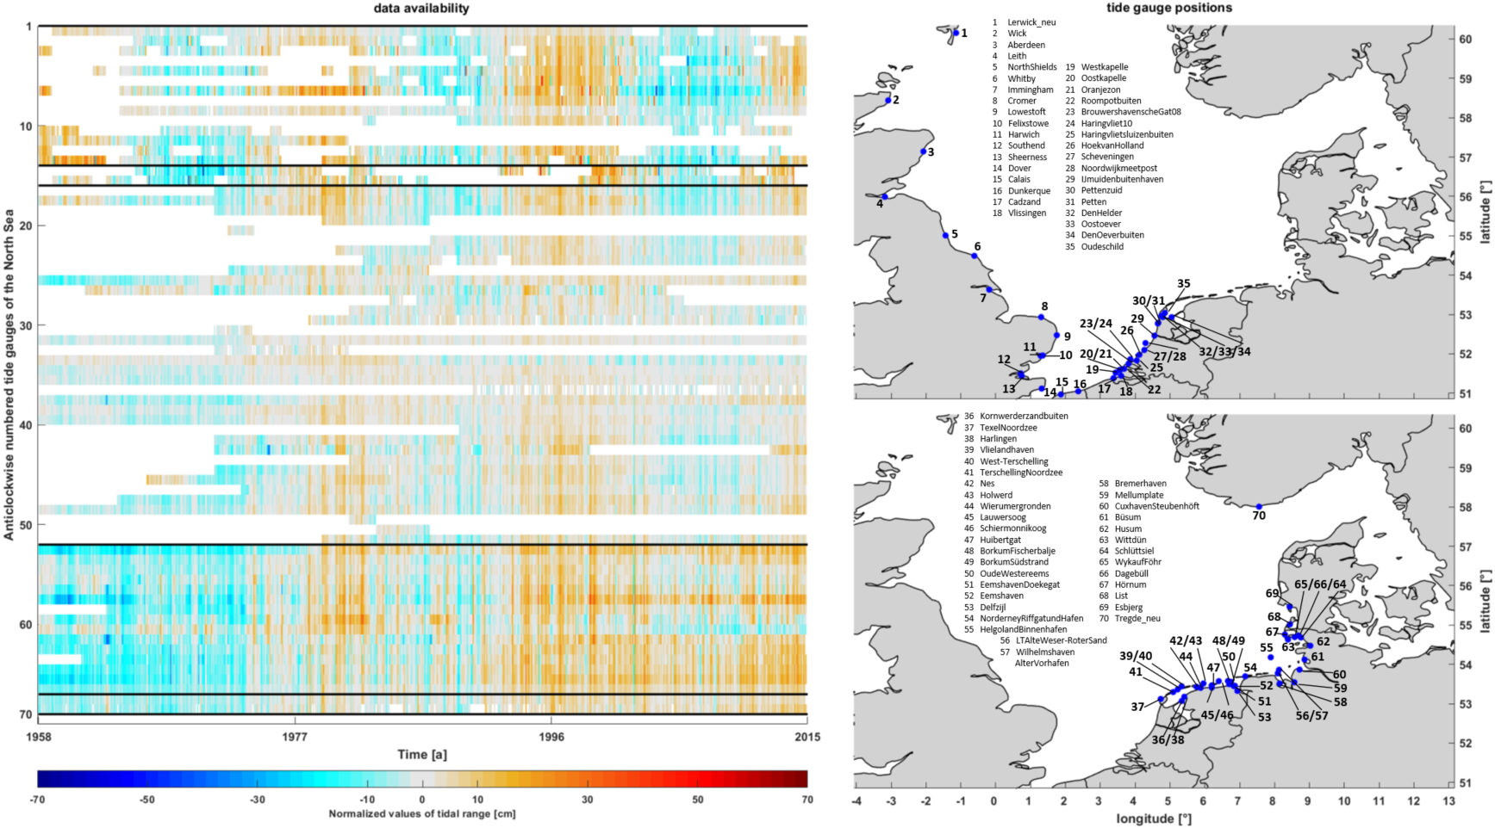
Reduced data basis
Data availability and spatial tide gauge positions

Slide 8
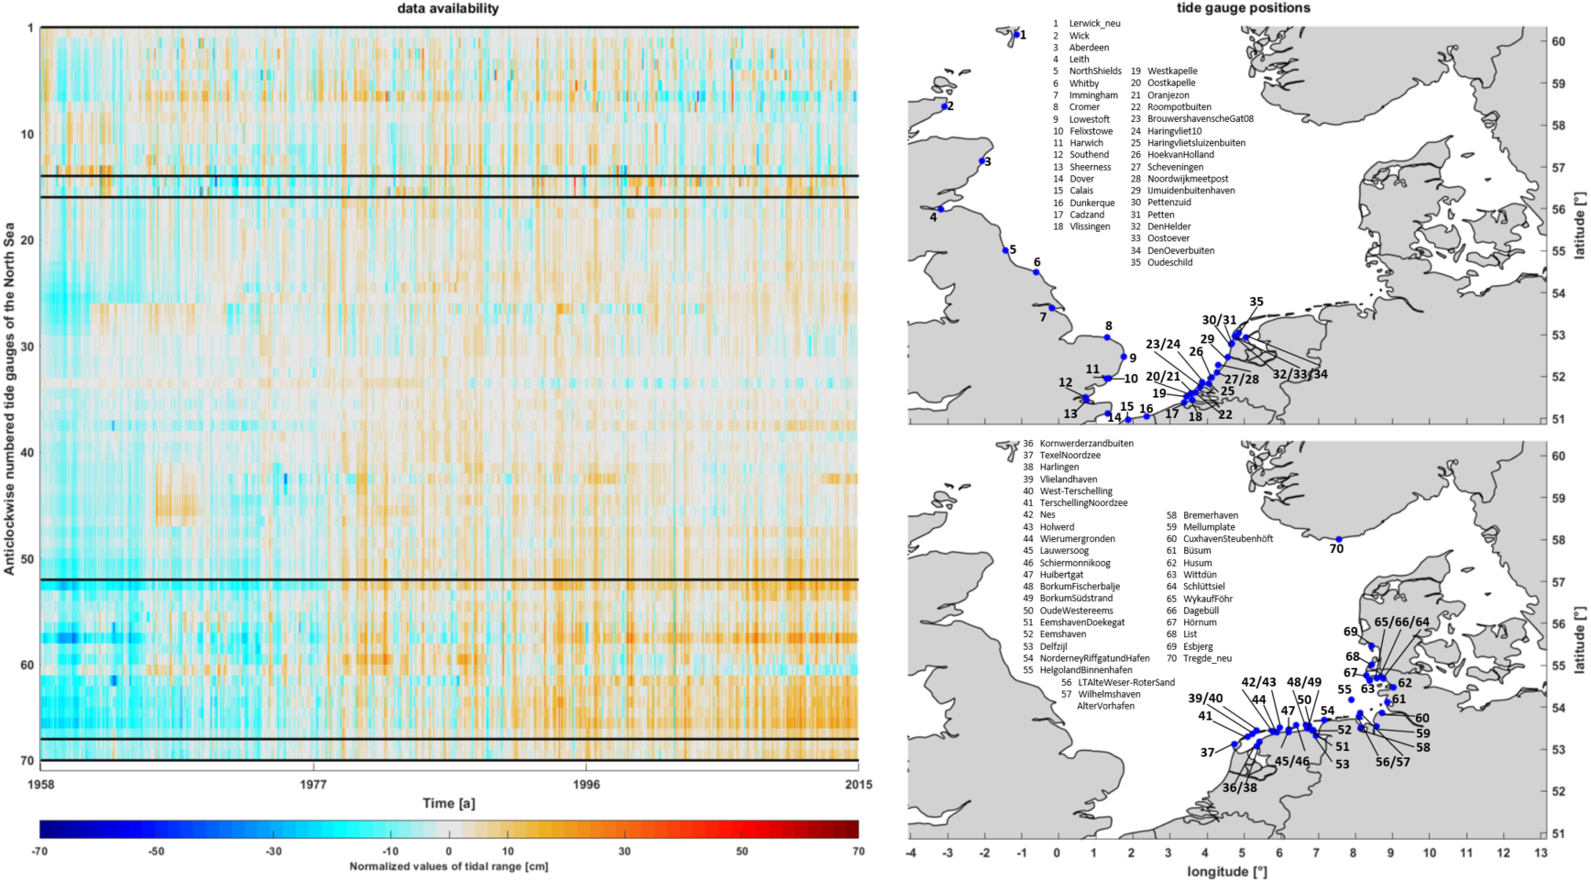
Interpolated data basis without nodal cycle
Data availability and spatial tide gauge positions

Slide 9
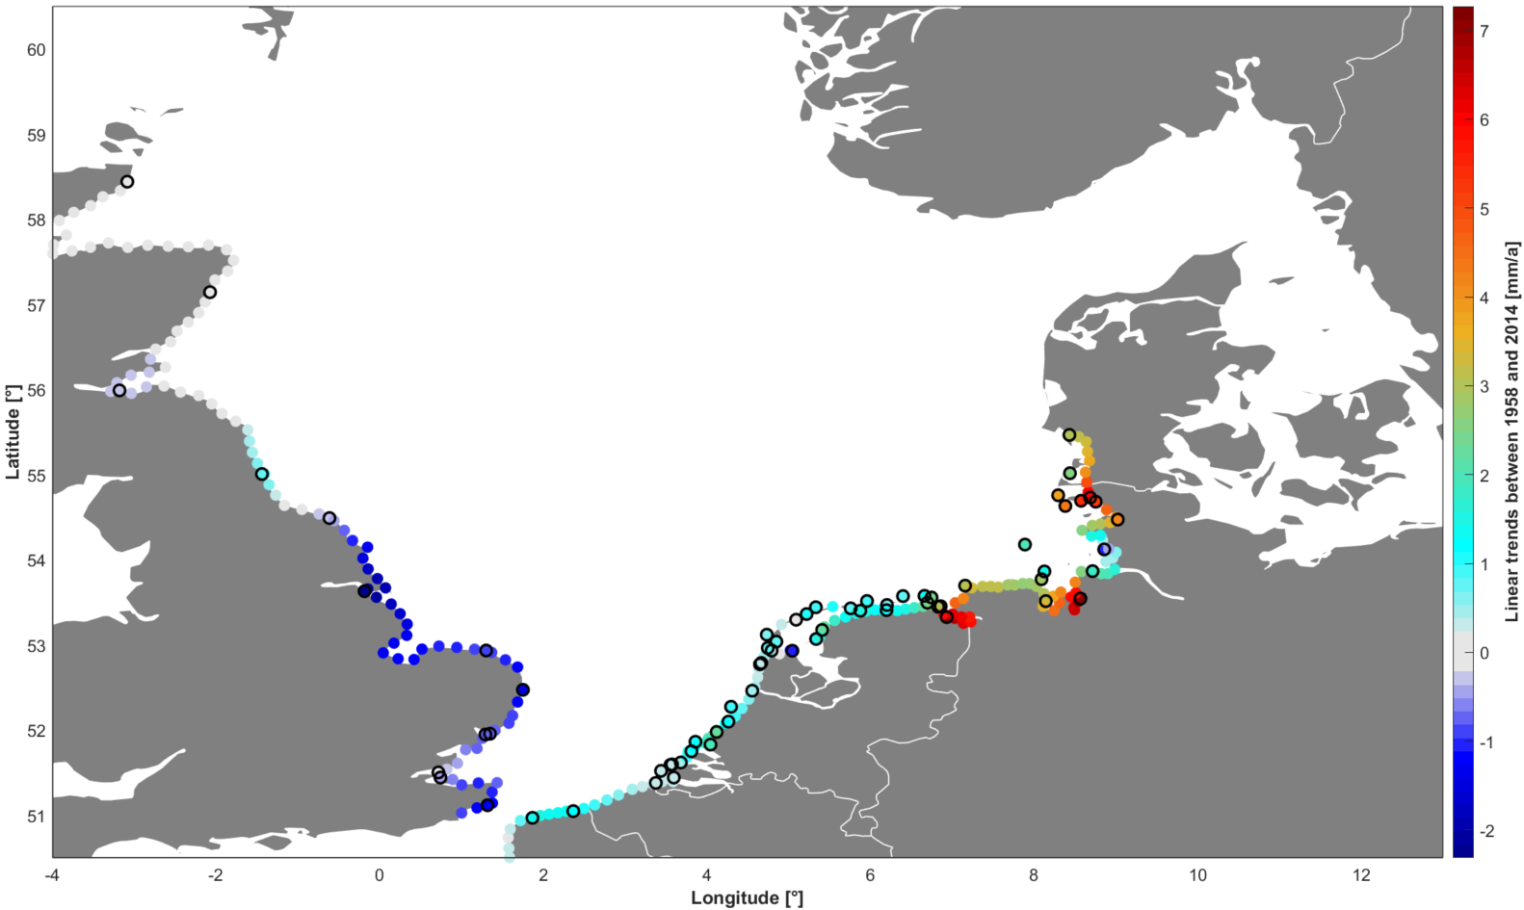
Linear trends of tidal range
Significant opposing trends
(„seesaw pattern“)
Linear trends of tidal range between 1958 and 2015 with filled data gaps and interpolated
coast line by kriging.

Slide 10
Questions to ask and problems to solve
Q1: Are significant changes in tidal range appearing only regional in the German Bight or are they a basin-wide phenomenon?
A1: There are significant changes in the tidal range in the whole
basin, but there seem to be differences in amplitude and
algebraic sign.
Q2: What are the causes of these changes and can they be differentiated against each other?
    The major challenge is the separation of local (e.g. building measures), regional (e.g. changes in topography or morphology) and large-scale changes (e.g. sea-level rise), because they superimpose each other.

Slide 11
Our approach using EOFs
Empirical orthogonal function (EOF) analysis can be used to find common signals (“principal components”) in a data set and sort them according to their quantitative impact on the explained variance of the entire data set.
  Large-scale effects will explain the largest percentage of variance, because the majority of the tide gauges would be affected.
  Small-scale (local) effects will explain very little of the overall variance, because only a small number of tide gauges would be effected.
The separation between local and large-scale effects is done by comparing the quantitative impact of the principal components on the explained variance.

Slide 12
Summary of detected local effects
Embankment of the Bay of Meldorf/
Dredging of the Elbe River
Data availability and spatial tide gauge positions
Andra Ebener, Poster Session OS4.2, X4.59 EGU2019-7159

Slide 13
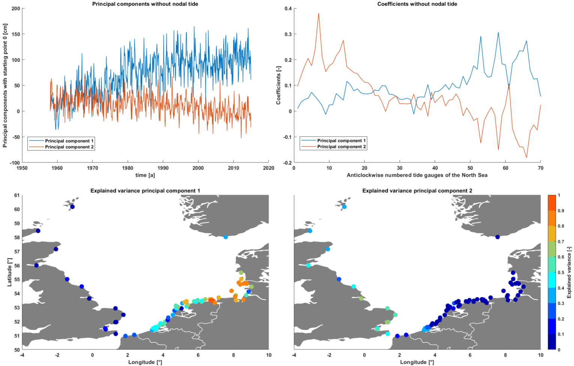
Large scale changes
(a)
(b)
(c)
(d)
Principal components 1 and 2 (a), coefficients 1 and 2 (b), explained variance 1 (c) and 2 (d)

Slide 14
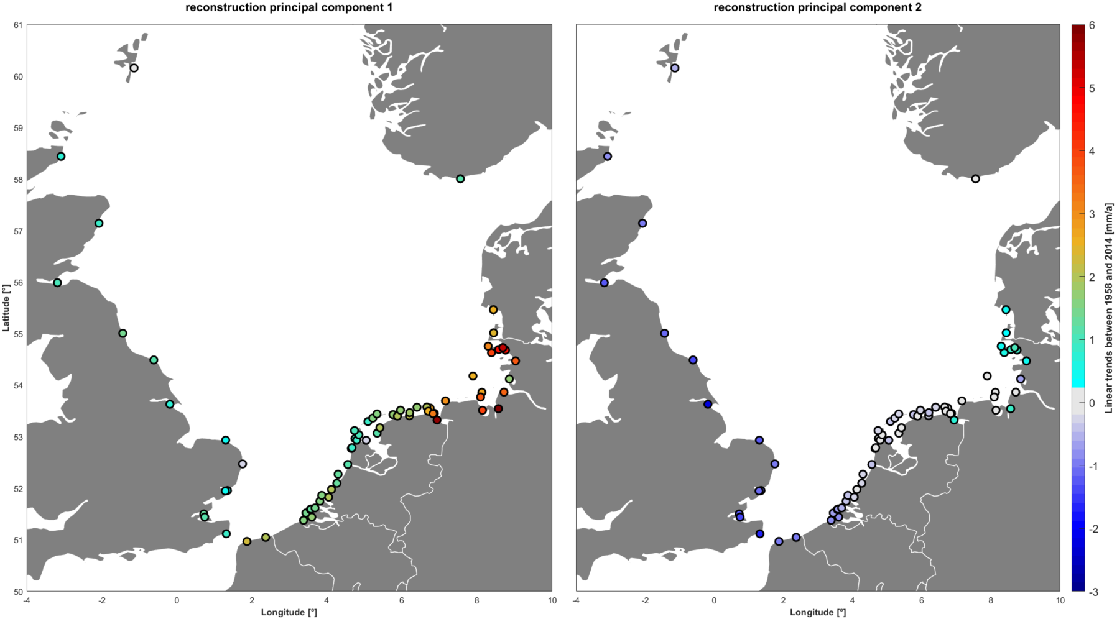
Linear trends of principal components 1 and 2
Significant positive trends
Significant negative trends
These two components explain about 70% of changes in tidal range of the North Sea

Slide 15
Questions to ask and problems to solve
Q1: Are significant changes in tidal range appearing only regional in the German Bight or are they a basin-wide phenomenon?
A1: There are significant changes in the tidal range in the whole
basin, but there seem to be differences in amplitude and
algebraic sign.
Q2: Are these changes homogeneous or can they be differentiated
against each other?
A2: There seem to be two different effects, which cause an increasing tidal range with largest amplitudes in the south-eastern North Sea and a decreasing tidal range with the lowest amplitudes in the south-western North Sea.

Slide 16
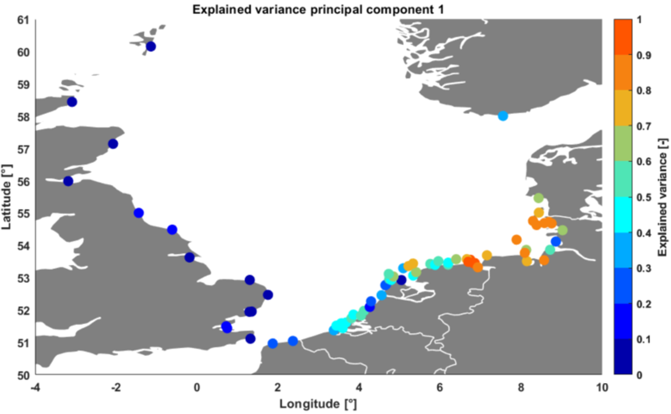
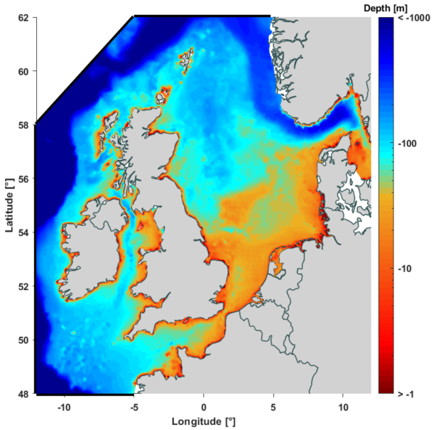
Our theory for the physical cause of EOF 1
We hypothesize that the first EOF reflects the North Sea basin’s response to a rising MSL and is mainly caused by changes in friction and other shallow water effects.
Bathymetry of the North Sea (Arns et al., 2015)

Slide 17
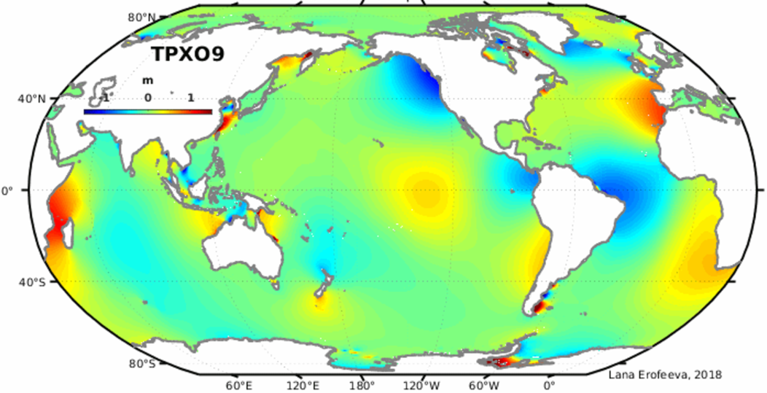
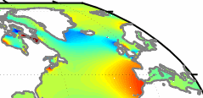
Our Theory for the physical cause of EOF 2
Animation of global tides
(Egbert & Erfoeeva, 2002)
Link/License:
http://volkov.oce.orst.edu/tides/
http://volkov.oce.orst.edu/tides/COPYRIGHT.pdf

Slide 18
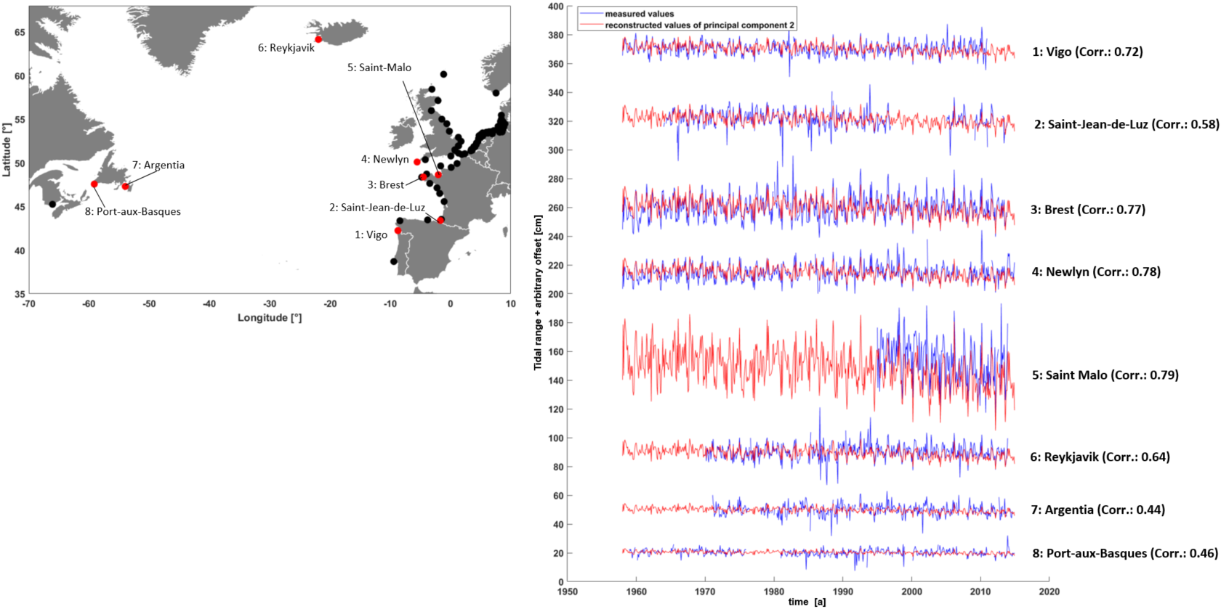
Our Theory for the physical cause of EOF 2
These correlations suggest a large-scale North Atlantic forcing mechanism.

Slide 19
Summary/Outlook
While the trends of tidal range in wide parts of the North Sea are rather low or even insignificant, a distinct pattern ("seesaw pattern") occurs between the English East Coast and the German Bight.
We separated local from regional and basin-wide effects and identified two components which explain about 70% of tidal range changes of the North Sea (“North Sea response/North Atlantic forcing”).
The next step is to perform numerical sensitivity studies (e.g. sea level rise or changing thermohaline boundary conditions) to explore the physical background of the EOFs.
A shift in the amphidromic system of the North Sea resulting from the detected effects is also under investigation.

Slide 20
German Reserach Foundation
Any questions or comments?

