Slide 1
Kinematics of the Guanacaste Volcanic Arc sliver boundary, Costa Rica: Revealed by deformation during the 2016 Bijagua earthquake sequence.
PICO 1.15
María Cristina Araya ^{1,2} (ma17417@bristol.ac.uk)
Dr. Juliet Biggs ¹
1- University of Bristol
2- University of Costa Rica

Slide 2
Forearc slivers
Caribbean Plate
Formed at subduction zones with oblique convergence.
Motion along the overriding plate is partitioned into arc parallel and trench perpendicular components within the continental plate.
Behaves as a rigid block, often observed on GPS measurements.
The sliver inner boundary accommodates the arc parallel slip along a strike slip fault or fault system.
Haciendas Chiripa fault system
Cocos Plate
PICO 1.15

Slide 3
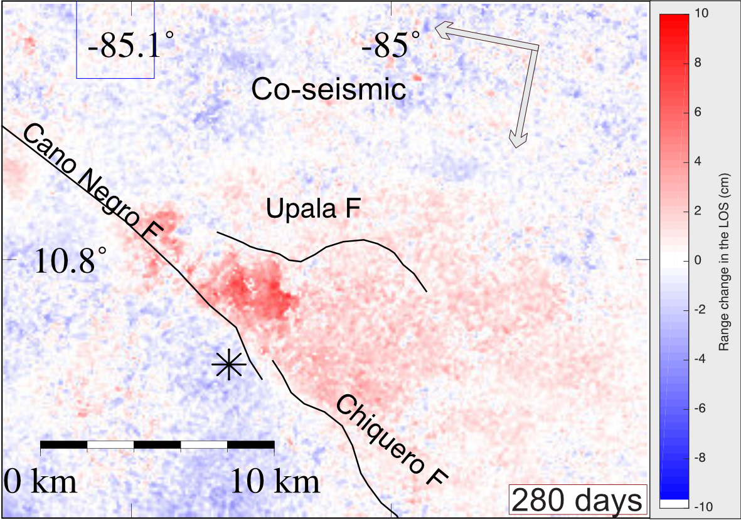
Co-seismic Ground Deformation
Co-seismic stack of the three interferograms from descending track April 2016 to October 2016.
The * is the location of the two biggest events (Mw 5.4 & Mw 5.1).
Red colour is negative range change (uplift or SE horizontal motion).
Blue colour is positive range change (subsidence or NW horizontal motion from the satellite line of sight).
PICO 1.15

Slide 4
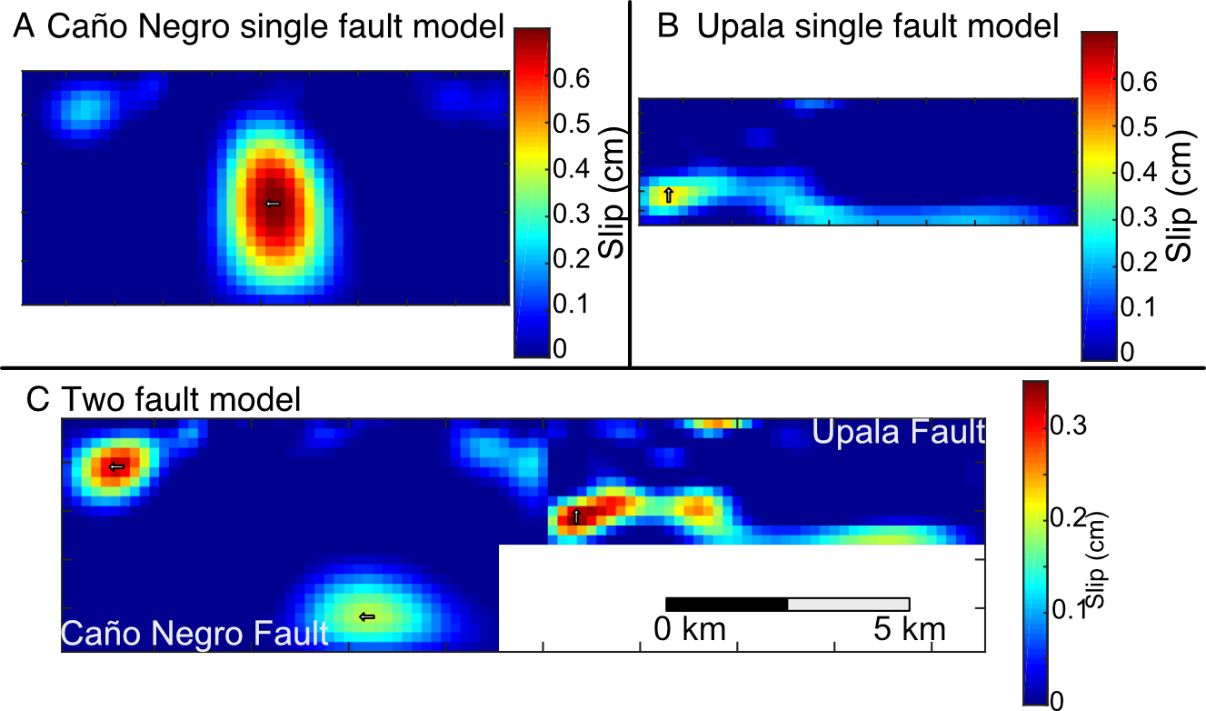
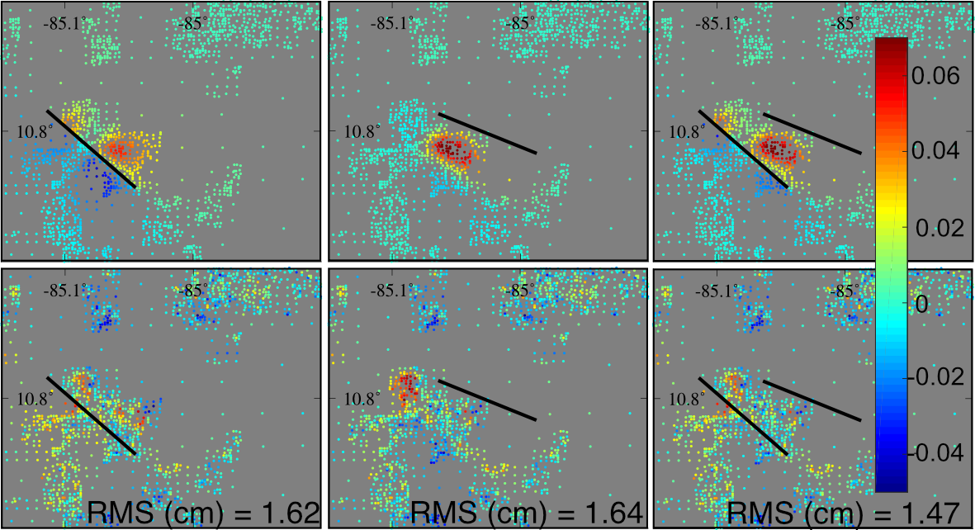
Slip distribution inversion
Models on known geometry faults
Caño Negro Fault Model
Upala Fault Model
Caño Negro & Upala
Faults Model
The best fit model is the 2 fault model with right lateral strike slip motion on the Caño Negro Fault and reverse motion on the Upala Fault
Residuals

Slide 5
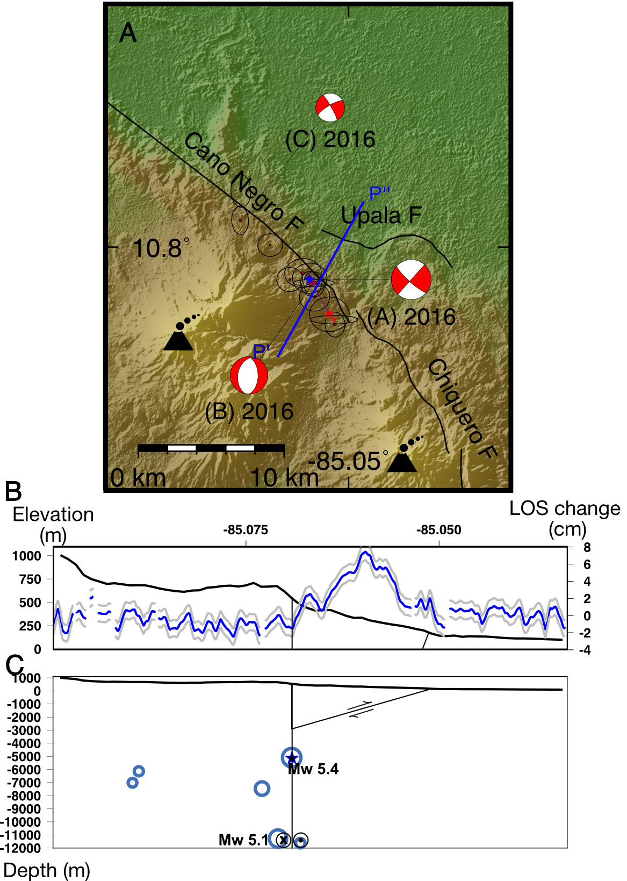
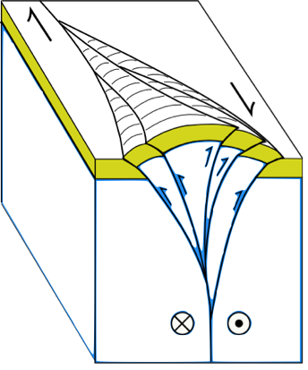
Co-seismic
Ground Deformation
Seismic location
Geodetic location
New Geodetic
locations
PICO 1.15.

Slide 6
Kinematics of the Guanacaste Volcanic Arc sliver boundary, Costa Rica, revealed by deformation during the 2016 Bijagua earthquake sequence.
PICO 1.15.
María Cristina Araya ^{1,2} (ma17417@bristol.ac.uk)
Dr. Juliet Biggs ¹
1- University of Bristol
2- University of Costa Rica

Slide 7
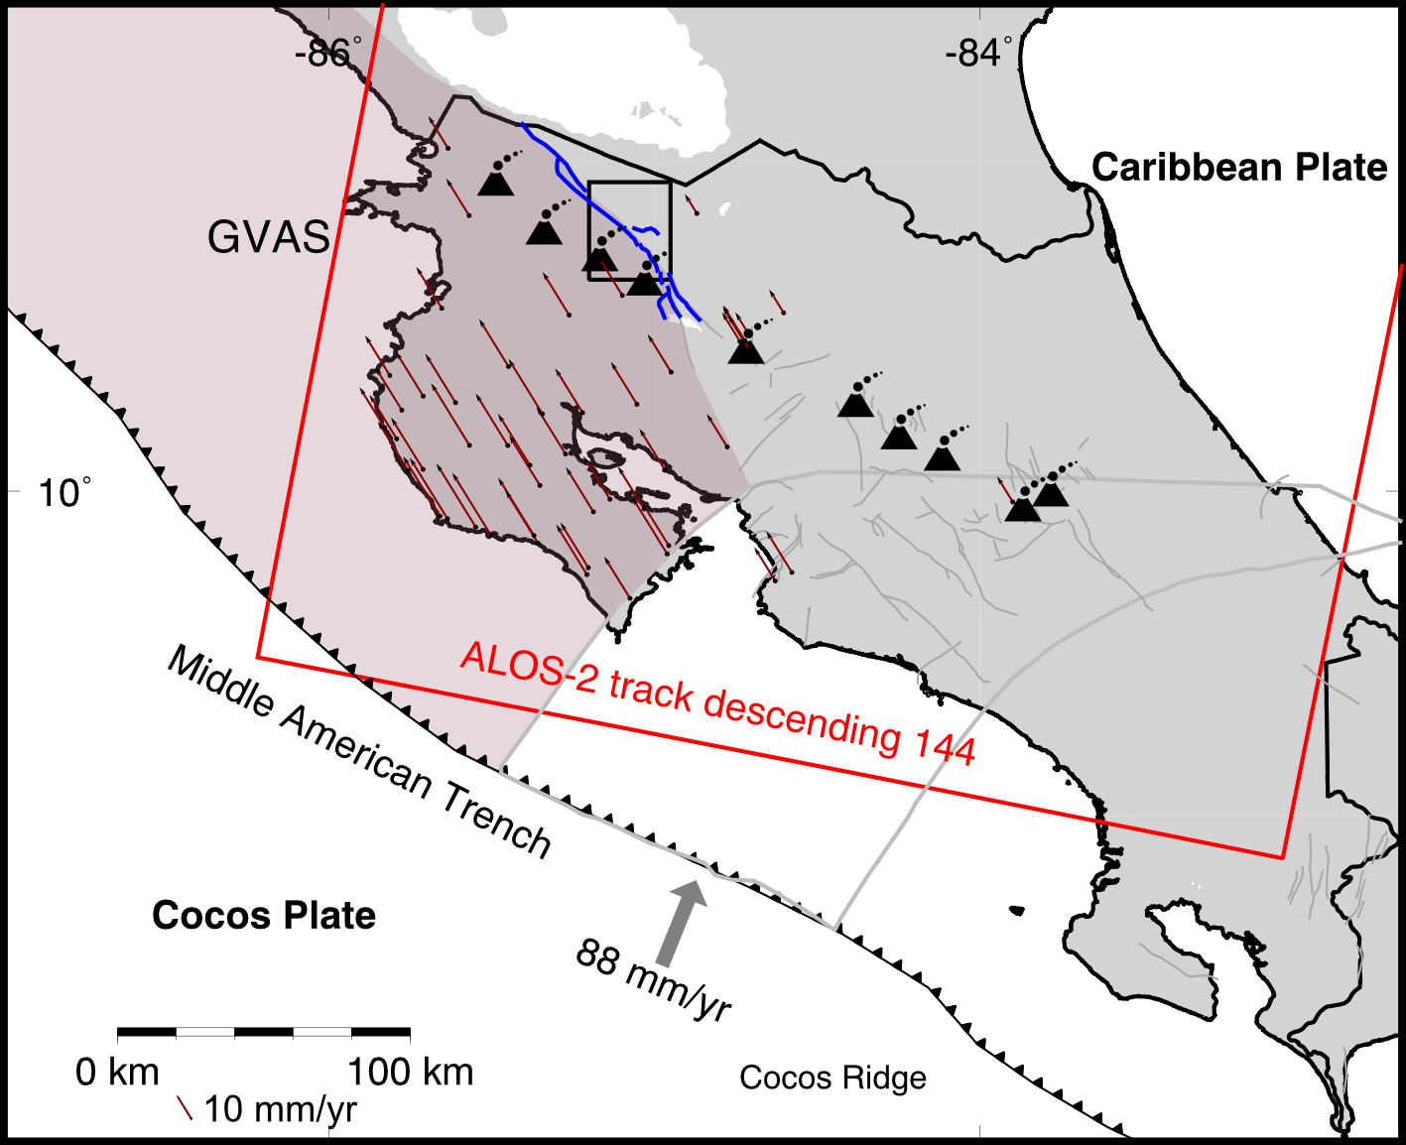
Guanacaste Volcanic Arc Sliver (GVAS) & the Haciendas Chiripa Fault System (HCFS)
Haciendas Chiripa fault system
The GVAS is a rigid block, with similar velocity vectors along the forearc.
The forearc sliver has a velocity a rate 11 mm/yr, relative to the Caribbean plate.
GPS spacing near the arc is very large (Distance >30 km between stations).
HCFS has NW-striking right lateral strike slip faults, and the Upala thrust fault.
The fault system is located 10 km behind the volcanic centres
In the past 20 yrs, two seismic sequences with the main earthquake of Mw 5.4.
The last one occurred in July 2016 (in red)
Notes:
The radar satellite images are from the 144 descending track from ALOS-2 from Jaxa, and the recorded seismicity is from the National Seismological network

Slide 8
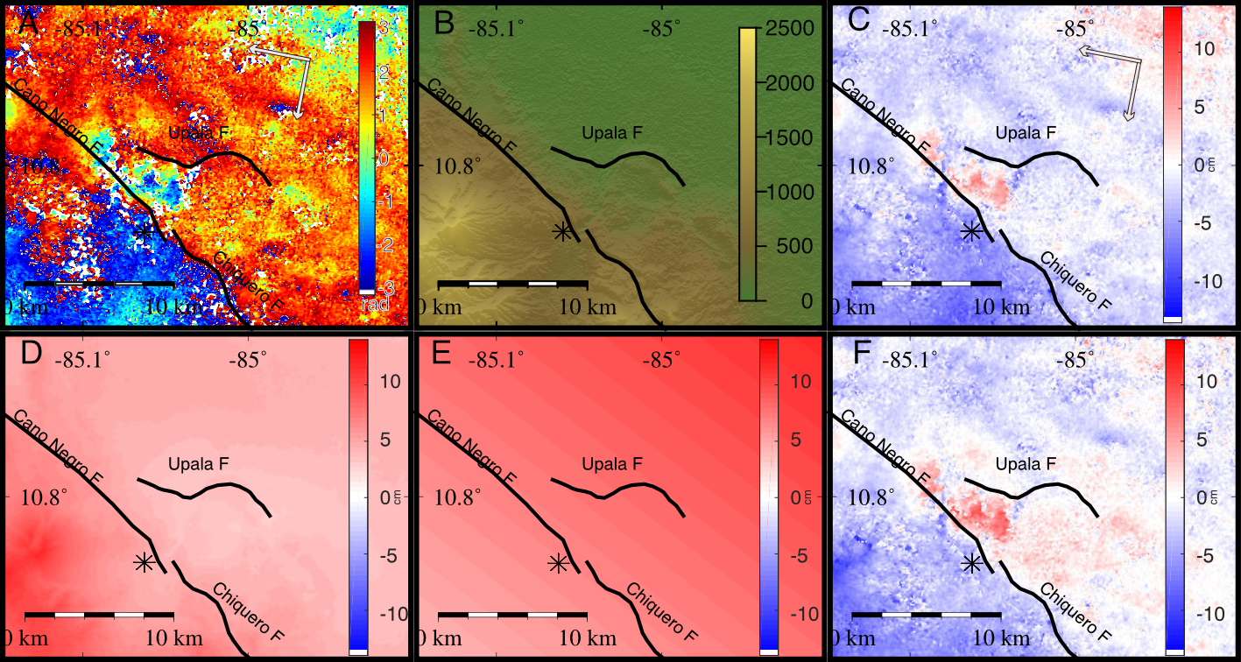
InSAR image corrections for Topography, Geometry and Atmospheric delays.
GAMMA for interferograms
30m DEM
Unwrapped
GACOS atmospheric corrections
Ramp
Corrected
Notes:
Interferograms using GAMMA
GACOS web service, of tropospheric delays
Change in geometry between image acquisitions

Slide 9
Three unwrapped co-seismic interferograms
Co-seismic stack
Interferogram | Date 1 | Date 2 | Days | Coherence% | ⊥ Baseline (m) | RMS (cm) | RMS (cm) corrected
I-1 | 14/01/2016 | 28/07/2016 | 196 | 99 | 42 | 9.80 | 2.35
I-2 | 07/04/2016 | 28/07/2016 | 112 | 94 | 146 | 5.45 | 2.94
I-3 | 07/04/2016 | 20/10/2016 | 196 | 99 | 211 | 2.86 | 2.64
Stack | 14/01/20116 | 20/10/2016 | 280 | 97 | − | 0.83 | 0.83
~6 cm of uplift or SE horizontal motion between Caño Negro and Upala faults
Notes:
3 independent interferograms
Deformation contained between the Upala and CNF.
Red towards the line of sight
No deformation pattern

Slide 10
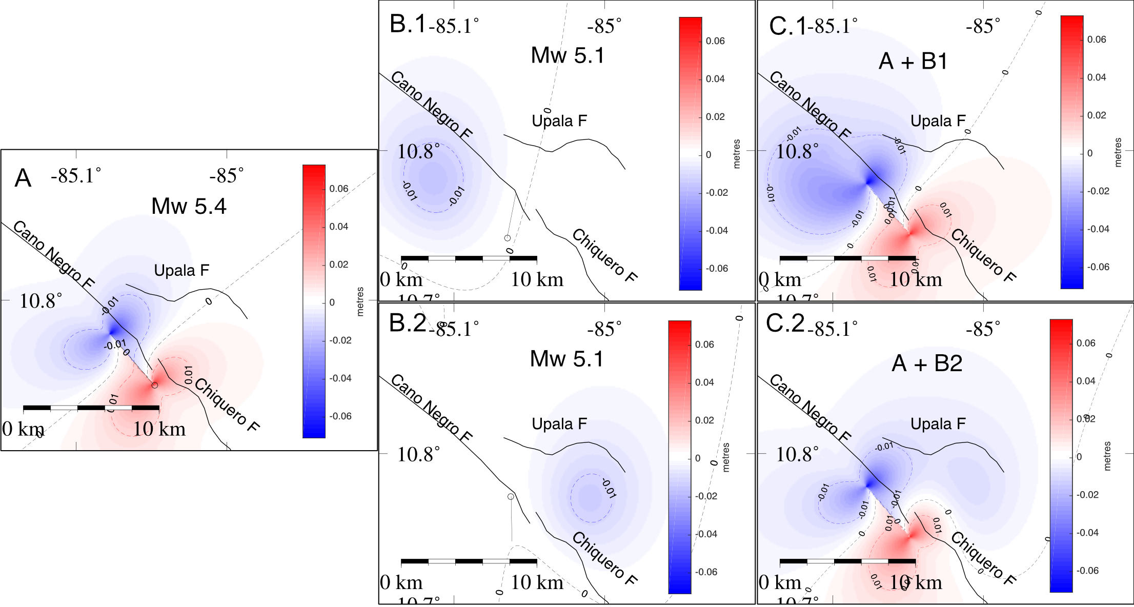
FORWARD MODELS
We compared the observed with the theoretical ground deformation.
Location, and motion based on recorded data from the local seismic network.
Three models for the 2 biggest recorded earthquakes from the 2016 sequence:
A - Mw 5.4 at ~2 km depth B - Mw 5.1 at ~8 km depth C - Combined models.

Slide 11
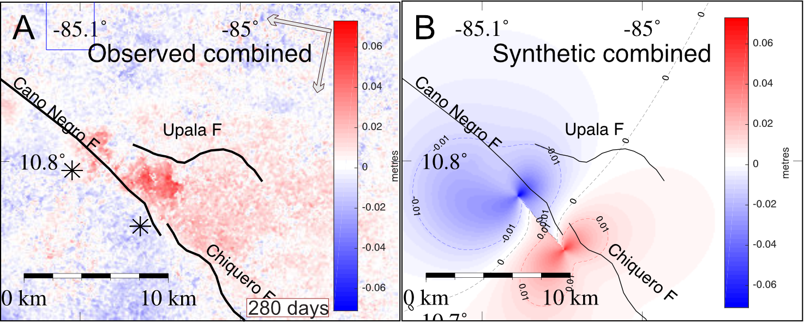
Comparison between the co-seismic stack and the forward models stack
We compared the results to the geodetic observations and found a poor fit between the pattern distribution.

Slide 12
SLIP DISTRIBUTION INVERSE MODELS
Models
A)
Caño Negro Fault Model
B)
Upala Fault Model
C)
Caño Negro & Upala
Faults Model
Inverse models to obtained the amount of slip and distribution on a fault with known geometry, using SlipInv (Funning, 2005), from the co-seismic stack.
We resampled the co-seismic stack for the inverse modelling using a quadtree algorithm for computing purposes.
We generated three inverse models for the slip occurring on:
A) The Caño Negro Fault,
B) The Upala Fault and,
C) On both faults.
Residuals

Slide 13
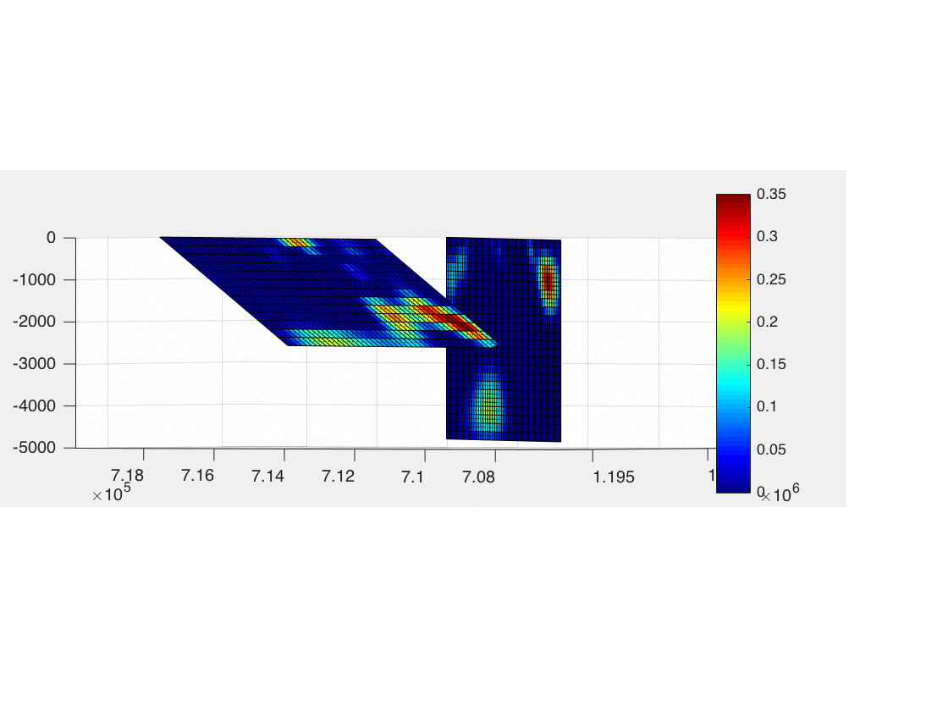
Slip distribution inversion
Models on known geometry faults
Caño Negro Fault Model
Upala Fault Model
Caño Negro & Upala
Faults Model
The best fit model is the 2 fault model with strike slip motion on the Caño Negro Fault and reverse motion on the Upala Fault
Residuals

Slide 14
Slip distribution inversion result from the two fault model
Caño Negro Fault is a Nearly vertical right lateral strike slip fault with 0.33 m of maximum slip
Upala Fault is a thrust fault with 0.35 m of maximum slip near where the two faults meet.

Slide 15
SLIP DISTRIBUTION INVERSE MODELS
Fault | Dip(◦) | Fault length (km) | Fault bottom depth (km) | Fault patches (m) | RMS (m) | Max slip (m) | Total M_{o} (Nm)
CNF | 90 | 10 | 4.8 | 1200 | 0.0162 | 0.71 | 5.94 x 10¹⁶
UF | 35 | 9 | 2.6 | 585 | 0.0164 | 0.45 | 5.89 x 10¹⁶
CNF & UF | 90 & 35 | 10 & 9 | 4.8 & 2.6 | 1795 | 0.0147 | 0.33 & 0.35 | 1.48 x 10¹⁷
The best fit model suggest the slip occurred on both faults.
The CañoNegro Fault had a maximum 0.33 m of slip and right lateral motion.
The geodetic moment released is 3.4 x 10¹⁷ Nm equivalent to a Mw 5.5 earthquake.
The Upala Fault had a maximum 0.35 m of slip and reverse motion.
The geodetic moment released is 1.4 x 10¹⁷ Nm equivalent to a Mw 5.1 earthquake, and 29% of the total geodetic moment observed.

Slide 16
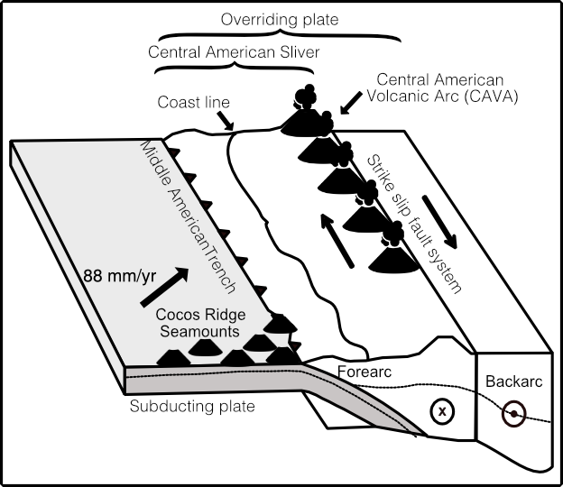
Structures associated to transpersonal strike slip faults.
Our observations leads us to propose the relation between the CNF and the UF as a transpressional system, trough a “Positive Flower Structure” that contains the deformation.
The hanging block over UF uplifts in association to the CNF strike slip motion.

Slide 17
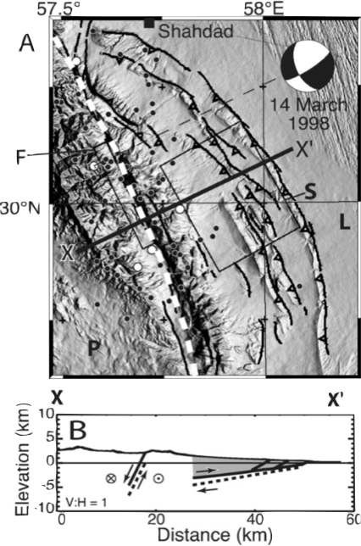
Our results show a right-lateral strike slip fault linked at depth to a splay reverse fault.
Relation to other areas with similar tectonic features.
These features are common on fold-trust regions like in Southeast Iran, on the Gowk fault system.
The 1998 Fandoqa earthquake Mw 6.6 occurred on this fault system and triggered aseismic slip for the following 6 months, which was also observed from geodetic data (Fielding et al., 2004).
Fielding et al., 2004

Slide 18
ASEISMIC SLIP ON A SLIVER BOUNDARY
This is a complex sliver boundary:
Major faults are NW striking faults with right lateral motion.
Secondary and parallel reverse splay fault linked at depth.
Pull apart basins between strike slip fault steps.
The trench parallel slip is accommodated through a transpressional positive flower structure.
Observations suggest this boundary is not yet mature, but with aseismic slip which is usually related to mature faults, as the transform faults on continental boundaries.
This study is the first to observe aseismic slip on a sliver boundary.

